Slide 1
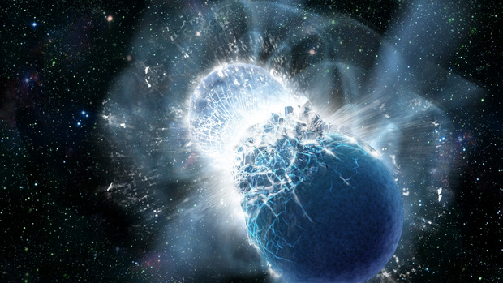
Nuclear physics experiments for dense matter
Credit: NASA/Swift Dana Berry
Prospectives Nationales 2020-2030
Physique Nucléaire et Astrophysique Nucléaire
F.Gulminelli, (LPC and Normandie Université, Caen) for:
Compact stars and matter at extreme conditions

Slide 2
Plan
Neutron Stars & mergers: the nuclear Equation of State
Core Collapse Supernovae: e-capture rates
Supernova explosion and r-process seeds: matter composition at the ν−sphere

Slide 3
1) NS&Mergers: the nuclear EoS
GR imposes a 1-to-1 correspondence between the nuclear EoS and static properties of NS
M(R) (NICER), Λ(R) (LIGO/VIRGO) M (SKA)
But EoS is model dependent
J.Lattimer Ann.Rev.Nucl.Part.Sci (2012)

Slide 4
1) the nuclear EoS: present status
Chiral
EFT
???? Extrapolations
I.Tews, J.Margueron, S.Reddy, PRC (2018)
LIGO/VIRGO data are a constraint for nuclear physics

Slide 5
1) the nuclear EoS: future challenge
Chiral
EFT
I.Tews, J.Margueron, S.Reddy, PRC (2018)
Nuclear physics can be a constraint for GW
=> alternative gravity

Slide 6
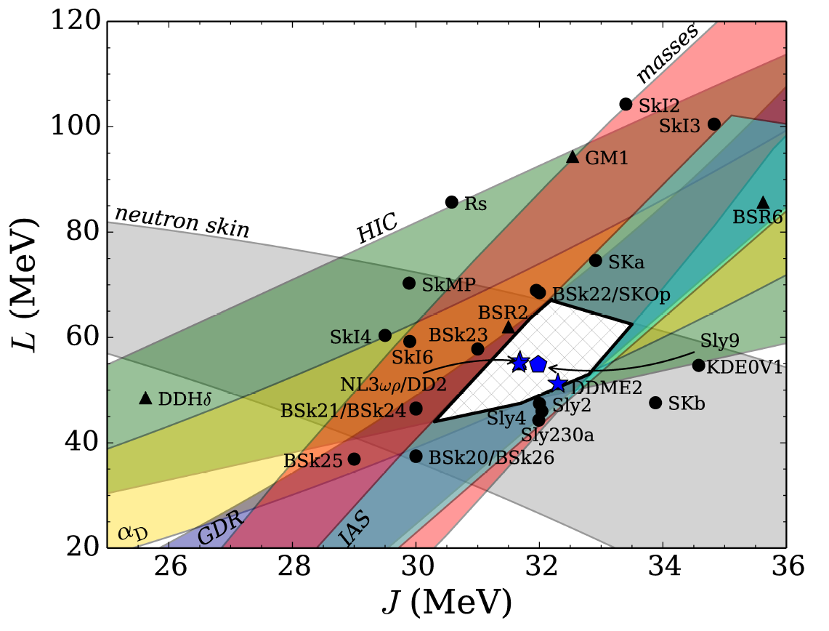


The contribution of nuclear experiments
$$δ=\frac{n_{n}−n_{p}}{n}$$
$$x=\frac{n−n_{0}}{n}$$
Definition of empirical parameters
  $e\left(n,δ\right)=\left(E_{0}+{\frac{1}{18}K}_{0}x^{2}+O\left(x^{3}\right)\right)+\left(J_{0}+\frac{1}{3}Lx+{\frac{1}{18}K}_{sym}x^{2}+O\left(x^{3}\right)\right)δ^{2}$
The coefficients can be
constrained comparing
the functional predictions
with data
M.Fortin et al, PRC (2016)

Slide 7
Strategy I: high density constraints
J.Xu, PRC 2013
(HADES, CBM, ...)
P.Russotto et al,PRC (2016)
AsyEOS@GSI (2016)
FOPI-LAND@GSI
(1993)
Au+Au 400 A.MeV
Differential elliptic flow
π⁺ / π⁻

Slide 8
Strategy II: high precision
Isovector probes with stable nuclei:
Skin
IAS
GDR response
Isospin transport in HIC (INDRA/FAZIA)
Exp: Δr_{np}= 0,1318-0,3072
X.Roca-Maza, G.Colo, H.Sagawa (2018)
X.Vinas et al (2014)
P.G.Reinhard, W.Nazarewicz (2016)
J.Yang, J.Piekarewicz (2017)
Notes:
Skin:208Pb
IAS:124Sn

Slide 9
Strategy III: new probes
Isoscalar probes in exotic nuclei:
Soft monopole
SSRPA calculations
0.02
0.04
0.01
³⁴Si
neutrons
r²ρ_{ν}
0.02
protons
0
r²ρ_{ν}
0
-0.01
E=11 MeV
-0.02
E=22 MeV
-0.02
-0.04
0
5
10
r (fm)
0
5
10
r (fm)
D.Gambacurta, Phys. Rev. C 100, 014317 (2019)

Slide 10
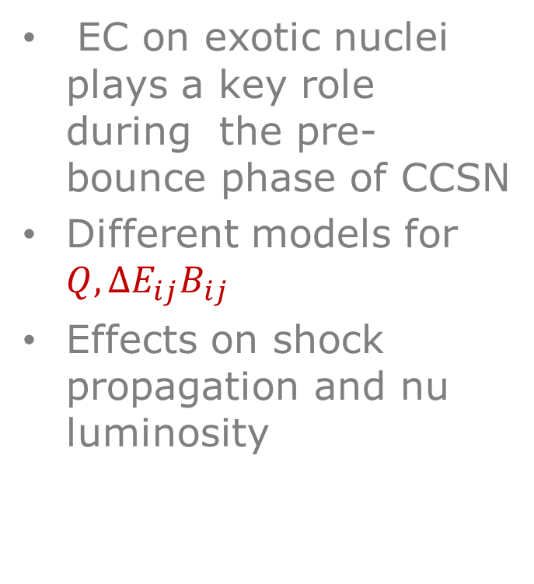
2) CCSN: e-capture rates
$λ^{EC}\left(A,Z\right)=\frac{ln2}{K}\sum_{i}{\frac{(2J_{i}+1)e^{−βE_{i}}}{Z_{β}}}\sum_{j}{{\int_{e_{m}}^{∞}{de}f \left(e,{Q,∆E}_{ij}\right)B}_{ij}}$
EC on exotic nuclei plays a key role during the pre-bounce phase of CCSN
Different models for ${Q,∆E}_{ij}B_{ij}$
Effects on shock propagation and nu luminosity
A.Pascal, PRC (2020)

Slide 11
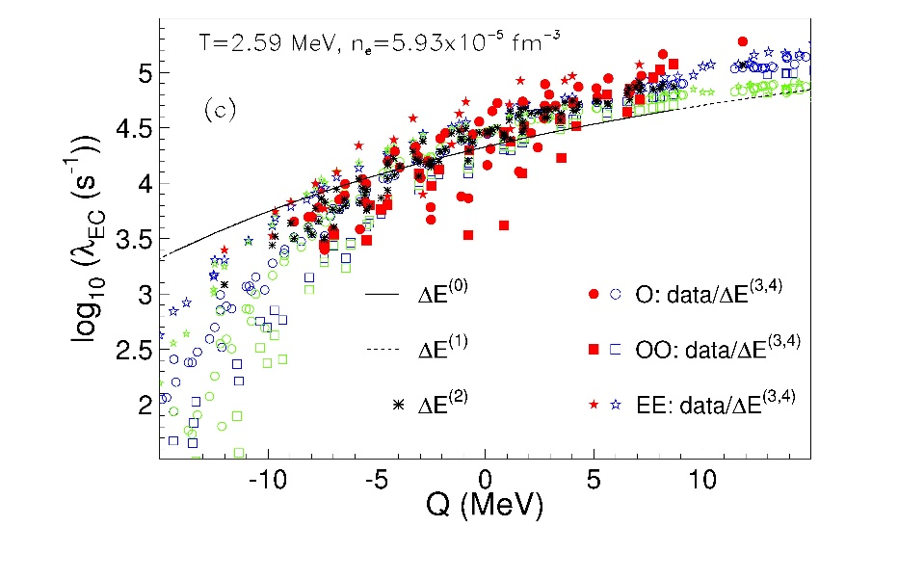
2) e-capture rates: present status
A.Raduta PRC (2016)
The differences between the models concern low Q-values where microscopic rates do not exist
=> Need to benchmark on relevant nuclei
A.Pascal, PRC 2020

Slide 12
2) e-capture rates: future challenge
⁹³Nb(t,³He+γ)
B.Gao et al. PRC 101 (2020) 014308

Slide 13
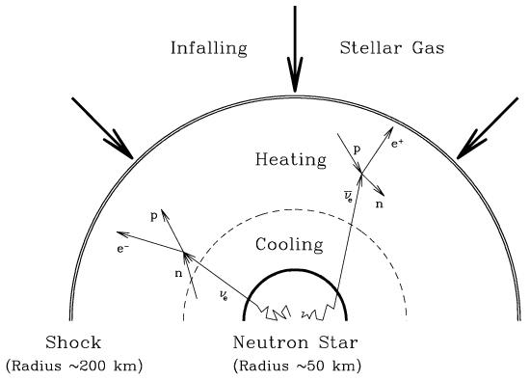
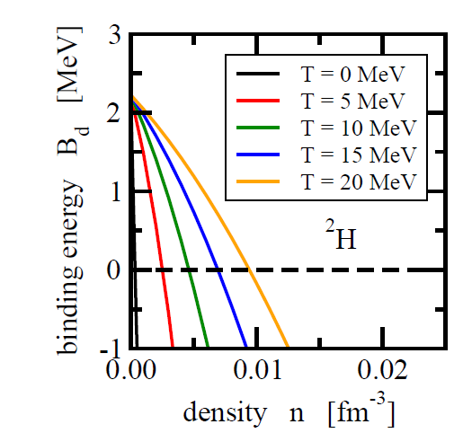
3) SN explosion and r-process seeds: matter composition at the ν−sphere
The energy deposition in the gain region depends on the position of the ν−sphere
Coherent scattering off nuclei is a crucial source of opacity
Composition depends on the in-medium modifications to the binding energy
S.Typel NPA (2009)

Slide 14
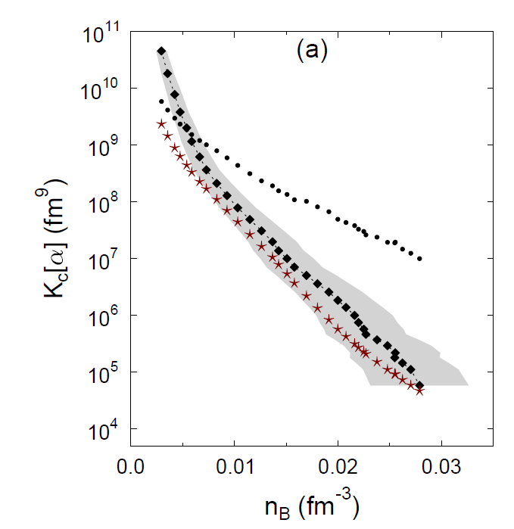
Chemical constants from multi-fragmentation
L.Qin PRL 2012
without
with
R.Bougault & INDRA coll. JPG (2019)
H.Pais & INDRA coll. PRL (2020)

Slide 15
Summary
Nuclear physics inputs needed for compact stars:
  Reliable EoS extrapolation to 2ρ₀ and beyond
  GT strength on n-rich nuclei
  Light clusters In-medium binding energy shifts
Experimental needs:
  Low energy: beam purification for ALTO and a TAS; SPIRAL2 phase2+DESIR
  High energy: reaccelerated n-rich beams above 20-25 A.MeV
  Detectors: FAZIA, ACTAR, PARIS
  Connection with the observations: large scale simulations and high performance computing
See also: M.Urban, F.Hammache, O.Sorlin contributions to GT02, Antonio Uras contribution to GT03
Concerned labs: GANIL, LPC Caen, ex-IPNO, Subatech, IPHC
Notes:
Low energy: bea decay beam purification=penning trap
High energy: collective modes, symmetry energy, charge exchange
Total Absorption Spectrometer

Slide 17

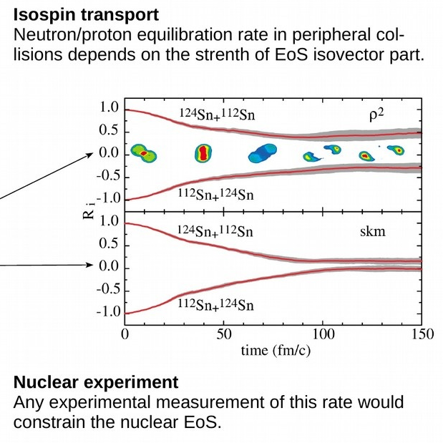
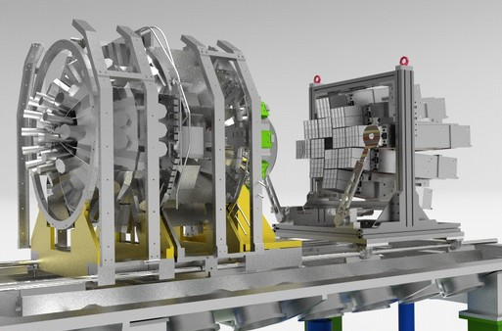
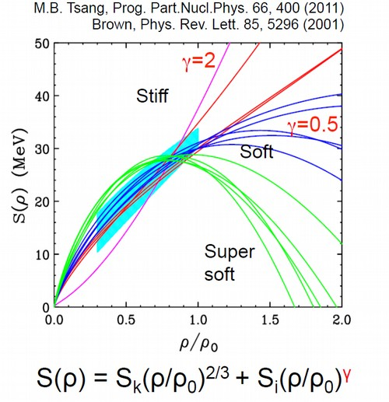
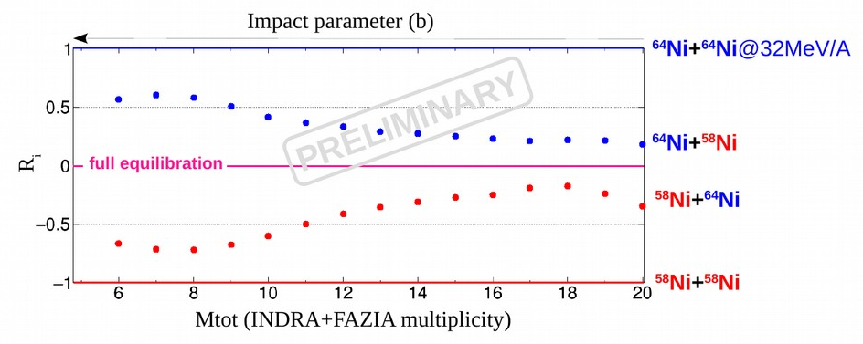
Constraining the density dependence of Symmetry Energy
INDRA
FAZIA
^{58/64}Ni + ^{58/64}Ni @ 32A/52A MeV: E789 performed in 2019
Preliminary results :
Notes:
17
17
17

