Slide 1
‘The strong interaction at the frontier of knowledge: fundamental research and applications’
WP31
Eric Voutier for the P3E team
CNRS/IN2P3/IPNO, Université Paris-Sud, Université Paris-Saclay
STRONG-2020 Kick-off meeting
October 23-25, 2019

Slide 2
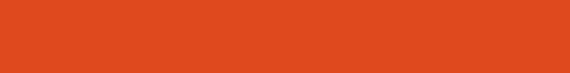
P3E
Polarized Electrons, Positrons and Polarimetry
Pushing further
the intensity frontier of polarized electron sources,
the intensity frontier of low energy polarized positron sources,
and the precision frontier of electron polarimetry.
P3E-1: High Intensity Polarized Electron Source
P3E-2: High Intensity Polarized Positron Source
P3E-3: High Precision Electron Polarimetry

Slide 3
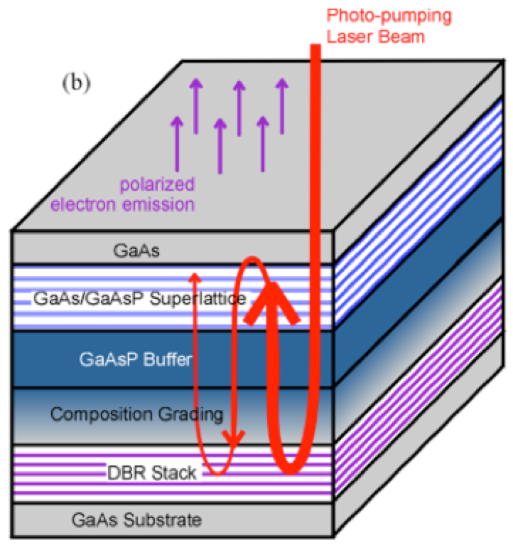

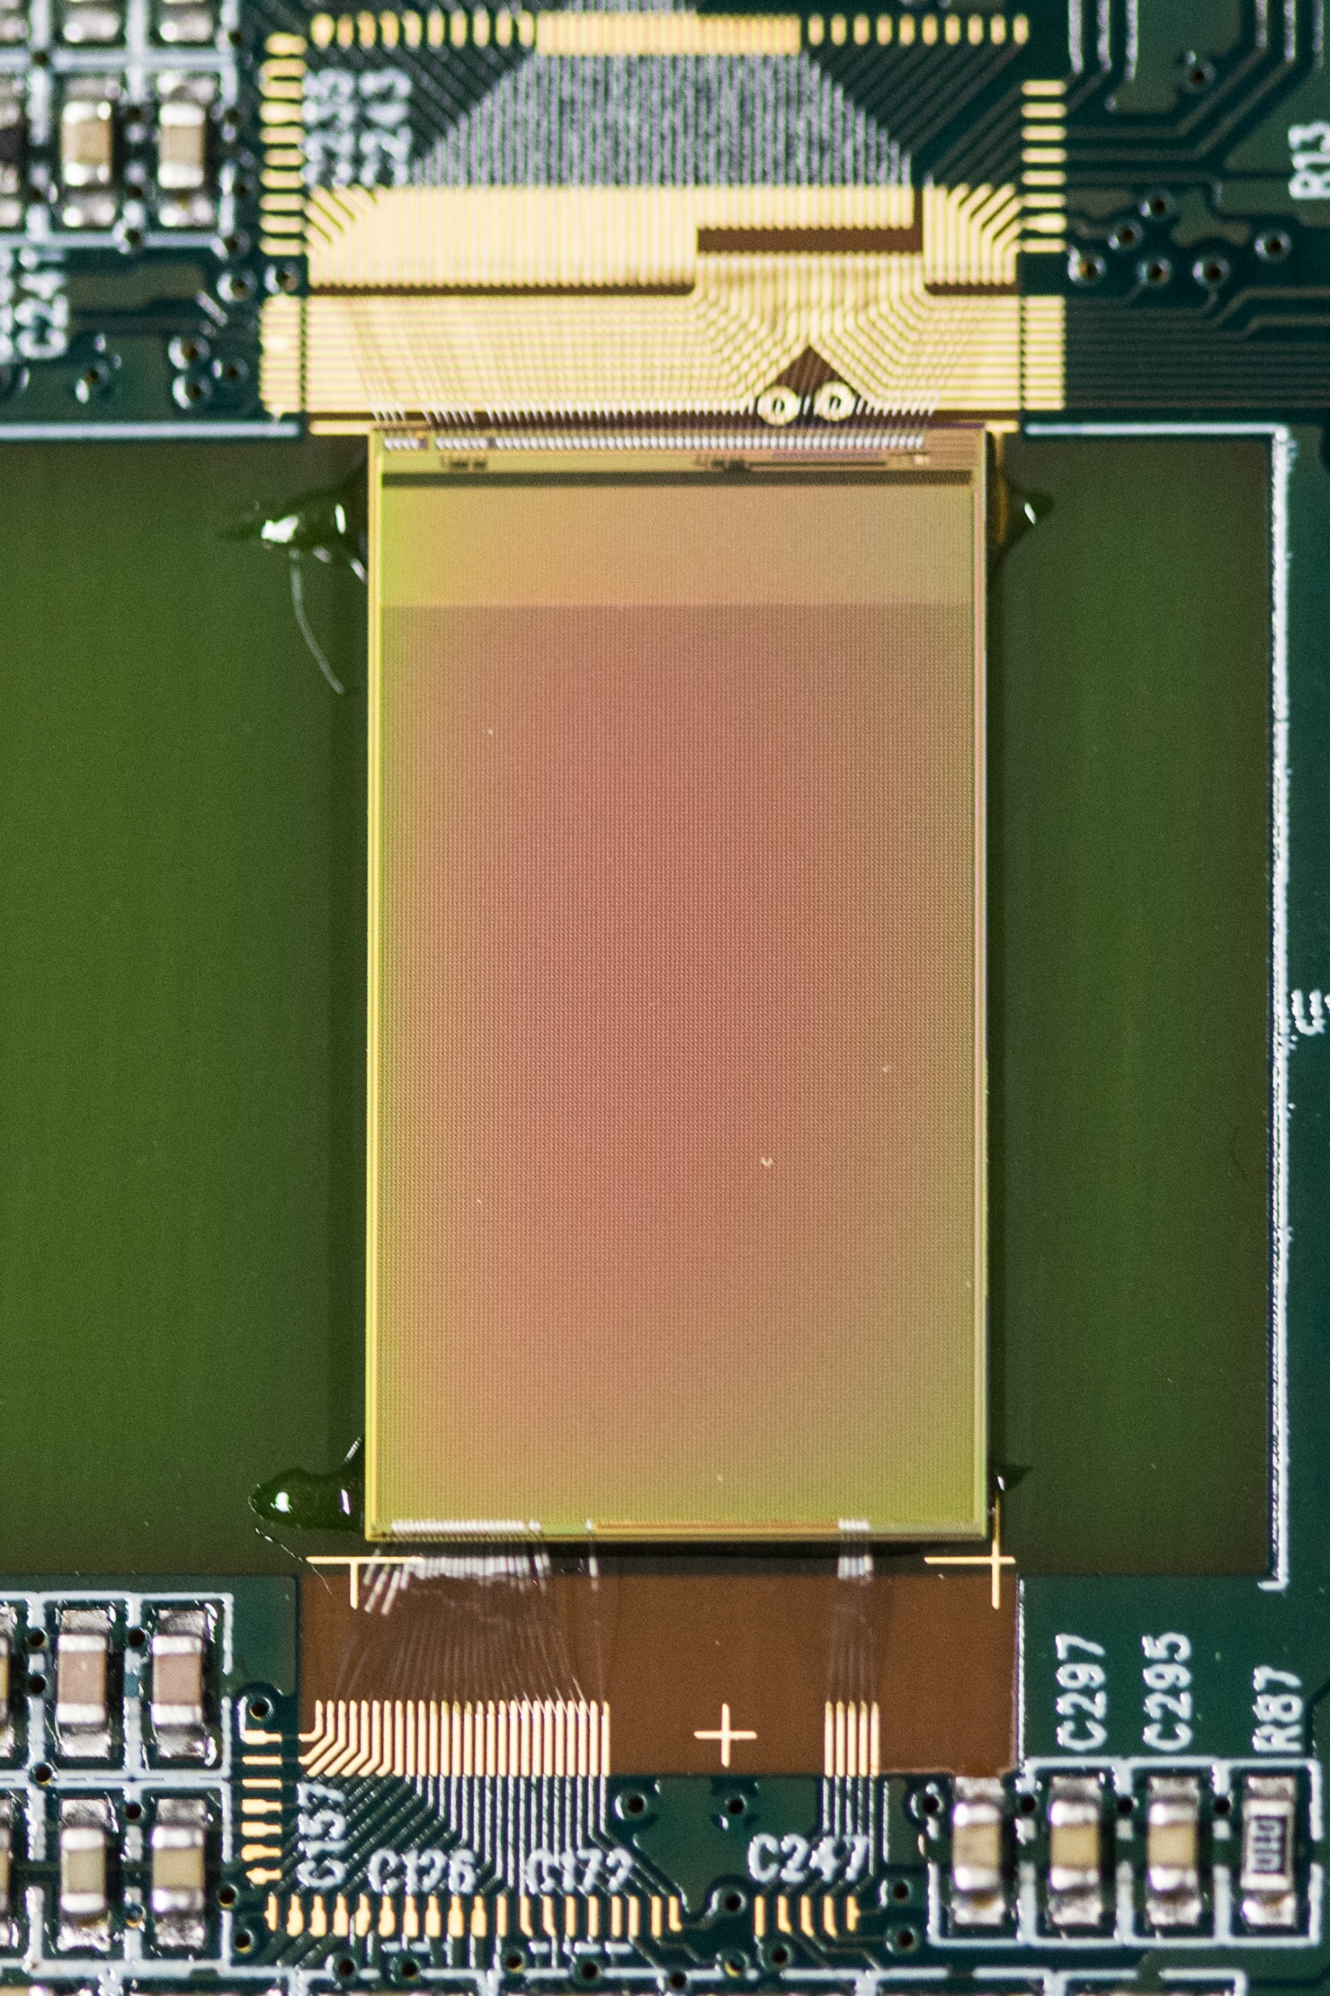
P3E
Polarized Electrons, Positrons and Polarimetry
Polarized Positron
R&D
Photocathode R&D
Sensors R&D
Development of
high quantum effciency
and long live-time photocathodes
Application of the newly demonstrated PEPPo technique to hadronic physics accelerators
Development and applications of
HV-MAPS sensors

Slide 4
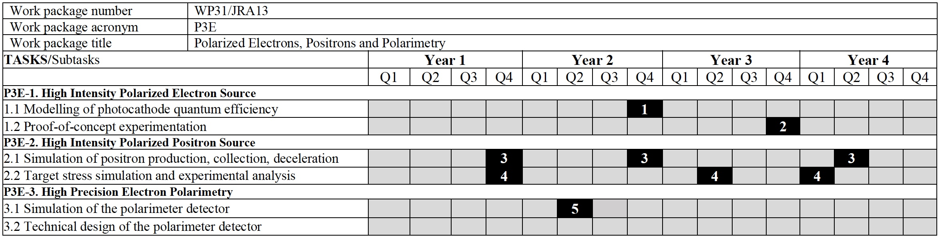
P3E
Polarized Electrons, Positrons and Polarimetry
P3E-1: JLab (Newport News), TUD (Darmstadt)
P3E-2: DESY (Zeuthen), IPNO (Orsay), LAL (Orsay), UH (Hamburg)
P3E-3: JGU (Mainz)
Leading institution Partner institution Funded institution

Slide 5
P3E
Polarized Electrons, Positrons and Polarimetry
P3E-1: JLab (Newport News), TUD (Darmstadt)
P3E-2: DESY (Zeuthen), IPNO (Orsay), LAL (Orsay), UH (Hamburg)
P3E-3: JGU (Mainz)
Leading institution Partner institution Funded institution

Slide 6

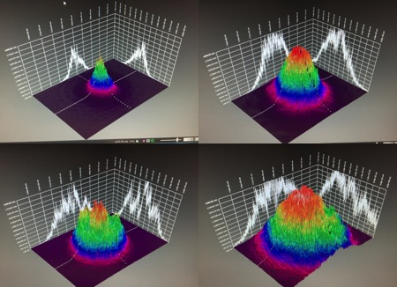
JRA13 : Update on progress (P3E-1)
J. Grames et al. at LHeC, FCC-eh and PERLE Workshop, Orsay, June 27-29, 2018
Polarized positrons for CEBAF and high current operation at eRHIC prompted experiments at CEBAF to characterize the influence of the laser spot size on the lifetime of high-polarization photocathodes
As expected, larger spot size improves lifetime
Diffracted Brag Reflection photocathode is an excellent candidate for improving quantum efficiency
On-going work to build a HV > 300 kV polarized electron gun
1 mA for 7 days is 600 C
1 mA
(2007)
4 mA
(2011)

Slide 7

JRA13 : Update on progress (P3E-2)
Publication of the JPos17 proceedings
(free access at https://aip.scitation.org)
describing the science of polarized positron beams and physics for JLab 12 GeV and JLEIC, and their applications for fundamental research in Atomic Physics and Material Science

Slide 8
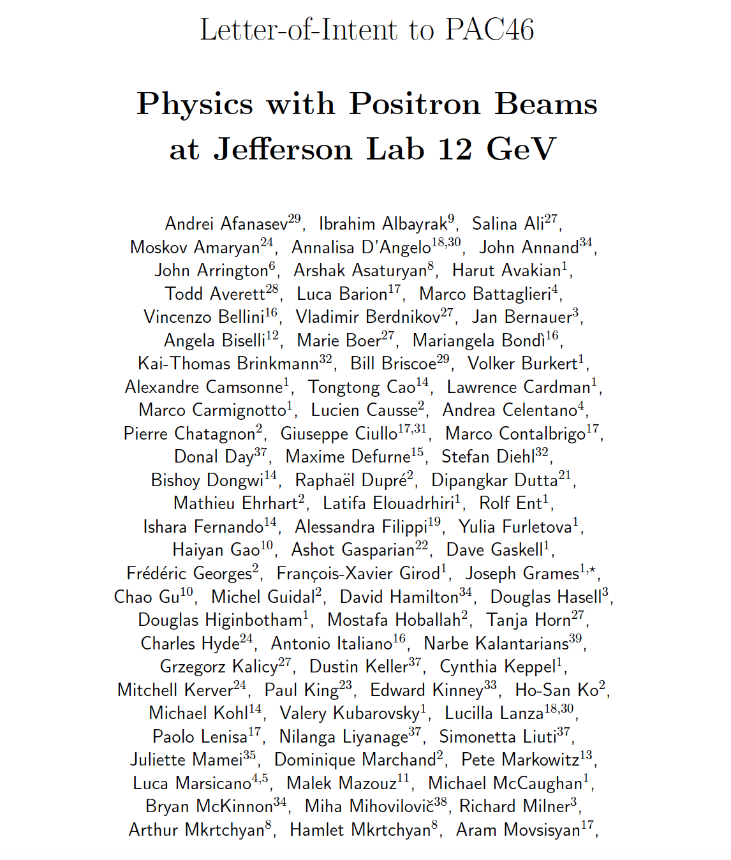

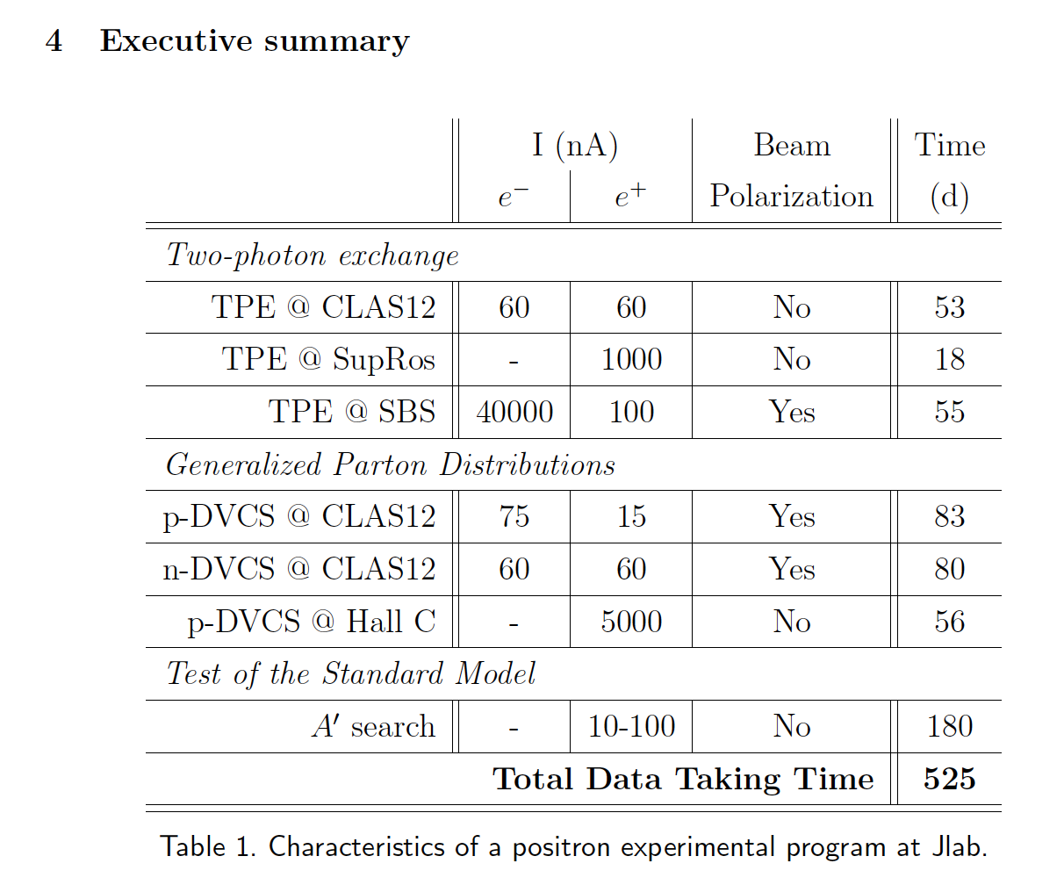

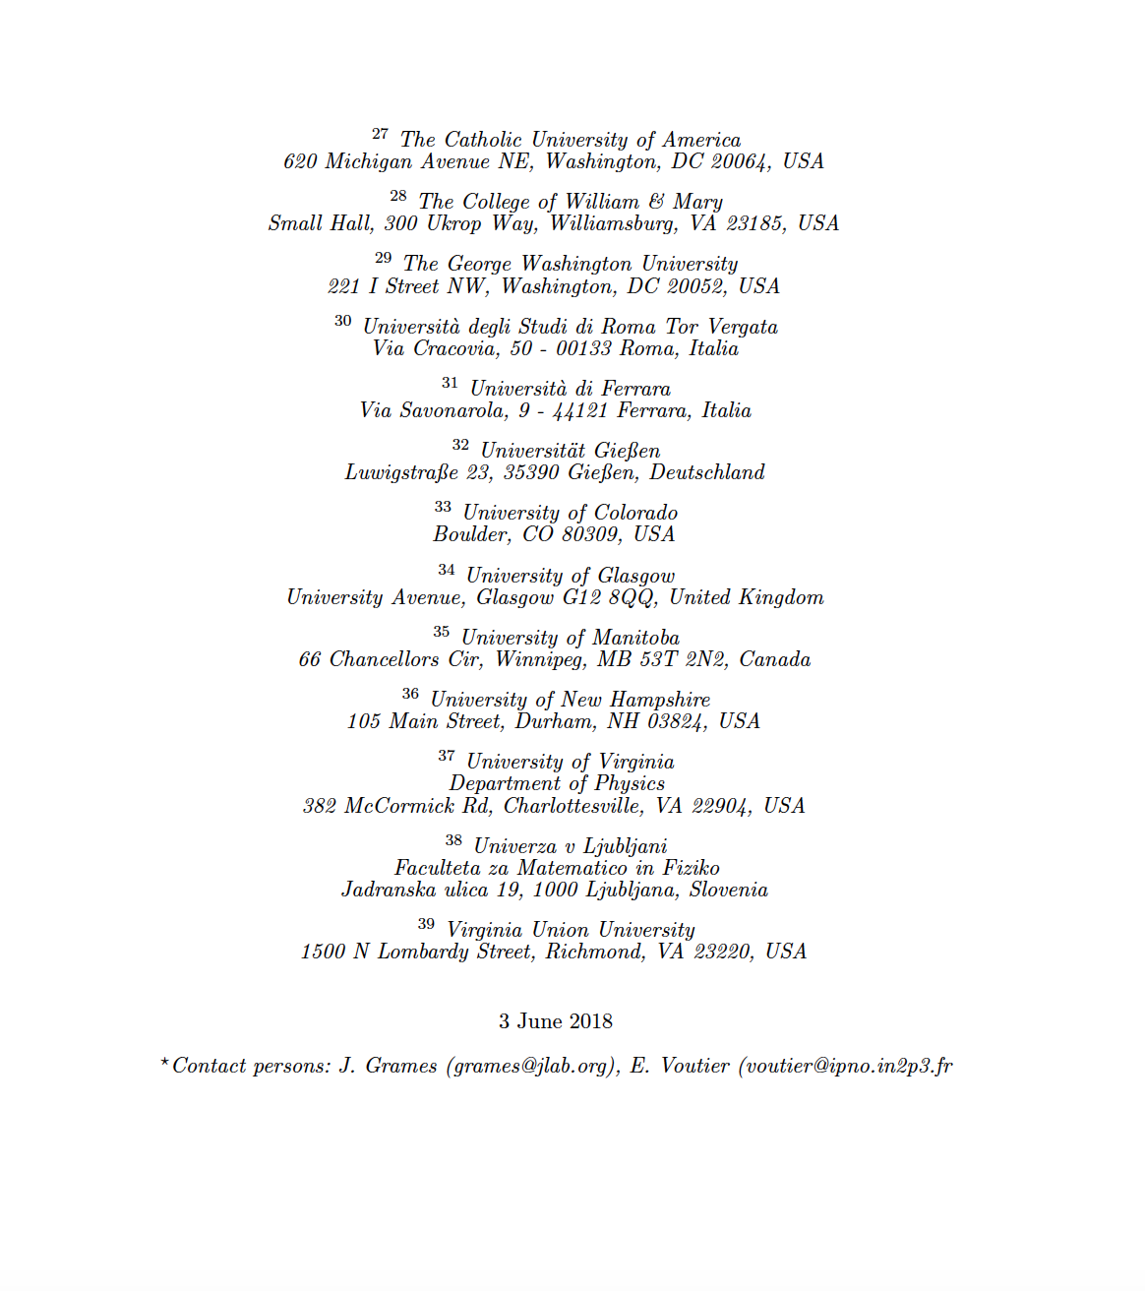
JRA13 : Update on progress (P3E-2)
J. Arrington, M. Battaglieri, J. Bernauer, V. Burkert,
A. Celentano, L. Elouadrhiri, F.-X. Girod, J. Grames,
L. Marsicano, C. Muñoz Camacho, S. Niccolai, A. Puckett,
A. Schmidt, E. Voutier…
120 Physicists from 39 Institutions
« These measurements all have significant physics interest. The proposers should carefully evaluate feasibility and present the best case possible in a future proposal. »

Slide 9
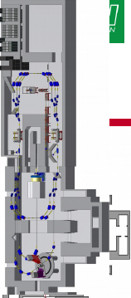
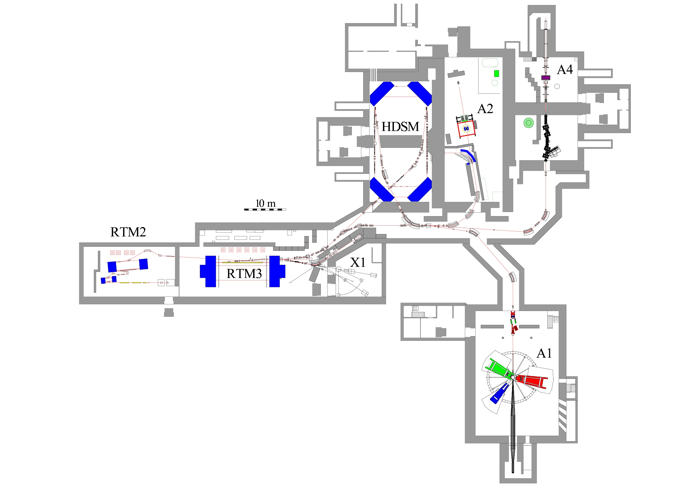
JRA13 : Update on progress (P3E-2)
K. Aulenbacher, I. Chaikovska, W. Hillert, D. Lott, G. Moortgat-Pick, E. Voutier
Combined PhD project bewteen the University of Hamburg and the University Paris-Saclay for the design of a high power target to operate a PEPPo-like polarized positron source
Target simulation and design evaluation at Orsay
Target tests at Mainz
Analyses of target materials at Hamburg
PETRA-3 beam for Material Analysis
High-energetic synchrotron radiation (50-200 keV) with high brilliance for Roentgen diffraction
Point-like analysis of material surface and bulk

Slide 10
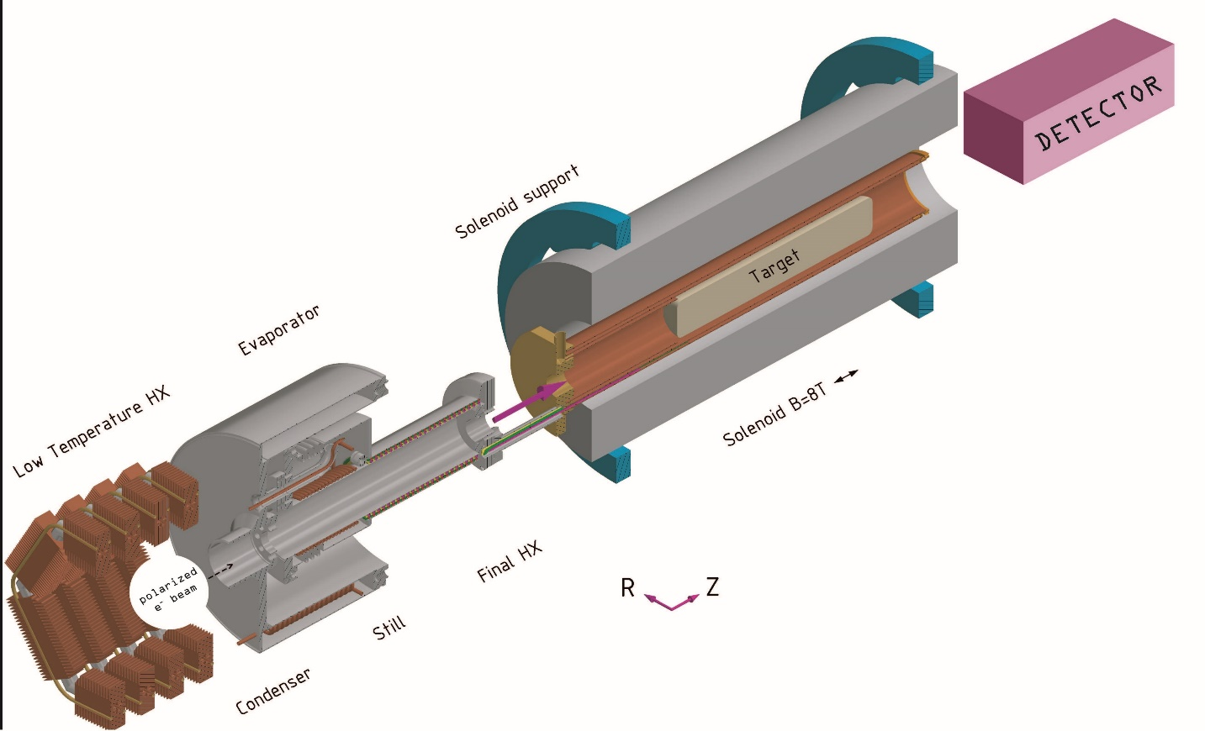

JRA13 : Update on progress (P3E-3)
Reminder : Hydro-Møller polarimeter for on-line polarimetry at ~100 MeV
P2 @ MESA
Trap and polarize atomic hydrogen in high-field solenoid at 0.3 K
Cover walls in superfluid helium to avoid hydrogen recombination
Requires dilution cryostat (under construction at Mainz)
Never done with high beam intensity
Measure double spin asymmetry
P3E-3 concerns
the development of the detection system

Slide 11
JRA13 : Update on progress (P3E-3)
First design available for a detection chicane to separate Møller and beam electrons
Simulation tracks electrons from hydrogen through the magnet system up to the detector
To do: integrate with target and detector into the polarimeter simulation package (HYMOSIM)
Contributions from
V. Tyukin, K. Kumar, R. Beminiwhatta, S. Riordan

Slide 12

JRA13 : Update on progress (P3E-3)
Candidate detector: High-Voltage Monolithic Active Pixel Sensors
First large (1.0x2.0 cm²) fully characterized and opertional
Next batch will focus on integration issues (powering, interfaces)
Simulation ready to integrate into HYMOSIM

Slide 13
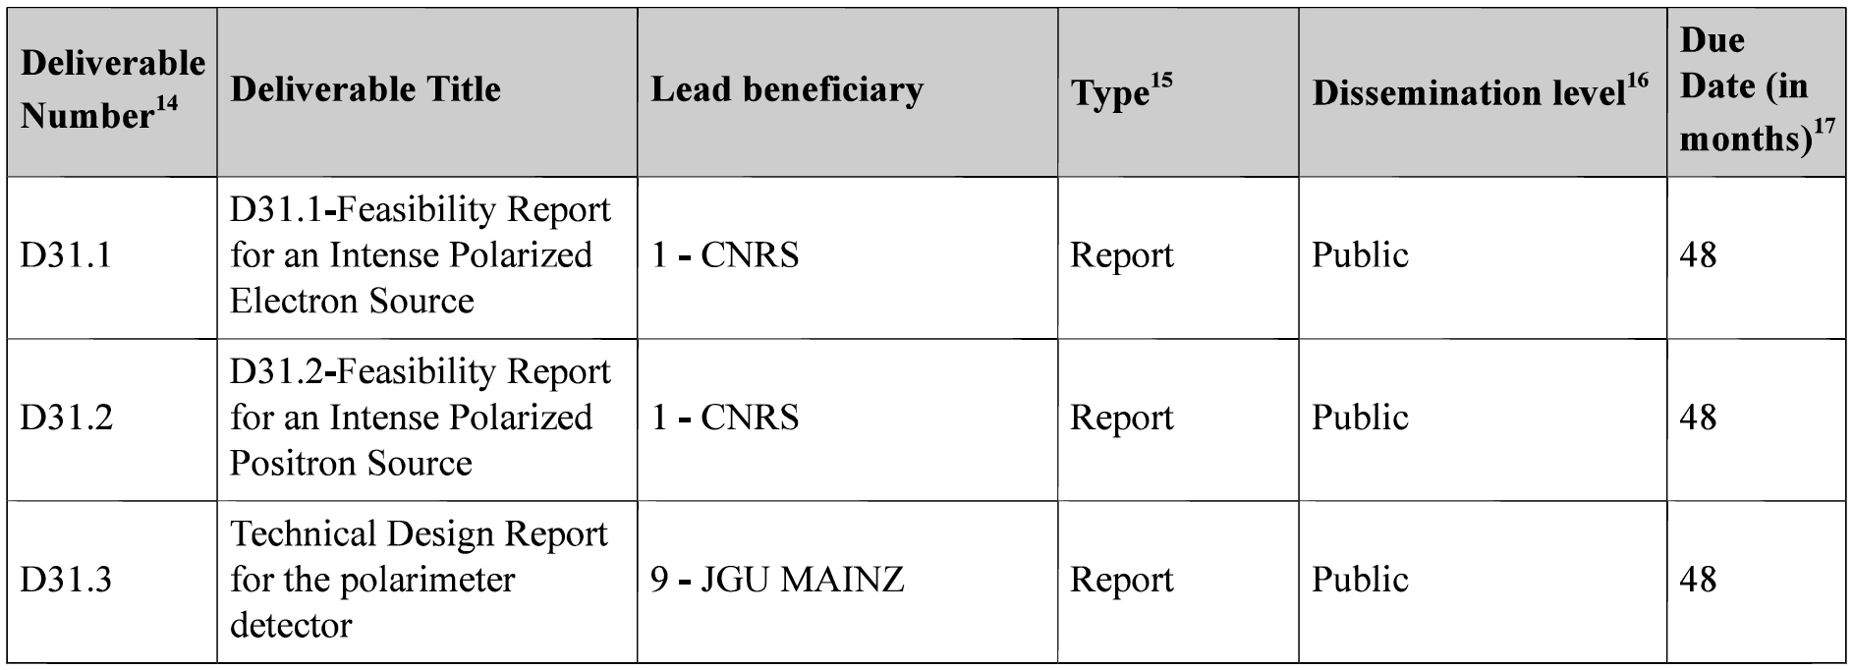
JRA13 : Deliverables
There are no deliverables due for Reporting Period 1 (18 months, June 2019-November 2020)
All deliverables are due on M48 at the end of the project

Slide 14
JRA13 : Milestones
MS79 has to be achieved M18 (November 2020)
Simulation of Møller process, magnet system and detectors running
Need to be fully integrated
Expected completion : September 2020

Slide 15
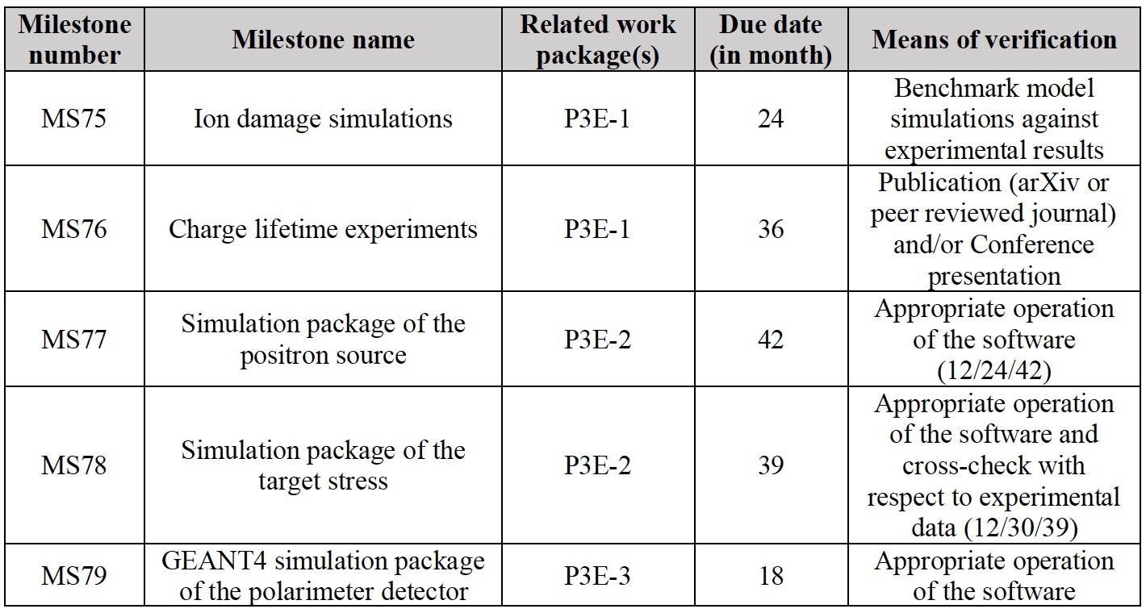
JRA13 : Milestones
MS77 advancement control at M12 (May 2020)
MS78 advancement control at M12 (May 2020)

Slide 16
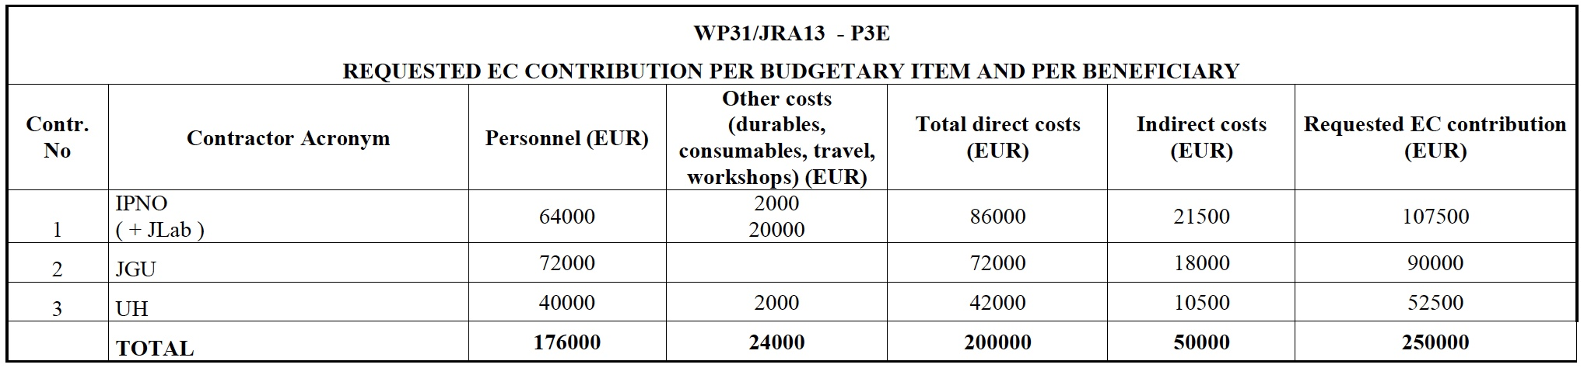
JRA13 : Funding
IPNO and UH combined their manpower funding within a cotutelle PhD thesis project about a High power target for low energy polarized positron source
JGU complemented its manpower funding to offer a 2 years term Post-Doctoral position

Slide 17
JRA13 : Funding
IPNO and UH combined their manpower funding within a cotutelle PhD thesis project about a High power target for low energy polarized positron source
JGU complemented its manpower funding to offer a 2 years term Post-Doctoral position
JRA13 scientific activity continues to successfully develop

