Slide 1
‘The strong interaction at the frontier of knowledge: fundamental research and applications’
WP7: Characterization of the QGP with heavy flavour probes
J. Aichelin
SUBATECH/NANTES
STRONG-2020 Kick-off meeting
October 23-25, 2019

Slide 2

WP 7 Characterization of the QGP with heavy flavour probes
WP objectives
“To organize the joined effort of experimentalists and theorists which is indispensable to assess our knowledge, approve or refine chosen direction and define experimental priorities and the best analyzing strategies for the upcoming high precision data on open and hidden heavy flavor. “
The goal of this analysis is
the exploration of the properties of the quark gluon plasma (QGP) via heavy flavor hadrons
the understanding of the interaction of heavy partons with the QGP
the understanding of the properties of hidden heavy flavour particles in the QGP
Barbara Erazmus, Coordinatrice du projet
Paris,08/02/2018

Slide 3
WP tasks
To develop the theoretical knowledge which is necessary to provide
theoretical models for predicting open and hidden heavy flavour
observables in pA and AA collisions for the RHIC and LHC. The goal
is to use heavy flavour hadrons to explore the properies of the QGP.
To characterize with high precision the QGP properties with heavy flavor observables exploiting the High Luminosity Heavy Ion Phase (HL-HI) of the LHC after the 2nd long shutdown of the LHC facility (LS2 in 2019-2020).
To built, together with the RHIC and LHC experiments, an
interface between simulation data and experimental data to
exploit the full complexity of these data and to allow for the
comparison of multi-particle correlations in theory and experiment

Slide 4
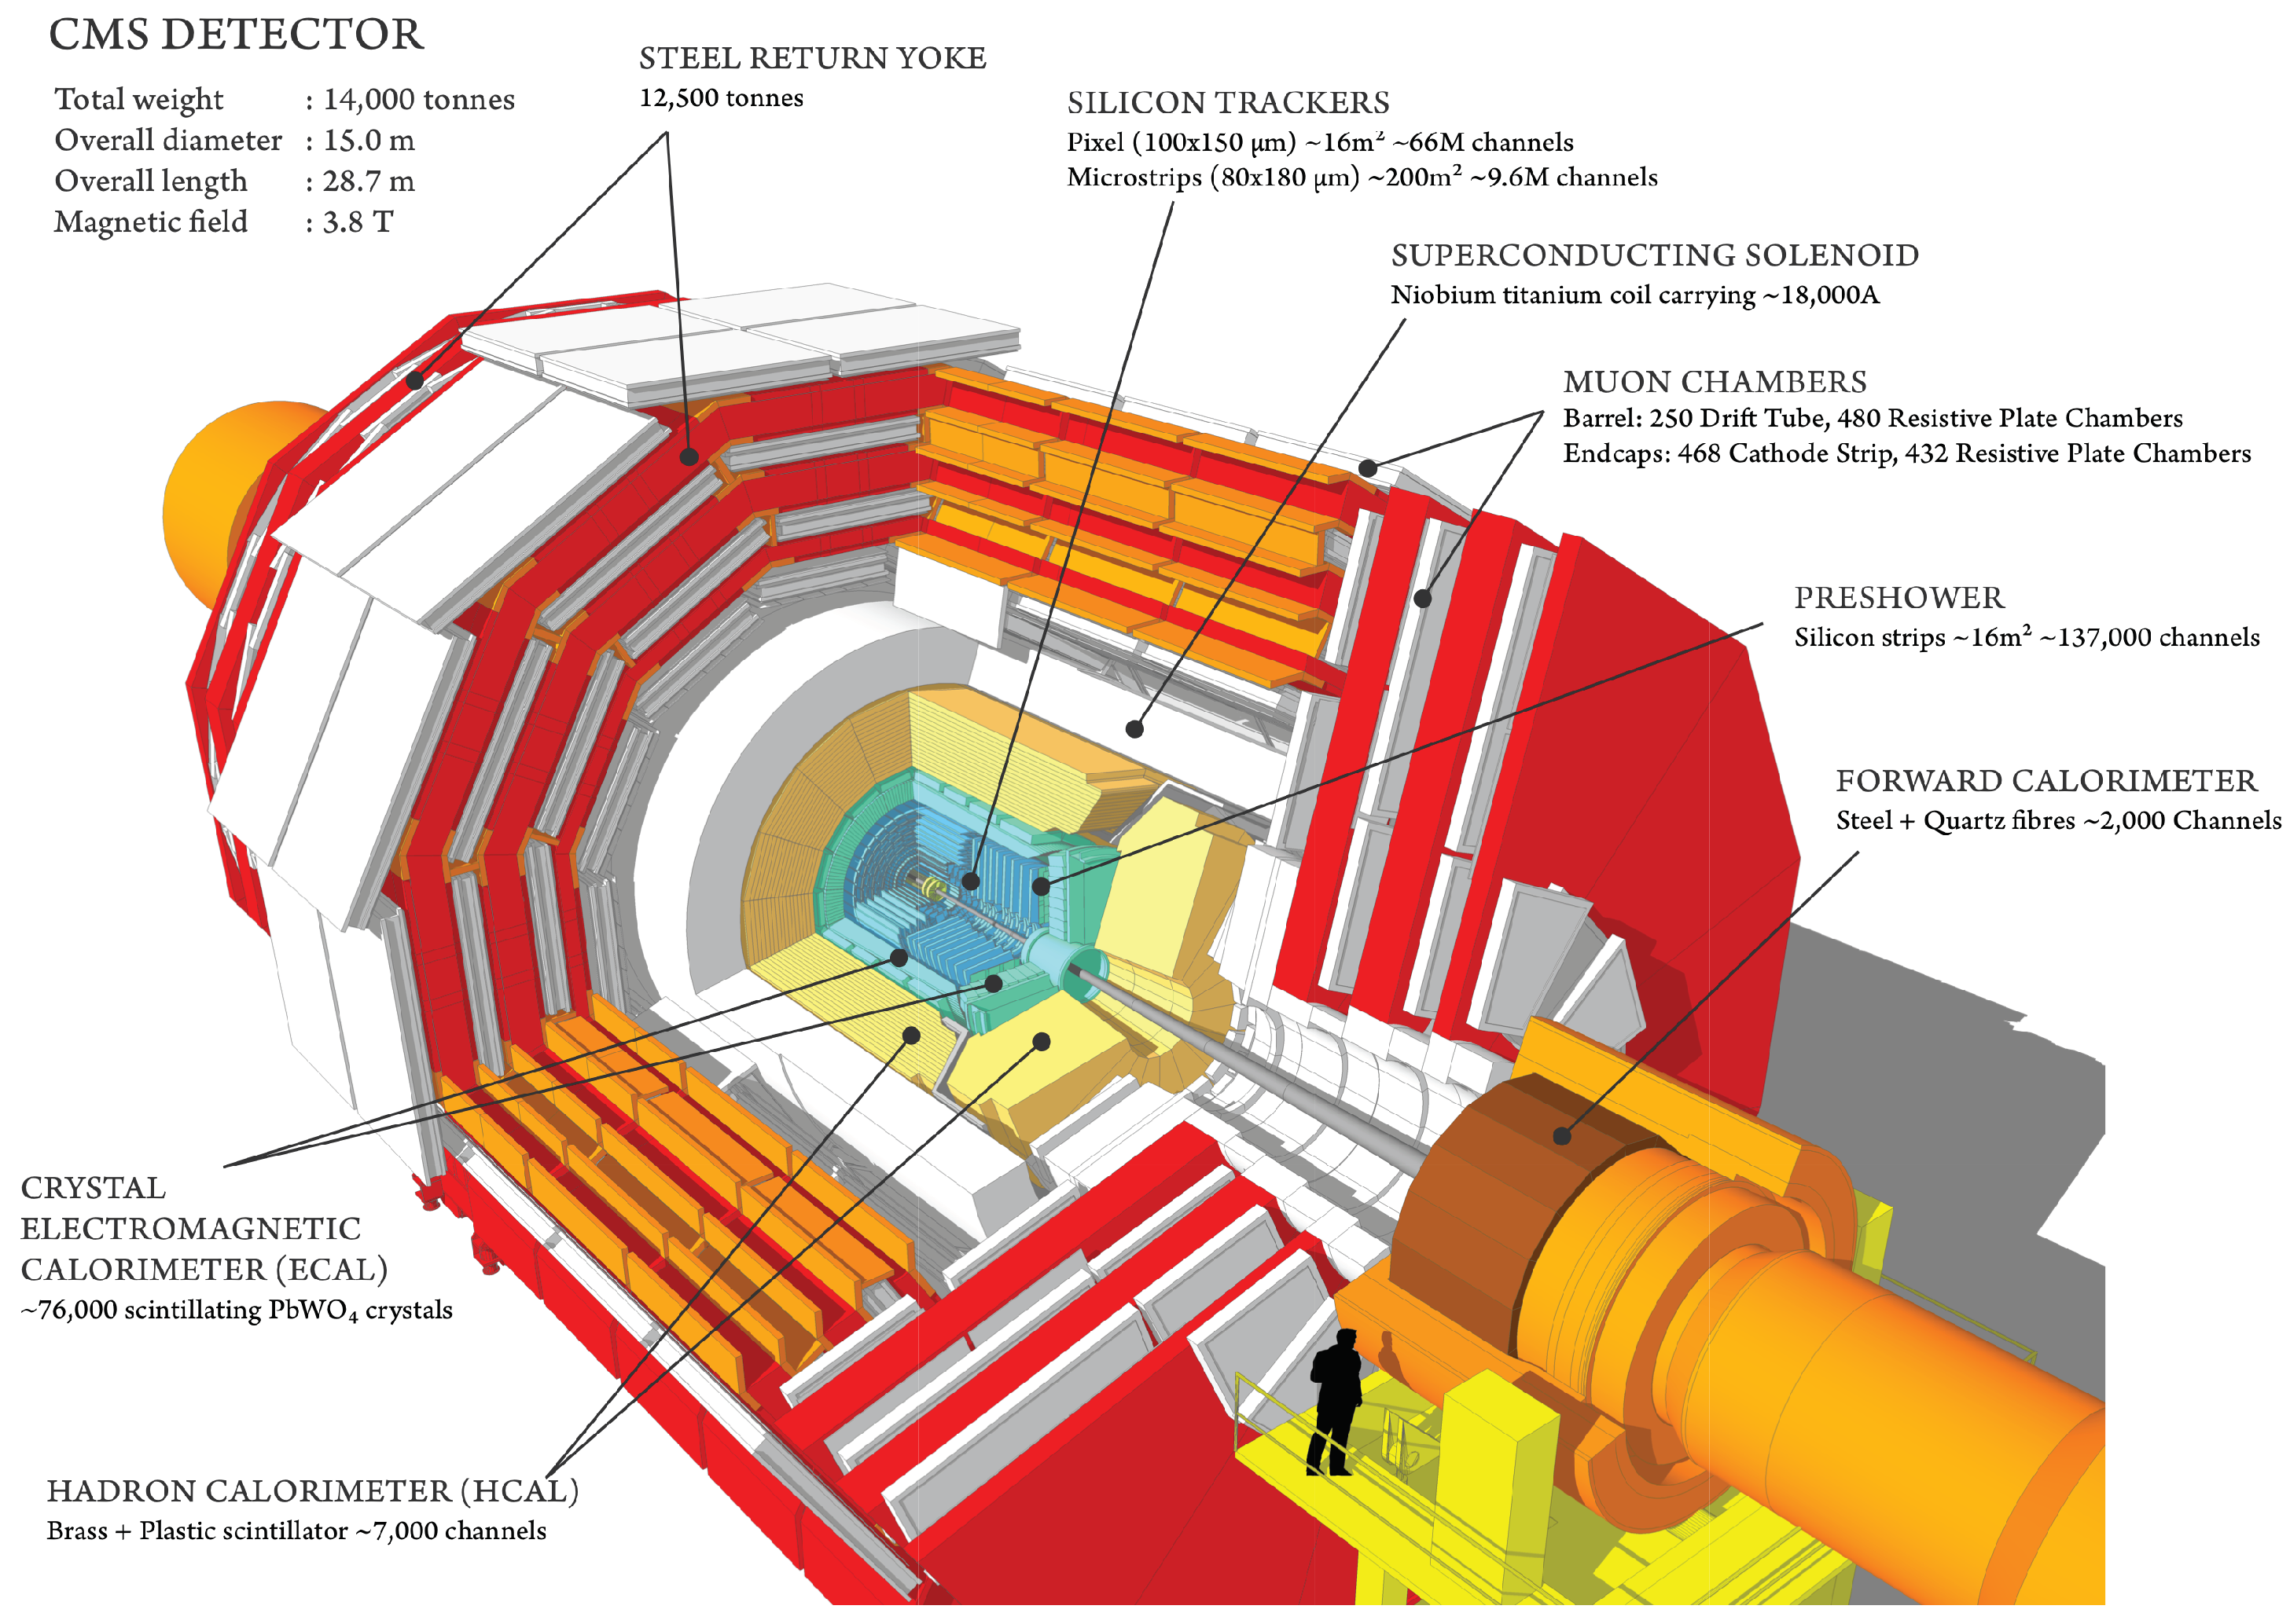
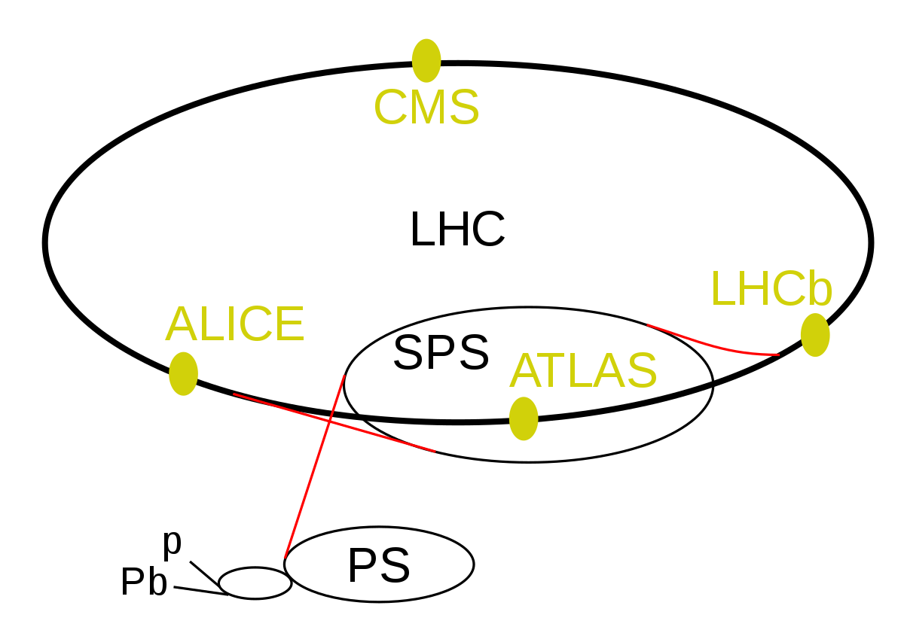
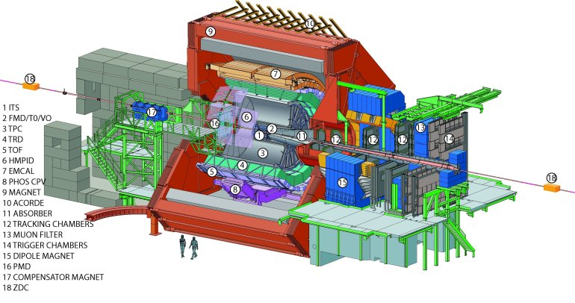
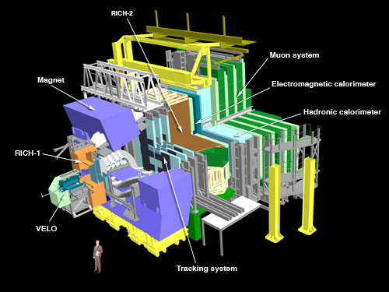
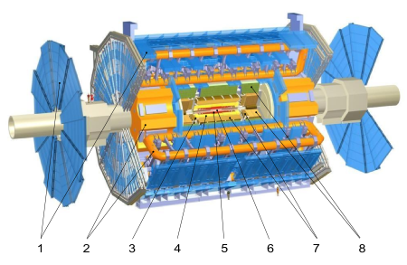
Task for the experimentalists:
optimize run conditions and reconstruction of heavy flavour probes in HL-HI at the LHC
CERN
MIT
ALICE
- INFN: Bari, Padua, Turin
CNRS/IN2P3: LPC, Subatech, IPNO, IPHC
CERN
GSI
Munster Uni.
Heidelberg Uni.
Frankfurt Univ.
Czech Technical Uni.
Utrecht Uni.
INFN
Cagliari
Lisbon
Prague

Slide 5
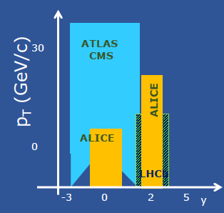
Task for the experimentalists:
optimize run conditions and reconstruction of heavy flavour probes in HL-HI at the LHC
Exploiting the complementarity of the experiments, also due to their different kinematic coverage. E.g. for J/ψ
Lisbon
Prague
CERN
MIT
- INFN: Bari, Padua, Turin
CNRS/IN2P3: LPC, Subatech, IPNO, IPHC
CERN
GSI
Munster Uni.
Heidelberg Uni.
Frankfurt Univ.
Czech Technical Uni.
Utrecht Uni.
INFN
Cagliari

Slide 6
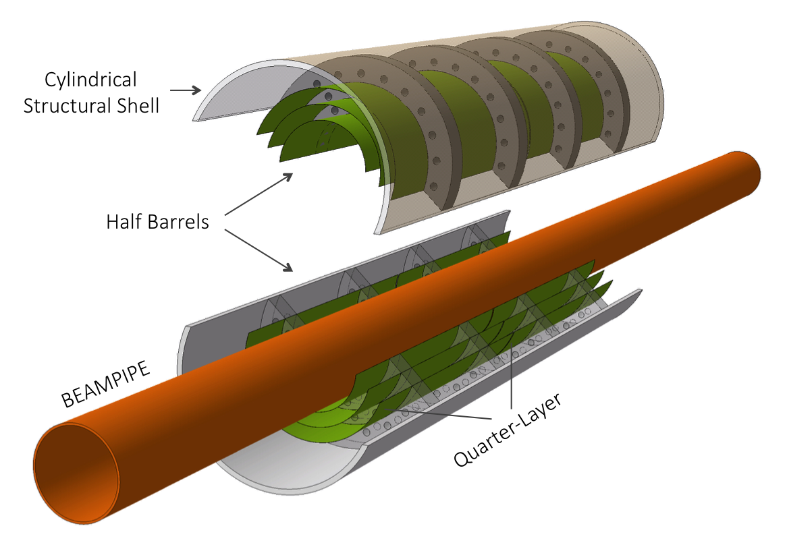
Task for the experimentalists:
optimize run conditions and reconstruction of heavy flavour probes in HL-HI at the LHC
Supporting and scrutinizing new initiatives, in the context of the common effort with theorists to characterize the QGP with heavy flavour. E.g. ALICE proposal of ultra-thin truly cylindrical barrel pixel detector for the innermost layers, or NA60+ proposal at SPS
ALICE ITS3
role of NA7 HF-QGP
Revisit the HF chapter of the Yellow Report
from WG5 of the Workshop on the “Physics
of the CERN HL-LHC, and Perspectives at the
HE-LHC (arXiv:1812.06772)
deliverable n.3 of NA-7

Slide 7
Task for the theory:
understand the complexity of heavy quark physics
→ study of the QGP with heavy quarks
Production of heavy quarks:
(hard) production of heavy quarks and bound states in initial NN collisions
(generalized parton distribution fcts,
pQCD, FONLL)
Jyvaskyla, Prag
hadrons
Quarkonia formation in QGP through c+c→Ψ+g fusion process
(finite temp QCD, pQCD)
Stavanger, Nantes, GSI
QGP

Slide 8
Interaction with the QGP:
Properties of QGP constituents
(Dyson Schwinger, eff. field theorie)
Coimbra, Darmstadt, Lyon, Nantes, Giessen, Frankfurt, Wuppertal
Interaction of heavy quarks with QGP constituents, LPM
pQCD, transport coefficients
Belgrad, Catania, Frankfurt, GSI, Rossendorf, Torino
hadrons
QGP
Evolution of the QGP (transport theory, lattice gauge theory)
Bergen, Firenze, Oslo, Paris, Wroclaw

Slide 9
Hadronization and hadronic interactions:
Hadronisation of light quarks:
Cross over or phase transition (statistical physics, nonpert. QCD)
Catania, Frankfurt, GSI, Nantes
D/B J/psi formation at the boundary of QGP
fragmentation or coalescence (pQCD)
Catania, Frankfurt, GSI, Nantes
hadrons
QGP
Hadronic interactions (hadron physics)
Banska Bystrica, Barcelona,
Budapest,

Slide 10
NA7: Update on progress
Since the application
on many of the subtasks progress has been reported
(around 50 permanent and 100 non-permanent people involved).
This progress has been published in journals
Here just three from the theory side:
the longstanding question how to determine the potential between c and cbar
from lattice gauge calculations has been solved
transport coefficients from different theoretical models have been compared and their
consequences analyzed.
Results from Langevin and Boltzmann equations have been compared and the
validity range assessed
Barbara Erazmus, Coordinatrice du projet
Paris,08/02/2018

Slide 11
NA7: Update on progress
First virtual meeting of NA7 held on October the 14th
Sub-structure of the networking has been defined, as anticipated in the proposal
  Open heavy Flavour
  Quarkonium
  HF in small colliding systems
Internal call for nomination of the conveners of the three subgroups has been launched
  two conveners per sub-group: an experimentalist and a theorist
  conveners will be appointed the next week
  they will have a key role in view of finalization of deliv. 3 forseen for NA7
    3 recommendation for the dedicated heavy-ion periods of LHC after the 2nd Long Shutdown for the different LHC experiments
In the process to hire the post-doc positions we are funded for
Barbara Erazmus, Coordinatrice du projet
Paris,08/02/2018

Slide 12
Before Strong-2020 has been accepted, a workshop on open
heavy flavor has been accepted by the ECT board
We discuss with the organizers about a possible participation
of NA7

Slide 13
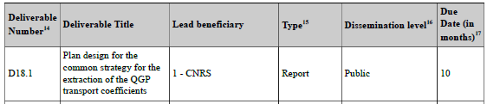
NA7: Deliverables
Deliverables due for Reporting Period 1 (18 months, June 2019-November 2020): D18.1 is due M10 (March 2020)
Barbara Erazmus, Coordinatrice du projet
Paris,08/02/2018
D18.1 Co-leadership with INFN. The deliverable will be publicly available on the dedicated web page of the network.
Thanks to the support of
Lorentz Center in Leiden
EMMI (Fair/GSI)
Jet –collaboration (US)
DAAD
This deliverable is ready

Slide 14
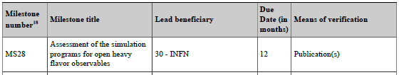
NA7: Milestones
Although not completely finished the essential is already published:
%\
This deliverable is ready in form of publications: The transport
coefficients have been identified and have been calculated in the
different transport approaches to pass the milestone
MS28 has to be achieved M12 (May 2020)
Barbara Erazmus, Coordinatrice du projet
Paris,08/02/2018
The simulation programs have been assessed. The essential results
for the transport coefficients as well as for the assessment have been
published as well.

Slide 15
G. Aarts et al., « Heavy-flavor production and medium properties in high-energy
nuclear collisions - What next?,‘ »
Eur. Phys. J.A53 (2017) no.5, 93
R. Rapp et al. « Extraction of Heavy-Flavor Transport Coefficients in QCD Matter,''
Nucl. Phys. A 979 (2018) 21 »
Y. Xu et al. « Resolving discrepancies in the estimation of heavy quark transport
coefficients in relativistic heavy-ion collisions, »
Phys.Rev. C99 (2019) 014902
S.Cao et al. « Toward the determination of heavy-quark transport coefficients in
quark-gluon plasma, »
Phys.Rev. C99 (2019) 054907
All papers are on arXiv and can be linked to the Strong 2020 homepage.
Some additional studies (transport coefficients in non-equilibrated matter) are
presently under way.

Slide 16
EXTRA SLIDES

Slide 17
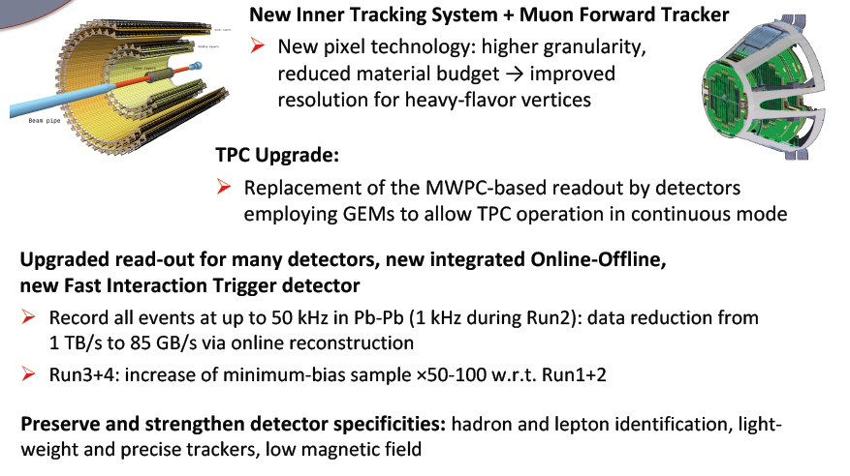
ALICE Upgrade Strategy: LS2

Slide 18
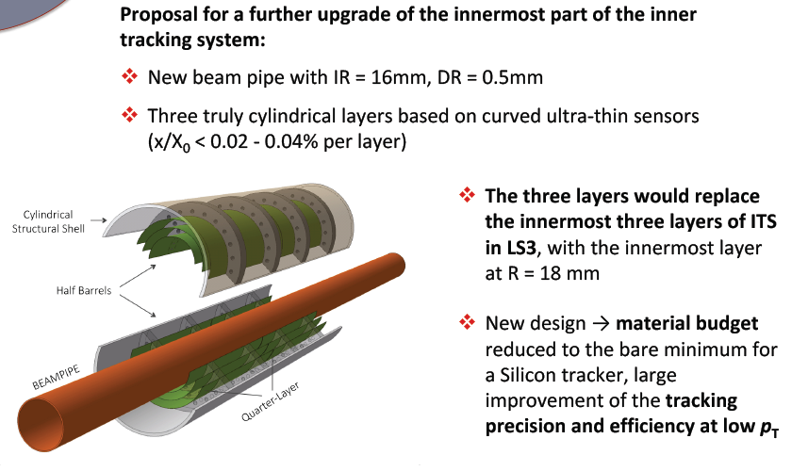
ALICE Upgrade Strategy: LS3

Slide 19
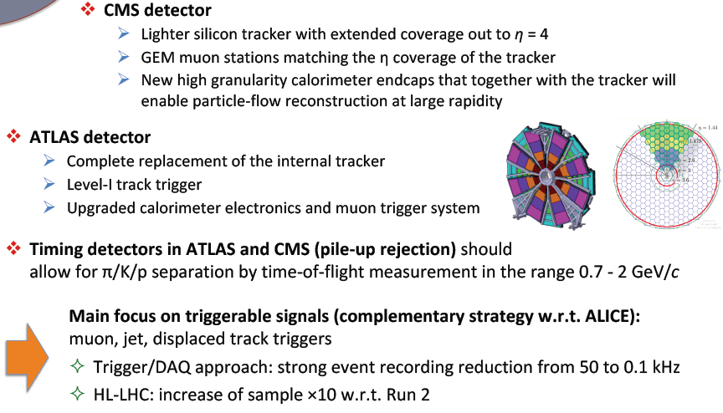
CMS/ATLAS Upgrades (LS3) Relevant for Heavy-Ions

Slide 20
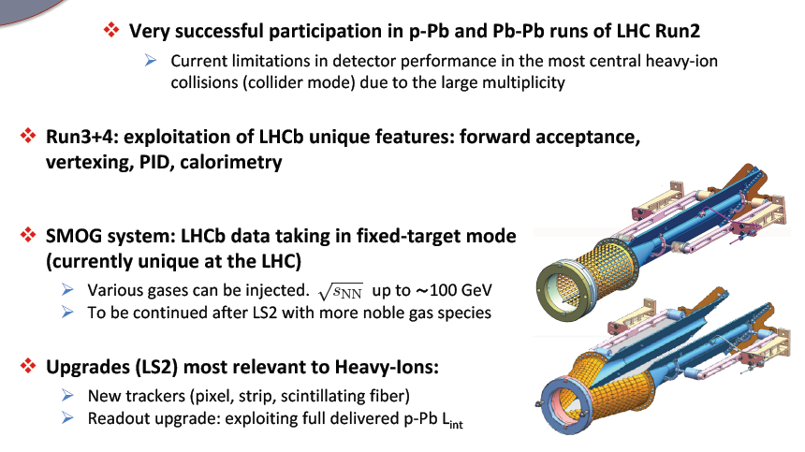
LHCb as a Heavy-Ion Detector

