Slide 1
‘The strong interaction at the frontier of knowledge: fundamental research and applications’
NA2 – Small-x Physics at the LHC and future DIS experiments
Cyrille MARQUET
École polytechnique and CNRS
STRONG-2020 Kick-off meeting
October 23-25, 2019

Slide 2
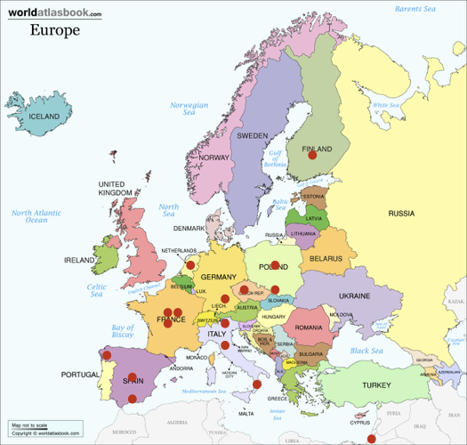
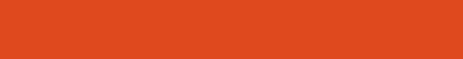
NA2 – Small-x Physics at the LHC and future DIS experiments
Organization and participants
Spokespersons: Néstor Armesto (Santiago de Compostela) and Tuomas Lappi (Jyväskylä).
Participants: 15 institutions, 9 countries, 24 permanent researchers.
- Ben-Gurion University of the Negev, Beer Sheva, Israel.
- Centre National de la Recherche Scientifique, France.
- Czech Technical University, Prague, Czech Republic.
- ECT*, Trento, Italy.
- Henryk Niewodniczański Institute of Nuclear Physics, Krakow, Poland.
- Commissariat à l’énergie atomique, Saclay, France.
- National Centre for Nuclear Research, Warsaw, Poland.
- Universidad Autónoma de Madrid, Spain.
- Universidad de Granada, Spain.
- Universidade de Santiago de Compostela, Spain.
- Università della Calabria, Cosenza, Italia.
- Università de Firenze, Italia.
- University of Groningen, The Netherlands.
- University of Jyväskylä, Finland.
- University of Regensburg, Germany.
Barbara Erazmus, Coordinatrice du projet
Paris,08/02/2018

Slide 3
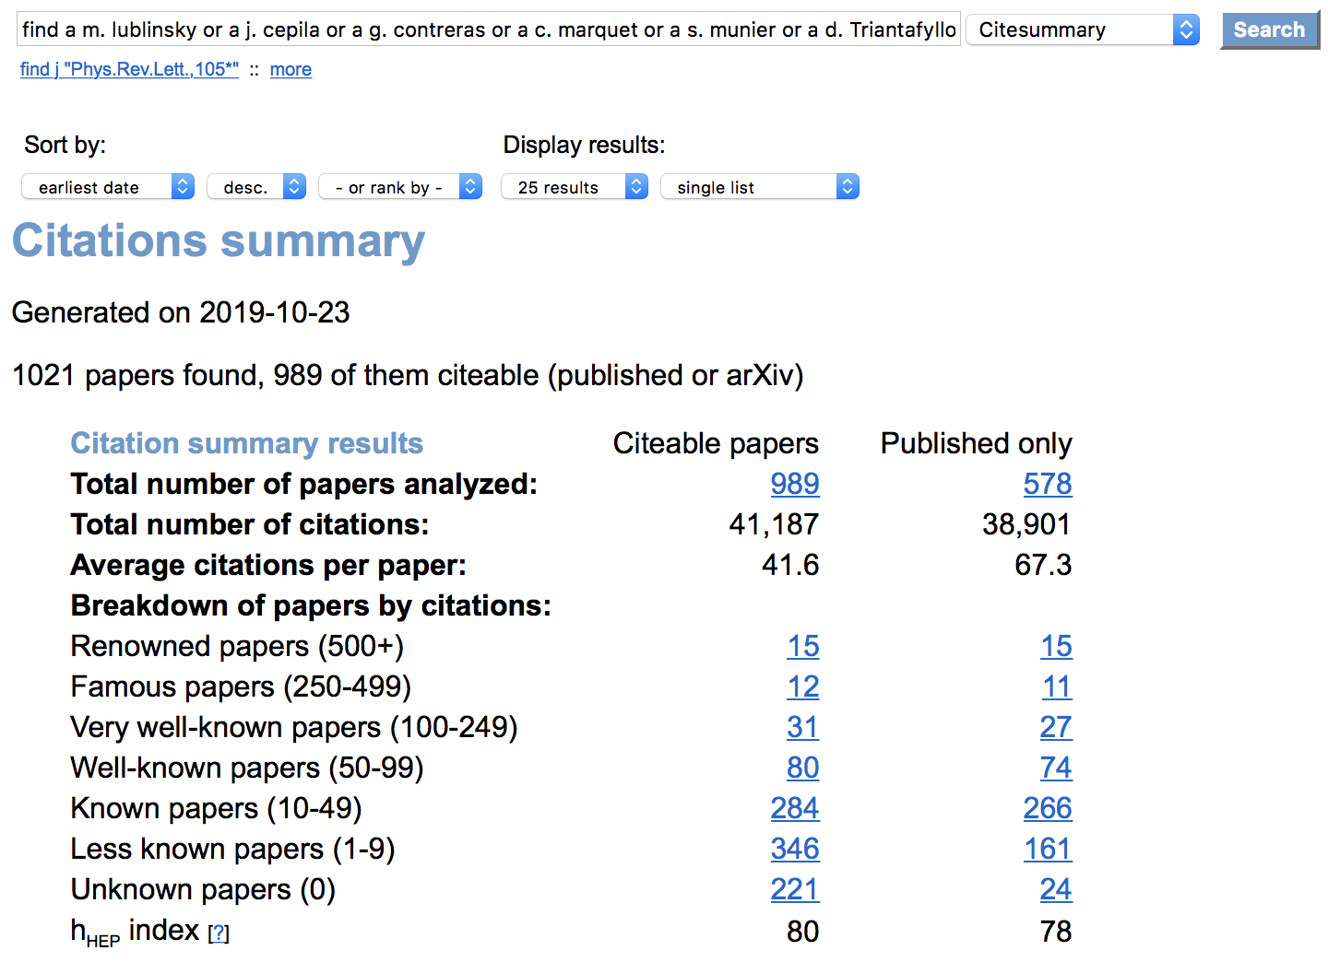
NA2 – Small-x Physics at the LHC and future DIS experiments
Participants
We aim at strengthening the communication and collaboration between
the European groups involved in theoretical and phenomenological
studies of small-x physics.
Our WP comprises most of the
theoretical small-x community in
Europe, with a large impact in
recent years (>2011).
We welcome and expect new
recruits (e.g. in Warsaw) and
recruits in new institutions
(e.g. in Bielefeld) to join our effort
Barbara Erazmus, Coordinatrice du projet
Paris,08/02/2018
http://inspirehep.net/search?ln=en&ln=en&p=find+a+m.+lublinsky+or+a+j.+cepila+or+a+g.+contreras+or+a+c.+marquet+or+a+s.+munier+or+a+d.+Triantafyllopoulos+or+a+k.+kutak+or+a+s.+sapeta+or+a+f.+gelis+or+a+e.+iancu+or+a+g.+soyez+or+a+s.+wallon+or+a+altinoluk+or+a+l.+Szymanowski+or+a+sabio+vera+or+a+albacete+or+a+armesto+or+a+a.+papa+or+a+d.+colferai+or+a.+d.+boer+or+a+t.+lappi+or+a+k.+eskola+or+a+h.+paukkunen+and+not+cn+alice+and+date+after+2011+and+not+cn+h1&of=hcs&action_search=Search&sf=earliestdate&so=d&rm=&rg=25&sc=0

Slide 4
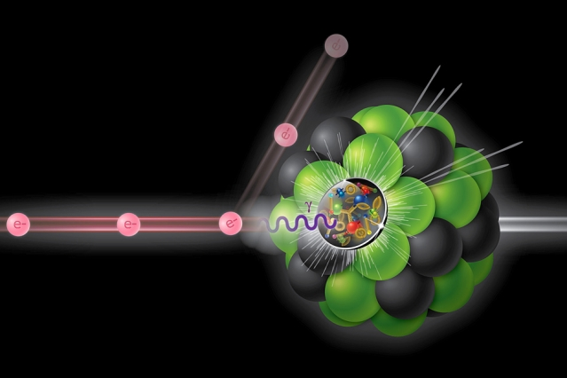
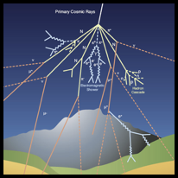
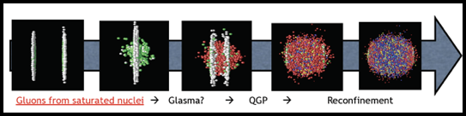
NA2 – Small-x Physics at the LHC and future DIS experiments
Small-x physics
Electron Ion
Collider (EIC)
high-energy
cosmic rays
initial stages of heavy-ion collisions

Slide 5
NA2 – Small-x Physics at the LHC and future DIS experiments
Objectives
➜ Nuclear PDFs: factorisation at small x, impact of new methods for determination and new data from RHIC and the LHC.
➜ Resummation in small-x evolution equations and production cross sections.
➜ New NLO calculations for new observables.
➜ Correlation calculations for more than 2 particles.
➜ Improving models for colour correlations inside hadrons and nuclei and their interplay with hydrodynamics.: connection with pp and UPCs @ LHC.
➜ Relations with spin physics (TMDs) at small x.
➜ Proposal of observables disentangling fixed-order, resummed and non-linear approaches.
➜ Implications of small-x CGC dynamics on thermalisation.rbaraParis,08/02/2018
Exploring the possibilities of the future runs at RHIC and the LHC, and
of future experimental programs on ep/A collisions, to clarify the structure of the non-linear regime of QCD.

Slide 6
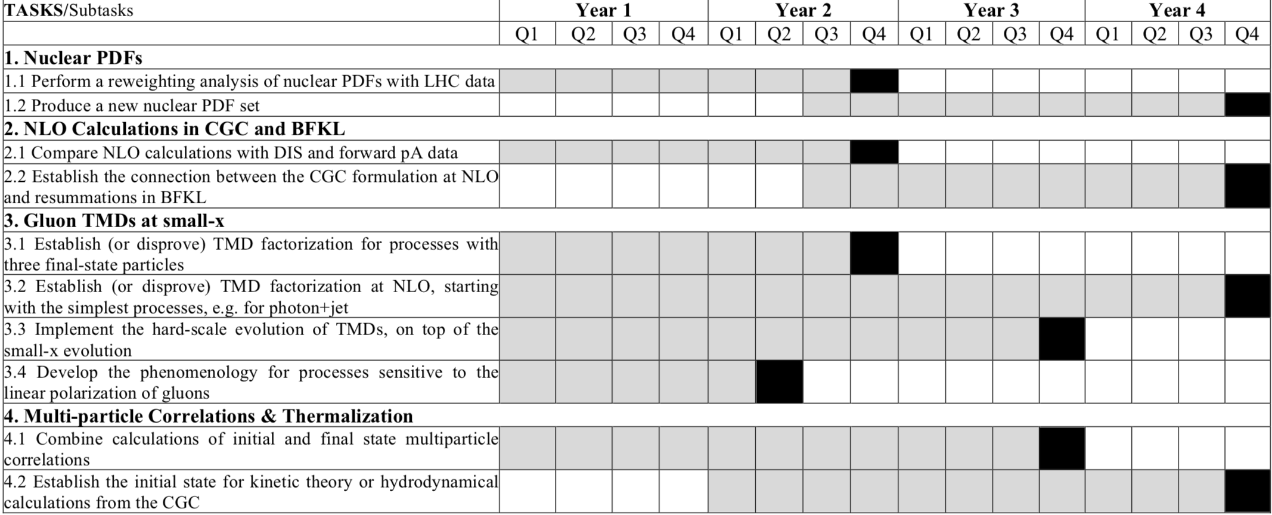
NA2 – Small-x Physics at the LHC and future DIS experiments
Tasks
we are there
Barbara Erazmus, Coordinatrice du projet
Paris,08/02/2018
The tasks are divided between participating institutions,
with four leading ones (Jyvaskyla 1, CNRS 2, Krakow 3, Santiago 4)

Slide 7
NA2 – Small-x Physics at the LHC and future DIS experiments
Budget

Slide 8
NA2 – Small-x Physics at the LHC and future DIS experiments
Concrete Plans
Postdoc #1: Joint Santiago/Jyvaskyla position [Task 1]
Fall 2020 -> Fall 2022 with second year funded by STRONG2020
Postdoc #2: Joint Krakow/CNRS (Orsay&Palaiseau) position [Task 3]
Fall 2020(1) -> Fall 2022(3) fully funded by STRONG2020
Workshop #1: ECT* Trento July 6-10 2020 (NA2 contact: A. Sabio Vera)
Workshop #2: considering ECT* again in ETC* for 2021 (if successful)
Workshop #3: considering NCBJ Warsaw (T. Altinoluk, G. Beuf) for 2022
Travel funds within consortium: requests handled by the WP leaders on a case-by-case basis; 3 trips planned so far
1 scientific visit (CNRS to Warsaw) & trips to Nantes for 2 representatives
Barbara Erazmus, Coordinatrice du projet
Paris,08/02/2018

Slide 9
NA2 – Small-x Physics at the LHC and future DIS experiments
Status Report
4.5 months into the project (~10% of total duration)
First publications acknowledging STRONG2020:
Effect of non-eikonal corrections on azimuthal asymmetries in the Color Glass Condensate
P. Agostini, T. Altinoluk and N. Armesto, Eur. Phys. J. C79 (2019) no9, 790
Towards a complete next-to-logarithmic description of forward exclusive diffractive dijet electroproduction at HERA: real corrections
R. Boussarie, A.V. Grabovsky, L. Szymanowski and S. Wallon, Phys.Rev. D100 (2019) no.7, 074020
STRONG2020 already acknowledged in conference talks
e.g. Light-Cone (Sep. 2019), …
Milestone MS13 (one of four) delivered before the end of the year, corresponding to the 1st part of deliverable D13.3
Barbara Erazmus, Coordinatrice du projet
Paris,08/02/2018

Slide 10
NA2 – Small-x Physics at the LHC and future DIS experiments
Thank you!
Barbara Erazmus, Coordinatrice du projet
Paris,08/02/2018

