Slide 1
  IMT Atlantique
  Bretagne pays de la loire
  General Presentation

Slide 2
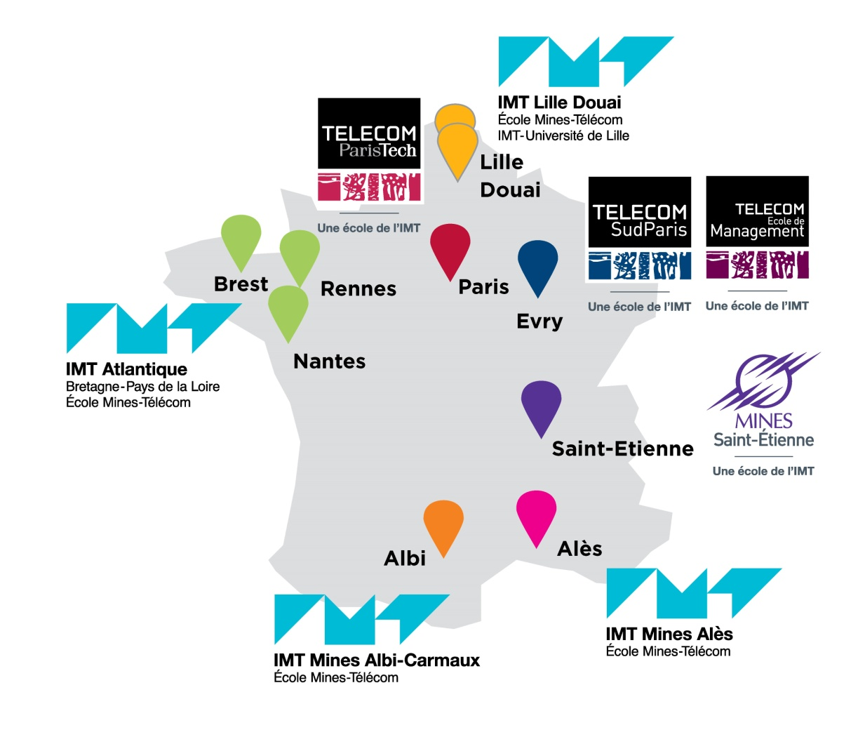
IMT GROUP
13 « grandes écoles »
12 300 students
4 200 diploma delivered per year
64 millions euros of research contract ressources
1 837 publications per year

Slide 3
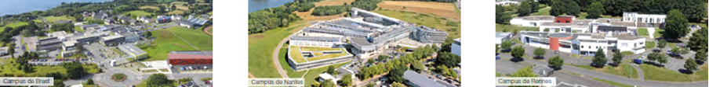
IMT Atlantique – AT A GLANCE
French Elite Graduate Engineering School, under the joint authority of
Minister of Industry and Electronic Communications
Minister of Higher Education and Research
Filiation : merger in 2017 of Telecom Bretagne and Mines Nantes. A Graduate Engineering School of IMT.
Ambition : combining digital, environment and energy to shape the society and the industry.
Resources :
      500 permanent staff.
      70M€ budget, including 27M€ from own resources (20 M€ Research & Innovation).
      3 campuses : Brest, Nantes, Rennes. 94,000 m2.

Slide 4
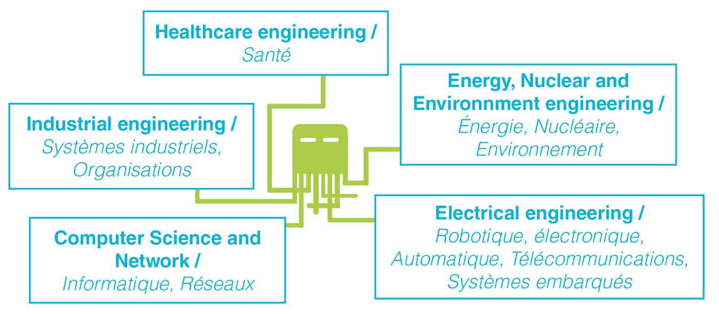
IMT Atlantique – AT A GLANCE
Education :
      2300 students – 1400 generalist and specialized graduate engineers .
      780 graduates / year (of which 80 PhDs).
      5 engineers diplomas including apprenticeship.
      20 Master level in French and English
      5 PhD doctoral school
      Very active in educational innovation (MOOC, etc.).

Slide 5
IMT Atlantique – AT A GLANCE
      Many academic partnerships, including international collaborations
      51 double degree agreements, > 70 nationalities on our campuses.
      20 Master level in French and English.
      4 off-shore formations (China, Ivory Coast, Morocco, Vietnam)
Sustainable development & Social responsibility
      Strong commitment of IMT Atlantique, labeled at a national level.
      Contribution to scientific, technical and industrial culture

Slide 6
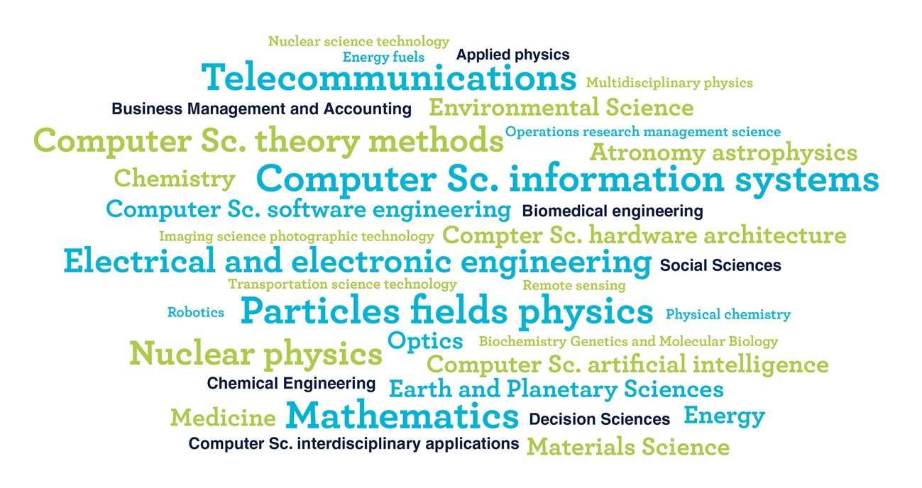
OUR MAIN SCIENTIFIC FIELDS
      2 major scientific fields ...
        Physics and engineering for energy and the environment.
        Digital sciences for industry and services.
        ... crossed by social, economic and management sciences.

Slide 7
Research & Innovation
Assocation of DOMAINS for better answers for the future
Energy transition Modelling of multi-energy networks, optimisation and decision aid for energetic systems, 5G mobiles, Waste management and valorization | Digital transition Cybersecurity of infrastructures, security of distributed systems and software, networks and communication systems,, Big data, Artificial Intelligence, IoT, 5G et beyond, software engineering | Health of the future Medical imaging, dynamical assistance to medical gesture, robot and health, health data security, radiobiology, nuceal medecine, medical logistics
Environnemental transition Satellite and underwater observations, prediction and understanding of data, instrumentation, radiochemistry of environment | Industrial transition Network of distributed and collaborative production systems, flexible and agile information systems, cloud manufacturing, adaptive robotics, bio-inspired robotics, and drones, digital transition for companies | Nuclear risks and interactions Detection of high energy particles, simulations, atomic interaction, non destructive control, nuclear and society, radiochemistry, high energy universe
Transformation of socio-technical systems
Notes:
HPDA = high performance data analysis.

Slide 8







Research & Innovation
Key figures
      290 researchers of which 115 HDR, 280 PhD,
      752 publications / year
      20,5 M€ research contracts, 18 european projects,
      13 industrial or international chairs, 4 joint labs with industry,
      68 patent groups,
      6 joint research units with CNRS, INRIA ou INSERM.

Slide 9


Research & Innovation
International rankings
      THE WUR [351-400] ;
      THE by subject :
      Physical sciences [251-300],
      Engineering & Technology [301-400],
      Computer Science [301-400]
      ARWU by Subject
      Telecommunication engineering [151-200]
      Electrical & electronic engineering [201-300]
      Computer science engineering [301-400]
      Physics [301-400]
      World Young Universities less than 50 years [57]

Slide 10
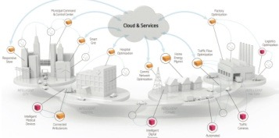
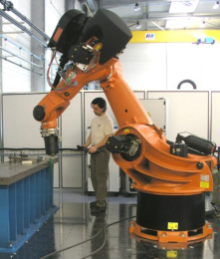
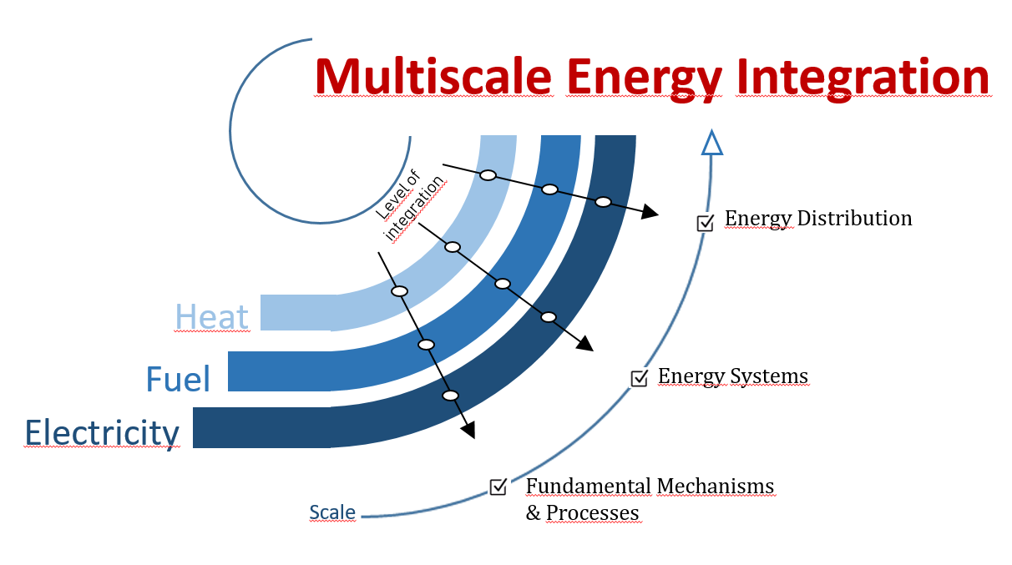
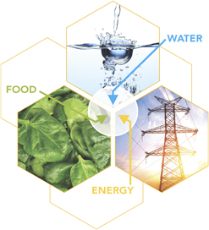
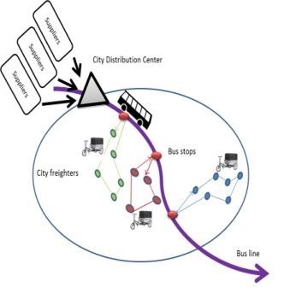
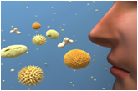
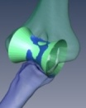
SOME RESEarch highlights
Cloud & IOT
Industry 4.0
Cobotics
Energy transition
Hybrid energy network
AIR
Environnemental Engineering
Water-air-energy nexus
Logistics and
ITS
Decision Aid for
Surgery Gesture

Slide 11
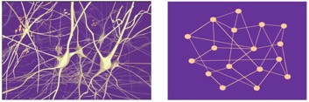
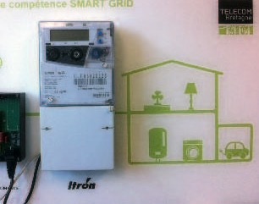
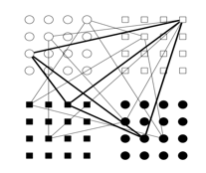

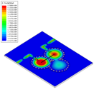

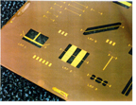
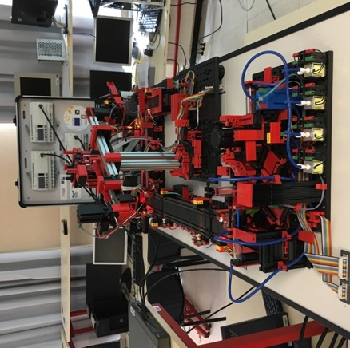


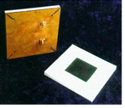
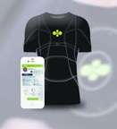
SOME RESEarch highlights
Neuro-inspired and embedded AI
Smart objects for Future of Internet
Radars
3D devices, physiological sensors
Enablers for
Smarter Environments

Slide 12
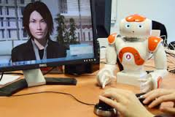
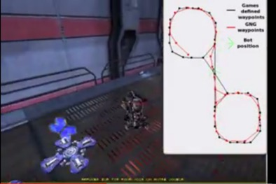
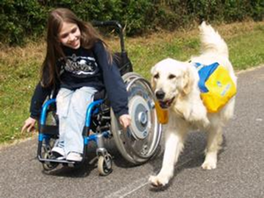
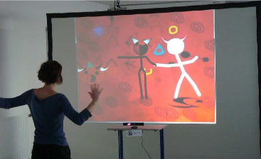
SOME RESEarch highlights
Human Avatar interaction
Human Robots interaction

