Slide 1

CONCLUSIONS
And list of actions …

Slide 2
A Look at Our Past History
The turning point:
1979 Nobel Prize to Glashow, Salam, Weinberg ⇔ The Standard Model
Discovery of the gluons at DESY
1983 Discovery of the Z⁰ and W± bosons at CERN
USA decides to: 1) cancel ISABELLE 2) launch the SSC
ISABELLE had taken risks with superconducting magnets and came too late.
SSC ignored the rest of the world and was far to optimistic on initial budgets.
It was cancelled by US administration in 1993.
CERN follows an ambitious but pragmatic strategy
Explore the Z/W physics extensively 2) Cover full m_{H} and TeV scale (unitarity)
The LEP project* gets a strong push (dig the 27 km tunnel) for Z/W precision
The LHC is established as the NLO future of CERN (magnet R&D needed)
2012 The H bosons is discovered at CERN
2013 Nobel prize to Englert and Higgs for the mechanism
What next ?
*First LEP Book 1976

Slide 3
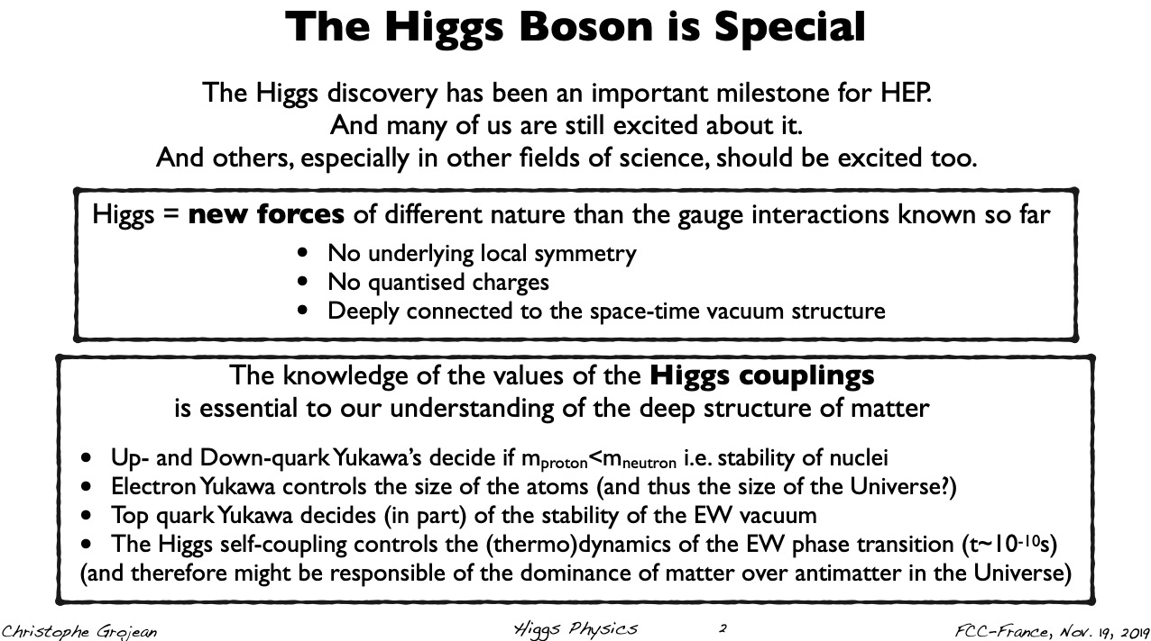
The New Player in the Game

Slide 4
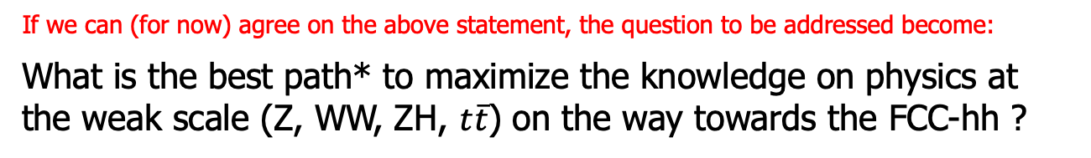
Towards a Consensus
"Rien de ce qui résulte du progrès humain ne s’obtient avec l’assentiment de tous"
Christophe Colomb
Assumption #1
The FCC-hh collider at O(100) TeV makes sense as great physics goal
for CERN on the long term (Higgs potential, scalar extensions, DM, BSM)
Defines the infrastructure :100 TeV, 16 T ⇔ O(100) km tunnel
If we can (for now) agree on the above statement, the question to be addressed become:
What is the best path* to maximize the knowledge on physics at the weak scale (Z, WW, ZH, $t\overline{t}$) on the way towards the FCC-hh ?
* Assuming realistic constraints
The H boson emphasizes the importance of the vacuum and the special role of the weak sector for the understanding of our material world
The FCC ee/hh(eh) sequence proposes to 1) explore H physics at weak scale (5 x 10¹² Z, 10⁶ HZ + 10⁵ WW → H) and 2) go for highest energies (HH, H rare decays, DM, BSM) with VLHC
⬄ best precision for small couplings, H and HH, rare processes and BSM
What are the (other ?) collider options ?

Slide 5
FCC-all : What we are talking about
See collider talks by
M. Benedikt, A. Chance, T. Proslier, B. Rousset,
I. Chaikovska, S. Bilgen, W. Kaabi, M. Serluca
M. Benedikt slide 2

Slide 6
The Other Options
Phyics at FCC: See talks by Patrick Janot and Alain Blondel

Slide 8
FCC-All : What it costs
Step 1
Civil eng. : 5.4 MChF (mostly common to both ee and hh)
FCC-ee : 6.2 MChF (machine+injector complex+technical infrastructure)
FCC-hh : 17.0 MChF (machine+injector complex+technical infrastructure)
Step 2

Slide 9
FCC-all : What it costs
10.6 M€ for FCC-ee + 15.6 M€ for FCC-hh
is a lot of money !!!
20 years
25 years
Equivalent to:
~ 50% of CERN actual annual budget* for the next 45 years
My personal view :
This will be possible only if we bring together the whole community
The relevant experimentalist community is 5000 to 6000 people
(for the next 45 years) from all over the world
We urgently need a consensus in France, Switzerland (CERN),
in Europe, … and then around the whole world (USA, Japan, …)
* CERN 2019 budget is : 1 146 002 250 ChF

Slide 10
France must take a leading role
1^{rst} FCC-France meeting:
A success with 87 participants including FCC experts & young people
With ~ 7 years of lead time (detector R&D, physics simulation, geological studies, …) and a minimum of 7 years for FCC-ee full construction we now have a window of opportunity for the necessary decisionstowards best physics and continuity at CERN in 21th century
HL-LHC physics program completed by 2038 (< 20 years for now)
France support for FCC is vital (Host state, expertise on SC Magnets @ CEA, ERL developments @ LAL, FCC-ee injector @ CEA + leading HEP institutes, strategical proximity of LAPP
French people have a leading role in promoting the project
(Alain Blondel, Patrick Janot, etc.)
The R&D on high field, cost, effective, reliable magnets (towards 16T) must remain a high priority in the decade(s)
Also work on cryogeny (need 1MW@4.5K) … “but no stopping point identified so far ” CEA, Air Liquide
Need precise collision energy calibration for e+e-
(transverse polarization at FCC-ee ⬄ use transverse depolarisation- A. Blondel et al.)

Slide 11
France must take a leading role
One example among others (my personal favorite) :
Common work between ATLAS, CMS and ILC via the LabEx P2IO
Great expertise on High Granularity Calorimeter FE Chips with OMEGA
A. Lobanov

Slide 12
France must take a leading role

Slide 13
Building Synergies

Slide 14
Building Synergies

Slide 15
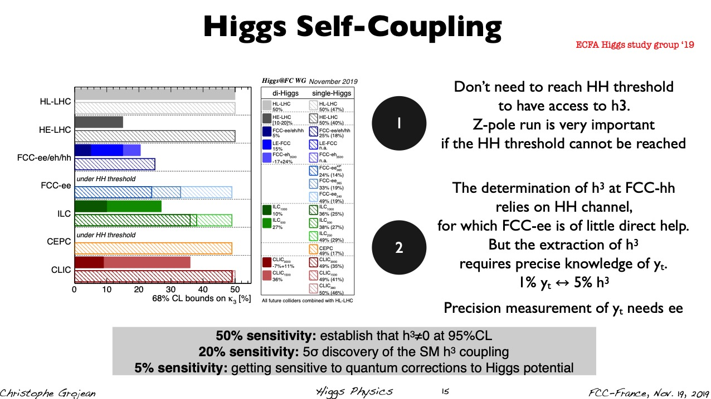
Building Synergies

Slide 16
Synergy on Detector R&D ?
See talks by M. Mentink, D. Attei, G. Calderini, D. Contardo, P. Giacomelli,
T. Guillemin, A. Lobanov
Very different requirements between FCC-ee and FCC-hh …
Conclusion taken from D. Contardo

Slide 17
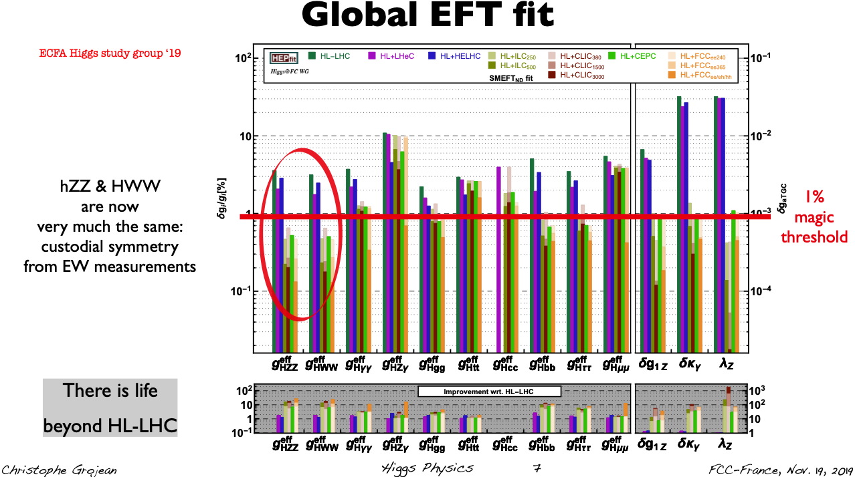
Life beyond the HL-LHC

Slide 18
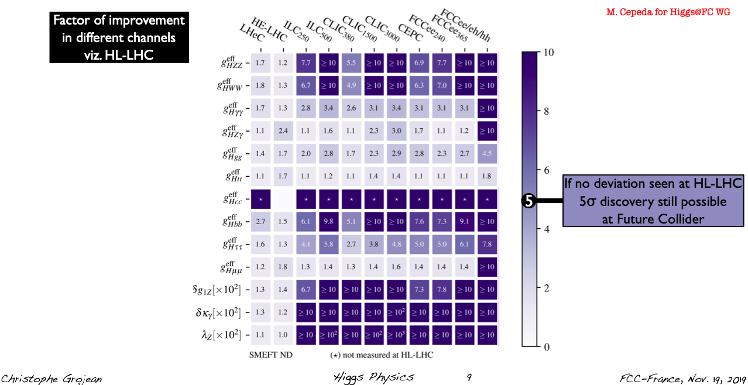
Life beyond the HL-LHC
FCC-All are precisions and discovery machines

Slide 19
Physics panorama at FCC-ee
E. Locci

Slide 20
Precision Measurements at FCC-ee
See talks by P. Janot, A. Blondel, E. Locci
Table from A. Blondel

Slide 21
Improved Systematics
Taking full profit of FCC-ee transverse polarisation via resonant depolarization, …
A. Blondel, slide 26

Slide 22
Precision Measurements at FCC-ee

Slide 23
Precision Measurements at FCC-ee

Slide 24
See « flavour » talks by G. Isodori and S. Monteil

Slide 25
Conclusions
There is absolutely GREAT physics prospects at FCC
We vitally and urgently need to built a consensus in favour of FCC-ee/hh
France should take a leading role in bringing Europe together behind
this sequence of projects at CERN
The physics prospects are the best possible given current knowledge
- Best coverage of « Higgs » physics and EWK symmetry physics
- Ideal complementarity between FCC-ee and FCC-hh
- Considerable precision improvement on SM parameters at FCC-ee
- Discovery reach (> 5σ) beyond HL-LHC – There is life beyond HL-LHC !
France have leading contenders for SC magnets, ERLs, main detector
concepts (high granularity calorimetry, tracking, etc), Polarisation, …
We (France) better get organized
around the FCC activities
Topics at the round table

Slide 26
Suggestions de sujets à aborder -- d’autres suggestions sont bienvenues
On part de l’hypothèse que le projet FCC sera recommandé par la stratégie Européenne
quels sont les éléments les plus attirants du projet?
au niveau physique (Higgs, EW, BSM searches, saveurs, QCD, autres non-mentionnés dans le Workshop)
au niveau technologique (SRF, aimants, métrologie, beam monitoring, MDI…)
au niveau physique d’accélérateurs (hi-lumi, polarisation, monochomatisation,…)
au niveau rayonnement international (France → Europe → Monde)
au niveau retombées sociétales, économiques, technologiques
2. Quels sont à votre avis les éléments critiques de R&D
Coté détecteur, supposant une période d’environ 10 ans ?
Quels développements spécifiques à FCC-ee? à FCC-hh ?
Quelles sont les actions spécifiques à mener du côté français ?
Mêmes questions coté accélérateur, le MDI, etc...

Slide 27
Suggestions de sujets à aborder -- d’autres suggestions sont bienvenues
3. Le programme actuel du CERN EP de «strategic R&D programme on technologies » est-il suffisant et complet ? Quels domaines spécifiques à prendre en compte pour maximiser l’impact des physiciens français ?
4. Quelles actions spécifiques à mener du côté français (expérimentateurs, théoriciens, accélérateurs, mais aussi accueil & infrastructure)?
- Quels sont les aspects critiques de la physique ou de l'accélératteur à explorer plus avant en vue de FCC ee? FCC hh ?

Slide 28
5. Y a-t-il un consensus suffisant au niveau français sur cette stratégie
d'infrastructure FCC et son programme de physique?
Quelle action peut être entreprise si nécessaire?
-- produire un document résumant les éléments importants de ce workshop
et de la discussion
-- à destinations internes (IN2P3, CEA)
-- produire un document en directions de nos représentants auprès de l’ESG ?
-- Quelles actions de communications à mener pour préparer le terrain dans les média ?
Quels arguments sont à mettre en avant prioritairement ?

Slide 29
Faut-il organiser FCC-FRANCE ?
par une série d'ateliers français (en plus des réunions internationales FCC)?
Si oui À quel rythme?
Faut-il créer une stucture de pilotage plus limitée (comité de coordination de FCC France)
7. Comment procéder pour obtenir une ligne budgétaire particulière et de quel ordre ?

