Slide 1
First look at technologies for FCC detector challenges
  FCC-France
  LPNHE Paris, 14-15 Novembre 2019
  D. Contardo - IP2I Lyon CNRS/IN2P3

Slide 2
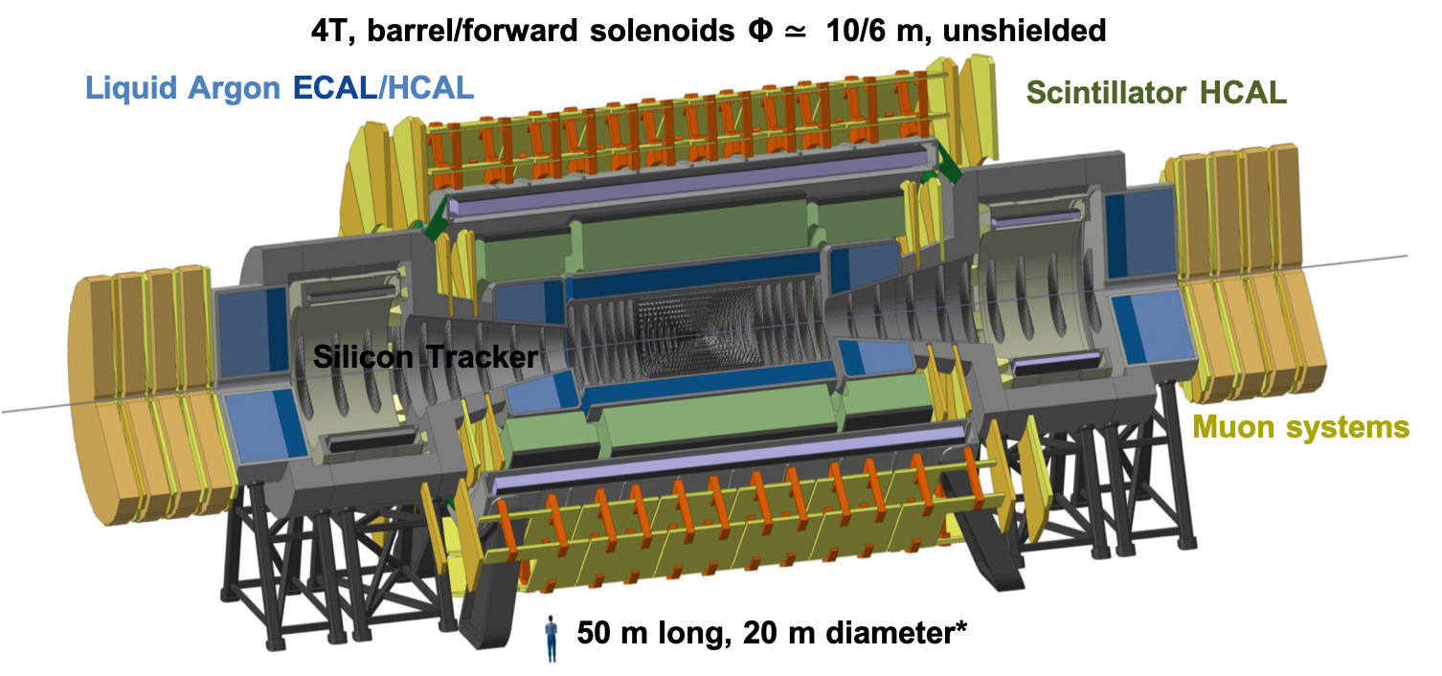
Overview considering present technologies proposed for FCC-ee & FCC-hh experiments
and also some alternatives, and mostly comparing current state-of-the-art to needs
12 m
11 m
11 m
13 m
CLD
IDEA
FCC-hh baseline
Experiment concepts in presentation of P. Giacomelli

Slide 3
Tracking systems for FCC-ee and FCC-hh

Slide 4
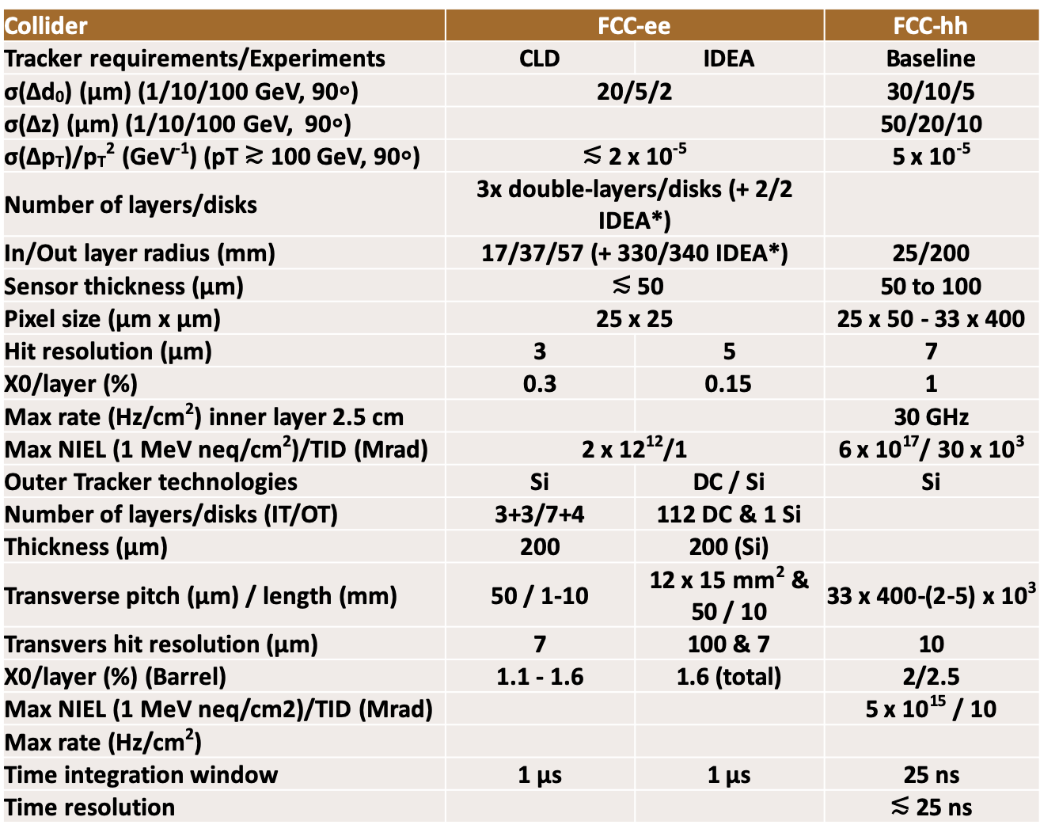
Tracking parameters at FCC-ee and FCC-hh
e-e experiments
  σ(d₀)/d₀ ≃ 2/5/20 µm (100/10/1 GeV at 90∘) and σ(p_{T})/p_{T}² ≲ 2 x 10⁻⁵ GeV⁻¹ (p_{T} ≳ 100 GeV at 90∘)
p-p experiments
  Precise tracking to mitigate pile-up of 1000 collisions (z-coord.), also for b-tag and high p_{T} resolution
  Hit rate readout up to 30 GHz/cm² in inner pixel layer
  Up to 10¹⁸ 1 MeV neq/cm² and 30 GRad for 20 ab⁻¹ integrated luminosity (x 30 HL-LHC)
Inner pixel layer at larger R
More material
d₀ and p_{T} resolutions ≃ x 2 e-e
An ideal p-p tracker could be a high rate and radiation tolerant e-e tracker
Outer Tracker Vertex

Slide 5
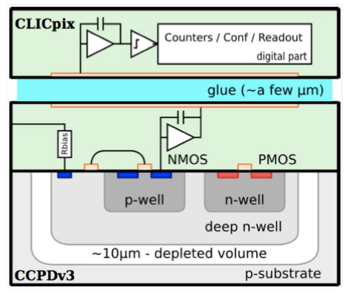
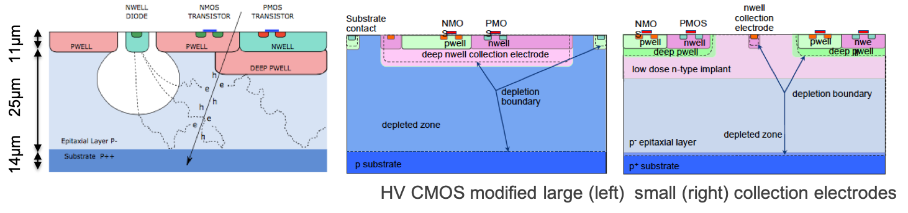
Silicon technologies for tracking, state-of-the-art and R&D*
Hybrid design, high depletion voltage planar or 3D Si-sensors, bump(wire) bonded to ASIC
Most radiation tolerant , high rate capabilities
LHCb Velo upgrade, ATLAS CMS upgrades
≃ 10 µm resolution
  ≃ 2 x 10¹⁶ neq/cm², sensors
  ≃ 0.5-1 Grad, 3 GHz/cm² TSMC 65 nm ASIC
Monolithic Active Pixels**, electronics grown on Si sensor in CMOS standard process
Lightest and most precise, radiation tolerance and rates limited
ALICE ITS2
  ≃ 5 µm resolution, ≃ 0.3% X₀ /inner layer
  ≃ 2 x 10¹³ neq/cm² and ≃ 3 MRad
  Binary readout sparsified, ≃ 5 µs integration time
Planar/3D sensors finer pitch for resolution
CMOS HV/HR modified for rad. tol. & faster/higher rate readout
3D Connection to ASIC, SoI TSV, CC glue…
* See talk of G. Calderini
** Also BELLE-II MAPs in DepFET technology

Slide 6
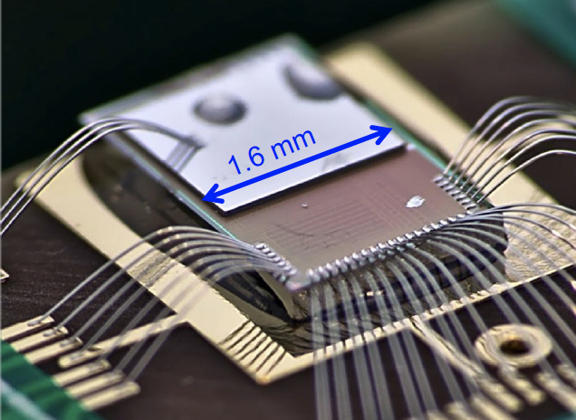
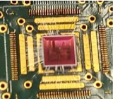
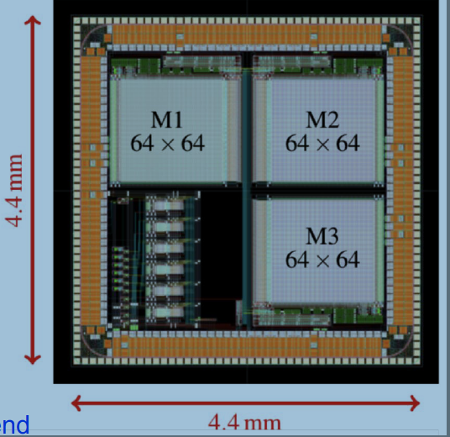
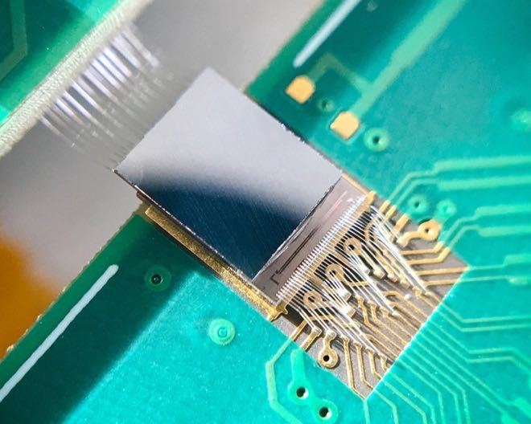
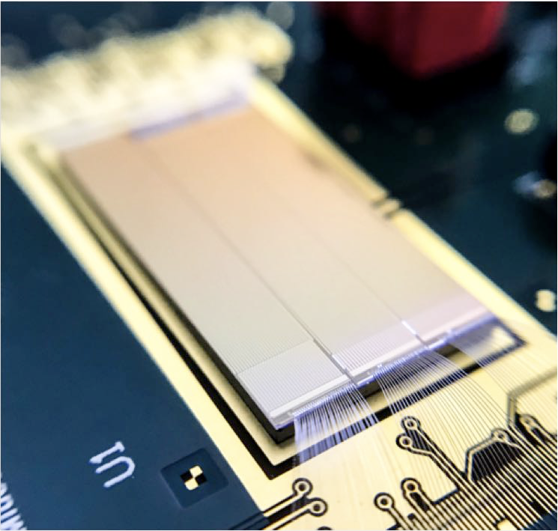
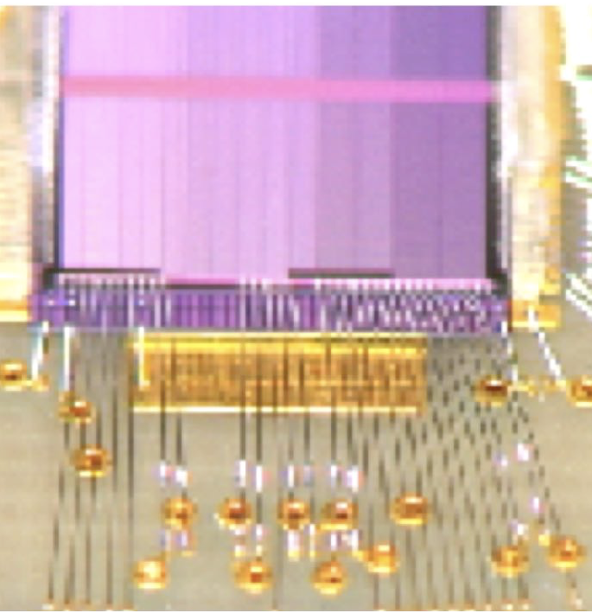
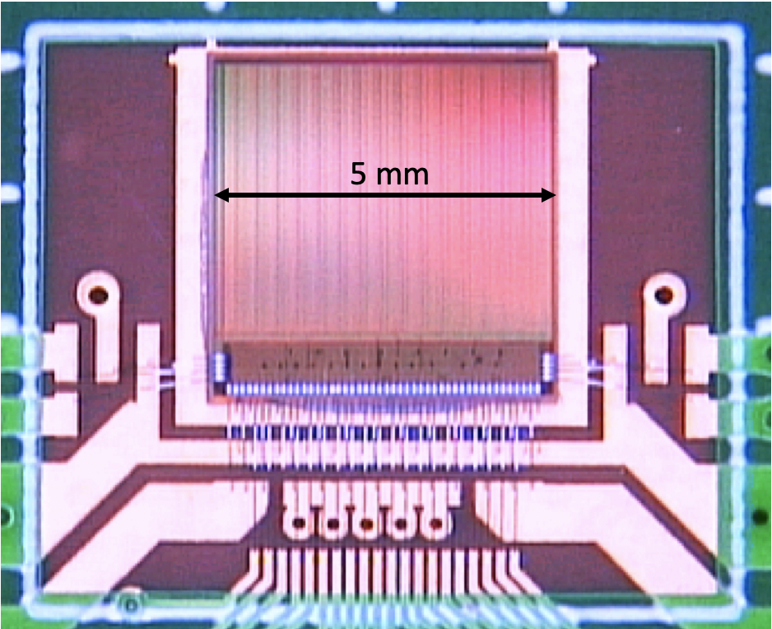
Silicon technology for tracking, R&D demonstrators (≃ 2 x 2 cm²)
Smaller pitch and thinner planar and 3D sensors for resolution
SoI process
Si/ASIC wafers connected
through Insulator Oxyde layer
Capacitive Coupling of HV CMOS design to ASIC through insulating glue
Modified HV-CMOS
depletion (< 100 V)
Modified HR-CMOS
depletion (6V)
with faster and higher rate readout capabilities
CLICPix
Cracov SoI
CLIPS
CCPD C3DP
ALICE investigator
CLICTD
MALTA
CLIPS
MALTA
ATLASPix
Silicon sensor R&D | Hybrid | SoI |  | CMOS Monolthitic |  |  |  | CCPD | CCPD
Demonstrator | CLICpix | Cracov | CLIPS (CLIC) | ALICE investigator | CLICTD | Malta/Monopix | ATLASpix(Mu3ePix) | C3DP/CLICpix | C3DP+CLICpix
Sensor | planar | planar | planar | HR-CMOS standard | HR-CMOS modified process |  | HV-CMOS
Connection to readout electronics | bump bonding | SoI | SoI | momolithic | monolthitic | monolithic | monolitic | CC with glue
ASIC technology (nm) | 65 | 200 | 200 | 180(TJ) | 180 (TJ) | 180(TJ)/150(LF) | 180(AMS)/150(LF) | 65
Thickness (µm) | 50 / 200 | 300 / 500 | 100 / 500 | 100 | 50 / 100 | 100 | 60 | 50
Pitch/cell size (µm x µm) | 25 x 25 | 30 x 30 | 20 x 20 | 28 x 28 | 30 x 300 | 36 x 36 | 40 x 130 | 25 x 25
Hit resolution (µm) | 9 / 3.5 | 5/2 |  | 4 |  | 4 | 12 | 7
Time resolution (ns) |  |  |  | 6 |  | < 10 | 5 | 7
Max NIEL (1 MeV neq/cm2)/TID (Mrad) | O(10¹⁶)/Grad |  |  | O(10¹⁵)/300 |  |  | O(10¹⁵)/100

Slide 7
Silicon technologies for tracking, status
Hit resolution is driven by charge sharing between pixels
  3 µm precision for vertex not yet achieved with 50 µm thick, 25 x 25 µm² neither in binary/digital readout
    Should be achievable with smaller pitch: 10/15 for binary/digital readout?
    And/or thicker sensors: 100 µm thick (0.1% X₀) and 20 x 20 µm²?
  7 µm for outer tracker seems to require more than 200 µm thickness for 50 µm pitch?
  Optimization issue (simulation can help to avoid several prototypes although there are subtle process effects), overall balance between benefit of hit resolution versus sensor thickness in track resolution should be considered (particularly for FCC-hh where cooling/readout contribution will be higher)
Radiation tolerance
  HV-HR CMOS MAPs have increased radiation tolerance, but are a priori not strictly needed for FCC-ee and still marginally at the level required for a FCC-hh outer tracker external layer
  High depletion voltage sensors of hybrid designs remain the most radiation tolerant, as of today applicable at ≳ 30 cm at FCC-hh, also considering the readout ASIC
  Radiation tolerance remains a major issue to be achieved both for sensors (fluence) and readout (dose)
    So far having similar limits with integrated luminosity?

Slide 8
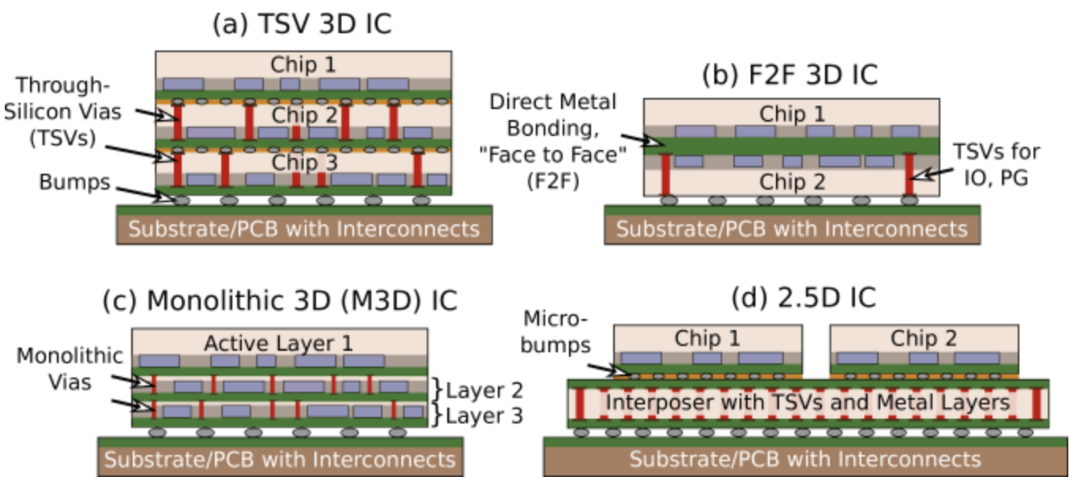
Silicon technologies for tracking, status
Rates
  In CMOS MAPs 200 MHz/cm² rate and ≃ 5 ns precision readout has been achieved, it is a priori not needed at FCC-ee *, it would work for external layers at FCC-hh
    Need deeper sub-micron technology than present 130-180 nm for the higher rate regions?
  3D interconnection is a complementary option, applicable to hybrid and MAP designs
    Can reduce high cost and small pitch limitation? in bump-bonding of pixel hybrid designs
    Allow separating analog and digital functions to release density issues for high rates
    Allow in some techniques to mix technologies according to specific specs, ex. voltage, power dissipation…
https://cds.cern.ch/record/2669397/files/AIDA-2020-SLIDE-2019-019.pdf
+ integrated antenna on top for inter-layer communication?
* CLIC needs 6 GHz/cm2 with for CLIC

Slide 9
Silicon technologies for FCC-ee and FCC-hh, summary
FCC-ee needs can be fulfilled with relatively standard MAPs and some work on hit resolution
  Other recent progress may also be beneficial
  Cylindrical mechanical designs could allow to further reduce material
For FCC-hh, evolving toward deeper submicron technologies and 3D integration are relevant steps toward increased rates and radiation tolerance*
  Planar/3D high depletion voltage sensors remain best option at this stage (still far from ultimate needs)
  → Diamond is a potential alternative to Silicon for highest radiation tolerance (RD42)
    First small prototypes of 3D (2.5 µm columns) with 4000 pixels 50 x 50 µm² produced: http://rd42.web.cern.ch/rd42/lhcc-talks/RD42-LHCC-OpenSession2019posted.pdf
    Radiation tolerance tests to be pursued to higher fluence (both with neutrons and protons)
  Cooling optimization is relevant
    Lower temperature than current to increase radiation tolerance (leakage current decreases by 2 every 7∘)
    Micro-channel cooling embedded in Silicon (LHCb VELO), possible in thin sensors, to be balanced for %X₀?
  Adjusting technologies according to radius may be needed for performance and/or cost optimization
* ALICE project for ITS3 upgrade at HL-LHC with MAPs in 65 nm, 10 x 10 µm² pixels, ≃ 20 µm thick sensors for 0.05% X₀

Slide 10
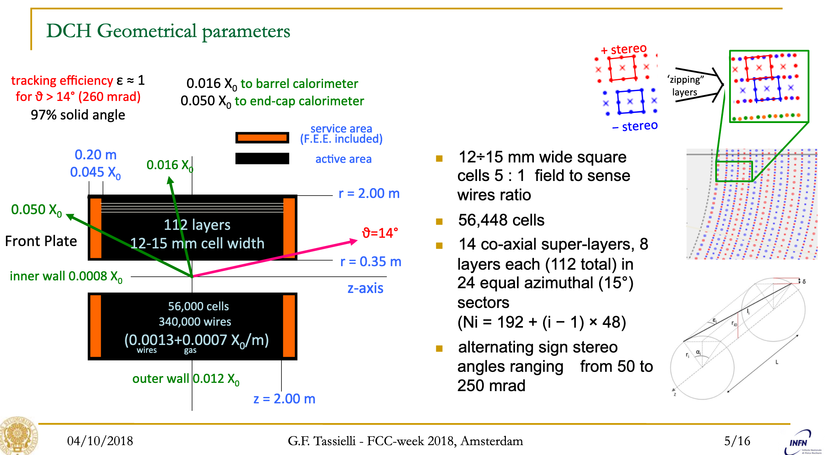
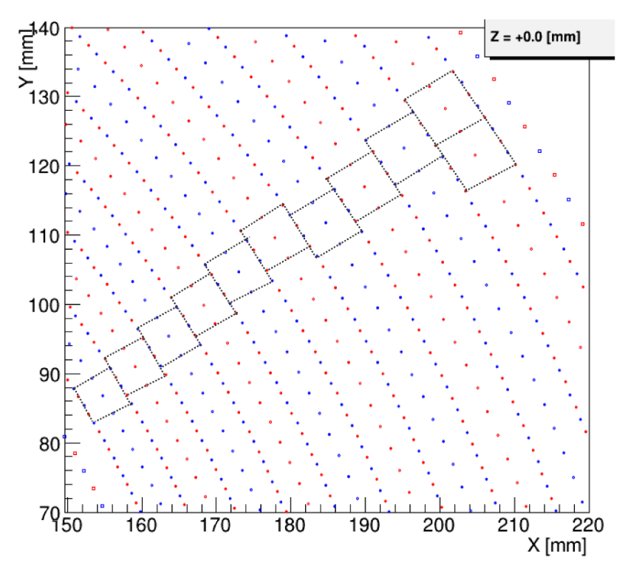
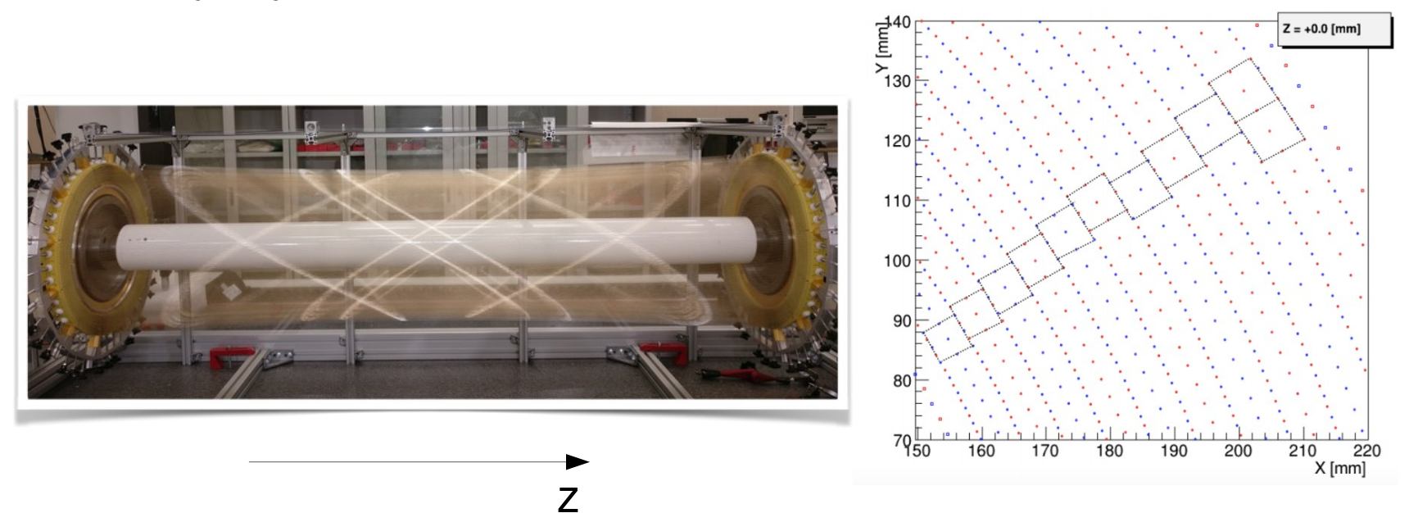
TPC and DC for outer tracking at FCC-ee
TPC and DC* can provide dE/dx measurement**
  Time Projection Chamber proposed for ILD/CePC, target 150 µm & 15 ns and 5% dE/dx resolutions)
  → Work on choice of MPGD readout (see gas detector section)
  Drift Chamber proposed by IDEA (KLOE/MEG-II design), target 100 µm and 2-3% dE/dx (cluster counting) resolutions
    Similar p_{T} resolution as full Si tracker (maybe slightly better(worse) at lower(higher) p_{T} (%X₀ vs hit resolution)?)
  Investigation of primary cluster counting with high frequency sampling to improve hit position and dE/dx resolutions
20(40) µm sense (field) wires
Stereo
MEG-II DC
* See talk of D. Attie, See presentation of P. Giacomelli
** Resolution with thin Si sensors would be rather limited and require digital readout)

Slide 11
Calorimetry for FCC-ee and FCC-hh

Slide 12
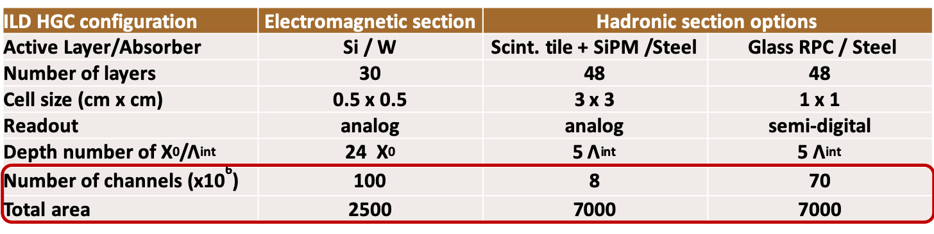
High Granularity Calorimeter for FCC-ee and FCC-hh*
CALICE concept for ILD: fine longitudinal segmentation and transverse granularity for 3D shower topology and Particle-Flow for Jet energy reconstruction (E_{jet} = E_{Track} (≃ 75 %) + Eγ (≃ 15%) + E_{h0} (≃ 10%))**
    Jet energy resolution 4-3% (≥ 50-100 GeV) for W/Z to jets separation
    Efficient rejection of collision pile-up at h-h collider - choice of CMS for HL-LHC upgrade
CMS HGC characteristics
CALICE HGC characteristics
253 tonnes, total power at end of life 160~180 kW @-30C
500m² Scint. tiles ≃2x2 and ≃5x5 cm² + SiPM, ~400kch.
CALICE Si/W + AHCAL prototype:
σ(E)/E (e/γ)≃16%/√E ⊕ 1% and σ(E)/E (π) ≃ 44%/√E ⊕ 2%
Scale of the detector is far beyond CMS HGC
600 m² of hexagonal 8” sensors in 25000 modules, ~6M channels 0.5 and 1 cm²
* See talk of A. Lobanov
** Software compensation possible for hadron showers

Slide 13
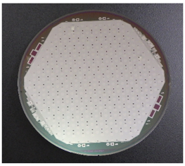
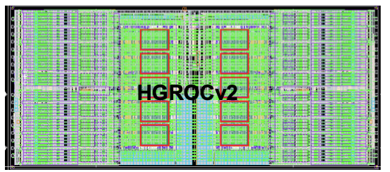
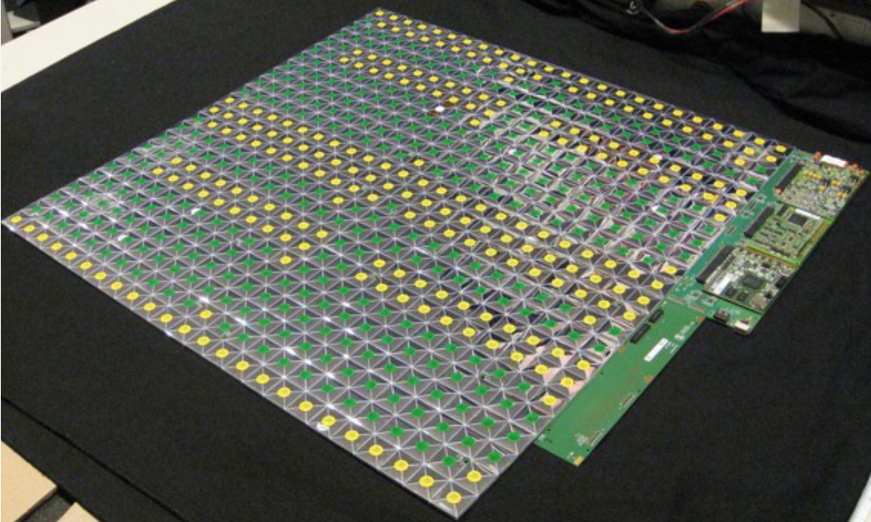
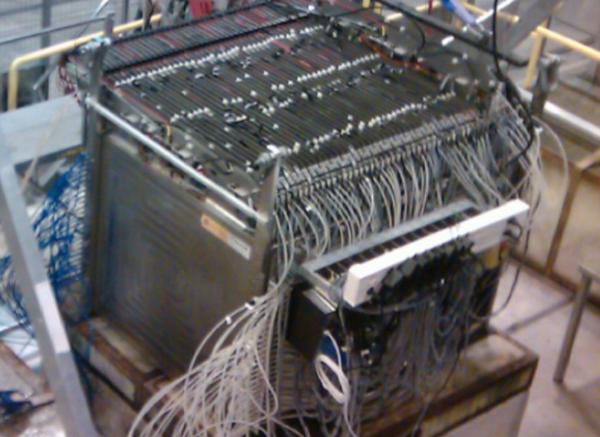
High Granularity Calorimeter status for FCC-ee and FCC-hh*
CMS
HGC-PFlow concept is well demonstrated for FCC-ee
  CMS HGC is at engineering design level
    First 8’’ wafer sensors 300/200/120 µm
    Complex ASIC in 130 nm technology with 50 ps precision timing
    Injection-moulded polystyrene versus casted PVT scintillators
    SiPM packaging for cooling performance (T ≃ -35∘)
    Radiation tolerance of organic scintillators O(1) MRad and SiPMs ≃ 5 x 10¹³ neq/cm² defines the boundary to Si-Sensors
  CMOS Monolithic sensors could be an alternative to planar pad-sensors
    Higher granularity could allow particle counting (need some simulation)? Plan of ALICE to integrate MAPs FoCAL project for HL-LHC
  SemiDigital-HCAL with Resistive Plate Chamber as sensitive elements is an option
    Particle counting with 3 energy thresholds
At FCC-hh, present technology should fulfil rad. Tol. needs up to η ≃ 2.5 and can provide ≃ 30 ps resolution (charged and neutral) for pile-up mitigation
CMS
3 x 3 cm² scintillating tiles + SiPMs
24 x 24 tile array (Calice)
SDHACL
1m³ prototype 50 layers
* See talk of A. Lobanov
Notes:
In terms of R&D, first 8’’
And interesting alternative in

Slide 14
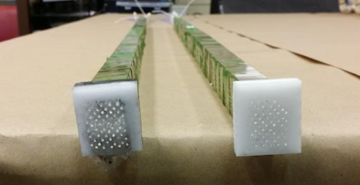
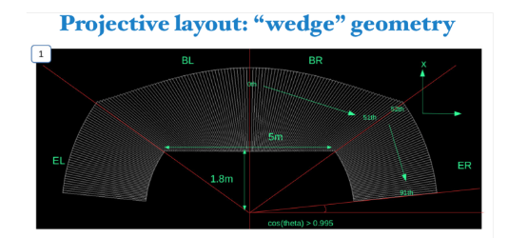
Dual readout calorimeter for FCC-ee
Tubelet concept
ECAL defined by 25 cm difference in length of fibers at the front of the calo.
IDEA Proposal for Dual REAdout Method (DREAM/RD52)*
  Energy response compensation measuring electromagnetic and hadronic shower components respectively in Chernekov and scintillating fibers
    1 mm fibers Scint./Cerenkov with 1.5 mm pitch in Pb or Cu
    σ(E)/E≃ 10(34)%/√E + 1% for e/γ(π)
  Projective design with ≃ 10⁸ fibers, 2m long, is a challenge
    Industrial production of grooved absorber, assembly…
  Readout with SiPM
  For a FCC-hh application (flavor experiment?)
    Longitudinal segmentation may be missing, options with fibers starting at different depths and/or extended use of precise timing
    Radiation tolerance depending on fiber material
32 + 32 scint./cerenkov prototype for SiPM readout
See presentation of P. Giacomelli
IDEA projective geometry
Notes:
In terms of R&D, first 8’’
And interesting alternative in

Slide 15
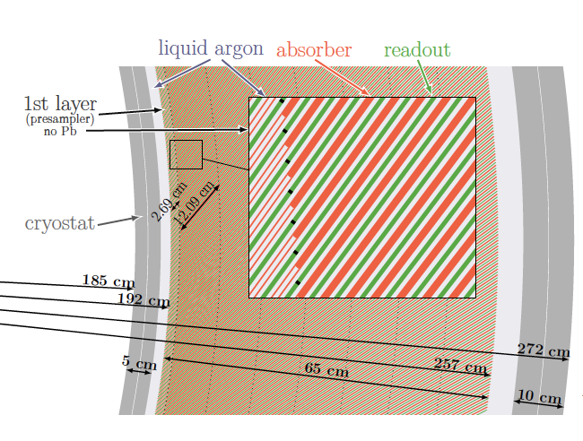
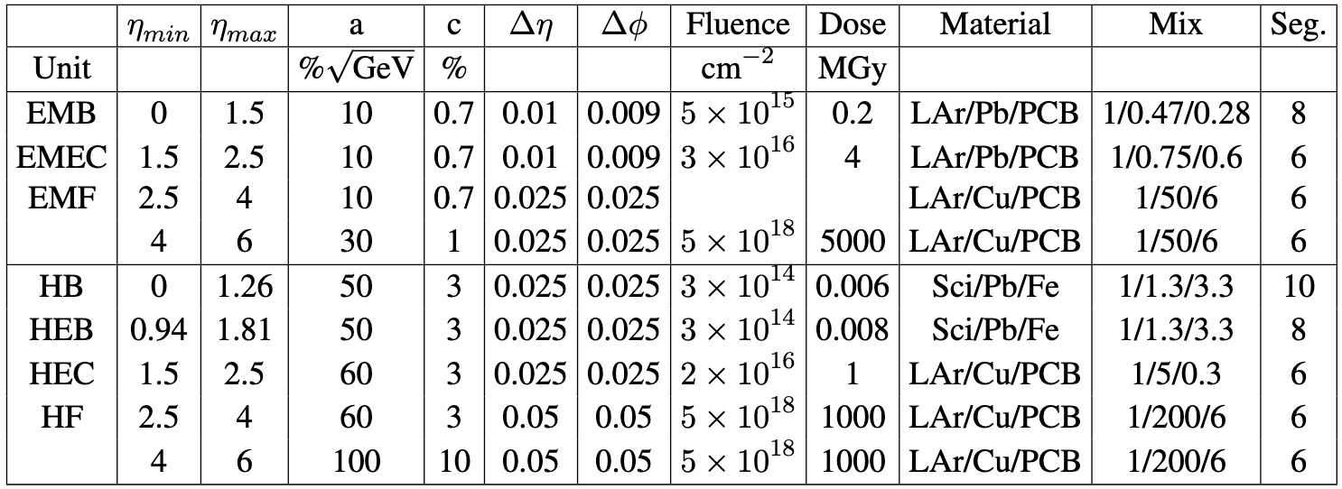
Liquid Argon and Scintillating tile calorimeters for FCC-hh*
Liquid Argon calorimeter is a unique technology to sustain radiation up to ≃ 5 x 10¹⁸ neq/cm² and 500 GRad
  Straight inclined structure design with 8 longitudinal segmentations Δη x Δϕ ≃ 0.01(0.025) x 0.01(0.025) in ECAL(HCAL) /10 ATLAS
  Engineering challenge to develop multilayer PCB electrodes, and high density feedthrough for readout outside the cold volume
  Interest for low mass cryostat
    Also for magnets, ex. IDEA design with calorimeters outside of magnet
  → Time resolution is limited, pile-up effect need simulation?
Scintillating tile + WLS + SiPM can sustain radiation for barrel Had. Calo.
  Vertical design /4 ATLAS granularity
LAr Calo. concept
FCC-pp requirements
Jet energy resolution similar to current ATLAS (≃ x 2 e-e)
Tile Calo. concept
* See talk of T. Guillemin
Notes:
In terms of R&D, first 8’’
And interesting alternative in

Slide 16
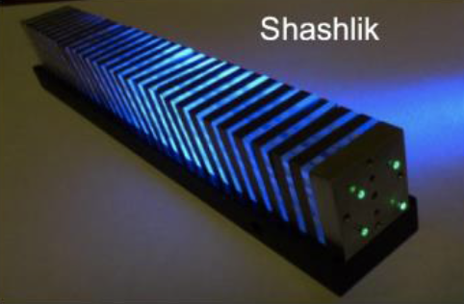
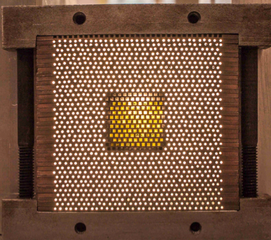
Alternative calorimeter designs/technologies and R&D
Sampling shashlik, spaghetti scintillating or crystal fibers, and homogenous with crystals (possibly in fibers)
  Could allow mixed design for em/hadronic sections?
  Candidates for Flavor and HI experiments at FCC-hh?
Several ongoing R&D
  Improve light yields, radiation tolerance*, timing precision…
    New materials: crystals (LSO/LYSO/YAG/GAGG…), nano-crystals (ex. quantum dots), organic scintillators (ex. nano-structure Organo-silicon Luminophor)
  → 3D printing to produce organic or inorganic (meta-crystals) scintillators
Strong synergy with R&D on photodetector (SiPM, MCP-PMT)
  Particularly for improved Photo Detection Efficiency in UV domain, and for timing resolution (synergies with PET)
LHCb Phase-2 upgrade sampling electromagnetic crystal calorimeter
≃ 300 Mrad, ≃ 50 ps
CMS homogenous
PbWO₄ crystals + APDs
FE ASIC ≃ 50 ps for 25 GeV
Time Imaging Calorimeter
Homogenous crystal fibers
Target ≃ 10 ps
Spaghetti
Intelum
* Currently O(1/100/1000) MRad for organic/crystals/quartz materials in typical experiment configurations
Notes:
In terms of R&D, first 8’’
And interesting alternative in

Slide 17
Gas detectors for FCC-ee and FCC-hh

Slide 18
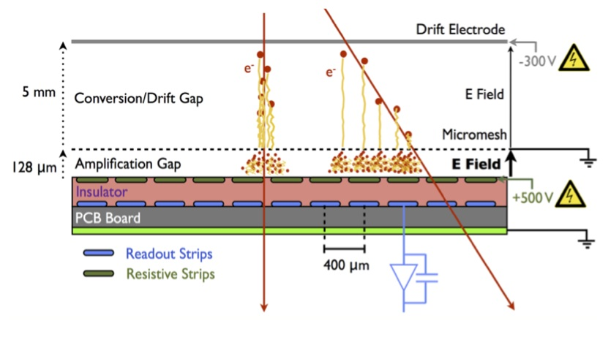
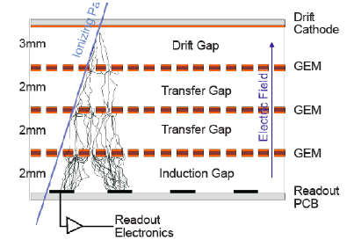
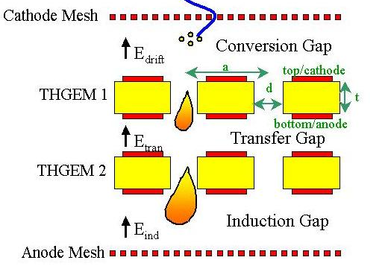
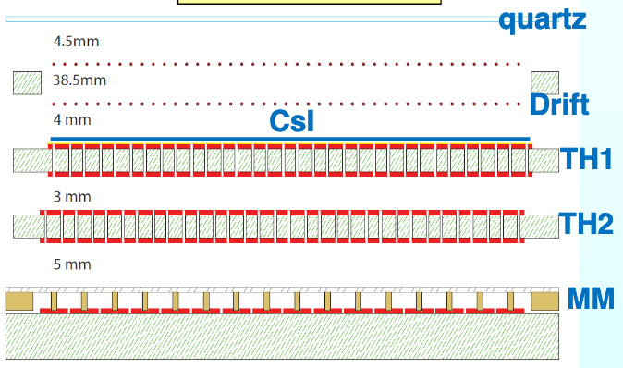
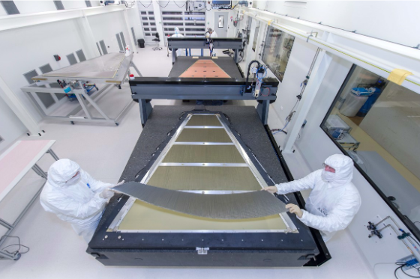
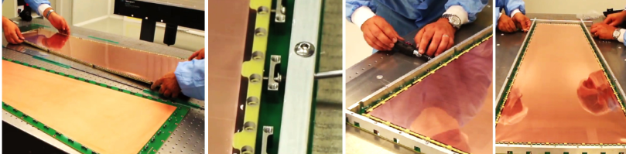
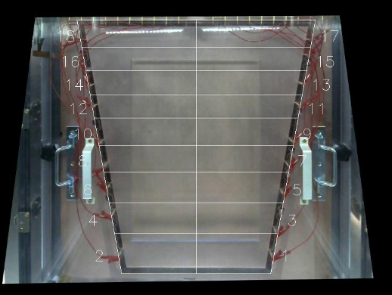
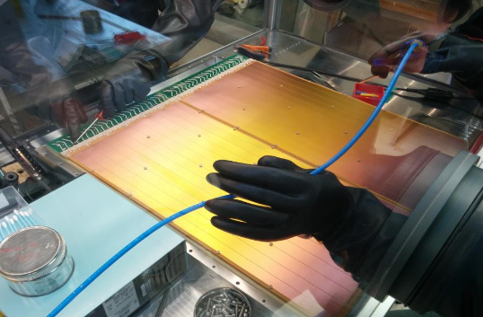
Gas detectors for muons and tracking at FCC-ee and FCC-hh
CSC, DT, RPC usual designs can continue to be used for large area muon systems in lower rate areas
  For FCC-hh needs to assess longevity at factor x 10 HL-LHC
  Needs to operate with eco-friendly gas mixture (no obvious solution so far)
Micro Pattern Gas Detectors
  For high rate areas at FCC-hh
  For TPC readout in tracking at FCC-ee (proposal for ILD/CepC)
  Proposal to use new µRwell design in IDEA pre-shower (0.4 mm x 50 cm cells) and muon system (1.5 mm x 50 cm)
MicroMegas (MM)
GEM
THGEM
Hybrid design THGEM + MM
ATLAS new small wheels
CMS GEM
ALICE TPC upgrade
COMPASS RICH
Notes:
In terms of R&D, first 8’’
And interesting alternative in

Slide 19
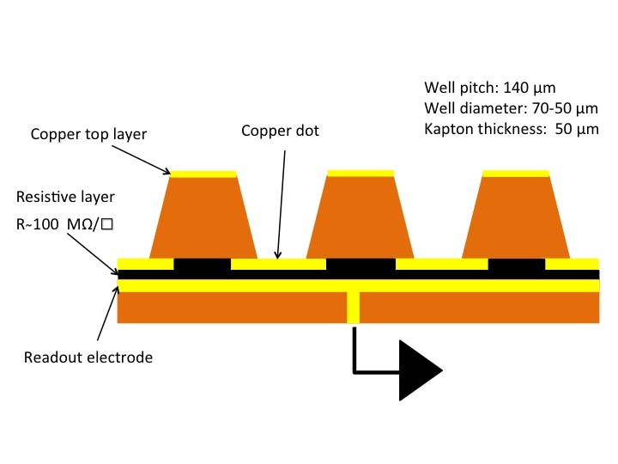
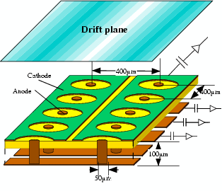
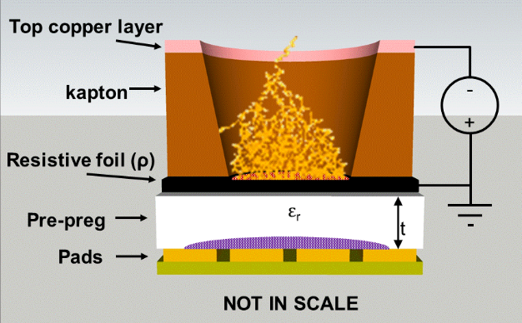
Gas detectors for muons and tracking at FCC-ee and FCC-hh
MPGD new designs
  → Single amplification stage designs (µPIC, µ-Resistive-Well/Resistive-Plate-Well)
    Ease fabrication, resistive layer with new material (ex. DLC) to improve rate capability O(≳ 100) MHz/cm²
  Fabrication process for large scale detectors and transfer to industry
    3D printing, dry plasma ink jet printing (developed for flexible devices)
  Monolithic CMOS production of MM design InGrid demonstrator
    Considered for ILD TPC, high granularity readout can allow primary cluster measurement for improved dE/dx
  Picosecond devices with radiator and radiation tolerant photocathodes
30-50 µm precision
25 ps achieved
µPIC
μ-Resistive-Well
Resistive-Plate-Well
InGrid CMOS MM
Radiator + photocathodes + MM
Notes:
In terms of R&D, first 8’’
And interesting alternative in

Slide 20
Time of Flight detectors for FCC-hh

Slide 21
Minimum Ionizing Particle Time of Flight detectors for FCC-hh
MIP ToF can mitigate effect of collision pile-up and provide relatively good π/K/p ID at FCC-hh
  At 1000 pile-up, 5-10 ps precision is needed to achieve ≃ of 30 ps foreseen at HL-LHC with LGADs and LYSO Crystals
    Number of layers will depend on performance improvements, they could be part of the tracking system
    Recent R&D of a MAP mini-sensor in BiCMOS SiGe 130 nm technology reached a 50 ps resolution*
ATLAS and CMS MIP ToF detectors for HL-LHC
Two double sided layers, 2.4 < η < 4.0
in front of Calorimeter endcap
2(3) hits per track for R >(<) 30 cm
LGADs 1.3 x 1.3 mm² pads, 6.3 m², 3.54 Mch
Barrel 1 layer in Tracker volume (28 mm)
Lyso Crystal bars 56 x 3 x 3 mm³ readout at both ends with 3 x 3 mm² SiPM, ≃ 350 kch, 40m²
Endcap 2 layers in front of Calorimeter (42 mm)
  LGAD 1.3 x 1.3 mm² pads, ≃ 4 Mch, 12 m²
* https://arxiv.org/abs/1908.09709

Slide 22
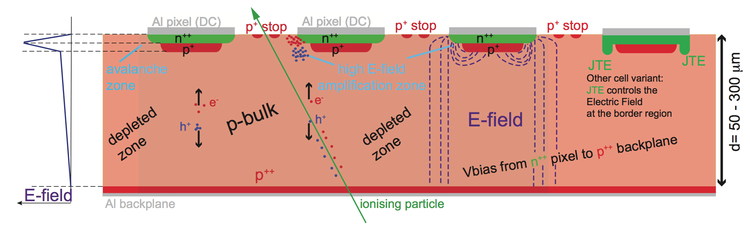
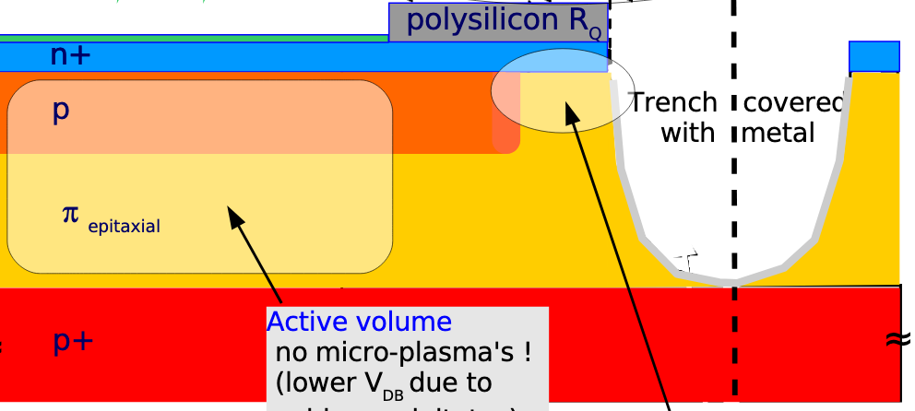
MIP ToF Detectors for FCC-hh
Low Gain Avalanche Photodiodes (LGAD)
  Usual Si planar sensors with p-doping below readout electrode to provide low amplification
    Resolution limited to 25 ps by Landau fluctuations with 50 ≃ µm thick and 1.3 x 1.3 mm² pad sensors
    After irradiation, gains 10 - 20 can be maintained at high voltage with σ_{(t)} ≤ 40 ps up to 3 x 10¹⁵ 1MeV neq/cm²
  Developments started to increase fill-factor to evolve from pad to pixel size, this could substantially reduce noise and improve resolution together with thinner sensor ≃ 25 µm?
  New material/process for radiation tolerance, presently marginally acceptable for an outer layer at FCC-hh
Scintillators organic-inorganic and Cerenkov quartz + SiPM can also provide high timing precision
  Radiation tolerance limits presently driven by SiPM Dark Current Rate (DCR) - 2 x 10¹⁴ 1 MeV neq/cm²
  Developments in process/material/designs
    Improve quantum efficiency in UV to exploit Cerenkov and cross-luminescence scintillation for timing
    Reduce Dark Current Rate (DCR)
  New emerging CMOS (monolithic) designs could be ultrafast and allow photon counting
Faster rise time amplifiers may also be needed (at low power consumption) to improve resolution
LGAD
SiPM
Active area
Critical edge
Similarities in design and process, monolithic (digital) SiPMs already available

Slide 23
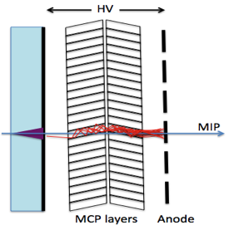
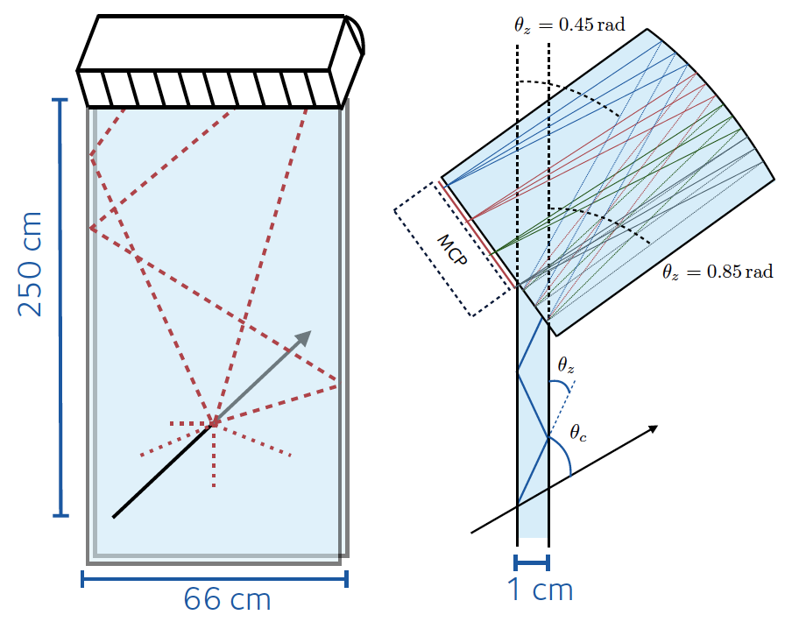
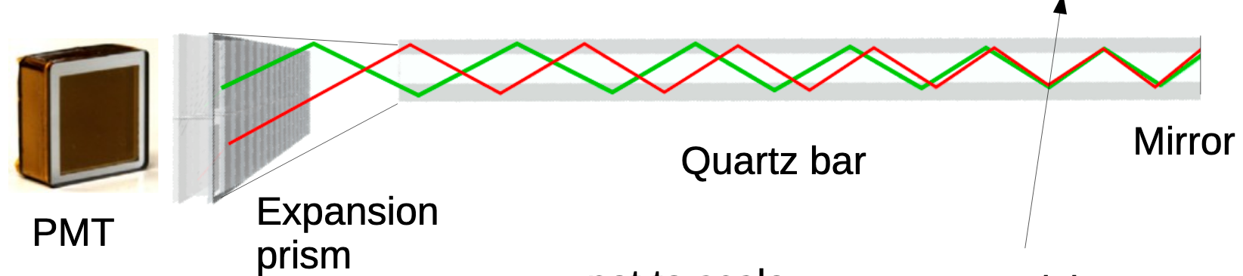
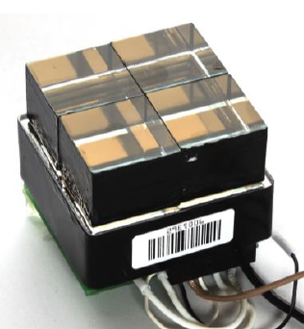
TOF alternative technologies and other applications
High gain APDs 2 x 2 mm²
Cerenkov radiator + MCP-PMT
40 ps SPTR → toward O(10) ps
Photocathode + MicroMegas
200 µm
50 µm
Ring Imaging CHerenkov → for FCC-hh flavor and HI experiments?
  Ex. BELLE-II Time Of Propagation and LHCb Time Of internally Reflected Cherenkov
  Target resolution ≲ 30 ps
Alice Fast Interaction Trigger
  Cerenkov module and MCP-PMT
  ≃ 33 ps resolution prototype
Belle-II TOP
LHCb TORCH

Slide 24
Ancillary components

Slide 25
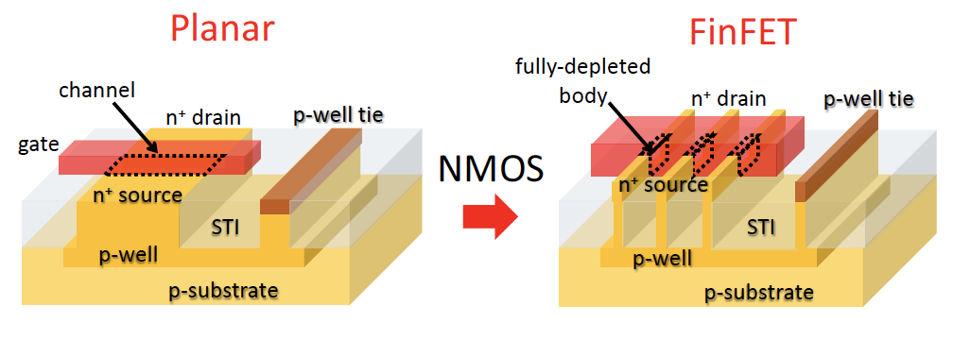
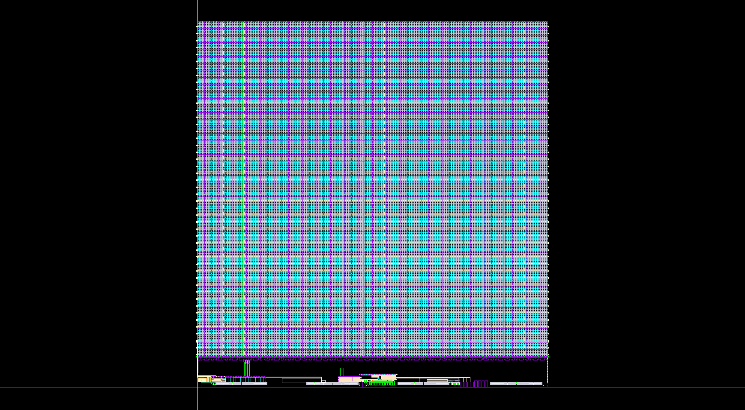
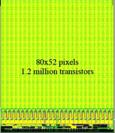
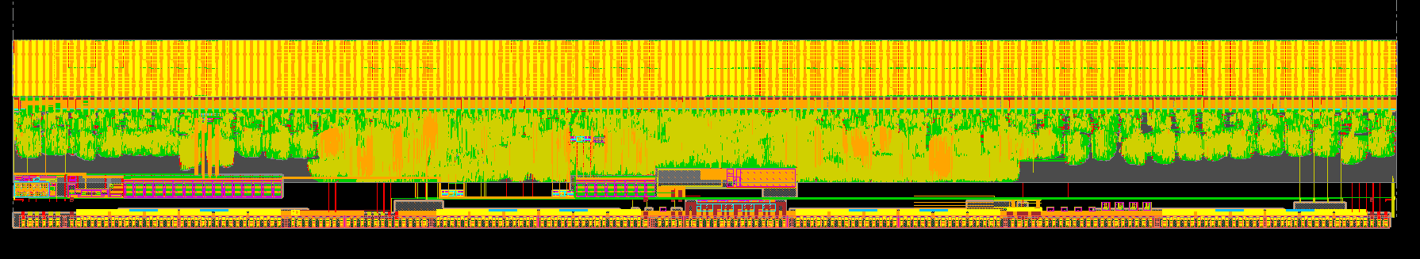
FrontEnd ASIC chips for FCC-ee and FCC-hh
For FCC-ee developments can build on developments for HL-LHC (a priori no technical issues)
  67 ASIC chips developed for HL-LHC, RD53, HGCROC, MIP ToF, LpGbt are the most complex covering all possible features in 130 and 65 nm technologies
  Work ongoing to implement hybrid system electronic features in MAPs
For FCC-hh next generation of vertex detectors will be ≳ x 4 pixels and x 10(30) in rate (radiation tolerance)
  Will need deeper submicron technology (rad. tol. not granted?)
    Evaluation of 28 nm technology started
    FinFET process in industry now at ≲ 10 nm
  Choice(s) can consider long lead time to develop radiation tolerance designs, large cost, commercial continuity
≃ pixel size/6 and x 10 transistors at each step
CMS pixel chip 250 nm CMOS
80 x 52 pixels, 100 x 150 µm²
7.9 x 9.8 mm², 1.2 x 10⁶ transistors
2005
FEI4 ATLAS IBL 130 nm CMOS
80 x 336 pixels, 50 x 250 µm²
20 x 19 mm², 80 x 10⁶ transistors
2010
RD53 ATLAS/CMS 65 nm CMOS
384 x 400 pixels, 50 x 50 µm²
21.6 x 19 mm², 700 x 10⁶ transistors
2019

Slide 26
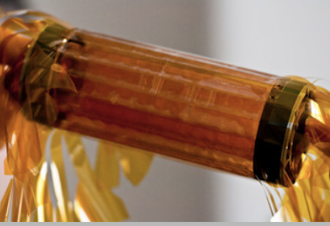
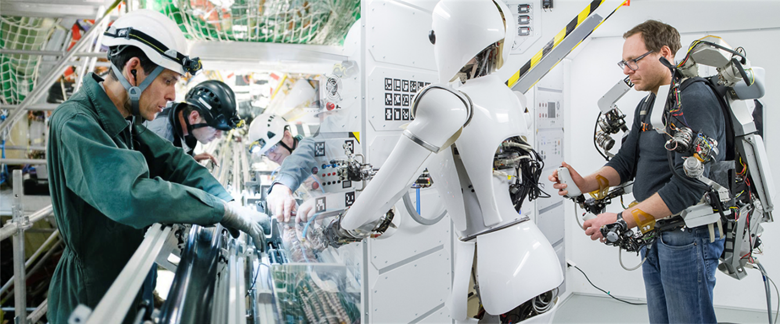
Other crucial ancillary components R&D
  Data transfer bandwidth increase by ≥ 10 will be needed at FCC-hh
    Current links at 10 Gbps, and limited to 5 x 10¹⁵ neq/cm², 100 Mrad in radiation tolerance
    Silicon photonics for optical conversion and multiple amplitude modulation can provide high bandwidth needs
    Wireless transmission, could allow on-detector data reduction ex. for trigger readout of trackers
Lightest mechanical structures and improved cooling will improve performance
  ≤ -40∘ cooling (current CO₂ limit) to increase radiation tolerance; pipes embedded in sensitive elements forFCC-hh and airflow cooling for linear ee-colliders to reduce % X₀
  New material ex. Carbon composite with graphene and Carbon nanotubes, CFRP with new resins… can reduce mass, and new fabrication process (3D printing…)
  Low mass cryostats for LAr and detector magnets will also reduce mass
  Automated manipulation will be needed for maintenance in high irradiation environment
Mu3e CMOS MAPs
Kapton structure
0.1% X₀/layer
Φ = 12 m

Slide 27
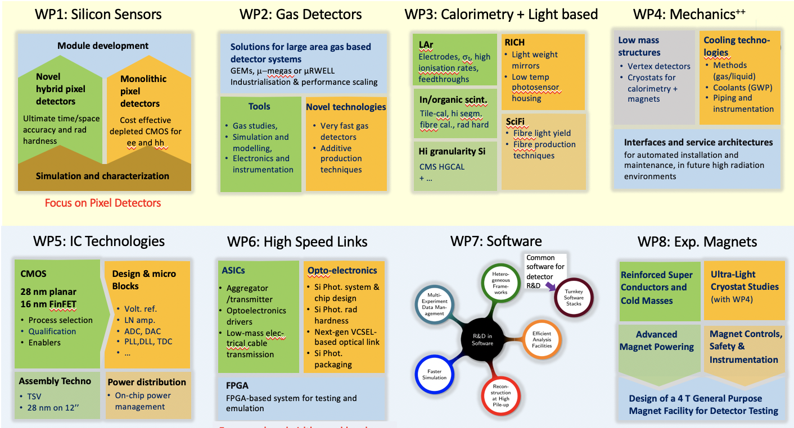
Outlook, CERN strategic R&D program
Past and current CERN RD international programs have been efficient to provide technologies needed
gather/form expertise, develop tools/protocols for simulation/qualification, ease access to material science/industry partners
C. Joram VIC2019: https://indico.cern.ch/event/716539/
→ 8 strategic Work Packages proposed to federate efforts starting in 2020 for 4-5 years**
technology/detector, common ancillary components, magnets, software
→ Also broader European programs: AIDA++ (HEP synergies)* - ATTRACT (technology synergies across fields)
** https://cds.cern.ch/record/2649646 , * See talk of P. Giacomelli,

Slide 28
Summary
Technologies for FCC-ee experiments
  Are mostly available and at the level of device engineering, from technical perspective a time scale ≃ 10 years toward start of production is relatively comfortable (if appropriate R&D funding is ensured before approval)
Technologies for FCC-hh experiments
  Will benefit from R&D for e-e collider experiments toward improved performance (including ILD/SiD/CLICdet)
  Radiation tolerance and data flows are major challenges
    To some extent it concerns all technologies to eventually optimize performance versus cost across the detector radius
    In current timeline scenario(s) there is ample time to find technical solutions, however it more than an incremental step in the inner part of the detectors, this will likely need several R&D steps, at minimum to track closely industrial progress
Industrial technology trends are relatively well identified
  Eg. nano-technology and hybridization/integration of all system features, with strong synergies with material science for R&D, and imaging industry in medicine or other field for fabrication
    Access to new technologies is however not easy and expensive (interest of wide R&D programs with international support)
  Increased radiation tolerance may come from nano-level, but it is not a constraint for public applications

