Slide 1
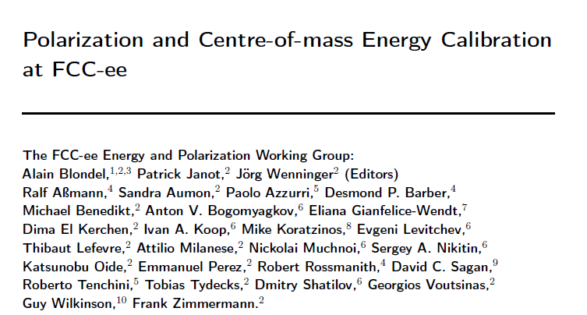
FCC-ee beam polarization and
centre-of-mass energy calibration
arXiv:1909.12245

Slide 2
Some references (not a complete set!):
B. Montague, Phys.Rept. 113 (1984) 1-96;
Polarization at LEP, CERN Yellow Report 88-02;
Beam Polarization in e+e-, AB, CERN-PPE-93-125 Adv.Ser.Direct.High Energy Phys. 14 (1995) 277-324;
L. Arnaudon et al., Accurate Determination of the LEP Beam Energy by resonant depolarization,
Z. Phys. C 66, 45-62 (1995).
Spin Dynamics in LEP http://dx.doi.org/10.1063/1.1384062
Precision EW Measts on the Z Phys.Rept.427:257-454,2006 arXiv:0509008v3
D.P. Barber and G. Ripken ``Handbook of Accelerator Physics and Engineering” World Scientific (2006), (2013)
D.P. Barber and G. Ripken, Radiative Polarization, Computer Algorithms and Spin Matching in Electron Storage Rings arXiv:physics/9907034
for FCC-ee:
First look at the physics case of TLEP arXiv:1308.6176, JHEP 1401 (2014) 164
DOI: 10.1007/JHEP01(2014)164
M. Koratzinos FCC-ee: Energy calibration IPAC'15 arXiv:1506.00933
E. Gianfelice-Wendt: Investigation of beam self-polarization in the FCC-ee arXiv:1705.03003
October 2017 EPOL workshop: https://indico.cern.ch/event/669194/
AB, P. Janot, J. Wenninger et al Polarization & Centre-of-mass Energy Calibration @ FCC-ee _{arXiv:1909.12245}

Slide 3
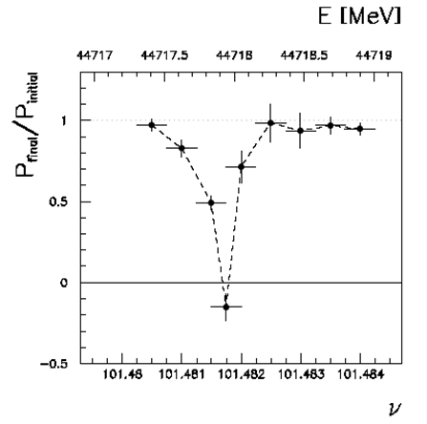
Beam Polarization can provide two main ingredients to Physics Measurements
Transverse beam polarization provides beam energy calibration
by resonant depolarization
→ low level of polarization is required (~10% is sufficient)
→ at Z & W pair threshold comes naturally σ_{E} ∝ E²/√ρ
→ at Z use of asymmetric wigglers at beginning of fills
since polarization time is otherwise very long (250h→ ~1h)
→ could be used also at ee → H(126)
→ use ‘single’ non-colliding bunches and calibrate continuously
during physics fills to avoid issues encountered at LEP
→ Compton polarimeter for both e+ and e-
→ should calibrate at energies corresponding to half-integer spin tune
→ must be complemented by analysis of «average E_beam» to E_CM relationship
For beam energies higher than ~90 GeV can use ee → Z γ or ee → WW events
to calibrate E_{CM} at ±1-5 MeV level: m_{H} (5 MeV) and m_{top} (20 MeV) measts

Slide 4
Beam Polarization can provide two main ingredients to Physics Measurements
2. Longitudinal beam polarization provides chiral e+e- system
-- High level of polarization is required (>40% )
-- Must compare with natural e+e- polarization due to chiral couplings of electrons (15%)
or with final state polarization analysis for CC weak decays (100% polarized) (tau and top)
-- Physics case for Z peak is very well studied and motivated:
A_{LR} = A_{e} , A_{FB}^{Pol}(f) etc… (CERN Y.R. 88-06)
figure of merit is L.P² --> must not lose more than a factor ~10 in lumi.
self calibrating polarization measurement requires controlled e+ and e- polarization
at high statistics A_{FB}^{Pol} = A_{e} plays the role of A_{LR} (Tenchini)
-- enhance Higgs cross section (by up to ~30%)
top quark couplings? final state analysis does as well (Janot arXiv:1503.01325)
enhance signal, subtract/monitor backgrounds, for ee→WW , ee →H
-- requires High polarization level and often both e- and e+ polarization
➔ not interesting If loss of luminosity is too high
-- Obtaining high level of polarization in high luminosity collisions is delicate in top-up mode
DECIDED to FOCUS ON TRANSERSE POLARIZATION FOR ENERGY CALIBRATION
As far as we could check, there is no physics that can be done with longitudinal polarization
that cannot be done without, given enough luminosity

Slide 5
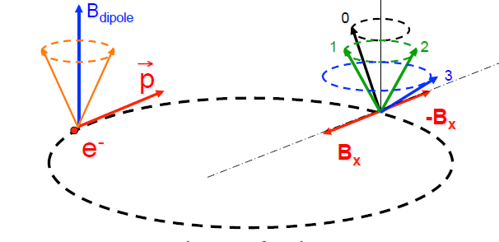
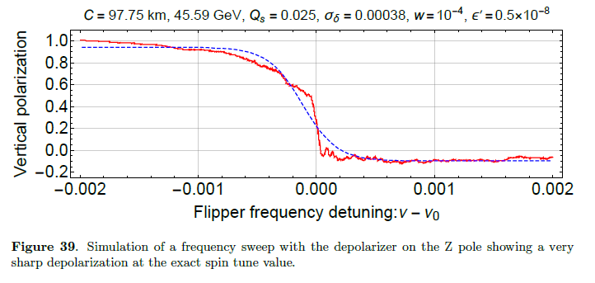
RESONANT DEPOLARIZATION
Once the beams are polarized,
an RF kicker at the spin precession frequencv
will provoke a spin flip and complete
depolarization
Simulation of FCC-ee by I. Kopp:
spin precession (ν is the spin tune)
δθ_{spin} = (g-2)/2 . E/m δθ_{trajectory}
= ν . δθ_{trajectory}
ν = E_{beam} / 0.4406486
= 103.5 at the Z peak

Slide 6
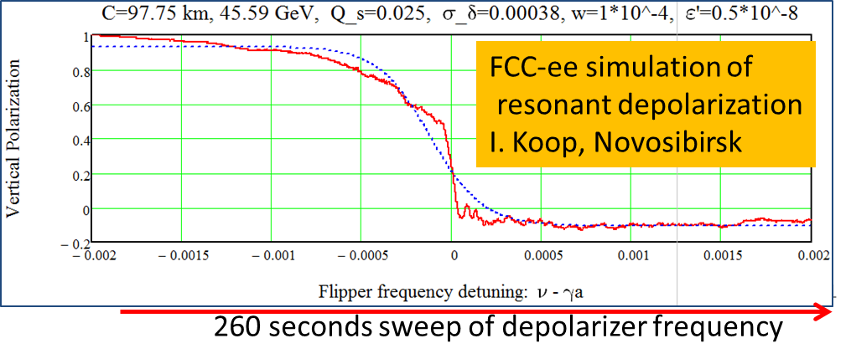
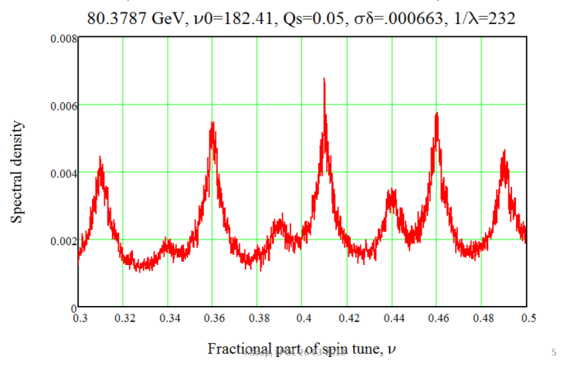
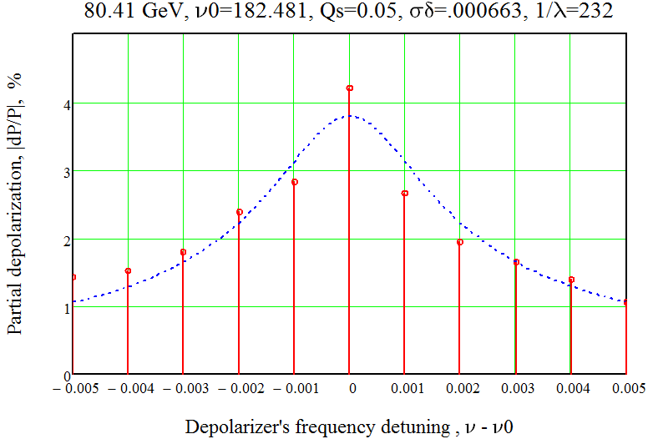
LEP
long sweep works well at the Z. Several depolarizations needed: eliminate Qs side band and 0.5 ambiguity
Less well at the W: the Qs side bands are much more excited because of energy spread, need iterations with
smaller and smaller sweeps – work in progress. see I. Koop presentation.
← Fourier analysis shows the
side band situation at W.
FCC-W
spectrometer ±1σ/s
First attempt at ‘LEP’
multiple sweep
technique →

Slide 7
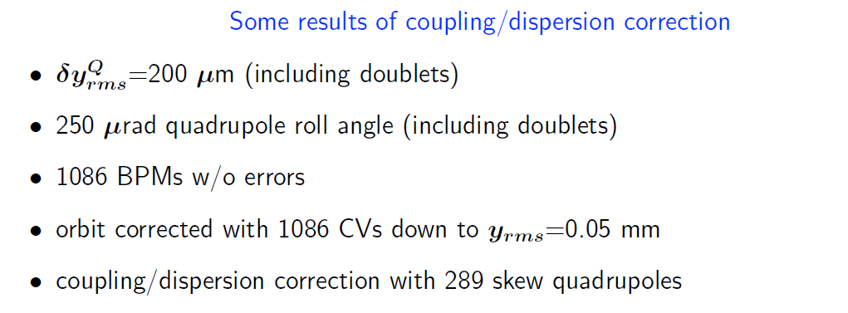
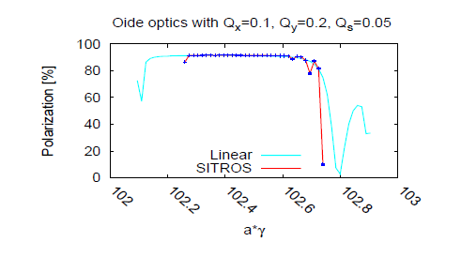
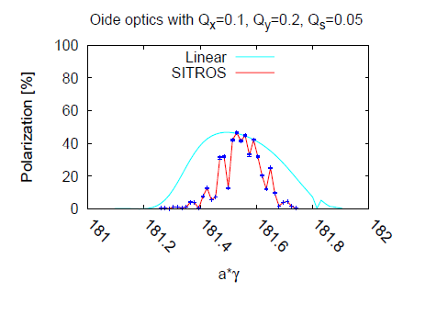
Simulations of self-polarization level with SITROS
orbit and emittance corrections needed
for the FCC-ee luminosity seem sufficient to
ensure useful levels of polarization
2. HOWEVER: same simulation does not
produce luminosity and polarization,
effect of simultaneous optimization
could not be simulated
E. Gianfelice
at the W
at the Z
Excellent level of polarization at the Z (even with wigglers) and sufficient at the W σ_{E} ∝ E²/ρ

Slide 8
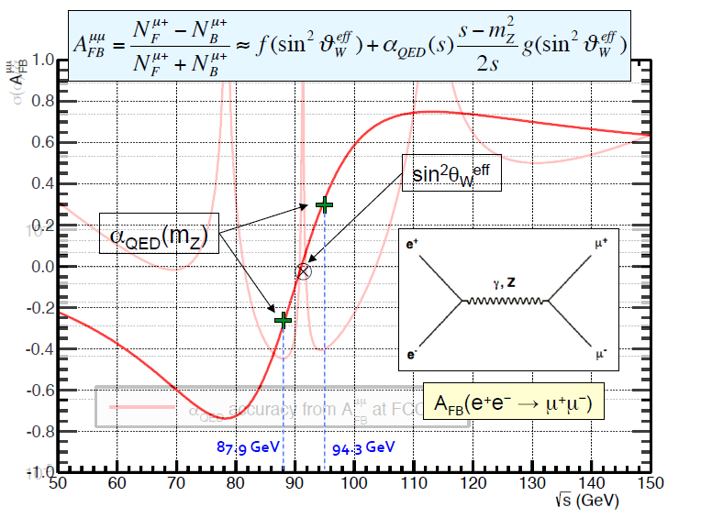
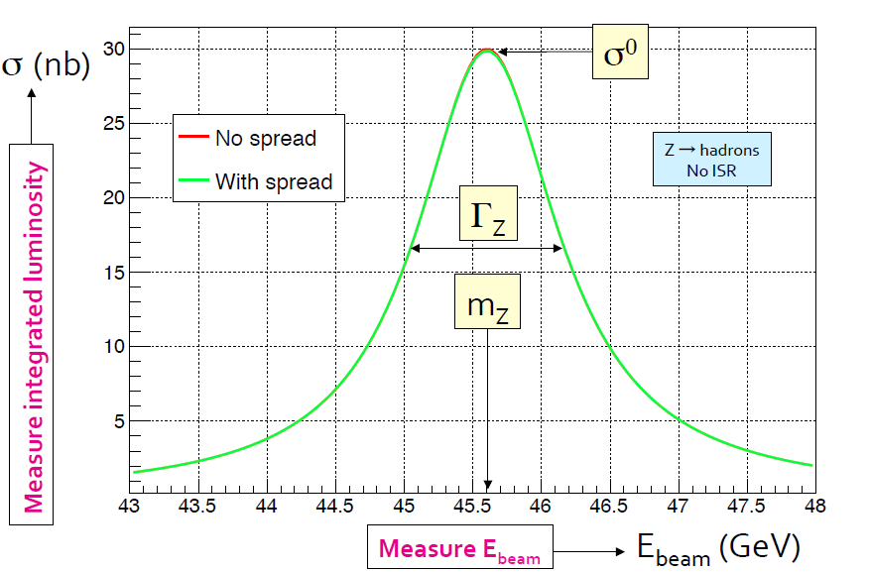
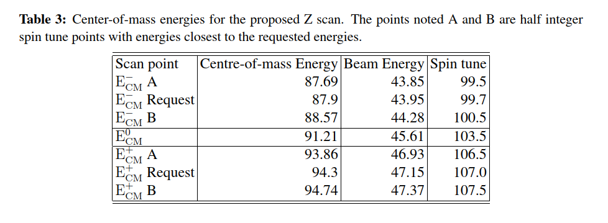
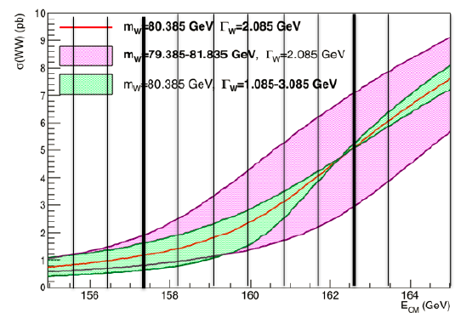
scan points for m_{Z} and m_{W}

Slide 9
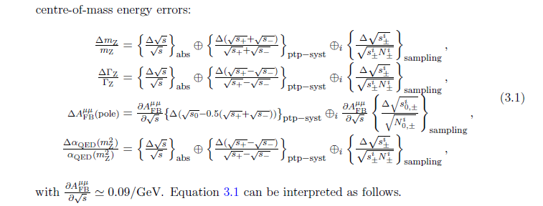
statistial precision at the Z
Three categories:
Absolute dominate for Z and W mass)
Point-to-point dominate for Γ_{Z} & A_{FB}^{μμ} (peak and off-peak)
Due to sampling – turns out to be negligible for 1meast /(15 min= 1000s) → 10⁴ measts

Slide 10
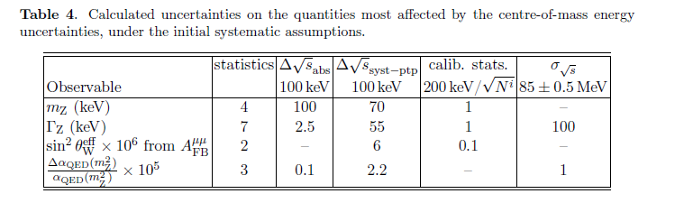
4

Slide 11

From beam energy to E_{CM}
IP1
α=30 mrad
≈ E⁺_{b} + E⁻_{b}
Δ_{SRe}
Energy gain (RF) = losses in the storage ring
Synchrotron radiation (SR)
beamstrahlung (BS)
Δ_{SRi}
E+ = E₀⁺ + 0.5Δ_{RF} -2Δ_{SRi} - Δ_{SRe} – 1.5Δ_{BS}
E⁻ = E₀⁻ - 0.5Δ_{RF} - Δ_{SRi} – 0.5Δ_{BS}
➔ E⁺ + E⁻ = E₀⁻+ E₀ (+ Δ_{SRe} - Δ_{SRi} )
Δ_{RF} = 2Δ_{SRi} + 2Δ_{SRe} + 2Δ_{BS}
at the Z (O of mag.):
Δ_{SR} = 2Δ_{SRi} + 2Δ_{SRe} =36 MeV
Δ_{SRe} - Δ_{SRi} ≈ α/2π Δ_{SR} = 0.17 MeV
Δ_{BS} = 0 up to 0.62 MeV
the average energies E₀ around the ring
are determined by the magnetic fields
➔same for colliding or non-colliding beams
-- measured by resonant depolarization
-- can be different for e⁺ and e⁻
Δ_{RF}
←E₀ at half RF
single RF system ➔ E⁺ + E⁻ constant
if e+, e- energy losses are the same
(mod higher order corrections)
cross-checks: E⁺ - E⁻ (boost of CM),
+ measured Z masses!
IP2

Slide 12
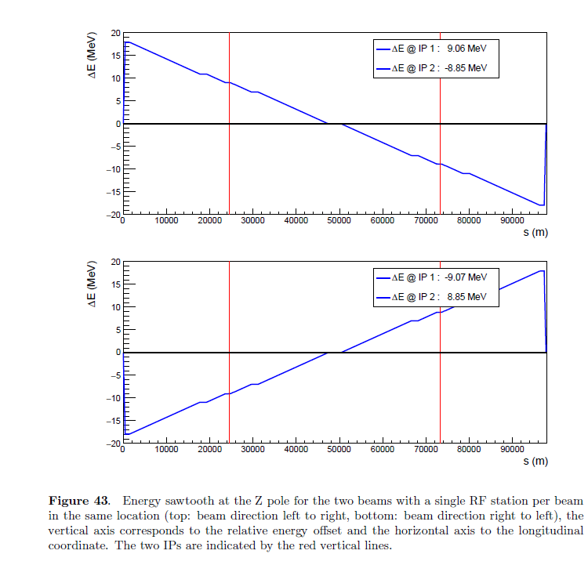
arXiv:1909.12245

Slide 13
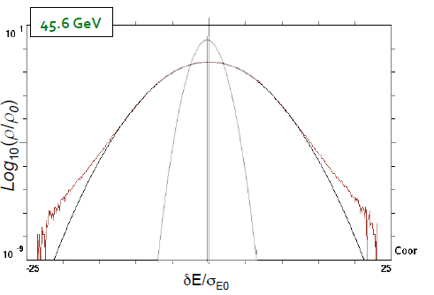
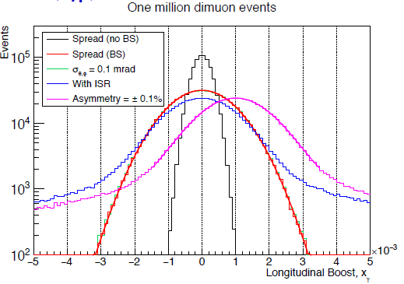

FCC-ee Beam Polarization and Energy Calibration
3. From spin tune measurement to center-of-mass determination ν_{s} = $\frac{g−2}{2}\frac{Eb}{me }= \frac{Eb}{0.4406486(1)}$
  3.1 Synchrotron Radiation energy loss (9 MeV @Z in 4 ‘arcs’) calculable to < permil accuracy
  3.3 Beamstrahlung energy loss (0.62 MeV per beam at Z pole), compensated by RF (Shatilov)
  3.4 layout of accelerator with IPs between two arcs well separated from single RF section
3.5 E_{b}⁺ vs E_{b}⁻ asymmetries and energy spread can be measured/monitored in expt:
e+e- → μ+ μ- longitudinal momentum shift and spread (Janot)
D. Shatilov:
beam energy
spectrum
without/with
beamstrahlung
z boost
P. Janot: 5 min/exp @Z ➔ 10⁶ μ+ μ- /expt →
50 keV meast both on σ_{ECM} and E⁺ - E⁻
and beam crossing angle α (error negl.)
also monitor relative ECM (ptp!)

Slide 14
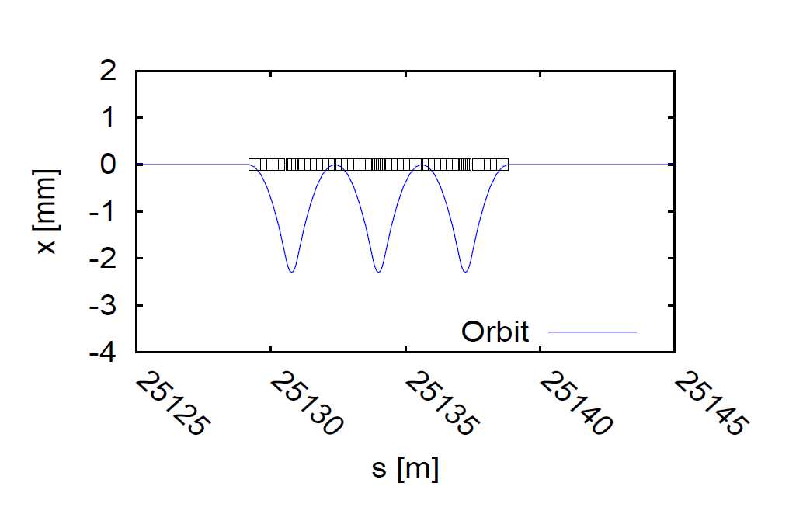
Hardware requirements: wigglers
Given the long polarization time at Z, wigglers will be necessary.
An agreement was reached on a set of 8 wiggler units per beam
Polarization wigglers
8 units per beam, as specified by Eliana Gianfelice
B+=0.7 T L+ = 43cm L-/L+ = B+/B- = 6
at Eb= 45.6 GeV and B+= 0.67 T
=> P=10% in 1.8H σ_{Eb} = 60 MeV E_{crit}=902 keV
placed e.g. in dispersion-free straight section H and/or F

Slide 15
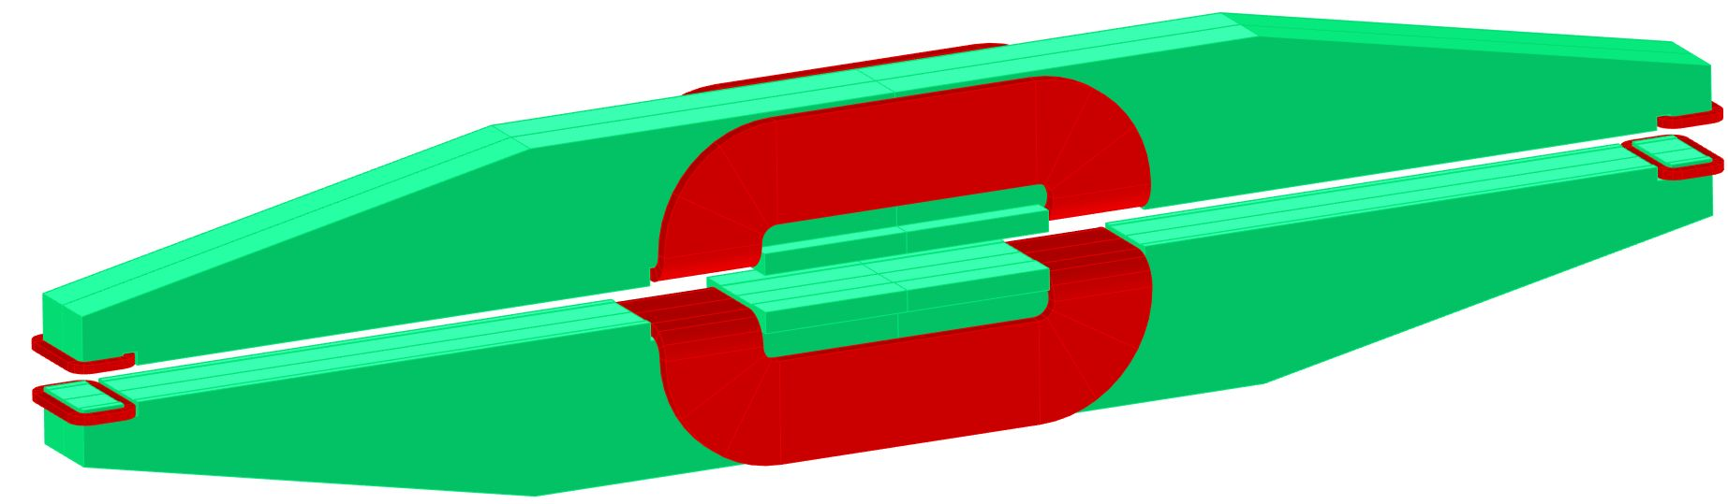
First single pole magnetic concept, keeps some of the ideas of the LEP design, in particular the “floating” poles
narrower (200 mm) lateral poles
central main coils
beam
side trim coils
wider (300 mm) central pole
mass ≈ 4 tons
A. Milanese

Slide 16
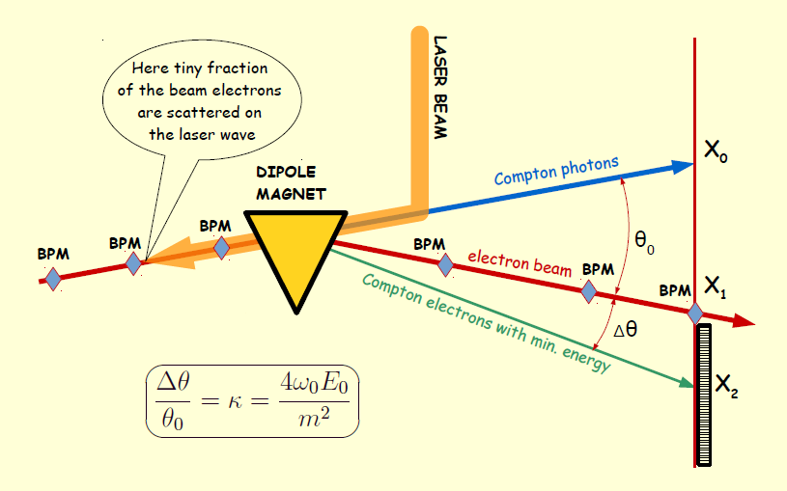
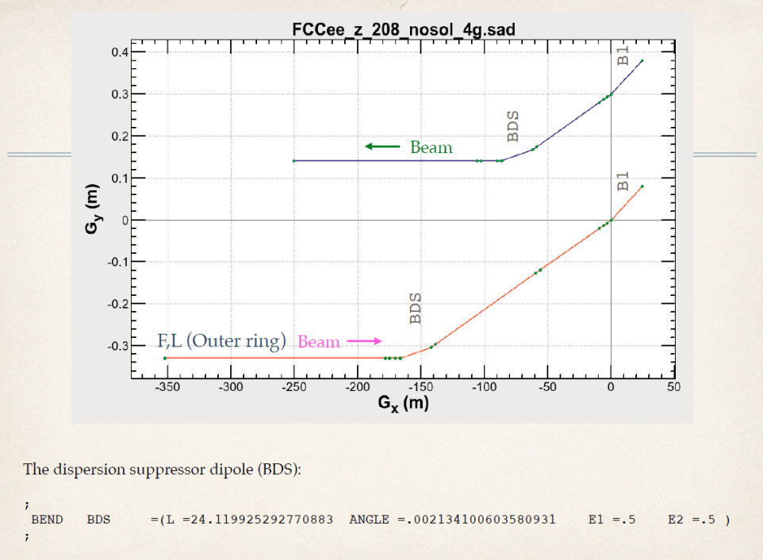
Hardware requirements: polarimeters
2 Polarimeters, one for each beam
Backscattered Compton γ +e → γ + e 532 nm (2.33 eV) laser; detection of photon and electron.
Change upon flip of laser circular polarization → beam Polarization ±0.01 per second
End point of recoil electron → beam energy monitoring ± 4 MeV per second
e’
e
laser
γ
install photon-electron IP on inner ring
in points H and F (Oide)
Munchnoy

Slide 17
polarimeter-spectrometer situated 100m from end of dipole.
Using the dispersion suppressor dipole with a lever-arm of 100m from the end of the dipole, one finds
-- minimum compton scattering energy at 45.6 GeV is 17.354 GeV
-- distance from photon recoil to Emin electron is 0.628m
 | laser (eV) | beam (GeV) | mc2(MeV) | B field | R | LM | theta | L | true beam
 | 2.33 | 45.6 | 0.511 | 0.013451 | 11300 | 24.119 | 0.002134 | 100 | 45.60005
nominal kappa = 4. E_laser.Ebeam_nom/mc2 | 1.627567296
true kappa = 4. E_laser.Ebeam_true/mc2 | 1.627568924
nominal Emin | 17.35445561
true Emin | 17.35446221
position of photons | 0
nominal position of beam (m) | 0.239182573
true position of beam (m) | 0.239182334 | 2.39182E-07
nominal position of min (m) | 0.628468308
true position of min (m) | 0.628468069 | 2.39182E-07
mouvement of beam and end point
are the same:
0.24microns for δEb/Eb=10⁻⁶ (δEb=45keV)
628mm
239mm
0
± 1mm
70mm
FCC-ee plane
end point
elliptic distribution
of scattered electrons
beam spot
and BPM
recoil photon
spot
A.Blondel

Slide 18
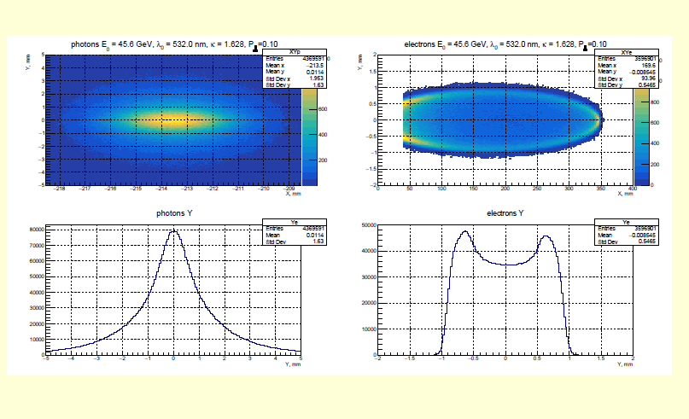
±1mm
350mm
Munchnoi

Slide 19
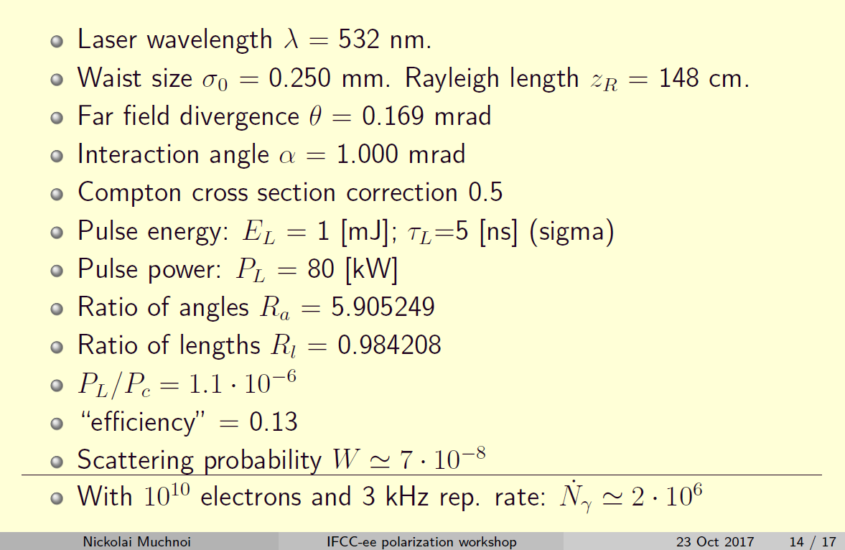
Compton Polarimeter: Rates

Slide 20
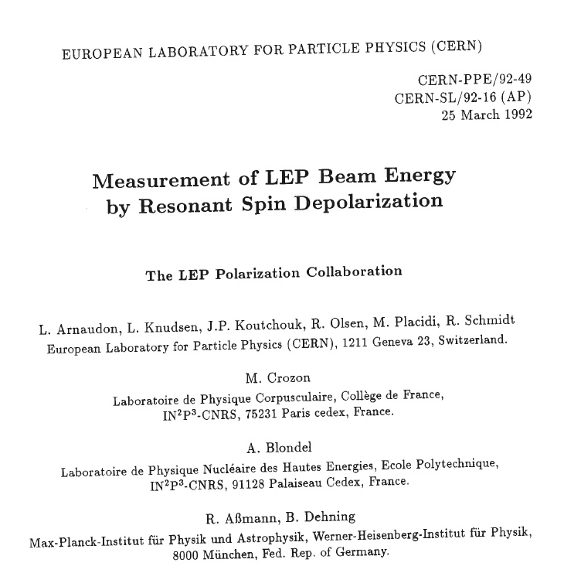
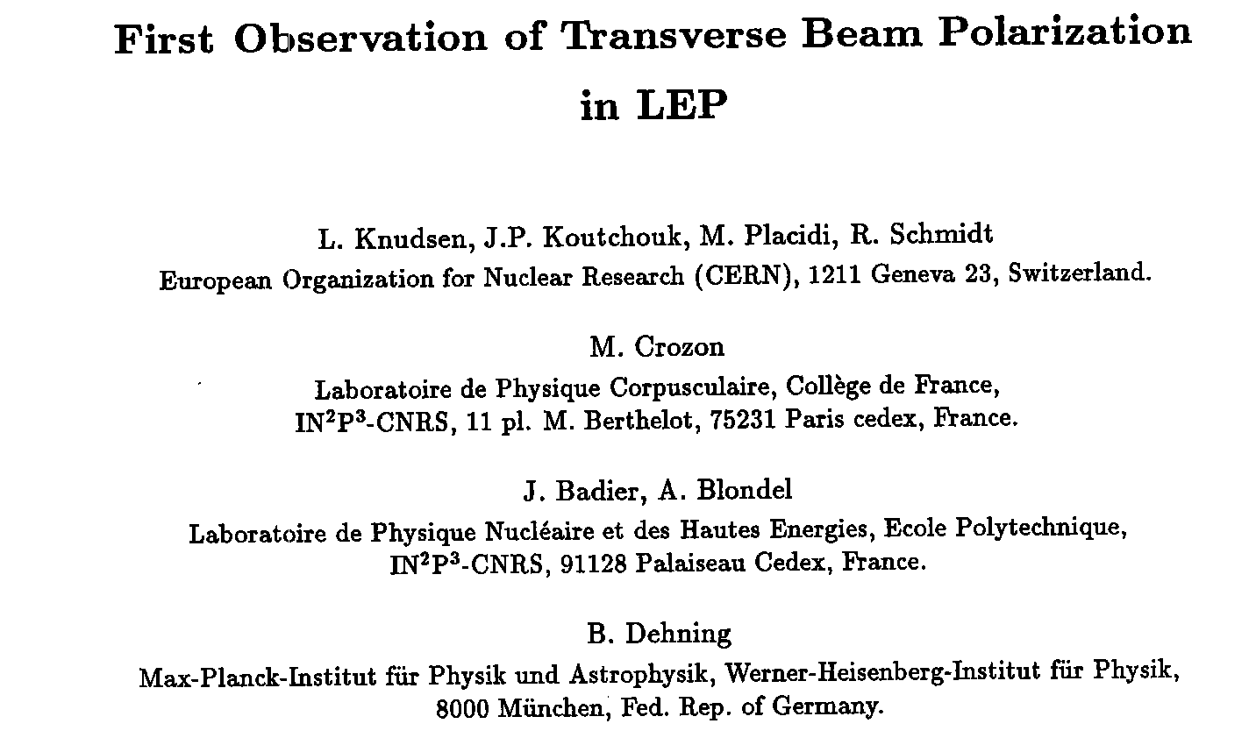
The polarimeter-spectrometer is a
beautiful device…
IN2P3 provided the laser system
(and optical box)
for the LEP polarimeter:

Slide 21
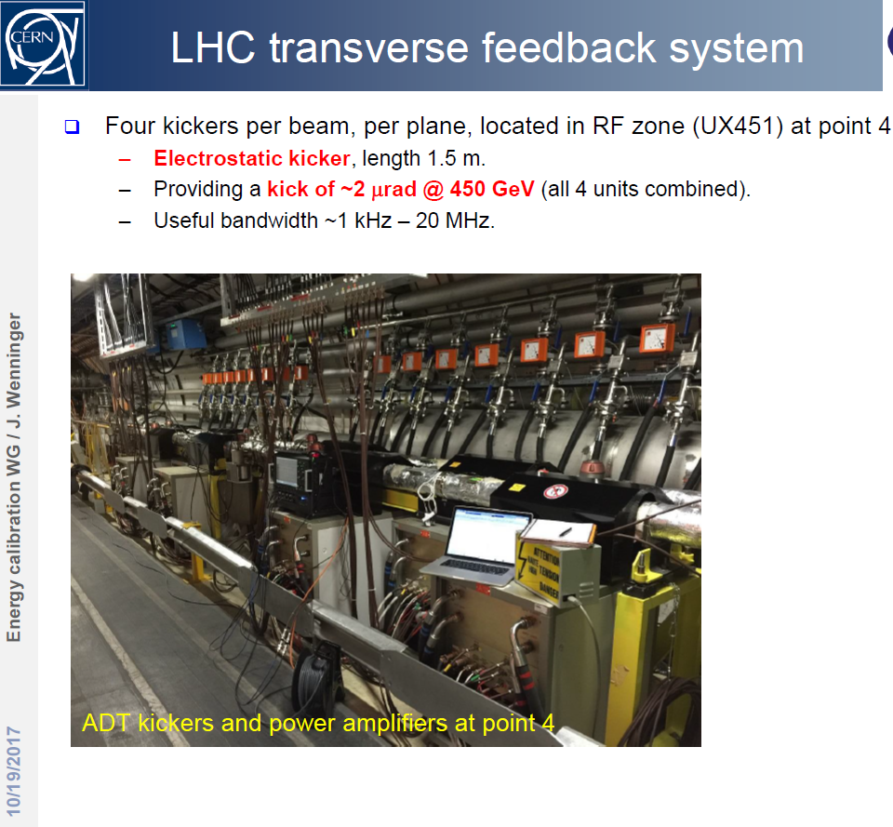
Depolarization
This is not-so trivial in FCC-ee!
16700 bunches circulate
time-between-bunches = 19ns,
depolarize one-and-only-one
of them.
Kicker must have fast (<9ns) rise.
The LHC TF system works essentially on a bunch by bunch basis for 25ns.
They would provide a transverse kick of up to ~20 mrad at the Z peak with ~10 MHz bandwidth. This is 10x more than what we may need-
a priori OK !

Slide 22
From resonant depolarization to Center-of-mass energy
-- 1. from spin tune to beam energy--
The spin tune may not be en exact measurement of the average of the beam energy
along the magnetic trajectory of particles. Additional spin rotations may bias the issue.
Anton Bogomyagkov and Eliana Gianfelice have made many estimates.
synchrotron oscillations ΔE/E -2 10⁻¹⁴
Energy dependent momentum compaction ΔE/E 10⁻⁷
Solenoid compensation 2 10⁻¹¹
Horizontal betatron oscillations ΔE/E 2.5 10⁻⁷
Horizontal correctors*) ΔE/E 2.5 10⁻⁷
Vertical betatron oscillations **) ΔE/E 2.5 10⁻⁷
Uncertainty in chromaticity correction O(10⁻⁶ ) ΔE/E 5 10⁻⁸
invariant mass shift due to beam potential 4 10⁻¹⁰
*) 2.5 10⁻⁶ if horizontal orbit change by >0.8mm between calibration is unnoticed
or if quadrupole stability worse than 5 microns over that time. consider that 0.2 mm orbit will be noticed
**) 2.5 10⁻⁶ for vertical excursion of 1mm. Consider orbit can be corrected better than 0.3 mm.

Slide 23
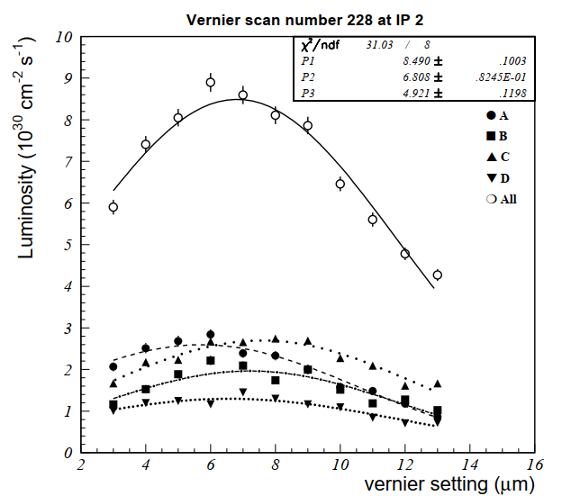

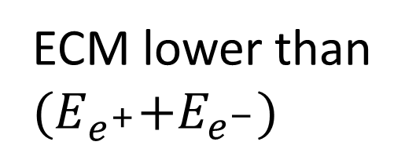

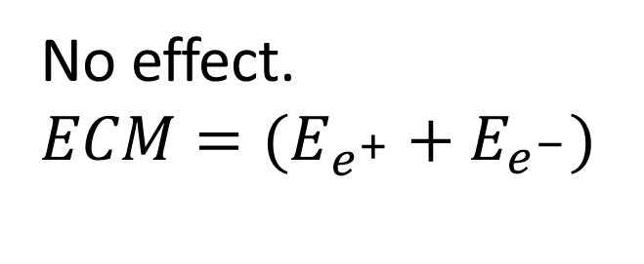


From resonant depolarization to Center-of-mass energy
2. from beam energy to E_{CM}
$$E_{e^{−}}$$
Experience from LEP – Vernier scans
No effect. ${ECM=(E}_{e^{+}}+E_{e^{−}})$
Van Der Meer today
Relative position of beams measured to 80 nanometers from one scan
$$E_{e^{+}}$$
$$E_{e^{−}}$$
ECM lower than ${(E}_{e^{+}}+E_{e^{−}})$
$$E_{e^{+}}$$

Slide 24
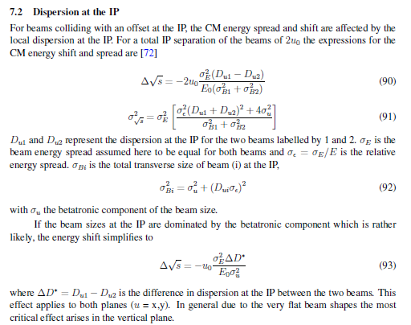
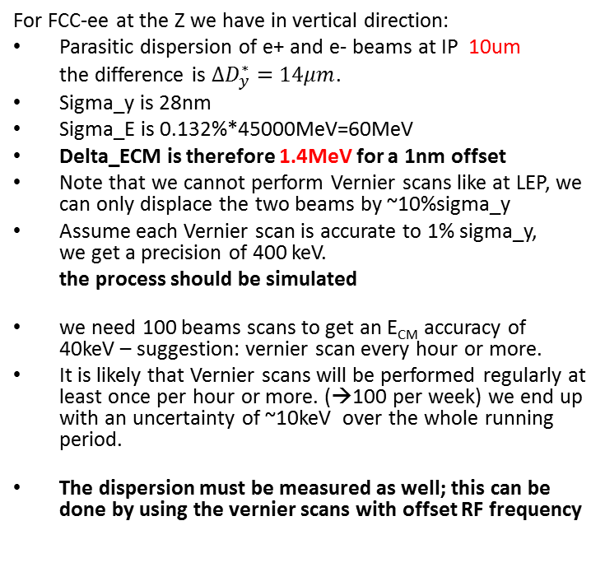
For FCC-ee at the Z we have in vertical direction:
Parasitic dispersion of e+ and e- beams at IP 10um
the difference is $∆D_{y}^{∗}=14μm$.
Sigma_y is 28nm
Sigma_E is 0.132%*45000MeV=60MeV
Delta_ECM is therefore 1.4MeV for a 1nm offset
Note that we cannot perform Vernier scans like at LEP, we can only displace the two beams by ~10%sigma_y
Assume each Vernier scan is accurate to 1% sigma_y,
we get a precision of 400 keV.
the process should be simulated
we need 100 beams scans to get an E_{CM} accuracy of 40keV – suggestion: vernier scan every hour or more.
It is likely that Vernier scans will be performed regularly at least once per hour or more. (→100 per week) we end up with an uncertainty of ~10keV over the whole running period.
The dispersion must be measured as well; this can be done by using the vernier scans with offset RF frequency
critical effect is in the vertical plane, but horizontal plane should be investigated as well

Slide 25
At full luminosity, a vernier scan is a tricky operation and beam beam blow up effects
might affect the result
Therefore a beamstrahlung or radiative bhabha monitor seeems highly worthwhile as it gives
information on the direction of the interacting particles.
it detects
the hard photons emmitted in either e+e- → e+e- γ
or
the hard beamstrahlung photons
Photons are not affected by the IR magnetic fields.
The beam-beam offset leads to a shift in the beamstrahlung photon beam which is
proportional to the offset (and to the charge of the opposite beam) for small offsets.
the measurement is passive
the zero position can be operationally established by colliding beams at lower intensity
where large vernier scan amplitude is possible.
An angular kick of up to 0.18 mrad is expected in the horizontal plane due to EM attraction.

Slide 26
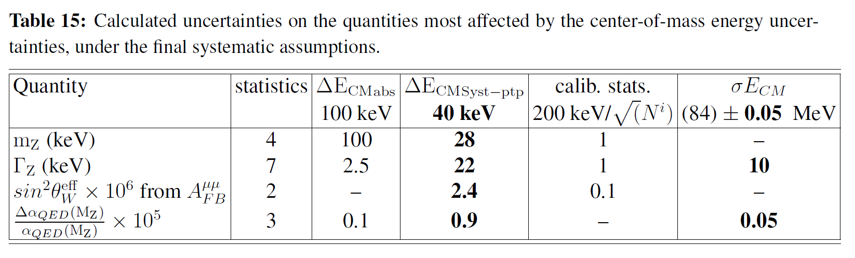
with the improved systematic error evaluation

Slide 27
Conclusions
We had a first look at the determination of centre of mass energy and energy spread in FCC-ee
Results look extremely promising of extraordinary, historical measurements
This must be improved and secured further.
there are many ways in which the program should move forward.
-1- unify the set of codes used to simulate the machine and verify (spurious) energy shifts
-2- simulate and improve the polarimeter/spectrometer in both functions
-3- completely re-think the IP collision monitoring and necessary measurements
-- vernier scans, fast lumi monitor,
-- beam-beam deflection monitor,
-- beamstrahlung monitor etc…
4. devise means to make it all automatic (RD, Verniers, Dispersion, etc…)
and more….

Slide 28
Measure vertical dispersion at the IP
According to Katsunobu Oide:
Use BPMs at the high beta points on both sides of the IP
If relative BPM resolution is 1 um, then resolution on dispersion is 1um/(dp/p)
(dp/p) (achieved through change of RF frequency) cannot be more than 1% to avoid non-linearities
➔ leading to a resolution on D_{y} of 100um on both sides of the IP
The dispersion at the IP is the sum of the dispersions on both sides of the IP, which have opposite signs as they are about 180 degrees apart.
Thus the dispersion at the IP is the subtraction of two big numbers, so relative cross calibration of the two BPMs is also important
knowing the optics it may be possible to perform a fit to the dispersion function…
More work is needed here. The required resolution (around 5um) is not yet there.

Slide 29
Beam Polarization can provide main ingredient to Physics Measurements
Transverse beam polarization provides beam energy calibration
by resonant depolarization
→ low level of polarization is required (~10% is sufficient)
→ at Z & W pair threshold comes naturally
→ at Z use of asymmetric wigglers at beginning of fills
since polarization time is otherwise very long.
→ could be used also at ee → H(126) (depending on exact m_{H} !)
→ use ‘single’ non-colliding bunches and calibrate continuously
during physics fills to avoid issues encountered at LEP
→ this is possible with e+ and e- Compton polarimeter (commercial laser)
→ should calibrate at energies corresponding to half-integer spin tune
→ must be complemented by analysis of «average E_beam» to E_CM relationship
For beam energies higher than ~90 GeV can use ee → Z γ or ee → WW events
to calibrate E_{CM} at ±2-4 MeV level: matches requirements for m_{H} and m_{top} measts
Aim: Z mass & width to ~100 keV (stat: 10 keV) W mass & width to ~500 keV (stat : 300 keV)

Slide 30
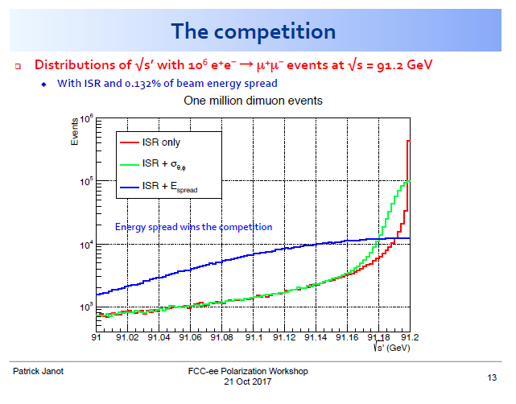

Slide 31
Beam Polarization can provide two main ingredients to Physics Measurements
2. Longitudinal beam polarization provides chiral e+e- system
-- High level of polarization is required (>40% )
-- Must compare with natural e+e- polarization due to chiral couplings of electrons (15%)
or with final state polarization analysis for CC weak decays (100% polarized) (tau and top)
-- Physics case for Z peak is very well studied and motivated:
A_{LR} , A_{FB}^{Pol}(f) etc… (CERN Y.R. 88-06)
figure of merit is L.P² --> must not lose more than a factor ~10 in lumi.
self calibrating polarization measurement *→ spares
-- uses : enhance Higgs cross section (by 30%)
top quark couplings? final state analysis does as well (Janot arXiv:1503.01325)
enhance signal, subtract/monitor backgrounds, for ee→WW , ee →H
-- requires High polarization level and often both e- and e+ polarization
➔ not interesting If loss of luminosity is too high
-- Obtaining high level of polarization in high luminosity collisions is delicate in top-up mode

Slide 32
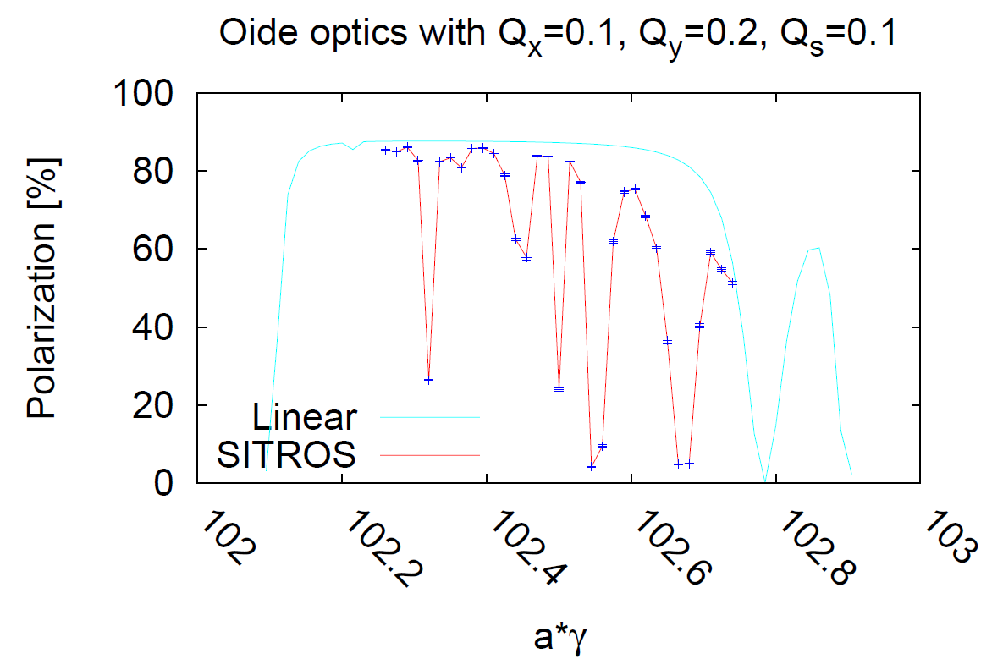
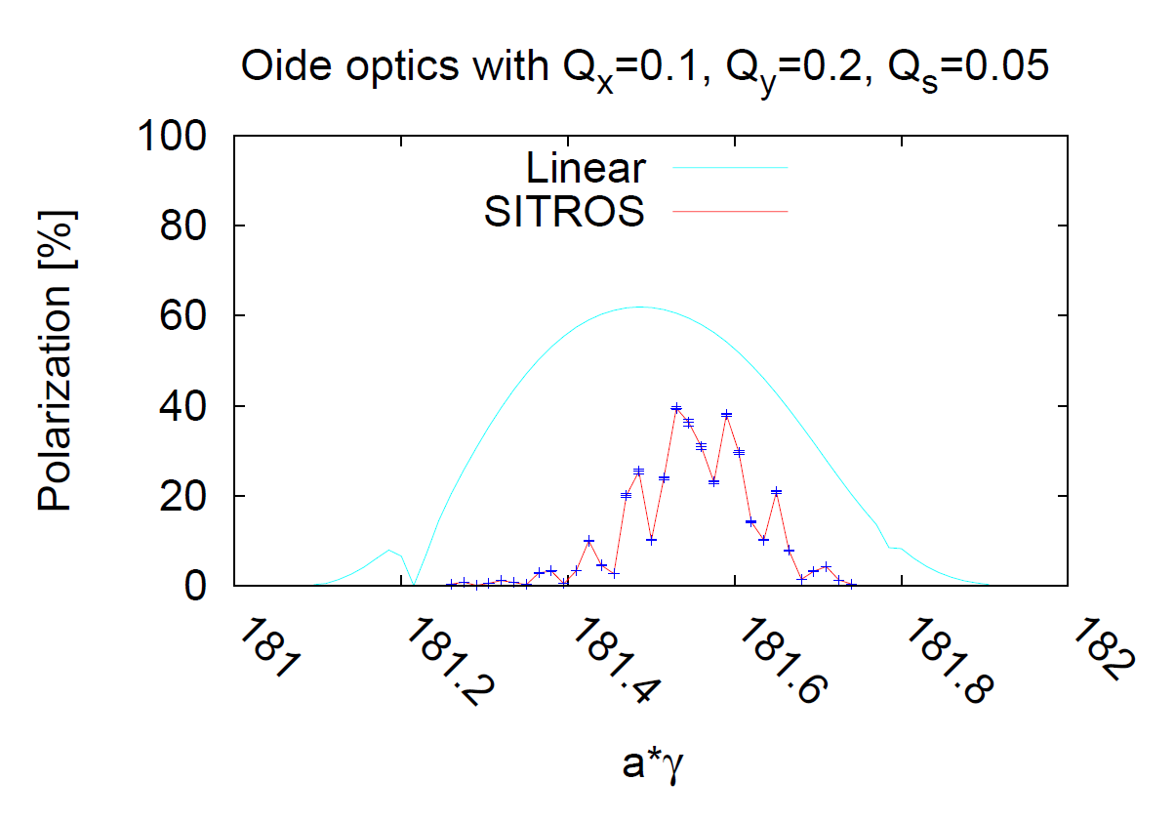
45 GeV
80 GeV
At the Z obtain excellent polarization level
but too slow for polarization in physics
need wigglers for Energy calibration
At the W expectation similar to LEP at Z
→ enough for energy calibration
Simulations by Eliana Gianfelice

Slide 33
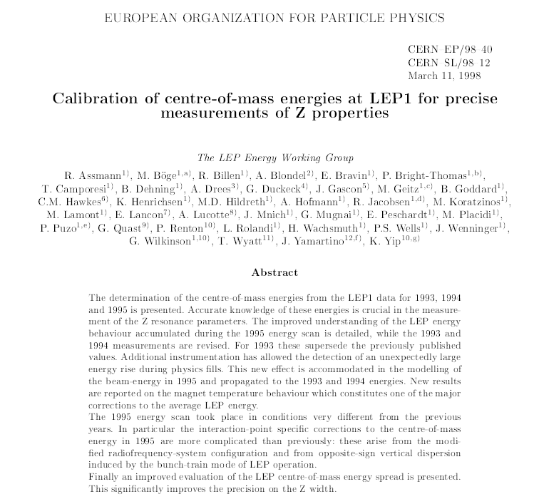

Slide 34
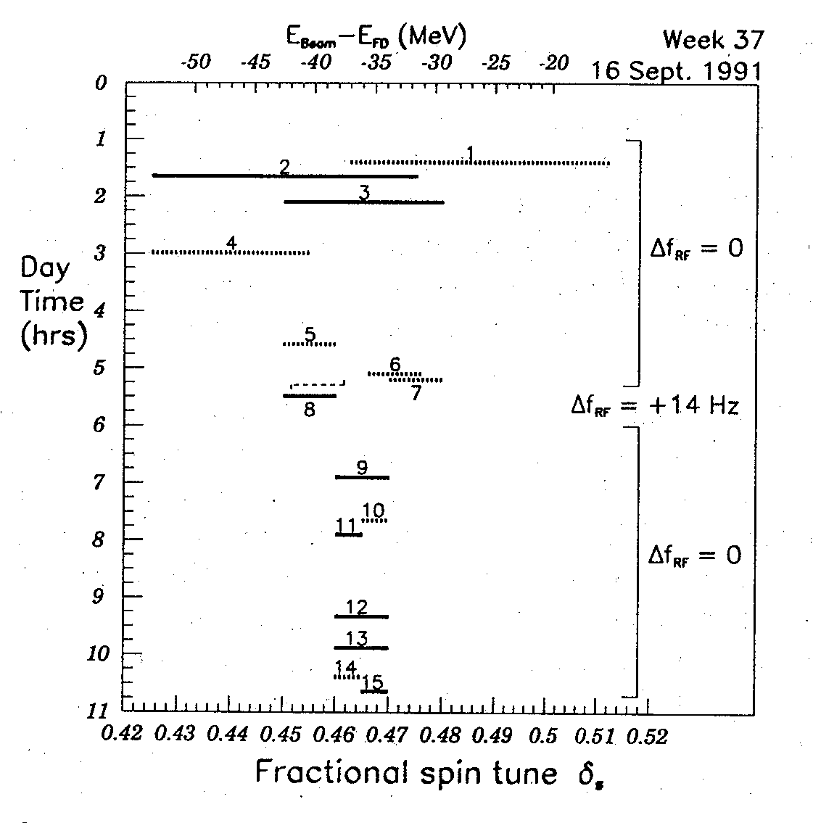
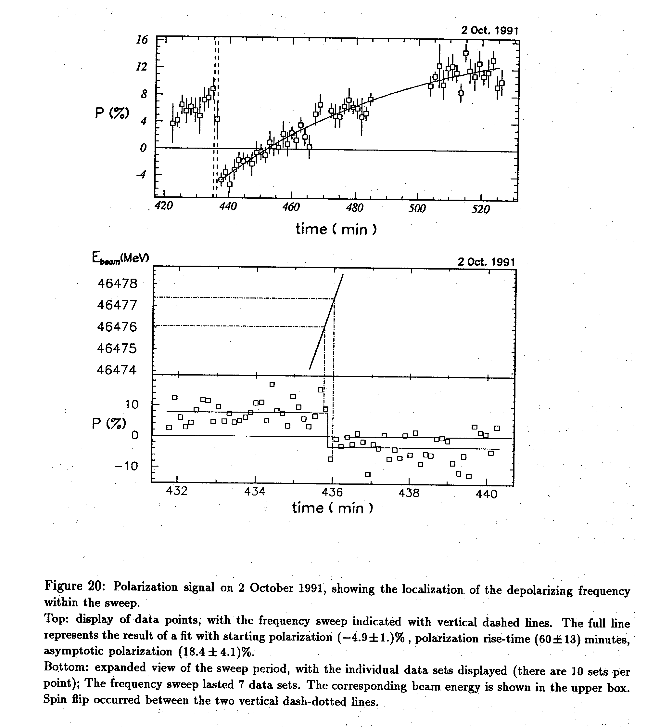
LEP Resonant depolarization, 1991
variation of RF frequency
to eliminate half integer
ambiguity

Slide 35
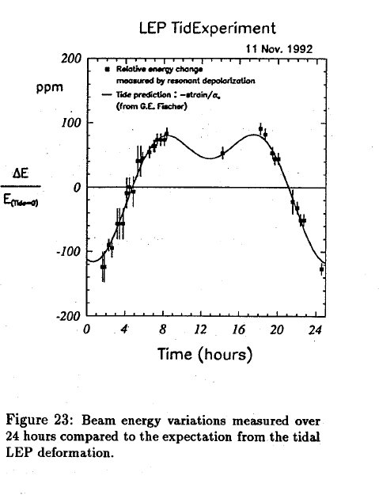
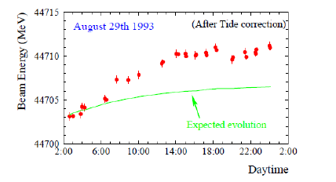
Many effects spoil the calibration if it is performed
outside physics time
-- tides and other ground motion
-- RF cavity phases
-- histeresis effects and environmental effects (trains…etc)

Slide 36
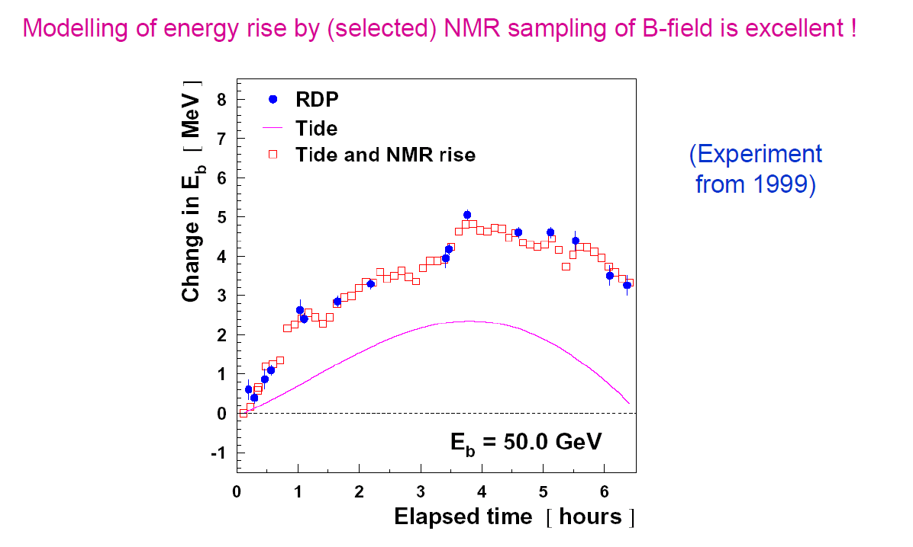
by 1999 we had an excellent model of the energy variations…
but we were not measuring the Z mass and width anymore
– we were hunting for the Higgs boson!

Slide 37
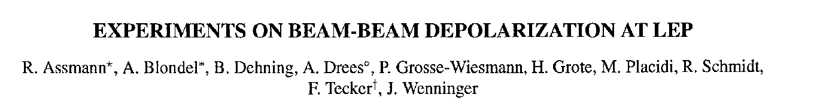
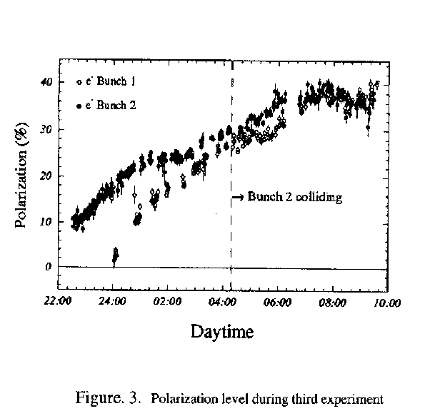
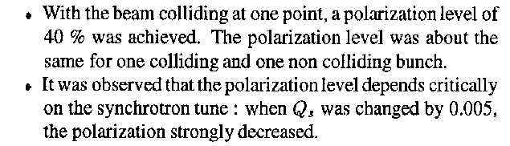
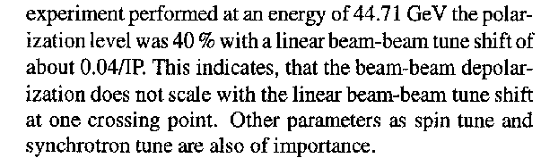
PAC 1995
LEP:
This was only tried 3 times!
Best result: P = 40% , ξ*_{y}= 0.04 , one IP
FCC-ee
Assuming 2 IP and ξ*_{y}= 0.01 ➔
reduce luminosity, 10¹⁰ Z @ P~30%

Slide 38
Longitudinal polarization at FCC-Z?
Main interest: measure EW couplings at the Z peak most of which provide measurements
of sin²θ^{lept}_{W} = e²/g² (m_{z})
(-- not to be confused with -- sin²θ_{W} = 1- m_{w}²/m_{z}²
Useful references from the past:
«polarization at LEP» CERN Yellow Report 88-02
Precision Electroweak Measurements on the Z Resonance
Phys.Rept.427:257-454,2006 http://arxiv.org/abs/hep-ex/0509008v3
GigaZ @ ILC by K. Moenig

Slide 39
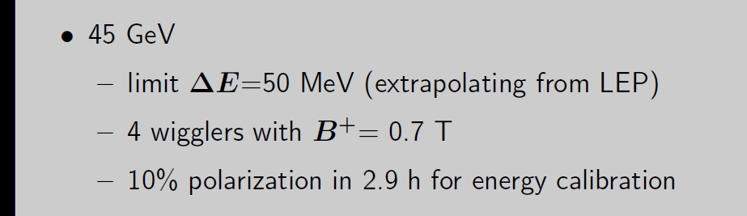
Longitudinal polarization: reduction of polarization due to continuous injection
The colliding bunches will lose intensity continuously due to collisions.
In FCC-ee with 4 IPs, L= 28 10³⁴/cm2/s beam lifetime is 213 minutes
In FCC-ee with 2 IPs, L= 1.4 10³⁶/cm2/s beam life time is 55minutes
Luminosity scales inversely to beam life time.
The injected e+ and e- are not polarized → asymptotic polarization is reduced.
Assume here that machine has been well corrected and beams
(no collisions, no injection) can be polarized to nearly maximum.
(Eliana Gianfelice in Rome talk)
(polarization time is 26h)

Slide 40
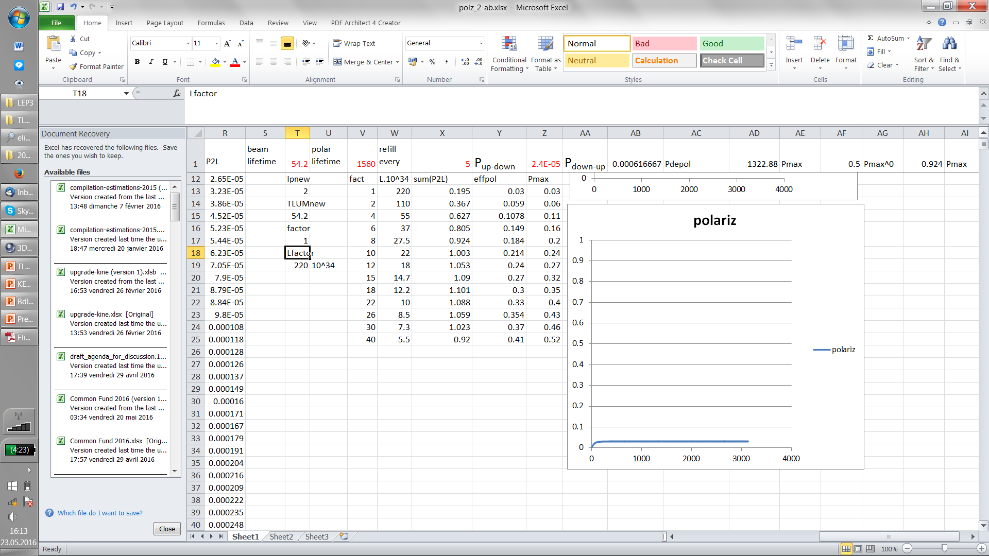


We have simulated the simultaneous effect of
-- natural polarization
-- beam consumption by e+e- interactions
-- replenishment with unpolarized beams
assuming optimistically a maximal 90% asymptotic polarization
Running at full luminosity
P_max=0.03! P_eff=0.03
Running at 10% Lumi
P_max=0.24, P_eff=0.21
Running at 1% Lumi
P_max=0.66, P_eff=0.5

Slide 41
Lumi loss factor | L.10^34 | Figure of merit: sum(P²L) | Peff | Pmax
1 | 220 | 0.195 | 0.03 | 0.03
2 | 110 | 0.367 | 0.059 | 0.06
4 | 55 | 0.627 | 0.1078 | 0.11
6 | 37 | 0.805 | 0.149 | 0.16
8 | 27 | 0.924 | 0.184 | 0.2
10 | 22 | 1.003 | 0.214 | 0.24
12 | 18 | 1.053 | 0.24 | 0.27
15 | 15 | 1.09 | 0.27 | 0.32
18 | 12 | 1.101 | 0.3 | 0.35
22 | 10 | 1.088 | 0.33 | 0.4
26 | 8 | 1.059 | 0.354 | 0.43
30 | 7 | 1.023 | 0.37 | 0.46
40 | 5 | 0.92 | 0.41 | 0.52
Δ A_{LR} scales as 1/√(P²L)
Optimum around a reduction of luminosity by a factor 18.
This is still a luminosity of ~10³⁵ per IP… and the effective polarization is 30%.
This is equivalent to a 100% polarization expt with luminosity reduced by 180.

Slide 42

observable | Physics | Present precision |  | FCC-ee stat Syst Precision | FCC-ee key | Challenge
M_{Z} MeV/c2 | Input | 91187.5 ±2.1 | Z Line shape scan | 0.005 MeV <±0.1 MeV | E_cal | QED corrections
Γ_{Z} MeV/c2 | Δρ (T) (no Δα!) | 2495.2 ±2.3 | Z Line shape scan | 0.008 MeV <±0.1 MeV | E_cal | QED corrections
$$Rl ≡\frac{Γ_{h}}{Γ_{l}}$$ | α_{s ,} δ_{b} | 20.767 (25) | Z Peak | 0.0001 (2-20) | Statistics | QED corrections
N_{ν} | Unitarity of PMNS, sterile ν’s | 2.984 ±0.008 | Z Peak Z+γ(161 GeV) | 0.00008 (40) 0.001 | ->lumi meast Statistics | QED corrections to Bhabha scat.
R_{b} | δ_{b} | 0.21629 (66) | Z Peak | 0.000003 (20-60) | Statistics, small IP | Hem. correlations
A_{LR} | Δρ, ε_{3 ,}Δα (T, S ) | sin²θ_{w}^{eff} 0.23098(26) | Z peak, Long. polarized | sin²θ_{w}^{eff} ±0.000006 | 4 bunch scheme | Design experiment
A_{FB}^{lept} | Δρ, ε_{3 ,}Δα (T, S ) | sin²θ_{w}^{eff} 0.23099(53) |  | sin²θ_{w}^{eff} ±0.000006 | E_cal & Statistics
M_{W} MeV/c2 | Δρ, ε_{3 ,} ε_{2,} Δα (T, S, U) | 80385 ± 15 | Threshold (161 GeV) | 0.3 MeV <0.5 MeV | E_cal & Statistics | QED corections
m_{top} MeV/c2 | Input | 173200 ± 900 | Threshold scan | ~10 MeV | E_cal & Statistics | Theory limit at 50 MeV?

Slide 43



Measuring sin²θ_{W}^{eff} (m_{Z})
sin²θ_{W}^{eff} ≡ ¼ (1- g_{V}/g_{A})
g_{V} = g_{L} + g_{R}
g_{A} = g_{L} - g_{R}
arXiv:0509008
$$\left({ge}_{V}^{}\right)$$

Slide 44


Slide 45

 | A_{FB}^{μμ} @ FCC-ee |  | A_{LR} @ ILC | A_{LR} @ FCC-ee
visible Z decays | 10¹² | visible Z decays | 10⁹ | 5.10¹⁰
muon pairs | 10¹¹ | beam polarization | 90% | 30%
ΔA_{FB}^{μμ} (stat) | 3 10⁻⁶ | ΔA_{LR} (stat) | 4.2 10⁻⁵ | 4.5 10⁻⁵
Δ E_{cm} (MeV) | 0.1 |  | 2.2 | ?
ΔA_{FB}^{μμ} (E_{CM} ) | 9.2 10⁻⁶ | ΔA_{LR} (E_{CM} ) | 4.1 10⁻⁵
ΔA_{FB}^{μμ} | 1.0 10⁻⁵ | ΔA_{LR} | 5.9 10⁻⁵
Δ$\text{sin}\text{2}\text{θ}\text{lept}\text{W}$ | 5.9 10⁻⁶ |  | 7.5 10⁻⁶ | 6 10⁻⁶ +?
All exceeds the theoretical precision from Δα(m_{Z}) (310⁻⁵) or the comparison with m_{W} (500keV)
But this precision on Δsin²θ^{lept}_{W} can only be exploited at FCC-ee!

Slide 46


The forward backward tau polarization
asymmetry is very clean.
Dependence on E_{CM} same as A_{LR} negl.
At FCC-ee
ALEPH data 160 pb⁻¹ (80 s @ FCC-ee !)
Already syst. level of 6 10⁻⁵on sin²θ^{eff}_{W}
much improvement possible
by using dedicated selection
e.g. tau→ π v to avoid had. model

Slide 47
Concluding remarks
There are very strong arguments for precision energy calibration with transverse
polarization at the Z peak and W threshold.
2. Given the likely loss in luminosity, and the intrinsic uncertainties in the extraction of
the weak couplings, the case for longitudinal polarization is limited
➔ We have concluded that first priority is to achieve transverse polarization
in a way that allows continuous beam calibration by resoenant depolarization
- this is all possible with a very high precision, both at the Z and the W.
calibration at higher energies can be made from the data themselves at sufficient level.
- the question of the residual systematic error requires further studies of the
relationship between beam energy and center-of-mass energy
with the aim of achieving a precision of O(100 keV) on E_CM

Slide 48

EWRCs
relations to the well measured
G_{F} m_{Z} α_{QED}
at first order:
Δρ = α /π (m_{top}/m_{Z})²
- α /4π log (m_{h}/m_{Z})²
ε₃ = cos²θ_{w} α /9π log (m_{h}/m_{Z})²
δ_{νb} =20/13 α /π (m_{top}/m_{Z})²
complete formulae at 2d order
including strong corrections
are available in fitting codes
e.g. ZFITTER , GFITTER

Slide 49

Extracting physics from sin²θ^{lept}_{W}
1. Direct comparison with m_{Z}
Uncertainties in m_{top} , Δα(m_{z}) , m_{H} , etc….
Δsin²θ^{lept}_{W} ~ Δα(m_{z}) /3 = 10⁻⁵ if we can reduce Δα(m_{z}) (see P. Janot)
2. Comparison with m_{w}/m_{Z}
Compare above formula with similar one:
sin²θ_{W} cos²θ_{W} = $\frac{1}{1−( ) }$
Where it can be seen that Δα(m_{z}) cancels in the relation.
The limiting error is the error on m_{W}.
For Δm_{W}= 0.5 MeV this corresponds to Δsin²θ^{lept}_{W} = 10⁻⁵

Slide 50

Will consider today the contribution of the Center-of-mass energy systematic errors
Today: step I, compare
ILC measurement of A_{LR} with 10⁹ Z and P_{e-} =80%, P_{e+} =30%
FCC-ee measurement of A_{FB}^{μμ} and A_{FB}^{Pol} ($$) with 2.10¹² Z

Slide 51

Comparing A_{LR} (P) and A_{FB} (μμ)
Both measure the weak mixing angle as defined by the relation A_{l} = $\frac{\left({ge}_{L}^{}\right)2−\left({ge}_{R}^{}\right)2}{\left({ge}_{L}^{}\right)2+\left({ge}_{R}^{}\right)2}$
with $\left({ge}_{L}^{}\right)$ = ½ -sin²θ^{lept}_{W} and $\left({ge}_{R}^{}\right)$ = -sin²θ^{lept}_{W} A_{l} ≈ 8(1/4 -sin²θ^{lept}_{W} )
A_{LR} = A_{e}
A_{FB}^{μμ}= ¾ A_{e} A_{μ} = ¾ A_{l}²
-- A_{FB}^{μμ} is measured using muon pairs (5% of visible Z decays) and unpolarized beams
-- A_{LR} is measured using all statistics of visible Z decays with beams of
alternating longitudinal polarization
both with very small experimental systematics
-- parametric sensitivity $\frac{d\text{A}\text{FB}\text{μμ}}{d\text{sin}\text{2}\text{θ}\text{lept}\text{W}}$ = 1.73 vs $\frac{d\text{A}\text{LR}}{d\text{sin}\text{2}\text{θ}\text{lept}\text{W}}$ = 7.9
-- sensitivity to center-of-mass energy (w.r.t. m_{Z} ) is larger for A_{FB}^{μμ}
$\frac{∂\text{A}\text{FB}\text{μμ}}{∂\sqrt{s}}$ = 0.09/GeV vs $\frac{∂\text{A}\text{LR}}{∂\sqrt{s}}$ = 0.019/GeV
“an 80 MeV uncertainty in Ecm corresponds to a 1% error on A_{LR}’’ (relative error)
But of course A_{FB}^{μμ} benefits from much larger statistics and Ecm precision of circular collider

Slide 52


Measurement of A_{LR}
Verifies polarimeter with experimentally measured cross-section ratios
ΔA_{LR} =
statistics
ΔA_{LR} = 0.000045 with 5.10¹⁰ Z and 30% polarization in collisions.
Δsin²θ_{W}^{eff} (stat) = O(2.10⁻⁶)

Slide 54
 | A_{FB}^{μμ} @ FCC-ee |  | A_{LR} @ ILC | A_{LR} @ FCC-ee
visible Z decays | 10¹² | visible Z decays | 10⁹ | 5.10¹⁰
muon pairs | 10¹¹ | beam polarization | 90% | 30%
ΔA_{FB}^{μμ} (stat) | 3 10⁻⁶ | ΔA_{LR} (stat) | 4.2 10⁻⁵ | 4.5 10⁻⁵
Δ E_{cm} (MeV) | 0.1 |  | 2.2 | ?
ΔA_{FB}^{μμ} (E_{CM} ) | 9.2 10⁻⁶ | ΔA_{LR} (E_{CM} ) | 4.1 10⁻⁵
ΔA_{FB}^{μμ} | 1.0 10⁻⁵ | ΔA_{LR} | 5.9 10⁻⁵
Δ$\text{sin}\text{2}\text{θ}\text{lept}\text{W}$ | 5.9 10⁻⁶ |  | 7.5 10⁻⁶ | 6 10⁻⁶ +?
All exceeds the theoretical precision from Δα(m_{Z}) (310⁻⁵) or the comparison with m_{W} (500keV)
But this precision on Δsin²θ^{lept}_{W} can only be exploited at FCC-ee!

Slide 55
The forward backward tau polarization
asymmetry is very clean.
Dependence on E_{CM} same as A_{LR} negl.
At FCC-ee
ALEPH data 160 pb⁻¹ (80 s @ FCC-ee !)
Already syst. level of 6 10⁻⁵on sin²θ^{eff}_{W}
much improvement possible
by using dedicated selection
e.g. tau→ π v to avoid had. model

Slide 56


Slide 57


Slide 58




Going through the observables
the weak mixing angle as defined by the relation
A_{l} = $\frac{2{ge}_{V}^{}{ge}_{A}^{}}{\left({ge}_{V}^{}\right)2+\left({ge}_{A}^{}\right)2}=$ $\frac{\left({ge}_{L}^{}\right)2−\left({ge}_{R}^{}\right)2}{\left({ge}_{L}^{}\right)2+\left({ge}_{R}^{}\right)2}$
with $\left({ge}_{L}^{}\right)$ = ½ -sin²θ^{lept}_{W} and $\left({ge}_{R}^{}\right)$ = -sin²θ^{lept}_{W}
A_{l} ≈ 8(1/4 -sin²θ^{lept}_{W} ) very sensitive to sin²θ^{lept}_{W} !
A_{LR} = A_{e} measured from (σ_{vis ,L -} σ_{vis ,R} ) / (σ_{vis ,L -} σ_{vis ,R} )
( total visible cross-section had + μμ + ττ (35 nb) for 100% Left Polarization
A_{FB}^{μμ}= ¾ A_{e} A_{μ} = ¾ A_{l}²
Or

Slide 59

Beam polarization and E-calibration
Precise meast of E_{beam} by resonant depolarization
~100 keV each time the meast is made LEP→
At LEP transverse polarization was achieved routinely at Z peak.
but measurement only performed at the end of fills (and only for e-!)
lots of effects (tides, trains, lake level, rain (…and tears) in data vs calib!
Polarization in collisions was observed (40% at BBTS = 0.04)
At LEP a beam energy spread σ_{E} > 55 MeV destroyed polarization above 61 GeV
σ_{E} ∝ E²/√ρ ➔ At FCC-ee transverse polarization up to > 81 GeV (WW threshold)
FCC-ee: use ‘single’ pilot bunches to measure the beam energy continuously
no interpolation errors due to tides, ground motion or trains etc…
<< 100 keV beam energy calibration around Z peak and W pair threshold.
Δm_{Z} ~0.1 MeV, ΔΓ_{Z} < 0.1 MeV, Δm_{W} ~ 0.5 MeV

Slide 60

Requirements from physics
Center-of-mass energy determination with precision of ± 100 keV around the Z peak
Center-of-mass energy determination with precision of ± 300 keV at W pair threshold
3. For the Z peak-cross-section and width, require energy spread uncertainty Δσ_{E}/σ_{E} =0.2%
NB: at 2.3 10³⁶/cm²/s/IP : full LEP statistics 10⁶ μμ 2.10⁷ qq in 6 minutes in each expt
-- use resonant depolarization as main measuring method
-- use pilot bunches to calibrate during physics data taking: 100 calibrations per day each 10⁻⁶ rel.
-- long lifetime at Z requires the use of wigglers at beginning of fills
take data at points where self polarization is expected
ν_{s} =$\frac{g−2}{2}\frac{Eb}{me}= \frac{Eb}{0.4406486(1)} ≈ N+\left(0.5±0.1\right)$E_{CM} = $\left(N+\left(0.5±0.1\right)\right)$ x 0.8812972 GeV
Given the Z and W widths of 2 GeV, this is easy to accommodate with little loss of statistics.
It might be more difficult for the Higgs 125.09+-0.2 corresponds to v_{s} = 141.94+-022

