Slide 1
NUPECC poster prize giving
ARIS 2023
Avignon, France

Slide 2
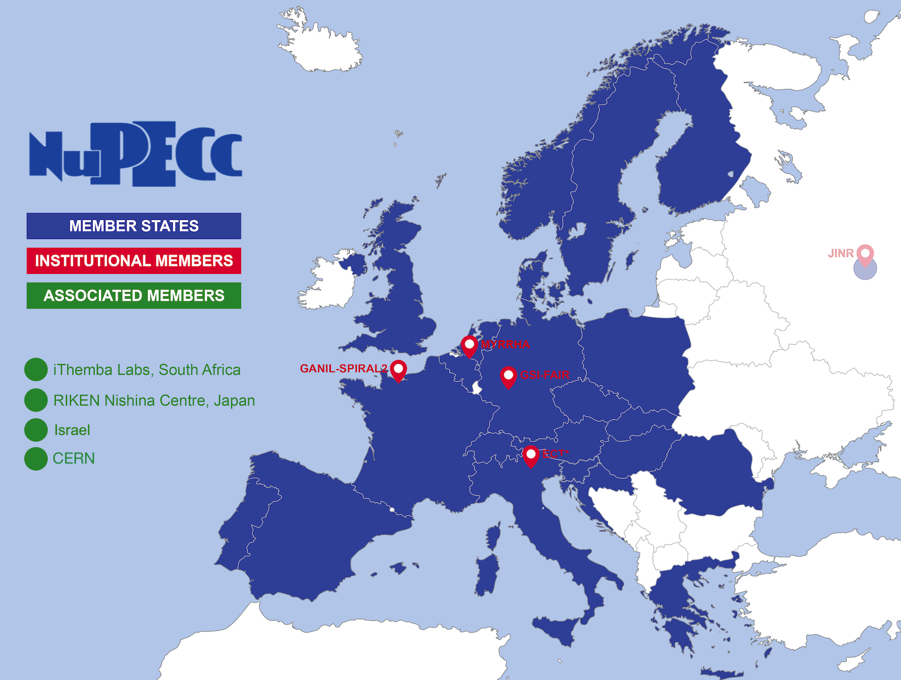
What is NuPECC ?
Nuclear Physics European Collaboration Committee (NuPECC)
Is the European Expert Board for Nuclear Physics
hosted by European Science Foundation
Representing
about 6000 scientists
Composition:
34 representatives from 22 countries (new member Ukraine), 3 ESFRI NP Infrastructures & ECT*
JINR Dubna – suspended in March 2022
4 associated members
  CERN
  Israel
  iThemba Labs
  Nishina Center
9 observers (ESF, NPD/EPS, ECFA, NSAC, ANPhA, ALAFNA, CINP, IAEA, APPEC)
34 Years of NuPECC activities
3 regular Committee meetings/y
https://nupecc.org
Marek Lewitowicz

Slide 3
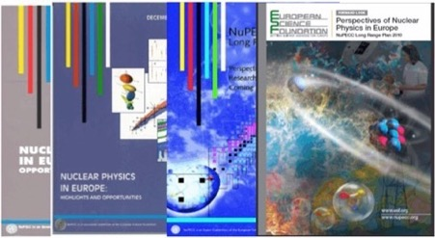
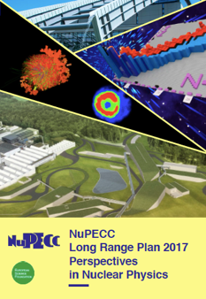
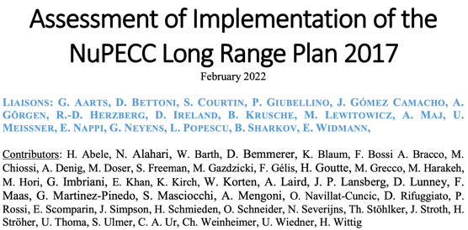
Towards NuPECC Long Range Plan 2024
1991
1997
2004
2010
The LRP identifies opportunities and priorities for the nuclear science in Europe
The LRP provides national funding agencies, ESFRI and European Commission with a framework for coordinated advances in nuclear science in Europe
NuPECC LRP 2017
February 2022
NuPECC LRP 2024
https://www.nupecc.org/lrp2016/Documents/lrp2017.pdf
https://nupecc.org/2017_LRP_Assessment_of_Implementation_final.pdf
Launched in May 2022 in Madrid
Marek Lewitowicz

Slide 4
NuPECC LRP 2024 – Contributions
of the community
Contributions per topic
LRP Contributions:
159 contributions submitted
by > 400
individual scientists, collaborations,
infrastructures,
and research institutions in Europe
https://nupecc.org/?display=lrp2024/call_for_input
Marek Lewitowicz

Slide 5
TWG coordinators and SC liaisons
Theory/Exp.
Over 200 members of TWGs; > 25 meetings

Slide 6
LRP2024 Timeline
First
report TWGs
9&12 May 2023
Secondreport TWGs
Sept. 2023
Approval and official presentation of LRP 2024
Assessment of the implementation of the 2017 LRP
Call for inputs dead-line 28/10/2022
Recommendations drafting session
GSI 30-31/10/2023
2021
2022
2023
2024
LRP 2024 launched
Call for inputs
Kick-off meetings of Working Groups
Town meeting
Presentation and community feedback on the draft of LRP 2024

Slide 7
NuPECC Support for nuclear physics conferences and schools (new) in Europe
Typically 10-15 conference and schools supported/year
Call for proposals for 2024 conferences and schools is opened
See https://nupecc.org/?display=support/conf
Dead-line October 1st , 2023

