Slide 1
Superallowed α decay to doubly magic ¹⁰⁰Sn
Darek Seweryniak
Argonne National Laboratory
4th International Conference on Advances in Radioactive Isotope Science
Palais des Papes, Avignon, France, June 4-9, 2023

Slide 2









Slide 3
Outline
Alpha-decay landscape
Microscopic description of α decay
Doubly-magic ¹⁰⁰Sn
Observation of the ¹⁰⁸Xe-¹⁰⁴Te-¹⁰⁰Sn α decay chain
Discussion of α-decay reduced widths
  ²⁰⁸Pb region vs ¹⁰⁰Sn region
  theoretical calculations for ¹⁰⁴Te/¹⁰⁸Xe
Summary and Outlook

Slide 4
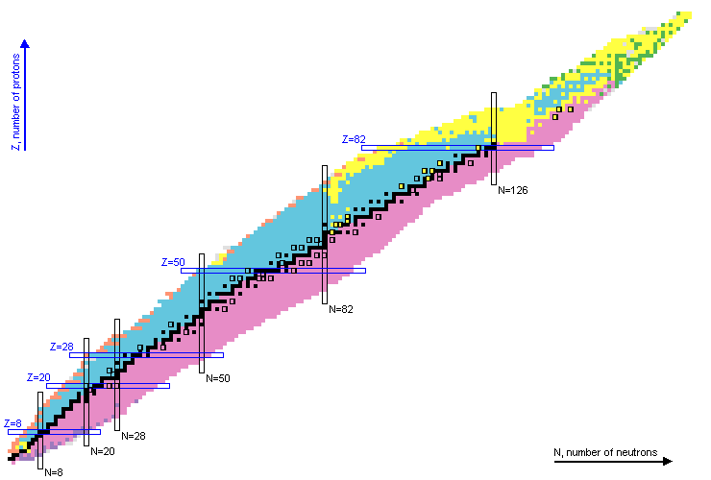
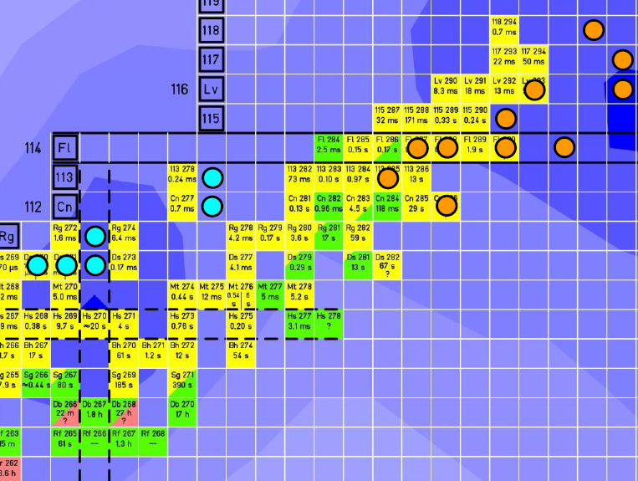
Alpha-decay landscape
New proton-rich isotopes
Super-heavy nuclei
Masses
Structure
Clustering, astrophysics
²⁰⁸Pb
Super-Heavy Elements
¹⁰⁰Sn
α decay of ²¹²Po to doubly magic ²⁰⁸Pb is the simplest case and serves as a benchmark
α decay of ¹⁰⁴Te to doubly magic ¹⁰⁰Sn, enhanced α preformation factor due to strong π-ν interaction, superallowed α decay
There are many empirical formulas
for calculating α-decay widths
but microscopic description
of α decay remains challenging

Slide 5
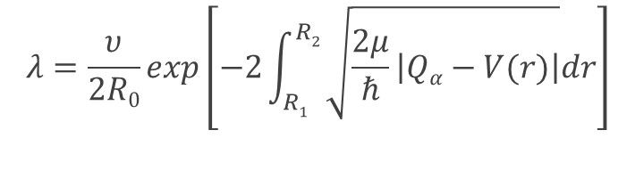


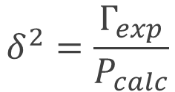

Gamow alpha-decay model
G. Gamow, Z. Phys. 51, 204 (1928)
Probabilistic interpretation of quantum mechanics
V(r)
$Γ=ℏλ=ℏνP$
Can be readily calculated
Very steep function of Q-value
Coulomb/centrifugal barrier
Eα
α
R₁
R₂
r
- decay constant
Γ – decay width
- assault frequency
P – penetration probability
δ² - reduced α decay width,
often normalized to ²¹²Po
(~α preformation factor)
Nuclear
potential

Slide 6
R-matrix expression of the alpha-decay width
Decay width:
P_{L}(R) - penetrability
R – channel radius (outside of the nucleus)
Reduced width amplitude:
R
=
Formation amplitude:
Overlap between parent nucleus and daughter nucleus + alpha
at a distance R outside of nuclear interactions

Slide 7
Complex-energy shell model
Locally adjusted double-folding potential
P. Mohr, Eur. Phys. J. A 31, 23 (2007)
Qα(¹⁰⁴Te)=5.42(0.07) MeV, T_{1/2} (¹⁰⁴Te) = 5 ns (assumed P=10%)
Qα(¹⁰⁸Xe)=4.65(0.15) MeV, T_{1/2} (¹⁰⁸Xe) = 60 μs (assumed P=5%)
R. Id Betan and W. Nazarewicz, Phys. Rev. C 86, 034338 (2012)
Spectroscopic factor, R-matrix
²¹²Po
Half life reproduced (spectroscopic factor formulation)
Calculated T_{1/2} is 36 times too long (R-matrix)
Too small configuration space
¹⁰⁴Te
No convergence
T_{1/2}<500 ns, assuming Qα=5.15 MeV
Need to add proton-neutron interaction
Better treatment of continuum

Slide 8
Multistep shell model
Monika Patial, R. J. Liotta, and R. Wyss, Phys. Rev. C 93, 054326 (2016)
R-matrix
²¹²Po
Calculated T_{1/2}=15 μs, experiment 298 ns
¹⁰⁴Te
Calculated T_{1/2}=1.5 μs, assuming Qα=5.06 MeV
α-particle formation probability 4.85 times larger in ¹⁰⁴Te compared to ²¹²Po

Slide 9
¹⁰⁰Sn physics
Z
super allowed
α-decay
rp process
end point
p, 2p decay
Self-conjugate
n-p T=0 pairing
Isospin non-conservation
¹⁰⁰Sn
Doubly-magic
Shell model
super-allowed GT β-decay
spe
n-n interactions
Isomers
seniority
spin-gap
βp
N

Slide 10
Charged-particle emitters near ¹⁰⁰Sn
and p decay island NE of ¹⁰⁰Sn
fusion-evaporation reactions
tiny cross sections
large background
¹¹²Ba
¹¹⁴Ba
¹¹⁵Ba
¹¹⁶Ba
CN
¹¹²Cs
¹¹³Cs
¹⁰⁸Xe
¹⁰⁹Xe
¹¹⁰Xe
¹¹¹Xe
¹¹²Xe
CN
N=50
¹⁰⁸I
¹⁰⁹I
α decay
¹⁰³Te
¹⁰⁵Te
¹⁰⁶Te
¹⁰⁷Te
¹⁰⁸Te
proton decay
¹⁰⁴Te
CN
β-delayed protons
with sizeable branch
Observed/expected
¹⁰⁴Sb
¹⁰⁵Sb
Z=50
⁹⁸Sn
⁹⁹Sn
¹⁰⁰Sn
¹⁰¹Sn
¹⁰²Sn
¹⁰³Sn
¹⁰⁴Sn
Excited states
Fusion-evaporation
CN
⁹⁶In
⁹⁷In
⁹⁸In
⁹⁹In
¹⁰⁰In
¹⁰¹In
¹⁰²In
¹⁰³In
CN
Decay properties
Fusion-evaporation
⁹⁴Cd
⁹⁵Cd
⁹⁶Cd
⁹⁷Cd
⁹⁸Cd
⁹⁹Cd
¹⁰⁰Cd
¹⁰¹Cd
¹⁰⁰Cd
CN
Decay properties
Existence
Fragmentation
⁹²Ag
⁹³Ag
⁹⁴Ag
⁹⁵Ag
⁹⁶Ag
⁹⁷Ag
⁹⁸Ag
⁹⁹Ag
¹⁰⁰Ag
¹⁰¹Ag
⁹⁰Pd
⁹¹Pd
⁹²Pd
⁹³Pd
⁹⁴Pd
⁹⁵Pd
⁹⁶Pd
⁹⁷Pd
⁹⁸Pd
⁹⁹Pd
¹⁰⁰Pd
CN
Existence
Fragmentation

Slide 11
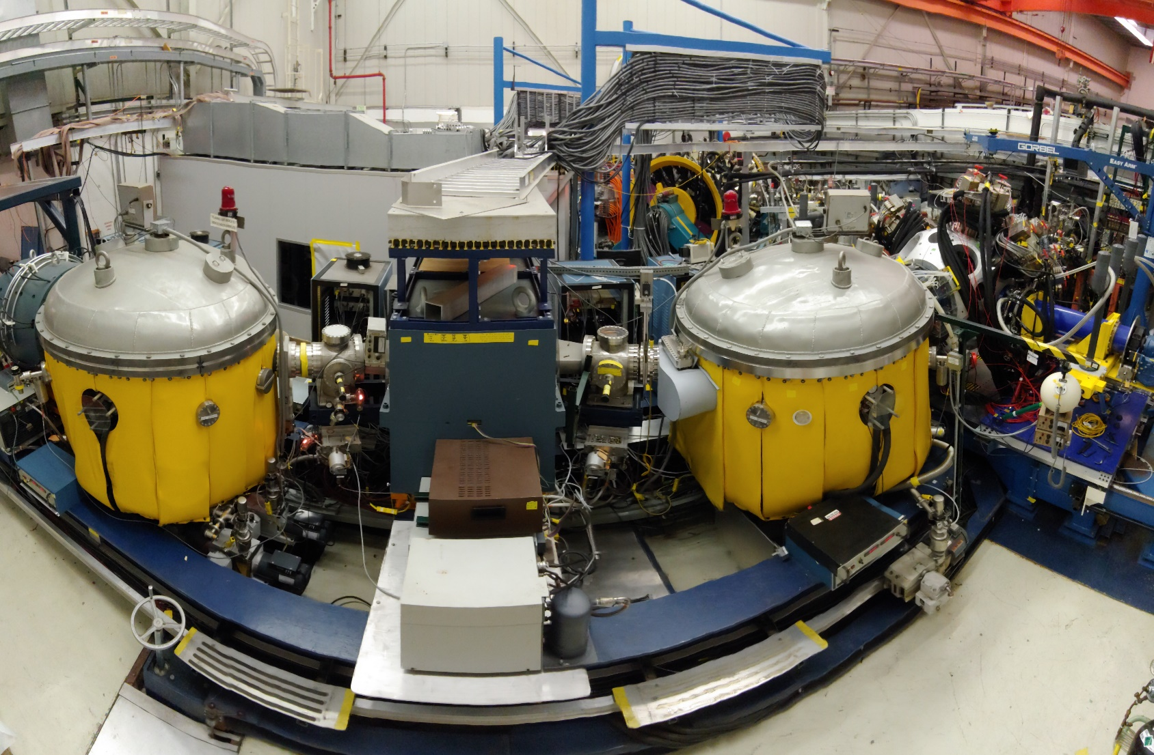
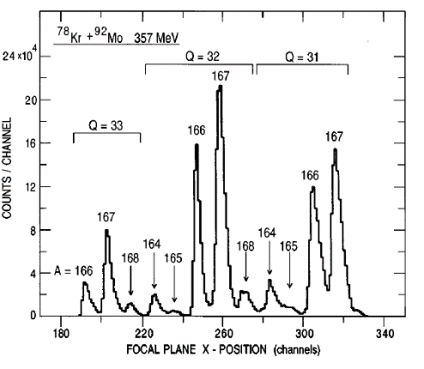
Argonne Fragment Mass Analyzer
Q2
ED
MD
ED
Q2

Slide 12
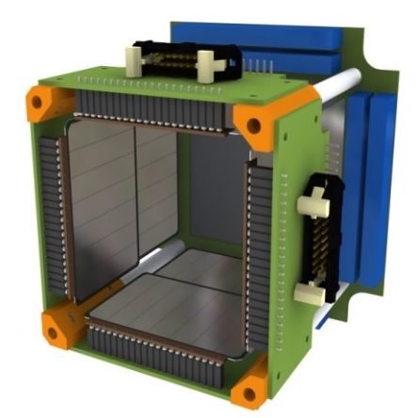
Super-allowed α decay ¹⁰⁸Xe-¹⁰⁴Te-¹⁰⁰Sn
4X7 Si SSD
E,t
Fragment Mass Analyzer
PPAC
Beam
α
E
E
α
Q
Q
B
Q
Q
Target
M/Q
Mass slits
160X160 DSSD
E,t
Implant-decay spatial and time correlations in DSSD
⁵⁸Ni(⁵⁴Fe,4n)¹⁰⁸Xe reaction, cross section ~1 nb out of 1b!
¹⁰⁸Xe
~100 μs
α₁
~4.5 MeV
α¹⁰⁸Xe
Digital DAQ to detect
α¹⁰⁸Xe-α¹⁰⁴Te pileup
Si box to catch
escaping alphas
¹⁰⁴Te
~10 ns
α¹⁰⁴Te
α₂
~5 MeV
¹⁰⁸Xe^{+26,27}
from FMA
¹⁰⁰Sn
Notes:
Very small xsection and large background
Very short 104Te lifetime
Recoil decay tagging
Distinct decay signature
Si box
Digital daq

Slide 13
Recoil-decay correlations
TWO fast high energy decay events
Expected 0.09 random events
BOTH events where in coincidence with the Si box (1 out of 400)

Slide 14
DSSD-Si box coincidences
The same total energy for both events - ΣE_{α}=9.3(1) MeV
Compared to α emitters different energy split
E_{α}(¹⁰⁴Te)=4.9(2) MeV, E_{α}(¹⁰⁸Xe)=4.4(2) MeV

Slide 15
DSSD traces for the ¹⁰⁸Xe-¹⁰⁴Te pile-up events
Doubly differentiated traces
EXP
SIMULATIONS
NO noticeable delay
TWO decays faster than 20 ns each imply T_{1/2}<18 ns

Slide 16
Alpha-decay Q value systematics
Rn
Po
Pb
¹⁰⁴Te
¹⁰⁸Xe
Q_{α}(¹⁰⁴Te)=5.1(2) MeV
Q_{α}(¹⁰⁸Xe)=4.6(2) MeV

Slide 17
Comparison with mass models

Slide 18
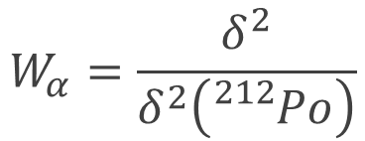
¹⁰⁸Xe-¹⁰⁴Te reduced width limits
E_{α}=4.5/4.8 MeV
E_{α}=4.3/5.0 MeV
W_{α}(¹⁰⁴Te)<13.1
W_{α}(¹⁰⁴Te)>1.9
W_{α}(¹⁰⁸Xe)=3.7(-3.5+41.6)
W_{α}(¹⁰⁴Te)W_{α}(¹⁰⁸Xe)>25
At least one W_{α} greater than 5

Slide 19
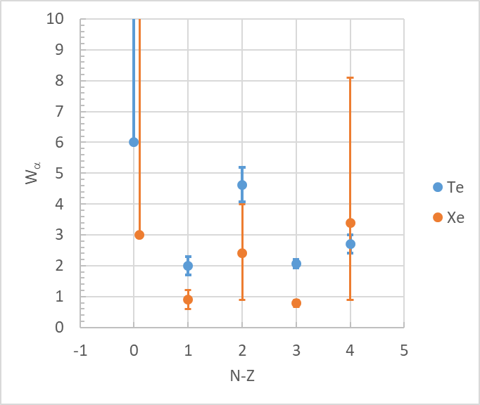
Reduced α-decay widths near ¹⁰⁰Sn
¹⁰⁴Te
¹⁰⁸Xe
If W_{α}(Te)/W_{α}(Xe)~2 as for ¹⁰⁶Te/¹¹⁰Xe pair: W_{α}(¹⁰⁴Te)>6, W_{α}(¹⁰⁸Xe)>3

Slide 20
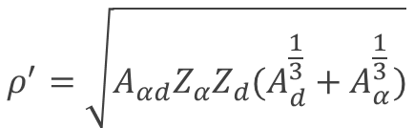
Reduced α-decay width global systematics
¹⁰⁴Te
²¹²Po
²¹²Po
C. Qi et al., Phys. Rev. C 81, 064319 (2010)
A.N. Andreev et al., PRL 110, 242502 (2013)
¹⁰⁴Te, ρ’~50, log₁₀|R F(R)|²>-1.3 (Wα>5)
Enhancement beyond pairing after size taken into account?

Slide 21
Superfluid Tunneling Model
F. Barranco, R.A. Broglia and G.F. Bertsch, PRL 60, 507 (1988)
Transition from spherical ground state to the scission point mediated by pairing followed by barrier penetration
Pairing gap:
P. Vogel, B. Jonson, and P. G. Hansen, Phys. Lett. B 139, 227 (1984)
x-N=134
x-Po
R.M. Clark et al., Phys. Rev. C 101, 034313 (2020)

Slide 22
Recent calculations for ¹⁰⁴Te/¹⁰⁸Xe
Density-dependent cluster model plus two-potential approach
Dong Bai and Zhongzhou Ren, Eur. Phys. J. A 54, 220 (2018)
T_{1/2}(¹⁰⁸Xe)=4-213 μs, T_{1/2}(¹⁰⁴Te)=7-166 ns
The super-fluid tunneling model
R.M. Clark et al., Phys. Rev. C 101, 034313 (2020)
Relativistic Density Functional DD-PC1+separable pairing of finite range
Dynamical least-action paths from equilibrium deformation to scission
F. Mercier et al., Phys. Rev. C 102, 011301(R) (2020)
T_{1/2}(¹⁰⁸Xe)=50 μs, T_{1/2}(¹⁰⁴Te)=197 ns
Quartetting wave function approach
Shuo Yang et al., Phys. Rev. C 101, 024316 (2020)
T_{1/2}(¹⁰⁴Te)=18 ns
Cluster-Formation Model+DDCM
Niu Wan and Jingya Fan, Phys. Rev. C 104, 064320 (2021)
T_{1/2}(¹⁰⁸Xe)=43 μs, T_{1/2}(¹⁰⁴Te)=54 ns
Double-folding potentials from chiral effective theory
Dong Bai and Zhongzhou Ren, Phys. Rev. C 103, 044316 (2021)
T_{1/2}(¹⁰⁴Te)>30ns
Improved density-dependent cluster model
Zhen Wang, Dong Bai and Zhongzhou Ren, Phys. Rev. C 105, 024327 (2022)
T_{1/2}(¹⁰⁸Xe)=62 μs, T_{1/2}(¹⁰⁴Te)=92 ns
Talk by Elias Khan yesterday
¹⁰⁸Xe reproduced well, ¹⁰⁴Te lifetimes longer (enhanced preformation, higher Qα)

Slide 23
Search for ¹⁰⁸Xe-¹⁰⁴Te-¹⁰⁰Sn with segmented scintillator
Tandem, Tokai
YAP scintillator
  faster detector
  worse energy resolution
  larger random background
Two candidate events:
  T_{1/2}(¹⁰⁸Xe)=30(+57-12) μs
  T_{1/2}(¹⁰⁴Te) < 4 ns, no pileup observed
  σ~130 pb
Y. Xiao et al., Phys. Rev. C 100, 034315 (2019)

Slide 24
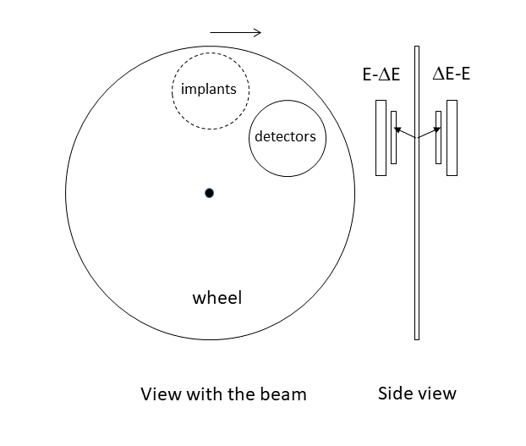
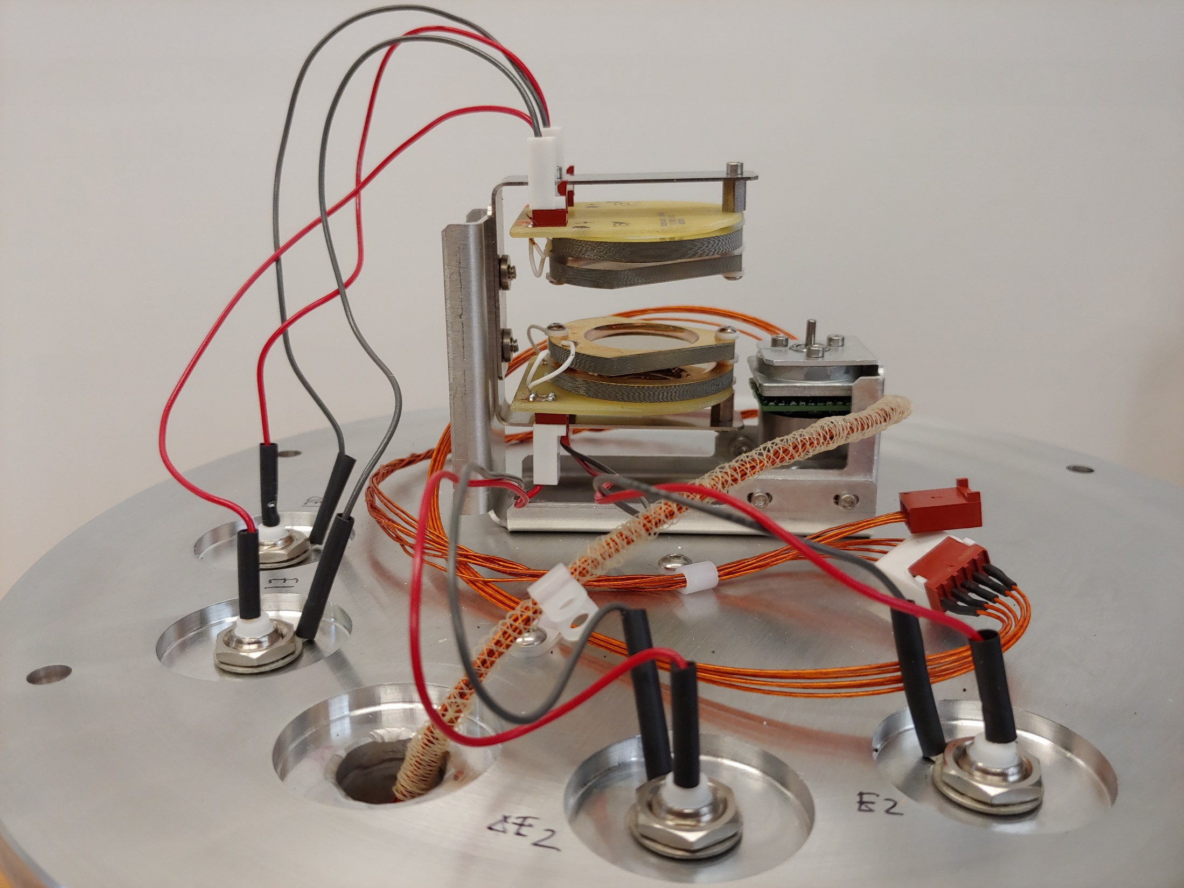
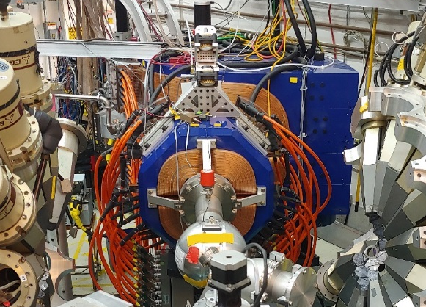
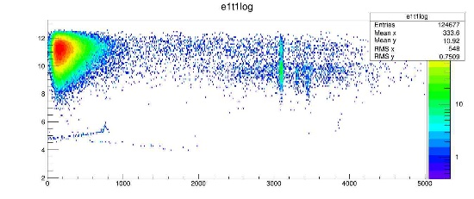
New approach - rotating stopper with AGFA
Search for triple α chains:
¹¹²Ba-¹⁰⁸Xe-¹⁰⁴Te
Higher efficiency
Higher beam intensity
Δt~1 ns
⁵⁴Fe+⁵⁸Ni
Argonne Gas-Filled Analyzer (AGFA)

Slide 25
Summary and Outlook
First observation of the ¹⁰⁸Xe-¹⁰⁴Te-¹⁰⁰Sn chain
  Enhanced alpha preformation compared to ²¹²Po
Numerous calculations reproduce ¹⁰⁸Xe lifetimes but predict longer lifetime for ¹⁰⁴Te
Future measurements
  More statistics
  ¹⁰⁴Te lifetime (~1 ns)
  more precise α-decay widths for ¹⁰⁸Xe and other N~Z α emitters
  ¹¹²Ba N=Z α emitter

