Slide 1
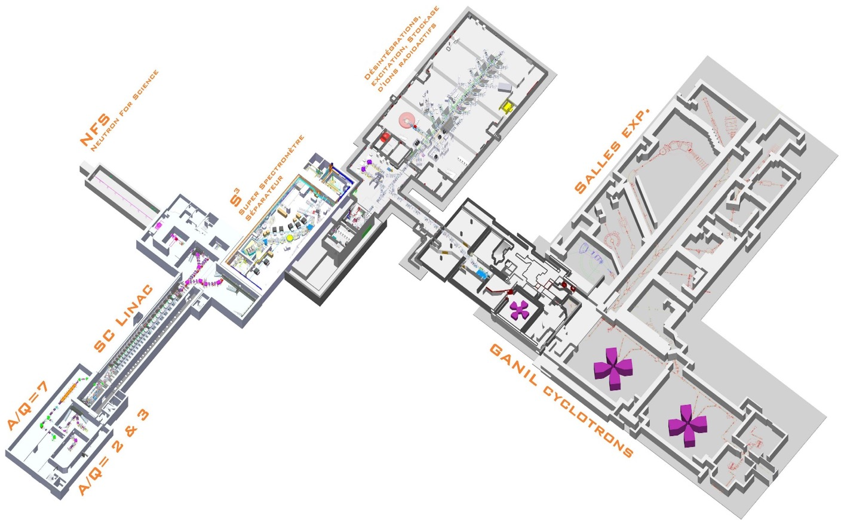
GANIL-SPIRAL2
Highlights

Slide 2
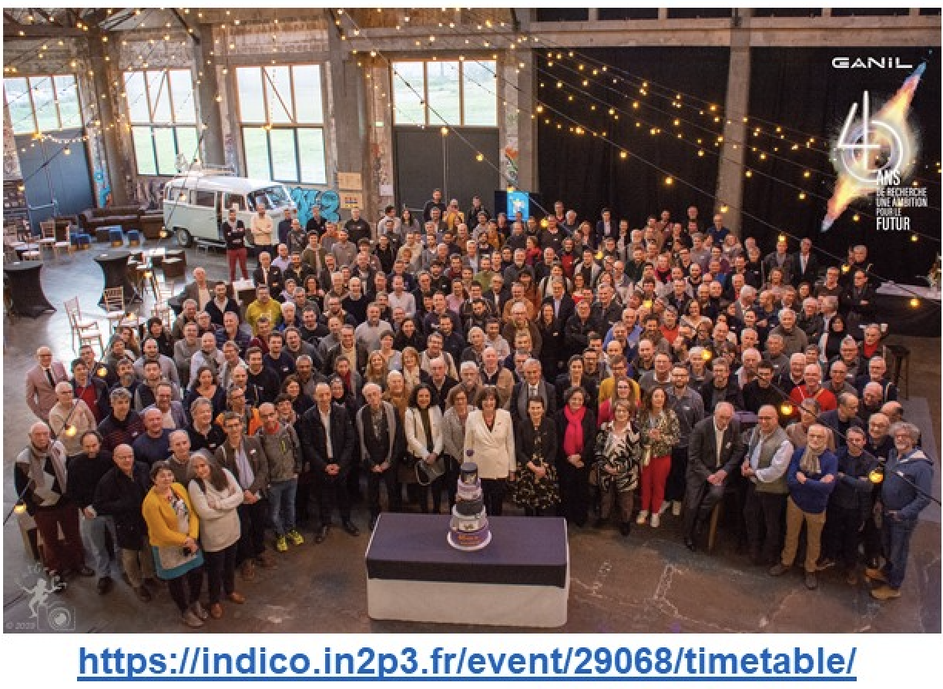
GANIL-SPIRAL2
4040th Anniversary of first GANIL experiment

Slide 3
Outline
GANIL Cyclotrons
Some selected results
Plans for the future
SPIRAL2 new experimental rooms
NFS: Neutrons for Science
  NFS first results
S3: Super Separator Spectrometer
  Status of construction
DESIR: Decay, Excitation, Storage of Radioactive Ions
  Status of the project
SPIRAL2 new injector NEWGAIN
  Status of the project

Slide 4

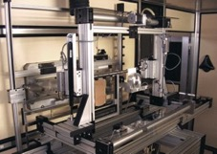
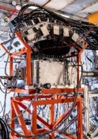
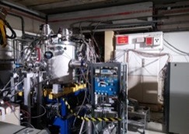
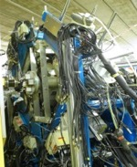
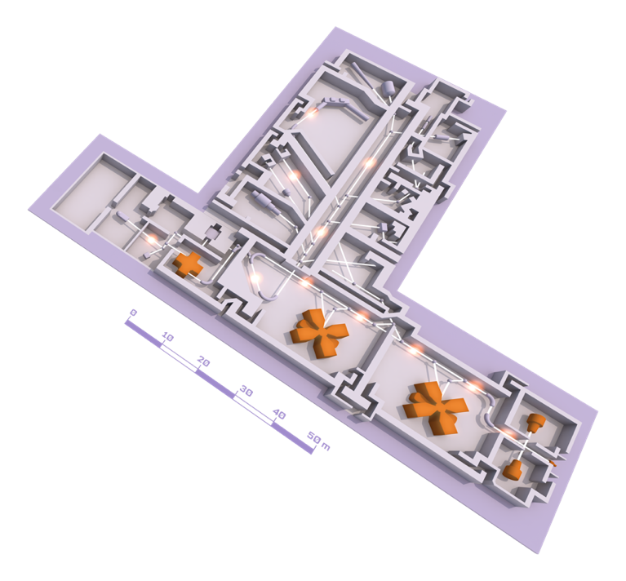
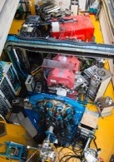
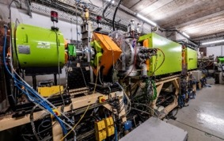
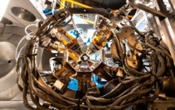
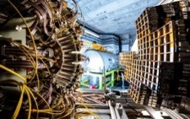
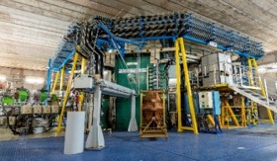
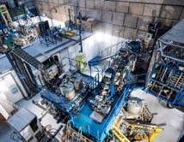
GANIL Cyclotrons and experimental equipment
EXOGAM
ACTAR TPC
Sample holder for irradiation
MUGAST
Experimental rooms
AGATA
LISE SPECTROMETER
VAMOS
Beams : ¹²C to U
Energy : from <1 MeV up to 95MeV/nucleon
Up to 4 experiments in parallel
Exotic beams with SPIRAL1
GANIL CYCLOTRONS
INDRA + FAZIA
CYCLOTRON
SOURCES

Slide 5
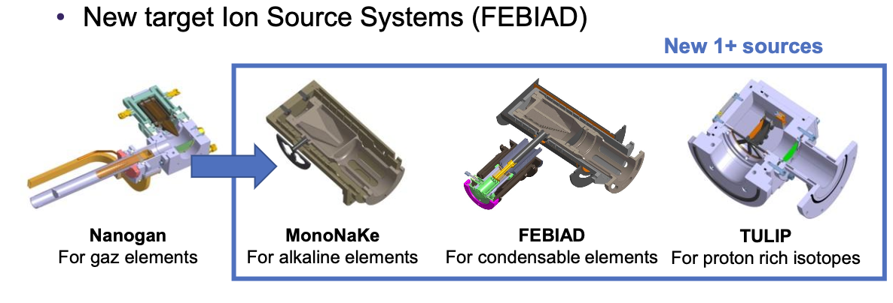
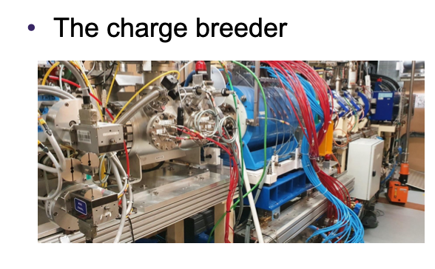
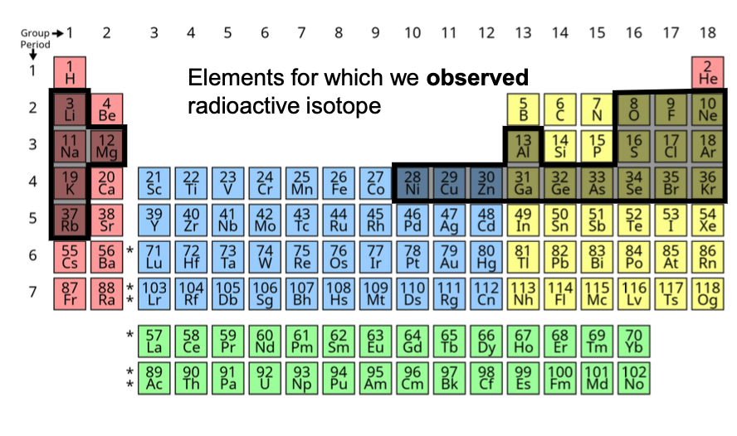
SPIRAL1 upgrade
50 new isomers/isotopes
With intensities suitable for acceleration
See PAC call for
further details
deadline September 28th

Slide 6
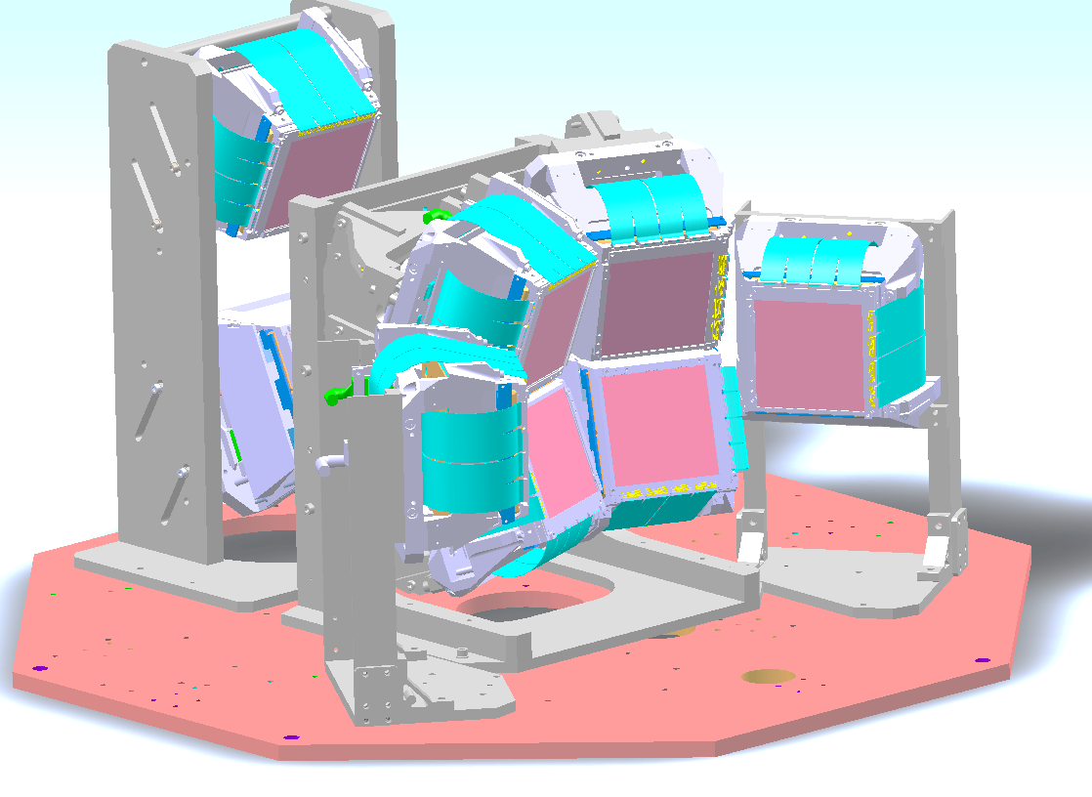

Study of mirror symmetries at both edges of the valley of stability ⁸C - ⁸He
Some recent results
4
?
2⁺
Ex (MeV)
⁹C(p,d)⁸C
0
0⁺
0⁺
⁸C
⁸He
p
mirror
⁸He : S_{n}= 2.13 MeV,
2⁺1 resonance unbound by 1.4 MeV
2n emission, Γ ~ 0.8 MeV
α
d
⁹C (50A.MeV) from LISE
⁸C : S_{p} = - 3.48 MeV
only g.s. is known α+4p emission, Γ = 130(50) keV
R. J. Charity et al., PRC 84 014320
LH₂ target :7 mg/cm²
Determine the 2⁺1 energy of ⁸C (large Γ expected)
-> What is the mirror energy difference?
Courtesy Olivier Sorlin, GANIL

Slide 7
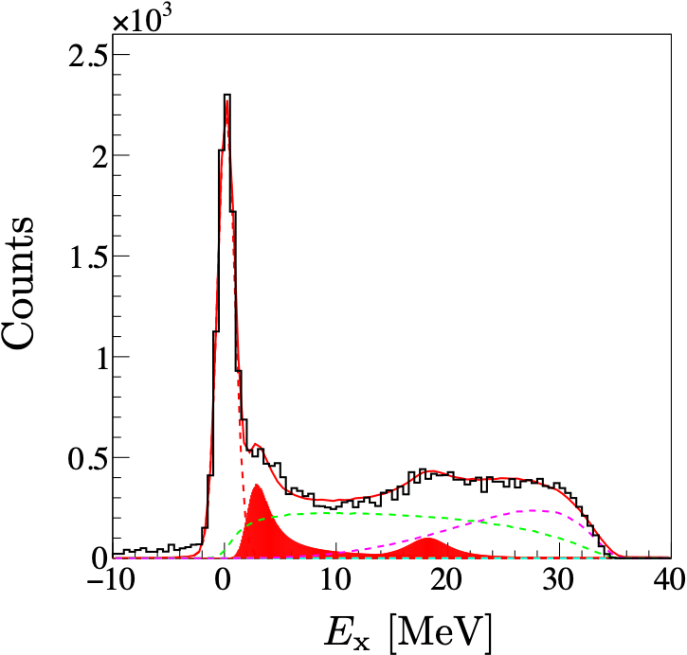
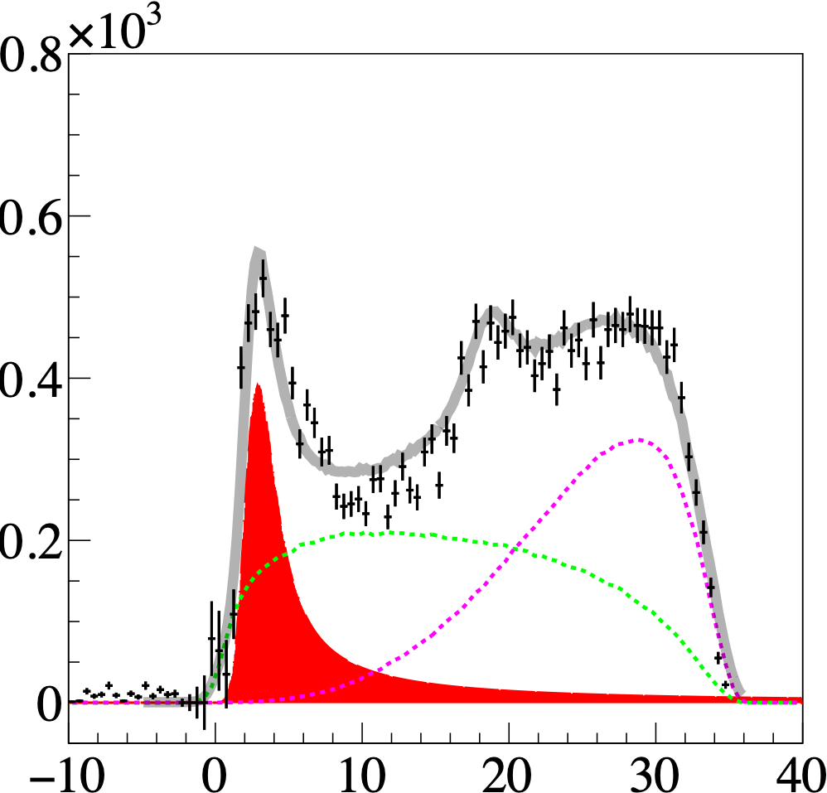
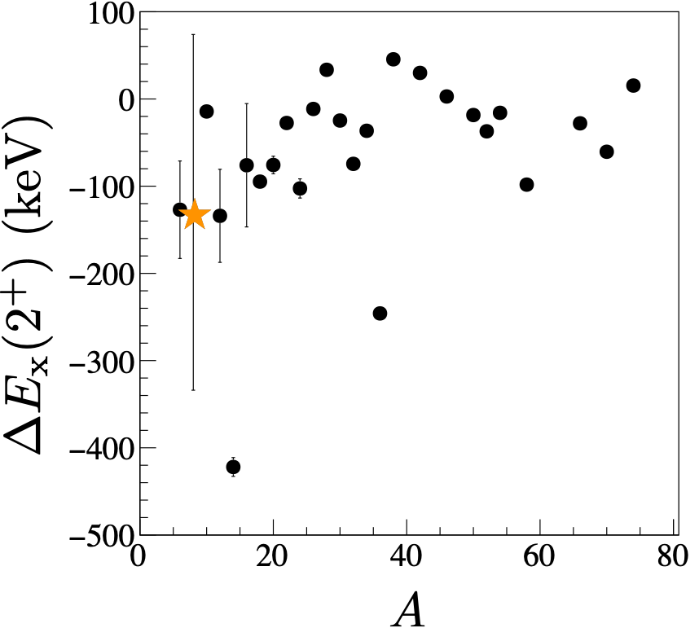
Some recent results
Transfer ⁹C(p,d)⁸C reaction (50A.MeV) to populate unbound states in ⁸C
Γ = 3.0(4) MeV
g.s.
subtracted
Ex = 3.4(2) MeV
g.s.
2⁺
2⁺
⁸C
Good symmetry in mirror energies between A=8 2⁺ states, both unbound,
⁸He by 1.4 MeV, ⁸C by about 6.9 MeV
and despite large difference between their width
MED
³⁶Ca
¹⁴O
Shumpei Koyama et al, to be published in Phys.Rev.C

Slide 8
Some recent results
‘Colossal’ MED (-700 keV) predicted between the 0⁺₁ and 0⁺₂ states in ³⁶S - ³⁶Ca, Valiente-Dobon et al., PRC 98 (2018).
³⁷Ca(p,d)³⁶Ca
³⁸Ca(p,t)³⁶Ca
Henderson and Stroberg,
PRC 102 (2020) 031303(R)
³⁶Ca
^{37,38}Ca (50A.MeV) from LISE
t
+
-
L. Lalanne, O. Sorlin, A. Poves et al., PRL 103 (2021) 055809
L. Lalanne, O. Sorlin, A. Poves et al., PRL 129 (2023) 122501
MED (keV)
B_{Coul}
E*
J^{π}
MED (keV)
4.83(17)
(0⁺)
J^{π}
E*
4.71(9)
2⁺
2⁺
4.577
+ 133(90)
LH₂ target :7 mg/cm²
4.24(4)
1⁺
1⁺
4.523
- 280(41)
3.045(2)
2⁺
0⁺
3.346
-516(130)
2.83(13)
0⁺
2⁺
3.295
- 245(5)
S_{2p}
S_{p}
0⁺
0⁺
³⁶Ca
³⁶S
Very large MED between the 0⁺₂ states -> first excited state in ³⁶Ca
Well reproduced by shell model calculations (sd-pf valence space)

Slide 9
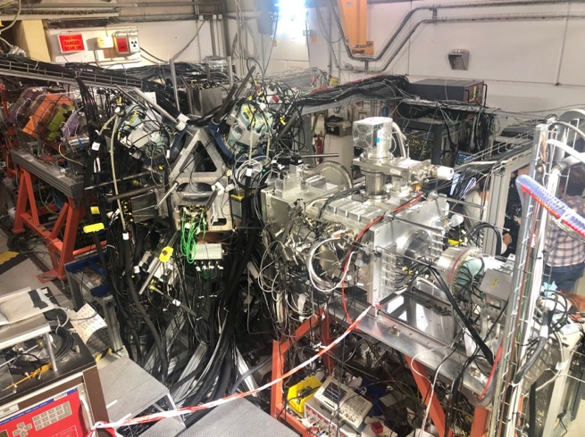
“Tandem” mode on LISE spectrometer
LISE2022 campaign : two experiments in tandem mode using ACTAR-TPC and EXOGAM-PARIS-ZDD : a world premiere with heavy ions !
First target(H)
ACTAR-TPC
Nuclear Excitation
Second target (Au)
8 EXOGAM2 + 8 PARIS
Coulomb Excitation
Simultaneous measurement of Coulomb and nuclear excitation for neutron rich isotopes of Si and S
=>Role of tensor force in the increase of collectivity in neutron riche Si nuclei
=> Study of double magicity in ³⁴Si and of its compression and vibration excitation modes
S. Grévy et al.
R.Lica et al.
ACTAR TPC
ZDD
8 PARIS
8 EXOGAM
EXOGAM 0°
Siliciums annulaires
See Poster 632 Quentin Delignac for Coulex

Slide 10
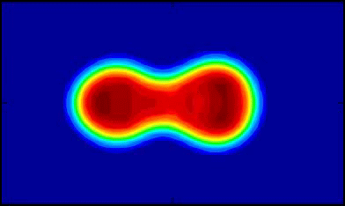

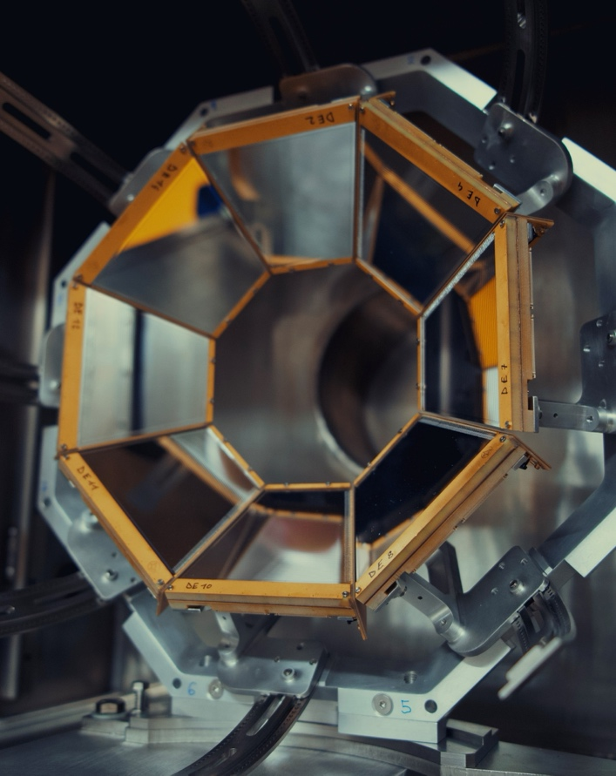
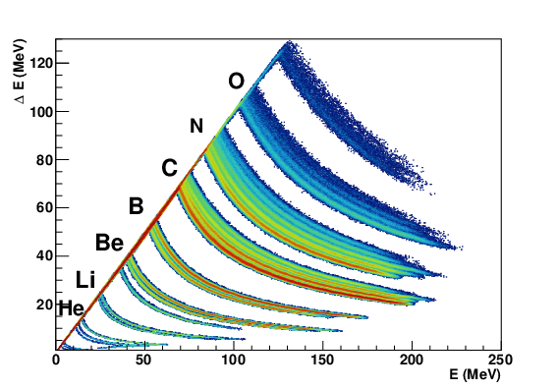
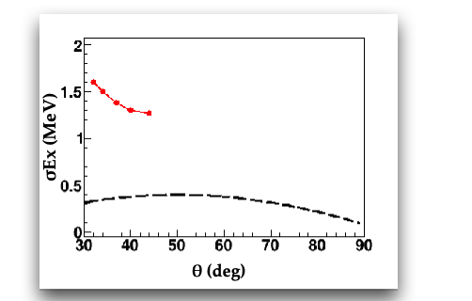
Some selected results
Fission experiment on VAMOS starting next week, in inverse kinematics : ²³⁸U +¹²C
Damping of shell effects in nuclear fission
Measurement of isotopic yields as a function of E* with the new PISTA array
Spokesperson: J. Taieb, CEA/DAM
SPIDER
PISTA
Courtesy Antoine Lemasson, GANIL
10
And also Talk of Jérôme Giovinazzo Proton radioactivity with ACTAR TPC
Talk of Marius Le Joubioux Dark decay in ⁶He
Poster 351 Tom Genard, Xe+Sn collisions
Poster 387 François de Oliveira, ²²Na in novae
Poster 577 Mohamad Kanafani, b-STILED experiment

Slide 11
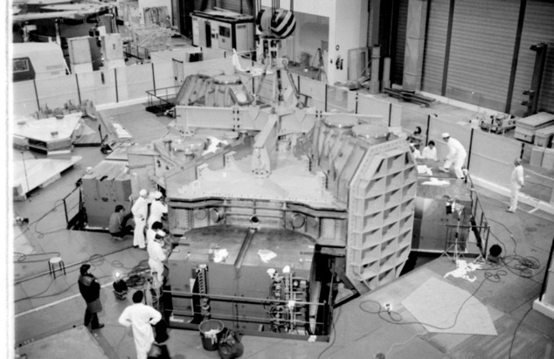
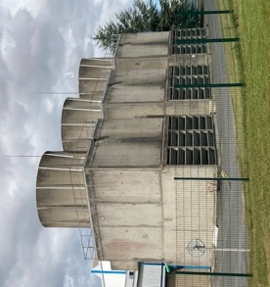
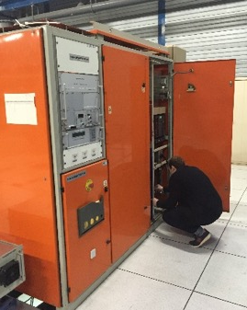
CYREN – Cyclotron Renovation
Last 10 years : Cyclotrons maintenance and refurbishment reduced to the strict minimum. GANIL manpower dedicated to SPIRAL2 building then commissioning.
Aging ↗ Reliability ↘ Manpower for curative maintenance ↗
Launch of the pre project CYREN : march 2022
1: keep the facility in operational conditions for at least 20 years
2 : optimize manpower needed for maintenance after refurbishment
Scope : full installation
Cyclotrons and experimental areas, infrastructure and utilities, safety, security, radioprotection
Conclusion: 2 scenarios
One new accelerating cavity/ 4 new cavities
Implementation:
Funding under discussion, 2024-2030, facility available during renovations with
possible shutdowns during some phases
Cyclotrons et experimental rooms
Power Supplies and Magnets
RF cavities and systems
Remote control
PLCs
Vacuum systems
Diagnostics
Production targets
Ions Sources
Infrastructures and utilities
Electricity Distribution
Cooling systems
HVAC
Buildings
Various networks (water, air, gas)
Computer Infrastructures
Safety / Security / Radioprotection Systems
Radioprotection devices (radiation detectors, active dosimeters, gamma spectrometers, …)
Access Management System
Fire Safety System

Slide 12
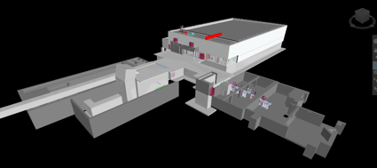
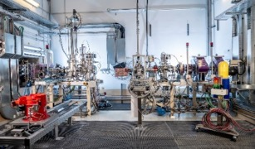
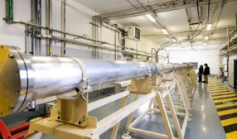
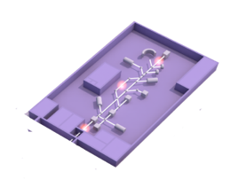


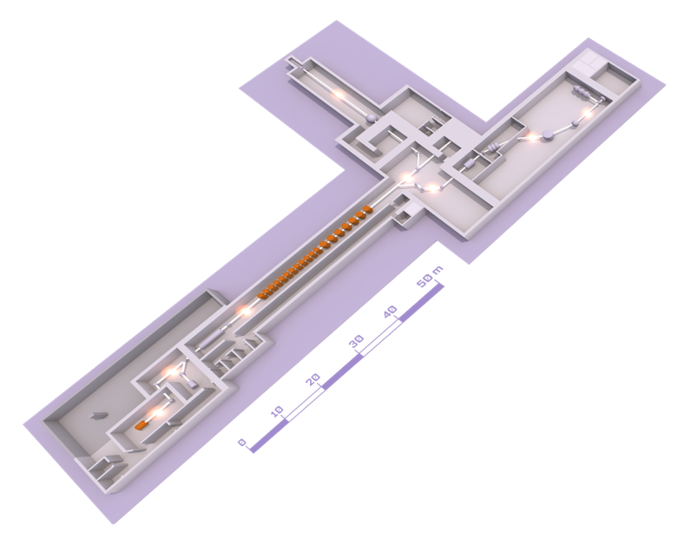
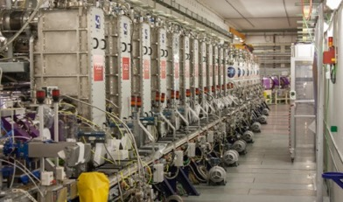
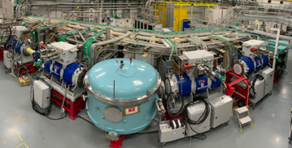
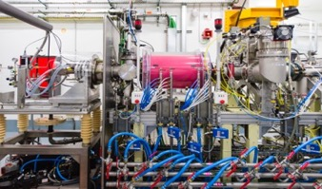
SPIRAL2 LINAC and the new experimental rooms
EXPERIMENTAL ROOM DESIR
(Desintegration,
Excitation and Storage of Radioactive Ions)
EXPERIMENTAL ROOM NFS (NEUTRONS FOR SCIENCE)
Convertor room
Time of Flight room
EXPERIMENTAL ROOM S3 (SUPER SEPARATOR SPECTROMETER)
LINEAR accelerator (LINAC)
High intensity beams :
5 mA, 33 MeV protons
5 mA, 40 MeV deutons
1 mA, <14,5 MeV/A heavy ions
ION SOURCE

Slide 13






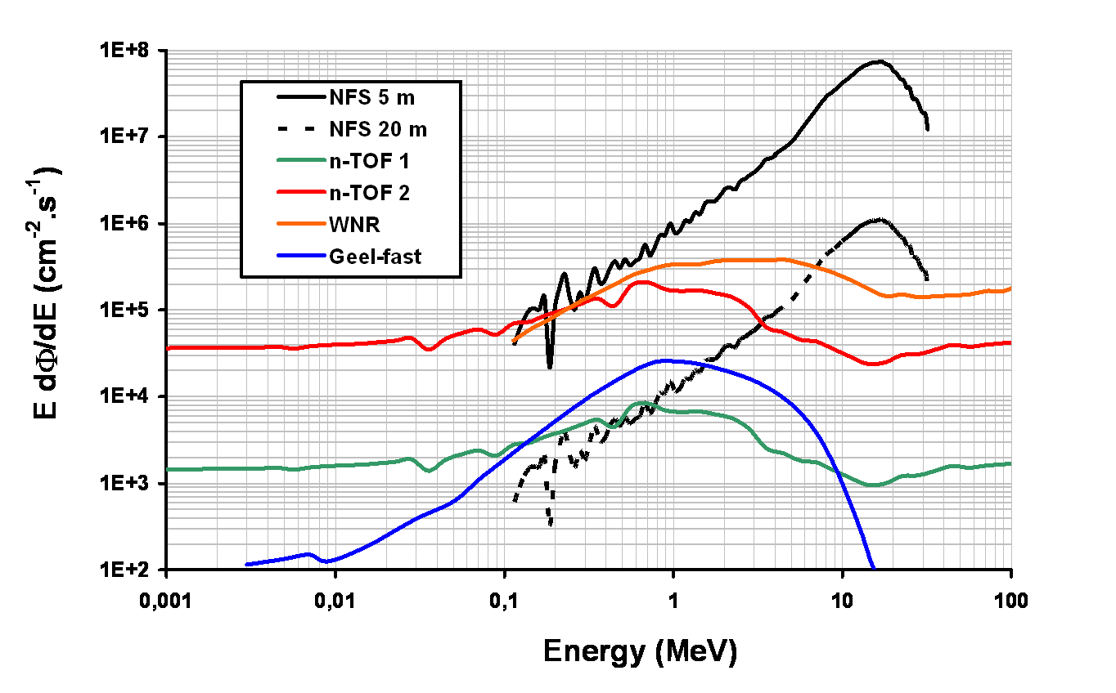
The Neutrons For Science facility
NFS is the first operational experimental area of SPIRAL2 at GANIL
International collaboration
50 physicists
15 laboratories
6 partners
Physics case
Fundamental physics
Astrophysics
New generation of reactor
Fusion technology
Radioisotopes production for medical applications
Biology (cells irradiation..)
Development and characterization of new detectors
Study of the single-event upsets
High neutron flux and good complementarity with other facilities

Slide 14
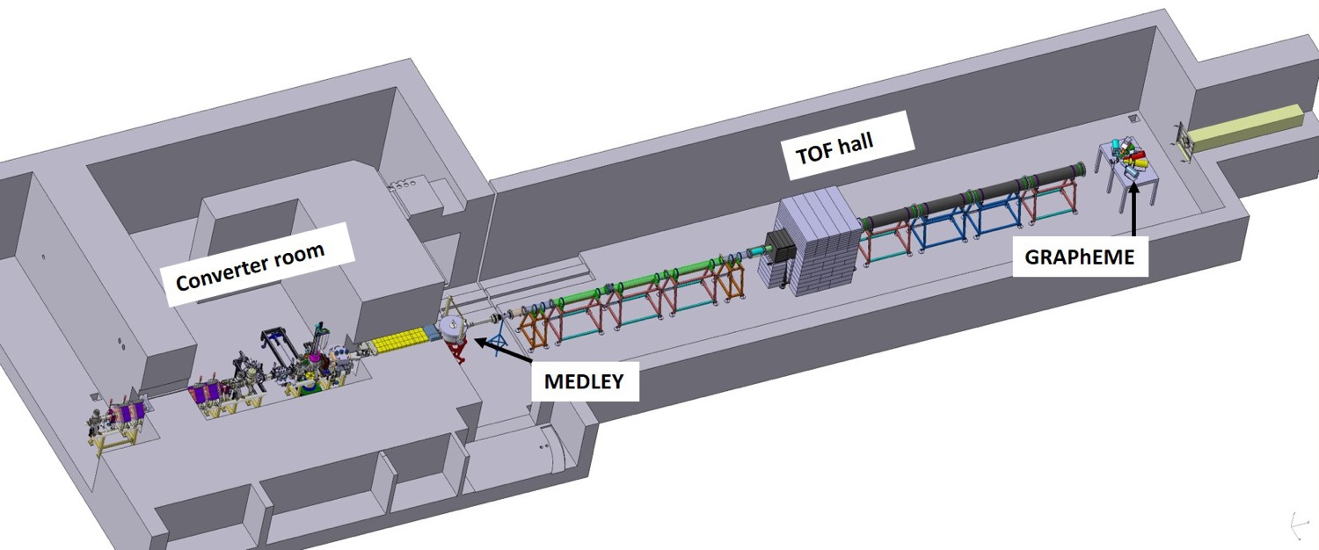
Layout of NFS
Collimator
LINAC
Beam
TOF hall
● Neutron Beam at 0°
● Collimator => beam quality
● Size (Lⅹl) ≃ (30m ⅹ 6m)
- TOF measurements
- different set-up positions : several experiments can be carried out at the same time, corresponding to different flight paths
- actinide targets (nuclear ventilation)
Converter room
● Ion and neutron induced reactions
● Irradiation station (n, p, d)
X. Ledoux et al, Eur. Phys.J. A (2021) 57:257
More details in Marine Vandebrouck talk tomorrow

Slide 15
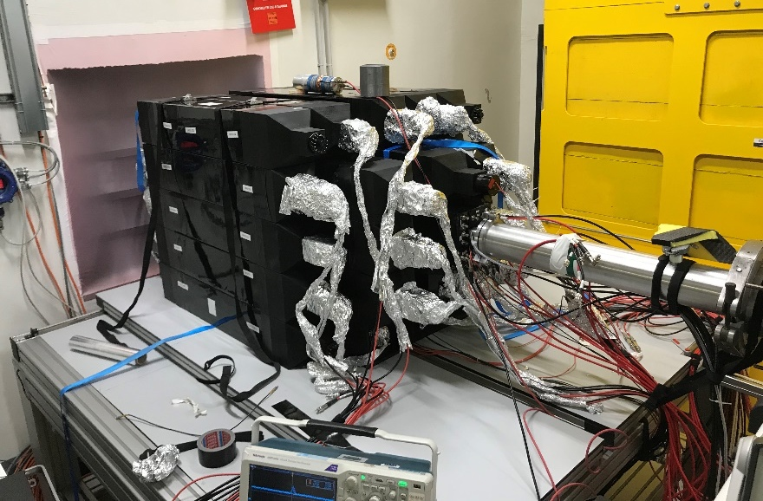
Study of the (n,xn) and (n,f) reaction for U238
First NFS results
Spokesperson : G. Bélier, CEA/DAM
(n,xn) reactions and fission are most probable processes in the 5-50 MeV range
(n,xn) cross-section measurement of actinide is very difficult:
  radioactive sample
  prompt neutron fission
Experimental technique :
  Veto fission (fission chamber)
  4π neutron detector SCONE
  6 MeV<En< 20 MeV

Slide 16
²³⁵U Fission fragment study with FALSTAFF at NFS
First NFS results
Spokesperson : D. Doré, CEA/Irfu/DPhN
Characterization of actinide fission fragments in the fast neutron domain
As expected, the distribution becomes less asymmetric when the excitation energy increases
Notes:
En bas: simulation avant manipe. Spectre neutrons plus fort à basse énergie vu avec FALSTAFF, il faudrait chambre à 235U (seuil fission 238U à 1 MeV, neutrons thermiques pour 235U, et on pourrait descendre en changeant la période des bursts)

Slide 17
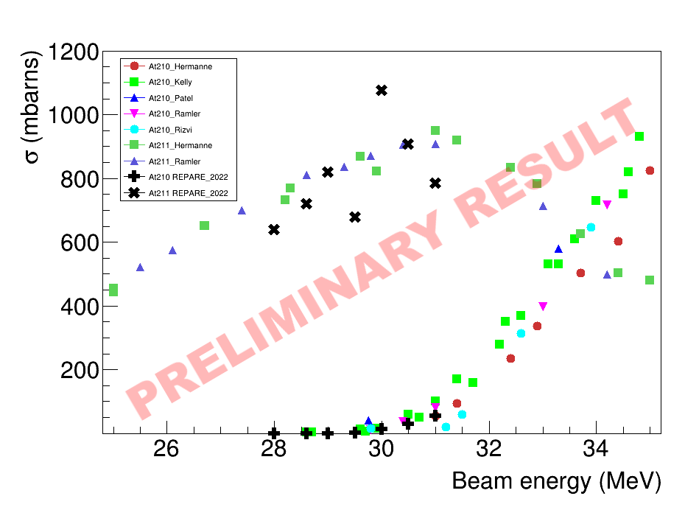
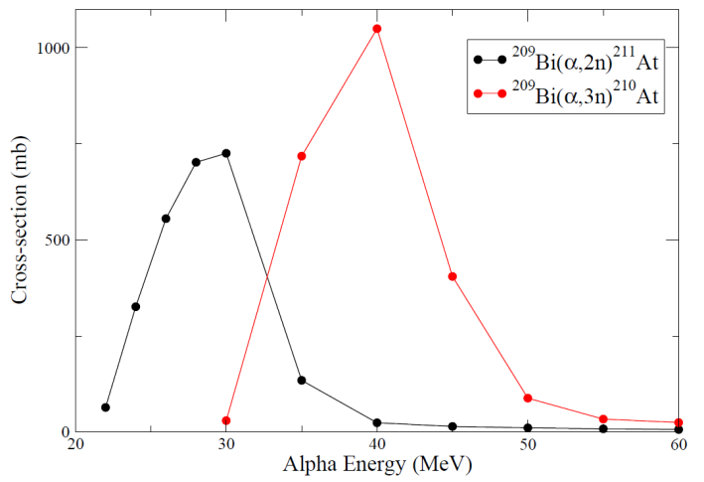
Radioisotopes for medical applications
First NFS results
Spokesperson : Gilles de France, GANIL
Study of alternative route production of several radioisotopes used in medical applications
Example : production of ²¹¹At (α emitter, T_{1/2} = 7.2 h)
First measurement in Sep 2022 (Subatech, NPI, Arronax, Ganil)
  ²⁰⁹Bi(α,3n)²¹⁰At excitation function, then decay to ²¹⁰Po
  8 energies : 27, 28, 28.6, 29, 29.5, 30, 30.5, 31 MeV
Next step : ²⁰⁹Bi(α,xn) and ²⁰⁹Bi(^{6,7}Li,xn) reaction
²⁰⁹Bi(α,2n)²¹¹At
²⁰⁹Bi(α,2n)²¹¹At
Also produce ²¹⁰At (decays to ²¹⁰Po, t_{1/2} = 138 d)
Reduce ²¹⁰At production if E_{alpha} <30 MeV
²⁰⁹Bi(α,3n)²¹⁰At
Collaboration Caen-Nantes (with ARRONAX)

Slide 18
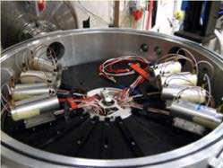
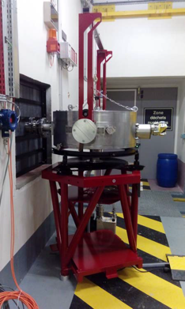
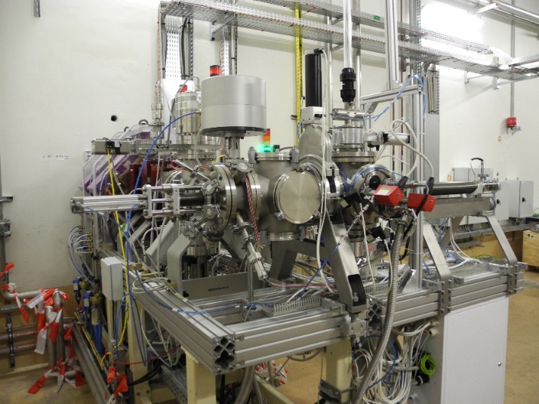
Excitation functions of short-lived isotopes in p- and d-induced reactions on various materials: ^{nat}Fe, ^{nat}Mo
First NFS results
Light ions production with MEDLEY
Spokespersons : A. Prokoviev and Diego Tarrio, Uppsala University
Measurement of double differential cross sections
  reactions on NEA High Priority Request List improvement
  Gas production (H, He) induced by neutrons
MEDLEY
Spokesperson : Eva Simeckova, NPI, Rez
Measurement of reaction cross-sections by activation technique :
  data for IFMIF facility design
  improvement of reaction models

Slide 19

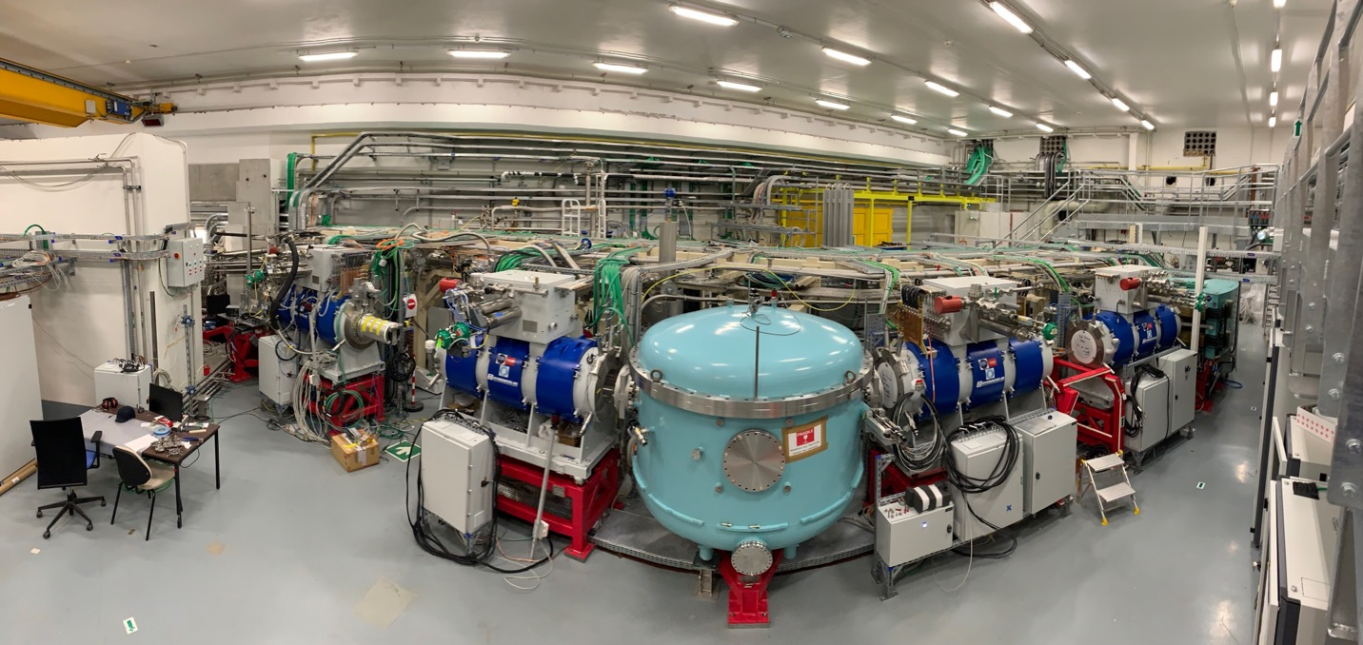



: the Super Separator Spectrometer
See Poster 478 Hervé Savajols, and Poster 470 Anjali Ajayakumar
Notes:
MR-ToF-MS: multi reflection ToF mass separator

Slide 20

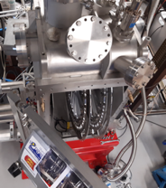
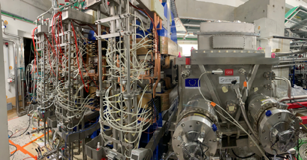
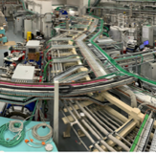
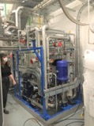
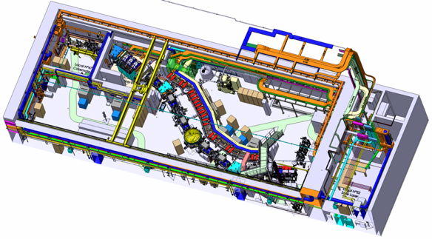














: the Super Separator Spectrometer
Fundamental research in Nuclear & Atomic physics
High selectivity > 10¹³ beam rejection
High efficiency 50%
Mass resolution > 350
Versatility : high resolution, high transmission, high beam rejection modes…
Unique instrumentation : SIRIUS for p, α, electron and γ spectroscopy, and S3-LEB with gas catcher, RFQ and MR-ToF-MS
Optical
Commissioning
Planned end 2024
SIRIUS commissioning in 2023
Open RT magnet & beam dump & Movable fingers
Cooling system, Laser room …
Dispersive zone
Infra / Interface
Target system
LEB @ LPC & GISELE Laser Lab
High power rotating targets
LEB
3 × M-dipoles
Large H & V gaps
DSSD, SSD, FEE/BEE, DAQ & Diagbox
SMT, PSS, Coldbox & LTC
E-Dipole
SIRIUS
SC Multipoles
20 cm gap & +/- 300 kV
Open slit in the anode
Notes:
MR-ToF-MS: multi reflection ToF mass separator

Slide 21

Heavy-ions in SPIRAL2-LINAC
September 2022 : First beams of ¹⁸O⁶⁺ 50μA, 7 MeV/nucleon
LINAC Transmission 98%
Quasi-automatic change of different charge states for acceleration
November 2022 : ⁴⁰Ar¹⁴⁺ 80μA, 7 MeV/nucleon
Getting ready for S3 scientific programme …

Slide 22






New injector for SPIRAL2: NEWGAIN
Floorplan, design intensities and time line
beam injector1 (injector2)
intensities 2023 2028 $≥$ 2030
Ions | Intensity (pµA) Phoenix V3 RFQ A/Q≤3 | Intensity (pµA) Phoenix V3 RFQ A/Q≤7 | Intensity (pµA) SC Ion Source RFQ A/Q≤7
¹⁸O | 80 | * | 375
¹⁹F | >15 | >40 | >40
³⁶Ar | 16 | 70 | 45
⁴⁰Ar | 3.6 | 70 | 45
³⁶S | 2.3 | * | *
⁴⁰Ca | 2.9 | 10 | 20
⁴⁸Ca | 1.2 | 10 | 20
⁵⁸Ni | 1.1 | 4 | 8
⁸⁴Kr | 0.1 | 10 | 20
¹³⁹Xe | 0.001 | 7 | >10
²³⁸U | <<0.001 | 0.1 | 6
Measured
Estimated
* -> no estimation
White Book
https://www.ganil-spiral2.eu/scientists/ganil-spiral-2-facilities/accelerators/newgain/
time line
2020 | 2021 | 2022 | 2023 | 2024 | 2025 | 2026 | 2027 | 2028
Study Phase
Construction Phase
first
beam
Courtesy of MH Moscatello, D. Ackermann

Slide 23
NEWGAIN Project – intensity
Comparison between different installations relevant to SHE studies
Beam intensities puA 100% enriched | SPIRAL2 GANIL, Caen |  | SHE factory FLNR, Dubna** | RIKEN Nishina Center Wako (Tokyo) |  | GSI Darmstadt
 | LINAG A/q≤3 Phoenix v3 | NEWGAIN* A/q≤7 SC source | DC-280 | RILAC | RRC (RILAC(2) as injector) | UNILAC***
¹⁸O | 80 | 300 | 16 | 10 | - | 1
⁴⁰Ar | 16 | 38 | 10 | 10 | 1 | 8
³⁶S | 23 | 30 | **** | - | - | -
⁴⁰Ca | 2.9 | 16 | **** | - | - | -
⁴⁸Ca | 1.2 | 16 | 10 | 3 | 0.3 | 4
⁵⁸Ni | 1.1 | 6.4 | **** | **** | **** | 2.2
⁸⁶Kr | 0.1 | 16 | **** | 10 | **** | 0.2
¹³⁶Xe | 0.001 | >10 | 16 | 10 | 0.3 | 1
²³⁸U | <<0.001 | 4.8 | 0.008 | 0.2 | 0.5 | 0.06^{i}
* 80% total transmission assumed ** http://flerovlab.jinr.ru/index.php/2017/03/23/she-factory/ *** for the cw-linac project with the assumption of a 50% total transmission, priv. comm. W. Barth et al., GSI **** beams not delivered i VARIS ion source, 80% Alvarez-transmission, mode: 2 Hz/0.1 ms, priv. com. W. Barth et al., GSI - intensities not provided Iiiii
Rates (pps) | S3 LEB (A/Q=3) | S3 LEB (A/Q=7) | FRIB1 | FRIB2 | FRIB Final
¹⁰⁰Sn | 7 | 34 | 0.05 | 0.2 | 4
¹⁰¹Sn | 170 | 850 | 3 | 10 | 161
⁹⁷In | 0.2 | 2.6 | 0 | 0 | 0
⁹⁸In | 4 | 11 | 0.02 | 0.09 | 4
⁹⁹In | 80 | 800 | 2.7 | 13 | 316
¹⁰⁰In | 740 | 7400 | 231 | 1150 | 18400
⁹⁸Cd | 3600 | 18000 | 505 | 2520 | 105000
⁹⁷Cd | 19 | 95 | 6.4 | 32 | 2030
⁹⁶Cd | 3 | 15 | 0.24 | 1.2 | 89
⁹⁵Cd | 0.4 | 2 | 0.004 | 0.02 | 1.6
⁹⁴Ag | 136 | 680 | 0.04 | 0.2 | 20
⁹⁵Ag | 870 | 4350 | 30 | 152 | 14700
⁹¹Pd | 81 | 405 | 0.02 | 0.12 | 27
⁹²Pd | 810 | 4050 | 1.7 | 8 | 1870
⁹⁰Rh | 210 | 1050 | 0.02 | 0.09 | 52
Highest intensity
N=Z nucleus Highest intensity
Courtesy Iulian Stefan
23

Slide 24





DESIR
Contracts for construction signed in September 2022
Authorisation obtained from Nuclear Safety Authority and Environmental Authority
public inquiry April 24-May 26
permit for construction expected in June,
First experiments 2027

Slide 25



Experimental room
HRS
Ion trapping
DETRAP
Precise mass measurements
In-trap decay spectroscopy
β-n angular correlations
S³-LEB beam
Collinear laser spectroscopy
Laser polarization (decay spectroscopy, β-NMR, …)
Laser
Spectroscopy
LUMIERE
UHRS
Decay
Spectroscopy
BESTIOL
β-delayed charge part.
Full absorption spectroscopy
(Trap/Laser-assisted) decay spectroscopy
Beam purification
and preparation
(Cooling/Bunching/Trapping)
SPIRAL1 beam
S³-LEB
S³-LEB
  Fusion-evaporation
  (Multi-)nucleon Transfer
Low-energy radioactive-ion-beam facility
Beams from SPIRAL1 and S³
Important beam preparation and purification capabilities
High resolution/precision experiments
Colloque GANIL 2021
SPIRAL 1 Upgrade
  Beam & target fragmentation

Slide 26








See Poster 548 Sophie Morard on MLLTRAP@IJCLab
Poster 378 Mathias Gerbaux on GPIB, Poster 487 Dinko Atanasov on PIPERADE
Poster 306 Sacha Daumas on MORA
S³-LEB beam
SPIRAL1 beam
Notes:
This is an artist view, but instrumentation is under construction and even under commissioning in different laboratories
High Resolution spectrometer for exceptionaly pure exotic beams, and even isomeric beams in LP2IB
MLLTRAP for mass measurements in IJCLAB
MORA in Jyvaskyla
…
The room is also exceptionaly large, and ready to host new equipments

Slide 27

Conclusions and perspectives
1983-2023: 40 years of research at GANIL with many highlights
Many results on cyclotrons experimental areas and NFS will be presented during ARIS2023
S3, DESIR, NEWGAIN progressing well
What’s next???
International Committee report « Vision for the future of GANIL » will be presented by Stephane Grévy on Friday

Slide 28

Vision for the future of GANIL
Talk Stéphane Grévy

Slide 29






See you in Caen for European Nuclear Physics Conference in 2025

Slide 30
Thank you for your attention

