Slide 1

Material science with radioactive isotopes - results from emission Mössbauer Spectroscopy
Hilary Masenda
School of Physics
University of the Witwatersrand
Johannesburg
Outline
Overview – materials, defects and radioactive isotopes, techniques
Emission Mössbauer Spectroscopy @ ISOLDE
Highlights
  Search for dilute magnetism in ZnO
  Lattice site and charge states in ternary nitrides: AlGaN and InGaN
Future work/concluding remarks
| Avignon | ARIS2023 | June 09 |

Slide 2


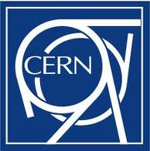












Collaborators
Aarhus
G. Weyer
Berlin
R. Sielemann
Bilbao
F. Plazaola, I. Unzueta
CERN
K. Johnston, J. Schell, A. M. Gerami
Durban
K. Bharuth-Ram,
Johannesburg
D. Naidoo, O. Mpatani
Leuven
A. Vantomme, L. M. Pereira,
G. Langouche
Linz
A. Bonanni, A. Tarazaga, R. Adhikari. A. Ernst
Lisbon
U. Wahl
Milan
R. Mantovan, M. Fanciulli
Reykjavík
S. Ólafsson, H. P. Gíslason, B. Qi,
H. P. Gunnlaugsson
Roskilde
T. E. Mølholt
Sofia
P. Krastev
e-ms.web.cern.ch

Slide 3
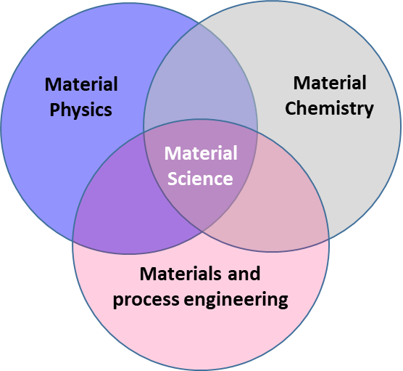
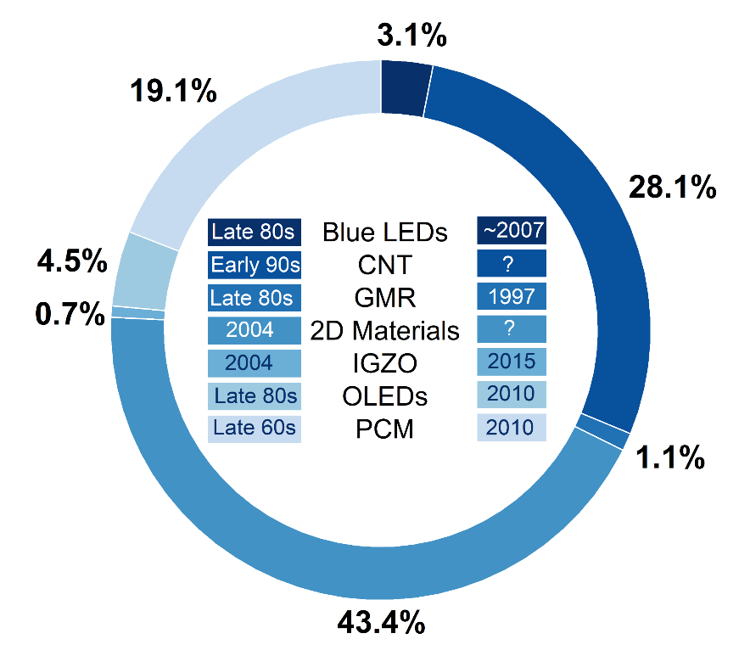
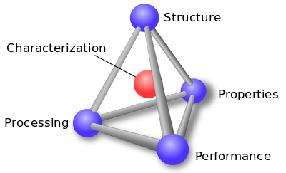
Material Science and Functional Materials
0.66M publications
Wikipedia
Scopus
Nov 2022
Functional Materials
“… are selected… for the nature of their response to electrical, magnetic, optical and chemical stimuli.” - R.W. Cahn
The Coming of Materials Science
encompasses a wide range including inorganic, organic, hybrids and nano-materials, soft matter and interfaces
Notes:
Inter-disciplinary field that cuts across the different field of physical sciences – mainly solid state physics and chemistry and linking with processing engineering
The synergy between the different disciplines is motivated by the quest for a more holistic approach to understanding the complex nature of materials….
Understanding materials requires knowledge of the different aspects…
Central to these is the ability characterise these attributes - to investigate using spectroscopic and chemical analysis techniques
Functional materials – Cahn

Slide 4
Material Modification: Doping (Semiconductor) Materials
Devices
smaller
faster
more efficient
new functionalities
…modify structure of materials…
….enhance electrical, optical, magnetic properties….
…..for tomorrow and the day after
… to realize functional materials …
…for optoelectronic, spintronic, photovoltaic, quantum … applications
…dopants …
During material growth
Nuclear reaction
Ion implantation
During material growth
Diffusion
Ion implantation
via proton or neutron irradiation
Notes:
The drive of science and technology has been to design or develop new materials with novel properties …. for devices
this requires in some cases modification of existing materials
Modify existing…
On of the main way is doping (e.g. Si), the introduction of foreign atoms in the materials
There are several ways in which this can be achieved….
Define - Ion implantation …. bombarding material with high energetic ions
Advantages of ion implantation:
Precise control of the depth distribution and concentration
By pass solubility and diffusion limits

Slide 5
Defects in Semiconductors/Materials
Notes:
Not particular to ion implantation, defects can be observed
…also available in as-grown materials …
even in as-grown samples.
– antisites are also common defects in compound semiconductors.
The native point defects in GaN are isolated vacancies (VGa, VN), interstitials (Gai,
Ni), and antisites (GaN, NGa), as well as their complexes, such as Vga-VN,
NGaVN, GaN
VGa, Gai
VGa, etc

Slide 6
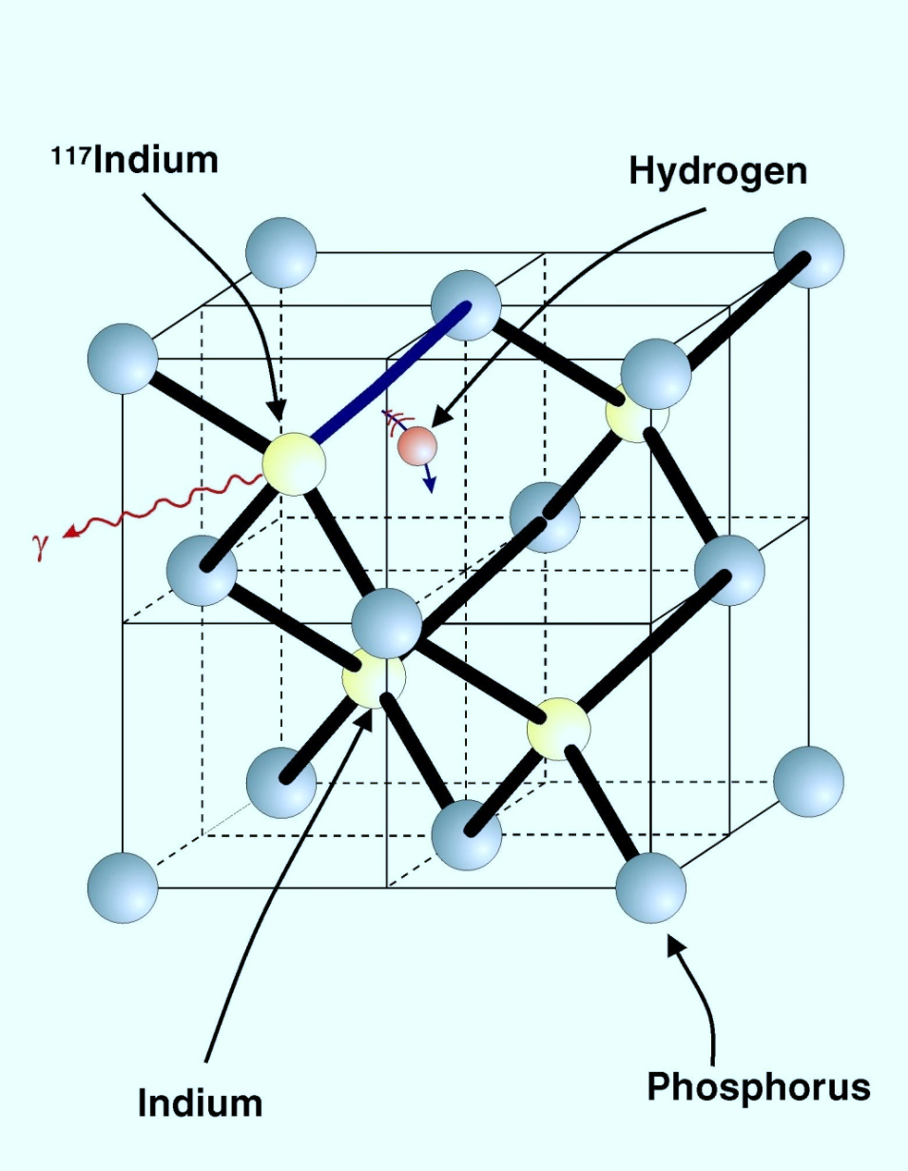
Defects in Semiconductors/Materials
To have quantitative control of the electrical, magnetic, optical properties of materials
....we should know the....
structure of the host material and properties
chemical identity of a defect or impurity atom
thermal properties of defects (diffusion, binding)…..
lattice site of a dopant and interaction with host atoms
interaction between impurity atoms and other defects
optical, magnetic or electrical properties of a specific defect and its effect on the host materials….

Slide 7
Materials Science with Radioactive Isotopes: Exploits 3 principle
Nuclear radiation can easily be detected with high sensitivity i.e. very low concentrations of radioactive impurity atoms in a material can be quantified.
Radiotracer Diffusion depth profiling [1920 G. v. Hevesy]
The half life of nuclear decay provides an opportunity of identifying the origin of conventional spectroscopic signals.
Radiotracer Deep Level Transient Spectroscopy (DLTS) [1990 Petersen+Nielsen]
Radiotracer Hall effect (HE) [1992 Gwilliam et al]
Radiotracer Photoluminescence (PL) [1965 Broser+Franke]
Unstable isotopes as “spies” transmitting information with atomic resolution via the particles they emit in their decay.
beta-Nuclear Magnetic Resonance (β-NMR) [~1959 D. Connor]
Perturbed Angular Correlation (PAC) [1951 Frauenfelder et al]
Emission Channeling (EC) [1965 B. Domeij]
Mössbauer Spectroscopy (eMS) [1958 R.L. Mössbauer]
Courtesy U. Wahl
Notes:
Diffusion
radiotracer techniques allow for a very direct measurement of the diffusion proﬁle which is strongly indicative of the diffusion mechanism of the species of interest.
The increase in sensitivity—due to the ease of detecting radioactive decay—also allows for a clearer interpretation of data than is the case for non-tracer methods
DLTS
enables the observation of the charging and discharging of deep levels in a semiconductor through the measurement of capacitance transients.
Three properties of deep levels can be determined: concentration, position in the band gap, and capture cross section for free carriers.
PL –
widely used in semiconductor physics in order to detect optical transitions involving electronic energy levels in or near the band gap.
highly sensitive to low concentrations of optically active defects
HOWEVER,
it does not provide direct microscopic information about the chemical identity of the optical centers responsible for the signals.
Correlating the intensity of PL lines with the radioactive decay of implanted isotopes in the sample allows such an identification..
Beta-NMR
provides information on the microscopic environment of the probe nucleus, based on the measured shift in the Larmor frequency (chemical shift), or relaxation time.
In material science the common probe is ⁸Li, since it's light and relatively easy to polarize, it has spin I=2, so quadrupole interaction is present.
PAC
experiments require probe atoms which decay by a γ–γ cascade via an isomeric nuclear state.
By measuring the two γ-quanta (γ1, γ2) in coincidence, an anisotropic angular distribution of the γ2 radiation is observed,
PAC allows the measurement of the local EFG and the magnetic ﬁeld that a probe nucleus experiences when embedded in matter, independent of its physical state, i.e., solids, liquid, amorphous materials and molecules can be studied.
EC
used to determine the lattice location of impurities in crystalline materials
During decay, the nuclei emit charged particles i.e. α, β+/− and conversion electrons.
As they travel through the crystal they experience either channelling or blocking effects.
The resulting anisotropic particle emission yield in the vicinity of major crystallographic directions depends in a characteristic way on the lattice sites occupied by the emitter atoms and is recorded with the aid of position sensitive detectors.

Slide 8

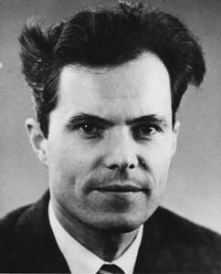

Mössbauer Effect
Free Nucleus
Rudolf L. Mössbauer
Nobel Prize in Physics in 1961 for his 1957 discovery of the Mössbauer effect.
Z,N
E_{r}
γ
1
2
Fujita
Notes:
A boy jumping from a boat on the water would fail to land on the shore because of an energy deficiency rising from the recoil of the boat. Likewise, a gamma ray emitted from a nucleus would not be absorbed by another nucleus due to a recoil reaction in emission.

Slide 9
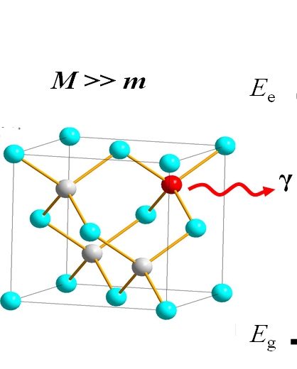
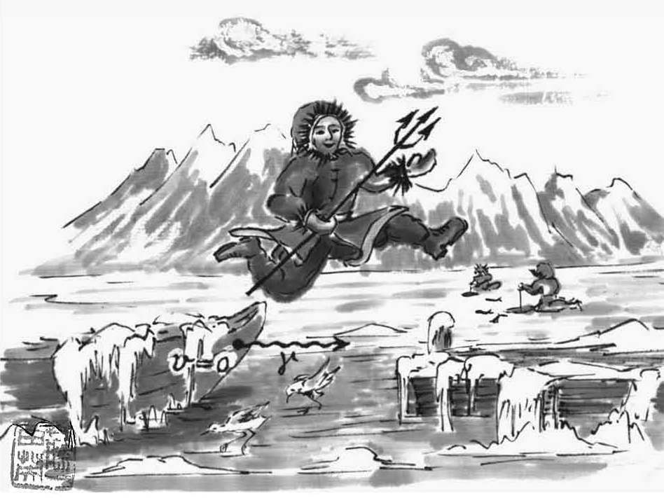
Mössbauer Effect
1
2
Fujita
Notes:
The same boy jumping from a boat frozen in ice can easily land on the shore, because no recoil reaction takes place. Likewise, a recoil-free emission and absorption of a nuclear gamma ray can be observed in solids, i.e. the Mössbauer effect (Fujita 1999).

Slide 10
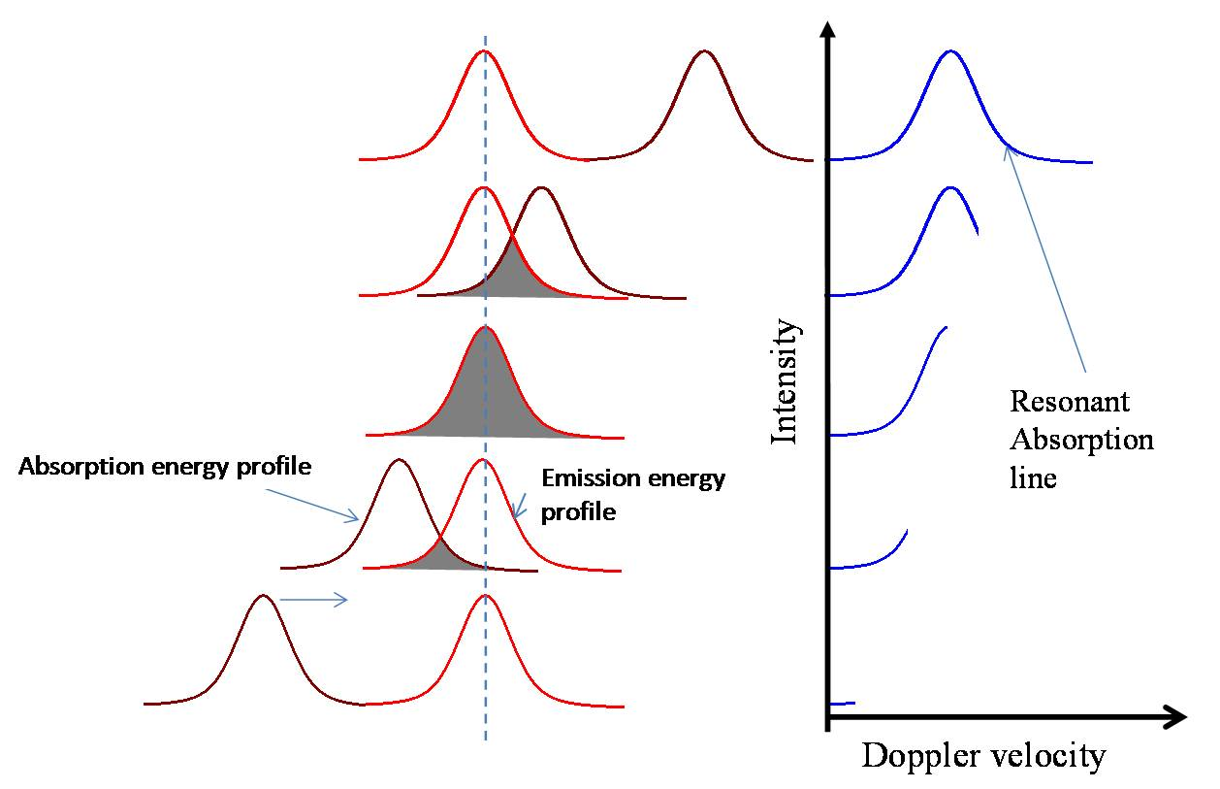
Observing Mössbauer Effect

Slide 11
Mössbauer Active Isotopes
P. Gütlich‘s Lecture slides
ME has been observed in > 40 elements
> 90% of all applications use ⁵⁷Fe
Notes:
The observation of resonance in Mössbauer spectroscopy for a particular nuclide is governed by the mean lifetime (τ_{N}) of the excited state and the transition energy E_{O}.

Slide 12
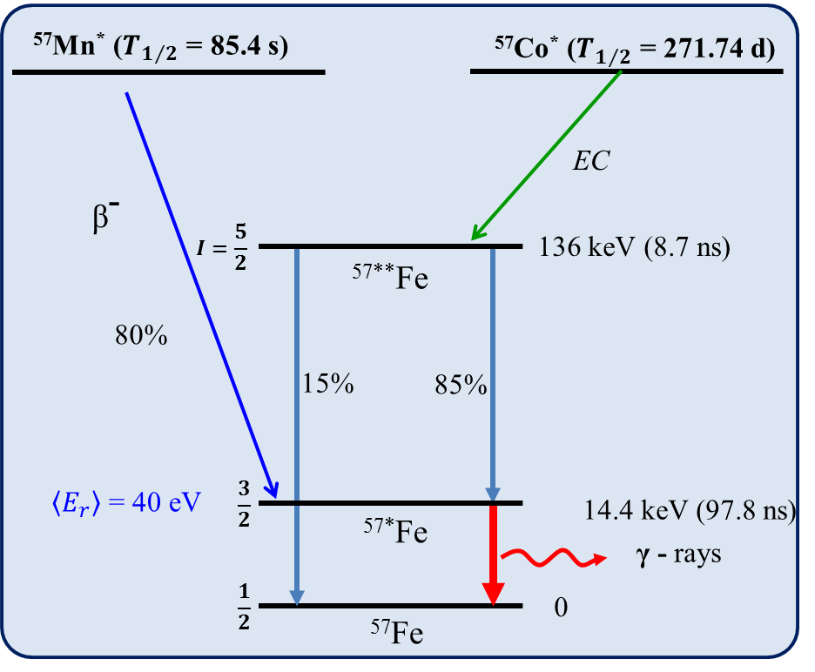
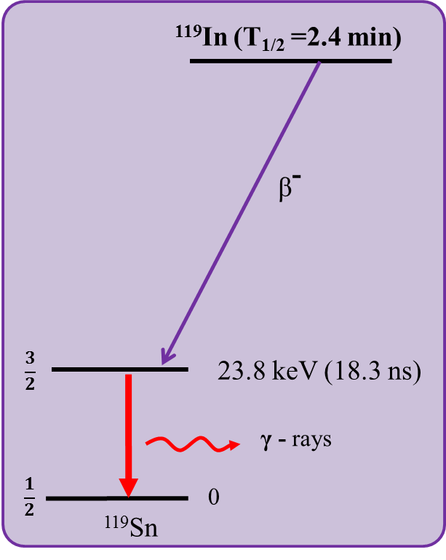
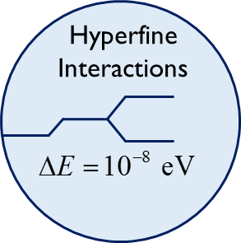
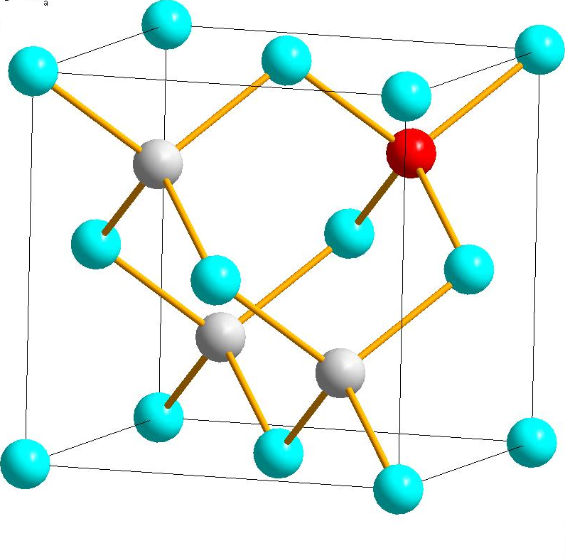
Emission Mössbauer Spectroscopy @ ISOLDE
...sensitive to charge density distribution at the nucleus and symmetry around the probe…
Fe^{n+}/Sn^{n+}
Notes:
Hyperfine interactions are interactions between the nucleus and its surrounding electrons which cause nuclear energy levels changes of the order of 10⁻⁷-10⁻⁸ eV

Slide 13
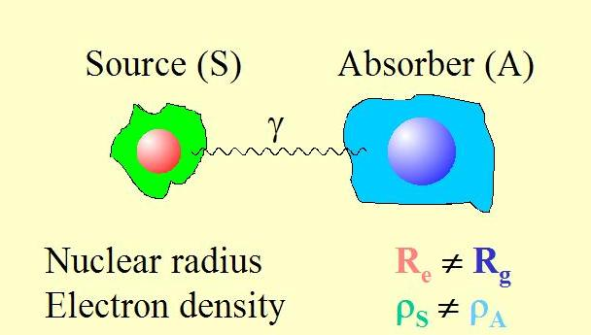
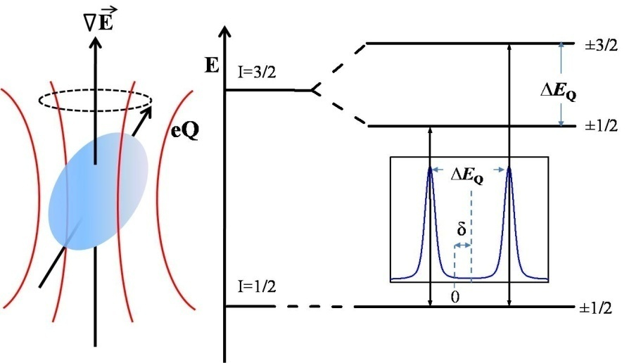
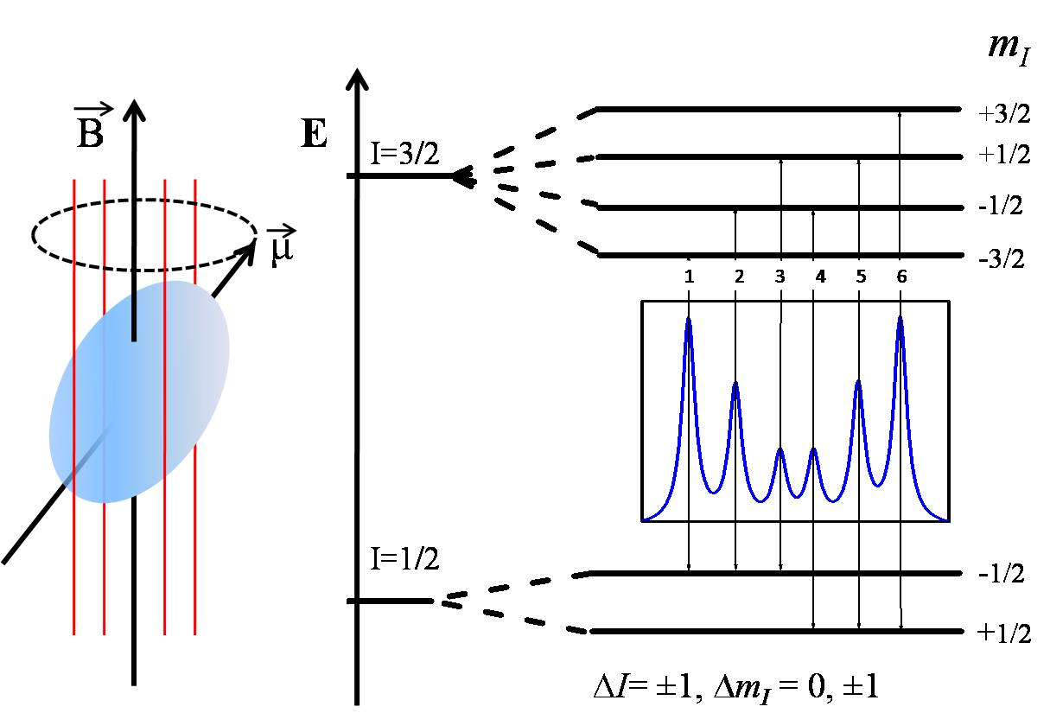

Hyperfine Interactions
Electric monopole interaction
Electric quadrupole interactions
Magnetic dipole interactions
Lattice asymmetry,
Clustering of atoms...
Size and Direction of B_{eff}
Chemical bonding, Charge states...
B_{eff} = B_{ext} + B_{hf}
Notes:
Hyperfine interactions are interactions between the nucleus and its surrounding electrons which cause nuclear energy levels changes of the order of 10⁻⁷-10⁻⁸ eV

Slide 14
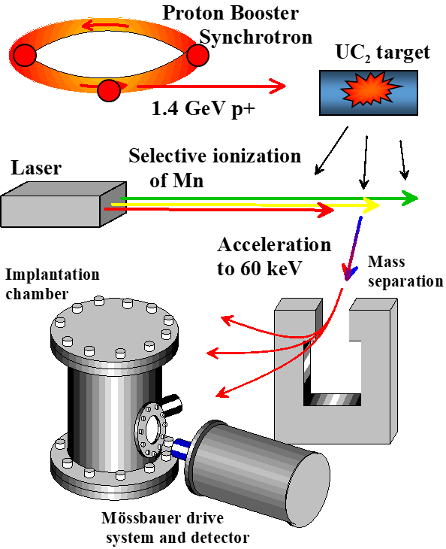
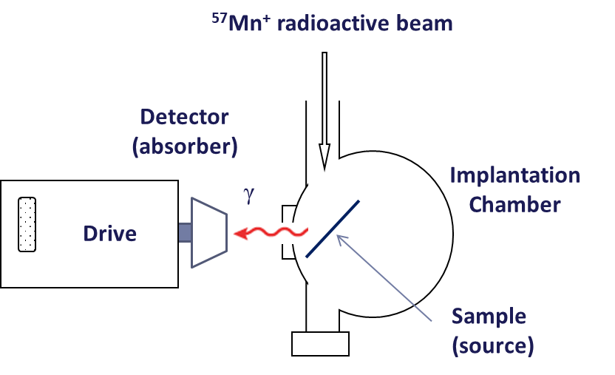
Emission Mössbauer Spectroscopy @ ISOLDE
...sensitive to charge density distribution at the nucleus and symmetry around the probe…
Beam production at ISOLDE
Fe^{n+}/Sn^{n+}
Charge and spin state of probe atom: Fe^{n+}, Sn^{n+}
Symmetry of lattice site (V_{zz})
Binding properties (Debye-Waller factors)
Magnetic interactions (ferro/para)
Paramagnetic relaxation (~10⁷-10⁸ Hz) ...plus...
Detect and distinguish up to 4-5 spectral components:
substitutional, interstitial, damage, vacancy-defects,…
Implantation angle = 30º w.r.t. c-axis
Emission angle = 60º w.r.t. c-axis
Fluence = ~ 3×10¹² ions/cm²

Slide 15
Search for dilute magnetism in ZnO
| Avignon | ARIS2023 | June 09 |

Slide 16
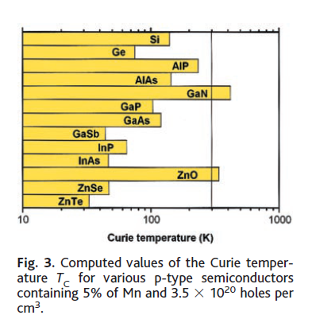

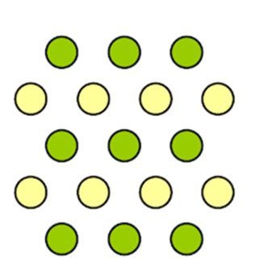
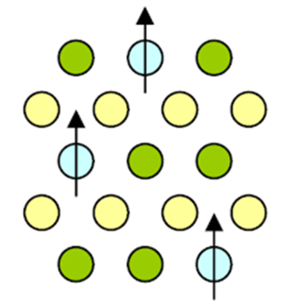
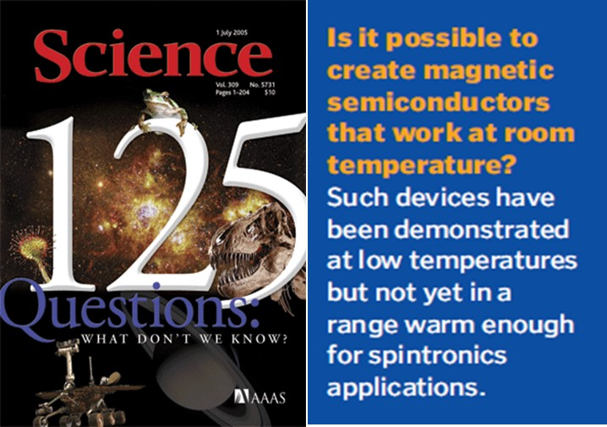

Example - Physics Case Motivation
Dietl et al, Science 287 (2000) 1019
semiconductor materials → information processing
metallic magnetic materials → data storage.
But
Different Crystal Structures
Conductivity mismatch
Desired
both properties in one material
chromium spinels
europium chalcogenides
Semiconductor
DMS
BUT
T_{C} < 100 K
Furdya: J. Appl. Phys. 64(1988) R29.
Nature and origin of magnetism
Notes:
Results from emission Mössbauer Spectroscopy studies revealed that Fe/Mn implanted ZnO and GaN shows slow paramagnetic relaxation.

Slide 17
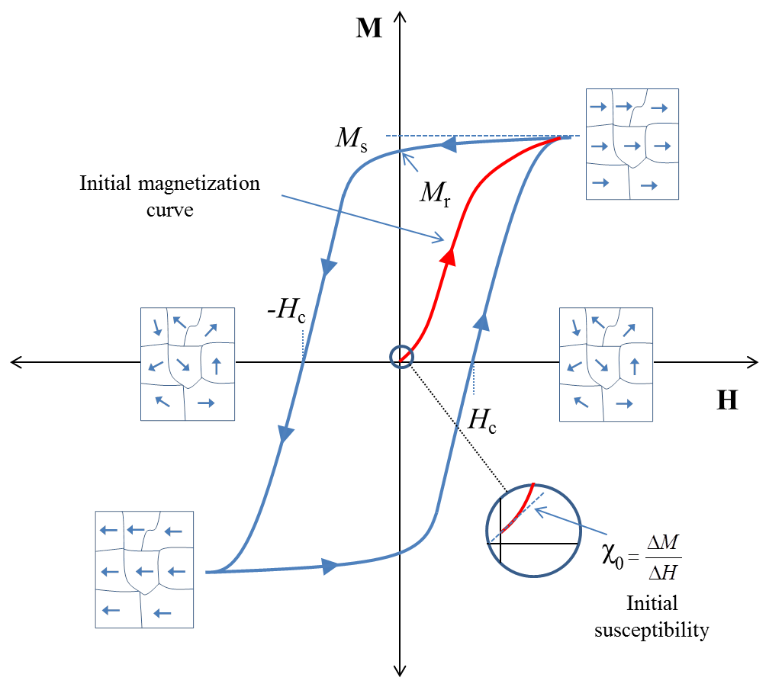
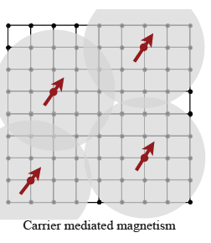
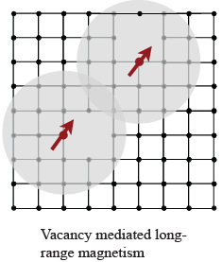
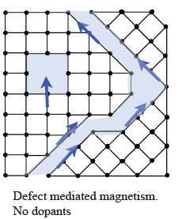
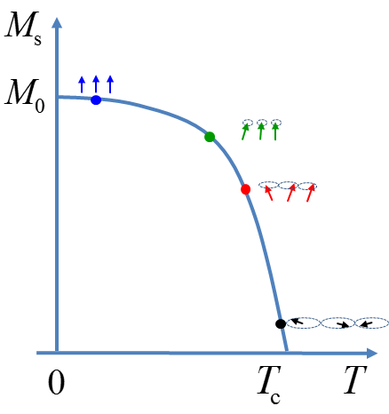
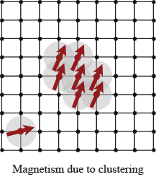
Motivation
Dietl et al, Science 287 (2000) 1019
Possible origin…
[1]
[2]
[3]
[4]
Notes:
Results from emission Mössbauer Spectroscopy studies revealed that Fe/Mn implanted ZnO and GaN shows slow paramagnetic relaxation.

Slide 18
Zinc Oxide
Ferromagnetic/Paramagnetic?
If the spin is stable for longer than 140 ns – Sextet is observed
Ferromagnetic material
Magnetic order
Δm_{I} = 0
B_{ext}
γ
Sample
3 4 1 1 4 3
3 0 1 1 0 3
Relative line ratios:
3:4:1 (90º) → 3:0:1 (0º)
eMS Spectra
Notes:
If the 57Fe probe interacts with a magnetic field it will cause a Zeeman splitting and the energy level of the nucleus split - resulting in six lines (due to the selection rule) – called a sextet.
--In the case of no external magnetic field and a sextet is observed… we know the spin alignment is stable for longer then 140 ns. Which is the measuring time of the experiment.
- if the material is magnetic
- or if the probe exhibit slow relaxing paramagnetism (but then more than one sextet is observed)
mean life time of the excited nuclear state (140 ns for ⁵⁷Fe)

Slide 19
Zinc Oxide
Ferromagnetic/Paramagnetic?
If the spin is stable for longer than 140 ns – Sextet is observed
Slow relaxing paramagnetism
  (not only one sextet)
Paramagnetism
Δm_{I} = 0 from S_{Z} = ±3/2
^{57*}Fe
S_{Z} = ±5/2
B_{ext}
S_{Z} = ±3/2
γ
S_{Z} = ±1/2
Sample
Relative line ratios:
3:4:1 (90º) → 3:0:1 (0º)
Notes:
In a crystal field potential, the ⁶S ground state of Fe³⁺ splits into three Kramers spin doublets with S_{z} ±5/2, ±3/2, and ±1/2, and in the limit of low spin relaxation rates each doublet produces its own Mössbauer magnetic hyperfine spectrum and experimentally a superposition of the three sextets is observed.
Here a simulation of a single sextet originating from ordered magnetism like ferromagnetism
--Pay attention to the relative line intensities of the sextet as the angle between the external magnetic field and the gamma direction change.
*Characteristic is that line 2 and 5 (from the ΔmI=0) goes to zero when the external magnetic field is parallel to the gamma emission
-As mentioned earlier – in the case of slow relaxing paramagnetism – it will give rice to 3 sextet (or actually 6 sextets). They originate from the three Kramers doublets.
--Important is that the three sextet exhibits the same angular dependence.!
Characteristic is the at 0 deg – the line 2 and 5 from the ΔmI=0 also becomes ZERO.
This is best observed for the Sz = 3/2 states

Slide 20
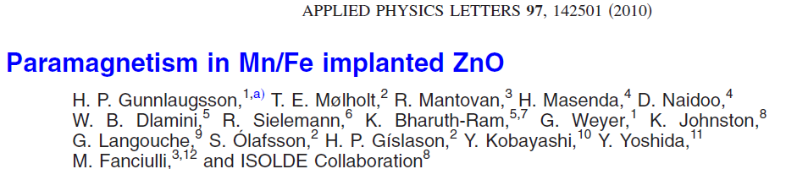
Zinc Oxide
Magnetic structure – complex
originates form more than one
Fe³⁺ (S_{z} = 5/2)
Δm_{I} → 0 from S_{Z} = ±3/2
NO ordered magnetism
But Paramagnetism 
Notes:
in the case of slow relaxing paramagnetism – it will give rice to 3 sextet (or actually 6 sextets). They originate from the three Kramers doublets.
--Important is that the three sextet exhibits the same angular dependence.!
Characteristic is the at 0 deg – the line 2 and 5 from the ΔmI=0 also becomes ZERO.
This is best observed for the Sz = 3/2 states

Slide 21
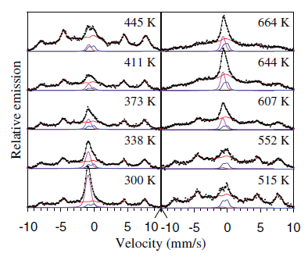
Zinc Oxide
Temperature Series
Temperature dependent B_{hf}
Cold
Hot
⟨B_{hf}⟩
T ↑ ⇒ ⟨B_{hf}⟩ ↓
No line broadening
T_{C} or T_{N}
Notes:
Spin-lattice relaxation between a paramagnetic ion and a crystal lattice occurs when energy transfer takes place between the electronic spin of the ion and phonons of the lattice vibrations which are responsible for a fluctuating crystalline electric field generated by neighbouring ligands at a central paramagnetic ion.

Slide 22
Zinc Oxide
Temperature Series
Simulation
[Blume M. and Tjon J.A.:
Phys. Rev. 165, 446 (1968)]
1 2/3/4/5 6
1/2/3/4/5/6
1 2 3 4 5 6
1 2 3/4 5 6
τ > 200 ns (slow)
τ = 100 ns
τ = 30 ns
τ = 13 ns
τ = 6 ns
τ = 3 ns
τ = 2 ns (fast)
T ↑ ⇒ ΓΔ ↑
line broadening
then collapse
Total collapse of all spectral lines
Collapse of inner lines 3 and 4
Collapse of inner lines 2 and 5
Notes:
The Larmor precession time gives the minimum time required for the nucleus to sense the hyperfine field and is defined as the time taken for a nuclear spin state, I to split into (2I+1) sub-states under the influence of the hyperfine field.
As the relaxation rate increases, the sextets start to collapse in pairs beginning with the inner most lines. This is because the Larmor precession time for the outer lines is shorter than that for the inner lines, since (τ_{l}) is proportional to the energy difference between spectral lines.

Slide 23
Zinc Oxide: ⁵⁷Mn + ⁵⁶Fe
Spin-spin
relaxation
contributes
Implantation damage
→ Fe³⁺ (S=5/2) decreases
Mantovan et al Adv. Electron. Mater. 1 (2015) 1400039
Masenda et al., Hyp. Int. 237 (2016) 40
Notes:
Spin-spin relaxation involves energy transfer between neighbouring spins through magnetic dipole and/or exchange interactions
This spin-spin interaction is influenced by the distance between the ions and hence depends on the concentration of paramagnetic ions in the sample. For very low concentration of Fe ions (<10⁻⁴ at.%) the spin-spin relaxation is negligible since the ions are widely spaced.

Slide 24
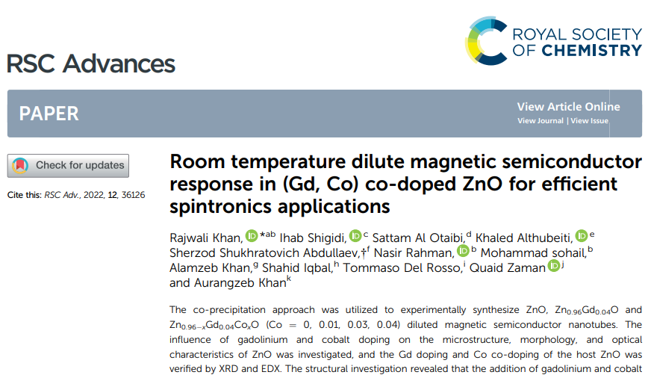
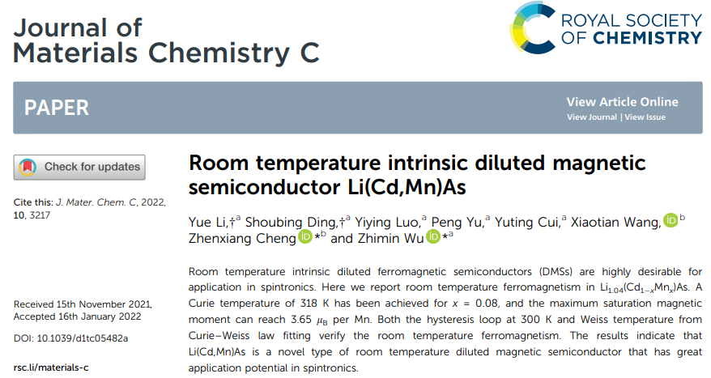
ZnO : Summary
Using eMS with short-lived radioactive ⁵⁷Mn* with fluence ~ 3×10¹² ion.cm⁻²
No dilute ferromagnetic behaviour is observed in the ZnO, ..... (<10⁻³ at. %)
Instead, paramagnetism in Fe implanted ZnO (and other oxides)
→ Slow paramagnetic relaxation of Fe³⁺
Leading candidate → Ga(Mn)As with current T_{c} = 185 K

Slide 25
Lattice site and charge states in ternary nitrides
| Avignon | ARIS2023 | June 09 |

Slide 26

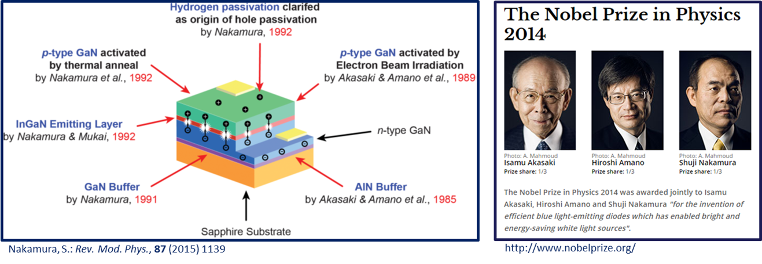
….from Binary to Ternary Systems
AlN and GaN → Al_{x}Ga_{1-x}N
Grown by MOVPE
Linz, Austria
InN and GaN → In_{x}Ga_{1-x}N
+ Mn doping → IS576
“a₀ engineering”
...tuning…
band-gap energy: 0.7 – 6.2 eV
magnetism (p-d hybridization)
effective masses of holes and electrons
dielectric constants

Slide 27
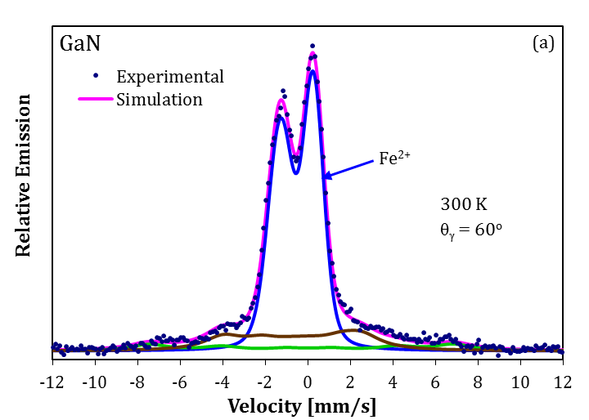
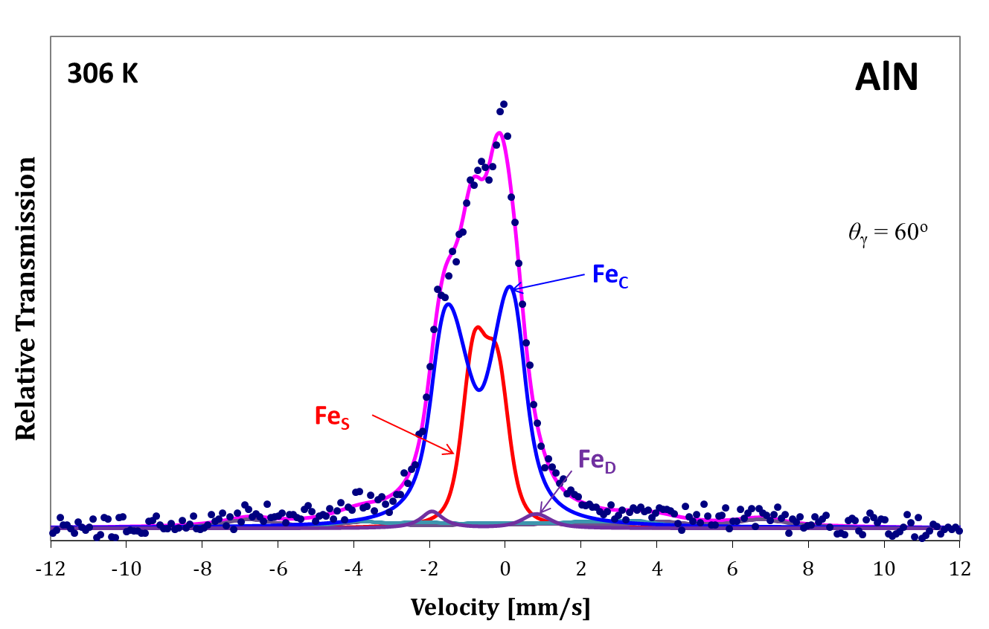
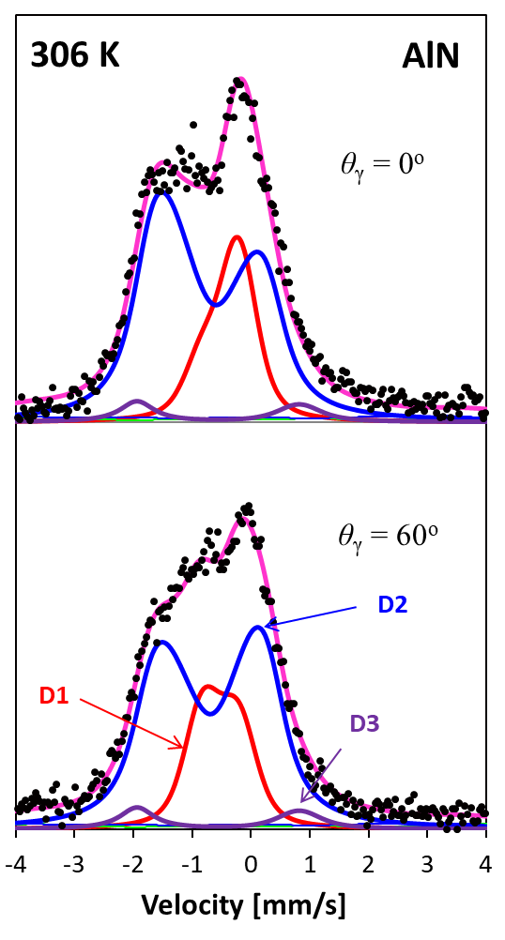
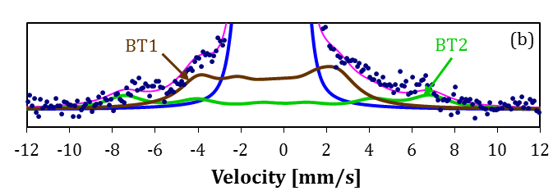
….Motivation - Binary to Ternary Systems
……different behaviour in ⁵⁷Fe eMS on GaN (Al_{x}Ga_{1-x}N)
→ suggests different physics between the AlN and GaN which is not well understood
BT sextets - Fe³⁺ (S=5/2)
→ paramagnetic
→ slow spin-lattice relaxation
[Blume M. and Tjon J.A.:
Phys. Rev. 165, 446 (1968)]
…..to gain essential insight into the role played by Mn dopants
Mølholt et al., Phys. Scr. T148 (2012) 014006
Masenda, H. et al: J. Magn. Magn. Mater. 401 (2016) 1130

Slide 28
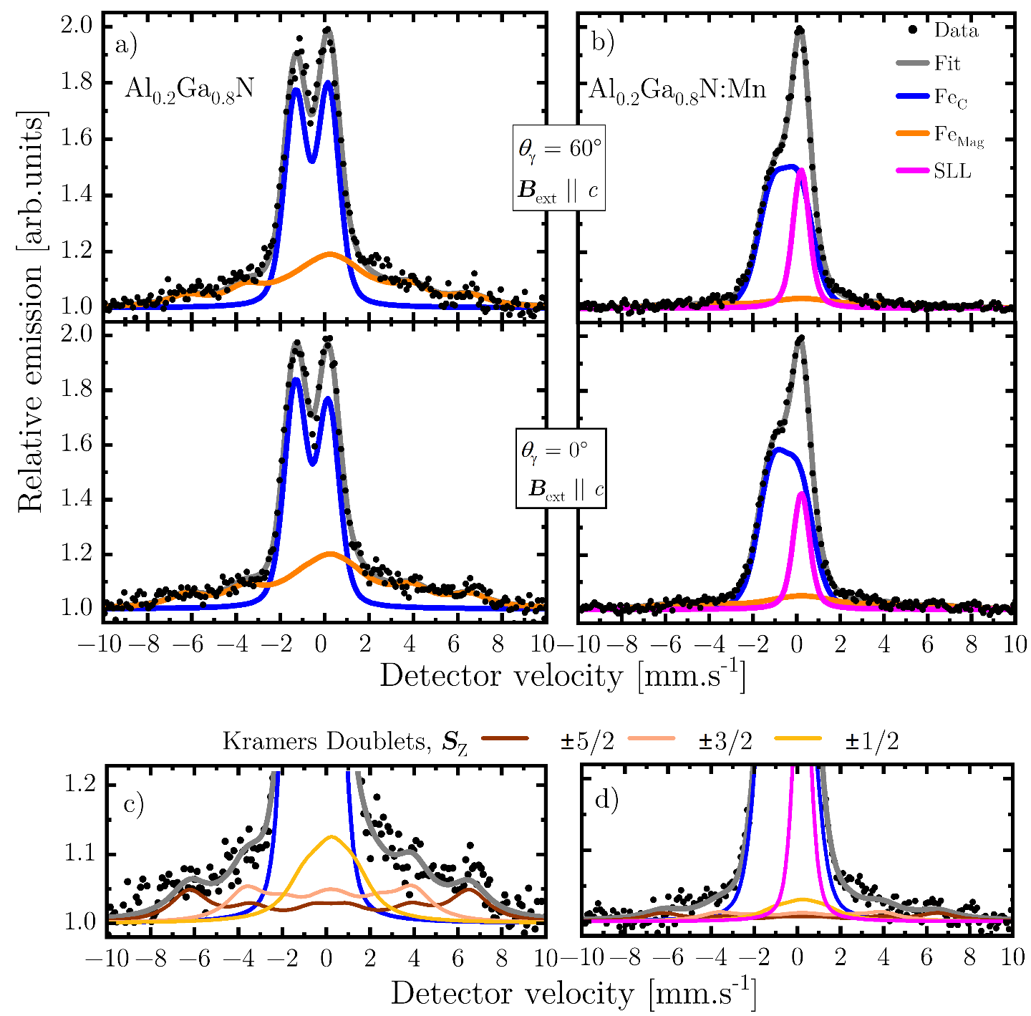
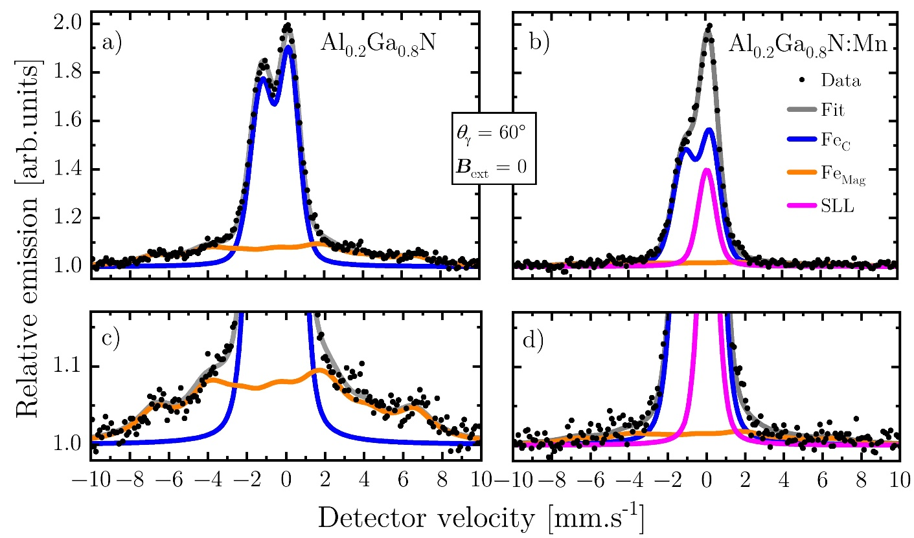
….AlGaN: Virgin and Pre-Doped with Mn
…with Mn doping;
Magnetic contribution decreases
New Single line like (SLL) feature

Slide 29
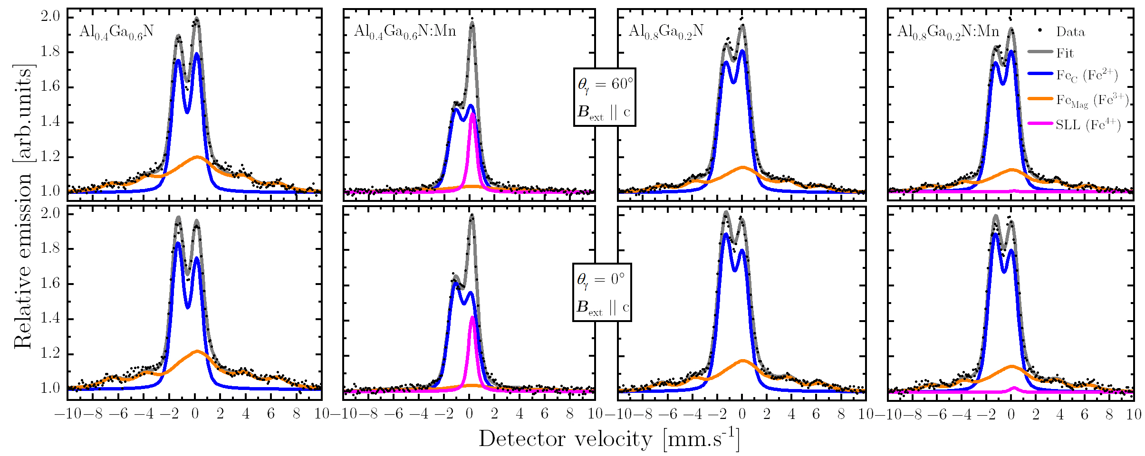
….Higher Al Concentration
Seems area of Fe⁴⁺ decrease significantly with higher Al concentration at the expense of Fe³⁺
Area of Fe²⁺??
Notes:
Room temperature angular dependence for 40% and 80% Al in both doped virgin and Mn doped AlGaN

Slide 30
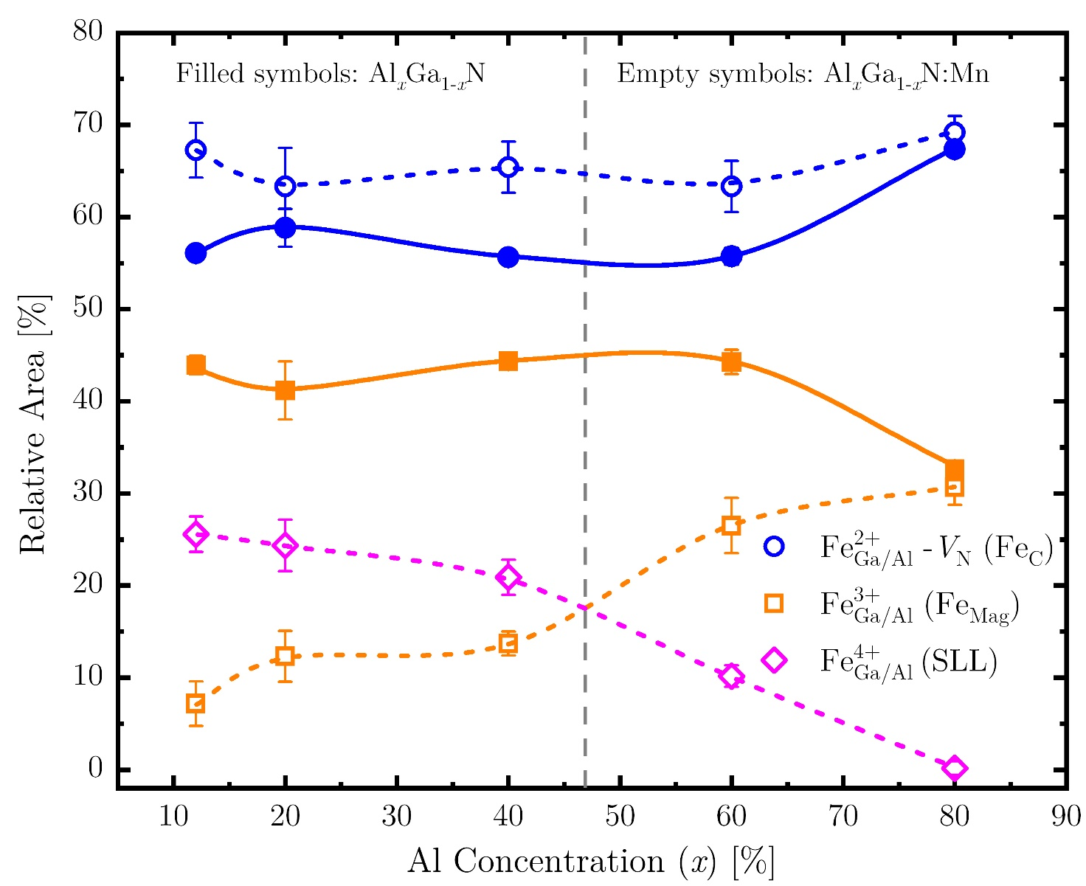
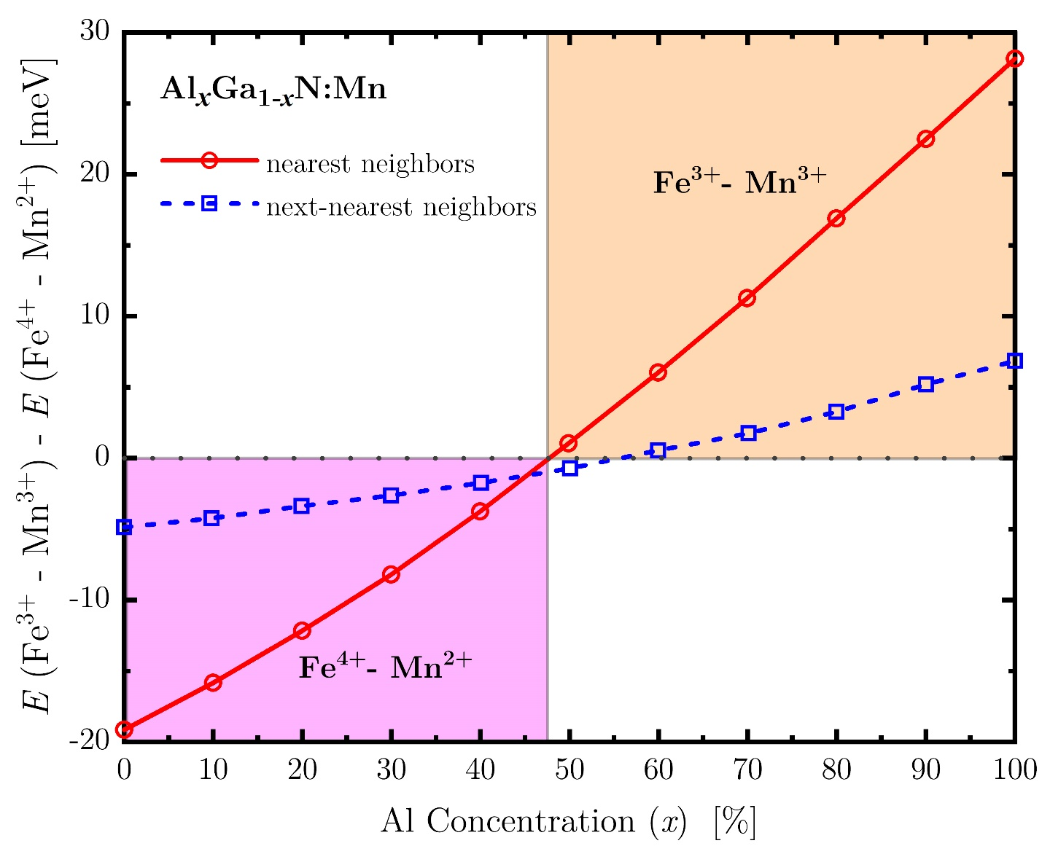
…. Experiment + DFT
~ 47%
… higher Al content samples → have less Fe⁴⁺ and more Fe³⁺ → the Fe²⁺ fraction fairly constant

Slide 31
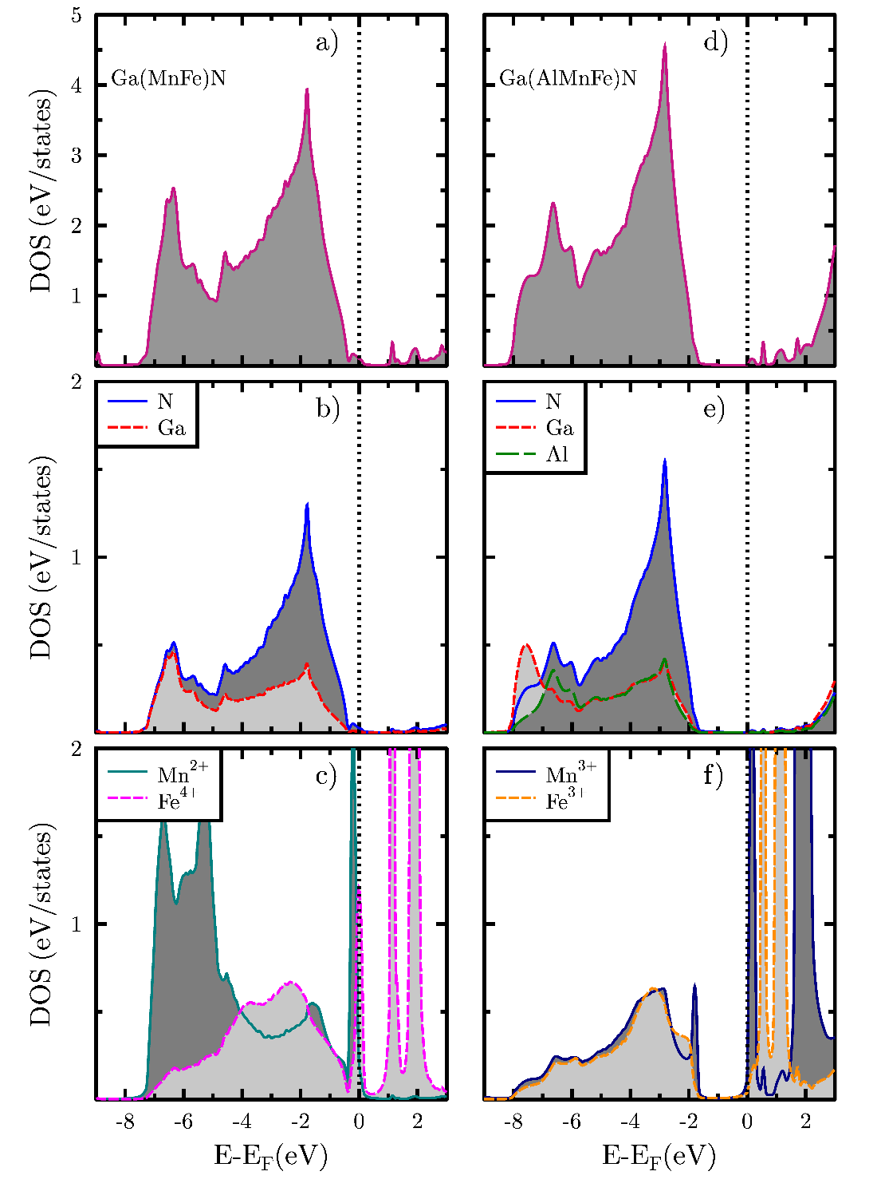

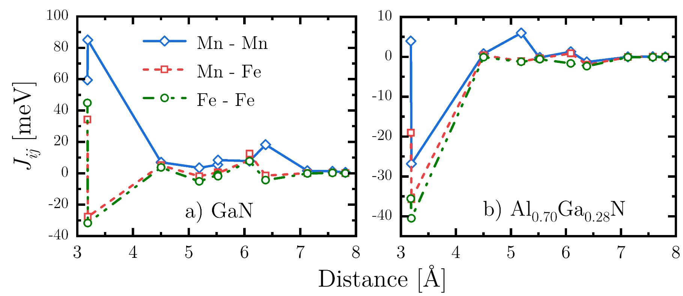
….AlGaN
The completely-filled spin-up orbitals in Mn²⁺ (3d⁵)
Expected to enhance magnetic exchange interactions

Slide 32
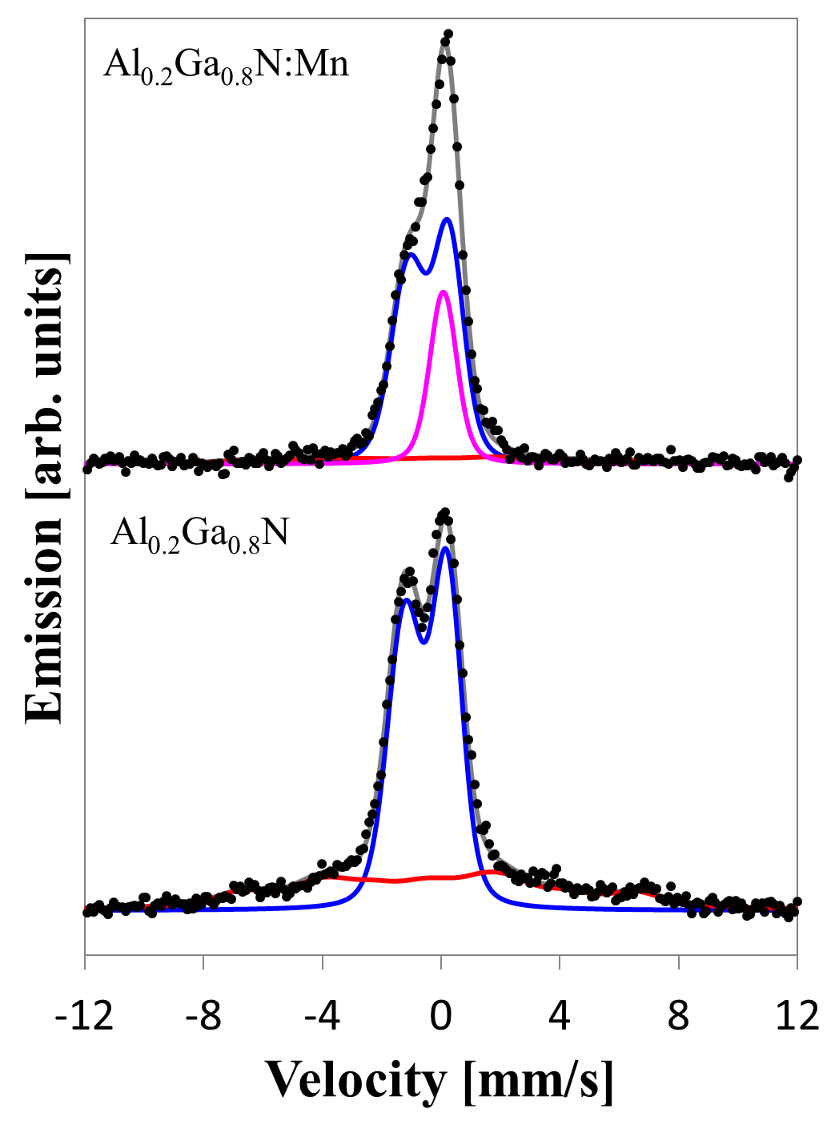
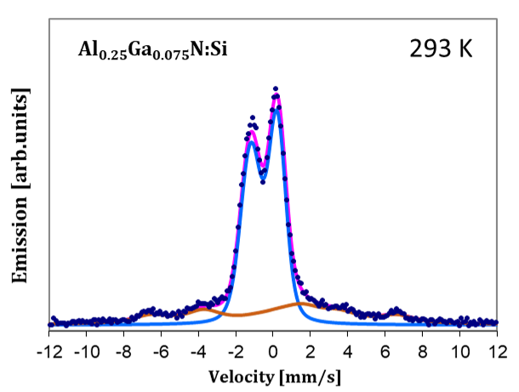
….Si Doping
…intentional doping with donor…
SL
Al_{0.25}Ga_{0.75}N:Si
Preliminary results
Fe³⁺ fraction decreases
New single line (SL) appears
Fe⁴⁺
...presents Fe³⁺ and no SLL…
Notes:
Implant (and measure) at elevated temperatures (RT-1000 K)
Remove the sample from vacuum, quench in LN, measure off-line

Slide 33
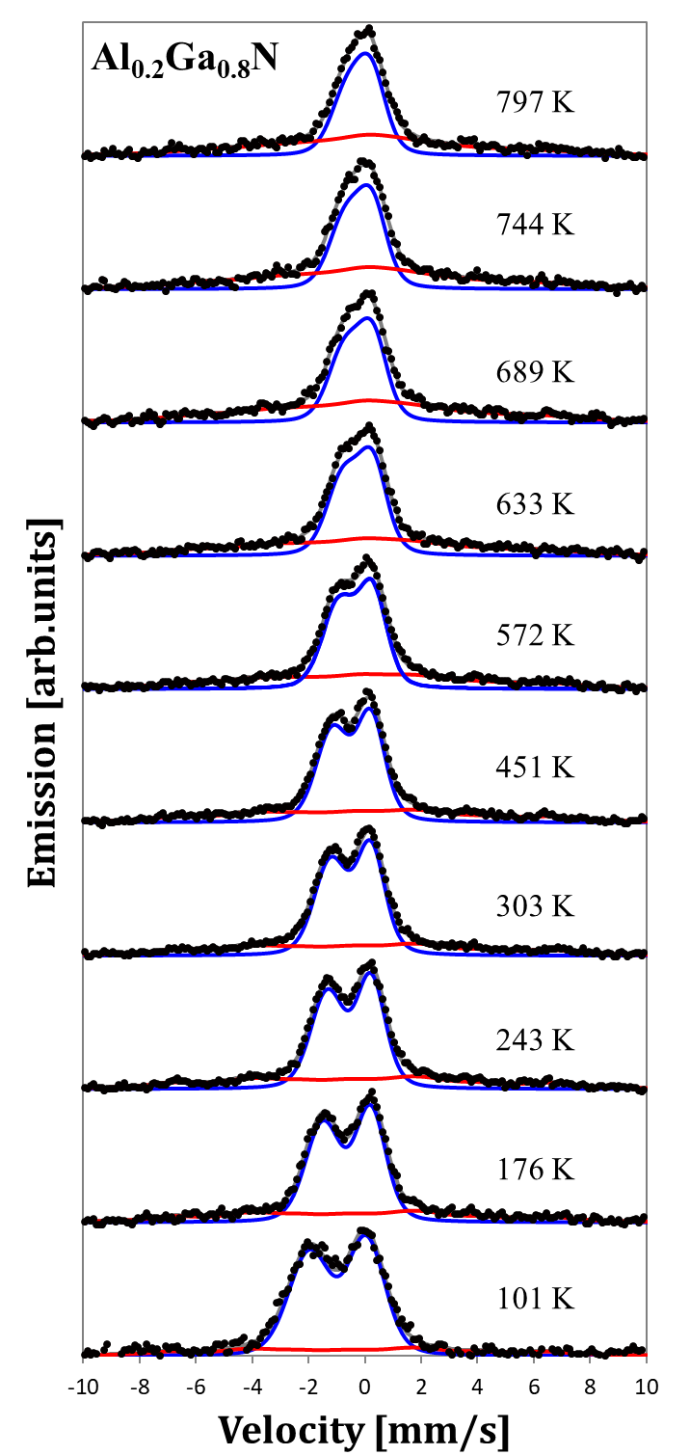
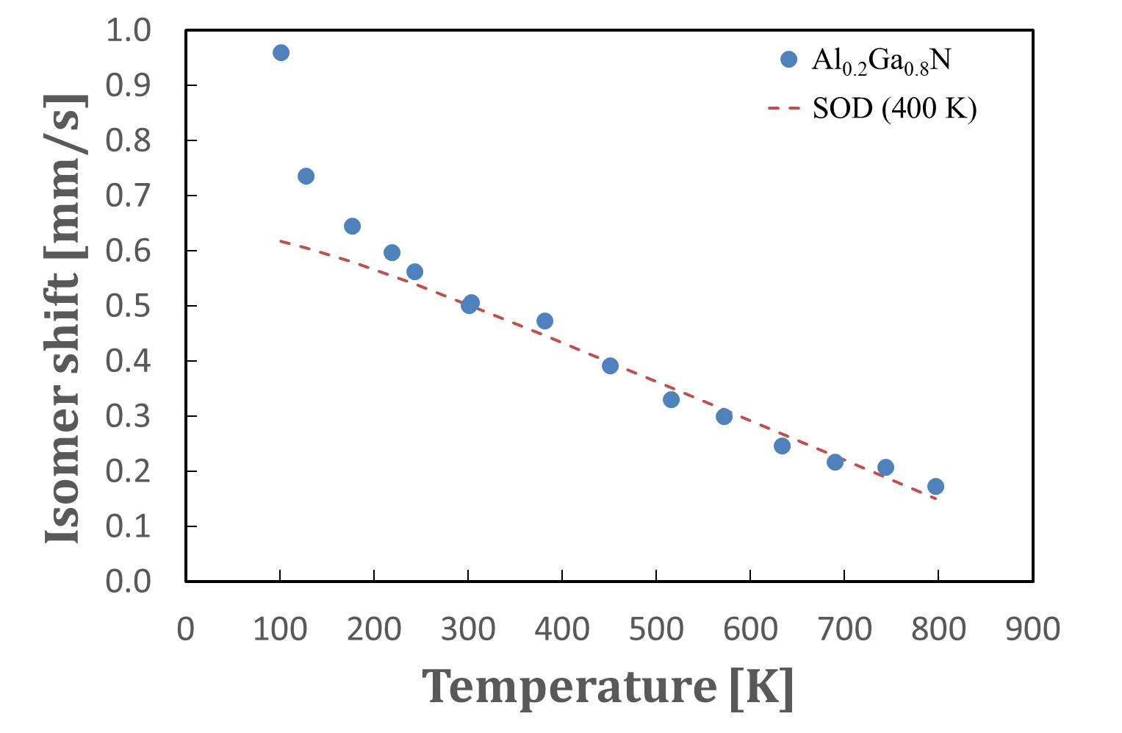
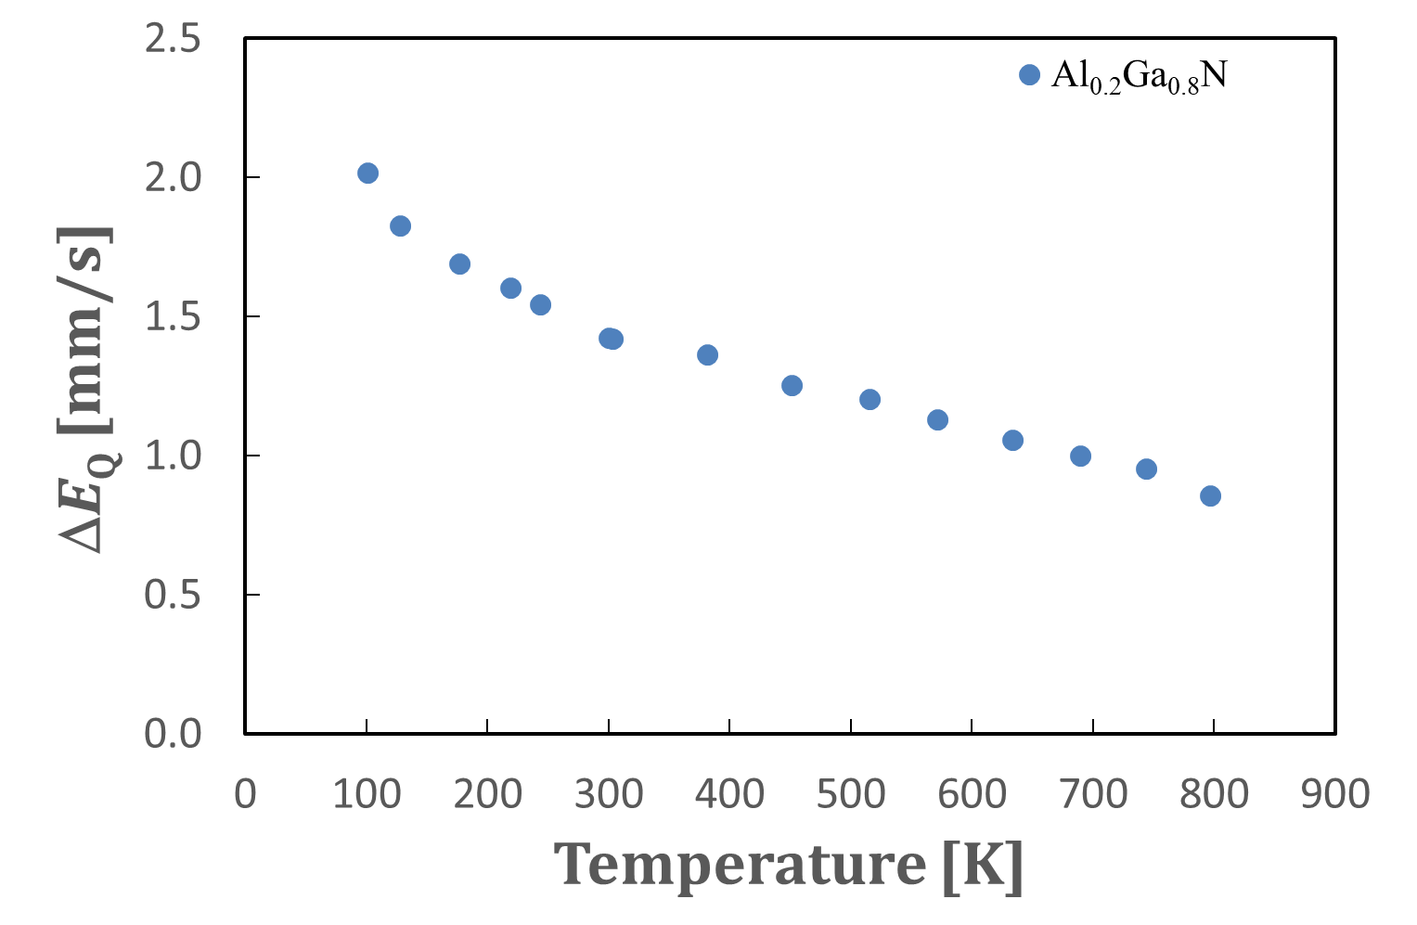
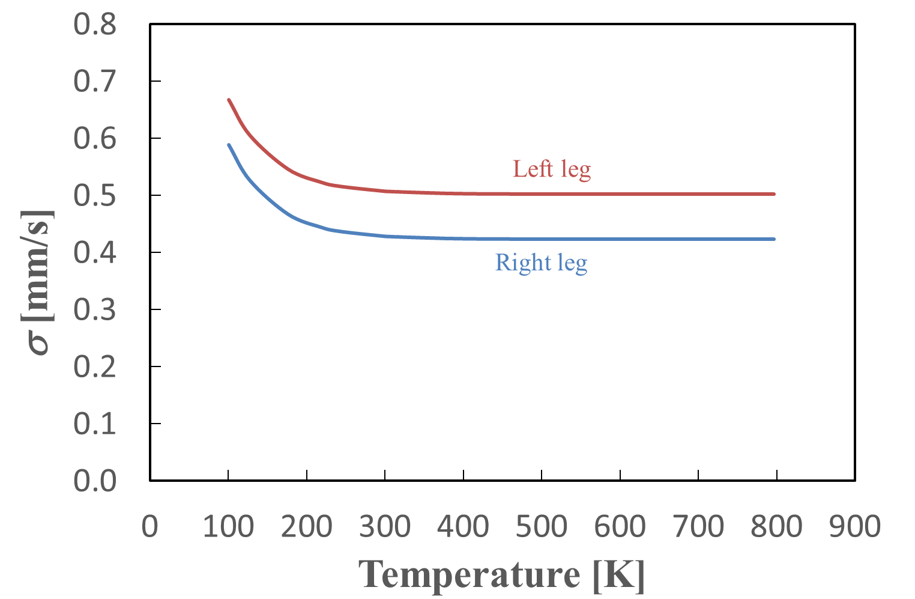
….from Temperature Dependence
Temperature dependence
does not follow the expect SOD at temperatures < 250 K
δ suggest Fe²⁺ and Fe³⁺
Large ΔE_{Q} identify doublet as due to Fe²⁺
additional broadening is due to isolated defects.

Slide 34



….Fast cooling experiments
Presence of implantation induced isolated defects at low temperatures
Fe²⁺ associated with defects
Literature
V_{N} main native defect in GaN [Many authors]
Stable up to very high temperature [Some authors]
Notes:
Implant (and measure) at elevated temperatures (RT-1000 K)
Remove the sample from vacuum, quench in LN, measure off-line

Slide 35

….AlGaN – Summary
…in Al_{x}Ga_{1-x}N samples (similar results to GaN) …
Paramagnetic Fe²⁺ on Al/Ga sites associated with a nitrogen vacancy or vacancies,
Paramagnetic Fe³⁺ on Al/Ga sites,
Fast cooling measurements confirmed the presence of isolated defects below 250 K
… when Al_{x}Ga_{1-x}N doped with Mn (1 %) …
Favour Fe⁴⁺ state on Al/Ga sites,
… stabilized by Mn²⁺
Fe⁴⁺ concentration decreases with increasing Al content due enhanced hybridization effects
Notes:
Unique charge states with co-doping

Slide 36



….IS630 - InGaN
....but single line (SL)….
→ Fe⁴⁺ as in Mn doped Al_{x}Ga_{1-x}N
InN and GaN → In_{x}Ga_{1-x}N
...development SL as a function of x …
Fe_{X}...not consistent with Fe²⁺-V_{N} as in GaN → δ_{RT} ~ 0.27 mm/s – too low
Alternative interpretation
…spin relaxation rates as a function of x
Fast relaxing high-spin Fe³⁺?
Low spin Fe²⁺ or Fe³⁺?
Interstitial Fe?
Fe²⁺-V_{N}, still a possibility?
... quadrupole interaction with temperature
…determine Debye temperatures
…apply theoretical calculations
Fe_{Y}… Fe²⁺-V_{N} → δ_{RT} ~ 0.83 mm/s
→ low intensity, V_{N} mobile in InN?
…temperature series and rapid cooling
No magnetic feature, no Fe³⁺
Notes:
InN did not reveal any magnetic behaviour and this could be explained by the absence of high spin Fe³⁺?

Slide 37


….Prospects for Unstable Isotopes - Halides
Notes:
Chalcogenide materials are characterized by fast and reversible phase transitions, which are typically accompanied
by orders of magnitude variations in their electrical resistivity, as well as by large differences in their optical
reflectivity, making them extraordinarily important for non-volatile memory applications.

Slide 38







….Ongoing and Prospects for Unstable Isotopes with EMS
Nitrides
Multiferroics + magnetoelectric
Chalcogenides
S. Dong et al., Advances in Physics 64 (2015) 519 - 626
Topological Insulators
2D materials + their hetero/hybrid structures
…plus more …
A. K. Geim and I. Grigorieva, Nature 499, 419 (2013)
Notes:
Chalcogenide materials are characterized by fast and reversible phase transitions, which are typically accompanied
by orders of magnitude variations in their electrical resistivity, as well as by large differences in their optical
reflectivity, making them extraordinarily important for non-volatile memory applications.

Slide 39
Thank You!!!
Acknowledgements
Aarhus
G. Weyer
Berlin
R. Sielemann
Bilbao
F. Plazaola, I. Unzueta
CERN
K. Johnston, J. Schell, A. M. Gerami
Durban
K. Bharuth-Ram,
Johannesburg
D. Naidoo, O. Mpatani
Leuven
A. Vantomme, L. M. Pereira,
G. Langouche
Linz
A. Bonanni, A. Tarazaga, R. Adhikari
A.Ernst
Lisbon
U. Wahl
Milan
R. Mantovan, M. Fanciulli
Reykjavík
S. Ólafsson, H. P. Gíslason, B. Qi,
H. P. Gunnlaugsson
Roskilde
T. E. Mølholt
Sofia
P. Krastev
| hilary.masenda@wits.ac.za |

