Slide 1
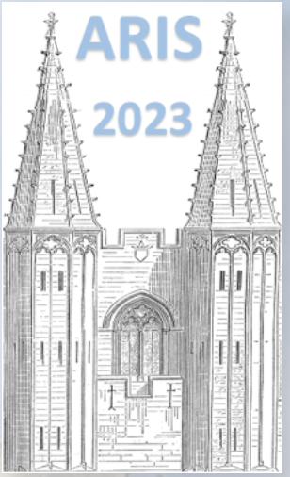





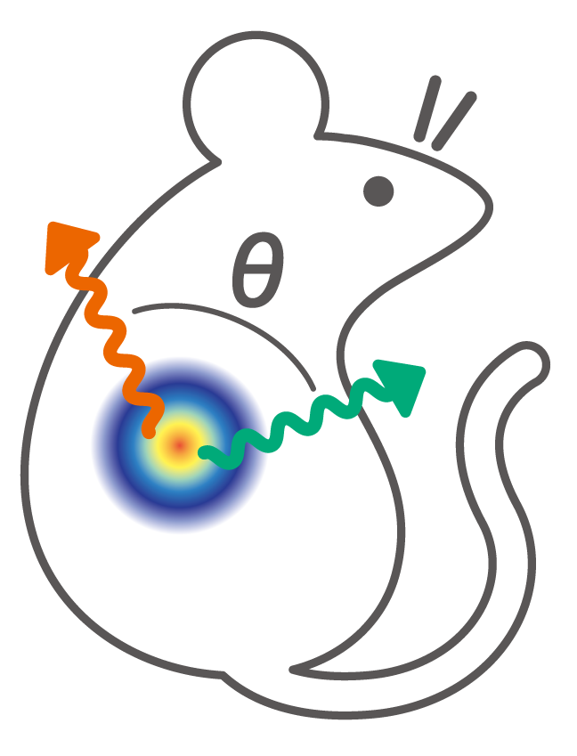
Simultaneous pH sensing and gamma-ray imaging via angular correction measurement using cascade nuclides
06/06/2023
○Mizuki Uenomachi¹, Taisei Ueki², Kenji Shimazoe², Hideki Tomita³, Ryohei Terabayashi², Tetsu Sonoda⁴, Momo Mukai³, Yudai Shigekawa⁴, Akira Sugiyama², Sachiyo Nomura², Takeshi Sato²
¹Kyoto University, ²The University of Tokyo, ³Nagoya University, ⁴RIKEN

Slide 2
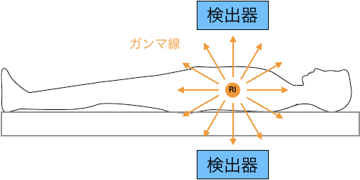
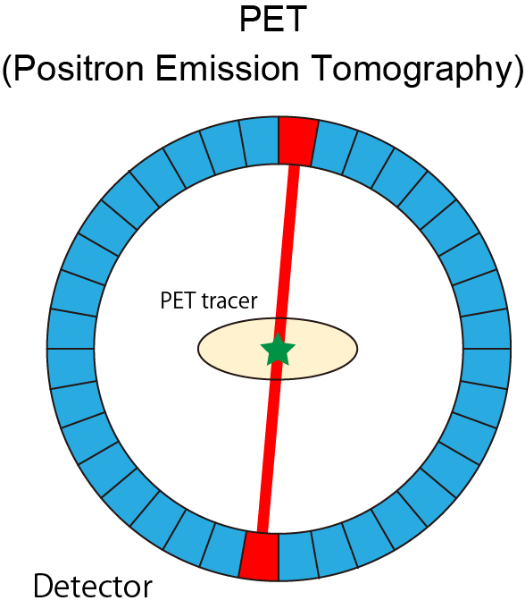
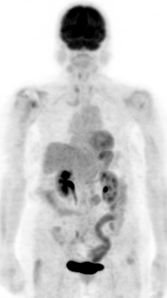

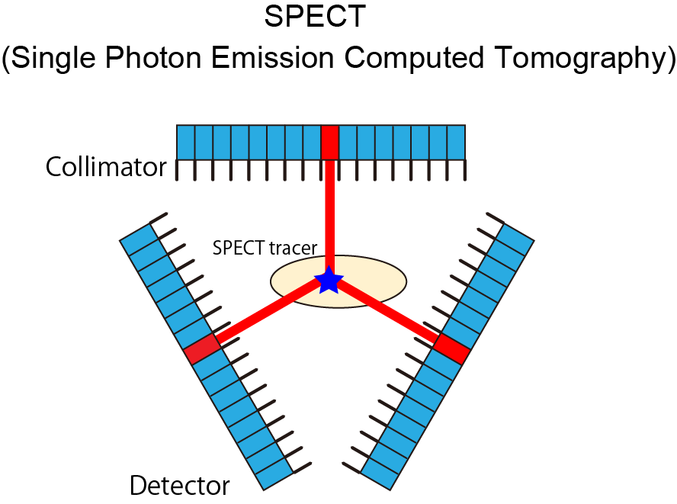
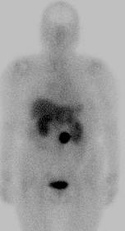
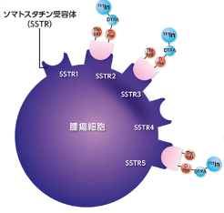
Research Background –nuclear medicine–
Nuclear Medicine
Detector
Gamma-rays
One of medical specialty to diagnose and treat disease by visualizing metabolic and functional information from the distribution of injected radioactive drug
Detector
Conventional imaging modality
・・PET * and SPECT **
Glucose imaging
* Positron emission tomography
** Single photon emission computed tomography
PET
Positron emitter (511keV annihilation gamma-rays)
Early detection of malignant tumors
Coincidence
detection
¹⁸F-FDG (annihilation gamma) etc…
Receptor imaging
SPECT
Single photon emitters (< 400 keV)
Blood flow, molecular dynamics, antibody imaging
^{99m}Tc (141keV),⁶⁷Ga (300keV), ¹¹¹In (171,245keV) etc..
Tumor
cell
However, these technologies can only visualize the distribution of a radioactive drug

Slide 3
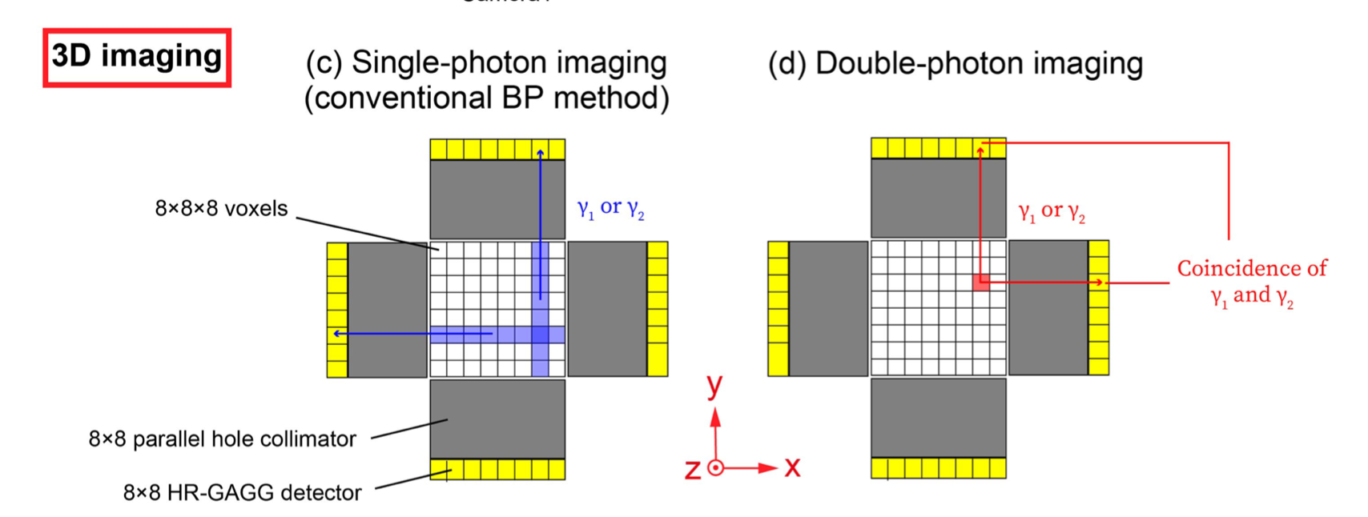
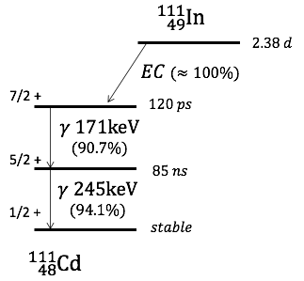
Cascade nuclides for medical imaging
Radionuclides in nuclear medicine
PET Positron emitter | SPECT Single photon emitter | Therapy Beta- or Alpha- emitter
¹⁸F ¹⁵O ¹¹C etc | ^{99m}Tc (140.5 keV gamma) ¹¹¹In (171, 245 keV gamma) ⁶⁷Ga (93, 300 keV gamma etc) etc | ¹³¹I (beta, 364 keV gamma etc) ¹⁷⁷Lu (beta, 113, 208 keV gamma) ²²³Ra (alpha, 145 keV gamma etc) etc
Cascade nuclides emits two or more photons via intermediate states from a nucleus
Coincidence detection of double photons can localize a radionuclide

Slide 4
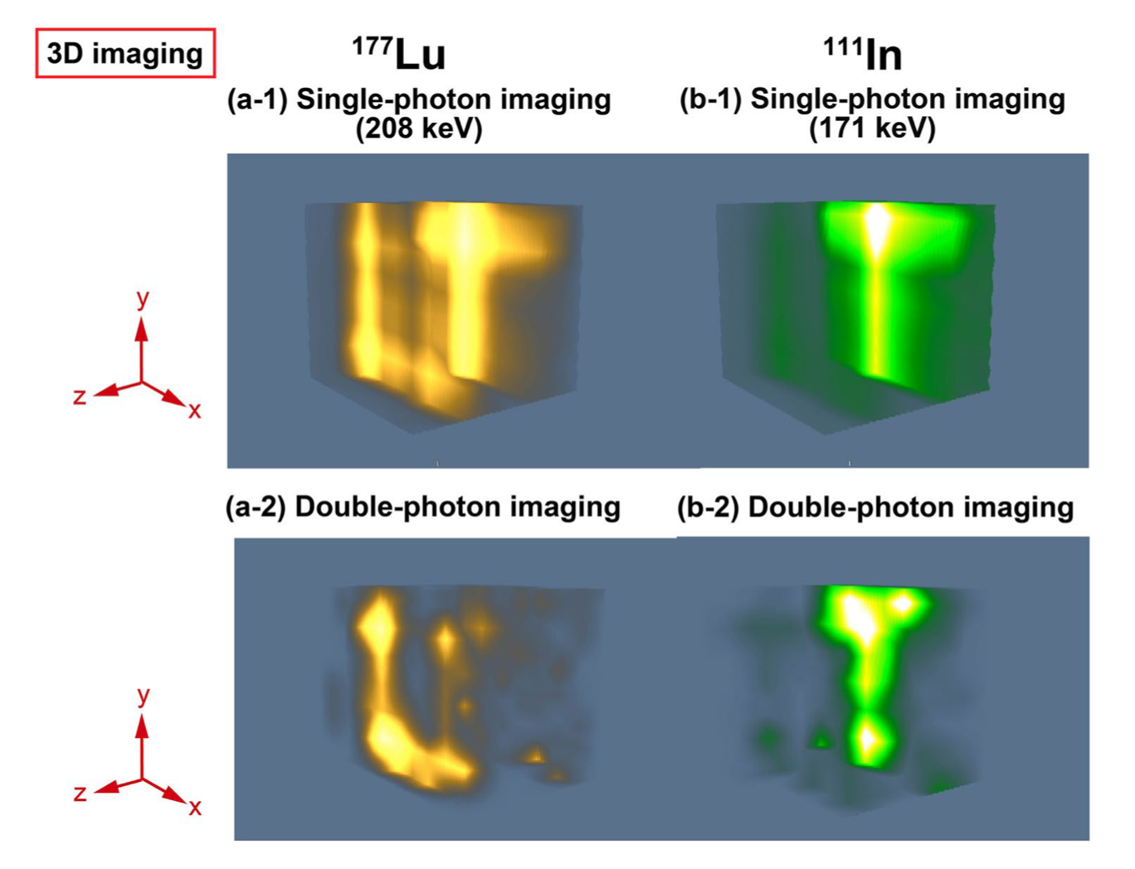
Cascade nuclides for medical imaging
Our experimental results of double photon coincidence imaging [1]
Conventional method
Coincidence method
Conventional
“Estimate”
“Specify”
the radionuclide position
[1] Mizuki Uenomachi et al., Sci. Rep., (2021): 13330
Coincidence
We succeeded to demonstrate double photon coincidence imaging for cascade nuclides.

Slide 5
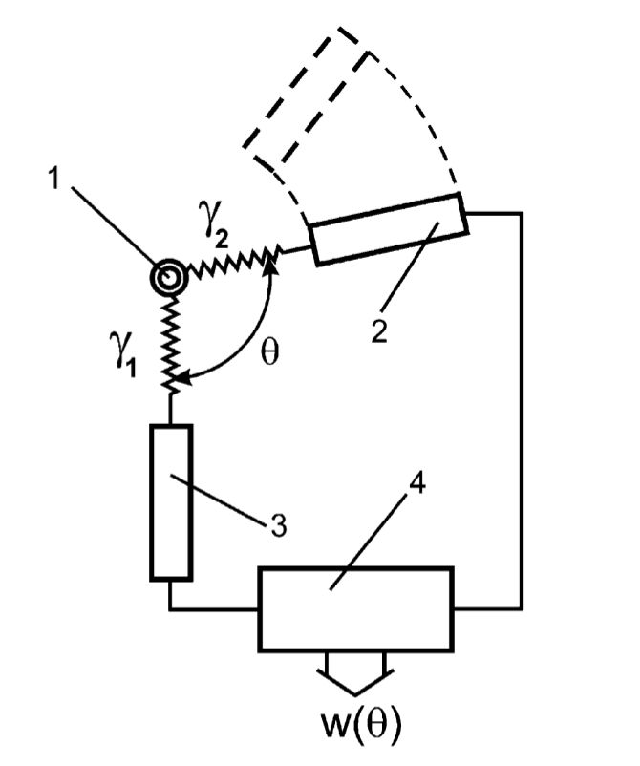
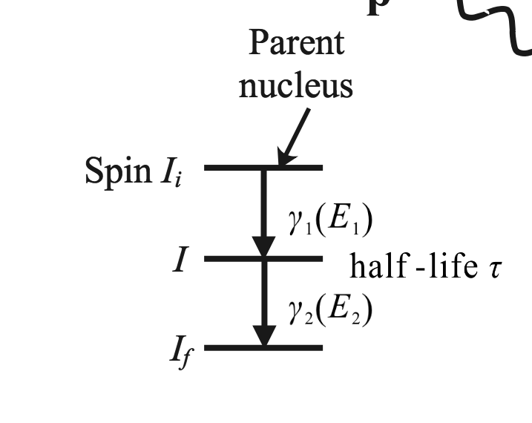
Cascade nuclides for PAC spectroscopy
Perturbed angular correlation (PAC) spectroscopy
Cascade nuclides have been used to measure magnetic and electric fields in crystal structures
Distribution of gamma-ray emission possibility
¹¹¹In decay
Z: quantization axis
+7/2
+5/2
+3/2
+1/2
-1/2
-3/2
-5/2
-7/2
source
spin
+5/2
+3/2
+1/2
-1/2
-3/2
-5/2
γ1
±h
detector
coincidence unit
detector
+1/2
-1/2
γ2
L: Angular momentum, M: Z-component of angular momentum
Angular correlation between emitted gamma rays is changed via intermediate state by the external field
Mainly caused by nuclear quadrupole interaction with an electric field gradient
D.V Filososofv. et al., Appl Radiat Isot., (2002): 437-443

Slide 6
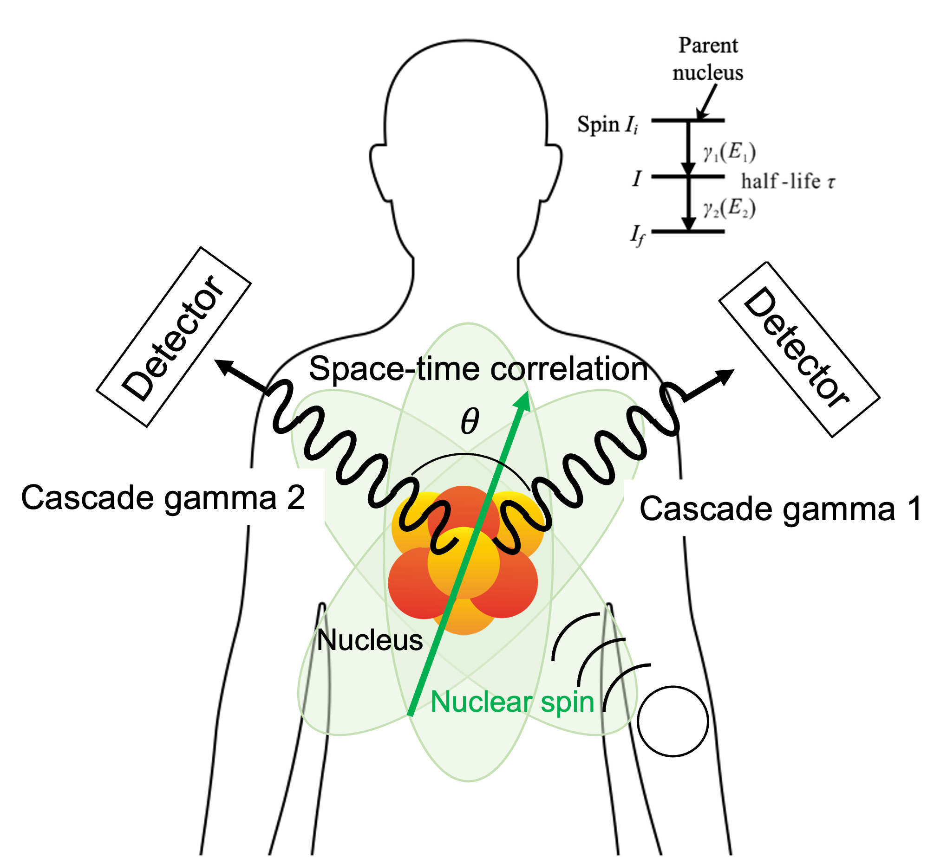
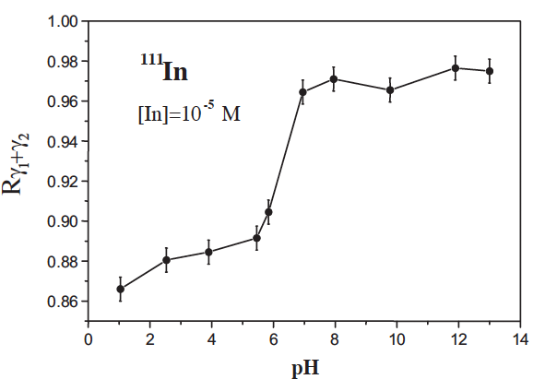
Objective
In this study, we demonstrated a novel imaging technology, which combines the double photon coincidence imaging and PAC principle, for detection of inter-molecular interaction in vivo.
Coincidence detection of cascade photons
Specify the nuclide position : Imaging
Angular correlation measurement
: Extraction of local environment information
Ex.) pH, intermolecular interaction etc..
External electromagnetic field
Filossofov, D. V., et al., Appl Radiat Isot., 57.3, (2002): 437-443

Slide 7
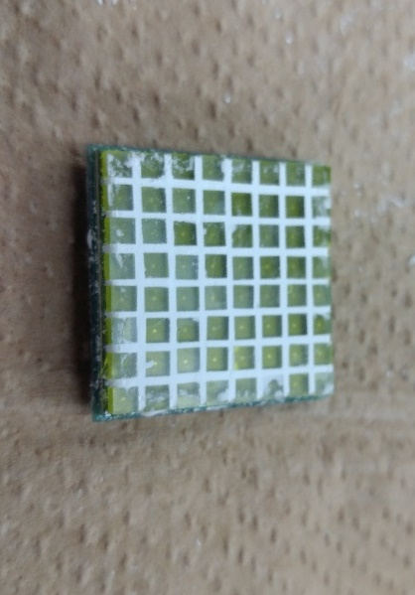
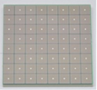
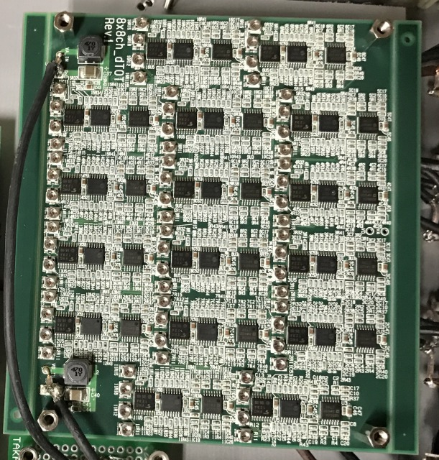
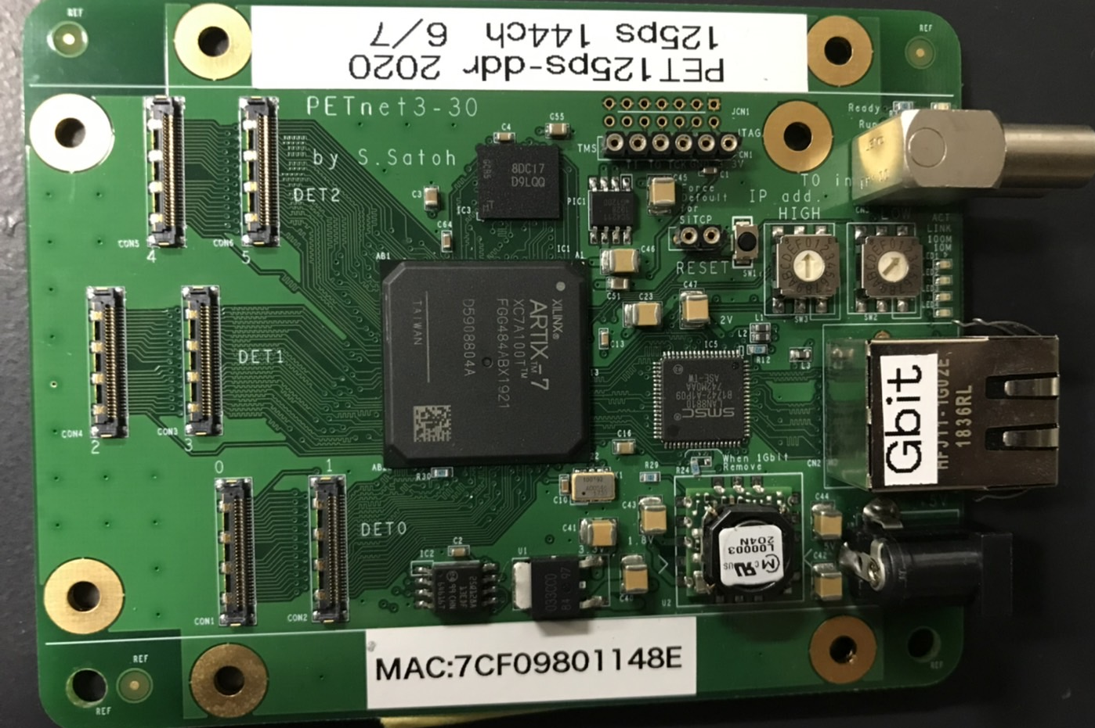
Detector setup for angular correlation depending on pH
Detector
HR-GAGG
SiPM
- Scintillator : High-resolution type Ce:GAGG (fabricated by Tohoku Univ.)
+
8 x 8 array, pixel size: 2.5 mm x 2.5 mm, pitch size: 3.2 mm x 3.2 mm
Thickness: 4 mm
3.2 mm
2.5 mm
- Optical sensor : SiPM (Hamamatsu, S-13361-3050N-08)
2.5 mm
3.2 mm
8 x 8 array, pitch size: 3.2 mm x 3.2 mm
Signal process
- 64 ch dynamic Time over Threshold (dToT) method [2]-based circuits
Improved linearity between ToT width and energy
Low power consumption
Parallel individual readout
Data Acquisition System
FPGA-based parallel ToT DAQ [3]
Time resolution : 128 ps
List mode data
Ch, time width, time information
[2] K.Shimazoe et al., IEEE trans. On Nuc. Sci., (2012): 3213-3217
[3] S. Sato et al., IEEE trans. On Nuc. Sci., (2021): 1801-1806

Slide 8
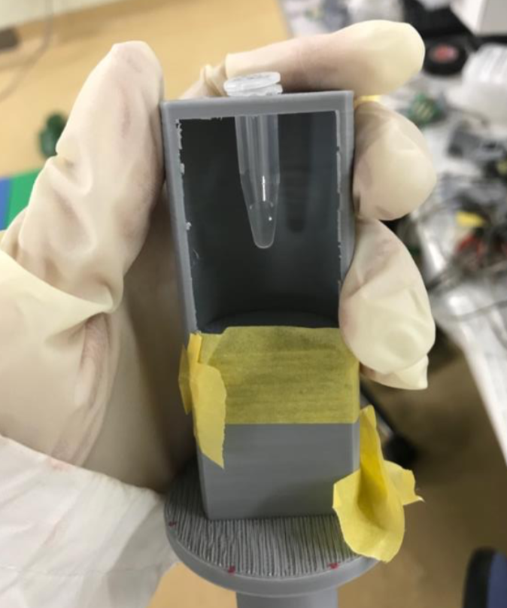
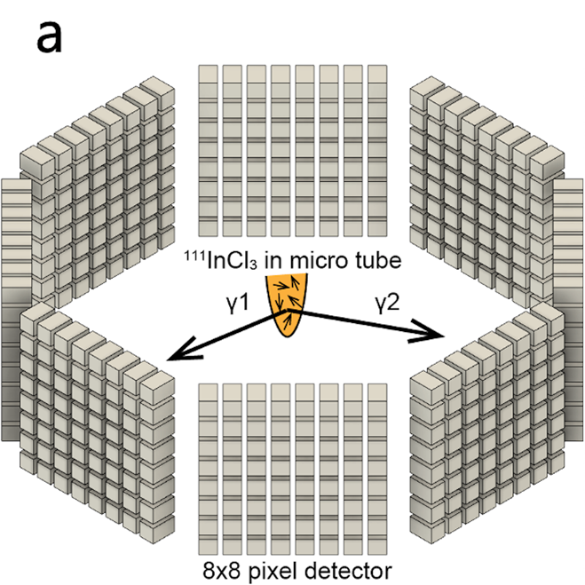
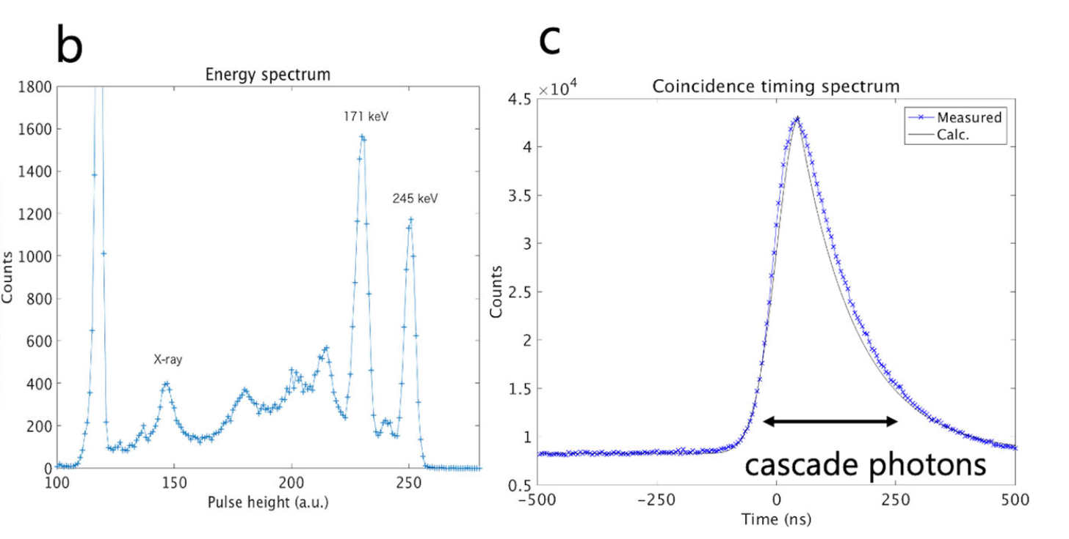
Experimental setup for measurement of angular correlation[4]
Experimental setup
InCl₃ Liquid tracer
(SPECT application)
pH 13 InCl₃ + NaOH
pH 9 InCl₃ + NaOH pH9 pH7
pH 7 InCl₃ + NaOH pH9 pH4
pH 5 InCl₃ + pH7
pH 3 InCl₃ + pH9
pH 1.9 InCl₃ solution
0.6~1MBq - 30min
[4] K.Shimazoe , Mizuki Uenomachi et al., Commun. Phys., (2022): 24

Slide 9
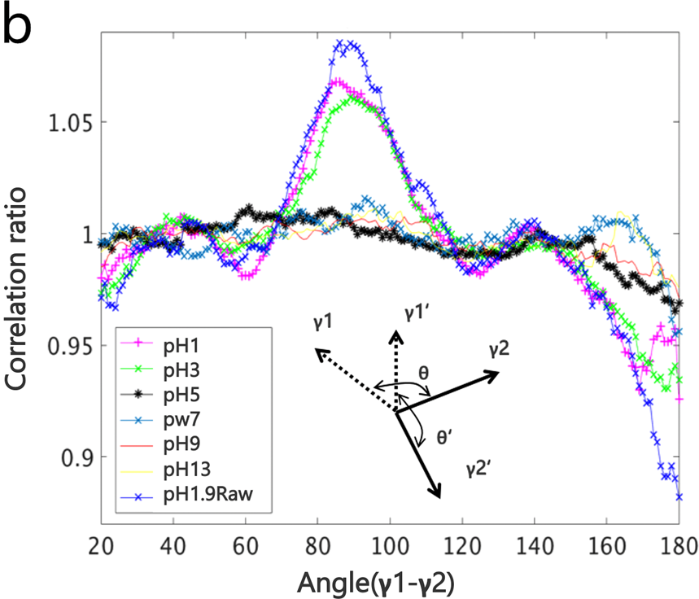
Measurement of angular correlation depending on pH [4]
Coincidence timing histogram
Distribution of the emission angles
pH3 ~ 5
coincidence event
background event
background event
Correlation ratio = C _{coin} (θ)/ C _{backgropund} (θ)
, C (θ): Count
The change in angular correlation around pH 3~5 was observed.
[4] K.Shimazoe , Mizuki Uenomachi et al., Commun. Phys., (2022): 24

Slide 10
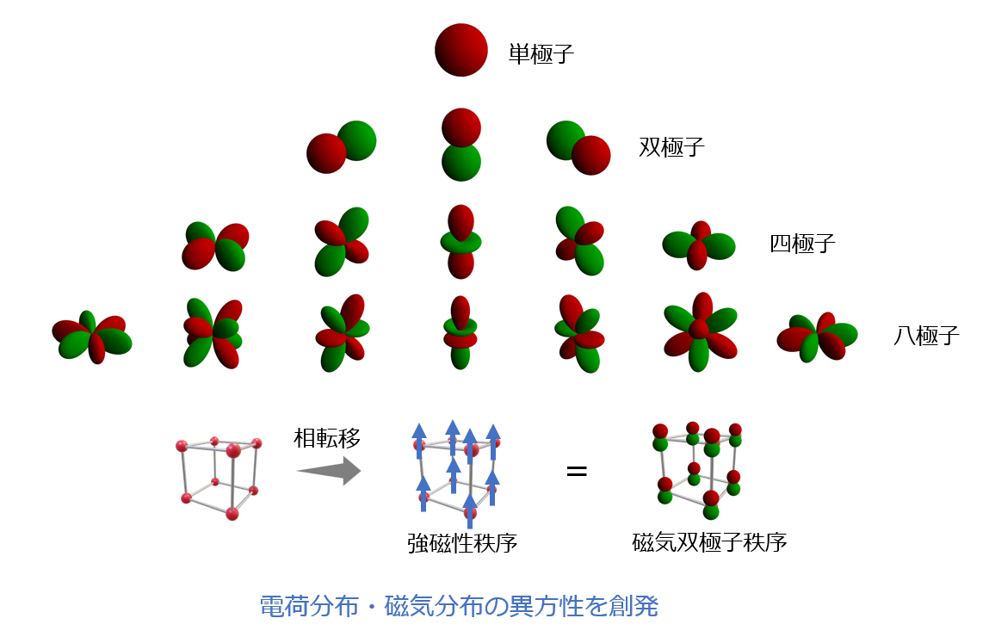
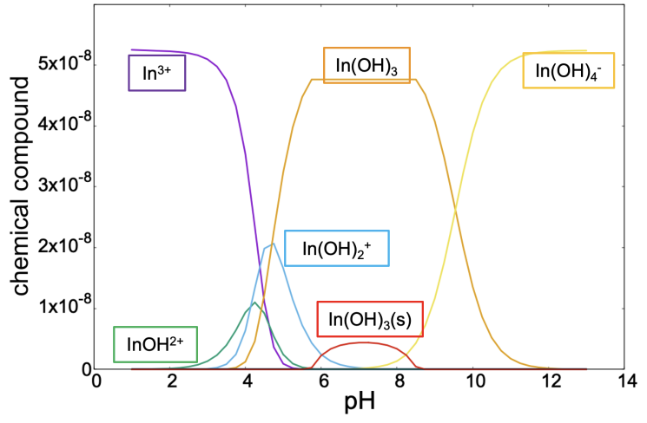

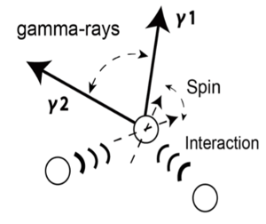
Why angular correlation was changed depending on pH?
Electric Quadrupole Interaction
Reaction with NaOH and InCl₃ vs pH
−
＋
＋
−
Charge non-uniformity in nuclei interact with external field (electric gradient) and perturbed
Simulation with PHREEQC
Dominant Chelator changed depending on pH

Slide 11
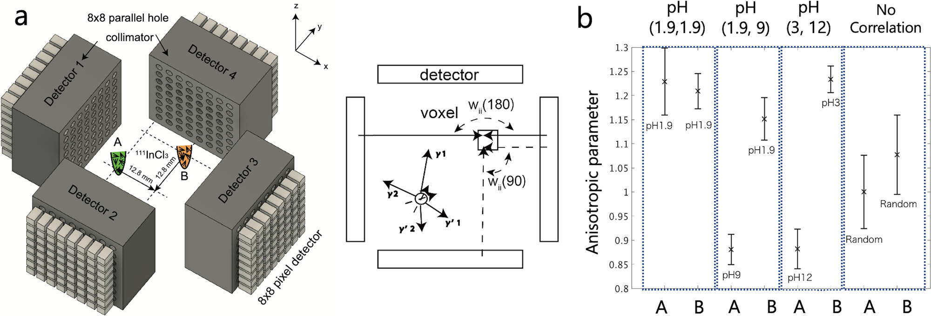
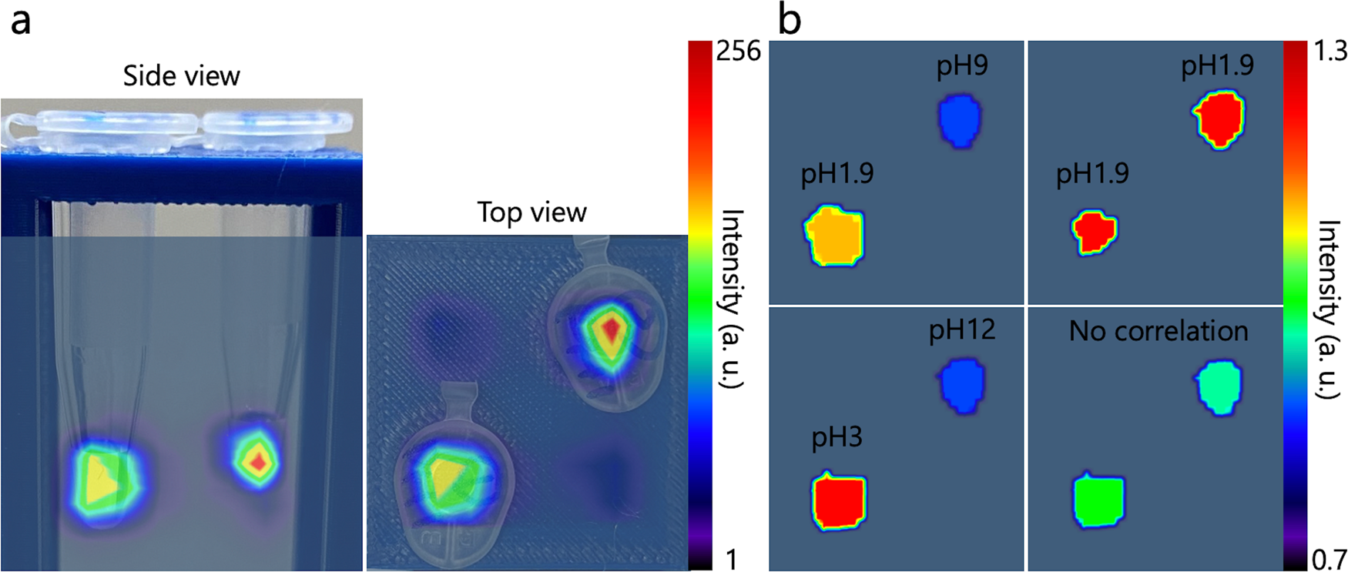
Demonstration of imaging and pH sensing using point sources [4]
pH of a point source was estimated by calculating the correlation ratio of 90° and 180° direction
Imaging was performed with parallel hole collimators
We succeeded to perform ¹¹¹In imaging and pH estimation simultaneously
[4] K.Shimazoe , Mizuki Uenomachi et al., Commun. Phys., (2022): 24

Slide 12
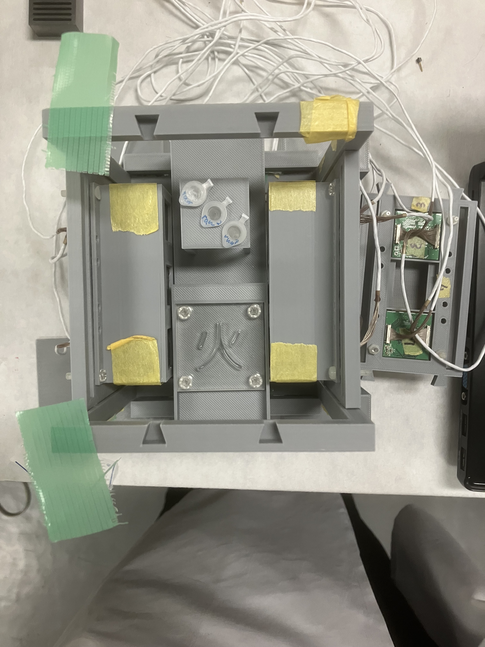
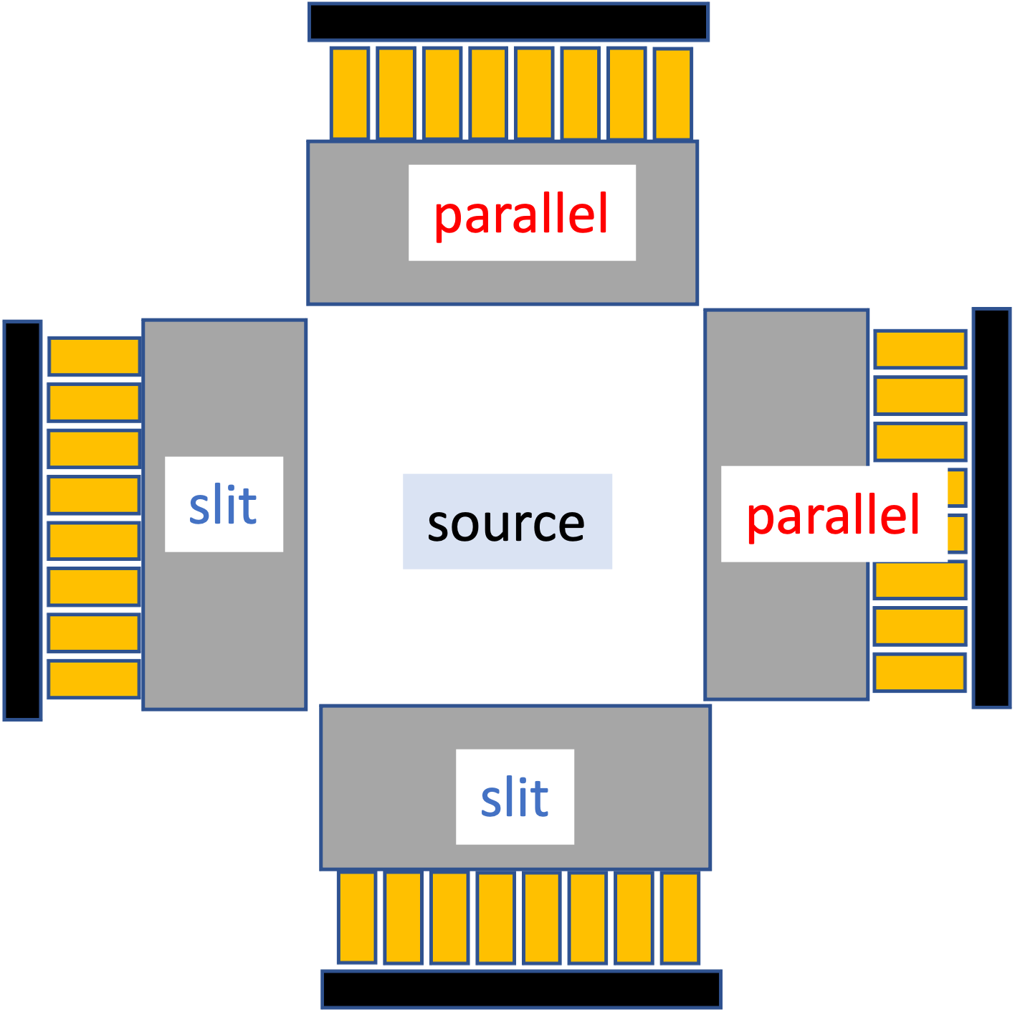
Demonstration of imaging and pH sensing using a distribution source
Phantom
Experimental setup
pH12
pH1.7
pH5
Measurement time: 32hour
pH | Volume(μl) | Activity(MBq) | Solution
1.7 | 30 | 0.42 | InCl₃
5 | 30 | 0.34 | InCl₃ + NaOH + HCl
12 | 120 | 1.26 | InCl₃ + NaOH

Slide 13
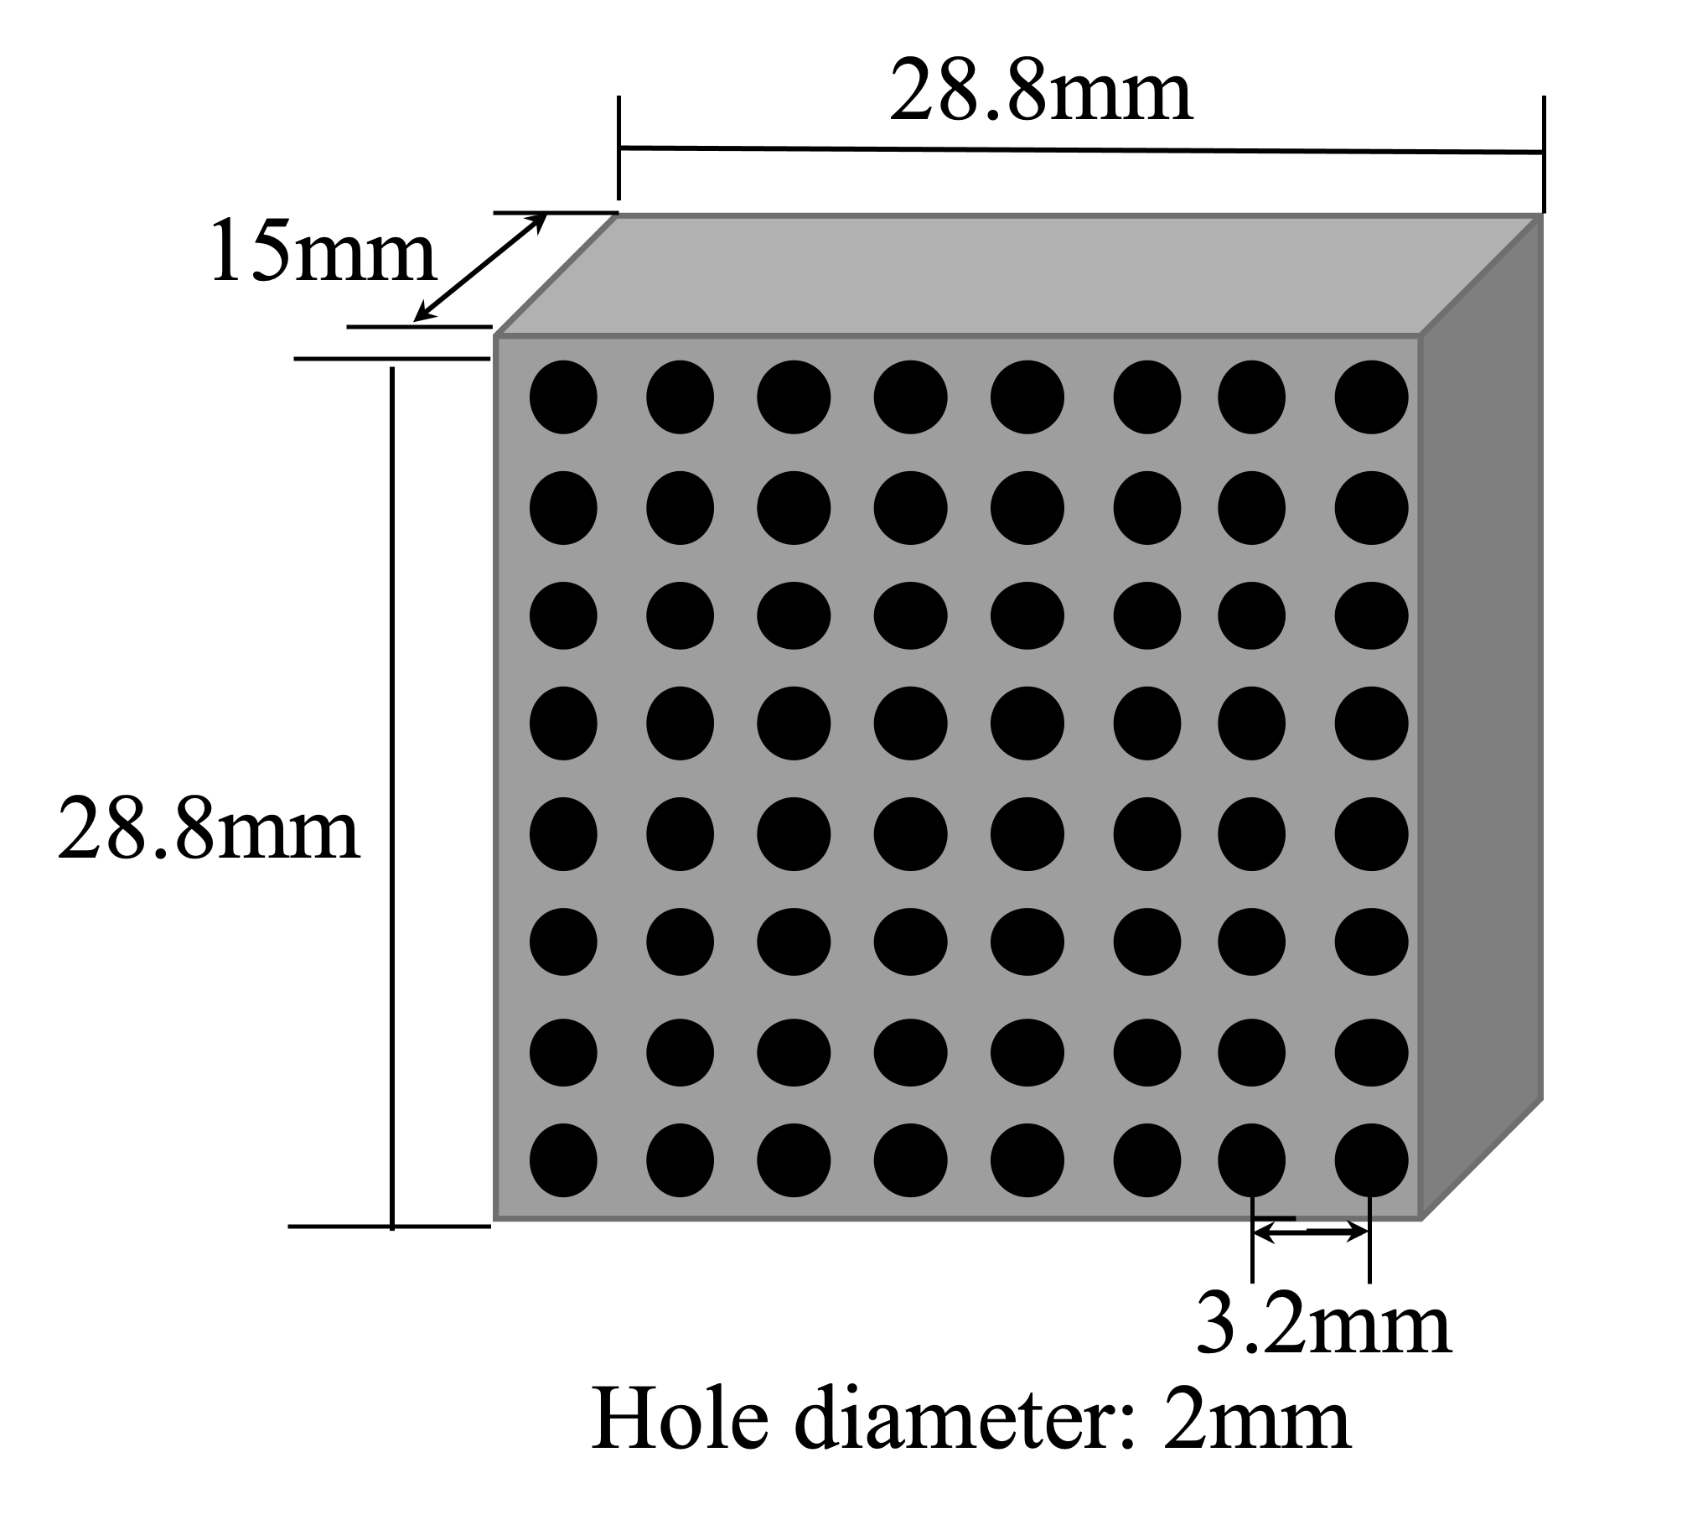
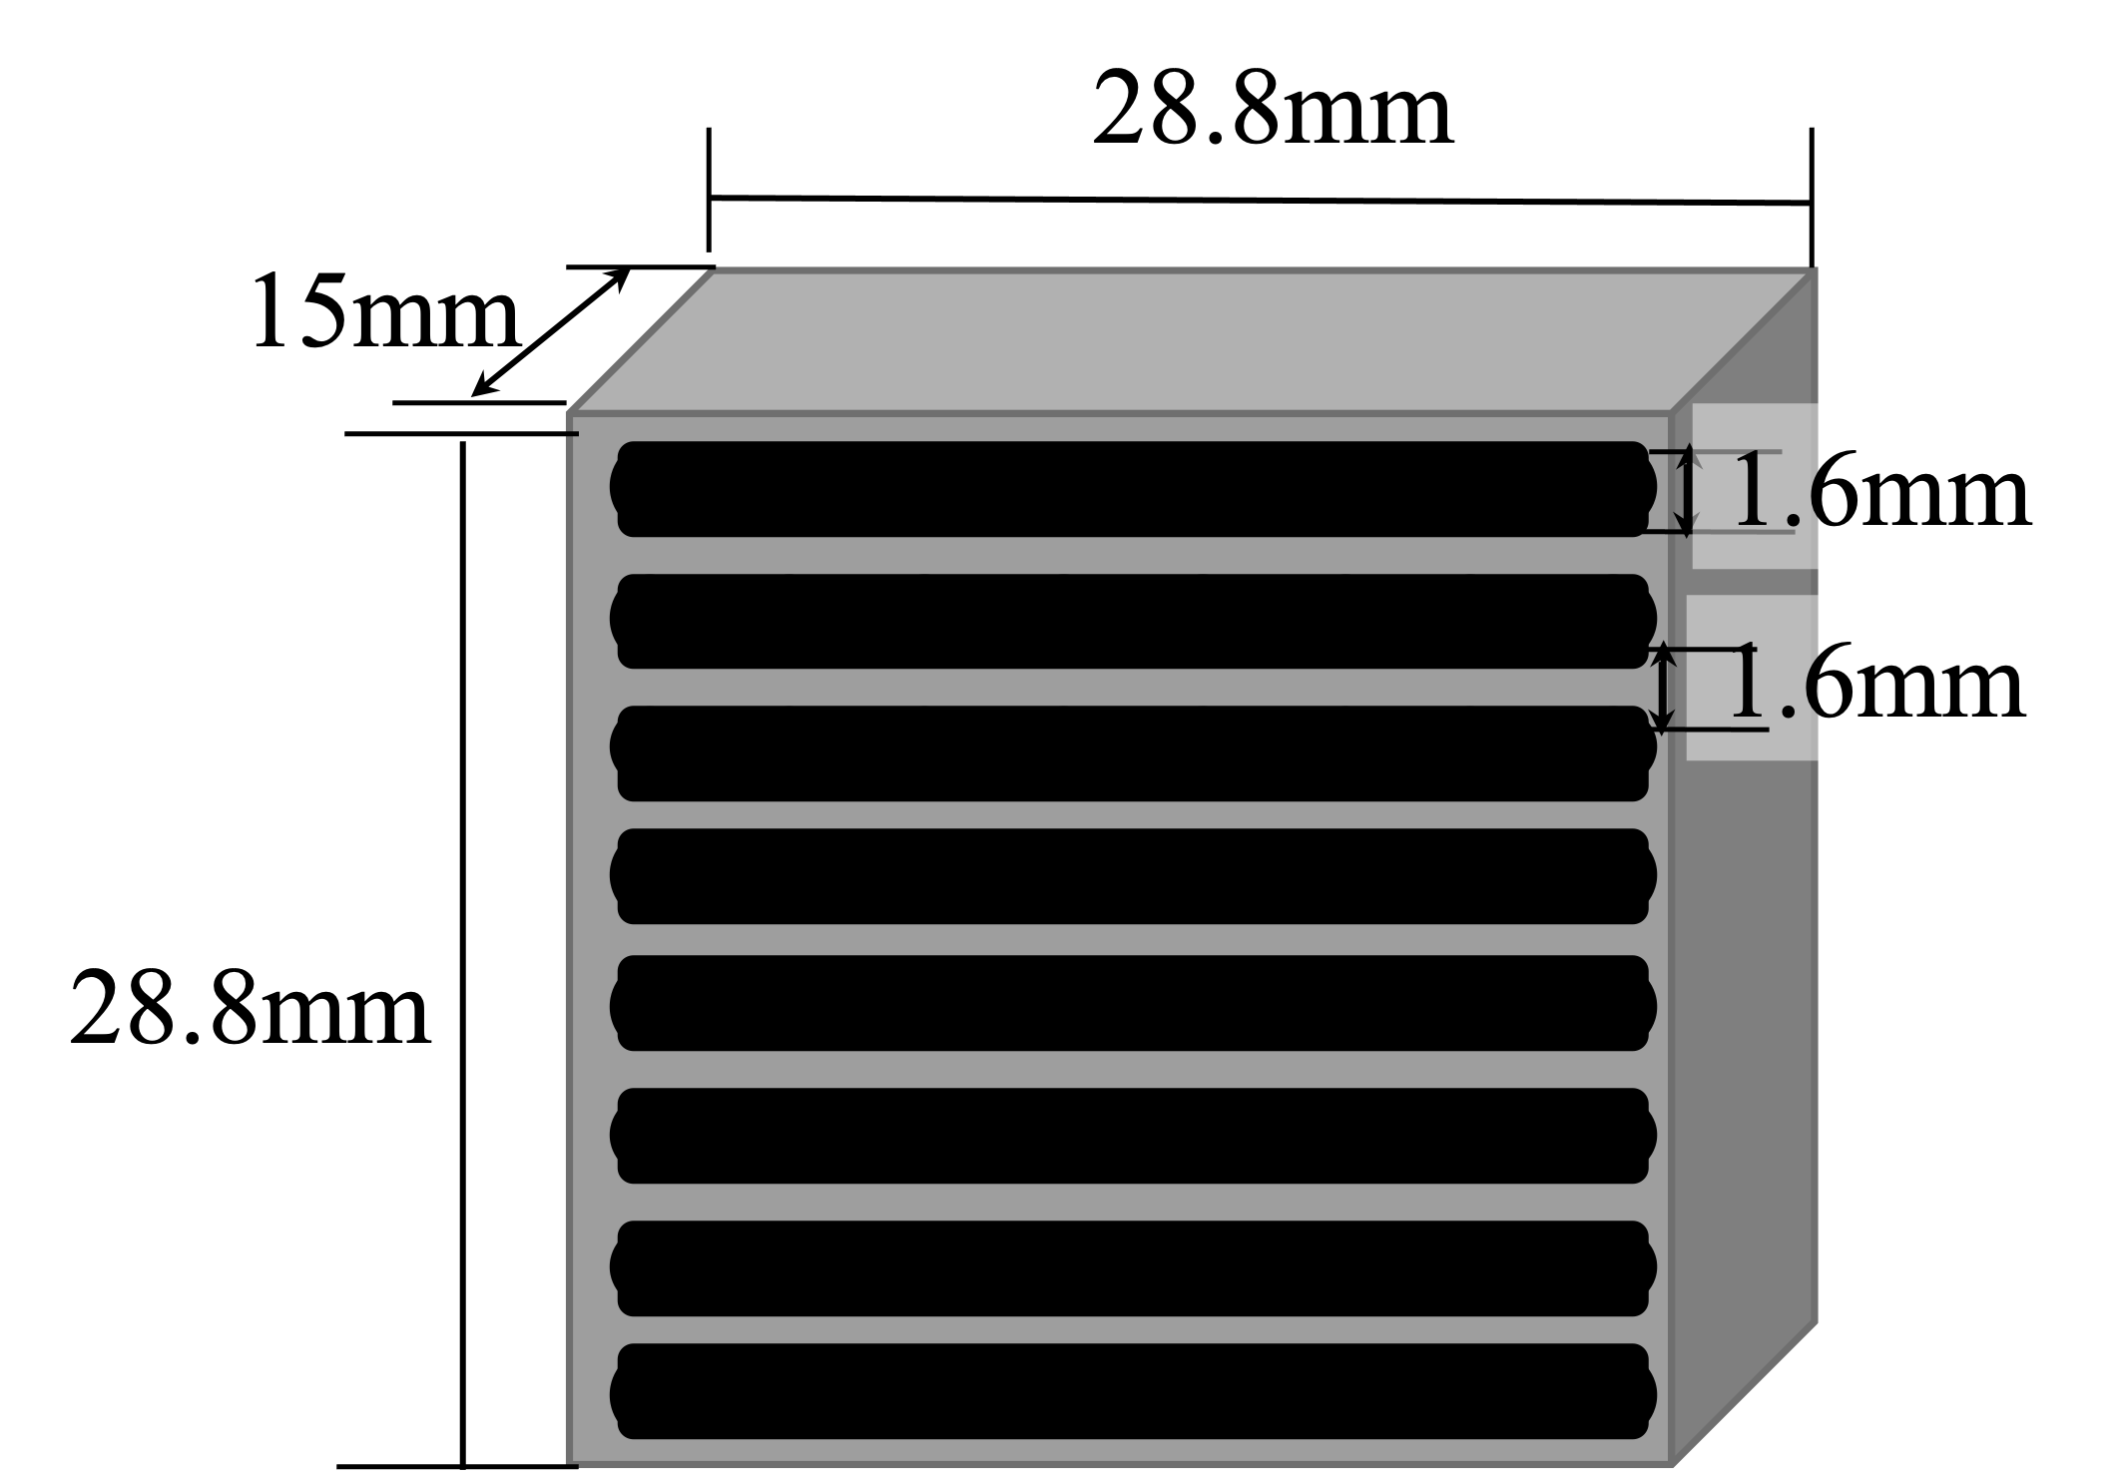
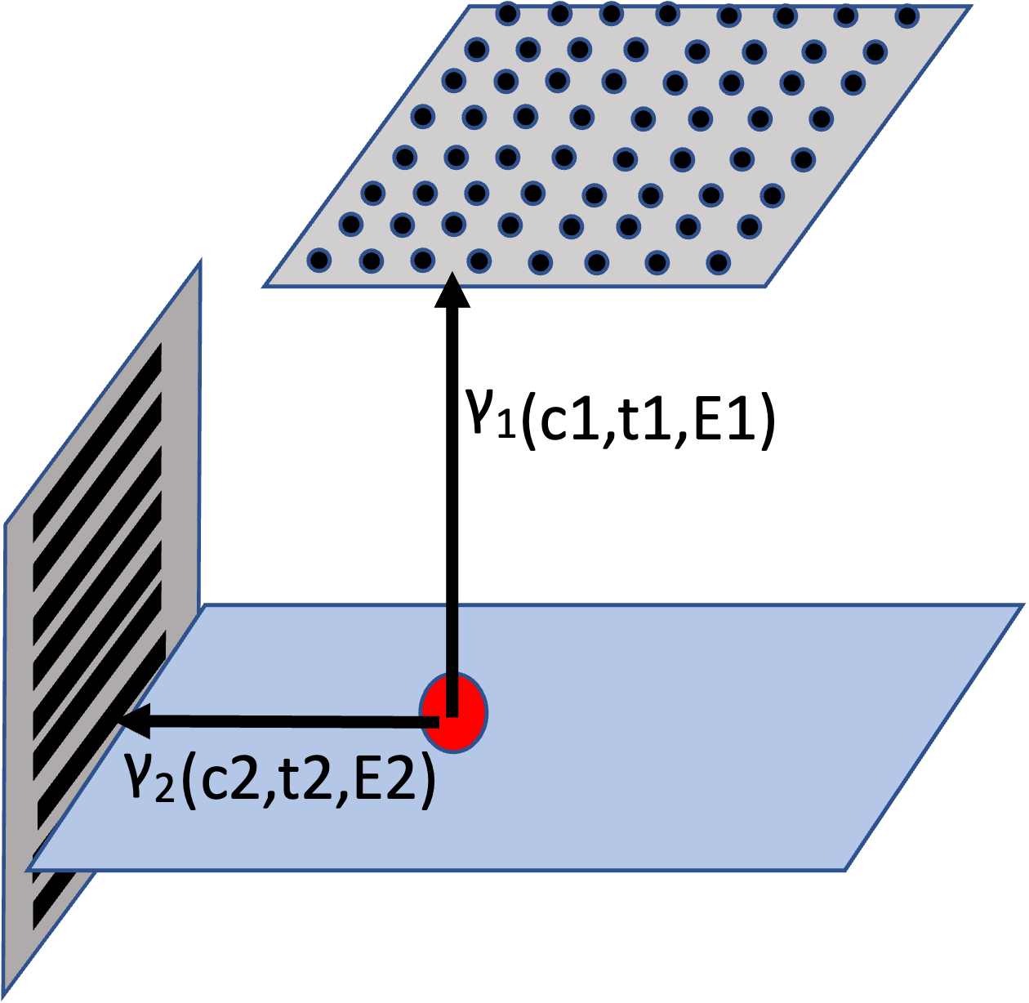
Demonstration of imaging and pH sensing using a distribution source
Collimator configuration: Parallel hole and slat hole collimators
parallel hole collimator
c: Channel
t: detection time
E: Energy
slat hole collimator
γ₁ and γ₂ : coincidence event

Slide 14
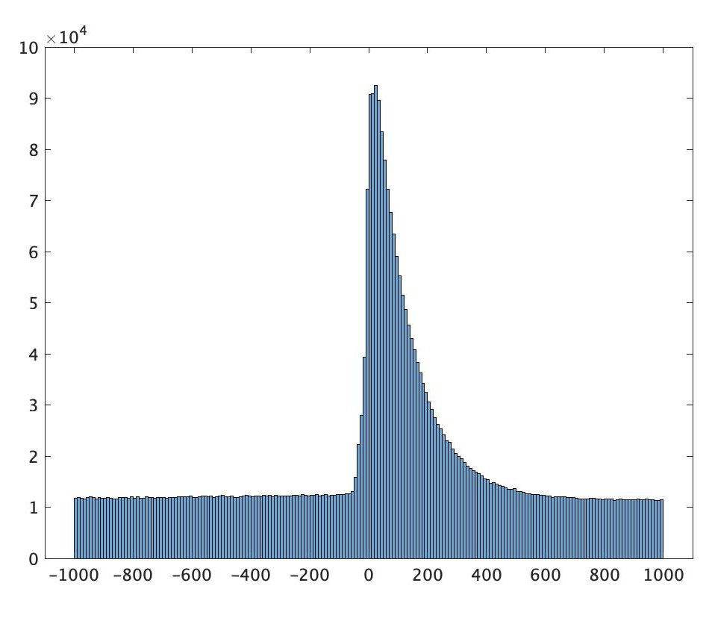
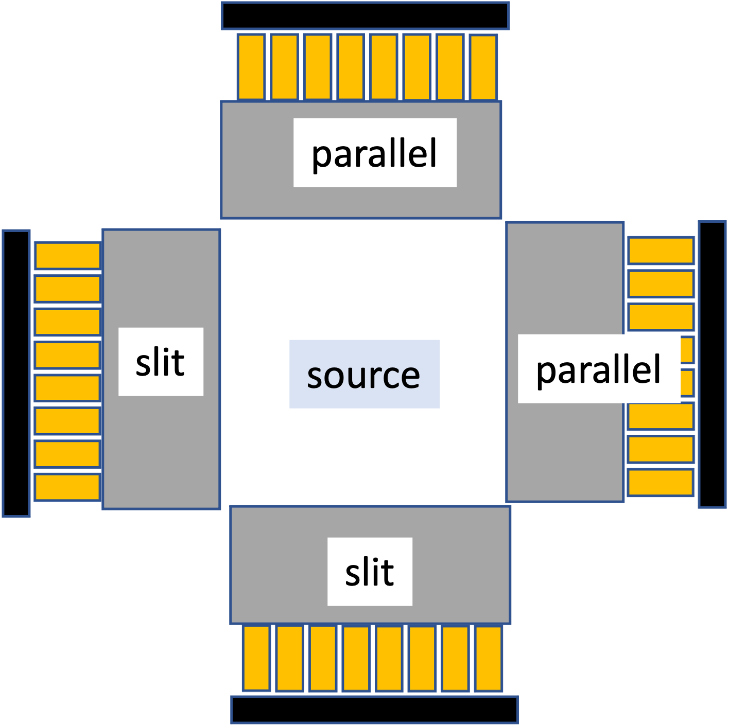
Demonstration of imaging and pH sensing using a distribution source
Calculate 90° and 180° emission ratios only for channels that exceed the threshold of detectors with parallel hall collimators
Emission time difference spectrum of ¹¹¹In
(Emission ration)=
R _{count} (90°)/ R _{count} (180°)
coincidence event
R _{count} (θ): Count ratio with background correction
background event
z
y
x
Time difference between 171keV and 245keV [ns]

Slide 15
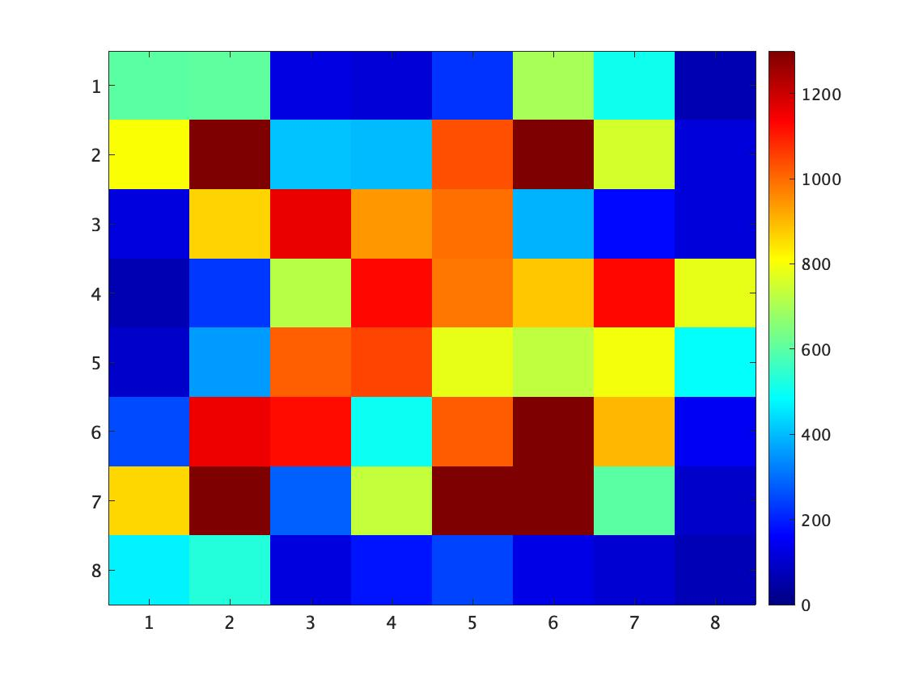
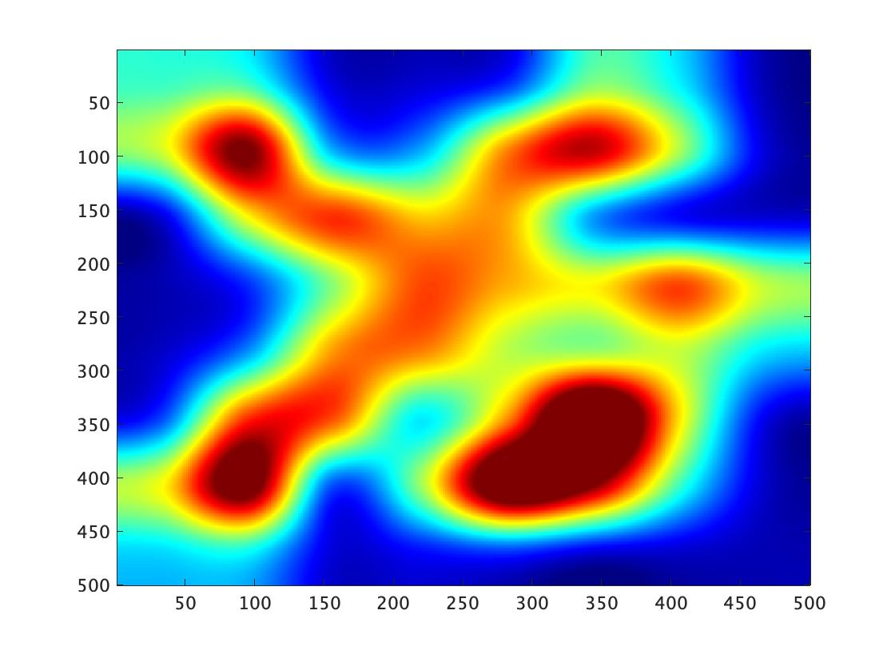
¹¹¹In Imaging results
Raw imaging results
Imaging results after smoothing
pH12
pH5
pH1.7
The shape of the phantom can be determined from the imaging results.

Slide 16
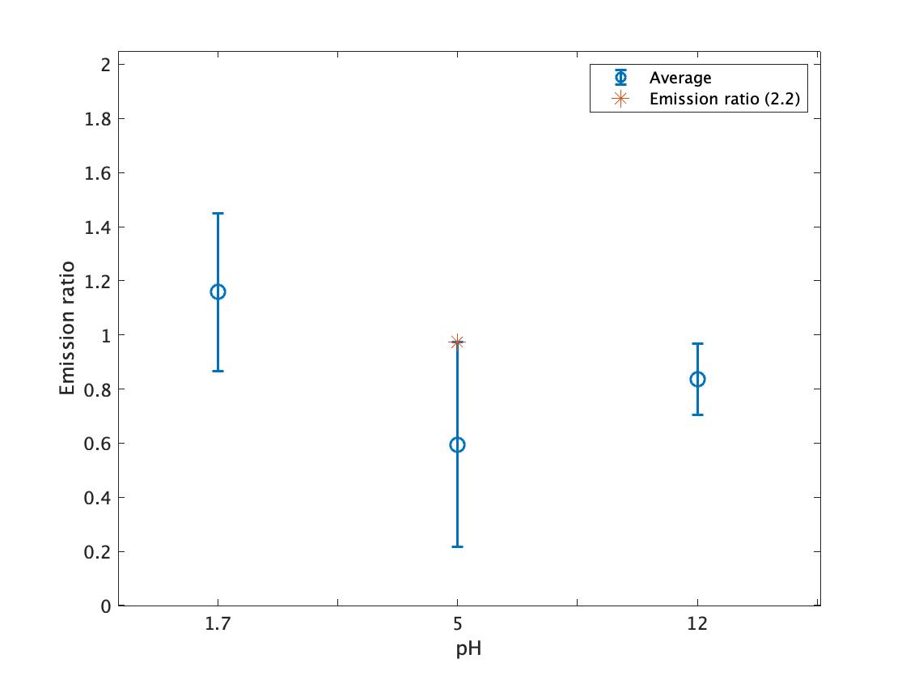
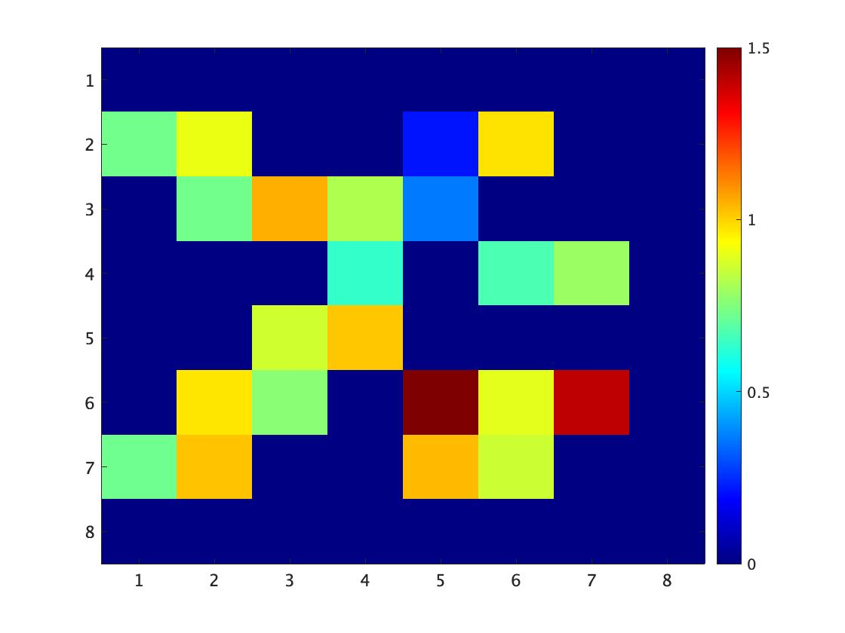
pH imaging results
pH imaging results
pH12
pH1.7
pH5
Preliminary
Preliminary
pH | Average of ratio | standard deviation
1.7 | 1.157 | 0.293
5 | 0.595(0.973) | 0.378
12 | 0.836 | 0.133

Slide 17
Summary and future works
We proposed a novel nuclear medicine imaging that extracts a local environment information as well as visualization of radionuclide via nuclear-spin.
We succeeded to observe the angular correlation change of ¹¹¹In solution depending on pH
The demonstration of imaging and pH estimation was succeeded with parallel hole collimators-based detectors.
Future works
In vivo application: observation of pH changes when the radioactive drug is taken into a cell
Extraction of other local environment information, such as temperature, viscosity, molecular size

Slide 18
Thank you for your attention

Slide 19
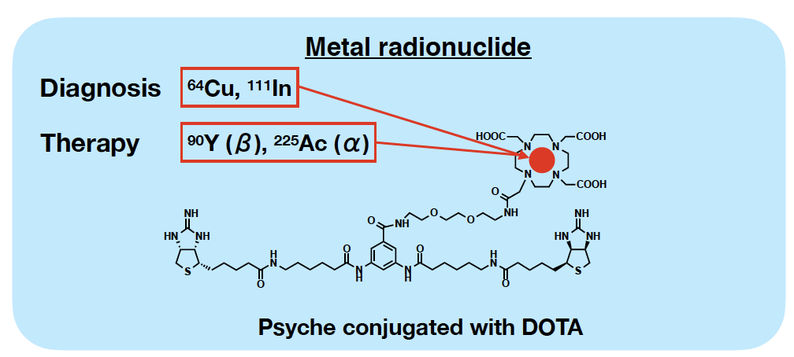
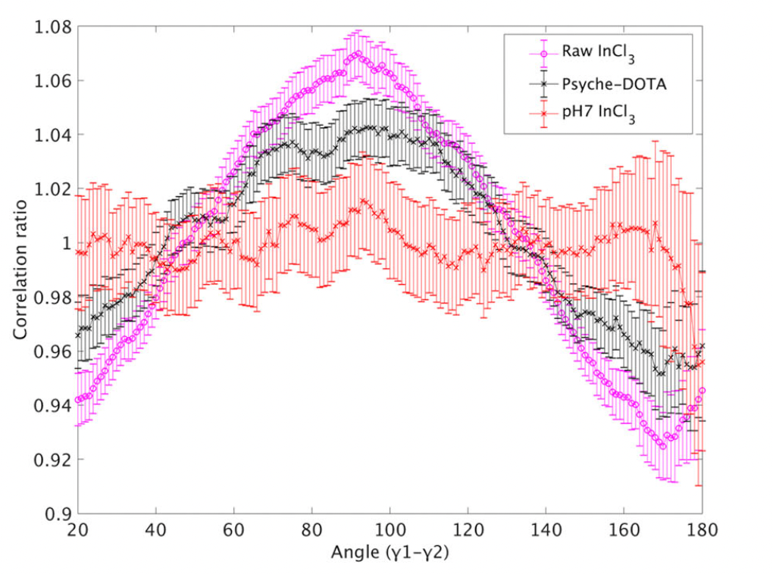
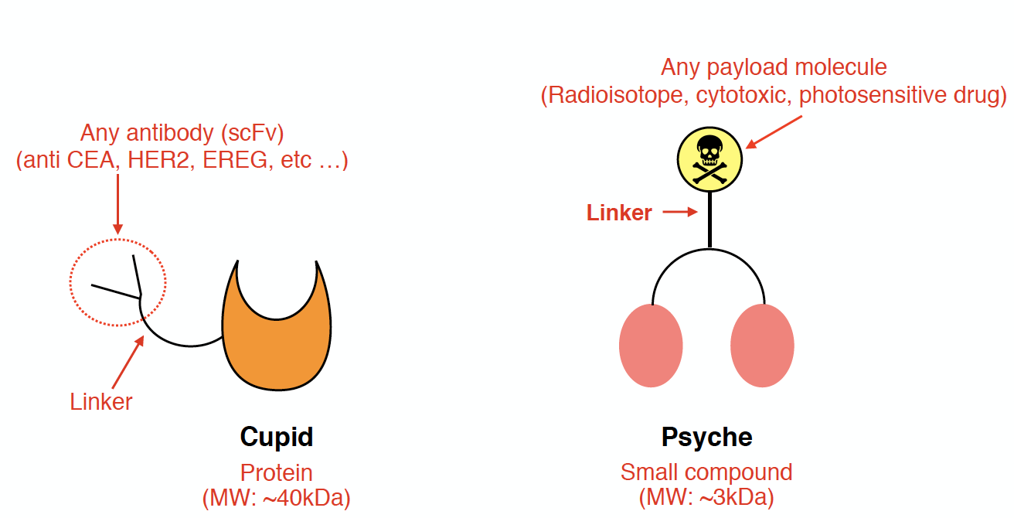
Angular correlation changes depending on types of molecules
Antibody-bonding detection with photon pair
Psyche-DOTA vs pH7 vs InCl₃

