Slide 1





The new Atomic Mass Evaluation (AME2020)
Wenjia Huang
Advanced Energy Science and Technology Guangdong Laboratory
On behalf of AME collaboration
M. Wang, F.G. Kondev, G. Audi and S. Naimi
ARIS2023，4/6-9/6, Avignon-France

Slide 2
Outline
Introduction to the AME
What’s new in AME2020
Conclusions & perspectives

Slide 3
Introduction to the AME
What’s new in AME2020
Conclusions & perspectives

Slide 4
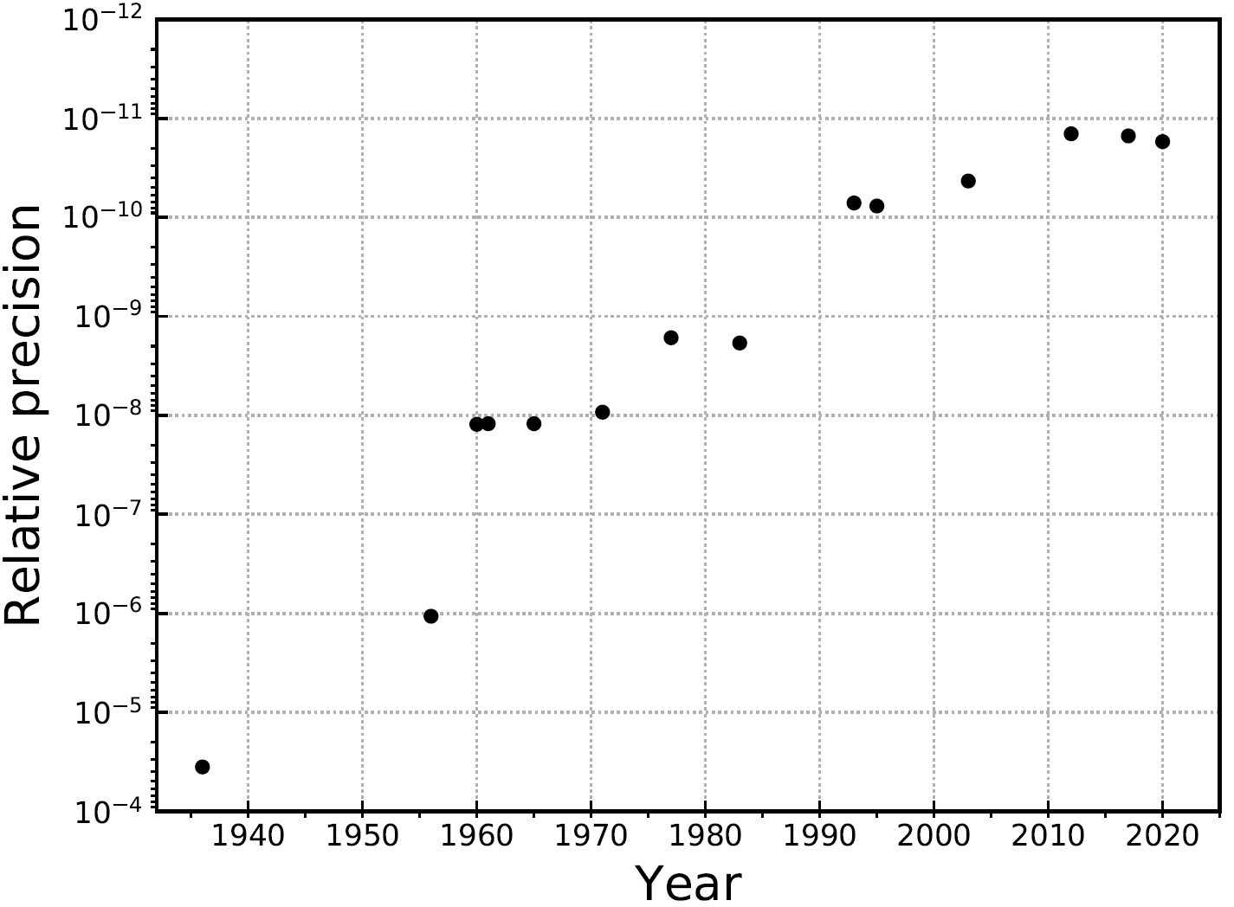
Precision of ¹⁴N
One order of magnitude improvement every 10 years
CPT test
Fundamental constants
Weak interaction
Nuclear structure / astrophysics
Chemistry & general physics

Slide 5
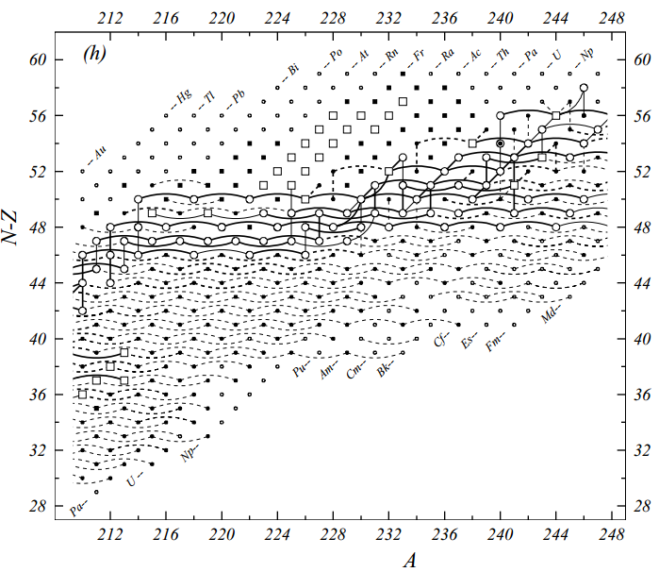
70 years of Atomic Mass Evaluation
In the early 1950’s, it was found that many relations (direct and indirect) overdetermined the mass value of many nuclides.
Aaldert H. Wapstra established a procedure using the least-squares method to solve the problem of overdetermination.
Least-squares method
Linearize each datum assuming masses are unknown
best mass values and mass uncertainties (mass table)
reveal systematic errors
α
β/EC
(n,γ)
MS
AME provides also estimated values
(TMS) for unknown nuclides.

Slide 6
Introduction to the AME
What’s new in AME2020
  Statistics, precision, MS, TMS
Conclusions & perspectives

Slide 7
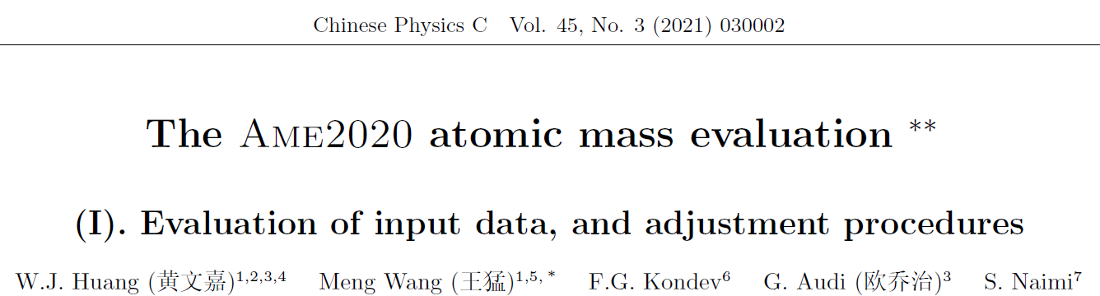
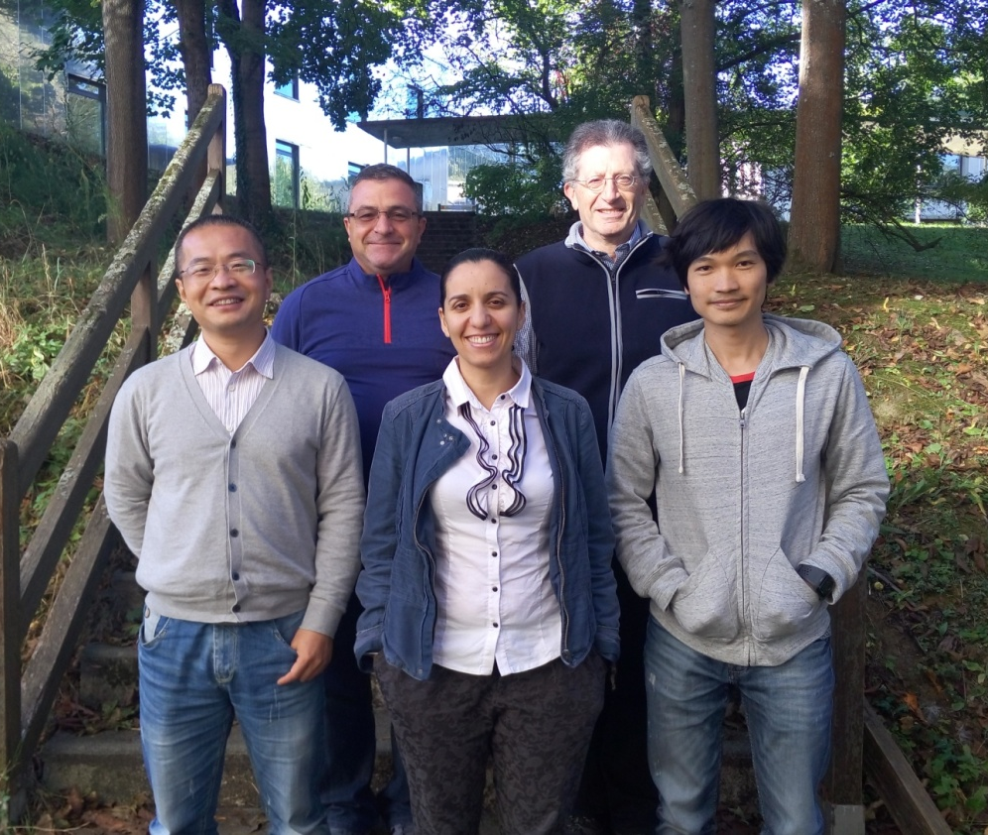
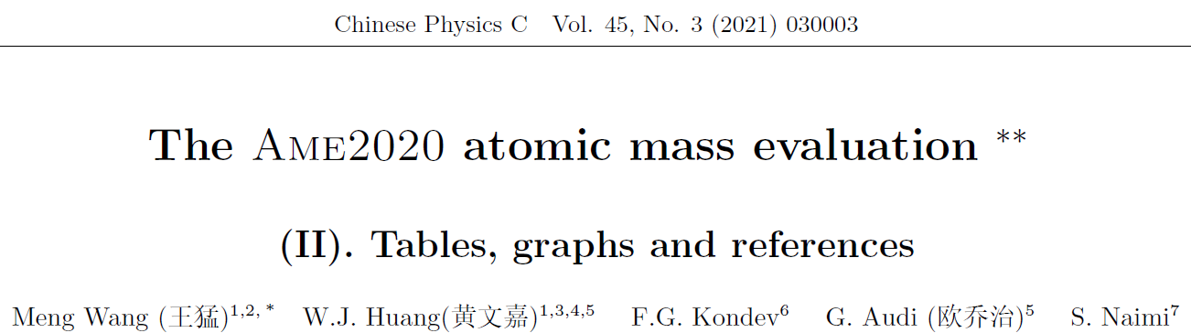
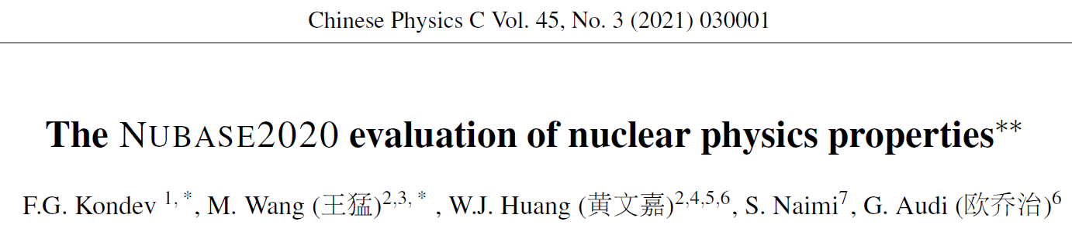
AME2020 collaboration
Files can be accessed https://amdc.impcas.ac.cn

Slide 8
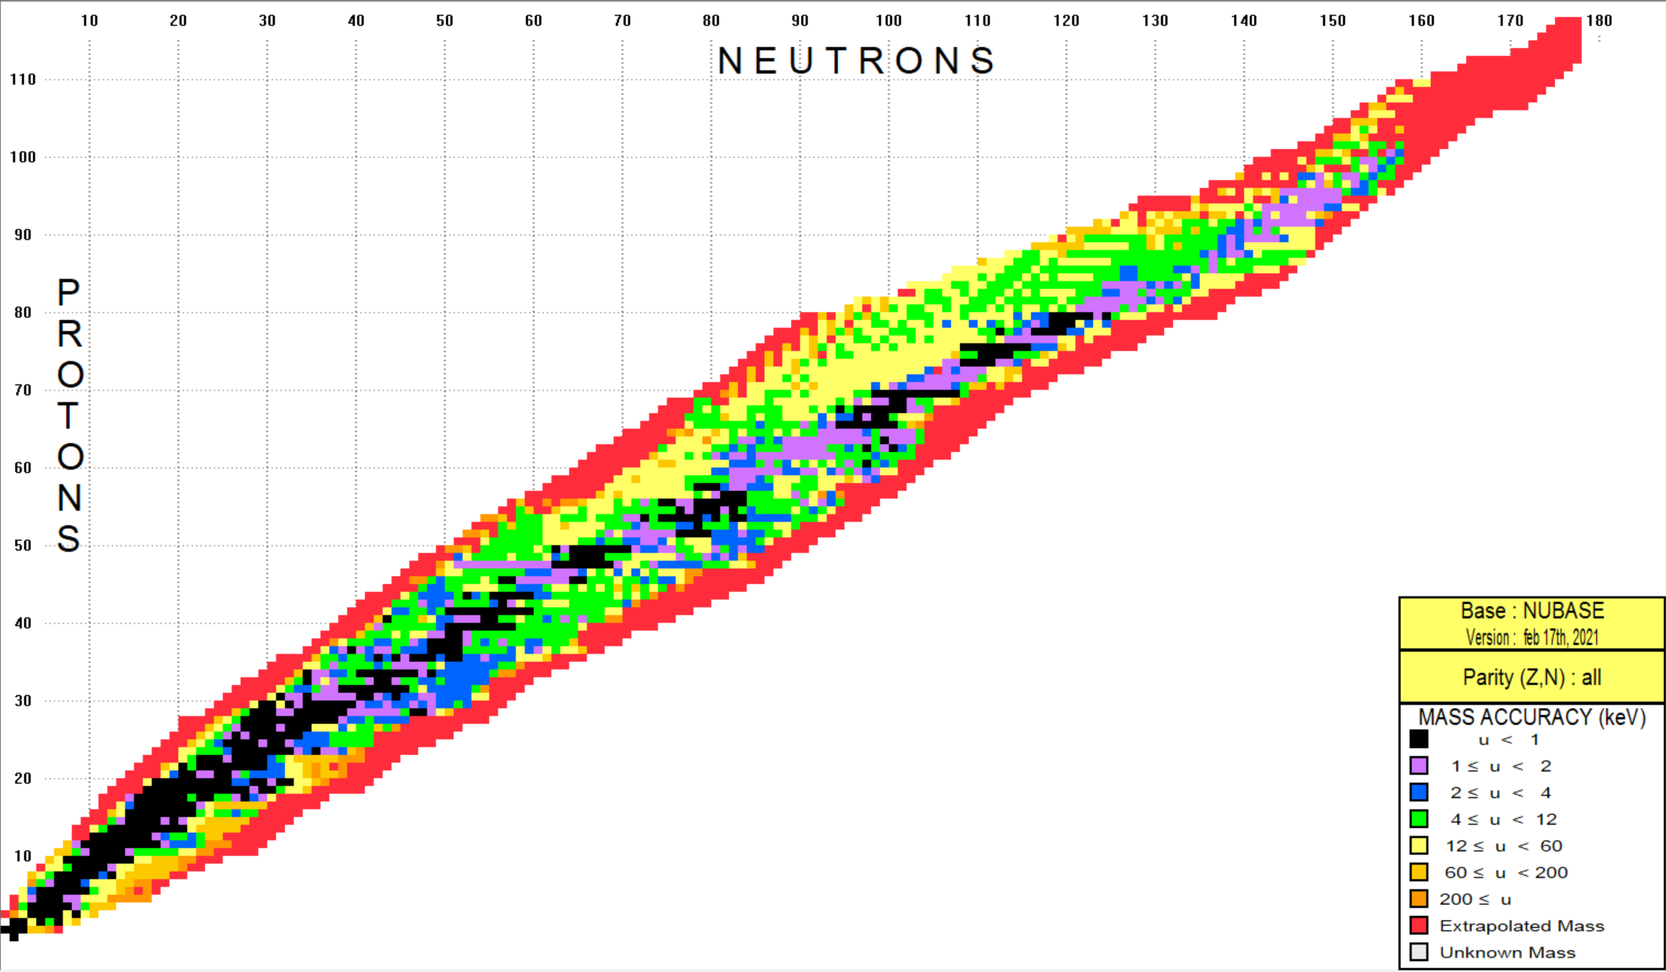
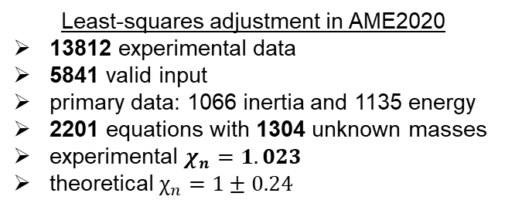
Statistics of AME2020
 | gs. | Isomer (>100ns)
experiment | 2549 | 406
TMS | 1008 | 101
Least-squares adjustment in AME2020
13812 experimental data
5841 valid input
primary data: 1066 inertia and 1135 energy
2201 equations with 1304 unknown masses
experimental $χ_{n}=1.023$
theoretical $χ_{n}=1±0.24$

Slide 9
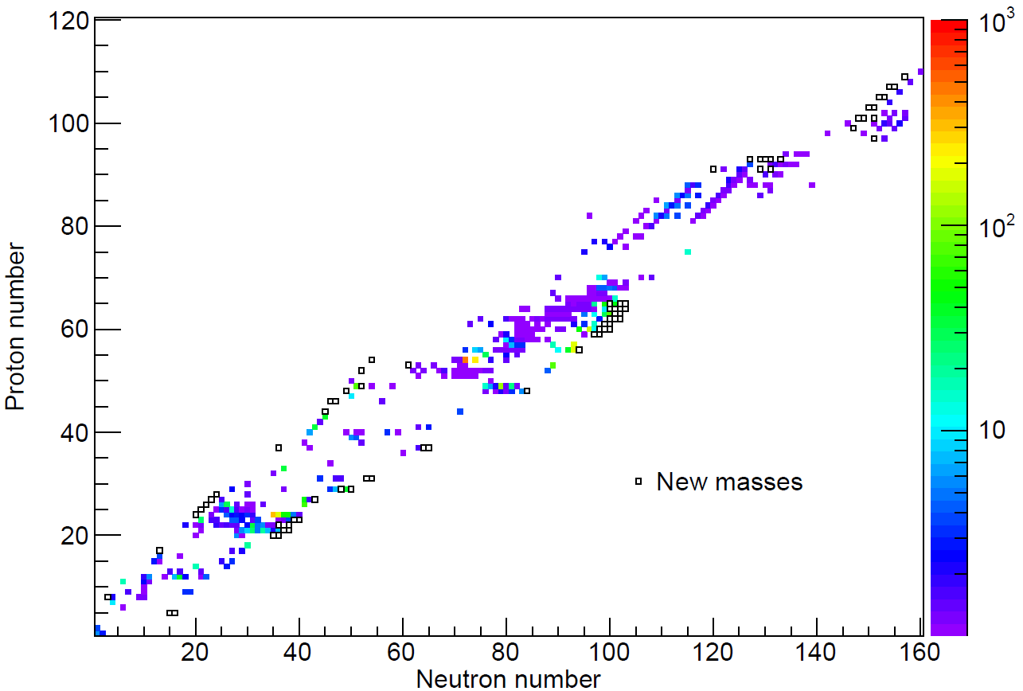

Precision comparison
Precisions of 427 mass are improved
 | < 0.1 keV | < 1 keV | < 10 keV | < 100 keV
AME2020 | 122 | 402 | 1532 | 2407
AME2016 | 107 | 366 | 1499 | 2240
increase | 15 | 36 | 33 | 67
$$\frac{σ_{AME2016} }{σ_{AME2020} }$$
RIKEN(MR-ToF)
Lanzhou(α)
Decays
CPT(PI-ICR)
CSR(IMS)
（74）
RIKEN(Bp-ToF)

Slide 10
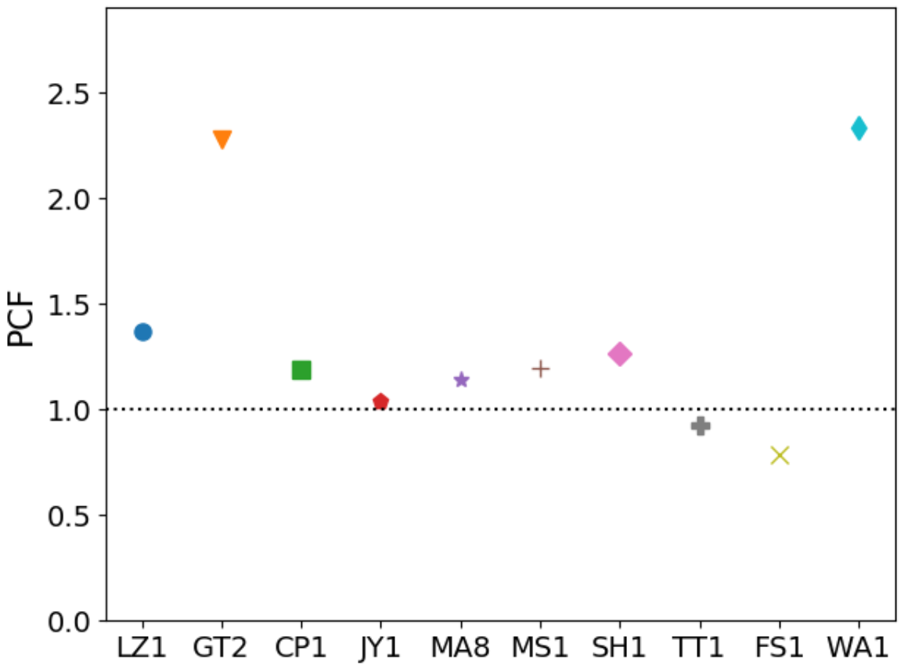
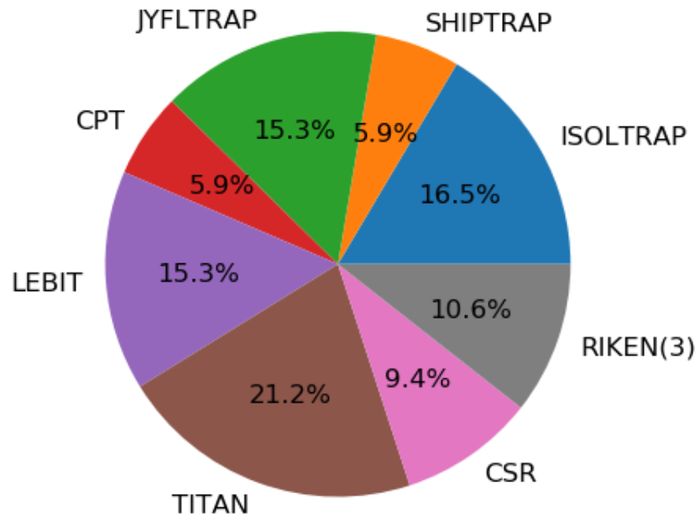
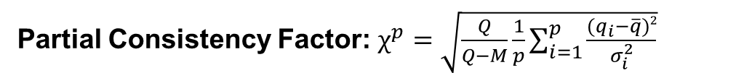
Worldwide mass spectrometer
Partial Consistency Factor: $χ^{p}=\sqrt{\frac{Q}{Q−M}\frac{1}{p}\sum_{i=1}^{p}{\frac{{(q}_{i}−\overline{q})2}{σ_{i}^{2}}}}$
On-line MS
ESR
Washington
CPT
Shiptrap
Isoltrap
CSR
Jyfltrap
Lebit
Titan
FSU
About 85 articles on masses were published since ARIS2017

Slide 11
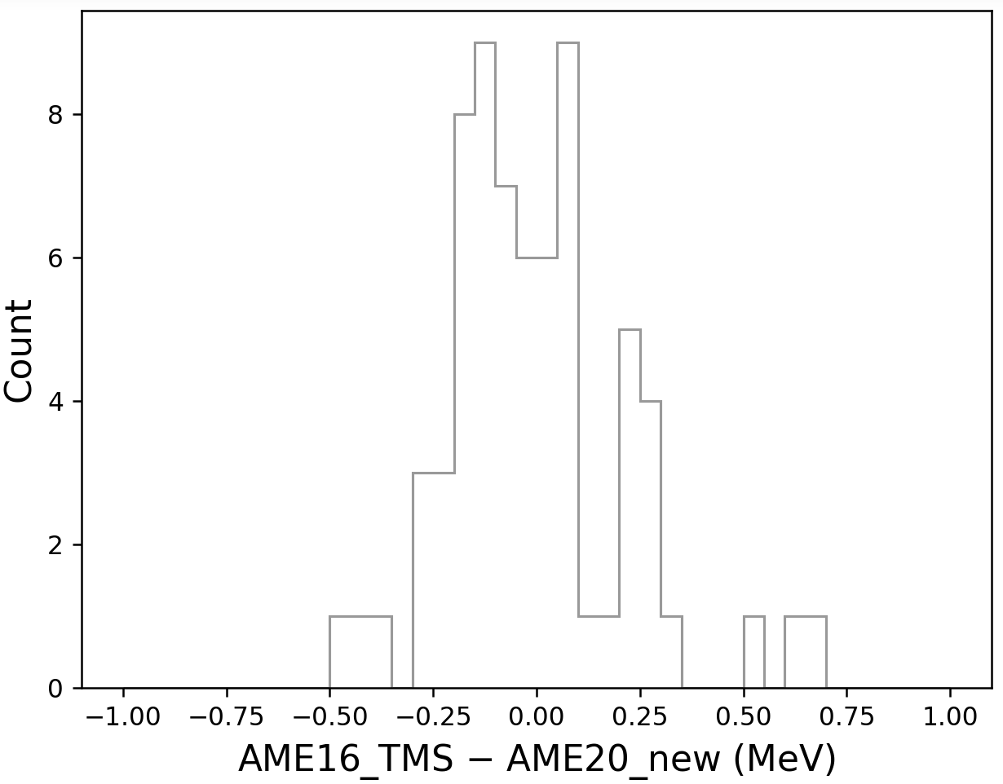
Accuracy of AME extrapolation
77 irregular masses were replaced by TMS values in AME2020
Isotope | Ref. | Exp. (keV) | AME16_TMS (keV) | PT | New Exp. (keV) | TMS – New (keV)
⁷⁰Co | 11Es06-tof | -46920(300) | -46630#(300)# | JYFLTRAP | -46525(11) | 100(300)
⁷⁴Ni | 11Es06-tof | -49210(990) | -48460#(200#) | JYFLTRAP | -48451.4(3.5) | 10(200)
⁷⁷Cu | 06Ha62 | -48300(500) | -48620#(150)# | JYFLTRAP | -48861.5(4.7) | 240(150)
¹⁵⁰Ba | 16Kn03-IMS | -51520(346) | -49900#(300#) | CPT | -49890(6) | 10(300)
rms = 215 keV
Conclusion：
Systematic in Tof-MS
Reliability of TMS
Attention:
Might not be correct if structural effects are involved.

Slide 12
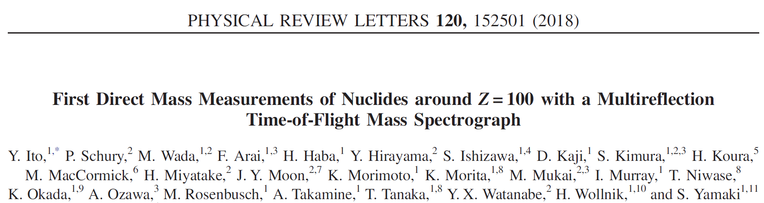
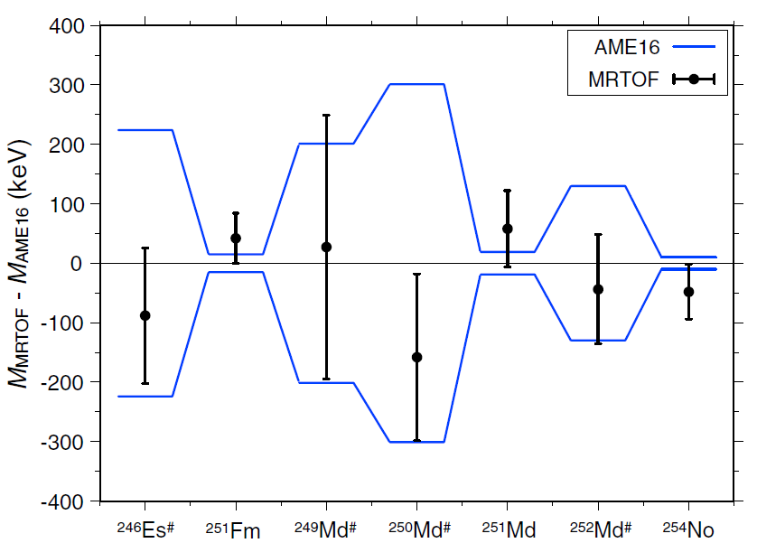
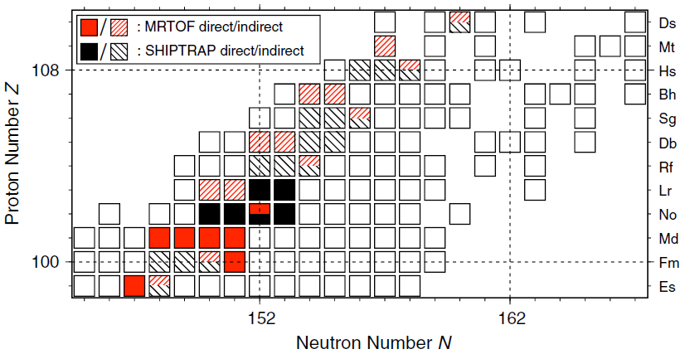
Highlight: anchor point in SHN
RIKEN-MR-ToF
Masses of ^{249,250}Md anchor α decay chains up to ²⁶¹Bh and ²⁶⁶Mt
²⁴⁹Md
²⁵⁰Md

Slide 13
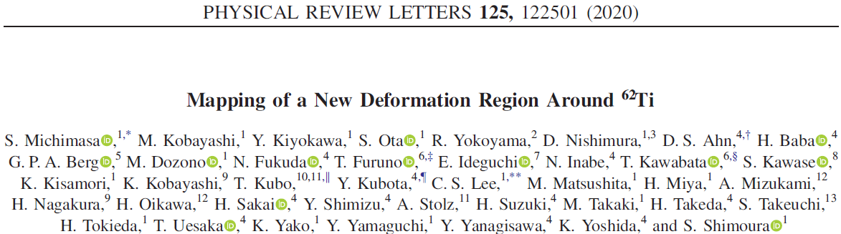
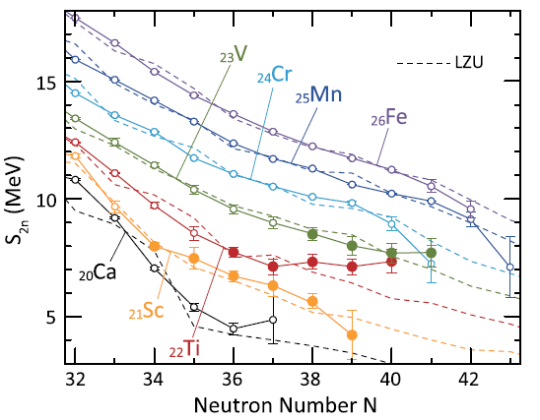
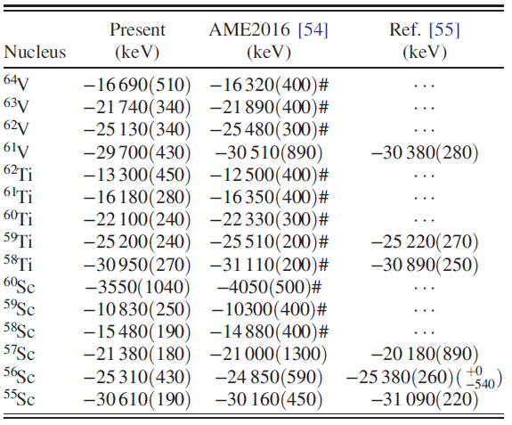
Highlight: deformation around N=40
RIKEN-Bp-ToF
Violate the smooth trend of mass surface and not supported by theory, replaced by TMS values.

Slide 14
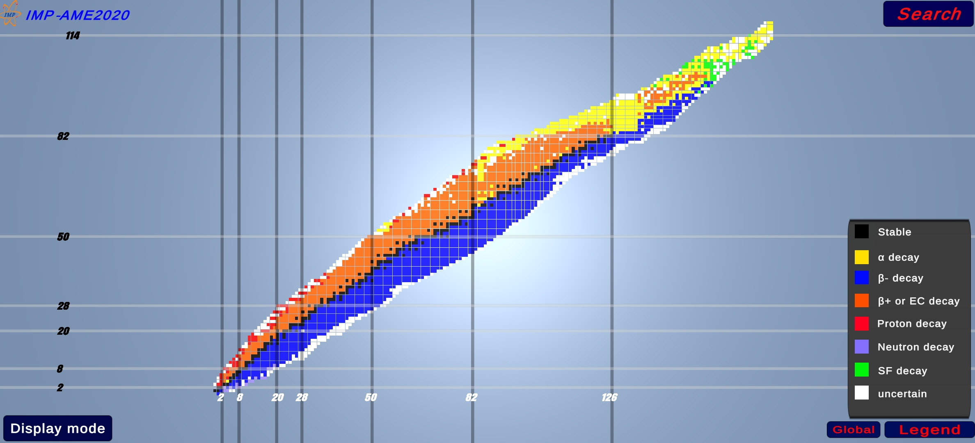
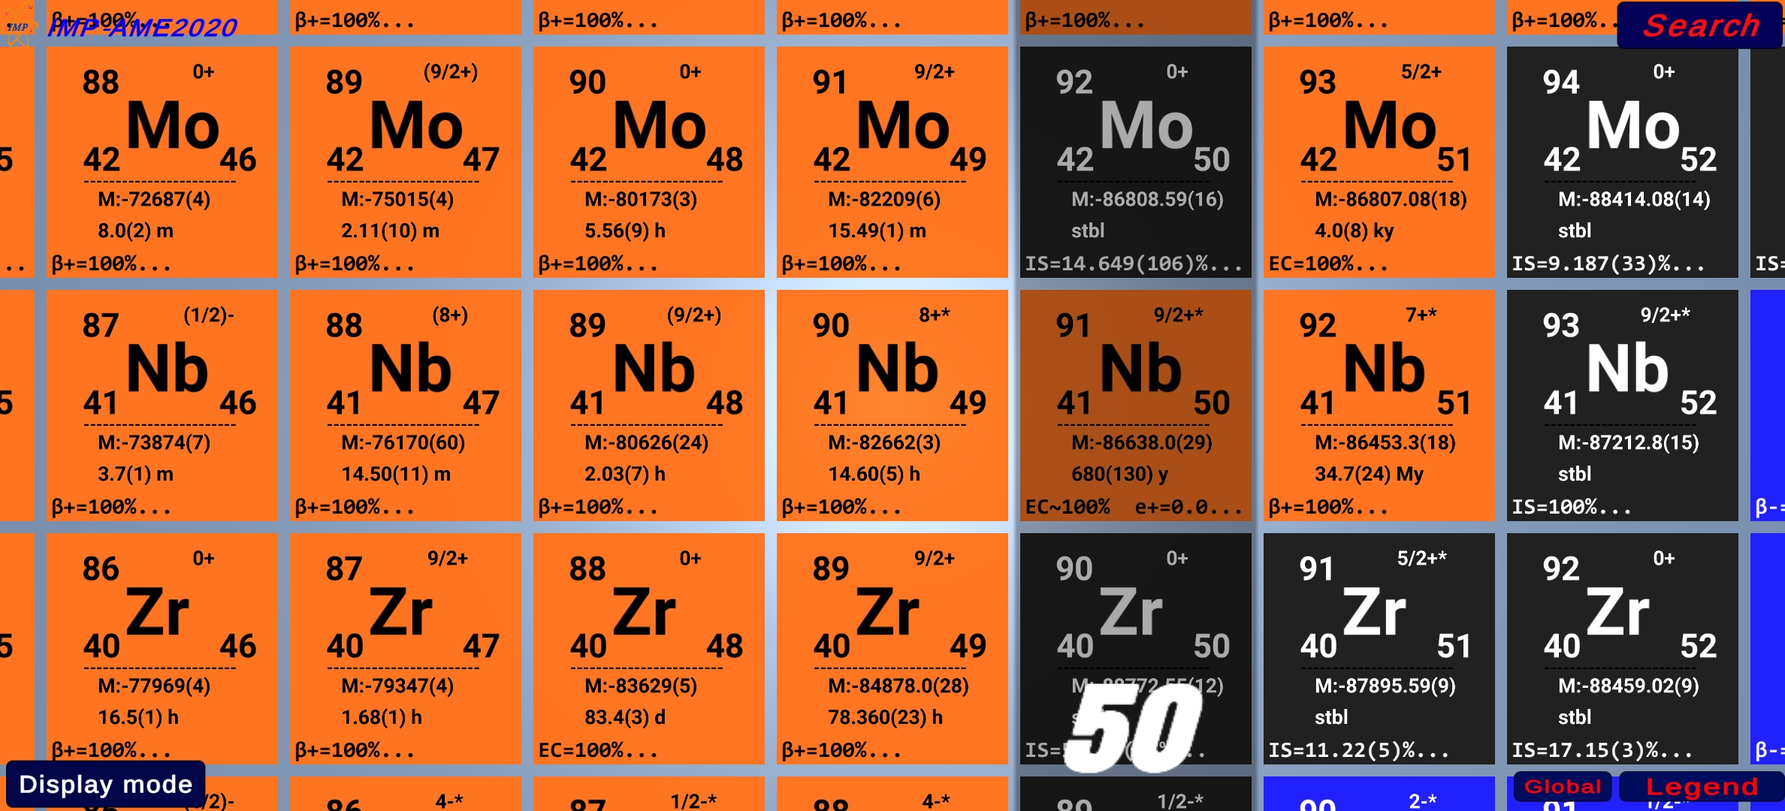
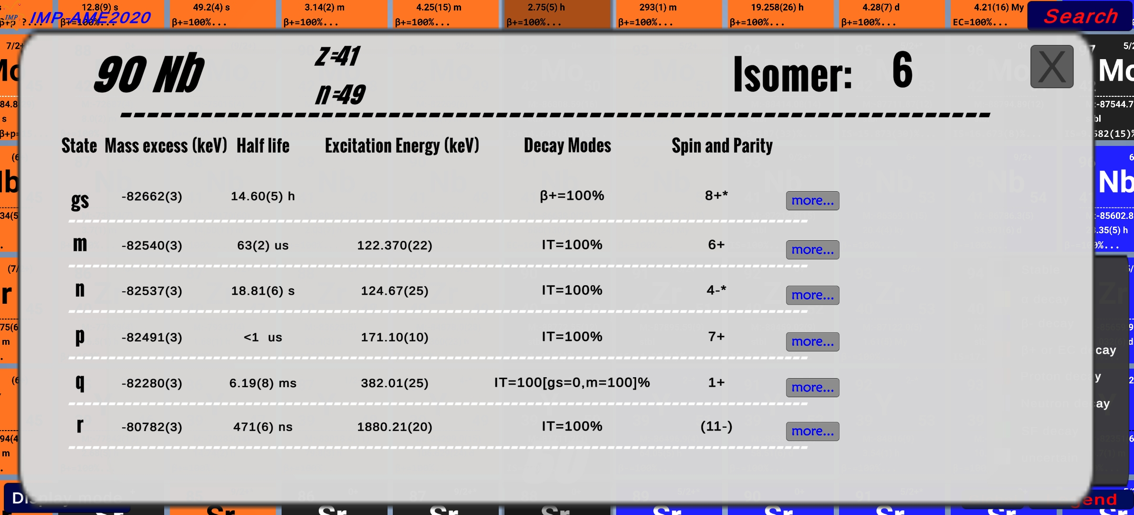
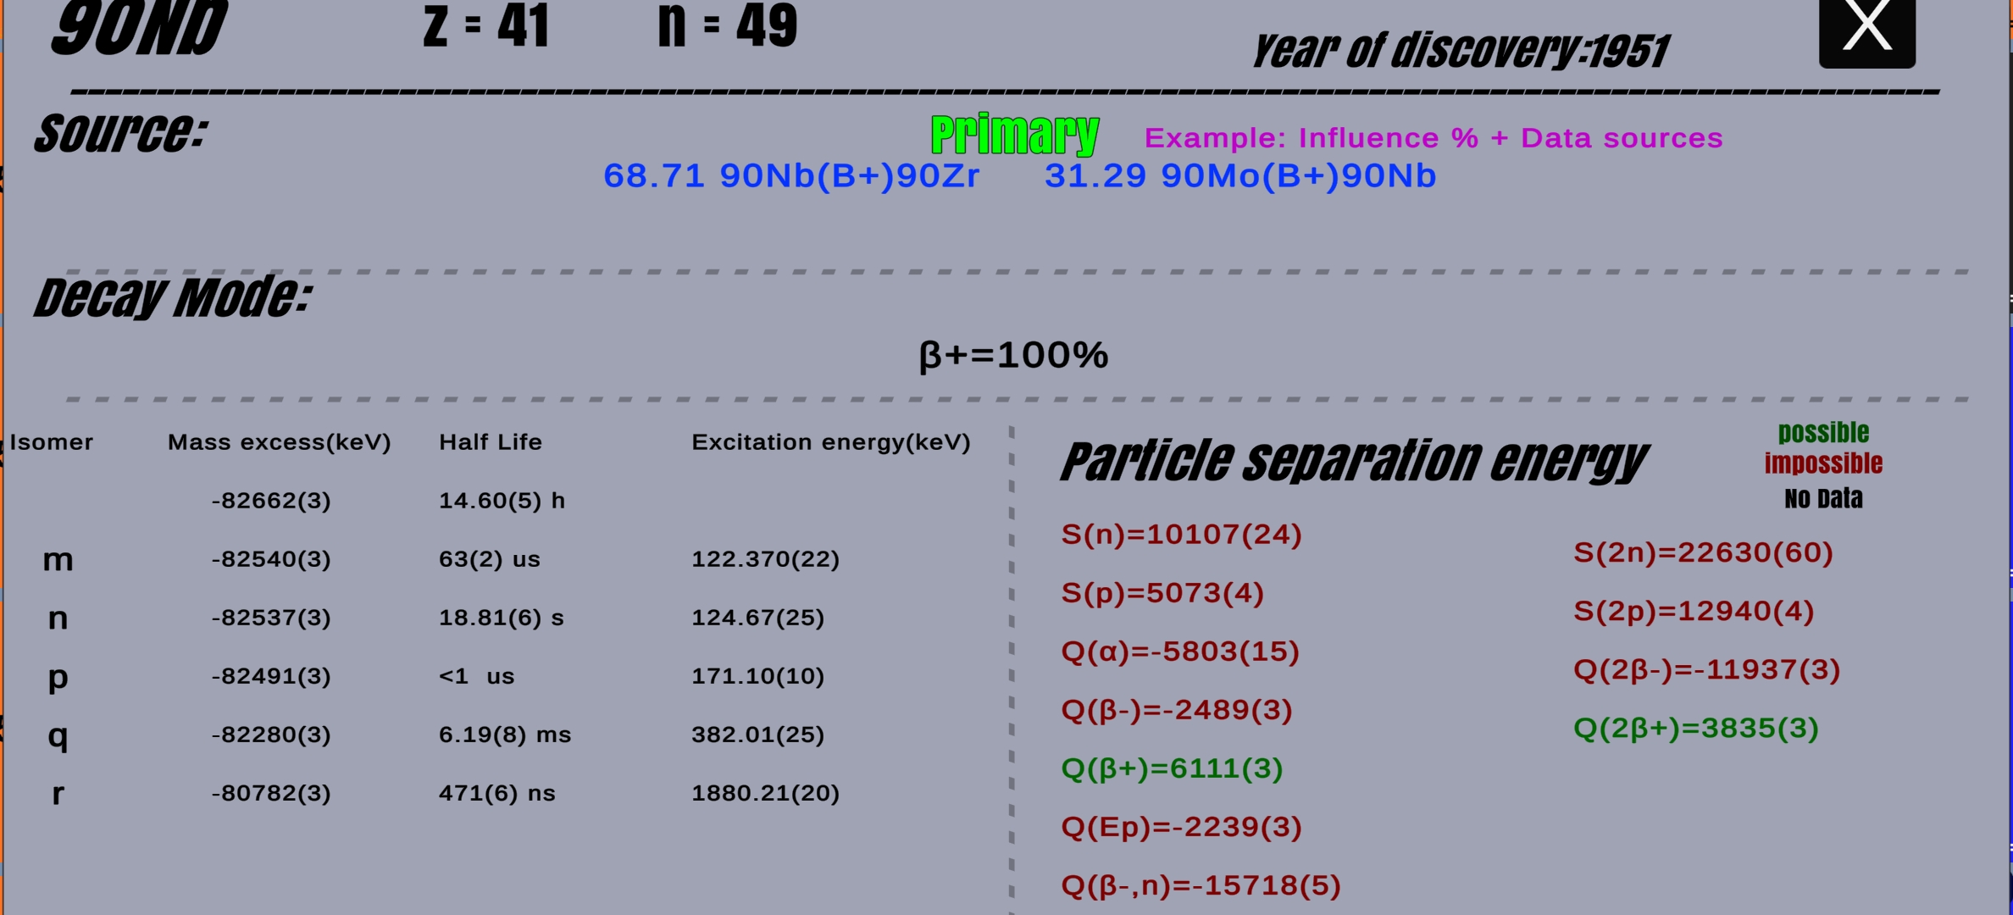
Ad: <<AME-NUCLEUS>>
Cross-platform software for displaying NUBASE and AME
Developed by J.Y. Shi at the IMP

Slide 15
Conclusions & perspectives
Credibility and reliability: identifies and solves contradictory results (not just compilation)
Complete: includes all measured quantities and uncertainties
up to date: results from most recent publications are included
Challenge
Heavy workload (articles, codes, software, documentation…)
Evaluation of nuclides far from the stability (TMS still holds?)
Thanks for your attention!

