Slide 1



Nuclear and molecular physics studies with laser spectroscopy of radioactive molecules
Michail Athanasakis-Kaklamanakis
June 4-9, 2023
ARIS2023

Slide 2
Can we extend the spectroscopic techniques to radioactive molecules?
Overarching question…
See talk by R. F. Garcia Ruiz on Friday!

Slide 3
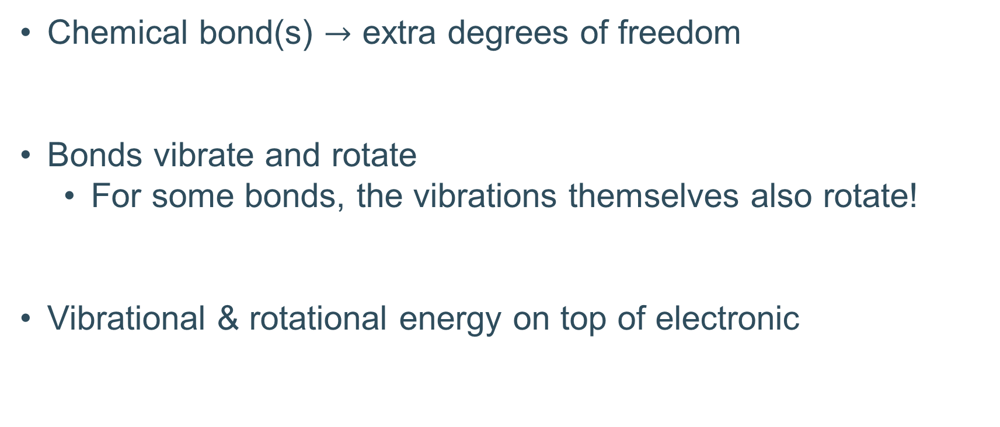
How are molecules different from atoms?
Chemical bond(s) $→$ extra degrees of freedom
Bonds vibrate and rotate
  For some bonds, the vibrations themselves also rotate!
Vibrational & rotational energy on top of electronic

Slide 4
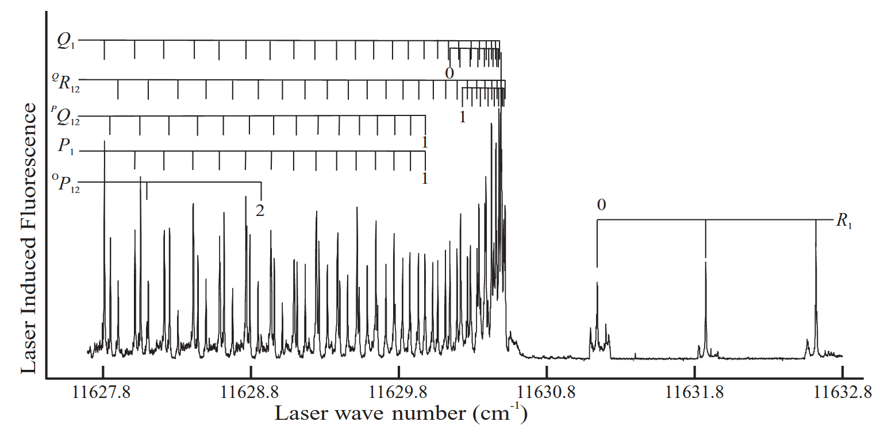
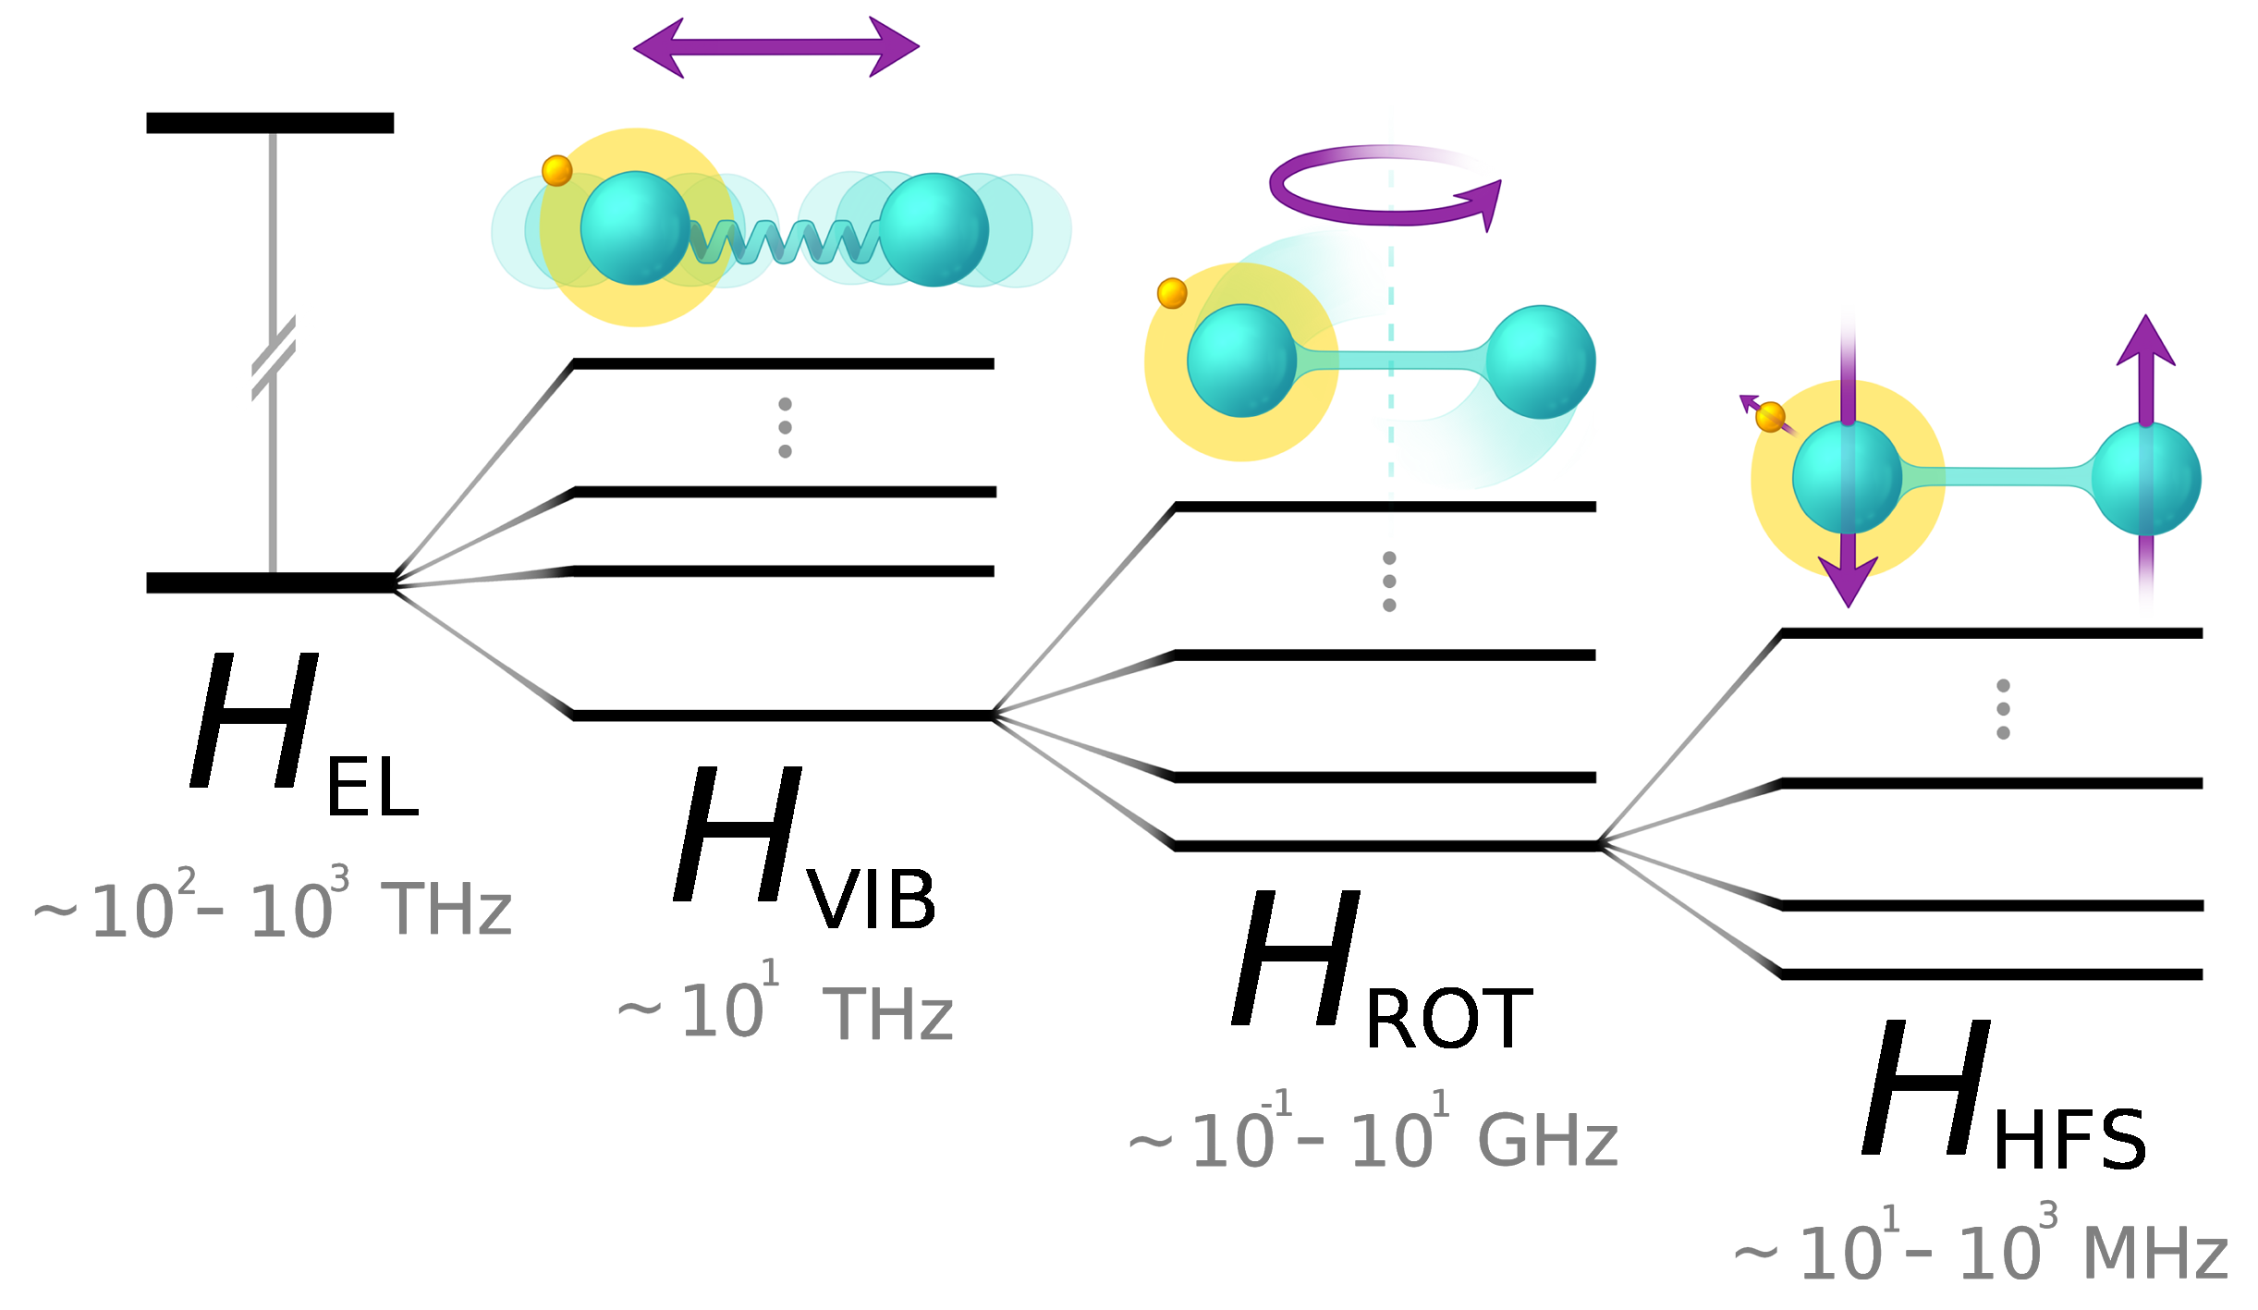
Simplest case: diatomic
Single bond
Still a very rich spectrum
1 atomic state would correspond to >1,000 molecular states at room temperature
High-resolution spectroscopy in BaF
Steimle et al., Phys. Rev. A 84, 012508 (2011)
Figure courtesy of Sonja Kujanpää

Slide 5

OK… but why radioactive?
What science with radioactive molecules?
Cool electron-nucleus interactions!
But interactions also not fully understood
Multiple isotopes needed to understand some molecules
  $→$ need radioactive
Some atoms have no stable isotopes
Or… because that’s what’s needed!
  Nuclear medicine, nuclear engineering
Nuclear structure
Molecular structure
New physics
Astrophysics
among others…

Slide 6
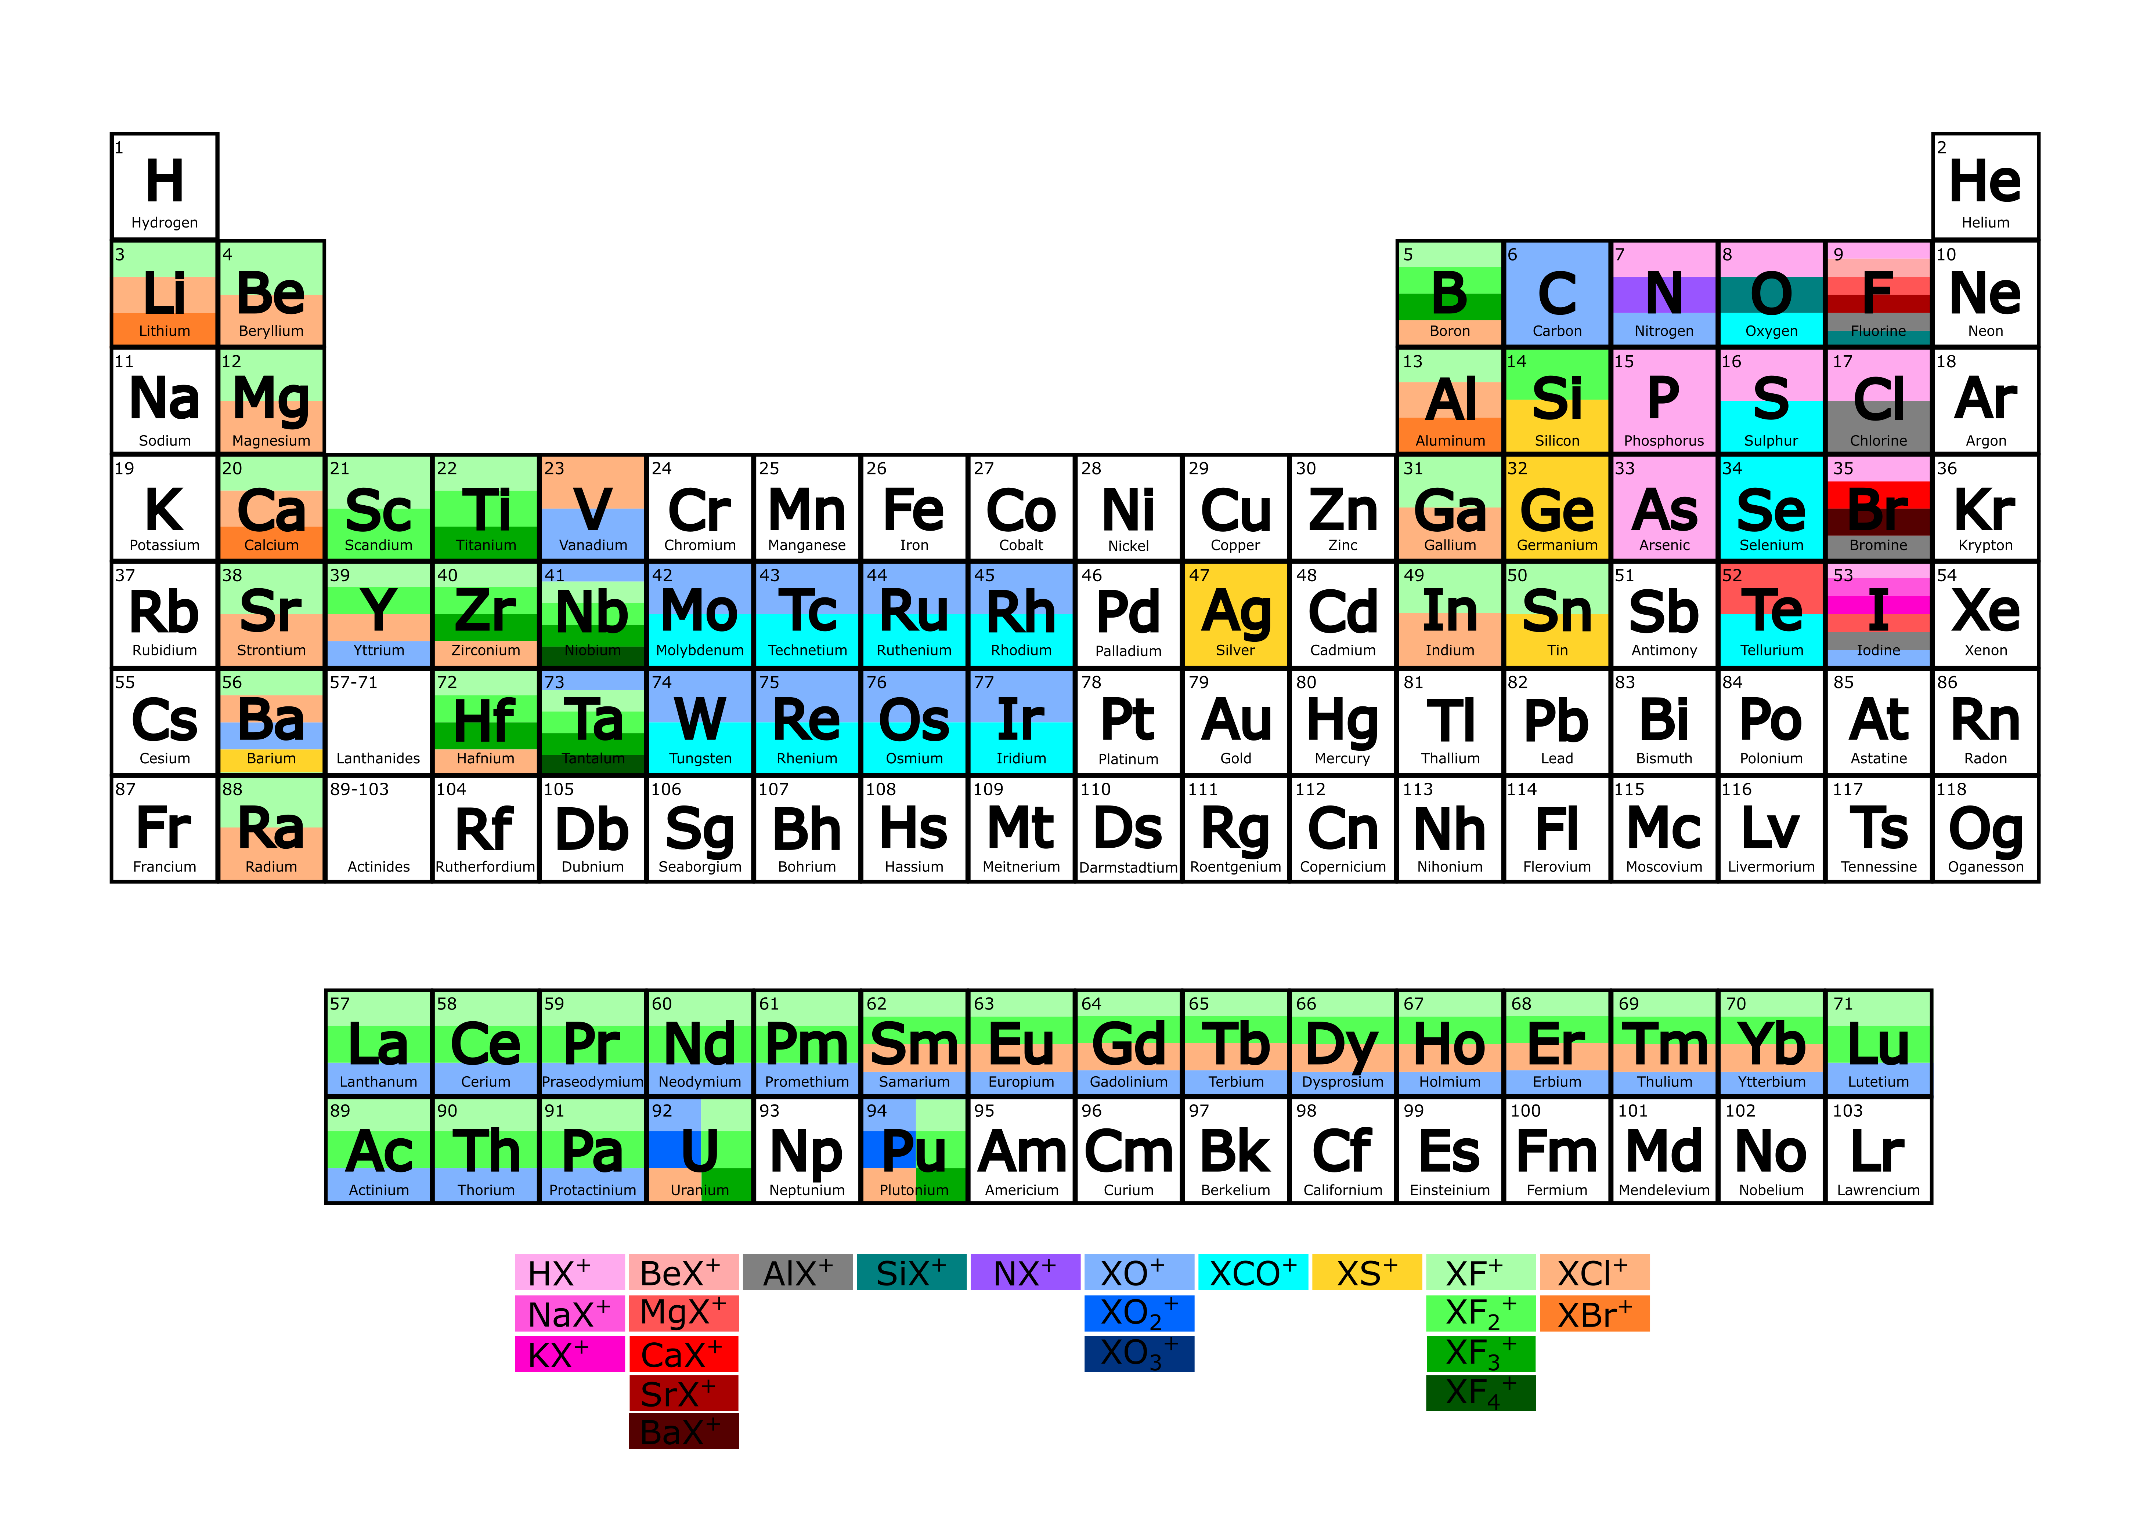
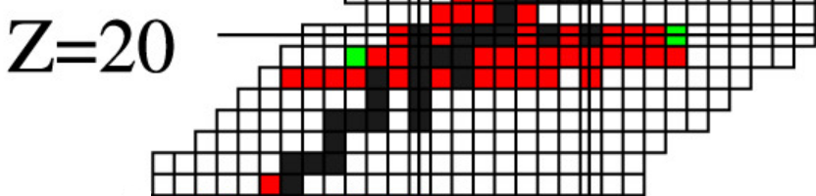
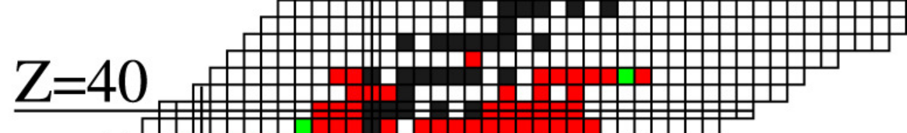
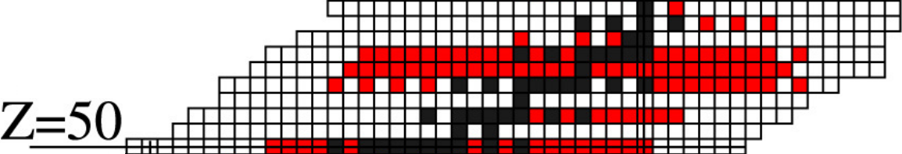
Use chemistry to your advantage
Gaps in laser spectroscopy
Reactive atoms
At radioactive ion facilities, chemistry is critical
Extraction efficiency + purity
  Faster extraction?
  Avoid contamination?
  What about reactivity?
Possible solution: extract as molecule!
Refractory atoms
Atoms with complex structure
Campbell, Moore, Pearson,
Prog. Part. Nucl. Phys. 86 (2016)
M. Au and J. Ballof, doi:10.5281/zenodo.6884293 (2022)

Slide 7
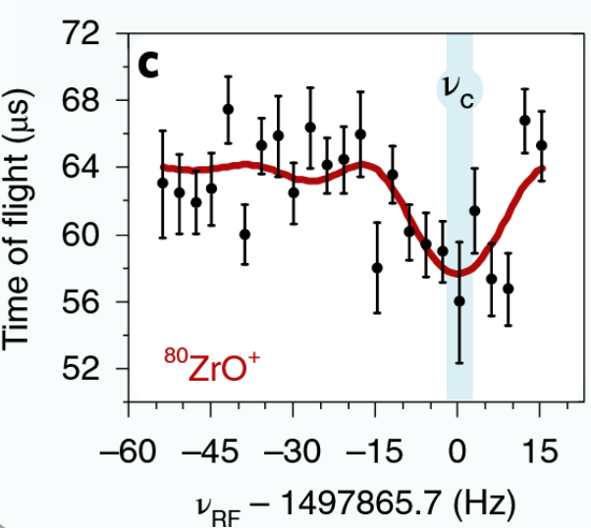
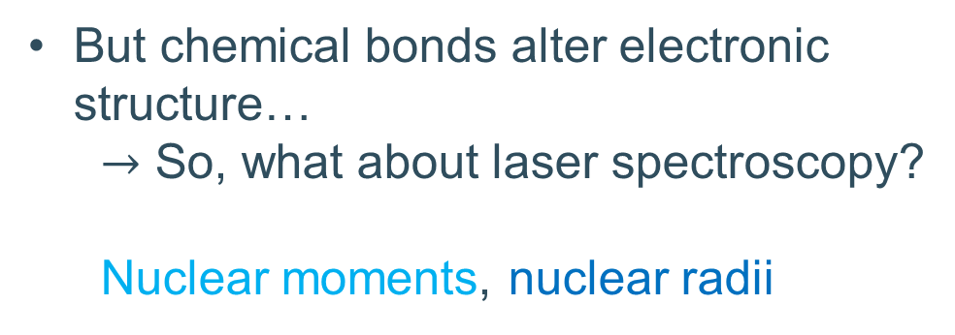
Can we study them?
Decay spectroscopy? ✓
Nuclear reactions? ✓
Mass spectrometry? ✓
But chemical bonds alter electronic structure…
  $→$ So, what about laser spectroscopy?
  Nuclear moments, nuclear radii
A. Hamaker et al., Nature Physics 17, 1408-1412 (2021)

Slide 8
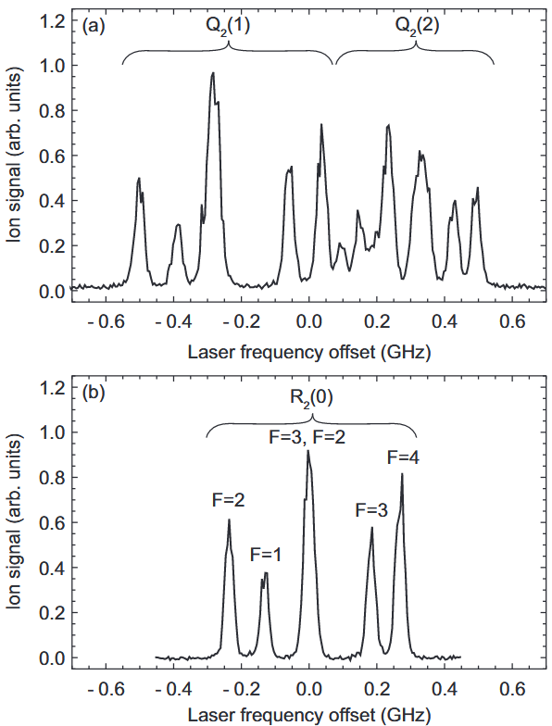
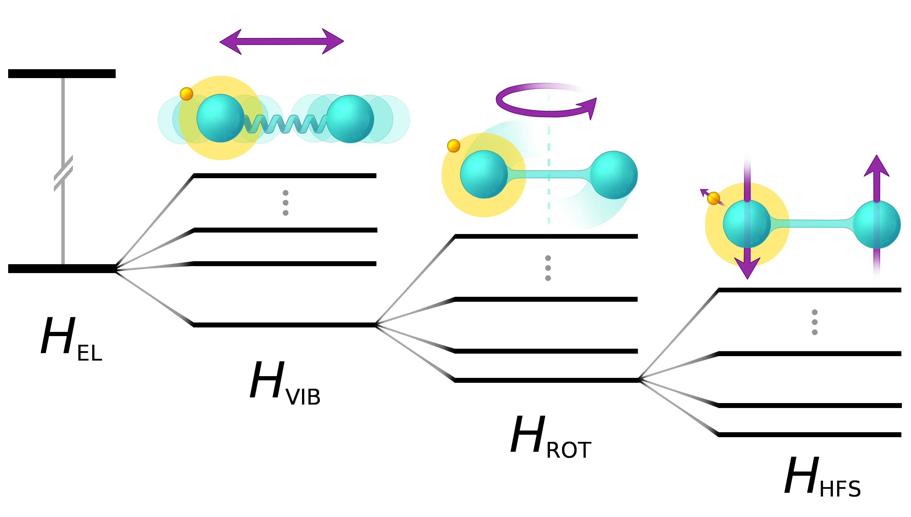
Molecules are sensitive to the nuclear moments
²⁷Al¹⁹F
Molecular hyperfine structure is well-studied
Sensitive to the moments
of both nuclei!
~10³ THz
~10 THz
~10⁻¹-10 GHz
~10-10³ MHz
S. Truppe et al., Phys. Rev. A 100, 052513 (2019)
Drawing courtesy of Sonja Kujanpää, JYU

Slide 9
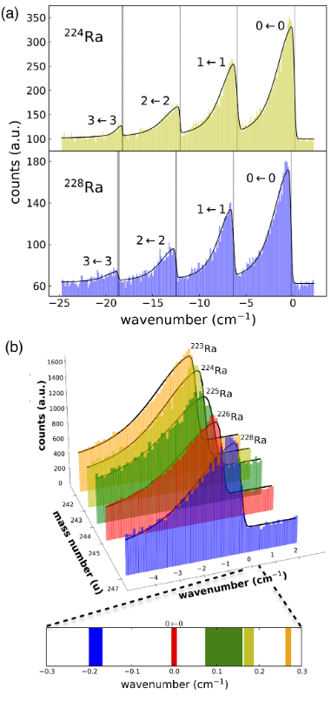
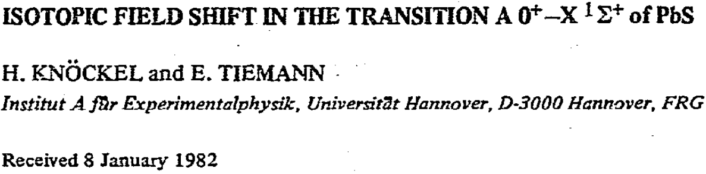
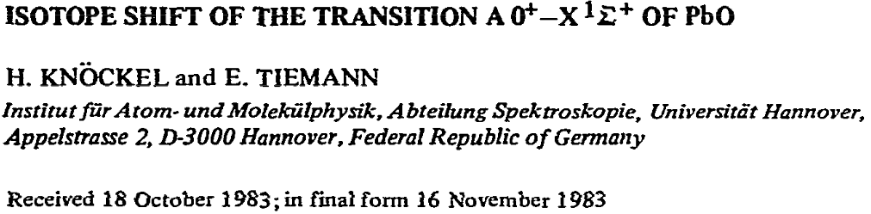
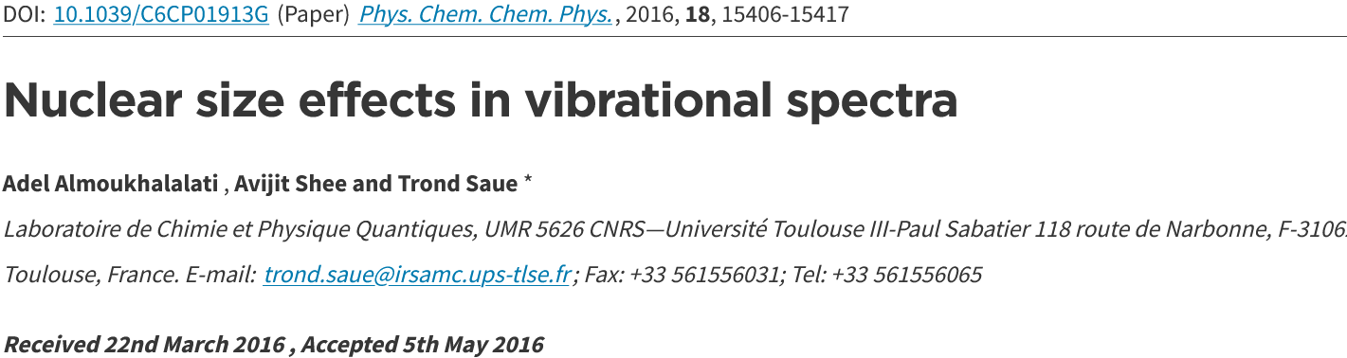
What about radii?
Early studies established the molecular field shift
Recently studied in radioactive molecules for the first time!
^{223-226,228}RaF
@ CRIS!
So far, no study
in light species!
More recent theoretical progress…
S. M. Udrescu et al., Phys. Rev. Lett. 127, 033001 (2021)

Slide 10

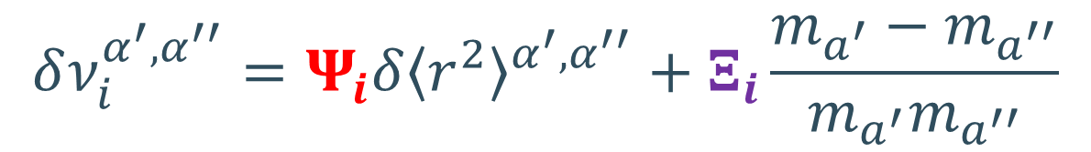






Charge radii from atomic/molecular isotope shifts
$$Ψ$$
$$Ξ$$
Values specific
to transition $i$
!Dominates light masses!
Isotope shift
Field shift
Mass shift
$$δ\left\langle r^{2}\right\rangle$$
$$m_{a}$$
transition-independent
$$δν_{i}^{α^{′},α^{′′}}=Ψ_{i}δ{\left\langle r^{2}\right\rangle }^{α^{′},α^{′′}}+Ξ_{i}\frac{m_{a^{′}}−m_{a^{′′}}}{m_{a^{′}}m_{a^{′′}}}$$
$$→$$
$$→$$
depends on the change of electronic overlap with nucleus between states
depends on all electron correlations
$$→$$
Calculations can be extremely challenging
$$→$$
Previous work on RaF ignored the mass shift
Has NEVER been calculated for a molecule
W. H. King, Isotope shifts in atomic spectra (2013)

Slide 11
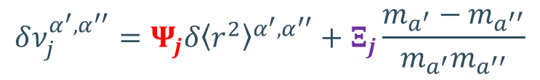
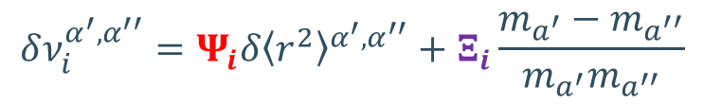


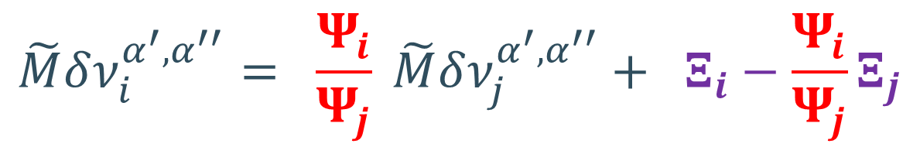

Radii in molecules – King Plot!
Combine isotope shifts from transitions in atom/ion/molecules
$$δν_{i}^{α^{′},α^{′′}}=Ψ_{i}δ{\left\langle r^{2}\right\rangle }^{α^{′},α^{′′}}+Ξ_{i}\frac{m_{a^{′}}−m_{a^{′′}}}{m_{a^{′}}m_{a^{′′}}}$$
and
$$δν_{j}^{α^{′},α^{′′}}=Ψ_{j}δ{\left\langle r^{2}\right\rangle }^{α^{′},α^{′′}}+Ξ_{j}\frac{m_{a^{′}}−m_{a^{′′}}}{m_{a^{′}}m_{a^{′′}}}$$
$$→$$
$$\tilde{M}δν_{i}^{α^{′},α^{′′}}= \frac{Ψ_{i}}{Ψ_{j}} \tilde{M}δν_{j}^{α^{′},α^{′′}}+ Ξ_{i}−\frac{Ψ_{i}}{Ψ_{j}}Ξ_{j}$$
where $\tilde{M}=\frac{m_{a^{′}}m_{a^{′′}}}{m_{a^{′}}−m_{a^{′′}}}$
Idea!
Extract $Ψ$ and $Ξ$ for a molecular transition j
from knowledge of $Ψ$ (F) and $Ξ$ (K) for an atomic transition i
M. Athanasakis-Kaklamanakis, S. G. Wilkins, A. A. Breier
and G. Neyens, Phys. Rev. X 13 (1), 011015 (2023)

Slide 12
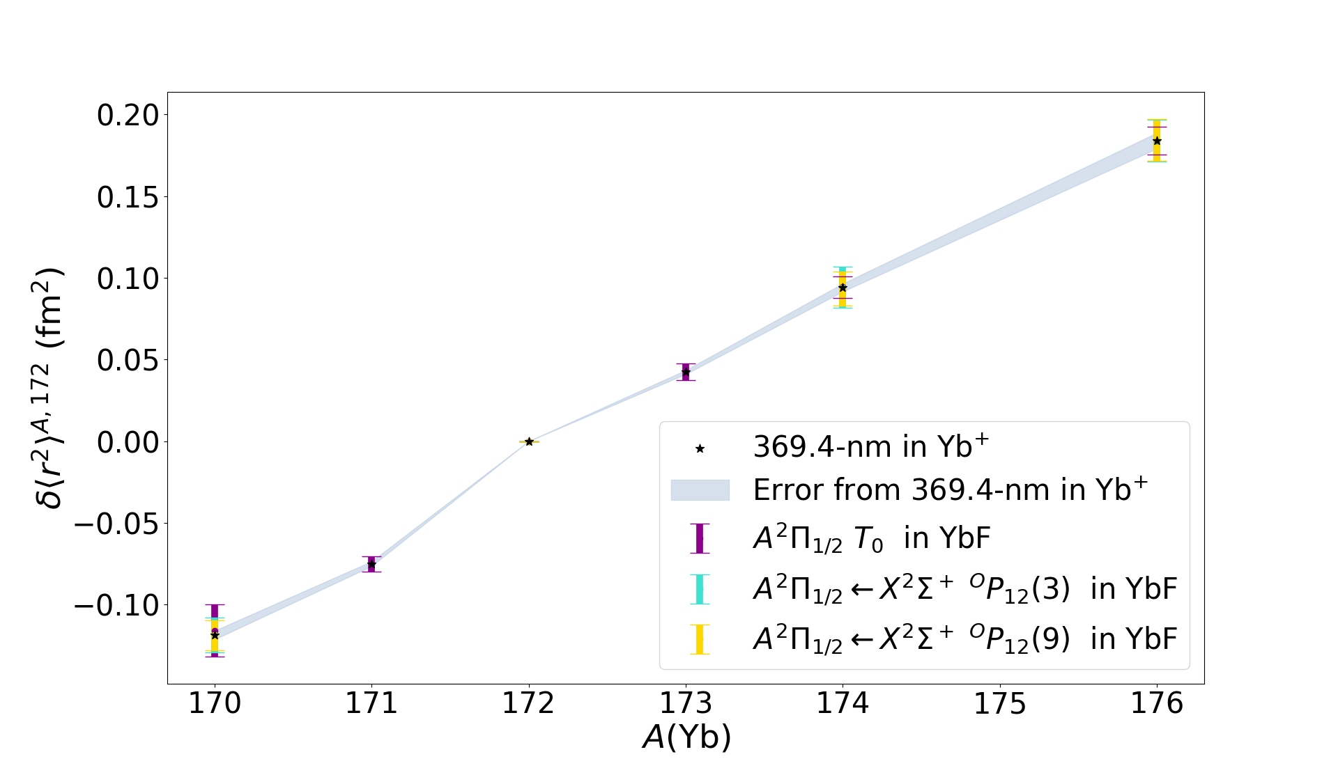
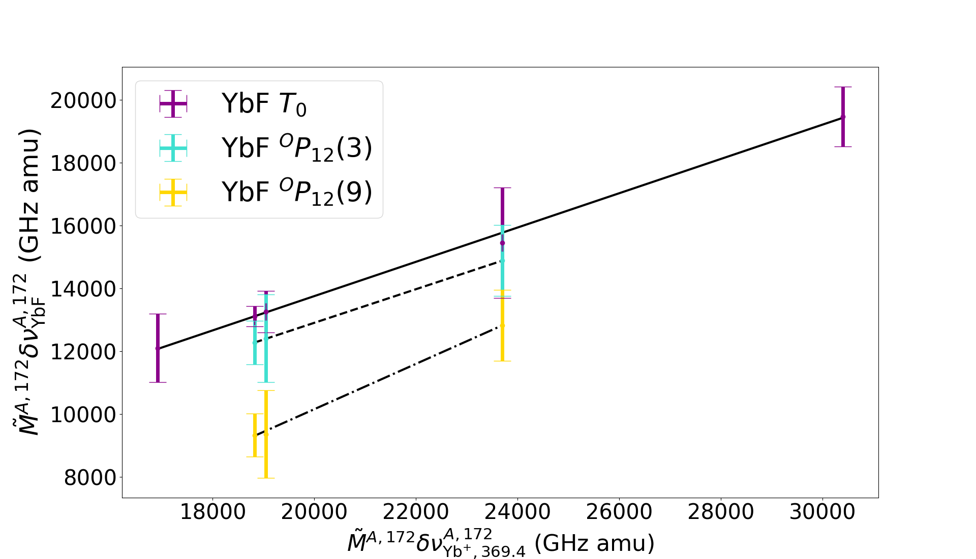


Laser transitions in YbF
Molecular isotope shifts in YbF contain nuclear-size information
King-plot analysis $→$ consistent radii extracted from molecules and atoms
M. Athanasakis-Kaklamanakis, S. G. Wilkins, A. A. Breier
and G. Neyens, Phys. Rev. X 13 (1), 011015 (2023)

Slide 13
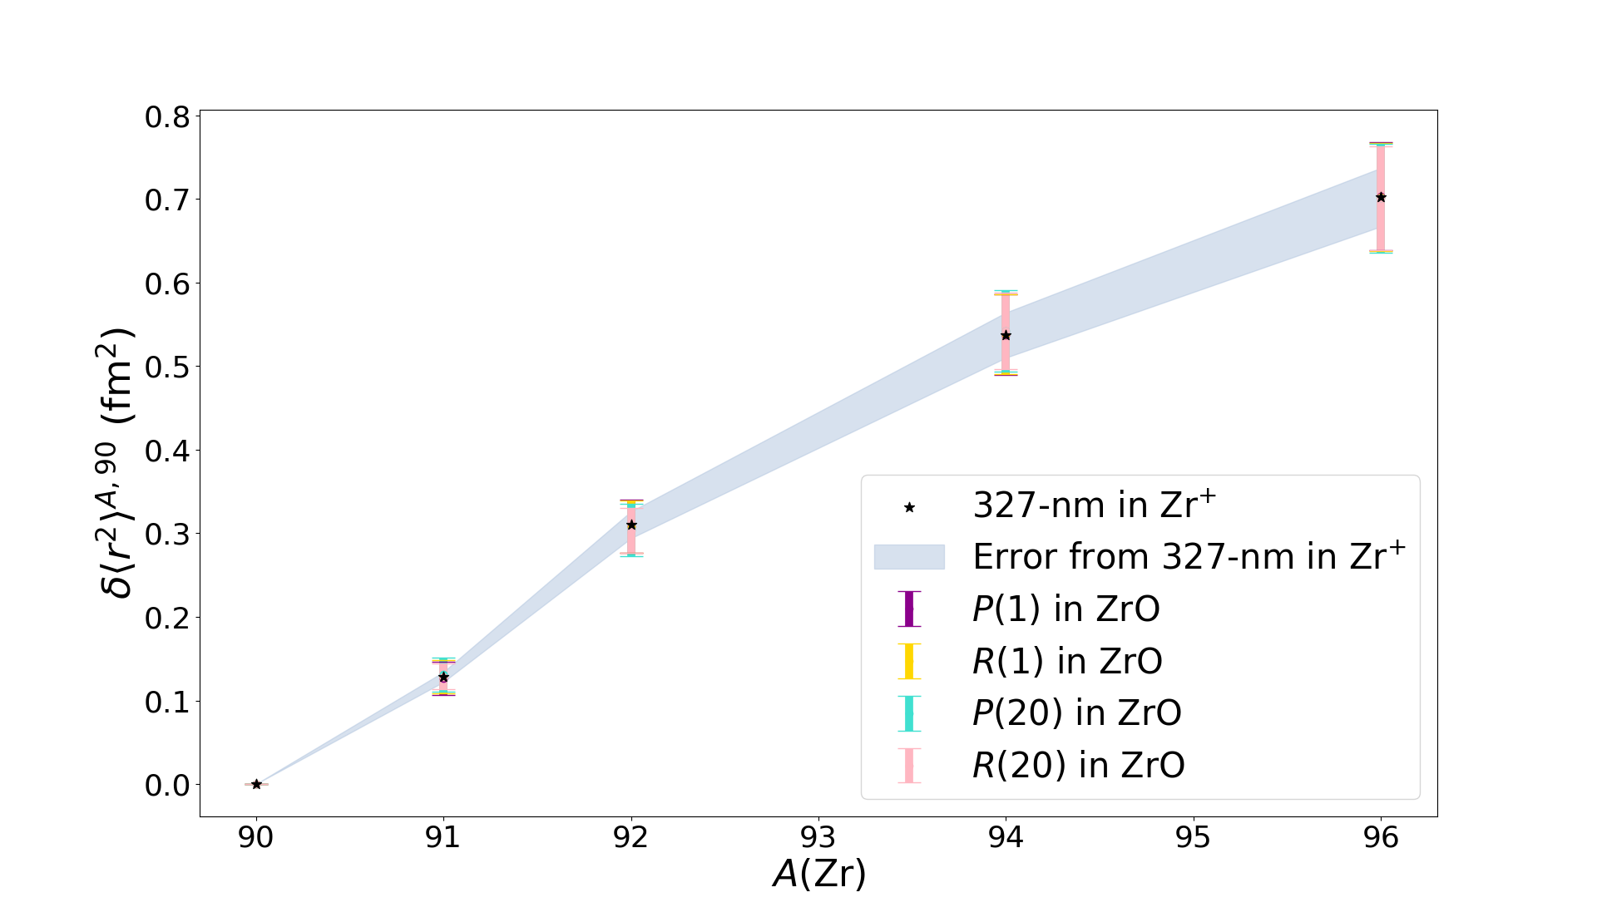
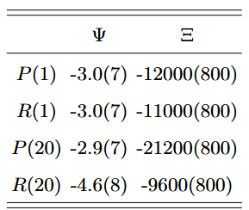
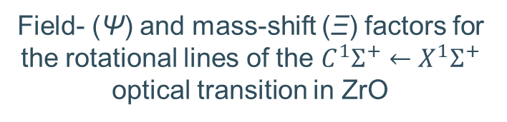
Laser transitions in ZrO
Field- (Ψ) and mass-shift (Ξ) factors for the rotational lines of the $C^{1}Σ^{+}←X^{1}Σ^{+}$ optical transition in ZrO
Dependence on the quantum numbers
→ molecular-structure information
Radioactive needed for most chains
M. Athanasakis-Kaklamanakis, S. G. Wilkins, A. A. Breier
and G. Neyens, Phys. Rev. X 13 (1), 011015 (2023)

Slide 14
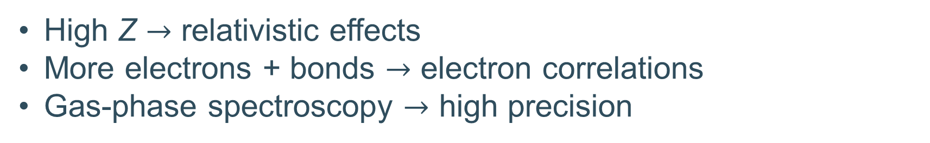
What about molecular structure?
High Z $→$ relativistic effects
More electrons + bonds $→$ electron correlations
Gas-phase spectroscopy $→$ high precision
Compare theory and experiment

Slide 15
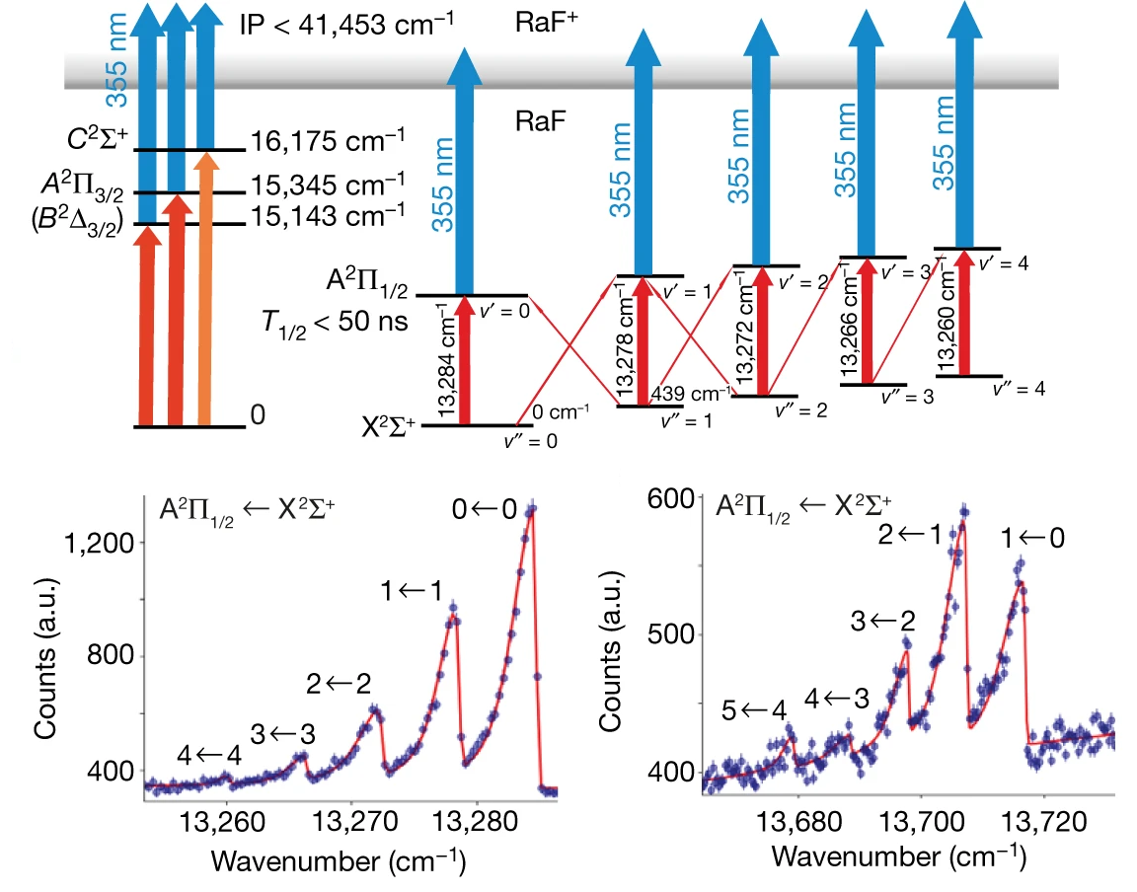
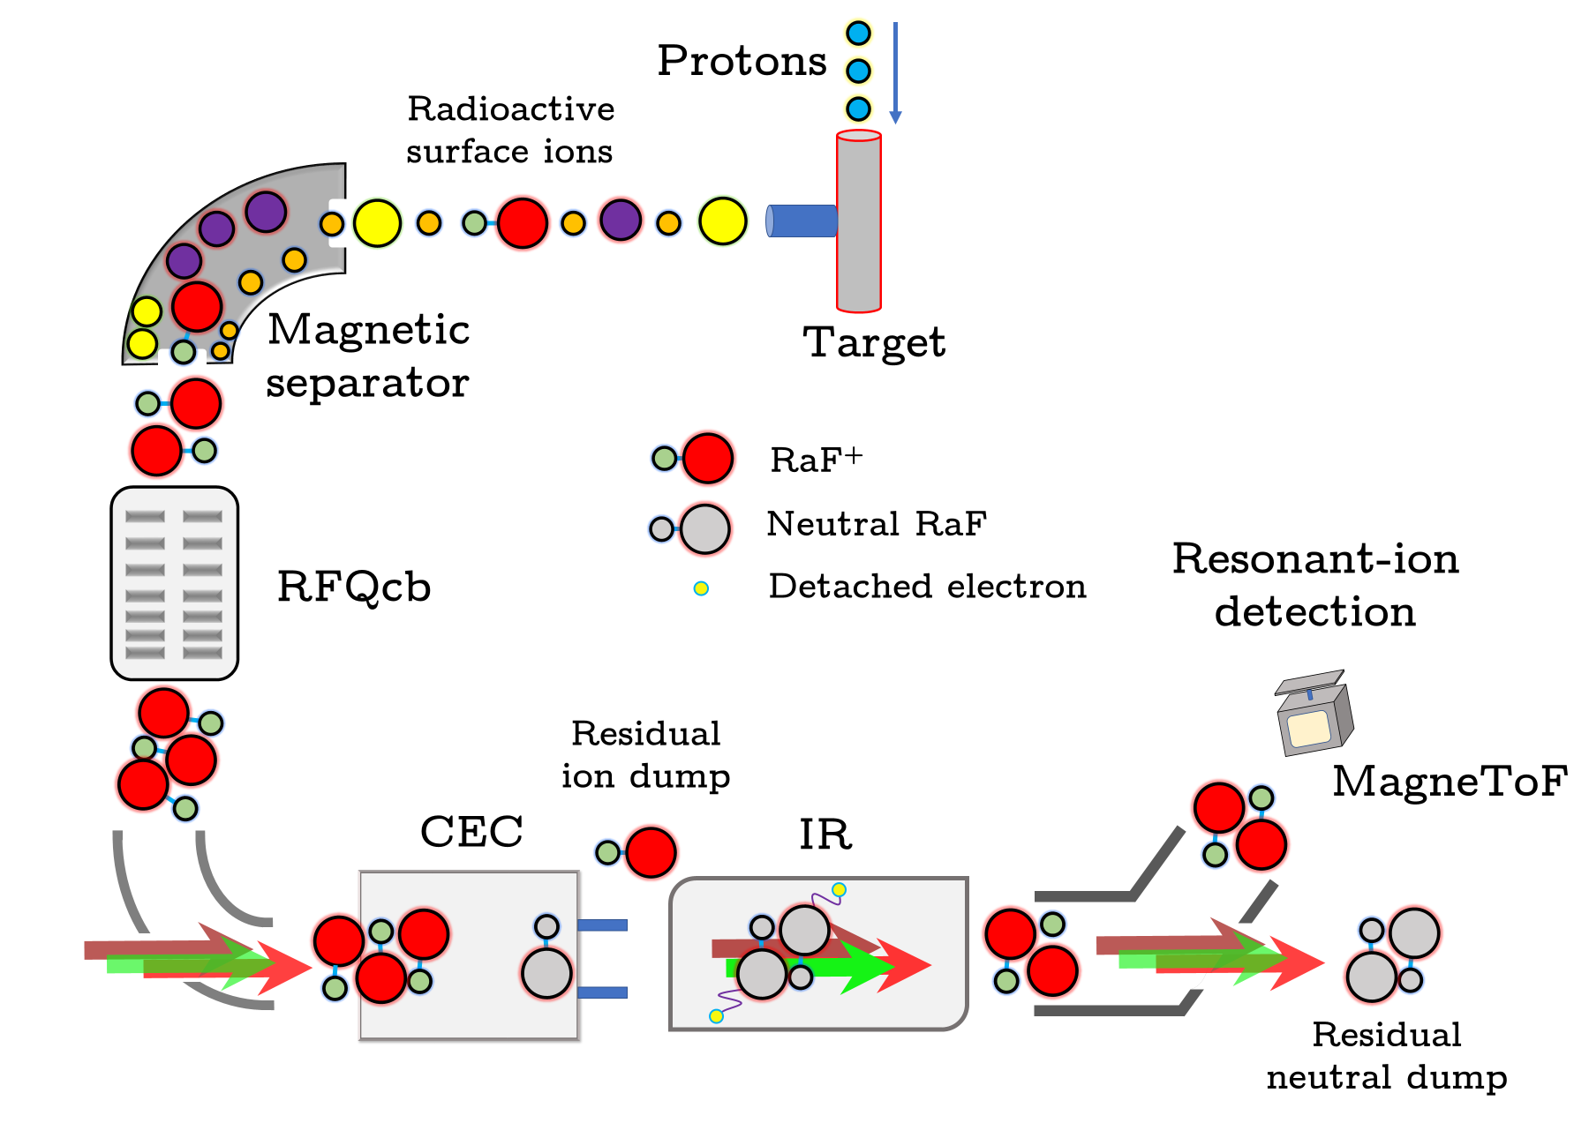
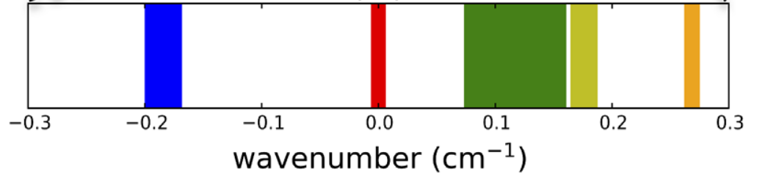
RaF at CRIS
RaF @ CRIS (2018)
Garcia Ruiz et al., Nature 581, 396-400 (2020)
²²⁶RaF
²²⁴RaF
²²⁸RaF
²²⁵RaF
²²³RaF
Udrescu et al., PRL 127(3), 033001 (2021)

Slide 16
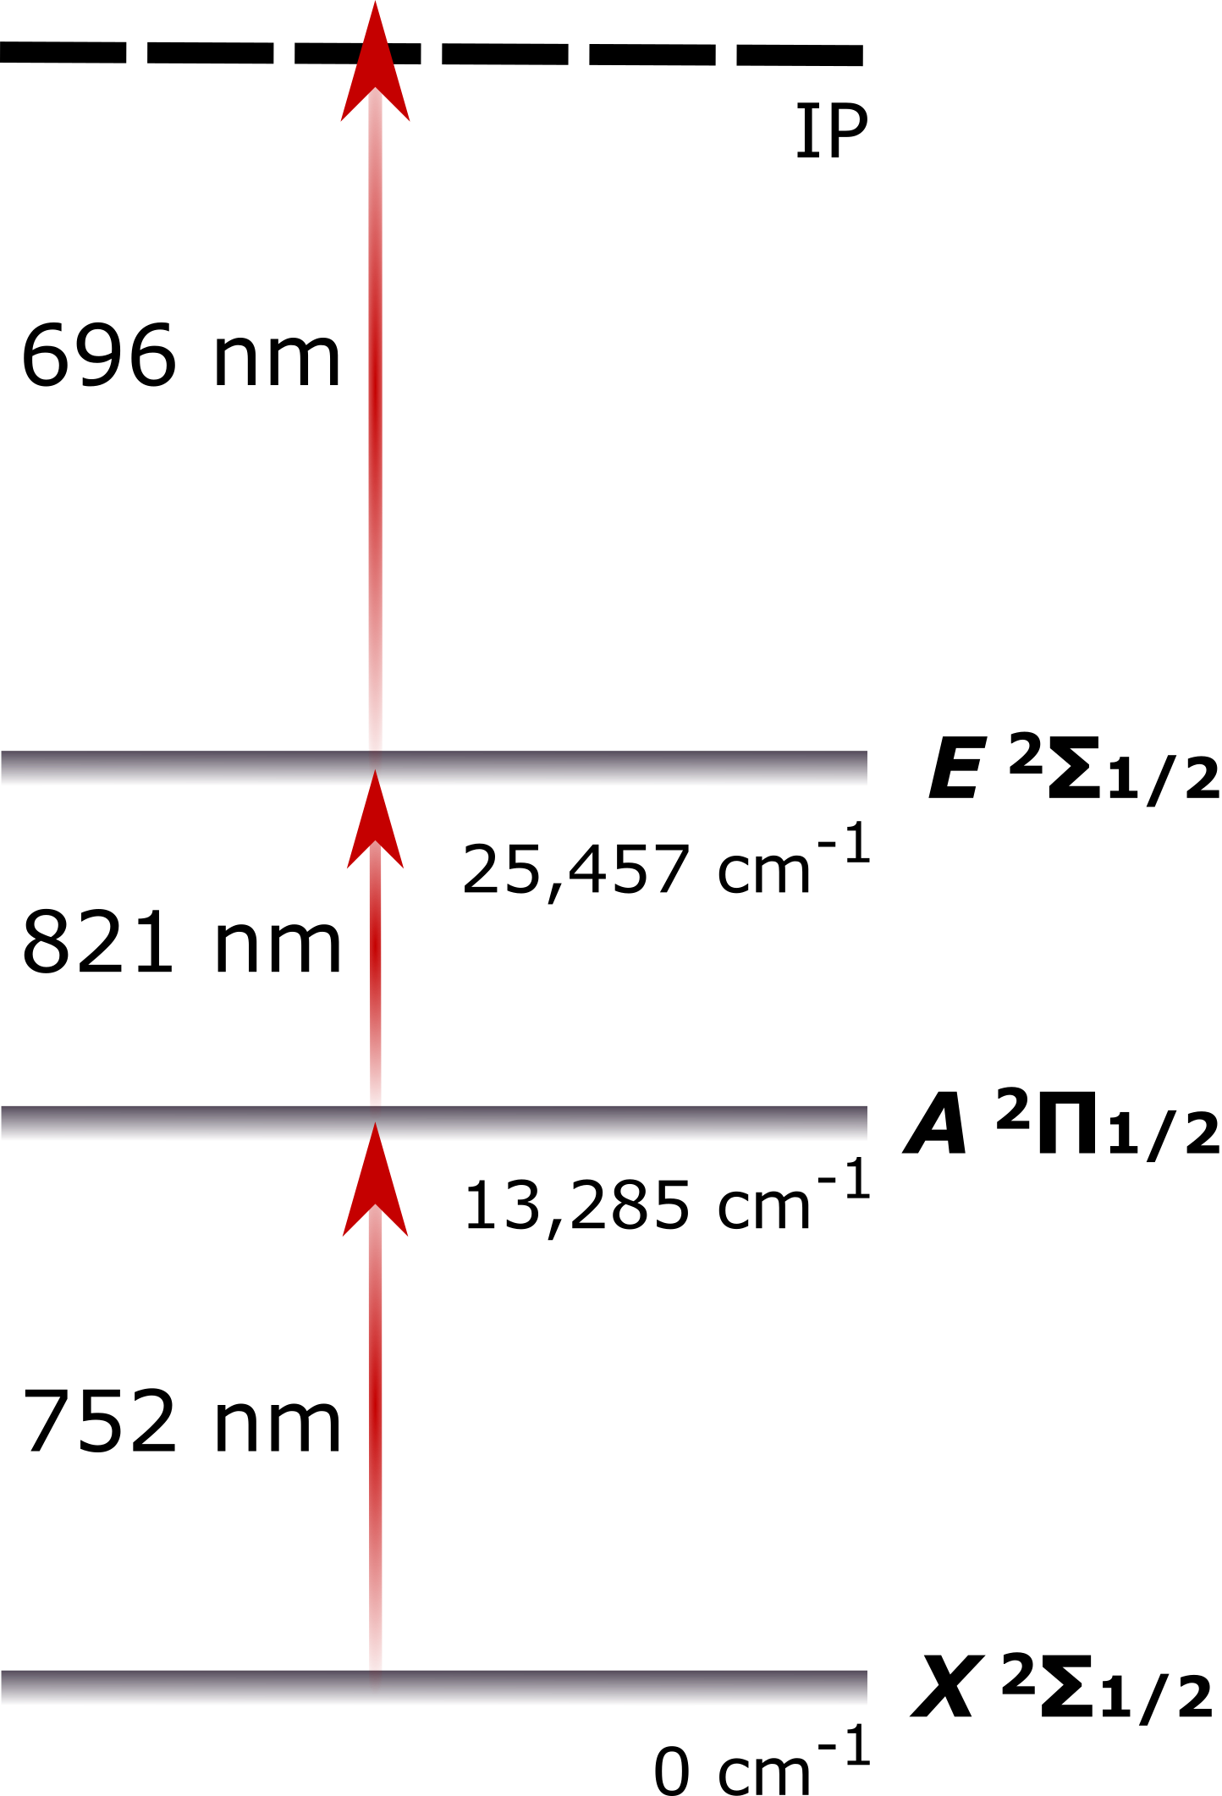
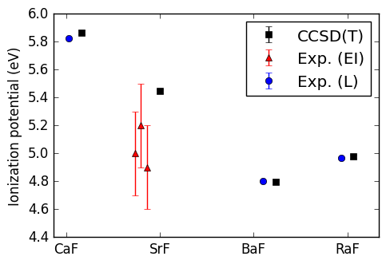
Easy observables: Ionization Potential
CRIS measurement
IP of RaF
S. G. Wilkins et al., In preparation (2023)
Pyridine 1
λ ~ 1 GHz
Grating Ti:Sa
λ ~ 3 GHz
(power-broadened)
injection-seeded Ti:Sa
λ > 1 GHz

Slide 17
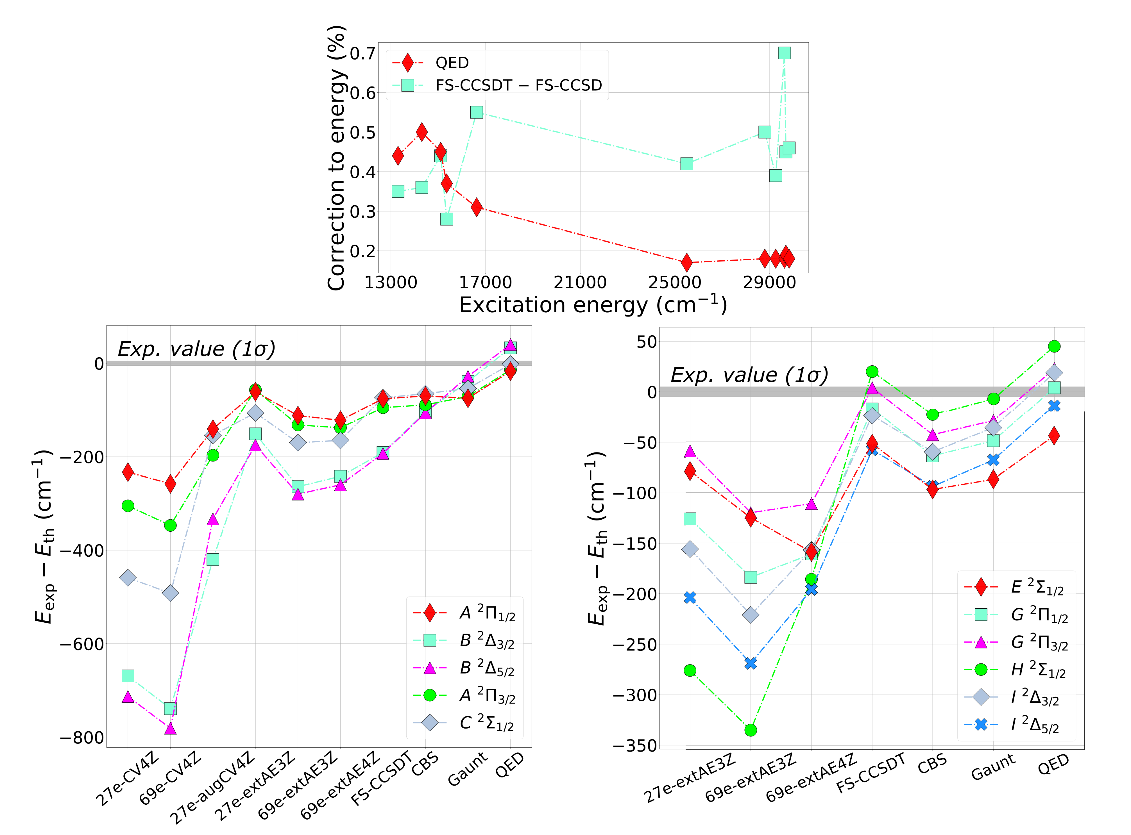
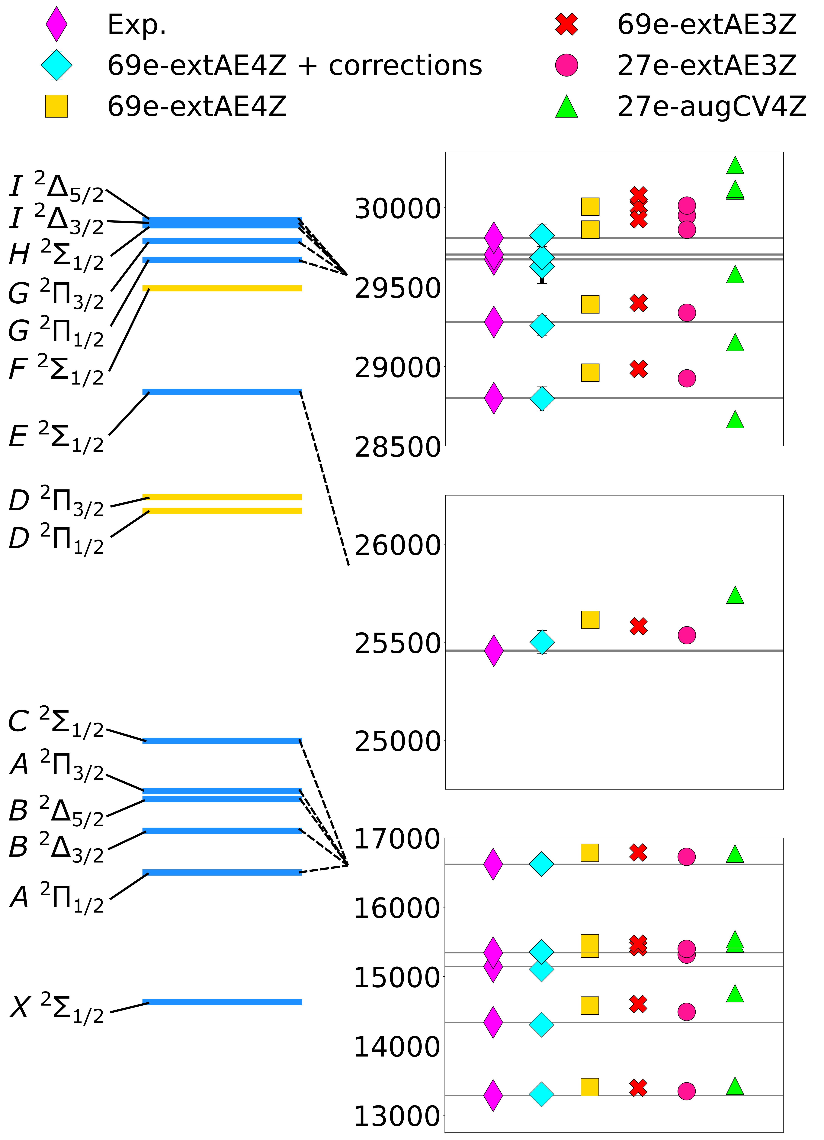
A bit harder: Excitation Energies
FS-RCCSD theory with 69 correlated electrons, triple excitations, basis-set extension, and Breit+QED corrections reproduces all excitation energies with an accuracy of 99.7% or higher!

Slide 18
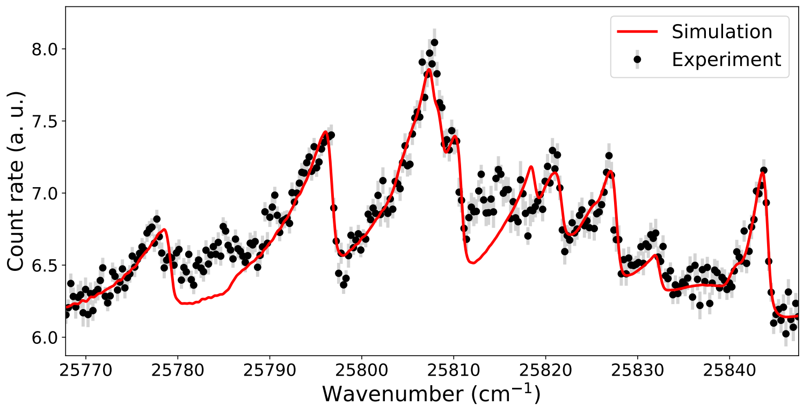
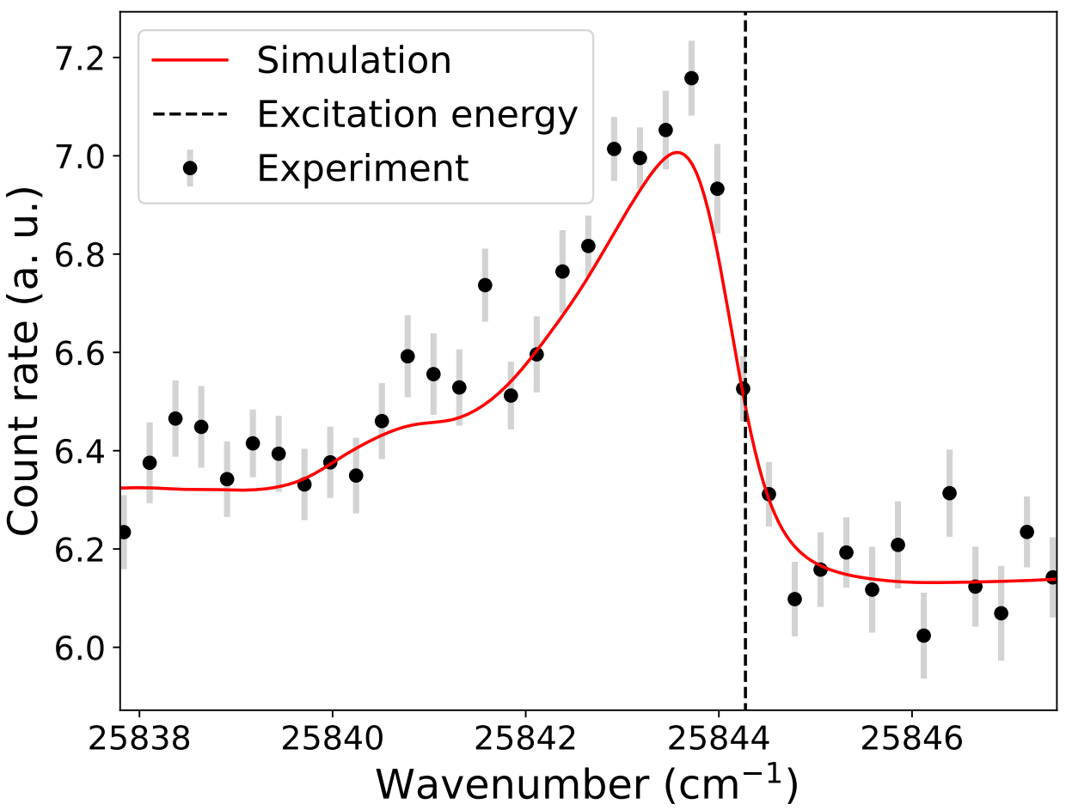
First spectroscopy of AcF at CRIS

Slide 19
In summary
Emerging field – under exploration
Many scientific opportunities
Chemistry and altered electronic structure as advantage
Tool for both nuclear and molecular studies
Follow R. F. Garcia Ruiz’s talk!

Slide 20








Special thanks
G. Neyens and the CRIS collaboration
https://isolde-cris.web.cern.ch/

Slide 21
SUPPORTING SLIDES

Slide 22
What about quantum chemistry?
High Z $→$ relativistic effects
More electrons + bonds $→$ electron correlations
Gas-phase spectroscopy $→$ high precision
Compare theory and experiment

Slide 23
Easy observables: Ionization Potential
CRIS measurement
IP of RaF
S. G. Wilkins et al., In preparation (2023)
Pyridine 1
λ ~ 1 GHz
Grating Ti:Sa
λ ~ 3 GHz
(power-broadened)
injection-seeded Ti:Sa
λ > 1 GHz

Slide 24
A bit harder: Excitation Energies
FS-RCCSD theory with 69 correlated electrons, triple excitations, basis-set extension, and Breit+QED corrections reproduces all excitation energies with an accuracy of 99.7% or higher!

Slide 25
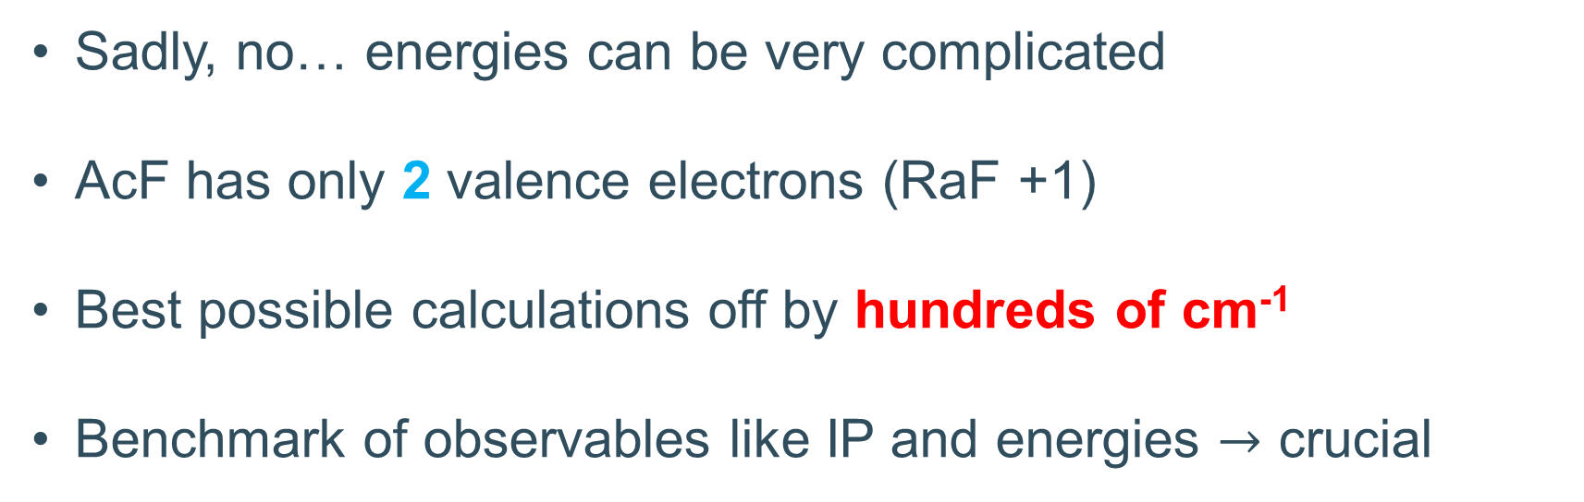
Is it all that simple?
Sadly, no… energies can be very complicated
AcF has only 2 valence electrons (RaF +1)
Best possible calculations off by hundreds of cm⁻¹
Benchmark of observables like IP and energies $→$ crucial

Slide 26
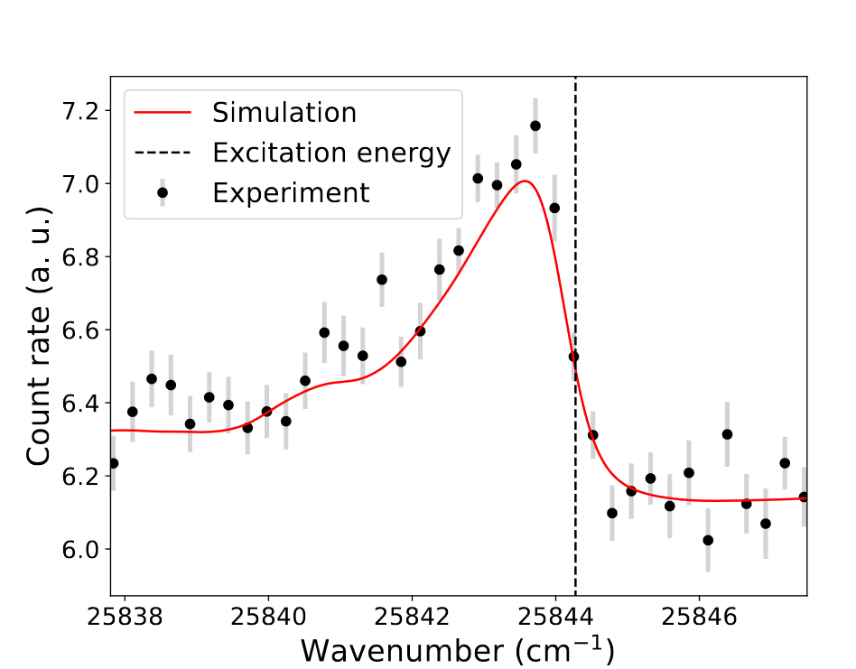
Recently, CRIS measurements in AcF

Slide 27
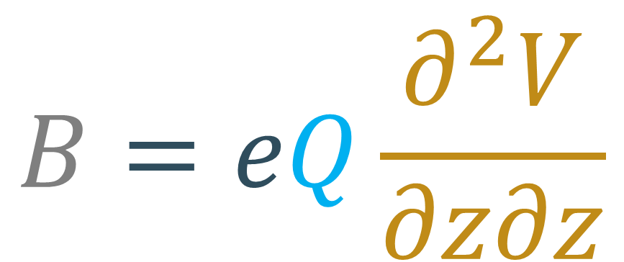
Altered electronic structure to our advantage!
Example: quadrupole moment of K
What we need to know
What we are looking for
What is measured
$$B=eQ\frac{∂^{2}V}{∂z∂z}$$
Electronic structure factor

Slide 28
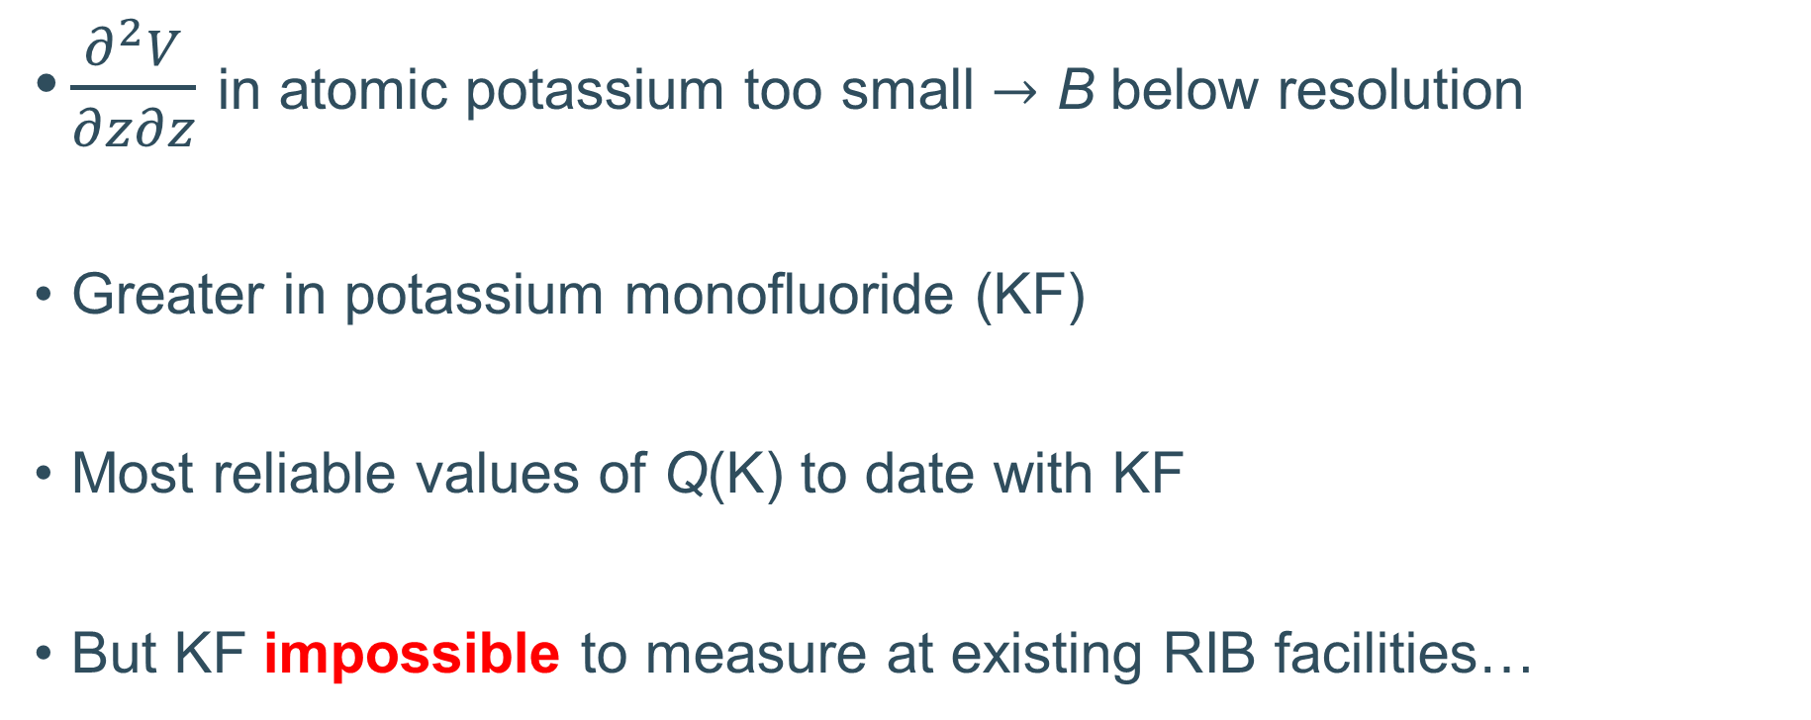
Q in K
$\frac{∂^{2}V}{∂z∂z}$ in atomic potassium too small $→$ B below resolution
Greater in potassium monofluoride (KF)
Most reliable values of Q(K) to date with KF
But KF impossible to measure at existing RIB facilities…
Teodoro et al.,
Phys. Rev. A 91, 032516 (2015)
Pyykkö, Molecular Physics 116 10 (2018)

Slide 29
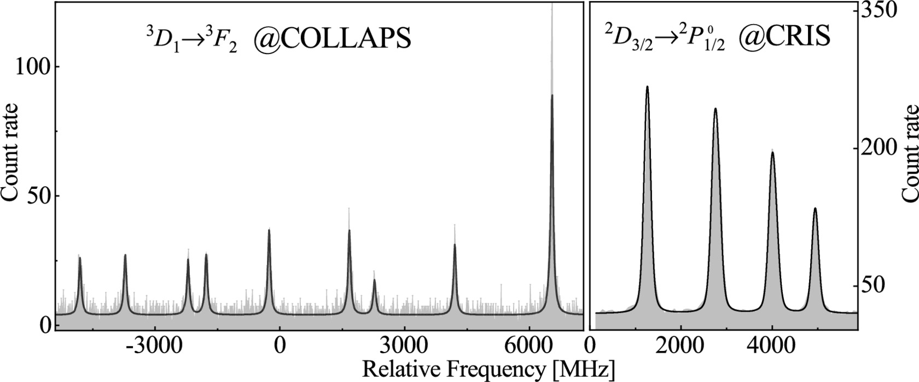
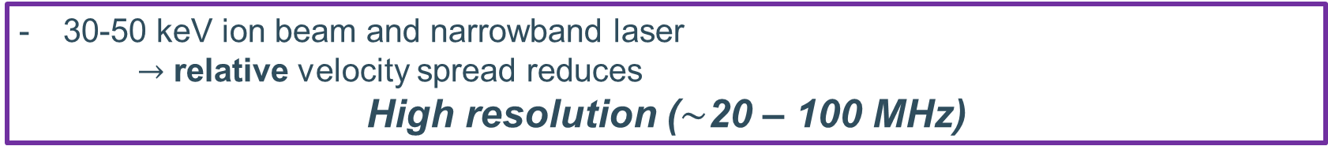
Collinear laser spectroscopy
30-50 keV ion beam and narrowband laser
  $→$ relative velocity spread reduces
High resolution ($∼$20 – 100 MHz)
Ion detection
detect a resonantly excited ion
continuum
⁴⁹Sc
λ₂
Photon detection
second step laser photon
excited state
Hyperfine splitting
laser photon
λ₁
detect fluorescence photons
S. W. Bai, Á. Koszorús et al., Phys. Lett. B 829 137064 (2022)
40 years of experience and continuous upgrades Neugart et al., Journal of Physics G 44, 064002 (2017)

Slide 30
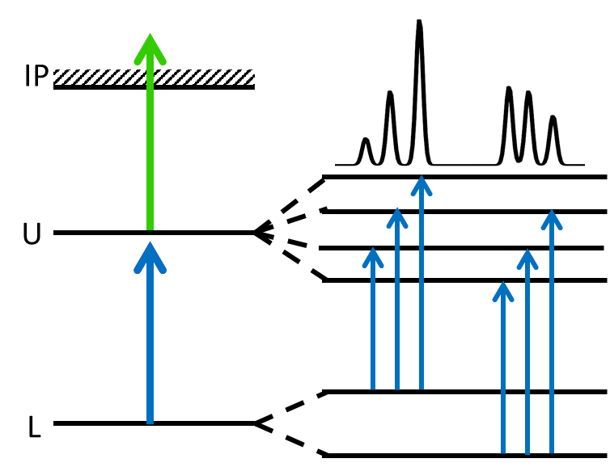
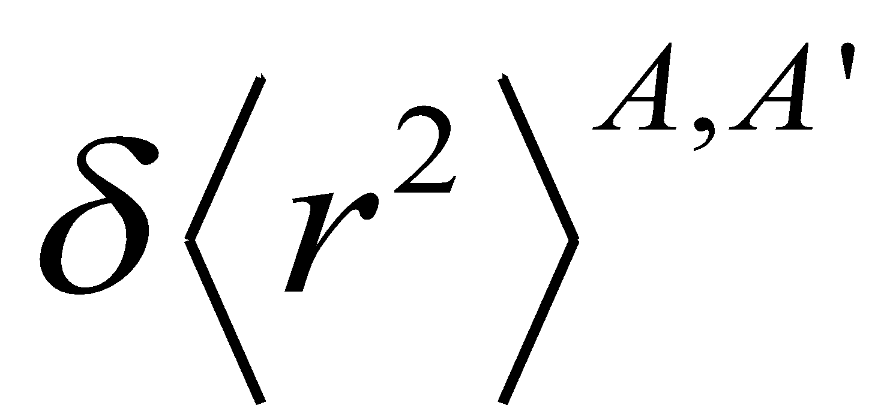
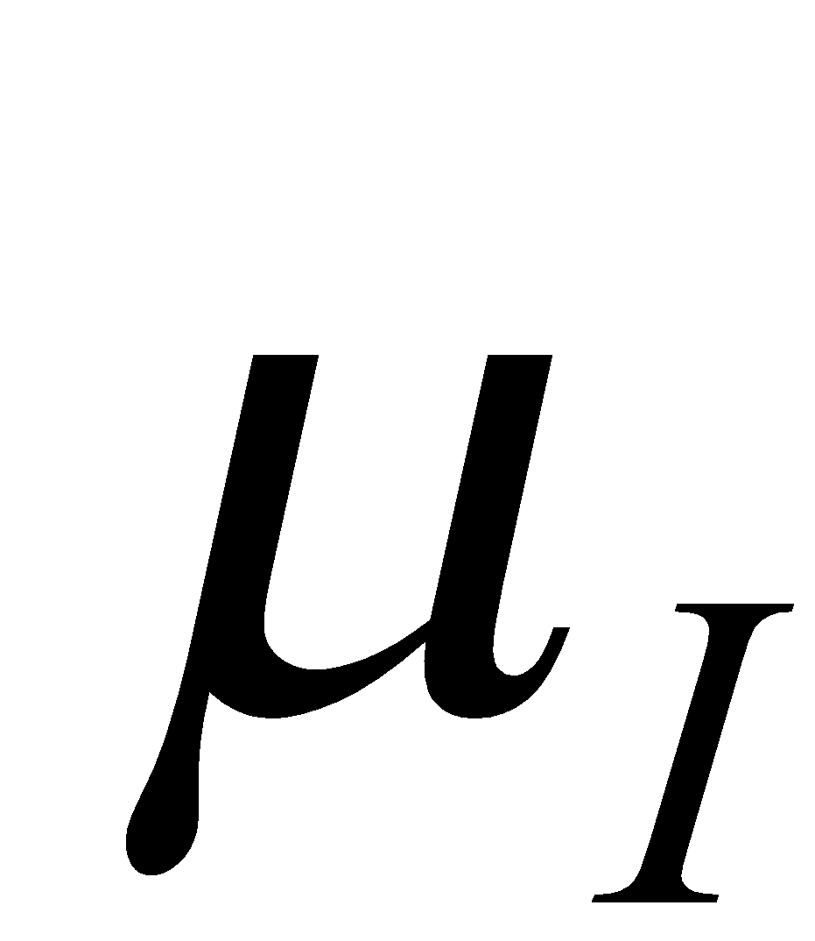


The CRIS technique
Change in mean-square charge radii
Magnetic dipole
moment
Electric quadrupole
moment
Laser light
Nuclear
spin
Neutralization
of ions
Ion counting
MagneTOF

Slide 31
Charge radii from atomic/molecular isotope shifts
$$Ψ$$
$$Ξ$$
Values specific
to transition $i$
!Dominates light masses!
Isotope shift
Field shift
Mass shift
$$δ\left\langle r^{2}\right\rangle$$
$$m_{a}$$
transition-independent
$$δν_{i}^{α^{′},α^{′′}}=Ψ_{i}δ{\left\langle r^{2}\right\rangle }^{α^{′},α^{′′}}+Ξ_{i}\frac{m_{a^{′}}−m_{a^{′′}}}{m_{a^{′}}m_{a^{′′}}}$$
$$→$$
$$→$$
depends on the change of electronic overlap with nucleus between states
depends on all electron correlations
$$→$$
Calculations can be extremely challenging
$$→$$
Previous work on RaF ignored the mass shift
Has NEVER been calculated for a molecule
W. H. King, Isotope shifts in atomic spectra (2013)

Slide 32
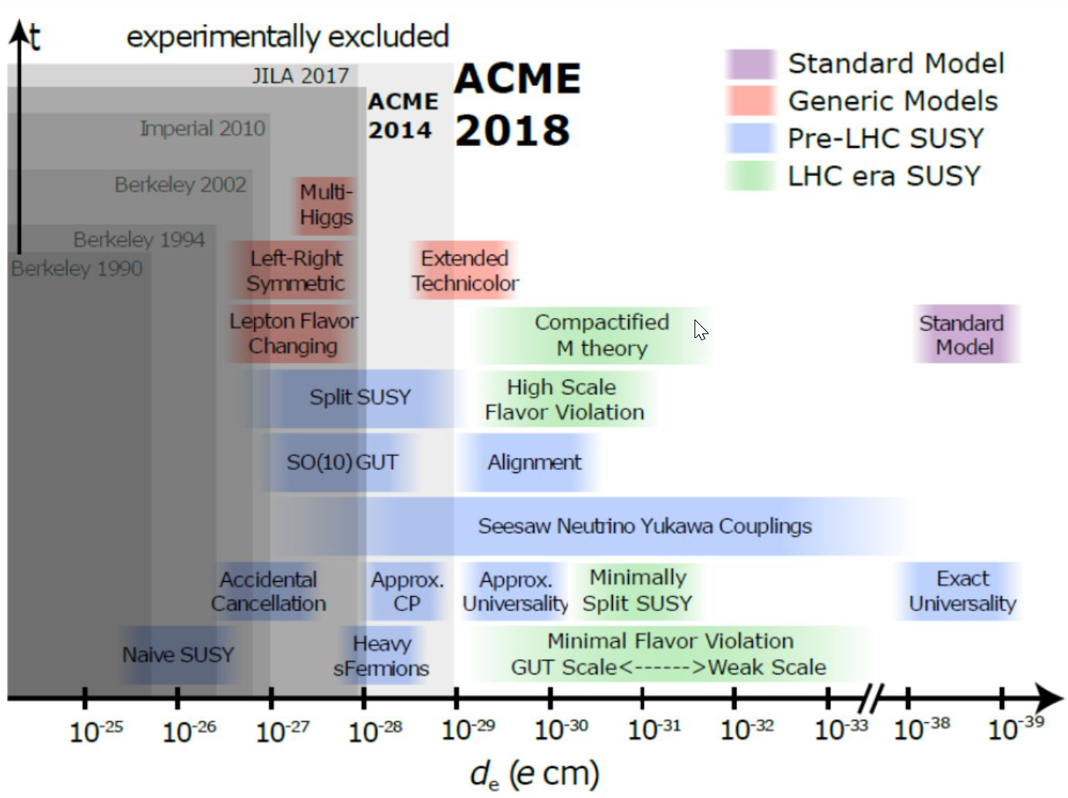
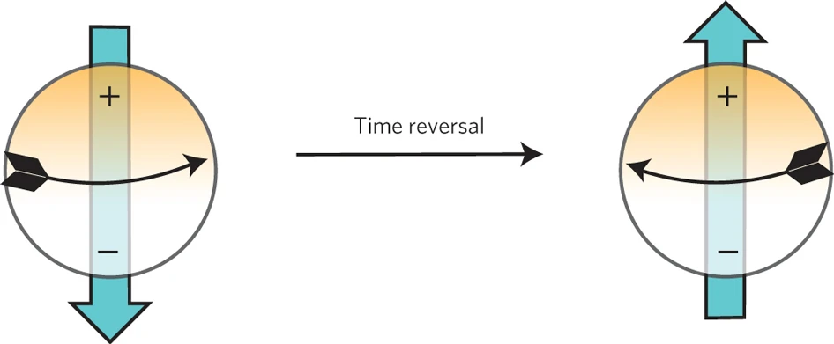
Symmetry-odd moments as a test of the Standard Model
The Standard Model is incomplete
e.g. baryon asymmetry, strong CP problem
Use magnitudes of symmetry-violating moments
  Electric dipole moments (proton, neutron, electron)
  Nuclear Schiff, MQM moments
Benchmarks of Beyond-the-Standard-Model theories
with the electron EDM
Rushchanskii et al., Nature Materials 9, 649–654 (2010)
https://cfp.physics.northwestern.edu/gabrielse-group/acme-electron-edm.html

Slide 33
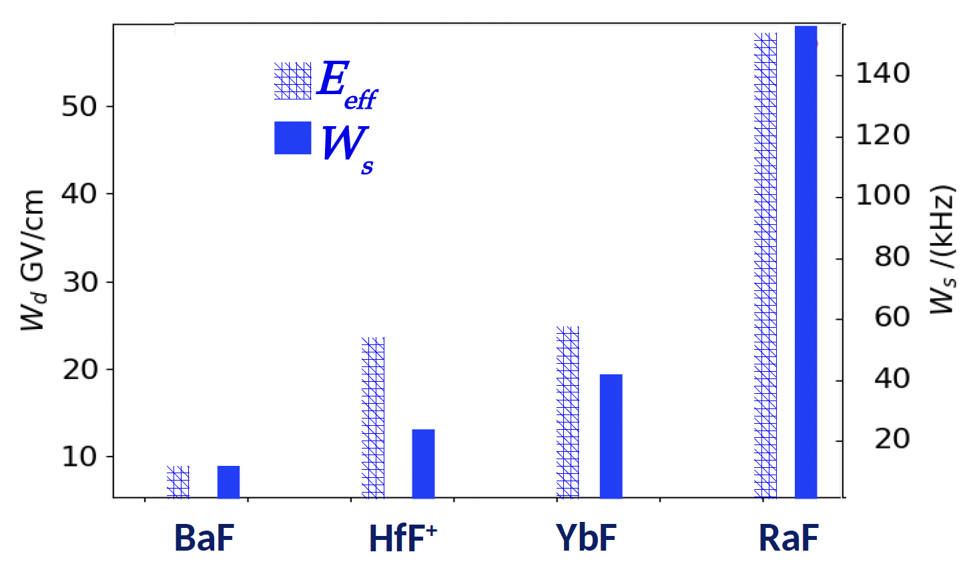
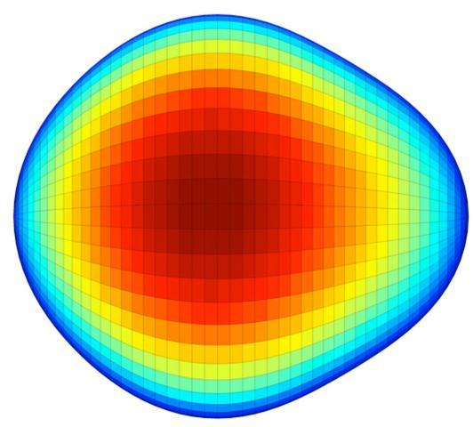

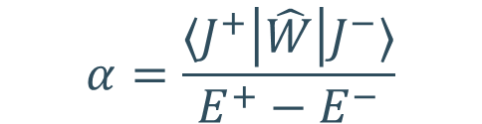

RaF is a highly promising system!
Heavy & deformed nucleus
Butler et al.,
PRL 124 (2020)
close-lying opposite-parity rotational doublet
Gaffney et al.,
Nature 497 (2013)
$$\left|J^{±}\right\rangle =\frac{1}{\sqrt{2}}\left( \left|Ω\right\rangle ±\left|−Ω\right\rangle \right)$$
stronger P,T-odd
interaction mixing
$$α=\frac{⟨J^{+}\left|\hat{W}\right|J^{−}⟩}{E^{+}−E^{−}}$$
Plot courtesy of R. F. Garcia Ruiz and S. G. Wilkins (MIT)
Signatures of P,T-violating moments can
be much stronger than in atoms!
Enhanced symmetry-violating nuclear moments in Ra

Slide 34

High-resolution spectroscopy: laser cooling
Rotational structure
High resolution
²²⁶RaF, no Ra spin!
Can we devise a laser-cooling scheme?

Slide 35


Laser-cooling scheme
S.M. Udrescu, S.G. Wilkins, et al., In preparation (2022)
Need just 3 lasers!

Slide 36

Laser spectroscopy at ISOLDE: In-source
detect a resonantly excited ion
continuum
Resonance Ionization (RI) Laser Ions Source (LIS)
Spectroscopy directly at place of production!
Detect produced ion after mass separation
  Decay spectroscopy, Penning trap
λ₂
second step laser photon
excited state
Hyperfine splitting
laser photon
λ₁
- Highest sensitivity (< 1 atom/minute)
- Resolution is low:
  in hot cavity ion source (~2000 K): doppler broadening ~ 4 GHz
    $→$ heavy elements only, no spins, no Q-moments
Atomic ground state

Slide 37


RILIS highlight
Shape-staggering in neutron-deficient Hg
1 atom per minute!
B. A. Marsh et al., Nature Physics 14 1163-1167 (2018)

Slide 38


Recent highlights from CRIS
⁵²K (Z = 19)
¹³¹In (Z = 49)
A. R. Vernon et al., Nature 607, 260-265 (2022)
Á. Koszorús et al., Nature Physics 17, 439–443 (2021)
CRIS @ ISOLDE
isolde-cris.web.cern.ch/

Slide 39
Isotope shifts
Centroid depends on nuclear mass and radius
Interaction well-understood in atoms
B. A. Marsh et al., Nature Physics 14 1163-1167 (2018)

Slide 40
Radii in molecules – King Plot!
Combine isotope shifts from transitions in atom/ion/molecules
$$δν_{i}^{α^{′},α^{′′}}=Ψ_{i}δ{\left\langle r^{2}\right\rangle }^{α^{′},α^{′′}}+Ξ_{i}\frac{m_{a^{′}}−m_{a^{′′}}}{m_{a^{′}}m_{a^{′′}}}$$
and
$$δν_{j}^{α^{′},α^{′′}}=Ψ_{j}δ{\left\langle r^{2}\right\rangle }^{α^{′},α^{′′}}+Ξ_{j}\frac{m_{a^{′}}−m_{a^{′′}}}{m_{a^{′}}m_{a^{′′}}}$$
$$→$$
$$\tilde{M}δν_{i}^{α^{′},α^{′′}}= \frac{Ψ_{i}}{Ψ_{j}} \tilde{M}δν_{j}^{α^{′},α^{′′}}+ Ξ_{i}−\frac{Ψ_{i}}{Ψ_{j}}Ξ_{j}$$
where $\tilde{M}=\frac{m_{a^{′}}m_{a^{′′}}}{m_{a^{′}}−m_{a^{′′}}}$
Idea!
Extract $Ψ$ and $Ξ$ for a molecular transition j
from knowledge of $Ψ$ (F) and $Ξ$ (K) for an atomic transition i
M. Athanasakis-Kaklamanakis, S. G. Wilkins, A. A. Breier
and G. Neyens, Phys. Rev. X 13 (1), 011015 (2023)

Slide 41
What about quantum chemistry?
High Z $→$ relativistic effects
More electrons + bonds $→$ electron correlations
Gas-phase spectroscopy $→$ high precision
Compare theory and experiment

Slide 42
Easy observables: Ionization Potential
CRIS measurement
IP of RaF
S. G. Wilkins et al., In preparation (2023)
Pyridine 1
λ ~ 1 GHz
Grating Ti:Sa
λ ~ 3 GHz
(power-broadened)
injection-seeded Ti:Sa
λ > 1 GHz

Slide 43
A bit harder: Excitation Energies
FS-RCCSD theory with 69 correlated electrons, triple excitations, basis-set extension, and Breit+QED corrections reproduces all excitation energies with an accuracy of 99.7% or higher!

Slide 44
Is it all that simple?
Sadly, no… energies can be very complicated
AcF has only 2 valence electrons (RaF +1)
Best possible calculations off by hundreds of cm⁻¹
Benchmark of observables like IP and energies $→$ crucial

Slide 45
Recently, CRIS measurements in AcF

Slide 46

Recently…
VS-IMSRG applied for atomic systems for the first time
No unknown interactions as in nuclei
Just a question of how the Hamiltonian is diagonalized
Agreement not incredible
Something to think about…
G. Tenkila et al., arXiv 2212.08188 (2022)

