Slide 1



The 4th International Conference on Advances in Radioactive Isotope Science
ARIS 2023, June. 4~9, 2023. Palais des Papes, Avignon, France
Initial RI Beam Commissioning of the RAON ISOL Facility
Jinho Lee
on behalf of Rare Isotope Science Project
Institute of Rare Isotope Science (IRIS, RISP)

Slide 2
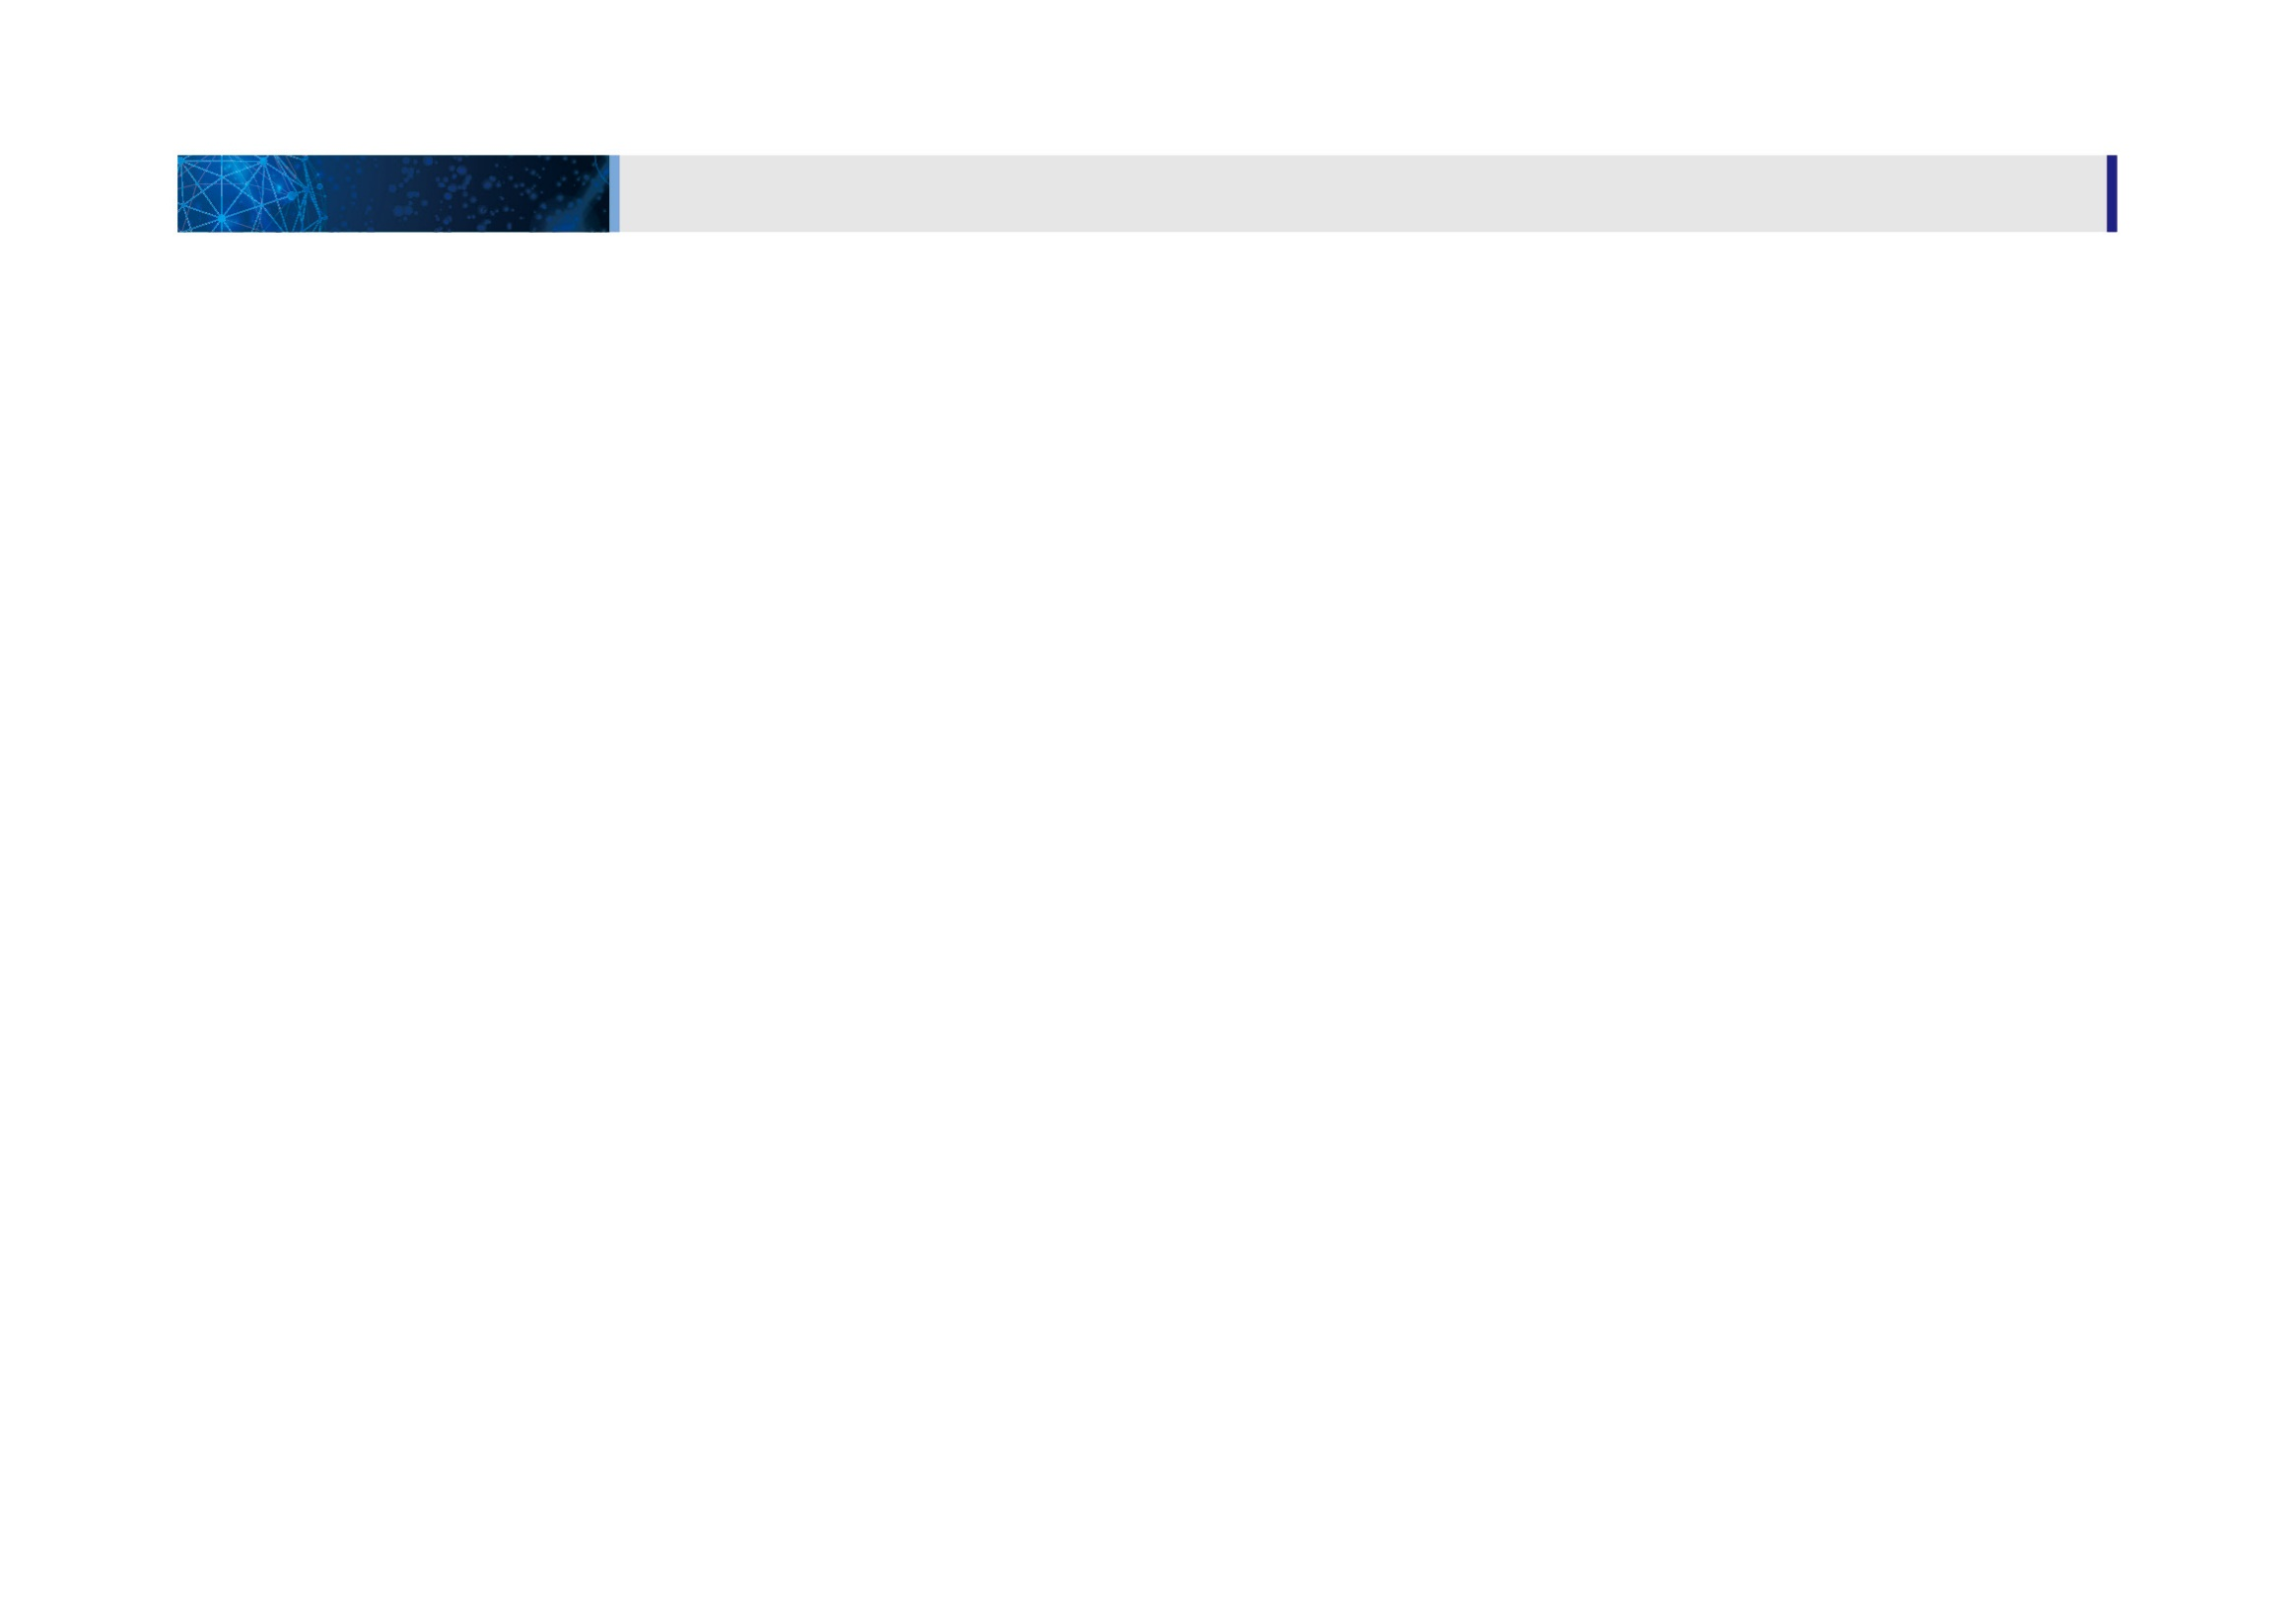
Contents
1. Introduction to the RAON
2. Current status of ISOL facility
3. ISOL beam commissioning
4. Summary & future Plan

Slide 3
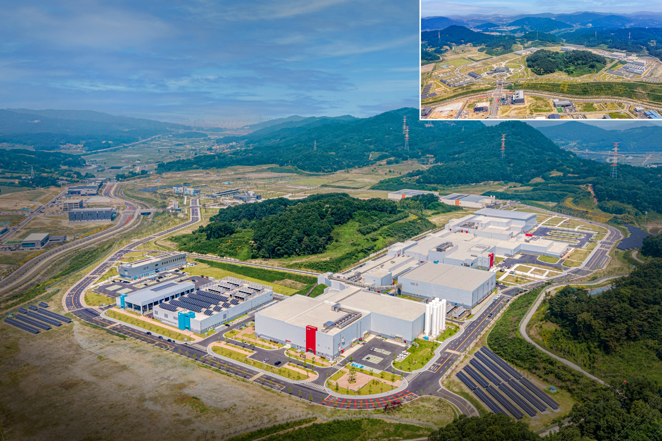
Bird’s-eye-view of RAON
● Accelerator System
● RI producing System
● Experimental System
● Conventional Utilities
Waste Storage
Assembly Bd.
Guest House
SRF Test Bd.
High Energy B
IF
HQ Office
Accelerator
SCL2
ISOL
Control Center
SCL3
High Energy A
Low Energy B
Low Energy A
Cryogenics Bd.
Utility Bd.
Electricity Bd.
Campus Area : 952,066㎡ (including the reservation area of 144,640㎡)
Building Area : 76,259㎡(11 bldgs) with total bldgs. Area of 116,252㎡
3

Slide 4
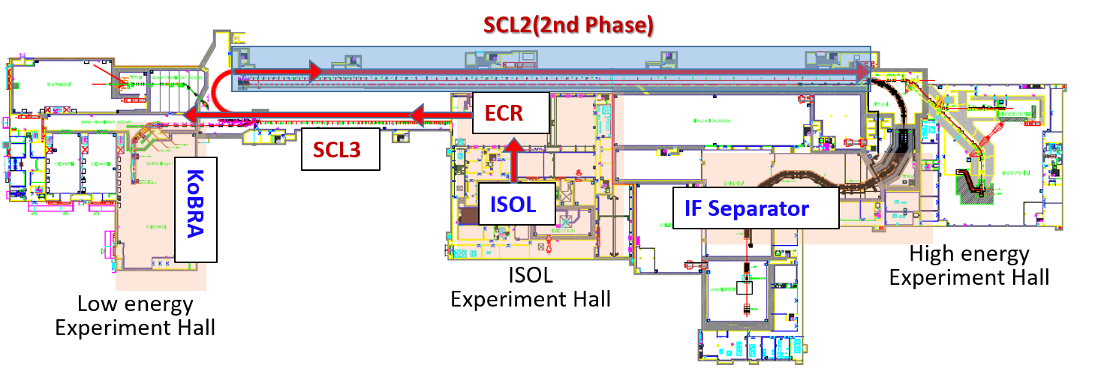
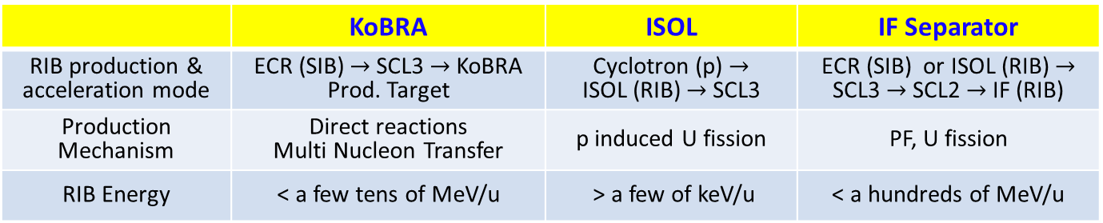
RI beam Production at RAON
 | KoBRA | ISOL | IF Separator
RIB production & acceleration mode | ECR (SIB) $→$ SCL3 $→$ KoBRA Prod. Target | Cyclotron (p) $→$ ISOL (RIB) $→$ SCL3 | ECR (SIB) or ISOL (RIB) $→$ SCL3 $→$ SCL2 $→$ IF (RIB)
Production Mechanism | Direct reactions Multi Nucleon Transfer | p induced U fission | PF, U fission
RIB Energy | < a few tens of MeV/u | > a few of keV/u | < a hundreds of MeV/u
KoBRA : Korea Board acceptance Recoil spectrometer & Apparatus ISOL : Isotope-Separator Om-Line
IF : In-flight Fragmentation separator SCL 3: (Low-energy) Super Conduction Linac 3 SCL2 : (High-energy) Super Conduction Linac 2
ISOL + IF
  ISOL : direct fission of ²³⁸U by 70 MeV protons
  IF : 200 MeV/u, 8.3 pμA of ²³⁸U
  ¹³²Sn : 10 keV/u (ISOL) → 25 MeV/u (SCL3) → 250 MeV/u (SCL2) → more exotic RI (IF)
  (up to ~10⁸ pps)

Slide 5
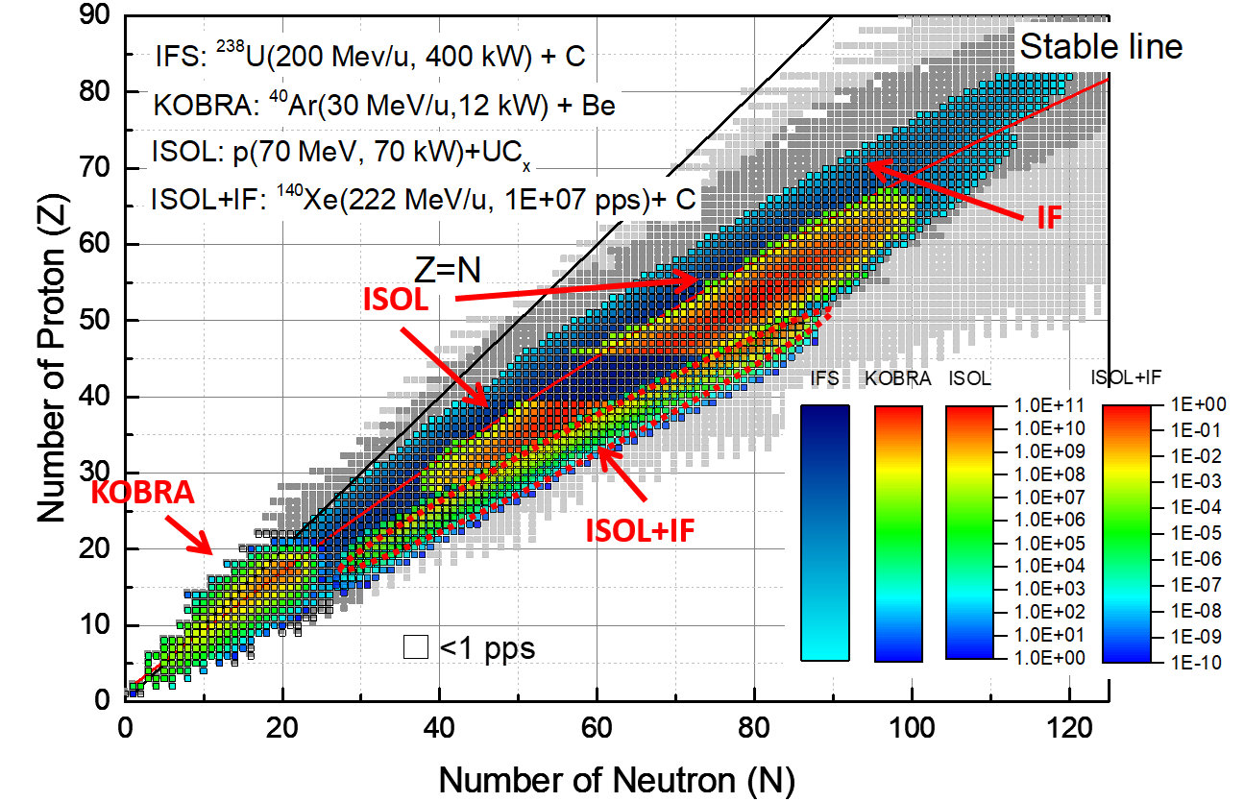
Expected RIs from RAON
RAON will provide access to unexplored regions of the nuclear chart

Slide 6
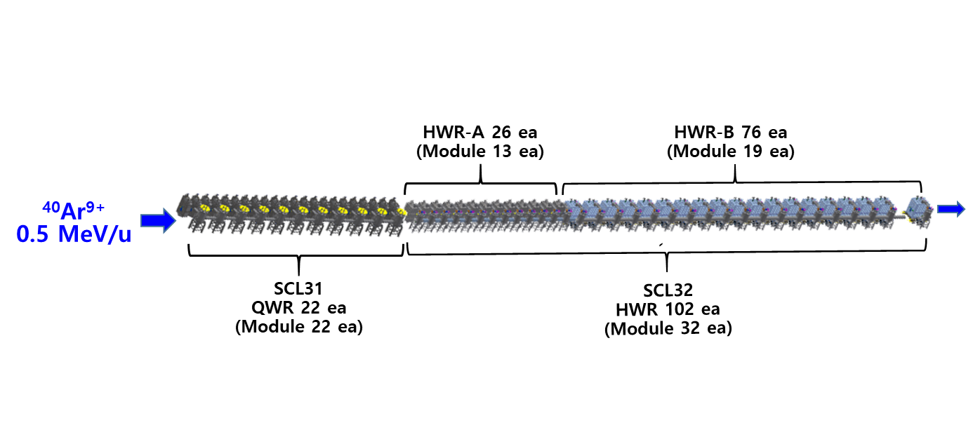
SCL3 beam commissioning
The first successful beam commissioning of the low-energy superconducting linac (SCL3) with ⁴⁰Ar⁹⁺ beam in May 23, 2023 (have been performed by Accelerator Division in IRIS)
Ar⁹⁺ beams accelerated by entire SCL3(QWR/HWR)
17.581 MeV/u
21.256 μA

Slide 7
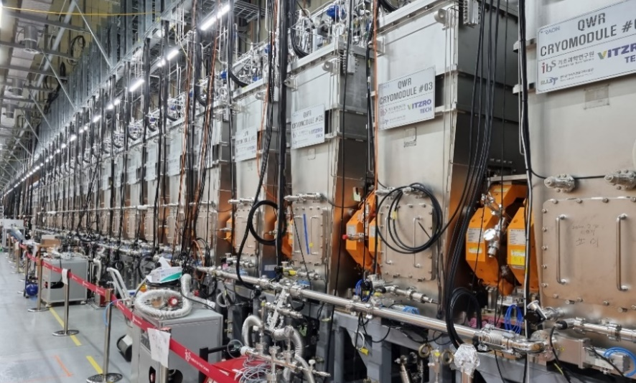
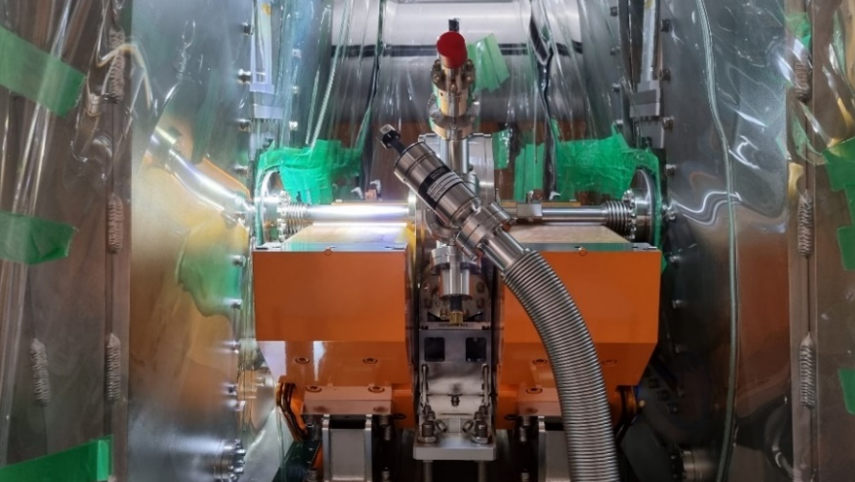
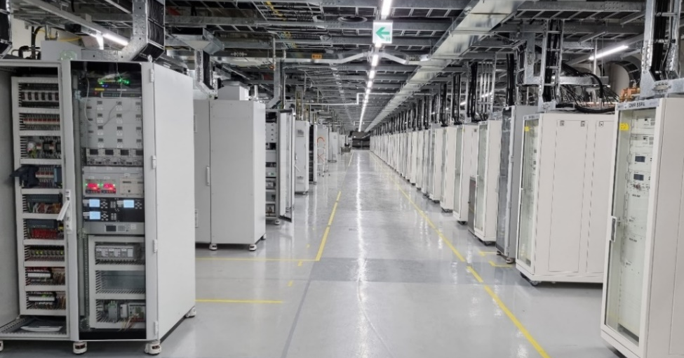
Superconducting linac SCL3
Tunnel and galley
QWR & HWR Cryomodules
Cryogenic Distribution to Cryomodules
Clean beam line assembly
CM/Cryogenic Control Rack and SSPA
Installation completed in 2021

Slide 8
1. Introduction to the RAON
2. Current status of ISOL facility
3. ISOL beam commissioning
4. Summary & future Plan

Slide 9
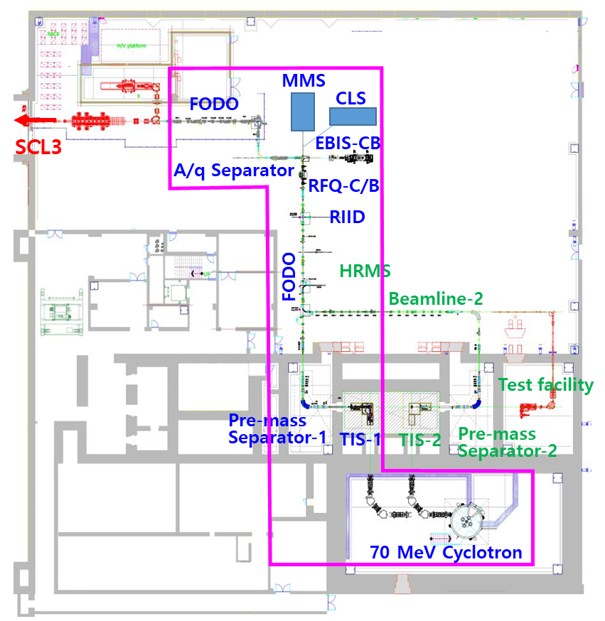
RAON ISOL facility
U fission target for 80 < A < 160 neutron-rich isotope production and delivery
Driver using Cyclotron : proton 40<K<70 MeV, up to 0.75 mA
Target: UCx & non-fissile target (SiC, BN, MgO, LaC₂, TiC, CaO etc)
Ion source : SIS. RILIS, FEBIAD
Pre-mass separator, Rm ~400
RIB: 10< K< 60 keV, up to 40 pi mm mrad, 10⁸ pps(Sn), > 90% purity @Exp.
RFQ-Cooler/buncher + EBIS charge breeder
A/q separator, R_{A/q} ~250
10 keV/u, A/q<6 to RFQ of post accelerator (SCL3) for RIB acceleration
Remote handling system for TIS/module
‘19. 10 ~ ‘21.05 | ISOL system installation and performance tests
’21.11 | ISOL system integration using a stable beam
’22.10 ‘22.11 | 70 MeV Cyclotron SAT ISOL stable beam commissioning with Sn¹⁺, K¹⁺, Na¹⁺and Cs¹⁺ using SIS and RILIS
‘23.01 ‘23.03~ | Cyclotron beam commissioning Initial beam commissioning using a SiC target

Slide 10
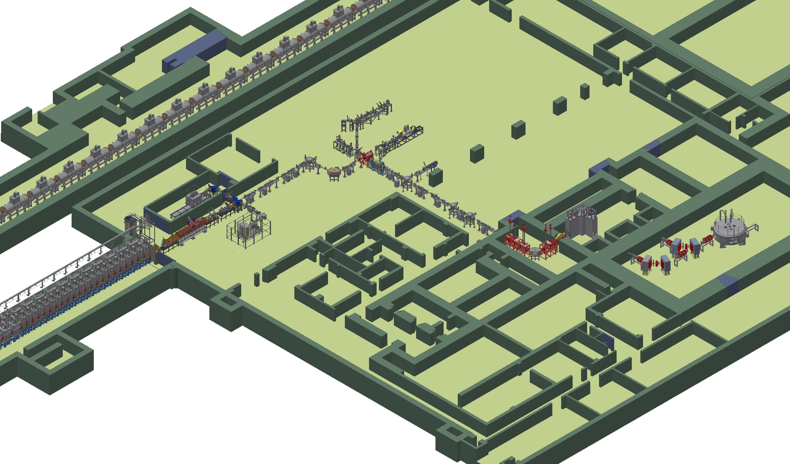
ISOL system layout
ISOL Experimental hall
CLS
EBIS-CB
MMS
RIID
(7)
FODO
A/q Sep.
RFQCB
Target station
FODO
(1)
(2)
Pre-sep
Cyclotron
(3)
(4)
(5)
Laser
(6)
UCx target room
TIS assembly
TIS module test room
Used TIS storage
Module storage
Hotcell
On-line test facility
TIS/module remote operation
& maintenance area
< First basement floor >

Slide 11
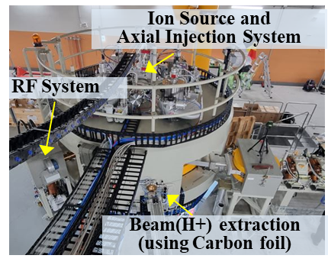
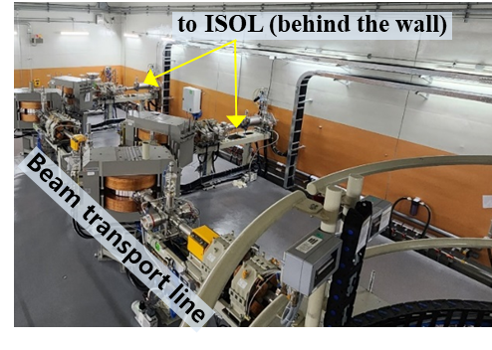
70 MeV Cyclotron
Specifications of 70 MeV Cyclotron
Energy | 40 ~ 70 MeV
Max. proton intensity | 750 uA
Simultaneous extracted beams | 2
Injected H- current | 10 mA (H-), Multicusp IS
Number of sectors | 4
Hill field | 1.6 Tesla
Harmonic mode | 4
Frequency (fixed) | 62 MHz
Total weight | 140 tons
Cyclotron dia. | 3.8 m
Cyclotron Cro-pumps | 6
40~70 MeV proton, 0.75mA max with two beam lines connecting to ISOL bunker (two target station)
Schedule
Contract(’19.6), pre-survey(’19.11), Design finalized (’20.4), FAT (’21.6) , Shipping(’21.8), Installation completed(’22.4.28), SAT(’22.10)
< Cyclotron & beam transportation line >

Slide 12
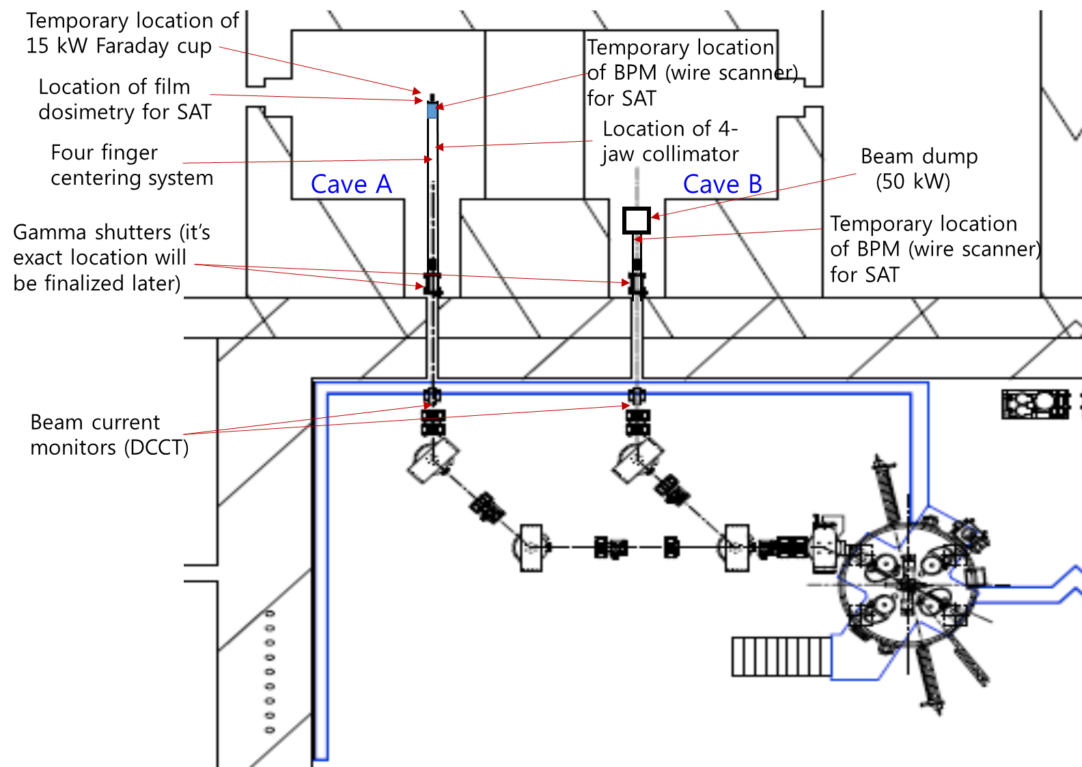
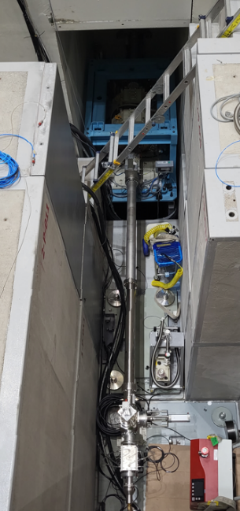
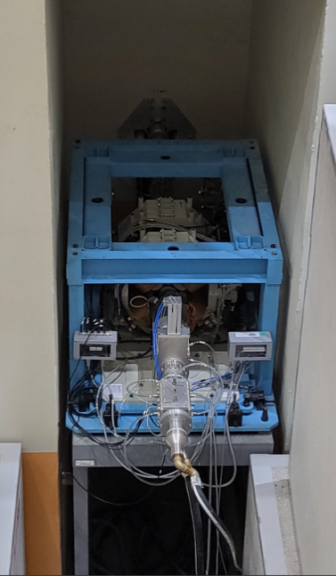
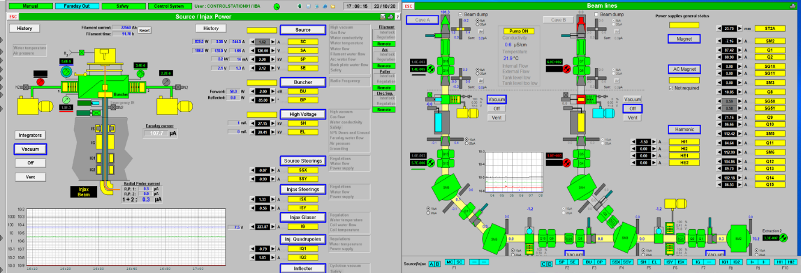
SAT of 70 MeV Cyclotron
Beam stability and uniformity test at ISOL target position of bunker-A
- 40 MeV & 70 MeV / beam diameter 2 cm & 5 cm / Wobbling on & off
- using BPM & beam dump
Max. beam power test at ISOL bunker B : 5 hours at 50 kW
bunker A
bunker B
Wall
BPM (2 wire X, Y scan)
Collimator
(50 mm, 20 mm)
Beam dump (50 kW)
Beam dump
ISOL bunker-A
ISOL bunker-B
Wall
Beam line transmission > 96% FC: 25 μA at bunker A & bunker B
Maximum Beam current : 711.8 μA @ 5hours, stability > 95 %
Beam wobbling : beam uniformity < ±10 % (@ 20 mm)

Slide 13
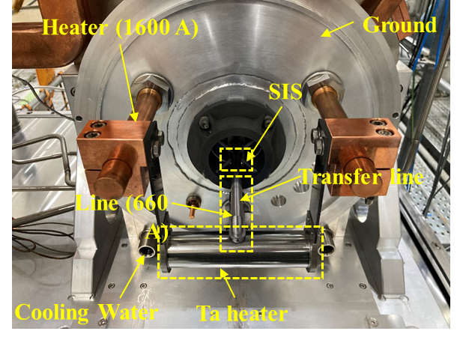
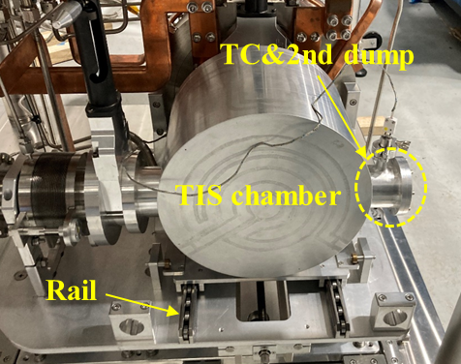
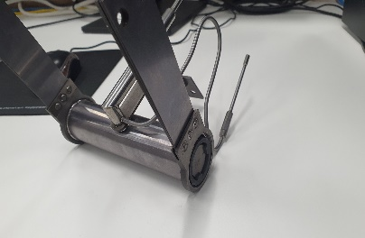
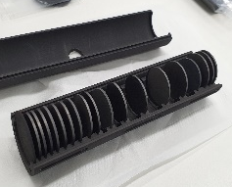
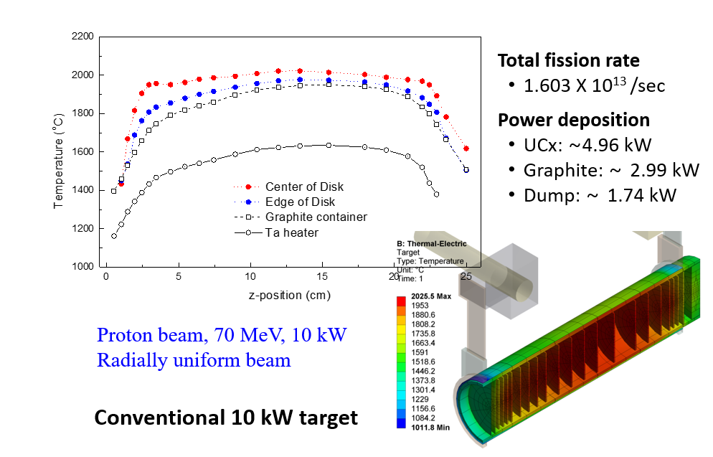
10 kW target ion-source
Ta Heater
< TIS system >
Target container & disks
TIS was benchmarked on SPES(INFN) & ISOLDE system
< Thermal distribution & power deposition of 10 kW UCx targets >

Slide 14
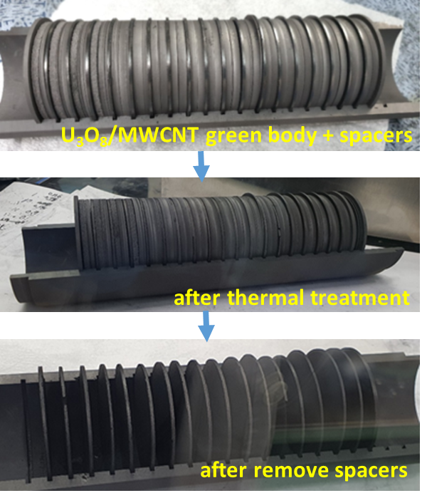
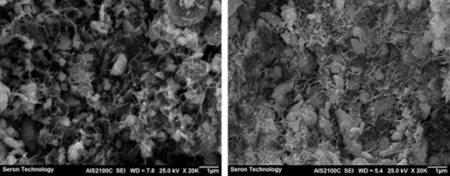
10 kW UCx target fabrication
Manufacturing of UCx/MWCNT target prototype
Density | Thickness | Diameter | Number of disks | Total uranium mass thickness
~2.5 g/cm³ | 1.3 mm | 50 mm | 18 | 5.32 g/cm²
U₃ O₈ + 19C 3UO₂ + 18C + CO₂ (600 ~ 1,000℃)
3UO₂ + 18C 3UC₂ + 6C + 6CO (1,250 ~ 2,000℃)
* Manufactured at KEPCO-NF in Korea
* UCx fabrication procedure was based on Nano-UCx of CERN-ISOLDE
 | MWCNT |  | sintered density (g/cm³)
 | Avention (wt%) | Nanocyl (wt%)
virgin U₃O₈ | 100 | 0 | 2.96±0.01
 | 95 | 5 | 2.37±0.12
 | 90 | 10 | 2.07±0.10
 | 80 | 20 | 1.66±0.17
< UCx target microstructure (before(L) and after(R) heat treatment) >
< UCx density according to MWCNT composition >

Slide 15
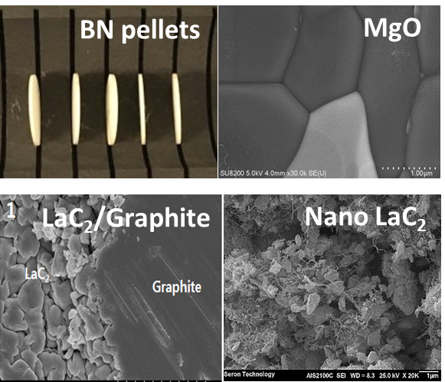
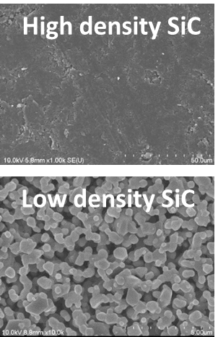
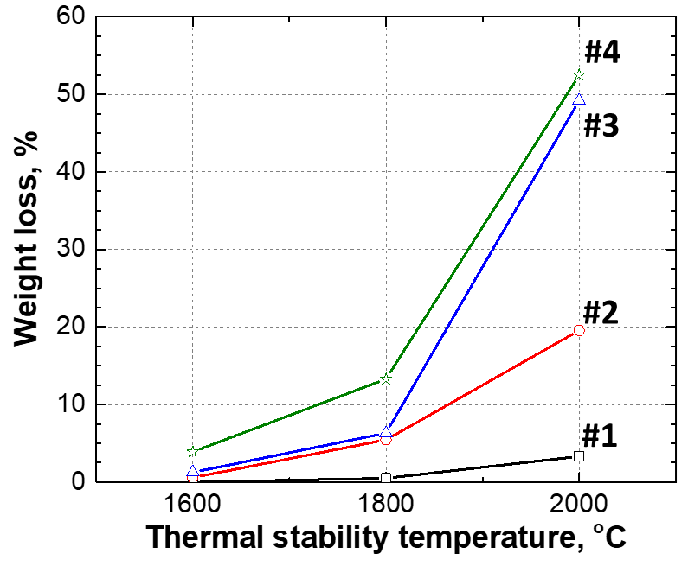
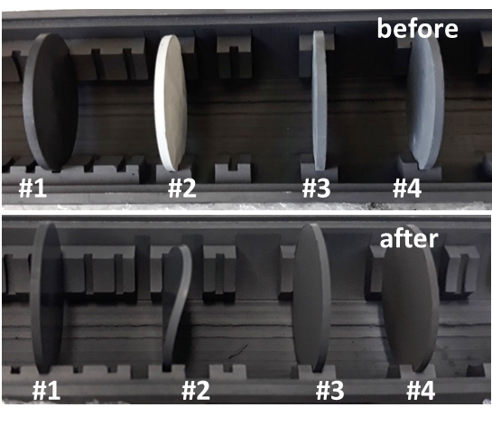
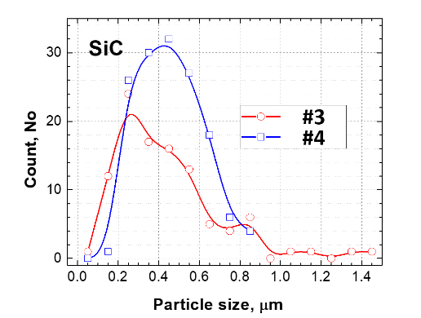
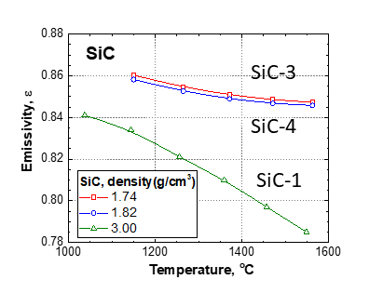
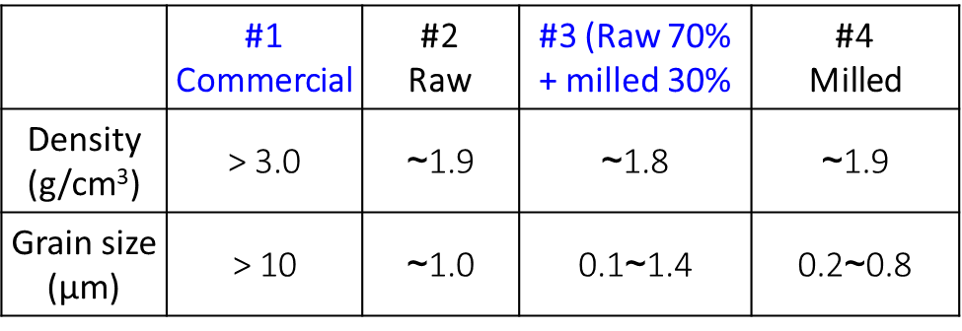
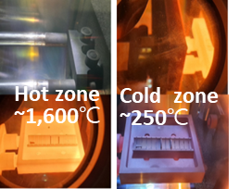
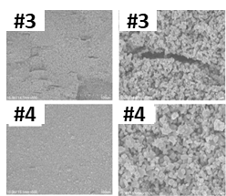
Non-fissile target
Non-fissile target preparation
Characteristic test results for SiC targets
Weight loss
< Heat treatment result at 1,800 ℃, 8h >
Grain size distribution
Emissivity
Diffusivity
SiC target manufacturing (for RI beam commissioning) : Density 1.7~2.0 g/cm³, grain size < 1 um, thick. 1.3 mm
#3
#2
#4
#3
#1
#4
< Thermal shock test (3 cycle) and SEM image >

Slide 16
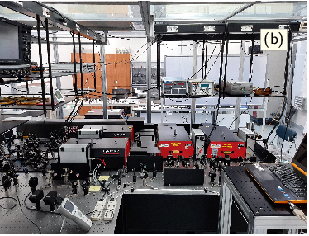
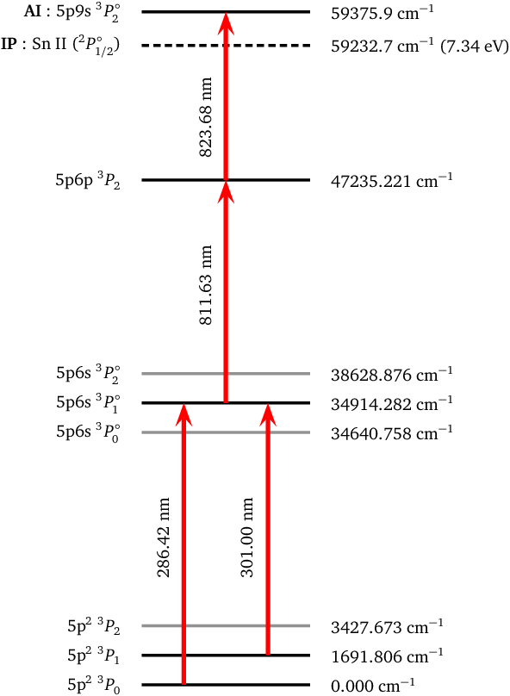
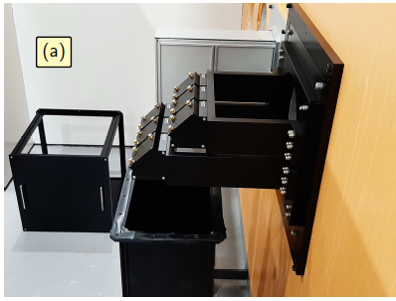
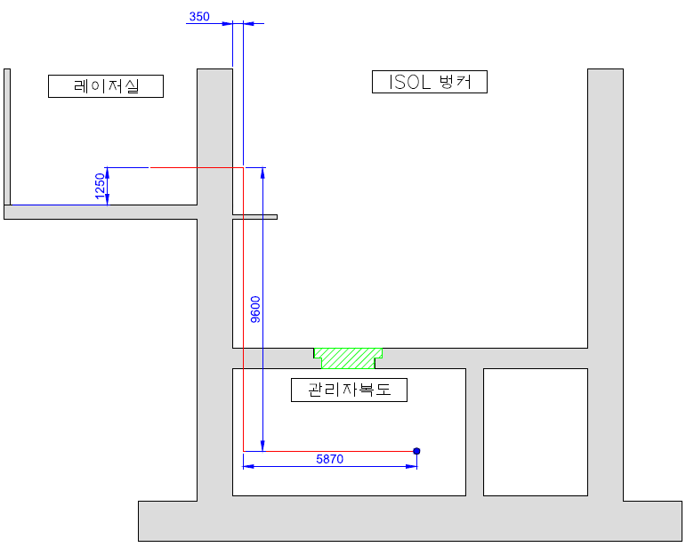
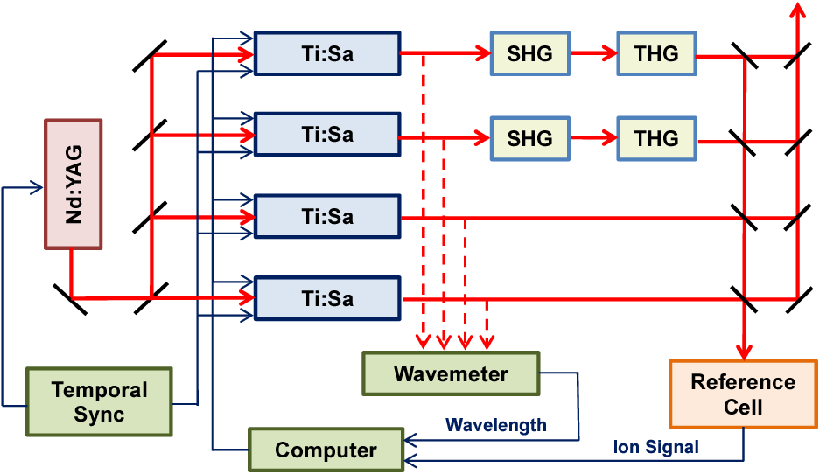
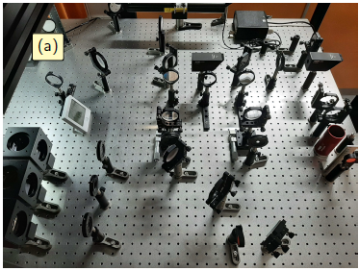
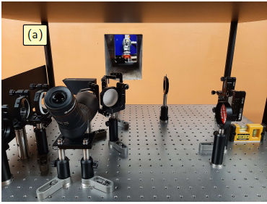
ISOL RILIS Laser system
Laser system for laser ion source
Laser | ㆍTi:Sa Laser (4), Nd:YAG Laser (1)
Specification | ㆍPump laser power : 100 W @ 532 nm ㆍFrequency tuning range : 750 ~ 940 nm ㆍClean booth : 4.2 m x 4.2 m x 2.4 m
Laser Room
Laser pass ~25m
to TIS
< Laser ionization scheme of Sn >
< Laser beam transport >
< Laser system and setup>

Slide 17
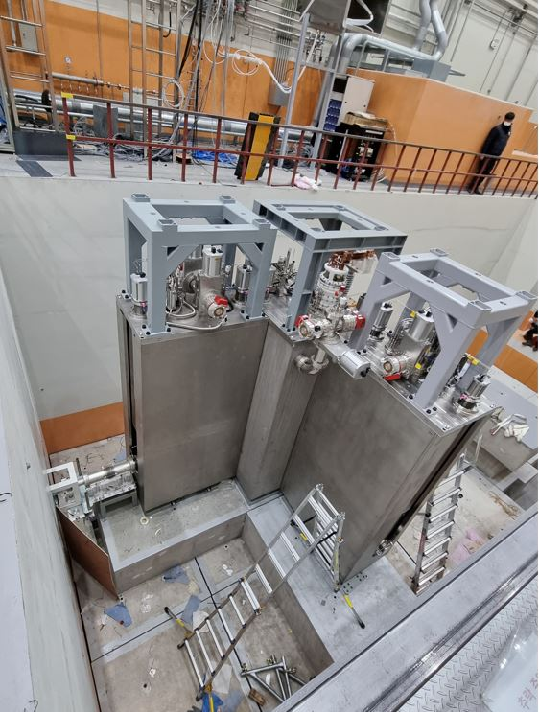
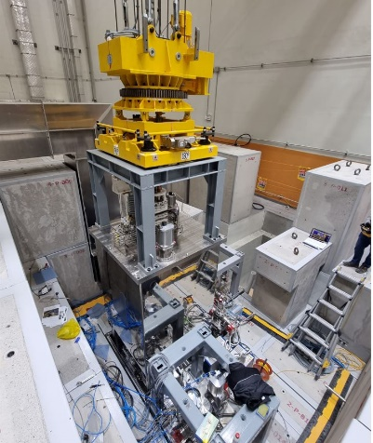
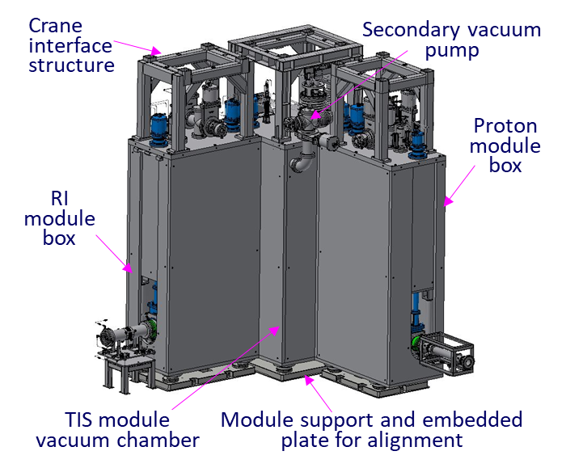
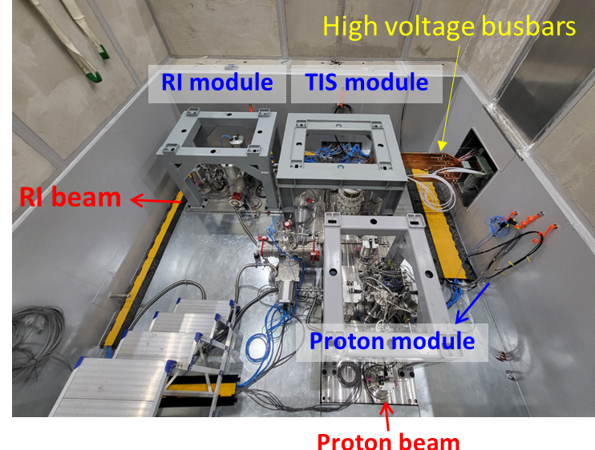
RI production module in ISOL bunker
TIS module / Proton beam module / RI beam module
Movable concrete blocks filled up around the modules inside the bunker
All module in ISOL bunker is removed and mounted with precise alignment within 1 mm remotely
Remote operation and TIS exchange in hot cell
Quick line connection/disconnection by person access
Radio-activated vacuum exhaust gas treatment system
< RI production module system in ISOL bunker >
※ TIS module benchmarked ISAC(TRIUMF) system

Slide 18
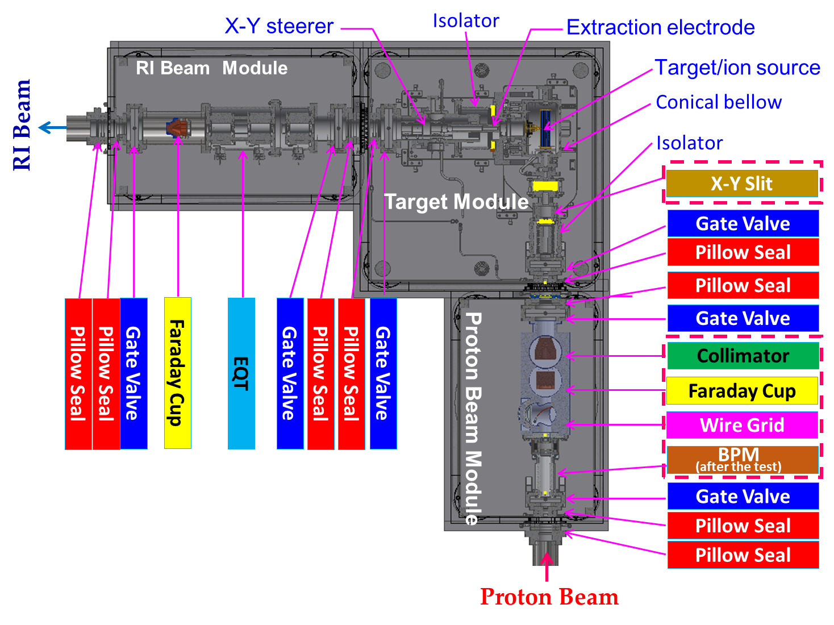
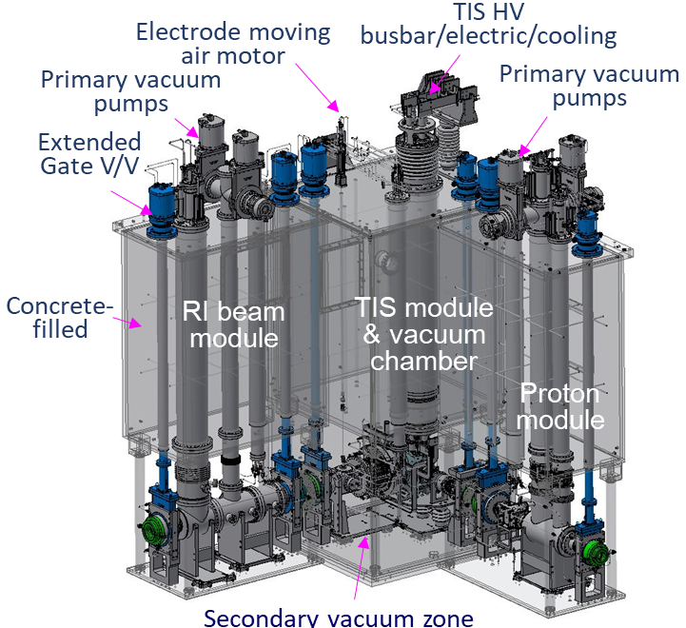
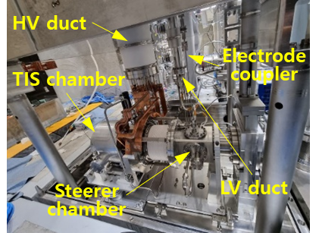
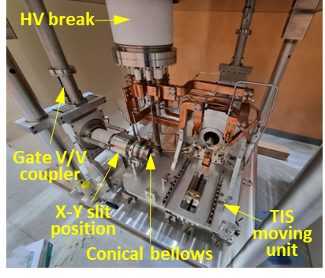
RI production module in ISOL bunker
Proton beam module is composed of Wire grid, F-cup, Collimator and BPM for minimum beam losses between TIS and cyclotron
Distance between collimator and ISOL target : ~1.2m → X-Y slit was located in front of TIS chamber
Beamline remotely connected/disconnected by pillow seal
< TIS & Front-end system >

Slide 19
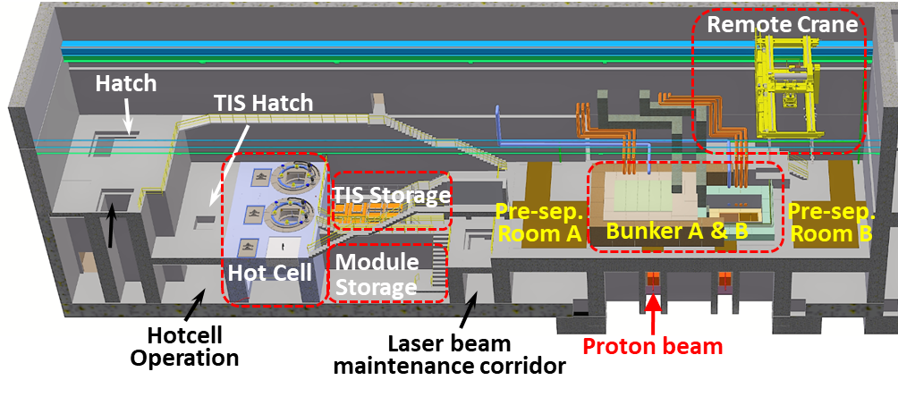
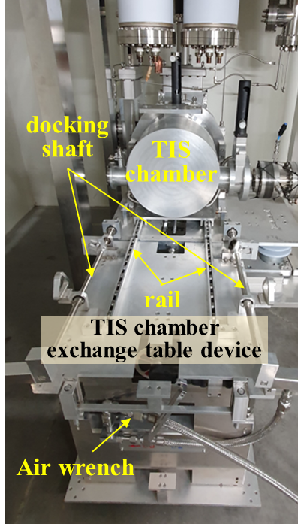




TIS remote handling system
RHS in Target hall

Slide 20

ISOL Beam separation and transport system

Slide 21













Beam diagnostics for ISOL beamline
For beam tuning
1. Tuning using stable beam such as Cs, K,…
- FC, Wire scanner, Wire Grid, Beam viewer, Emittance meter
2. Changing magnetic field of MD
3. Tuning for RIB
- Plastic scintillator(50x50x50 mm³) covered by thick aluminum
- Low intensity beam monitor of MCP (max. 10⁶ pps)
Beam selection point for pre-mass separator
Beam selection
point for AQ separator
< Position for beam diagnostics >
Wire scanner
Pepper-pot
< Typical diagnostic chamber >
Faraday cup
Scintillator
Wire grid
Slit
< Plastic Scintillator + Aluminum layer + PMT >

Slide 22




RIID Station
10~80 keV RI identification at ISOL beamline γ-spectroscopy (HPGe)
RI stop position move using Linear Guide
Tape speed (linear guide) > 2.5m/s (position resolution <1 mm)
After 2 days
< RIID Station >
< The first RI ID with HPGe (’23.3.2) >

Slide 23
1. Introduction to the RAON
2. Current status of ISOL facility
3. ISOL beam commissioning
4. Summary & future Plan

Slide 24






Stable beam commissioning
First ion beam extraction test in ISOL on-line (¹³³Cs¹⁺ with energy of 20 keV)
Beam transport efficiency from RI module to F1 is ~100%
Mass resolving power of Pre-mass separator is ~1,000
20 mm
2.11 nA
40 mm
<F1 beam viewer >
< Sample preparation in TIS chamber >
2.06 nA
1.19 nA + K¹⁺, Na¹⁺
Beam emittance of TIS extracted Cs beam
X(2σ) : 15 π mm mrad
Y(2σ) : 17 π mm mrad
< Beam size measurement by F2 slit >

Slide 25






Stable beam commissioning
Sn beam separation and charge breeding
Cooling time ~100 ms
Repeatation rate 10 Hz
< Beam profile of ¹²⁰Sn¹⁺ delivered to RFQ-CB (in M6 wire scanner) >
< Sn bunching beam profile from RFQCB >
< Result of mass scan >
In EBIS,
SC magnet 6T
E-gun 1A
Breeding time 40 ms
< A/q spectrum for ¹²⁰Sn^{n+} >
< Charge state distribution of ¹²⁰Sn^{n+} >

Slide 26


Stable beam commissioning
Sn beam transport to end of ISOL beamline
Beam transport efficiency from EBIS to end of beamline
 | Current [A] | Number of ions | Transmission from previous point | Transmission from EBIS
EBIS Magnet | 5.40E-9 | 2.34E+7 | - | -
after A/q Separator | 4.35E-9 | 1.88E+7 | 80.50 % | 80.50 %
after Deflector | 4.25E-9 | 1.84E+7 | 97.70 % | 78.70 %
at End | 4.07E-9 | 1.76E+7 | 95.76 % | 75.37 %
< Resolving power of A/q spectrum >

Slide 27

Purpose of the RAON ISOL system
RI beam commissioning
Experimental procedure
stable beam tuning using ³⁹K¹⁺ with energy of 20 keV
optimization of proton beam (70 MeV, 1 ~ 1.4 uA) delivered to a SiC target (using a collimator, beam diagnostics and a double slit in front of target)
beam extraction from TIS and mass separation of RIBs
RI beam measurement & decay test using a scintillator + PMT
RIB transport to RIID for RI confirm

Slide 28




Purpose of the RAON ISOL system
RI beam commissioning
SiC targets for initial RI experiments
²⁵Na
Characteristic analysis results of SiC commissioning targets
²⁰Na
[1] R.G. Munro, J. Phys. Chem. Ref. Data, Vol 26, No 5, 1997
< Release time of Na isotopes for density and grain size >

Slide 29



Purpose of the RAON ISOL system
RI beam commissioning
transport a low-power proton beam to ISOL target
(3)
(2)
Wall
(1)
< Cyclotron beamline >
< ISOL tunnel & bunker-A >

Slide 30



Purpose of the RAON ISOL system
RI beam commissioning
1st RI beam experiments using #1 SiC target (Feb. 27 ~ Mar. 15, 2023)
Proton beam transmission
- Source current : 12 μA
- Stripper current, position (1) : 1.1 μ A
- Cyc. beam line Faraday cup, position (2) : 1.1 μ A
- Proton module F-cup, position (3) : 0.53 μA
* 50 % loss from the last faraday cup of cyclotron vault ← Beamline misalignment between CYC beamline and ISOL target
→ beamline re-alignment performed
RI beam measurement
- Scintillator + PMT configuration
- Scintillator : 50 x 50 x 20 mm³, BC408, covered by aluminum foil
- Signal from PMT is discriminated and with counted by Hamamatsu devices
²¹Na Half-life
: 22.49(4) s
²⁵Na Half-life
: 59.1(6) s
²⁴Na Half-life
: 14.99 h
< Measurement results and Na beam decay analysis >

Slide 31



Purpose of the RAON ISOL system
RI beam commissioning
2nd RI beam experiments (’23, May 23~)
Proton beam current : 7 μ A @ Ion Source, 1.2 uA @ Stripper, 1.2 uA @ Proton module
→ > 95% beam transmission from the last faraday cup of Cyclotron vault to Proton module
Beam profile at wire grid : X 35 mm, Y 30 mm (focusing condition)
signal line problem
Beam size at slit :
X ~20 mm, Y ~17 mm
Focusing, centering and profile change tests for proton beam using quadrupoles (Q14 & Q15)
X-Y slit current
< Proton beam current of 4-jaws collimator in Proton module >
< Proton beam current of 4-jaws slit in front of ISOL target >

Slide 32




Purpose of the RAON ISOL system
RI beam commissioning
Experimental results
Proton beam 70 MeV, 1.2 μ A
SiC target temperature ~1,400℃ (Ta heater ohmic heating 1.8 kW)
Measured RIs (so far June 1)
^{26m}Al
Yield :
7.4 x 10⁶ cps
(preliminary)
Yield :
2.4 x 10⁶ cps
(preliminary)
< Measurement results using scintillator + PMT >

Slide 33






Purpose of the RAON ISOL system
RI beam commissioning
Measured results for ²⁰Na (half-life : 0.447.9 s)
Yield :
1.7 x 10⁵ cps
(preliminary)
< Measurement result of ²⁰Na using scintillator + PMT >
Na RIs detected by HPGe at RIID

Slide 34
Purpose of the RAON ISOL system
Summary & future plan
After completing the ISOL system installation in June 2021, the design requirements of the ISOL system were verified through the separation/transport test using a stable beam
RI production/separation tests using high- and low-density SiC targets are ongoing from March 2023
RI beams (^{20~22}Na, ^{24~25}Na, ^{26m}Al isomer) were measured and confirmed using scintillator + PMT and HPGe
through the measurement of the ²⁰Na at low power (~100W), the possibility of measuring various short-lived RI beams was confirmed
for the time being, we plan to perform RI production/release tests according to the target environment using low-density SiC target
Future Plans
2nd half of 2023: production of ²⁶Al beam using laser ion source and delivery to MMS or CLS
1st half of 2024: start ISOL RI beam transport to SCL3 injector
plasma ion source is currently under development
from 2025, the UCx target will be used, and the beam power will be gradually increased to 5 kW
We will continue to cooperate with foreign ISOL organizations

Slide 35

Thank you for your attention !
“We thank the international ISOL reviewers for their valuable advice and assistance”

