Slide 1
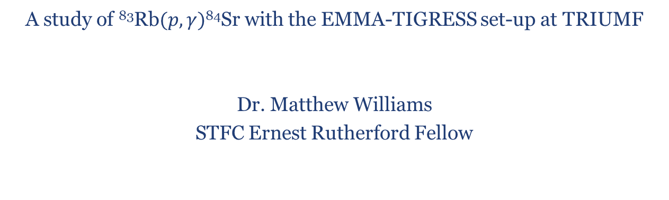
First measurement of a p-process reaction with a radioactive ion beam
A study of ⁸³Rb$(p,γ)$⁸⁴Sr with the EMMA-TIGRESS set-up at TRIUMF
Dr. Matthew Williams
STFC Ernest Rutherford Fellow

Slide 2
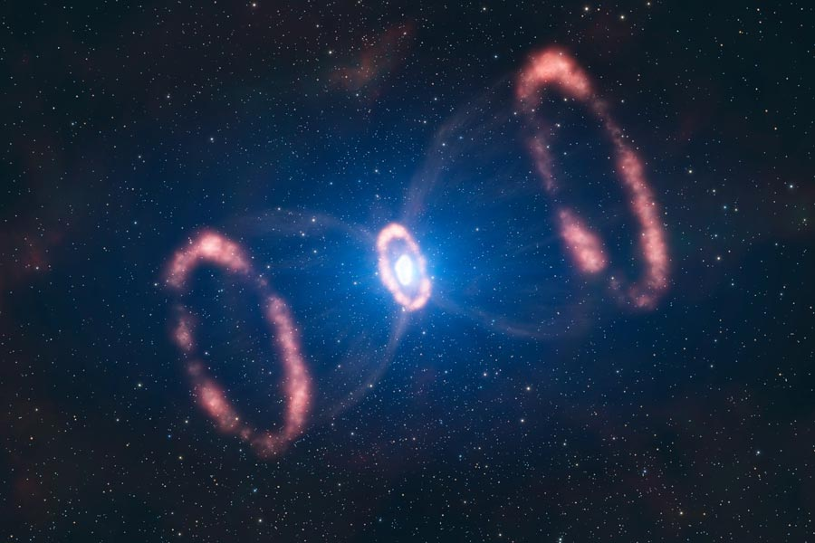
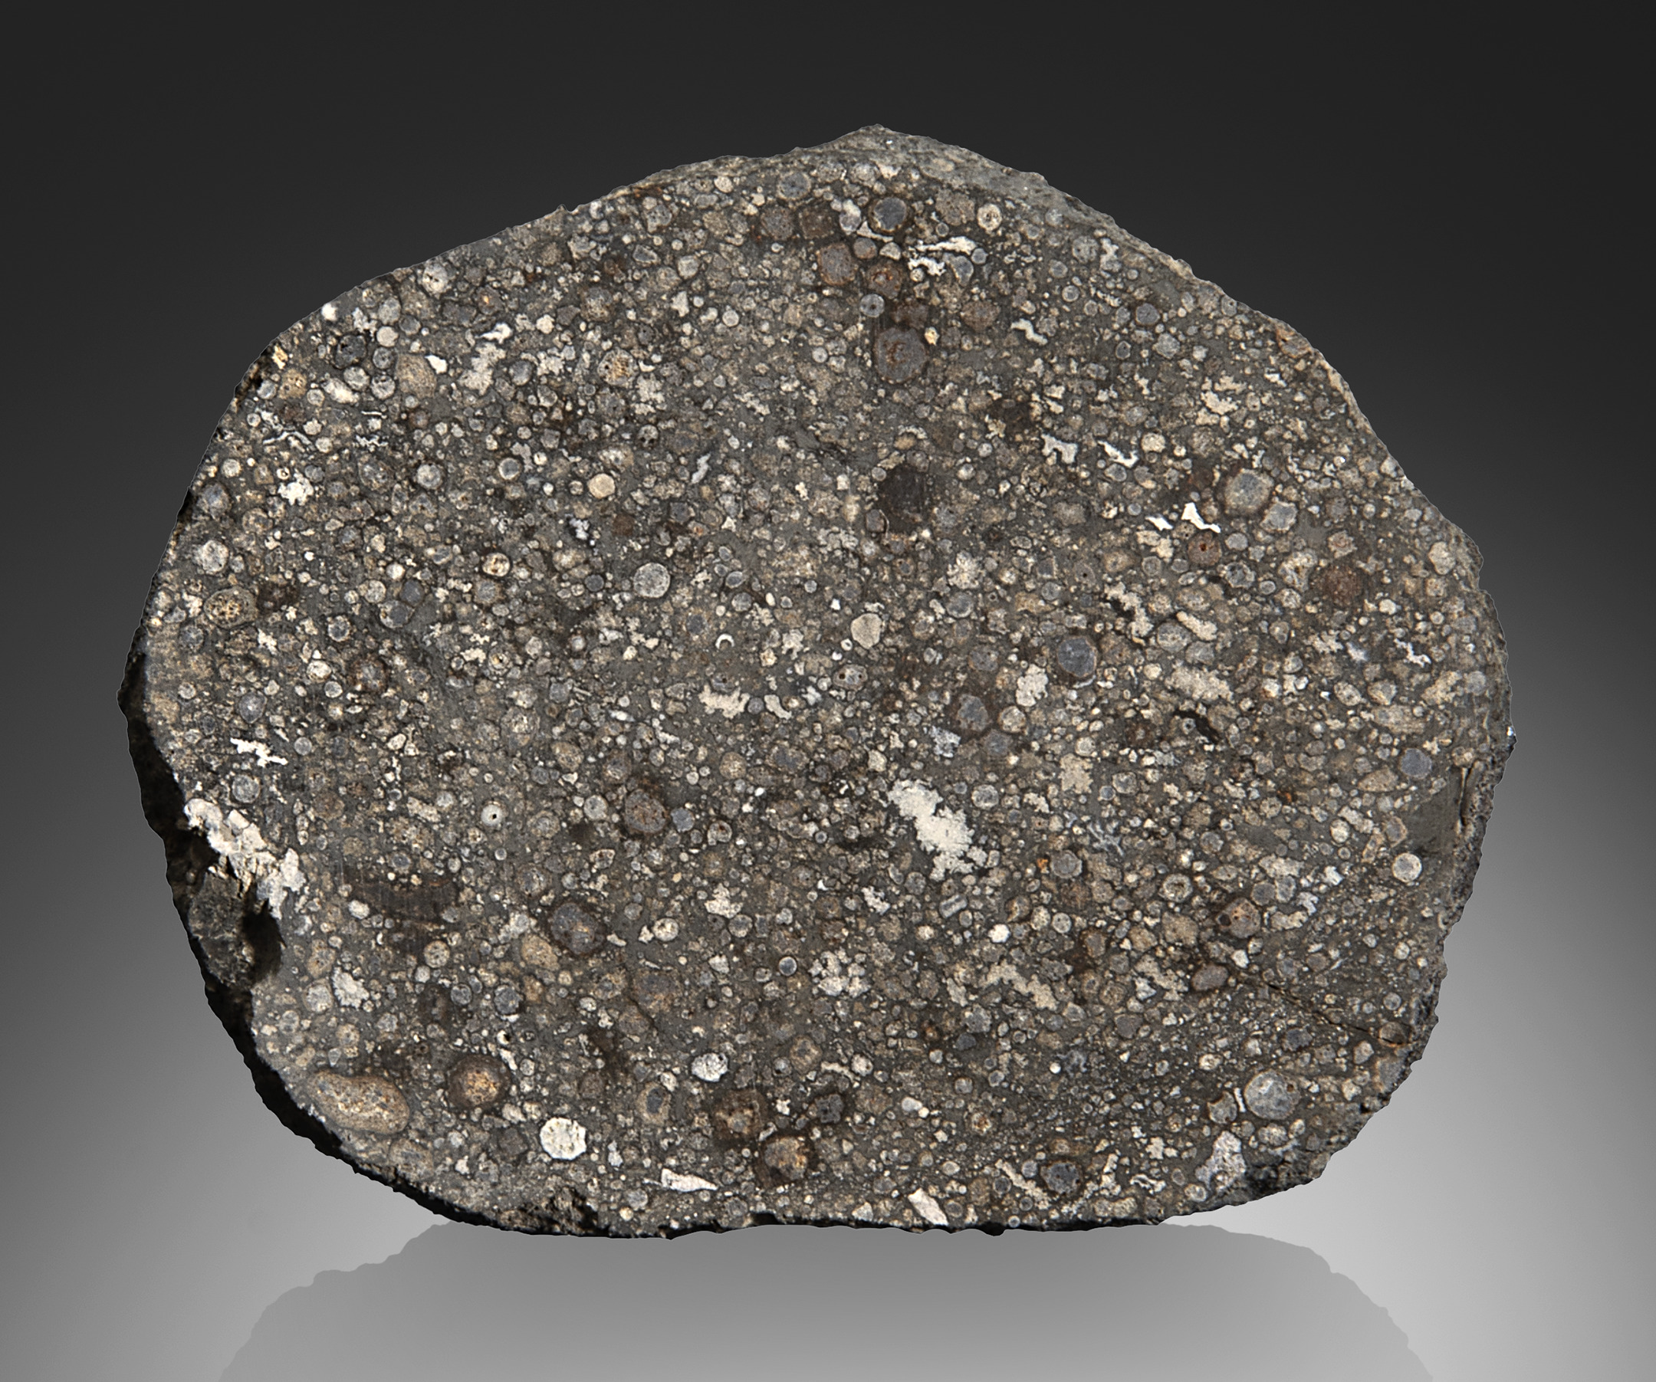
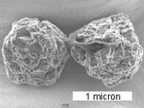
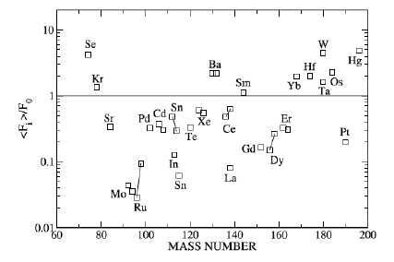
The puzzle of the p-nuclei
~30 stable isotopes cannot be produced via neutron capture processes.
Best candidate: Core-collapse Supernovae of massive stars
Very high temperatures cause stable nuclei to shed neutrons.
Observed abundances vary from prediction by orders of magnitude.
Questions:
Is there just one astrophysical source for all p-nuclei?
Could other scenarios contribute to p-nuclei?
Small abundance, so can only be observed via isotopic analysis of meteorite grains.
Origin of the p-nuclei not well understood.

Slide 3
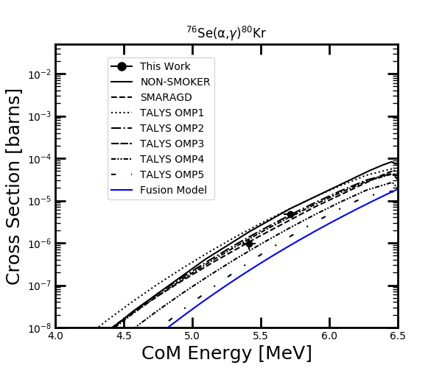
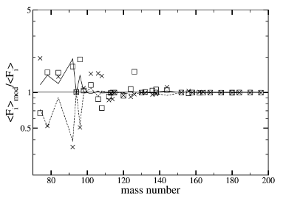
Nuclear uncertainties in the p-process
Production of p-nuclei involves many reactions on radioactive nuclei, none of which have been measured directly.
Models rely on cross-sections predicted by Hauser-Feshbach models that can vary depending on the calculation inputs (e.g. Optical model parameters, γSF, NLD) largely based on studies of stable nuclei.
For light p-nuclei, production rates are most sensitive to variations in (γ,p) / (p,γ) cross sections.
Fallis, J. et al. Physics Letters B 807 (2020) 135575.
Rapp, W., et al. The Astrophysical Journal 653.1 (2006): 474.
Rayet, M., et al. Astronomy and Astrophysics 298 (1995): 517.

Slide 4
Investigating the p-process: A technical challenge
Why are no p-process reactions measured for radioactive nuclei?
Low cross-sections: cross-sections of order few μb (or less) typical for (p,γ) reactions important for light p-nuclei at astrophysical temperatures.
Radioactive beams: Strongly limits available intensity and creates a large γ-ray background.
Inverse kinematics: A+1 recoils are very difficult to separate from more copious unreacted beam, which have similar kinematics and mass.

Slide 5
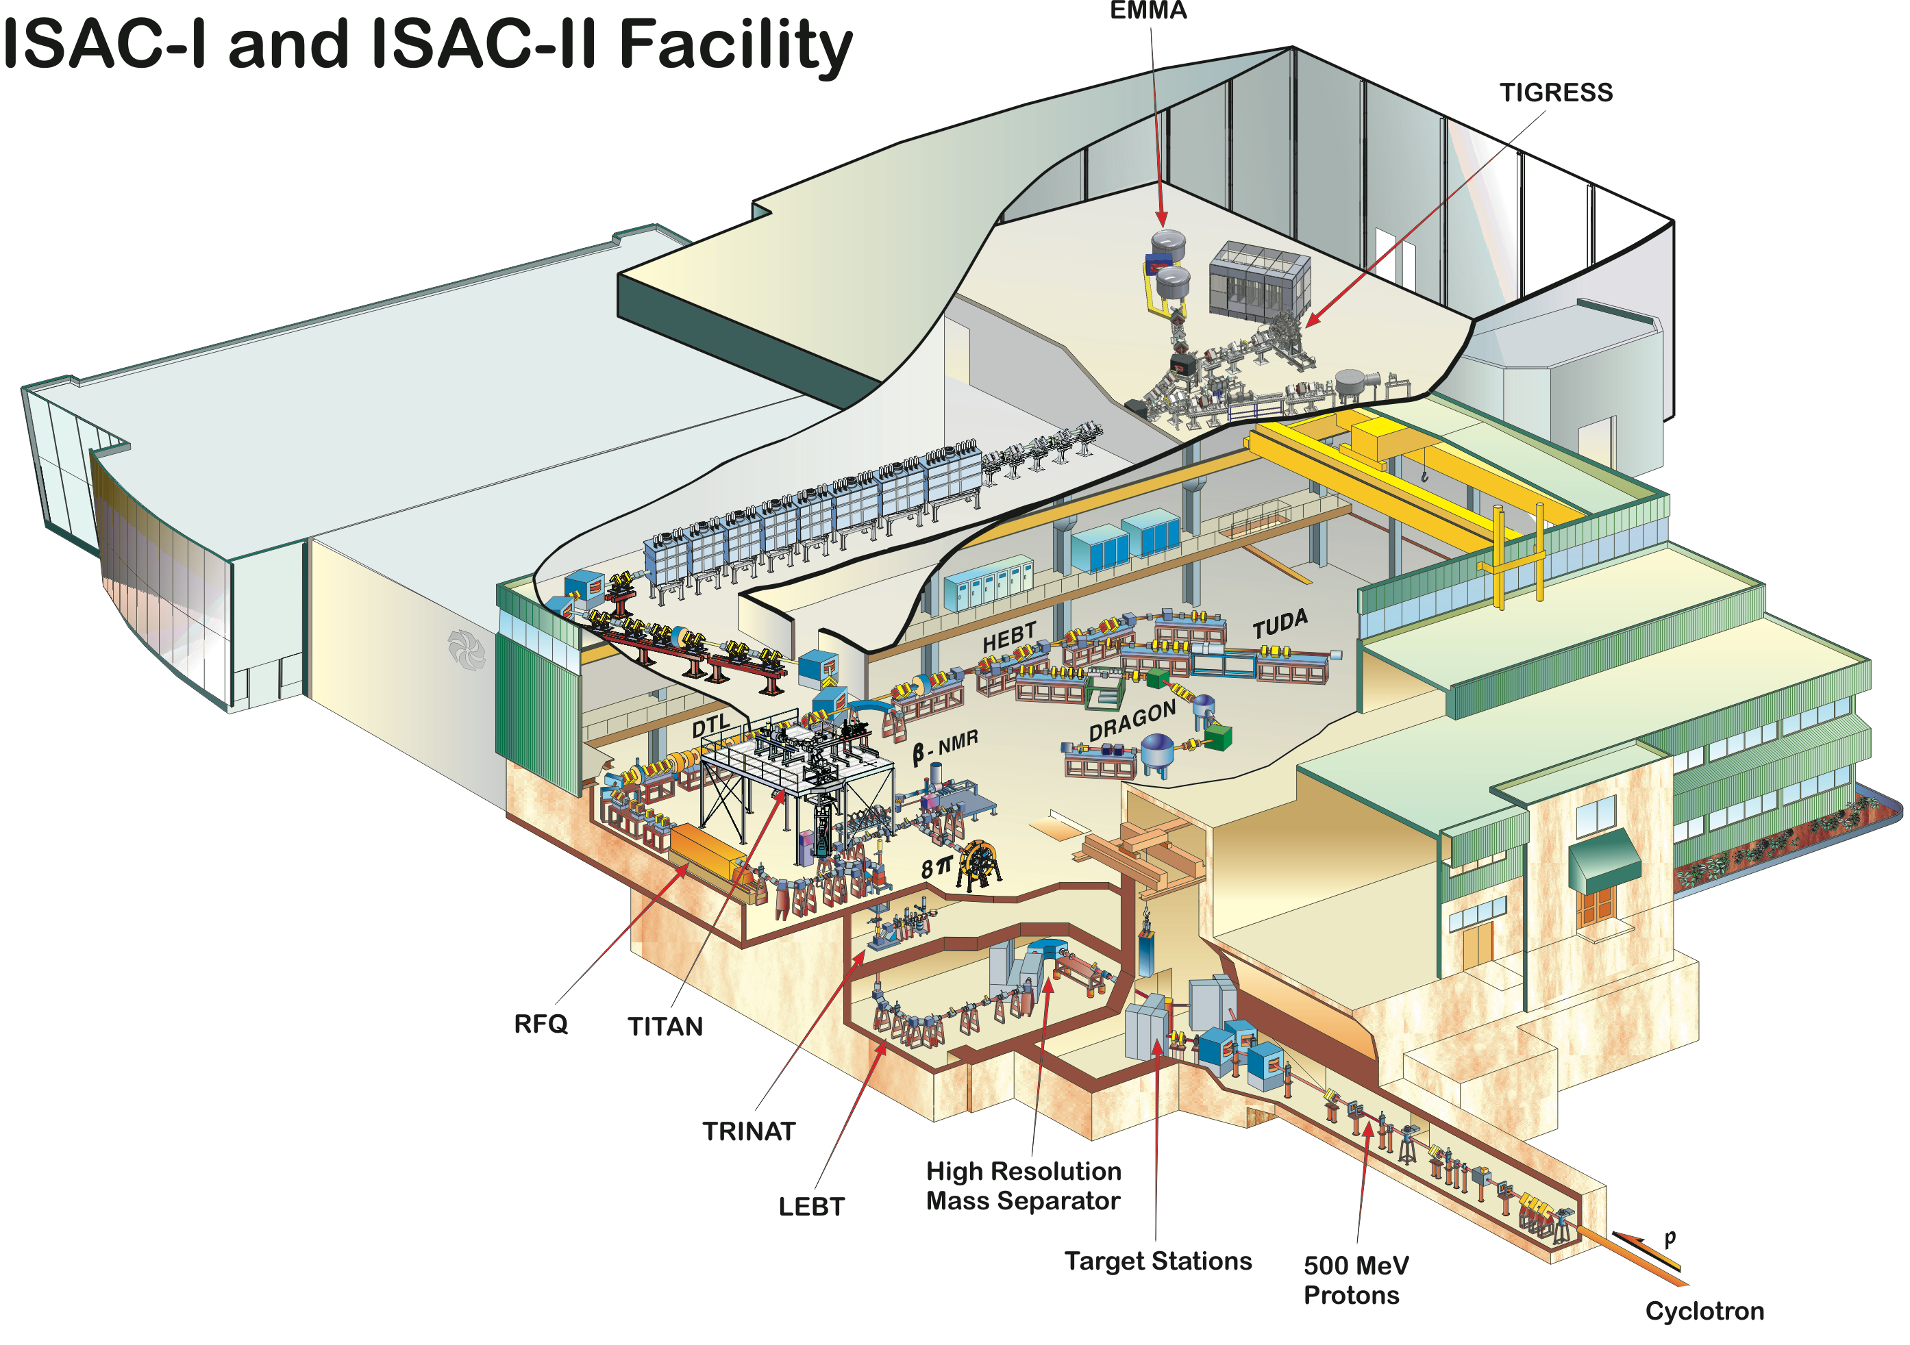
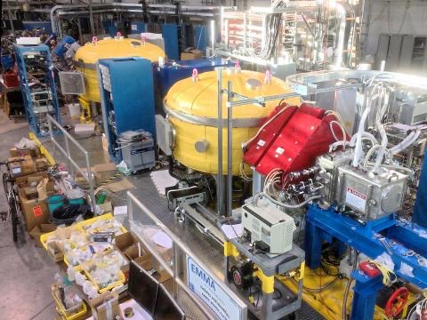

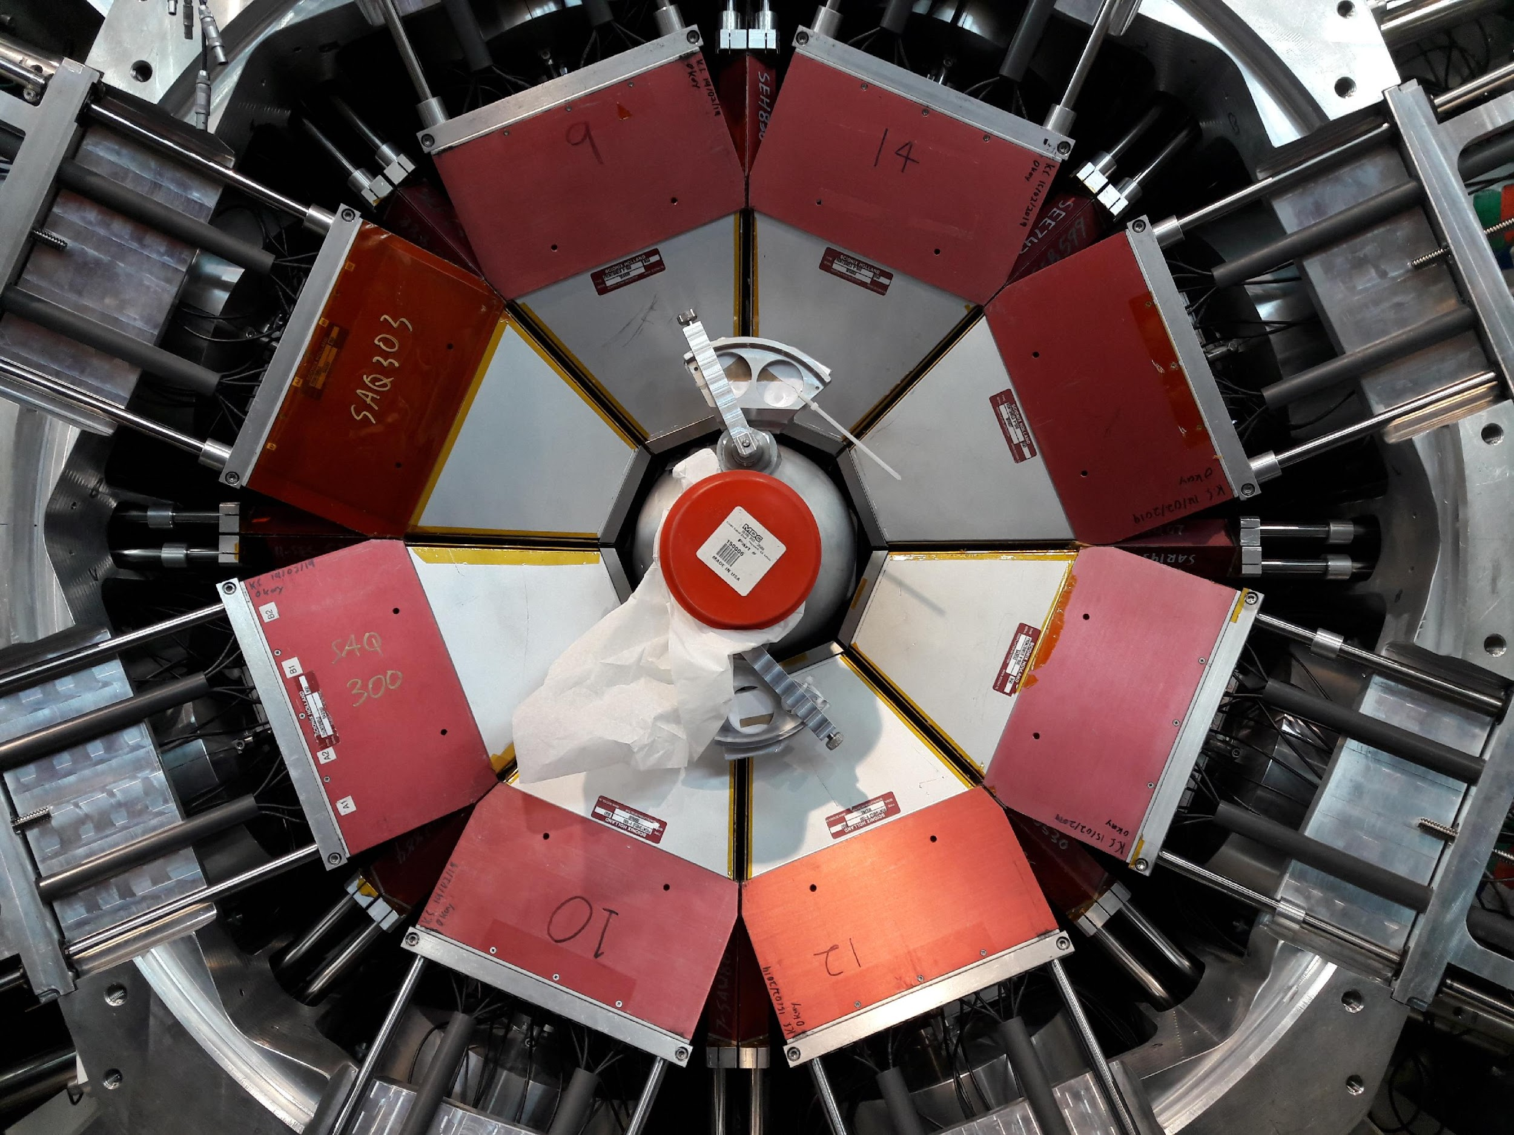

Measurement of ⁸³Rb$(p,γ)$⁸⁴Sr at TRIUMF
Can a mass spectrometer and HPGe array be used to measure p-process reactions?
Targeted ⁸³Rb(p,γ)⁸⁴Sr reaction (important for ⁸⁴Sr p-nucleus abundance) using a ⁸³Rb beam produced by 500 MeV protons incident on UCx ISAC targets at TRIUMF (Vancouver, Canada) (intensity @ Experiment = 5 x 10⁷ pps)
Impinged on CH₂ foil targets to populate ⁸⁴Sr. (thicknesses between 300 and 900 μg/cm² ) at bombarding energies of 2.7 and 2.4 A MeV.
2⁻, 3⁻
⁸³Rb + p
Use the EMMA mass spectrometer to transmit A=84 recoil products to the focal plane detectors.
⁸³Rb: $J^{π}={5/2}^{−}$
2⁺
793 keV
Search for characteristic secondary γ-rays in coincidence with TIGRESS Compton suppressed HPGe array.
12 clovers in use:
x8 at 90°, x4 at 135°
0⁺
⁸⁴Sr

Slide 6
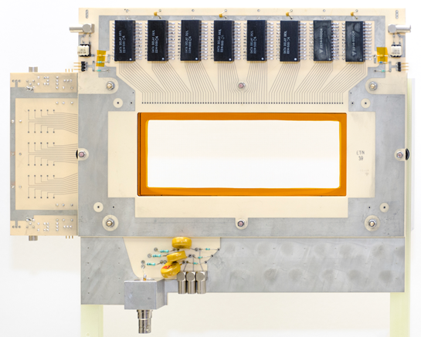
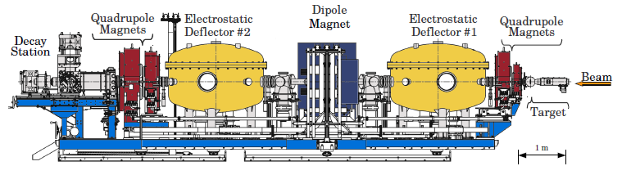
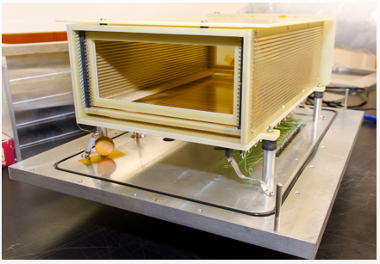
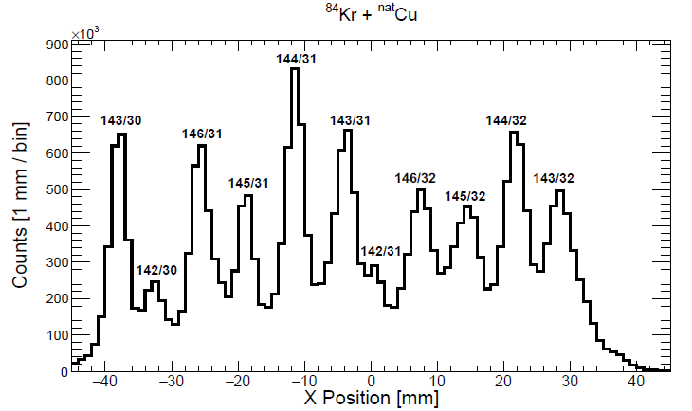
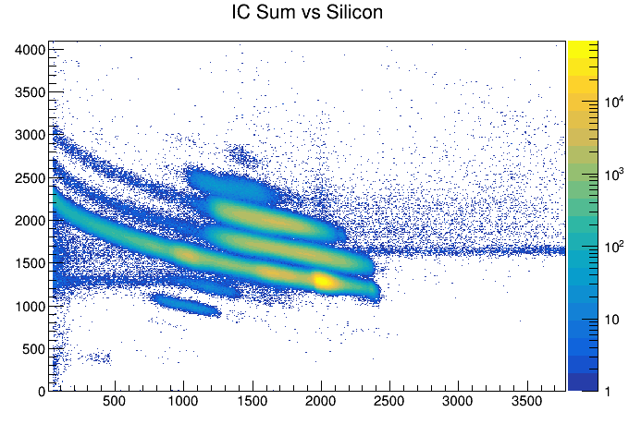
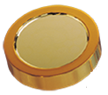
The Electromagnetic Mass Analyser (EMMA)
PGAC
Angular Acceptance: ± 3.6° | Energy Acceptance: +25% / -17% | m/q acceptance = ±4%
Ion Chamber
PGAC spectrum from Fusion Evap test run:
IC PID plot from ¹⁷O experiment:
Ion-implanted Silicon
[1] B. Davids, M. Williams, et al., NIMA 930, 191-195 (2019).
.

Slide 7
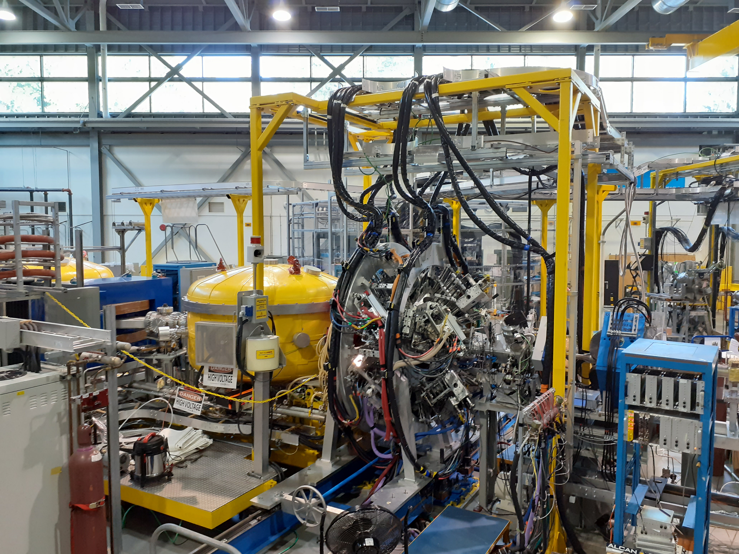
The Electromagnetic Mass Analyzer (EMMA)

Slide 8
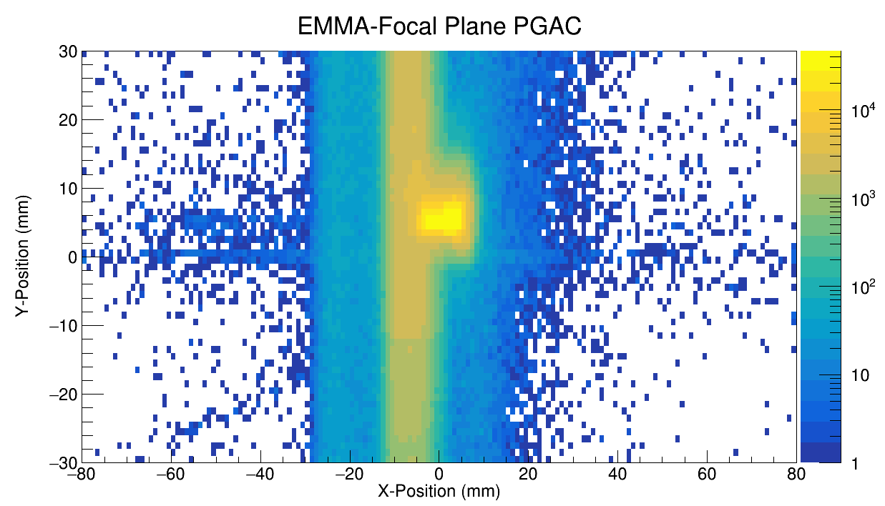
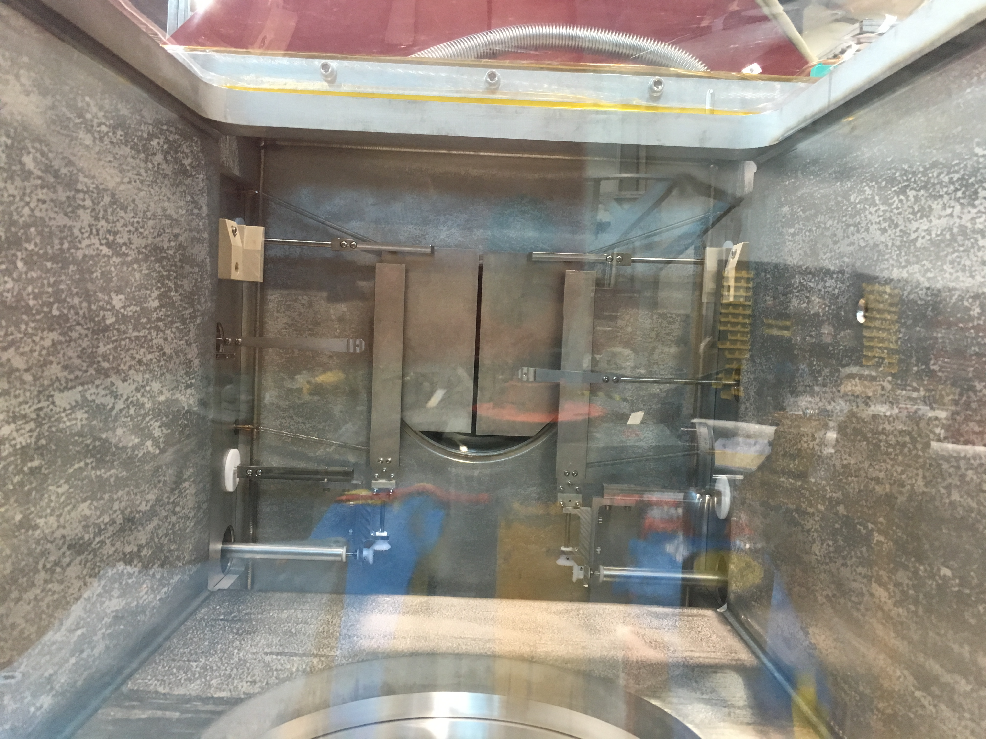
Stable beam proof-of-principle
First tested technique using a stable ⁸⁴Kr beam with an energy of 2.7 A MeV.
Tuned EMMA to the q=25⁺ ⁸⁵Rb recoil charge state with a kinetic energy of 160.5 MeV
EMMA is not optimized for beam rejection, the q=25⁺ beam also makes it to the focal plane.
Focal plane slits
Need to use EMMA’s slit systems to improve beam suppression.

Slide 9
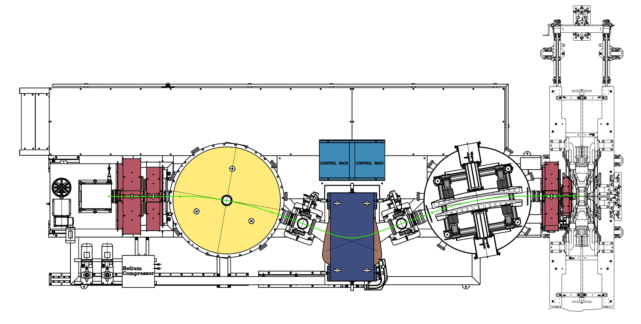
Stable beam test: Increasing Beam Suppression
Further beam suppression was achieved by narrowing the slits either side of the magnetic dipole.
The raw beam suppression factor we achieved was around 5 x10⁴ with no cuts on the data.
Suppression Slits
Magnetic Dipole

Slide 10
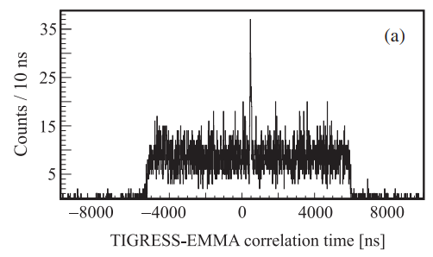
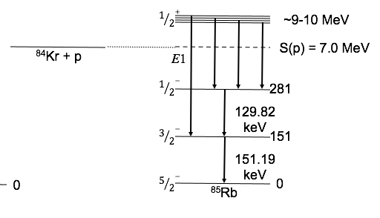
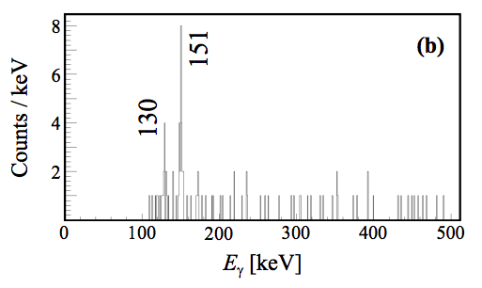
Measurement of ⁸⁴Kr$(p,γ)$⁸⁵Rb
Raw beam suppression was enough to see a clear timing correlation peak between TIGRESS and EMMA events.
Gating on the timing peak reveals characteristic low-lying γ-rays in the ⁸⁵Rb final nucleus.
1/2-
281
3/2-
151
5/2-
⁸⁵Rb

Slide 11
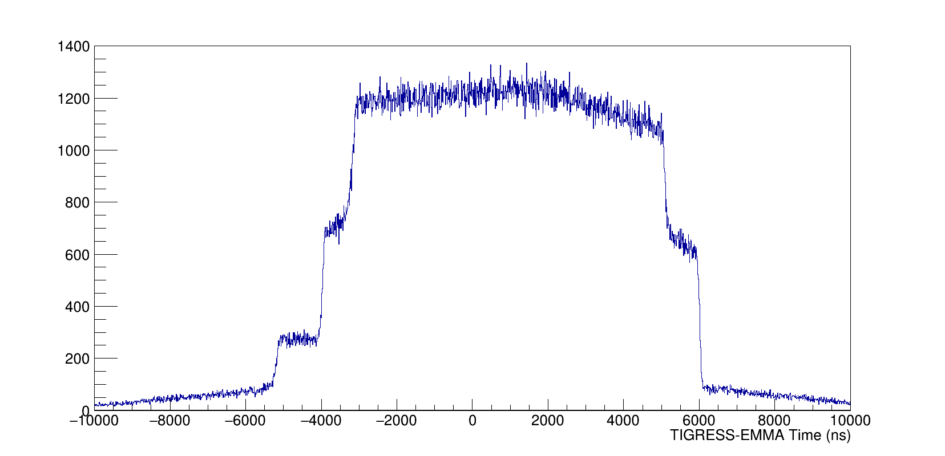
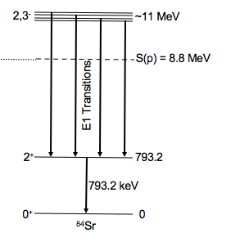
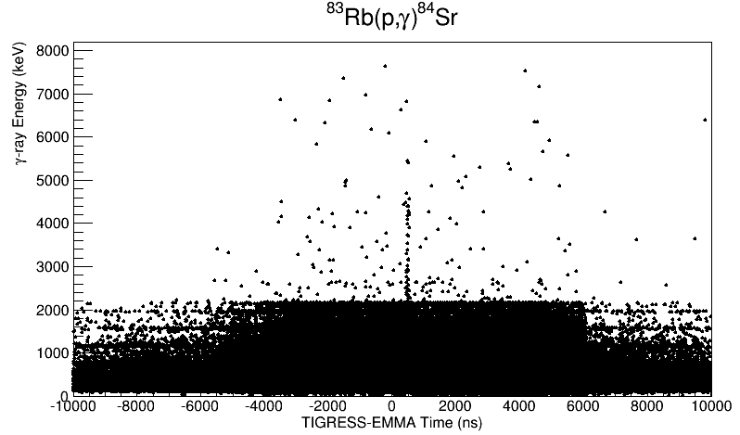
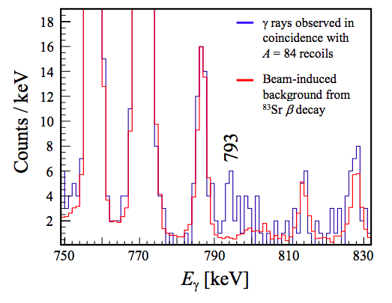
Measurement of ⁸³Rb$(p,γ)$⁸⁴Sr
Large background from ⁸³Sr contamination in the beam, which scatters onto EMMA’s entrance aperture → obscures the timing peak!
Plotting γ-ray energy vs the correlation time reveals signal of high energy γ-rays at the expected correlation time.
Gating around the correlation peak reveals the transition from the first 2⁺ to ground state transition in ⁸⁴Sr. (16 events above background)
G. Lotay, S. Gillespie, M. Williams, et al., Phys. Rev. Lett. 127, 112701

Slide 12
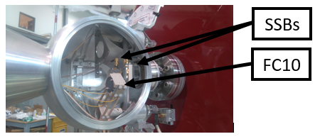
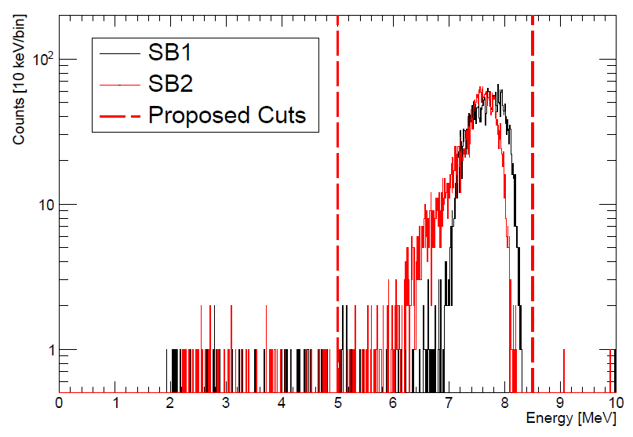
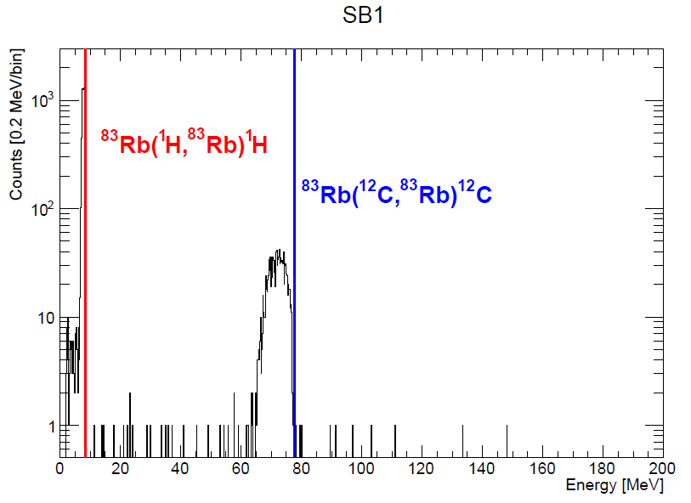


Beam Normalisation
To extract an absolute cross-section we need to monitor total luminosity over the experiment.
Measure scattered protons from CH₂ target
Normalisation factor to relate scattering rate to beam current and target thickness
Find time-integrated luminosity by multiplying normalisation by total number of detected protons:
Target density
Beam Intensity
Scattering rate

Slide 13
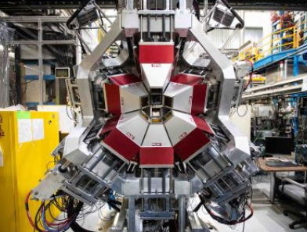
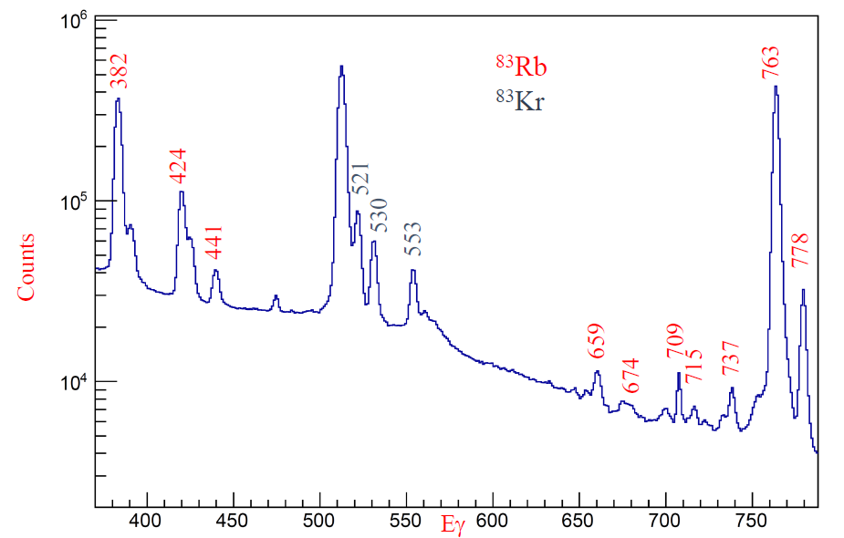
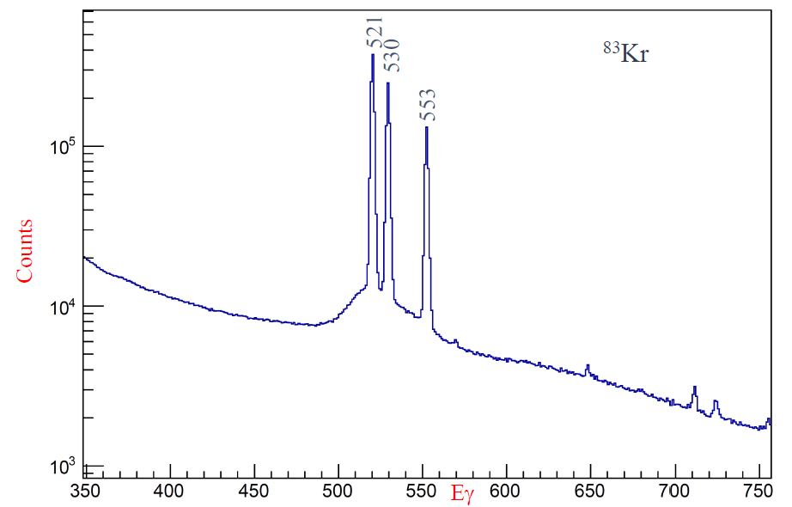
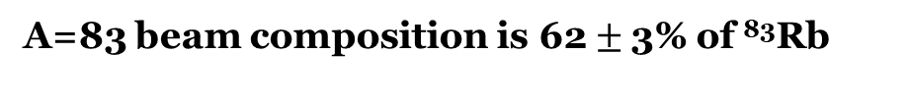
⁸³Sr Beam Contamination
Measured the decay of ⁸³Sr and ⁸³Rb built up on the removable entrance aperture of EMMA.
Aperture placed inside the GRIFFIN decay station, where measurements taken 2 hours and 22 days after the experiment were used to determine the ratio of initial activity.
~2 hrs after experiment
~22 days after experiment
A=83 beam composition is 62 $±$3% of ⁸³Rb

Slide 14
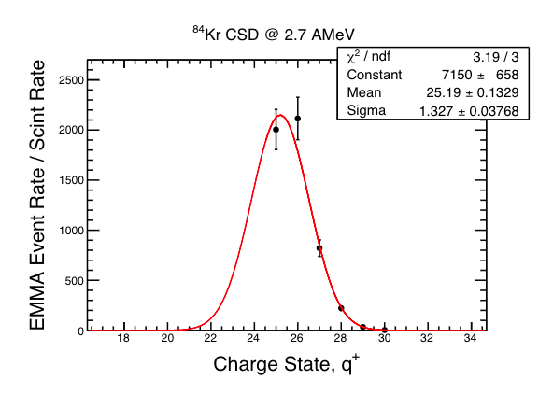
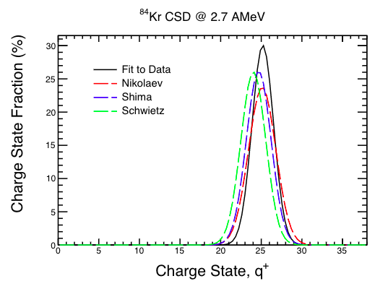
Recoil Charge State Distributions
Only one recoil charge state is transmitted to the focal plane detectors so need to determine fraction.
Measured the charge state distribution for the (attenuated) Kr stable beam.
Then used the Z and Energy dependence of semi-empirical model to extrapolate from the stable beam CSD to the recoil CSD.

Slide 15
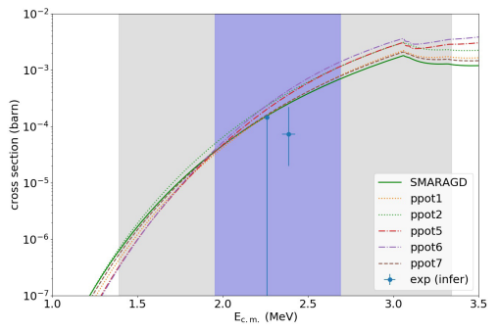
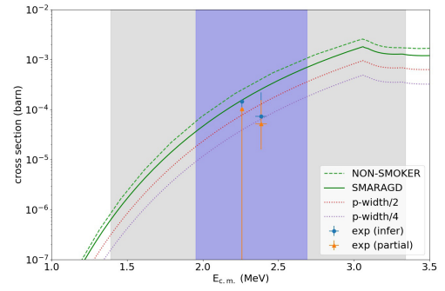
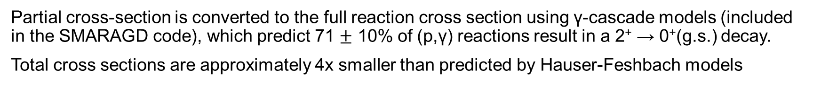
First measurement of a p-process reaction with a radioactive beam
Partial cross-section is converted to the full reaction cross section using γ-cascade models (included in the SMARAGD code), which predict 71 $±$ 10% of (p,γ) reactions result in a 2⁺ → 0⁺(g.s.) decay.
Total cross sections are approximately 4x smaller than predicted by Hauser-Feshbach models
G. Lotay, S. Gillespie, M. Williams, et al., Phys. Rev. Lett. 127, 112701 (2021).
M. Williams, et al., Phys. Rev. C 107, 035803 (2023).
Statistical modeling by T. Rauscher

Slide 16
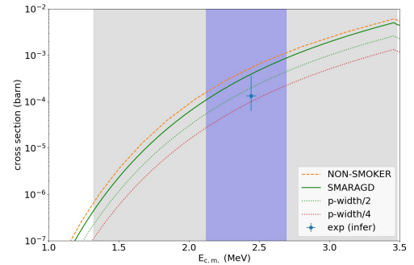
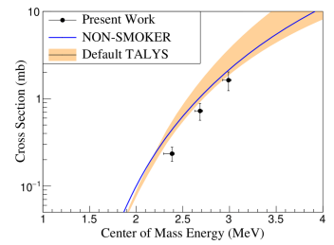
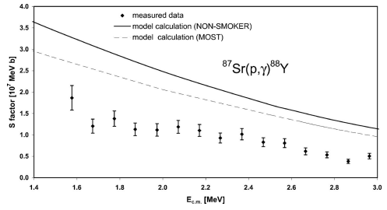
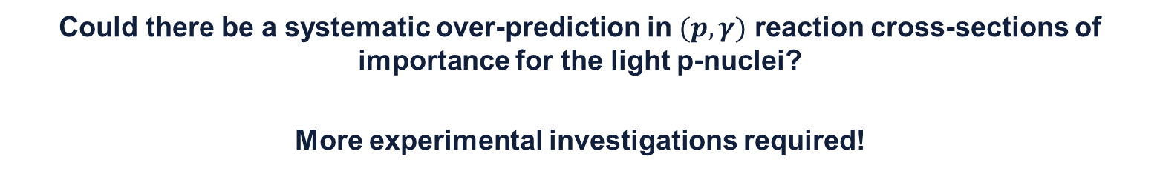
Evidence of systematic shift in proton-widths important for light p-nuclei
We observe similar over-prediction from statistical models in the ⁸⁴Kr(p,$γ$)⁸⁵Rb reaction.
Similar over-predictions have also been observed in ⁸²Kr(p,$γ$)⁸³Rb, ⁸⁶Sr(p,$γ$)⁸⁷Y, ⁸⁷Sr(p,$γ$)⁸⁸Y
Could there be a systematic over-prediction in $(p,γ)$ reaction cross-sections of importance for the light p-nuclei?
More experimental investigations required!

Slide 17
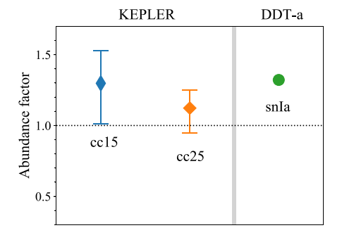
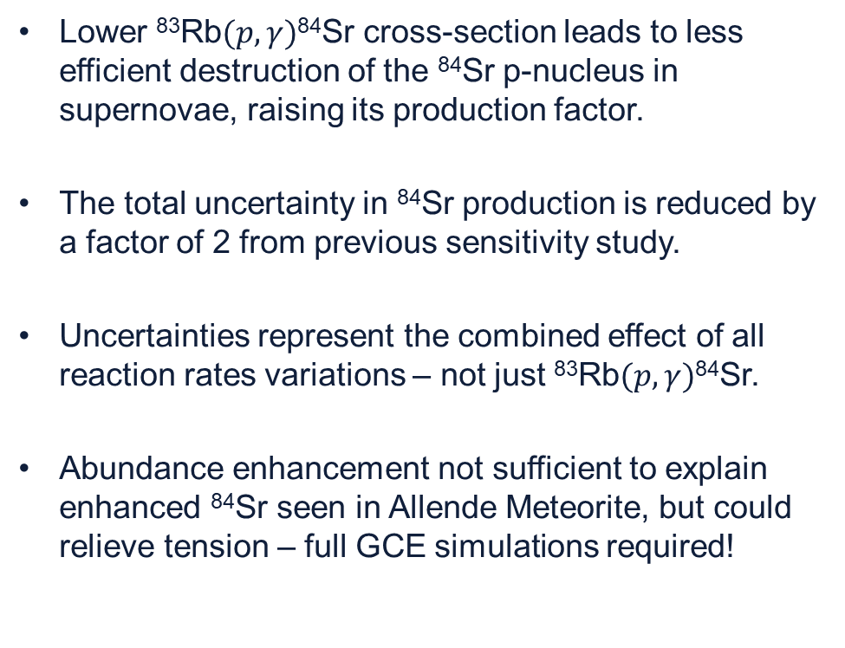

Astrophysical impact of ⁸³Rb$(p,γ)$⁸⁴Sr measurement
Impact investigated for both Type II and Type Ia supernovae explosions
Lower ⁸³Rb$(p,γ)$⁸⁴Sr cross-section leads to less efficient destruction of the ⁸⁴Sr p-nucleus in supernovae, raising its production factor.
The total uncertainty in ⁸⁴Sr production is reduced by a factor of 2 from previous sensitivity study.
Uncertainties represent the combined effect of all reaction rates variations – not just ⁸³Rb$(p,γ)$⁸⁴Sr.
Abundance enhancement not sufficient to explain enhanced ⁸⁴Sr seen in Allende Meteorite, but could relieve tension – full GCE simulations required!
15 $M_{⊙}$ CCSNe = +30 %
25 $M_{⊙}$ CCSNe = +12 %
Type 1a SNe = +32 %
M. Williams, et al., Phys. Rev. C 107, 035803 (2023).
Astrophysical modeling by N. Nishimura

Slide 18
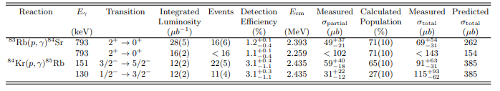
Summary
Measured partial cross-sections for both the ⁸³Rb(p,𝛾)⁸⁴Sr and ⁸⁴Kr(p,𝛾)⁸⁵Rb reactions in what was the first EMMA+TIGRESS experiment.
This is the first ever measurement of p-process reaction using a radioactive ion beam, obtaining cross-sections within the Gamow window for the γ-process in core collapse supernovae
Our resulting cross section is approximately a factor of x4 lower than statistical model predictions, demonstrating the necessity of further experimental studies on the p-process.

Slide 19












A. M. Amthor, D. Baal, G. C. Ball, S. Bhattacharjee, H. Behnamian, V. Bildstein, C. Burbadge, W. N. Catford, B. Davids, C. Aa. Diget, D. T. Doherty, N. Esker, F. H. Garcia, A. B. Garnsworthy, S. A. Gillespie, G. Hackman, S. Hallam, K. Hudson, S. Jazrawi, E. Kasanda, A. R. L. Kennington, Y. H. Kim, A. M. Laird, A. Lennarz, G. Lotay, R. S. Lubna, C. Natzke, N. Nishimura, B. Olaizola, C. Paxman, A. Psaltis, T. Rauscher, C. E. Svensson, B. Wallis, J. Williams, M. Williams and D. Yates.

