Slide 1


Cells integration tool overview
Jean-Philippe LOGIER | Mathieu NICLAS | Eric Vigeolas
Cells integration meeting | 03/09/2019

Slide 2
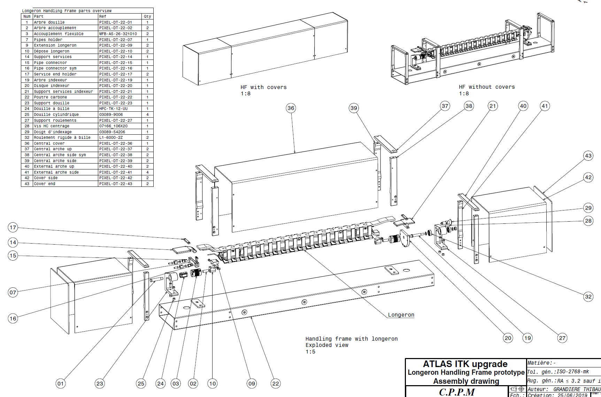
Cells integration tool overview
Longeron handling frame status
  Prototype first version completed (3D+drawings)
  Submitted to Oreka for discussion with the design office
  Prototype to be ordered in October
Pending points
  Carbon truss design
  Interfaces finalization
    with longeron (proto for L3 longeron ok?)
    with cell integration tool
03/09/2019
JP. Logier | M. Niclas | E. Vigeolas
2

Slide 3
Cells integration tool overview
Longeron + HF configurations
With covers: shipping configuration
Central cover removed + longeron rotated:
Cells integration configuration
Side covers removed: Test configuration
03/09/2019
JP. Logier | M. Niclas | E. Vigeolas
3

Slide 4
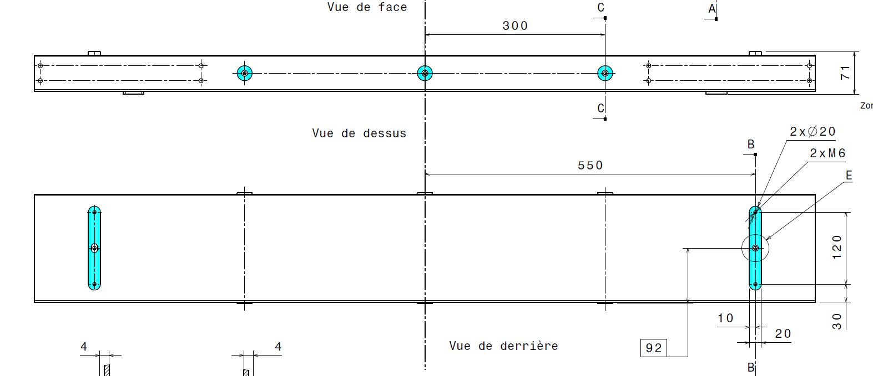
Cells integration tool overview
HF interfaces with cells integration tool
  Design TBD with Oreka
  Positionning tolerances TBD:
    Accurate repetability on HF vs cells integration tool positionning?
    Accurate positionning of the longeron vs cells integration tool ?
Allow cells reworking without re-alignment
Avoid any global alignment system (or some axis)
BUT depends on manufacturing tolerances between base blocks and longeron mounting interfaces + HF tolerances
Common zone flatnesses
+ perpendicularity
Located centering holes
03/09/2019
JP. Logier | M. Niclas | E. Vigeolas
4

Slide 5
Cells integration tool overview
Cells integration tool layout
Flexible hinge
+ local alignment system?
Preliminary integration procedure
  HF mounted on cells integration tool
  Global alignment tool vs longeron (TY-TZ-RX-RY-RZ)
  Cell mounted on the holding system
  Holding system plugged on the tool (kinematic mount)
  Cell insertion (TX) on the longeron with flexible hinge
    No stress applied to the cell/longeron
    Overlap control
    Local alignment if necessary
  Screws installation throught longeron structure
  Screws tightening with torque tool
  Tool removed from the cell
  Pitch offset to aim another cell location
Cell holding system
Kinematic mount
Z
X
Aiming/overlap control system
Insertion system
Slot alignment system
TX
Pitch /TY
TY-TZ
RX-RY-RZ
Global alignment system
Screw holder /
Screwdriver
Structure
Position of the global alignment system? Adjustable axis TBD
Need local alignment (1 by cell)? Depends on accuracy dispersion between base blocks
Configuration of aiming system: Cells overlap control for safety or target position measurement?
….
03/09/2019
JP. Logier | M. Niclas | E. Vigeolas
5

Slide 6
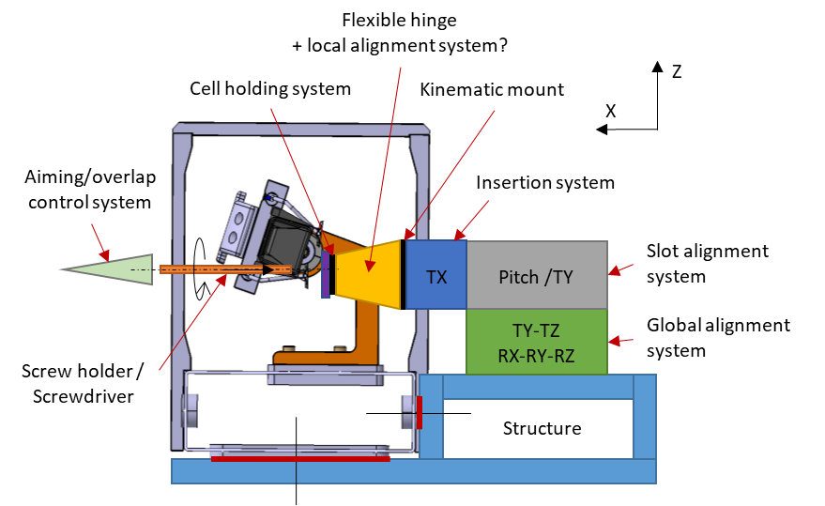
Cells integration tool overview
Workpackages on cells integration tool development
 | CPPM | LAPP | LPSC | CERN | UniGe
Integration baseline procedure | X
Reworking procedure |  | X
Structure + If with HF | X
Global alignment system
Slot alignment system
Insertion system
Aiming/overlap control system
Cell holding system
Flexible hinge + local alignment system | X
Kinematic mount | X
Screw holder/ tightening tool | X | X
Screw design | X |  |  | X
To be done firstly
  Integration baseline procedure definition
  Adjustable axis needed (tolerances study on longeron + HF)
  Screws definition
03/09/2019
JP. Logier | M. Niclas | E. Vigeolas
6

