Slide 1


Quantum Computing (QC) for many-body systems at the nucleonic scale or below: some current international status and recent examples
Denis Lacroix
Summary
Generalities
Few examples of recent QC applications to nuclear/particle physics
Example of international initiative: the US QC/QIS collaboration
Discussion
A viewpoint from an external actor

Slide 2
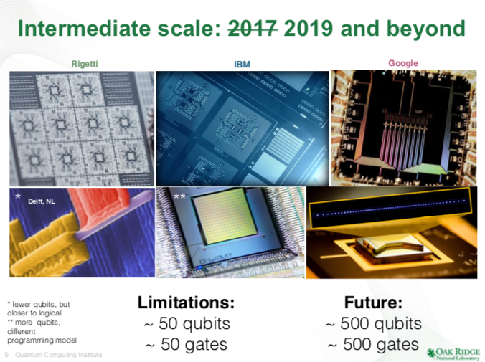
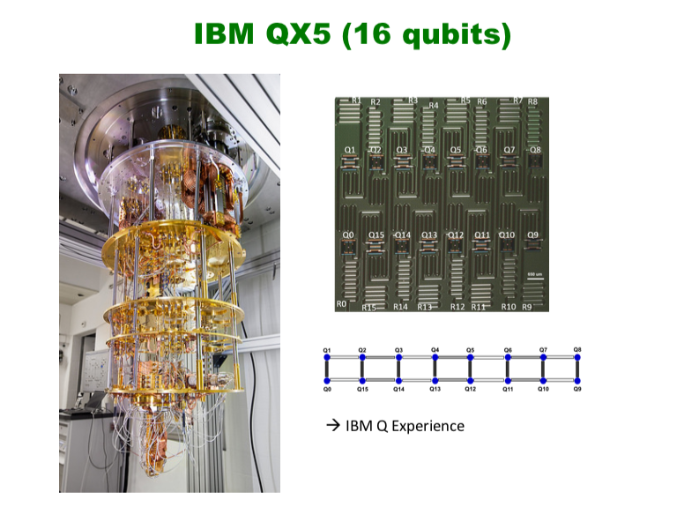
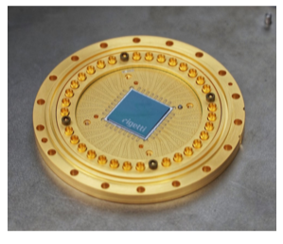
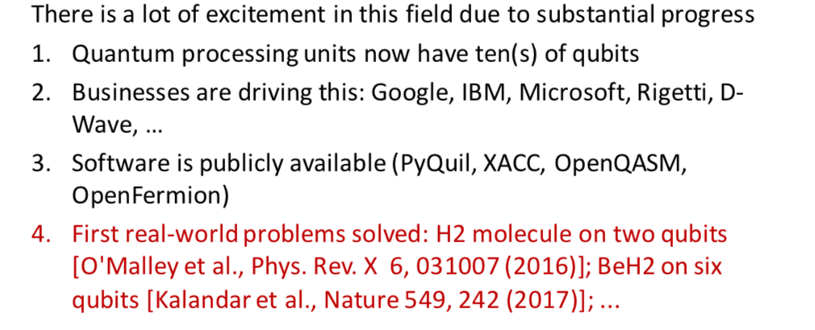
Some recent technical realizations
Example
RIGETTI superconducting 19 Qubit
A timely period
(from G. Hagen)
Notes:
From Dimitrescu Senta Fe, 2019

Slide 3
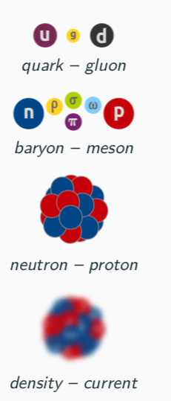
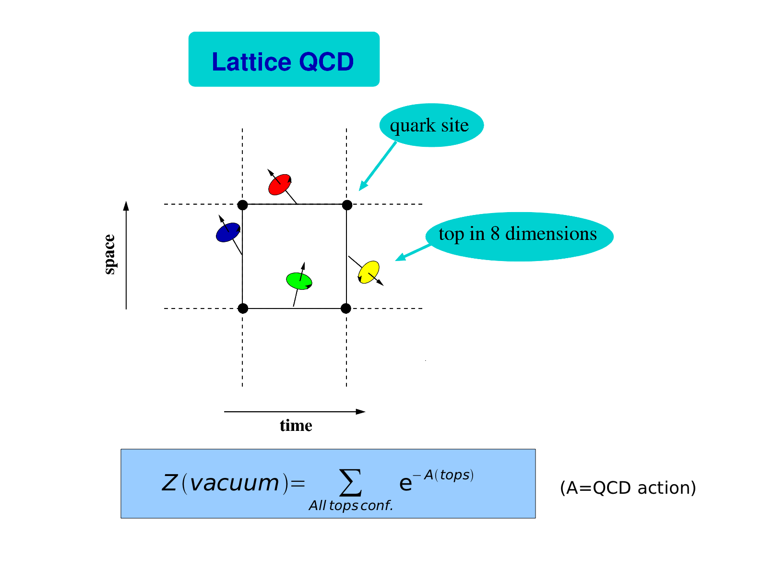
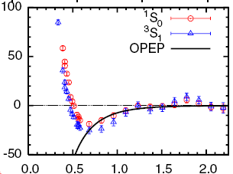
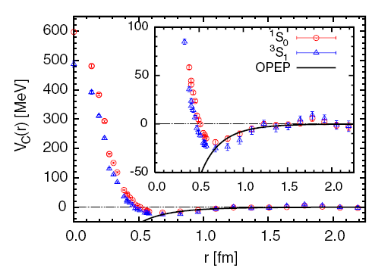
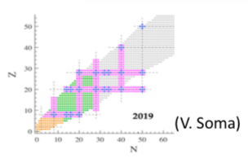
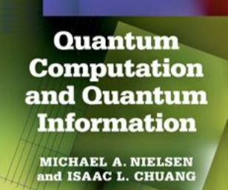
Quantum Computing at the nucleon scale and below
Overall Goal
Some current numerically costly challenges
Understanding quarks,
hadrons and mesons
from first principle
Understanding the strong
Interaction from quarks
Ishii, PRL. (2007)
Provide a full ab-initio
Picture of the whole nuclear
chart
QC is not a new subject
Simple problems easily described
in a CC can be very difficult on a QC
QC can lead to major breakthrough
In complex problems

Slide 4
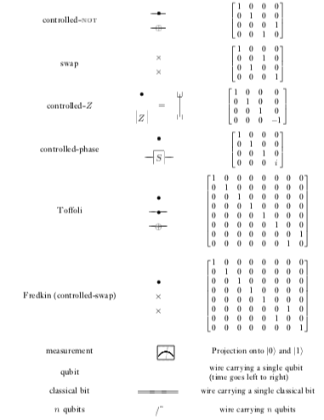
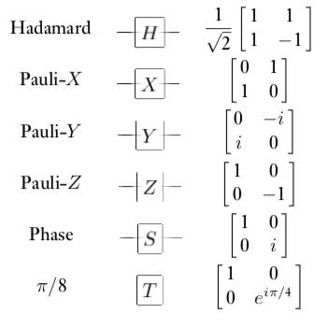
General strategy
Strategy
Take a simple version of
your favorite many-body problem
Constraint:
-Work with a restricted number of operation
Map/formulate it as a problem with Qubit
Use standard QC algorithms
or
Propose new QC algorithms
Test on a
QC emulator
Test on a true
QC
-Design new algorithms adapted to the
many-body problem
-Control the inherent quantum noise

Slide 5
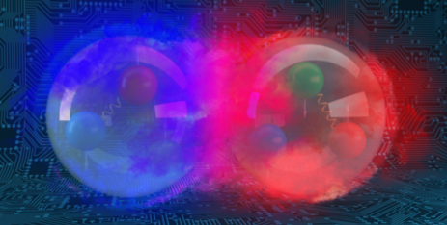
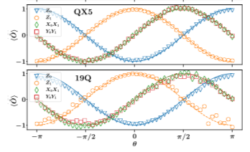
Illustration I
Strategy
Take a simple version of
your favorite many-body problem
Schematic deuteron Hamiltonian in Harmonic basis
create (annih.)
1 deuteron in
Use Pauli matrices+Jordan-Wigner transformation
Map/formulate it as a problem with Qubit
0 (1) particles in
This automatically map the Hamiltonian as a
function of Pauli Matrix
Use the VQE quantum-classical algorithm
with 10000 measurements on QX5 (19Q)
Use standard QC algorithms
or
Propose new QC algorithms
Test on a
QC emulator
Test on a true
QC

Slide 6
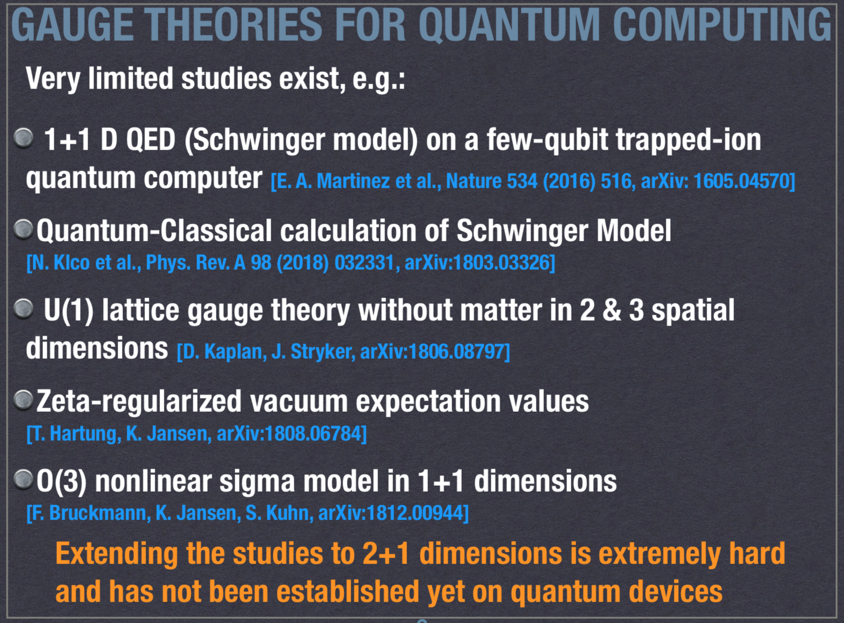
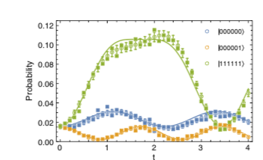
Illustration II
Strategy
Take a simple version of
your favorite many-body problem
Start with the discretized σ model
Map it to a Spin algebra (fuzzy sphere)
Map/formulate it as a problem with Qubit
J_{k} are generators of the SU(2) algebra
“only” j=1/2 was considered
This gives the link with Pauli matrices
Use standard QC algorithms
or
Propose new QC algorithms
Use the Suzuki-Trotter method for the propagator
+ specific QC circuits for each contribbutions
Test on a
QC emulator
Test on a true
QC
(from M. constantinou, Santa Fe)
N.B: works only on QC emulator

Slide 7
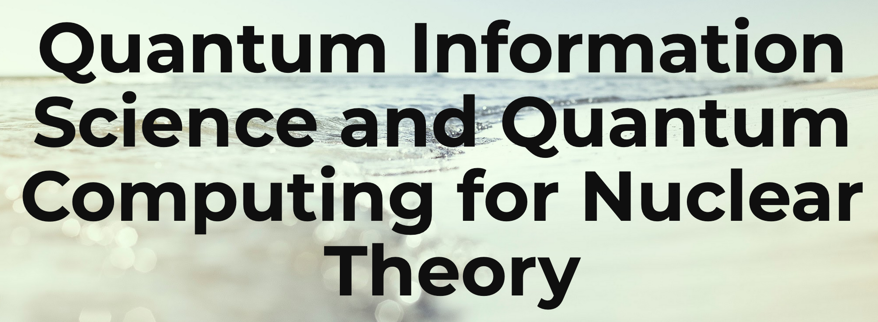

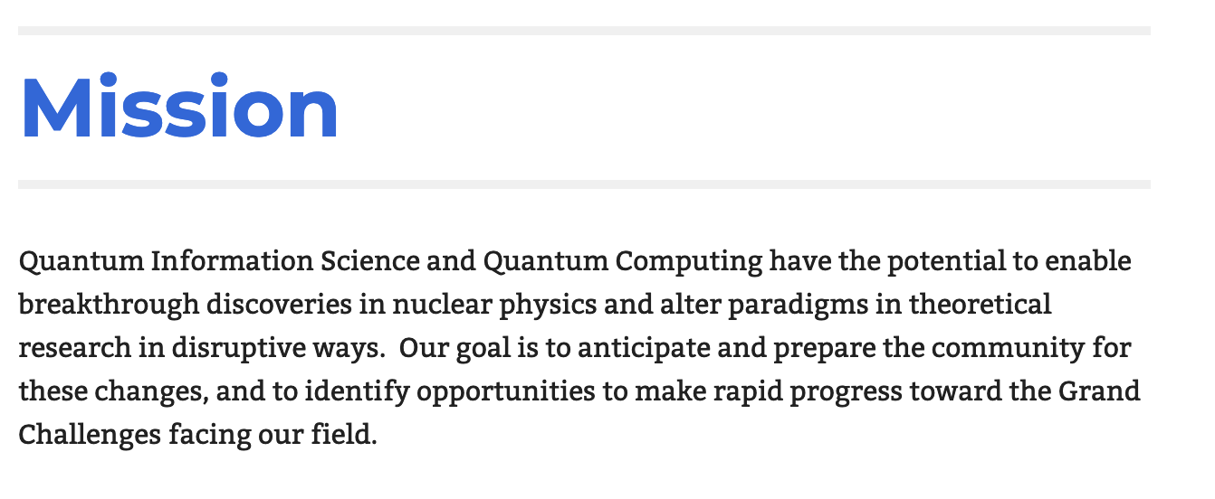
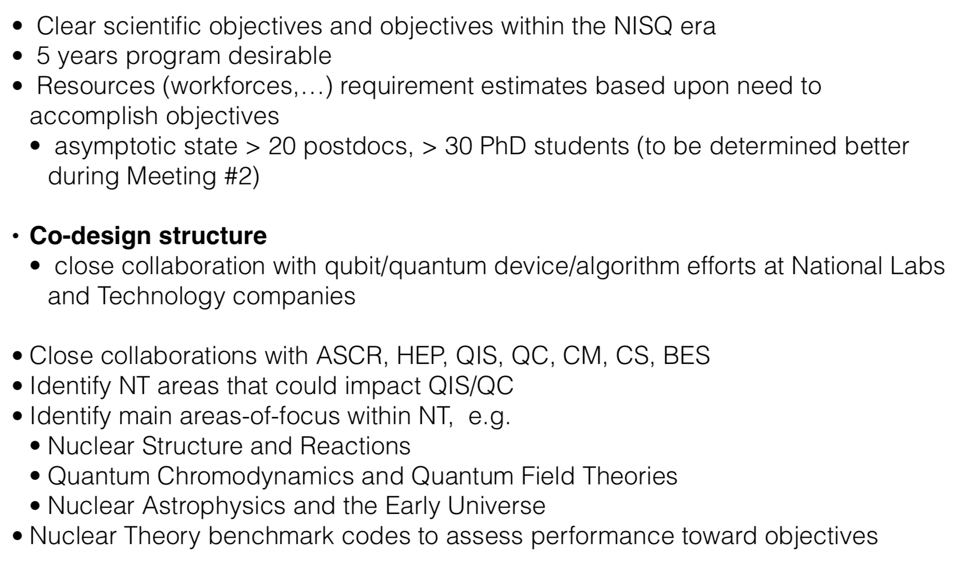
International context
Illustration of the QC/QIS for nuclear theory project (USA)
Nov. 2017
Early INT-Seattle workshop on Quantum Computing for Nuclear Physics
Decision for a pre-pilot project granted by DOE
The QC/QIS scientific community
Jan. 2019
Sante Fe meeting of the QC/QIS for nuclear theory
Converge on the final project (5 years, size: 20 PostDoc, 30 PhD)

Slide 8
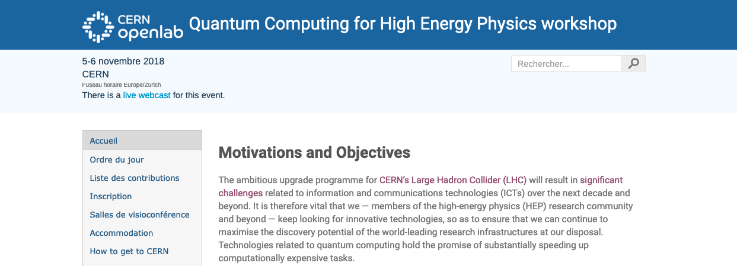
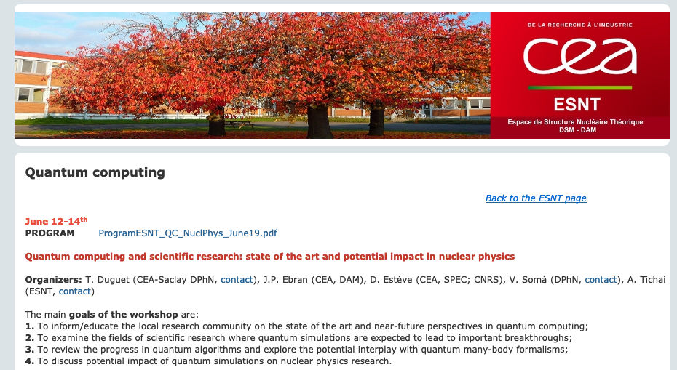
In or close to France

Slide 9
Some general concluding (personal) remarks
Computation with QC is a very challenging/exciting challenge
It is also intellectually satisfactory to think about our problem in a very different way
It might ultimately lead to major breakthrough in different IN2P3 fields
It also leads to natural synergies between public research and private companies
There is nowadays emerging strong collaborations that start to work
actively in the field
(Rapid) actions if we want to be competitive? And major effort should be done
to learn and be at the forefront of the field.
Eventually this will not work...
Thank you …

