Slide 1












Matter’s Origin from the RadioActivity of trapped and laser oriented ions
Pierre Delahaye for the MORA collaboration

Slide 2
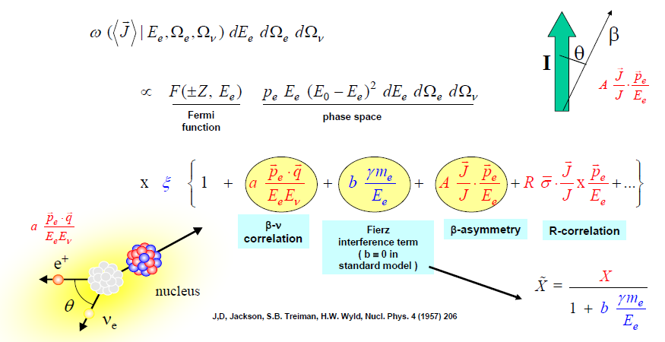
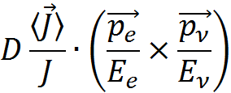
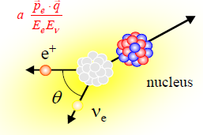
β-decay as a laboratory for weak interaction
Review: Prog. Part. Nucl. Phys, M. Gonzalez Alonso, O. Naviliat Cuncic and N. Severijns, 2018
D-correlation
I
© N. Severijns, PSI, 2007
Correlations in nuclear β decay
Coupling constants of the β decay Hamiltonian: C_{V}, C_{A} and C_{S}, C_{T}

Slide 3
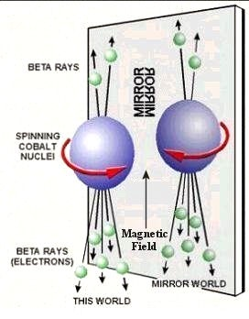
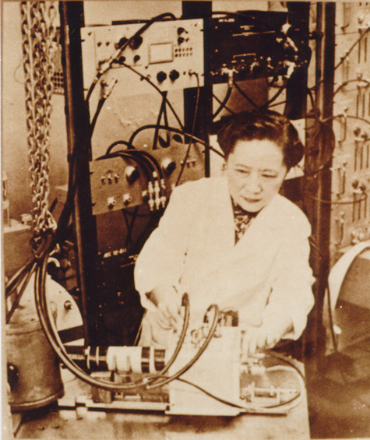
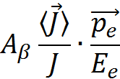
β-decay as a laboratory for weak interaction
Probing intrinsic symmetries
C. S. Wu et al., Phys Rev 105(1957)1413
Parity violation in ⁶⁰Co decay
P odd
Polarized nuclei
A_{β} (C_{A}²,C_{V}C_{A})

Slide 4
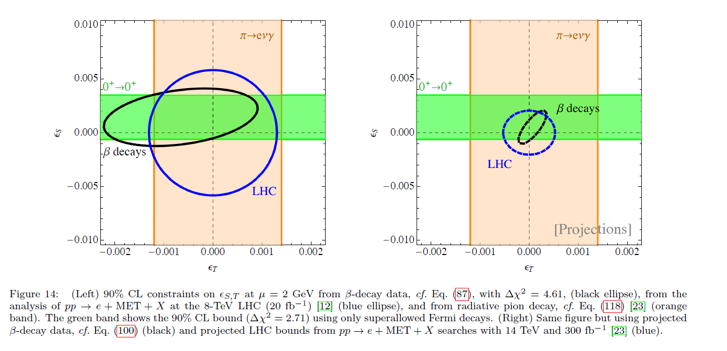
β-decay as a laboratory for weak interaction
Review in Prog. Part. Nucl. Phys, M. Gonzalez Alonso, O. Naviliat Cuncic and N. Severijns, 2018
  EFT analysis gives direct comparison between high energy searches and beta decay
  Example: Sensitivity to NP: Scalar and Tensor current limits from LHC and beta decays
Present
Future
ε_{S}
ε_{S}
ε_{T}
ε_{T}
ε_{S} and ε_{T} : relative couplings of scalar and tensor currents vs V-A currents

Slide 5
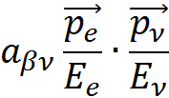
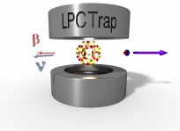

β-decay as a laboratory for weak interaction
Unpolarized nuclei
LPCTrap@GANIL
Recoil detection
β - recoil coincidences
a (C_{S}², C_{V}², C_{T}², C_{A}²)
Pure GT: a_{GT} (C_{T}², C_{A}²) = -1/3 (SM)
Pure F: a_{F} (C_{S}², C_{V}²) = +1 (SM)
P, T even
Search for exotic currents
Polarized nuclei
The MORA project!
β - recoil coincidences
Fixed J
Triple correlation
I
D ∝ Im (C_{V}C_{A}*)
T odd
Search for new sources
of CP violation
D = 0 (SM)

Slide 6
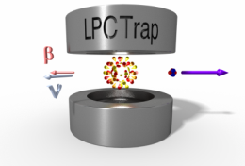
LPCTrap: a Paul trap based precision experiment
- Transparent Paul trap, UHV
- Ions confined in the middle of the device, nearly at rest
- In coincidence detection of the electron and the recoil ion
E_{β}, t_{start}
t_{stop}
β particle
  θ_{er}
Recoil ion
Beta telescope
Silicone stripped detector
+ Scintillator
MCP
Delay lines anode
E. Liénard et al., Hyp. Int. 236 (2015) 1 and references therein.
In coincidence measurement of:
  the time of flight of the recoil ion t_{R}
  the beta particle energy E_{β}
  the angle between these two particles θ_{er}

Slide 7
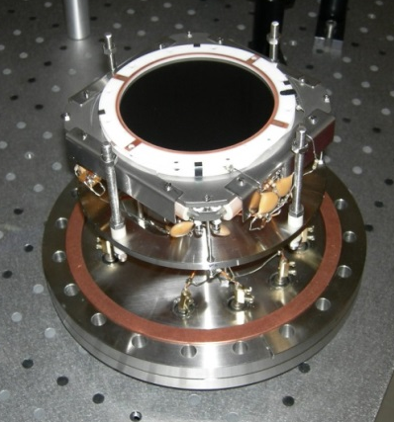
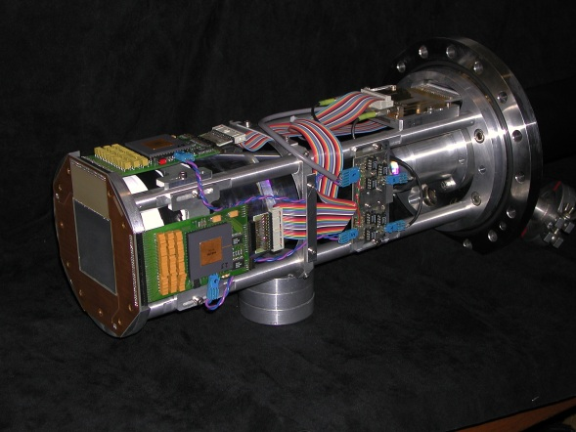
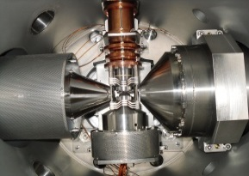
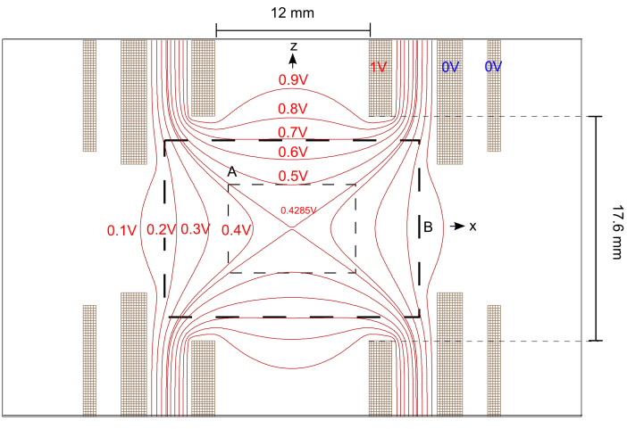
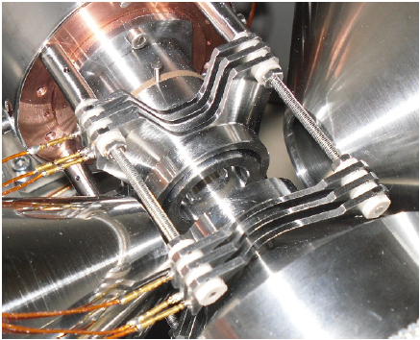
Trap and detection setup
G. Ban et al, ADP 525(2013)576 , E. Liénard et al., Hyp. Int. 236 (2015) 1 and references therein.
MCP
DSS Si Detector
Active Ø80 mm
60 x 60mm x 300μm
σ_{T} ~ 200ps
1 mm resolution
Delay lines
Plastic scintillator
σ_{x},σ_{y} ~ 200μm
σ_{E} 10 % at 1 MeV
E. Liénard et al.
NIMA 551(2005)
σ_{T} ~ 200ps
Trap
Effective trapping radius 5mm
P. Delahaye et al, The open LPC Trap for precision measurements in beta decay, Eur. Phys. J. A (2019) 55: 101

Slide 8

Results of LPCTrap
⁶He decay
Couratin et al., PRL108 (2012)
a_{βν} measurement for different nuclei
  Analysis ongoing within « THESMOG »
  New constraints on |C_{T}|/|C_{A}| from ⁶He decay
  Improvements on σ(V_{ud}) / V_{ud} from mirror decays of ³⁵Ar and ¹⁹Ne
Shake – off probabilities and precise tests of atomic physics models
p-value=0.37
Li²⁺
Li³⁺
Nucleus | Date | a | σ_{stat} | σ_{syst} | Published results
⁶He | 2006 2010 | -0.3335 -1/3 (SM) | 0.0073 0.0015 | 0.0075 ? | σ_{a} /a ~ 3% Fléchard et al. JPG38 (2011) Shakeoff Couratin et al. PRL108 (2012)
³⁵Ar | 2011 2012 | / 0.9004 (SM) | / 0.0013 | / ? | Shakeoff Couratin et al. PRA88 (2013)
¹⁹Ne | 2013 | 0.0438 (SM) | 0.0046 | ? | Shakeoff Fabian et al. PRA97(2018)

Slide 9
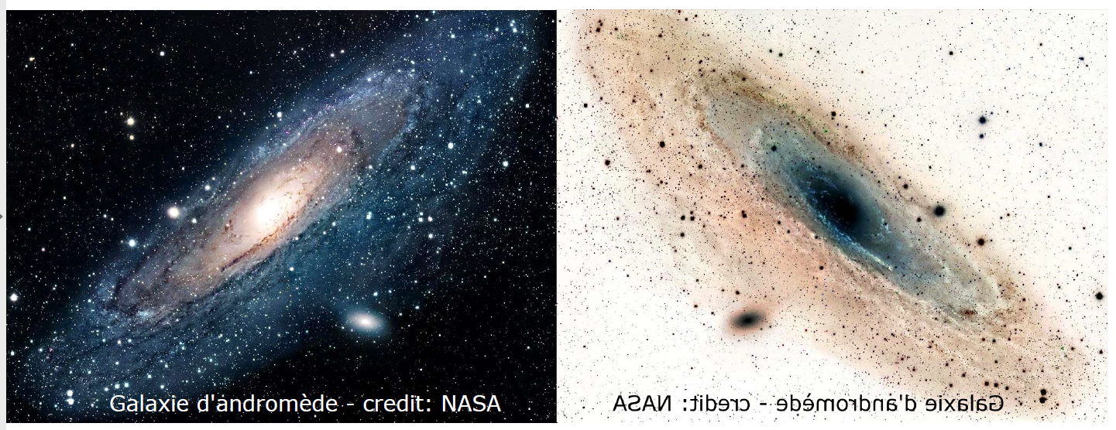

Precision measurement of the triple correlation D
A non-zero D can arise from CP violation
  CP violation observed in the K and B - meson decays is not enough to account for the large matter – antimatter assymetry
  T-odd correlations in beta decay (D and R) and n-EDM searches are sensitives to larger CP violations by 5 to 10 orders of magnitude
See P. Herczeg, Prog. Part. Nucl. Phys. 46 (2001) 413.
Below 10⁻⁴, Final State Interactions mimic a non zero correlation
D correlation measurement to the 10⁻⁵ level with some beam, laser and trapping R&D
  Best measurement so far D_{n}<2 10⁻⁴
  Complementary probe to search for New Physics with nEDM and LHC searches
  First approach /probe of D_{FSI}

Slide 10
Sensitivity to NP
D correlation measurements in neutrons and nuclei
  Best limits on T-violating phase Im(C_{V}/C_{A})
    neutron decay, D_{n}= (−0.94 ±1.89±0.97) 10⁻⁴ → Im(C_{V}/C_{A})<(1.6±6.3)×10⁻⁴
    ¹⁹Ne decay, D=0.0001 ±0.0006, limited by statistics
  Sensitivities depends on the transition D_{X} = F(X) × Im(C_{V}/C_{A})
  Final State Interactions as well
emiT collaboration, PRL 107, 102301 (2011), Phys. Rev. C 86 (2012) 035505
    O. Naviliat-Cuncic and M. Gonzalez-Alonso, Ann. Phys. (Berlin) 525 (2013) 600.
Calaprice et al, Hyp. Int. 22 (1985) 83
J. D. Jackson S. B. Treiman and H. W. Wyld, Jr, Nucl. Phys. 4 (1957) 206.
J. C. Brodine Phys Rev D1(1970)1
 | n | ¹⁹Ne | ²³Mg | ³⁹Ca
F(X) | -0.55 | 0.66 | 0.82 | -0.90
D_{FSI} | 1.2×10⁻⁵ | 1.5×10⁻⁴ | 1.2×10⁻⁴ | -3×10⁻⁵
²³Mg and ³⁹Ca can be laser polarized as ions
²³Mg best produced and laser polarized→ first candidate

Slide 11
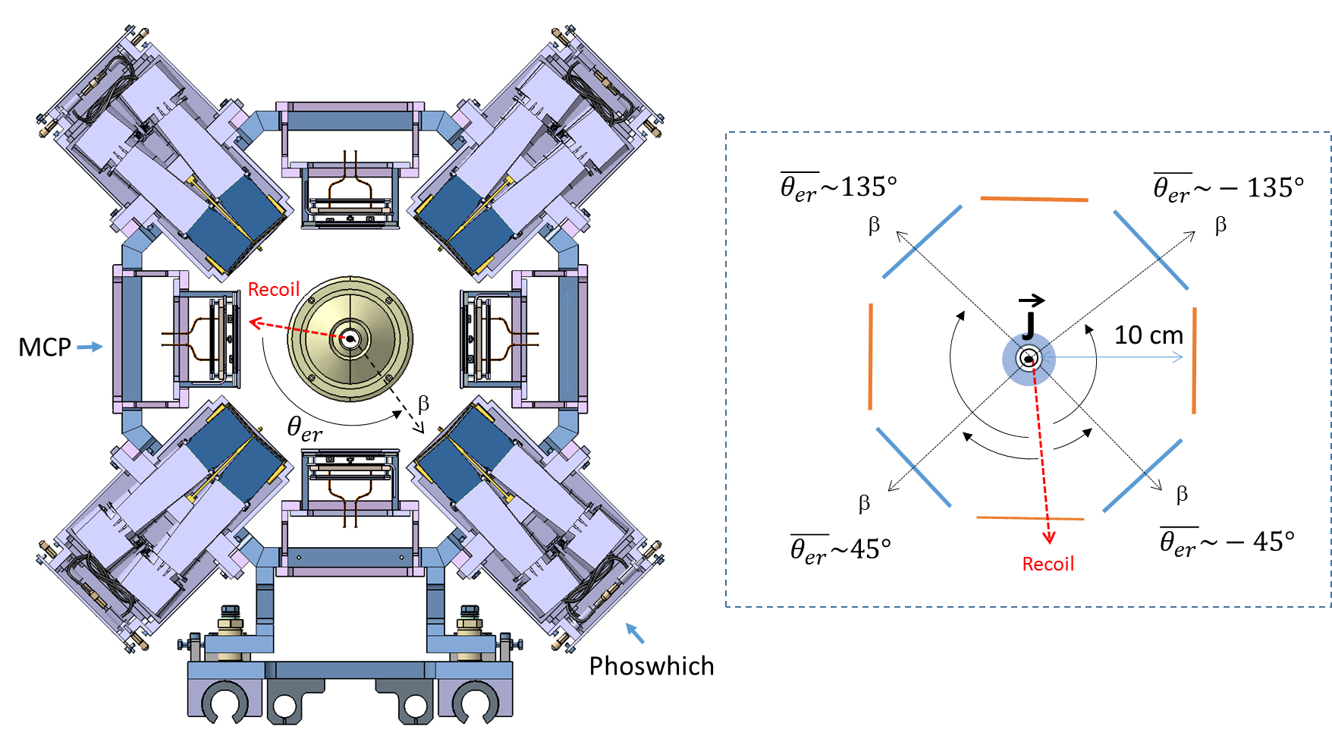

D correlation measurement setup
P. Delahaye et al, The MORA project, Hyp. Int. (2019) 240:63
In trap optical polarization
Where δ is depending on the phase space coverage

Slide 12
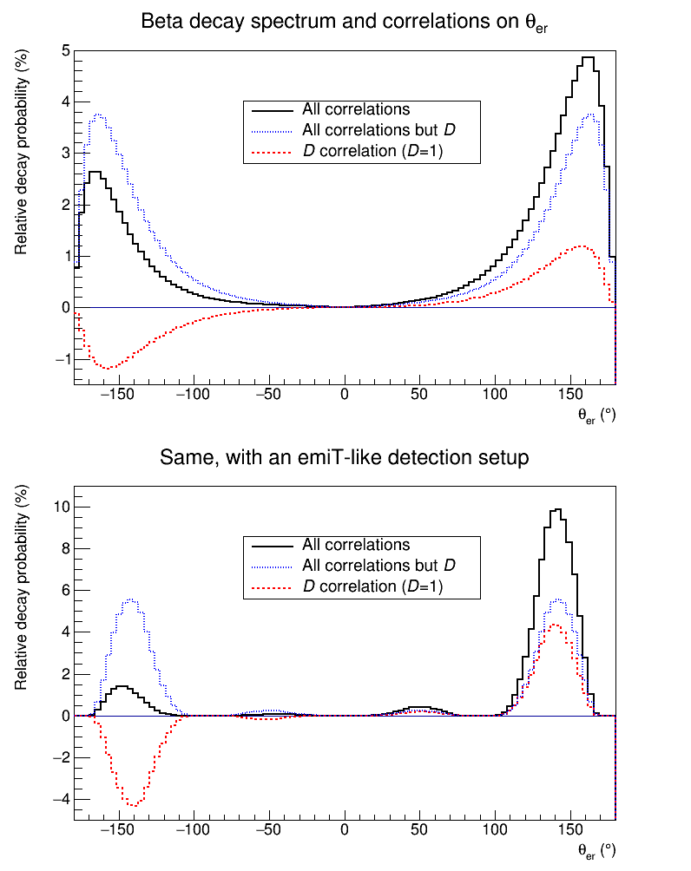
D correlation measurement setup
P. Delahaye et al, The MORA project, Hyp. Int. (2019) 240:63
In trap optical polarization
Full phase space
emiT-like phase space
δ=0.775(1) for ²³Mg, compared to δ∼0.3 for the neutron
Where δ is depending on the phase space coverage

Slide 13
D versus nEDM
D correlation measurements
  Best values
    neutron decay, Dn= (−0.94 ±1.89±0.97) 10⁻⁴, emiT collaboration, PRL 107, 102301 (2011), Phys. Rev. C 86 (2012) 035505
    ¹⁹Ne decay, D=0.0001 ±0.0006 Calaprice et al, Hyp. Int. 22 (1985) 83, limited by statistics
Current indirect bounds from nEDM as derived using an EFT approach
    But the bounds from nEDM are still below those from D, at least for the leptoquark model
      J. Ng and S. Tulin, Phys. Rev. D 85 (2012) 033001.
      C.-Y. Seng et al., Phys.Lett. B 736 (2014) 147. → constraints relaxed by one order of magnitude
      Summary in K.K. Vos et al, Rev. Modern Phys. 87 (2015) 1483
    And D is a “cleaner” probe than nEDM, not a complex mixture of operators
    D and nEDM are complementary approaches to search for CP violation
New Physics probed with σ_{D} <5×10⁻⁵
    A full classification of models evading EDM constraints, such as leptoquarks, is still missing
    A dedicated study using the EFT framework has just started
A. Falkowski, LPT Orsay

Slide 14
Why LQ models are so interesting
A non zero D is particularly sensitive to leptoquarks
3 Sakharov conditions for Baryogenesis (matter antimatter assymetry observed in the universe)
  (i) a large C and CP violation
  (ii) a violation of the baryonic number,
  (iii) a process out of thermal equilibrium.
2 of the 3 conditions fulfilled, LQ appear in the first theories for Baryogenesis
  A. Y. Ignatiev, N. V. Krasnikov, V. A. Kuzmin and A. N. Tavkhelidze, Phys. Lett. B 76(1978)436.
  M. Yoshimura, Phys. Rev. Lett. 41(1978)281, M. Yoshimura Phys. Rev. Lett. 42(1979)746.
  S. Weinberg Phys. Rev. Lett. 42(1979)850.
    Decay out of equilibrium in GUT Theories
Popular explanation for the flavor non conversation observed in B meson decay by the LHCb, BABAR and Belle collaborations
  Projection on S1 scalar leptoquarks explaining the anomaly:
    Present: MS1 < 400–640 GeV (8 anf 13 TeV LHC searches)
    Future: MS1 ≲ 600 - 800 GeV at the 14 TeV LHC with L = 300/3000 fb−1 of accumulated data
    Potentially discovery of a leptoquark up to 1.1TeV with over 5σ significance with a 14TeV LHC with L=3000fb⁻¹
See eg Dumont et al, Phys Rev D 94 (2016)
Competitive sensitivities from the D measurement

Slide 15
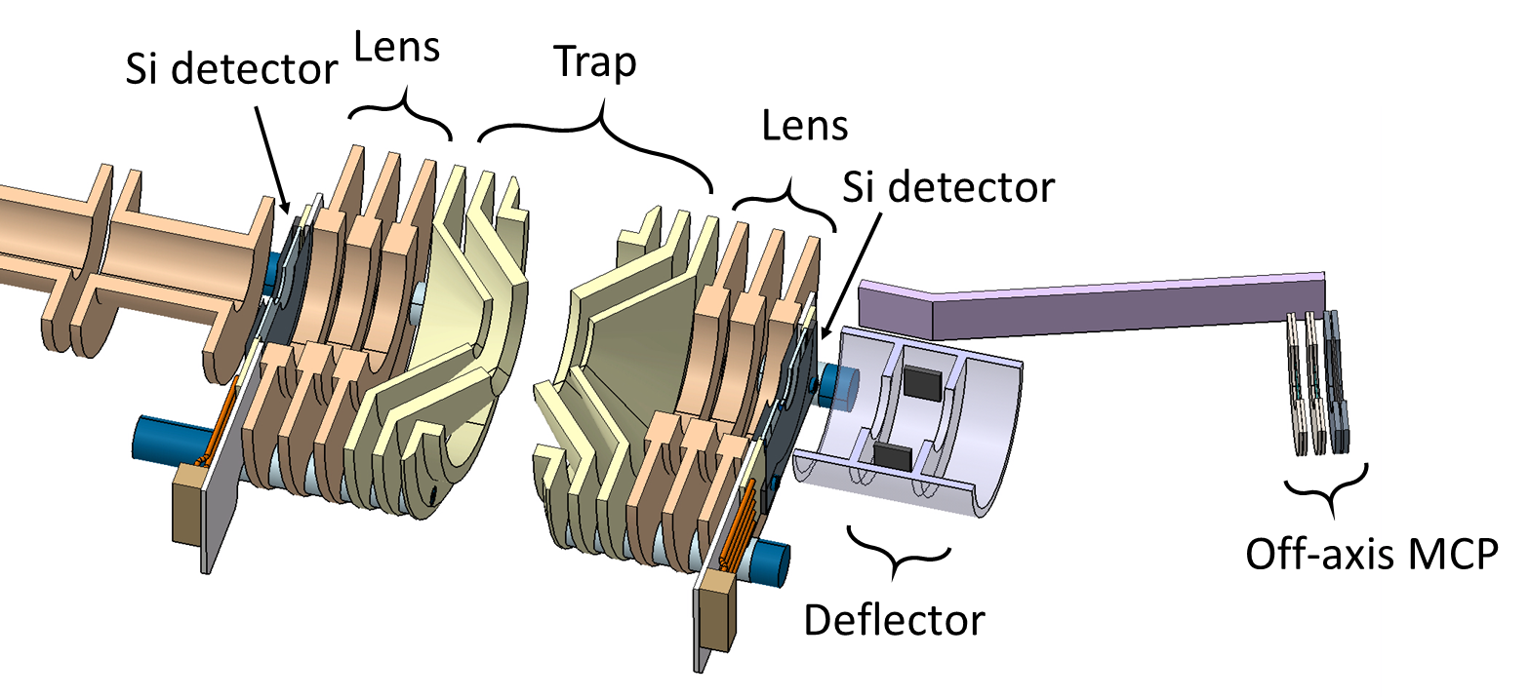

Experimental challenges
P. Delahaye et al, The MORA project, Hyp. Int. (2019) 240:63
In trap polarization:
  Novel method - not yet tested
  Simulations with 10kHz pulsed lasers → >99% polarization in ~1ms
Trapping capacity and trapping half life
  Presently 5∙10⁵ ions/bunch, aiming at 5∙10⁶/bunch
  Presently 500ms, aiming at several s (²³Mg: T_{1/2}=11s)
Systematic effects ≲10⁻⁵
  D_{n} measurement, dominated by statistics, give hints
  Tests and simulations of the detection setup are just starting
    GEANT 4 simulations for electrons
    Home made simulations for dynamics of trapped ion and recoil ion trajectories
Sensitivity ~$\frac{1}{\sqrt{N}}$
Optimized trap geometry M. Benali and G. Quemener
Trapping radius
From: 4.5mm (LPCTrap + environment)
To: 11mm (MORA + environment)
Negligible evaporation losses
pseudo-potential depth x 5

Slide 16
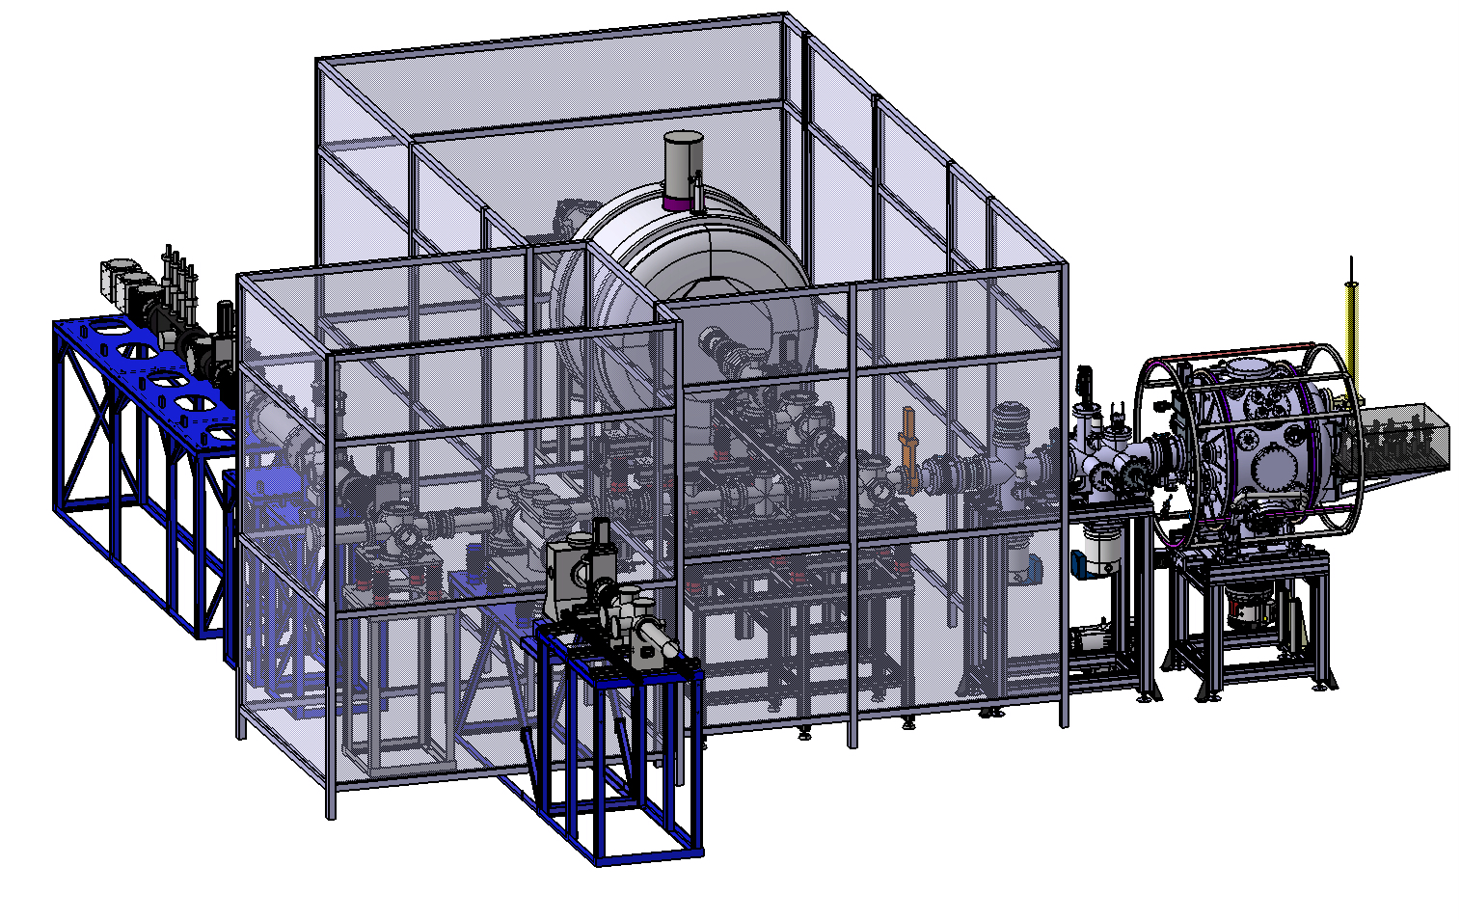
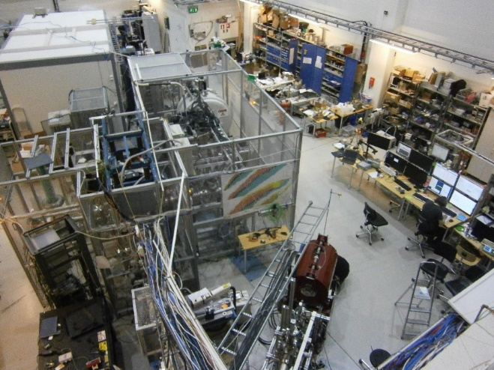
Proof of principles
2020-2023
Laser
Injection line
coils
PDT
MR-ToF-MS
Optics table
RFQ
BEAM
Main chamber
JYFL: ~10⁵ ²³Mg/s
Laser setup readily available
Polarization degree measurement ~% level
D correlation measurement ~ 5⋅10⁻⁴ level

Slide 17
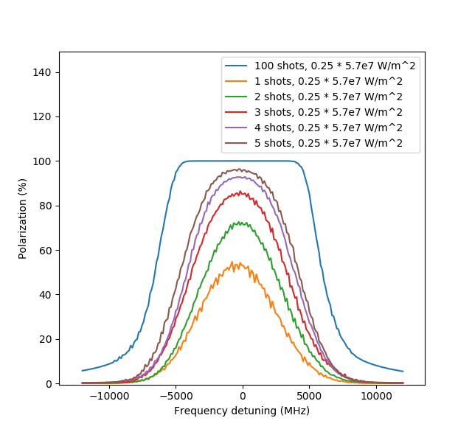
Optical pumping
The nuclear spin I interacts with the atomic one J → F=I+J
σ+ or σ- light to scan the hyperfine structure forces ions in the m_{F}=±F state
Transition probabilities: numerical simulations R. de Groote, X. Fléchard and W. Gins
²³Mg hyperfine structure
^{F= I+J}
3²P_{1/2}
F=1
-1
0
+1
F=2
D₁
L1
L2
F=1
Taking into account the velocity of the trapped ions
3²S_{1/2}
F=2
-2
-1
0
+1
+2
L1+L2 lasers excited using trippled Ti:Sa laser pulses λ~280nm σ+ polarization
Collisions with He atoms (no spin) do not depolarize
With the power available at JYFL
More than 99% achievable in 1ms
Experience from COLLAPS
Examples!
³¹Mg: G. Neyens et al, PRL 94, 022501 (2005)
²¹⁻³²Mg: D. T. Yordanov et al, PRL 108, 042504 (2012)
Probable limitation: laser light polarization

Slide 18
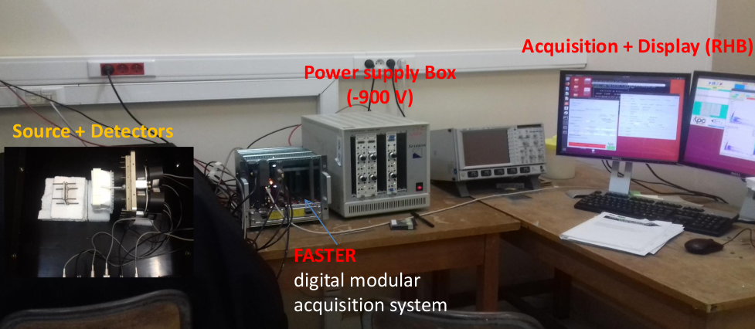
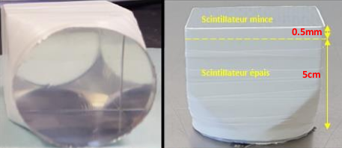
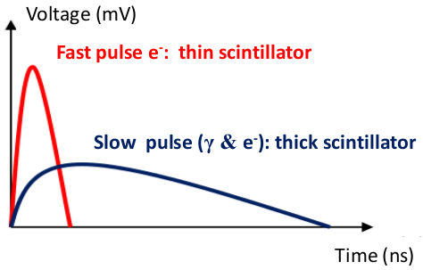
Phoswich detectors tests
Phoswich detector :
combination of two plastic scintillators :
thin scintillator (0.5 mm , τ=1.8 ns)
thick scintillator (5 cm , τ=285 ns)
(+ Mylar + Téflon)
Q_{fast}
Q_{slow}
Q_{tot}
=> beta, gamma discrimination
M. Benali
Notes:
Qfast correspond (impulsion rapide donnée par le scintillateur mince qui à une constante du temps très faible ) ➔ detection des electrons
Qslow correpond a l’impulsion fournie par le scintillateur lent ➔ interaction des electrons ou gamma avec le scintillateur lent
Qtot: la somme de Qfast+Qslow

Slide 19
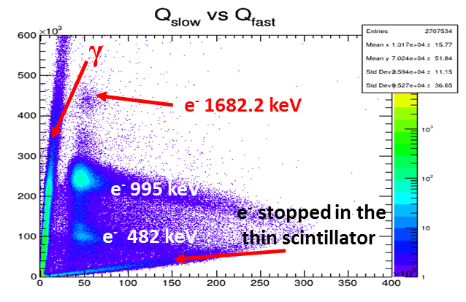
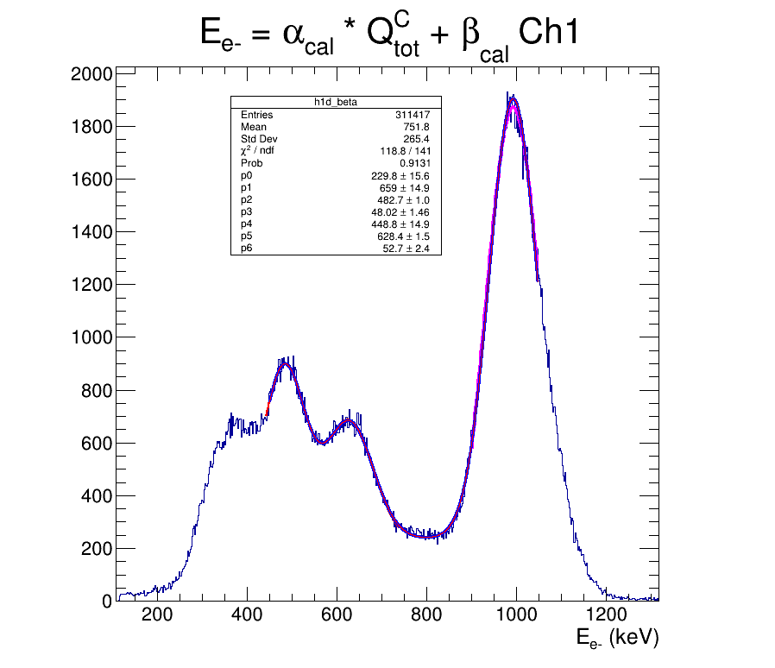
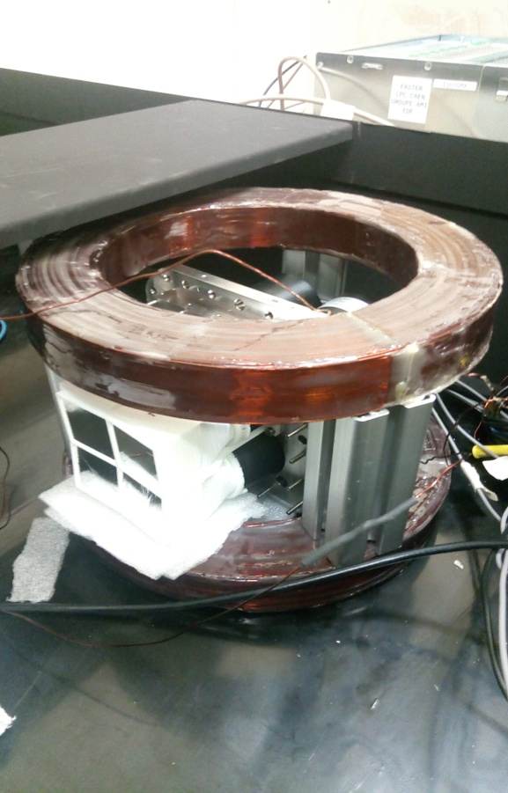
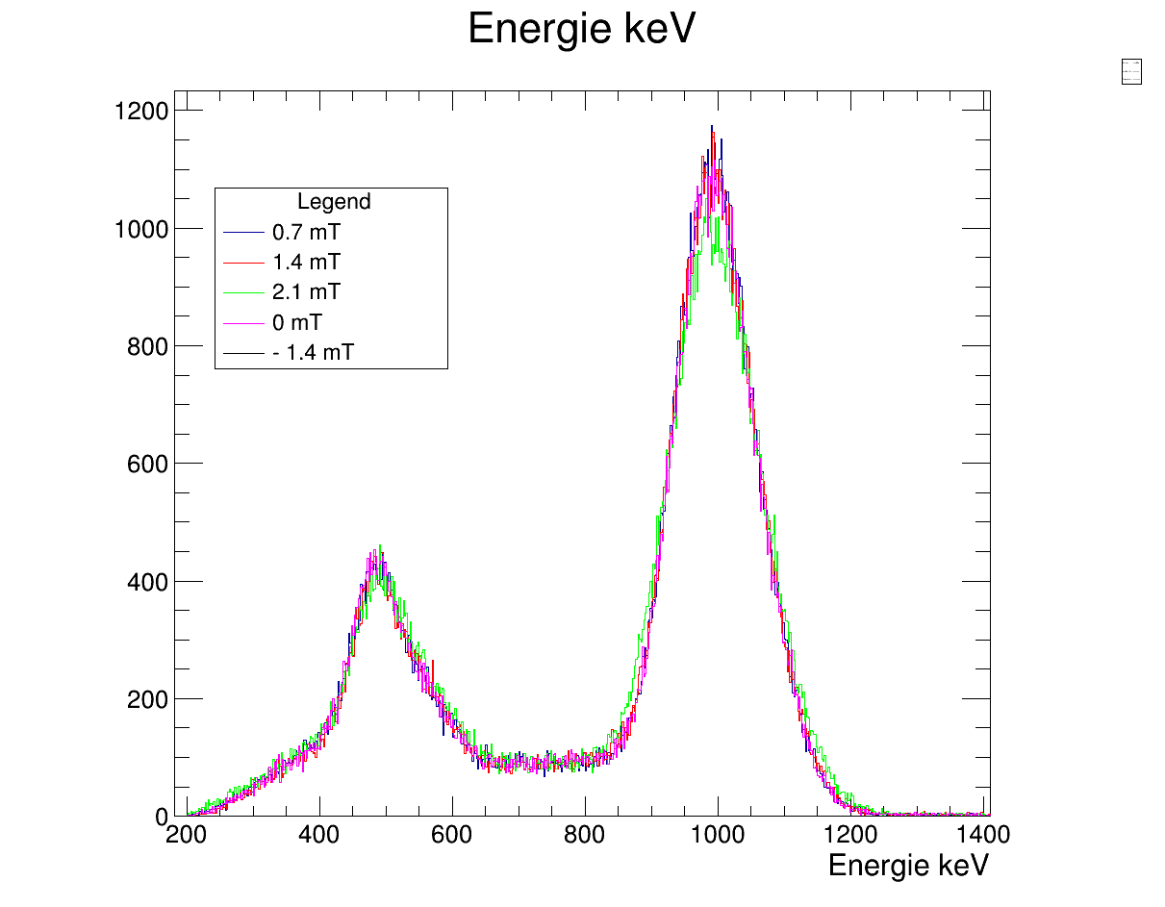
Phoswich detectors tests
Detectors calibration using ²⁰⁷Bi (β,γ) and ¹³⁷Cs (β)
Done
Study of the magnetic field effect on PMs
Done
(effect of magnetic field
on signal resolution and PMs gain)
Detector test in a secondary vacuum
Done
GEANT 4 simulations
in progress
995 keV
482 keV
629 keV
Energy spectrum using ²⁰⁷Bi and ¹³⁷Cs sources
B
Stable resolution by varying the magnetic field
M. Benali

Slide 20

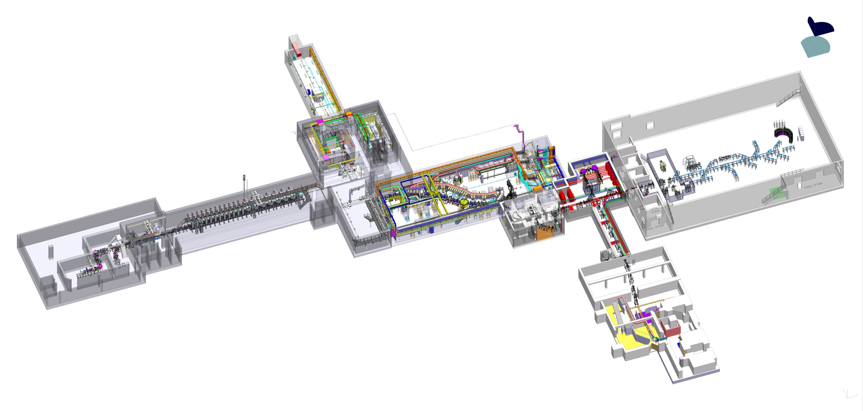
Highest sensitivity measurements
2024-…
Neutron for Science experimental area
Up to 30 MeV n
Experimental hall for very low energy beams (keV)
NFS
DESIR
High intensity p, d, He beams (1-5mA) 30-40 MeV
High intensity heavy ion beams (1-10 pµA) 14.5 AMeV
SPIRAL 2 LINAC
S3
Super Separator Spectrometer
RIBs from fusion reactions
SPIRAL1: >10⁸ ²³Mg/s
?? S3-LEB: >10⁶ ³⁹Ca/s
GANIL
D correlation < 5⋅10⁻⁵ level
Experimental areas and cyclotrons: heavy ions (pµA) up to 95AMeV
SPIRAL 1 facility: RIBs from fragmentation

Slide 21
Summary/Perspectives
New perspectives with polarized beams with MORA at JYFL
  Proof of principle of the polarization to be done at JYFL
    Adapted IGISOL – 4 Laser setup
      Pulsed (TiSa) or CW (Dye) laser schemes are being investigated
    Adapted trapping setup from LPCTrap
    Adapted detection setup carried out by GANIL and LPC Caen
  First measurement of D at JYFL
    Best sensitivity for nuclear beta decay is probably possible
      LoI for ²³Mg beam characterization
  Theoretical efforts
    for defining what NP one is probing with D measurements to the 10⁻⁵ level
    For reviewing D_{FSI} calculations
D correlation measurement with unprecedented accuracy in SPIRAL 2
  1 week of beam time:
    same accuracy as for the neutron with existing techniques
    Better sensitivity to NP: type of transition and selection of detection plane
  Sensitivity down to the 10⁻⁵ level with some beam, laser and trapping R&D
    improvement by 1 order of magnitude on the sensitivity to NP Im(C_{V}/C_{A})
    First approach /probe of D_{FSI} for ²³Mg
  Great physics with great challenges!
Project has officially started in April 2018
ANR funds for PhD and postdoc positions as of 2020
2018-2021
2020-2023
2024-…

Slide 22


Thanks a lot for your attention
E. Liénard
Y. Merrer
M. Benali
X. Fléchard
G. Quéméner
P. Delahaye
B.M. Retailleau
P. Ujic
F. De Oliveira
N. Lecesne
R. Leroy
I. Moore
T. Eronen
R.P. De Groote
A. De Roubin
A. Jokinen
A. Kankainen
M. Kowalska
G. Neyens
N. Severijns
W. Gins
Falkowski
M. Gonzalez-Alonso
M.L. Bissel

Slide 23
Backup material
Sensitivity to non zero D at JYFL and GANIL
Monitoring polarization
Further comparison to Dn
Further aspects of D vs nEDM
More details for 6He a_{βν} experiment

Slide 24

Sensitivity to NP
Aimed accuracy
Place and type of measurement | Trapped ions /s | Decays/s | Meas. time (d) | Detected coinc. (P) | σ_{P} stat (%) | Detected coinc. (D) | Sensitivity on D
JYFL: polarization degree | 2.00E+04 | 6.13E+02 | 8 | 1.7E+05 | 1.9E+00 | 1.5E+06 | 1.0E-03
JYFL: D correlation | 2.00E+04 | 6.13E+02 | 32 | 6.7E+05 | 9.4E-01 | 6.1E+06 | 5.2E-04
DESIR: D correlation* | 1.00E+06 | 3.07E+04 | 24 | 2.5E+07 | 1.5E-01 | 2.3E+08 | 8.5E-05
DESIR: D correlation** | 5.00E+06 | 3.07E+05 | 24 | 1.3E+08 | 6.9E-02 | 1.2E+09 | 3.8E-05
*present trapping capacity
** optimized trapping capacity
With some trapping R&D (optimized trap and RF)→ Below 5.10⁻⁵ is feasible

Slide 25
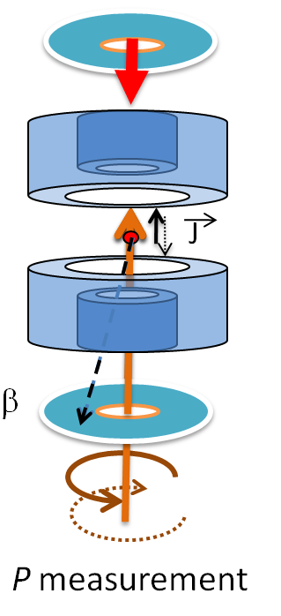
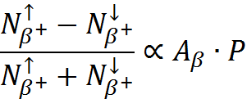
Monitoring of polarization
On-line monitoring of the polarization
A_{β} measurement
Remember: C. S. Wu et al., Phys Rev 105(1957)1413
Extended interaction time with laser light
→ Very high polarization degree
>90%: enough for the measurement of D!

Slide 26
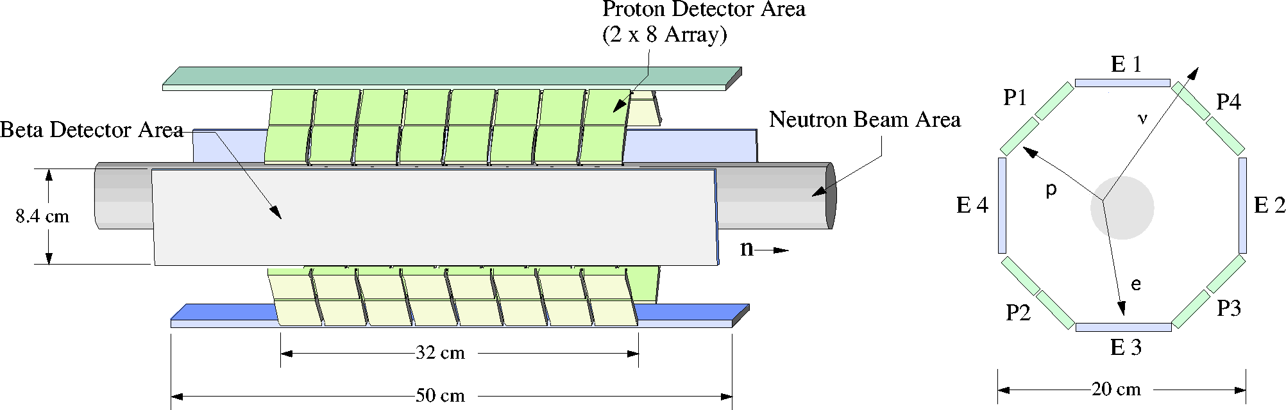
Sensitivity to NP
Comparison to D_{n} experiment
H. P. Mumm et al, Rev. Sci. Instrum. 75, 5343 (2004)
H. P. Mumm et al, PRL 107, 102301 (2011)

Slide 27
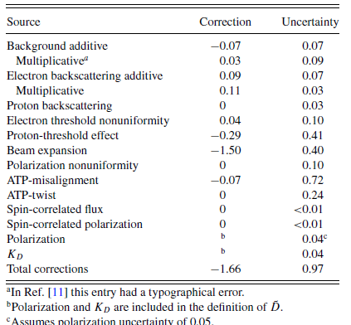
Sensitivity to NP
Comparison to D_{n} experiment
Systematic effects
Most of the dominant effects should be highly suppressed by the trap confinement
Beam expansion
  From 5 cm for the neutron to ~2mm for trapped ions
ATP= assymetric transverse polarization
  Very good definition of the axis of polarization thanks to the lasers and magnetic field
  negligible expansion of the cloud
  effect can be canceled for uniform beam using 2 adjacent cell
The proton/recoil threshold should be minimal for MCPs compared to SBDs, but will be affected from RF field to confine ions
Dn= (−0.94 ±1.89±0.97) 10⁻⁴
H. P. Mumm et al, Rev. Sci. Instrum. 75, 5343 (2004)
H. P. Mumm et al, PRL 107, 102301 (2011)

Slide 28
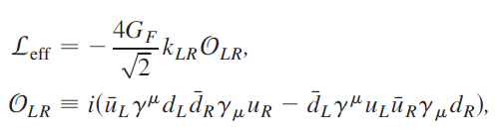
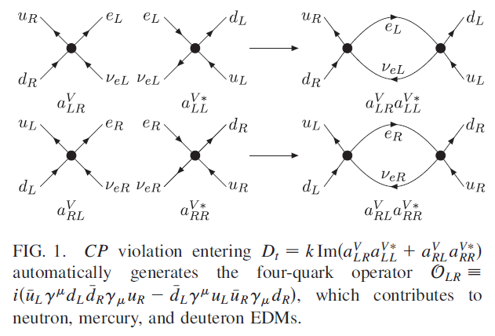

Sensitivity to NP
The EDM are sensitive among others to a CP odd four fermion interaction
Ng et Tulin, Phys Rev D 85 (2012) + Seng et al, Phys Lett B 736(2014
That implies for
L-R symmetric models
Models with exotic fermions
R-parity violating MMSM
-6
Limit is relaxed by one order of magnitude Seng et al, Phys Lett B 736(2014)
→Non adequate d_{n} determination from earlier meson theory

Slide 29
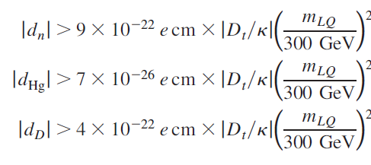

Sensitivity to NP
The EDM are also sensitive (but less!) to Leptoquarks (LQ)
LQ models were considered in the past « EDM safe »
But: Radiative corrections generate contributions to EDM
8 fermion operator
in the SMEFT expansion
Ng et Tulin, Phys Rev D 85 (2012) + Seng et al, Phys Lett B 736(2014)
For models with right-handed neutrinos:
-4
This limit is relaxed by one order of magnitude Seng et al, Phys Lett B 736(2014)
→Non adequate d_{n} determination from earlier meson theory
Review: Vos et al, Rev. Mod. Phys. 87 (2015)

Slide 30

First ⁶He experiment
Results and outcome
X. Fléchard et al ,J. of Phys. G 38 (2011) 055101
Subtracting background
Neutrino mass invariant
M_{ν}²<2.5MeV²c⁴
Main systematic uncertainties
σ_{a/a}=5% (tot)
χ²/ν~0.92
Source | Δa_{βν} (x10⁻³)
Cloud temperature | 6.8
MCPPSD calibration | 1.3
Eβ | 1.1
Background (acc.+off trap) | 0.9
β scattering | 1.9
V_{RF} | 1.7
Shake - off | 0.6
Reduced by statistics
May become dominant
Re- measured
Shake off was only known in theory! Arbitrary ±100%
…
Total 7.5

Slide 31
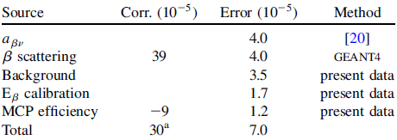
Results of LPCTrap
⁶He decay
Experimental conditions (2010):
⁶He⁺ Intensity ~10⁸ pps
~ 1,5 nA of ¹²C²⁺ contamination (lost in RFQ)
~ 1.2 10⁶ « good » coincidences in ~ 4 days
Shake-off analysis:
Complete Monte-Carlo simulation including
all relevant systematic effects
Fit of P_{shake-off} assuming a_{βν} = -1/3
p-value=0.37
Li²⁺
Systematic error budget
Li³⁺
Couratin et al., PRL108 (2012)
P_{shake-off} = 0.02339(35)_{stat}(07)_{syst}
ΔP_{shake-off} =3.6 10⁻⁴
Pshake-off (theory): 0.02322
Test of the soudain approximation
Couratin et al. PRL108 (2012)

Slide 32
Summary of results a_{βν}
Nucleus | Date | a | σ_{stat} | σ_{syst} | Publication
⁶He | 2006 2010 | -0.3335 -1/3 (SM) | 0.0073 0.0015 | 0.0075 ? | σ_{a} /a ~ 3% Fléchard et al. JPG38 (2011) Shakeoff Couratin et al. PRL108 (2012)
³⁵Ar | 2011 2012 | / 0.9004 (SM) | / 0.0013 | / ? | Shakeoff Couratin et al. PRA88 (2013)
¹⁹Ne | 2013 | 0.0438 (SM) | 0.0046 | ? | Shakeoff Fabian et al. , under press
Measurement of a_{βν} for ⁶He under analysis
  Measurement from Johnson et al. (1963!) for ⁶He:
  If σ_{syst} = σ_{stat} a_{βν}=-1/3(SM)±.0021
  → Potentially constraints on |C_{T}|/|C_{A}| from 7% to 5%
Projections for mirror nuclides
  With the ³⁵Ar measurement alone, assuming σ_{syst} = σ_{stat} : σ_{a} /a ~ 0.21%
  → Gain factor on ρ=(C_{A}M_{GT})/(C_{V}M_{F}): σ_{ρ} /ρ: 5.4
  ◊ Potentially σ(V_{ud}) / V_{ud} (2018) from 1.4×10⁻³ to 9. ×10⁻⁴
a_{βν}=-.3343±.0030
+ constraints from ⁸Li decay
(cf previous presentation)
Including latest ³⁷K measurement at TRINAT

