Slide 1
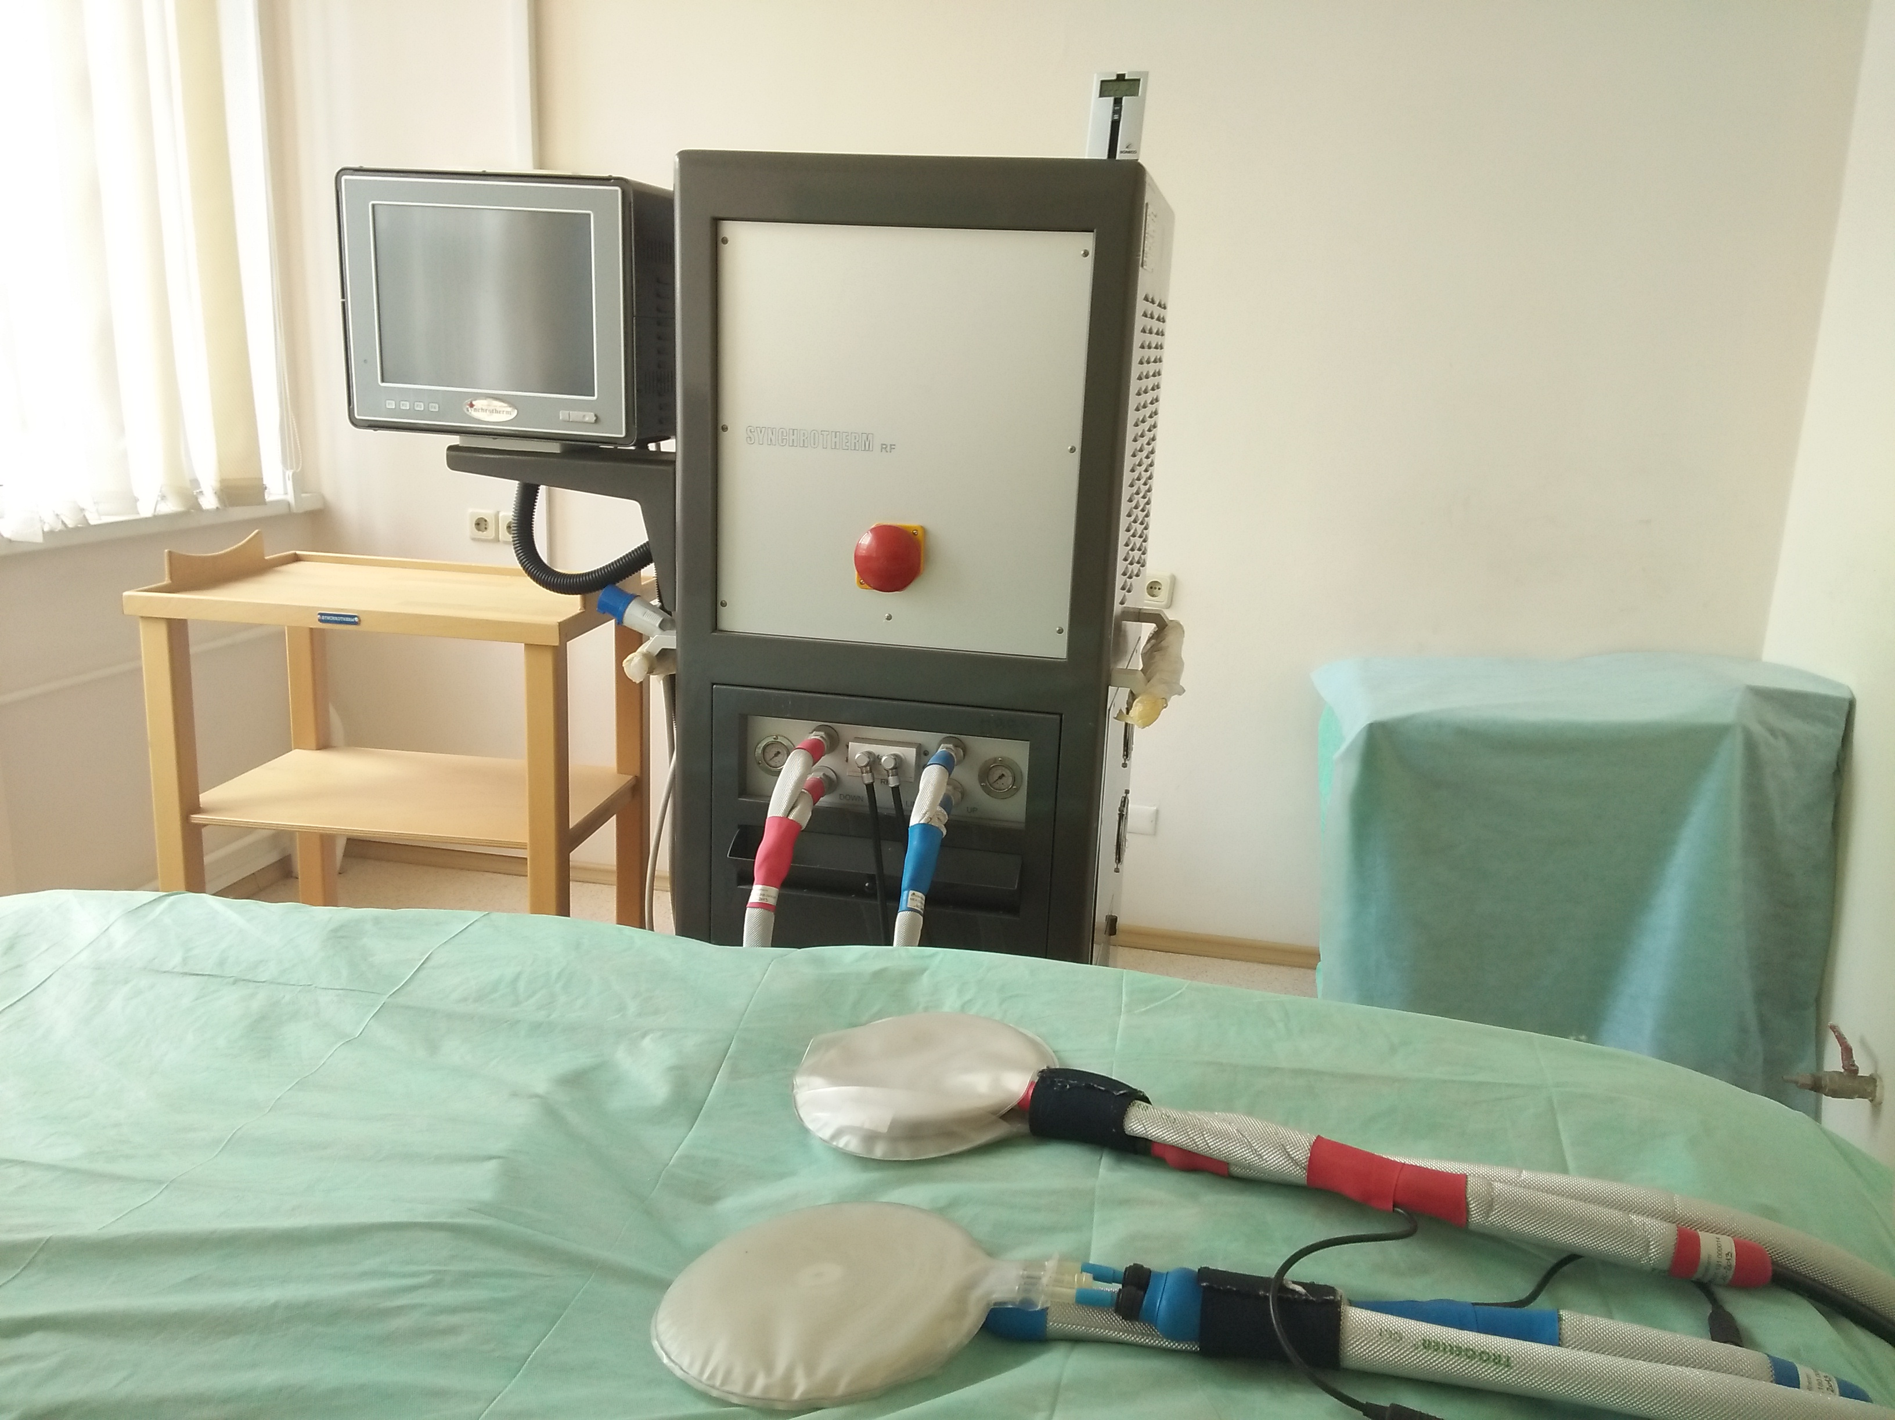
LOCAL HYPERTHERMIA
Duong Thi Nhung
National Research Nuclear University MEPhI (Moscow Engineering Physics Institute)

Slide 2
Content
Overview (definition, effects of heat on cells)
Methods (local, regional , whole body)
Local hyperthermia: techniques
Combined results ( Blokhin National Medical Research Centre of oncology)

Slide 3
Overview
Hyperthermia (also known as thermotherapy) is generally regarded as a mean body temperature higher than normal. High body temperature is often caused by illness, such as fever or heat stroke.
Hyperthermia, the procedure of raising the temperature of tumour-loaded tissue to 40–43°C, is applied as an adjunctive therapy with various established cancer treatments such as radiotherapy and chemotherapy.

Slide 4
Overview
Effects of heat on cells
Range of temperatures (oC) | Time impacts | Physical effects | Biological effects
30-39 | Unlimited | No change | Enhance bio-effects
40-46 | 30-60 min | Changes the optical properties of tissue | Enhanced blood circulation
47-50 | >10 min | Necrosis, coagulation | Protein breakdown
>50 | After 2 min | Necrosis, coagulation | Protein breakdown, membrane rupture, cell contraction

Slide 5
Methods
Local hyperthermia
Regional hyperthermia and part-body hyperthermia
Whole-body hyperthermia

Slide 6
Local hyperthermia
Superficial tumours can be heated by means of antennas or applicators emitting mostly microwaves or radiowaves placed on their surfaces with a contacting medium.
Several types of applicators have been used clinically, such as waveguide applicators, horn, spiral, current sheet, and compact applicators (The electromagnetic coupling of the applicator to the tissue is ensured by a water bolus (preceding water path)).
Local hyperthermia has become a recognized and quite widespread adjuvant method of chemotherapy and / or radiation treatment of resistant tumors.

Slide 7
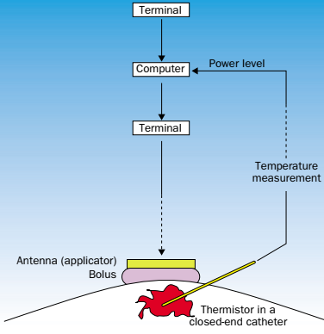
Local hyperthermia
Bolus: often used to improve the coupling between the applicator and the patient.
Application of bolus has the following advantages:
Smooth Transmission from Applicators into Tissue
Skin Cooling to avoid surface Heating
Maintenance of the Body Surface at a Fixed Distance from the Applicator …

Slide 8
Regional and part-body hyperthermia
Deep-seated tumours—eg, of the pelvis or abdomen—can be heated by arrays of antennas. The Sigma-60 applicator is a widely spread applicator, which consists of four dipole antenna pairs arranged in a ring around the patient.
Planning systems describe correctly to some extent the power-density and temperature distribution depending on various treatment variables. Even though each antenna pair can be controlled in phase and amplitude, there are restrictions in terms of the generated SAR distribution.

Slide 9
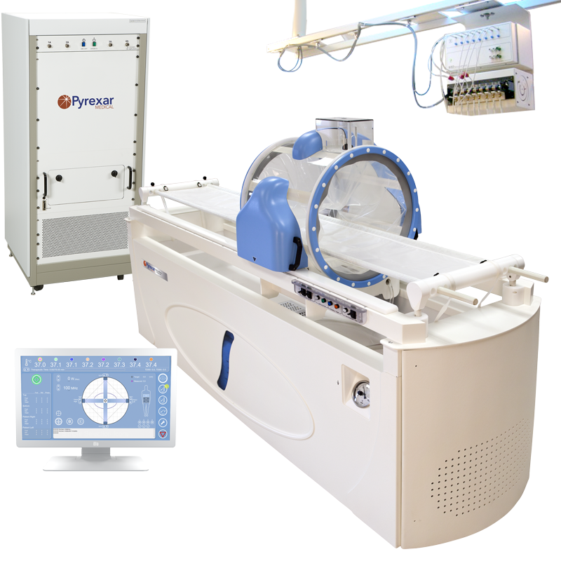
Regional and part-body hyperthermia
Sigma-60 applicator (four dipole pairs) with treatment couch of the BSD-2000 system for regional hyperthermia (https://www.pyrexar.com/hyperthermia/bsd-2000)

Slide 10
Whole-body hyperthermia
Whole body hyperthermia is applied to treat metastatic tumor that has spread throughout the body.
A steady state of 42 °C is maintained for 1 h along with the acceptable adverse effects. With the help of sedation of general anesthesia, the procedure would be possible.

Slide 11
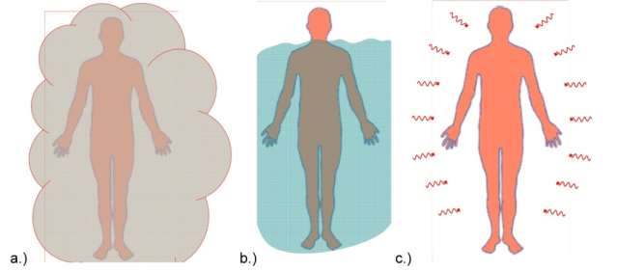
Whole-body hyperthermia
Various main methods of the whole-body heating: (a) steam, (b) water, (c) electromagnetic radiation

Slide 12
Side Effects
Side effects of local hyperthermia is that it might lead to pain at the target site, bleeding, blood clots, infection, swelling, burns, blistering, and also cause damage to skin, nerves and muscles around the treated area.
Side effects of regional and whole-body hyperthermia are that it could lead to nausea, vomiting, and diarrhea. In severe cases (rarely) it leads to problems associated with heart, blood vessels, and other major organs.
=> But improved technology, experience, and better skills led to fewer side effects.

Slide 13
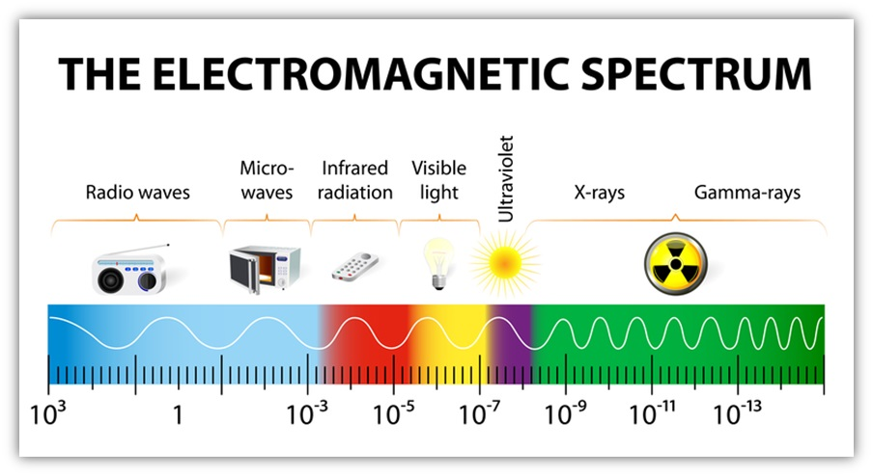
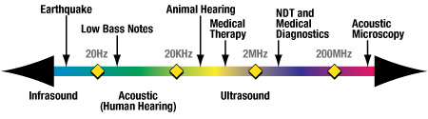
External heating techniques for delivery of localized hyperthermia

Slide 14
Heat-producing Modalities
Ohmic heating(EM)
Produced by electrical currents generated from radiofrequency sources and by electrical waves generated from microwave sources
Mechanical friction (ultrasound)
Caused by an ultrasound wave shaking the molecules
EM and ultrasound beams follow the general laws of waves as they propagate through the body

Slide 15
EM Techniques
EM Heat can be generated in tissue by different kinds of interaction between EM fields and biological systems. One such way is by rotating polar molecules; the friction associated with the rotation of the atoms and molecules causes heat
generation when time-varying
EM fields are applied.

Slide 16
Standard
For hyperthermia, the EM generators that are commercially available operate at the ISM band frequencies of 13.56, 27.12, 40.68, 915, and 2450 MHz. A frequency of 433 MHz is also authorized in Europe.
For hyperthermia, the power range also varies normally within the range of 10 to 500 Watts for a single applicator at microwave frequencies (915 and 2450 MHz)

Slide 17
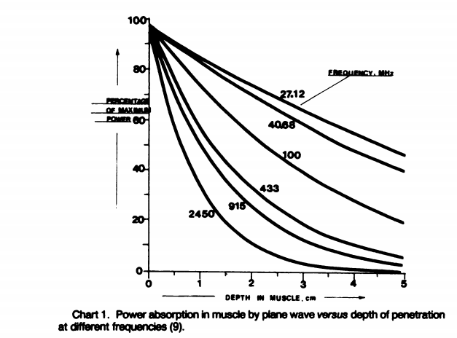
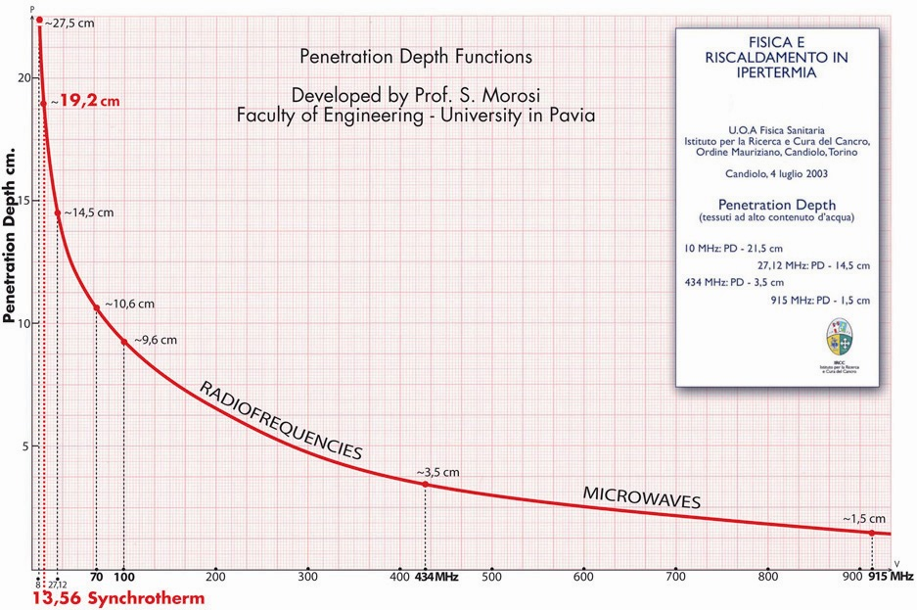
EM Techniques
How can we choose range of Frequency ?
Where E- The magnitude of electric field (V/m),
and σ- the conductivity (S/m) . P is the same as the specific absorption rate

Slide 18
EM Techniques
Advantages
Not required (Due to the presence of air within and in the vicinity of areas such as the lungs, stomach, bowel, bladder, rectum, and pelvis, the use of EM technique is suggested for cancer therapy in these region)
EM energy is not hindered by bones.
The preferred approach for brain tissue heating is microwave with single or multiple external beams.
Microwave radiation can penetrate deeply into low-water-containing tissue, like fat, and since the breast is composed largely of fat, deep penetration for cancer therapy is possible.
Large volumes can be heated with multiple applicators or phase-array microwave
Disadvantages:
Potential hazards for the EM technique in hydrate tissues or in tissues close
The fat near the fat-muscle interface may overheat due to large reflections.
Depth of dose is limited to a few cm by using a single applicator, particularly with microwaves.

Slide 19
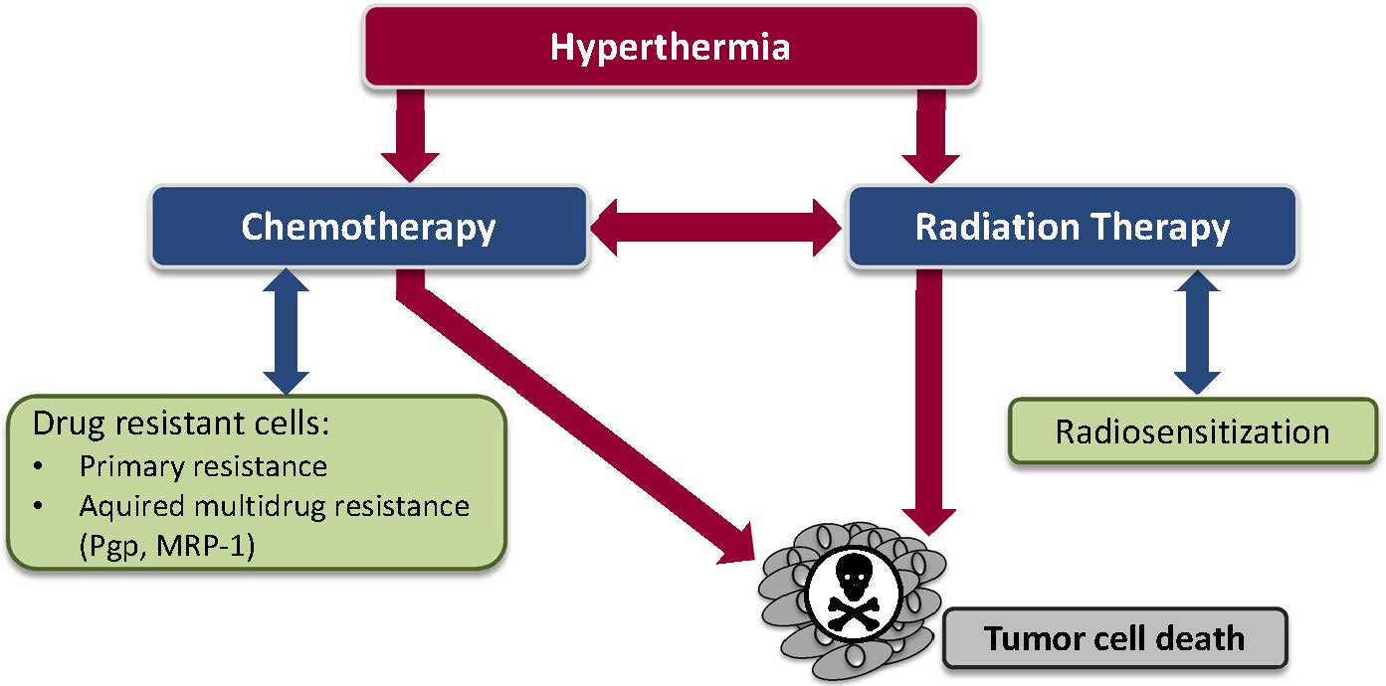

Slide 20
Combined with radiotherapy
1
Hyperthermia enhances the oxygenation and perfusion of hypnotic cells, where the ionizing radiation increases three times more than the normal cells. As a result, radiotherapy activity becomes 1.5-5 times more proficient
2
Hyperthermia is sensitive to S-phase where cells are radio-resistant. The combination of hyperthermia and radiotherapy increases damage to all phases of tumor cells
3
Various DNA repair pathways are involved in re-establishment of damage after ionizing irradiation. Heat shock affects the kinetics of all of them.

Slide 21
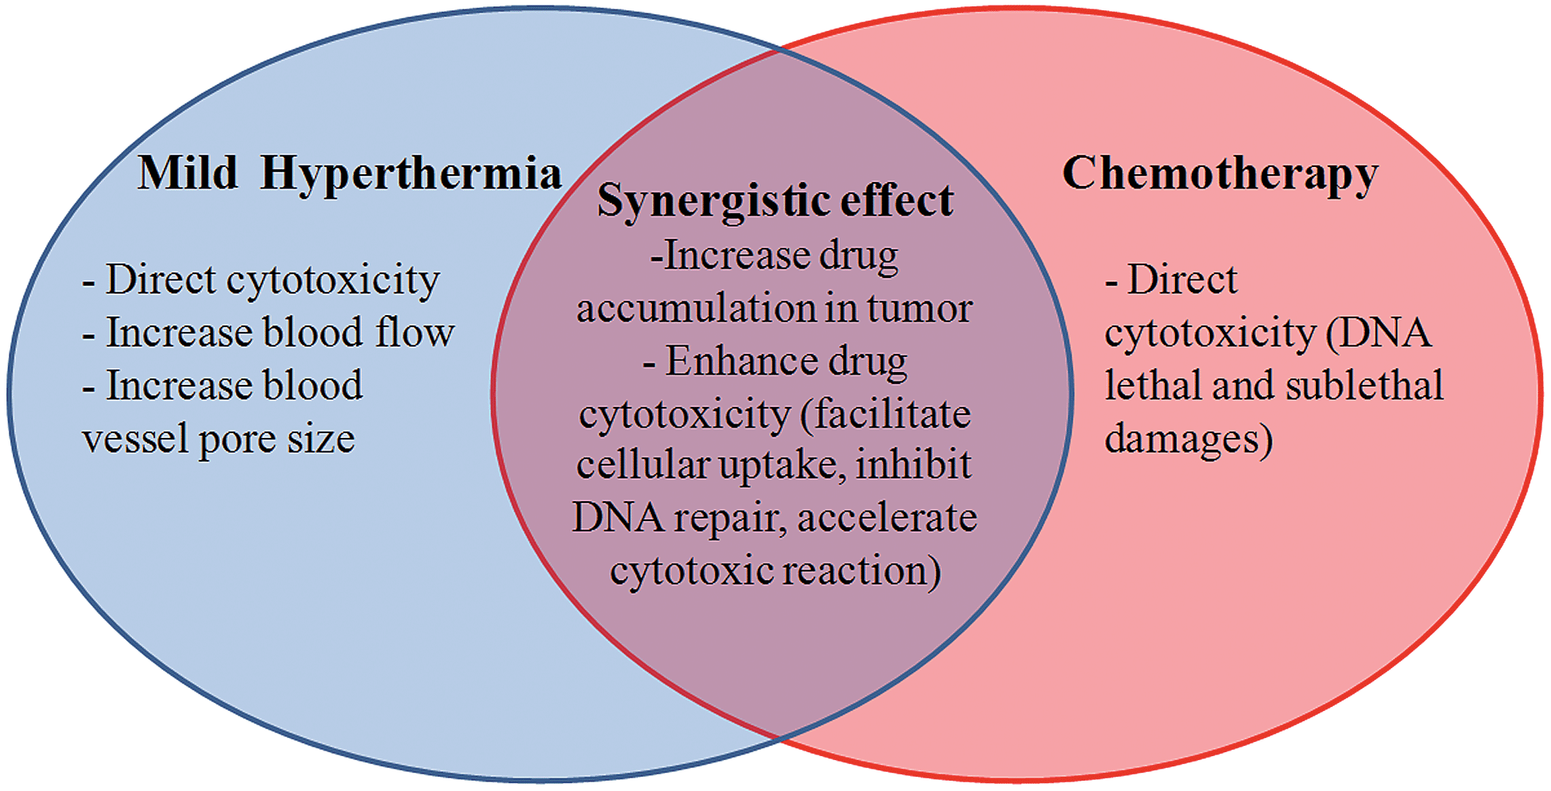
Combined with chemiotherapy

Slide 22
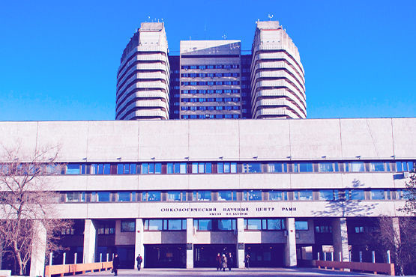
The results in the Blokhin National Medical Research Centre of oncology
Equipment
Result

Slide 23
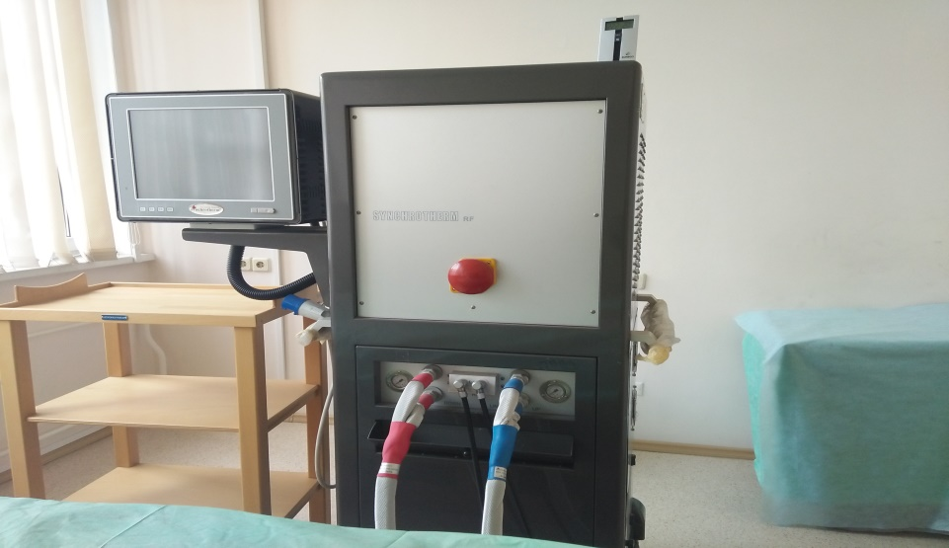
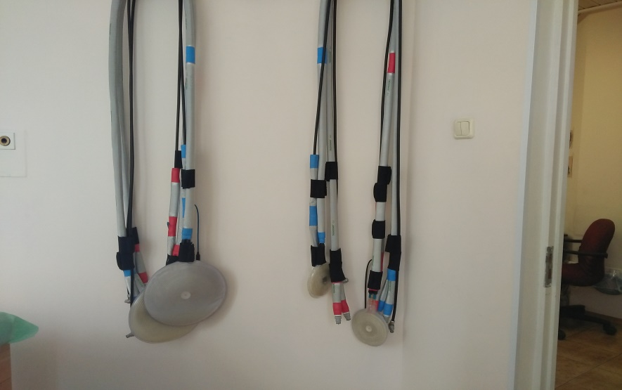
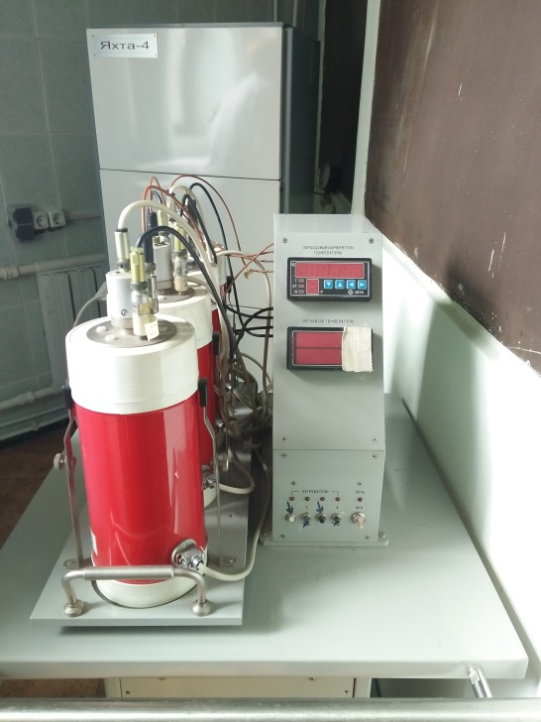
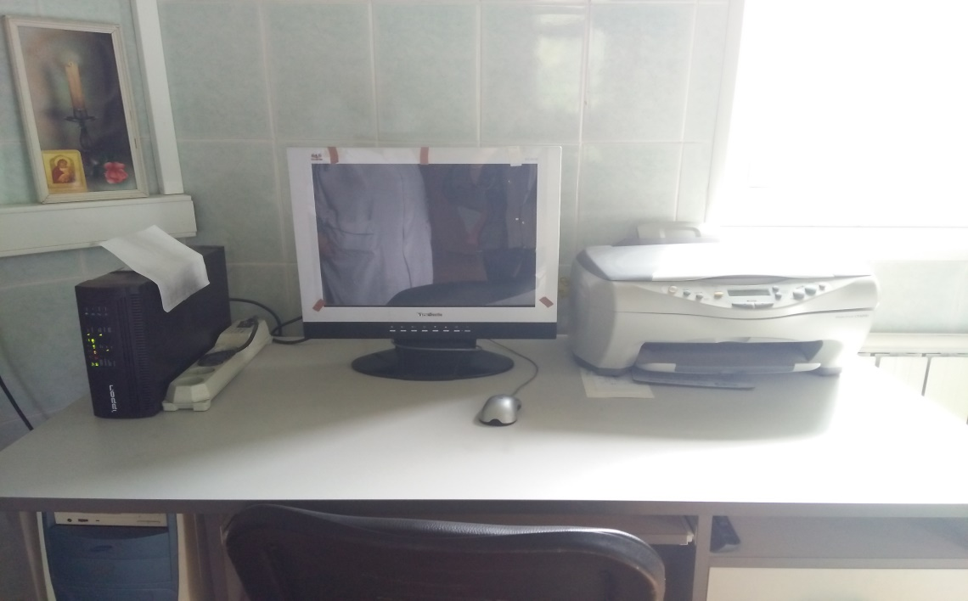
Equipment for local hyperthermia

Slide 24
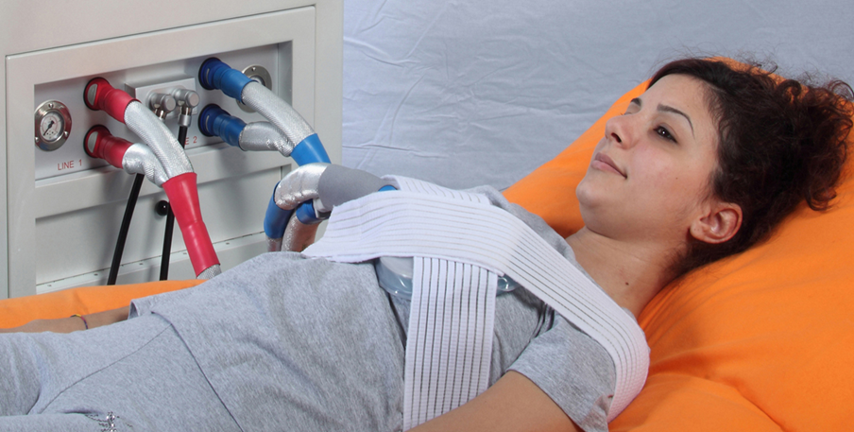
Equipment for local hyperthermia

Slide 25
Result
The probability of complete tumor regressions after a full course of radiation or thermoradiotherapy
Local tumor | Treatment method
 | Thermoradiotherapy (%) | Radiotherapy (%)
Prostate cancer | 94 | 69
Soft tissue sarcomas | 45 | 14
Regional metastasis of squamous cell carcinoma of the neck | 57 | 12
Squamous-cell carcinoma of the anal canal | 100 | 60

Slide 26
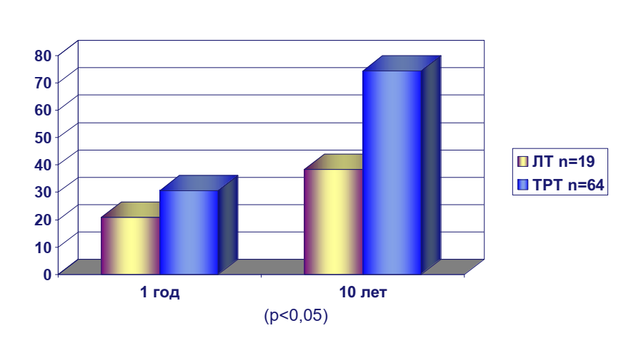
Result
Probability of complete regressions of desmoid soft tissue tumors after radiation (RT) and thermoradiotherapy (TRT)

Slide 27
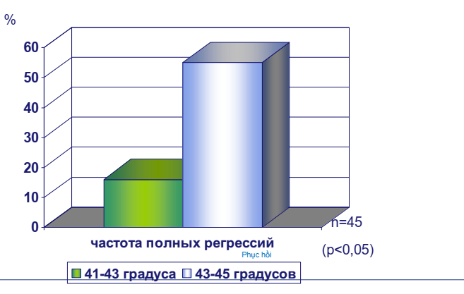
Result
The frequency of complete regression of desmoid fibroids depending on the temperature of overheating of the tumor at thermoradiotherapy

Slide 28
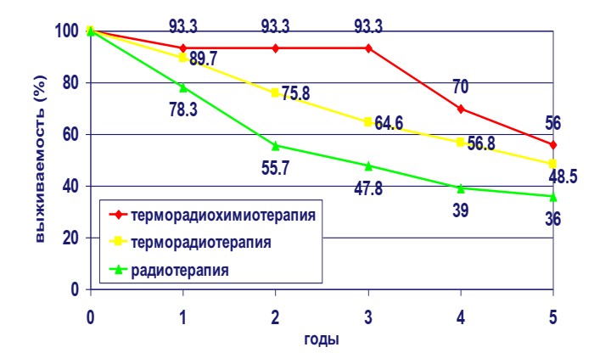
Result
Relapse-free survival of patients with soft tissue sarcomas depending on the method of treatment

Slide 29
References
Ivanov.S.M. Lecture 2018. Local hyperthermia in combined and complex treating patients malignant tumors.
Wust P, et al. (2002) Hyperthermia in combined treatment of cancer. Lancet Oncol 3(8):487–497.
Jha S, Sharma PK, Malviya R (2016) Hyperthermia: Role and Risk Factor for Cancer Treatment. Achiev Life Sci 10(2):161–167.
Cheung AY, Neyzari A (1984) Deep local hyperthermia for cancer therapy: External electromagnetic and ultrasound techniques. Cancer Res 44(10 SUPPL.).
Zheng Z., Zhang T. (2012) Local Hyperthermia in Oncology – To Choose or not to Choose? Sch Enviromental Sci:0–82.

Slide 30

Thank you for your attention!!

