Slide 1


Probability distribution of nucleons inside nuclei
Denis Lacroix
Summary
Where are the nucleons? Some motivations
Extracting the counting statistics in superfluid systems.
Some illustration inside and at the surface of the nucleus
Outlooks

Slide 2
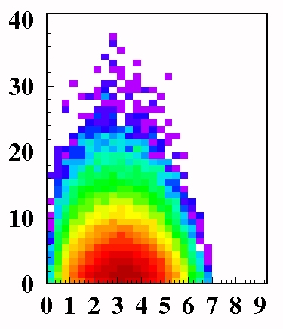

Phase-space exploration in cluster emission:
What are the important ingredients?
A simplified experiment: E_{Beam} ~ E _{Fermi}
proton
(A-1)
(A)
ε_{k}
(A-4)
Example :
p+208Pb α+X
at E_{B}=39 MeV
absorption
Cluster
formation
emission
E_{B}
r_{c}
Rule 1: cluster creation
Clusters are formed by taken randomly
nucleons in the Fermi sphere
Pb
α + Hg
A.S. Goldhaber, PLB74(1978).
(A_{c}=4)
α
ε _{k}
(A-Af)
Rule 1 defines
the total phase-space
for clusters
r_{c}
(A_{f})
ε_{k} (MeV)
Lacroix, van Lauwe, Durand, PRC 69, 054604 (2004)
Lacroix, Blideanou, Durand, PRC 71, 024601 (2005)
r_{c} (fm)

Slide 3

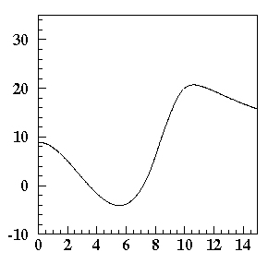





Rules for cluster emission
(A)
(A-A_{c})
(A_{c})
r_{c}
Rule 2: energy constraints
on cluster escape
+
Pb
α + Hg
I-Energy balance:
V_{A+Ac}(r_{c} ) MeV
ε_{k}
V_{B}
If not…
+
r_{c} (fm)
II-Barrier constraint:
+

Slide 4
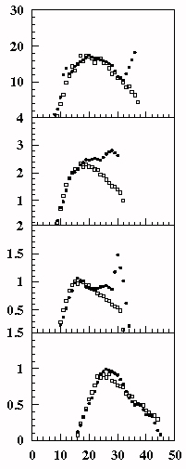
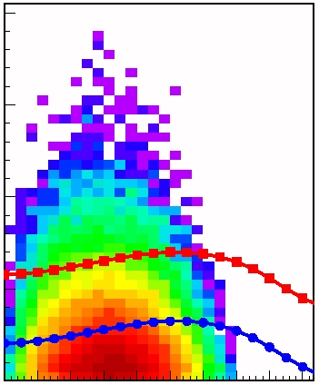
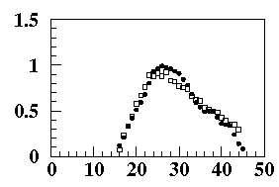
Naïve application of the rules
Application to p+208Pb α+X at E_{B}=39 MeV
Step 1: phase-space
proton
Step 2: Fix the potential
α
α
Step 3: apply
the constraint
ε_{k} (MeV)
V(r_{c} ) MeV
deuton
P(ε_{k}) (arb. units)
triton
r_{c} (fm)
r_{c} (fm)
Step 4: propagate the configuration
alpha
Data
P(ε_{k}) (arb. units)
Calc.
ε_{k} (MeV)
ε_{k} (MeV)

Slide 5
Some intermediate remarks
The probability to find 1, 2, … N particles in a given volume is a key ingredient
Participant
region
Incident
nucleon
Incident
nucleon
Incident
nucleon
d_{travel}
Minimal
distance
b
R_{inf}
b
b
Quasi-Target
Here, I used a simple semi-classical approximation
In general, we are interest in effects beyond the simple
phase-space sampling: like preformed “clustering”
of nucleons, long-range pairing correlations, …
Most often (at low excitations), we probe quantum probability distributions (waves)

Slide 6

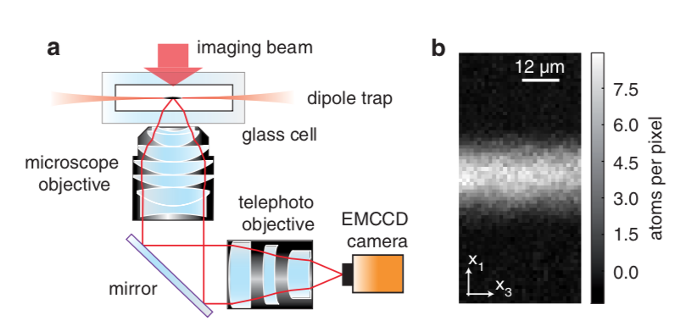
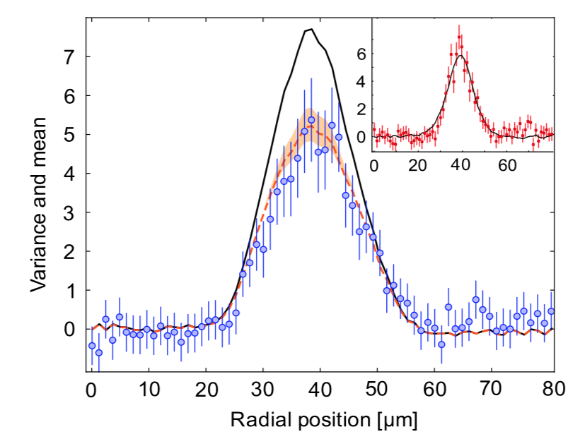
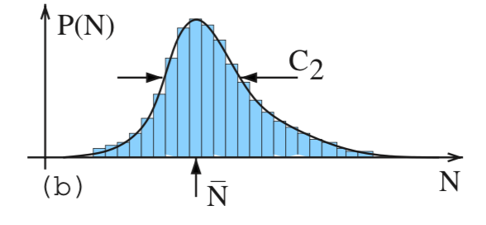
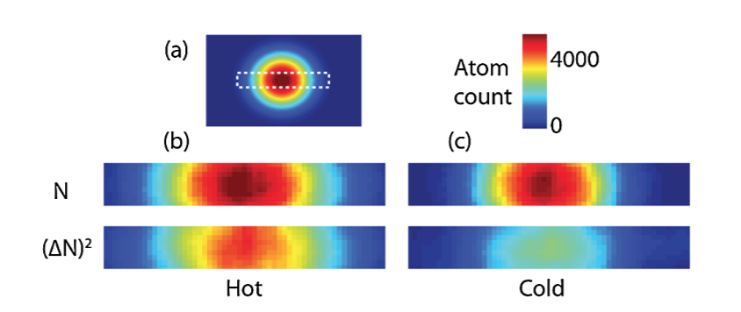
Stating the problem
Find the probability distribution (counting statistics) to find
1,2, … particles in a finite volume inside the nucleus
Our starting point: the nucleus wave-function
Volume
three-body
This is a generic problem in physics (Ion traps)
two-body
T. Muller et al, PRL 105, 040401 (2010)
one-body
T. Sanner et al, PRL 105, 040402 (2010)

Slide 7

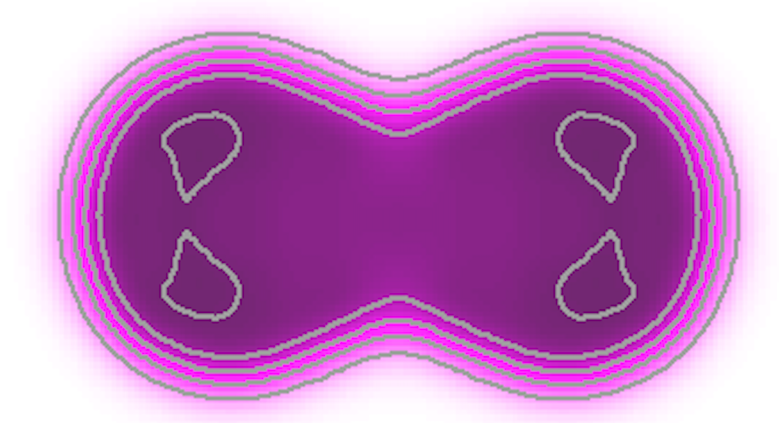
Stating the problem
Find the probability distribution (counting statistics) to find
1,2, … particles in a finite volume inside the nucleus
Our starting point: the nucleus wave-function
Volume
three-body
“Specificities” of nuclei:
two-body
-1-400 particles (mesoscopic systems )
-with short and long range correlations
beyond the Independent particle picture
one-body
But, I already saw this problem !!!
Particle number

Slide 8

Intuitive combinatorial solution to the problem
The independent particle case
Volume
Simple sampling of the probabilities
Make the sampling of each =0 or 1
with probability
But: The probabilities are not fully independent
(Pauli principle, correlations)
Note that if many particles contributes
The probability should be Gaussian (central limit theorem)

Slide 9
The more professional solution
Projection and the generating function of the probabilities
We introduce the operator that count particle in the volume
Volume
Then we can use the projector on a given number
of particles:
The trick
So imagine that:
and

Slide 10
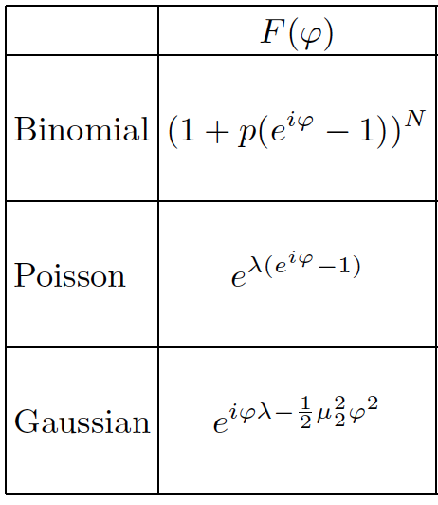
The more professional solution
Projection and the generating function of the probabilities
Volume
Making contact with probability language
Generating Function
Fourier
Inverse Fourier

Slide 11
Illustration
The independent pair approximation
Volume
Assume a BCS like state
Probability to occupy the pair
Probability to not occupy the pair
Probability to be in the
volume
Characteristic function
Sampling technique

Slide 12
Some extra difficulties
Pairs are not independent
(need a numerical estimate)
I use the Pfaffian technique
Volume
(Robledo, Bertsch, …)
Projection here
Total particle is not preserved
In a BCS and HFB theory
Requires 2 projections
Projection also here

Slide 13
Counting statistics inside the nucleus
Interparticle distance
Volume
Nature of the probabilities
Poisson
Gaussian
Pairing
Lacroix, Ayik, arxiv 1910.11096
Delta

Slide 14
Counting statistics at the surface of the nucleus
How pairing and projection affects surface probabilities ?
No pairing
BCS
BCS
+ proj
Lacroix, Ayik, arxiv 1910.11096

Slide 15
Conclusions
Knowing the probability to find particles (with or without correlations) is a useful tool
The technique can be applied to more complex wave-functions
(clustering, quarteting, ab-initio…)
Most probably, it can be connected also to short- and long-range correlations
Applications
Phase-space partition
of quantum correlated systems
and quantum clustering
Can also be useful
For reactions
Fission
Thank you !

