Slide 1
Radon
Background, capture, etc
Jose Busto
CPPM / Université d’Aix-Marseille
GDR Neutrino
Bordeaux 30 / 10 /2019

Slide 2
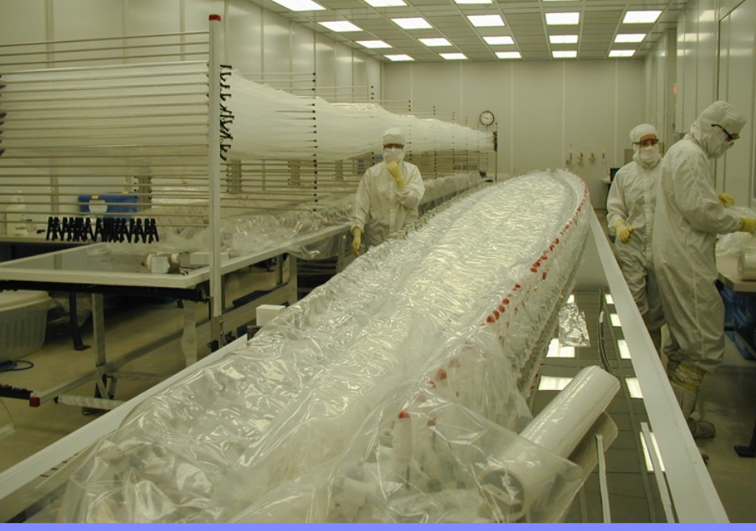
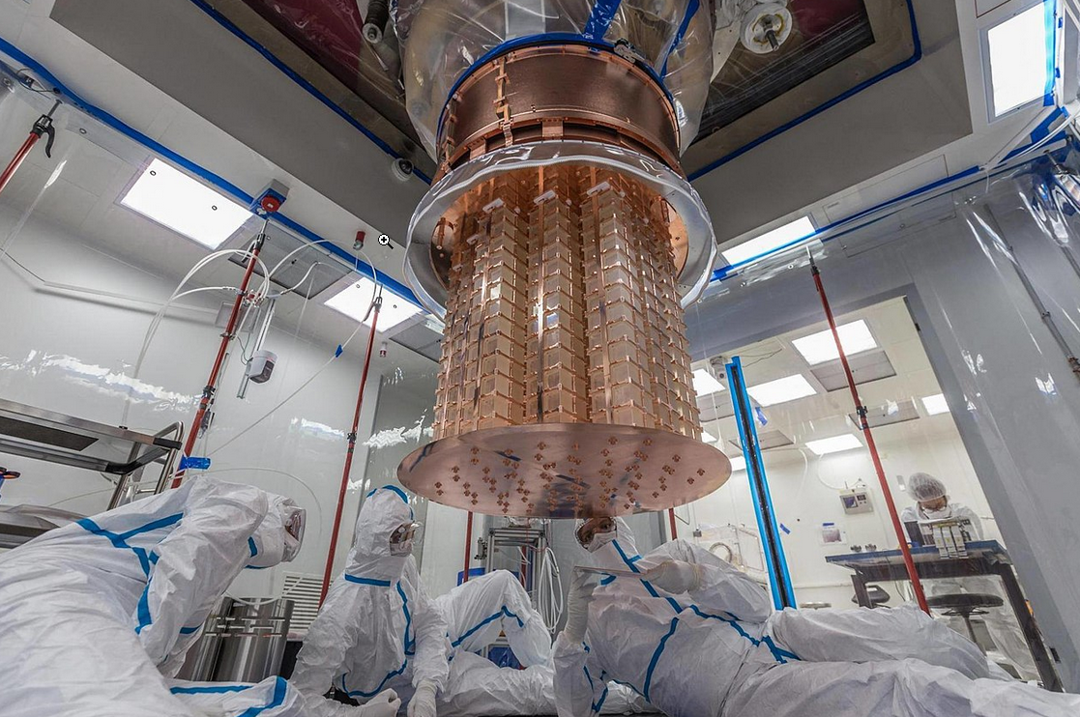
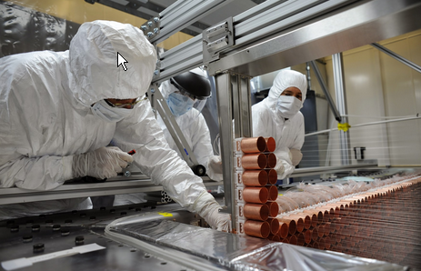
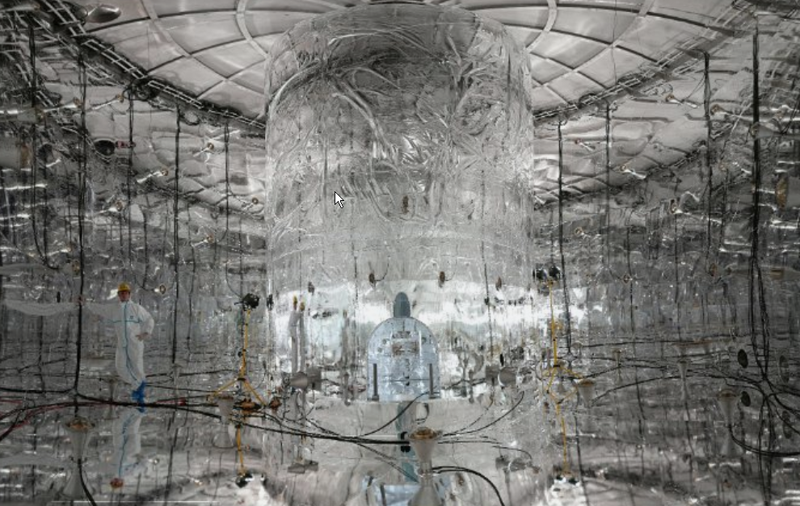
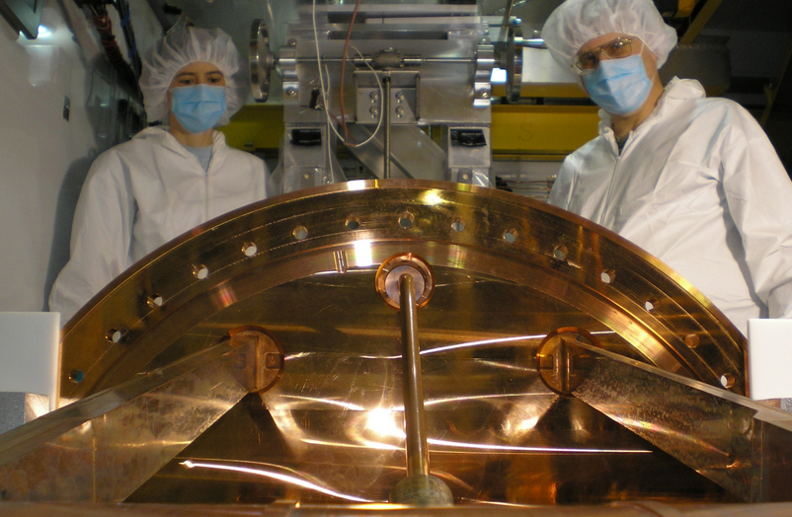
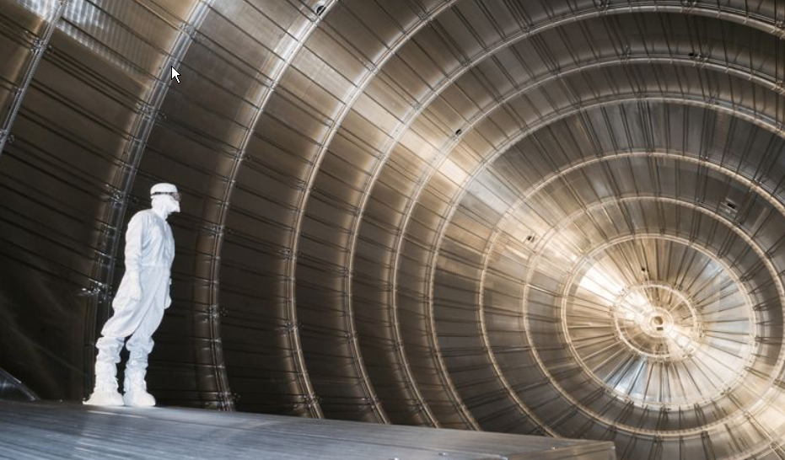
CUORE
SuperNEMO
BOREXINO
CUORE
GERDA
EXO
KATRIN
Radioactive background is the main limitation
of the sensitivity of Low Energy Neutrino Physics

Slide 3
Background sources
²³⁸U ( 4.4 x10⁹ y ), ²³²Th ( 1.4x10¹⁰ ), ⁴⁰K ( 1.2x10⁹ y) , …..
⁶⁰Co (5 y ), ¹³⁷Cs (30 y), ⁸⁵Kr (10.7 y), ⁶⁸Ge (271 d), ⁴²Ar (33 y) …
²¹⁰Pb (22 y), ²²²Rn (3.8 d), …
The background requirements depends on the signal, the technique, and change in the time
NEMO 2 < 20 mBq/kg (~ 1990)
NEMO 3 < 0.3 mBq/Kg (~ 2000)
SuperNEMO < 0.01 mBq/kg (~ 2010)
Ex :
Purity requirements
for NEMO ββ source
²³⁸U
Nec plus ultra on cooper purity :
Mitsubishi company Copper : > 0.1 μBq/kg
=> 1 atom of ²³⁸U in 10¹⁴ atoms of Cu

Slide 4
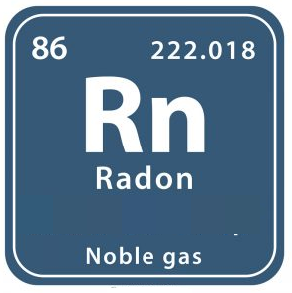
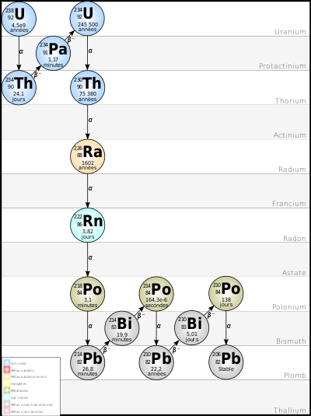
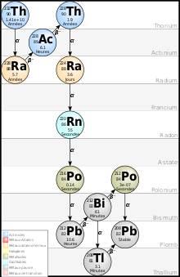
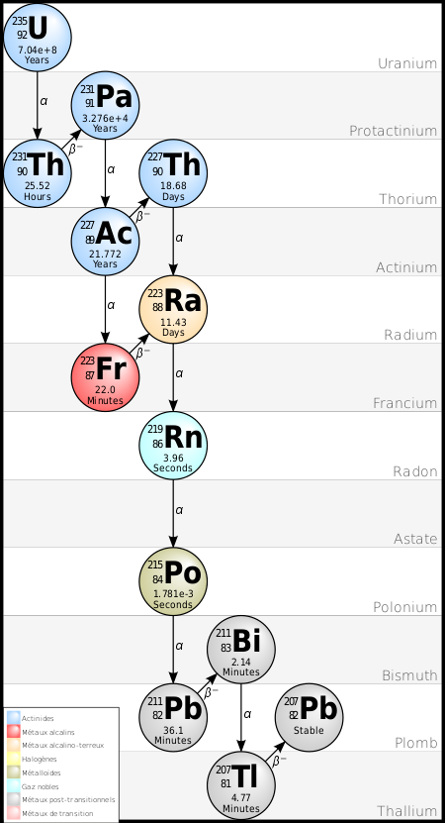
Radon is a noble, natural, radioactive gas produced in the U and Th chains.
*
²²²Rn (3.82 j)
²²⁰Rn (55 s)
²¹⁹Rn (3.96 s)

Slide 5
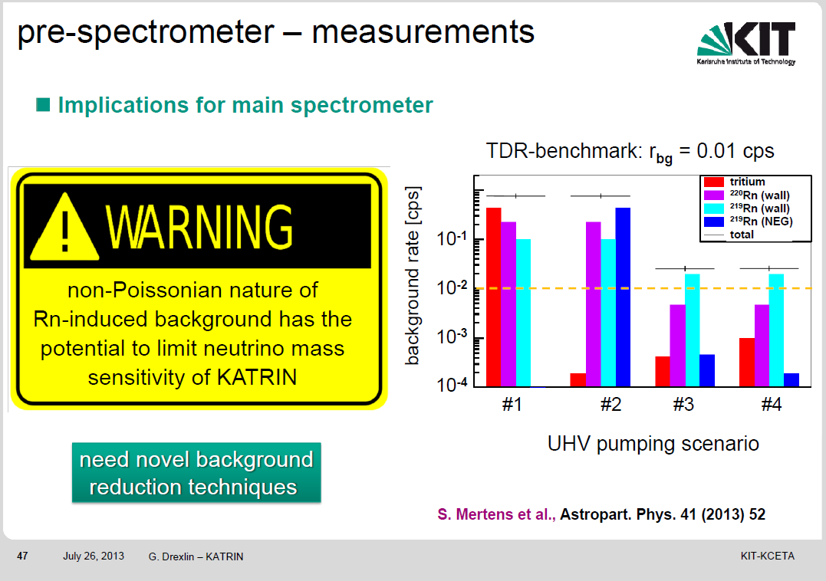

Slide 6









Radioactive gas
Radioactive background (²²²Rn)
$${}_{86}^{222}{Rn}$$
3.8 j
α
Q = 5.49 MeV
Q = 3.27 MeV
= 1.54 MeV
= 1.51 MeV
$${}_{84}^{218}{Po}$$
$${}_{84}^{214}{Po}$$
$${}_{84}^{210}{Po}$$
β⁻
138 j
3.1 m
164 μ
α
Q = 6.00 MeV
$${}_{83}^{214}{Bi}$$
β⁻
α
Q = 7.89 MeV
$${}_{83}^{210}{Bi}$$
Q = 1.2 MeV
19.8 m
α
Q = 5.3 MeV
β⁻
5 j
β⁻
$${}_{82}^{210}{Pb}$$
$${}_{82}^{214}{Pb}$$
Q = 17 keV
$${}_{82}^{206}{Pb}$$
26.8 m
Q = 672 keV
= 729 keV
22.3 a
α | 5 à 8 MeV
β | ≤ 3.27 MeV
γ | ≤ 2.20 MeV
ββ decay

Slide 7









Radioactive gas
Two components of background (²²²Rn)
uncorrelated
(history of the materials - surface contamination)
direct
$${}_{86}^{222}{Rn}$$
3.8 j
α
Q = 5.49 MeV
Q = 3.27 MeV
= 1.54 MeV
= 1.51 MeV
$${}_{84}^{218}{Po}$$
$${}_{84}^{214}{Po}$$
$${}_{84}^{210}{Po}$$
β⁻
138 j
3.1 m
164 μ
α
Q = 6.00 MeV
$${}_{83}^{214}{Bi}$$
β⁻
Q = 7.89 MeV
$${}_{83}^{210}{Bi}$$
Q = 1.2 MeV
Q = 5.3 MeV
19.8 m
α
α
β⁻
5 j
$${}_{82}^{214}{Pb}$$
β⁻
$${}_{82}^{210}{Pb}$$
Q = 17 keV
$${}_{82}^{206}{Pb}$$
26.8 m
Q = 672 keV
= 729 keV
22.3 a
Very high intrinsic activity
Ex : SuperNEMO gas : < 150 μBq/m³
=> 1 Rn atom in 10²⁴ gaz atoms

Slide 8
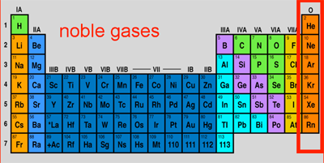
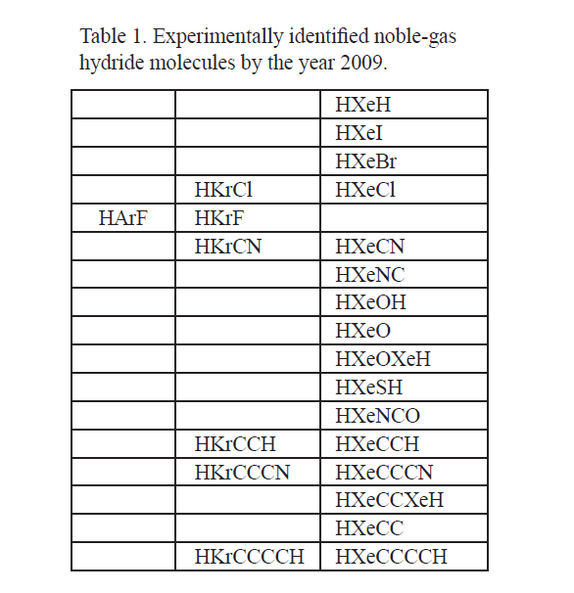
Radon is a noble gas (the heaviest)
Noble gas
Noble gases
Full outer shell ( 8 e⁻)
=> no valence electrons
=> very small reactivity
Nevertheless
Possible compounds for heavier noble elements
Kr, Xe
Rn must interact with matter better than Xe
However radon is a pure radioactive short period gas
= > poor knowledge of chemical properties
Chemistry of noble gases is possible but very poor
Very difficult capture by chemisorption

Slide 9
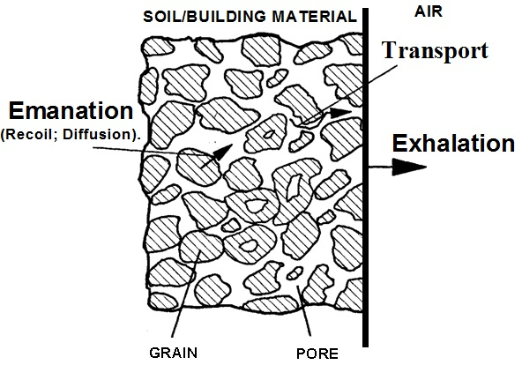
Emanation - Exalation
²²⁶Ra → ²²²Rn
He
Ra
He +EthOH
Emanation dans :
He pur (2)
He + 5% éthanol (3)
Emanation dans
He pur (2)
He + 5% eau (3)
Dependence on : porosity,
: surface roughness
: temperature
: surrounding gas *
: etc

Slide 10
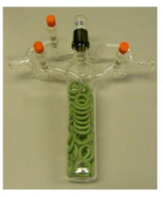
Emanation - Exalation
Emanation chamber 700 L (N₂)
CENBG
Emanation chamber few cm³ (vacuum)
MPK - Heidelberg
Often the emanation is measured in vacuum or N₂, He
➔ Very rarely the emanation is measured in the detection gas (Xe)

Slide 11
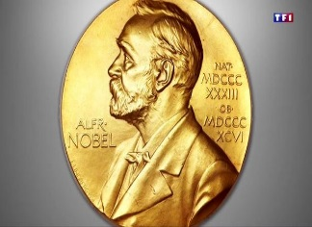
Emanation - Exalation

Slide 12
Nobel gases capture
Capture mainly by physisorption (adsorption)
Capture on surface
Irregularities in the surface generate potential wells (Van der Waals)
C
C
If Φ is much smaller than kT, the Rn atom is not trapped (gas phase)
If Φ is much larger than kT, the Rn atom is trapped (solid phase)
C
C
Equilibrium adsorption - desorption
=> Not permanent capture
=> Slow down the movement of
the atoms
Gas phase
Solid phase
If the Rn disintegrates in solid phase,
it will be definitively captured
t

Slide 13
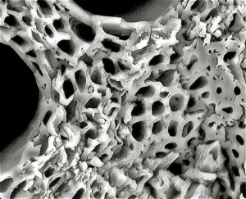
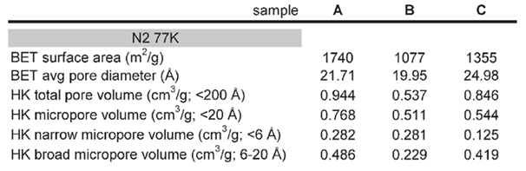
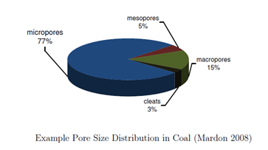
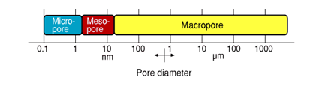
How to increase the capture capacity
- large surface area => high porosity
- reduced the temperature
Typical porosity of active charcoals :
Enormous surface area
of active charcoal
The effective surface area is distributed
between different porous size

Slide 14
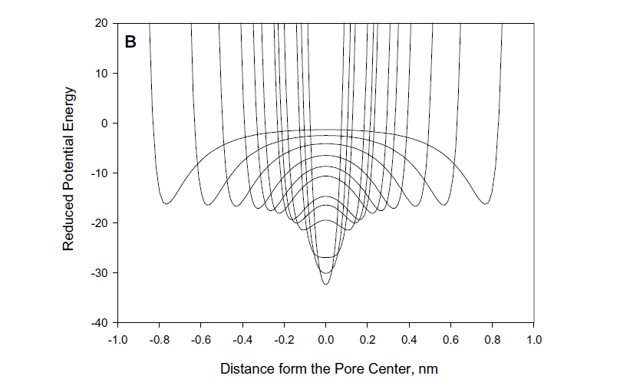
The size and the shape of the pores are also important parameters
D_{a}
D_{a}
Enhancement of the adsorption energy in a slit
shaped pore of various widths
D_{a}
D_{p}
D_{p}
Too narrow
pore
Too large pore
OK
Not very large, not very small, need for optimization

Slide 15
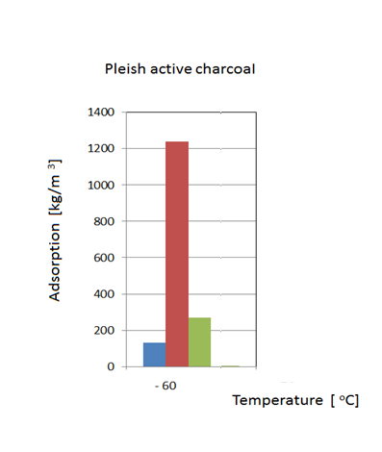
Adsorption competition
Atome | Atom. Radius (nm) Van der Waals
He | 0.140
N | 0.150
CF4 | 0.155
Ar | 0.188
Kr | 0.202
Xe | 0.216
Rn | 0.220
In Xe experiments, very high competition between
carrier gas and radon
Rn adsorption on active charcoal in CF₄, He and N₂
CF₄ 0.107 nm
He 0.032 nm
N₂ 0.075 nm
Rn 0.133 nm
Radon capture in Xenon is a big challenge

Slide 16
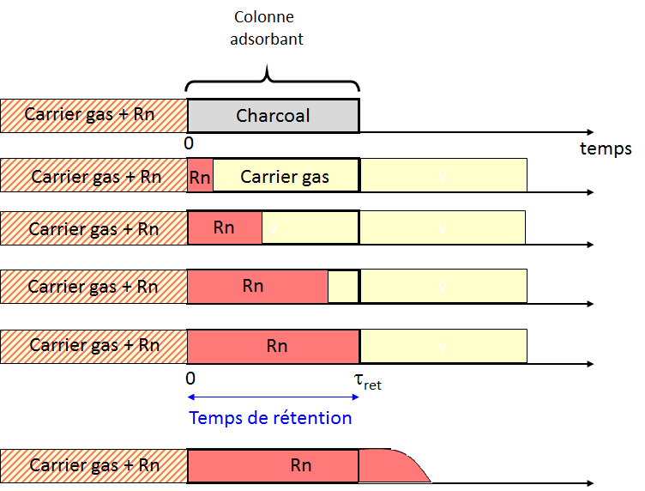
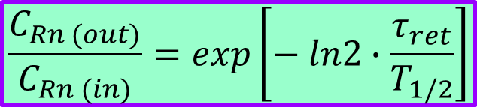
Radon removal capacity
Radon capture by chromatography
Velocity of carrier > Velocity of Rn
split of the two gas components
As long as t < t _{ret} ,no radon at the exit of the column
Réduction de la concentration de Rn
C_{Rn}(in)
Charcoal
C_{Rn}(out)
$$\frac{C_{Rn (out)}}{C_{Rn (in)}}=exp\left[− ln2∙\frac{τ_{ret}}{T_{1/2}}\right]$$
T_{1/2} = 3.8 j

Slide 17
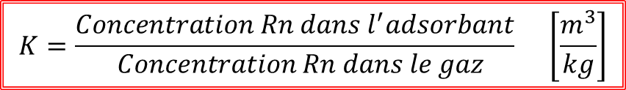
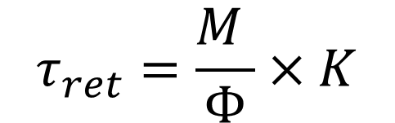
Adsorption coefficient (K factor)
$$K=\frac{Concentration Rn dans l^{′}adsorbant}{ Concentration Rn dans le gaz} \left[\frac{m^{3}}{kg}\right]$$
Retention time v.s. adsorption capacity
$$τ_{ret}=\frac{M }{Φ}×K$$
M : adsorbent mass
Φ : gaz flow
K : Adsortion Coefficient
Chromatographie =>
Microscopic properties of the adsorbent (porosité)
Température
Pressure
Chemical composition
K depends on

Slide 18
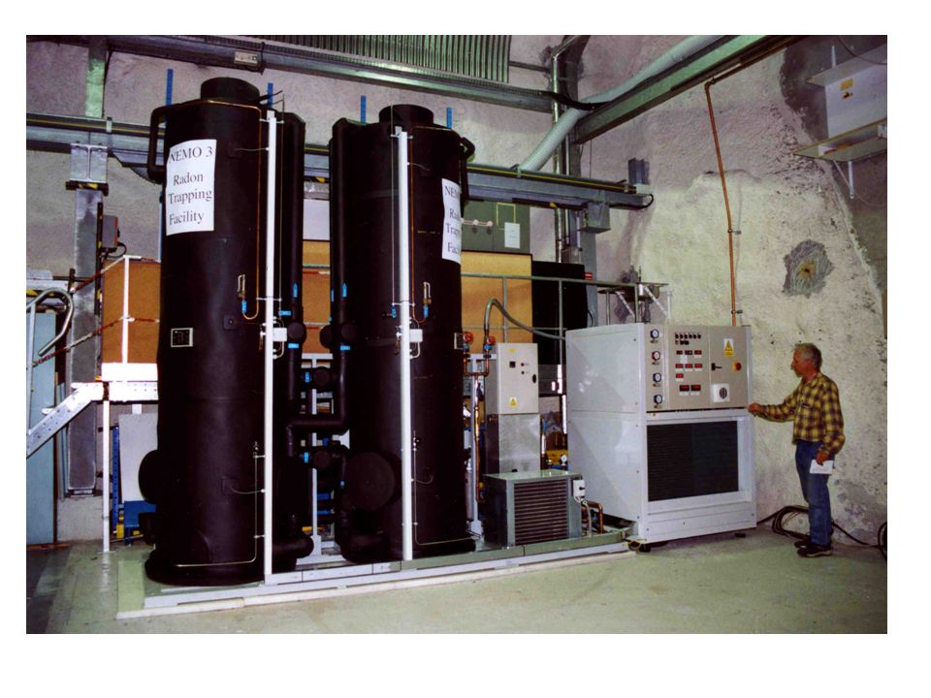
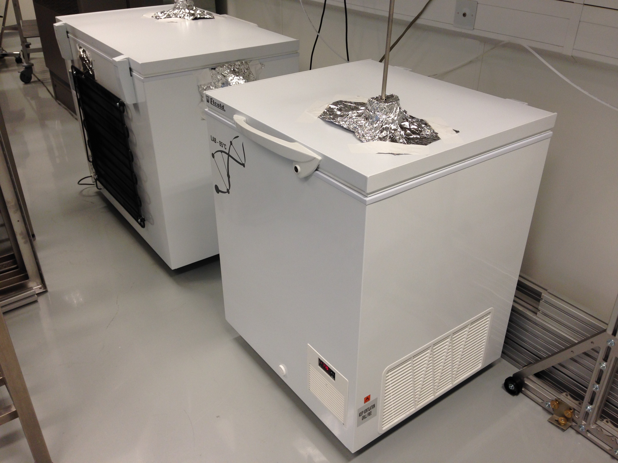
Modane Antiradon facility
Antiradon facilities
2 x 500 kg charcoal (only one used)
Flux : 150 m3/h air
Activity of ²²²Rn :
Before facility = 15 Bq/m³
After facility < 15 mBq/m³
SuperNEMO antiradon trap
1.5 kg charcoal @ - 50°C
0.5 kg charcoal @ - 80°C
Flux : 1 m3/h N2
Activity of ²²²Rn :
Before facility = 1000 μBq/m³
After facility = 20 ±12 μBq/m³
- 50°C
- 80°C

Slide 19
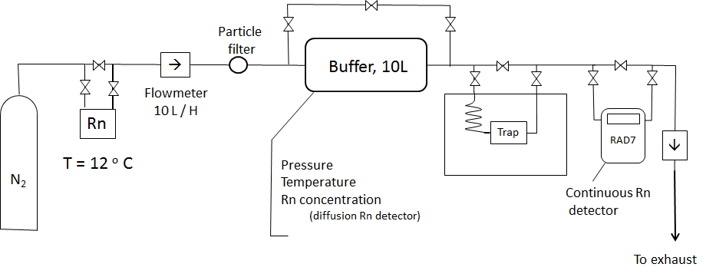
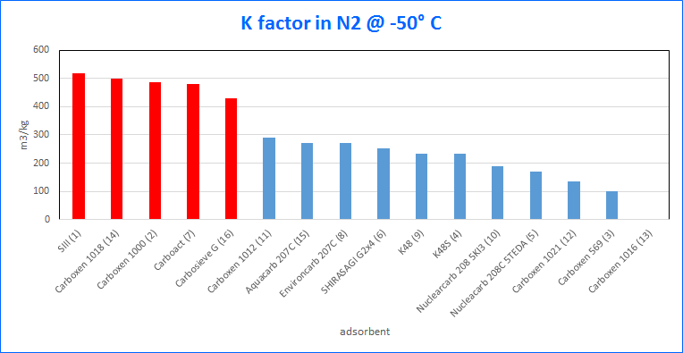
Radon adsorption facility (CPPM)
High density of porous 0.5 - 0.7 nm / high sulphur
- Actif Charcoals
- Carbon Molecular Sieves
- Metal Organic Framework
- Aerogels
- Zeolites
- …
adsorbents
N₂ from 20 to -50 °C

Slide 20
Conclusion
Rn is one of the main background sources in physics and astrophysics experiments at low-energy particles.
Significant progress has been achieved (emanation, capture,...) but many questions remains unanswereded
Difficult and long measurements (physical-chemistry, materials, etc.)
=> Need accurate metrology.
=> Coordination of knowledge (interdisciplinarity)
In the future, requirements for very high purity will be strongly increasing
=> We need new ideas, and techniques

