Slide 1
Lecture 2: Gauge Symmetry
I. Abelian gauge symmetry
II. SU(N) groups
III. Non-Abelian gauge symmetry

Slide 2
Abelian gauge symmetry
Let us start with Dirac Lagrangian of a free fermion field
This Lagrangian is symmetric with respect to a global U(1) transformation given by
Now we consider local transformations:

Slide 3
Replacing the partial derivative by the covariant derivative

Slide 4
The gauge field is massless because the mass term is not gauge invariant.
The (minimal) coupling of Ψ to the gauge field is contained in the covariant derivative and is determined by its transformation property under the gauge symmetry.
The gauge field does not have the self-coupling because the gauge field does not carry a U(1) charge.

Slide 5
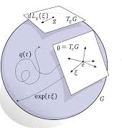
SU(N) groups
A Lie group $G$ is a continuous group that all elements $g∈G$ are parameterized by a set of continuous parameters
Representation of the group
In a neighbourhood of the identity element

Slide 6
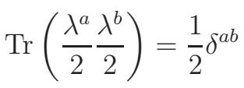
Group multiplication allows us to obtain any other finite element of the group as
SU(N) groups are the group of $N×N$ unitary matrices with unit determinant
Matrices of generators are normalized as

Slide 7
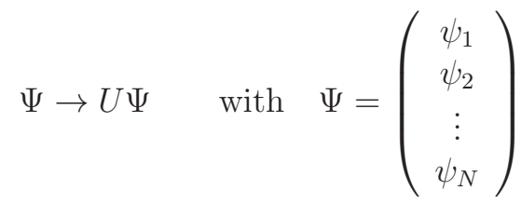
Representation of SU(N) groups
One representation of $SU\left(N\right)$ is the fundamental or $N−$ dimensional representation
Another $N−$ dimensional representation of $SU\left(N\right)$ is the antifundamental or conjugate representation

Slide 8
$N^{2}−1$ dimensional adjoint representation of $SU\left(N\right)$
Trivial (one dimensional) representation of $SU\left(N\right)$

Slide 9
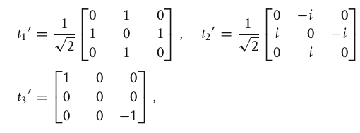
SU(2) groups
J=1/2 representation
J=1 representation

Slide 10
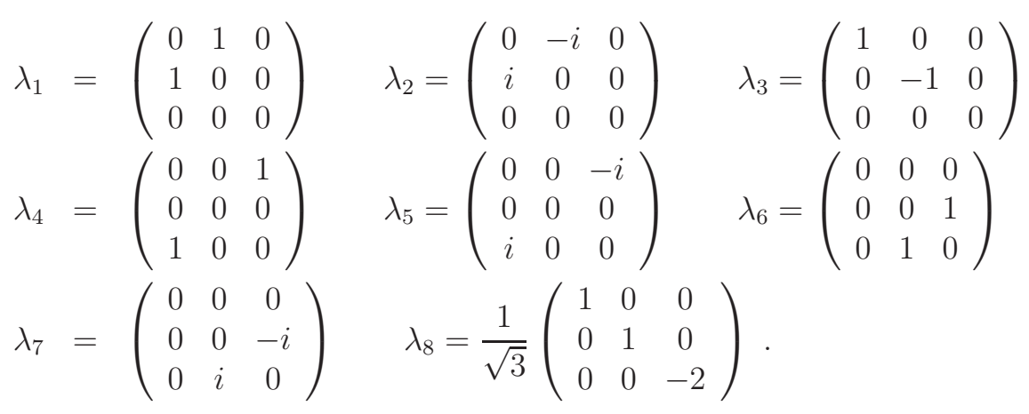
SU(3) groups
Fundamental representation

Slide 11
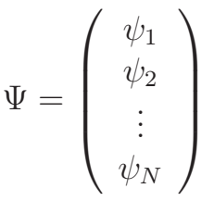
Non-Abelian gauge symmetry
Let us start with Dirac Lagrangian of a free fermion field, which is invariant under global $SU\left(N\right)$ transformations
Now we consider local transformations:

Slide 12
The kinetic Lagrangian for the gauge fields

Slide 13
The gauge fields are massless, the coupling of Ψ to the gauge field is contained in the covariant derivative and is determined by its transformation property under the non-abelian gauge symmetry.
The number of the gauge fields is equal to the number of generators of non-Abelian gauge symmetry.
The gauge fields have the self-couplings.

