Slide 1

Neutrinos: What the CMB Can Show, and What Other Experiments Can Show the CMB
Towards Coordination of the European CMB Programme
Paris, September 13th, 2019
Massimiliano Lattanzi
INFN, sezione di Ferrara

Slide 2
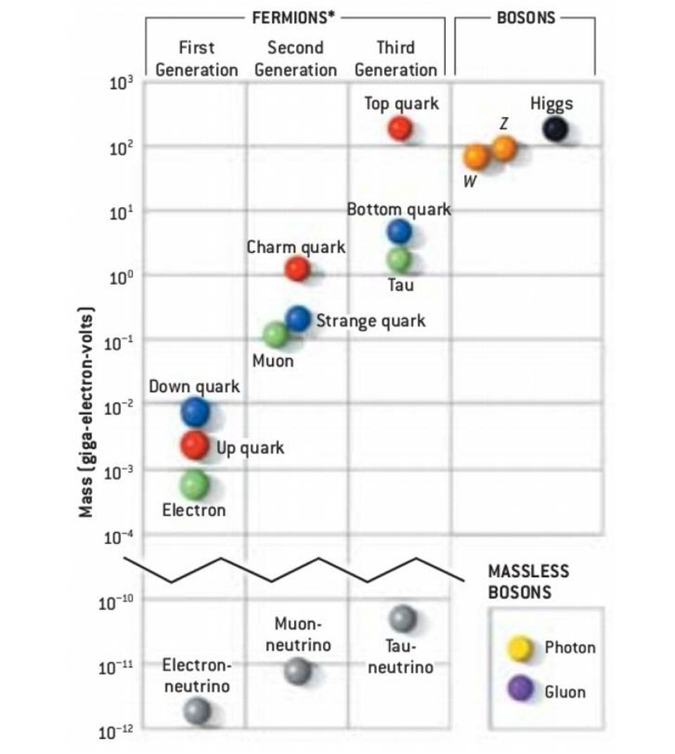
Neutrinos are part of the standard model of particle physics….
… however their properties might be related to physics beyond the SM
Many open questions to date:
absolute mass scale?
origin of (small) masses?
origin of mixing pattern?
mass hierarchy?
Majorana or Dirac?
CP violation?
?
?
?
Image credit: G. Kane

Slide 3
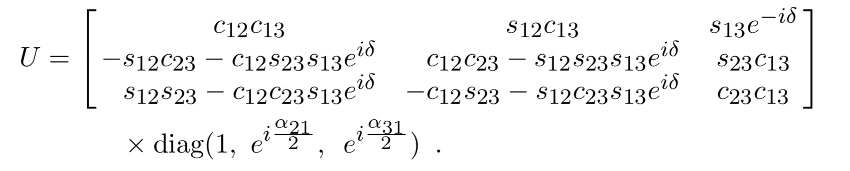
Three-neutrino mixing
Neutrino flavour eigenstates are superpositions of the mass eigenstates
PMNS matrix
3 mixing angles
1 CP-violating Dirac phase
2 CP-violating Majorana phases

Slide 4
Three-neutrino mixing
Neutrino flavour eigenstates are superpositions of the mass eigenstates
PMNS matrix
3 mixing angles
1 CP-violating Dirac phase
2 CP-violating Majorana phases
+ 3 masses (1 mass scale, 2 mass differences)

Slide 5
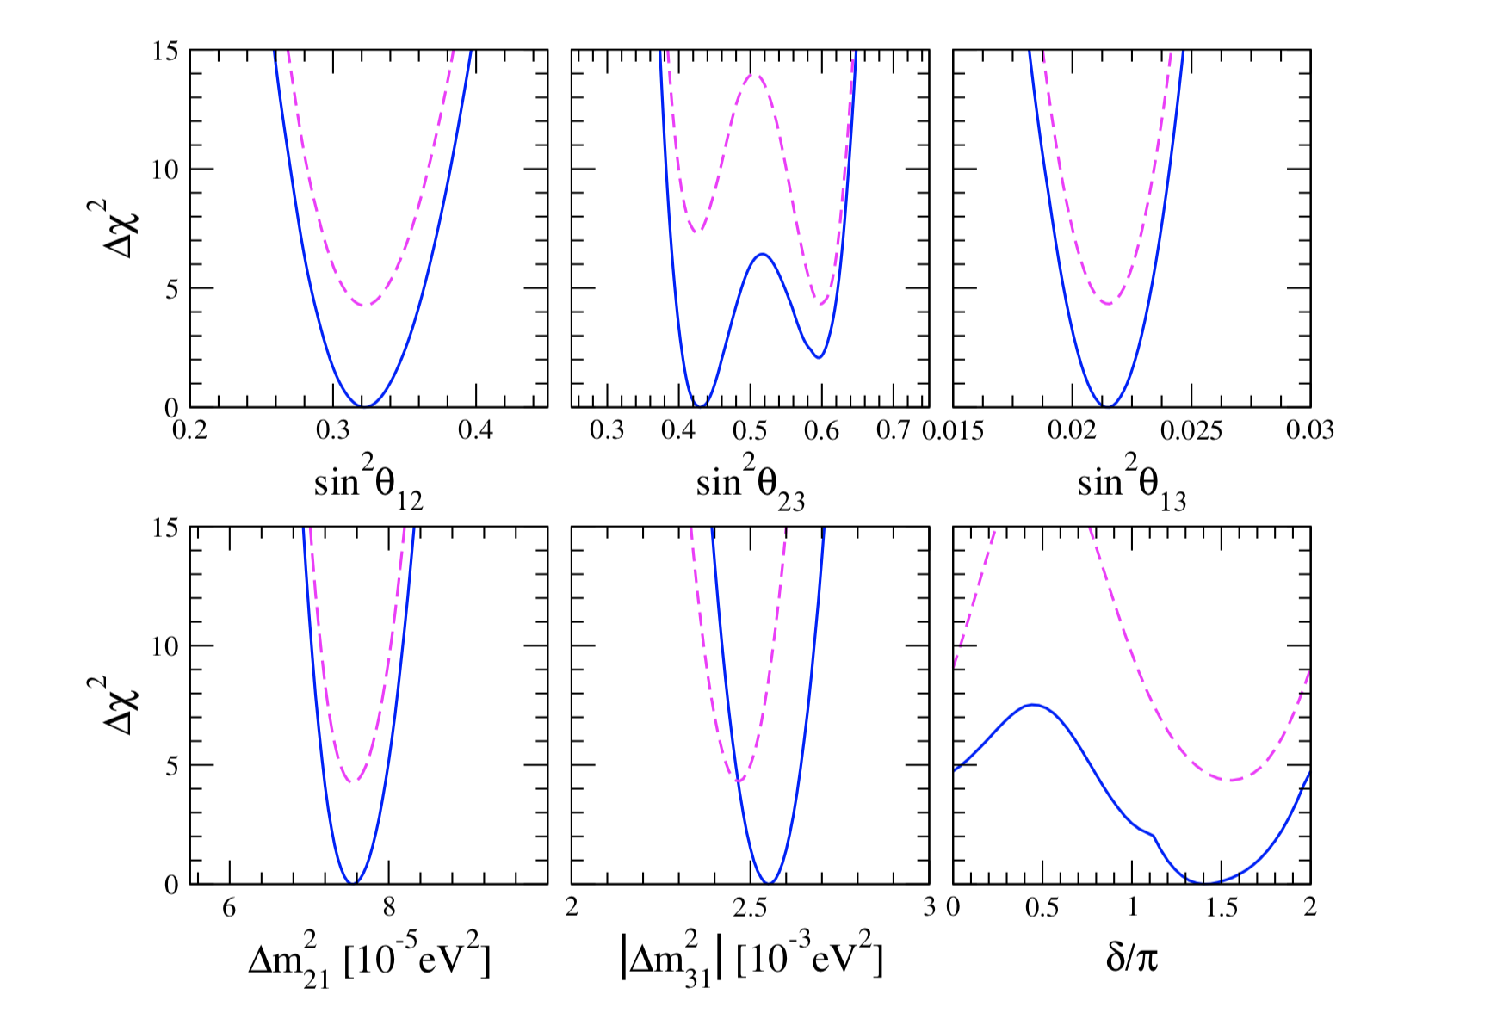
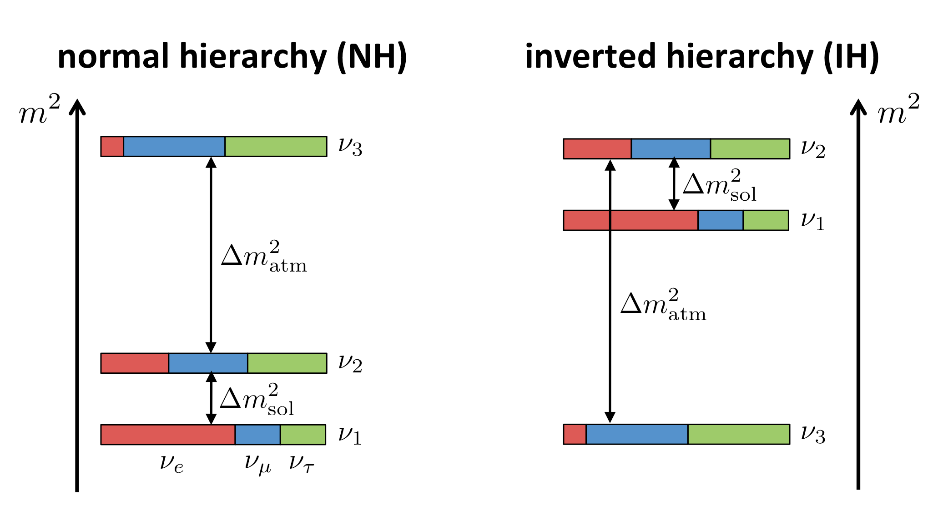
Gariazzo et al. 2018; see also Capozzi et al. 2018; Esteban et al. 2018
vs.
Σm_{ν} > 0.06 eV
Σm_{ν} > 0.10 eV

Slide 6
The absolute mass scale can be measured through:
- tritium beta decay
< 2.05 – 2.3 eV @ 95%CL
- neutrinoless double beta decay
< 0.06 – 0.16 eV @ 90%CL
- cosmological observations
< 0.12 – 0.24 eV @ 95%CL
(Troisk-Mainz)
(Kamland-Zen)
(Planck+…)

Slide 7
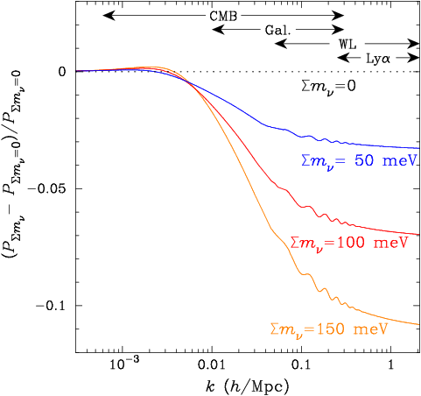
In a Universe with neutrinos, small-scale density perturbations are suppressed due to collisionless damping (free-streaming).
Neutrinos are collisionless and have large thermal velocities (they have been relativistic for most of the history of the Universe).
They do not cluster below a critical scale, the free-streaming length (corresponding to the scale of the horizon at the time of the nonrelativistic transition).
Abazajian et al.
At small scales:
In principle the effect can be seen directly in the matter power spectrum
There are issues however: non-linearities, scale-dependent bias……

Slide 8
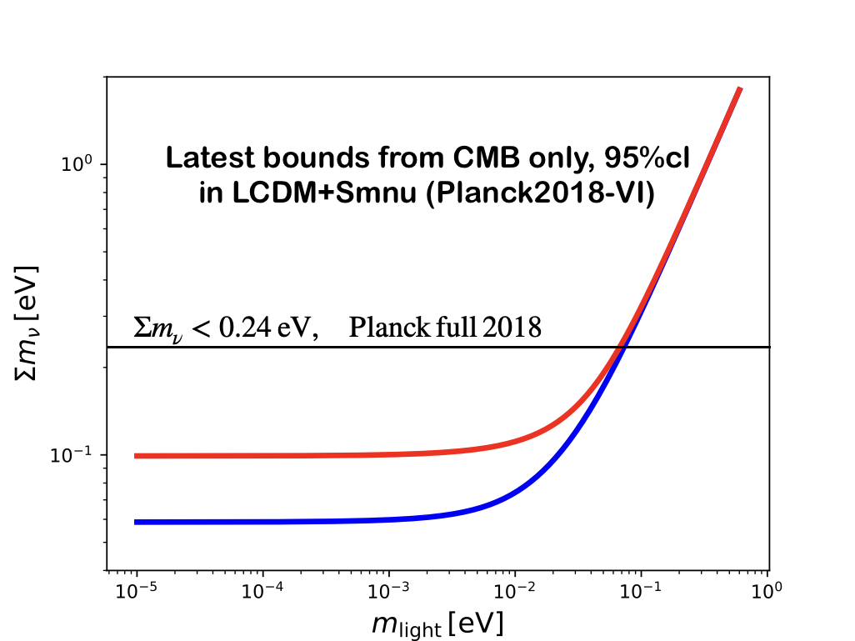
Inverted
Normal

Slide 9
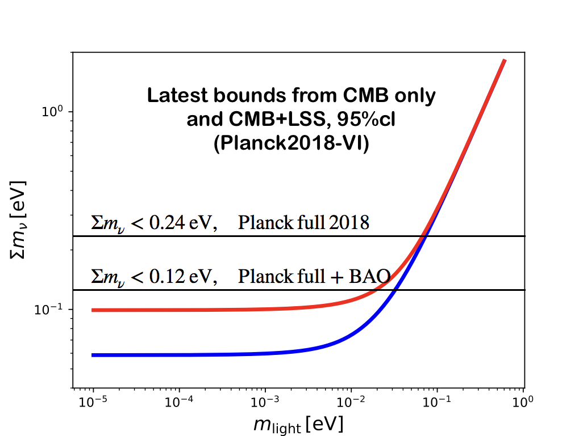

Slide 10
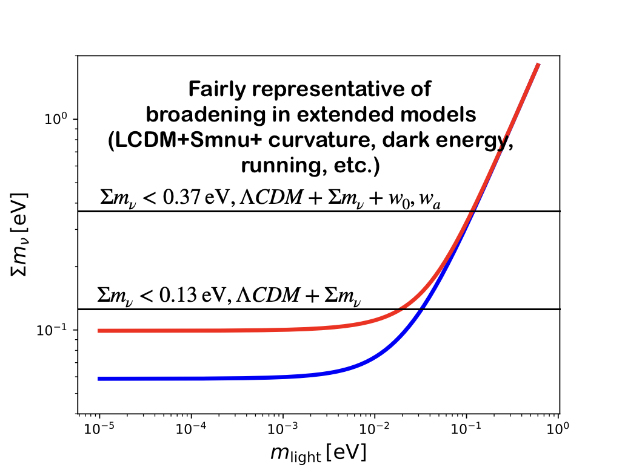

Slide 11
To increase sensitivity to neutrino masses AND reduce model dependency, we need:
Precise measurement of the CMB lensing signal (both from 2- and 4-point correlation functions)
Cosmic variance limited measurement of the reionization optical depth
other CMB probes of structure formation, e.g. SZ galaxy clusters
+ non CMB information
BAO information to reduce geometrical degeneracies
Full shape of the matter power spectrum
CMB/LSS cross correlations

Slide 12
SO Forecasts for neutrino mass bounds
CMB lensing from SO combined with DESI BAO
Sunyaev-Zeldovich cluster counts from SO calibrated with LSST weak lensing
thermal SZ distortion maps from SO combined with DESI BAO
legacy SO dataset combined with cosmic-variance-limited measurement of reionization optical depth
SO collaboration, 2018

Slide 13
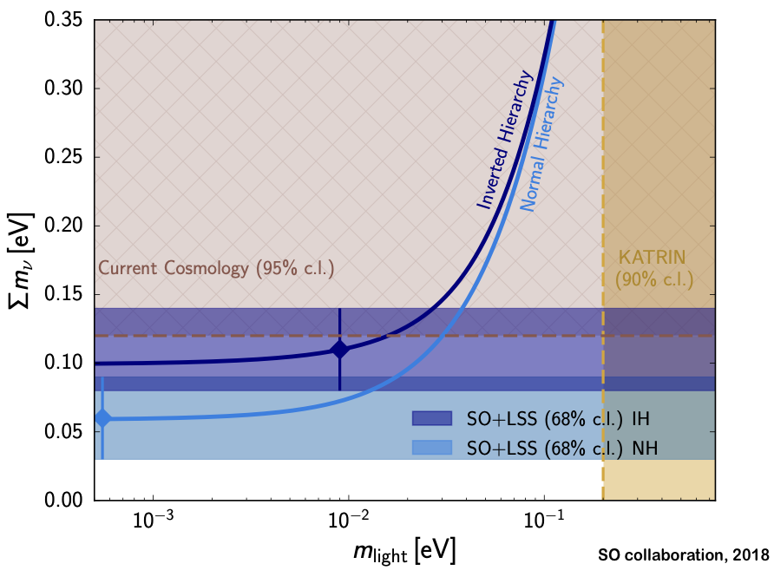

Slide 14
Credit: M. Hazumi

Slide 15
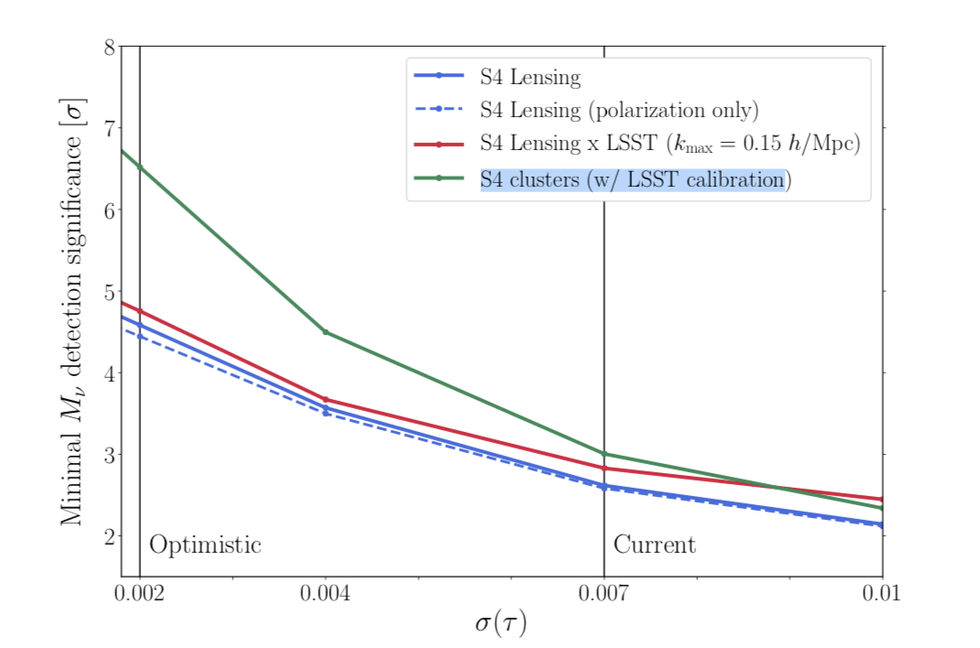

Slide 16
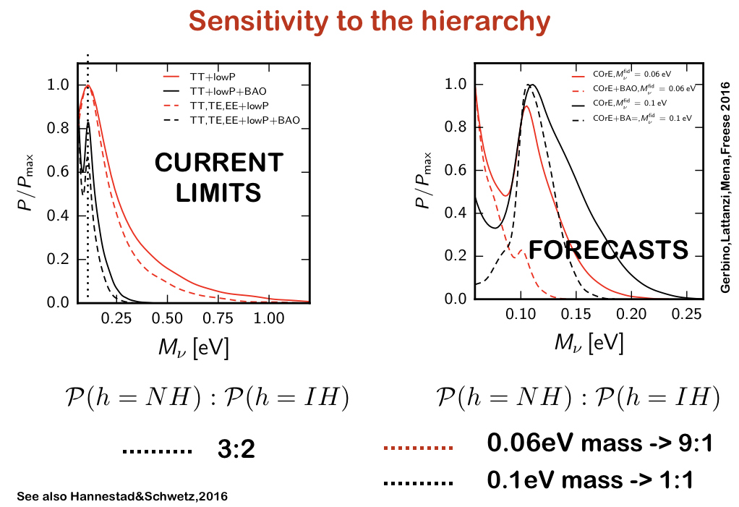

Slide 17
The absolute mass scale can be measured through:
- tritium beta decay
< 2.05 – 2.3 eV @ 95%CL
- neutrinoless double beta decay
< 0.06 – 0.16 eV @ 90%CL
- cosmological observations
< 0.12 – 0.24 eV @ 95%CL
(Troisk-Mainz)
(Kamland-Zen)
(Planck+…)

Slide 18
Complementarity with laboratory probes
IH
Gerbino & Lattanzi 2018

Slide 19
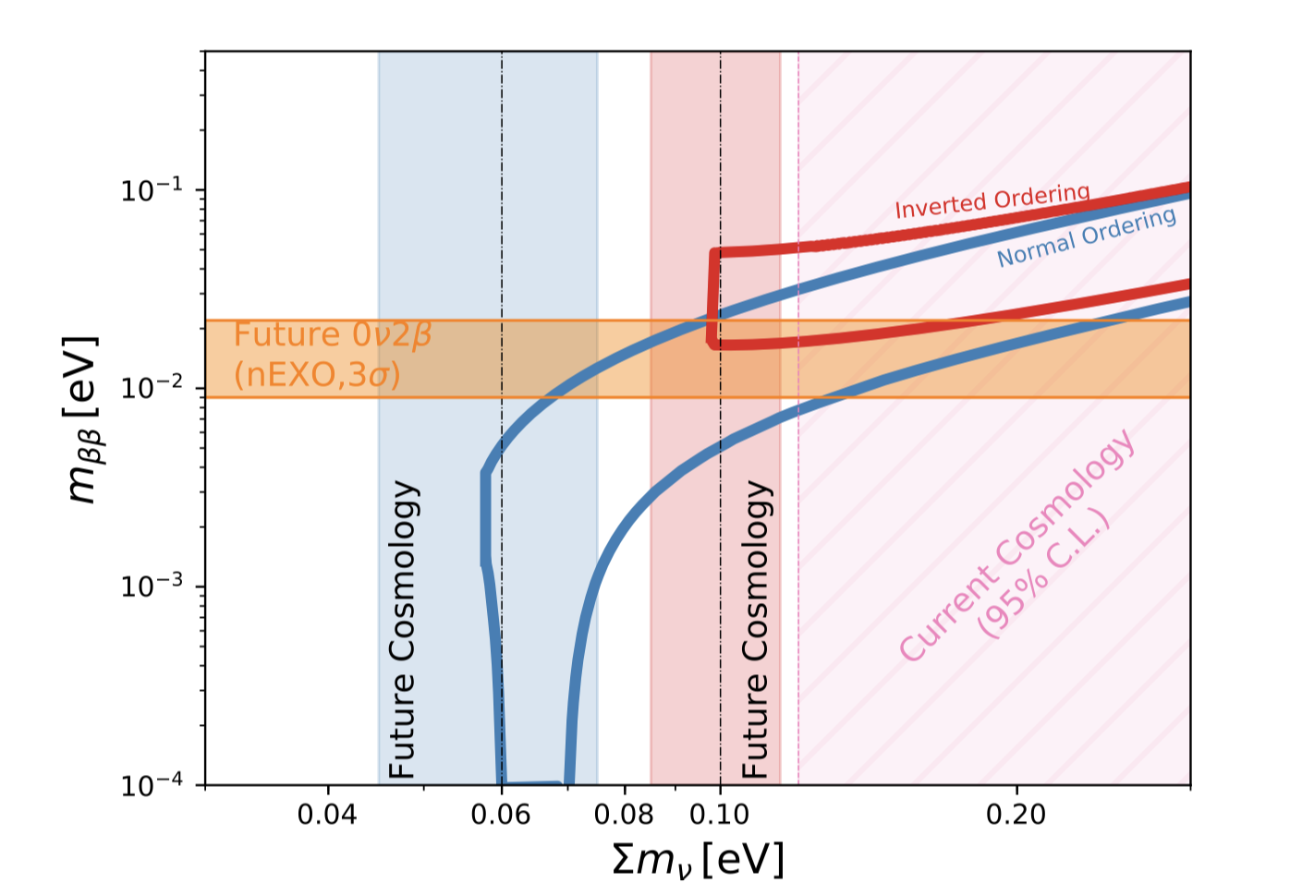
Complementarity with laboratory probes
S4 collaboration, 2019

Slide 20
Several interesting scenarios are possible (I am being sketchy here):
Concordant signals from both cosmology and 0nu2b. Neutrinos are Majorana. Hierarchy might be determined or not.
Signal from cosmology with Mnu<0.1 eV, no signal from 0nu2b. Hierarchy is normal. Majorana/Dirac undetermined.
Signal from cosmology with Mnu > 0.1 eV, no signal from 0nu2b. Neutrinos are Dirac. Hierarchy is undetermined.
No signal from cosmology, signal from 0nu2b. OR we see discordant signals. Neutrinos are Majorana. New physics? E.g. BSM neutrino interactions?

Slide 21
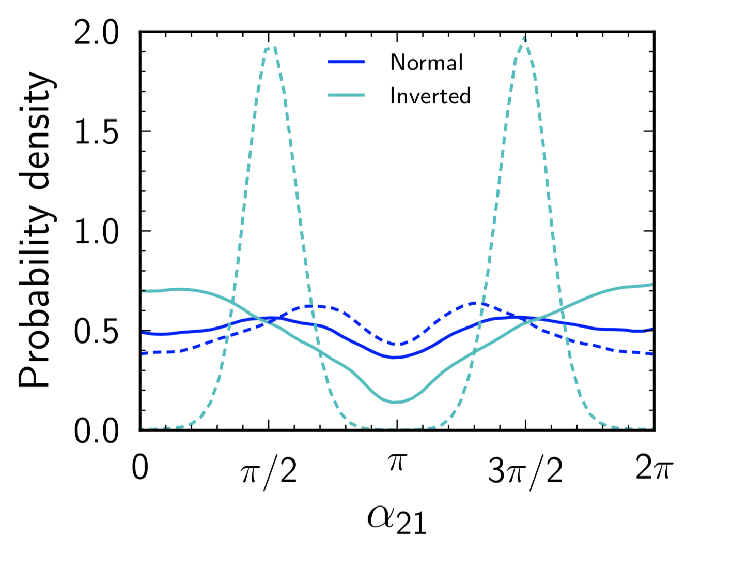
Measuring the Majorana phases?
Next-gen cosmo+0nu2b
Gerbino, ML, Melchiorri 2017

Slide 22
Effective number of relativistic species
Planck 2018 + BAO: Neff = 2.99+/- 0.17
Energy density in units of “standard” neutrino density
(thermally distributed with T=1.9 K)
Due to non-instantaneous decoupling, the standard expectation is N_{eff} = 3.045 (updated calculation from de Salas & Pastor 2016; see also Dolgov 2002, Mangano et al. 2005)
(note I am showing ~ l⁴ C_{l}, not l² C_{l})

Slide 23
Primary CMB temperature and polarization power spectra from SO
SO collaboration, 2018

Slide 24
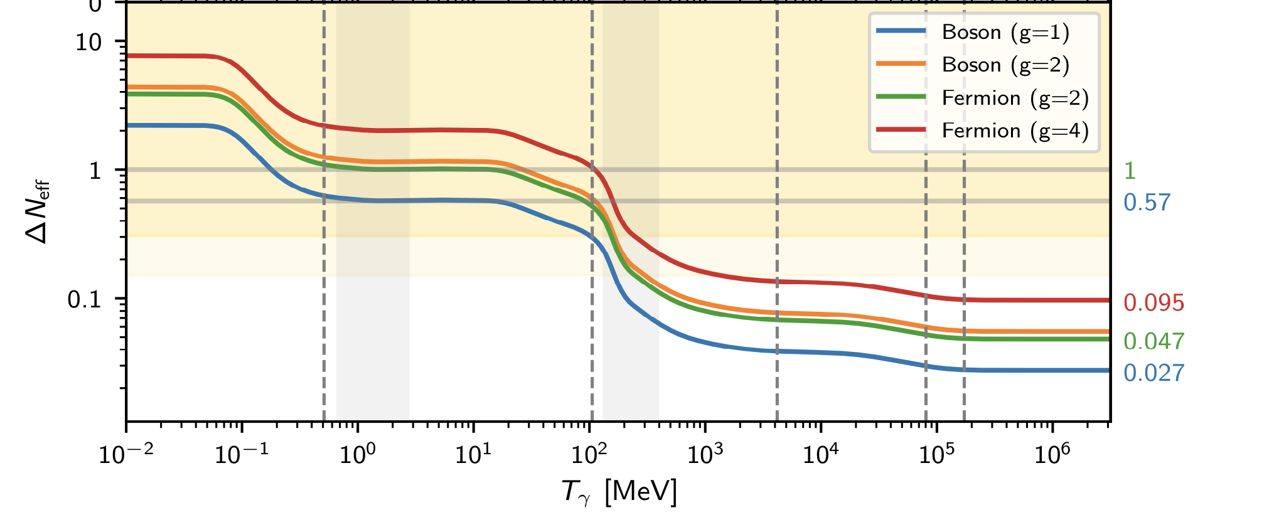
Decoupling temperature of
relativistic species
QCD Phase
Trans.
Neutrino
decoupling
An extra neutrino that was in thermal equilibrium in the early Universe should decouple at T>~100 MeV
Planck collaboration, VI 2018

Slide 25
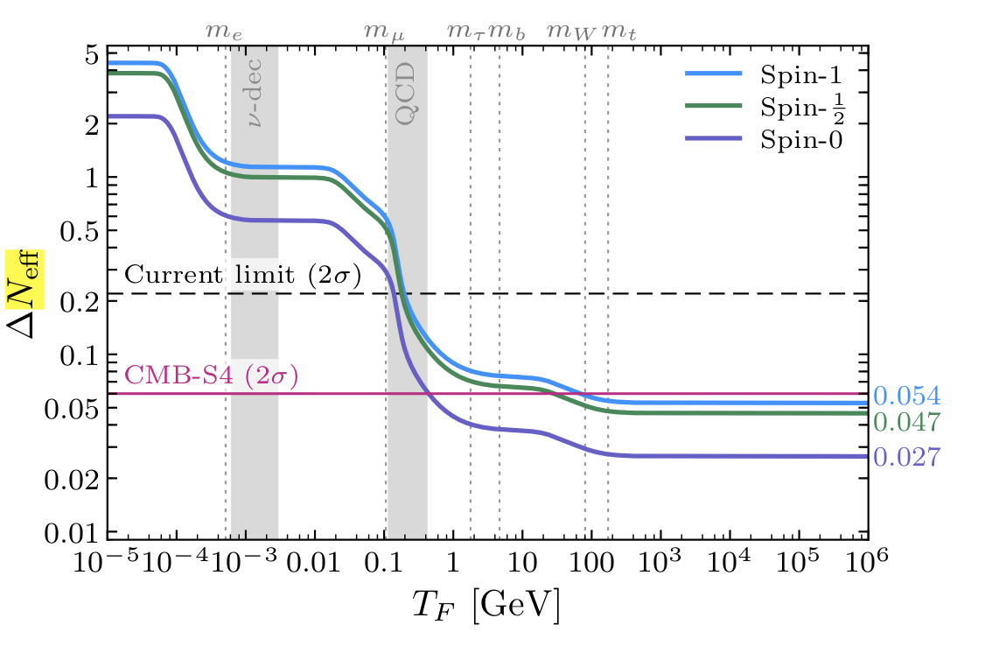
S4 collaboration, 2019

Slide 26
Conclusions

Slide 27
BACKUP SLIDES

Slide 28
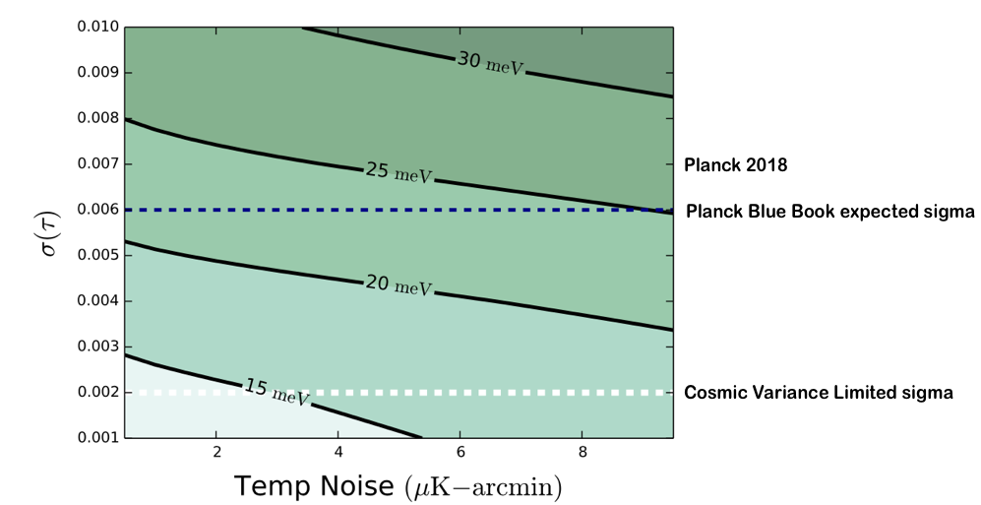

Slide 29
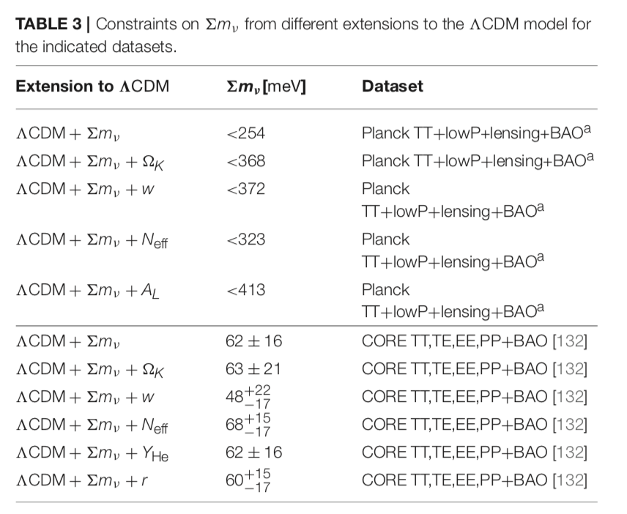
Model dependency

