Slide 1
Impedance Simulations And Measurements For ThomX
Ezgi Ergenlik
Phd student(DEPACC)
Supervisors
Christelle Bruni (LAL)
Pierre Lepercq
25.11.2019

Slide 2
Outline
ThomX
Collective effects
What is Impedance? Why do we need it?
The Coaxial Wire Technique
The Goal
Experimental Setup
Comparison with The Former Results
Results

Slide 3
ThomX
ThomX X-Ray
Flux
10¹³ ph/sec
Brigthness
10^{11*}
Transv. beam
size
70 μm
E_{X-ray}
30-90 KeV
Usage
Art History
Radiotherapy
Imaging
Area of ThomX ~ 13 $m^{2}$
much smaller than the sychrotron light sources
*$ph/sec/mm^{2}/0.1\%bw/mrad^{2}$

Slide 4
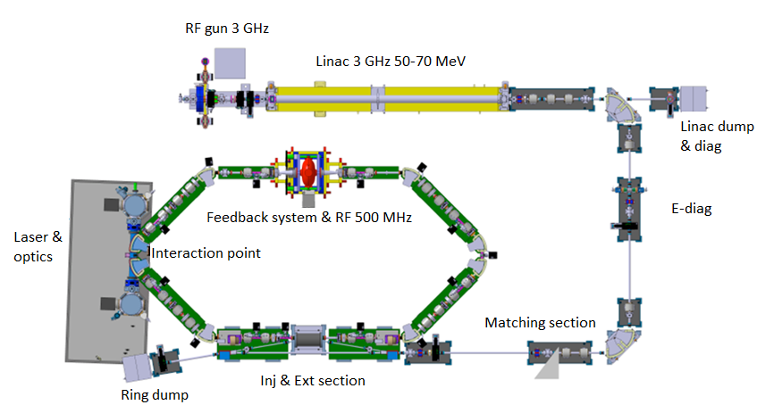
ThomX-Compton backscattering
$$E_{X-raymax}≈4γ^{2}E_{photon}$$
Photon
ThomX
50 MeV electrons
40 k times of the laser energy
$$e^{-}$$
X-Ray
13 m
8 m

Slide 5
X-Ray Quality
The energy of the X-ray depend on the energy of the electrons and laser.
$$E_{X-raymax}≈4γ^{2}E_{photon}$$
Create other problems!
$$Flux=N_{e}N_{ph}cos\frac{θ}{2}\frac{1}{\sqrt{σ_{ye}^{2}σ_{yph}^{2}}(σ_{xe}^{2}σ_{xph}^{2})cos{\frac{θ}{2}}^{2}+σ_{ze}^{2}σ_{zph}^{2})sin{\frac{θ}{2}}^{2}}$$
To maximizing the flux of the light sources we need:
High beam charge
Small interaction angle
Low beam size

Slide 6
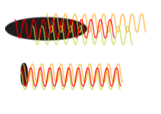
Collective Effects
Space Charge
Beam Coupling Impedance
Impedance
Coulomb attraction with the particles inside the beam
$$F_{E}$$
ThomX
I->
Beam pipe
$$F_{B}$$
1 nC bunch 50 MeV
Distortions
Emittance growth
Bunch oscillations
Instabilities
Beam losses
Coherent Synchrotron
Radiation
Intra beam Scattering
Collisions of the particles inside the beam change the colliding particles momentum by addition of multiple random small-angle scattering events.
Beam-Ion Interaction
$$F_{E}$$
Ions($H^{+},H_{2}^{+}etc..$)
Coulomb attraction of the particles with the ions of residual gases

Slide 7
The Goal
Impedance Simulations &
Measurements
Wake Function
Calculations
Comparison Results with
Machine Measurements
Beam Dynamics
Program(CODAL)
Study of Beam
Dynamics

Slide 8
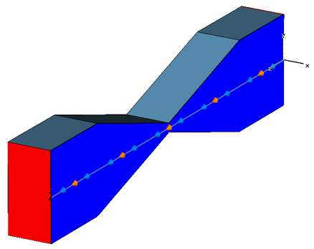
Impedance
When a particle beam passing through inside the beam pipe it can create electromagnetic fields behind it. These fields,which are called the wake fields, can have big effect on the beam dynamics for causing the energy lost. These fields can be define by wake potential or Impedance.
The electromagnetic simulation programs and bench measurements are allow us to obtain impedance easily. The bench measurements called “Wire Measurements”. When the beam is replaced by a wire, measured attenuation of the TEM wave will be related with the impedance.

Slide 9
Beam vs. Coaxial Cable
The bunch interacts with a beam pipe in exactly the same way as a coaxial cable.
Ultrarelativistic beam field $E_{r}(r,w)=Z_{0}H_{ϕ}(r,w)=\frac{Z_{0}q}{2πr}exp(-j\frac{w}{c}z)$
TEM mode coaxial wave guide $E_{r}(r,w)=Z_{0}H_{ϕ}(r,w)=\frac{Z_{0}q}{2πr}exp(-j\frac{w}{c}z)$

Slide 10
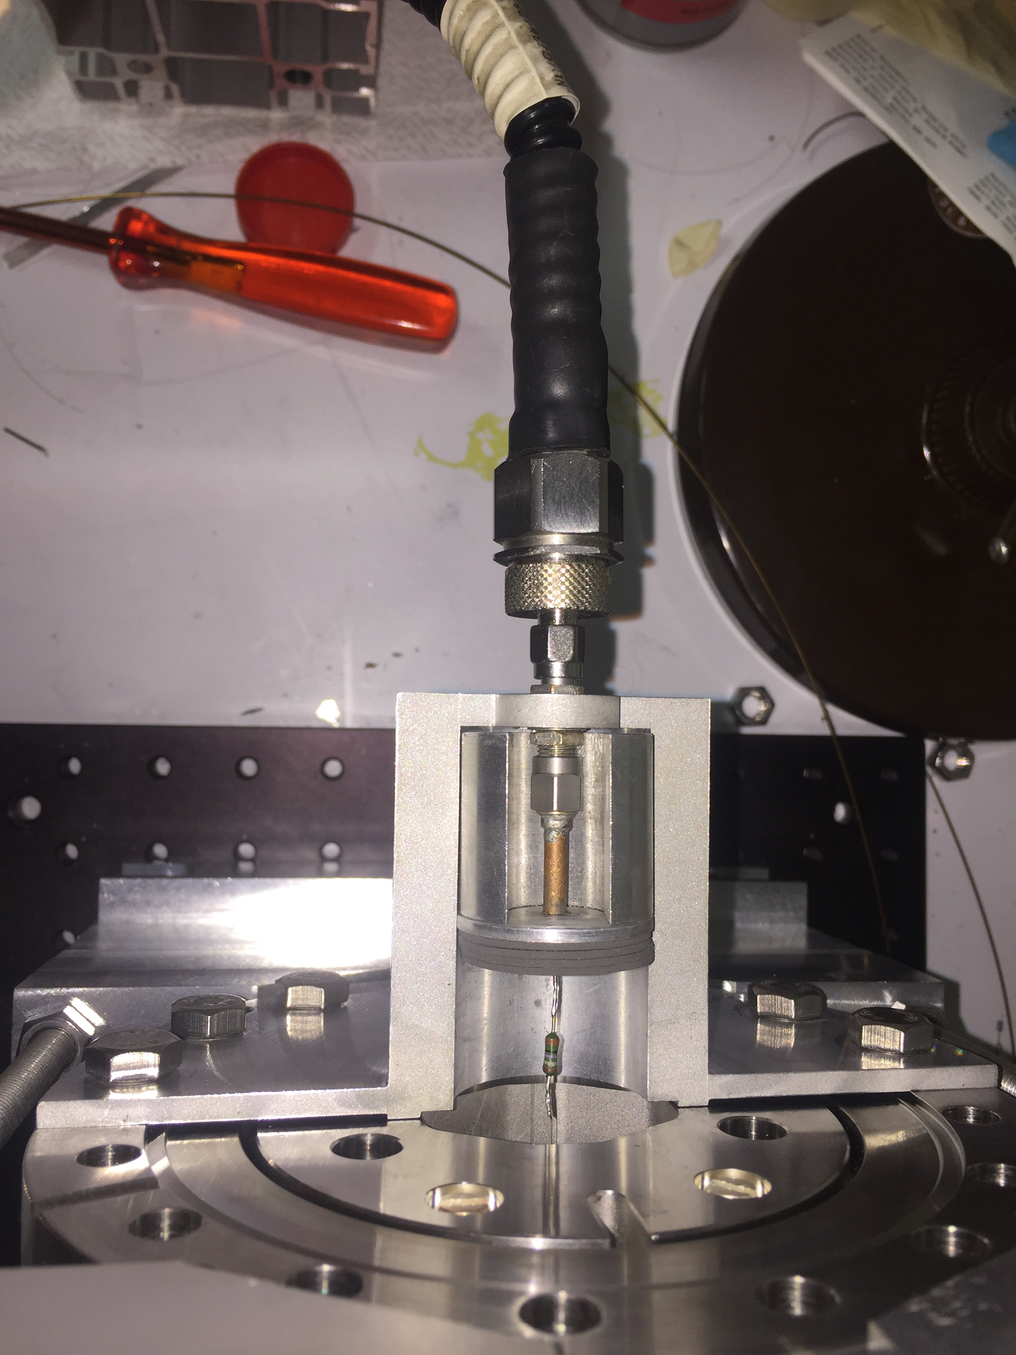
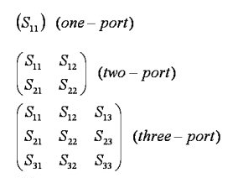
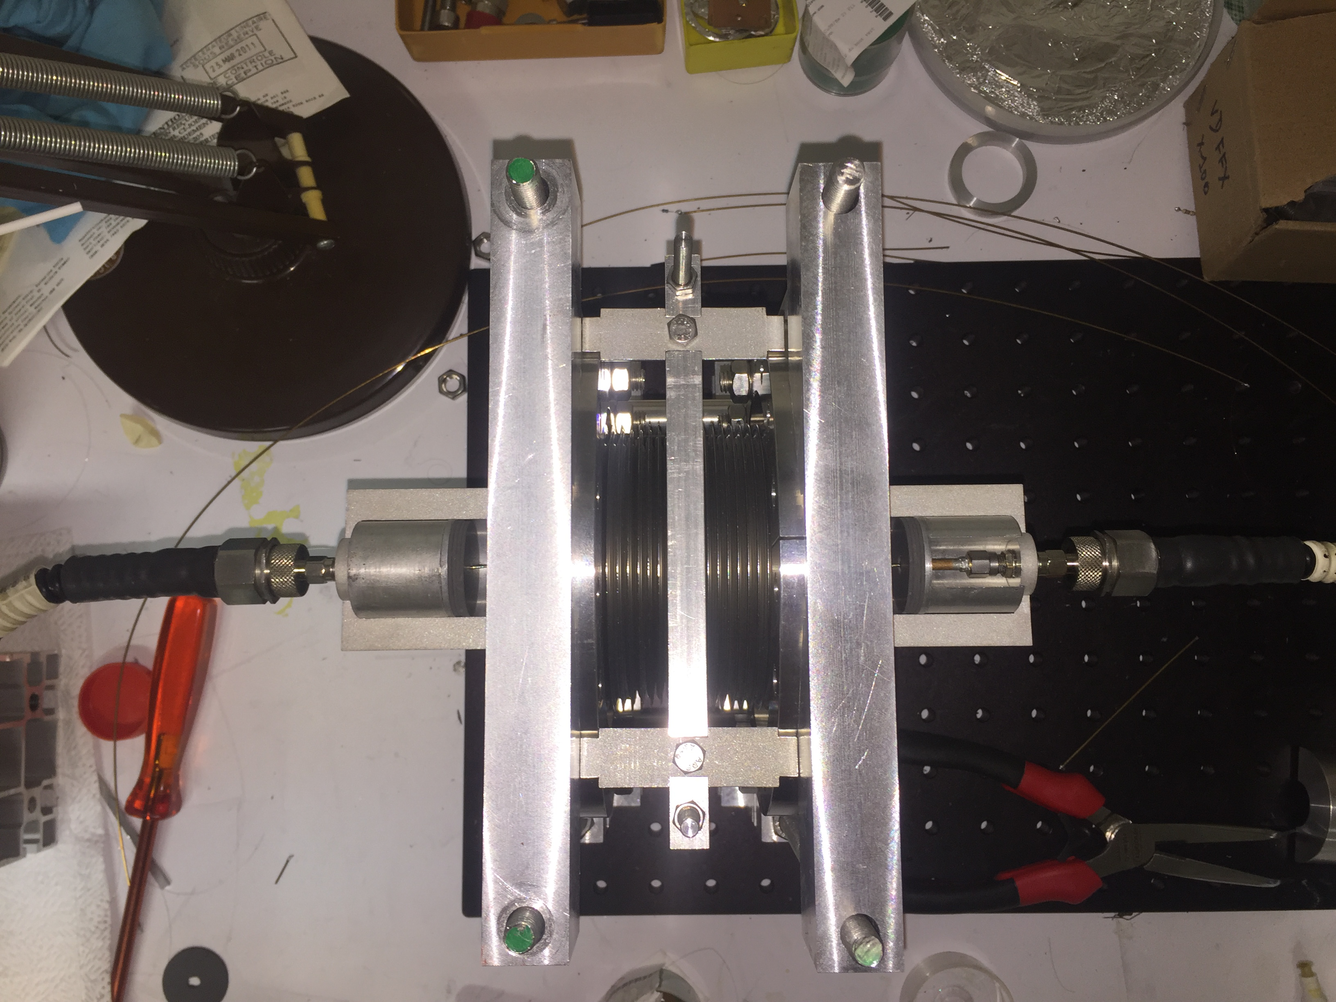
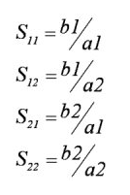
Experimental setup
The scattering matrix is a mathematical construct that quantifies how RF energy propagates through a multi-port network
DUT
(Device Under test)
The impedance of the VNA ($Z_{0}=50Ω$) must be matched with the line impedance for electromagnetic wave propagate through wire to VNA without refection.
VNA port 1
VNA port 2
$$Z=-2Z_{L}ln(\frac{S{21}_{DUT}}{S{21}_{REF}})$$
$$Z_{L}=\frac{Z_{v}}{2π}ln(\frac{D}{d})$$
where $Z_{L}$ is the line impedance $S{21}_{DUT}$ is the measured S parameter of the device under test and $S{21}_{REF}$ is the measured S parameter of the referance section,D is the diameter of the pipe and d is the diameter of the wire.

Slide 11
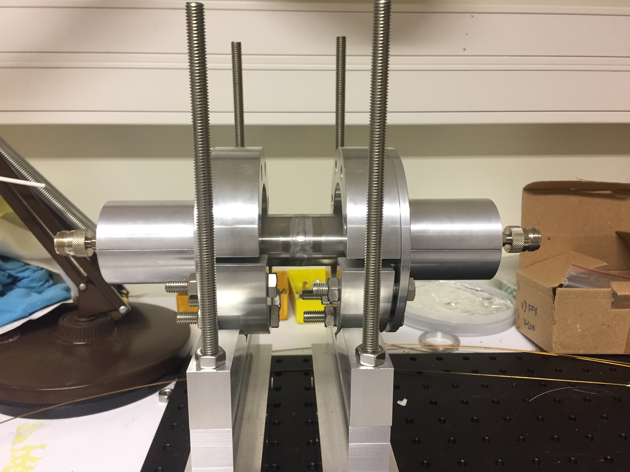
Reference Section
picture of reference section
The reference should be taken into account the defaults of the setup and the particular geometry of the beam pipe cross section.

Slide 12
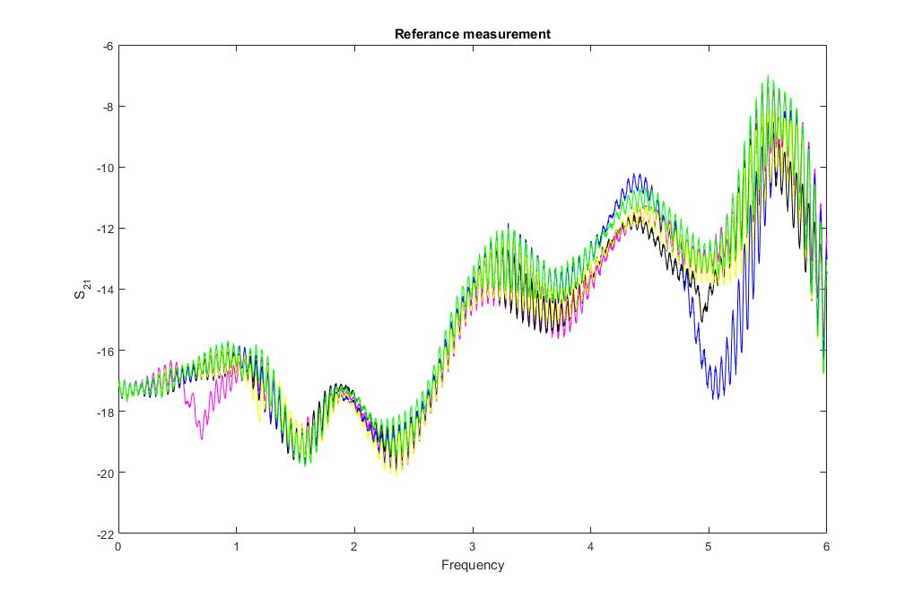
Measurements
5 measurements were taken for the each element in the same condition to test the repeatability of the measurement. A lot of different factors can change the results (wire tension,welding etc.)
In each measurement the weldings,resistors and the wire tension are changed to estimate the effect of these parameters.

Slide 13
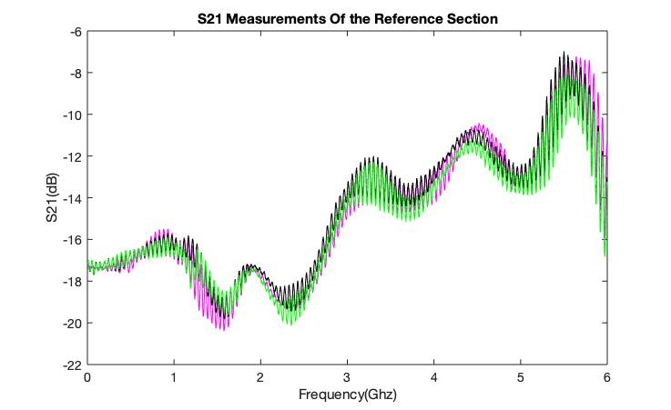
Reference Measurements
These two problems are coming from the contact problem of the shields. After it understood properly the data which has these problems were taken out from the analysis.

Slide 14
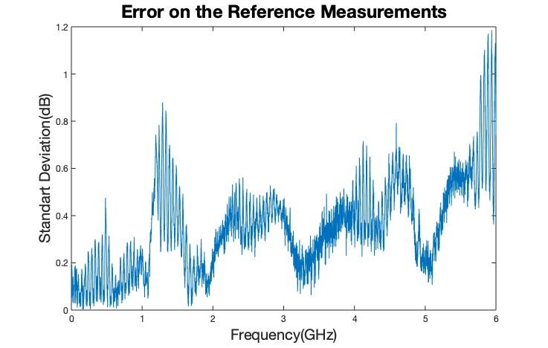
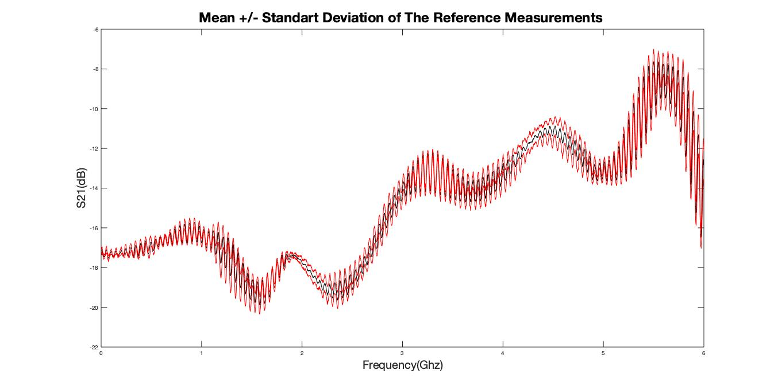
Error On the Reference Measurements

Slide 15
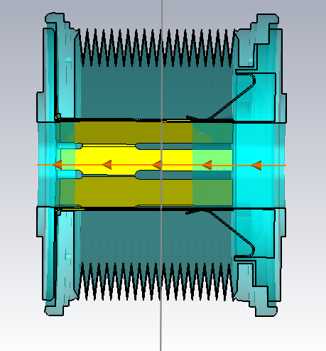
Bellow
Bellows are frequently used in accelerators and storage rings.
It gives flexibility for termal expansions and misalignments.
Without shielding, they are one of the main source of impedance and instabilities.
Rf Shielding
Cst Model of the Bellow

Slide 16
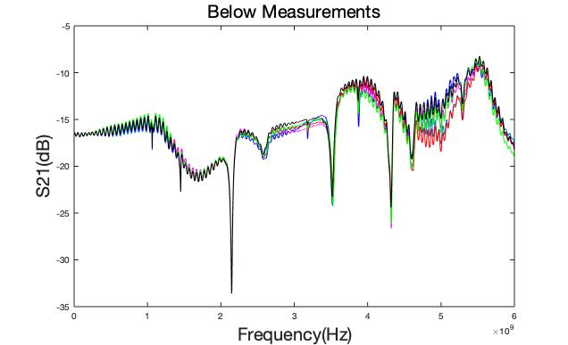
Bellow(DUT) Measurements
Noise coming from the connection of
the connector shieldings

Slide 17
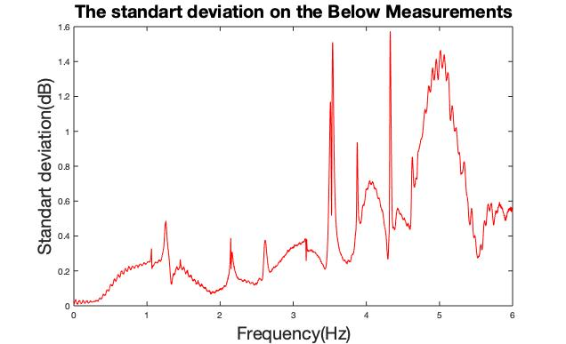
Standart Deviation on Bellow Measurements
The standart deviation of the 5 measurements. Each time, the resistors fere changed and all the soldiers fere renewed.

Slide 18
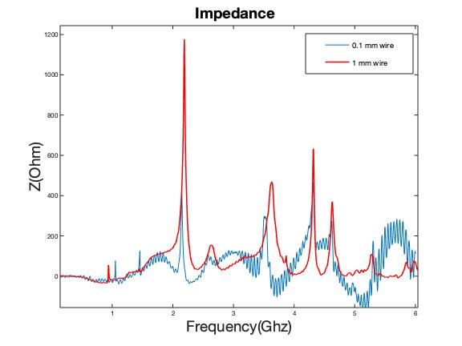
Impedance Calculations

Slide 19
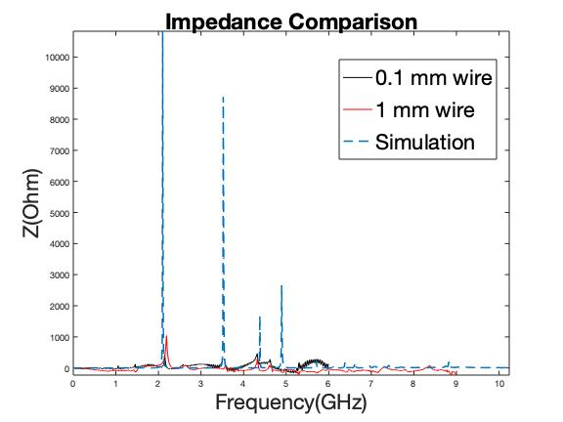
Comparison with the Former Works
The peaks of thinner wire are at 2.2 GHz , 3.6 GHz, 4.4 GHz and 4.8 GHz which are comparable to CST simulation results

Slide 20
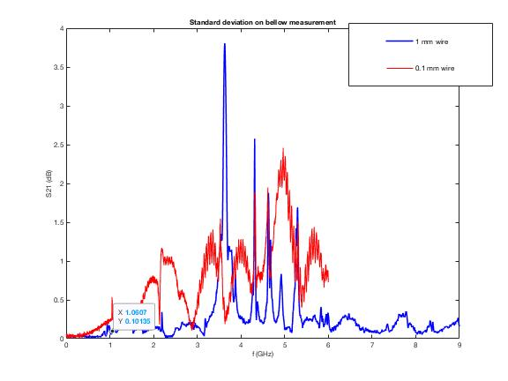
The Error Comparison
The errors with this wire is nearly the half of the thicker wire.Especially on the high resonance peaks we can get better results.

Slide 21
Results
The errors on the measurements, which was done with thinner wire, decreased on both reference and DUT section significantly.
These measurements were also checked with different VNA’s and it was observed that the base errors is changing with respect to the VNA.
The frequency shift was observed in the thick wire. The further investigations continue about this effect.
Line impedance is decreased which allows us to measure high impedance components.
The bench parts, which can cause an unwanted errors, were found and changed in the transverse impedance measurements setup.

Slide 22
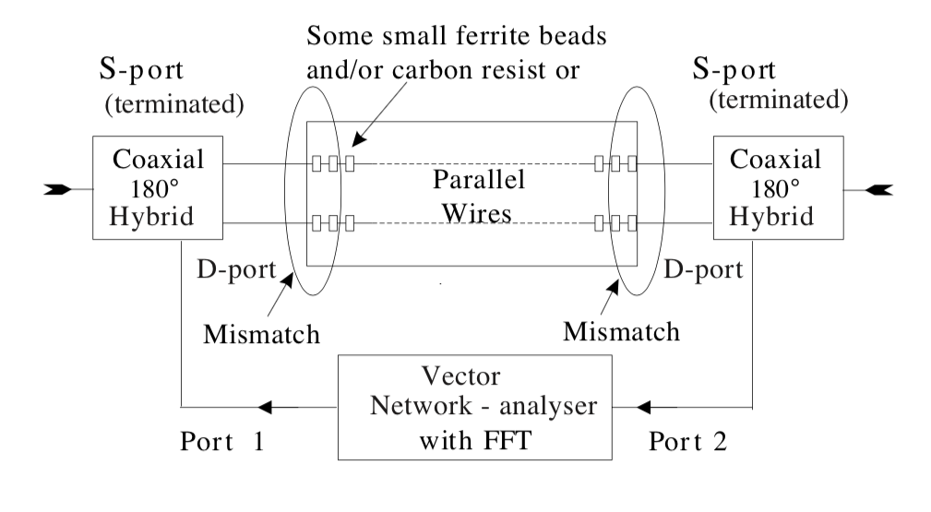
Future Measurements
Two wire measurements for Transverse Impedance
$$Z_{TR}=\frac{cZ}{wΔ^{2}}$$
where w is the frequency and $Δ$ is the distance between two wire

Slide 23
Thank you for your attention!

