Slide 1
Optomechanical parametric instabilities study for Virgo
David Cohen¹ dcohen@lal.in2p3.fr
PhD director: Nicolas Arnaud^{1,2}
Co-supervisor: Thibaut Jacqmin³
¹LAL, Univ. Paris-Sud, CNRS/IN2P3, Université Paris-Saclay, F-91898 Orsay, France
²European Gravitational Observatory (EGO), I-56021 Cascina, Pisa, Italy
³Laboratoire Kastler Brossel, Sorbonne Université, CNRS, ENS-Université PSL, Collège de France, F-75005 Paris, France
Monday the 25th of November 2019

Slide 2
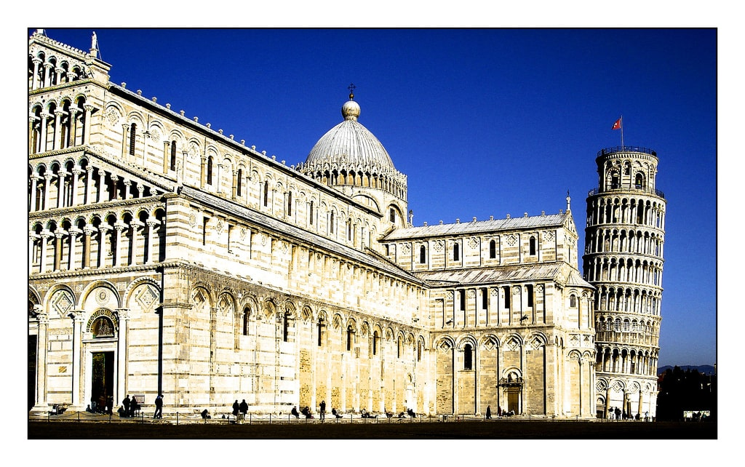
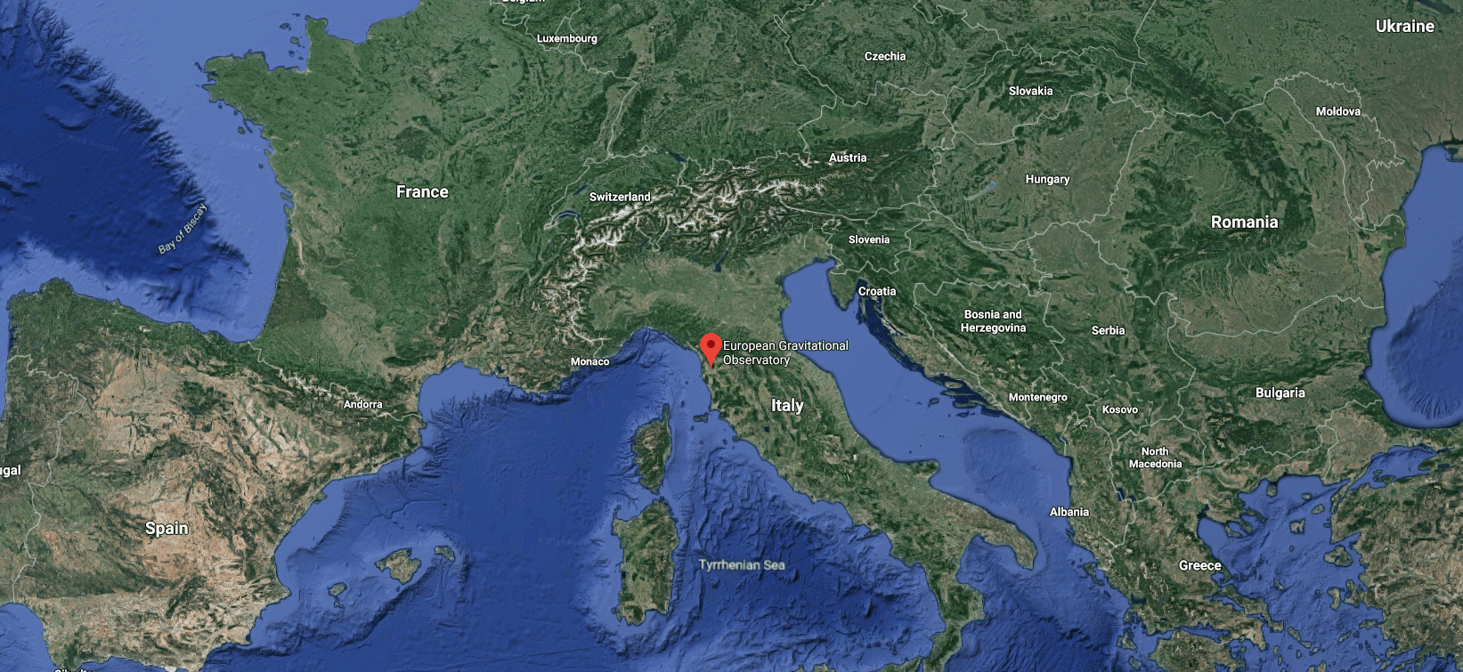
© Wikimedia commons

Slide 3
Introduction
Gravitational waves basics
How to detect gravitational waves
Detections

Slide 4
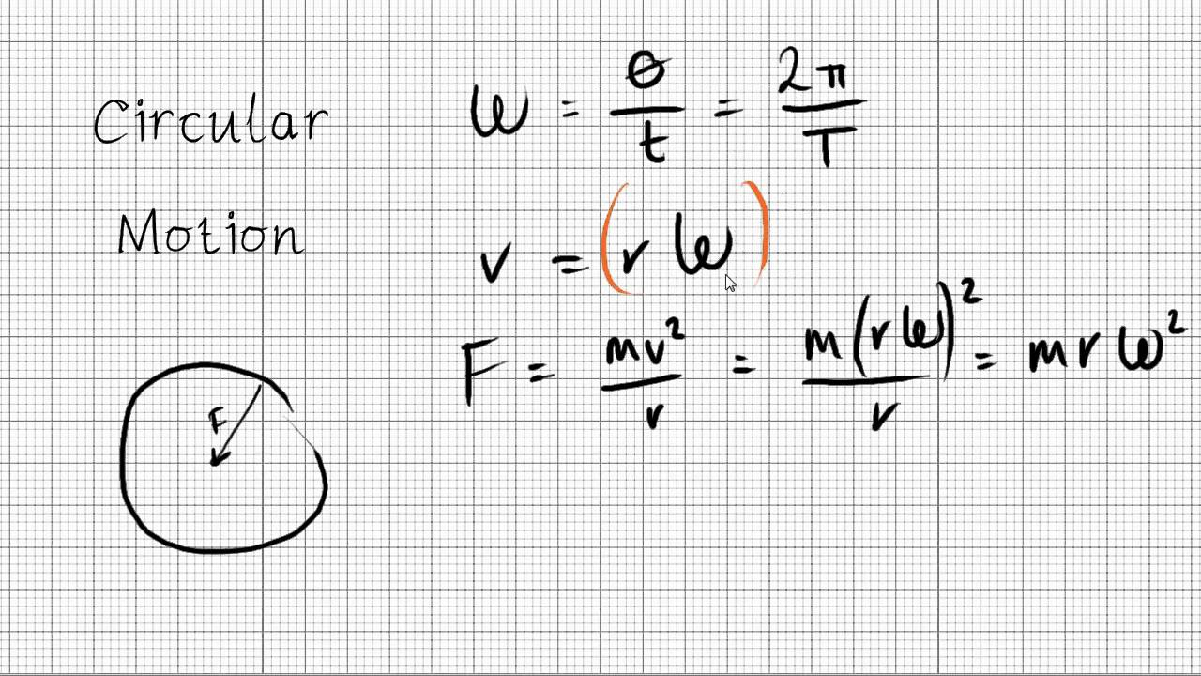
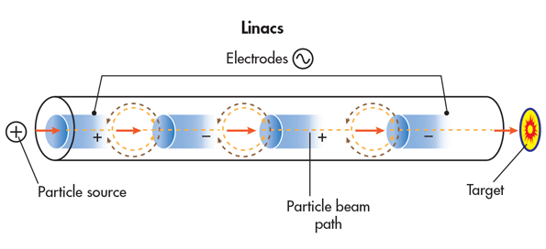
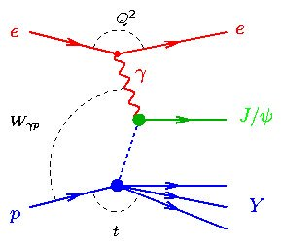
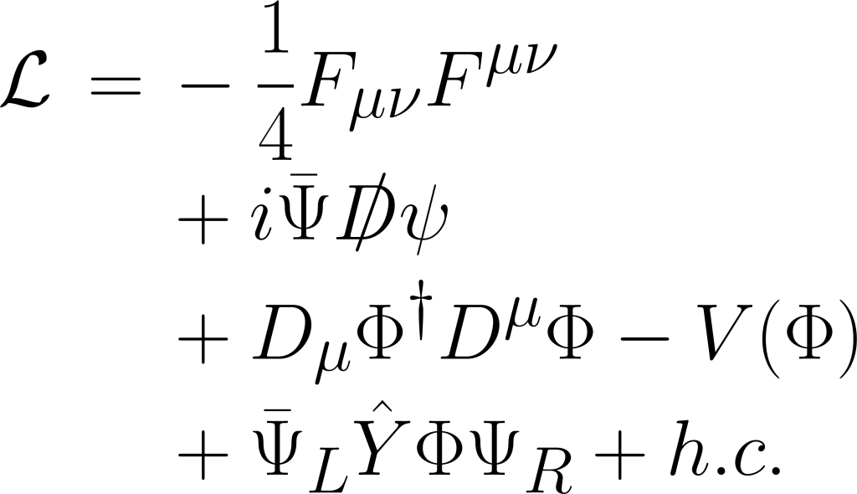
u/d/c/s/t/b
e⁻/ν/μ⁻
γ/W/J/Њ/Ϫ/Ϣ/Ђ/א/מ/ؿ/ڠ
© YouTube - Useful Equations in Particle Physics - A Level Physics Revision
© Symmetry Magazine
© DESY - H1 Collab., A. Aktas et al., Phys Lett B568 (2003) 205-218 , 06/03

Slide 5
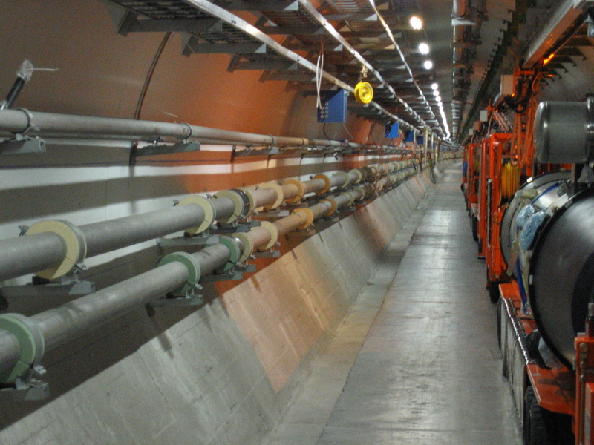
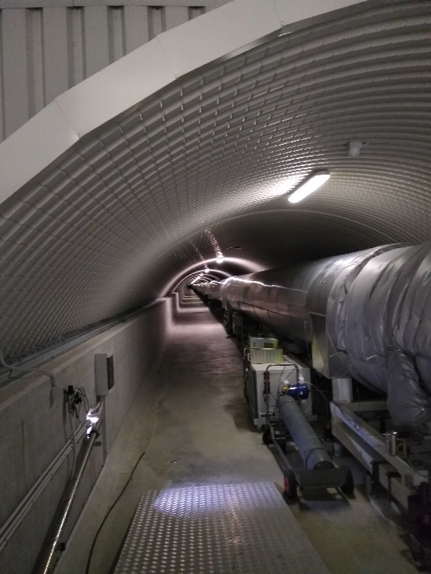
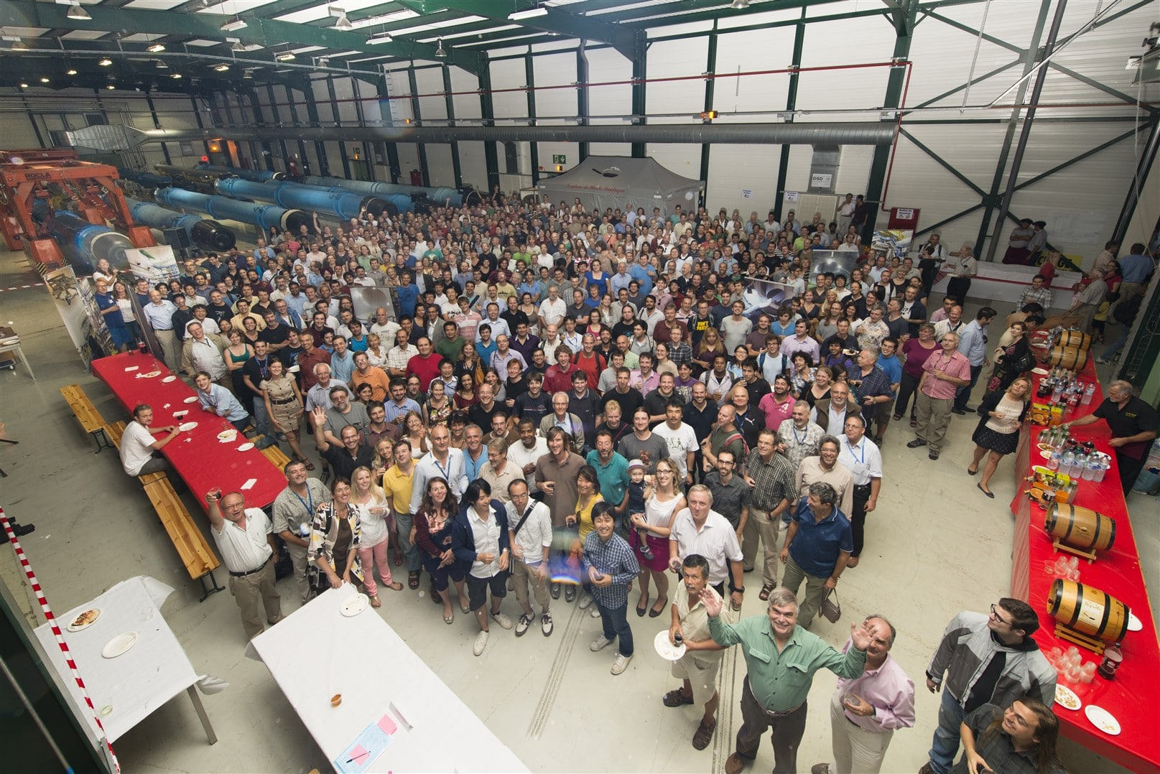

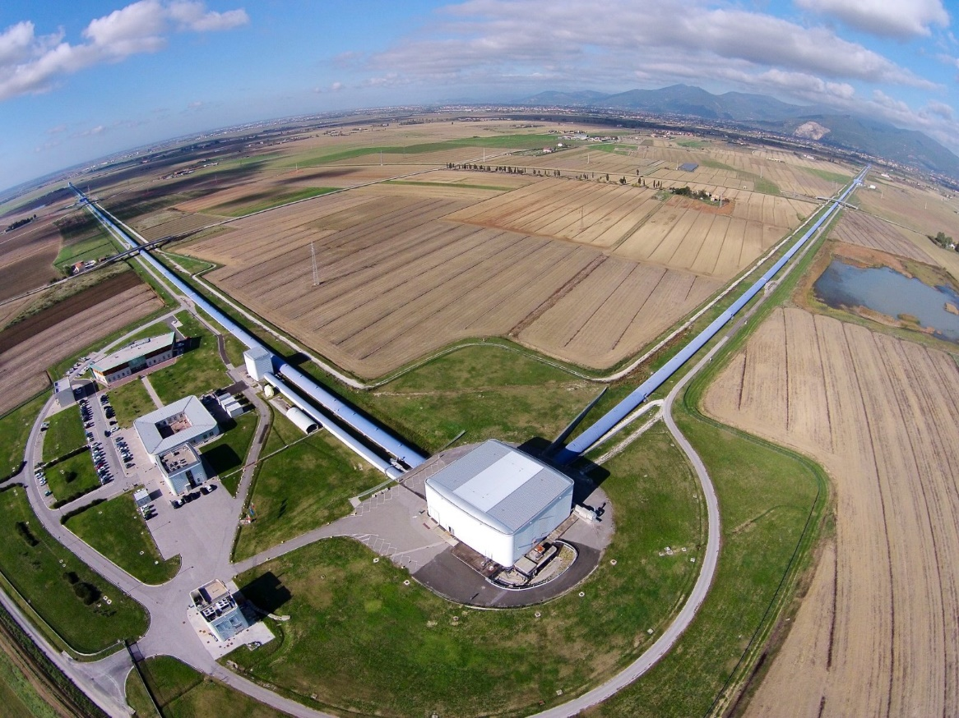
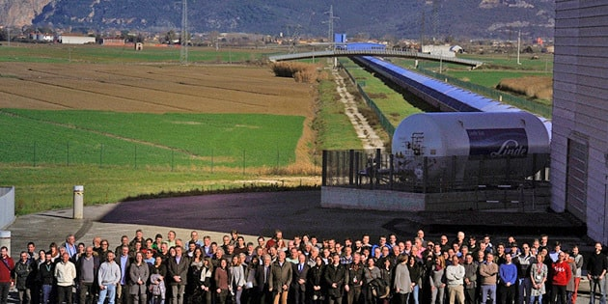
© Nikolai Schwerg (GNU FDL 1.2, not modified)
© Jean-Grégoire Ducoin
© CERN
© Maximilien Brice (CERN)
© The Virgo collaboration/CCO 1.0
© The Virgo collaboration

Slide 6
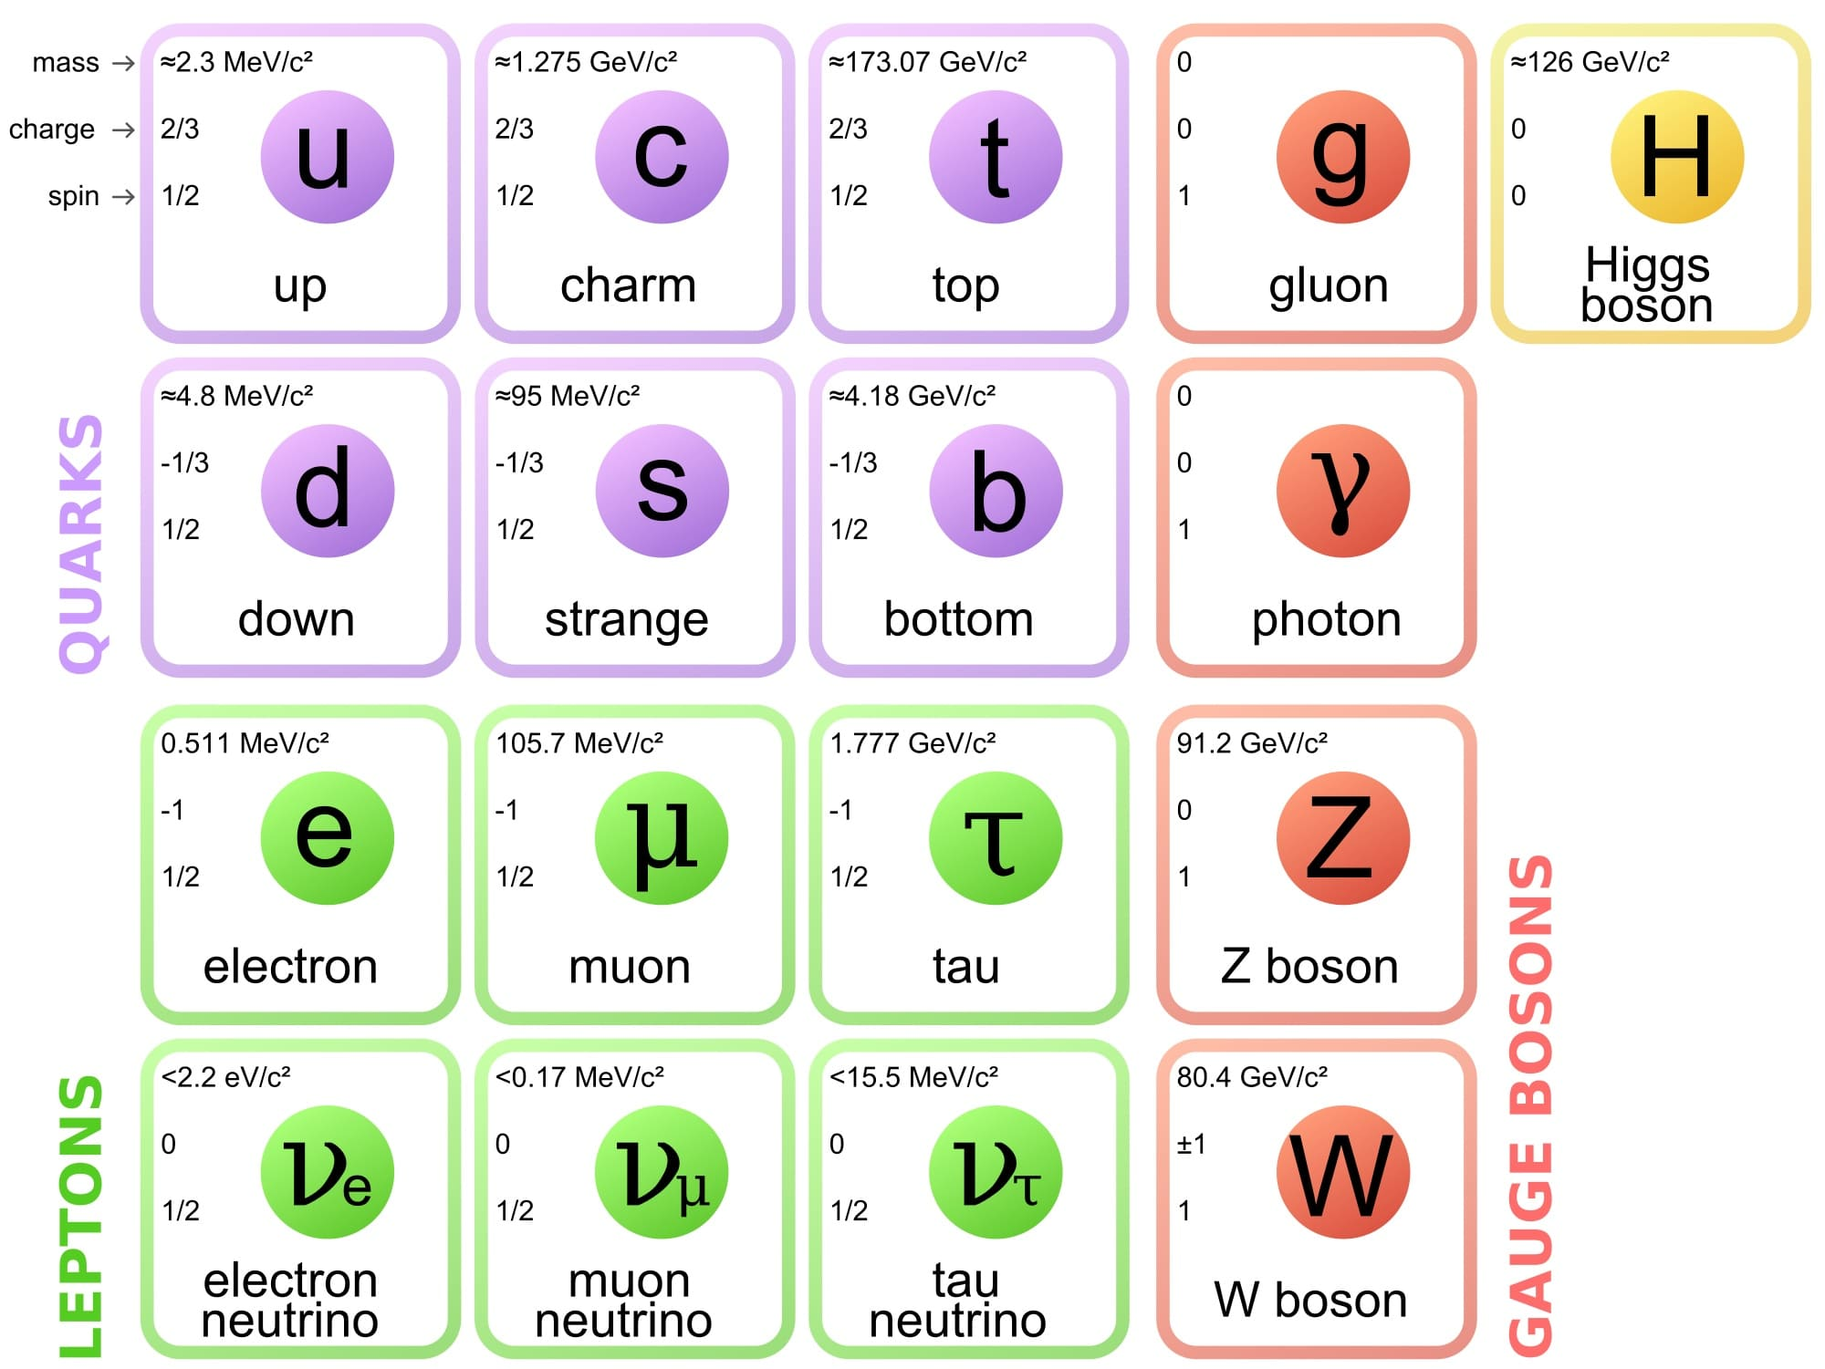
Image courtesy of Wikimedia Commons.

Slide 7
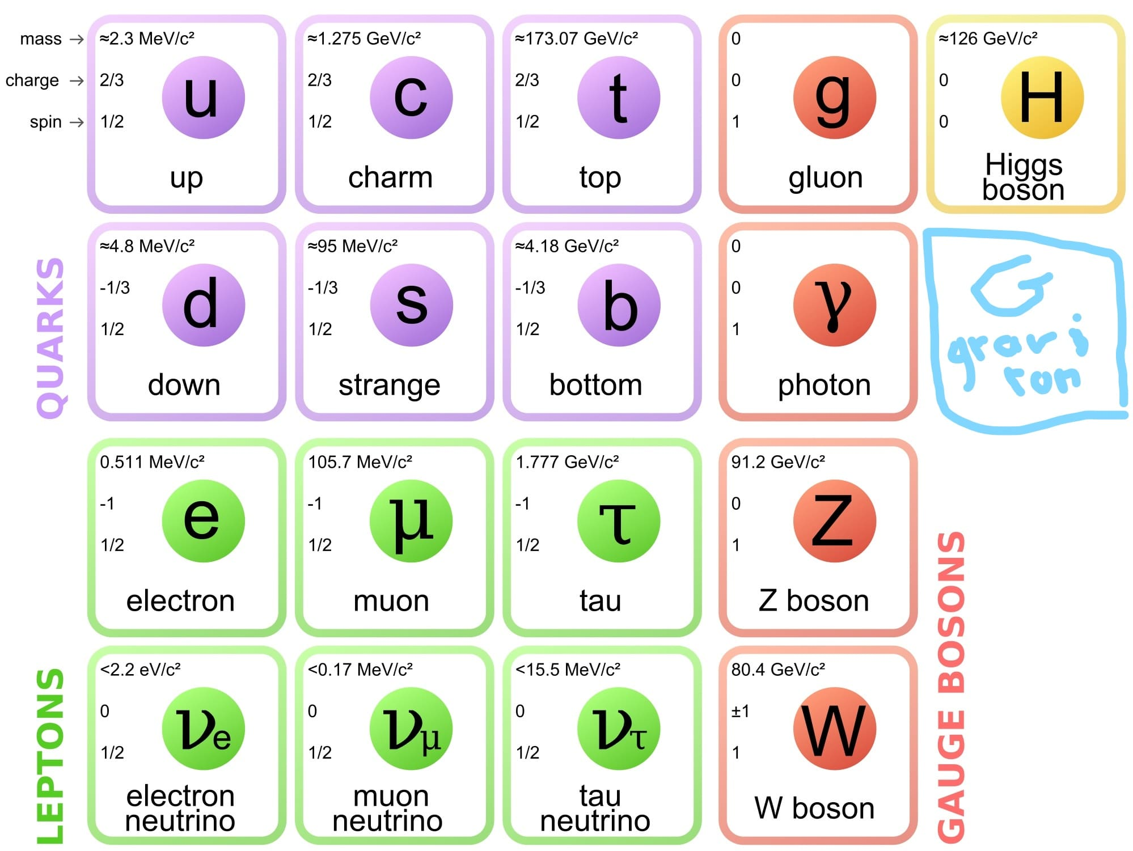
Image courtesy of Wikimedia Commons,
modified.

Slide 8
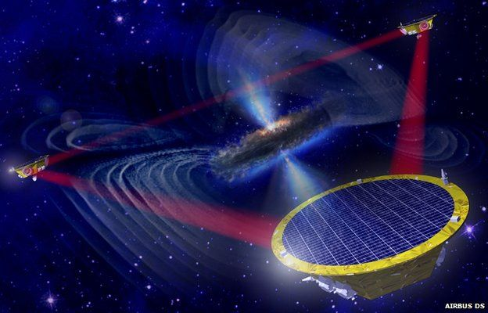
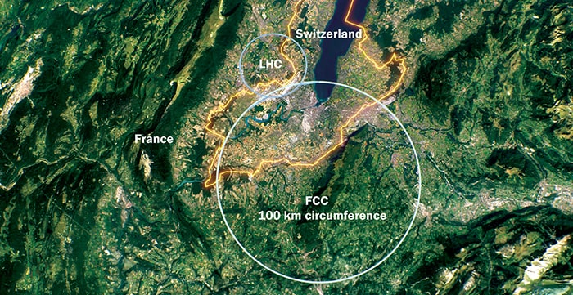
© CERN

Slide 9
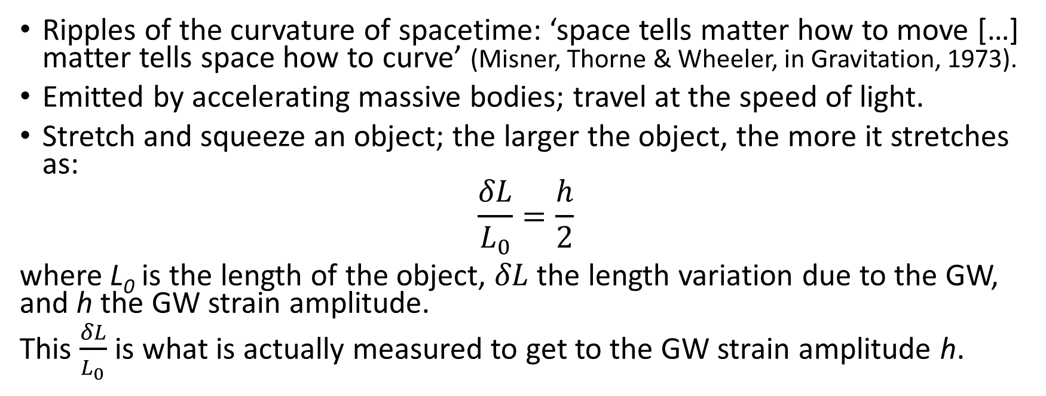
Gravitational waves (GW): basics
Ripples of the curvature of spacetime: ‘space tells matter how to move […] matter tells space how to curve’ (Misner, Thorne & Wheeler, in Gravitation, 1973).
Emitted by accelerating massive bodies; travel at the speed of light.
Stretch and squeeze an object; the larger the object, the more it stretches as:
$$\frac{δL}{L_{0}}=\frac{h}{2}$$
where L₀ is the length of the object, $δL$ the length variation due to the GW, and h the GW strain amplitude.
This $\frac{δL}{L_{0}}$ is what is actually measured to get to the GW strain amplitude h.

Slide 10
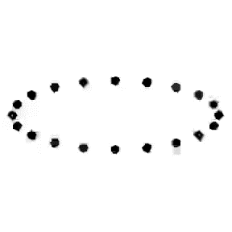
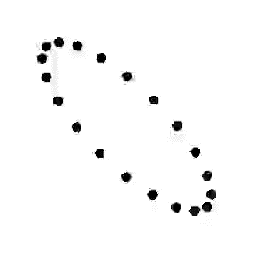
Gravitational waves (GW): basics
Transverse waves ➔ similar to tidal effect
+ polarisation
+ polarisation

Slide 11
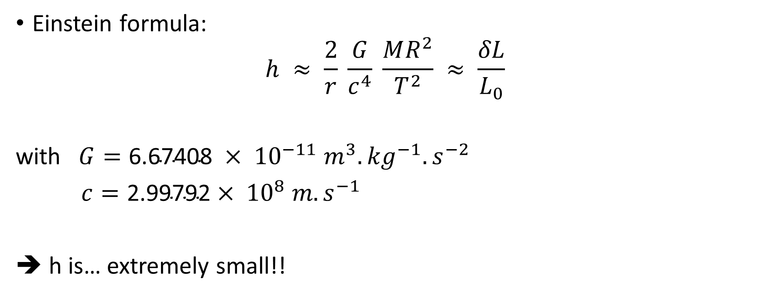
GW strain amplitude
Einstein formula:
$$h ≈ \frac{2}{r} \frac{G}{c^{4}} \frac{MR^{2}}{T^{2}} ≈ \frac{δL}{L_{0}}$$
with $G=\text{6.67}\text{40}\text{8} × {10}^{−11} m^{3}.{kg}^{−1}.s^{−2}$
$c=\text{2}\text{.}\text{99792}× {10}^{8} m.s^{−1}$
➔ h is… extremely small!!

Slide 12
1st detector condition
A gravitational wave detector has to be very sensitive!!

Slide 13
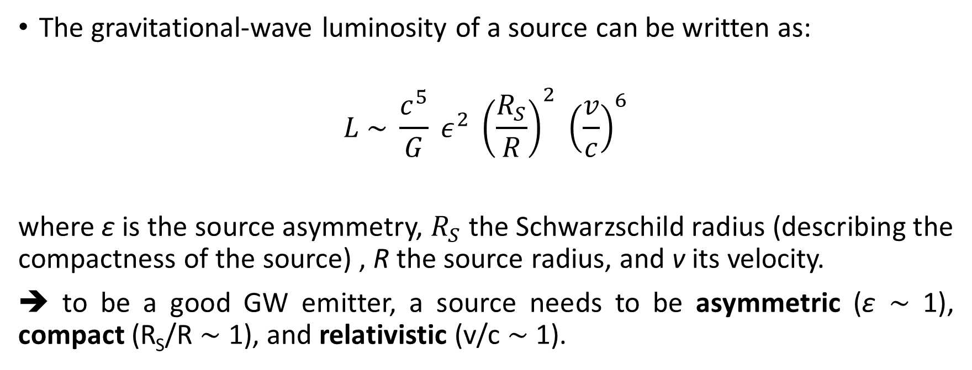
Sources luminosity
The gravitational-wave luminosity of a source can be written as:
$$L \sim \frac{c^{5}}{G} ε^{2} {\left(\frac{R_{S}}{R}\right)}^{2} {\left(\frac{v}{c}\right)}^{6}$$
where ε is the source asymmetry, $R_{S}$ the Schwarzschild radius (describing the compactness of the source) , R the source radius, and v its velocity.
➔ to be a good GW emitter, a source needs to be asymmetric (ε $\sim$ 1), compact (R_{S}/R $\sim$ 1), and relativistic (v/c $\sim$ 1).
➔ astrophysical events

Slide 14
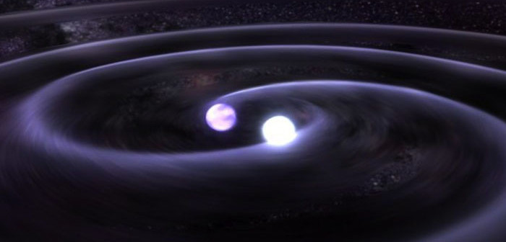
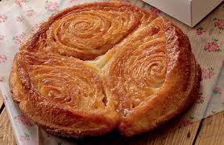
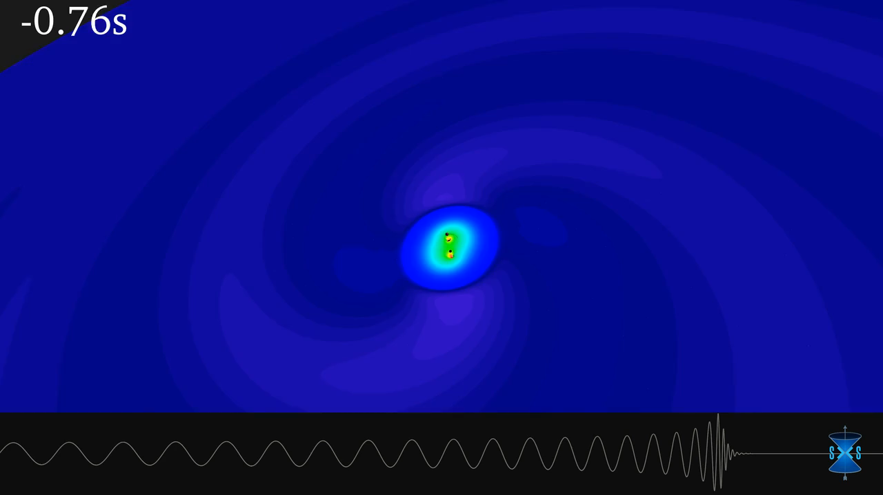
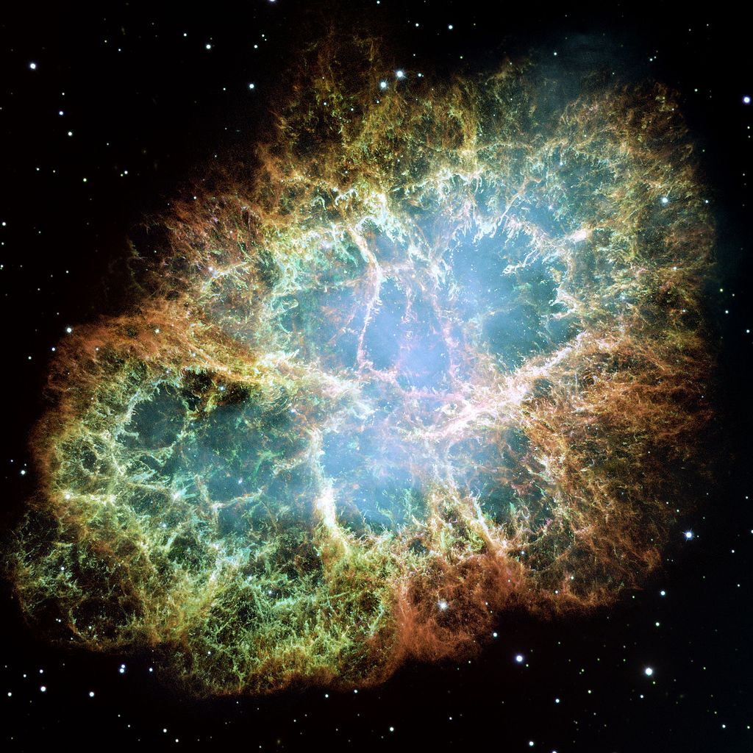
Binary Neutron Stars merger
Binary Black Holes merger
Supernova
Kouign-amann
© NASA
© Daniel Mettoudi
© NASA, ESA, J. Hester and A. Loll (Arizona State University)
© SXS Collaboration/Canadian Institute for Theoretical Astrophysics/SciNet

Slide 15
Outline
Introduction
  Gravitational waves basics
  How to detect gravitational waves?
  Detections
Three-mode parametric instabilities

Slide 16
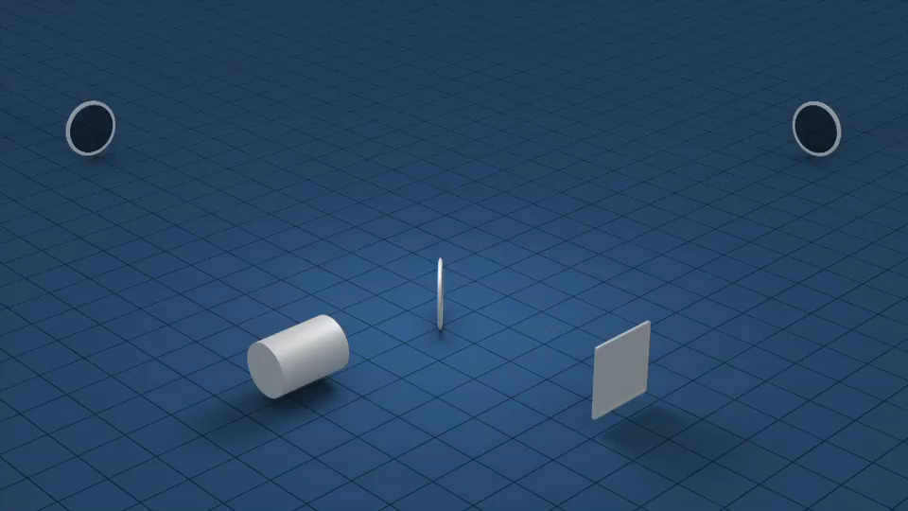
Ground-based interferometer for GW detection

Slide 17
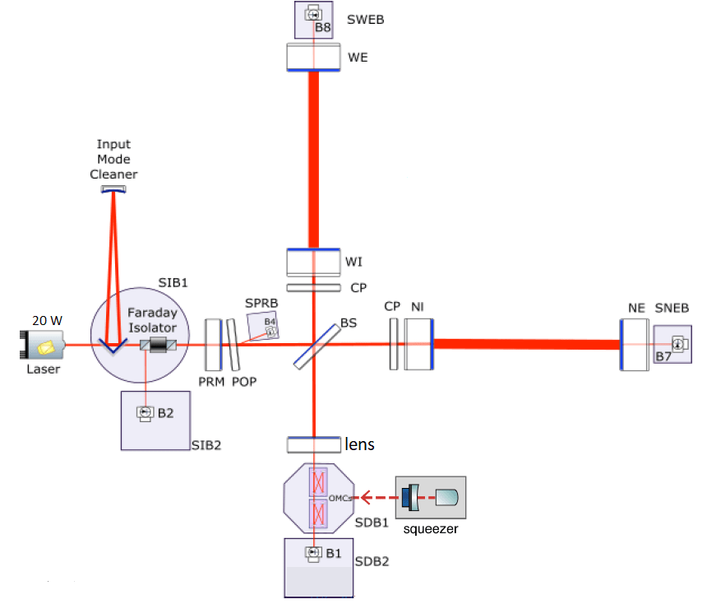
What is Virgo?
Michelson interferometer (ITF)
→ direct detection of gravitational waves
3 km arms with Fabry-Perot cavities to increase the light path
Working point @ dark fringe (destructive interferences)
Power Recycling mirror that reflects the light back to the ITF increasing the power in the ITF.
Real-time active control of the working point:
Sensing: photodiodes
Actuation: mirrors, suspensions, laser
Large optics (mirrors) contained in superattenuator towers (inverted pendulums). They are the test masses that perceive the space-time variations induced by GW.
Small optics (telescopes, photodiodes) on suspended benches
Laser:
wavelength = 1064 nm
input power = 12-25 W continuous

Slide 18
Outline
Introduction
  Gravitational waves basics
  How to detect gravitational waves?
  Detections
Three-mode parametric instabilities

Slide 19
Observation Runs
For any GW detector, observation phases last for a certain time, called an Observation run.
Between two Observation runs, GW detectors are upgraded.
The first detection GW150914 occurred during the Observation run 1 (O1). The first triple detection GW170814 occurred during O2.
Since 1 April 2019, O3 has started and will last for a whole year. At present, only potential candidates to GW events have been recorded and one will need several months for confirmation.
O1
commissioning
O2
O3a
O3b
commissioning
commissioning
11/2017 – 08/2018: LIGO
08/2018: + Virgo
04/2019 – 10/2019: LIGO/Virgo
11/2019 – 04/2020 LIGO/Virgo
09/2015 – 01/2016: LIGO

Slide 20
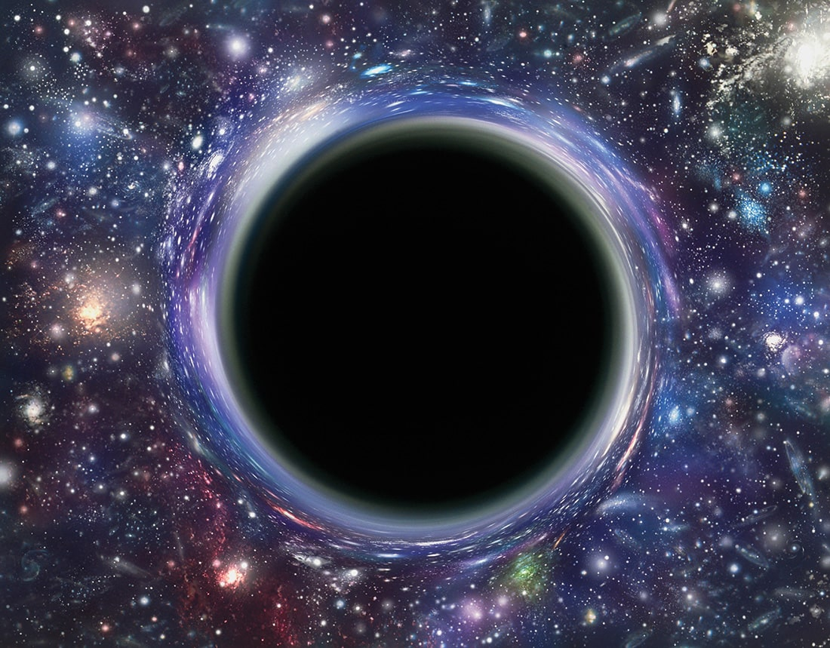
A couple of interesting links
Virgo news: http://www.virgo-gw.eu/
Potential candidates: https://gracedb.ligo.org/superevents/public/O3/
App to keep track of the latest gravitational wave alerts: http://chirp.sr.bham.ac.uk
© Mehau Kulyk/Science Photo Library

Slide 21
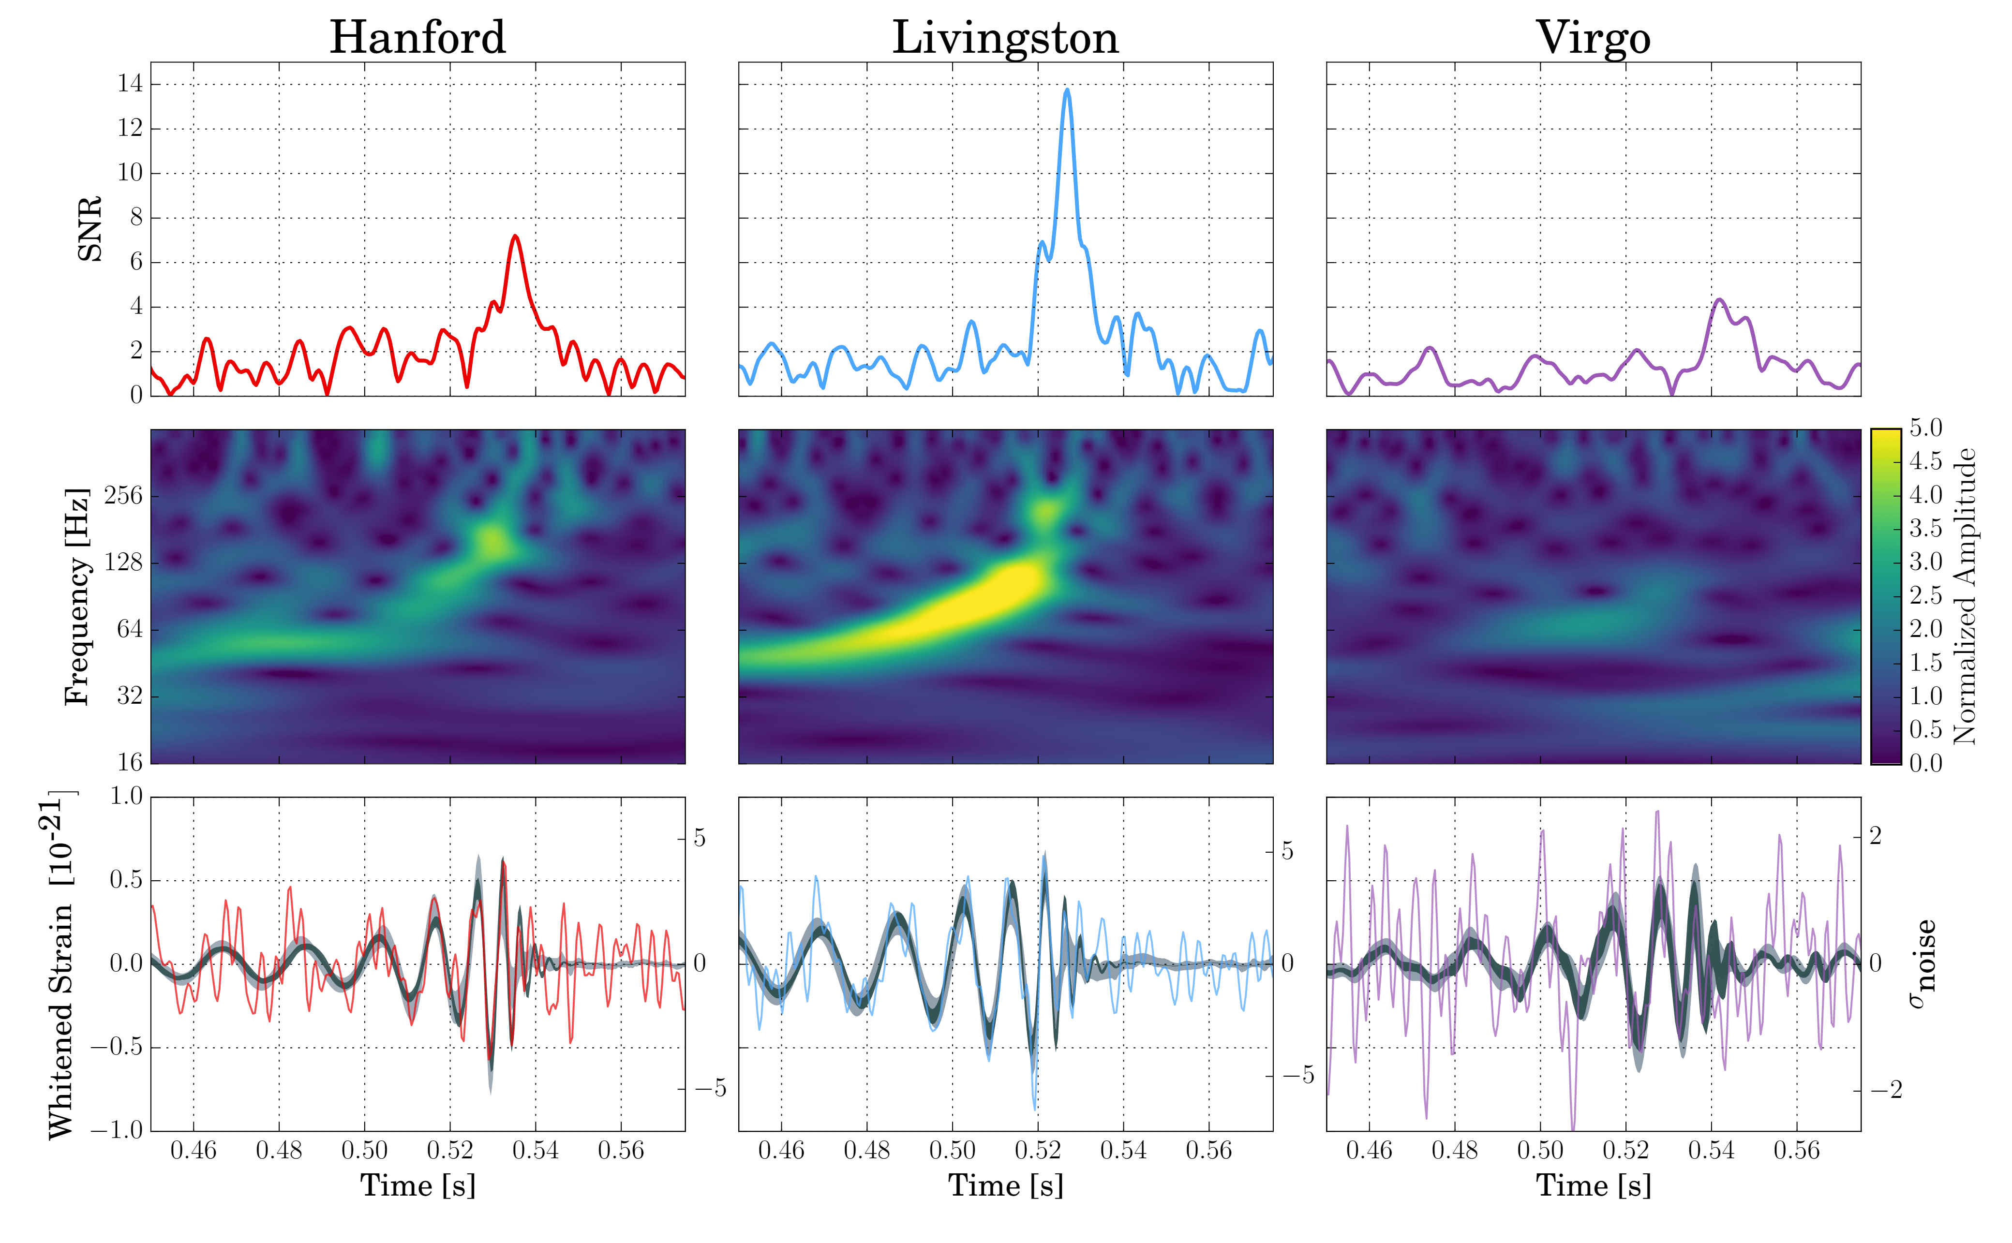

Detections
GW170814: the first triple detection (LIGO + Virgo) of a binary black hole merger

Slide 22
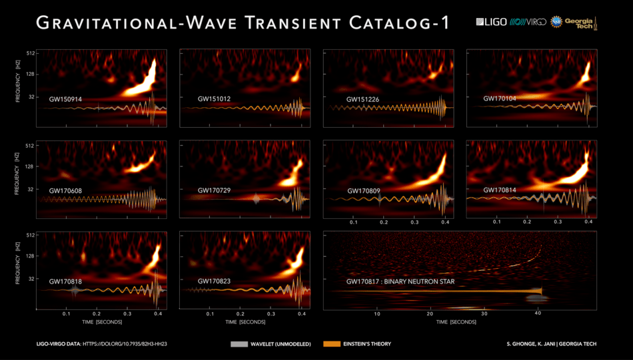
Detections
LIGO Scientific Collaboration and Virgo Collaboration/Georgia Tech/S. Ghonge & K. Jani,
CC BY-SA 4.0, not modified

Slide 23
2nd detector condition
A gravitational wave detector system control has to be very stable!!

Slide 24
Image courtesy of Wikimedia Commons,
modified.

Slide 25
Three-mode parametric instabilities
AKA only ‘parametric instabilities’ (PI)

Slide 26
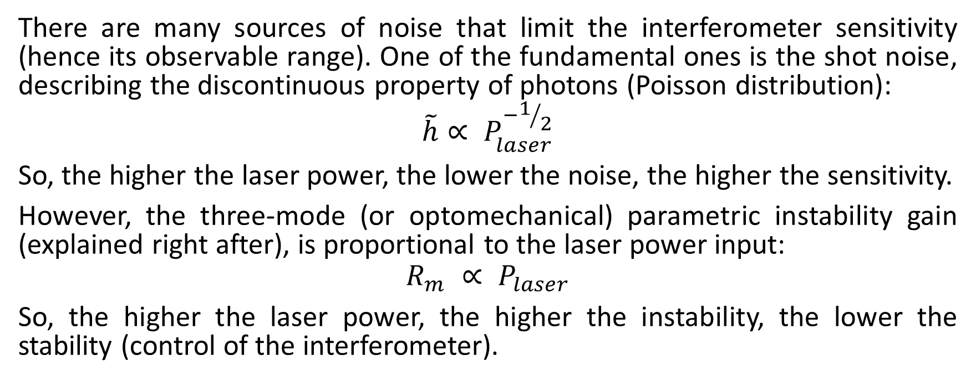
Parametric gain
There are many sources of noise that limit the interferometer sensitivity (hence its observable range). One of the fundamental ones is the shot noise, describing the discontinuous property of photons (Poisson distribution):
$$\tilde{h}∝ P_{laser}^{−1/2}$$
So, the higher the laser power, the lower the noise, the higher the sensitivity.
However, the three-mode (or optomechanical) parametric instability gain (explained right after), is proportional to the laser power input:
$$R_{m} ∝ P_{laser}$$
So, the higher the laser power, the higher the instability, the lower the stability (control of the interferometer).

Slide 27
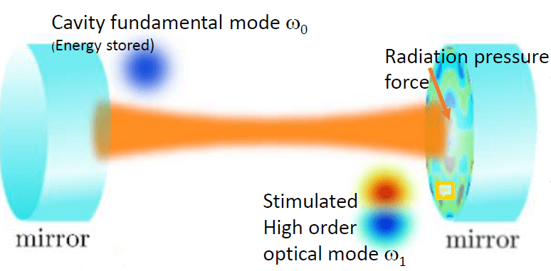
3-mode interaction

Slide 28
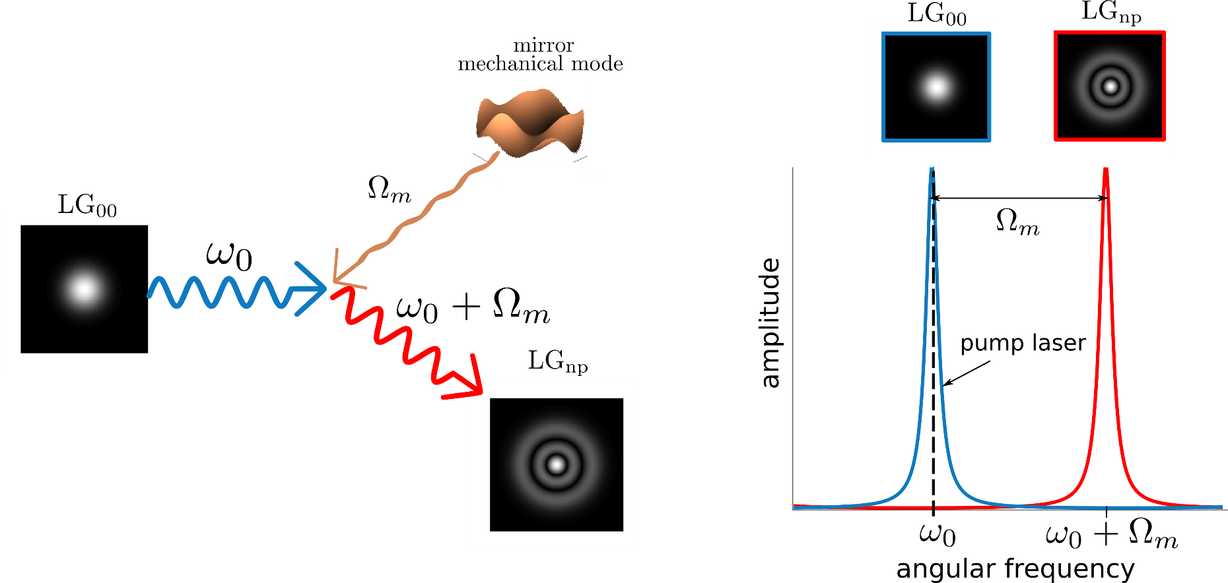
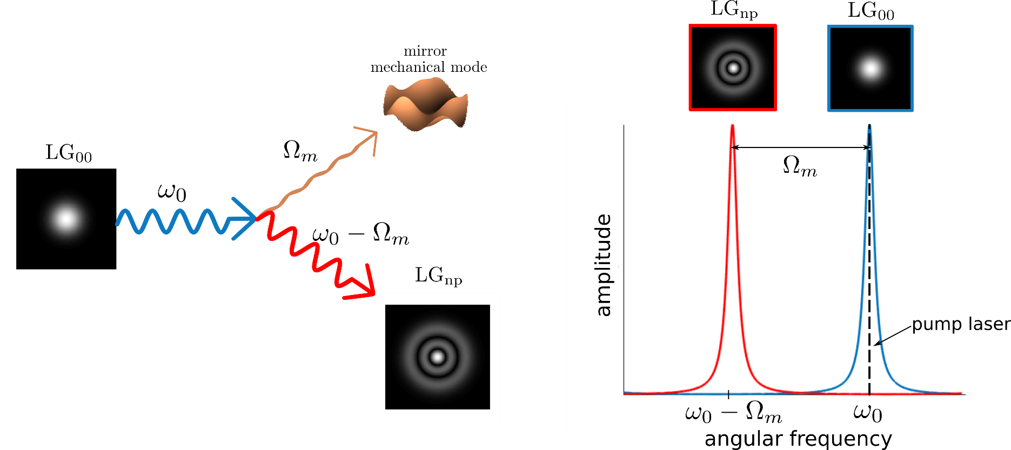
3-mode interaction
Anti-Stokes process: cooling
Stokes process: heating

Slide 29
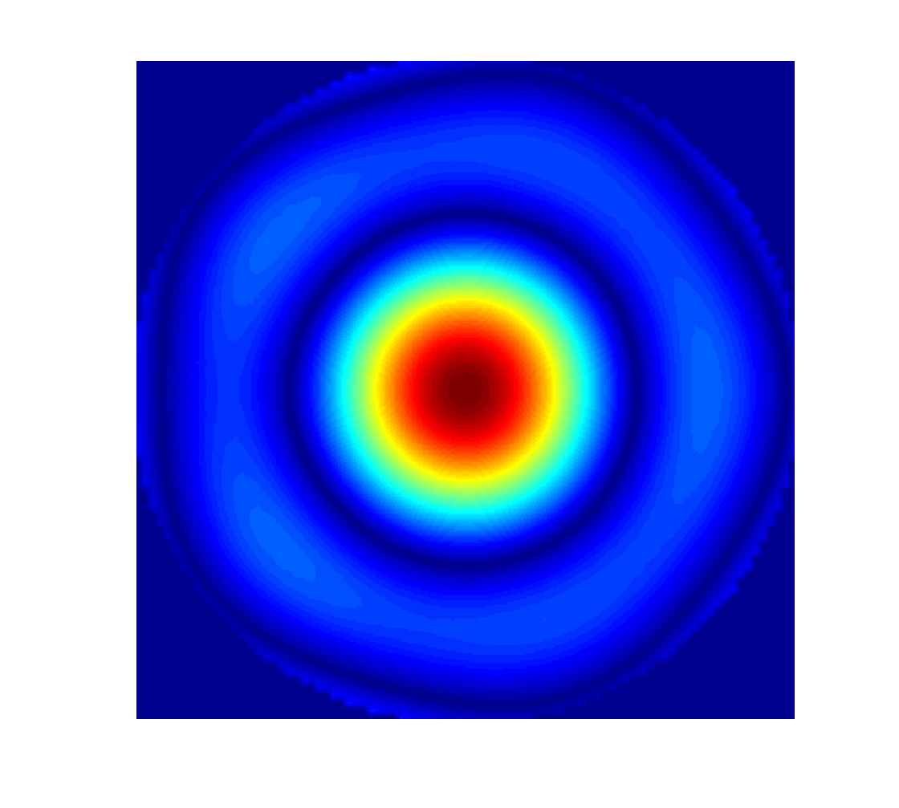
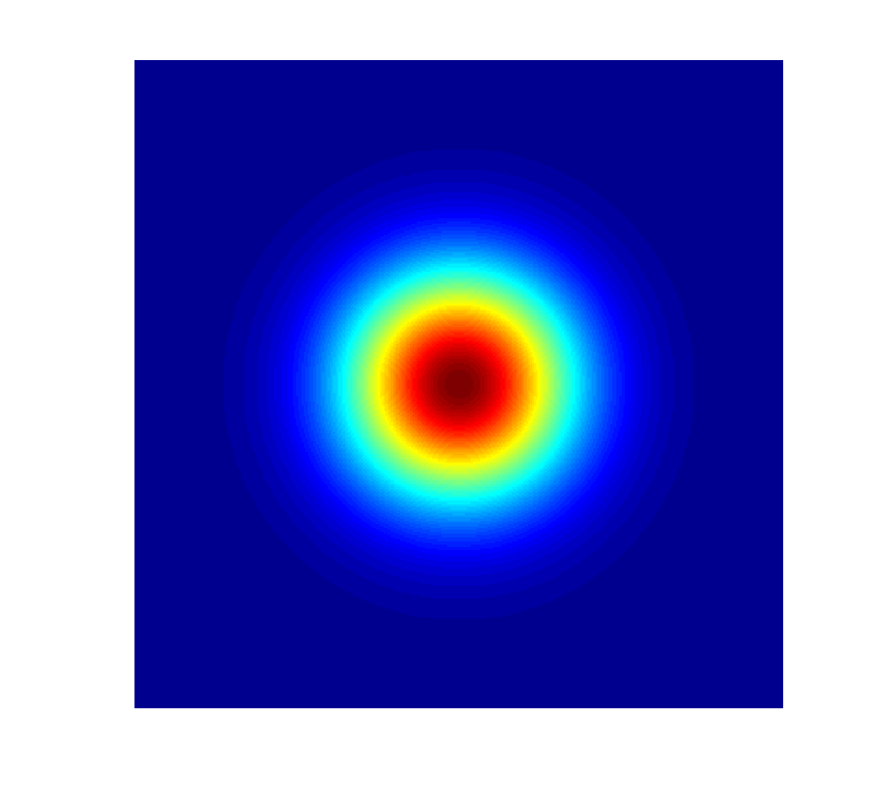
Mechanical and optical modes overlap
Mechanical mode
Optical mode

Slide 30

Parametric gain
mechanical mode quality factor
power travelling through the arm (Fabry-Perot cavity)
optical gain (function of mechanical mode frequency, cavity lengths, Gouy phase, mirror reflectivities)
$$R_{m} ∝ \frac{Q_{m}P_{arm}}{Mω_{m}^{2}λ}\sum_{all beam modes n}{{\left\{optical gain\right\}}_{n} ×} {\{overlap\}}_{n, m}$$
mechanical mode pulsation
spatial overlap between optical mode and mechanical mode
mass of the mirrors
laser wavelength
The mechanical mode is unstable if its parametric gain R_{m} is higher than 1.

Slide 31
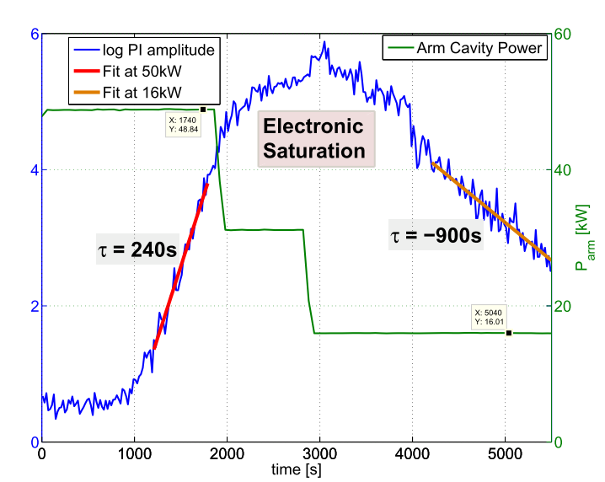
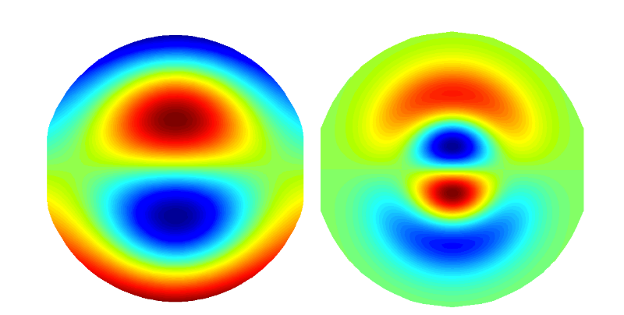

Parametric instabilities (PI) at LIGO
The instability rings up until the electronics begins to saturate, at which point the control of the interferometer is lost. Before the electronic saturation, the growth was long enough for them to try to decrease the laser power input.
The mechanical mode and the optical mode responsible for the PI.
Mechanical mode (15.5 kHz)
Optical Mode
$$τ_{m}=\frac{2Q_{m}}{ω_{m}(R_{m}−1)}$$
Evans et al, Phys. Rev. Lett. 114.16 (2015): 161102

Slide 32
Image courtesy of Wikimedia Commons,
modified.

Slide 33
Outline
Introduction
  Gravitational waves basics
  How to detect gravitational waves?
  Detections
Three-mode parametric instabilities
  Basics
  At Virgo

Slide 34
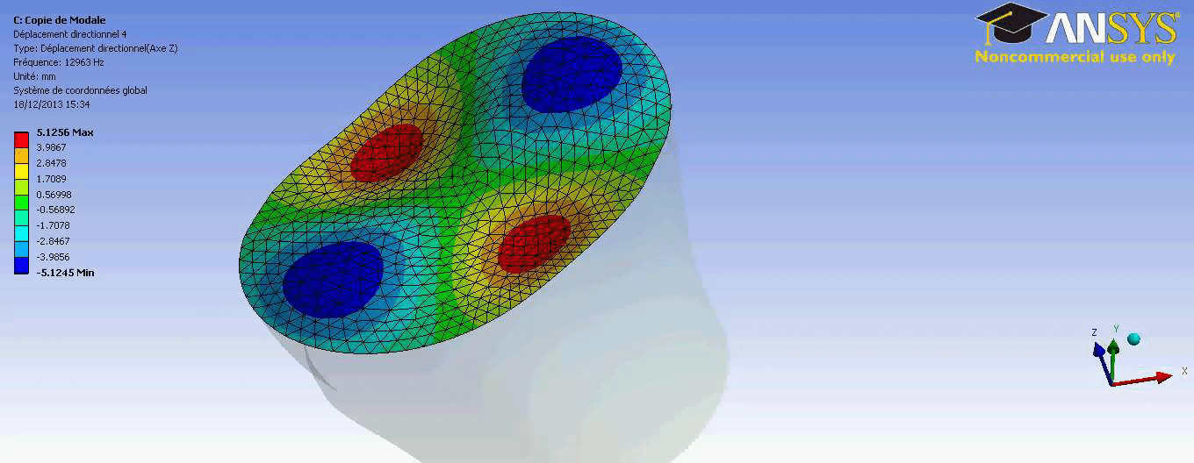
Mechanical modes computation

Slide 35
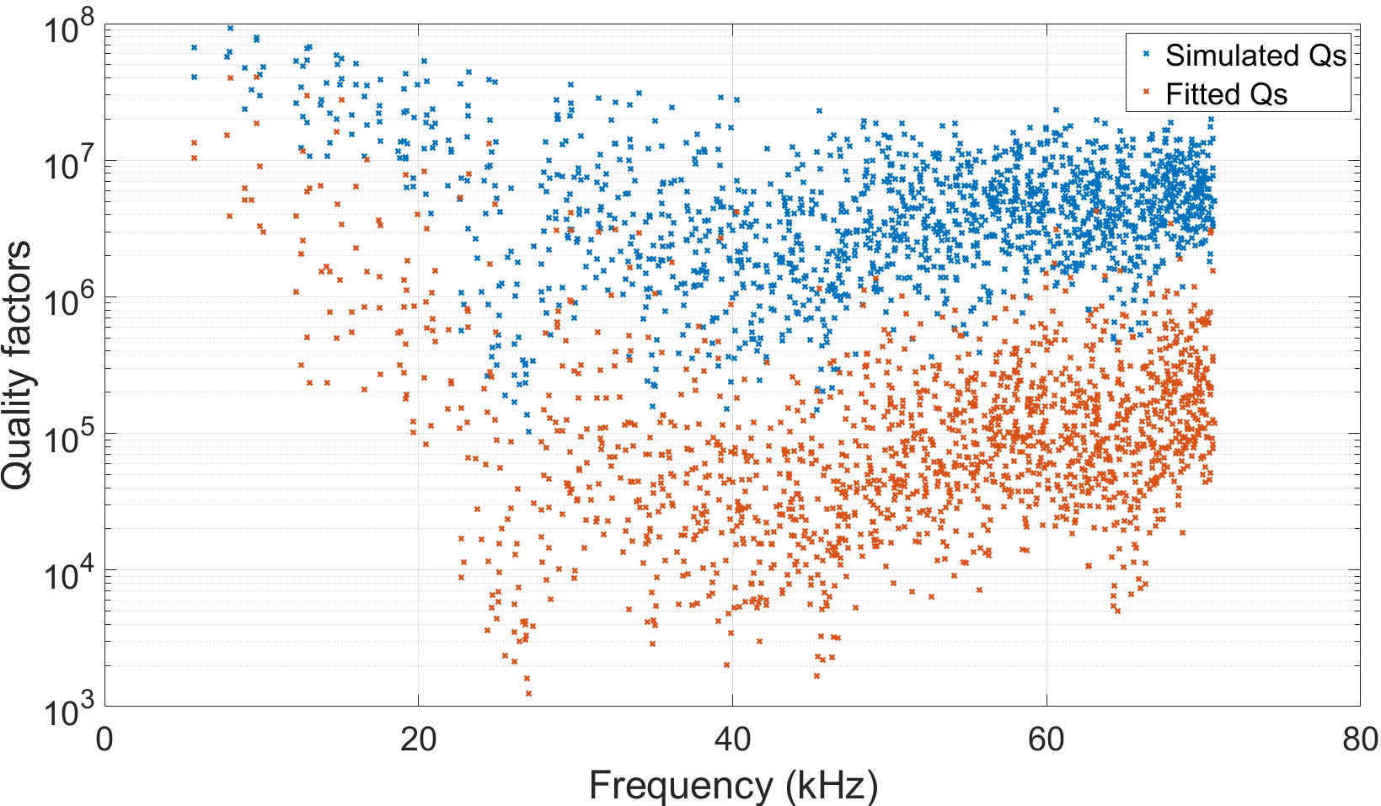
Mechanical modes’ quality factors (Qs)
On the left panel are displayed two different sets of Qs. The ‘fitted’ ones are closer to the real ones, because they were fitted from a measurement.
A new set is being measured: so far, measured Qs are even lower than the ‘fitted’ ones.
LIGO mirrors’ mechanical modes have higher Qs.

Slide 36
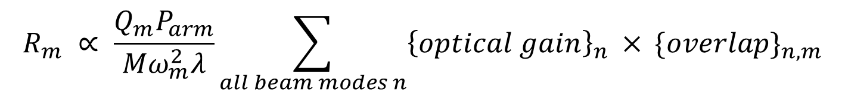
Recall of the parametric gain relation
$$R_{m} ∝ \frac{Q_{m}P_{arm}}{Mω_{m}^{2}λ}\sum_{all beam modes n}{{\left\{optical gain\right\}}_{n} ×} {\{overlap\}}_{n, m}$$
These are lower than those ‘fitted’, which are lower than those ‘simulated’, which are lower than those from LIGO!
Virgo is less likely to face PI!

Slide 37
Homemade code for PI computation
Analytical method taken from Evans et al. "A general approach to optomechanical parametric instabilities." Physics Letters A374.4 (2010): 665-671
Matlab Oriented Object Programming (OOP) code
+
Graphical User Interface (GUI)

Slide 38
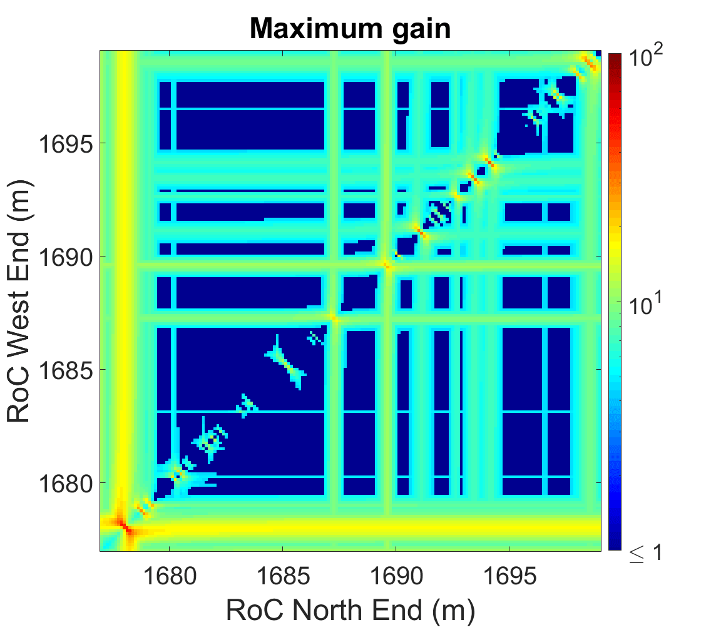
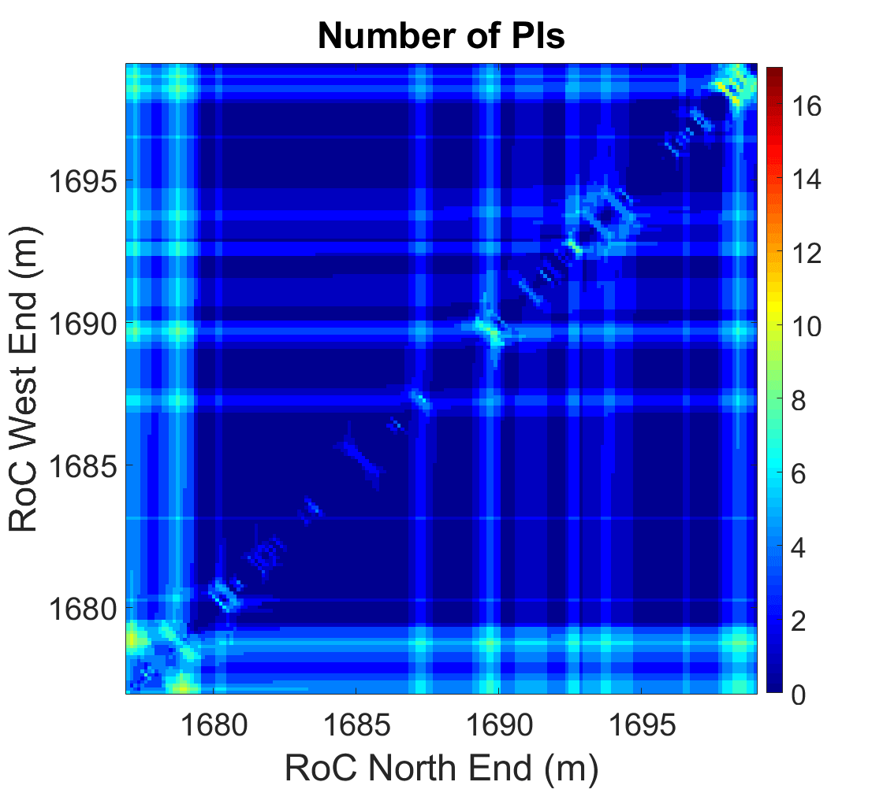
What kind of results do we get?
With all mechanical Q factors set to 10⁷
Radii of curvatures (RoC) of the two END mirrors are scanned over a chosen range in order to take various uncertainties into account.
The Virgo working point (WP) has been measured: around 1686 m for both END mirrors.

Slide 39
What kind of results do we get?
With all mechanical Q factors set to 10⁷
For each configuration (here it is a position in terms of radius of curvature), there are from 0 to less than 20 unstable mechanical modes.
Each mechanical mode resonates at a certain radius of curvature. So one can get back to the unstable mode thanks to this kind of map.

Slide 40
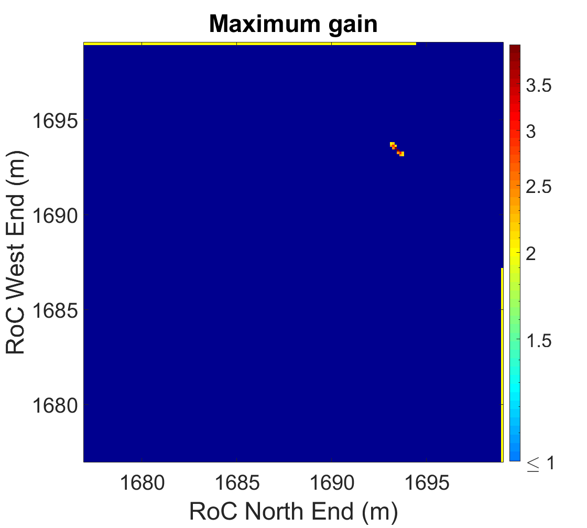
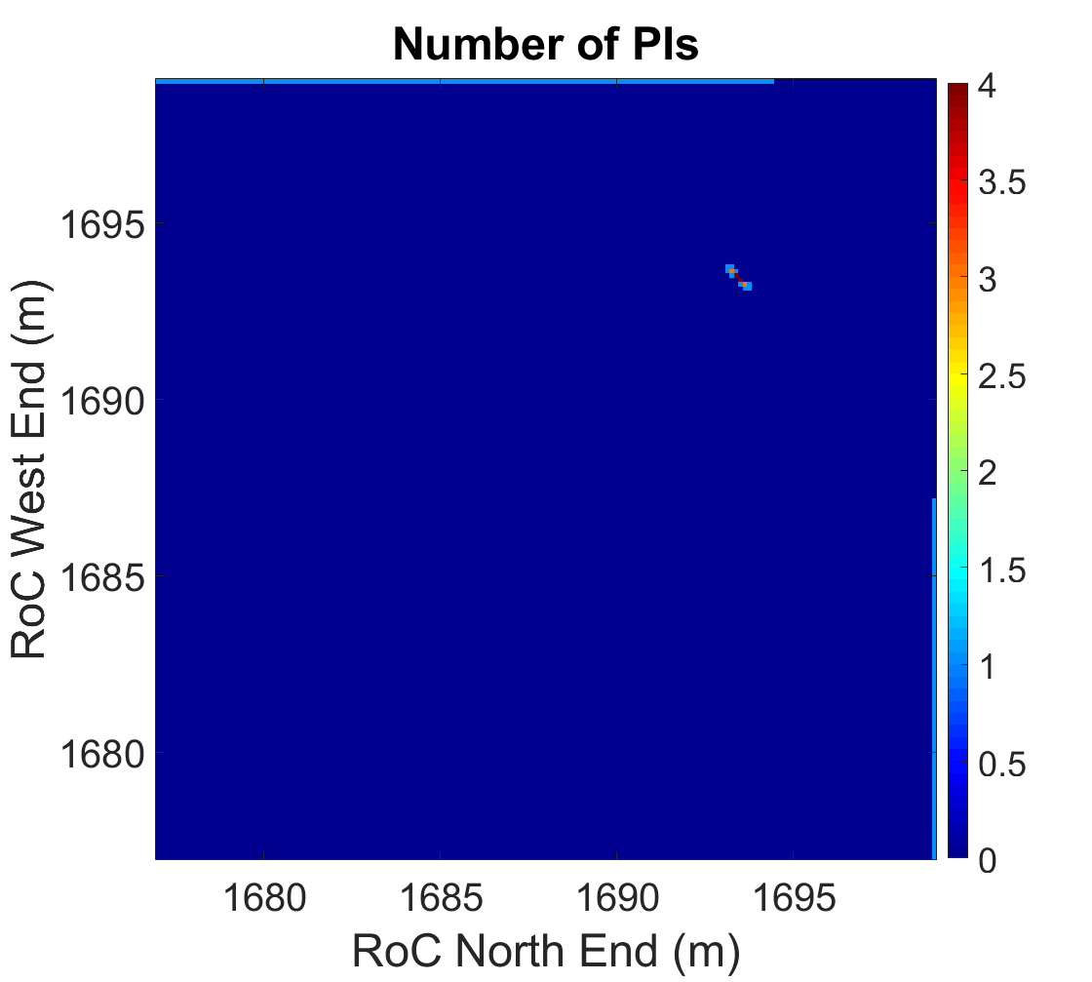
What kind of results do we get?
With all ‘fitted’ quality factors
In a more real situation, Virgo should not face any PI for the O3 setting, as one can see here. This is mainly due to the very low mechanical Qs.
The two unstable mechanical modes, the 12.516 kHz, and the 12.914 kHz, are quite far away from the WP.

Slide 41
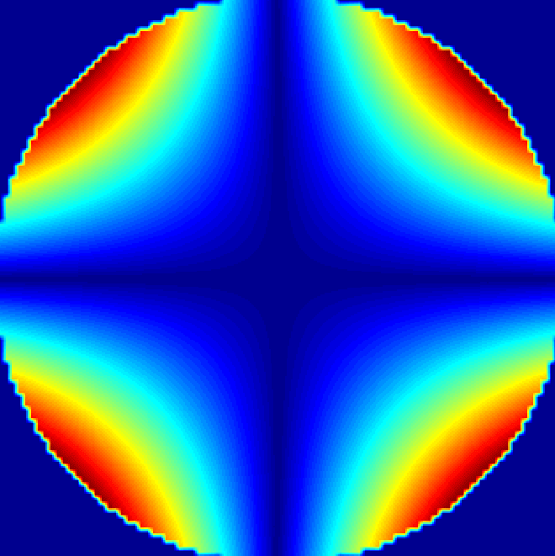
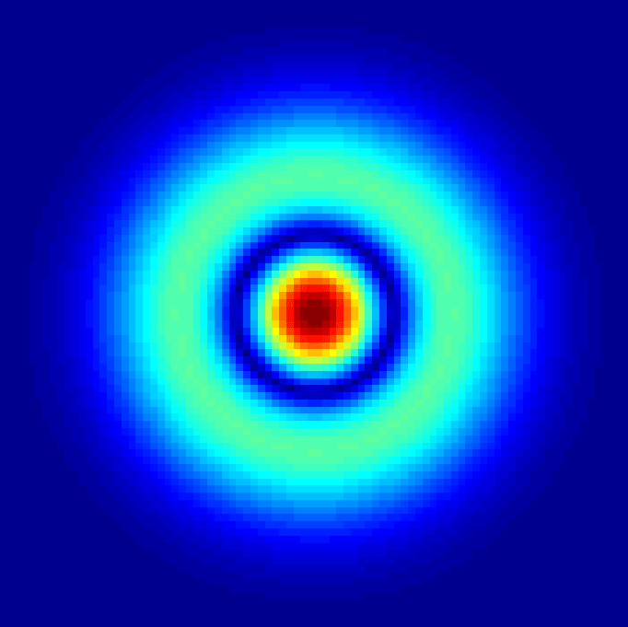
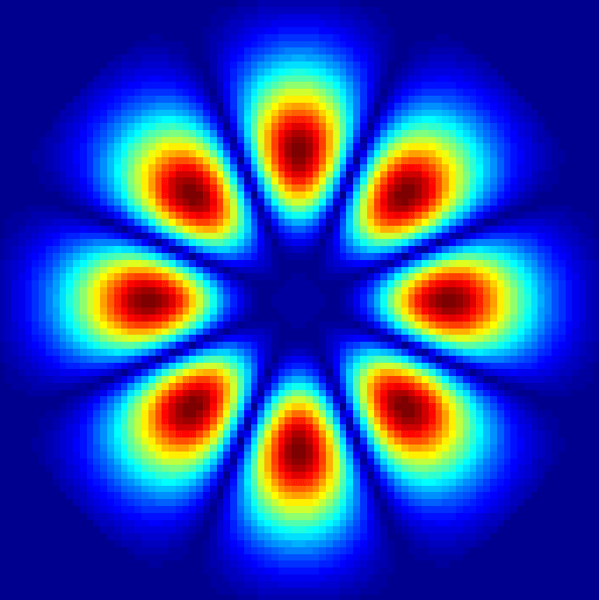
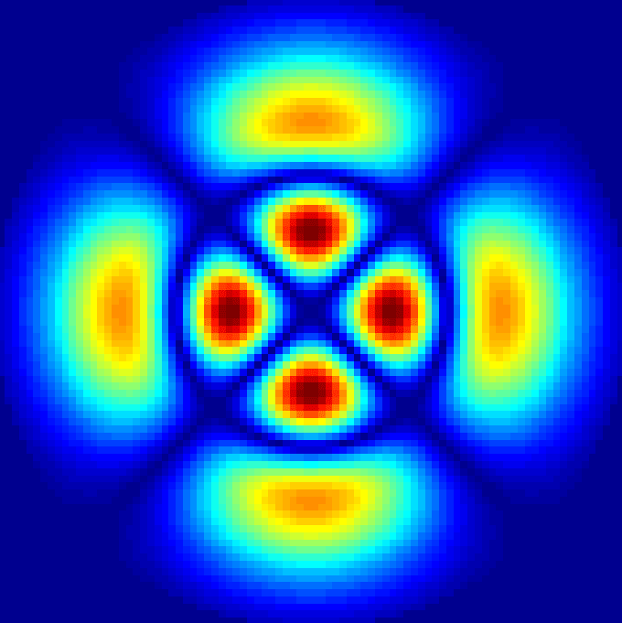
What kind of results do we get?
Mechanical mode
Main contributing optical modes
12.516 kHz
Order 2
Order 4
Order 4
As one can see, the overlap is not obviously the main contributor to the parametric gain. The optical gain plays an important role as well!

Slide 42
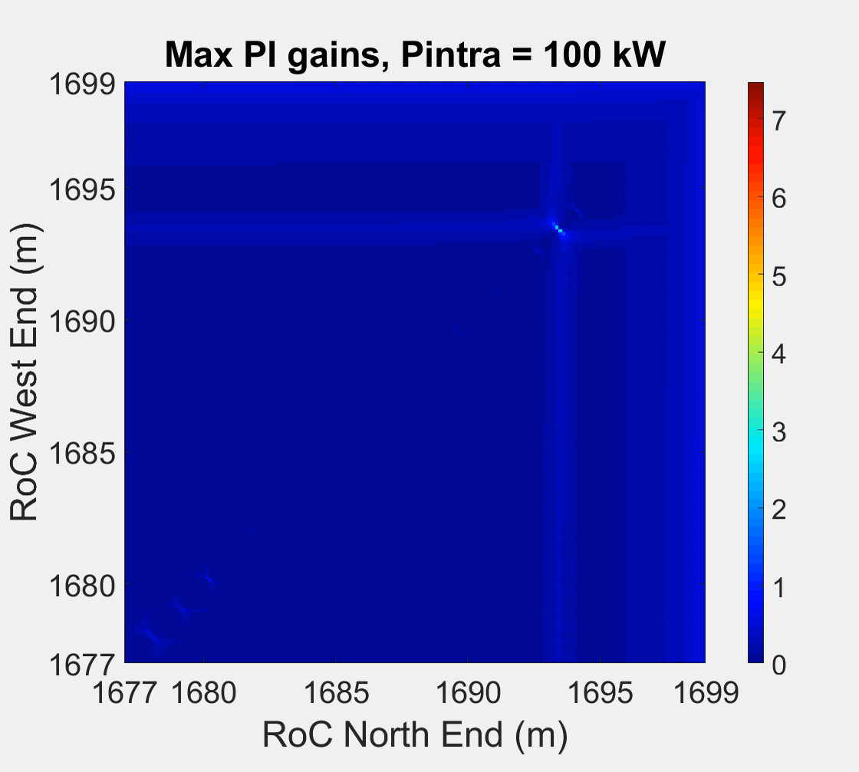

Evolution of the instabilities when the input power increases

Slide 43
At present
Virgo has never observed any optomechanical parametric instabilities so far. Our simulations helped endorse the fact that none is foreseen with the current O3 configuration.
With the same configuration, the intracavity power can be increased up to about 1500 kW.
However, the next Virgo configurations should be quite different.

Slide 44
Next steps
Perform a simulation for the O4 configuration, that is with a higher laser power input, and with an extra mirror, thus creating a new optical cavity in the interferometer (Signal Recycling Cavity).
Perform a simulation for the O5 configuration, that is with an even higher laser power input, and new mirrors.
Perform a simulation for the LIGO configuration as an extra sanity check. Indeed, they observed some of these instabilities at LIGO, therefore we should be able to find them with our program.

Slide 45
Image courtesy of Wikimedia Commons,
modified.

Slide 46


trugarez [/tʁy.ˈɡa.ʁe/]

Slide 47
Spare slides

Slide 48

Mitigation

Slide 49

GUI for commissioners
PI gains + associated mechanical
mode to the selected PI
Optical modes amplifiers contributing the most to the select PI
Optical modes dampers contributing the most to the select PI
Settings panel

Slide 50

GUI for commissioners
Panel to select the interferometer configuration, ie selecting both END mirrors RoCs
→ the first panel is modified accordingly

