Slide 1
10th International Conference on High Level Environmental Radiation Areas
27 - 30 June 2022, Strasbourg - France
Materials & Methods
Grain size effect on radon exhalation rate and uranium activity of Moroccan sediment
Results & Discussion
Conclusion
Introduction
Plan
Meryame JABBADE
meryamejabbade@gmail.com

Slide 2
1
Introduction
2
Materials & Methods
Materials & Methods
Conclusion
Introduction
Results & Discussion
Discussion
3
Plan
4
Conclusion

Slide 3
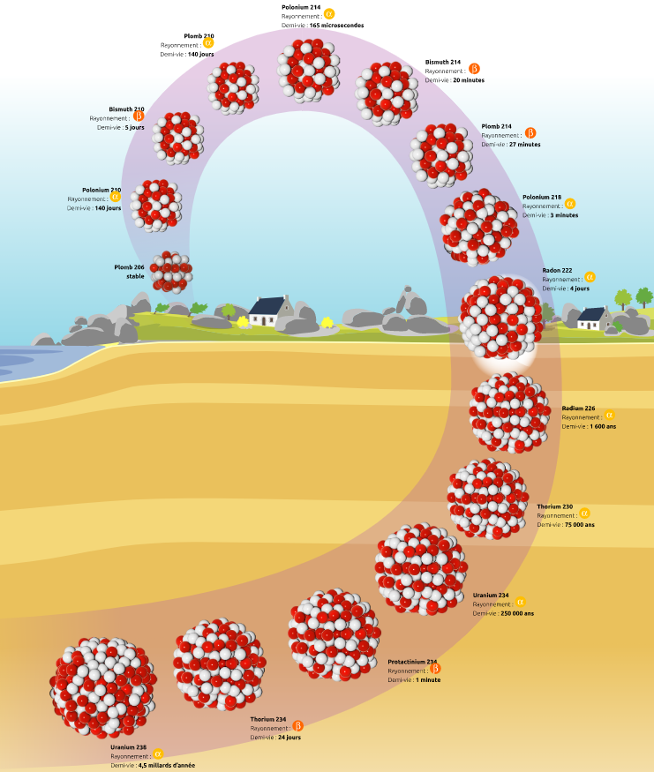
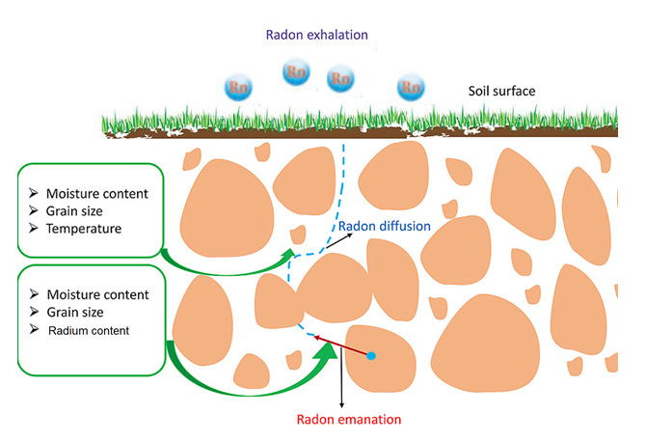
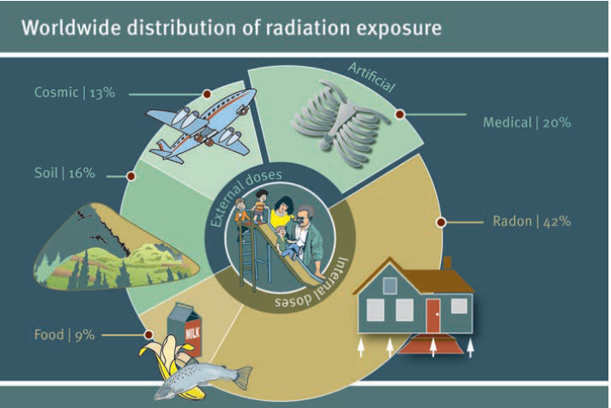
Radon is odorless, colorless gas
Radon is naturally occurring and can be found everywhere around us.
Conclusion
Methods
Discussion
Introduction
Plan
 # 2nd cause of lung cancer after tobacco
 Assessment of the exhalation rate allows a classification of materials according to their potential risk of exposure to radon.

Slide 4
Morocco has the largest phosphate reserves and is the third producer in the world.
Phosphate bearing rocks are an economical material used in the manufacturing of phosphoric acid and fertilizers.
In phosphate rocks, sometimes naturally occurring radioactive elements such as ²³⁵U, ²³⁸U and their decay products may be present with a high concentration.
Conclusion
Methods
Discussion
Introduction
Plan
Radon exhalation from phosphate may pose a health risk to people involved in the mining and processing of these materials for the manufacturing of fertilizers and other chemical products.

Slide 5
Sample preparation :
Collected from a Moroccan sedimentary phosphate deposit;
Dried at 105±1°C for 24 hours to remove moisture;
Sieved with different mesh sizes and sorted into seven fractions, namely: F1 (<0.063 mm), F2 (0.063-0.125 mm), F3 (0.125-0.25 mm), F4 (0.25-0.5 mm), F5 (0.5-1 mm), F6 (1-2 mm) and F7 (>2 mm).
Radon exhalation rate measurement :
Materials & Methods
Conclusion
Discussion
Introduction
Plan
Parameters:
Chamber volume : 2 l
Sample weight : 30 g
Exposition time : 17 day
Detector
Phosphate sample

Slide 6
Radon exhalation rate measurement:
The evolution of the radon concentration as a function of time is described by the following equation :
$$C_{Rn}\left(t\right)=C_{Rn}^{∞}×\left(1−e^{−λ_{eff}×t}\right)+C_{Rn}^{0}×e^{−λ_{eff}×t}$$
$C_{Rn}^{∞}$is the saturation concentration of radon (Bqm⁻³); $C_{Rn}^{0}$is the initial concentration of radon inside the chamber (Bqm⁻³); λ_{eff} is the effective radon decay constant.
Materials & Methods
Conclusion
Discussion
Introduction
Plan
The calculation of the radon exhalation rate is established by applying the relationship between the radon saturation concentration and the exhalation rate after fitting the radon growth equation :
$$E_{A}=\frac{C_{Rn}^{∞}×V×λ_{eff}}{A}$$
$$E_{M}=\frac{C_{Rn}^{∞}×V×λ_{eff}}{M}$$
E_{A} is the surface exhalation rate (Bqm⁻²h⁻¹); A is the surface area of the phosphate sample (m²); E_{M} is the mass exhalation rate (Bqkg⁻¹h⁻¹); M is the sample weight (kg).

Slide 7
Uranium activity measurement:
Parameters:
Capsule height : 1 cm
Capsule radius : 1.7 cm
Sample weight : 3.5 g
LR-115
Phosphate sample
Conclusion
The track densities registered on the LR-115 films were counted using a semiautomatic system.
The stored images were analysed through ImageJ 1.53e (Image Processing and Analysis in Java).
The uranium activity can be deduced from the measured track density using the following equation :
Materials & Methods
Discussion
Introduction
Plan
$$D=A×\left(1.961a+0.350b\right)$$

Slide 8
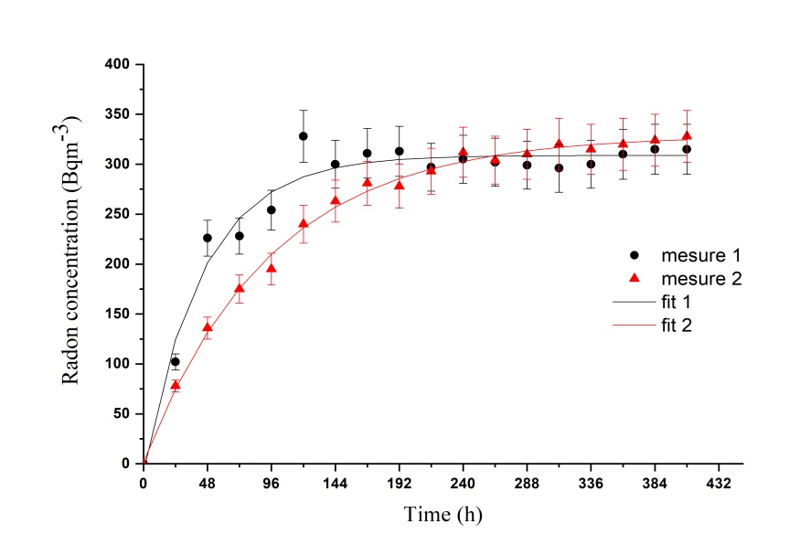
Radon exhalation rate measurement:
These results highlight the good reproducibility of the measurements.
The results are fitted well by the model described, indicating that our simple experimental setup provides good results.
Materials & Methods
Results & Discussion
Conclusion
Introduction
Plan

Slide 9
Radon exhalation rate measurement:
 | Saturation radon concentration (Bqm⁻³) | Mass exhalation rate (Bqkg⁻¹h⁻¹) | Surface exhalation rate (Bqm⁻²h⁻¹)
Bulk | 284±6 | 0.407±0.009 | 1.437±0.030
F1 : <0.063 mm | 288±5 | 0.413±0.007 | 1.458±0.025
F2 : 0.063-0.125 mm | 270±4 | 0.387±0.006 | 1.367±0.020
F3 : 0.125-0.25 mm | 312±5 | 0.447±0.007 | 1.579±0.025
F4 : 0.25-0.5 mm | 251±5 | 0.360±0.007 | 1.270±0.025
F5 : 0.5-1 mm | 228±4 | 0.327±0.006 | 1.154±0.020
F6 : 1-2 mm | 213±3 | 0.305±0.004 | 1.078±0.015
F7 : >2 mm | 215±5 | 0.308±0.007 | 1.088±0.025
Materials & Methods
Results & Discussion
Conclusion
Introduction
Plan
No notable trend is observed for grains smaller than 0.125 mm.
A decrease in radon exhalation rate with increasing grain size is noticed for grains larger than 0.125 mm.

Slide 10
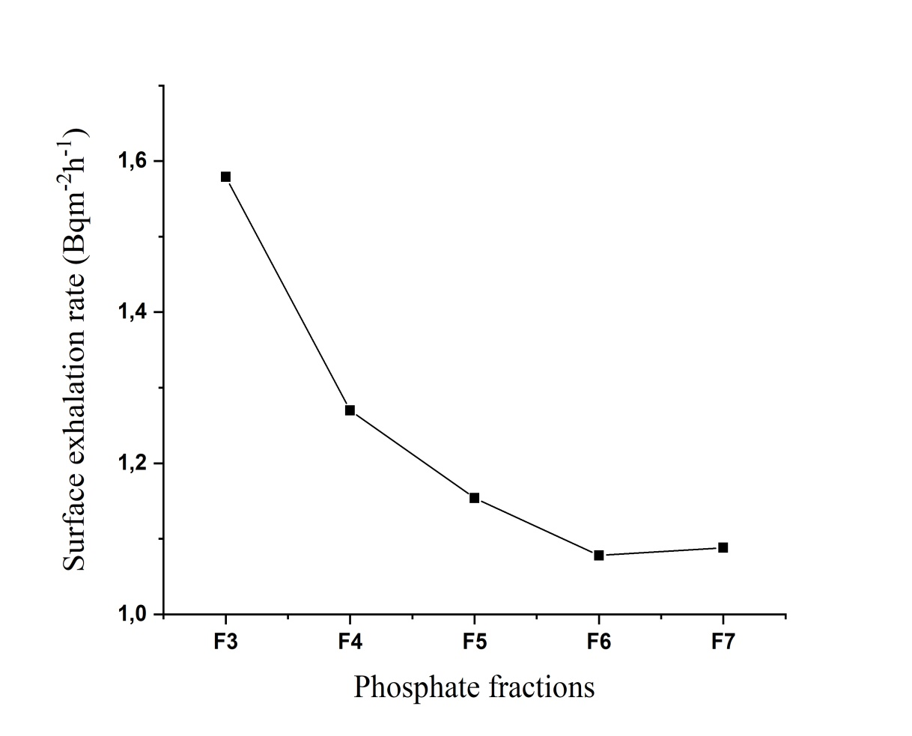
Radon exhalation rate measurement:
This decrease followed an inverse power law.
The decrease in grain size results in an increase in the specific surface area.
The smaller grains are characterized by high porosity values.
Materials & Methods
Results & Discussion
Conclusion
Introduction
Plan
 E_{A}< 57600 Bq.m⁻².h⁻¹

Slide 11
Uranium activity measurement:
It is noted that the uranium activity increases significantly with sample mass.
Sample mass (g) | Track density (trm⁻²s⁻¹) | Uranium Activity (Bqkg⁻¹)
1 | 21.16±2.77 | 926±122
2.5 | 23.81±2.92 | 1039±128
3 | 27.54±3.12 | 1205±137
3.5 | 29.76±3.24 | 1309±142
5 | 24.80±2.98 | 1093±131
7.5 | 25.46±3.01 | 1119±132
10 | 12.24±2.17 | 535±95
Materials & Methods
Results & Discussion
Conclusion
Introduction
Plan
A weight of 3.5 g is sufficient to determine the uranium content of phosphate rocks using the same capsule.

Slide 12
Uranium activity measurement:
We notice that the uranium activity is higher in all the fractions than in the bulk phosphate sample.
 | Uranium Activity (Bqkg-1) | Uranium content (ppm)
Bulk | 1174±135 | 95±11
F1 : <0.063 mm | 1039±128 | 84±10
F2 : 0.063-0.125 mm | 1235±139 | 100±11
F3 : 0.125-0.25 mm | 1613±157 | 131±13
F4 : 0.25-0.5 mm | 1809±166 | 147±13
F5 : 0.5-1 mm | 1762±164 | 143±13
F6 : 1-2 mm | 1660±152 | 134±13
F7 : >2 mm | 1492±128 | 121±12
Materials & Methods
Results & Discussion
Conclusion
Introduction
Plan
For a better comparison between the uranium content of a selected fraction and that of its corresponding unfractionated phosphate sample, we use enrichment factor (EF) :
$$EF=\frac{A_{F}}{A_{B}}×ω_{F}$$

Slide 13
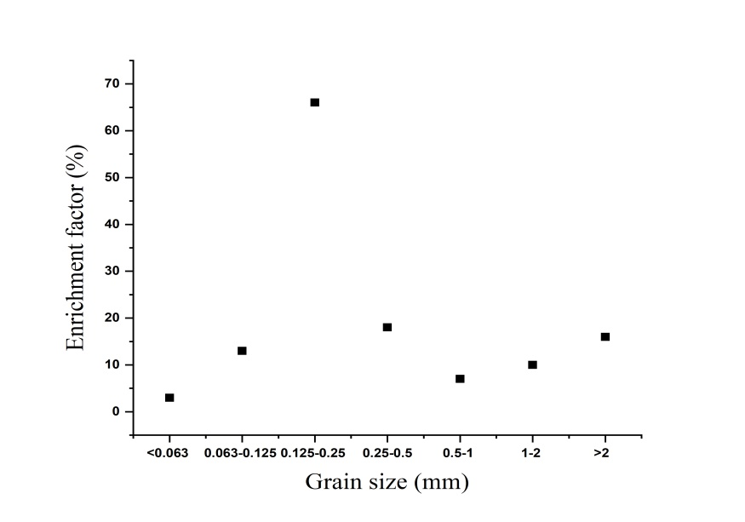
Uranium activity measurement:
The fractions with a diameter between 0.125 and 0.315 mm are constituted mainly by phosphate grains which concentrate more uranium than the constituents of the other fractions.
We note that the sum of the enrichment factors of fractions F5, F6, and F7 is only equal to 33%, even though they have high uranium contents.
Materials & Methods
Results & Discussion
Conclusion
Introduction
Plan

Slide 14
The aim of the present study is to investigate the grain size effect of the phosphate on the radon concentration and the uranium activity.
The radon exhalation rate was found to decrease with an increase in grain size above 0.125 mm.
The uranium content increases for the smallest particles (<0.25 mm), reaching a maximum for the particles (0.25-0.5 mm), decreasing for the larger particles (>0.5 mm).
The measured values of radon exhalation rates and uranium content of the sediment sample are under the radon exhalation rate and uranium content limits reported worldwide.
Results & Discussion
Methods
Conclusion
Introduction
Plan
14

Slide 15
THANK YOU FOR
YOUR ATTENTION
Results & Discussion
Methods
Conclusion
Introduction
Plan
M. JABBADE June 23, 2022
meryamejabbade@gmail.com
15

