Slide 1


Radiation Dose Assessment and Mobility Studies of Thorium in Soil from a High Level Natural Background Radiation Area in Sri Lanka
S. Ratnayake^{1,2}, J. Lützenkirchen¹, P. Mahakumara², U. De Silva³, H. Geckeis¹
¹Institute for Nuclear Waste Disposal, Karlsruhe Institute of Technology, Germany
²Sri Lanka Atomic Energy Board, Wellampitiya, Sri Lanka
³Geological Survey and Mines Bureau, Pitakotte, Sri Lanka
Institute for Nuclear Waste Disposal
28.06.2022
Notes:
Prof. Dr. Claus Feldmann

Slide 2
Overview
Introduction
Background of study
Methods
Characterization of environmental samples
Potential mobility of target elements
Conclusions
1

Slide 3
Introduction
Background
Methods
Characterization
Mobility
Conclusions
1. Introduction
2

Slide 4

Introduction
Background
Methods
Characterization
Mobility
Conclusions
1. Introduction
Background radiation
Area with enhanced levels of terrestrial radiation levels
World Average: 2.4 mSv yr⁻¹
2

Slide 5
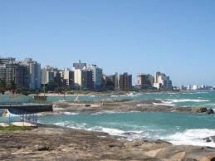

Introduction
Background
Methods
Characterization
Mobility
Conclusions
1. Introduction
Background radiation
Area with enhanced levels of terrestrial radiation levels
World Average: 2.4 mSv yr⁻¹
Brazil
(Guarapari)
~175 mSv yr⁻¹
India
(Kerala)
~70 mSv yr⁻¹
Ref: - Sohrabi, M., Applied Radiation and Isotopes, 1998. 49(3): p. 169-188
- Ramasamy, V., et al., Applied Radiation and Isotopes, 2014. 85: p. 1-10 -
2
Notes:
The source is sand eroded from Monazite, an ore of the naturally radioactive element thorium commonly found in mountains backing the shore. In Guarapari up to 175 mSv (millisieverts)) per year have been measured. Compare this figure with the current annual safe limit for nuclear workers: 20 mSv a year. Not coincidentally, Japanese government’s enforced 20 km exclusion zone around the stricken Fukushima Daiichi nuclear power plant is also rated at 20 mSv per year.
China-the sand in the region has eroded from hills containing monazite, annual NBR exposures three times the world’s average.
Kerala-Though today the region’s minerals are being exploited by rare earth metal mining operations, some of those minerals (monazite to be exact) have been eroding into beach sand and alluvial deposits for millions of years

Slide 6
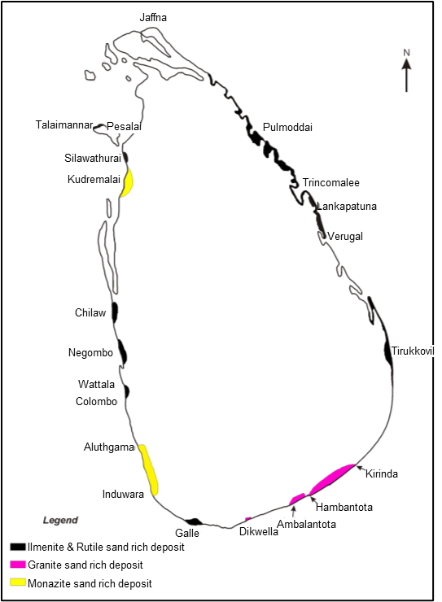
Introduction
Background
Methods
Characterization
Mobility
Conclusions
1. Introduction
Background radiation
Area with enhanced levels of terrestrial radiation levels
World Average: 2.4 mSv yr⁻¹
Brazil
(Guarapari)
~175 mSv yr⁻¹
Sri Lanka
(Beruwala)
~23 mSv yr⁻¹
India
(Kerala)
~70 mSv yr⁻¹
0
40
80 km
Ref: - Sohrabi, M., Applied Radiation and Isotopes, 1998. 49(3): p. 169-188
- Ramasamy, V., et al., Applied Radiation and Isotopes, 2014. 85: p. 1-10 -
- Withanage, A. and P. Mahawatte, Radiation protection dosimetry, 2013. 153(3): p. 384-389
2

Slide 7
Introduction
Background
Methods
Characterization
Mobility
Conclusions
2. Background of study
3
Notes:
Base line environmental monitoring program
exploring the availability of natural radio-minerals in Sri Lanka is one of the responsibilities of SLAEB.
in 2011 a proposal submitted to the iaea technical cooperation programme was accepted
Survey of Nuclear Raw Material with Emphasis on Locating Thorium and Uranium Mineralization and demarcating Radiogenically Hazardous Areas. (~ 190,000 Euros)
Occurrence of Thorium Bearing Minerals in Sri Lanka & Progress of Survey of Nuclear Raw Material with Emphasis on Locating Thorium and Uranium Mineralization and Demarcating Radiogenically Hazardous Areas
(Project SLR-2009)
Beach minerals: 28-35 mSv/yr

Slide 8
Introduction
Background
Methods
Characterization
Mobility
Conclusions
2. Background of study
Collaborative Project 2011 – 2015:
Sri Lanka Atomic Energy Board (SLAEB)
Geological Survey and Mines Bureau (GSMB – SL)
International Atomic Energy Agency (IAEA)
3

Slide 9
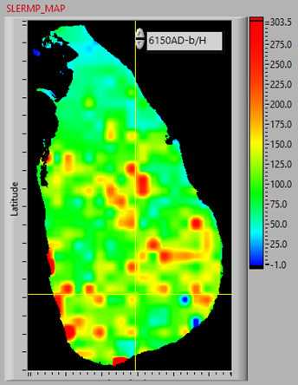
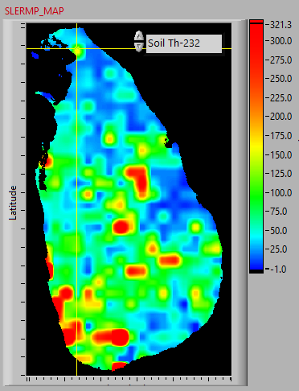
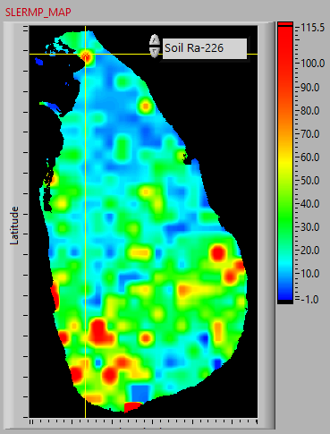
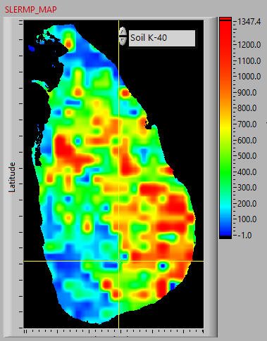
Introduction
Background
Methods
Characterization
Mobility
Conclusions
2. Background of study
Overall
nGy/h
Th-232
Bq/kg
Collaborative Project 2011 – 2015:
Sri Lanka Atomic Energy Board (SLAEB)
Geological Survey and Mines Bureau (GSMB – SL)
International Atomic Energy Agency (IAEA)
Ra-226
Bq/kg
K-40
Bq/kg
0
80
160 km
Ref: SLAEB, Baseline Radioactivity Data, https://aeb.gov.lk
3
Notes:
1.1.%, 6-8% of monazite in beach sand

Slide 10

Introduction
Background
Methods
Characterization
Mobility
Conclusions
2. Background of study
Overall
nGy/h
Th-232
Bq/kg
Collaborative Project 2011 – 2015:
Sri Lanka Atomic Energy Board (SLAEB)
Geological Survey and Mines Bureau (GSMB – SL)
International Atomic Energy Agency (IAEA)
Ra-226
Bq/kg
K-40
Bq/kg
Motivation
Target location is a school – playground
Lack of systematic studies on
Radiological/geochemical characterization
Environmental behavior of natural radionuclides (NRs)
0
80
160 km
Ref: SLAEB, Baseline Radioactivity Data, https://aeb.gov.lk
3

Slide 11
Introduction
Background
Methods
Characterization
Mobility
Conclusions
3. Methods
Gamma spectrometry (in-situ, laboratory)
X-ray Diffraction (XRD)
X-ray Fluorescence spectroscopy (XRF)
Scanning Electron Microscopy-Energy Dispersive X-ray spectroscopy (SEM-EDX)
Synchrotron-based X-ray Absorption Spectroscopy (XAS)
Trace element analysis by ICP-MS
4

Slide 12
Introduction
Background
Methods
Characterization
Mobility
Conclusions
4. Characterization of soil samples
5

Slide 13
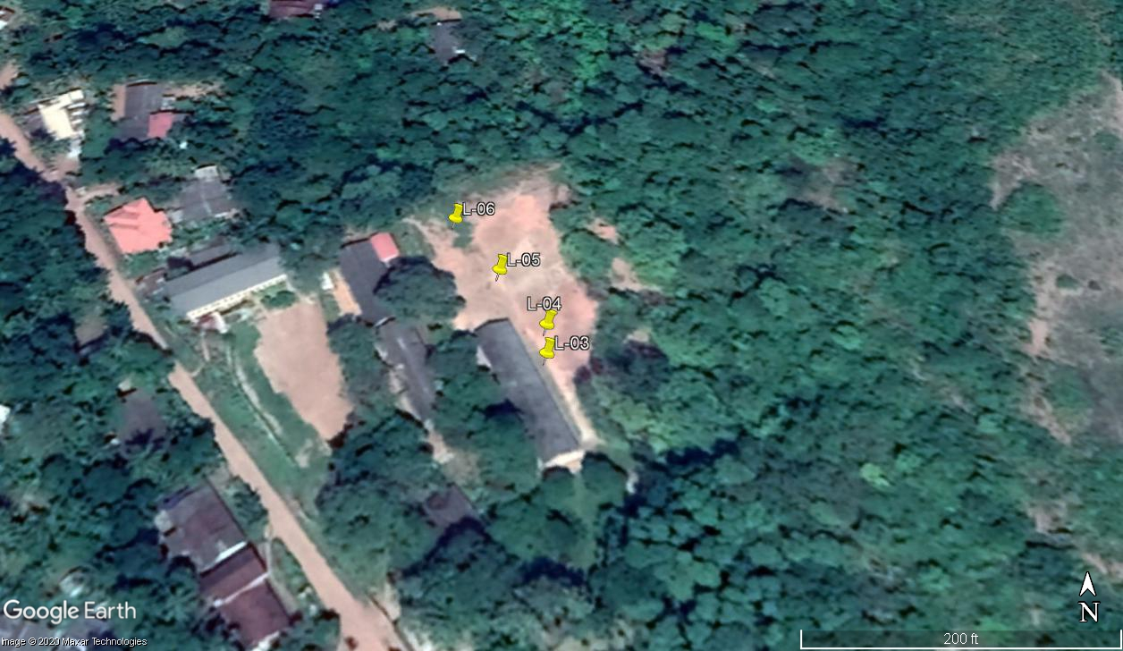
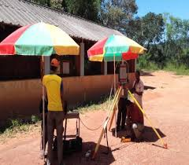
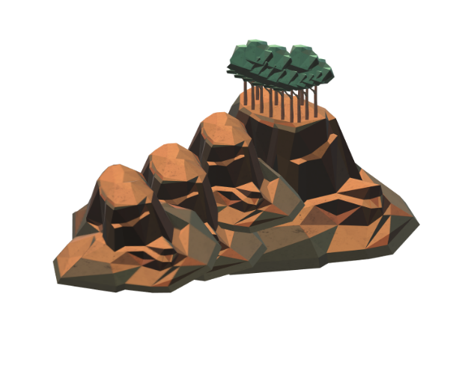
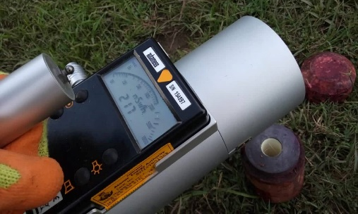
Introduction
Background
Methods
Characterization
Mobility
Conclusions
4. Characterization of soil samples
Radiological: In-situ measurements
A
B
A
L-06
B
L-05
C
L-04
D
L-03
C
D
E
E
A
B
Measured effective dose rates:
2.5 ± 1.2 µSv/hr
21.6 ± 10.9 mSv/yr
C
D
World average : 2.4 mSv/yr
World range : 1 – 10 mSv/yr
E
362 m
Ref: UNSCEAR, 2000. Sources and Effects of Ionizing Radiation. United Nations, New York.
M.R. Carter, E.G.G., 2007. Soil Sampling and Methods of Analysis, Second ed. CRC Press, Florida.
G. Estefan, R.S., J. Ryan, 2013. Methods of Soil, Plant and Water Analysis, International Centre for Agricultural Research in the Dry Areas, Lebonan
5

Slide 14
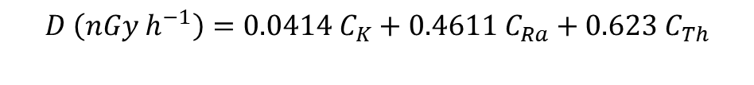
Introduction
Background
Methods
Characterization
Mobility
Conclusions
Radiological: Activity measurements
Gamma Spectrometric Analysis:
Th-232 : 4000 – 7600 Bq/kg
K-40 : 300 – 550 Bq/kg
Ra-226 : 300 – 600 Bq/kg
For Th-232
World average : 30 Bq/kg
World range: 11 – 64 Bq/kg
$$D \left(nGy h^{−1}\right)=0.0414 C_{K}+0.4611 C_{Ra}+0.623 C_{Th}$$
Calculated absorbed dose rates in air:
3000 – 4600 nGy/h
World average : 18 – 93 nGy/h
Kerala and Madras : 200 – 4000 nGy/h
Ref: UNSCEAR, 2000. Sources and Effects of Ionizing Radiation. United Nations, New York
6
Notes:
Absorbed dose rate: Monazite sands, coastal areas 200 km long, 0.5 km wide
Calculated 4.5 ± 0.2 mSv/yr
SOURCES AND EFFECTS
OF IONIZING RADIATION
United Nations Scientific Committee on the Effects of Atomic Radiation
UNSCEAR 2000 Report to the General Assembly

Slide 15
Introduction
Background
Methods
Characterization
Mobility
Conclusions
Geochemical:
pH: 4.4 ± 0.2
TOC: 1.4 ± 0.4 g/kg
Ref: - Ratnayake, S.Y., et al. (submitted 1)
7
Notes:
TOC: K2Cr2O7 is titrated with ammonium ferrous sulphate using diphenyl amine indicator. Get oxidizable OC and using equations can calculate TOC
pH: 10 g of sediment sample with 50 mL of Milli-Q water. The samples were stirred intermittently for 30 min and allowed to stand for 1 hour

Slide 16
Introduction
Background
Methods
Characterization
Mobility
Conclusions
Geochemical:
pH: 4.4 ± 0.2
TOC: 1.4 ± 0.4 g/kg
XRD:
Bulk
Sieved
<40 µm
Ref: - Ratnayake, S.Y., et al. (submitted 1)
7

Slide 17
Introduction
Background
Methods
Characterization
Mobility
Conclusions
Geochemical:
pH: 4.4 ± 0.2
TOC: 1.4 ± 0.4 g/kg
XRD:
XRF:
Bulk
P₂O₅
Fe₂O₃
Al₂O₃
SiO₂
REEs
U
Th
La + Ce + Nd
Sieved
<40 µm
Ref: - Ratnayake, S.Y., et al. (submitted 1)
7

Slide 18
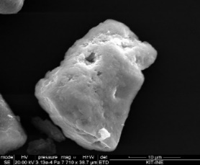
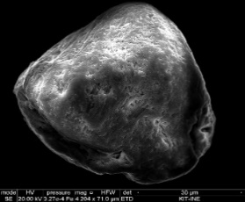
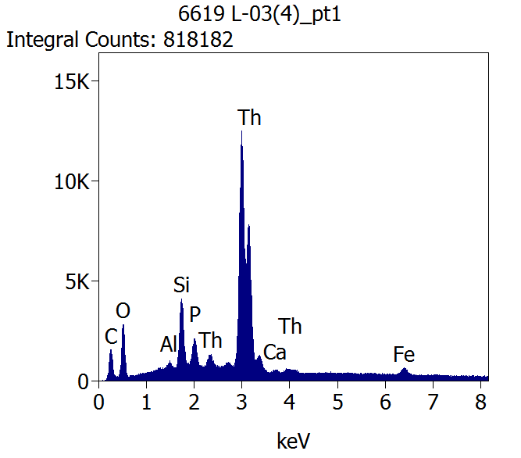
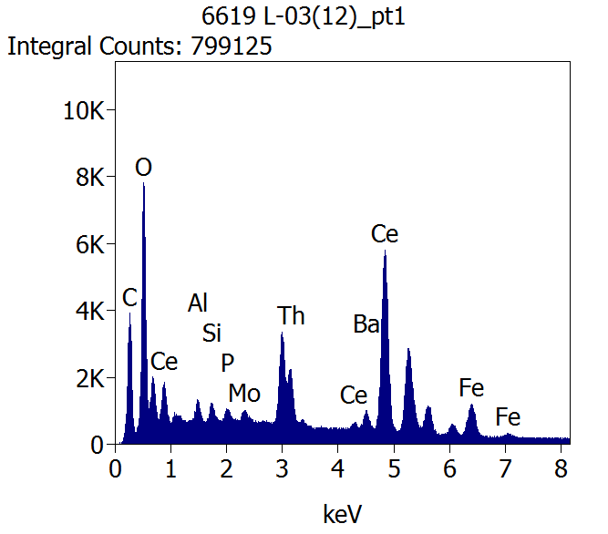
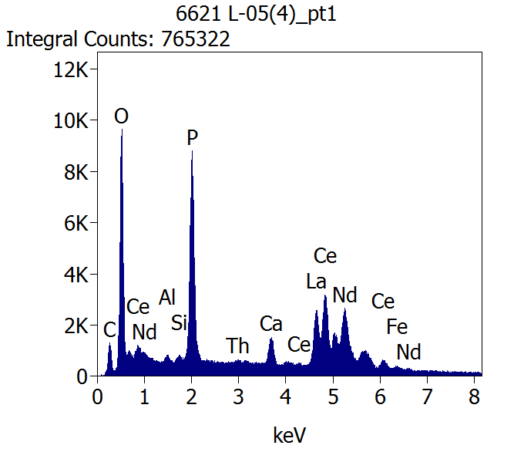
Introduction
Background
Methods
Characterization
Mobility
Conclusions
SEM-EDX (INE)
Th-silicate
Th-oxide
Th-phosphate
2.5 µm
5 µm
10 µm
µ-XRF (KARA)
Ref: - Rothe, J., et al., Review of scientific instruments, 2012. 83(4): p. 043105
- Ratnayake, S.Y., et al. (submitted 1)
- Ratnayake, S.Y., et al. (submitted 2)
8
Notes:
shell by shell fitting approach is not possible-Th in the sediments is associated with more than one mineral phase: possible overlap from shells located at comparable distance in the host structures
LCF analysis provides direct information on the proportion of each mineral phase to the experimental data
LCF: Th speciation in the soil samples is dominated by Th-phosphate, with lower contributions from Th-silicate and Th-oxide
energy position of the edge of these spectra are consistent with that of Th(IV)

Slide 19
Introduction
Background
Methods
Characterization
Mobility
Conclusions
XAS (Th L₃ – edge, 16.3 keV), here for L-05
EXAFS
LCF – EXAFS
Monazite: 61 ± 7 wt.%
ThSiO₄: 24 ± 7 wt.%
ThO₂: 16 ± 7 wt.%
Average for L-03 – L-06:
Ref: - Rothe, J., et al., Review of scientific instruments, 2012. 83(4): p. 043105
- Ratnayake, S.Y., et al. (submitted 2)
- Ravel, B. and M. Newville, Journal of synchrotron radiation, 2005. 12(4): p. 537-541
9
Notes:
Monazite: P K-edge in literature

Slide 20
5. Potential mobility of target elements
Introduction
Background
Methods
Characterization
Mobility
Conclusions
10

Slide 21
5. Potential mobility of target elements
Introduction
Background
Methods
Characterization
Mobility
Conclusions
Sequential extraction experiment (operationally-defined fractions)
2 g of soil (L-05)
F1: Exchangeable – 20 mL, 1 M MgCl₂, pH 7, 2 hrs
F2: Carbonates – 30 mL, 1 M NaOAc/HAc, pH 5, 7 hrs
F3: Organic – 20 mL, 0.1 M Na₄P₂O₇, pH 9.8, 2 hrs
F4: Amorphous Fe/Mn oxyhydroxides – 20 mL, 0.2 M NH₄C₂O₄/H₂C₂O₄, pH 3, 5 hrs
F5: Crystalline Fe/Mn oxyhydroxides – 20 mL, 0.2 M Sodium citrate/Citric acid + dithionite, pH 5, 6 hrs
F6: Residual – XRF
Ref: - Guo, P., et al.,Talanta, 2007. 71(2): p. 778-783.
- Ratnayake, S.Y., et al. (submitted 1)
10
Notes:
Selective extraction steps provide some kind of estimations for the element fraction which could be potentially mobilized. The assignment of a certain metal ion fraction to a host phase turns out to be very difficult. Addition of a chemical reagent (complexing ligand, acid etc.) will not only selectively dissolve the “operationally defined” phase, but also a certain part of the minerals where Th, La, U are initially bound to. We can assume that the solid phase, which has the highest solubility in the soil will be Th-oxides (incl. mixed phases containing REE and U). It is extremely difficult, if not impossible to distinguish e.g. Th dissolving from ThO₂ from the fraction potentially bound to amorphous Fe/Mn oxihydroxides.

Slide 22
5. Potential mobility of target elements
Introduction
Background
Methods
Characterization
Mobility
Conclusions
Sequential extraction experiment (operationally-defined fractions)
2 g of soil (L-05)
F1: Exchangeable – 20 mL, 1 M MgCl₂, pH 7, 2 hrs
F2: Carbonates – 30 mL, 1 M NaOAc/HAc, pH 5, 7 hrs
F3: Organic – 20 mL, 0.1 M Na₄P₂O₇, pH 9.8, 2 hrs
F4: Amorphous Fe/Mn oxyhydroxides – 20 mL, 0.2 M NH₄C₂O₄/H₂C₂O₄, pH 3, 5 hrs
F5: Crystalline Fe/Mn oxyhydroxides – 20 mL, 0.2 M Sodium citrate/Citric acid + dithionite, pH 5, 6 hrs
F6: Residual – XRF
Ref: - Guo, P., et al.,Talanta, 2007. 71(2): p. 778-783.
- Ratnayake, S.Y., et al. (submitted 1)
10

Slide 23
5. Potential mobility of target elements
Introduction
Background
Methods
Characterization
Mobility
Conclusions
Sequential extraction experiment (operationally-defined fractions)
2 g of soil (L-05)
F1: Exchangeable – 20 mL, 1 M MgCl₂, pH 7, 2 hrs
F2: Carbonates – 30 mL, 1 M NaOAc/HAc, pH 5, 7 hrs
F3: Organic – 20 mL, 0.1 M Na₄P₂O₇, pH 9.8, 2 hrs
F4: Amorphous Fe/Mn oxyhydroxides – 20 mL, 0.2 M NH₄C₂O₄/H₂C₂O₄, pH 3, 5 hrs
F5: Crystalline Fe/Mn oxyhydroxides – 20 mL, 0.2 M Sodium citrate/Citric acid + dithionite, pH 5, 6 hrs
F6: Residual – XRF
Largest fractions of Th, U and La
Associated with refractory minerals (F6)
Th is less mobile than U and La
No significant exchangeable fractions of Th and U
Can be mobilized
Hardly mobilized
Ref: - Guo, P., et al.,Talanta, 2007. 71(2): p. 778-783.
- Ratnayake, S.Y., et al. (submitted 1)
10

Slide 24
Introduction
Background
Methods
Characterization
Mobility
Conclusions
Batch leaching experiments
Simulated rainwater (SRW)
0.2 g of soil (L-05) in 50 mL of SRW, pH 5
Procedures: rotating (7 days) and without rotating
Ref: Ranasinghe, R., D., et al., Engineer: Journal of the Institution of Engineers, Sri Lanka, 2014. 47(2).
11
Notes:
10-6 M ionic strength
SRW approach is the most realistic way to mimic the mobility of Th, U, and La in the site. The target area is affected by heavy monsoon and inter-monsoon rains during some periods of the year, which could be a possible mode for mobilization and subsequent transport.
ionic strengths of each SRW are very low thereby any kind of colloids or even small sized particulates released from the soil could be kept stable in suspension.

Slide 25
Introduction
Background
Methods
Characterization
Mobility
Conclusions
Batch leaching experiments
Simulated rainwater (SRW)
0.2 g of soil (L-05) in 50 mL of SRW, pH 5
Procedures: rotating (7 days) and without rotating
11

Slide 26
Introduction
Background
Methods
Characterization
Mobility
Conclusions
Batch leaching experiments
Simulated rainwater (SRW)
0.2 g of soil (L-05) in 50 mL of SRW, pH 5
Procedures: rotating (7 days) and without rotating
Rotated > unrotated → mechanically enhanced release of elements into mobile phase
Absence of NRs in unrotated samples → probably released exclusively in colloidal or in particulate form in rotated samples
11
Notes:
Th under the DL (0.1 ng/L in triple quad)
The differences in metal concentrations in rotated and non-rotated samples are very likely mainly due to some kind of mechanically enhanced colloidal release. Such colloidal species are often the reason for unexplainable variations in concentrations (as e.g. seen for La in SRW after 21 days).

Slide 27
6. Conclusions
Introduction
Background
Methods
Characterization
Mobility
Conclusions
First detailed study of both radiological/geochemical characterization and corresponding environmental mobility of Th and U in environmental samples from central Sri Lanka.
12

Slide 28
6. Conclusions
Introduction
Background
Methods
Characterization
Mobility
Conclusions
First detailed study of both radiological/geochemical characterization and corresponding environmental mobility of Th and U in environmental samples from central Sri Lanka.
Radiological analyses
External
Activity measurements + dose calculations
Clearly above world average
According to criteria in UNSCEAR report
Area proposed to be classified as HBRA
Solid phase characterization
Sample and mineral heterogeneity
3 major phases identified for Th:
Th-oxides, Th-silicates, Th-phosphate
+ intergrown mineral assemblages
12
Notes:
UNSCEAR (United Nations Scientific Committee on the Effects of Atomic Radiation) provided a list of worldwide ‘high background radiation areas’ (HBRA), although the specific criteria to characterize an area as HBRA are still needed. Review of the current list showed that these areas mainly have high absorbed gamma dose rates in the air (>300 nGy h⁻¹), enhanced soil radionuclides activity concentrations and ²²²Rn concentrations in the air (indoor ²²²Rn > 150 Bq m⁻³). According to results of the present study, this location should be considered as an HBRA. These locations are of interest to illustrate chronic human exposure to elevated natural radiation levels, as well as in studies of possible effects due to low dose exposure.

Slide 29
Introduction
Background
Methods
Characterization
Mobility
Conclusions
6. Conclusions (Cont.)
Potential mobility
Sequential extractions
Th relatively low in mobility and mostly with residual fraction (solids of low solubility)
U potentially more mobile than Th
Batch experiments
(SRW)
Release of Th and U is driven by particulates and colloids
13
Notes:
Under aerobic conditions uranium will exist in oxidation state VI not in IV! Solubility of U(VI) solid phases are much higher. In the present case, the situation is complex. Uranium in the stable crystalline Th-phases (monazite, thorite and thorianite) will exist in oxidation state IV. At the mineral surface/oxic water interface it will be oxidized to U(VI) (i.e. UO₂²⁺ species). Resulting U concentrations in solution are then hardly predictable.
Solution-homogeneous mixture
main differences between a suspension and colloid:
Particles in a suspension are usually more than 1,000 nm, while those in a colloid range from 1-1,000 nm.
Unlike those in a suspension, particles in a colloid do not separate when sitting still.
The particles in a suspension may be separated by filtration unlike those in a colloid.
Colloids are able to scatter light, but suspensions cannot transmit light.
Particles in a suspension can be seen by the naked eye, but those in a colloid must be viewed using a light microscope

Slide 30


Acknowledgements
Prof. Dr. H Geckeis
Dr. J Lützenkirchen
DAAD
INE – Friends & Colleagues
KARA beamline
Staff of SLAEB
Staff of GSMB
INE
Sri Lanka Atomic Energy Board

Slide 31
Thank You…

