Slide 1
Estimation of radiation dose due to Thoron and progeny inhalation in high Background natural radiation area of Eastern Coastal Area of Odisha, India
By
MUKESH PRASAD
Chitkara University, Himachal Pradesh
On behalf of
Dr. R.C. Ramola
Senior Professor
Department of Physics, HNB Garhwal University, Badshahi Thaul Campus, Tehri Garhwal-249 199, India
10th International Conference on High Level Environmental Radiation Areas
Strasbourg, France
June 28, 2022

Slide 2
Overview
Background
Exposure to Thoron and its Progeny
Dose Conversion Factors: Radon & Thoron
High Natural Background Radiation Areas in India
HBRA of Odisha, India
Experimental Techniques
Results
Conclusions

Slide 3
Exposure to Thoron & its Progeny
A major portion (˃ 50%) of the natural background radiation dose to humans - Inhalation of indoor ²²²Rn, ²²⁰Rn & Progeny
The presence of thoron in indoor environment was often neglected because of its short half life.
Since thoron is so short lived, it cannot travel as far from its source as can radon before it decays.
It is commonly observed that compared to radon, a much smaller fraction of soil-gas thoron ever reaches the interior of the building.

Slide 4
In some cases thoron can still be hazard since its progeny ²¹²Pb with a half-life of 10.6 h can accumulate to significant levels in breathable air.
Recent studies shows that in some areas the dose due to ²²⁰Rn and its progeny can exceed than that of ²²²Rn and its progeny.
6.404 MeV
8.78 MeV
6.906 MeV
6.208
MeV

Slide 5
UNSCEAR 2000
(2006/2008)
Estimated Annual Effective Dose due to Inhalation of Radon and Daughters
1 Bq.h.m⁻³ = 9 nSv
Estimated Annual Effective Dose due to Inhalation of Thoron and Daughters
1 Bq.h.m⁻³ = 40 nSv

Slide 6
High Natural Radiation Background Areas in India
Area | Characteristics of area | Absorbed dose rate in air (nGy/h) | Reference
Kerala Coast | Monazite Sand | 200-4000 | Sunta et al. (1982)
Ullal (Karnataka) | Monazite Sand | 2100 | Radhakrishna et al. (1993)
Tamil Nadu Coast | Monazite Sand | 200-4000 | Sunta (1993)
Kudiraimozhi (Tamil Nadu) | Monazite Sand | 200-900 | Paul et al. (1998)
Bhimilipatanam (Andhra Pradesh) | Monazite Sand | 200-3000 | Paul at al. (1998)
Kalpakkam (Tamil Nadu) | Monazite Sand | 3500 | Kannan et al. (2002)
Ayirmamthengu (Kerala) | Monazite Sand | 200-1400 | Sunta (1993)
Neendakara (Kerala) | Monazite Sand | 200-3000 | Sunta (1993)
Chhatrapura (Odisha) | Monazite Sand | 375-5000 | Mohanty et al. (2004)

Slide 8
Preliminary Results Range of Natural Radionuclides and Absorbed Dose
Radionuclide/Dose | Range | Average
²³²Th (Bq kg⁻¹) | 550 - 7600 | 2500
²³⁸U (Bq kg⁻¹) | 60 - 600 | 230
⁴⁰K (Bq kg⁻¹) | 30 - 350 | 120
Absorbed Gamma Dose Rate (nGy h⁻¹) | 375 - 5000 | 1625
This area has been identified as a high background radiation area due to the presence of radiogenic heavy minerals (Mohanty et al., 2004; Sahoo et al., 2010)
Mohanty et al. 2004. J. Environ. Radioact. 75, 15-33
Sahoo et al. 2010. Rad. Prot. Dosim. 141, 416-419

Slide 9
Experimental Techniques
Measurements of Radon & Thoron Concentrations
Radon/Thoron Discrimination Technique-RADUETs (CR-39 detector)
Pinhole Dosimeters (LR-115 SSNTDs)
RAD7 Monitor
Measurements of Thoron Progeny Concentrations
Deposition Thoron Plates (CR-39 detector)

Slide 10
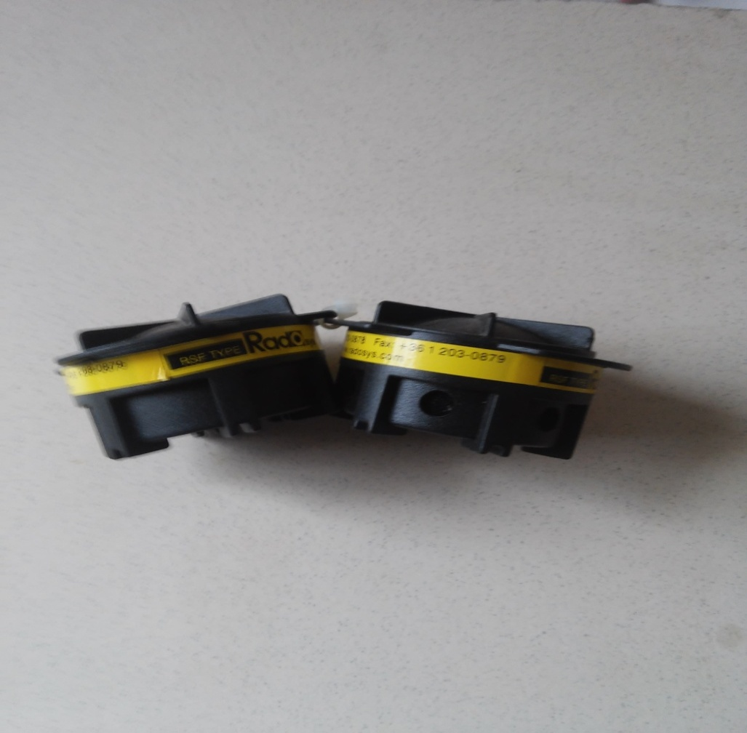
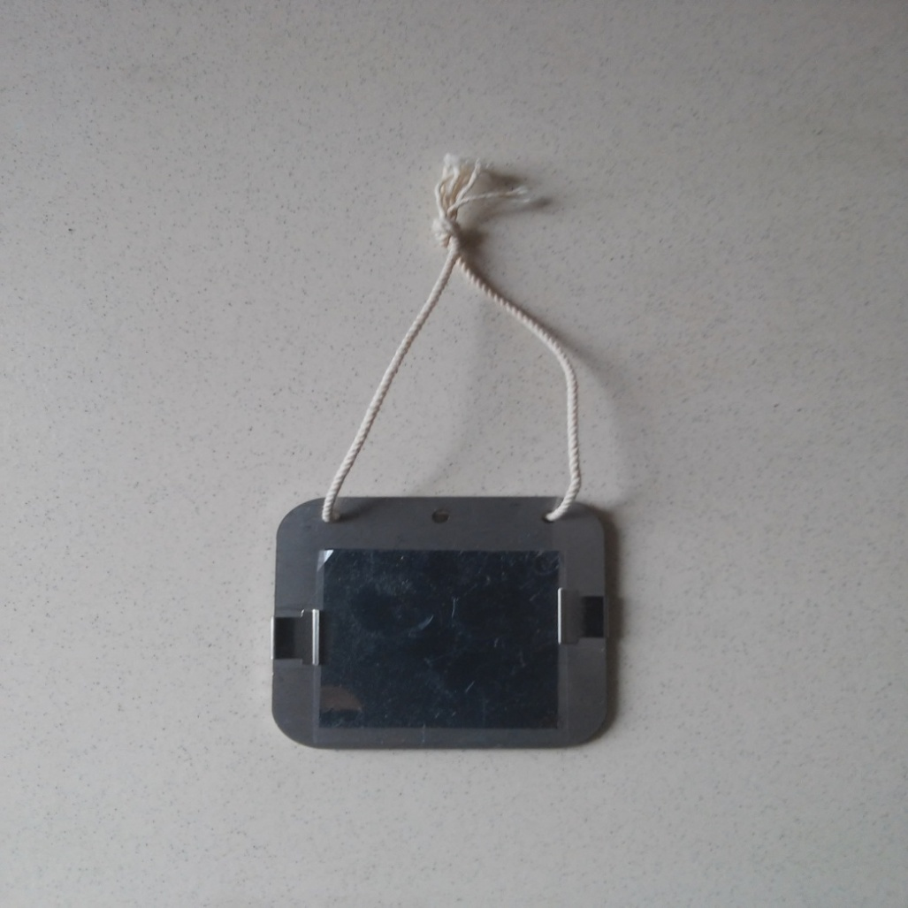
Radon/Thoron Discriminating Chamber- Raduet (CR-39 detector)
Deposition based Thoron Plate (CR-39 detector)

Slide 11
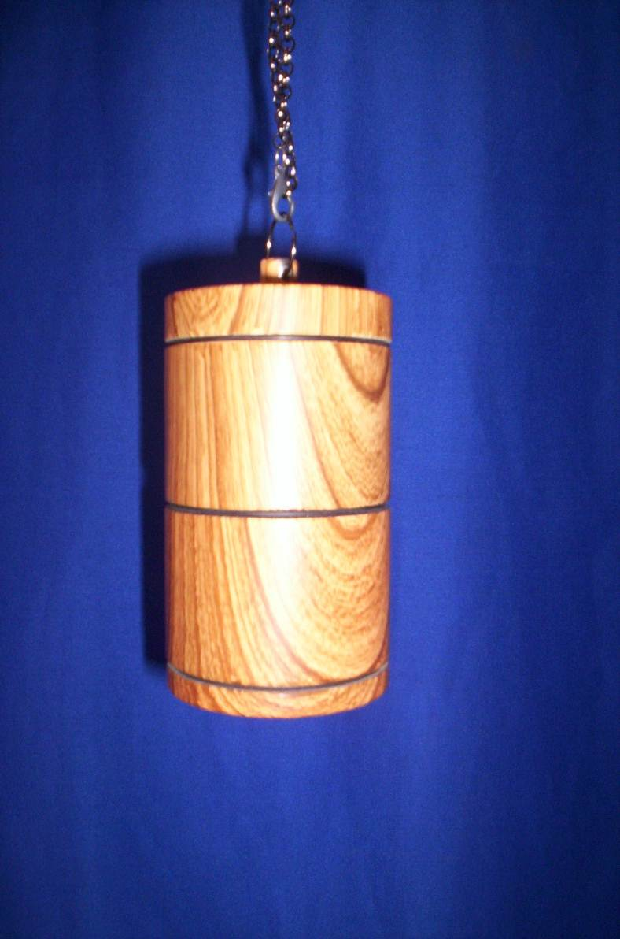
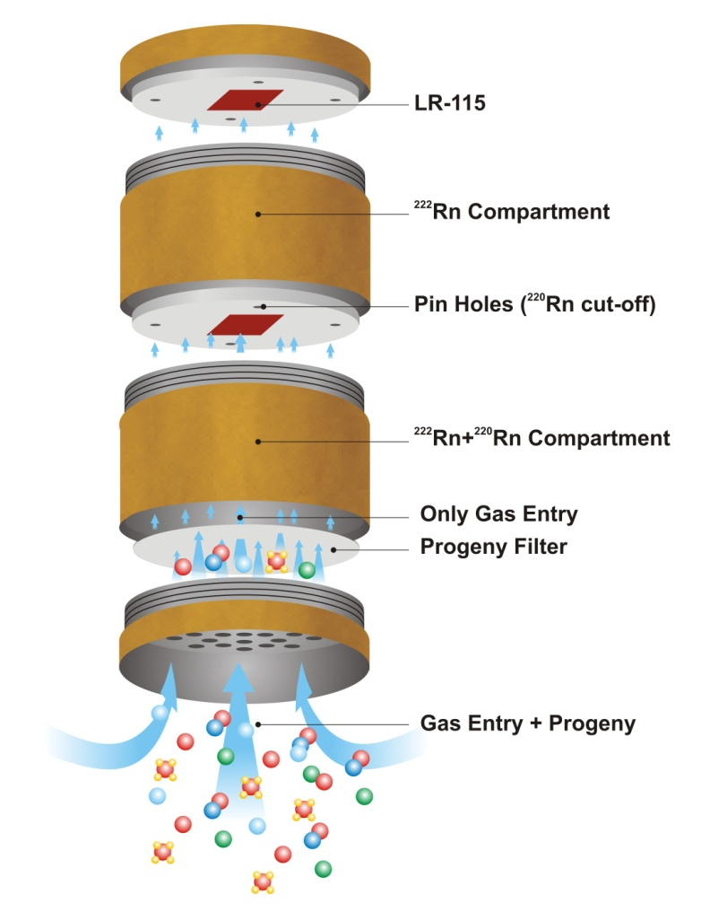
Measurement of Radon/Thoron
(LR-115 detector based Pin-Hole Dosimeter Technique)
Sahoo et al. 2013, Radiation Measurements 58 (52-60)
Calibration factor: For radon, k_{R} = 0.0170 ± 0.002 tracks.cm⁻² per Bq.d.m⁻³
For thoron, k_{T} = 0.010 ± 0.001 tracks.cm⁻² per Bq.d.m⁻³

Slide 12
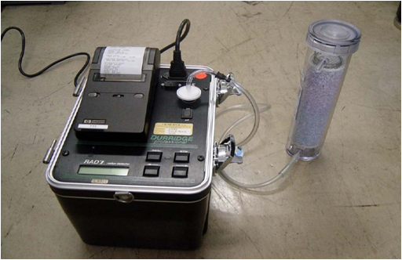
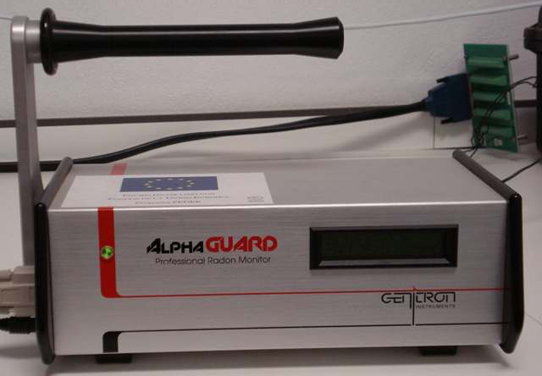
RAD7
Continuous radon/thoron monitor
Silicon semiconductor detector based on electrostatic charge collection method
Radon/thoron measurements in air water and soil
AlphaGuard
Continuous radon/thoron monitor
Ionization Chamber
Radon/thoron measurements in air water and soil

Slide 13
Thoron and its Progeny Concentrations in Chattarpur, Odisha
(Ramola et. al 2010. Radiat. Prot. Dosim. 141 (4) 379–382
S. No | Gamma Dose Rate |  | Radon (Bq/m³) | Thoron (Bq/m³) |  | Th Progeny (Bq/m³)
 | Indoor | Outdoor |  | Raduet | RAD7
1 | 0.276 | 0.136 | 8±3 | 41±8 | 8±15 | 3.36±0.17
2 | 0.215 | 0.212 | 7±2 | 41±6 | NR | 3.07±0.21
3 | 0.215 | 0.194 | 8±2 | 34±3 | NR | 3.67±0.24
4 | 0.193 | 0.162 | 6±2 | 37±4 | NR | 3.24±0.22
5 | 0.231 | 0.191 | 13±2 | 28±3 | NR | 2.06±0.17
6 | 0.225 | 0.199 | 8±2 | 14±1 | NR | 2.92±0.20
7 | 0.248 | 0.159 | 9±2 | 36±4 | 62±44 | 2.79±0.20
8 | 0.233 | 0.174 | 7±2 | 62±2 | NR | 4.24±0.25
9 | 0.242 | 0.185 | 6±2 | 25±6 | NR | 6.04±0.29
10 | 0.225 | 0.130 | 3±2 | 23±6 | 77±22 | 2.24±0.18
11 | NR | 0.118 |  |  | NR | 0.20±0.05
12 | NR | 0.110 | LOST | LOST | NR | LOST
13 | 0.218 | 0.121 |  |  | NR | 0.17±0.05
14 | 0.175 | 0.185 | 6±3 | 7±5 | NR | 1.16±0.16
15 | 0.210 | 0.181 |  |  | NR | 2.34±0.13
16 | 0.235 | 0.156 | 6±3 | 16±6 | NR | 1.09±0.11
17 | 0.236 | 0.178 | 6±2 | 31±5 | NR | 2.62±0.17
18 | 0.229 | 0.183 |  |  | NR | 2.50±0.20
19 | 0.230 | 0.163 | 8±2 | 40±2 | NR | 1.20±0.11
20 | 0.234 | 0.176 | 8±3 | 13±3 | NR | 1.48±0.12

Slide 14
Radon/Thoron and Resulting Doses in Gopalpur, Odisha R.C. Ramola et al. 2013. Radiation Measurements (71) 53-54
S.No. | Location | Concentration (Bq m⁻³) |  | Annual effective dose (mSv)
 |  | Radon | Thoron | Radon | Thoron
1 | Kanamana | 79 | 344 | 2.29 | 8.67
2 | Kanamana | 59 | 689 | 1.17 | 17.36
3 | Chattarpur | 24 | 115 | 0.7 | 2.9
4 | Matikhalo | 65 | 113 | 1.88 | 2.85
5 | Kanamana | 49 | 570 | 1.42 | 14.36
6 | Matikhalo | 62 | 102 | 1.8 | 2.57
7 | Chattarpur | 30 | 279 | 0.87 | 7.03
8 | Matikhalo | 47 | 322 | 1.36 | 8.11
9 | Chattarpur | 83 | 134 | 2.41 | 3.38
10 | Chattarpur | 46 | 163 | 1.33 | 4.11
11 | Chattarpur | 71 | 46 | 2.06 | 1.16
12 | Badaputti | 60 | 448 | 1.74 | 11.29
13 | Badaputti | 75 | 224 | 2.17 | 5.64
14 | Kaliabali | 46 | 609 | 1.33 | 15.35
15 | Kaliabali | 76 | 459 | 2.2 | 11.57
16 | Kaliabali | 98 | 188 | 2.84 | 4.74
17 | Kaliabali | 44 | 157 | 1.28 | 3.96

Slide 15
Conclusions
The high values of thoron concentration and resulting effective doses are observed in the eastern coastal Orissa, India.
Thoron concentration in the study area was found three to four times higher than radon concentration in most of the houses.
Radon concentration was found within the recommended level.
The indoor and outdoor gamma dose rates are also relatively higher in the area.
Therefore, the radiation doses produced by thoron and its progeny can not be neglected because it can be more significant contributor in comparison of radon and its progeny due to its high concentrations and high dose conversion factors in the thorium rich areas (HBRAs).

Slide 16
Acknowledgement
The work has been partly supported by the grant in- aid ‘Construction of Natural Radiation Exposure Study Network’ from the Special Coordination Funds for Promoting Science and Technology of Ministry of Education, Culture, Sports, Science and Technology, Japan
We are also thankful to
University Grant Commission, New Delhi
Council for Scientific and Industrial Research, New Delhi
Atomic Energy Regulatory Board, Govt. of India

Slide 17
Thanks..

