Slide 1
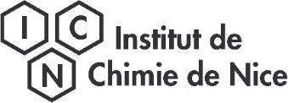
ICHLERA 2022
27th of June 2022
Bacterial diversity characterization of naturally radioactive mineral springs: Role of these bacterial communities in uranium biogeochemistry
Guillaume Holub¹, Claire Sergeant¹, Marie-Hélène Vesvres¹, Lory-Anne Baker ²⁻⁴, Sofia Kolovi ⁵ Aude Beauger ², David Biron⁴, Patrick Chardon ⁵, Lydia Maigne ⁵, Didier Miallier ⁵, Hervé Michel ³, Gilles Montavon ⁶, Vincent Breton ⁵ , Clarisse Mallet⁴
¹Laboratoire de Physique des 2 Infinis Bordeaux (LP2IB), Université de Bordeaux/ CNRS IN2P3, 19 chemin du Solarium, CS10120, 33175 Gradignan, France, ²GEOLAB, Clermont-Ferrand, France, ³ICN, Nice, France, ⁴LMGE, Aubière, France, ⁵LPC Aubière, France, ⁶Subatech, Nantes, France

Slide 2
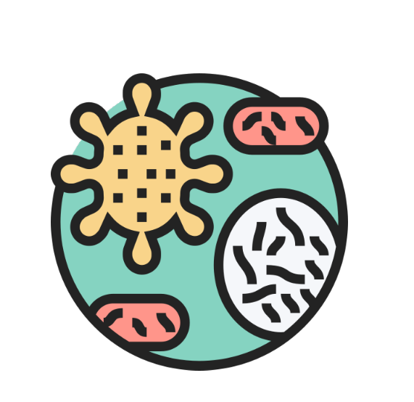
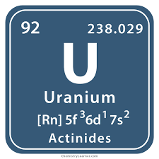
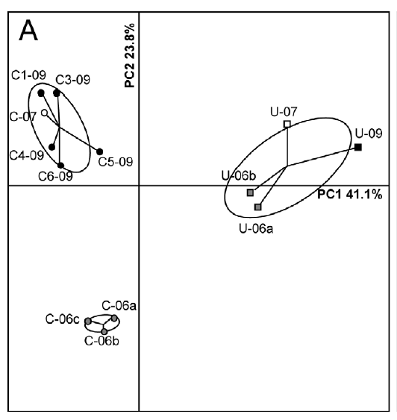
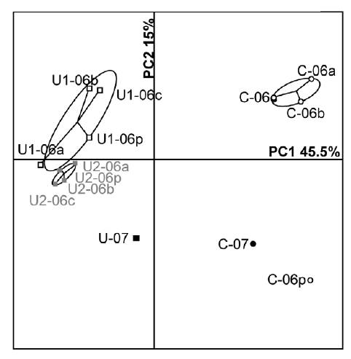
Introduction
2
Context
Bacteria are present in extreme environments including radioactive environments
Uranium : 4 Oxidation sates: III, IV, V, VI
Chemotoxic and radiotoxic
Impact on bacterial communities (diversity, richness, genetic mutation)
Role in uranium speciation and mobility
Biosorption
Bioaccumulation
B
U(VI) (UO₂²⁺)
Bacillus sphaericus JG-7B (Merroun et al., 2008)
U(VI) (UO₂²⁺)
L
Pseudomonas aeruginosa (Choudhary et Sar., 2011)
U(VI)
Bacterial cell
U(VI) soluble
(UO₂²⁺)
Citrobacter sp. (Macaskie et al., 1996)
Bioreduction
PCA of DGGE profiles of Villard (A) and Vénachat (B) soil samples: C corresponds to control samples; U, U1, U2 correspond to uranium-rich samples (From Mondani et al., 2011)
HPO₄²⁻ + UO₂²⁺ HUO₂PO₄, 4H₂O
Desulfovibrio desulfuricans (Lovley et al., 1992)
U(IV) insoluble
(UO₂)
Bioprecipitation
G.Holub 27/06/2022

Slide 3
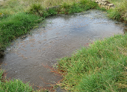
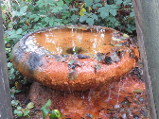
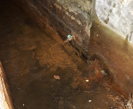
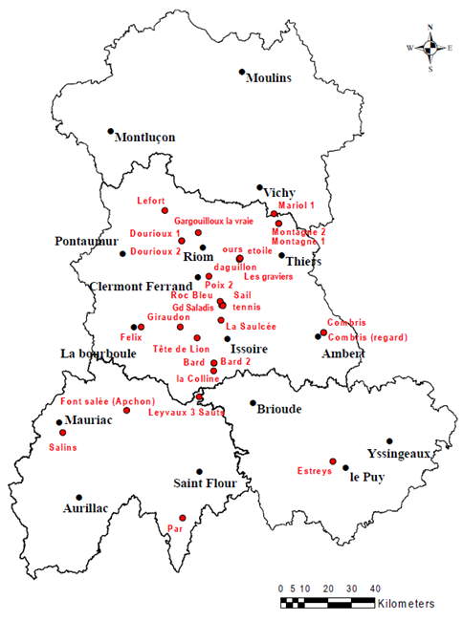
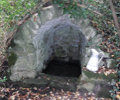
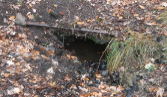
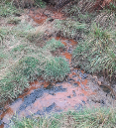
Sampling site : Naturally radioactive mineral springs
3
Project TIRAMISU (V.Breton)
BiodiversiTy In RAdioactive MIneral SoUrces
Selection of 6 springs: sediment sampling of these sources in October 2019 and June 2020
Main objective : Study and understand the effects of radioelements (radiation / chemical toxicity) on microorganisms living in mineral sources
1
2
3
Radioactive mineral springs in Auvergne (France)
4
5
6
Sources de 1) Graviers; 2) Mariol ; 3) Montagne ; 4) Dourioux ; 5) Bard ; 6) Leyvaux (Crédit C.Sergeant)
Objective
Understanding the role of these microorganisms in the biogeochemistry of radioelements in these environments
1
Identify and characterise the bacterial populations that inhabit natural springs
2
Study the impact of radioelements on the structure of these communities
3
To understand the role of these microorganisms in the biogeochemistry of radioelements in these environments
Crédit : Aude Beauger (GEOLAB)
G.Holub 27/06/2022

Slide 4
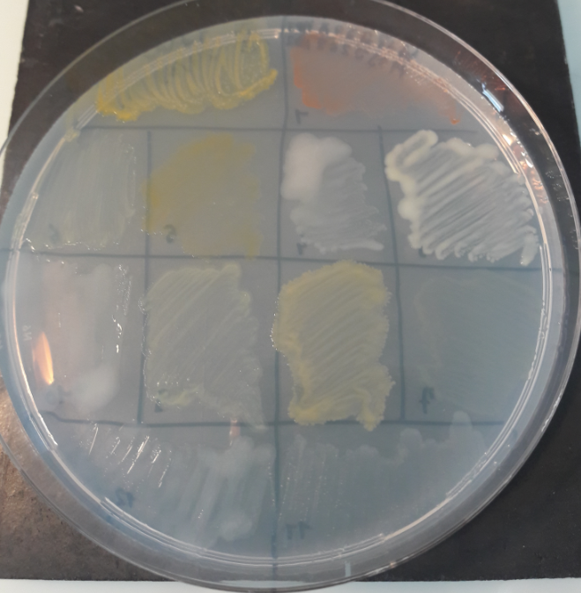
Materials & Methods
4
Metagenomic
1
2
3
Microbial culture
Technique for sequencing and analysis of total DNA contained in a sample
Technique for the controlled growth of microorganisms in vitro
4
5
6
Metabarcoding:
Sequencing of a single gene (16S rRNA) common to several species
Sources de 1) Graviers; 2) Mariol ; 3) Montagne ;
4) Dourioux ; 5) Bard ; 6) Leyvaux (Crédit C.Sergeant)
Aerobic culture:
Culture on rich media (TSB) to obtain a wide range of bacteria
Objective : Analyse and characterise the bacterial composition and diversity present in these sources
Objective : Isolate potentially uranium-resistant strains from these naturally radioactive sources
Isolation and identification by comparison of the 16S rRNA gene’s sequence with databases (NCBI)
Alpha diversity: measure indicating the diversity of a sample
16S taxonomic composition
Beta diversity: Analysis of diversity between samples
Phylogenetic tree :
Groups species according to their genetic similarity
Abundance
Bacteria - uranium interaction study :
>
PC2 (%)
Sample
1
Sample
2
Ex : Shannon Index
Strain 1
Strain 2
PC1 (%)
Sample 1
Sample 3
Sample 2
Sample 4
G.Holub 27/06/2022

Slide 5
Results and discussion : 1) Identification and characterization of the bacterial community
5
Some of the isolated strains are related to radiotolerant species known for their ability to interact with radioelements
A total of 300 different bacterial strains isolated
Firmicutes: Multiple isolates: Bacillus, Paenibacillus
An isolated strain related to the species Bacillus thuringiensis
Bacillus thuringiensis strains BRC-ZYR3 et BRC-ZYR4, isolated from uranium-contaminated soils, are capable of bioaccumulating and biotransforming uranium (Pan et al., 2015)
G.Holub 27/06/2022

Slide 6
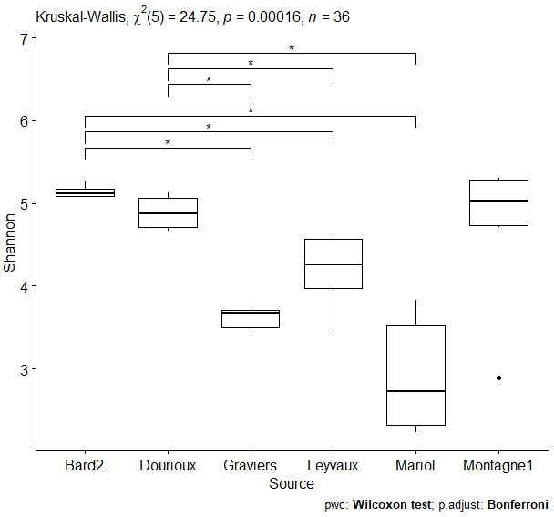
Results and discussion : 1) Identification and characterization of the bacterial community
6
Analysis of the bacterial diversity: Alpha diversity
The bacterial diversity in Mariol is the lowest compared to other sources
Increasing diversity
The bacterial diversity is significantly different (p value < 0.05) between these 6 springs
G.Holub 27/06/2022

Slide 7
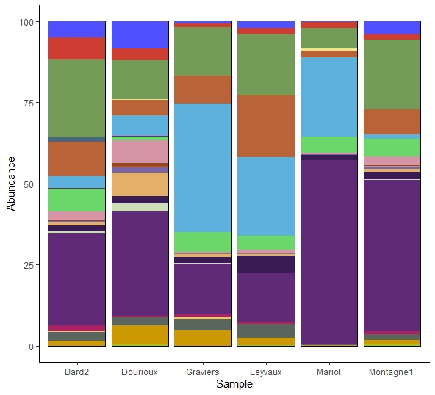
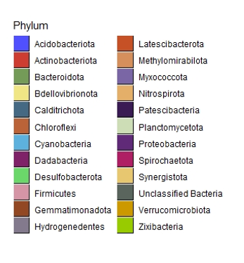
Results and discussion : 1) Identification and characterization of the bacterial community
7
Analysis of the bacterial diversity : 16S taxonomic composition
Predominant phyla:
Proteobacteria
Bacteroidetes
Chloroflexi
Cyanobacteria
Other studies have also found a majority of Proteobacteria and Bacteroidetes in natural radioactive environments (Mondani et al., 2011; Yan et Luo, 2015)
G.Holub 27/06/2022

Slide 8
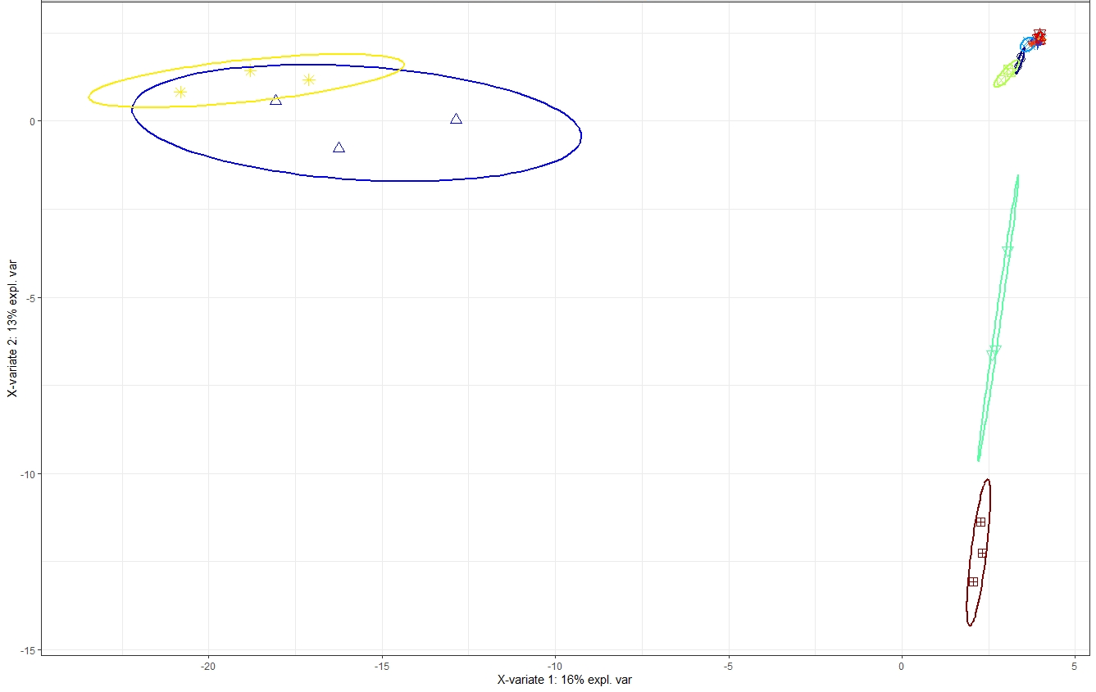
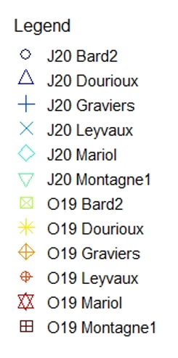
Results and discussion : 1) Identification and characterization of the bacterial community
8
Analysis of bacterial community structure between samples : beta diversity
sPLS-DA on the most discriminating OTUs (VIPs) (confidence level : 95%)
Dourioux and Montagne1 are different from the other sources due to certain OTUs prevalent in these both sources
OTUs predominantly affiliated with:
Proteobacteria
Bacteroidetes
Acidobacteria
Firmicutes
G.Holub 27/06/2022

Slide 9
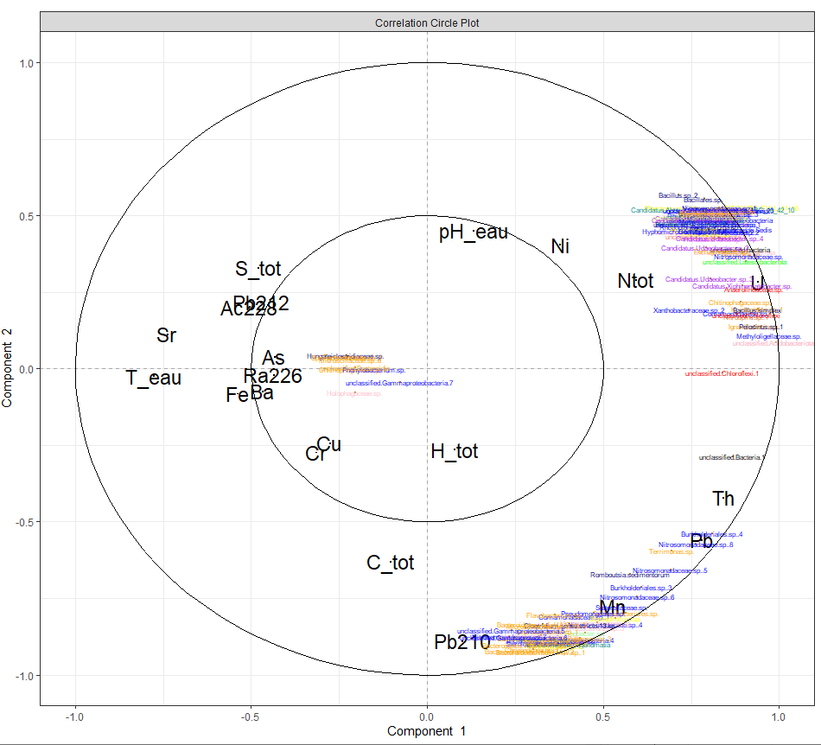
Results and discussion : 2) Impact of radioelements on bacterial communities
9
sPLS on the most discriminating OTUs with the most discriminating physico-chemical parameters (VIPs)
Uranium concentration is the most discriminant parameter
U
Presence of these OTUs is correlated with the concentration of uranium
Presence of these OTUs is correlated with the concentration of lead, manganese, thorium and the activity of ²¹⁰Pb (²³⁸U radioactive decay)
The difference in uranium concentration in these sources could explain the presence of some OTUs
G.Holub 27/06/2022

Slide 10
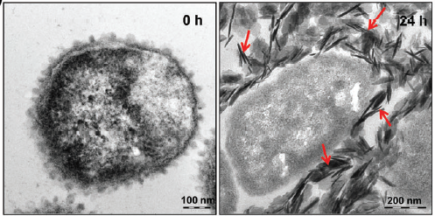
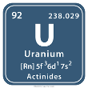
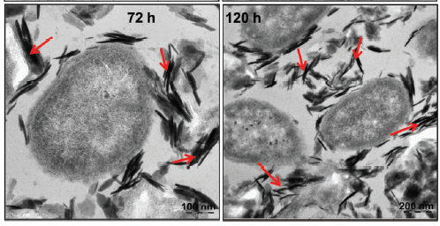
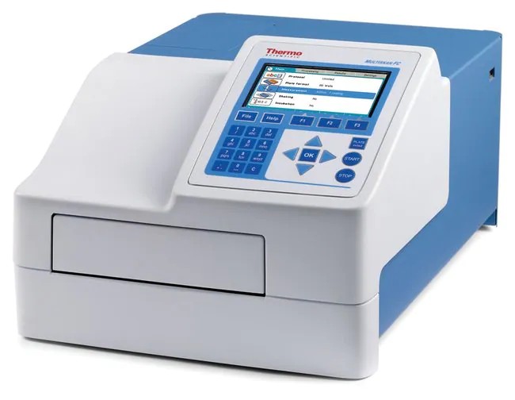
Results and discussion : 3) Role of bacteria in the biogeochemistry of uranium
10
Objective
To understand the metabolic mechanisms used by resistant strains to grow and survive in these radioactive environments
Selection of 3 resistant strains: study of the interaction mechanisms of these bacteria with uranium
Bacterial strain transferred into 0.9% NaCl (pH 4)
Measurement of the amount of uranium (VI) remaining in the medium after exposure
Determination of the localization of uranium in the cells by transmission electron microscopy coupled with energy dispersive X-ray spectroscopy (TEM-EDX)
(In progress)
+
Measurement of orthophosphate concentration
Exposure to 100µM uranium
Localization of bioprecipitated uranium in Serratia cells with 1mM uranyl carbonate at pH 7 (TEM-XRD)
From Chandwadkar et al. 2018
G.Holub 27/06/2022

Slide 11
Results and discussion : 3) Role of bacteria in the biogeochemistry of uranium
11
Experiment: Bacteria with 100µM uranyl nitrate in a 0.9% NaCl solution at pH 4 (+ Heat killed bacterial cells and control)
Percentage of U removal in the medium per bacterial strain in 24h
Shewanella sp. strain A16OP11
Shewanella sp. strain A16OP11 (Heat killed)
Pseudomonas sp ADAK22
Pseudomonas sp ADAK22 (Heat killed)
Aeromonas salmonicida strain A1
Aeromonas salmonicida strain A1 (Heat killed)
Sterile media
Measurement [phosphate]: below detection limit (10µM)
Biosorption mechanism?
Observation of cells by electron microscopy
Uranium removal in the 3 strains studied
Uranium elimination is not related to the metabolism of the strains
G.Holub 27/06/2022

Slide 12
Conclusions
Conclusions
13
12
Study of bacterial communities present in naturally radioactive mineral springs in Auvergne
Objective
To characterise the bacterial diversity present in these sources and understand the impact of radioelements on bacterial communities
These naturally radioactive mineral springs contain diverse bacterial communities despite the presence of radionuclides. The structure of these bacterial communities differs between the 6 sources studied
1
2
The difference in uranium concentration in these sources, with the lead, manganese and thorium concentrations, could explain the distribution of bacterial communities
Some isolated strains are resistant to these particular conditions and seem to interact with uranium ( by biosorption mechanism). These strains can therefore modify the speciation of uranium in the environment, making it less mobile and therefore less toxic
3
G.Holub 27/06/2022

Slide 13
Acknowledgement
13
Colleagues
Bordeaux University (thesis grant)
Zone Atelier : « Territoires Uranifère »
CNRS IN2P3
Thanks for your attention!
G.Holub 27/06/2022

Slide 14
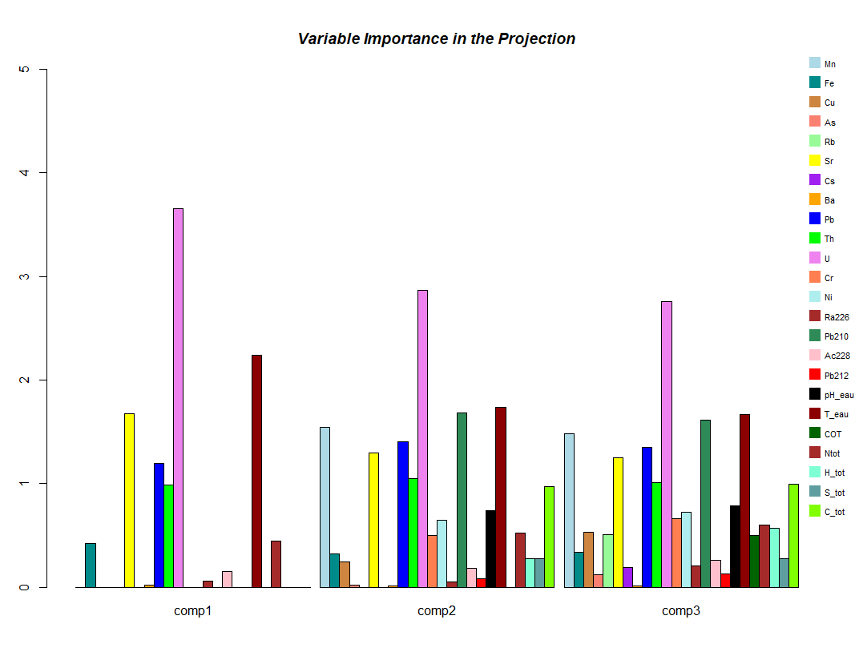

Slide 15
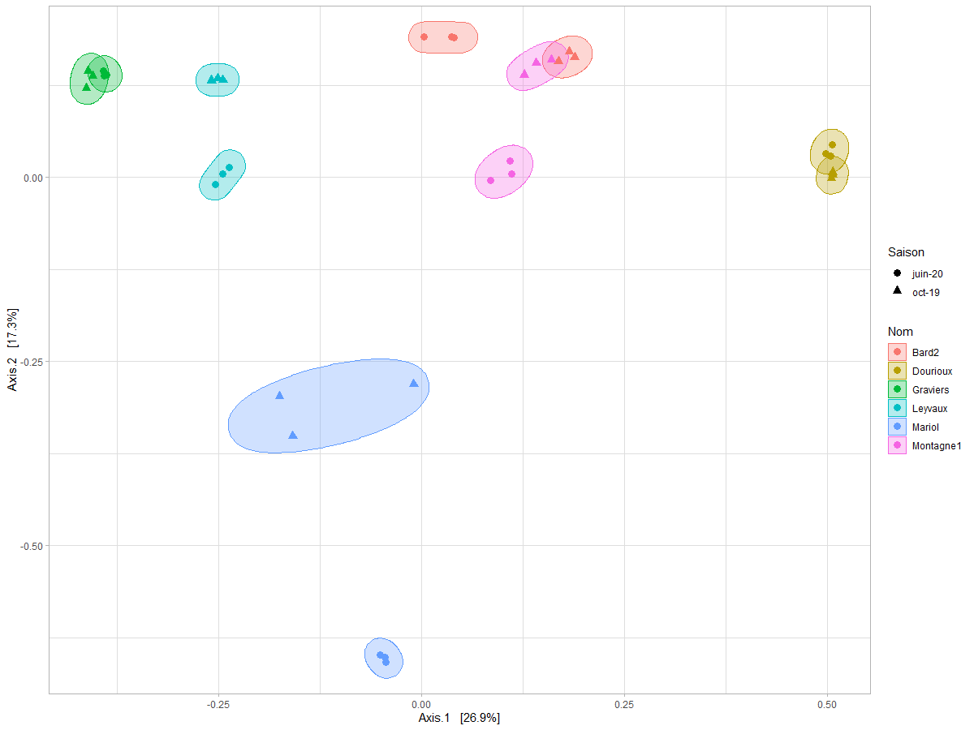

Slide 16
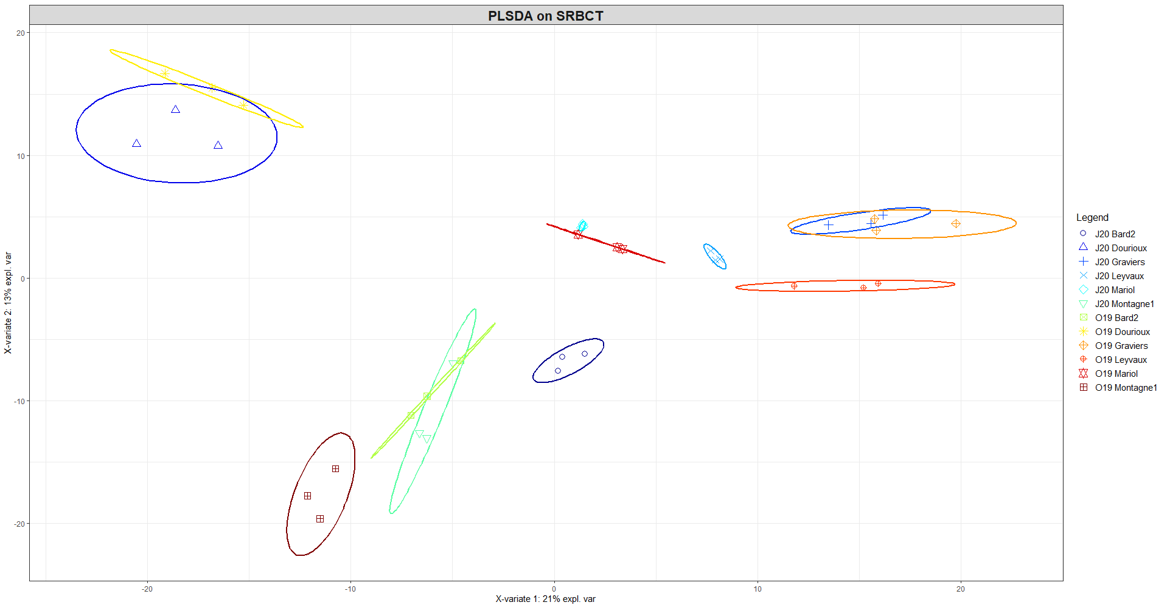

Slide 17
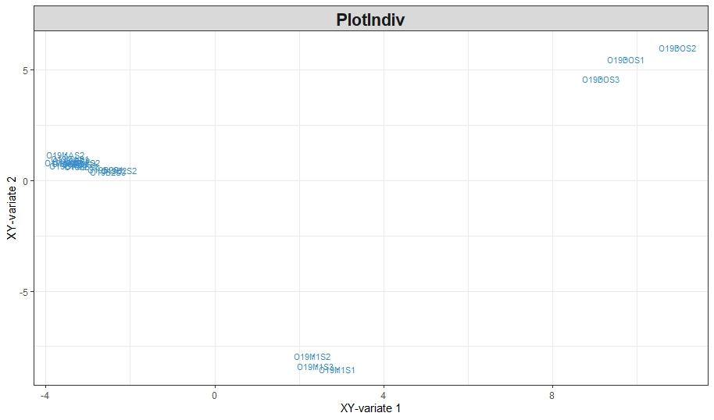

Slide 18
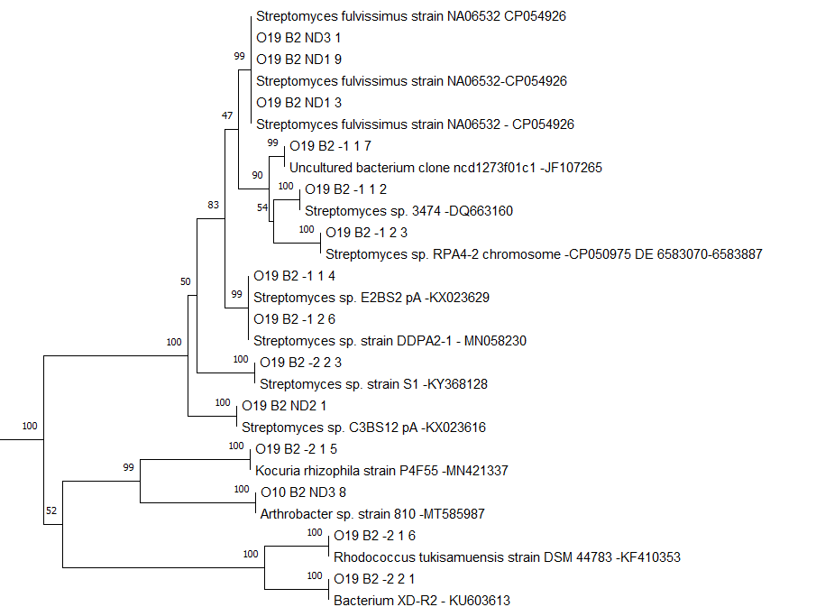
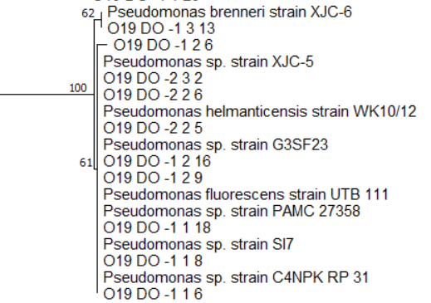
Proteobacteria : 150 OTUs identified
Actinobacteria : 30 OTUs identified
Mostly isolated genus : Agrobacterium, Acidovorax, Pseudomonas
Mostly isolated genus : Streptomyces, Microbacterium, Arthrobacter
Gamma proteobacteria dominated by Pseudomonas: Some species of this genus are resistant to radionuclides (Pseudomonas stutzeri, Chabalala and Chirwa., 2010)
Genus isolated from Chernobyl contaminated soil (Chapon et al., 2012)
Phylogenetic tree of Dourioux's Gammaproteobacteria

