Slide 1
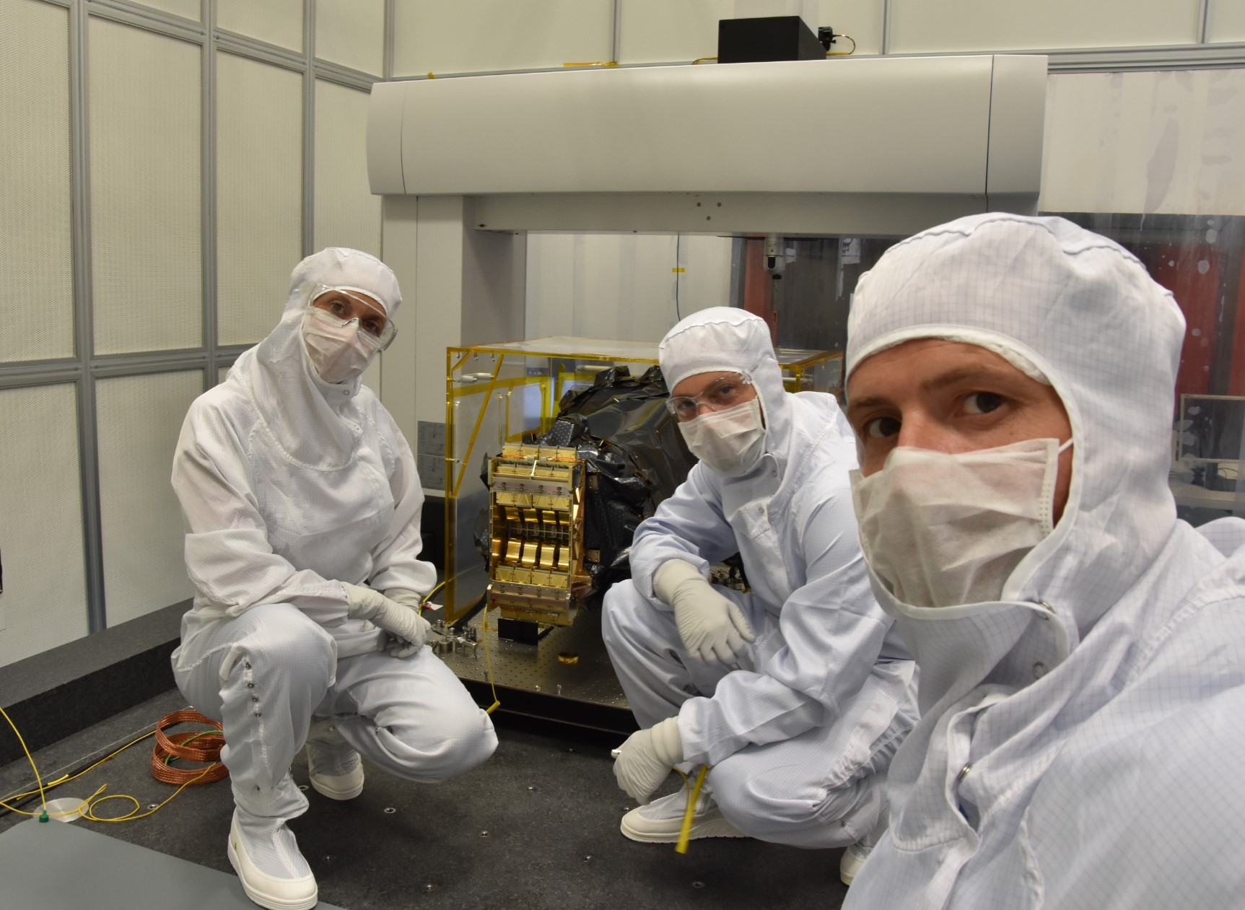
Integration des SCE sur NI-DS
Operation successful by spatial team CPPM

Slide 2
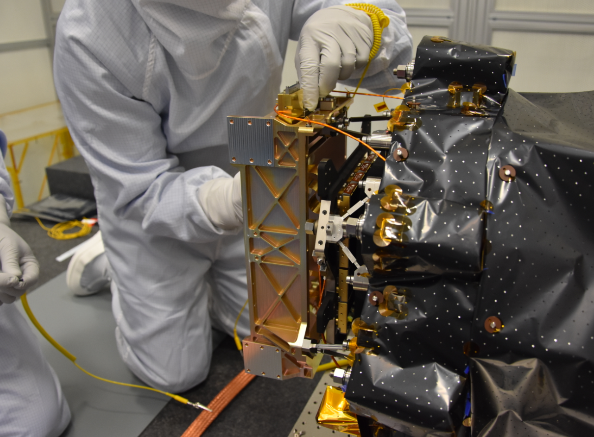

Slide 3
