Slide 1




Journées du GDR MI2B 2019
Setting up of the 10 ps challenge: progress status
Christian Morel

Slide 2
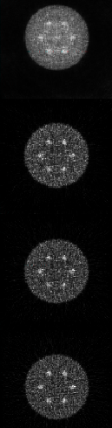
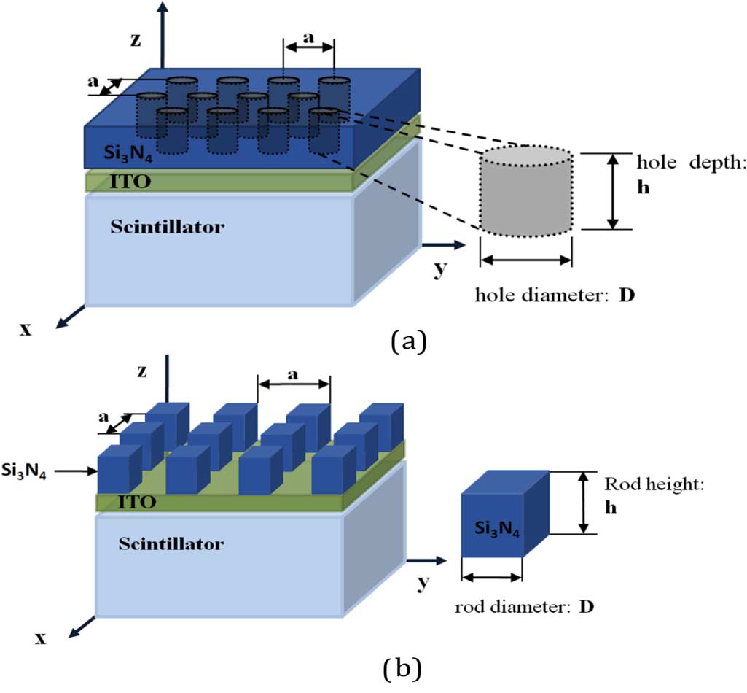
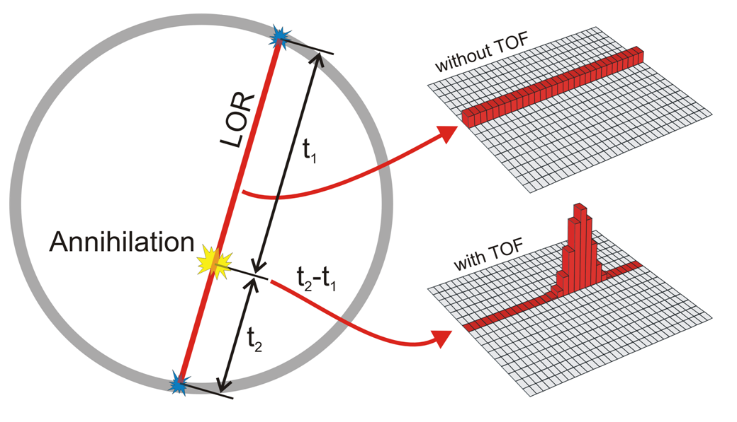
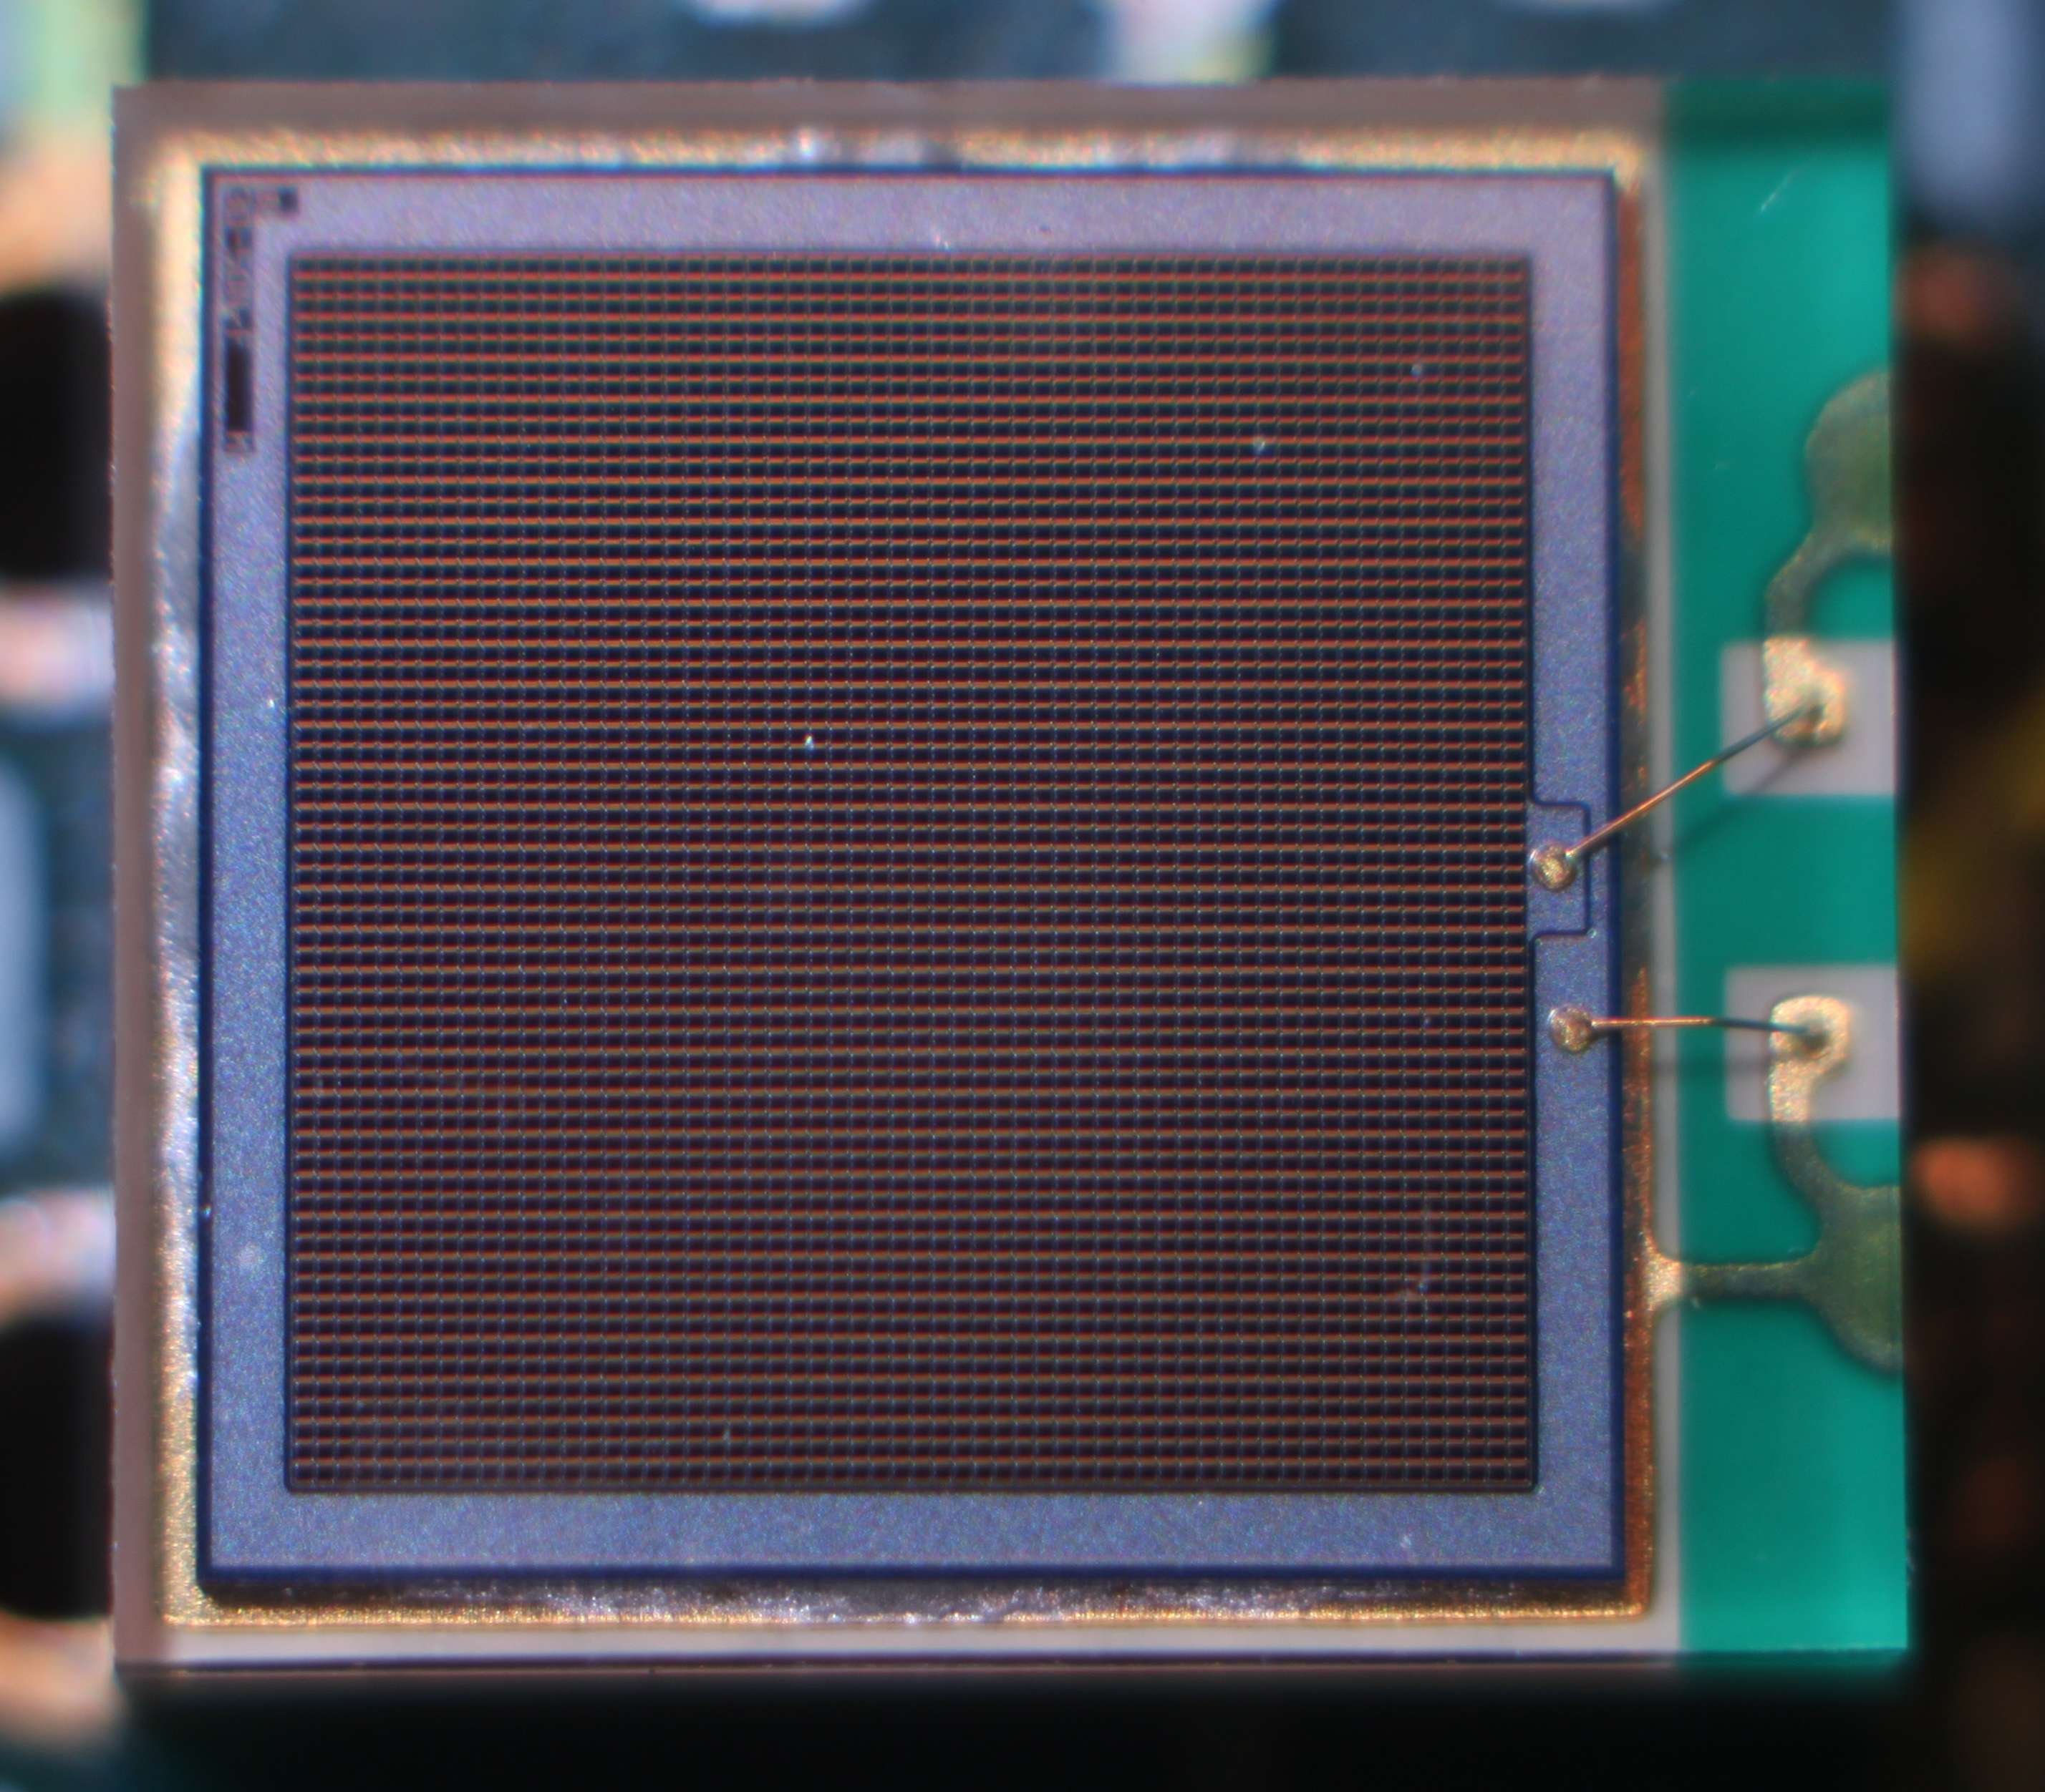


Time-Of-Flight Positron Emission tomography (TOF-PET)
  No TOF
  700 ps
4D total absorption Time Imaging CALorimeter
P Lecoq et al. Nucl. Instrum. Meth. A 718 (2013) 569
  500 ps
  300 ps

Slide 3
11-12 Jun 2018: The French GDR MI2B org-anized a 10 ps challenge workshop in Paris
Contribute to the setting up of an international challenge: thought-provoking on the 10 ps challenge motivations, expectations and implementation
  for what purpose ?
  for what goal(s) ?
  with what organization ?
  how to communicate ?
Motivations for the 10 ps challenge
  Promising technologies under development ➟ P. Lecoq
  Technical challenge with a strong clinical and societal impact ➟ J. Nuyts
  Interest beyond the new generation TOF-PET scanners for Compton cameras, prompt gamma imaging in hadrontherapy, …
  The challenge as a spur on technological development
  ➟ C. Morel

Slide 4

The 10ps TOFPET challenge
Paul Lecoq
CERN, Genève
When you have an impossible dream
Setup a challenge!
This work and presentation are made
in the frame of the ERC Advanced Grant Agreement N°338953–TICAL

Slide 5






Resolution in TOF-direction: ~1.5 mm
Resolution in detector direction: 5 mm
true activity
non-TOF backproj
TOF backproj
Courtesy: J. Nuyts, Univ Leuven
true attenuation
non-TOF OSEM
TOF OSEM
Journées du GDR MI2B, 20-22 novembre 2019, Nantes

Slide 6

The 10 ps challenge: a step toward reconstruction-less TOF-PET
The 10 ps challenge:
a spur on the development of fast timing
an opportunity to get together
an incentive to raise funding
a way to shed light on nuclear instrumentation for medical imaging and beyond
One unique challenge launched for 5 to 10 years and operated by an international organisation with rules issued by the community based on the measurement of CTR combined to sensitivity
Several milestones and prizes:
3 years after the launch of the challenge: 1M€ expected for the Flash Gordon prizes delivered to the 3 best certified achievements
until the end of the challenge: 1M€ expected for the Leonard McCoy prize for the first team meeting successfully the specifications of the challenge
  Non-TOF backproj
  Non-TOF OSEM
10 ps TOF backproj
10 ps TOF OSEM

Slide 7

The10ps-challenge.org

Slide 8
EANM should:
Appoint an executive committee
Set up accounting to receive donations
Host a link to the web site of the 10ps challenge
The executive committee will:
Nominate a scientific advisory board
Define the rules for the challenge and submit it to
the scientific advisory board for advice
Seek funding for the prizes and operational costs of
the challenge organization
Organize the communication about the challenge
with the help of the EANM physics committee
Provisional planning:
Feb 2020: Appointment of the executive board
by EANM
May 2020: nomination of the scientific
advisory board
Sep 2020: draft of final rules for the
10ps challenge
Dec 2020: publications of the rules for the 10ps challenge and official launch of the challenge
Oct 2021: funding of the Flash Gordon Prize (stop & go)
Fall 2023: Flash Gordon contest (possibly at CERN)

Slide 9

The 10 ps challenge: a step toward reconstruction-less TOF-PET
Thank you
  Non-TOF backproj
  Non-TOF OSEM
10 ps TOF backproj
10 ps TOF OSEM

Slide 10
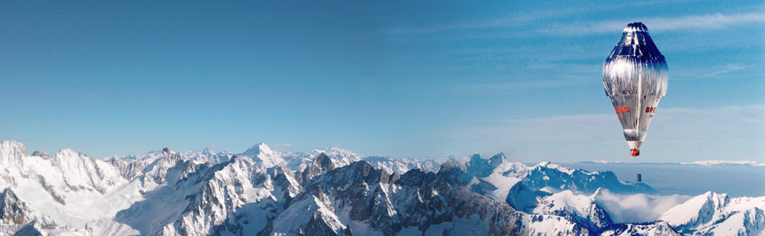
1992: FAI raised a challenge for the first balloon circumnavigation
March 1999: Brian Jones and Bertrand Piccard circumnavigated the globe with the Breitling Orbiter III in 19 days 1 hour 49 minutes and won the Budweiser Cup
This was a clear-cut case to shed light on TOF-PET with CTR < 10 ps FWHM and raise a challenge on reconstruction-less positron tomography

Slide 11
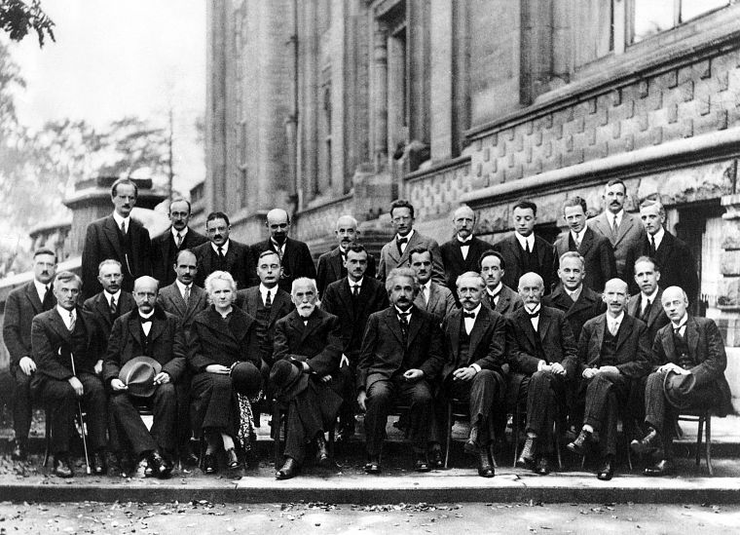
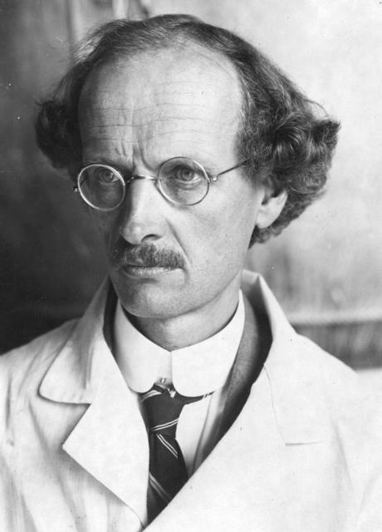
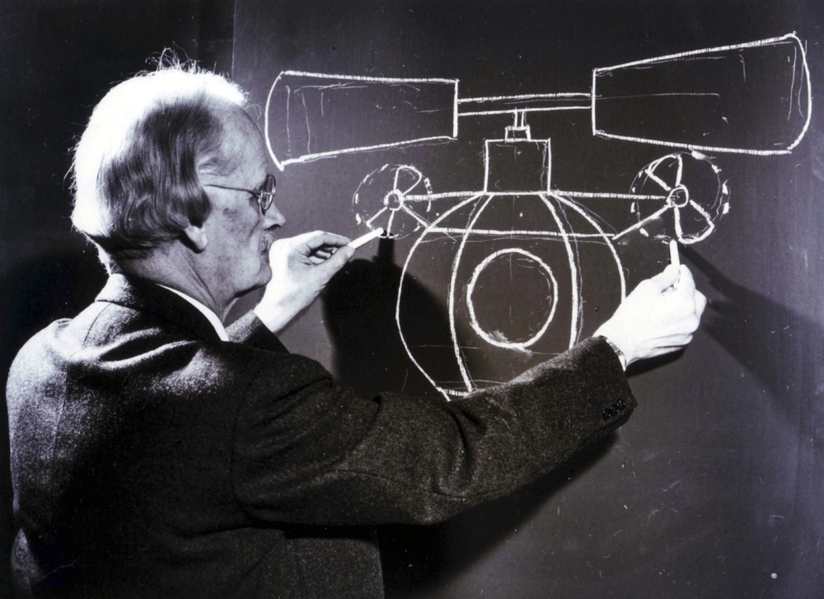
5th Solvay Congress, 1927
Auguste Piccard

Slide 12
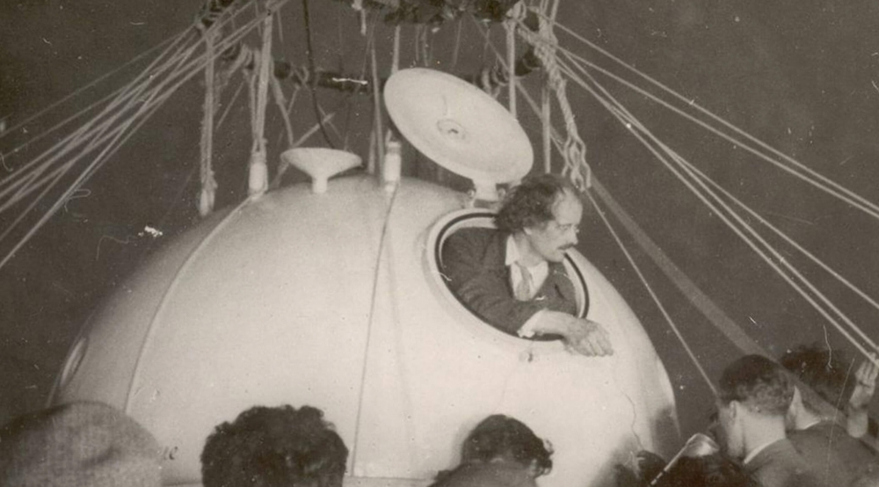
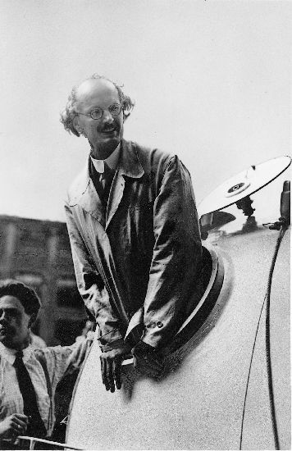

1931: Auguste Piccard performed the first stratospheric balloon flights above 16000 m

Slide 13

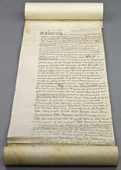
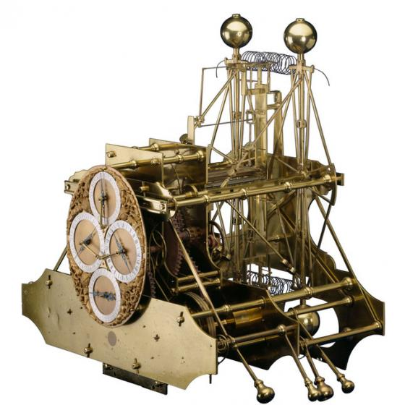
The challenge as a spur on technological development
The Longitude Act was enacted by the parliament of the United Kingdom in July 1714 after the shipwreck of the HMS Association on the reefs of Gilstone Ledges during the night of Oct 22 1707, leading to the death of 1400 to 2000 mans.
Le Longitude Act established the Longitude Office in Greenwich and offered a reward to anybody who would find a simple and practical way to determine precisely the longitude of a ship.
Longitude rewards:
£ 10,000 < 1°
(= 110 km on the equator)
£ 15,000 < 40’
£ 20,000 < 0,5°
John Harrison received £ 10,000
(~1.33 million £ in 2016) in 1765 for the development of the marine chronometer
John Harrison's H1 Marine Chronometer

Slide 14
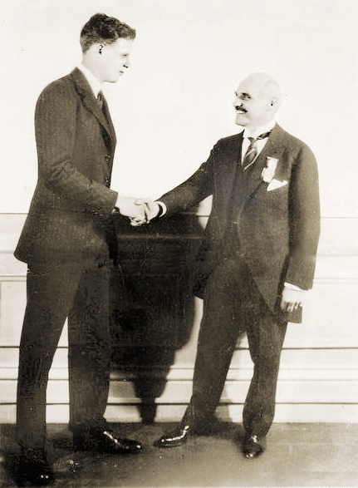
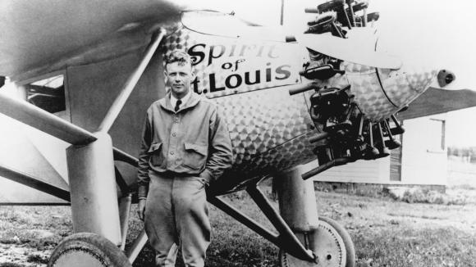
1919: Raymond Orteig offered a prize of 25,000 US$ to the first aviator who would flight from New York to Paris without stops
The Orteig Prize offer was initially available for 5 years, and then was renewed for another 5 years in 1924
May 1927 : Charles Lindbergh made the first flight from New York to Paris on board of the Spirit of Saint-Louis in 33 h and 30 minutes
VI MEDAMI Workshop, 15-17 May 2019, Valencia, Spain

Slide 15


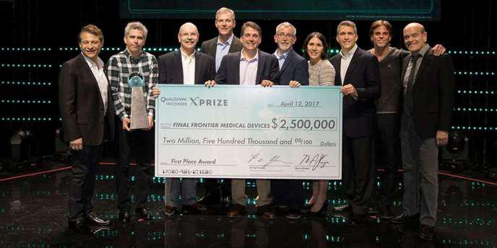
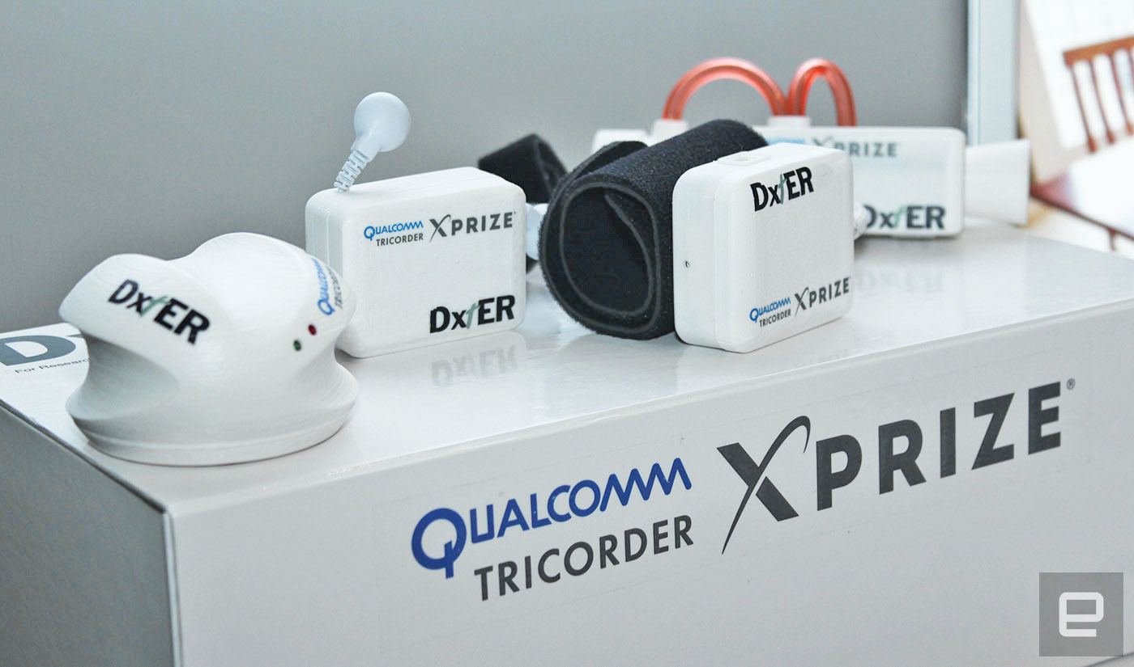
XPRIZE is an innovation engine
A facilitator of exponential change
A catalyst for the benefit of humanity
https://www.xprize.org/
Foundation based in California distributing prices of several millions of dollars for challenges launched in the domains of energy & environment, life sciences, exploration and development
Its slogan is making the impossible possible
Elon Musk, James Cameron, Larry Page, Arianna Huffington, Ratan Tata are members of its administration council
2012 : Qualcomm Tricorder XPrize 10 M$

Slide 16



Horizon Prizes
The European Commission launched a series of prizes
rewarded between 1 and 4 M€.
These are incentive prizes that reward the best answers to a given challenge, the proposed solution being innovative, safe, and resizable at the European scale.
The goal is to stimulated innovation and find solutions to problems that matters to European citizens.
These competitions are opened to any legal entity, including individuals. The propositions will be evaluated by independent experts.
http://ec.europa.eu/research/horizonprize

