Slide 1
A bi-compartmental model to resolve R2* relaxometry
Maxime Michaud
ToNIC, Toulouse NeuroImaging Center, Université de Toulouse, Inserm, UPS, France

Slide 2
Introduction
1
2
3
4

Slide 3
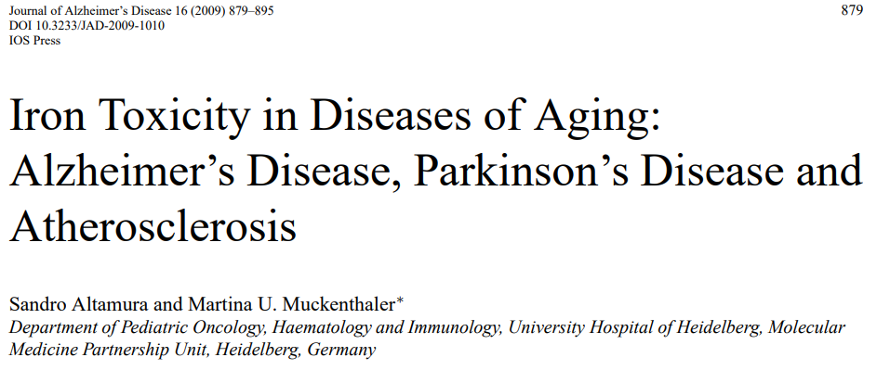
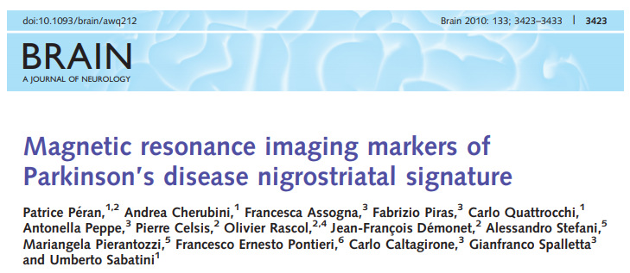
Introduction
Introduction
Applications
Discussion
Simulation
1
Why R2* ?
Detection of neurodegenerative diseases
Postmortem : evidence of iron
Gradient echo (R2* = 1/T2*) to quantify iron content

Slide 4
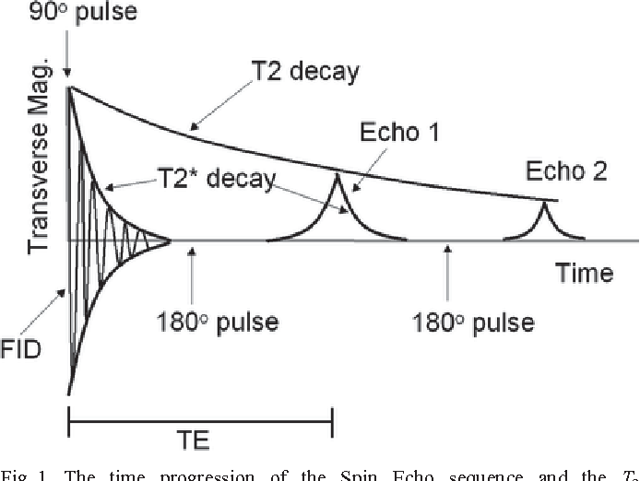
Introduction
Introduction
Applications
Discussion
Simulation
1
Why R2* ?
Gradient echo sequences :
No 180° pulse
Magnetic susceptibility link to iron content :
↗ Magnetic susceptibility ↘ T2* value

Slide 5
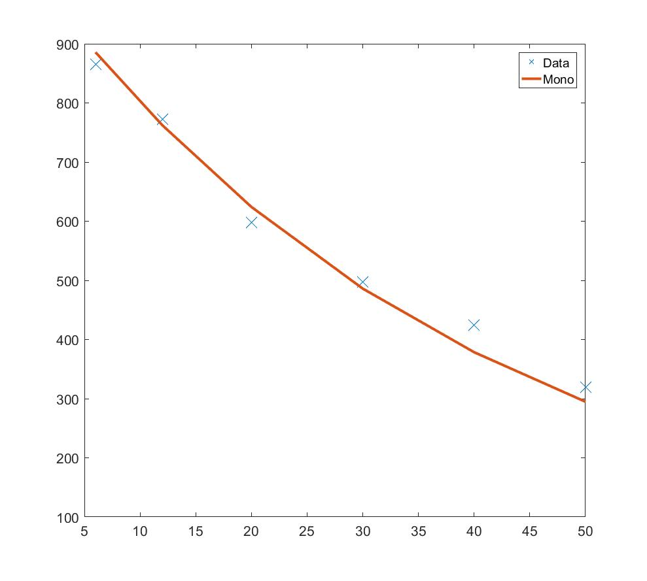
Introduction
Introduction
Applications
Discussion
Simulation
1
How to obtain R2* ?
$$R_{2}^{∗}$$
$S\left(t\right)=S_{0}.$ $e^{−TE.R_{2}^{∗}}$

Slide 6
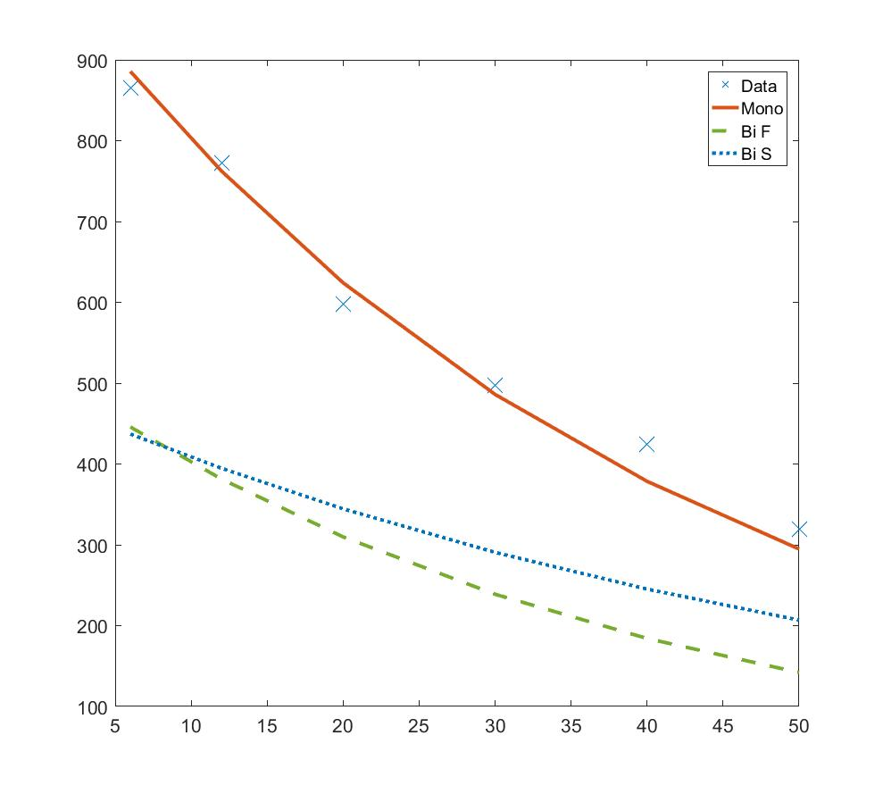
Introduction
Introduction
Applications
Discussion
Simulation
1
Bi R2* ?
$$R_{2}^{∗}$$
$S\left(t\right)=S_{0}.$ $e^{−TE.R_{2}^{∗}}$
$S\left(t\right)=M_{01}.$ $e^{−TE.R_{2F}^{∗}}$ + $M_{02}.$ $e^{−TE.R_{2S}^{∗}}$
$$R_{2F}^{∗}$$
$$R_{2S}^{∗}$$

Slide 7
Simulation
1
2
3
4

Slide 8
Simulation
Introduction
Applications
Discussion
Simulation
2
How to differentiate a voxel with a mono or bi exponential decay ?
Sim : Mono decay
Sim : Bi decay close
Sim : Bi decay far
$R_{2}^{∗}$
(1) $S\left(t\right)=M_{0}.$ $e^{−TE.R_{2}^{∗}}$
$R_{2S}^{∗}$ $R_{2F}^{∗}$
(2) $S\left(t\right)=M_{01}.$ $e^{−TE.R_{2F}^{∗}}$ + $M_{02}.$ $e^{−TE.R_{2S}^{∗}}$
$R_{2S}^{∗}$ $R_{2F}^{∗}$
$R_{2}^{∗}$ maps
$$R_{2F}^{∗}$$
$$R_{2S}^{∗}$$
Noise
40 echoes (1:1:40 ms)
Mono
Bi-c
0 %
Bi-f
Non-linear fitting
$S\left(t\right)=S_{0}.\left(e^{−TE.R_{2F}^{∗}}+e^{−TE.R_{2S}^{∗}}\right)$
Mono
Bi-c
5 %
5 set of images
Noise 0:1:5 %
Bi-f
Need a threshold to avoid creating false bi voxel

Slide 9
Simulation
Introduction
Applications
Discussion
Simulation
2
How to differentiate a voxel with a mono or bi exponential decay ?
Sim : Mono decay
Sim : Bi decay close
Sim : Bi decay far
$R_{2}^{∗}$
(1) $S\left(t\right)=M_{0}.$ $e^{−TE.R_{2}^{∗}}$
$R_{2S}^{∗}$ $R_{2F}^{∗}$
(2) $S\left(t\right)=M_{01}.$ $e^{−TE.R_{2F}^{∗}}$ + $M_{02}.$ $e^{−TE.R_{2S}^{∗}}$
$R_{2S}^{∗}$ $R_{2F}^{∗}$
40 echoes (1:1:40 ms)
Correlation Threshold bi – Noise
5 set of images
Noise 0:1:5 %

Slide 10
Simulation
Introduction
Applications
Discussion
Simulation
2
How to create a link between MRI image and threshold?
MRI simulation
TE similar to the study
Normalization to subject
Calculation of echo series
Noise 0:1:5%
SNR calculation
(Signal Noise Ratio)
Smooth R2*
Correlation SNR – Noise
Correlation SNR – Threshold bi

Slide 11
Applications
1
2
3
4

Slide 12
Applications
Introduction
Applications
Discussion
Simulation
3
In vitro study
Phantom
Synthetic image
1
2
3
Tube 1 : White matter + CuS04 (0,8 g/L)
Tube 2 : White matter + CuS04 + Fe II (8 g/L)
Tube 3 : CuS04 + Fe II

Slide 13
Applications
Introduction
Applications
Discussion
Simulation
3
In vitro study
Tube 1 : White matter + CuS04 (0,8 g/L)
Tube 2 : White matter + CuS04 + Fe II (8 g/L)
Tube 3 : CuS04 + Fe II
R2*
R2*
$$R_{2F}^{∗}$$
$$R_{2S}^{∗}$$
Gradient echo (mFFE)
Phillips 3T
TE₁ : 2.6 ms
ΔTE : 3.6 ms
nTE : 8
1
2
3
Bi comp
0
10
20
30
40
(ms)
Bi voxels tube 1 and 2
No bi voxels tube 3
Higher $R_{2s}^{∗}$ for tube 2

Slide 14
Applications
Introduction
Applications
Discussion
Simulation
3
Study of normal aging
Subjects :
40 young (29 ± 6 years old)
37 elderly (68 ± 6 years old)
3D T1-FFE EPI sequence
6 TE : 6-12-20-30-45-60 ms
Treatment
Subject i
Statistical Analysis
Normalization to homemade template
Nonparametric permutation two-sample t test
Subject 1
Denoise – NESMA filter
SNR calculation – threshold bi
$R_{2}^{∗}$ calculation
$$R_{2}^{∗}$$
Bi map
n Subjects
$$R_{2F}^{∗}$$
X
Subject 77
$$R_{2F}^{∗}$$
$$R_{2S}^{∗}$$
Bi map
$$R_{2S}^{∗}$$

Slide 15
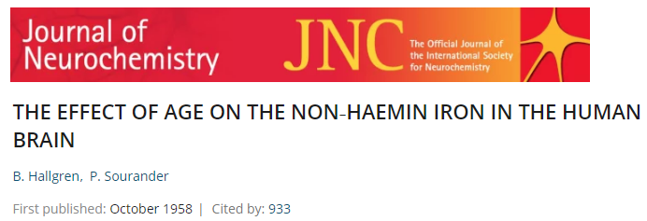
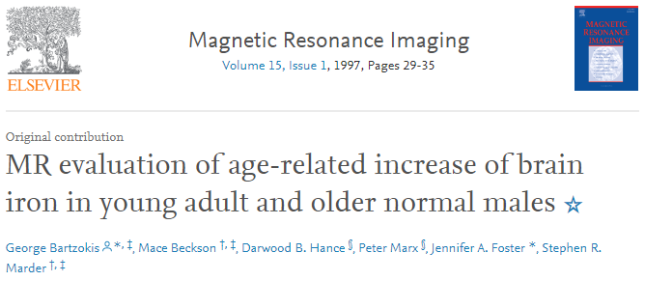
Applications
Introduction
Applications
Discussion
Simulation
3
Study of normal aging
Elderly > Young (P < 0.01 tfce corrected)
$$R_{2}^{∗}$$
$R_{2}^{∗}$ maps result in accordance with the literature
Significant age-related increases in putamen

Slide 16
Applications
Introduction
Applications
Discussion
Simulation
3
Study of normal aging
Elderly > Young (P < 0.01 tfce corrected)
$$R_{2}^{∗}$$
More information than $R_{2}^{∗}$
Bi voxels in white matter
$R_{2F}^{∗}$ represent almost all bi voxels
$R_{2S}^{∗}$ found in putamen
Bi
$${BiR}_{2F}^{∗}$$
$${BiR}_{2S}^{∗}$$

Slide 17
Applications
Introduction
Applications
Discussion
Simulation
3
Study with neurodegenerative patient’s
Subjects :
24 Parkinson’s disease (PD)
29 Multiple System Atrophy (MSA)
3D T1-FFE EPI sequence
6 TE : 6-12-20-30-40-55 ms
Better differentiation between MSA and PD to improve diagnostic accuracy
Same treatment as the previous study
Statistical Analysis
Normalization to T1 of subject
Region Of Interest (ROi) : segmentation and analysis
Normalization to homemade template
Smoothing of parametric maps
Nonparametric permutation two-sample t test with WM mask
$$R_{2}^{∗}$$
Mean
$$Bi$$
% Bi voxel / ROi
${BiR}_{2F}^{∗}$
${BiR}_{2S}^{∗}$
$$ROi$$
Total of voxels
Mean values
Student’s t-test

Slide 18
Applications
Introduction
Applications
Discussion
Simulation
3
Study with neurodegenerative patient’s
Pallidum
Putamen
No significant result for white matter other than atrophy

Slide 19
Discussion
1
2
3
4

Slide 20
Discussion
Introduction
Applications
Discussion
Simulation
4
Perspective
Amelioration
In progress
More information
Iron accumulation in whiter matter as function of age only
Iron increase related to atrophy
Amelioration of differentiation between MSA and PD for pallidum
Correlation threshold bi only with noise
Consideration of heterogeneity
Correlation with Quantitative Susceptibility Mapping (QSM)

Slide 21
Thanks for your attention
Maxime Michaud

