Slide 1
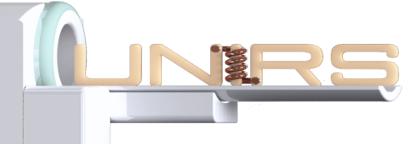
Ex vivo mapping of the cyto- and myeloarchitecture of the human cerebral cortex using ultra-high field MRI
Raïssa Yebga Hot^{1,2}, Alexandros Popov^{1,2}, Justine Beaujoin¹, Gaël Perez^{1,3}, Fabrice Poupon^{1,2}, Igor Lima Maldonado⁴, Jean-François Mangin^{1,2}, Christophe Destrieux⁴ and Cyril Poupon^{1,2}
¹CEA-NeuroSpin, Gif-sur-Yvette, France, ²Université Paris-Saclay, Orsay, France, ³CentraleSupélec, Gif-sur-Yvette, France, ⁴Imaging and Brain laboratory (iBrain), Université de Tours, INSERM UMR 1253, Tours, France
Notes:
21/04/16
1

Slide 2
Outline
Raïssa Yebga Hot
Introduction
Materials and methods
Results
Conclusion and perspectives
2
Notes:
21/04/16
2

Slide 3
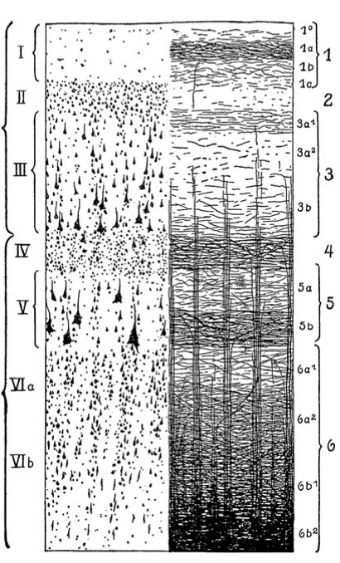
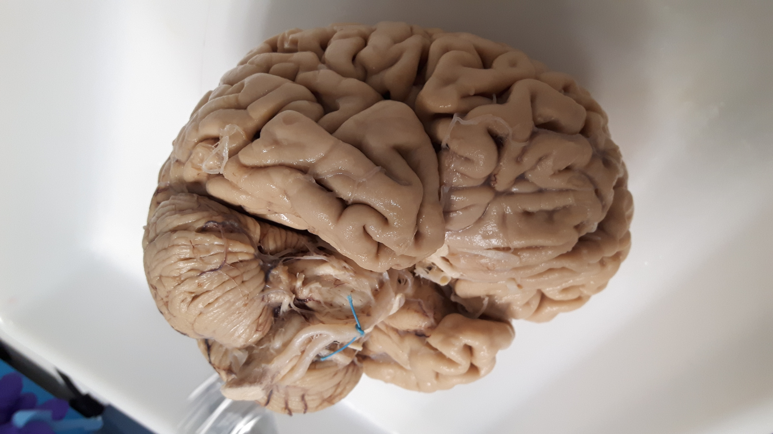
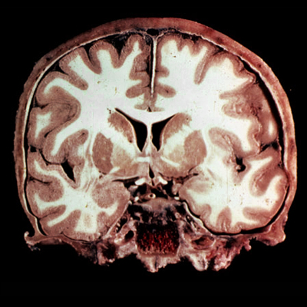
The human cerebral cortex
Introduction
Raïssa Yebga Hot
Cerebral cortex (pallium) = outer layer of the cerebrum
1-4.5mm thick
Mostly made of neuronal cell bodies (gray matter)
Contains billions of neurons
Laminar structure (cellular and myelinated layers)
Cerebrum
Cerebellum
CHU de Tours
Neuranat
Nieuwenhuys, 2013
3
Notes:
21/04/16
3

Slide 4
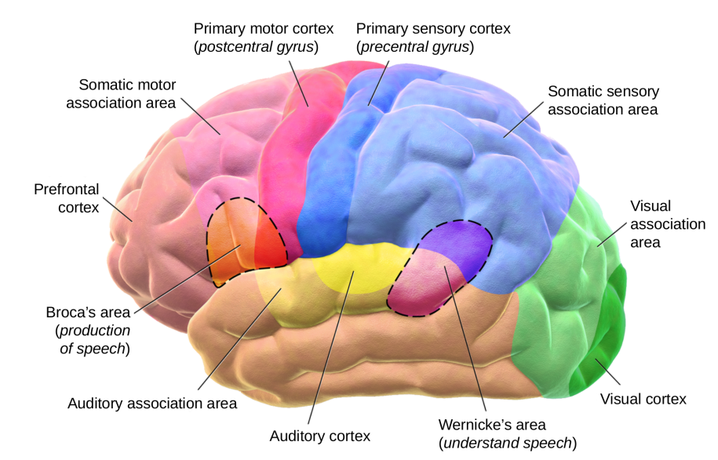
The human cerebral cortex
Introduction
Raïssa Yebga Hot
Divided in functional areas => Brodmann atlas (1909)
Involved in neurodevelopmental, neurodegenerative and psychiatric diseases (Alzheimer’s)
Existing atlases of cytoarchitectonics and myeloarchitectonics at the microscopic/macroscopic scales
No structural and quantitative atlas at the mesoscopic scale (~100µm)
4
Notes:
21/04/16
4

Slide 5
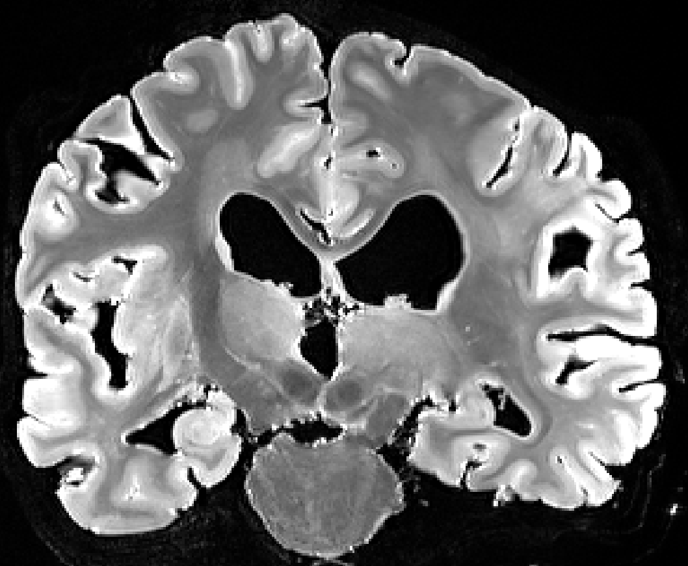
Quantitative MRI
Introduction
Raïssa Yebga Hot
Quantitative features
T₁-relaxation time (T₁)
T₂-relaxation time (T₂)
T₂*-relaxation time (T₂*)
Proton density (ρ)
Myelin water fraction (MWF)
Apparent diffusion coefficient (ADC)
…
One voxel
Neurons with myelinated / unmyelinated axons
+
Glial cells
+
Blood vessels
+
Cerebrospinal fluid
qMRI => high sensitivity to microscopic tissue changes, provides biomarkers in clinics
5
Notes:
21/04/16
5

Slide 6
Diffusion MRI
Introduction
Raïssa Yebga Hot
Diffusivity++
MRI signal--
One voxel
Axons
Brownian
motion
Diffusivity--
MRI signal++
Postmortem dMRI => longer scan times, less artefacts and mesoscopic resolution (~100µm)
$$S(o) =S0e^{\left.−bD(o\right)}$$
Stejskal and Tanner, 1965
6
Notes:
21/04/16
6

Slide 7
Outline
Raïssa Yebga Hot
Introduction
Materials and methods
Results
Conclusion and perspectives
7
Notes:
21/04/16
7

Slide 8
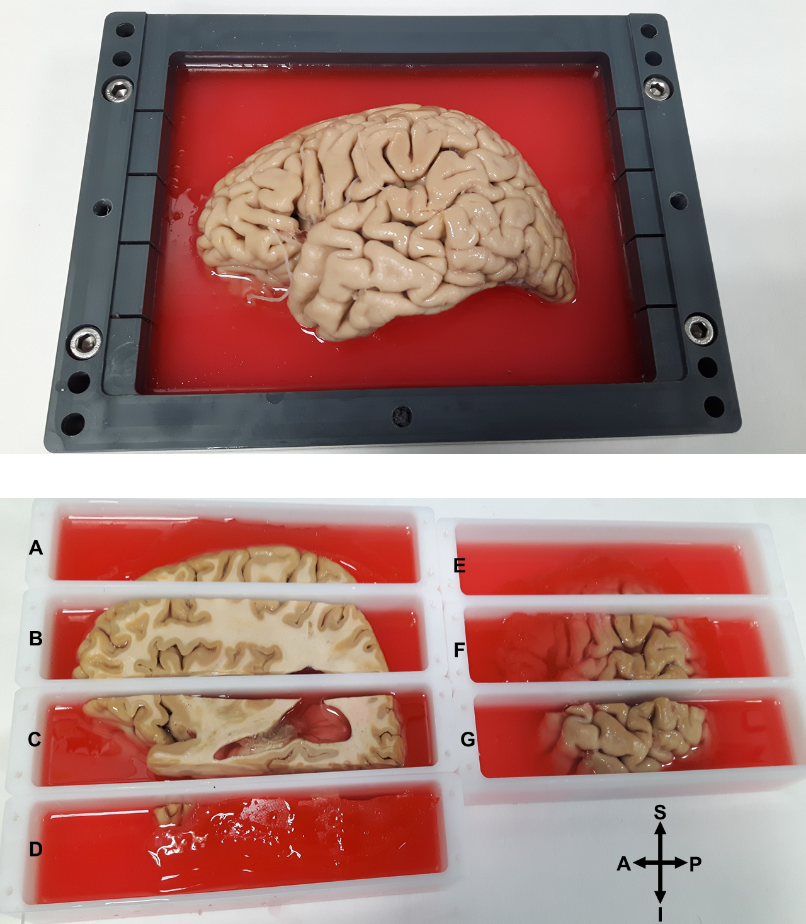
Scanning the occipital cortex
Materials & methods
Raïssa Yebga Hot
FOV = 5.6x4x4cm
8
Notes:
21/04/16
8

Slide 9
Acquisition protocol @11.7T
Materials & methods
Raïssa Yebga Hot
MRI system
Preclinical Bruker 11.7T MRI scanner
Anatomical MRI
2D T₂-weighted spin echo (150µm isotropic resolution)
Diffusion MRI
Scan duration
3D segmented EPI PGSE
200µm isotropic resolution
b=1500/4500/8000s/mm²
25/60/90 directions
Gmax=780mT/m
3h30 aMRI 150µm
3D T₂-weighted multi slice multi echo (100µm isotropic resolution)
30 segments
Total = 108 hours per field of view
22h13 aMRI 100µm
82h dMRI 200µ
9
Notes:
21/04/16
9

Slide 10
Acquisition protocol @7T
Materials & methods
Raïssa Yebga Hot
MRI system
Preclinical Bruker 7T MRI scanner
Quantitative MRI
3D variable flip angle FLASH (T₁ mapping)
B1 Mapping
Scan duration
Dual flip angle EPI
Gmax=750mT/m
200µm isotropic resolution
Total = 72 hours per field of view
3D T₂-weighted multi slice multi echo (T₂ mapping)
3D T₂*-weighted GRE EPI (T₂* mapping)
Flip angles = 30/60°
200µm isotropic resolution
10
Notes:
21/04/16
10

Slide 11
Post-processing
Materials & methods
Raïssa Yebga Hot
Denoising the images with a non-local means filter => Gaussian noise
Fitting of the qMRI data using a non-linear Nelder-Mead-based algorithm
Application of the NODDI model on the dMRI data
Registration of the 7T and 11.7T datasets using 3D affine transformation
Not filtered
Filtered
11
Notes:
21/04/16
11
Booster le contraste sur les images anat 150mu et mettre plutôt des grosses flèches avec AC et PC

Slide 12
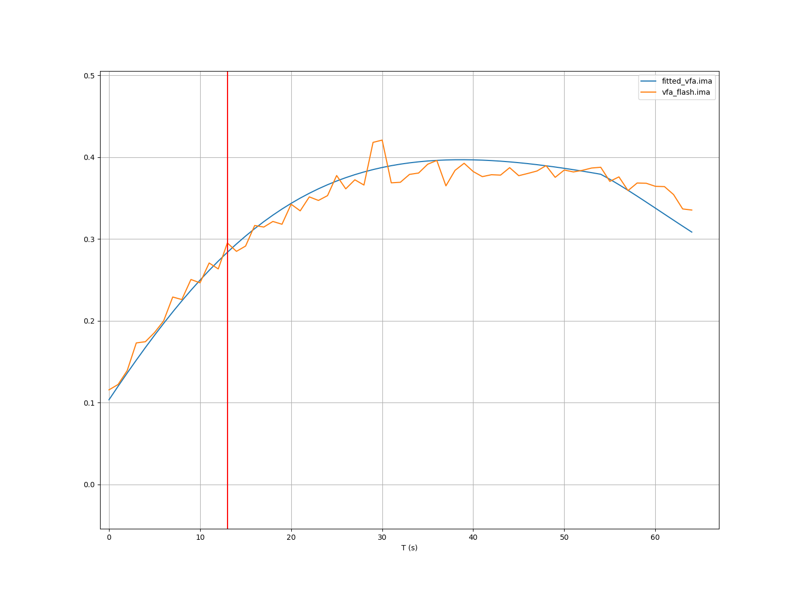
Post-processing
Materials & methods
Raïssa Yebga Hot
Fitted model
Actual signal
Denoising the images with a non-local means filter => Rician noise
Fitting of the qMRI data using a non-linear Nelder-Mead-based algorithm
Application of the NODDI model on the dMRI data
Registration of the 7T and 11.7T datasets using 3D affine transformation
VFA-FLASH signal equation:
12
Notes:
21/04/16
12
Booster le contraste sur les images anat 150mu et mettre plutôt des grosses flèches avec AC et PC

Slide 13
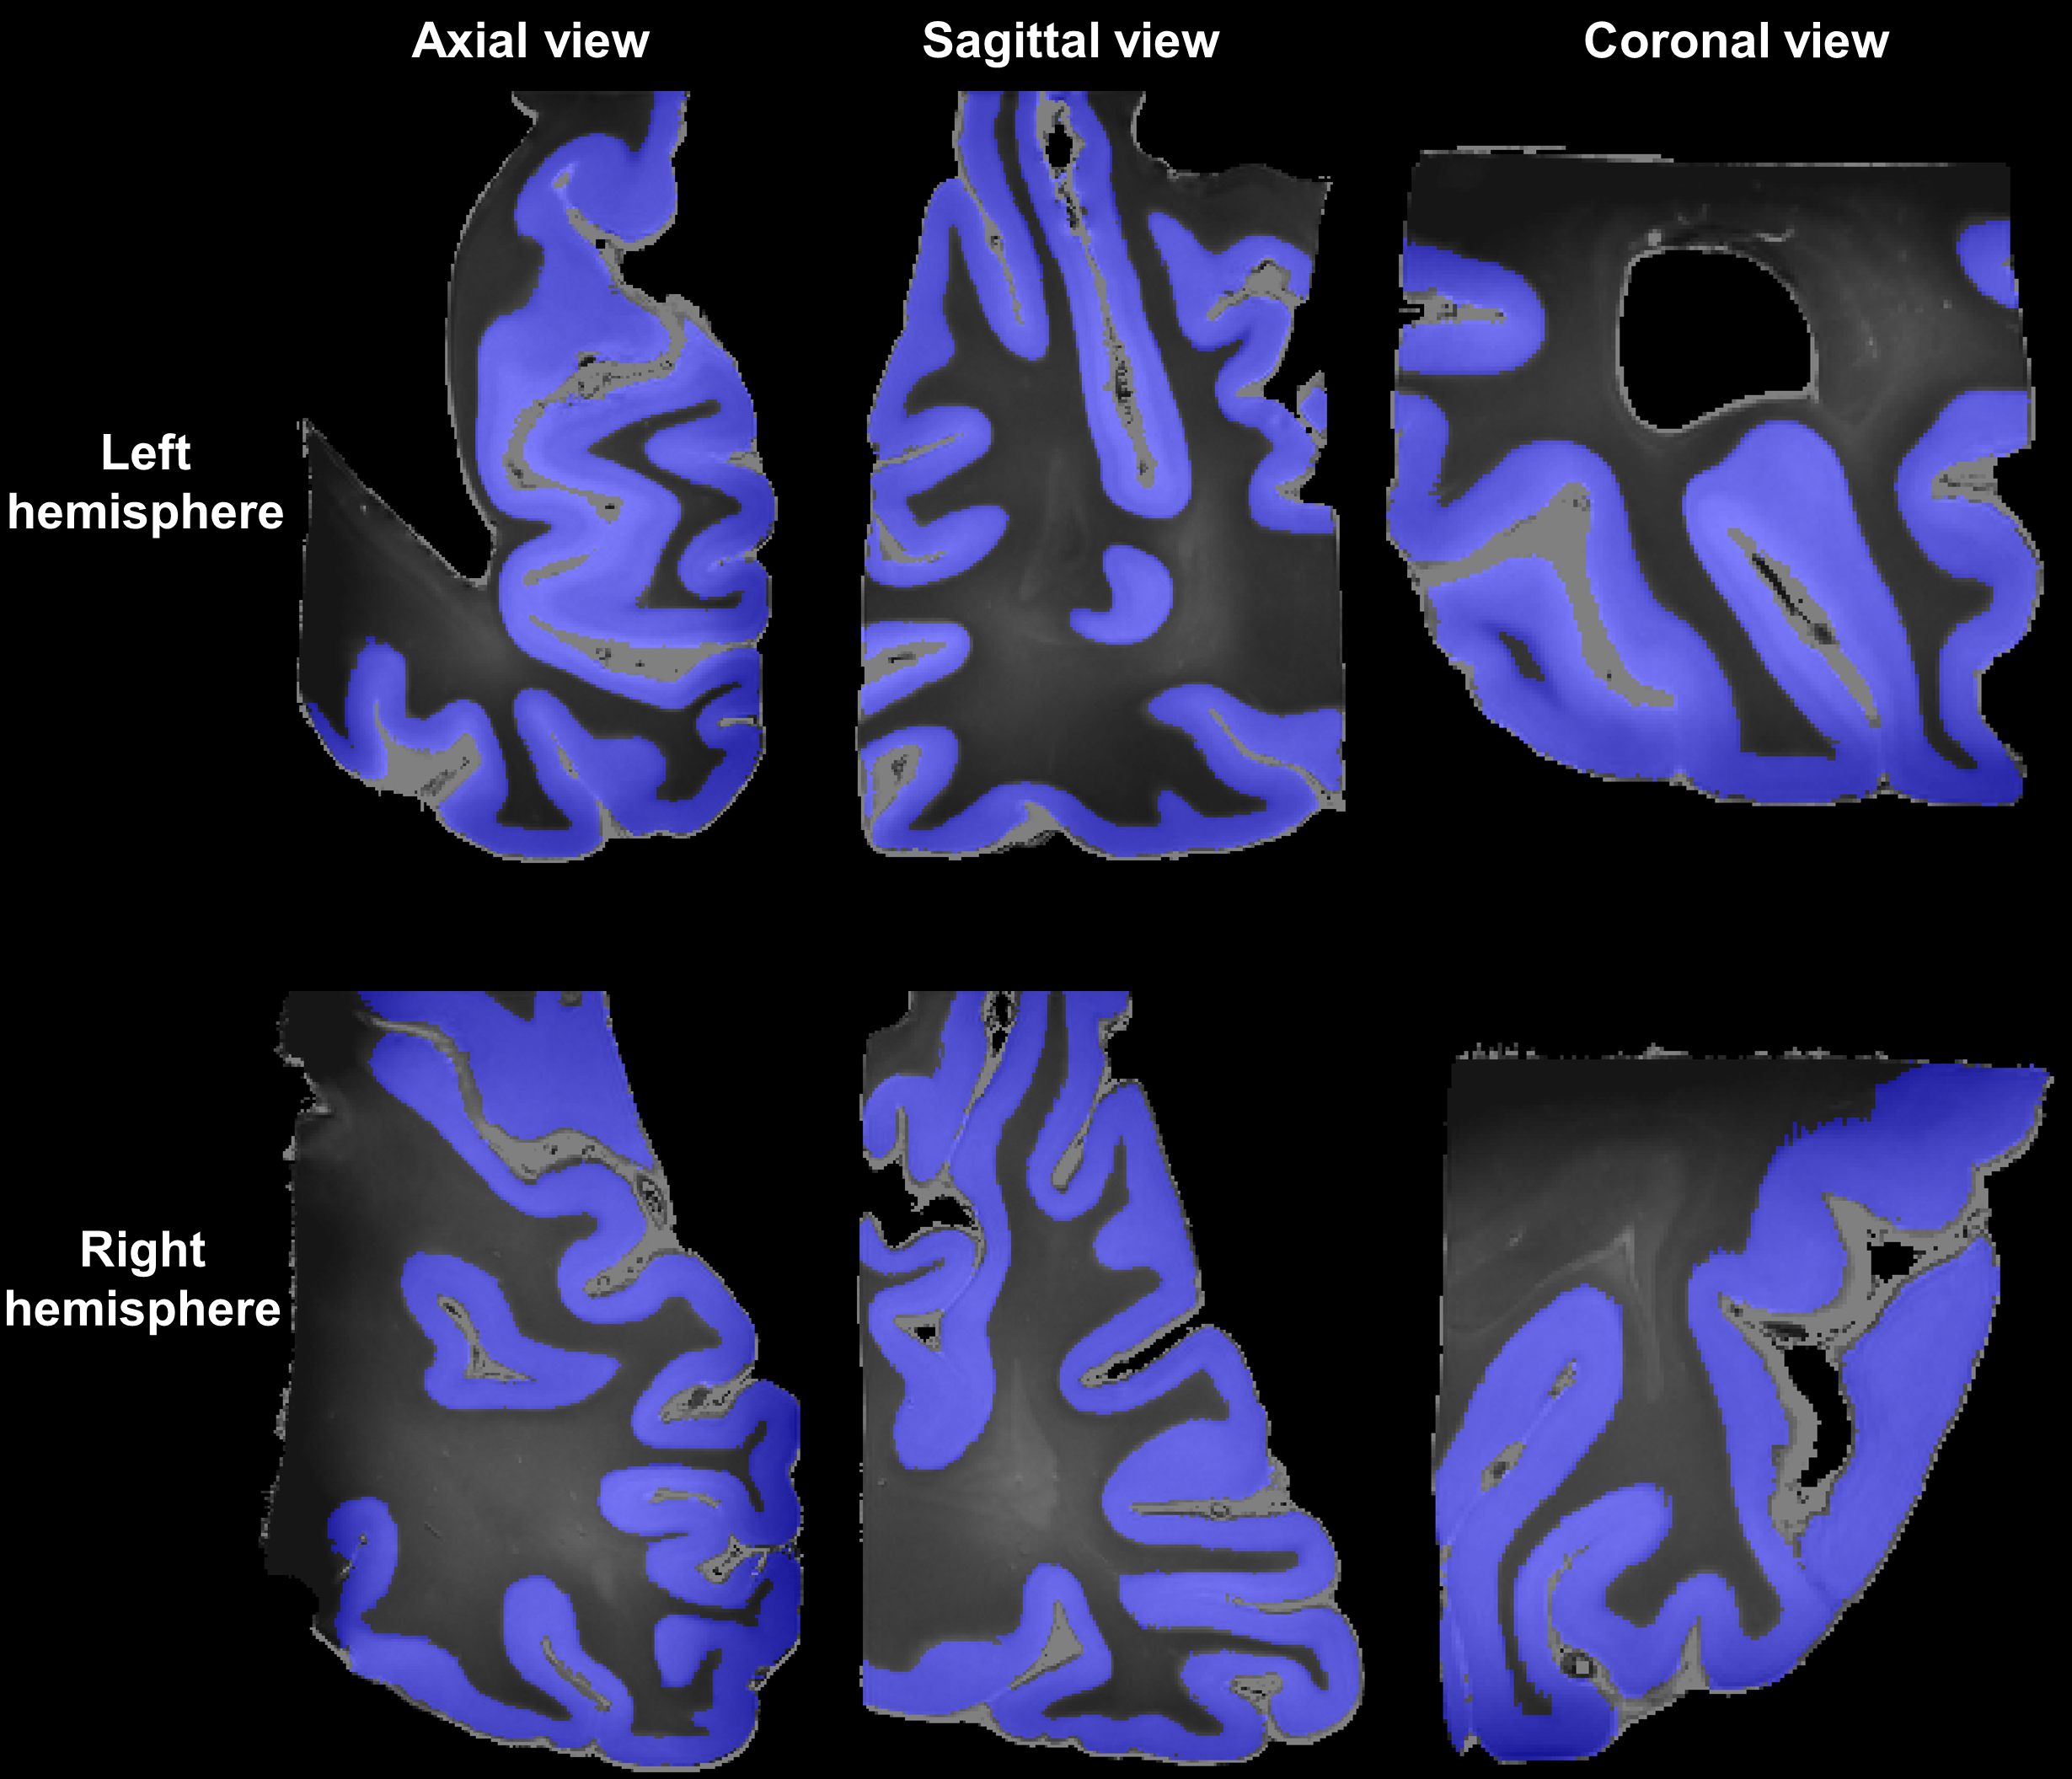
Cortices’ masks and clustering
Materials & methods
Raïssa Yebga Hot
Trade-off between a minimum BIC score and a plausible clustering of the cortical layers
Only gray matter and subcortical white matter
13
Notes:
21/04/16
13
Booster le contraste sur les images anat 150mu et mettre plutôt des grosses flèches avec AC et PC

Slide 14
Outline
Raïssa Yebga Hot
Introduction
Materials and methods
Results
Conclusion and perspectives
14
Notes:
21/04/16
14

Slide 15
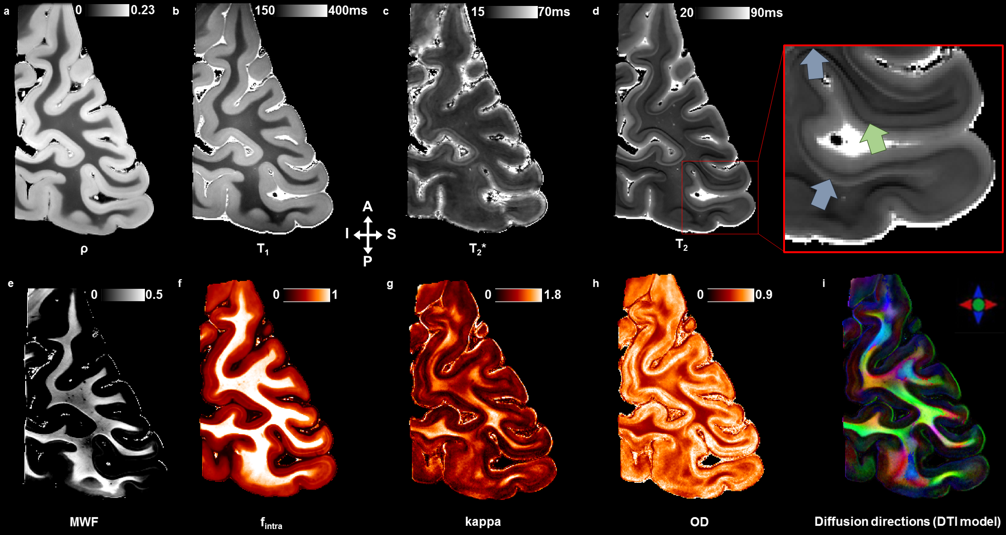
Quantitative relaxometric and diffusion maps
Results
Raïssa Yebga Hot
Subcortical white matter
The Gennari stripe (highly myelinated layer)
15
Notes:
21/04/16
15

Slide 16
Cytoarchitecture of the cortex
Results
Raïssa Yebga Hot
8 classes found
Combination of quantitative T₂ and two NODDI parameters: intracellular volume fraction & kappa
One more cellular layer for the left hemisphere
Left hemisphere
Right hemisphere
16
Notes:
21/04/16
16

Slide 17
Myeloarchitecture of the cortex
Results
Raïssa Yebga Hot
6 classes found
Combination of quantitative T₁, T₂ and myelin water fraction
Specific subcluster within the calcarine sulcus
Gennari line (layer 4b of V1 in myelorarchitectonics) detected
Left hemisphere
Right hemisphere
17
Notes:
21/04/16
17

Slide 18
Outline
Raïssa Yebga Hot
Introduction
Materials and methods
Results
Conclusion and perspectives
18
Notes:
21/04/16
18

Slide 19
Conclusion and perspectives
Raïssa Yebga Hot
Exploiting ultra-high field quantitative and diffusion MRI to map the human occipital cortex’s microstructure
Discovering the cellular and myelinated environments of the cortex at the mesoscopic scale
Exploring the differences and commonalities of the two hemispheres
Currently scanning ex vivo the entire human brain specimen to obtain a complete structural and quantitative mapping of the human cortex
Focusing now on the existing results and a potential link with functional networks
19
Notes:
21/04/16
19
Cet atlas est le référentiel dans lequel les populations seront comaprées

Slide 20
Acknowledgements
raissayh@gmail.com
Raïssa Yebga Hot
My colleagues from NeuroSpin
My collaborators from iBrain (CHU de Tours) :
Pr. Christophe Destrieux and Dr. Igor Lima Maldonado
The donor who gave his body to science for this study
This work received funding from the European Union’s Horizon 2020 Framework Program for Research and Innovation (Grant Agreement No 720270, Human Brain Project SGA2)
Notes:
21/04/16
20

