Slide 1
Anne-Sophie Dirand, Frédérique Frouin, Irène Buvat
IMIV, CEA, Inserm, CNRS, Univ. Paris-Sud, Université Paris-Saclay, Orsay, France
A downsampling strategy to assess the predictive value
of radiomic features

Slide 2
What is radiomics / Why?
Lesion delineation
First order features computation
PET/CT
MRI
CT
Ultrasound
Tumor characteristics
Response to treatment
Prognosis
Medical images
Model building
Discretization
Precision medicine
Texture matrices computation
Texture features computation
Orlhac F. thesis

Slide 3
Recurrent problem in radiomics
No satisfying classification/prediction model is found because
No information in the data?
Not enough patients?
Add other type of data
Enlarge cohort

Slide 4
Goal
Predicting the performance to be expected when building a classification model based on radiomic features by accounting for the experimental conditions
Distinguishing between no relevant information and insufficient number of patients

Slide 5
Material and Methods
Cohort of N patients with 2 status. X features for each patient.
Classifying methods :
Multivariate models :
Machine learning (ML) : Logistic regression (LR), Support vector machine (SVM), Least Absolute Shrinkage and Selection Operator (LASSO)
Feature reduction methods : Recursive Feature Elimination (RFE), Principal Component Analysis (PCA), univariate ROC analysis (ROC)
Performance metrics : Area Under the Curve (AUC) & Youden index (sensitivity + specificity - 1)

Slide 6
Material and Methods
Machine Learning
Training set & Validation Set (TRS & VS)
SKFCV (K folds)
Fold 1
...
50 runs (i from 1 to 50)
Fold 2
...
Fold K
...

Slide 7
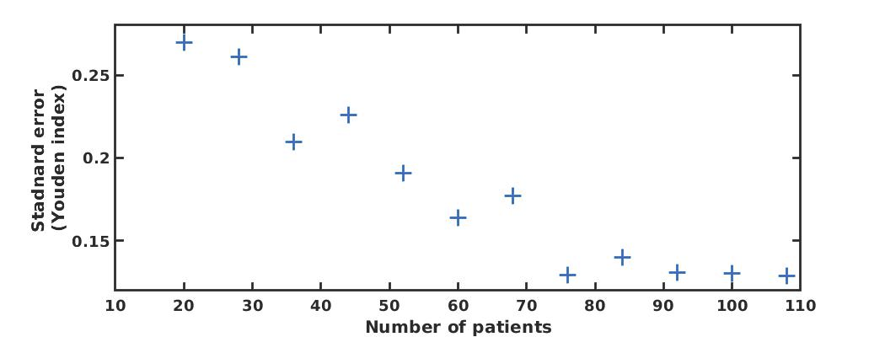
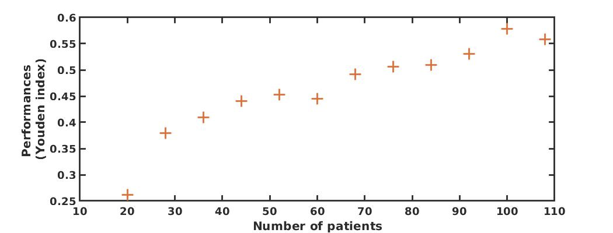
Material and Methods
Downsampling method

Slide 8
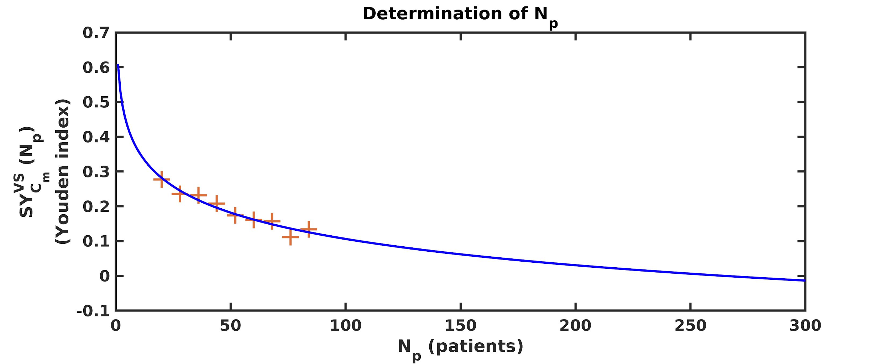
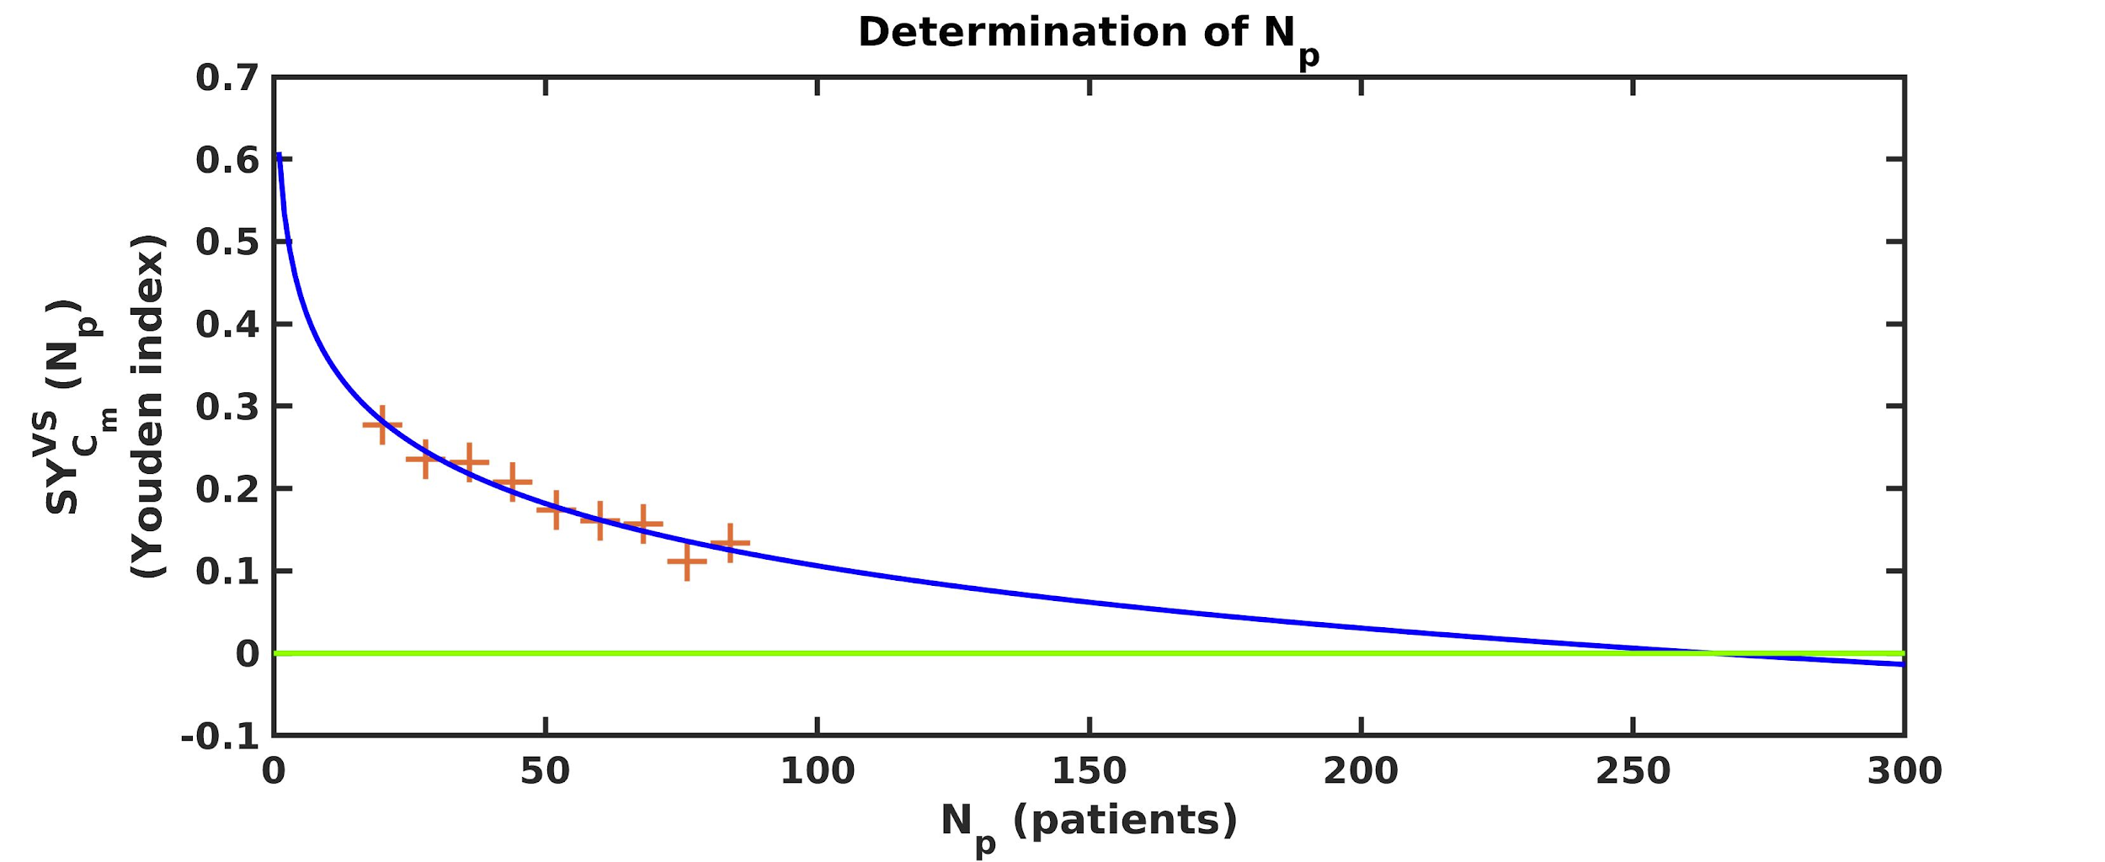
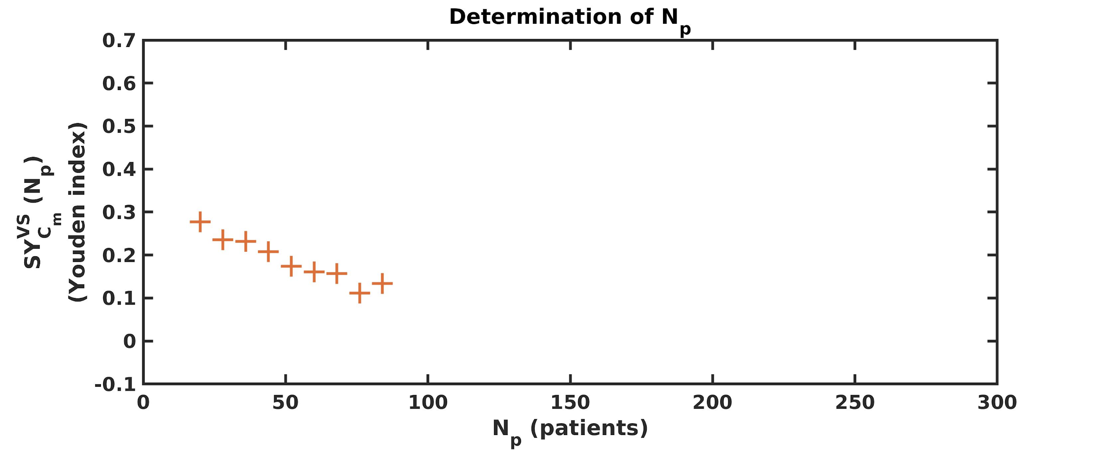
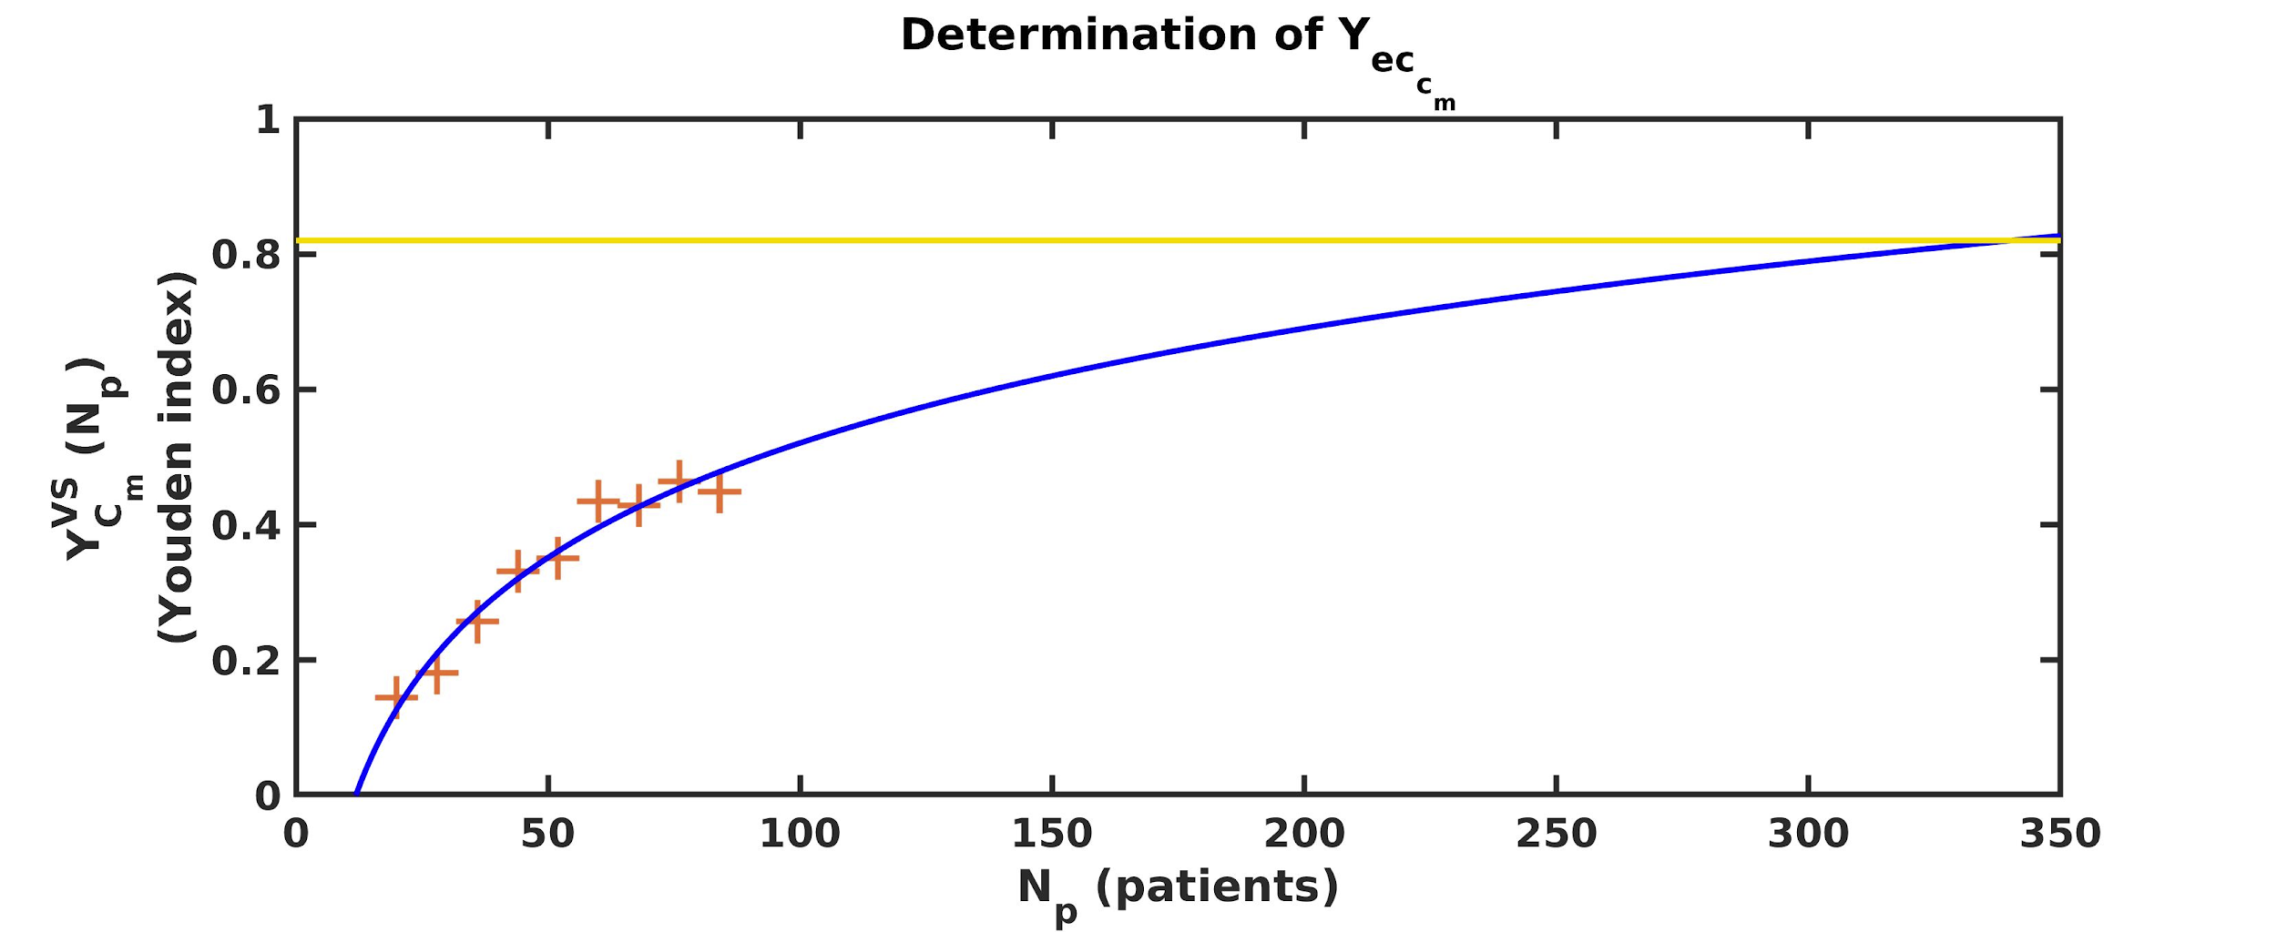
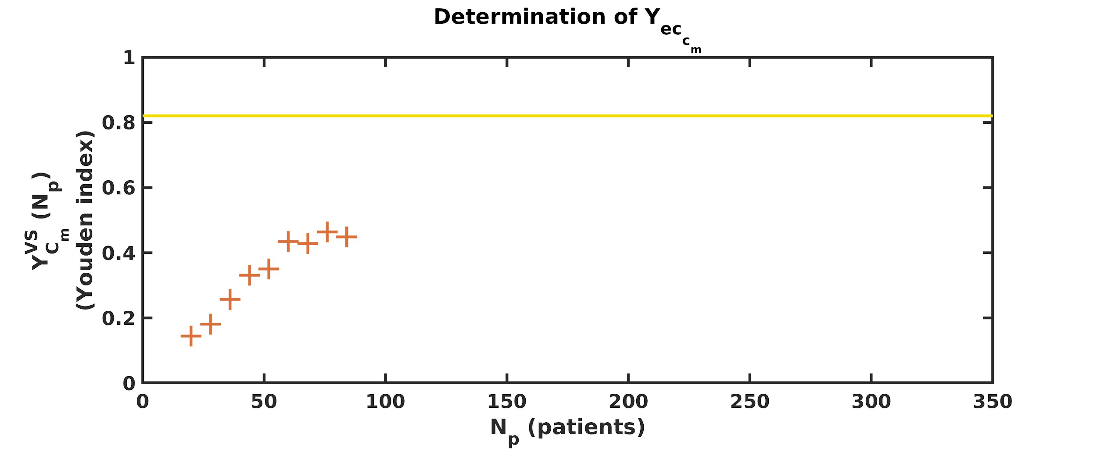
Material and Methods
Determination of Nc
Prediction ML
N_{c}
Determination of Y_{eccm}
Y_{eccm}
N_{c}

Slide 9
Cohorts
Cohort 1 [1] : 414 PET images of patients with lung lesions (303 primary lesions / 111 metastases). 43 features per patient.
Cohort 2 [2] : 569 fine needle aspiration images of breast (357 benign masses / 212 malignant masses). 30 features per image.
Synthetic cohorts 1 & 2 : 2 synthetic cohorts with no predictive information created from cohorts 1 and 2 by arbitrarily assigning one of the 2 status to each patient.
[1] Kirienko et al, Eur J Nucl Med Mol Imaging, 45:1649-1660, 2018.
[2] Wolberg et al, Hum Pathol 26:792-796, 1995.

Slide 10
Material and Methods
Number of patients
ML | Cohort 1 | Cohort 2 | Synthetic cohort 1 | Synthetic cohort 2
From XX patients | 220 | 73 | 220 | 73
To XX patients | 36 | 19 | 36 | 19
Step S | 8 | 3 | 8 | 3
Number of experimental conditions (EC) | 216 | 171 | 120 | 95
24 x 9
number of
patient’s possibilities
to start with
number of
ML methods

Slide 11
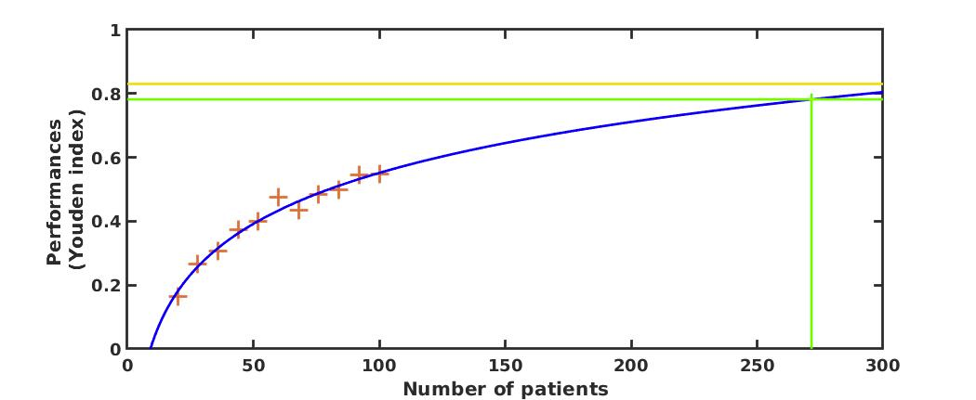
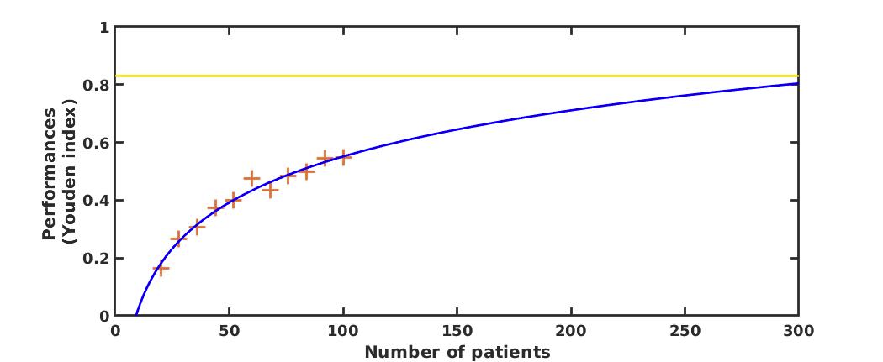
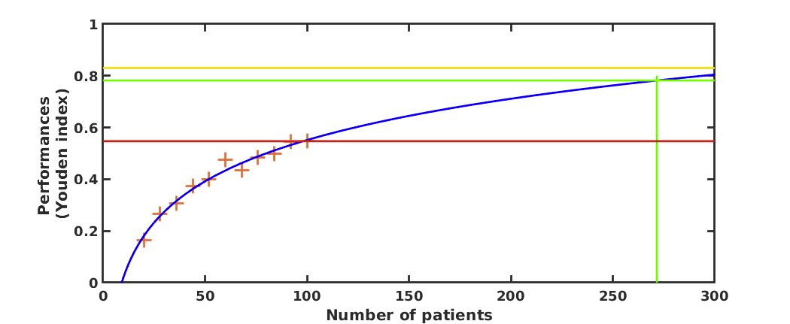
Material and Methods
Evaluation of the prediction
QF1
QF1
Youden obtained with all the patients
Curve fitting
Experimental points
QF2
+
QF1 = how far the prediction is from the reachable value at stability (the smaller, the better)
QF2 = how far the obtained performance with N patients is from the reachable value at stability

Slide 12
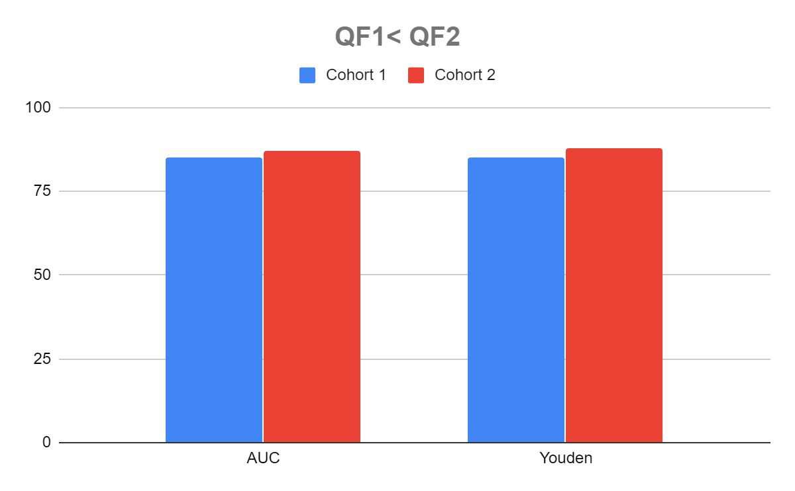
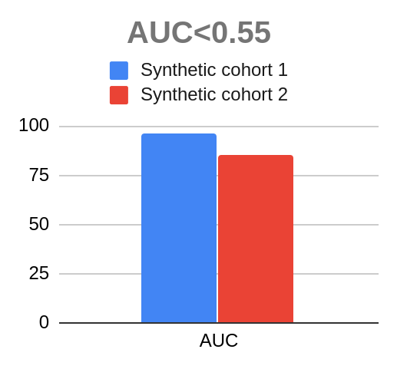
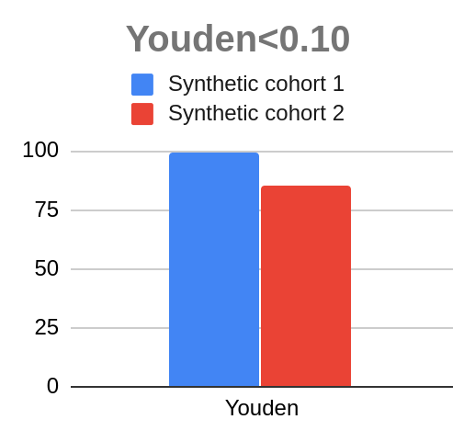
Results
Real cohorts
Synthetic cohorts

Slide 13
Results
Example of use
Determination of Nc
Cohort of 88 patients :
downsampling done with 84 out of these 88 patients
N_{c}
QF1 = 0.07
Y_{eccm}
QF2 = 0.35
N_{c}

Slide 14
Discussion / Conclusion
Downsampling approach :
lead to a better estimate of the performance to be expected
does not conclude at the presence of information if there is none
distinguishes cases with discriminant information but not enough patients from cases without any discriminant information

Slide 15
Thank you for your attention !
Anne-Sophie Dirand
dirandannesophie@gmail.com

