Slide 1
HL-LHC Use Case
Simone Campana
CERN, Geneva, Switzerland
Amsterdam, 1 July 2019

Slide 2
Intro
This presentation focus on ATLAS and CMS experiments at HL-LHC
Other experiments (LHCb, Alice) present less of a challenge at the time of HL-LHC
Both ATLAS and CMS use Rucio (CMS is migrating) so that is at the core of data orchestration and organization
Metadata is managed in separate catalogs (different for each experiment). Rucio contains also some metadata

Slide 3
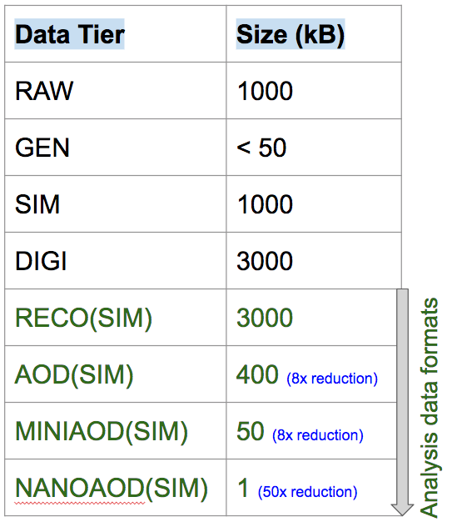
Data Production
The numbers on the right are TODAY. In HL-LHC multiply by ~x5
All numbers refer to compressed data
Data are organized in files of 1-5 GB. Events are stored in files as contiguously as possible to facilitate further processing. In HL-LHC, we foresee files of the same size.
Because files are event collections, we can make them as big (or small) as we want, if this demonstrates to improve performance/usability
T. Boccali, M Klute
2018 numbers

Slide 4
Data Model
Data formats in green are the formats used by analyzers
We need 2 copies of RAW data on tape (CERN plus another center). Could (hardly) be re-discussed
RECO (ESDs) disappeared (produced/stored on demand)
AODs today on disk. For HL-LHC we are testing having them on tape only (or mostly) and accessing them through organized campaigns.
MiniAOD and NanoAOD should be the ones on disk, multiple copies. We want to concentrate on those in ESCAPE
T. Boccali, M Klute
2018 numbers

Slide 5
Data Model
AODs are produced ~1/year (could be 2) in organized (reprocessing campaigns).
Mini/NanoAODs are produced more often (say, 4 times/year)
Rucio features are used to manage replica lifecycles: volatile replicas are automatically created based on popularity (with different methods including ML) and cleaned by Rucio if space is needed
On top of that, data lifecycle is implemented: how many versions of AODs are retained, etc .. Applies to disk AND tape.
T. Boccali, M Klute
2018 numbers

Slide 6
Data Access and Data Processing
RAW data are unusable for physicists (apart from low level detector debugging): they are processed ASAP (currently within ~48h) and (Mini/Nano)AODs are produced
Each experiment has a Workload Management system to do so. The WMS is also used to produce AODs from Monte Carlo
The WMS schedules workload on distributed clusters (mostly Grid). No need for MPI: HPCs are used as ”a bunch of cores”
The WMS is integrated with the Data Management system to organize files/datasets and orchestrate data movement
No plan to change any of that
There is “data driven processing”, but triggered/organized at a higher level than the storage. We are very interested however in automating data loss recovery through those mechanisms.

Slide 7
Thoughts about Data Lakes

Slide 8
Thoughts about data lakes .. in practice
We foresee >1 datalakes (think about US, EU, Asia-Pacific at least)
Generally, each datalake should be able to contain a full set of most analysis products (Mini?/NanoAODs)
End user analysis would (largely) be possible by accessing data from one data lake.
Could be Grid jobs, local batch clusters/machines. Could be notebooks. Under evaluation, probably all the above
In the data lake there are:
Sites with archival storage (tape today), managed disk storage (and possibly cache storage) and CPUs
Sites with managed disk storage (and possibly cache storage) and CPUs
Sites with cache storage and CPUs
Sites with CPUs only

Slide 9
Data Access and Data Processing
We need to be able to process data from tape for organized activities (not for end user analysis). We are happy with the current WMS->Rucio->FTS->Storage for staging
We use both CopyToWN and Direct Access modes for data processing. We foresee the need for remote data access. This could be facilitated or not by a latency hiding mechanism (such as XCache) depending on the sites and the application. We consume both random events or the full content in a file
Some data are heavily re-used and some are not very frequently re-used. Caching would be needed for the first ones
We need storage QoS for different type of data. This could be a considerable cost saver while improving performance. More than just “disk and tape”, so different disk QoS, less than 5. Focus on performance at higher cost and less reliability at lower cost

Slide 10
Data Access Control
Data embargo policies depend on the experiment
Data are “released” for open access on a different system. So:
No anonymous access
Only very simple ACLs within an experiment (production/generic user)
We surely want the ESCAPE prototype being Token-based for Authentication. In the WLCG infrastructure we plan to use INDIGO-IAM

Slide 11
Our use case for ESCAPE
Provide a Data Lake prototype in Europe
Integrate heterogeneous storage solutions, we see Rucio as the orchestrator
Demonstrate 3rd party copy capabilities through HTTP/xrootd (gridFTP-free) at increasingly high scale
Token based AAI
Provide different QoS exposed through Rucio
Host a sizeable set of experiment data for commissioning. Those would be Mini/NanoAODs
Provide a caching/latency hiding layer (possibly based on XCache) to serve data for analysis at sites in Europe. We would test initially this with Hammercloud

