Slide 1
Welcome
Giovanni LAMANNA
22 Mai 2019

Slide 2
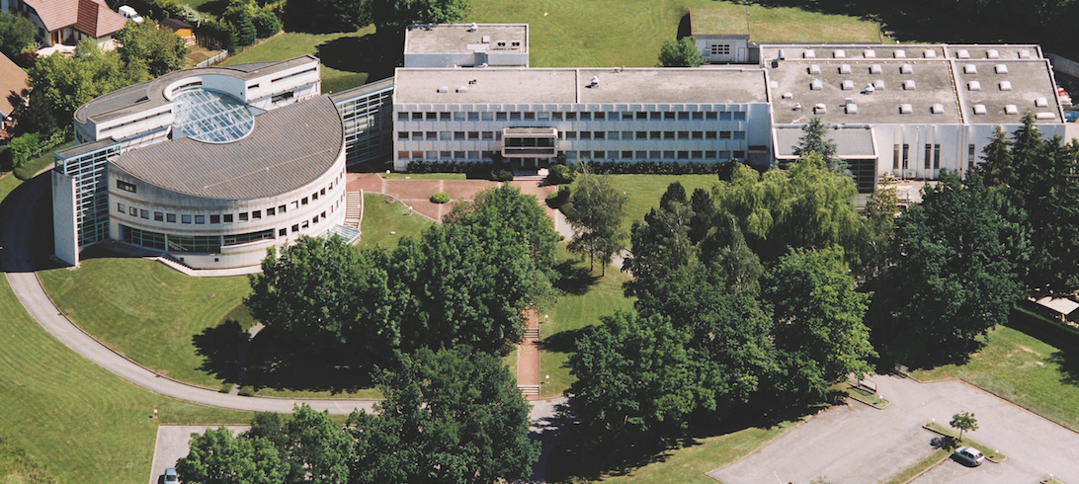
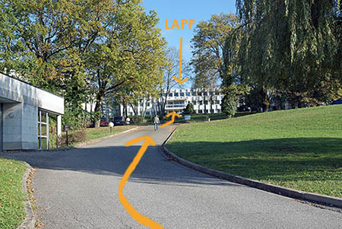
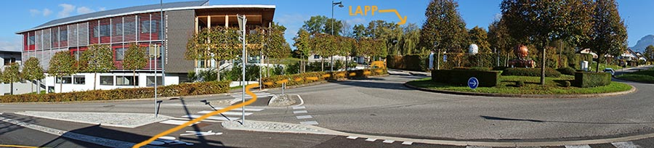
Fundamental research in Annecy
Created in 1976, LAPP is a laboratory of the CNRS National Institute for Nuclear and Particle Physics (IN2P3) and USMB.
Particle and Astroparticle physics.
Combination of the experimental investigations of the two infinities, from the largest-scale structures in the observable Universe to the most fundamental particles
LAPP, 22/05/19
G. Lamanna
2

Slide 3
Fundamental research in Annecy
LAPP was born 43 years ago as a gateway-laboratory to CERN for French CNRS scientists.
Today more than 150 researchers, engineers, technicians, administrative personnel, students..
Frontier technologies in different fields:
  mechanics,
  electronics,
  mechatronics,
  computer science,
  scientific and control software and e-infrastructures.
LAPP hosts a Theory Laboratory (LAPTh) within its premises.
LAPP, 22/05/19
G. Lamanna
3

Slide 4
Particle physics
ATLAS
LHCb
Neutrinos
At LHC, CERN
At LHC, CERN
Matter-antimatter asymmetry
Neutrino properties: oscillation, 4th family, matter-antimatter asymmetry
Search for new physics
Higgs boson discovery, 2012
STEREO, SuperNEMO and WA105/DUNE
Search for new physics
One of the major French contributions in ATLAS
Long-term involvement In ν-physics
Important involvement in the upgrading for the HL-LHC
LAPP, 22/05/19
G. Lamanna
4

Slide 5
Astroparticle physics and Cosmology
AMS
HESS & CTA
Virgo
Search for dark matter and antimatter in the Universe
Search for dark-matter
Gravitational waves detection
LSST
On the ISS
Telescopes in Namibia, Chile and La Palma
Study of high energy cosmic rays sources
Interferometer installed in Pisa, Italy.
General relativity, gravitational astronomy
Chile.
Dark matter and dark energy studies
Particle physics in Space
27 years involvement. Pioneer and a reference leading role in Virgo.
A key role in CTA and the largest CNRS-IN2P3 contribution
LAPP, 22/05/19
G. Lamanna
5

Slide 6

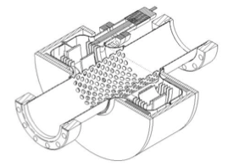
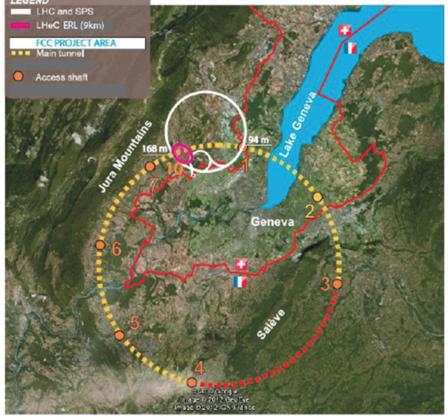
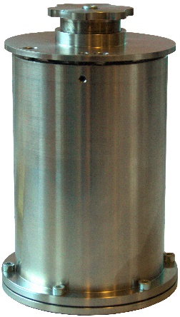

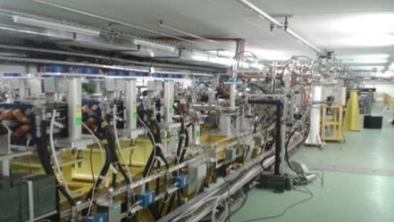
Future colliders
Post-LHC colliders R&D at CERN
Would be deployed in the Haute Savoie region and bringing the CERN experiments close to the LAPP site.

Slide 7

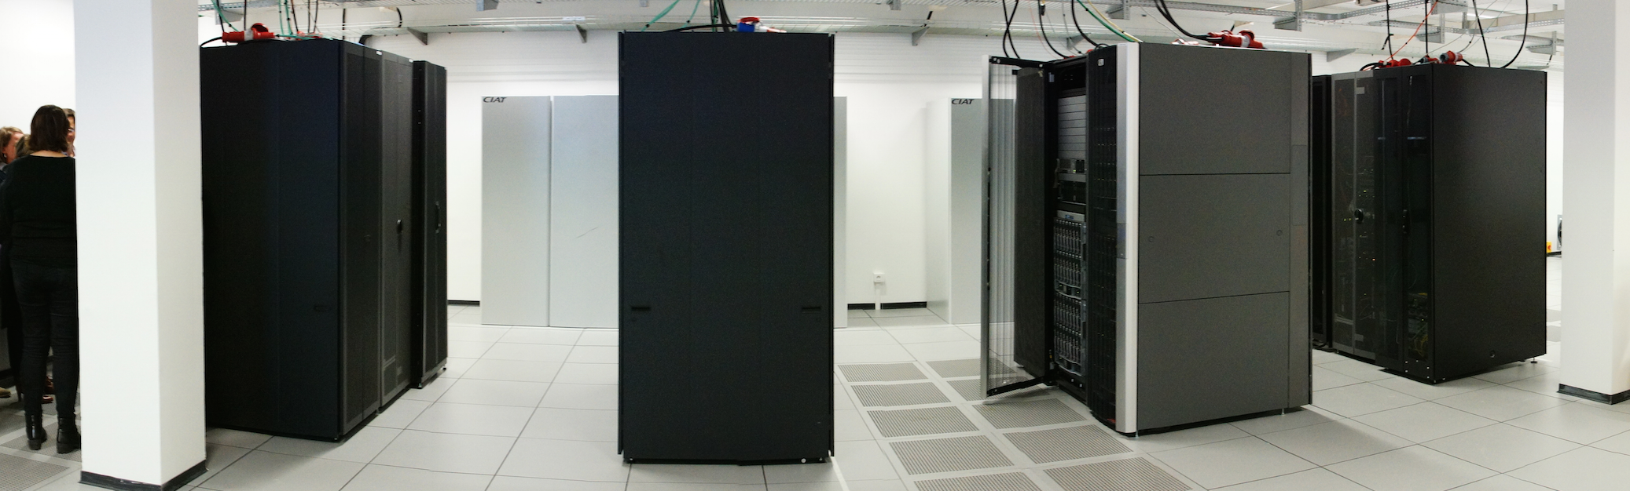
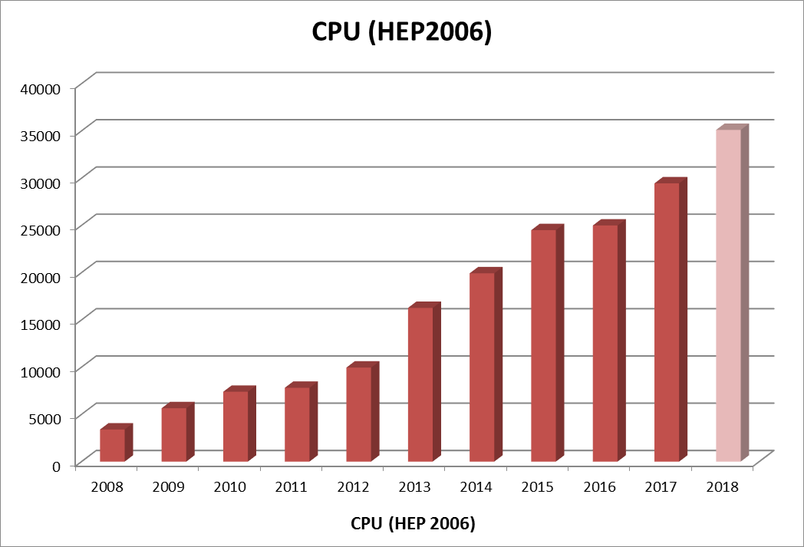
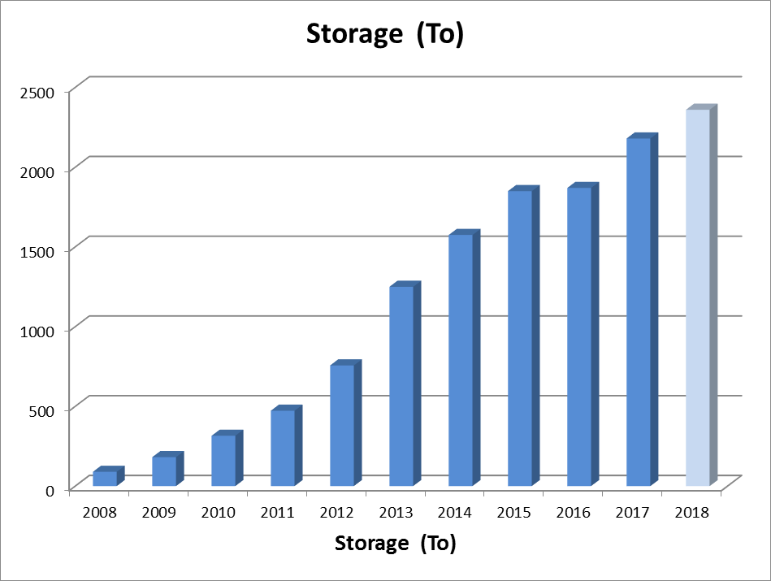
Computing and data science
LAPP hosts the MUST multidisciplinary Data and Computing Centre
(WLCG Tier2/ ATLAS Nucleus, CTACG and various projects).
In 2018:
3600 cores
2.3 PB
Sustainable Data Centre
with continuous growing capacities
LAPP, 22/05/19
G. Lamanna
7

Slide 8

DATA-Science at LAPP towards HL-LHC …

Slide 9

Domain Cluster projects
H2020-INFRAEOSC-04-2018 call
Clusters to ensure the connection of the EFRI RIs with EOSC
(and the construction of EOSC)
Expected impact:
Improve access to data and tools leading to new insights and innovation
Facilitate access of researchers to data and resources for data driven science.
Create a cross-border open innovation environment.
Rise the efficiency and productivity of researchers through open data services and infrastructures for discovering, accessing, and reusing data.
Foster the establishment of global standards.
Develop synergies and complementarity between involved research infrastructures.
Adopt common approaches to the data management for economies of scale.
Making data FAIR …
LAPP, 22/05/19
G. Lamanna
9

Slide 10

Background
ESCAPE is based on the capacity building of the H2020 ASTERICS cluster of ESFRI projects (in astrophysics and astroparticle physics) addressing Big Data challenges and already succeeding in:
  enabling interoperability between the facilities,
  minimising fragmentation,
  encouraging cross-fertilisation and
  developing joint multi-messenger capabilities.
Astronomy ESFRI & Research Infrastructure Cluster
ASTERICS - 653477
LAPP, 22/05/19
G. Lamanna
10

Slide 11

ASTERICS
Astronomy ESFRI & Research Infrastructure Cluster
ASTERICS - 653477
Astronomy ESFRI & Research Infrastructure Cluster
Horizon 2020 Work Programme INFRADEV-4-2014/2015 Call –
“Implementation and operation of cross-cutting services and solutions for clusters of ESFRI and other relevant research infrastructure initiatives”
Focus of ASTERICS: SKA, CTA, KM3NeT, close links to E-ELT, EGO, EUCLID, LSST.
Funded at 15 M€ for 4 years (1/5/2015-30/4/2019)
22 partners in 6 countries, representing a major collaboration in Astronomy/Astrophysics/Astroparticle Physics
ASTRON, CNRS, INAF, UCAM, JIVE, INTA, UEDIN, UHEI, OU, FAU, VU, CEA, UVA, UGR, FOM, IEEC, IFAE, UCM, INFN, STFC, DESY, SURFnet.
5 Work Packages.
WP3:
OBELICS (OBservatory E-environments LInked by common ChallengeS)
LAPP, 22/05/19
G. Lamanna
11

Slide 12
Astronomy and Particle Physics
ESCAPE is a step forward…
The astronomy-related ESFRI projects and the accelerator-based particle physics ESFRI facilities will open together new paths towards the understanding of the Universe through a multi-probe approach.
Enhance the coordination leveraging two major complementary excellences in data stewardship:
  i) the astronomy Virtual Observatory infrastructure;
  ii) long-standing expertise of the particle physics community in large-scale
  distributed computing and big-data management.
LAPP, 22/05/19
G. Lamanna
12

Slide 13
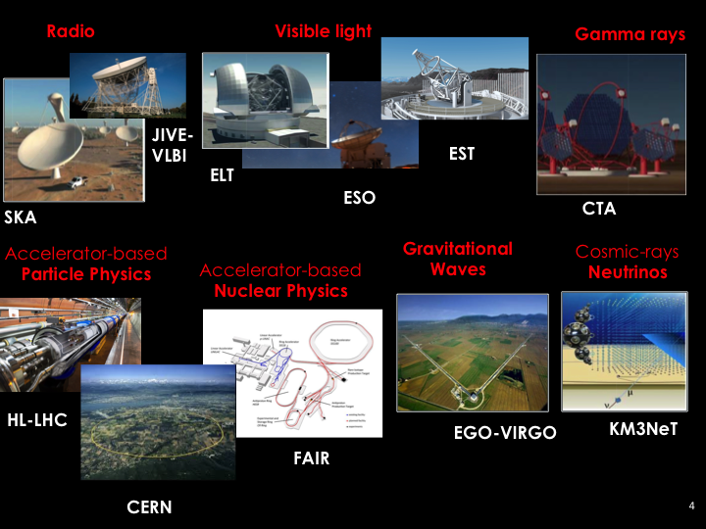

Slide 14
ESCAPE in a nuthshell
ESCAPE convenes a large scientific community
31 partners (including 2 SMEs)
7 ESFRI projects & landmarks: CTA, ELT, EST, FAIR, HL-LHC, KM3NeT, SKA
2 pan-European International Organizations: CERN, ESO (with their world-class established infrastructures, experiments and observatories).
4 supporting ERA-NET initiatives: HEP (CERN), NuPECC, ASTRONET, APPEC
1 involved initiative/infrastructure: EURO-VO
2 European research infrastructures: EGO and JIV-ERIC
Budget: 15.98 M€
Started: 1/2/2019
Duration: 42 months (end date 31/7/2022)
Coordinator: CNRS
Home page: https://projectescape.eu ; Twitter: @ESCAPE_EU
LAPP, 22/05/19
G. Lamanna
14

Slide 15
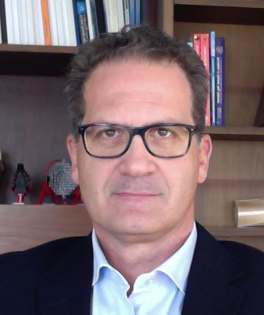
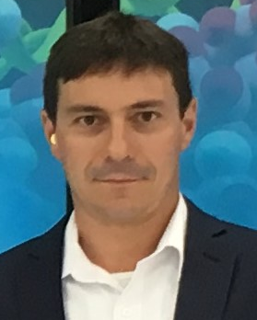
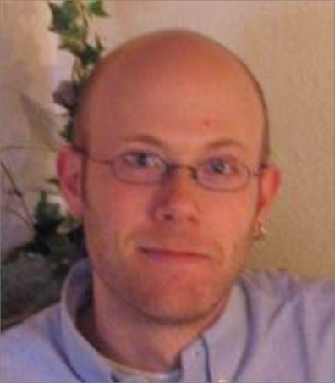
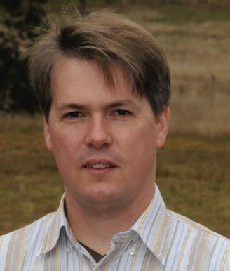
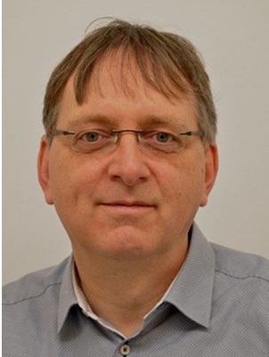
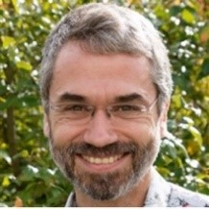
ESCAPE work programme
WP1 MIND. Leader: Giovanni Lamanna, ESCAPE Coordinator, LAPP-CNRS
Management and policy.
WP2 DIOS. Leader: Simone Campana, CERN
Contribute to the federation of global EOSC resources through an implementation of the Data-Lake concept (evolution of WLCG and other ESFRI RIs computing models) to manage extremely large volumes of data up to the multi-exabyte scale
WP3 OSSR. Leader: Kay Graf, FAU
Support for "scientific software" as a major component of the ESFR-RI “data” to be stored and displayed in EOSC via dedicated community-based catalogues. Implementation of a community-based approach for the continuous development of shared software and for training of researchers and data scientists.
WP4 CEVO. Leader: Mark Allen, CDS-CNRS
Extend FAIR standards, methods, tools of the Virtual Observatory to a broader scientific context; demonstrate EOSC's ability to include existing platforms.
WP5 ESAP. Leader: Michiel van Haarlem, ASTRON-NWO
Implementation of scientific analysis platforms enabling EOSC researchers to organize data collections, analyse them, access ESFRI's software tools, and provide their own customized workflows.
WP6 ECO. Leader: Stephen Serjeant, Oxford Open University
Citizen Science, Open Science et Communication
LAPP, 22/05/19
G. Lamanna
15

Slide 16
A warm welcome !
Have a fruitful workshop…
… and enjoy Annecy !
LAPP, 22/05/19
G. Lamanna
16

