Slide 1
Guide Tube for DS20k calibration
Pierre Barrillon, Stephan Beurthey, Fabrice hubaut, pascal pralavorio

Slide 2
Outline
History/strategy
Synthesis of the documents read
Questions

Slide 3
History/strategy
CPPM team showed interest in working on the calibration system of DS20k early this year
2 engineers from CPPM joined Fabrice & Pascal on this effort:
  Stephan Beurthey: head of mechanical department
  Pierre Barrillon: engineer in instrumentation
First approach: bibliographic work to have an overview of what was/is/will be/could be done on the calibration of DS-like experiments
List of questions (before this meeting) with the goal of having most of the inputs to start the feasibility study
Present the status of this study in June this year

Slide 4
The documents
DoubleChooz thesis (http://inspirehep.net/record/1610669/files/file_1%20(2).pdf) : pages 60-76 and appendix C + other documents (https://www.phy.bnl.gov/~partsem/fy11/ostrovskiy_may252011.pdf, http://inspirehep.net/record/1395929/files/u0015_0000001_0001402.pdf )
TDR LZ (https://arxiv.org/pdf/1703.09144.pdf) : pages 189-199
DS-50 calibration paper (https://arxiv.org/pdf/1611.02750.pdf)
DarkSide Yellow book (https://arxiv.org/pdf/1707.08145.pdf) : pages 84-93 + few talks
Notes from the first 3 experiments in back-up slides

Slide 5
Calibration DS20k

Slide 6
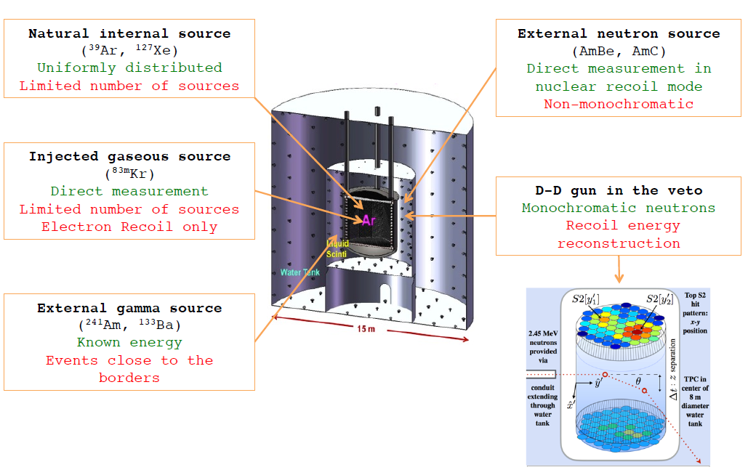
DS20k Calibration: strategy
  Sources:
  Diffuse gaseous sources: ^{83m}Kr, ²²⁰Rn → measure TPC light yield (ER) - injected through cryo system → TPC full coverage
  Gamma sources (⁵⁷Co, ¹³³Ba, ¹³⁷Cs, AmBe) and positron (²²Na) – background like (ER) → energy scale + scan [0.04-4.4 MeV] and position resolution at the edge of the TPC
  Neutron sources AmBe / AmLi [γ4.4MeV+n] or AmC+2mm of Lead [α+n]– signal like (NR) Tag&Probe → TPC and neutron veto
  Other neutron sources (²⁵²Cf fission 40n/s tagged, miniature neutron generator)
  Neutron generators: Limitation LNGS 10⁴ n/s
  DD gun : 10⁴ n/s with no γ → Neutron detector efficiency
  Pyroelectric crystals : 160 n/s, E=2.45 MeV → TPC efficiency (periodically deployed)

Slide 7
DS20k Calibration: sources & generators
Neutron generators:
  « D-D gun »: custom version of a ²D-²D generator with a limited fluc (10⁴ n/s) and dimensions (6 inches = 15.24 cm) compatible with the organ pipe of the DS-50 LSV.
  Pyroelectric crystals (e.g : LiTaO₃): 2.45 MeV, 160 n/s. 50-70 mm diameter and length.
Sources:
  ²⁴¹Am ¹³C: few neutrons/s (DS-50) + α (<4MeV)
  AmBe : γ (4.4 MeV) + 50 n/s.
  ²⁵²Cf tagged: 316 α/s + 37.6 n/s
  Gamma sources: ⁵⁷Co, ¹³³Ba , ¹³⁷Cs and ^{83m}Kr. Used outside for DS-50. A miniaturized version is foreseen for DS-20k to be inserted in the tube.
  Gaseous sources distributed through the cryogenic system: ^{83m}Kr and ²²⁰Rn
Temperature gradient to produce a 10⁵ kV/cm electrical field

Slide 8
DS20k Calibration: the guide Tube
  The guide tube system for the TPC will have to bring the radioactive sources from the top of the cryostat to the external surface of the TPC going through the nVeto (insertion points necessary) without any contact with the sources.
  The tube is foreseen to be made of stainless steel and is supposed to go below the cryostat. The system is supposed to work in closed loop to allow the source to be pushed/pulled out in case it would get detached from the guide cable.
  Foreseen diameter: 1.8 cm (reduction of dead zone and parasitic radioactivity) in the yellow book, 3.8 cm in a talk from 2018. To be studied (impact on nVeto).
  « Swagelok » connectors between tube segments
  Miniaturized sources will be attached to a cable coupled to a step motor. The wire driver will be equipped with a set of encoders and a sensor box (precise positioning). A pair of ring type inductive proximity sensors placed inside the sensor box will be used to reset the encoders when sources pass through a sensor at exactly known locations. Teflon tube around sources and cable to avoid frictions.
  Low pressure nitrogen foreseen to be injected continuously in the tube to avoid humidity and ice

Slide 9
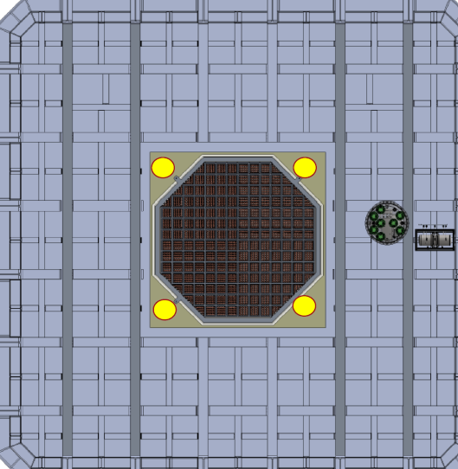
Calibration DS20k: questions
  4 insertion points mentioned:
    does this mean 2 tubes are foreseen ? or 2 possible paths ?
    → 2 tubes foreseen with U shape, going diagonally below the TPC
    Is it mandatory to have 2 ?
    → It is important to have more confidence on the homogeneity (4 sides calibrated instead of 2)
    What are the dimensions of these insertion points ? What freedom do we have to adjust them ?
    → Since the external diameter of the tube will be smaller than 4 cm (baseline), there should be no problem to add these 4 holes.
  U shaped tube mandatory ? Is it needed to go below the TPC ?
  → Interest to have sources below (additional informations)

Slide 10
Calibration DS20k: questions
  What are the constraints on the tube system dimensions ? External/internal diameters, thickness of the tube ? → effect on the detectors (TPC and nVeto)
  The radioactive sources can be as small as a « point ». Neutron generator could be as small as 2 cm. Internal diameter could be 3cm, thickness of the tube should be as small as possible (~1mm).
  NB: Important to keep in mind the shrinking of the tubes inside the cryostat (due to the low temperature), the rigidity of the tube segments, the effect on the calibration and the nVeto.
  What materials are eligible for the tube ?
  → Stainless steel is the baseline. Cleanliness mandatory to maintain Argon pure (virgin stainless steel, screened tests to be done: go/no go). Moisture → ice blocs
  The tube should be fixed to the TPC surface ? What type of fixations ? Material ?
  Fixations (tbd) should be added at different locations of the structure (the ones holding the SiPMs and the TPC, top & bottom). Material to be defined (acrylic used for DoubleChooz).
  NB: keep in mind the important effect of Argon thickness (to be crossed by the gammas) on the S1 signal efficiency. The fixations should not drive away to much the tube from the TPC surface.

Slide 11
Calibration DS20k: questions
Cryostat (1m thick)
  What are the constrains coming from the nVeto ? Tube should be leak tight ? Material used ? Impact on tube dimensions ? Cryostat feedthroughs.
  Clean tube (virgin stainless steel). Leak tight mandatory. No feedthroughs for the crossing of nVeto 10 cm of acrylic and thin EM shield, « just holes » but need to discuss with the corresponding groups. Flanges at the level of the cryostat (1m thickness).
  Question: What about the nVeto sheets (vertical acrylic walls) below the TPC ? Several ones to be crossed. Vertically the crossing of the nVeto should be ok.
  How is foreseen the low pressure nitrogen injection ?
  → Nitrogen injection mandatory at all time (even when no calibration is running). Injection system to be defined ?
  What should be the source position precision ?
  In z (along the side of the TPC, vertical axis): ~1cm. Horizontally: ~half of the internal diameter of the tube since the sources need freedom. Requirements from physics: precision in z, not (x,y).
EM shield (thin)
20cm ?
40cm
nVeto 10cm
40cm
TPC
340cm

Slide 12
Calibration DS20k: questions
  Motor specifications ? 2 motors needed ? Area available on the top of the cryostat ? Location ?
  Insertion holes and motors should be located aside the main cap (many feedthroughs (data and TPC position adjustment) already there). The motor and sensor boxes would be translated with respect to the original drawing (slide 8).
  4 motors seem better solution than two motors in closed loop circuit. 2 pairs of motors synchronized.
  NB: Think about the sources insertion box or feature with cleanliness procedure.
  D-D gun: see next slide
  CAD of the cryostat, is it available ? When will the design be frozen ? Tender sent to GTT ?
  → EDMS version available next week. Workshop on cryostat 6-10 of May. Discussion on calibration tube could be added to the agenda.
Motor + sensor box
Cryostat (1m thick)
nVeto 10cm
TPC

Slide 13
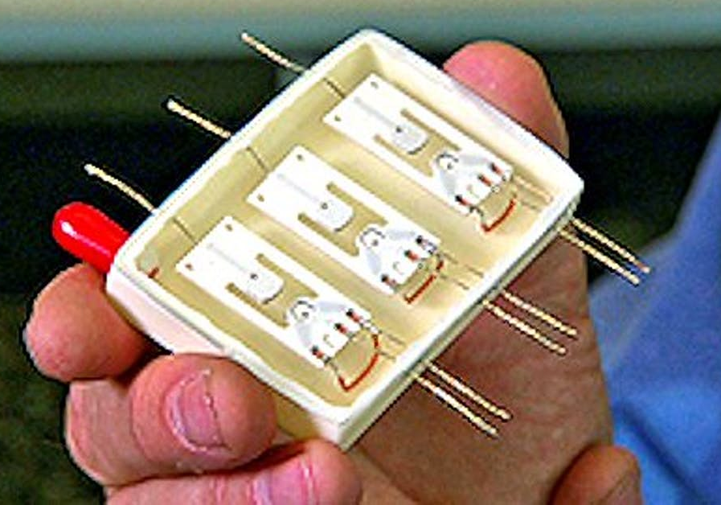
Calibration DS20k: questions + Additional informations
  In the yellow book and 2018 report it is mentioned that CALIS (cf DS-50) would be recycled for DS-20k after few adjustments. Meant for sources too big to go in the guide tube. Is it still valid ?
  → 1 recycled + 3 additional ones. Will need adjustements to deal with Argon (extra care on cleanliness and fixation). Purpose is not clear.
  Neutrister (commercial tool): world smallest neutron generator (https://newatlas.com/sandia-neutristor-neutron-generator-chip/23856/). Neutrons are generated orthogonally to the main surface. 1 cm is the dimension impacting the tube diameter → need to discuss with Russian group (in charge of the crystals). Way to bring the HV and LV ? No-cable solution ? (capacitor).
  Tube installation :
    Better having more segments shorter than fewer longer
    Welding of the segments more robust than swagelock connectors
    Installation prior to the insertion of the TPC inside the cryostat
    Part of the welding might be done inside ?
    Curvature on the 2 TPC bottom corners limited by the distance of the tube to the TPC surface. Special segment ?
HV
~1 cm
GND & LV
For temperature (tbc)

Slide 14
Calibration DS20k: baseline option
  2 tubes U shaped going below the TPC filled with nitrogen
  Internal diameter of 3 cm, thickness 1-2 mm
  Stainless steel wire encapsulated in teflon tube
  Approximate total length: 4m (bottom) + 5.5 x 2 (vertical) = 15m/tube
  Guide wire: 2*15 = 30m/tube
  4 motors, paired and synchronized
  Sensor box: tbd
  Source fixation system: tbd
  Nitrogen injection system: tbd
Guide wire
Virgin
stainless
steel tube
1-2 mm thick
Source
Teflon tube (1mm thick ?)
Diameter: max size of the source (~1 cm ?)
3cm

Slide 15
Calibration DS20k: guide tube interfaces
  Cryostat (feedthrough and occupancy on the top)
  EM shield
  nVeto
  TPC
  Need to discuss with the corresponding groups

Slide 16
Back-up (DS50 & ds20K)

Slide 17
DS-50 Calibration: introduction
CALIS: a CALibration Insertion System
Gamma and neutrons radioactive sources can be deployed in the LSV (Liquid Scintillator Veto) to study and calibrate the detectors (TPC & LSV) response and the neutron detection efficiency.
TPC calibration: the sources must be as close as possible to the cryostat to minimize the rate losses due to absorption.

Slide 18
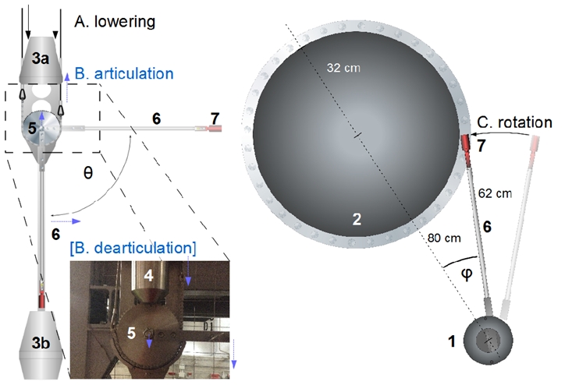
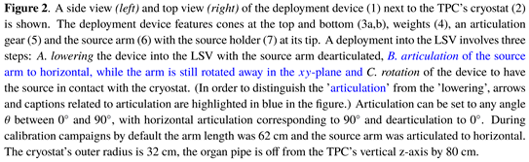
DS-50 Calibration: deployment
The deployment is done in 3 steps (A, B and C on the figure): lowering, deployment of the arm then rotation to come as close as possible of the cryostat.
The source is located in a source holder (7)
The system is 240 cm long
Angle θ between 0 and 90°

Slide 19
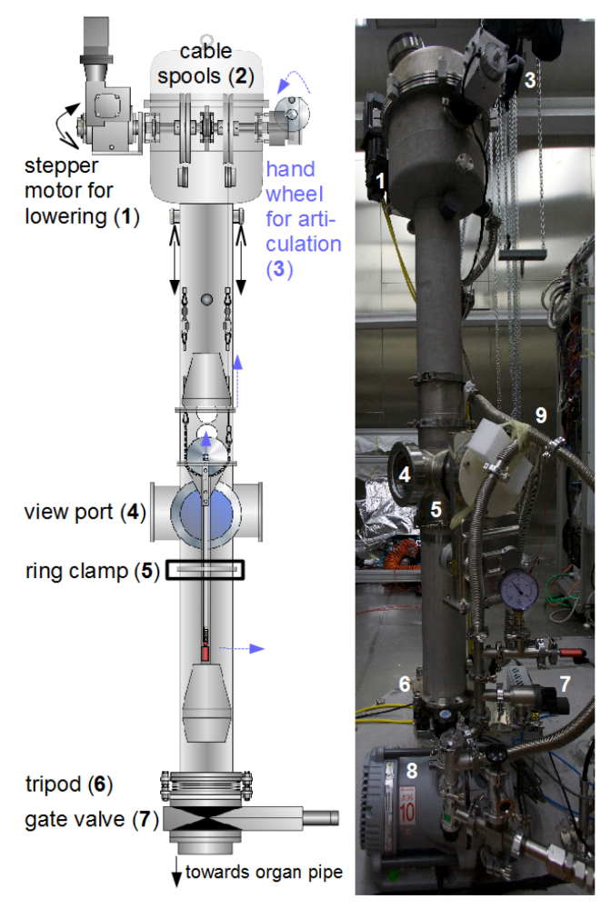
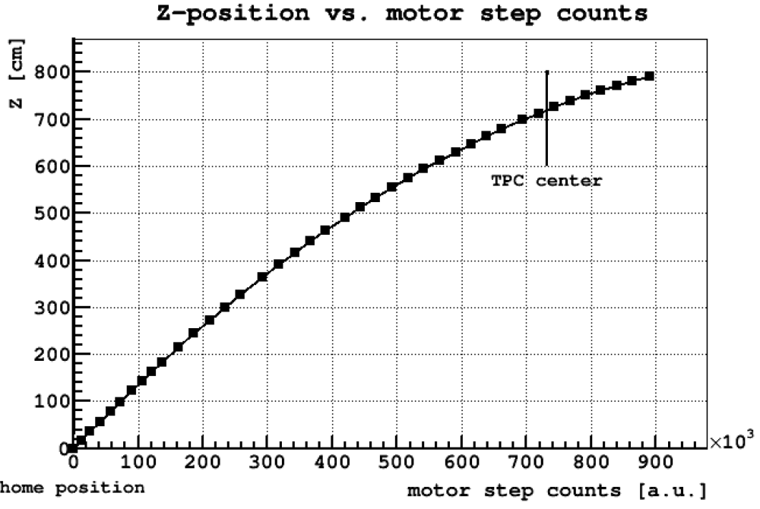
DS-50 Calibration: deployment
Stepper motor: rotation of 2 spools to lower the system, thanks to cables, in the LSV. Controled by a Labview interface.
Absolute encoder for z position. Desired position can be specified in the Labview program (motor step counts).

Slide 20
DS20k Calibration: TPC geometry
Side
Below

Slide 21
DS20k Calibration: SPECS
Calibration must cover several aspects (e.g : response to the single photo-electron of the photo-detectors and acceptance as a function of the energy for the nuclear recoils)
It must include:
  Photosensor charge and time response;
  TPC and nVeto scintillation light yield;
  Spatial uniformity of the TPC detector response;
  Pulse shape discrimination of nuclear and electron recoils;
  Neutron detection efficiency in the nVeto;
  Stability of the detectors' responses over time (TPC, nVeto).
  The combination of radioactive sources, neutron generators and light sources proposed here ensures a robust calibration plan.

