Slide 1
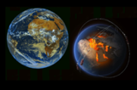
French Research Infrastructure
Data and Services
for the Earth System
Richard Moreno, directeur technique IR Système Terre

Slide 2
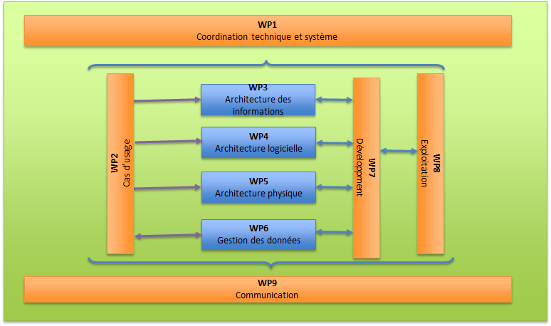
‘Plan de développement’
  Groupes de réflexion / travail
    Comité de direction
    GT_TECH : réunions toutes les 3 semaines environ
    Interpole
    ENVRI FAIR

Slide 3
‘Plan de développement’
Activités prioritaires & en cours
  Catalogue & modèle de données & thesaurus & ontologies
    Démarré dans le cadre Interpole
  Authentification & autorisation
  DOI
  Licences (Interpole)
  Outils entrepôts de données et diffusion avancée (dataverse)
    ~datalake
  Infrastructures / architecture => preparation réponse PIA3

Slide 4
Status of the Data and Service Hubs
4/5 Data and Services Hubs (AERIS, FORM@TER ODATIS, THEIA & PNDB)
  Very different
  Not the same level of FAIRisation
  Data from French / European satellites, but also from other countries (NASA, JAXA, USGS, NOAA, …)
  In-situ data, models, …
  Each Hub is distributed among several data & services centers
  The current state of the Data & Services Hubs is to be taken into account
  The volume of data is increasing
  A mandate to open up to the downstream sector
A few figures
  ~20 Data & services infrastructures
  30 CES : scientific expertise consortium
  50 000 TB (2017) - 100 0000 TB (2022)
  350 scientists, data scientists, engineers, technicians - 170 FTE full time equivalent
In progress & in discussion:
  5th data & Services hub on biodiversity : PNDB

Slide 5
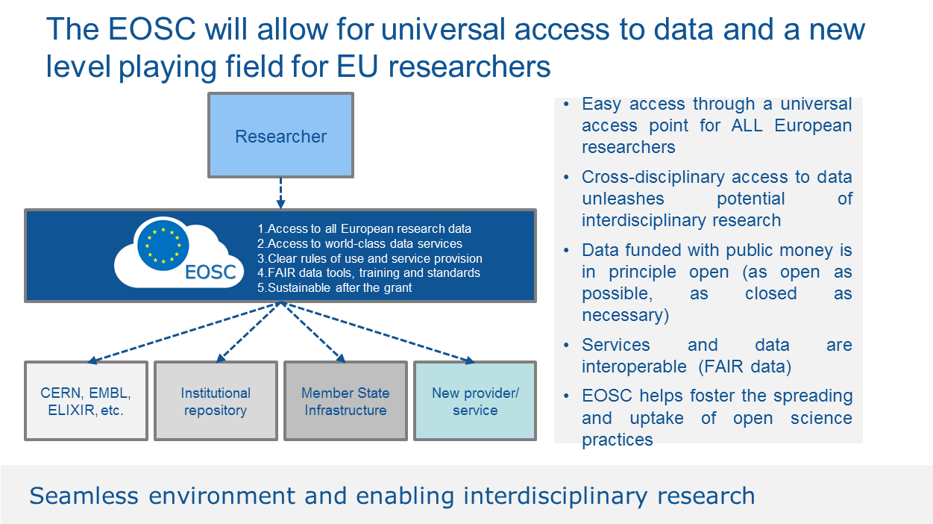
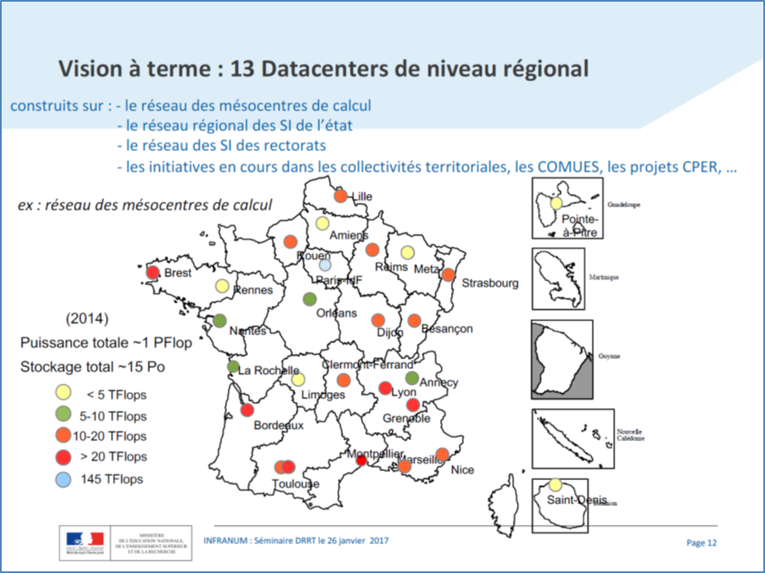
Contexte des infrastructures
EOSC
  Incontournable
    Fortes sources de financement
    Implication des ESFRI dans EOSC
INFRANUM
  Incontournable
    Directive des Ministères
DIAS ESA & WeKEO
  A considerer
    Certains AO pourraient imposer l’utilisation des DIAS
    Intégrer WeKEO nous permettrait de nous ‘rapprocher’ des données météo et climat’ et de disposer éventuellement de moyens cloud commerciaux à proximité pour les usages aval
Les infrastructures en place dans les pôles
  A considérer
    Sur la durée et selon ce qui sera faisable avec
    INFRANUM (contraintes du monde HPC)
PEPS
  Utilisé par
    THEIA
    Form@ter dans le cadre projet Etalab
  Compatible CREODIAS – pas avec les autres DIAS…
CNES HPC & Datalake
  Missions spatiales : gros volumes

Slide 6
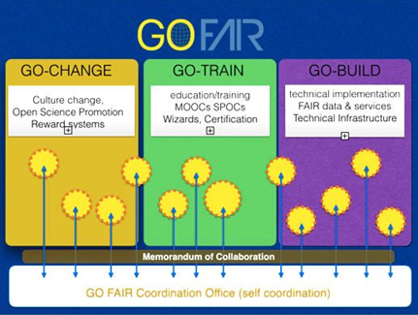
‘Technical harmonization’
Paradigm change from CNES point of view
  Satellite data is not anymore the main source of data
  The user community is not only the scientists close to space agencies (eg PIs)
  => Classical standardization forums (CEOS, GEO, ESA DCB, NASA, OGC, ISO, …) are still useful
Standardization forums of Science / Earth Science
  Interpole working group
      Created in 2014 to promote technical exchange between the Data & Service Hubs
    A two-days workshop every 6 months
    Example of topics
      Long term preservation, Authentication & Authorization, catalogues, formats, DOI, Licenses, processing, …
  RDA – Research Data alliance
    95 working groups !
    RDA Europe deeply involve in EOSC
  H2020 : ENVRI+ / ENVRI FAIR in an ESFRI context
    ENVRI & ENVRI FAIR similar to Interpole at European level
    Work on progress to combine both activities
  GO FAIR initiative in the context of EOSC
    Germany + France + The Netherlands
Interoperability of processing chains ?

Slide 7
Réponses à AO Européens
PHIDIAS
  Réponse à AO CEF (mi-novembre)
    WP1 : Management
    WP2 : Compute and storage workflow management
    WP3 : Technical coordination, development of the common system
    WP4 : Intelligent screening of large amount of satellite data for detection and identification of anomalous atmospheric composition events
    WP5 : Big data EO: processing on-demand for environment monitoring
    WP6 : Ocean Use case
    WP7 : Dissemination, Impact and Sustainability Path
Pas plus d’informations ici car confidentiel

Slide 8

Réponses à AO Européens
Part. N° | Participant organisation name | Country
1 | Consortium GARR (GARR) | Italy
2 | Consiglio Nazionale delle Ricerche (CNR) | Italy
3 | CINECA Consorzio Interuniversitario (CINECA) | Italy
4 | Istituto Nazionale di Fisica Nucleare (INFN) | Italy
5 | Fondazione Centro Euro-Mediterraneo sui Cambiamenti Climatici (CMCC) | Italy
6 | Universität Wien (UNIVIE) | Austria
7 | Centre Informatique National de l’Enseignement Supérieur (CINES) | France
8 | Centre National de la Recherche Scientifique (CNRS) | France
9 | Institut National de la Recherche Agronomique (INRA) | France
10 | Institut National de la Recherche en Informatique et Automatique (INRIA) | France
11 | Institut Francais de Recherche pour l’Exploitation de la Mer (IFREMER) | France
12 | Institut National de la Santé et de la Recherche Médicale (INSERM) | France
13 | Karlsruher Institut für Technologie (KIT) | Germany
14 | Deutsches Klimarechenzentrum GmbH (DKRZ) | Germany
15 | Fraunhofer Gesellschaft zur Förderung der Angewandten Forschung e.V..(Fraunhofer) | Germany
16 | Helmholtz Zentrum Potsdam, Deutsches Geoforschungszentrum (GFZ) | Germany
17 | Gent University (UGENT) | Belgium
18 | Trust-IT SRL (TRUST-IT) | Italy
Work package No | Work Package Title
1 | Management
2 | The human factor of the EOSC: Dissemination, Outreach and Community building
3 | National Initiatives Survey
4 | From National Initiatives to trans-national services
5 | The Data layer: establishing FAIR data services at the national and transnational level
6 | EOSC in action: Use cases and community-driven pilots
7 | The infrastructure layer: delivering horizontal data storage and computing services, from national to transnational

Slide 9
Technical Solution

Slide 10
Overarching principle of operation
    Main motivation of the “Earth System” Research Infrastructure
      not to re-invent the wheel
      but to take benefits on existing initiatives by improving the standardization and the interoperability of the systems already in place.
      Base developments on open source software with wide communities
    Improve transdisciplinarity and across domain interoperability.
    Provide services on both space data AND in-situ data..
    Take into account the evolution of the computing infrastructure landscape
      in France (Infranum) and in Europe (EOSC, DIAS, ...)
      and to be able to integrate into this ecosystem.
    Re-use of what has been done in each Data and Services Hubs (ODATIS, THEIA, …).
      In order to encourage this re-use and to push for the sharing of practices, a working group (named Interpole) was set up four years ago.
        technical experts from each Hub to explore technical topics of common interest
        DOI, Long Term Preservation, Catalogue, Format, SSO, processing, …
      this work takes in account and implements the recommendations established by the Working Groups of the Research Data Alliance (RDA).

Slide 11
Inspiring models
  NASA EOSDIS hub
    Common Metadata Repository / Unified Metadata Model
    Combined with their progressive migration toward cloud computing
  Hub Pangeo (~datacube)
    Already used for atmosphere, ocean and climate data
  GeoDAB: GEOSS data hub
  EuroGEOSS, AmeriGEOSS, NextGEOSS
    CKAN & cloud computing capabilities
  ESA DCB Initiative: ‘Network of Exploitation platforms’
    And their cloud initiatives: DIAS, TEP/MEP/MAP
  ENVRIfair H2020 project
    Naturally linked to EOSC
    French Data&Services Hubs are part of the consortium
      IAGOS, ACTRIS, EURO-ARGO, EPOS, EMSO, ANAEE, SeaDataCloud, …
Opensource
Opensource
Opensource

Slide 12
Processing Topology
Increase of data volumes
  => better to bring the processing close to the data
    Not for everyone; downloading data is still an option
      Cf Copernicus dissemination statistics
    Very interesting for newcomers (eg startup, …)
    Mandatory for very big volumes e.g. NISAR
Need to combine data from different compartments
  => have data very close from each other
    In the same cluster
      e.g. NASA EOSDIS evolution (AWS) & Copernicus CGS evolution
    In a limited number of cluster linked with high speed network
      e.g. : WeKEO, Current CGS architecture, AERIS/ESPRI, INFRANUM (AC),
      EOSDIS (DAAC)
    Distributed in several data centers not linked with HS network
  Use ad-hoc technologies to give unity to the system
    e.g. Ceph object storage / IRODS / …
Increasing distance

Slide 13










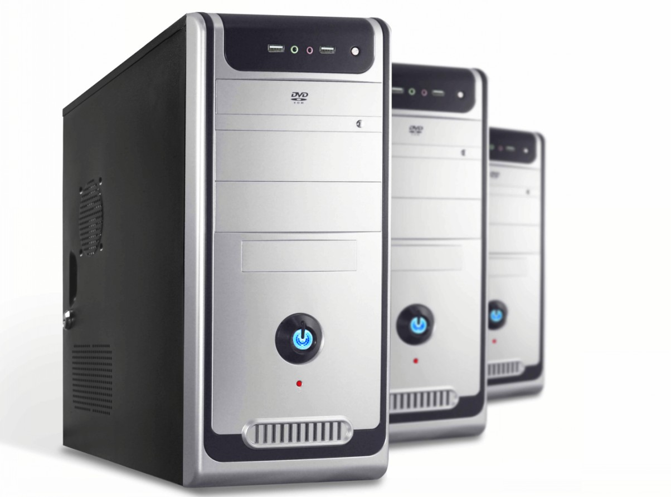
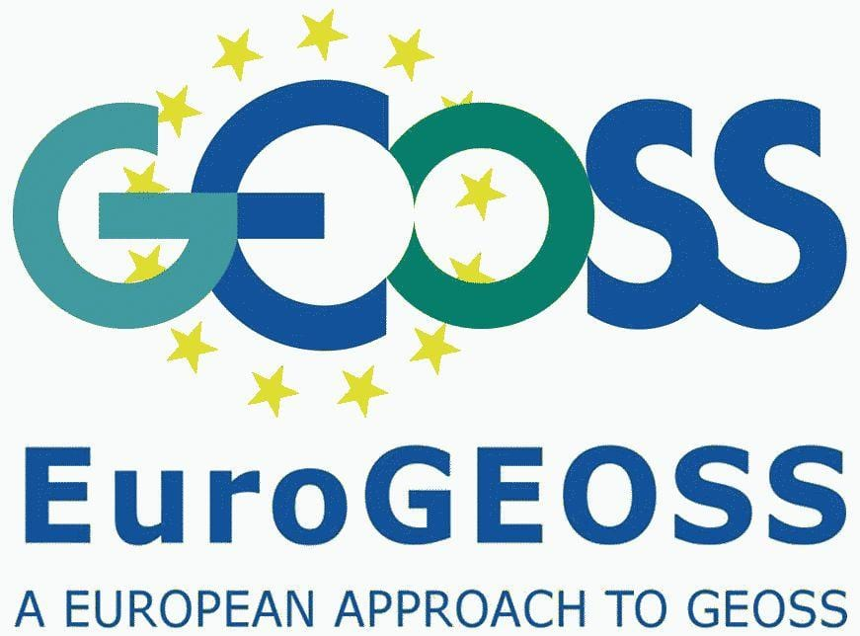
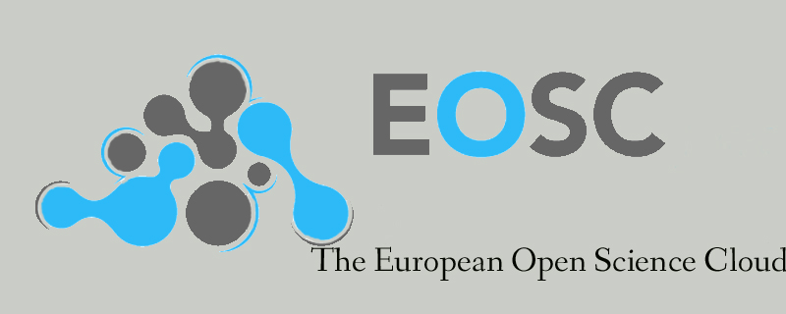
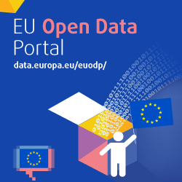
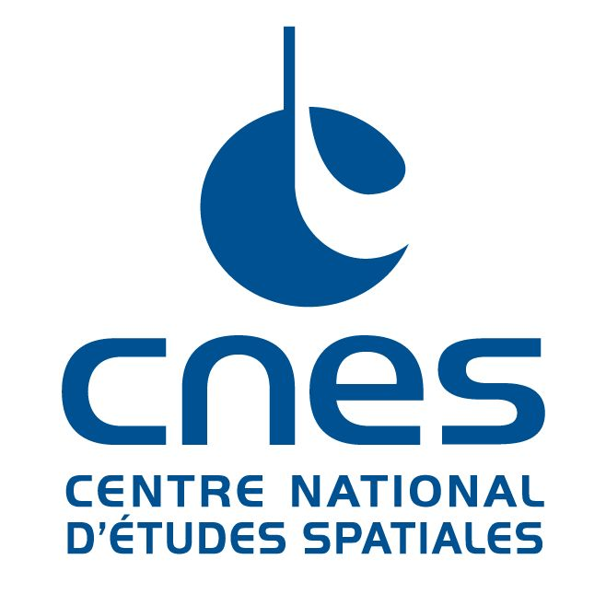


Other data
- Linked data
- socioeconomic
- Social media
Thesaurus &
Knowledge &
Tagging services
Catalogue
Help desk
- User support
- Developer support
- Project support
- Animation centers
Data model
Identity
server
Hosted processing & online data
Execution Management Service
Application Deployement & Execution Service
http
DOI
server
Advanced visualisation services
Data
Producers &
distributors
Users
Pre-analysis
Services:
Datacube
Web services
CDS
Structured observations
Data &
services
e.g WPS,
WMS
Jupyter, …
Data curation
Data production
Re-processing
Expertise for HD
Data Access Portal
"Datalake"
Data management
opensearch
SNO, IR, TGIR, ESFRI
Satellite
Harvester
AD
Third Parties observations
GEO-DCAT
NASA EODIS
NASA coverage
Copernicus
Data &
processing chains
Data repository & publication service
« Multi-source big data »
Infrastructure
Individual observations
Other processing
resources
Long Term Preservation
Partners
In situ
CDIAS
CNES, IFREMER, IGN, …
Transversal services
- SSO & AAI & DOI
- QoS surveillance
- Usage analytics

Slide 14
Key ideas
Strong and operational help desk
  To support users
    e.g. allow feedback on datasets
    e.g. present locally : CART
  To help set up new projects : Development support
  Support to data and processing migration
  Capacity building : AI, Cloud computing, coding language, orchestration, DevOPS, …
Collocate data as far as possible
  To ease the combination between data from different compartments
  As a consequence of the “bringing the processing close to the data” paradigm
  Datalake technologies – smooth/efficient data management tool
    CNES datalake | ENS(Elastic Node Server)/dhus (ESA) | AERIS/ESPRI (Ceph, …), NASA EOSDIS, …
Operational and trustworthy catalogue of data & services
Foster interoperability between processing platforms
  DIAS, EOSC, INFRANUM, PRACE, …
Not techno push
  Need from users and IR ST strategy
Quality of service
  IR ST system monitoring / analytics
FAIRisation of data

Slide 15
Data: IR ST data catalog
A unique, operational catalog
  Containing all data metadata and pole services
    Like the NASA EOSDIS CMR (https://earthdata.nasa.gov/about/science-system-description/eosdis-components/common-metadata-repository)
  Requires a unified data model (~ UMM NASA & HMA ESA)
    Taking into account spatial data, in-situ, models, ...
    Based on ISO and Inspire recommendations for example
    Work in progress as part of the ‘Interpole’ catalog WG
  Vocabularies / ontologies
    adoption and maintenance of commonly agreed vocabularies and ontologies,
    set up of standardized vocabulary servers
With interfaces
  interoperable
    INSPIRE, CEOS opensearch, Linked data / RDF, Geo DCAT, WIGOS / WMO standards, ...
  Adaptable (nothing is fixed)
  Two step search: collections then granules
    CEOS connected data assets, GEOS, NASA EOSDIS, ESA FedEO, ...

Slide 16
Processing
Centralized / common way for multi-source treatments
  => Cf INFRANUM
Offer cloud compatible technology solutions
Ability to launch projects on DIAS and EOSC
  => processing interoperability (ex: EOPEN or OPENEO or NextGEOSS)
  To answer calls for projects UE and ESA
  Compatibility of RI interfaces with DIAS and EOSC
Propose (after user needs analysis)
  An innovative solution for data analysis like:
    datacube + Jupyter
    Pangeo
    Knowledge graph
    SeaScope (Ocean Datalab)
  Strong Artificial intelligence capacities

Slide 17
Technical Strategy

Slide 18
Computing Infrastructures
Target = INFRANUM
  Progressive but determined approach
  Migration when data is used in a transverse IR ST framework (SCO example)
  Migration when IT means become obsolete
  Some datasets may not be migrated
    Old and little used
    Necessary proximity of the producer in case of a reasonable data volume: case of certain in-situ data => concept of technical cache
Ability to be distributed across multiple sites
  At the beginning the IR ST will still be spread over several CDS themselves distributed over several sites
  On opportunities to be able to switch to external means like DIAS or EOSC
    Eg for European projects
Need for adaptation & fine analysis
  INFRANUM ⬄ HPC : not compatible with the IR ST way of working
    => need for adaptation of INFRANUM centers to be able to cope with HPDA or HTC
  All IR ST compute services may not be able to join INFRANUM
    Even if there is an evolution of INFRANUM
  Analysis & discussion with INFRANUM are necessary

Slide 19
Computing Infrastructures
INFRANUM not operational within 3 years
Target is also EOSC
  How is it compatible ?
Intermediate step on relatively limited means
  Temporary infrastructure to choose
    CINES : EUDAT => EOSC
    CALMIP or any regional or National (IN2P3, …) INFRANUM center
    CNES
    IFREMER, IGN, any IR ST CDS infrastructure
    DIAS
    EOSC ⬄ EUDAT, EGI, …
  A way to learn and validate the consideration of user needs
  Software for the intermediate stage
    Limit specific developments (at least for this step)
      Catalog and data hub (CKAN, NASA CMR, CNES datalake, ...)
      'Modern' means of processing data: Datacube + Jupyter / Pangeo / ...
  Rapid Implementation of Development / Migration Support service

Slide 20
Computing Infrastructures
Il est illusoire de penser que l’IR ST pourra être concentré sur un seul et unique MesoCentre d’INFRANUM.
Mais une fois INFRANUM en place la distribution de l’IR sera limitée aux MésoCentres régionaux et nationaux
  Bretagne
  Haut De France
  Calmip (Occitanie)
  …
Avec prise en compte des MesoCentres nationaux
  IDRIS, CINES, IN2P3
  Notamment pour la combinaison des données très volumineuses
  Et / ou besoin de très gros moyens de calculs
D’où une architecture distribuée
  Pour les données
  Et les traitements
  Avec les solutions techniques afférentes

