Slide 1
CURRENT ACTIVITIES
and FUTURE PLANS
of the LPNHE neutrino group
Boris A. Popov
May 2018, LPNHE Scientific Council

Slide 2
The LPNHE neutrino group
The group is composed of
(5 permanents) Bernard Andrieu (CR), Claudio Giganti (CR/HDR), Jacques Dumarchez (DR), Luca Scotto Lavina (CR), Boris Popov (DR)
+ new MdC SU to start from September 2018
(1 benevole) Jean-Michel Levy
(1 PhD student) Simon Bienstock (2015-2018) [STEPUP grant, T2K oscillation analysis]
- (3 PhD students) Laura Zambelli (2010-2013) [ED grant, analysis of NA61/SHINE data for T2K], Pierre Bartet-Friburg (2013-2016) [CNRS grant, analysis of ND280 data], Matej Pavin (2014-2017) [ILP grant, analysis of NA61/SHINE data for T2K]
The group participates in the following experiments:
T2K [till 2020] (T2K-II [till 2026])
NA61/SHINE (for T2K and for FNAL neutrino beams [till 2020], for HK/DUNE > 2021)
WA105 [2014-2017]
Recently joined Hyper-K ([2018-])

Slide 3
The LPNHE neutrino group
Main research topics:
Precise measurement of neutrino and anti-neutrino oscillation parameters and search for CP-violation in the lepton sector
Measurements of neutrino and anti-neutrino interaction cross sections
Hadron production measurements for precise predictions of accelerator neutrino fluxes
The group had and still has some important responsibilities:
T2K Oscillation Analysis convener (CG), T2K Beam Group convener (BP), ND280 Magnet operation, TPC operation, Publication Board members, Speakers Board members, Internal referees, NA61/SHINE analysis coordinator, etc.
More than 40 publications during the last 5 years
Awards: Le Prix “La Recherche” Physique (2012) and Breakthrough Prize in Fundamental Physics (2016)

Slide 4
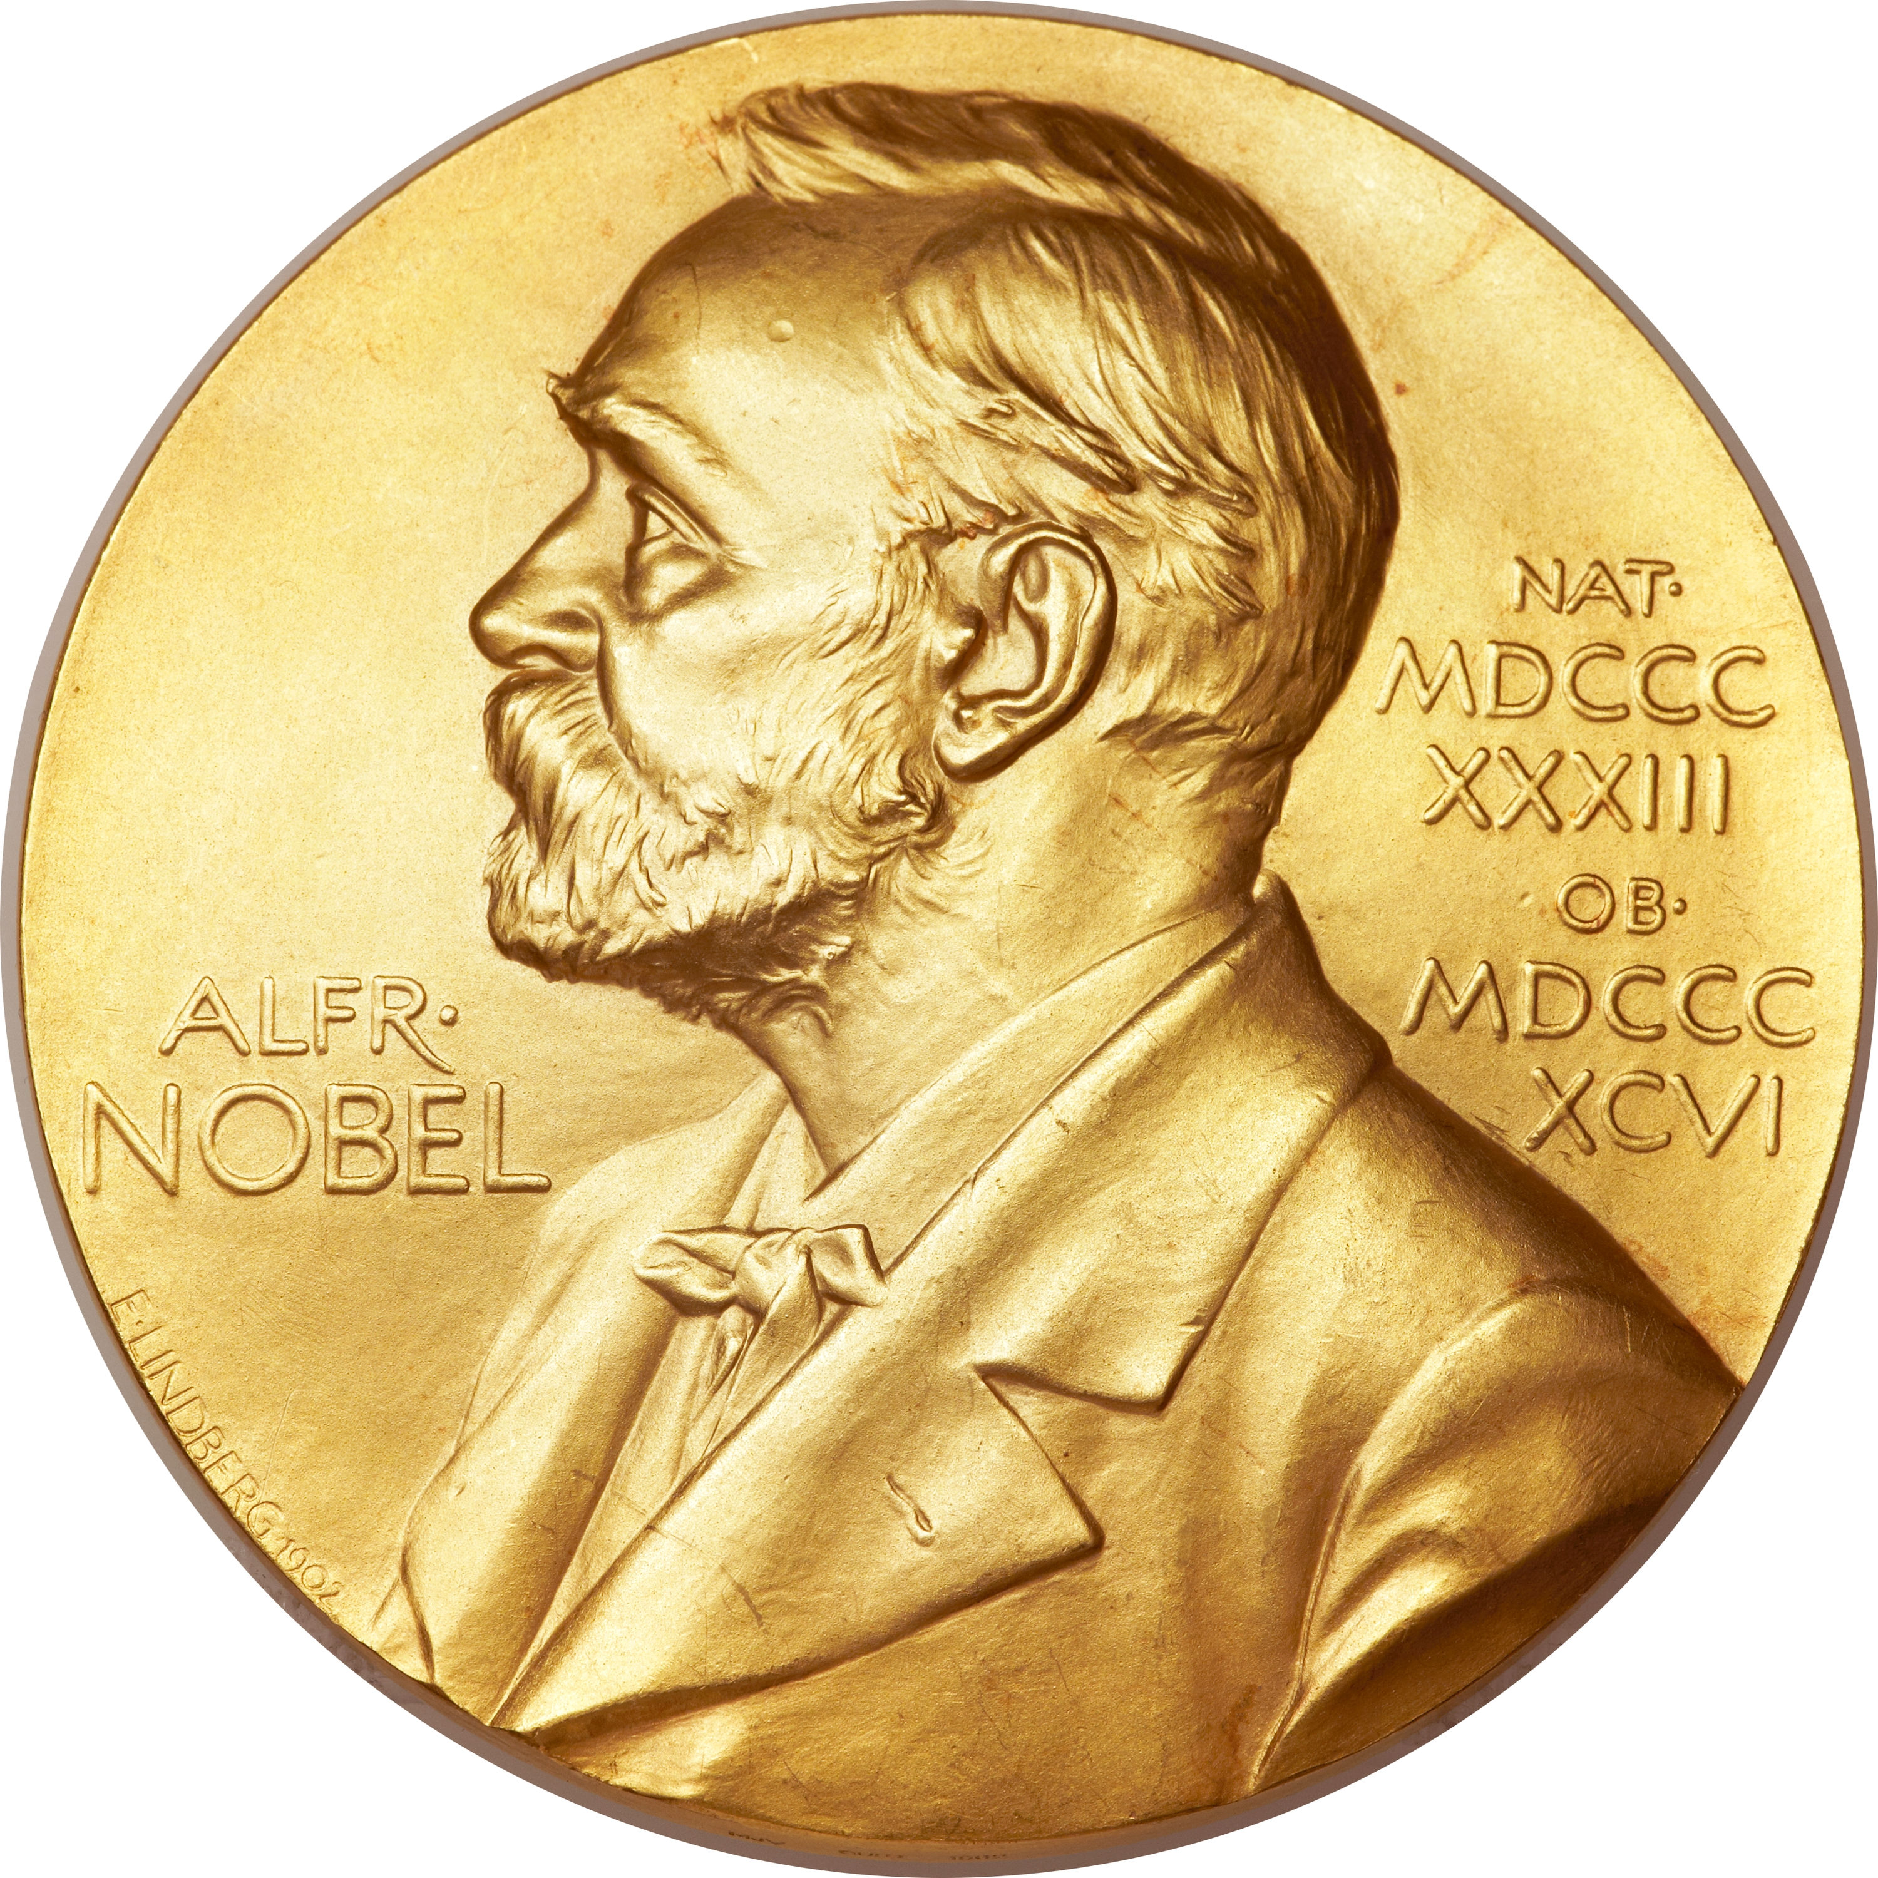
Neutrino oscillations
“The discovery that neutrinos can convert from one flavour to another and therefore have nonzero masses is a major milestone for elementary particle physics. It represents compelling experimental evidence for the incompleteness of the Standard Model as a description of nature... Neutrino oscillations and the connected issues of the nature of the neutrino, neutrino masses and possible CP violation among leptons are today major research topics in particle physics.”
[Scientific Background on the Nobel Prize in Physics 2015]
Pontecorvo-Maki-Nakagawa-Sakata (PMNS) mixing matrix

Slide 5
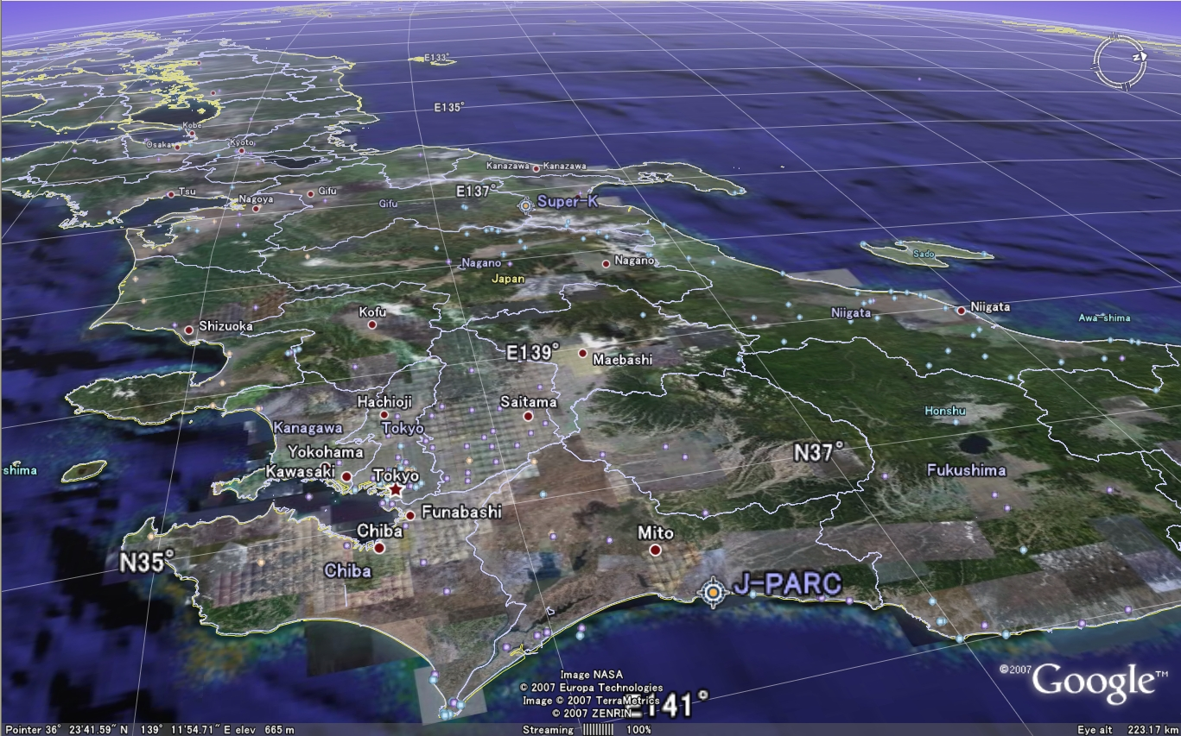
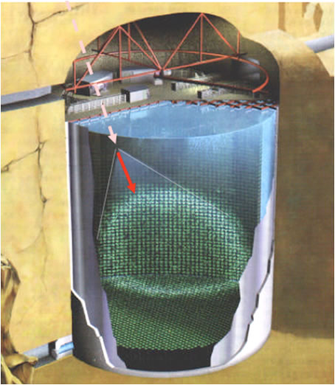
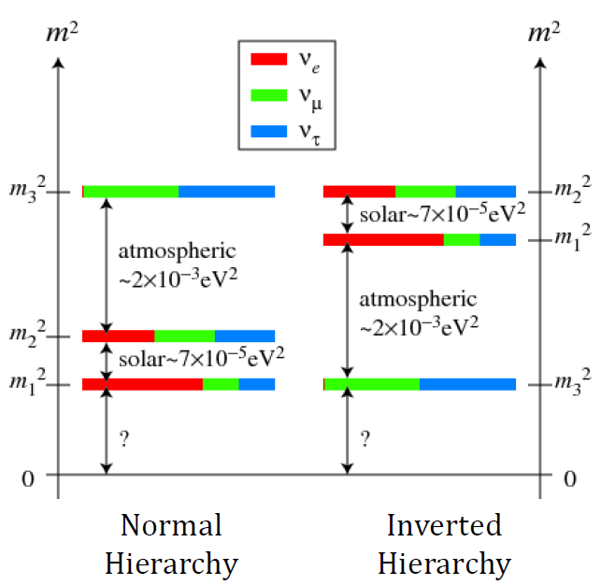
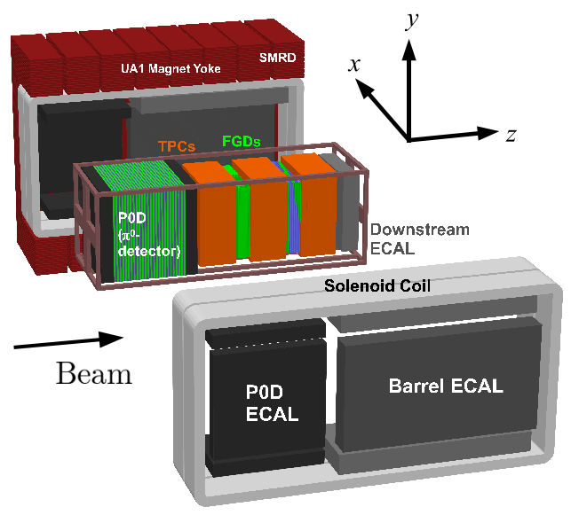
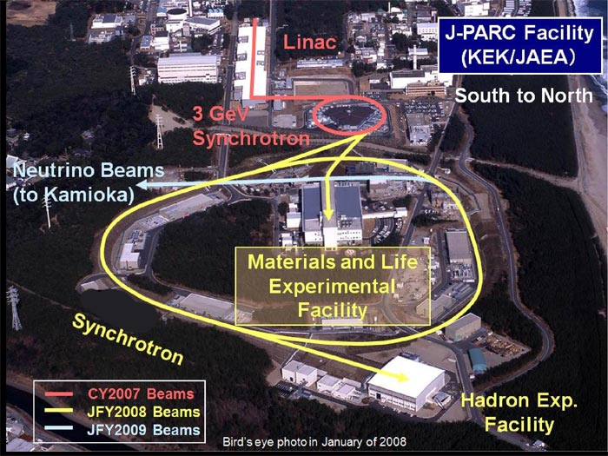
T2K experiment in Japan
T2K is a long-baseline accelerator neutrino oscillation experiment.
Super-Kamiokande
ν_{e}
ν_{μ}
.
Main goals are to study
ν_{μ} disappearance and ν_{μ} ν_{e} appearance,
thus to measure the parameters θ₁₃, θ₂₃ and δ_{CP}
ν_{τ}
295km
ND280+INGRID
ν_{μ}
J-PARC

Slide 6
Neutrino oscillation probabilities
For neutrino oscillations in vacuum, the flavour change probability is
Formulae for neutrino oscillation probabilities (relevant for T2K):
The ν_{μ}-survival probability for a neutrino with energy E traveling a distance L:
The ν _{e}-appearance probability (to first-order approximation in matter effects)

Slide 7
T2K Analysis strategy
NA61/SHINE
external data
ND280 detector
model
ND280 data reduce
neutrino flux and
cross section
uncertainties
Neutrino flux
model
INGRID & Beam
Monitor data
ND280 fit
ND280
data
External cross
section data
Cross section
model
Oscillation fit
Super-K
data
Super-K detector
model
Oscillation
parameters

Slide 8
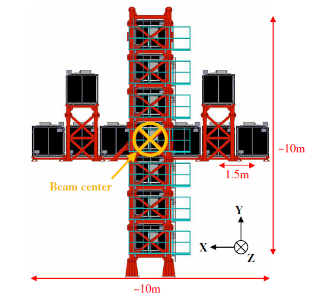
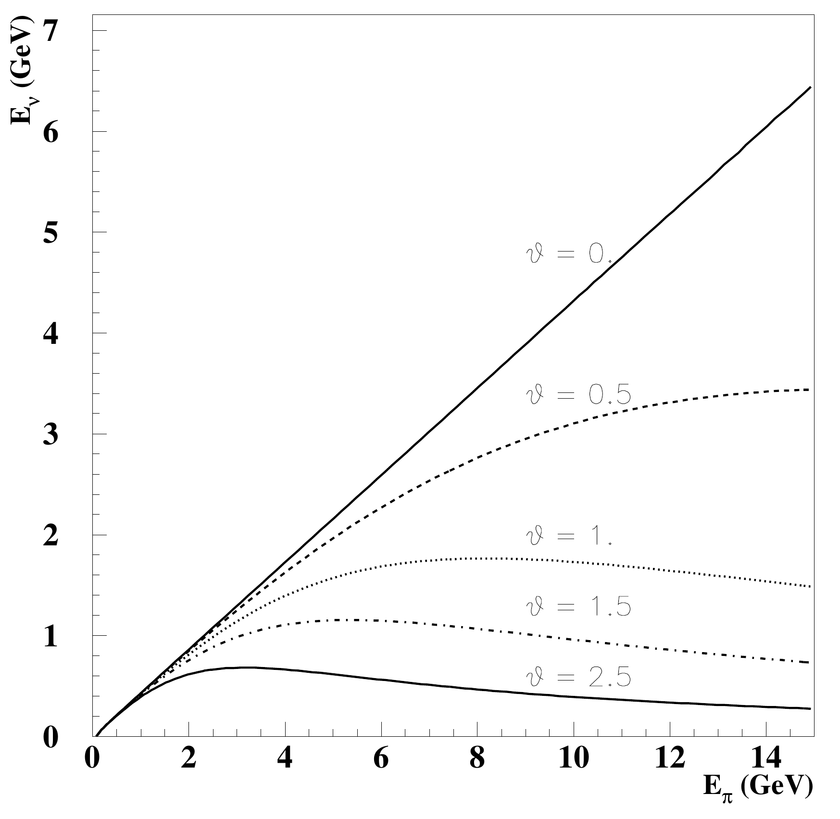
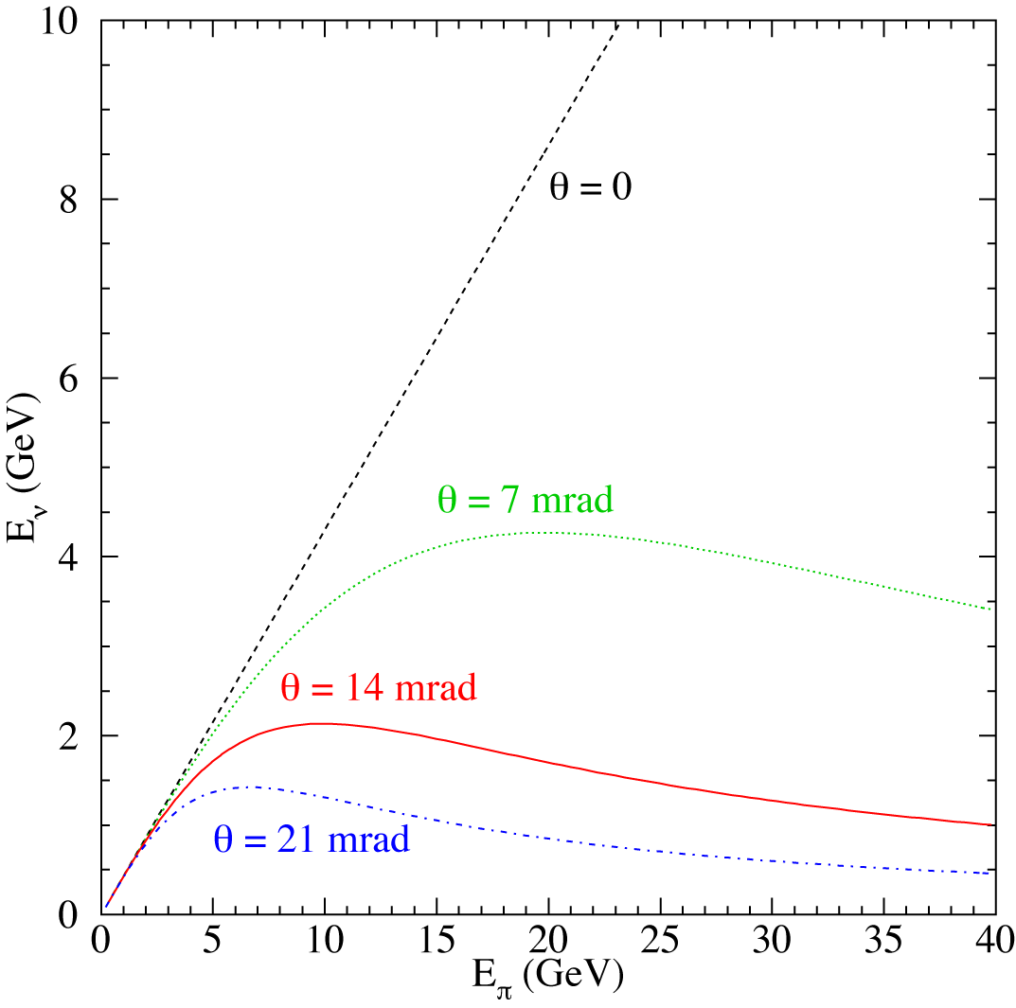
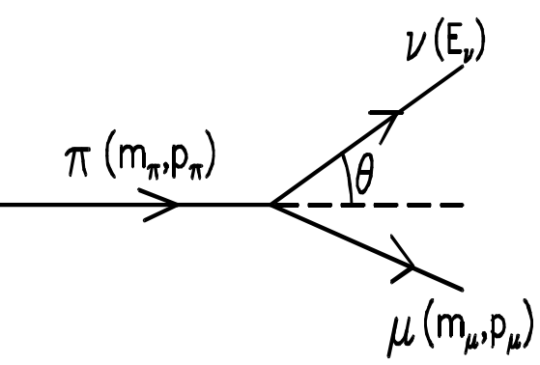
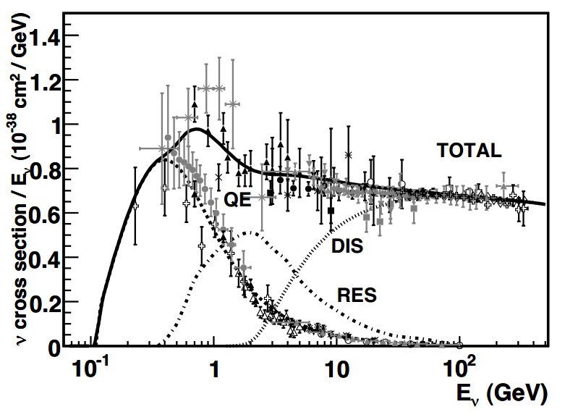
The neutrino beam: Off-axis technique
Horn
System
Beam dump
Off-axis angle = 2.5⁰
Target
Decay volume
30GeV protons
To ND280 and SK
Muon Monitor (MUMON)
INGRID
1
Enhances neutrino oscillation effects
Enhances CCQE (n_{m} n → m- p) interactions
Reduces background from p⁰ production
Reduces ν_{e} contamination at the peak

Slide 9
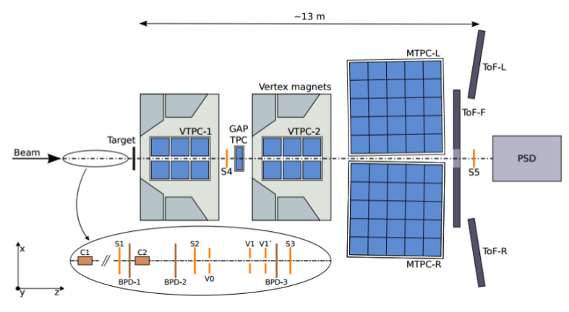
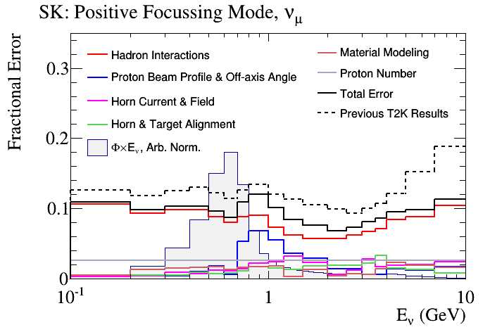
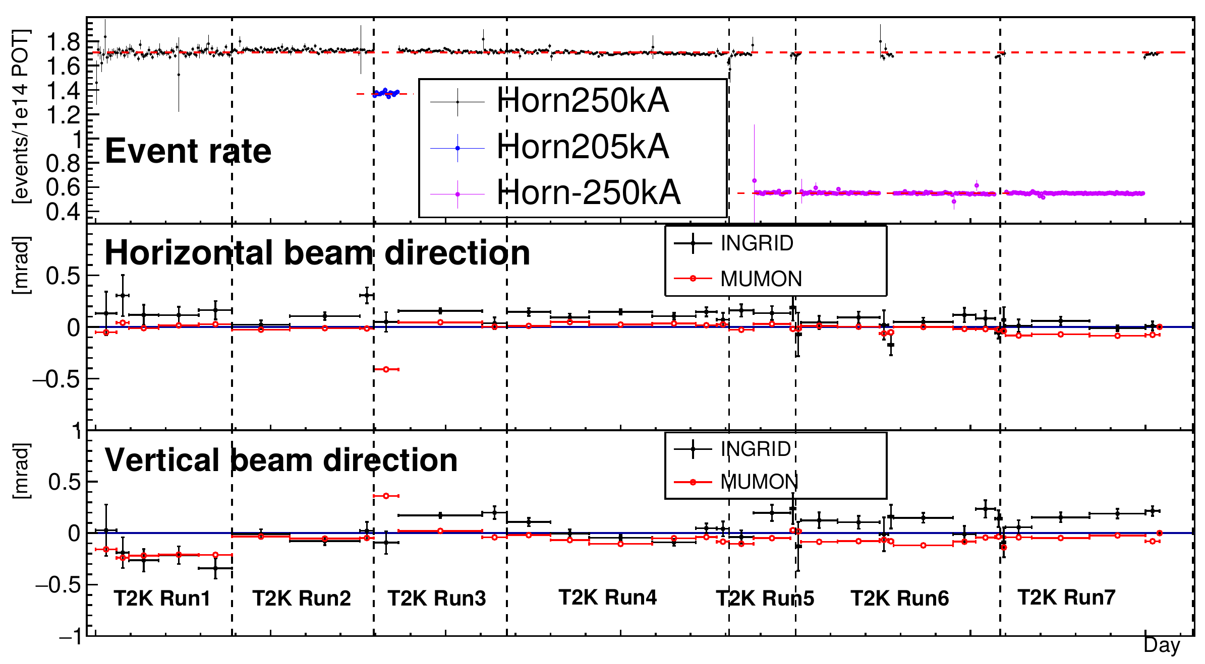
The neutrino beam: flux predictions
Fluxes are predicted from a data-driven simulation → NA61/SHINE experiment measures hadron production cross-sections using a thin carbon and a T2K replica target
Beam alignment monitoring provides input to estimations of beam systematics
INGRID detector provides high-statistics monitoring of the beam intensity, direction, profile and stability
π
Graphite target
Horn
π
Proton Beam
Flux error reduction from ~25% to ~10%
K
Flux errors
n mode
Flux errors are further constrained with the ND280 analysis of ν_{μ} CC events

Slide 10
NA61/SHINE experiment @ CERN
Large-acceptance spectrometer

Slide 11
NA61/SHINE for T2K (pC @ 31 GeV/c)
L.Zambelli’s PhD

Slide 12
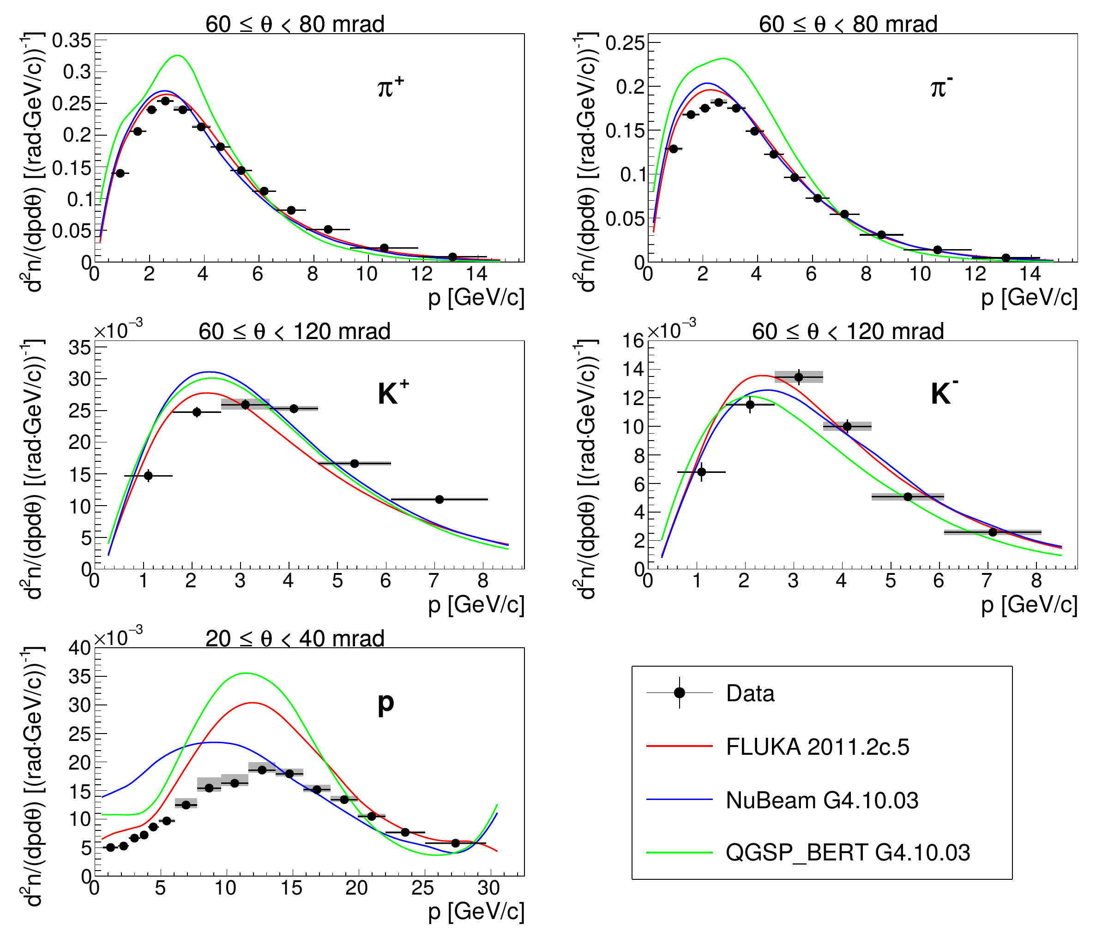
NA61/SHINE: T2K replica-target results
Measured hadron
yields from second
longitudinal (18-cm
long) target bin
in a selected polar
angle interval.
Comparison with
model predictions.
These new data are
being prepared for
publication.
They will be used
for further reduction
of uncertainties on
(anti-)neutrino flux
in T2K, see later.
M.Pavin’s PhD

Slide 13
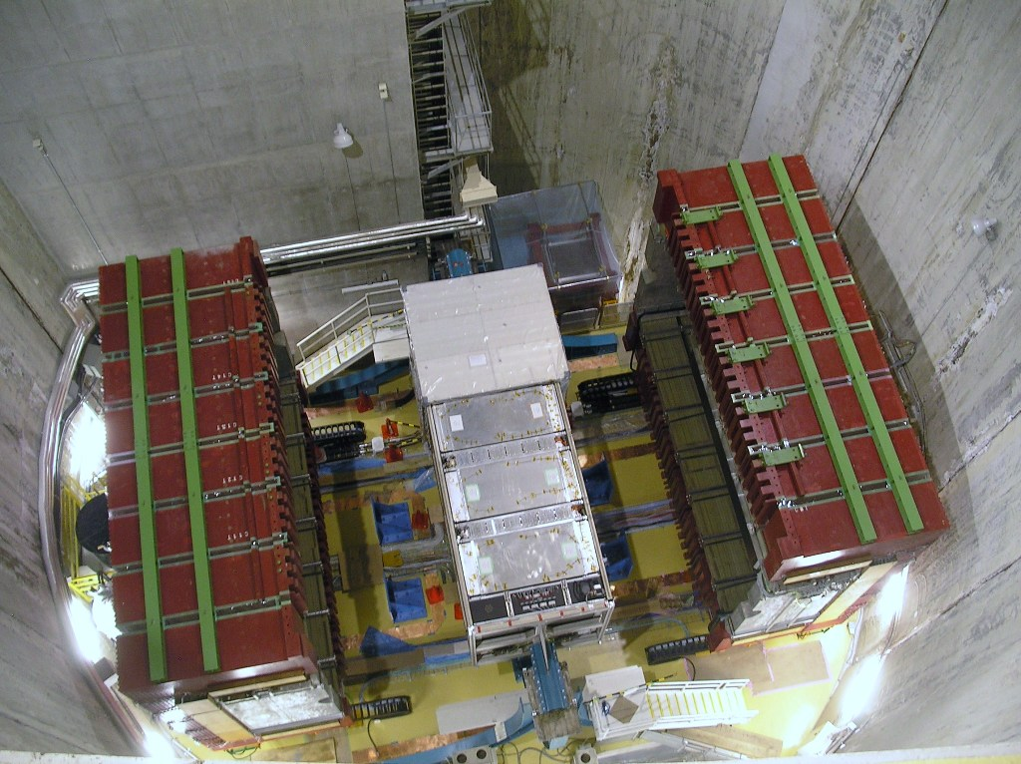
The T2K off-axis near detector: ND280
@280 m from the proton target
0.2 T magnetic field
ν beam
Tracker

Slide 14
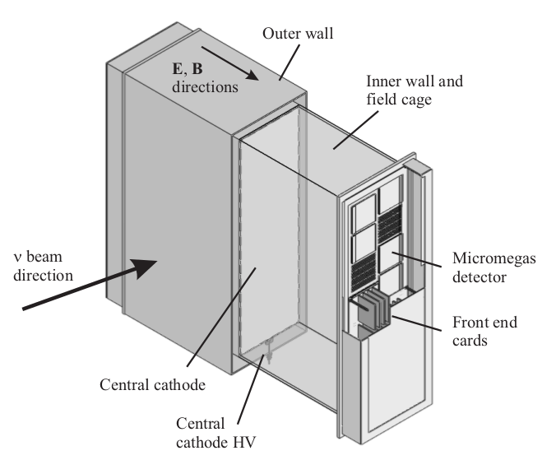
Time Projection Chambers (TPCs)
Argon-based gaseous detectors with good tracking and particle identification
Measure the momentum (10% resolution at 1 GeV/c) and the sign of charged particles
Good separation between muons and electrons
TPC1
TPC3
TPC2
LPNHE contributions: magnet and TPCs

Slide 15
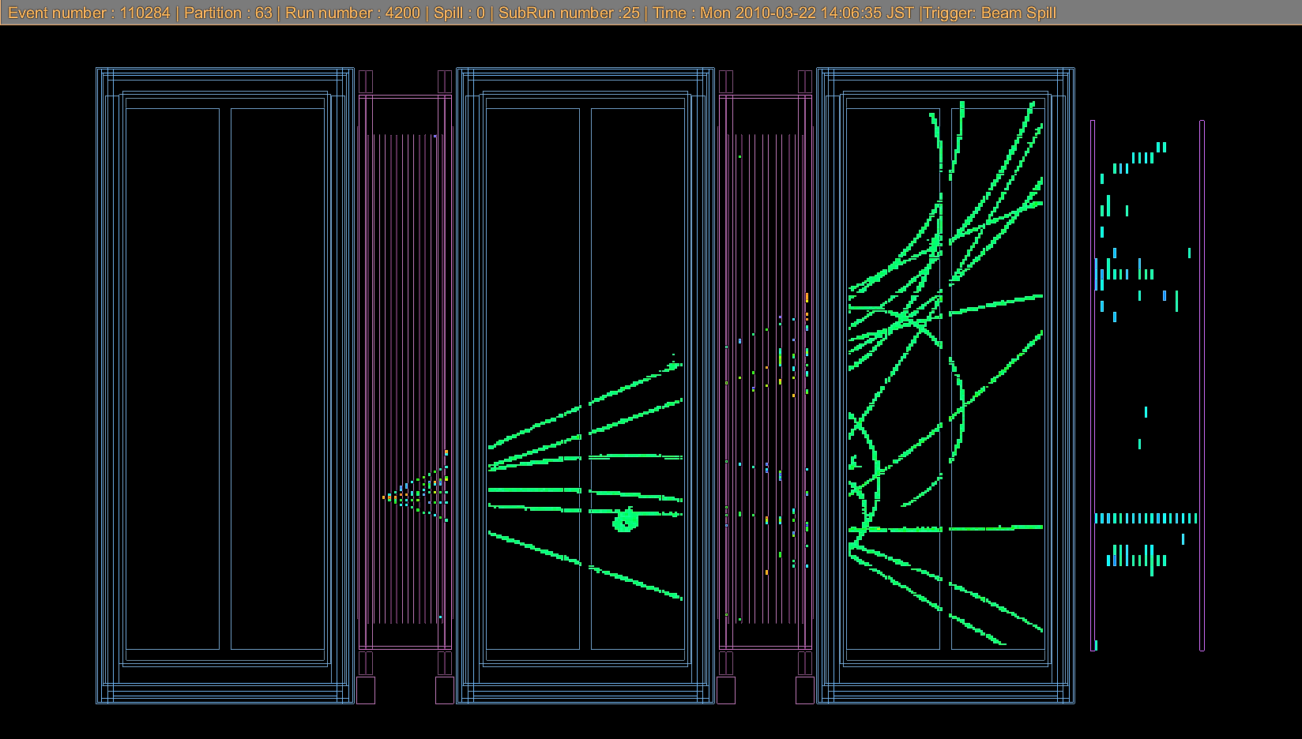
ND280 reconstructed (tracker) event
TPC1
TPC1
TPC2
TPC3
FGD1
FGD2
DsECal
ν

Slide 16
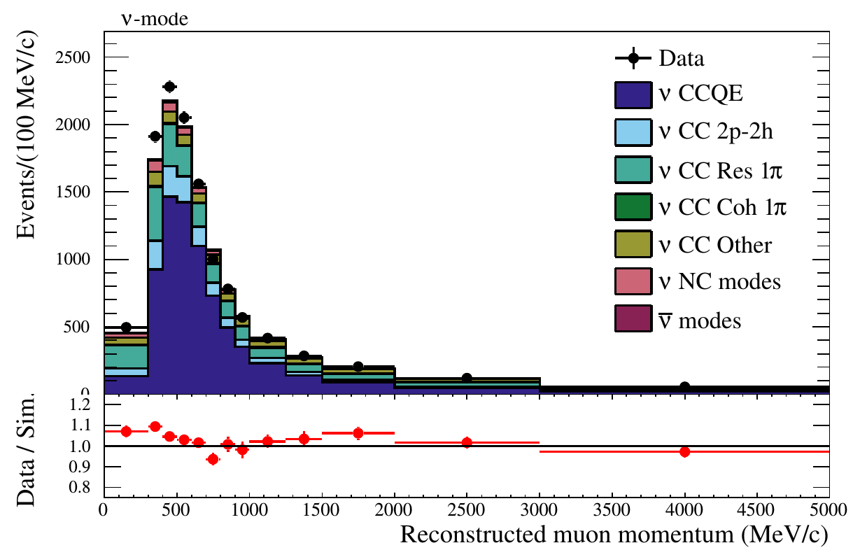
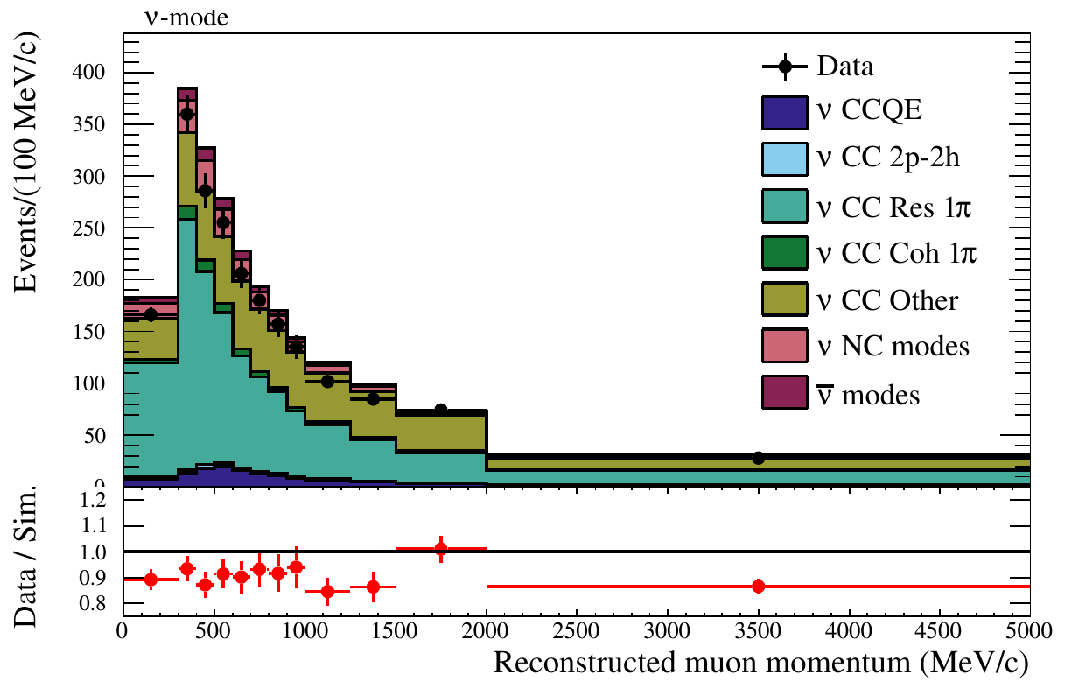
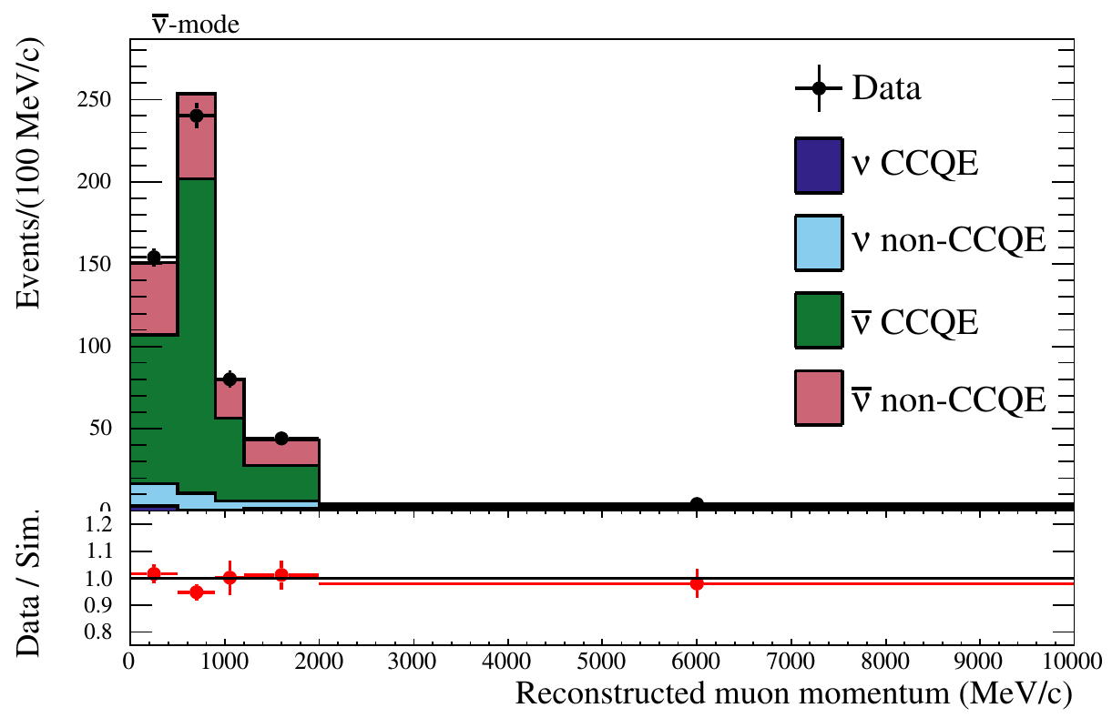
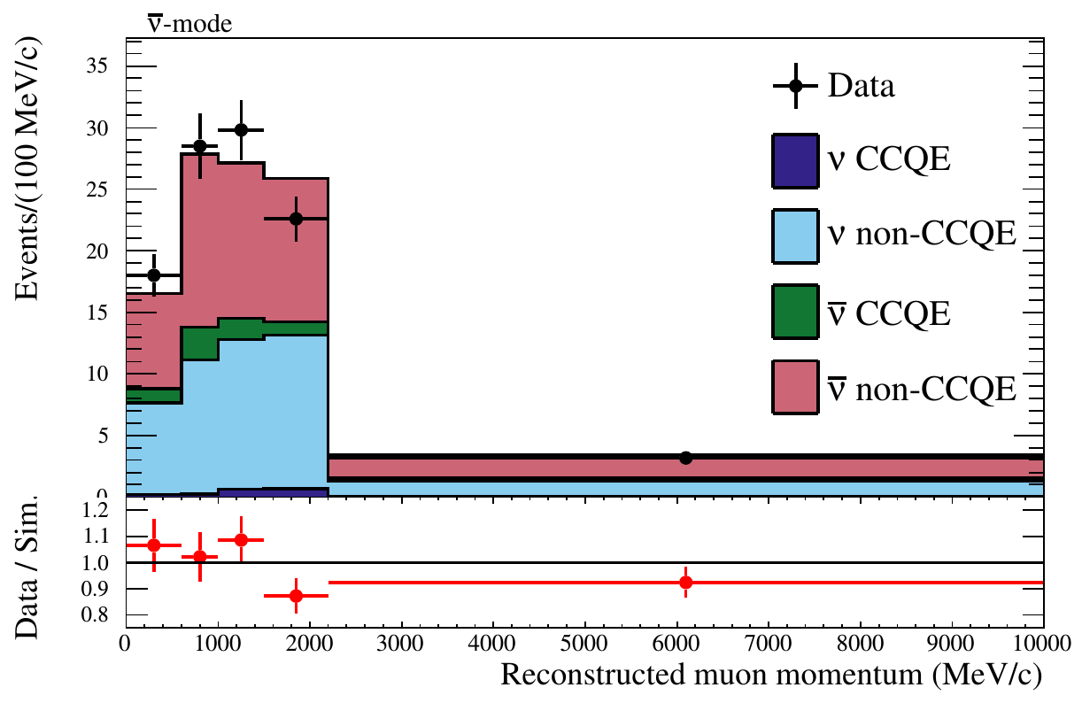
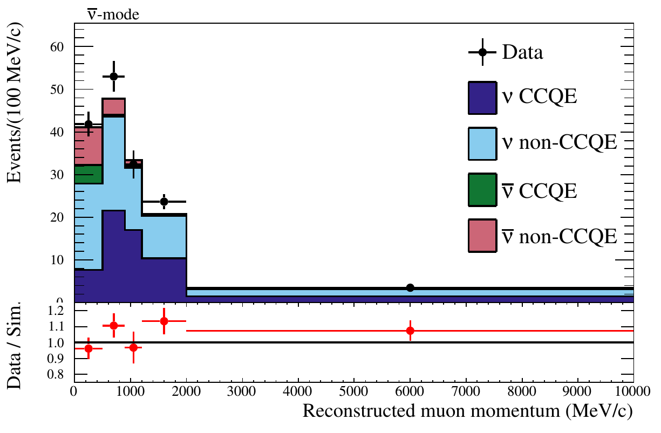
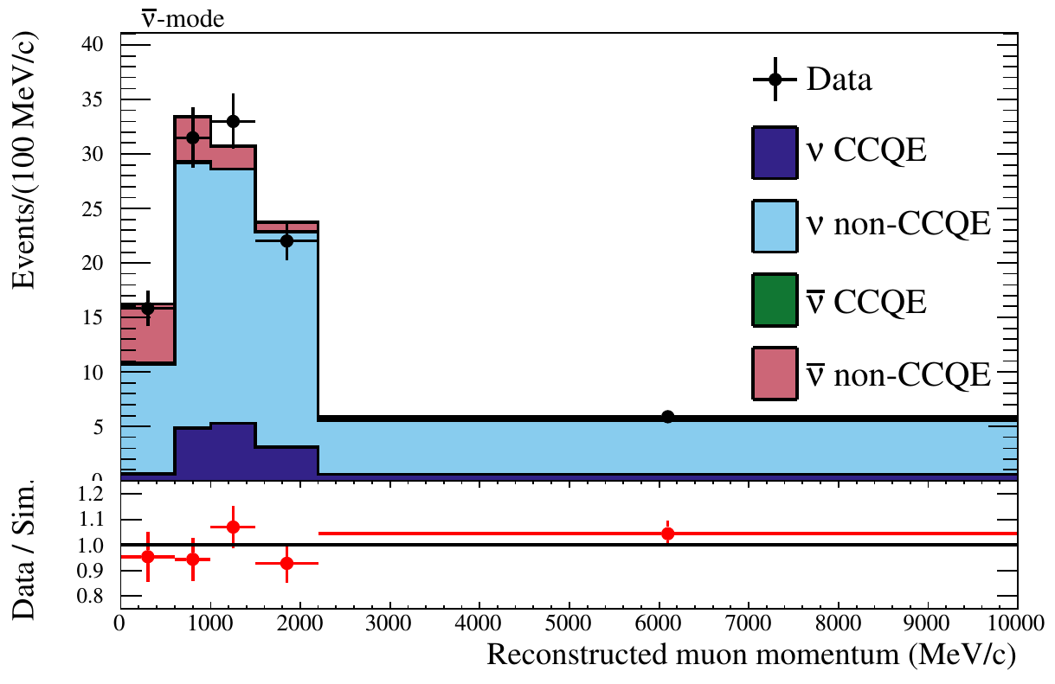
ND280 constraints
ND280 data reduce the uncertainty on the expected number of events
at SK (flux x cross-section) from
~25% down to below ~3%
Several ν_{μ}CC and ν_{μ}CC samples in n-mode and n-mode are selected according to the event topology
The simulation is fit to the data to adjust flux and cross-section parameters
n-mode ν_{μ}CC-0π
n-mode ν_{μ}CC-1π⁺
n-mode ν_{μ}CC-1-track
68% CCDIS purity
n-mode ν_{μ}CC-N-track
n-mode ν_{μ}CC-1-track
n-mode ν_{μ}CC-N-track

Slide 17
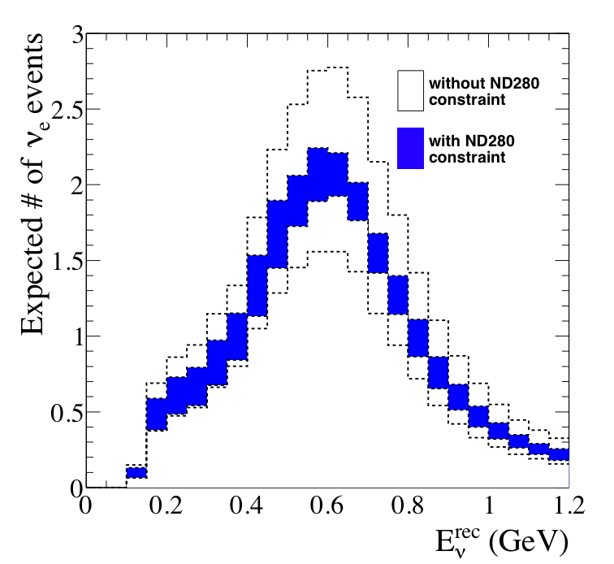
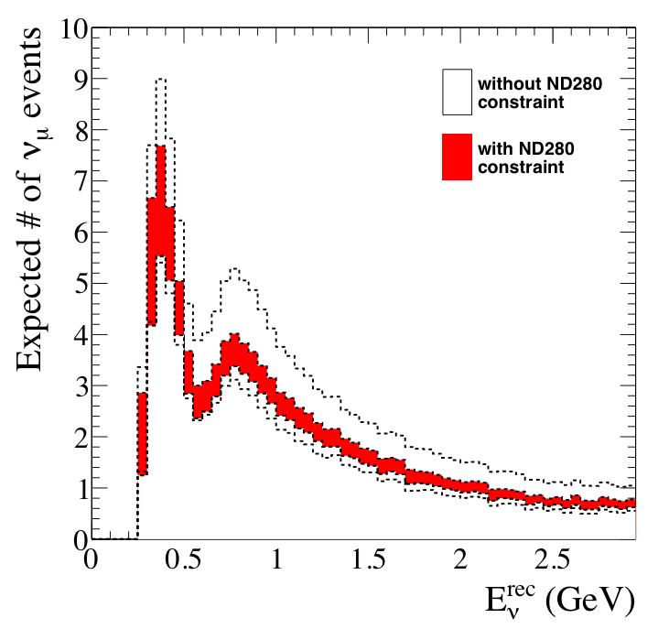
ND280 constraints for Super-K
Examples of error reduction on the expected number of events in Super-K
For ν_{μ} → ν_{e} appearance
For ν_{μ} disappearance

Slide 18
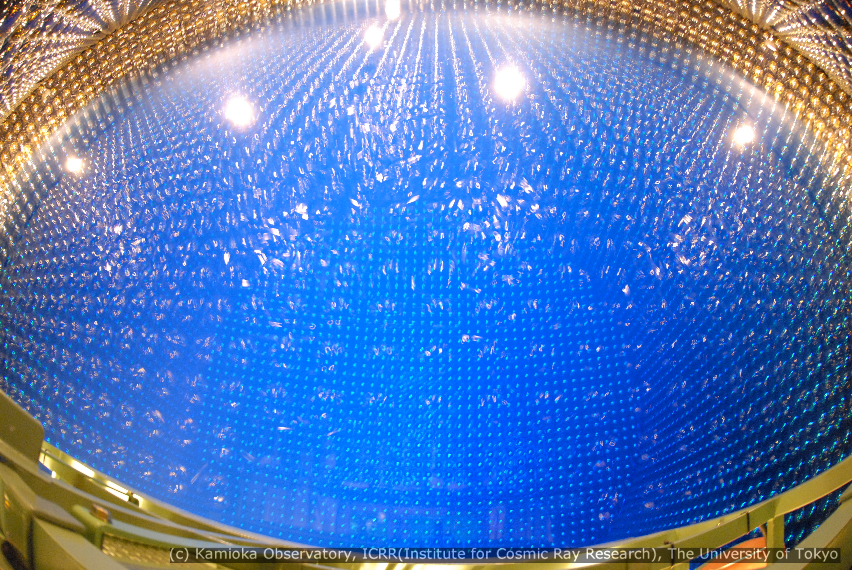
The T2K far detector: Super-K
Water Cherenkov detector,
> 20 years of operation,
excellent m/e separation
@295 km from the target,
11129 inward-facing PMTs,
22.5 kt fiducial volume

Slide 19
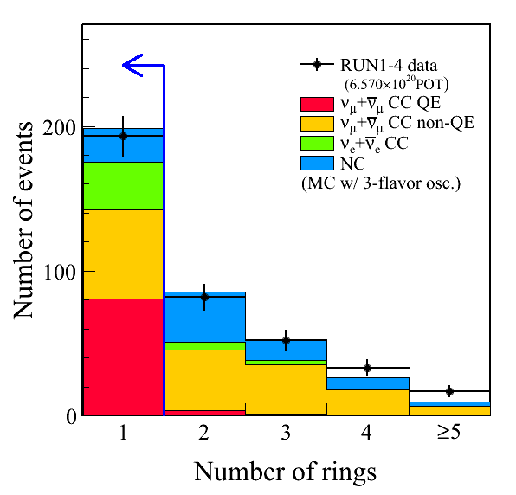
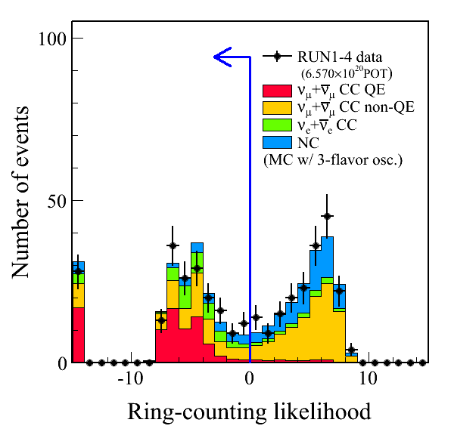
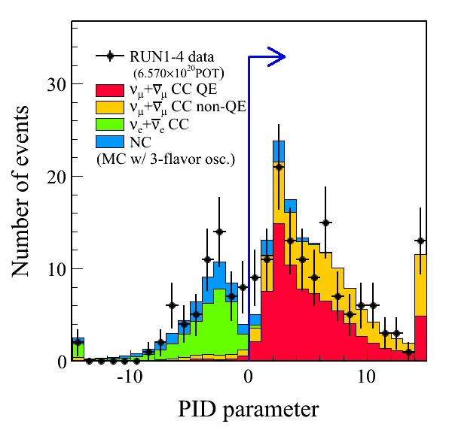
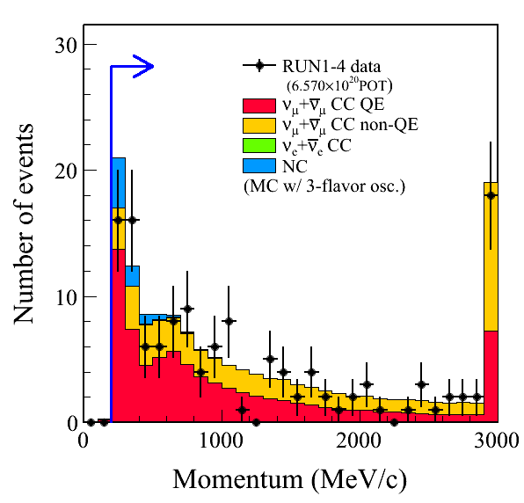
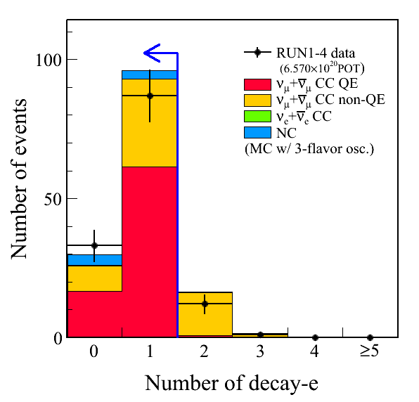
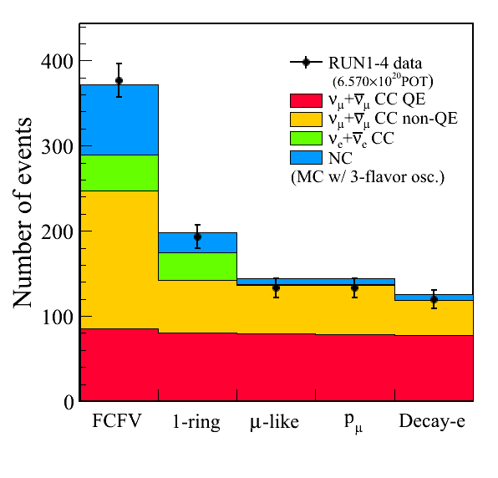
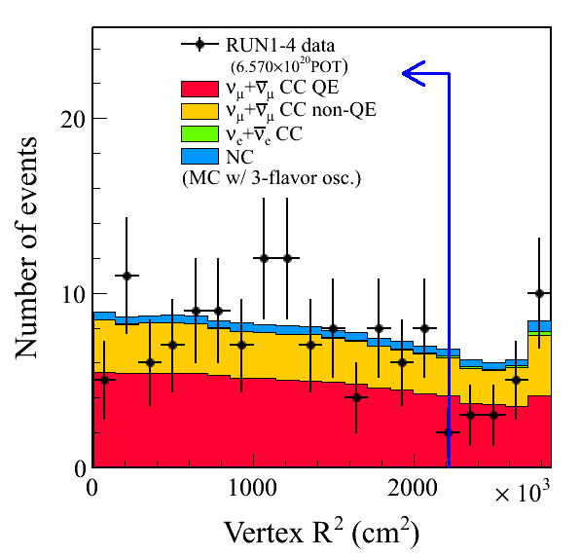
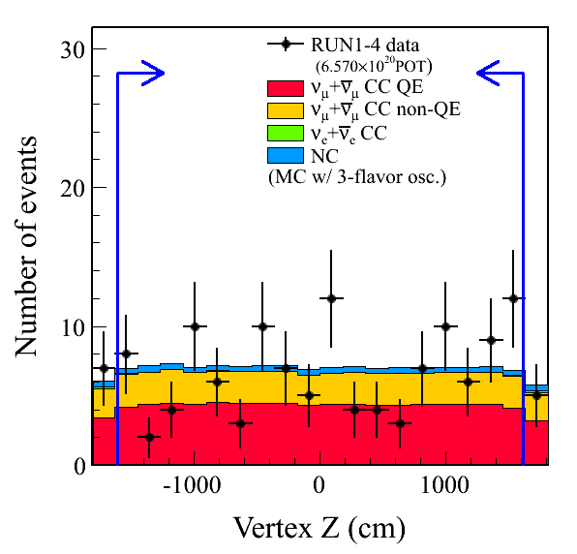
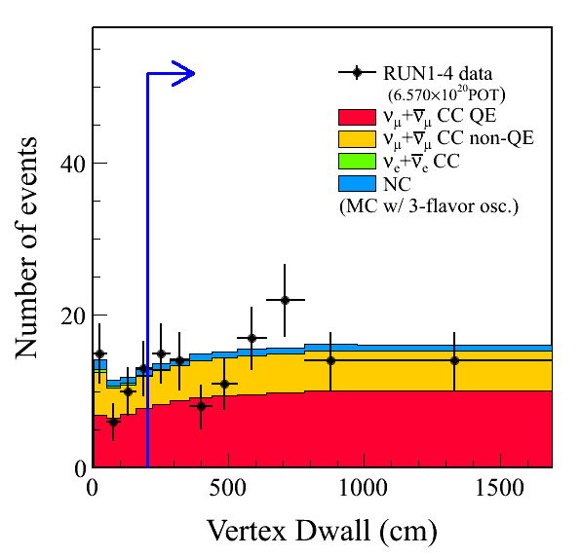
Super-K event selection examples
Detector is well-understood

Slide 20
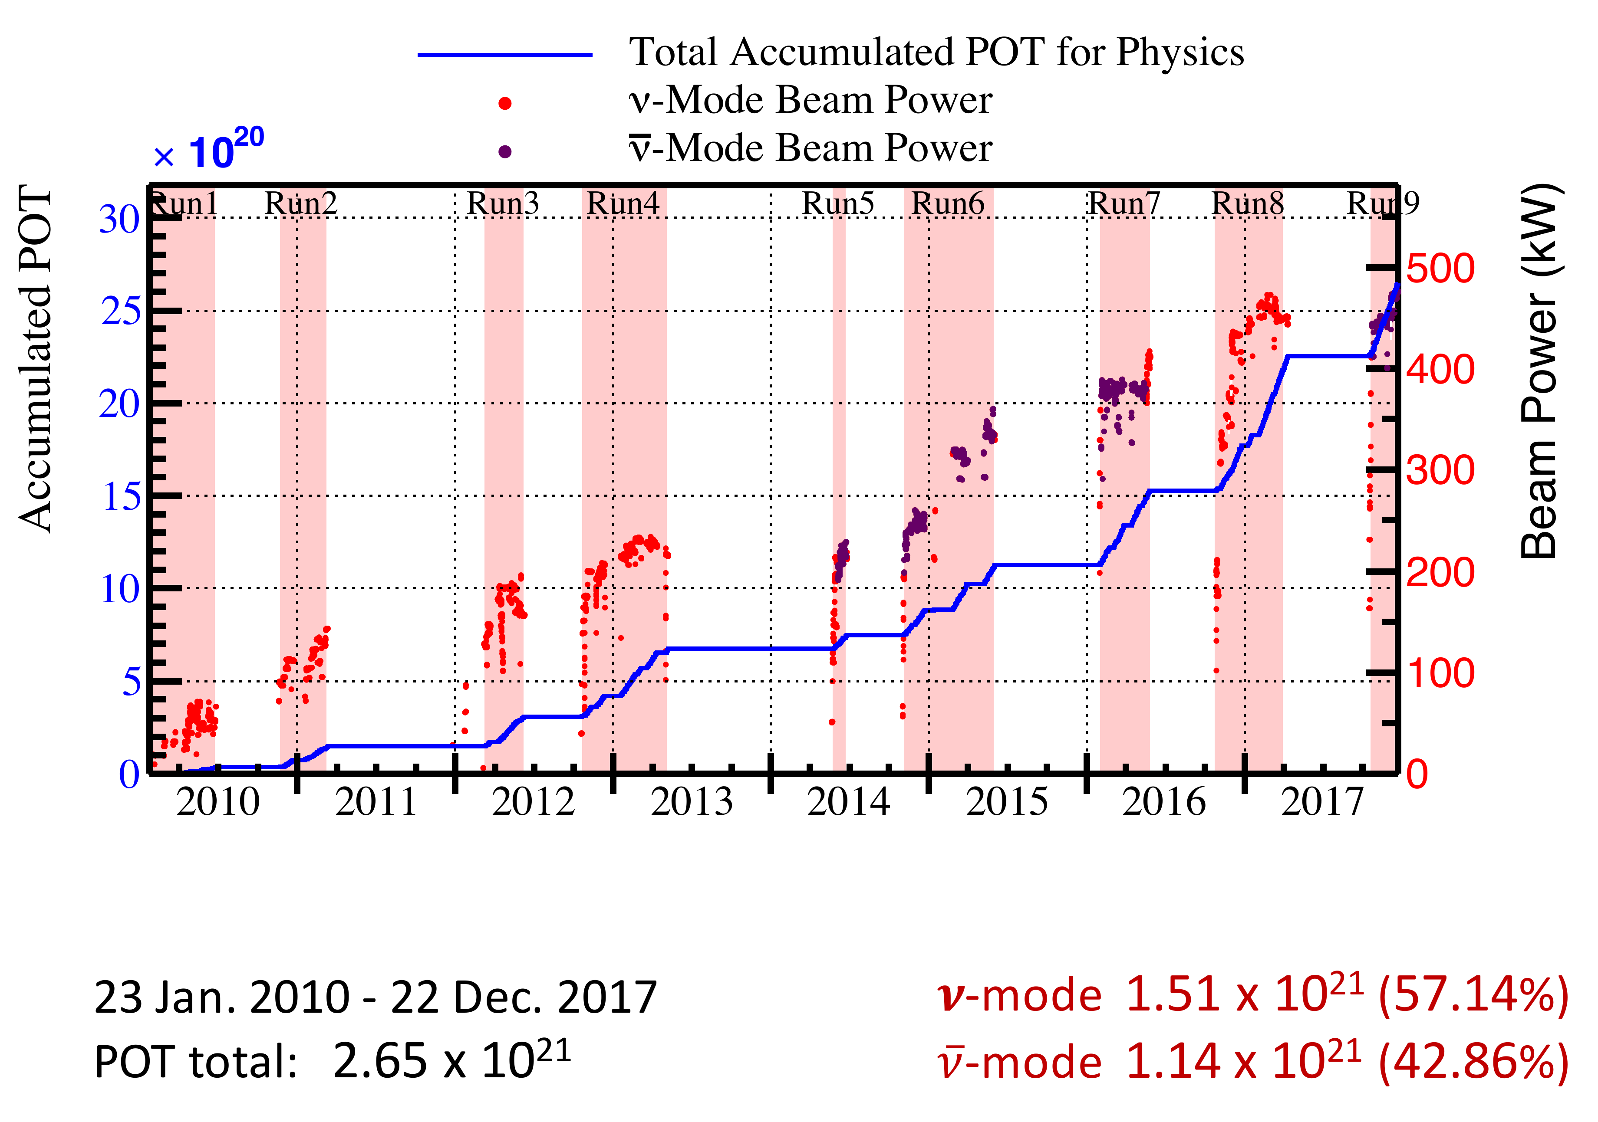
Collected data (up to end of 2017)
Reached stable operation at 480 kW beam power by now!

Slide 21
A selection of recent T2K results
First T2K physics paper
(as of Dec,20 2017)
2016 BREAKTHROUGH PRIZE
in FUNDAMENTAL PHYSICS
Based on 1.43x10²⁰ p.o.t.
6 events observed while expected background
is 1.5 ± 0.3 (syst)
First indication of ν_{μ} → ν_{e} appearance and non-zero
value of θ₁₃ with a significance of 2.5σ

Slide 22
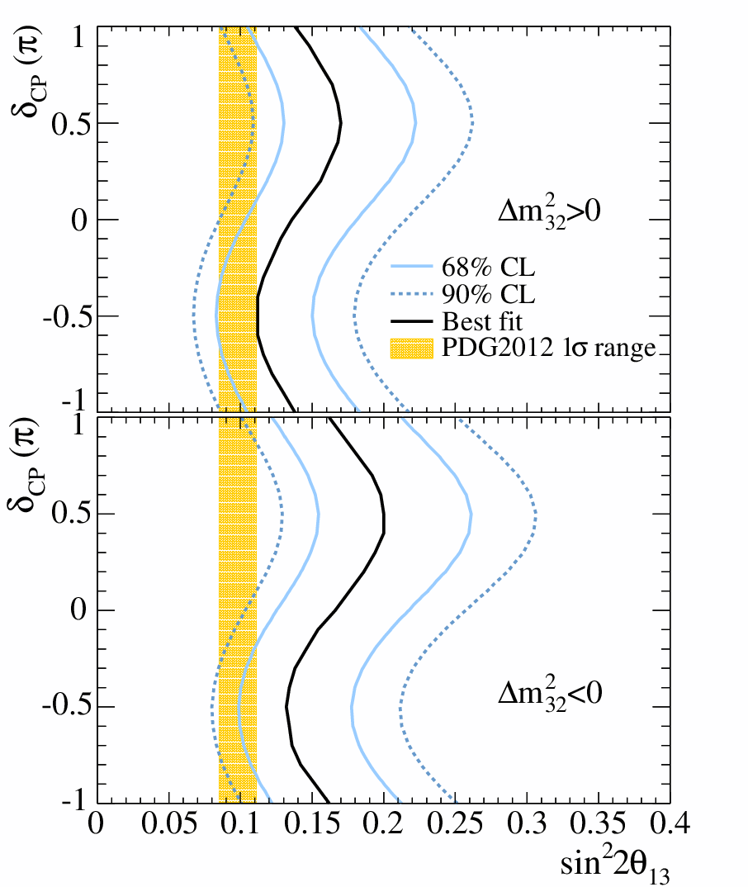
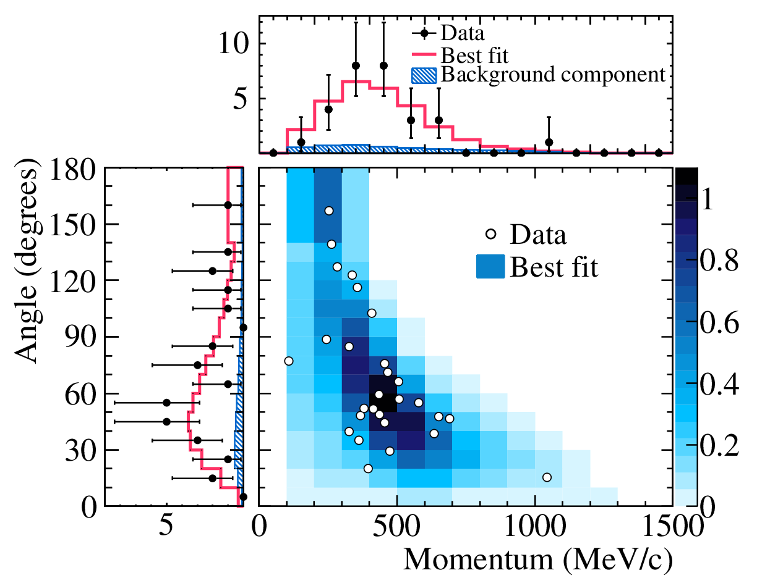
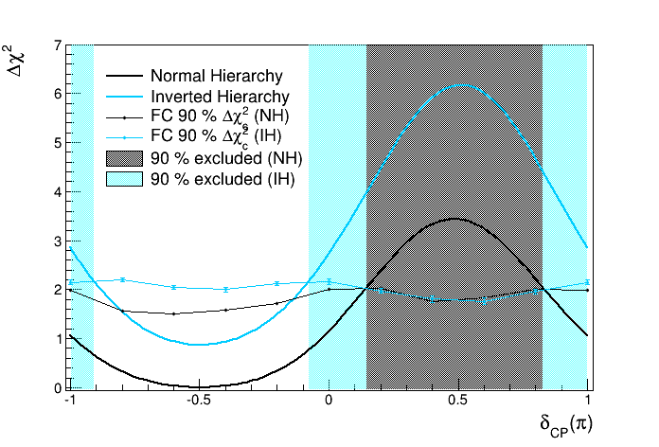
Discovery of ν_{μ} → ν_{e} appearance
Reactor constraint
Phys. Rev. Lett. 112 (2014) 061802
Based on 6.57x10²⁰ p.o.t.
28 events observed while expected
background is 4.92 ± 0.55
First observation of neutrino appearance
with a significance of 7.3σ
Assuming |Δ m²₃₂|=2.4x10⁻³ eV², sin²θ₂₃=0.5,
δ_{CP}=0, and Δ m²₃₂>0 (Δ m²₃₂<0) a best fit is
sin² 2θ₁₃=0.140^{+0.038} (0.170^{+0.045})
-0.032
-0.037
First constraints on δ_{CP}

Slide 23
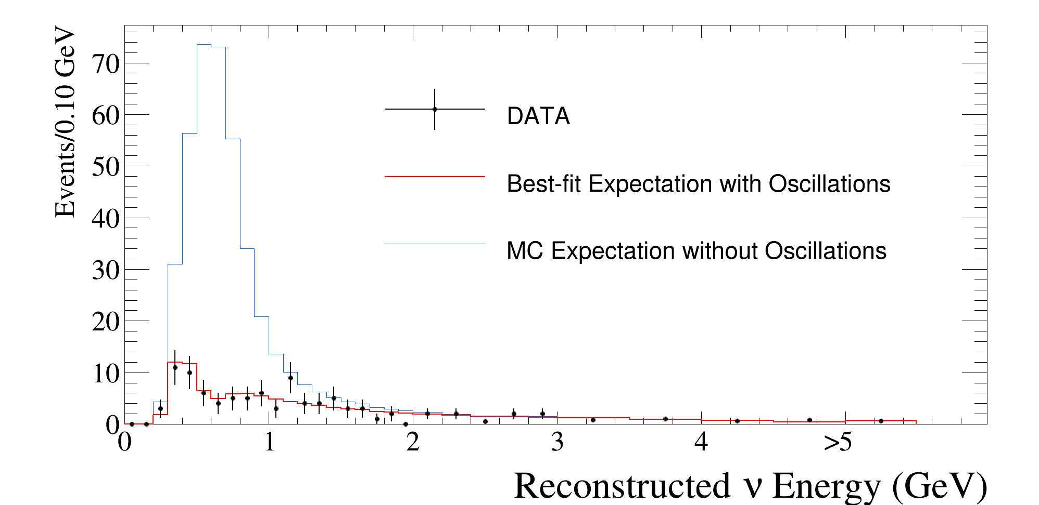
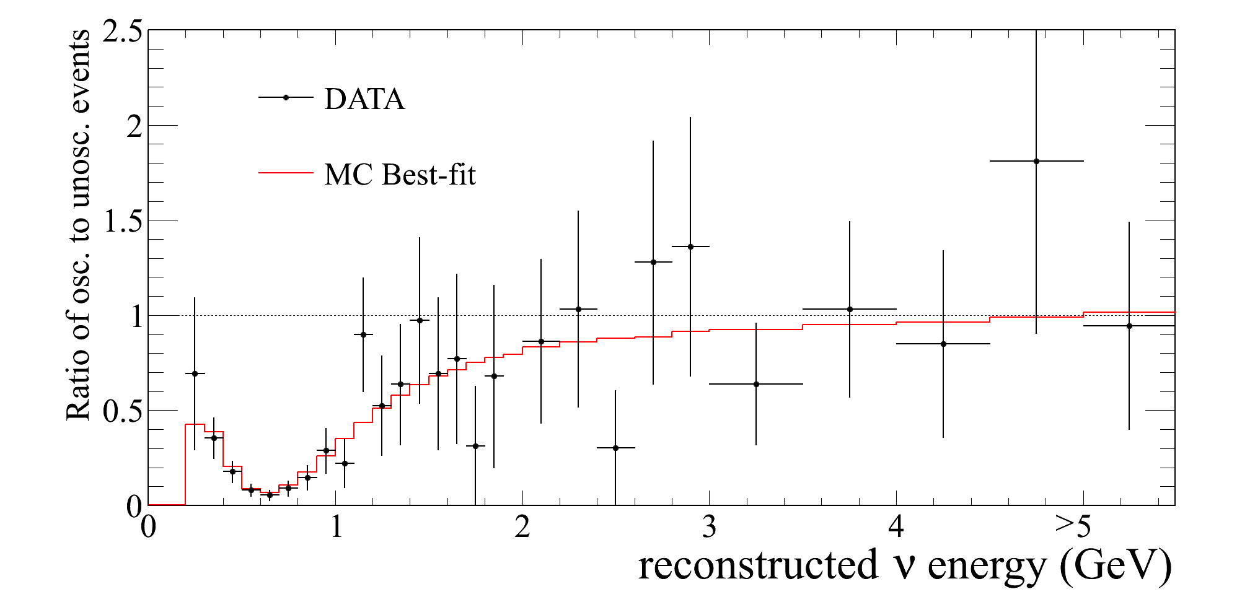
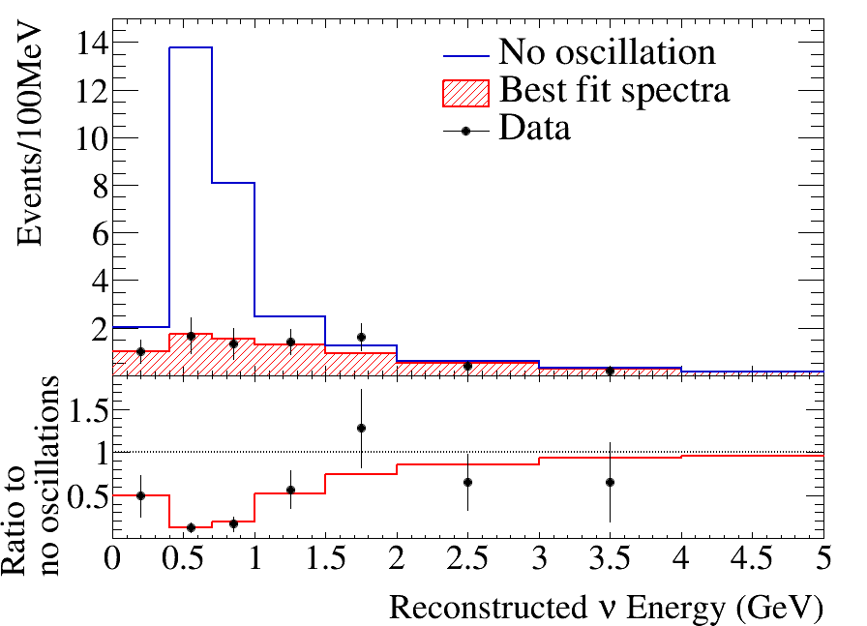
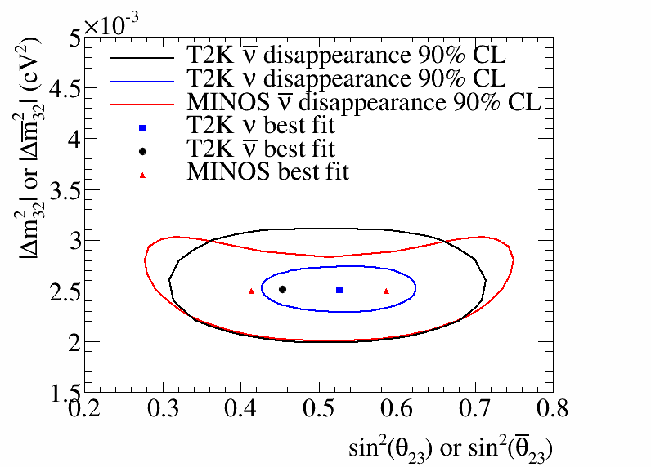
Results on ν_{μ} and ν_{μ} disappearance
Phys. Rev. Lett. 116 (2016) 181801
Since 2014 T2K started running in
anti-neutrino mode
First analysis of ν_{μ} disappearance:
Based on 4.01x10²⁰ p.o.t.
34 events observed
Best-fit:
sin² θ₂₃ = 0.45, |Δ m²₃₂| = 2.51x10⁻³ eV²
ν_{μ}
ν_{μ}
(best measurement of θ₂₃)

Slide 24
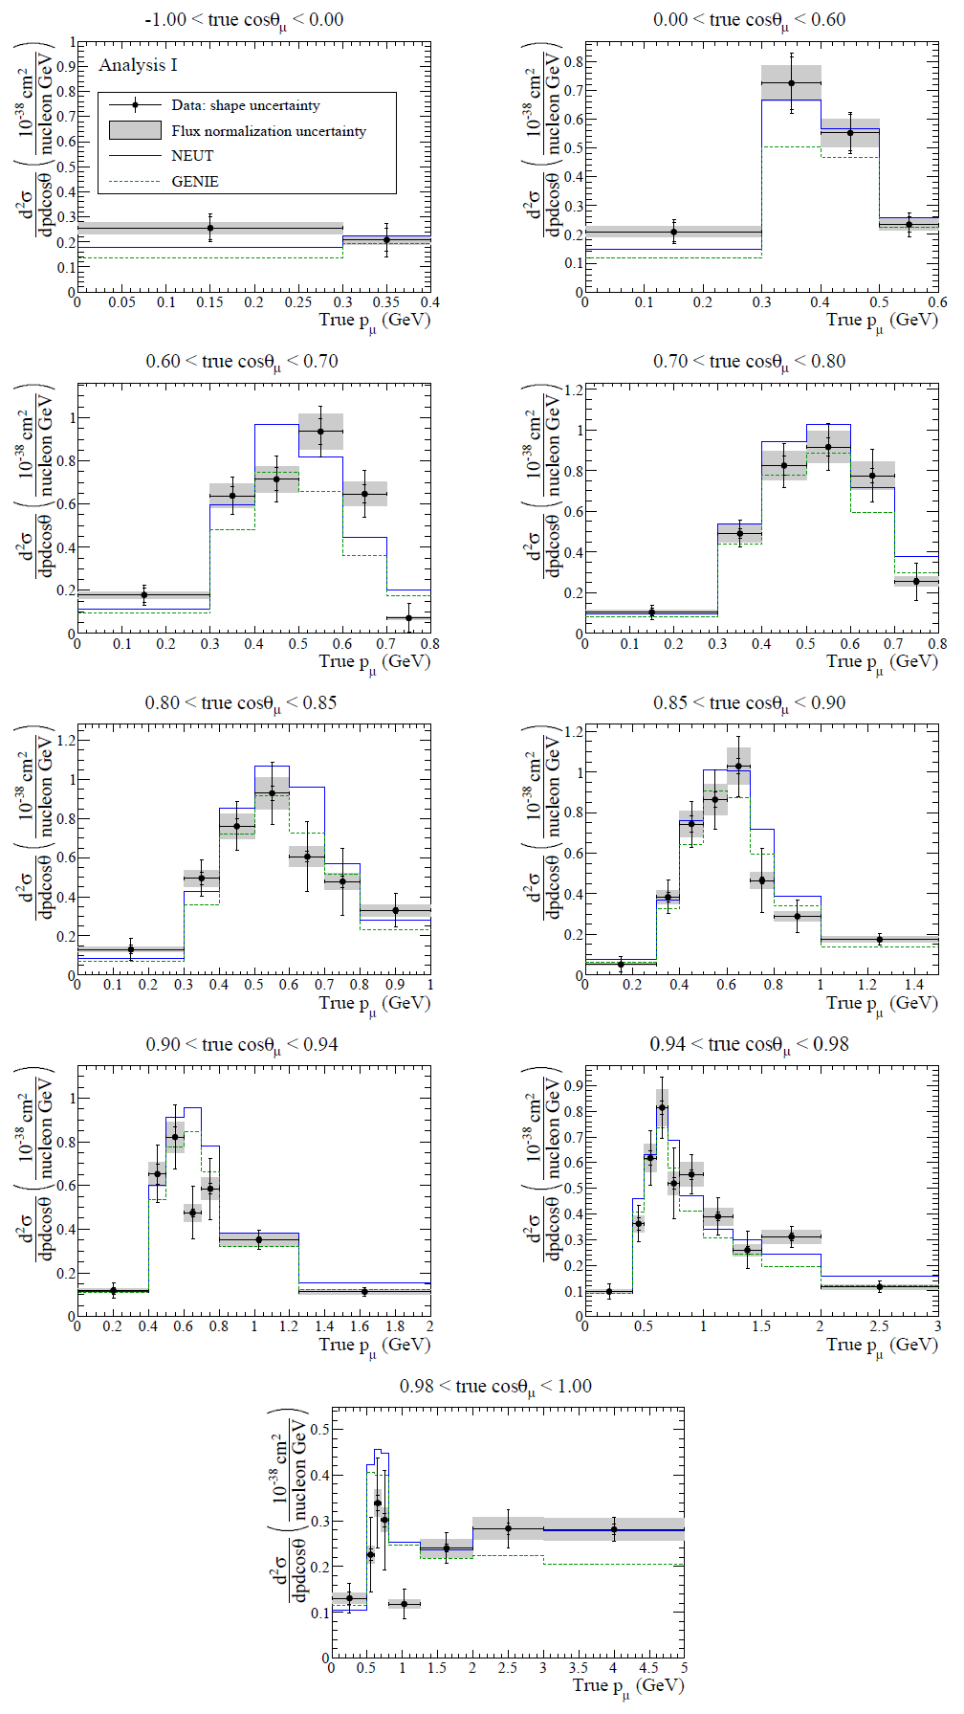
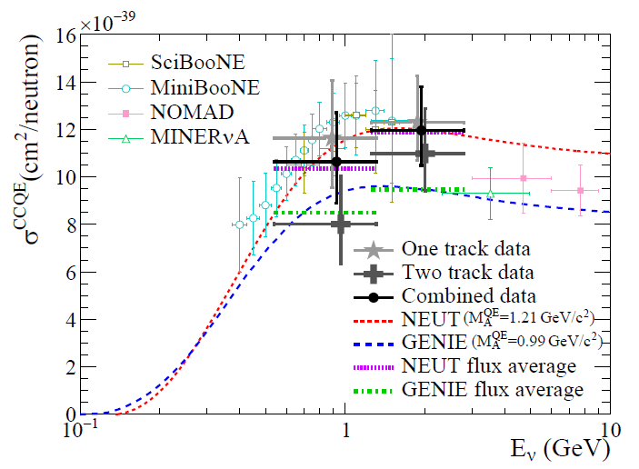
ν cross section measurements in T2K
Significant efforts within T2K towards better
measurements of neutrino cross sections
Crucial for precise determination of
oscillation parameters
Measurements are performed using ND280,
INGRID and SK
Examples are shown here: recent results
on double differential ν_{μ} CC interactions
on C₈H₈ without pions in the final state
and ν_{μ} CCQE cross section on Carbon
INGRID
ND280

Slide 25
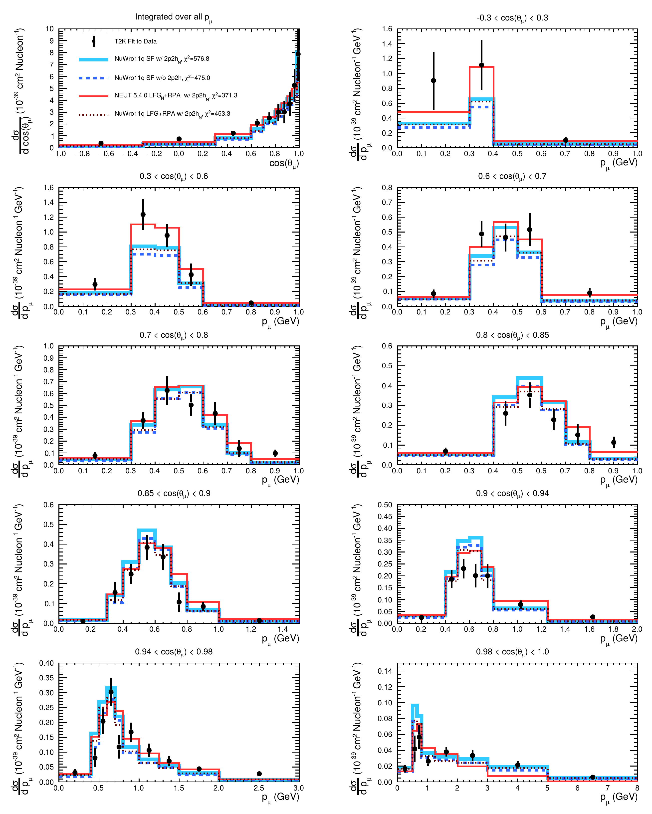
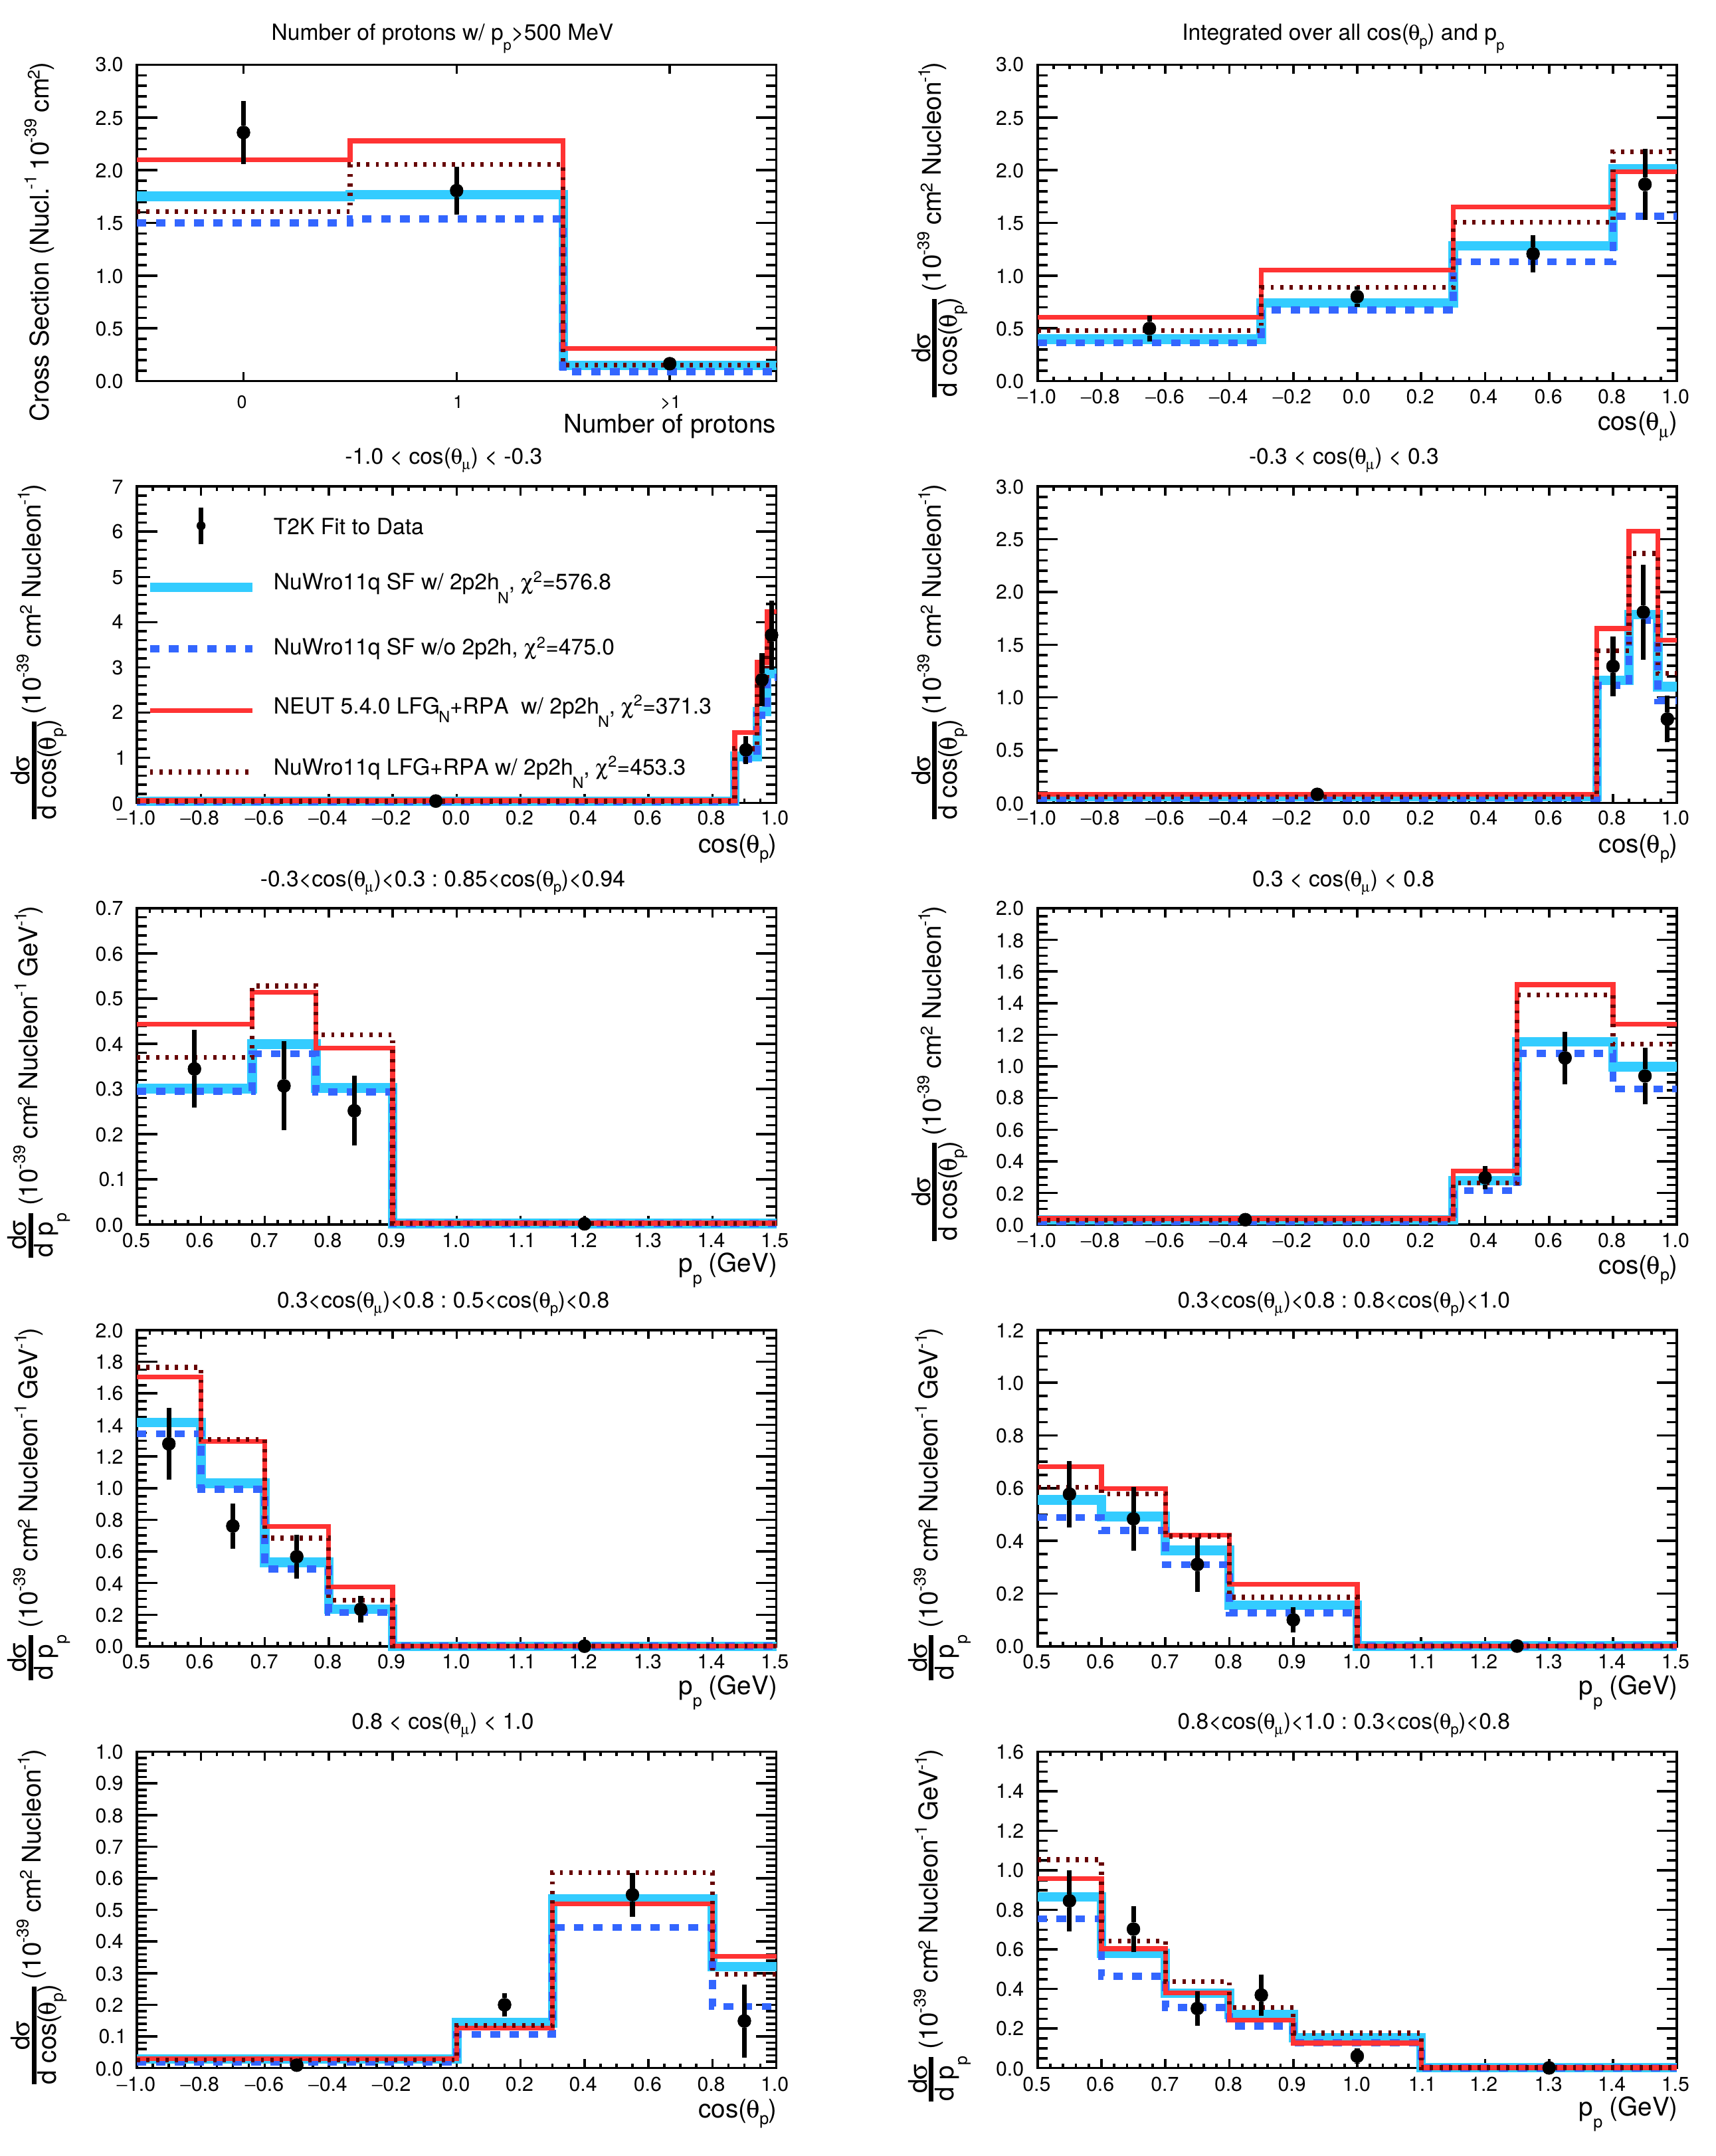
ν cross section measurements in T2K
Recent measurements from ND280:
ν_{μ} CC pionless cross section as a function
of muon and proton kinematics
(for interactions with 0, 1 and 2 protons)
Based on P.Bartet-Friburg’s work
Important for characterization of nuclear
effects in neutrino interactions
no protons with p>500 MeV
1 proton with p>500 MeV

Slide 26
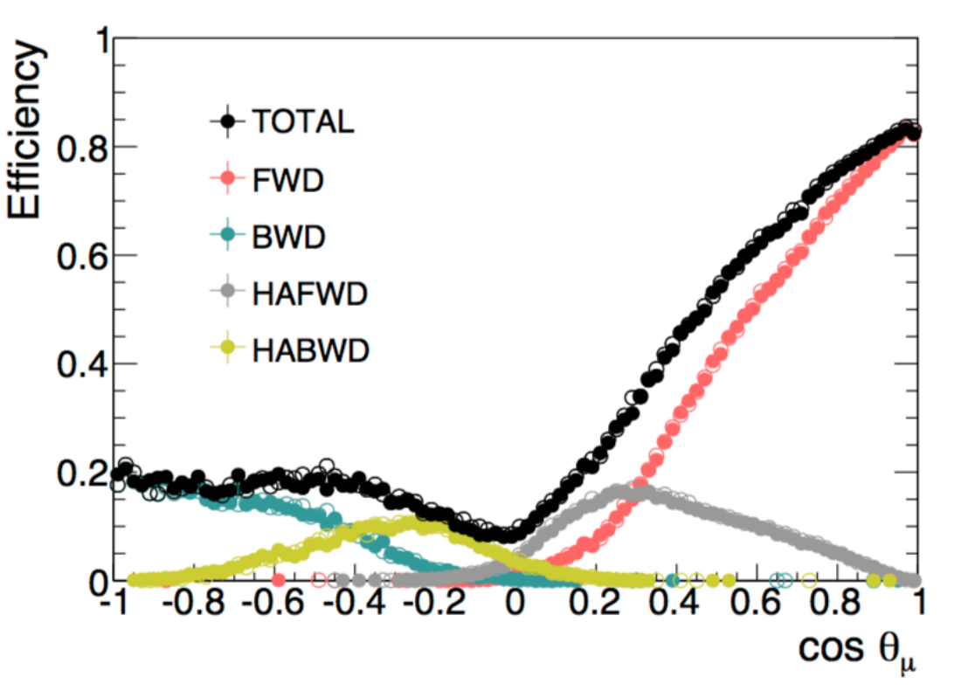
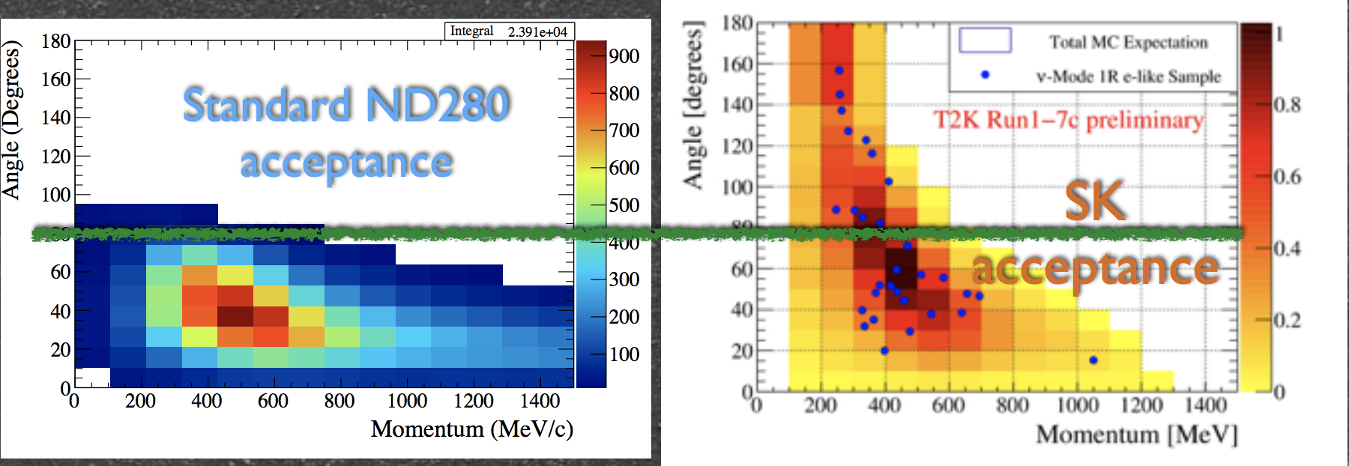
ND280 improved constraints
The group contributed to the improved selection of n_{m}CC samples
The efficiency for large-angle and backward-going tracks is improved
P.Bartet-Friburg’s PhD

Slide 27
T2K current oscillation analysis: ND
Improved ND280 constraint
Neutrino flux parameters and neutrino cross
section parameters are constrained by using
14 ND280 data samples (6 for ν_{μ} , 8 for ν_{μ} )
A binned likelihood is maximized to get the
central values and the systematic uncertainties
Examples are shown here: for neutrino flux
parameters and for cross section parameters
Fitted flux parameters are close to their
nominal values
The fit enhanced some of the cross section
parameters (related to 2p-2h and RPA)
Neutrino flux parameters
S.Bienstock’s PhD

Slide 28
T2K current oscillation analysis: SK
New reconstruction algorithm in Super-K
Re-optimization of the fiducial volume cut:
leads to ~30% increase in effective statistics

Slide 29
T2K current oscillation analysis: SK
New reconstruction algorithm in Super-K
Re-optimization of the fiducial volume cut:
leads to ~30% increase in effective statistics

Slide 30
T2K analysis: systematic errors (%)
Current systematic uncertainties (in %) on the number of events in Super-K
To be further improved with on-going and future efforts...
ND280

Slide 31
T2K: joint fit of n + n data
Joint fit of 5 SK data samples in n and n mode
Final systematics pending
{|Δ m²|, sin²θ₂₃}: fit the normal and inverted hierarchy
separately, θ₁₃ is reactor-constrained
{sin²θ₁₃, δ_{CP}}: T2K-only fit (without reactor constraint)
gives θ₁₃ value compatible with reactor measurements,
δ_{CP} close to -p/2 is preferred

Slide 32
T2K joint fit of n + n data: d_{CP} result
Joint fit of 5 SK data samples in n and n mode
Final systematics pending
{sin²θ₁₃, δ_{CP}}: T2K fit (with reactor constraint)
clear preference for δ_{CP} around -p/2
Best fit point: -1.83 radians with Normal mass ordering
2s C.L. intervals:
Normal Ordering [-2.98; -0.60] radians
Inverted Ordering [-1.54; -1.19] radians
CP conserving values 0,p both fall
outside of the 2s C.L. intervals

Slide 33
Future plans : T2K Phase II proposal
Approved T2K statistics (7.8x10²¹ p.o.t.)
can be accumulated by JFY2020. Recently
reached 3.0x10²¹ p.o.t.
Next generation long-baseline neutrino
experiments (Hyper-K and DUNE) are
expected to start around 2026
T2K Phase II, if extended to 2026, could
collect about 20x10²¹ p.o.t.
Neutrino beamline upgrade and analysis
improvements (SK fiducial volume to add
new event samples) could effectively add
about 50% of statistics
Reduction of systematic uncertainties
would enhance sensitivity of CPV studies
unknown
known
Mass hierarchy

Slide 34
ND280 upgrade
ND280++
Given a large statistics to be collected by T2K-II, systematics needs to be reduced
down to 2-3%. Thus, upgraded ND280++ to be installed in 2021 to avoid
major limitations of the current detector: reduced angular acceptance and
reconstruction of low-momentum hadrons.
LPNHE group contributions:
Optimization of the new detector configuration leading to the ND280++ design;
Participation in the construction of the new High-Angle TPCs
(development and production of readout electronics – Front-End Cards;
mechanical suspension system; new DAQ).
T2K-II
The ND280 upgrade project is an important part of the T2HK experiment!

Slide 35
ND280 upgrade (physics motivation)
T2K-II

Slide 36
ND280 upgrade (lab's resources)
The following manpower has already been allocated by the LPNHE directorate:
- electronics engineers to work on TPC FECs (J.-M.Parraud, F.Toussenel)
- mechanical engineers to work on FEC mechanics and cooling (Y.Orain) and
on detector integration (W.Ceria)
T2K-II

Slide 37
NA61/SHINE beyond 2020
Preliminary
The usage of replica-target NA61/SHINE would allow for further improvement
in T2K (anti-)neutrino flux uncertainty (down to ~5%). Even better knowledge
is desired for T2K-II and Hyper-K. New measurements are planned for DUNE
and Hyper-K after the CERN LS2 (see, CERN-SPSC-2018-008):
- improved measurements with T2K replica target, considering alternative
target material – Super-Sialon (Si₃N₄Al₂O₃);
- with additional tracking detectors surrounding the long target;
- hadron production with low momentum beam (<12 GeV/c).
NA61++

Slide 38
More distant future: Hyper-K
New version of Hyper-K TDR (arxiv:1805.04163) was released on May,9 2018

Slide 39
More distant future: Hyper-K
New version of Hyper-K TDR (arxiv:1805.04163) was released on May,9 2018

Slide 40
More distant future: Hyper-K
We consider the Hyper-Kamiokande experiment as the most attractive option
to pursue our scientific activities:
- Already proven water Cherenkov technique
- Large detector size sensitive to rare events (proton decays, supernovae neutrinos)
- Our past, on-going and future contributions to T2K/T2K-II are important investments
- Full participation in Hyper-K will open a possibility to enlarge the group experience
by studying solar, atmospheric and supernovae neutrinos and by performing a combined
analysis with accelerator (anti-)neutrinos.
Possible hardware contributions are being investigated (underwater multi-PMT tests / APC;
electronics for PMT readout based on a chip developed by the Omega lab?)
Participation in T2K and T2K-II allows to work towards Hyper-K

Slide 41
Summary and conclusions (1)
Very successful participation in the T2K experiment.
The data samples analysed by T2K so far correspond to
14.7x10²⁰ protons on target in neutrino mode
7.6x10²⁰ protons on target in anti-neutrino mode
while the total approved exposure is 7.8x10²¹ p.o.t.
T2K reported first observation of neutrino appearance (ν_{μ} → ν_{e})
Muon anti-neutrino disappearance results are consistent
with our world-leading ν_{μ} disappearance measurements.
T2K is currently taking more anti-neutrino data to establish
electron anti-neutrino appearance and to further constrain δ_{CP}.
Crucial contributions to oscillation analysis (S. Bienstock PhD).
Plan to contribute to future joint T2K+SK and T2K+SK+NOvA
analyses.
Proposal for T2K-II (with a goal of 20x10²¹ p.o.t.) is formulated
to reach more than 3σ significance for large CP violation.
We are contributing to these efforts.

Slide 42
Summary and conclusions (2)
Made significant contributions to the NA61/SHINE experiment.
The analysis of data samples collected for T2K
(with a thin carbon target and a replica of the T2K target)
allowed to reach <10% uncertainty on (anti-)neutrino fluxes
Important hadron production results recently published
The recently finalised analysis of the ultimate 2010 Replica
Target data (Matej Pavin's PhD) could allow to further reduce
the T2K flux uncertaities down to ~5%. Paper in preparation.
Given the success of the 'NA61/SHINE for T2K' program,
similar measurements are now being performed for Fermilab
neutrino beams.
Program of future measurements beyond 2020 is formulated
We are contributing to these efforts.

Slide 43
Summary and conclusions (3)
We are now on the road towards future long-baseline
neutrino experiments with a clear goal to study CP violation
in the lepton sector.
During 2014-2017 the group has been involved in the WA105
R&D project for DUNE.
We concentrated our efforts on the software development for
double-phase LAr TPC in a generic LArSoft framework.
This activity will not be pursued given the choice to participate
in the Hyper-Kamiokande project.

Slide 44
Summary and conclusions (4)
We are now on the road towards future long-baseline
neutrino experiments with a clear goal to study CP violation
in the lepton sector.
In September,2017 the group has chosen to participate in
the Hyper-K project
This is a natural continuation of our involvement in the
Japanese neutrino program
Our contributions to the ND280 upgrade project are crucial
for both T2K-II and T2HK experiments
Exact hardware contributions to HK are still to be defined
in collaboration with LLR and CEA groups

Slide 45
Backup

Slide 46
T2K neutrino beam composition
Flux prediction (Beam MC)
ν_{μ}
positive focussing
ν_{e}
ν_{μ}
~93%
ν_{μ}
~6%
ν_{e}
~1.1%

Slide 47
The near detectors
ND280
Characterize the off-axis neutrino beam composition in function of the energy
Neutrino monitors at 280 meters from the source → Studies neutrino fluxes BEFORE the oscillations
INGRID
Characterize the neutrino beam measuring the intensity and the direction with 0.4mrad precision

Slide 48
Collected data (up to Run9)
Reached stable operation at 470 kW beam power by now!

Slide 49
Events in Super-K (ν_{e} candidate)

Slide 50
Discovery of ν_{μ} → ν_{e} appearance
Phys. Rev. Lett. 112, 061802 (2014)
Based on 6.57x10²⁰ p.o.t.
28 events observed while expected
background is 4.92 ± 0.55
First observation of neutrino appearance
with a significance of 7.3σ
Assuming |Δ m²₃₂|=2.4x10⁻³ eV², sin²θ₂₃=0.5,
δ_{CP}=0, and Δ m²₃₂>0 (Δ m²₃₂<0) a best fit is
sin² 2θ₁₃=0.140^{+0.038} (0.170^{+0.045})
-0.032
-0.037
Reactor constraint

Slide 51
Precise measurement of ν_{μ} disappearance
Phys. Rev. Lett. 112, 181801 (2014)
Based on 6.57x10²⁰ p.o.t.
120 events observed while expectation
without oscillations is 446 ± 22.5
World best measurement of θ₂₃
The 68% C.L. on sin²θ₂₃ is 0.514^{+0.055}
(0.511±0.055) assuming normal (inverted)
mass hierarchy. Δm²₃₂=(2.51±0.10)x10⁻³ eV²
Δm²₁₃=(2.48±0.10)x10⁻³ eV² for normal
(inverted) MH.
-0.056
Precise measurements of θ₂₃ can
constrain models of neutrino mass generation

Slide 52
Combined appearance & disappearance
Phys. Rev. D 91, 072010 (2015)
Based on 6.57x10²⁰ p.o.t.
Combined analysis of ν_{e} appearance
and ν_{μ} disappearance to estimate
the four oscillation parameters -
|Δ m²|, sin²θ₂₃, sin²θ₁₃, δ_{CP},
and the mass hierarchy (MH).
At 90% C.L. including reactor results
we exclude the region δ_{CP}=[0.15,0.83]π
(δ_{CP}=[-0.08,1.09]π) for normal (inverted) MH

Slide 53
Study of ν_{e} appearance
Too low statistics for ν_{e} appearance:
with 4.01x10²⁰ p.o.t. 3 events observed
Additional collected data are under analysis

Slide 54
NA61/SHINE coverage for T2K (ν mode)

Slide 55
Comparison of K- spectra with models

Slide 56
Comparison of K- spectra with models
A similar program of hadron production
measurements is now approved for
Fermilab neutrino beams (including
DUNE)
Data-taking plans for the 3 coming years
GEANT4 physics lists

Slide 57
p+RT @ 31 GeV/c analysis

