Slide 1
L.C Physics Charged/Neutral hadron separation and energies at 0.5 and 3 TeV

Slide 2
Physics Processes
Pyhthia8 was used to generate the following processes
e⁺ + e⁻ → Z/γ→ H⁰ + Z⁰
e⁺ + e⁻ → f f̄ H⁰ (Z Z fusion)
e⁺ + e⁻ → f f̄ H⁰ (W W fusion)
e⁺ + e⁻ → Z/γ→ W⁺ + W ⁻
e⁺ + e⁻ → Z/γ→ t + t̄
10000 events/process, only ISR, no beam background

Slide 3
Definitions
For each event the tracks of the neutral (nh) and charged hadrons (ch) are propagated to the input plane of the HCAL barrel or end cap. The quarks (qu) are taken as jet axis. The distance dLqn (nh to qu) or dLqc (ch to qu) is computed and the hadron is assigned to a jet . For each jet the distance dLnc (ch to nh) is computed; dLnc1 is the DCA of the ch closest to the nh, dLnc2 is the next closest.

Slide 4
Output distributions
The plots show the following distributions
Event topology (Number of jets vs number of leptons)
Jet topology (Number of neutral hadrons vs charged hadrons)
dN/dL (nh to qu) and dN/dl (ch to qu)
dN/dLnc1 : distance between the neutral hadron and the closest charged hadron, for 0 < θ (nh) < 180 and for
138 < θ (nh) < 42 (forward/backward regions)
dN/dLnc2 : distance between the neutral and the next to the closest charged hadron.
Δθ/ΔΦ between the neutral hadron and charged hadron.
Energy E(nh) vs E(qu) , E(ch) vs E(qu) and E(ch) vs E(nh)

Slide 5
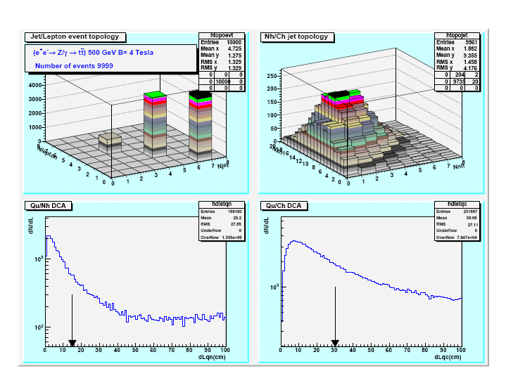
e⁺ + e⁻ → Z/γ→ t + t̄ (0.5 TeV)
Cut to assign nh to a jet

Slide 6
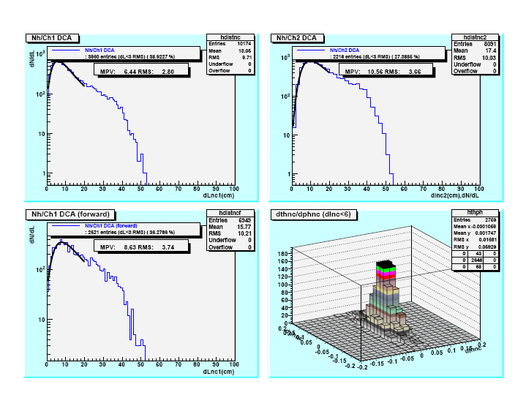
e⁺ + e⁻ → Z/γ→ t + t̄ (0.5 TeV)

Slide 7
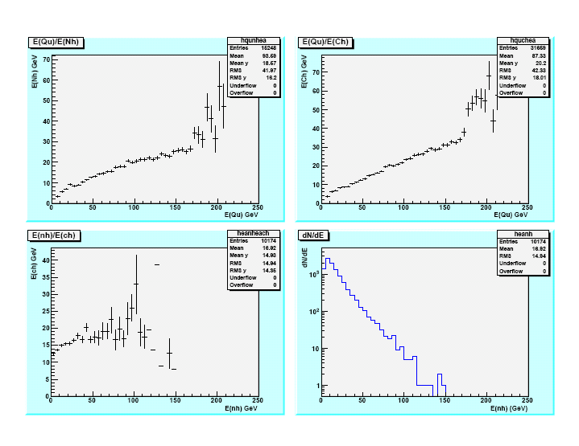
e⁺ + e⁻ → Z/γ→ t + t̄ (0.5 TeV)

Slide 8
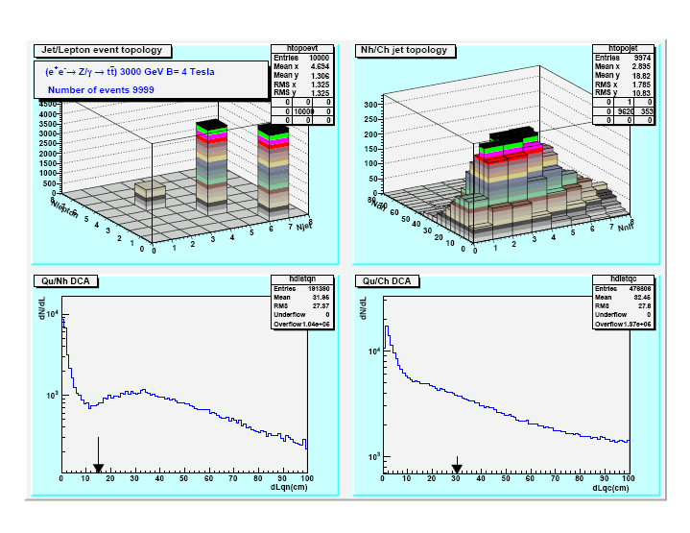
e⁺ + e⁻ → Z/γ→ t + t̄ (3 TeV)

Slide 9
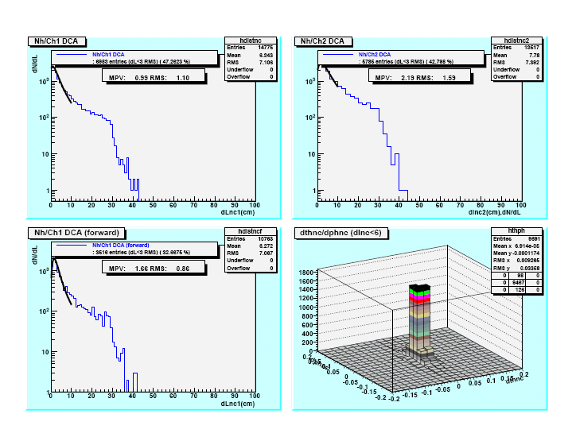
e⁺ + e⁻ → Z/γ→ t + t̄ (3 TeV)

Slide 10
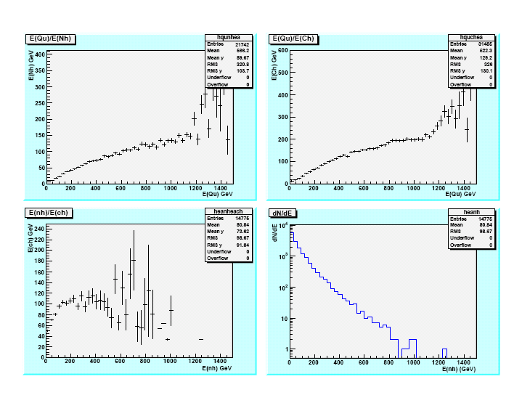
e⁺ + e⁻ → Z/γ→ t + t̄ (3 TeV)

Slide 11
Summary table
Njet,Ecm,B | dN/dLcn1 MPV (cm) | dN/dLcn1 RMS (cm) | dN/dLcn1 MPV (F/B) (cm) | DN/dLcn1 RMS (F/B) (cm) | dN/dLcn2 MPV (cm) | dN/dLcn2 RMS (cm)
2J, 0.5, 4T ZZ fusion | 8.0 | 3.6 | 9.7 | 4.4 | 13.2 | 4.8
2J, 3.0, 4T | 3.8 | 2.6 | 2.6 | 2.4 | 6.6 | 3.4
4J, 3.0, 4T H0, Z0 | 0.6 | 0.7 | 1.4 | 0.7 | 1.0 | 1.1
4/6J, 0.5,4T t ,t̄ | 6.4 | 2.8 | 8.6 | 6.7 | 10.6 | 3.7
4/6J, 3.0,4T t ,t̄ | 1.0 | 1.1 | 1.7 | 0.9 | 2.2 | 1.6
4/6J, 3.0,5T t ,t̄ | 1.4 | 1.2 | 1.9 | 1.0 | 2.7 | 1.6

Slide 12
Comments
For the physics channels considered:
The separation depends on E(c.m) and event topology
At 3 TeV the separation is small; this should affect the PFA performances.
The separation doesn’t degrade for jets having the neutron in the forward regions (likely because the distance to the end caps is large).
At 3 TeV increasing the B field doesn’t improve significantly the separation
At 3 Tev the energy of the hadrons can reach up to ~ 500 GeV; the HCAL depth must allow to contain the shower.
Next steps: check other physics channels, analyze e/γ separation and understand PFA.

