Slide 1
Virgo Computing
Franco Carbognani

Slide 2
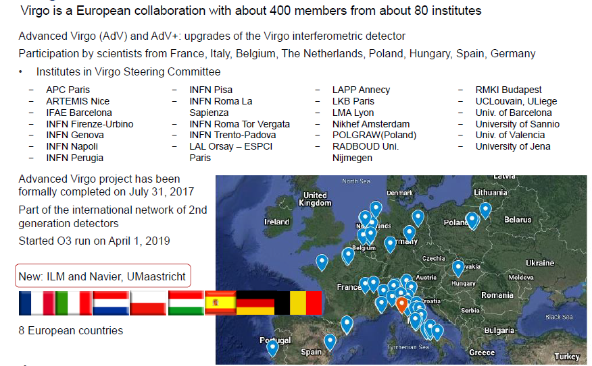
Virgo Collaboration
KIT visit to Cascina , 22 March 2019

Slide 3
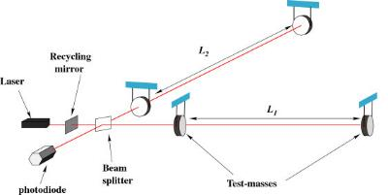
Detecting GWs with Interferometers
Laser used to measure relative lengths of two orthogonal arms
Arms are few km
Measure difference in length to one part in 10²¹ or 10⁻¹⁸ meters
…causing the interference pattern to change at the photodiode
As a wave passes, the arm lengths change in different ways….

Slide 4
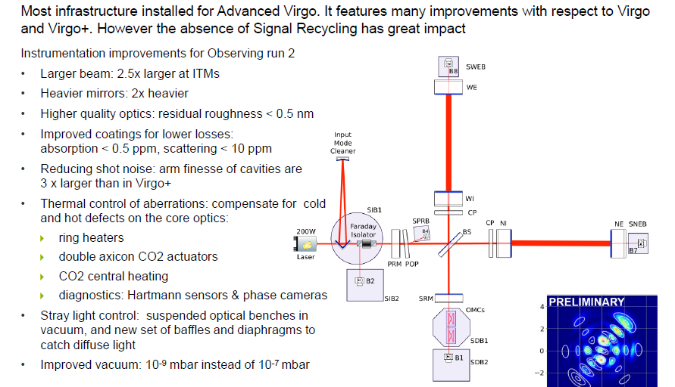
Advanced Virgo
KIT visit to Cascina , 22 March 2019

Slide 5
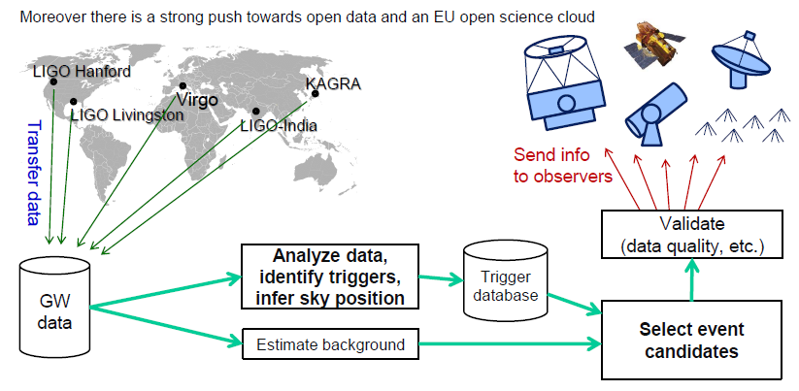
Multi-Messenger Astronomy (MMA)

Slide 6
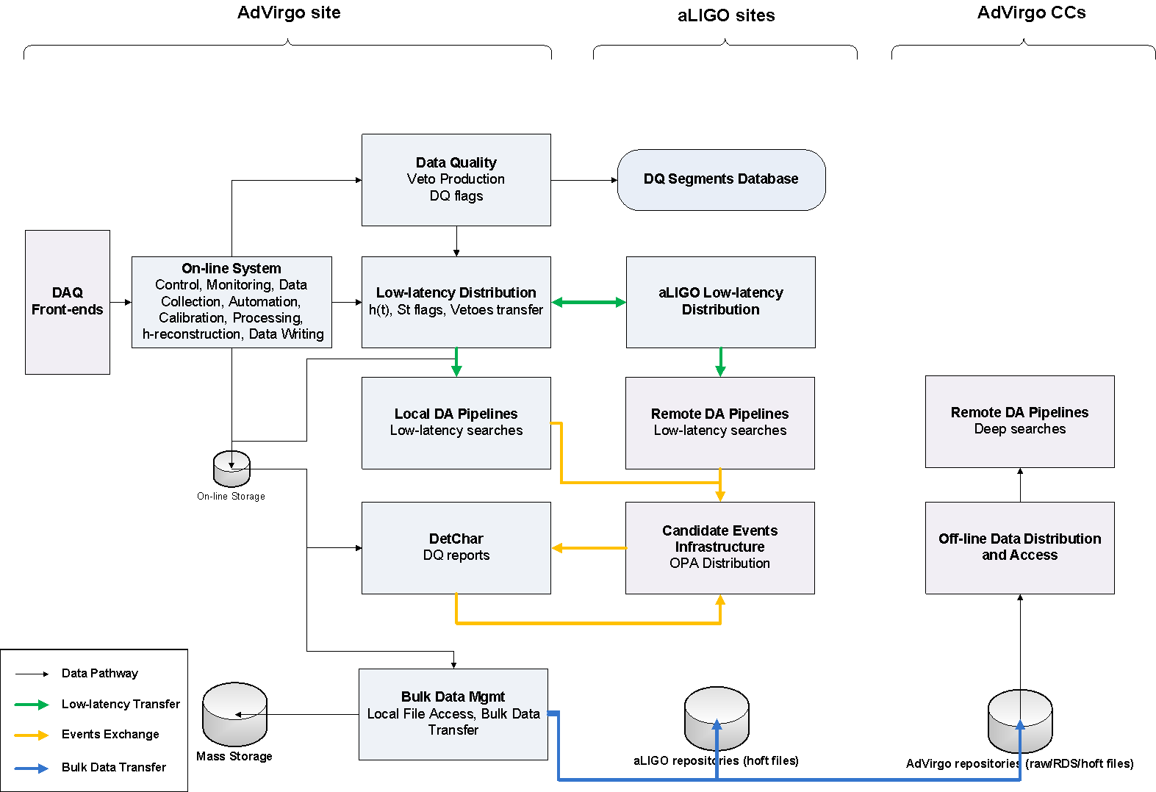
AdVirgo Data Flow schema

Slide 7
AdVirgo Data Flow: The GW170814 case
The signal arrives
Data composed into frames
Calibration of the data
Veto, DQ flags production
h(t) transfer
Low-latency matched-filter pipelines
Upload to GraceDB
Data written into on-line storage
Low-latency data quality
Low-latency sky localization
GCN Circular sent out
Data written into Cascina Mass Storage
Data transfer toward aLIGO and CCs

Slide 8
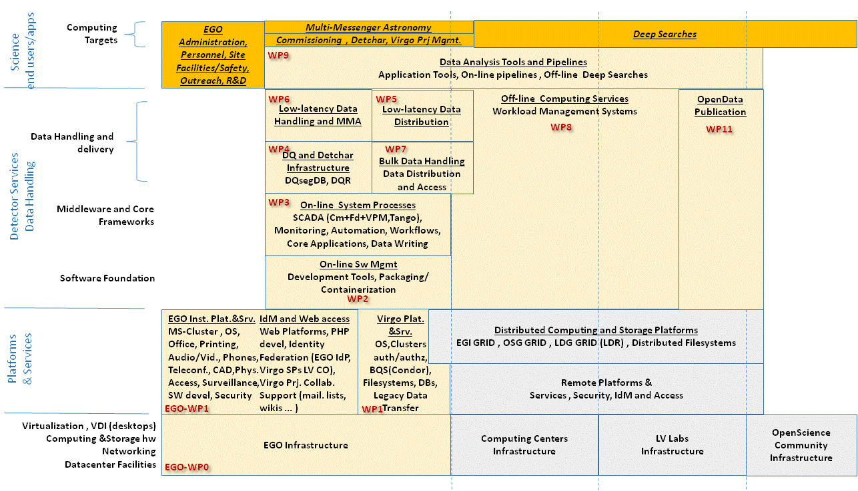
AdVirgo Computing Layers

Slide 9
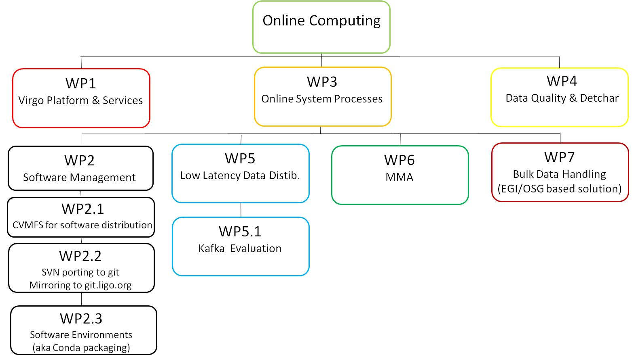
Online Computing
ESCAPE WP5 Use Case Requirements workshop
LVC Meeting March 2019

Slide 10
Offline Computing
Offline Computing
WP8
Offline Computing Services
WP9
Data Analysis Tools and Pipelines
WP10
LVC Computing Strategy
WP12
New Developments
WP11
Public Data Open Science
WP8.1
CVMFS support at CCs
WP9.1
Continuous Waves (CW)
WP10.1
Updated Virgo Computing Model
WP11.1
O2 Data Release
WP12.1
ML/DL strategies for GW detections
WP8.2
Usage reporting in LVC accounting
WP9.2
Compact Binary Coalescence (CBC)
WP11.2
Open Data Science Workshop

Slide 11
Virgo Platform & Services (WP1)
Storage Farm: Raw Data Circular Buffer
Expanded to 700TB => ~ 6.3 months at 40 MB/s
1PB final expansion (~12 months) ongoing
Computing Farm: Bare Virtual Machines / Condor farm, used for Detchar and low latency pipelines (~ 500 vcpu)
Cascina site link bandwidth: 10Gb/s.
Bulk data transfer to Tier1 CC
Legacy solution, GFAL2/iRODS based

Slide 12
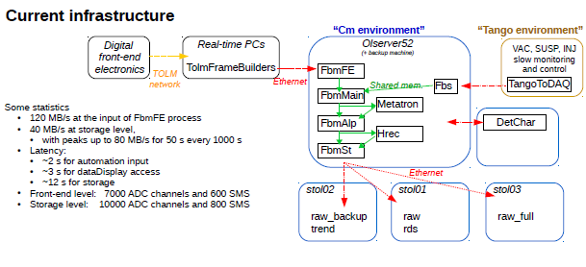
Online System Processes (WP3)

Slide 13
Data Quality & Detchar (WP4)
• All analysis run at Cascina on EGO machines
One dedicated machine for high CPU/memory analysis
5 virtual machines for online analysis
Condor farm for the data quality reports (DQRs)
Outputs uploaded to GraceDB to produce joint LIGO-Virgo DQRs
Analysis of the past day run on a nightly basis
Interactive machines: farmn & ctrl
• Main input: raw data
• Few TB of storage
• DBs: segments, noise lines, etc.
• Web server to display results and browse the associated reports

Slide 14
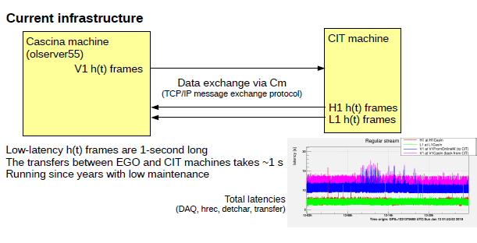
Low Latency data distribution (WP5)
Activities and plans
Transfer LIGO h(t) frames from LLH and LHO to EGO directly (by-passing the CIT node)
Evaluating use of Kafka instead of Cm for intersite h(t) frame exchange (WP5.1)

Slide 15
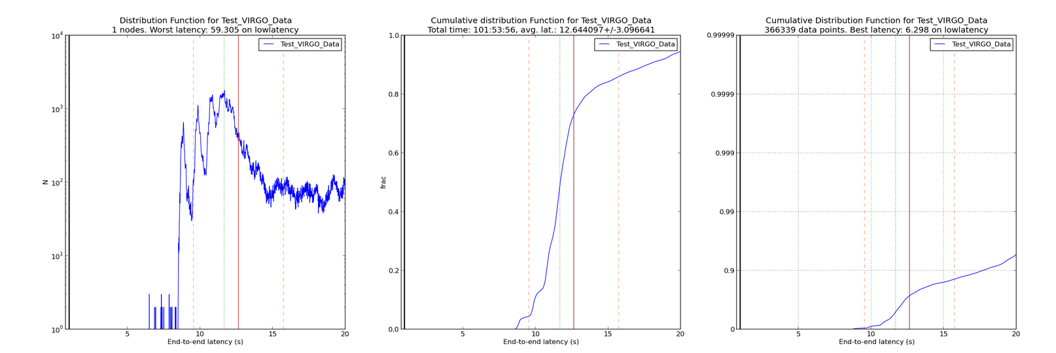
Low Latency data distribution (WP5)
Kafka evaluation
We are evaluating the use of Kafka for the Cascina – aLIGO link as a replacement for the current Cm (Virgo specific) based solution. Kafka is a modern message-query which embed a smart fail-over mechanism and will be used by aLIGo for all other Low Latency links (including toward Kagra).
Status:
Setup parallel live data Kafka streams (CIT <-> Cascina) being compared with Cm based ones

