Slide 1


Mechanical Activities at CPPM
S. Beurthey - P. Karst - April 2019
Measure of the 200 mm discs
Investigation of the laser welding of the LaAlO3

Slide 2
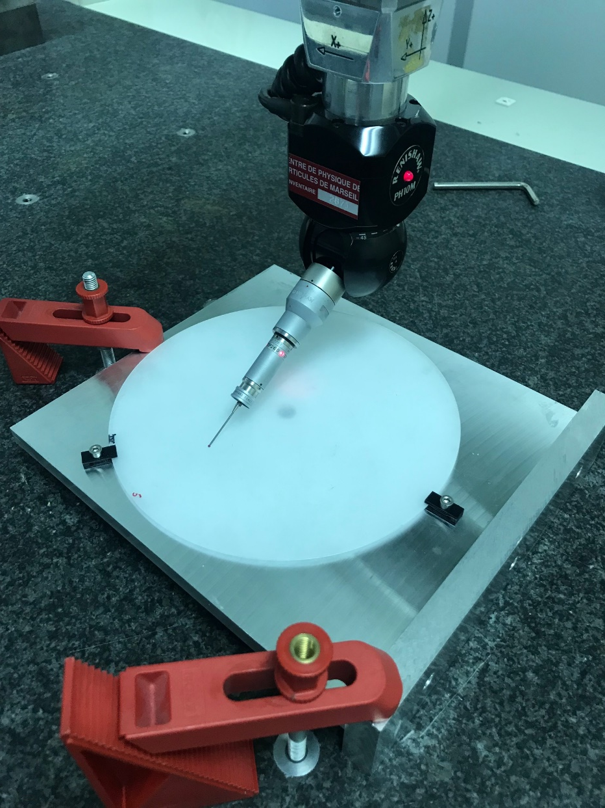
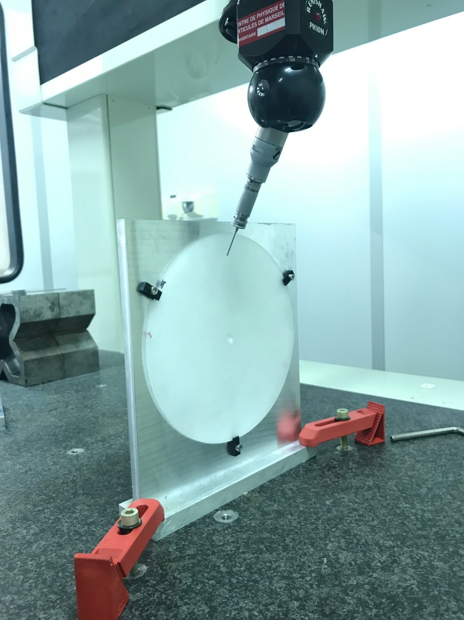
Setup : measure with stylus
Contribution :
Fabrice Gallo
Supporting tool
Maximum Estimated displacement under contact = 5 µm
Accuracy of the measurement < 5 µm

Slide 3
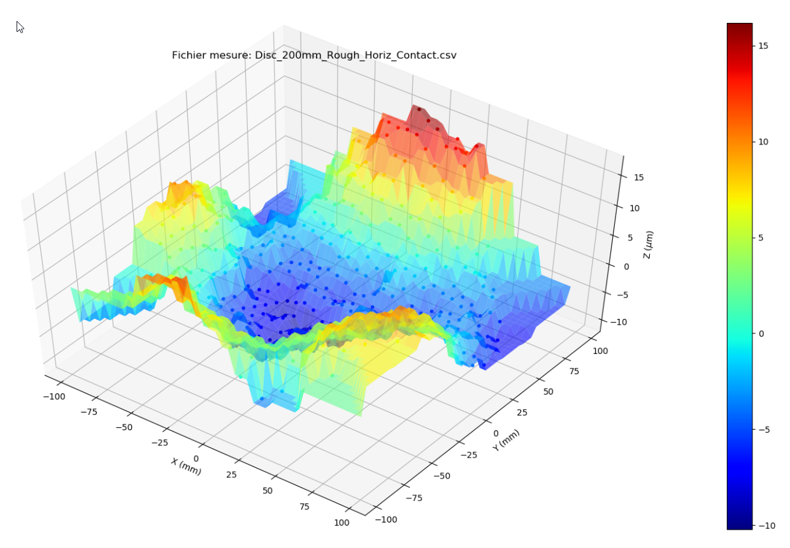
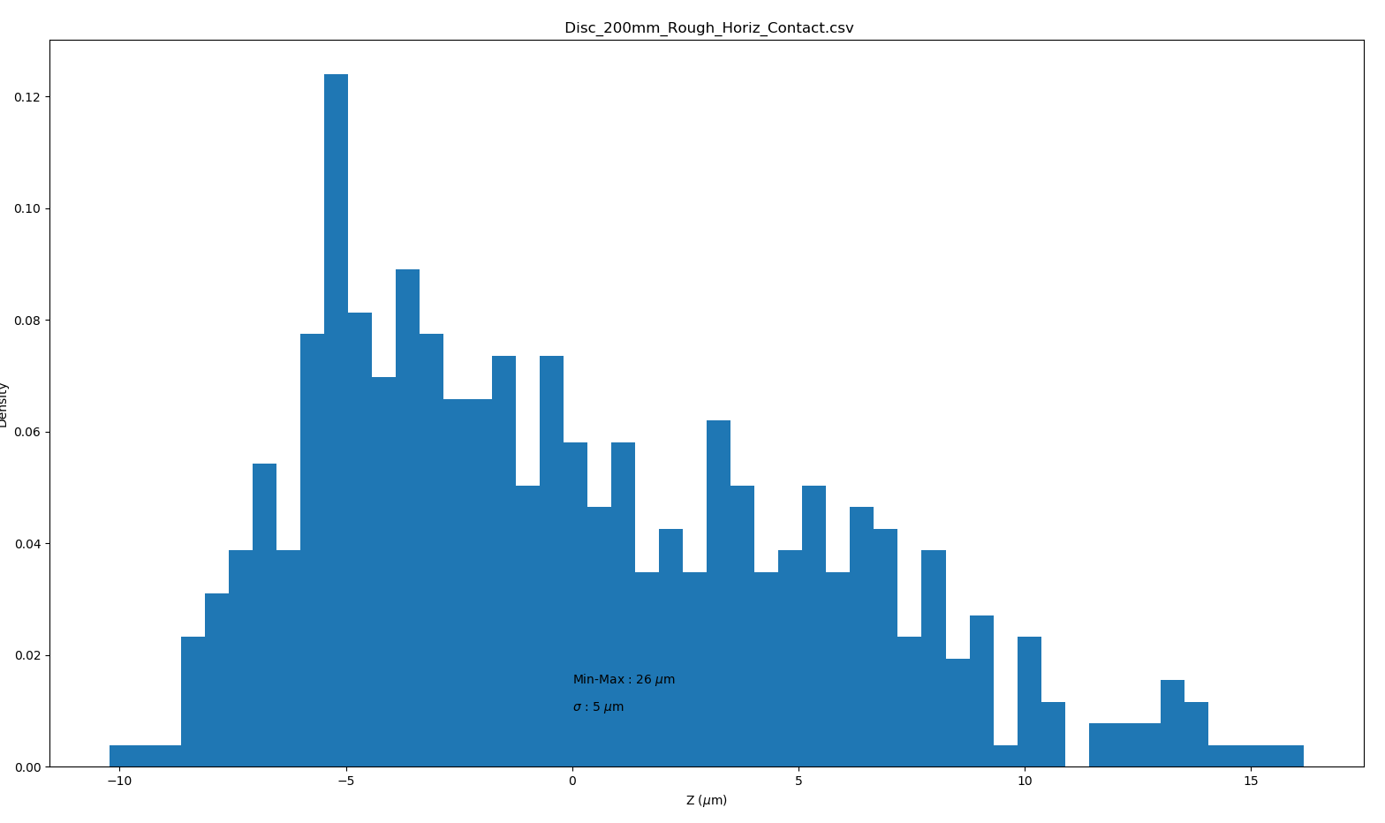
Disc 1 - 200mm Rough surface
Horizontal position
Planarity = 26 µm
Distribution RMS = 5 µm

Slide 4
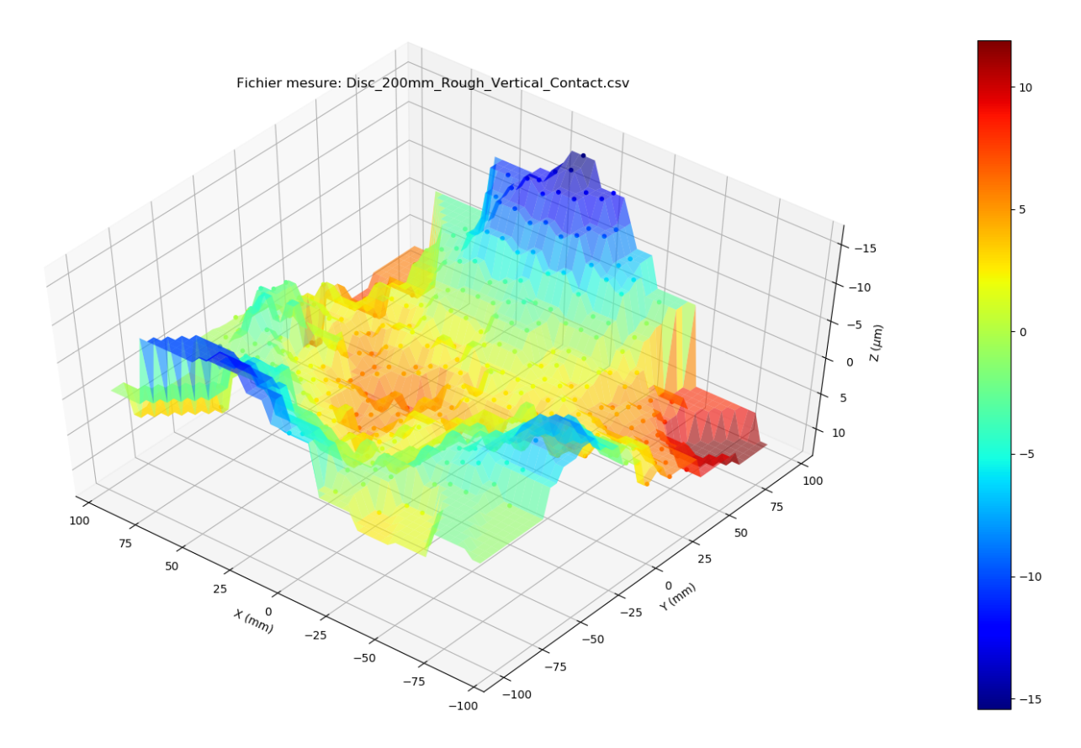
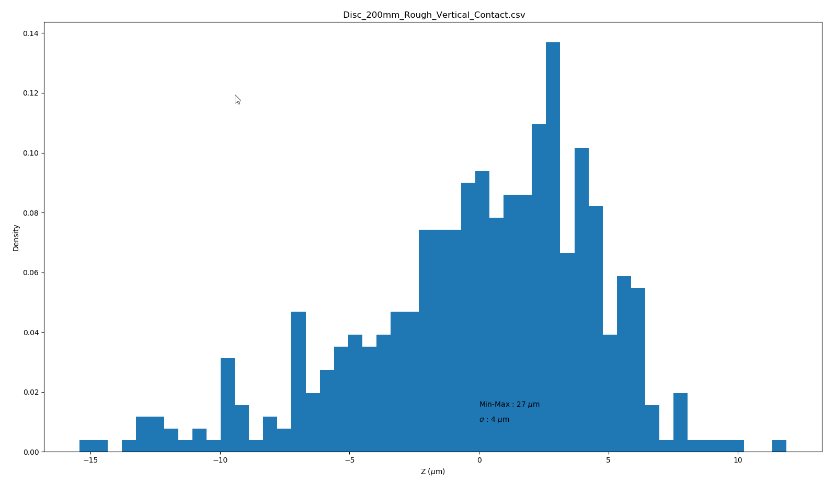
Disc 1 - 200mm Rough surface
Vertical position
Planarity = 27 µm
Distribution RMS = 4 µm

Slide 5
Disc 1 - 200 mm Rough surface
Comparison Vertical/Horizontal

Slide 6
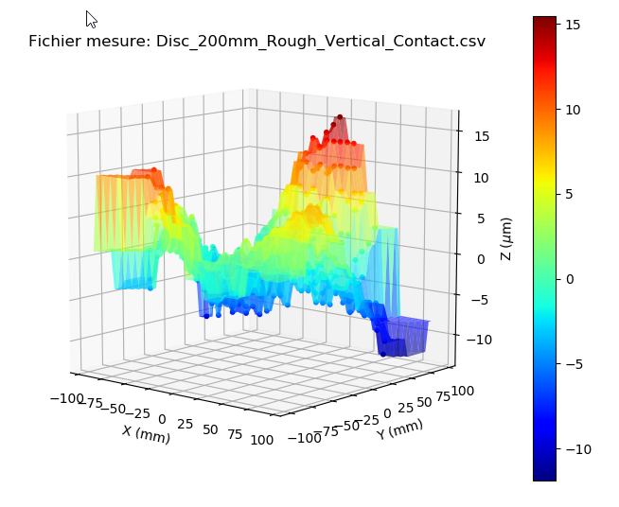
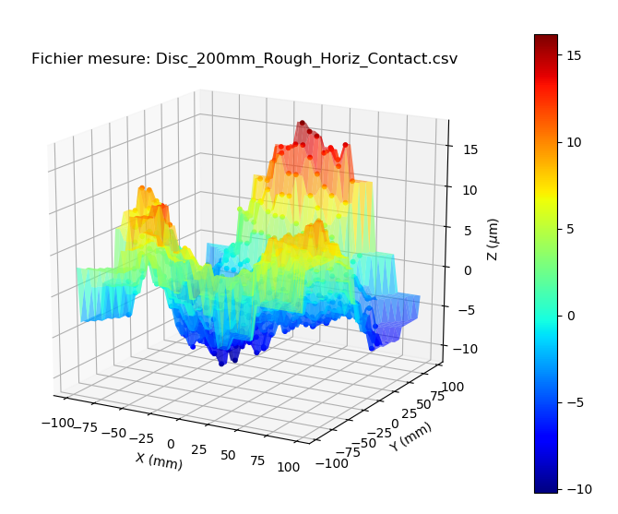
Disc 1 - 200 mm Rough surface
Comparison Vertical/Horizontal

Slide 7
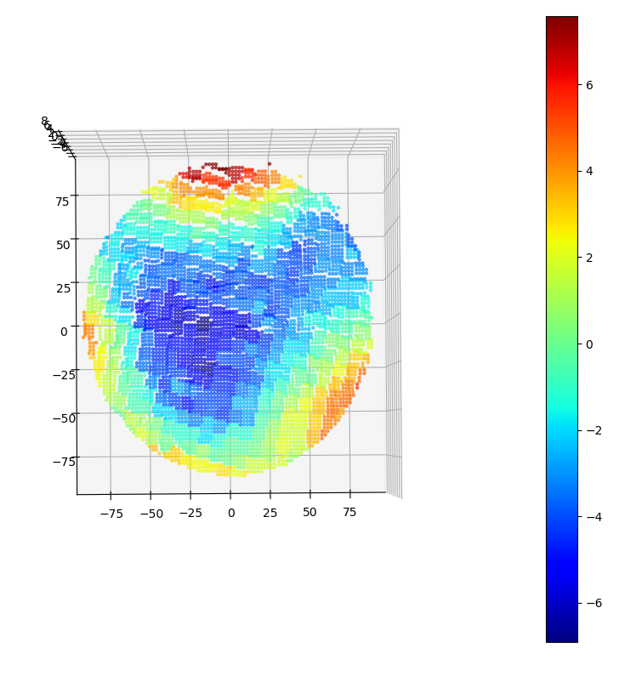
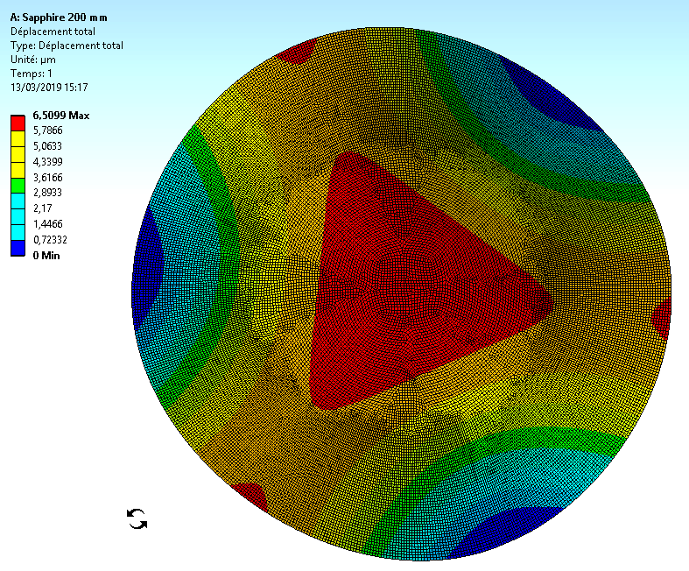
Disc 1 - 200 mm Rough surface
Difference Horizontal-Vertical

Slide 8
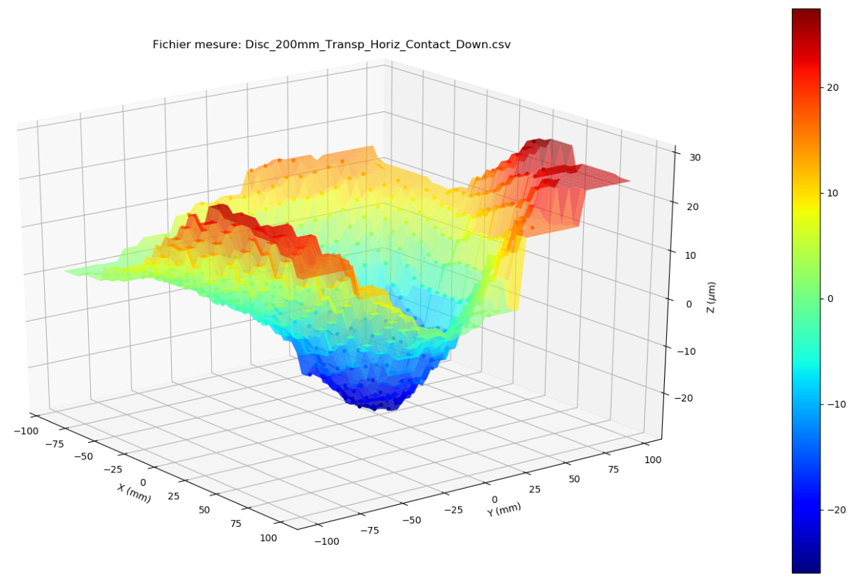
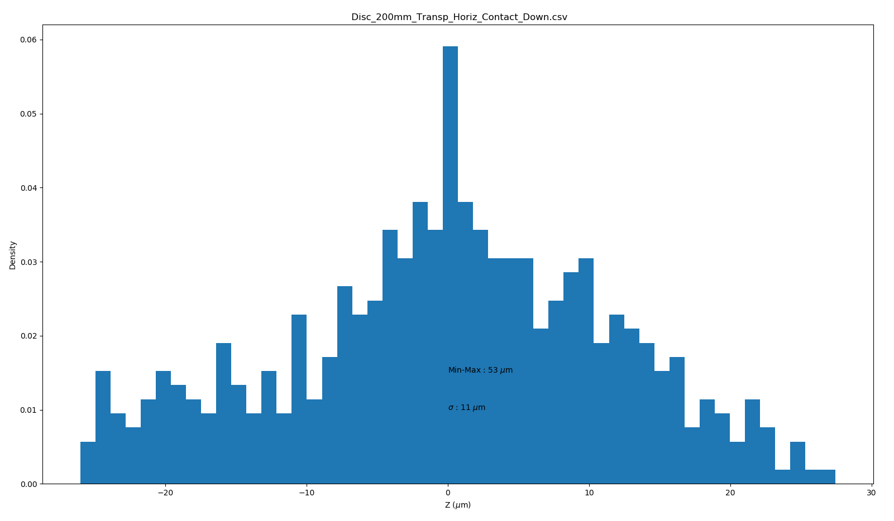
Disc 2 - 200mm transparent surface – Down side
Measure with contact
Planarity = 53 µm
Distribution RMS = 11 µm

Slide 9
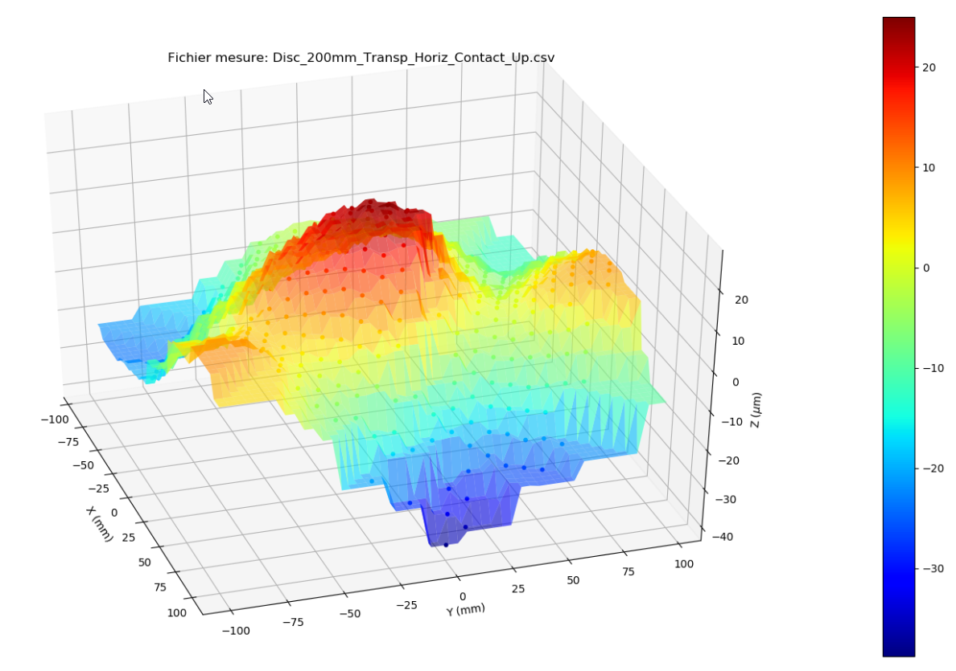
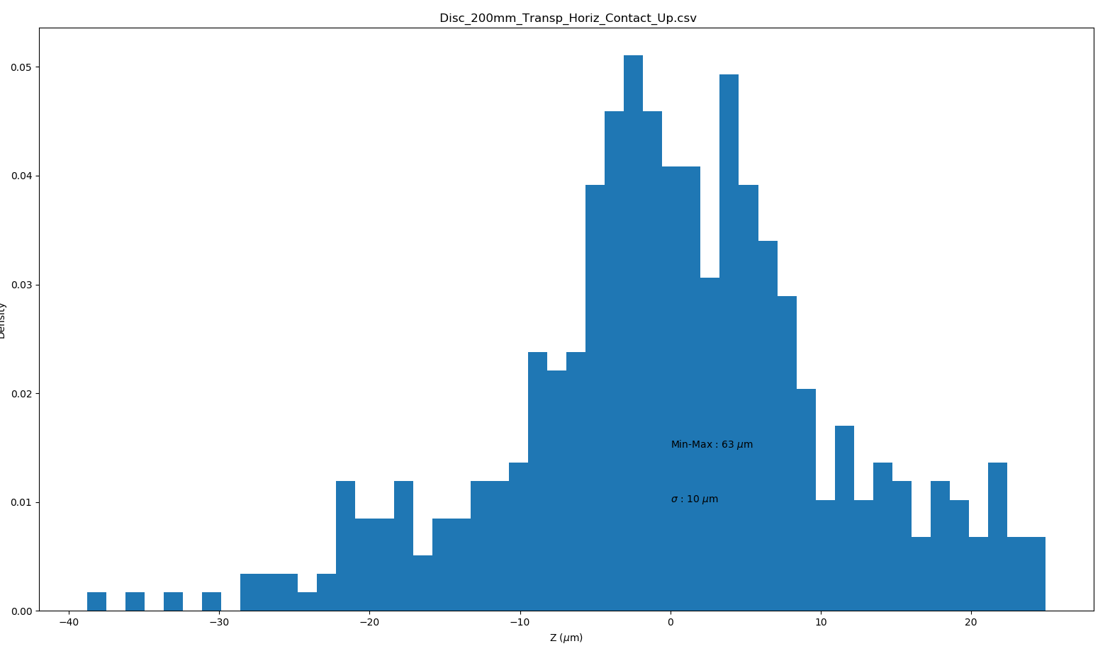
Disc 2 - 200mm transparent surface – Up side
Measure with contact
Planarity = 63 µm
Distribution RMS = 10 µm

Slide 10
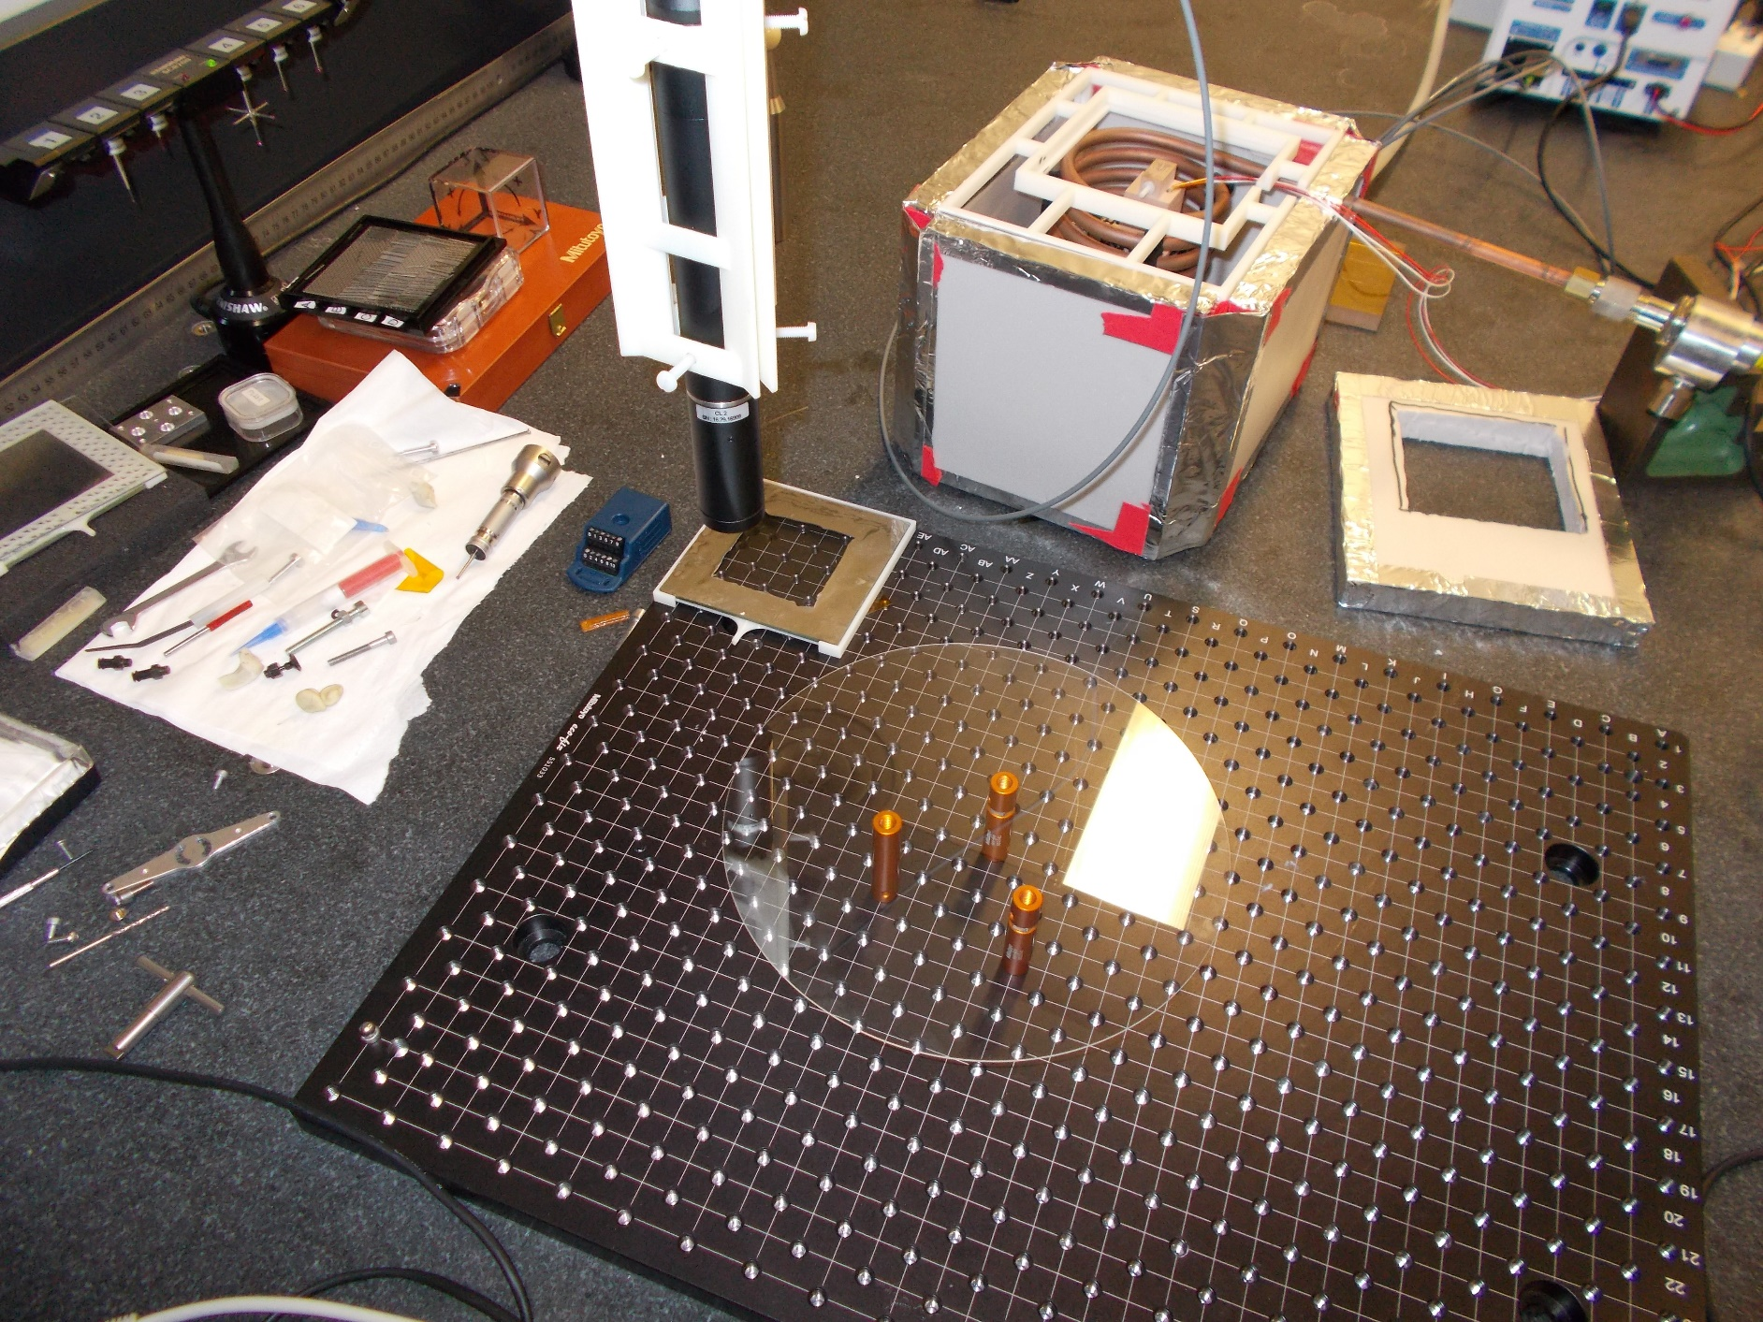
Setup Optical Measurement Disc 2
Contributions :
Eric Vigeolas
Mathieu Niclas
Stephan Beurthey
Stil Optical Pen
on a 3D measuring machine
Transparent Sapphire
Accuracy of the measure < 2 µm in depth of focus

Slide 11
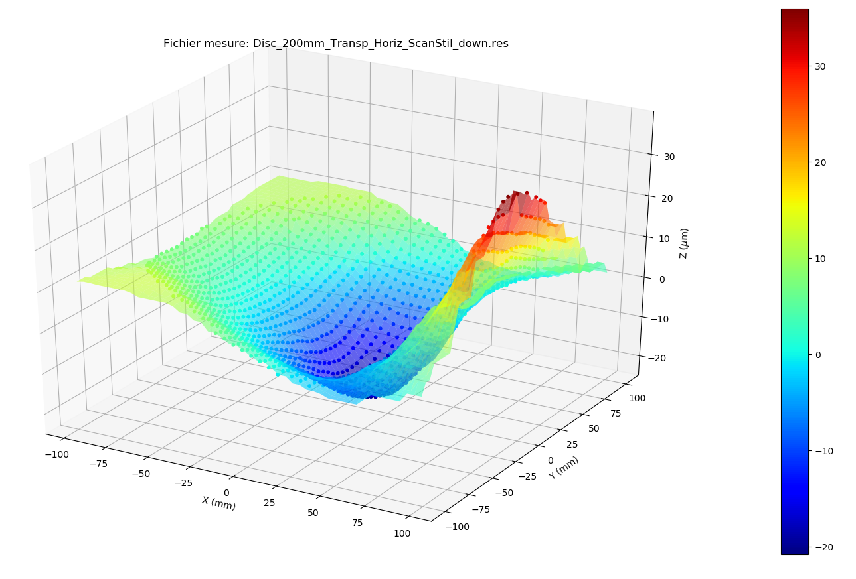
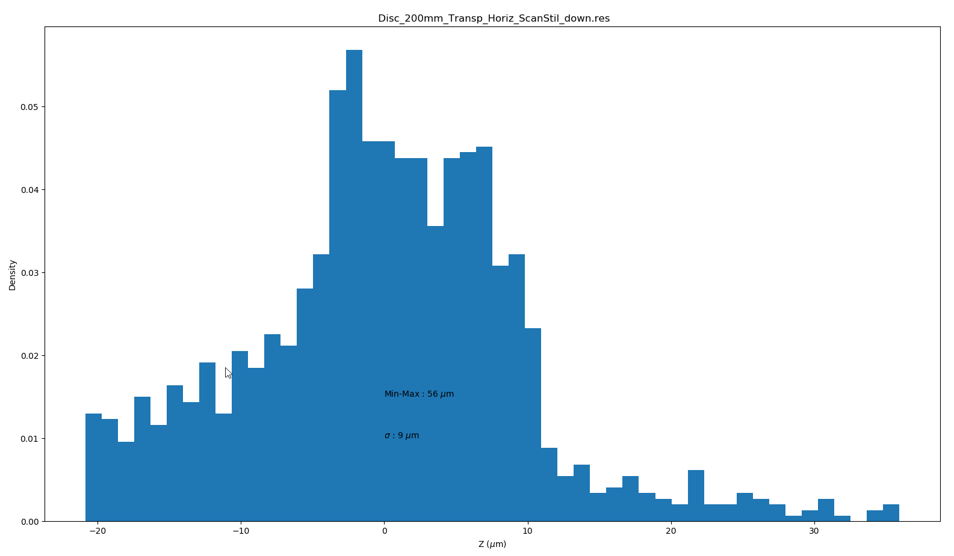
Disc 2 - 200mm transparent surface – Down side
Scan with Stil
Planarity = 56 µm
Distribution RMS = 9 µm

Slide 12
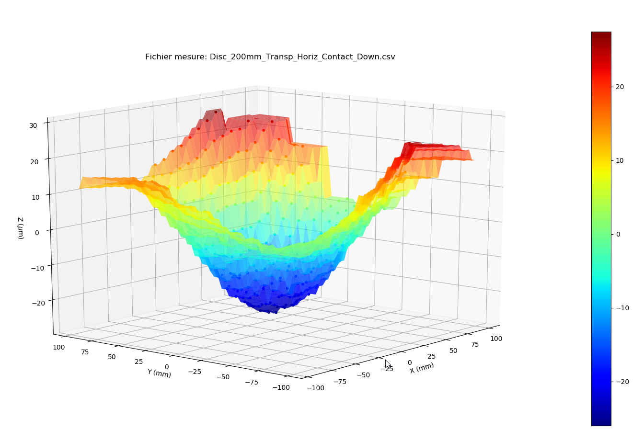
Disc 2 - 200mm transparent surface – Down side
Comparison ScanStil/Contact
Planarity = 56 µm
Distribution RMS = 9 µm
Planarity = 53 µm
Distribution RMS = 11 µm
Note : the boundary conditions were not the same

Slide 13
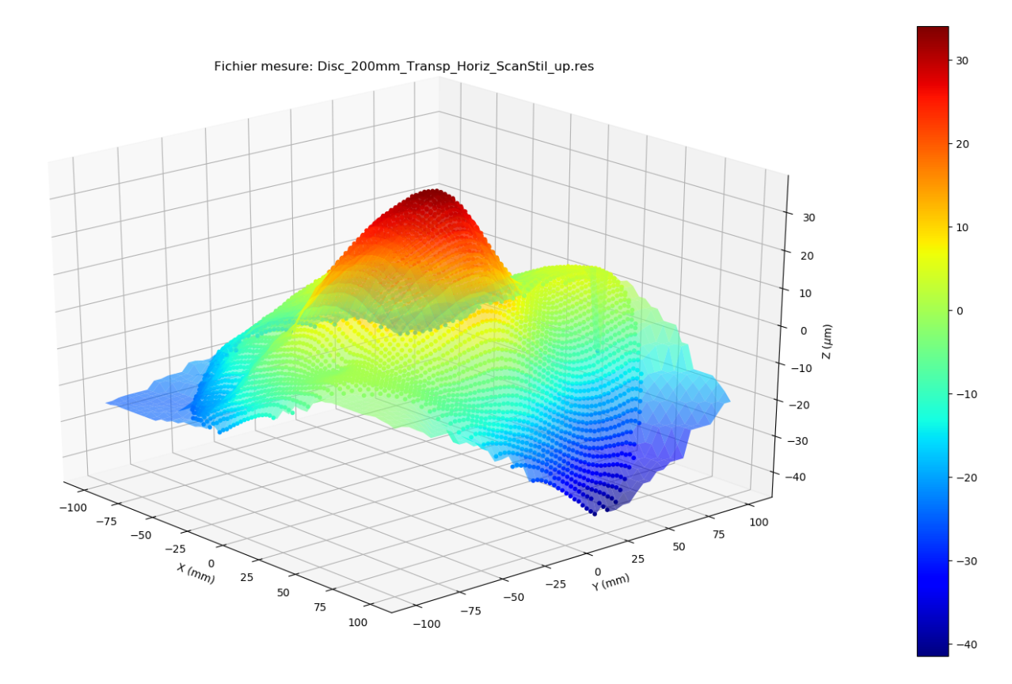
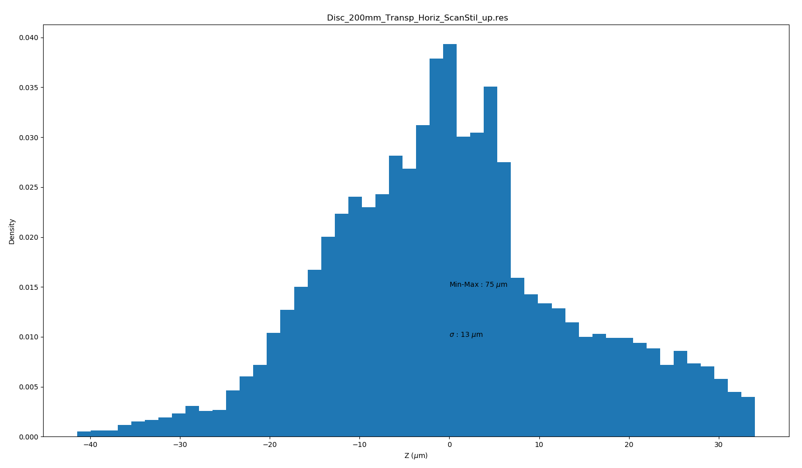
Disc 2 - 200 mm transparent surface – Up side
Scan with Stil
Planarity = 75 µm
Distribution RMS = 13 µm

Slide 14
Disc2 - 200 mm transparent surface – Up side
Comparison ScanStil/Contact
Planarity = 75 µm
Distribution RMS = 13 µm
Planarity = 63 µm
Distribution RMS = 10 µm

Slide 15
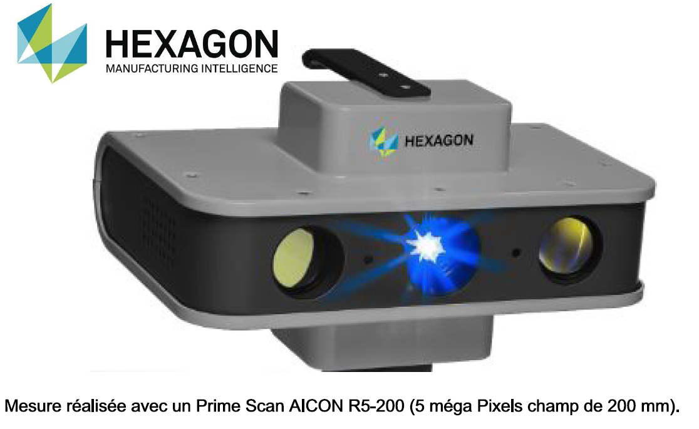
Measure with a double camera scanner

Slide 16
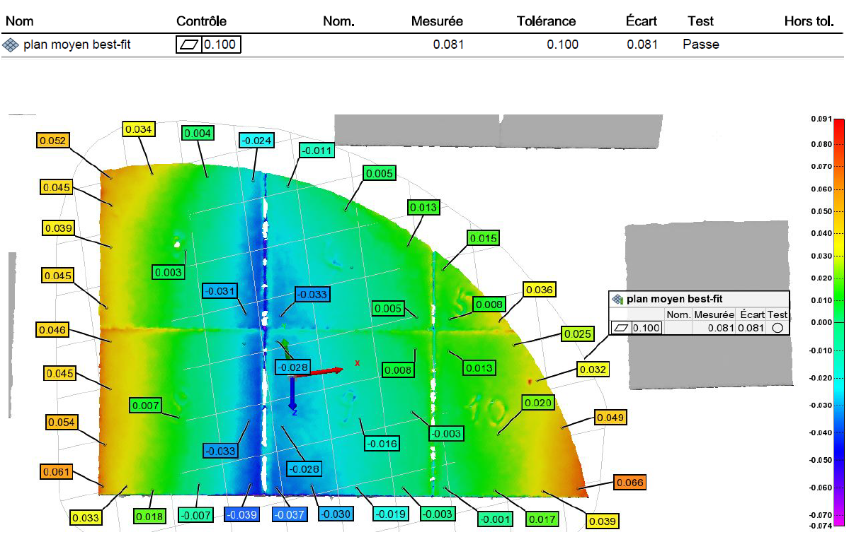
Measure with a double camera scanner
Measurement accuracy < 7 µm in depth of focus

Slide 17

Laser welding of LaAlO3 samples
Collaboration with the laboratory LP3 at Marseille
LP3 = the Lasers, Plasmas and Photonic Processes
First meeting CPPM/LP3 in March for defining what could be done in the next year :
  few welding tests
  1 mm seems to be thick for this process, try to weld on both faces
  Need a straightness less than 5 µm (laser beam = 20 µm)
Purchasing of 6 samples 10x10x1 mm (expected in April)

Slide 18
Further Work
Complete the measure with the optical scan of the rough surface disc with and without the supporting tool.
Carry out laser welding tests
Implement the strength tests of the welding

Slide 19
Spares

Slide 20
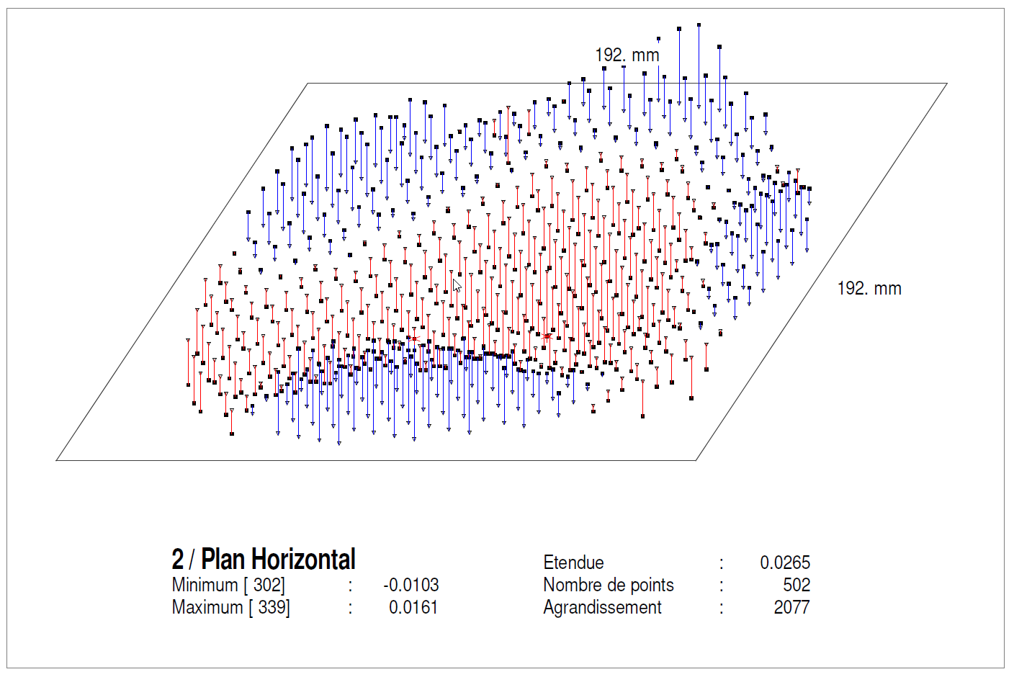
Mesure Stylet Disque Opaque Horizontal

Slide 21
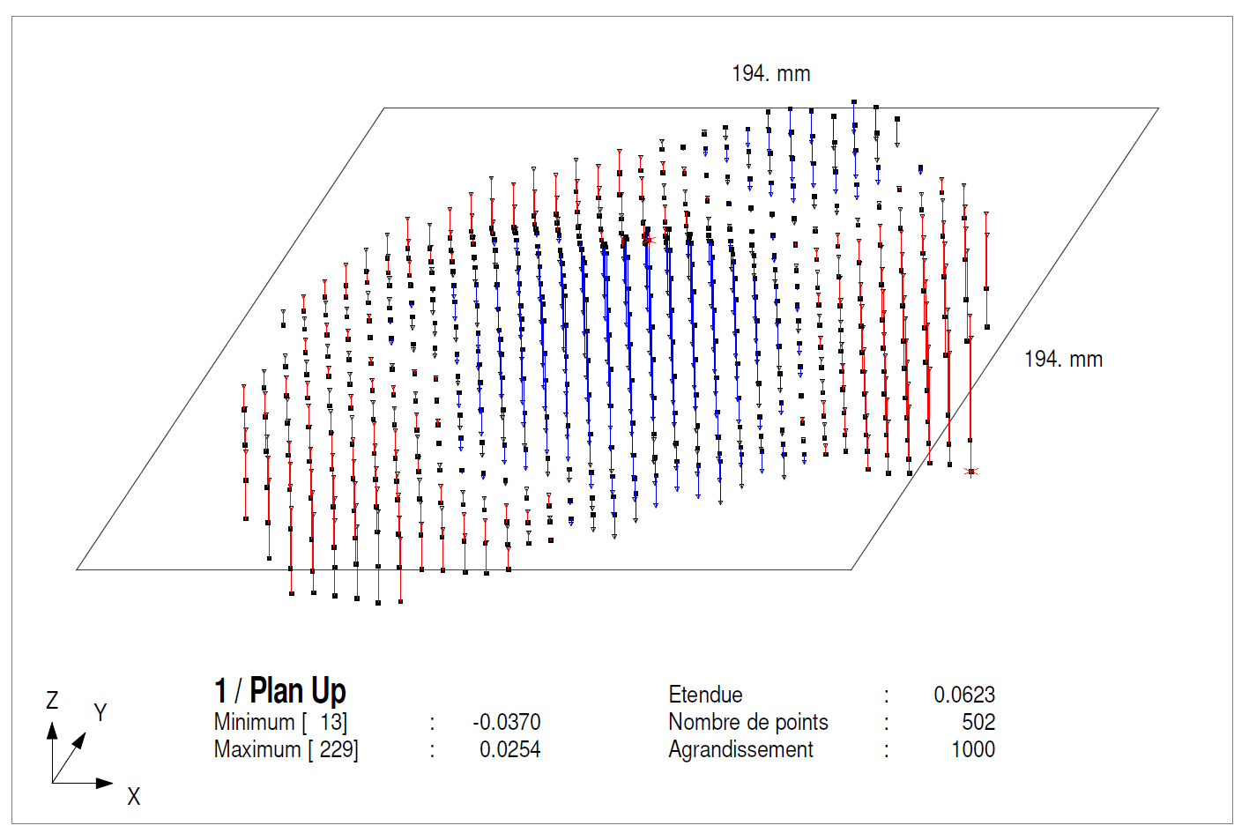
Mesure Stylet Disque Poli face up Horizontal

Slide 22
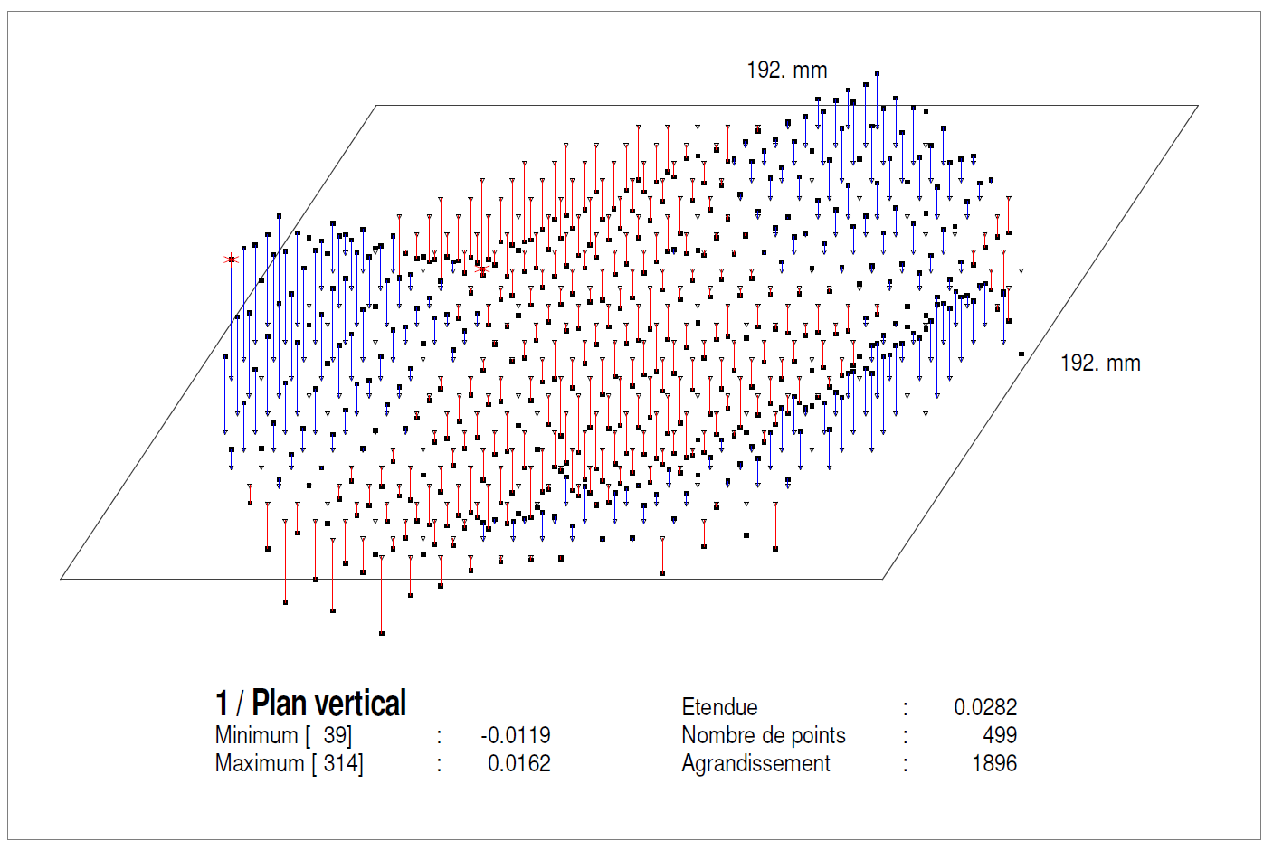
Mesure Stylet Disque Opaque Vertical

Slide 23
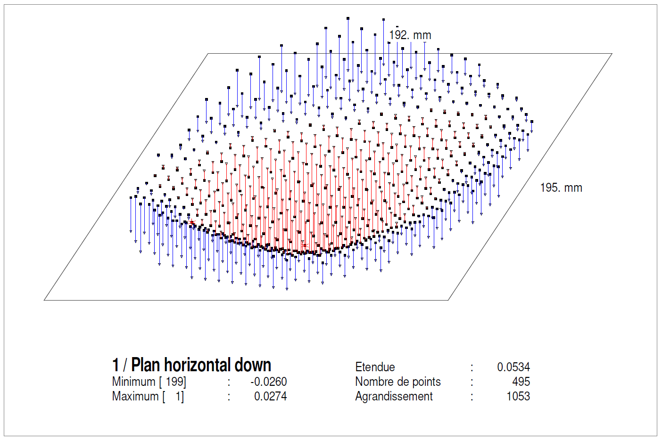
Mesure Stylet Disque Poli face down Horizontal

Slide 24
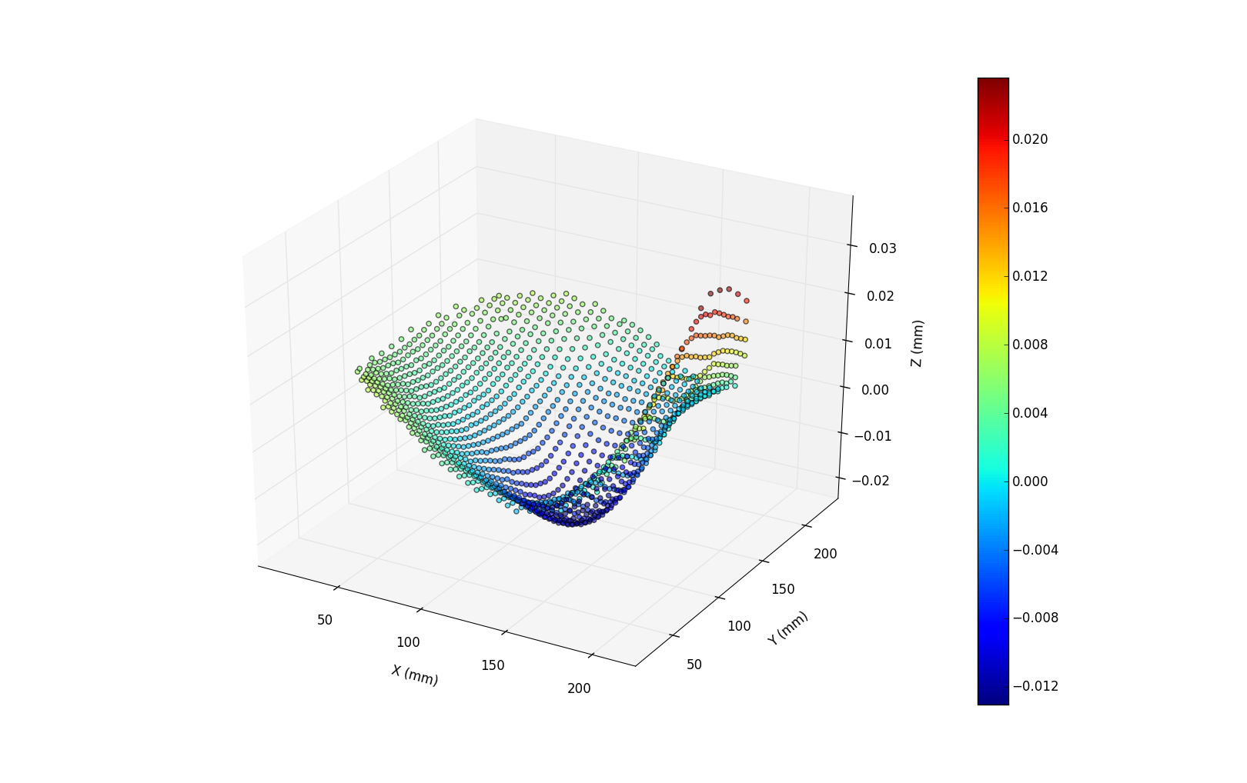
Mesure Crayon Stil : face down
Planéité = 51 µm

Slide 25
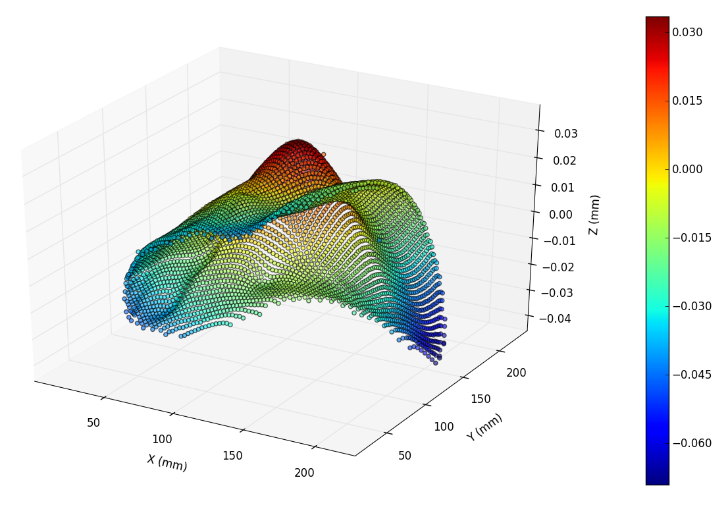
Mesure Crayon Stil : face up
Planéité = 74 µm

Slide 26
Planéité = 51 µm
Planéité = 53 µm

