Slide 1
Product Generation with Heterogeneous Task Nodes and
A Data Model for Easier Data Exchange Among the Nodes
Maohai Huang, NAOC
March 12 – 15, 2019, IAP, Paris

Slide 2
Standard Product Generation
Specifically ‘Data Products’ means deliverable legacy data of the mission with controlled quality.
CSC produces L0d – L2.5 Data Products from L0c data, calibration data, and external auxiliary data. Short Description of “L” levels:
  L0d: telemetry reorganized for L1 generation.
  L1: uncalibrated instrument data.
  L2: calibrated instrument data with physical units that can be used by the general community.
    Calibration models and algorithms are published, standardized, and configuration controlled.
  L2.5: conceptually simple merging of L2 data to: e.g. stitched maps, connected spectra and SEDs, light curves.
    May be derived from multiple instruments.
    Calibration models and algorithms are published, standardized, and configuration controlled
  “L” levels are not always the same as “SP” levels.
L3: Calculation depends on model and/or external data sets.
  Not part of SPG. (TBC)

Slide 3
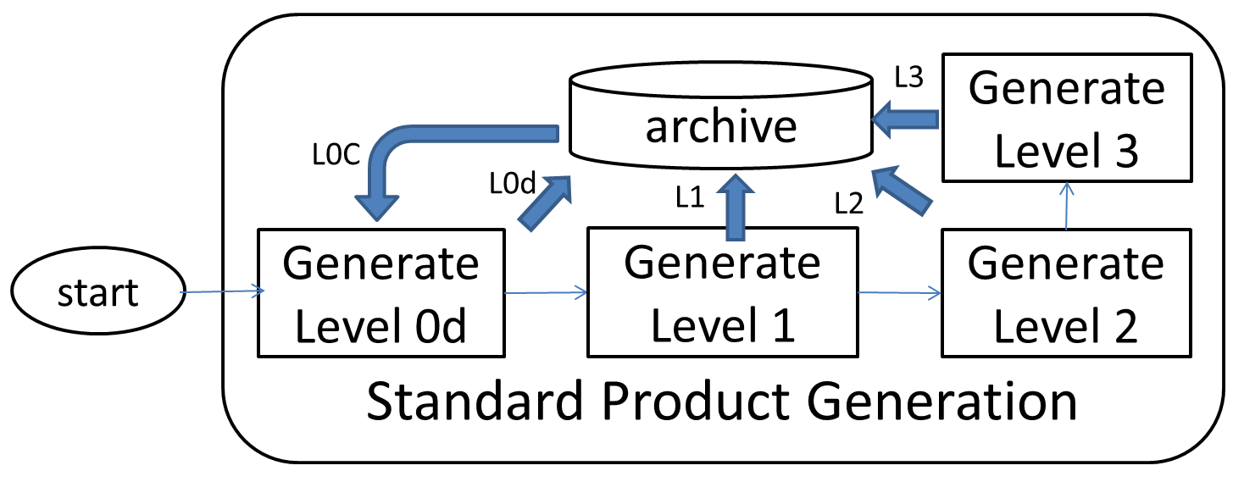
A naiive view of the pipelines

Slide 4
Constant updating of pipelines is inevitable.
Pipeline algorithms and software will undergo continuous debugging, improving, throughout mission life cycle.
Instrument models, calibration and auxiliary data change, too.
Products must accommodate these changes and be versioned.
Level3 s/w
SVN
changes
Level0d s/w
Level1 s/w
Level2 s/w
SVN
SVN
SVN
changes
changes
changes

Slide 5


Product Generation
L0c
Automatic SPG started by the arrival of new data from VHF, S-band, X-band (L0c), and ground instruments.
  Runs only once.
  Uses the latest production release pipeline and calibration products.
Updating SPG started by hand or scheduler.
  Runs after every new production release of pipeline and calibration products on all data as needed.
  Uses the latest production release pipeline and calibration products.
Customized Product Generation: a possible subset of all pipelines are run with customized configuration by a creator.
In Automatic and Updating SPG, pipelines are run by a central scheduler. sequentially to traverse a SPG dependency Tree. (in parallel TBD)
In all cases the starter should provide with a ‘Creator’ and a ‘RootCause’ parameters to the piplelines, which will produce Products that remember these parameters.

Slide 6
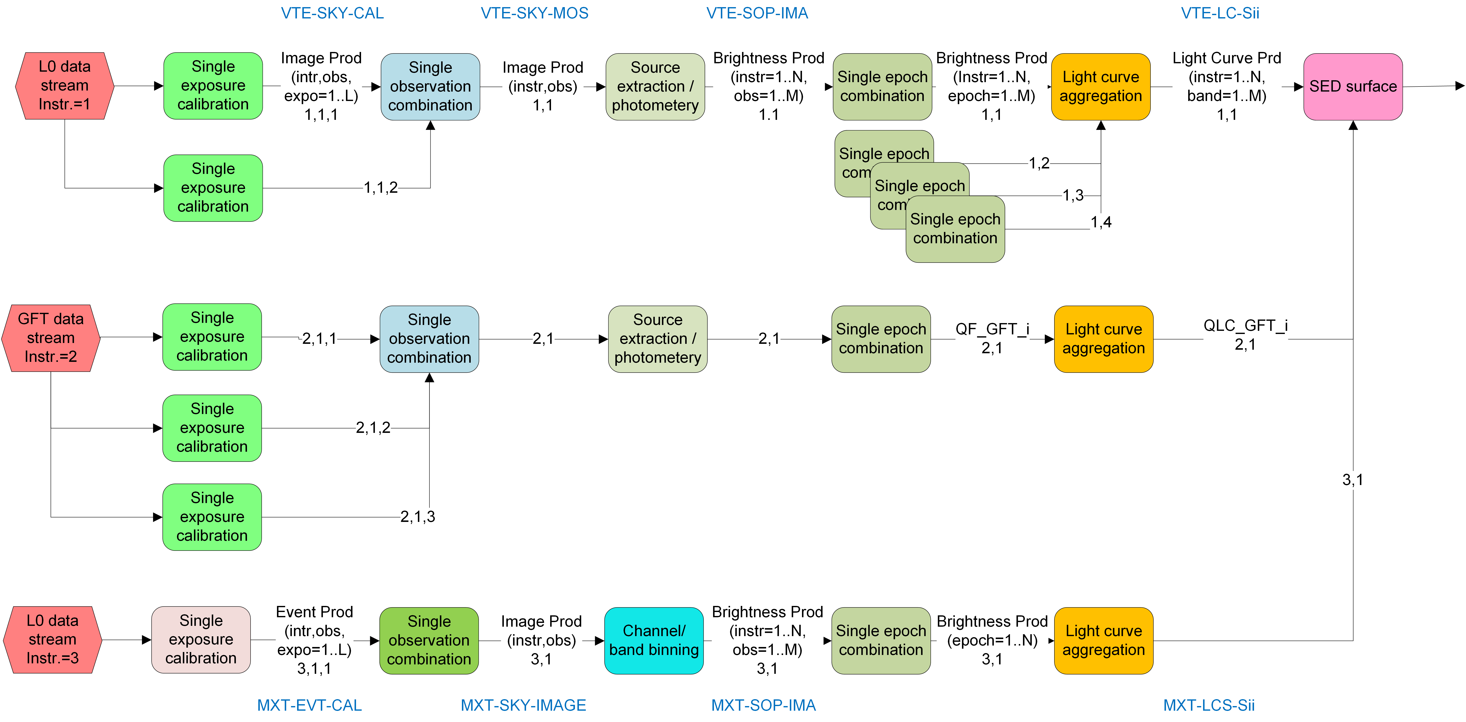
A Pipeline usually does not produce only one Product. Upstream Products do not need downstream ones.
The Central Scheduler sends the processing results to the central DB immediately after generated.
Every new result of a Product should have a unique URI, besides Creator and RootCause.
But deploying one instance for each module may not be enough…

Slide 7
Not synchronized!
Cross instr. calibration

Slide 8
Parallel and asynchronous run of nodes
The same pipeline node/module could be used at the same time
  By different instruments or
  By prompt Automatic processing and Updating, Customized product generation
Solutions:
  Job-queuing mechanism for every node.
  Deploying multiple instances for the same node/module according to usage pattern, and make it possible to create more instances if needed. (Preferred)
  ?
Pipeline dependence topology is not going to like a tree but a network.

Slide 9
See and be ready for products’ multiple and unforeseen uses
Every individual Product instance in general should be expected to be used by other pipelines/users, even though we may not see such use now.
Pipeline best practices
  should be modularized so that every Product is produced by one and only one module. A product can be calculated immediately with sufficient input (VHF, S- X-bands, GFTs, calibration data updates).
  Every module should have an output interface through which the latest result is computed.
A Data Wrapper wraps all output data to facilitate flexible data exchange
  in JSON format.
  FITS is used for Product Delivery to science user.

Slide 10
And there are multiple objects being observed …
GRB 20231224a
GRB 20231224b
ToO 20231225a
GW 20231225

Slide 11
A Scalable Pipeline Deployment Architecture is Needed
Pipeline deployment architecture should allow robust and easy scaling as
  Number of objects that need simultaneous observation fluctuates
  Understanding of instrument and calibration parameter/tables change, so the need to run a certain module changes.
  Pipeline update happen continuously so all modules need to be updated routinely.

Slide 12
Look into Processing Pipeline development
Pipeline author:
  Astronomers from different backgrounds:
    Develop models, Develop algorithms, Test pipelines
    Can do some programming, not afraid of new approaches, not good at repetitive tedious things
    many do not write document well unless trained.
  Professional software developers
    Proficient and efficient in delivering software given clear requirement
    Do not understand numeric and scientific details
  Students
Favorite tools runs one different OS depending on particular third-party tools/libraries. Resource does not allow re-implementing tools on one platform.
Algorithm developers and BAs need easy and quick access of all products, with standard API syntax and queries.

Slide 13
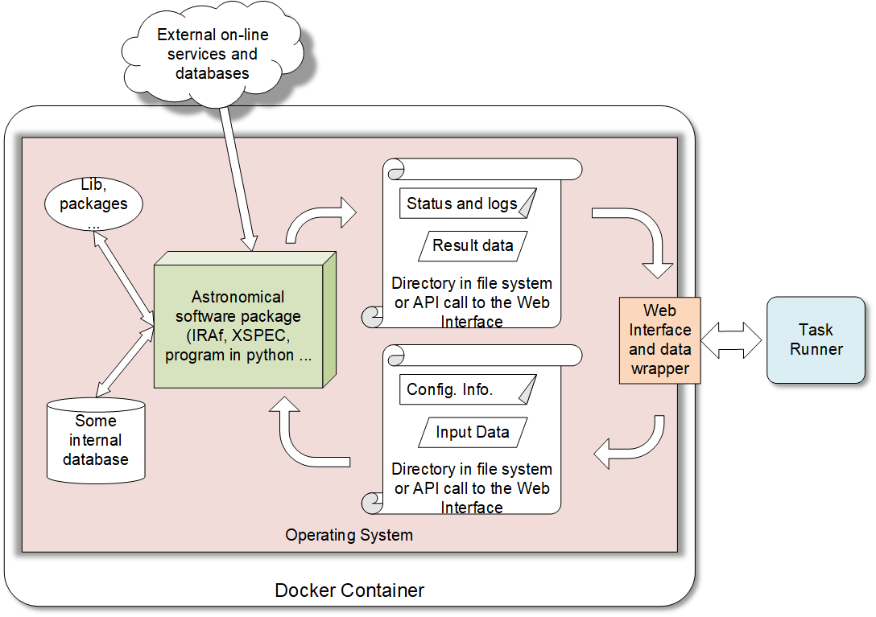
Proposal: “Heavy-weight” Processing module in a deployable container with web interfaces
Astronomers develop the Processing Task Software (PTS) in his/her favorite environment.
PTS is stateless -- the result can be calculated and reproduced with given input and configuration. PTS does not remember previous runs.
PTS, supporting tools and libraries, can be cloned to a cleanly installed OS. All are made into a Docker container.
A standard web interface module is provided to
  Pass input data and configuration from the pipeline runner to the PTS
  Run the PTS and produce results (successful or not)
  Collect the results and return them to the pipeline runner.
To be deployable anywhere on the Internet
  Subject to performance, security, and regulation constraints

Slide 14
“Light-weight” modules
Run in one container local to the Scheduler.

Slide 15
A Data Model for Easier Data Exchange Among the Processing Nodes
Maohai Huang, NAOC
March 12 – 15, 2019, IAP, Paris

Slide 16
Data Products and the Need to Describe Them
Generally ‘products’ means output results of a processing tasks to be shared by other tasks or users.
People tend to store data with no meaning attached to them.
Without attach meaning of the collection of numbers you have, it is difficult for other people to fully understand your data, it could be difficult for even you to recall the exact meaning of these numbers after a while.
Adapted from HCSS v15 Doc

Slide 17
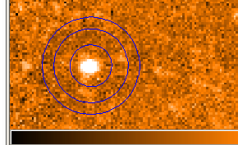
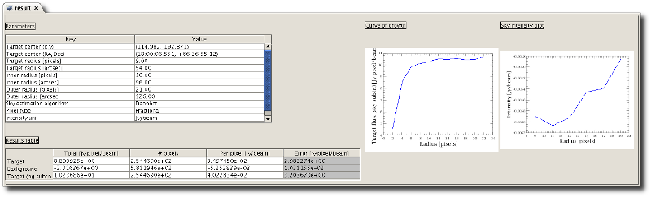
What are needed to describe data products
Describing data may mean just naming the data, attaching a short description to it (can be annotated).
Possibly quantifying your data with unit and so on.
Some data have properties that define them (have attributes), e.g. the creator of a product.
It is very useful to know how these data were generated in the first place. In other words, it can be very useful to know the history of that data.
Considering table data or array data (such as images), the information in such data may need some additional quantities (metadata) that provide essential information about the data.
For example, the table represents aperture photometry information that is distilled from an image. Therefore you may want to store result table and the ‘curve of growth’ as a single entity. They may even share some common metadata, e.g., the instrument that generated the raw image. (composite)
Adapted from HCSS v15 Doc

Slide 18
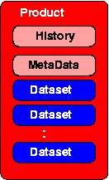
Structure Product that enabled full self-describing
A Product consists of the following components:
zero or more datasets: defining well described data entities (say images, tables, spectra etc...).
history of this product: how was this data created,
the accompanying meta data of any product is two fold:
  required information such as who created this product, what does the data reflect (say instrument) and so on
  a product may have additional meta data that is specific to that particular product type
Adapted from HCSS v15 Doc

Slide 19
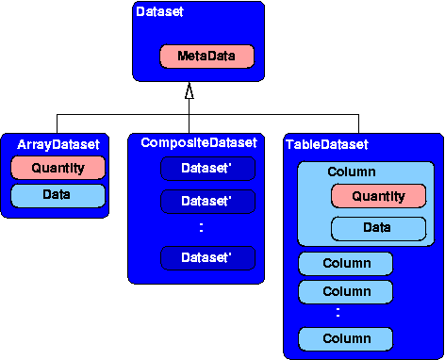
Data Sets
Three types of datasets allow you to store potentially any data as a dataset.
Like a product, all datasets may have meta data, with the distinction that the meta data of a dataset is related to that particular dataset only.
array dataset
a dataset containing array data (say a data vector, array, cube etc...) and may have a unit.
table dataset
a dataset containing a collection of columns. Each column contains array data (say a data vector, array, cube etc...) and may have a unit. All columns have the same number of rows. Together they make up the table.
composite dataset
a dataset containing a collection of datasets. This allows arbitrary complex structures, as a child dataset within a composite dataset may be a composite dataset itself and so on...
Adapted from HCSS v15 Doc

Slide 20
Meta Data and Parameters
Meta Data: data about data
The meta data is defined as a collection of parameters.
Parameter: named scalar variables.
Apart from the value of a parameter you can ask it for its description and -if it is a numeric parameter- for its unit as well.
This package provides the following parameter types:
Parameter: Contains an arbitrary value and no unit
NumericParameter: Contains a number with possibly a unit
Example of meta data with three parameters:
name | description | Internal Data type | Example value | unit
VTDT | VT detection time | Integer | 603853323456789 (2019-02-19T01:02:03.456789) | microsec
VT_PWR | Voltage of VT power supply | float | 20.12 | V
Creator | Name of the creator of a product | string | ‘scheduler’ | -
Adapted from HCSS v15 Doc

Slide 21
History
The history is a lightweight mechanism to record the origin of this product or changes made to this product. Lightweight means, that the Product data itself does not records changes, but external parties can attach additional information to the Product which reflects the changes.
The sole purpose of the history interface of a Product is to allow notably pipeline tasks (as defined by the pipeline framework) to record what they have done to generate and/or modify a Product.
Adapted from HCSS v15 Doc

Slide 22
Products must be Serializable
In order to transfer data across the network between heterogeneous nodes data needs to be serializable.
JSON format is being considered to transfer serialized data for its wide adoption, availability of tools, ease to use with Python, and simplicity.
>>> import json
>>> data = dict(name='SVOM', year=2019, result=[1.3, 4.7, 6, 45])
>>> print(data)
{'name': 'SVOM', 'year': 2019, 'result': [1.3, 4.7, 6, 45]}
>>> print(data['name'])
SVOM
>>> print(data['result'])
[1.3, 4.7, 6, 45]
>>> js = json.dumps(data)
>>> print(js)
{"name": "SVOM", "year": 2019, "result": [1.3, 4.7, 6, 45]}
>>> restored = json.loads(js)
>>> print(restored)
{'name': 'SVOM', 'year': 2019, 'result': [1.3, 4.7, 6, 45]}
>>> print(restored['result'])
[1.3, 4.7, 6, 45]
>>>

Slide 23
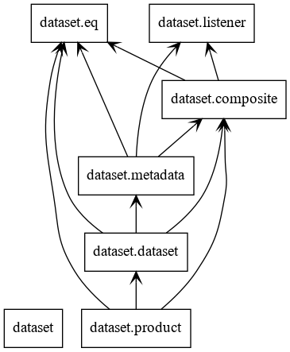
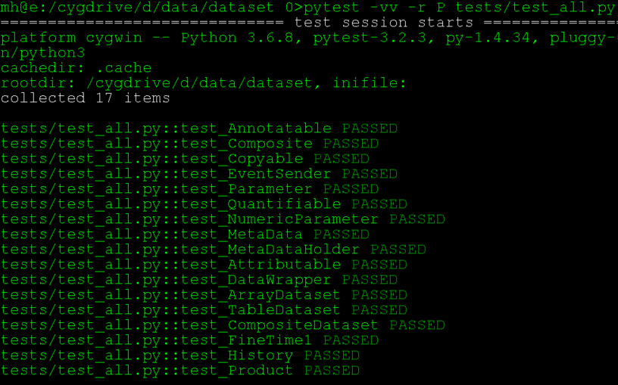
A Prototype ‘dataset’ is developed to satisfy the Requirements
Written in python 3.6.8
< 4000 lines code
>2000 lines unit test and serialization function test

Slide 24
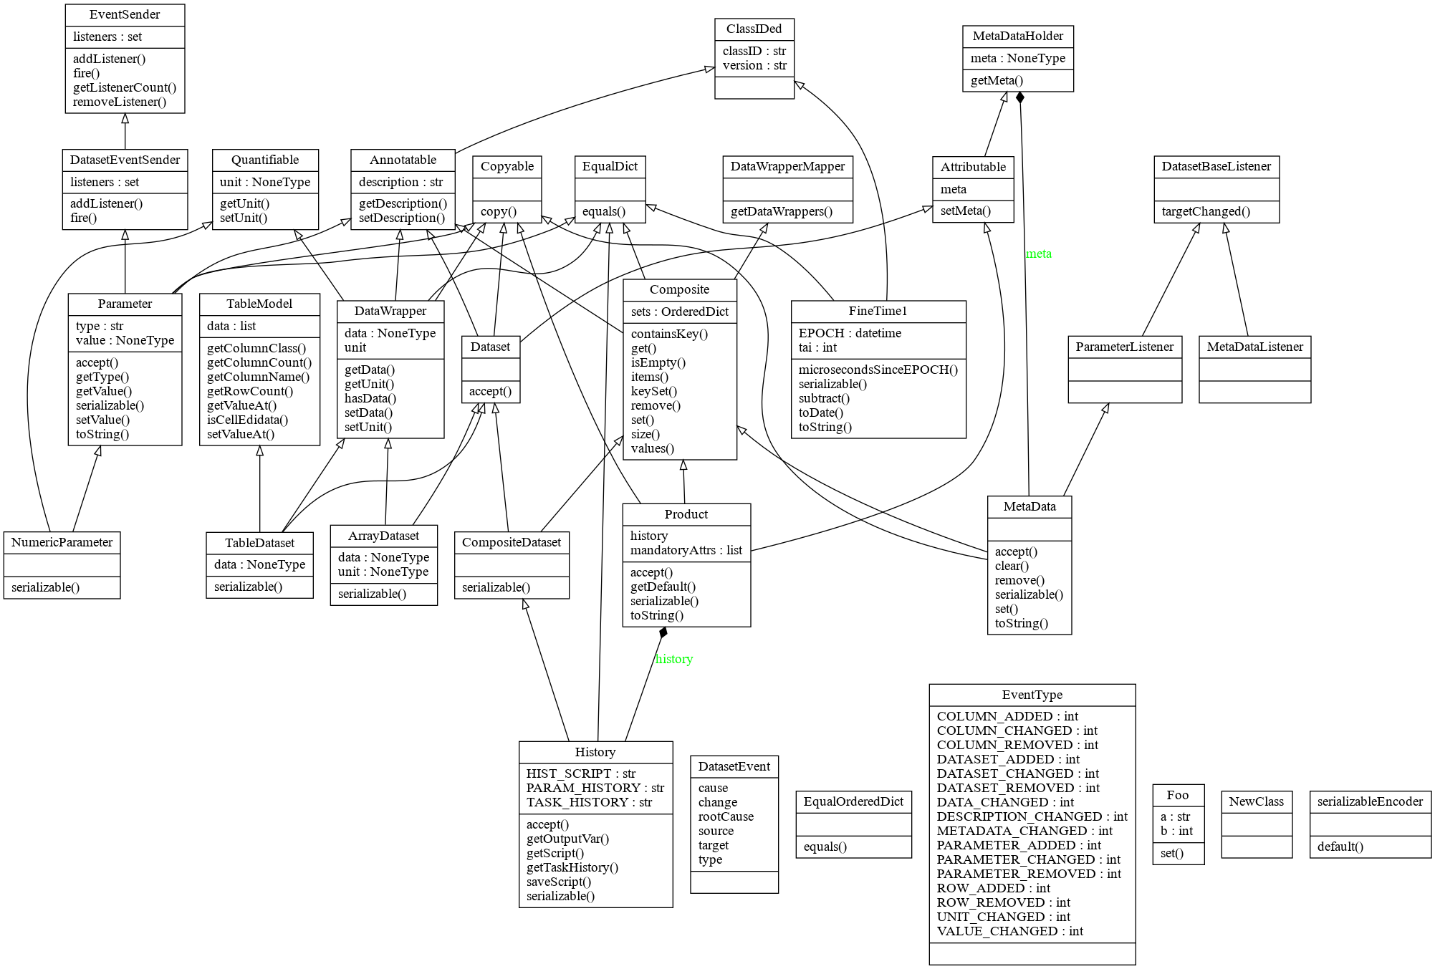

Slide 25
Dataset examples -- ArrayDataset
from dataset.dataset import ArrayDataset
a1 = [1, 4.4, 5.4E3] # a 1D array of data
a2 = 'ev' # unit
a3 = 'three energy vals' # description
v = ArrayDataset(data=a1, unit=a2, description=a3)
v1 = ArrayDataset(a1, a2, description=a3) # simpler but error-prone
>>> print(v)
ArrayDataset{ description = "three energy vals", data = "[1, 4.4, 5400.0]", unit = "ev"}
>>> print(v == v1)
True
>>> v.data = [34]
>>> v.unit = 'm'
>>> print('The diameter is %f %s.' % (v.data[0], v.unit))
The diameter is 34.000000 m.
Create
Change
Use

Slide 26
Dataset examples -- TableDataset
Create
Change
from dataset.dataset import TableDataset
a1 = [dict(name='col1', unit='keV', column=[1, 4.4, 5.4E3]),
dict(name='col2', unit='cnt', column=[0, 43.2, 2E3])
]
v = TableDataset(data=a1)
>>> v.getColumnName(0)
'col1’
>>> v.getValueAt(rowIndex=1, columnIndex=1)
43.2
>>> v.setValueAt(aValue=42, rowIndex=1, columnIndex=1)
>>> v.getValueAt(rowIndex=1, columnIndex=1)
42

Slide 27
Metadata and parameter examples
from dataset.metadata import Parameter, NumericParameter, MetaData
a1 = ‘parameter_1'
a2 = Parameter(description='test param', value=534)
v = MetaData(description=‘my metadata’)
v[a1] = a2
v[‘more’] = NumericParameter(description='another param', value=2.3, unit='sec')
>>> print(v)
MetaData[my metadata, parameter_1 = Parameter{ description = "test param", value = 534, type = int}, more = NumericParameter{ description = "another param", value = "2.3", unit = "sec", type = "float"}, ]
>>> print(v.description)
my metadata
>>> print(v['more'])
NumericParameter{ description = "another param", value = "2.3", unit = "sec", type = "float"}
>>> v['parameter_1'].value
534
Create parameters
Create metadata
Use

Slide 28
Product example
from dataset.product import Product
from dataset.dataset import ArrayDataset, TableDataset
x = Product(description="This is my product example", instrument="MyFavourite", modelName="Flight")
# ways to add datasets
i0 = 6
i1 = [[1, 2, 3], [4, 5, i0], [7, 8, 9]]
image = ArrayDataset(data=i1, unit=“magV”, description=“image 1”)
s1 = [dict(name='col1', unit='keV', column=[1, 4.4, 5.4E3]),
dict(name='col2', unit='cnt', column=[0, 43.2, 2E3])]
spec = TableDataset(data=s1)
x["RawImage"] = image
>>> print( x.sets["RawImage"].data[1][2] ) # should be i0
0
x.set('QualityImage', 'aQualityImage’) # diff syntax same function as above
x.sets["Spectrum"] = spec
>>> x["Spectrum"].getValueAt(columnIndex=1, rowIndex=0) # should be 0
0

Slide 29
More than a data wrapper
These data classes can be inherited, extended, and generally re-used to support many kinds of specific product types.
  Arbitrary number of keywords can be added ad hoc: x.proposal_inst = ‘NAOC’ or formally: class(Proposal): def __init__(self): self.inst = ‘’
  Special functions can be associated with specific product types
  Similar kind of products (e.g. General Program products and Core Program ones) can share common data and function signatures without duplicating code and documents, by sharing the same super-classes.
These data classes have concrete programming signatures, and form an enforceable “access contract” between data products and their users.
A set of API (Application Programming Interface) can be built on them with flexible and layered structure allow users to access, and lazy-load, part of a Product.
Remote access through REST web interface can be easily built and maintained.

Slide 30
To do
Validate with a prototype pipline
Dataset v0.1 release
Define messaging architecture

Slide 31
thanks

