Slide 1



Development of front-end readout systems
FOR DIAMOND hodoscope
F. RARBI
A. Bes, G. Bosson, J. Collot, S. Curtoni, D. Dauvergne, L. Gallin-Martel, ML Gallin-Martel, A. Ghimouz, C. Hoarau, J.-Y. Hostachy, A. Lacoste, J. Livingstone, S. Marcatili, J-F. Muraz, O. Rossetto, N. Rosuel, L. Tribouilloy, M. Yamouni

Slide 2
Outline
Project overview
Electronic design
  COTS amplifier version
  ASIC Front-End version
Conclusion

Slide 3
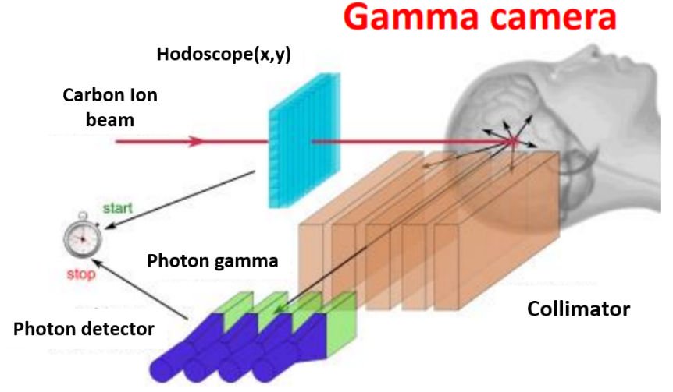
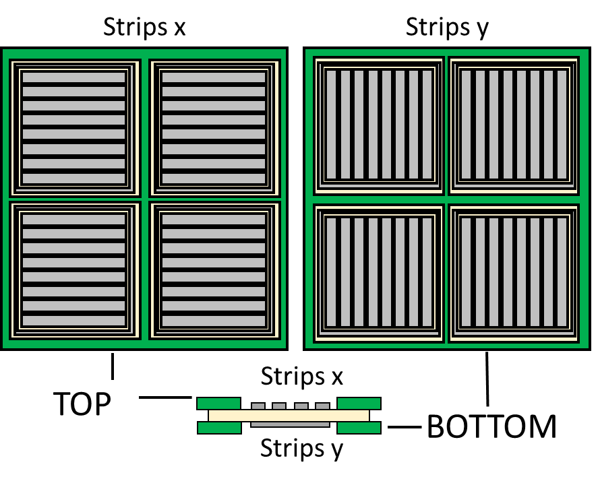
Project overview
Medical physics
  Particle therapy hodoscope: position + time stamp
Using diamond as detector material:
  Intrinsic radiation hardness
  Fast signal risetime enables timing precision of a few tens of ps
  Low noise
  Cost
  Availability of large area
Beam tagging hodoscope for online ion range verification in hadrontherapy:
  Time resolution of 100 ps
  Count rate of 10 MHz/channel
  Spatial resolution ≈ 1 mm
  Radiation hard
Diamonds
double side stripped detectors

Slide 4
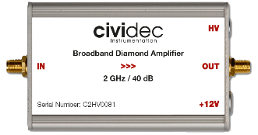
Electronic design
Diamond characterization made with a Fast Current Preamplifier
  DBA III from GSI
  Broadband amplifier from Cividec
Towards a beam tagging hodoscope
  Dozens read-out channels ➔ Home made preamplifier
DBA III GSI
Bandwidth: 2 GHz
Gain: 40 dB
Impedance: 50 Ω
Dynamic range: ~ +/- 1 V
Power Supply: 12 V / 100 mA

Slide 5
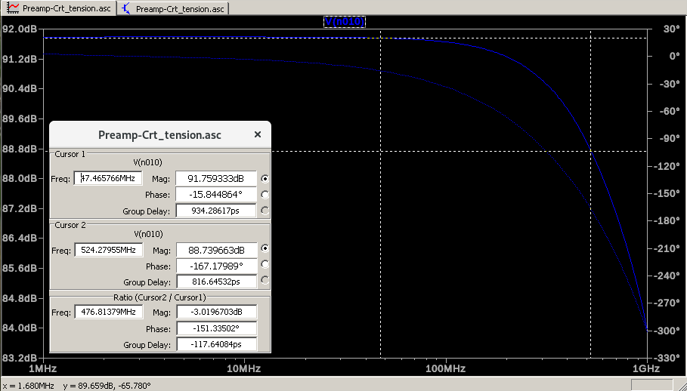
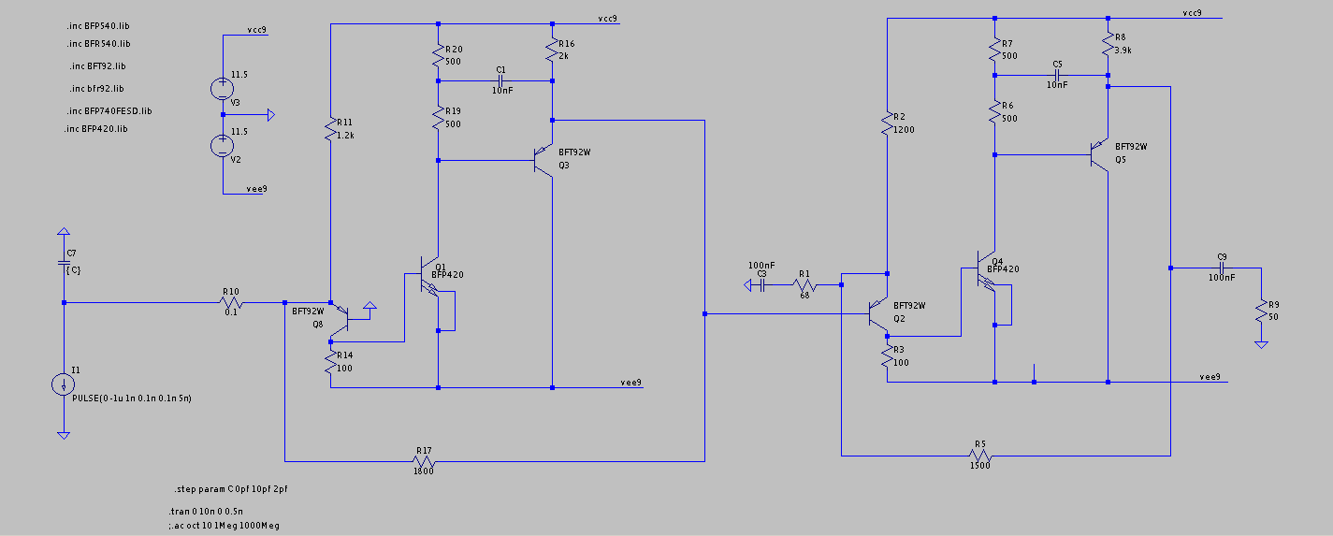
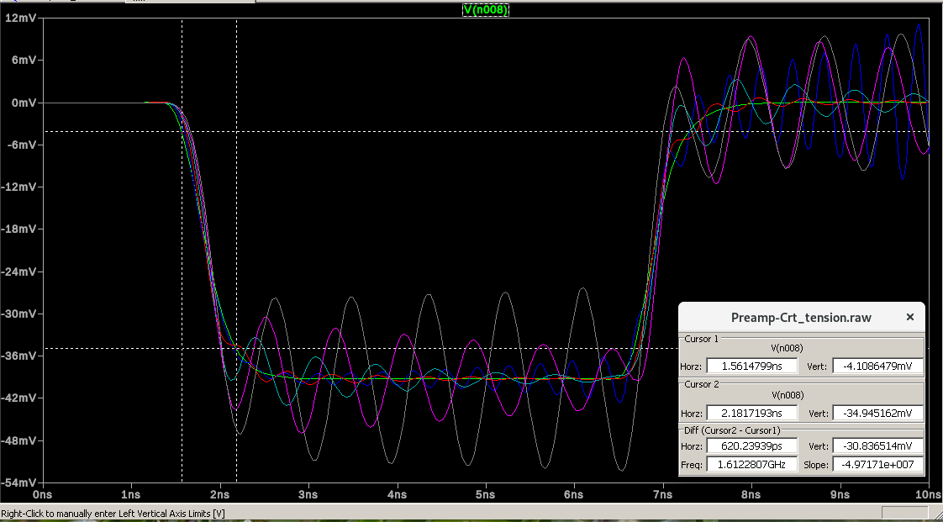
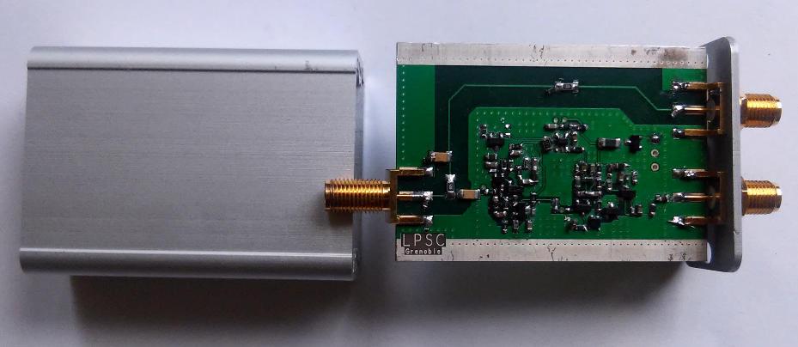
COTS amplifier version
Commercial NPN and PNP bipolar transistor
  1st stage TIA amplifier with resistive feedback followed by a non-inverter amplifier
    Total gain of 92dB
    Cut-off frequency about 520MHz

Slide 6
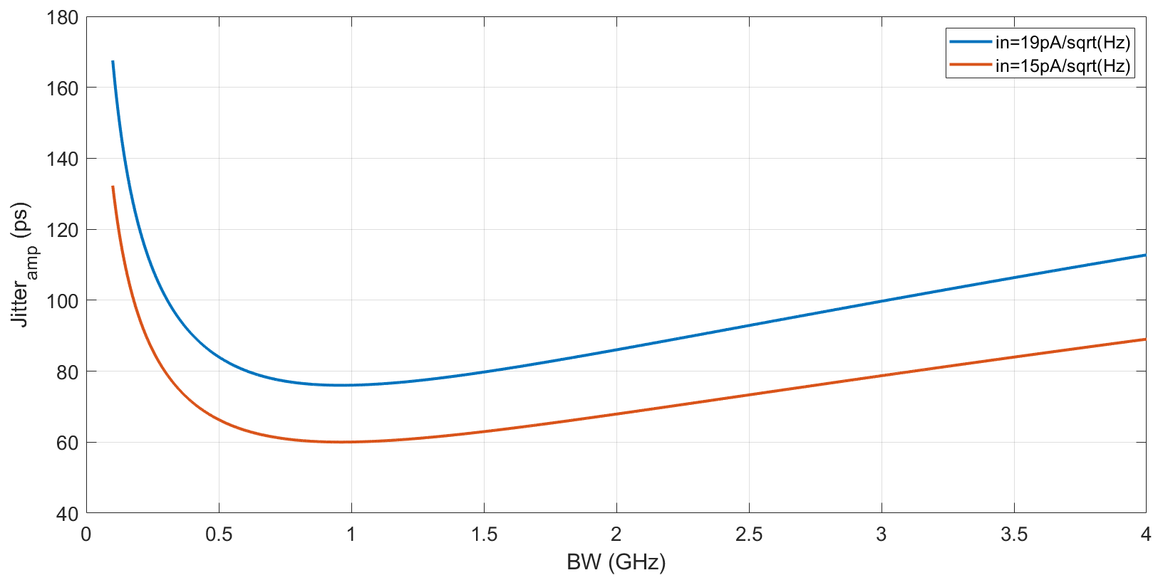

ASIC Front-End version
Timing resolution defined by: $σ_{t}=\sqrt{σ_{Jitter }^{2}+σ_{TimeWalk }^{2}+σ_{TDC }^{2} }$
For fast system, $σ_{Jitter }= \frac{T_{rise}}{ SNR}$, with $SNR=\frac{dV}{σ_{n}}$ and $σ_{n}=G_{TIA}×i_{n}×\sqrt{α×BW}$
  We define a new expression:
    $σ_{Jitter = \frac{i_{n}×\sqrt{α×BW}×T_{r}}{I_{{in}_{max}}}}$

Slide 7
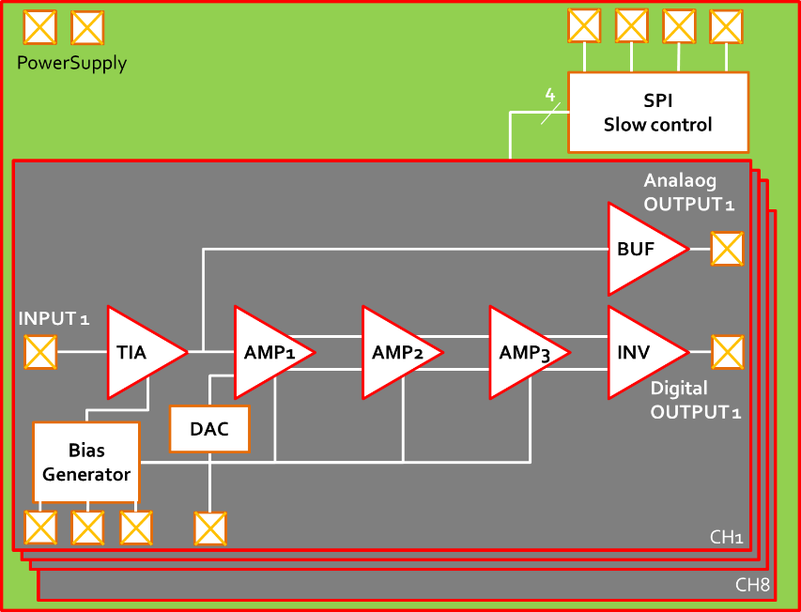
ASIC Front-End version
Design of a multi channel Integrated Circuit:
  CMOS 130nm process technology
  Radiation tolerant technology
  8 channel Trans Impedance Amplifier (TIA) + Fast Discriminator
TIA Parameters | Value
A₀ | > 60 dB
F_{-3dB} | 560 MHz
Z_{in} | 20 Ω
V_{n,out} (output noise) | < 1 mV_{RMS}
Input Dynamic range | 3 µA – 120 µA (<1% linearity)
P_{TOT} | 2.5mW @ 1.2V

Slide 8
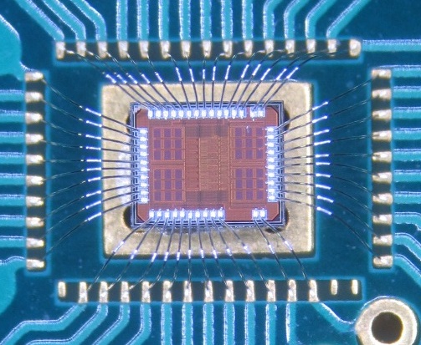
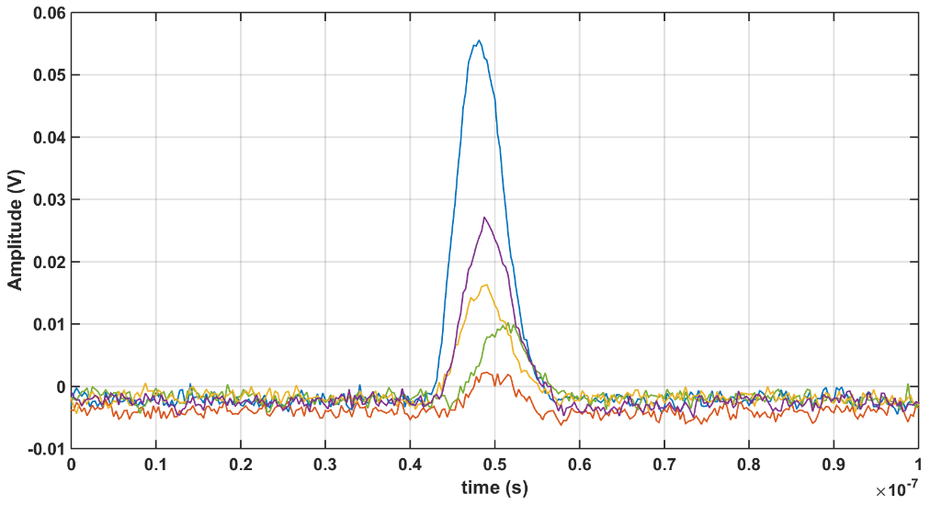
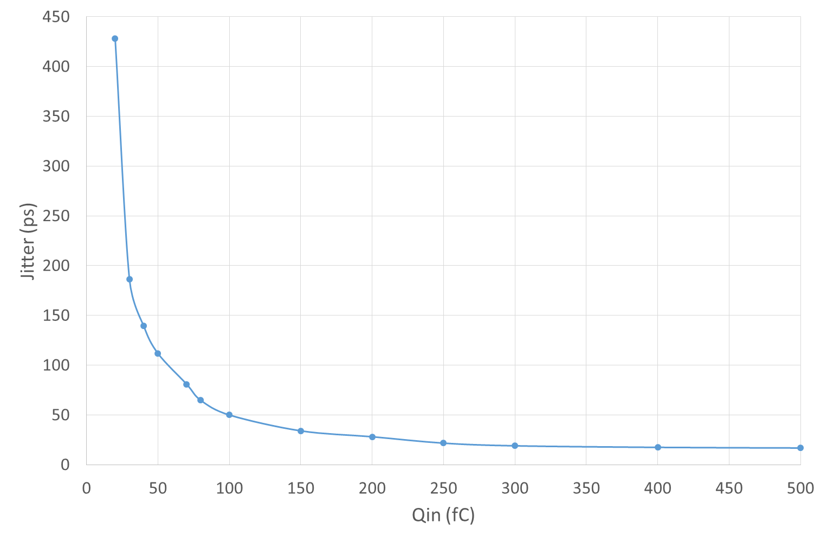
ASIC Front-End version
RMS Output noise about 1.5mV
Timing resolution about 400ps (@ 20fC) due to issues in output buffer (BW about 100MHz) and discriminator stages
Chip On Board
1st prototype
Analog output signal for different input charge (10fC, 20fC, 30fC, 50fC and 100fC)

Slide 9
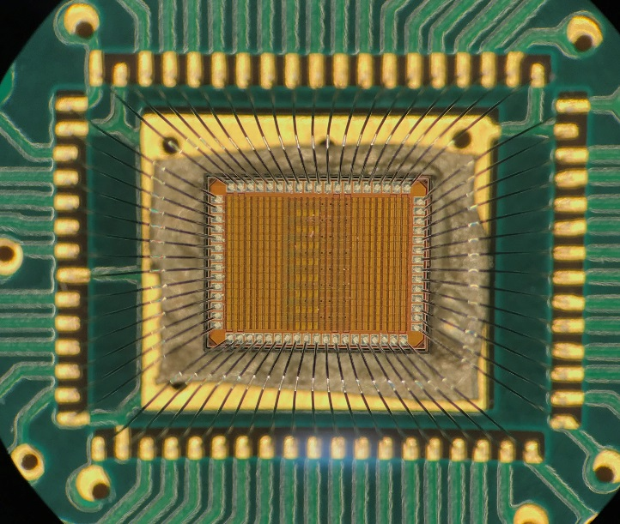
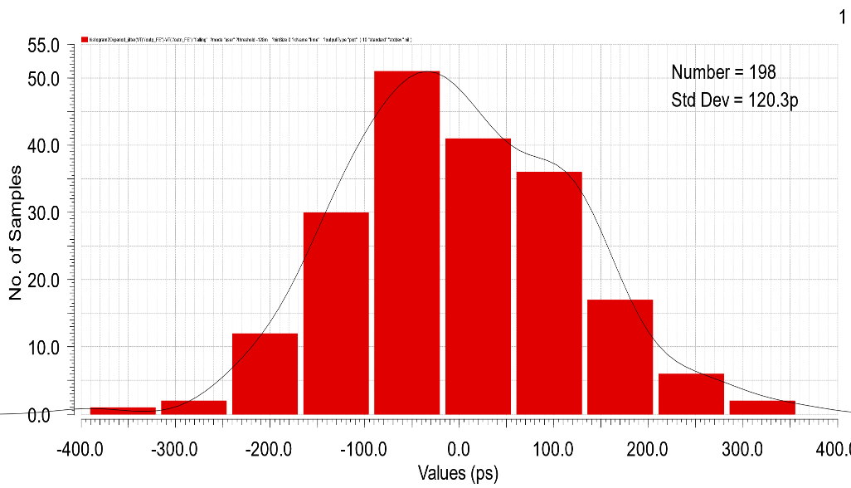
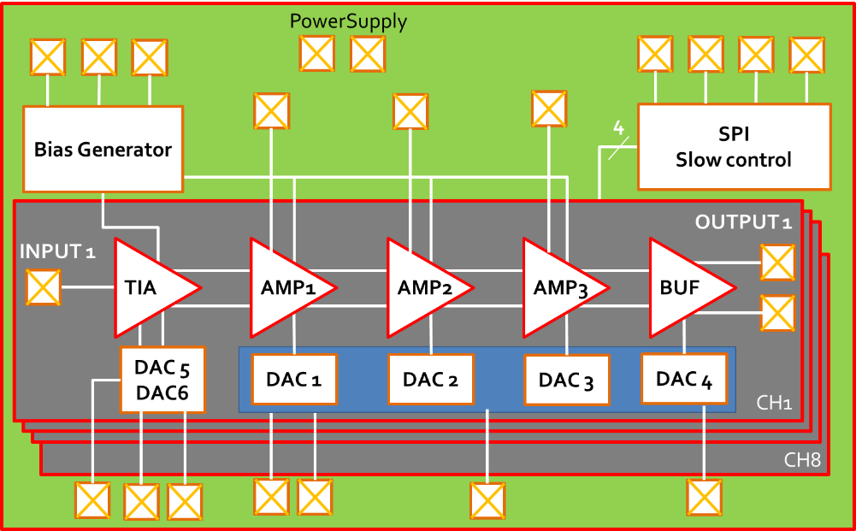
ASIC Front-End version
  Part of DIAMASIC (IN2P3 fund project) in collab. with LPC Caen
  2nd prototype improvements:
    Differential signal propagation (immunity to noise issues)
    Multi-gain amplification through voltage control
    Wideband output buffer
  Expected timing resolution about < 120ps (@ 10fC)
    Improve noise in the first stage
Chip On Board
2nd prototype
Channel Read-Out Parameters | Value
A₀ | > 80 dB
F_{-3dB} | 560 MHz
Z_{in} | 60 Ω
V_{n,out} (output noise) | < 5 mV_{RMS}
Input Dynamic range | 3 µA – 150 µA
Estimated jitter @10fC

Slide 10
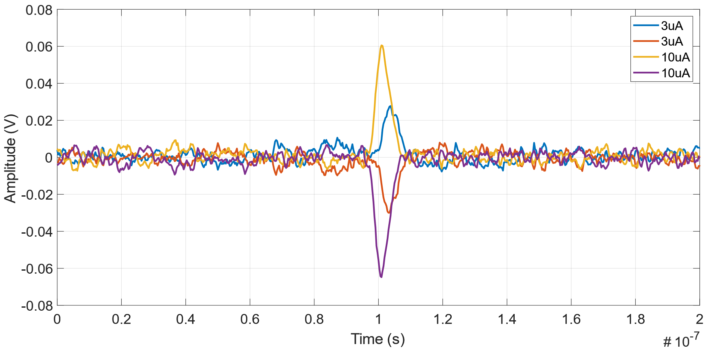
Testing Results
Preliminary testing results
A RMS Output noise of about 3.7mV
A Minimum detectable Current input amplitude of about 3µA
Pulse Generator
DUT
WaveCatcher

Slide 11
Conclusion
Several design at LPSC Grenoble
  COTS components + ASIC versions TIA
ASIC development through IN2P3 project: DIAMASIC
Many improvement still needed!
Thank you for your attention

