Slide 1

CACTUS: A High Voltage CMOS Monolithic Timing Sensor
Y. Degerli, F. Balli, F. Guilloux, C. Guyot, J.P. Meyer, Ph. Schwemling, A. Ouraou, M. Vandenbroucke (IRFU)
T. Hemperek (Univ. of Bonn)
Journées Thématiques du Réseau Semi-conducteurs IN2P3-IRFU, 26 June 2019, Marseille

Slide 2
HV-CMOS Sensor PRINCIPLE
HV-CMOS Sensor Pixel
LV-CMOS Sensor Pixel
DNW/HR p-substrate charge collection diode
HV (≥100V) applied on the substrate (from top or back)
Large depletion depth (>100µm)
Charge collection by drift (fast)
Potentially rad-hard
Electronics integrated inside charge collection diode (NMOS and PMOS)
NW/HR p-epi charge collection diode
LV (few Volts) applied on charge collection diode
Small depletion area
Charge collection by diffusion (slow)
Potentially low noise, low power (small detection cap.)
Better granularity
Only NMOS in-pixel electronics in most processes
→ Particularly suitable for timing

Slide 3
HV-CMOS Sensor TECHNOLOGY
HV-CMOS Sensor
NMOS
PMOS
Initially proposed by I. Peric (no full isolation of in-pixel electronics in first prototypes…)
Electronics doesn’t see the HV! (possibility to use standard cells etc.)
When depleted, detector capacitance dominated by perimeter capacitance, capacitance added by in-pixel electronics (DNW/DPW etc.) and interconnections
Process
The process chosen is LFoundry 150nm HV-CMOS
One of the CMOS processes studied extensively for the CMOS option of the ATLAS Inner Tracker Upgrade
→ other processes : AMS/TSI 0.18µm (HV), Tower-Jazz 0.18µm
Possibility to use HR (~2kΩ.cm) wafers
Supply voltage: 1.8V (electronics)
6 metal layers + 1 thick metal
The HV option features several wells (PSUB, NISO…) used for isolation of in-pixel electronics
Wafers can be thinned and backside processed (for backside polarization and good charge collection uniformity)

Slide 4
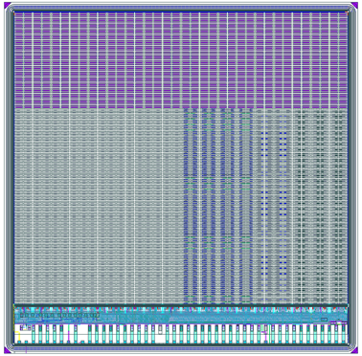
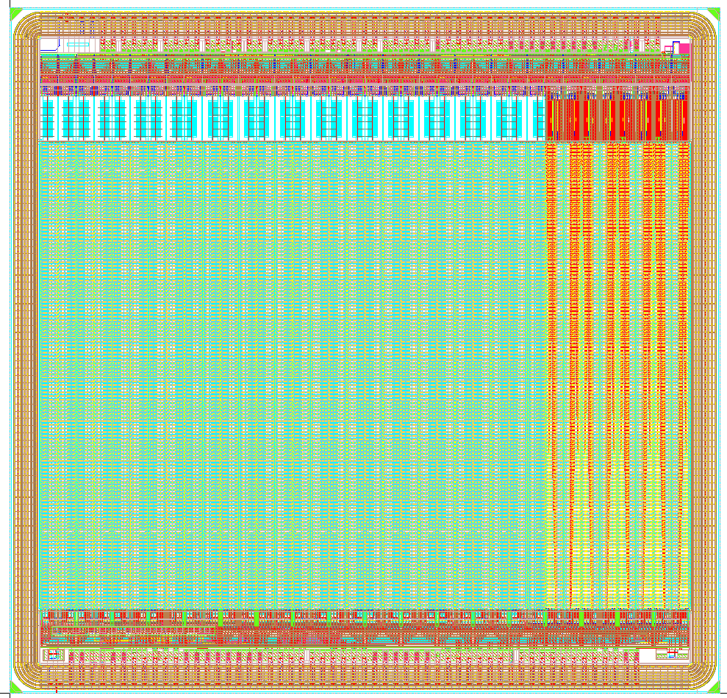
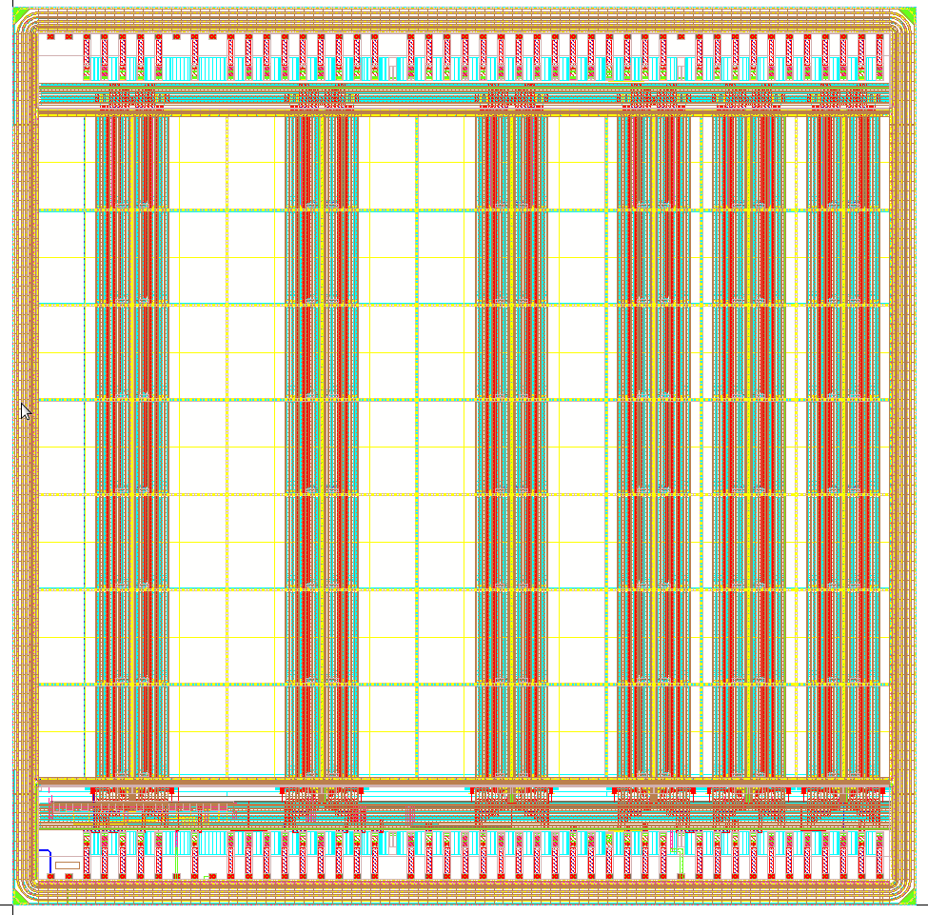
HV-CMOS Sensor PROTOTYPES IN LF150 NM PROCESS
(for LHC ATLAS UPGRADES)
ATLAS ITk Upgrade
HV-CMOS + FE-I5
ATLAS ITk Upgrade
HV-MAPS (full monolithic)
LHC Upgrades
(Other applications possible)
LF-CPIX
LF-MONOPIX
CACTUS
LF-CPIX demonstrator
- CPPM, IRFU, Bonn col.
- Sub. March 2016
- Fast R/O coupled to FE-I4
also pixels stand alone testable
- 50 x 250 µm² pixels (tracking)
- Promising results before and after irradiation
LF-MONOPIX demonstrator
- Bonn, IRFU, CPPM col.
- Sub. August 2016
- LF-CPIX + FE-I3 RO
- 50 x 250 µm² pixels (tracking)
- Promising results before and after irradiation; tests on-going
CACTUS demonstrator
- Mainly IRFU design
- Re-use of several parts of LF-CPIX
- 1 x1 mm² and 0.5 x 1 mm² pixels
- Very fast RO (timing)
- Expected timing resolution ≤ 100 ps
- Submitted to fabrication in Dec. 2017
- First fabricated standard wafer received in June 2018
[Y. Degerli et al., JINST, vol.11, Dec. 2016]
[T. Wang et al., JINST, vol.12, Jan. 2017]
(+ other conferences)
[Y. Degerli et al., IEEE NSS’2017 Conf. Rec.]

Slide 5
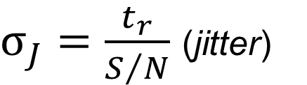
TIMING PRINCIPLES
$σ_{t}^{2}≈σ_{J}^{2}+σ_{TW}^{2}$ (timing variance/resolution)
Preamp
Discri
$σ_{J}=\frac{t_{r}}{S/N}$ (jitter)
$σ_{TW}={\left[\frac{t_{r}{.V}_{th}}{S}\right]}_{rms}$ (time walk – fixed threshold)
σ_{J} : jitter (timing variation due to noise)
σ_{TW}* : time walk (timing variation due to signal amplitude variations)
t_{r} : 10% to 90% preamp rise time (t_{charge collection} ≤ t_{r})
N : rms noise
S : signal amplitude
*correction by CFD (Constant Fraction Discri.) or ToT measurements
→ TW needs to be corrected to get good timing resolution

Slide 6
TIMING DETECTOR
Target: Development of a monolithic timing sensor in a commercial CMOS process
Potentially cheaper than dedicated hybrid solutions
Possibility to integrate all functionalities (detection, analog + digital signal processing) on the same chip
The front-end studied is based on a fast preamplifier followed by a leading edge discriminator
Time walk corrections will be done off-line by ToT measurements
Use of HR substrates allows size of depleted region of about 100 μm-300 µm (8-24 ke-)
Backside versus top biasing → Need backside polarization to ensure best charge collection and signal shape uniformity!

Slide 7
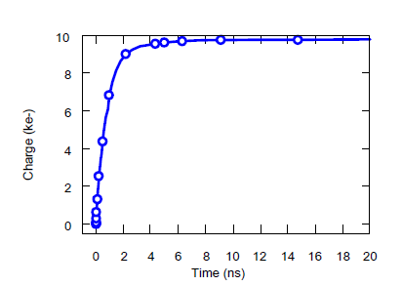
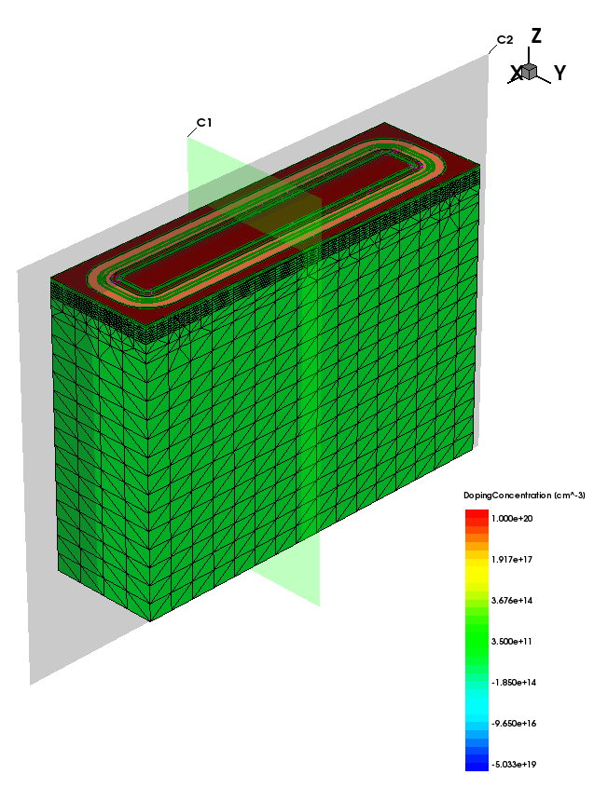
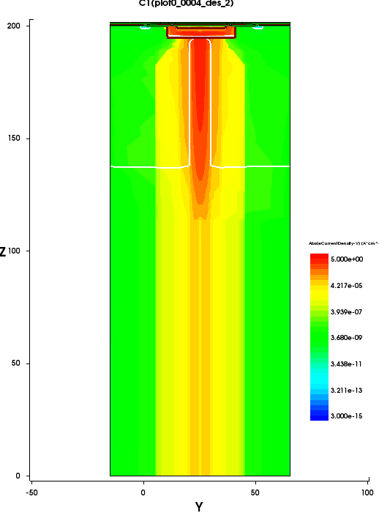
DEVICE SIMULATION
Sentaurus TCAD software used to estimate pixel capacitance (mainly diode contribution), charge collection time, total collected charge and breakdown voltage
Possibility to import geometry from Cadence software
These simulations are very useful for pixel optimization, but the results should be seen as qualitative
(transient signal)
Typical simulated charge collection for a 1 x 1 mm² pixel
(100µm thick sensor and -80V backplane polarization)
(work done by M. Lachkar)

Slide 8
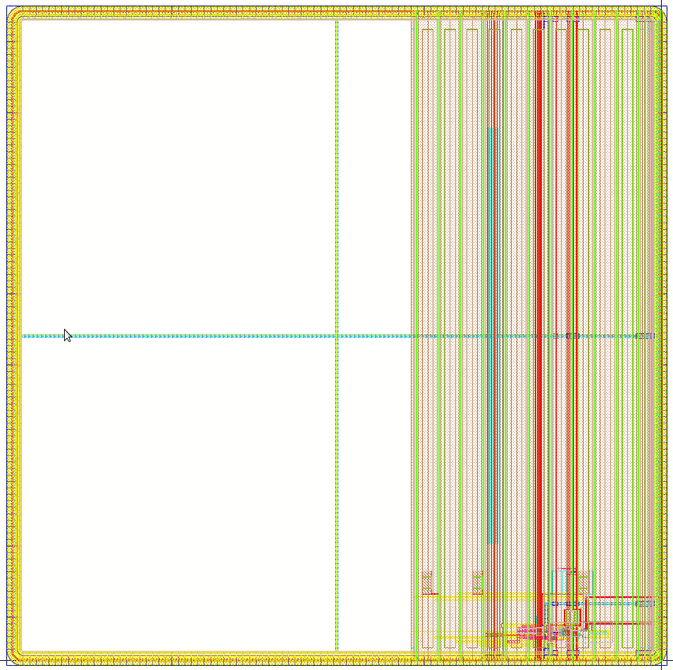
MAIN PIXEL Characteristics OF TIMING DEMONSTRATOR CHIP
The estimated charge is ≥ 8000 e- for 100 µm depletion (the depletion depth should be higher for ~200V)
Two pixel sizes have been studied and implemented in the demonstrator (the smaller is a quick stretch of the baseline pixel)
The total detector capacitances have been estimated from Sentaurus TCAD simulations (diode contribution), Cadence tools (front-end contribution) and other prototypes (LF-CPIX) in this process
Parameter | 1 mm x 1 mm (baseline) | 1 mm x 0.5 mm
Estimated total detection capacitance | 1.5 pF | 1 pF
Nominal bias current (could be reduced) | ~ 800 µA | ~ 800 µA
Static power dissipation (sensitive area) | ~145 mW/cm² | ~290 mW/cm²
Pixel layout (1mm x 1mm)
Pixel electronics

Slide 9
CSA
Cfb
Bias and
feedback currents
are set from outside
by a 6-bit DAC
for fine-tuning
Rfb
BL
IP2
IP1
RBL
Vcasc
CBL
OutBL
Rbias
Cc
ISF
Cdet
-HV
Source
Follower
Baseline
restorer
Basically the charge amplifier architecture implemented in LF-CPIX with a different fast CS amplifier (gain and bandwidth boosted cascode)
CSA architecture works well in LF-CPIX and LF-MONOPIX chips

Slide 10
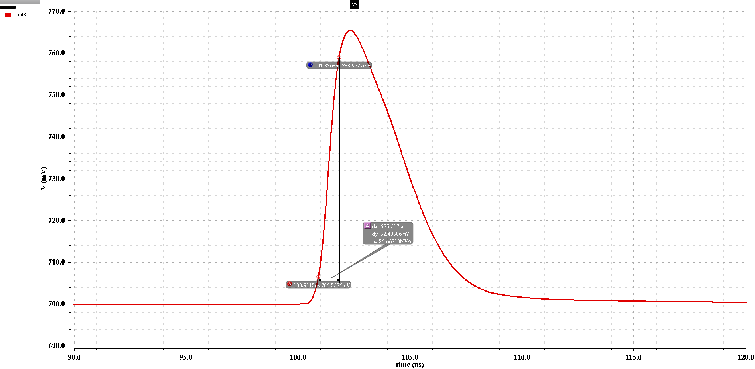
SIMULATION RESULTS (CSA)
Simulation results of the CSA
typical analog pulse at the BL output (@Cdet=1.5pF, 4000e-)
Parameter | 1.5 pF | 1 pF
Rise Time (from 10% to 90%) | ~ 0.9 ns | ~ 0.8 ns
Input Referred Noise [estimated from AC simulations] | ~ 290 e- | ~ 220 e-
Jitter [estimated from t_{r} /(S/N) ] | ~ 67 ps | ~ 44 ps

Slide 11
FULL FRONt-END (ONE COLUMN)
The leading edge discriminator is an optimized version of the discriminator used in LF-MONOPIX
A local 4-bit DAC is used for offset tuning
Source follower output for low-noise
Possibility to enable/disable each pixel
The digital outputs of one column are summed at the bottom of each column and sent to a pad (each column has its own pad)
When a pulse is seen at the pad, the address of the hit pixel is available on dedicated pads thanks to an on-chip address encoding circuit
It is also possible to readout the in-pixel registers in a serial way
The precise measurements of the pulse is done off-line
Column Architecture

Slide 12
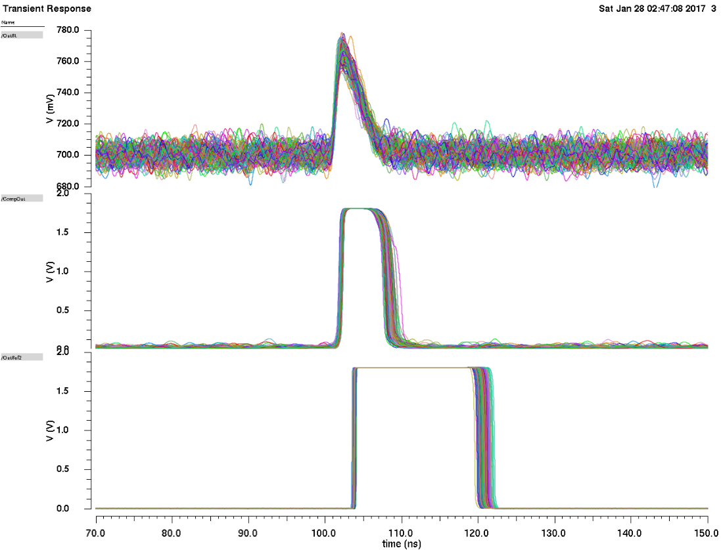
SIMULATION RESULTS (Full FRONT-END)
Estimation of jitter and dispersion of ToT of the full front-end
AC noise simulations not suitable for the digital part → Transient noise simulations
Transient noise simulations are very time consuming
Calculation of σ for the leading edge and ToT
In this mode, the estimated jitter values are higher than the jitter values estimated from AC simulations (~50% higher)
OutBL
Typical transient noise simulations results with 100 iterations
Discri Output
Digital Output
(End of Column)

Slide 13
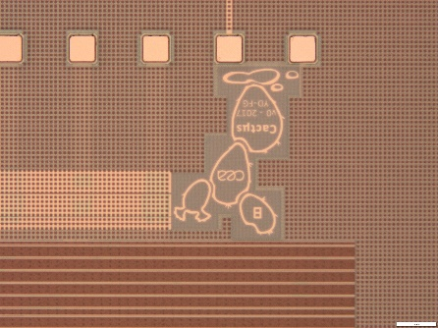
MONOLITHIC TIMING DEMONSTrATOR Chip
Cactµs (Cmos Active Timing µSensor) Chip
Developed mainly at IRFU
Architecture based on the LF-CPIX chip
Re-use of several parts of LF-CPIX chip with some modifications (guard-rings, DACs, global shift register, in-pixel registers, etc.)
The main difference is the new fast front-end, the pitch of pixels and direct digital outputs
Each pixel can be enabled/disabled individually
Most of the pixel parameters (biases etc.) are programmable
Pulse injection circuitry (analog pulse generated locally to minimize dispersion)
Address encoding circuitry
12 fast LVDS & CMOS digital outputs, 1 HITOR output
1 analog monitoring output with the possibility to choose the analog signal of one pixel
No on-chip ToT correction (done off-line)
2 versions with different external guard-rings (increase of BV)
Wafers thinned to 200 µm and 100 µm and backside processed

Slide 14
IN-LAB TESTS
IN-LAB TEST-BENCH
Test-bench developed by Jean-Pierre Meyer
A Raspberry-Pi used for slow control and a WaveCatcher for fast data sampling of analog or digital outputs
Programmable supplies with GPAC board
WaveCatcher digitizer : 5 ps rms timing resolution
Timing resolution of PMT: ~90 ps_{rms}

Slide 15
IN-LAB TESTS
Up to now, several chips tested in-lab:
6 un-thinned chips from standard wafers (ver. A and B.)
3 thinned (200 µm) chips (ver. B)
2 thinned (100 µm) chips (ver. A and B.)
These chips are fully functional, only 1 chip has a short (could be a bonding issue), others functional with very similar electrical behavior. No dead pixel observed. Very reproducible results (good or bad!).
Some 100 µm-thinned chips coming from the edge of the wafer don't work (slow control and leakage issues)

Slide 16
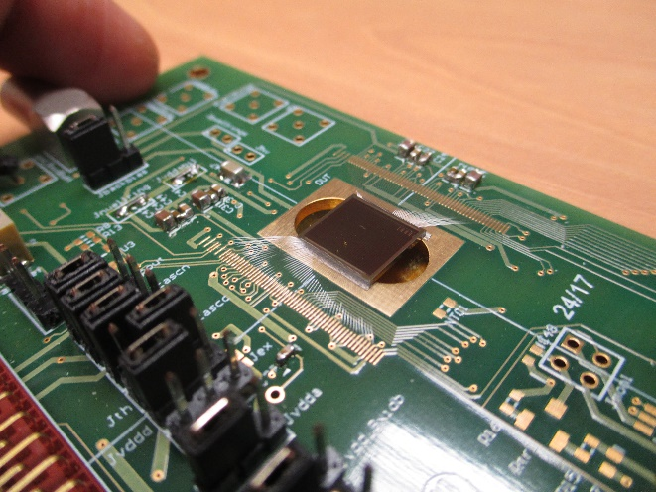
IN-LAB TEST RESULTS
MEASURED BREAKDOWN VOLTAGES
Un-thinned CACTUS chip wire-bonded on PCB
Ver. B
Ver. A

Slide 17
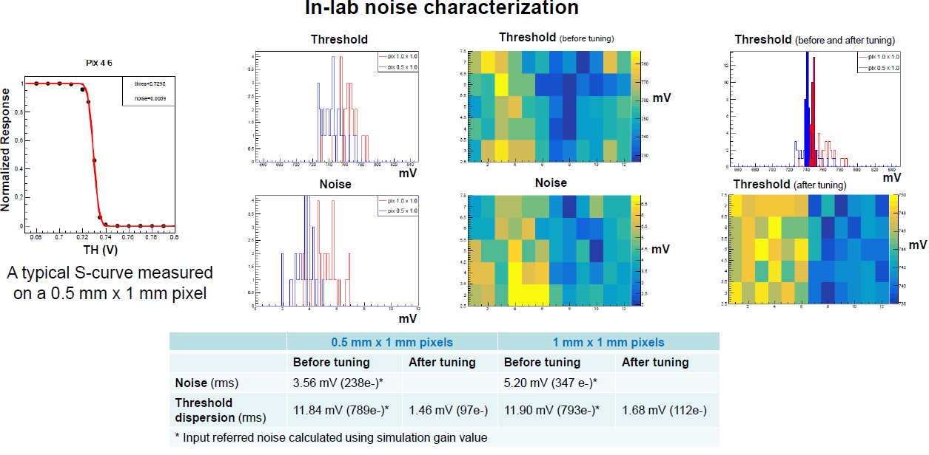
IN-LAB TEST RESULTS
Noise level consistent with simulations
Threshold dispersion lower than temporal noise after tuning

Slide 18
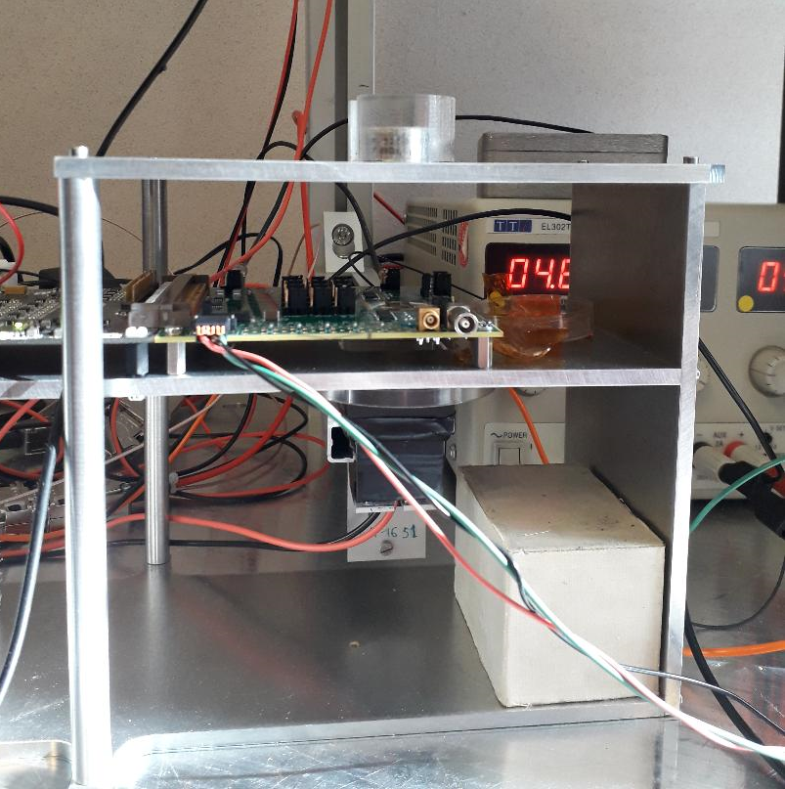
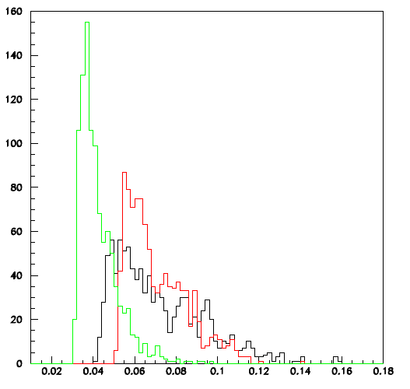
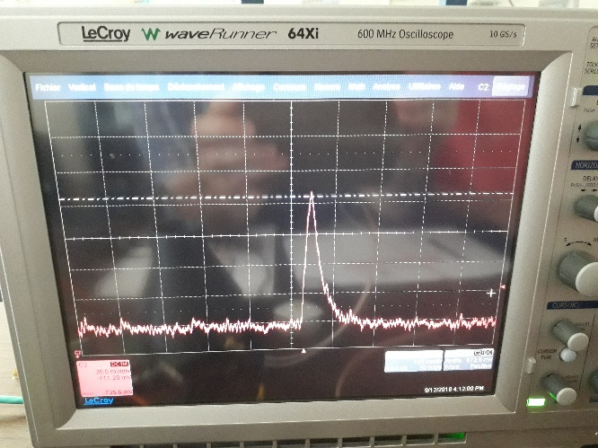
TESTS WITH ⁹⁰SR SOURCE
⁹⁰Sr
DUT
100 µm
200 µm
700 µm (un-thinned)
PMT
Test-bench used for tests with ⁹⁰Sr
V
Typical spectra with analog monitoring output
Typical analog monitoring output signal with ⁹⁰Sr

Slide 19
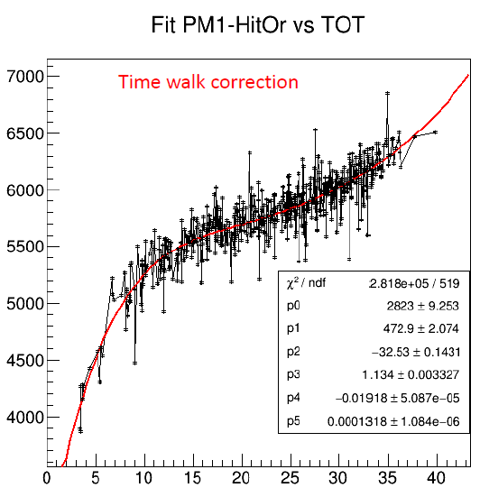
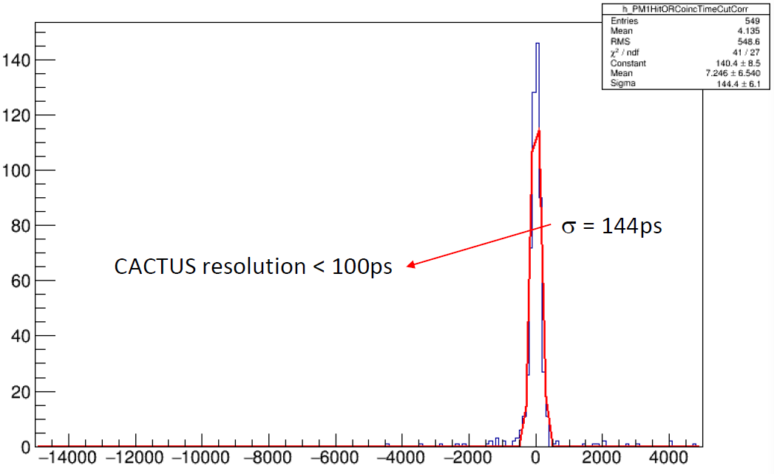
TESTS WITH ⁹⁰SR SOURCE
TIME RESOLUTION MEASUREMENTS ON DIGITAL OUTPUT
200 µm-thinned CACTUS chip, backside bias (-300V)
Good time resolution after TW correction

Slide 20
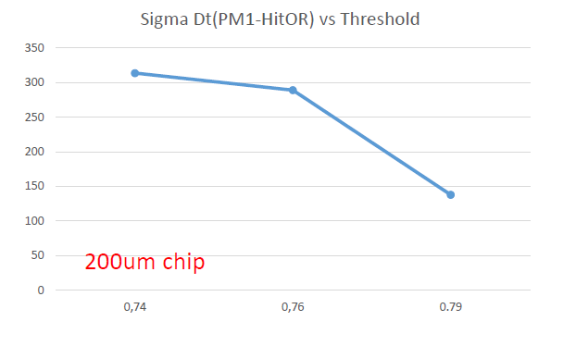
TESTS WITH ⁹⁰SR SOURCE
TIME RESOLUTION MEASUREMENTS ON DIGITAL OUTPUT
Resolution improves with increased threshold (efficiency to be checked!)
Similar tests done with untinned 700 µm chips give resolution > 600 ps
100 µm thinned chips received recently, in-lab characterization on-going

Slide 21
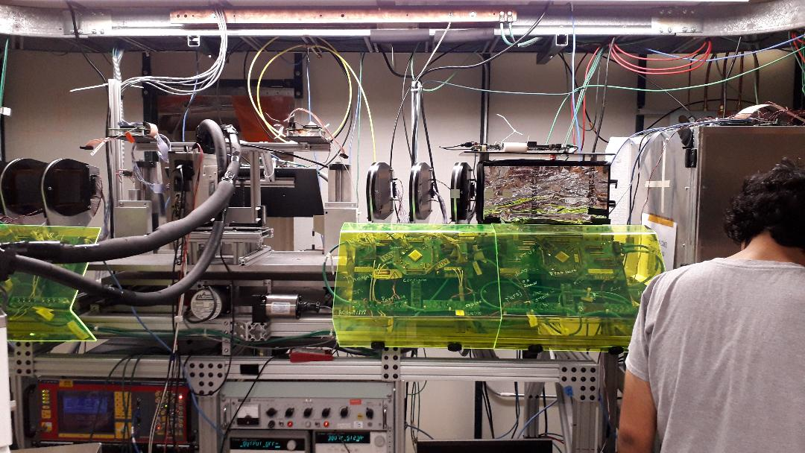
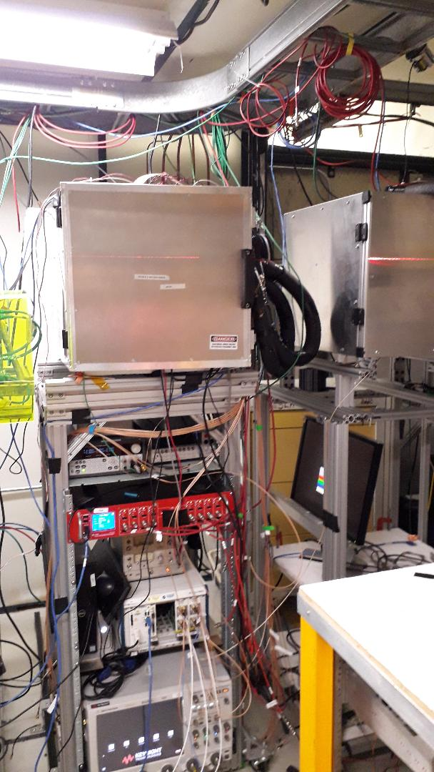
TESTBEAM AT FERMILAB
DUT inside this cold box
17-22 June 2019
Mainly 120 Gev protons
4-plane telescope used for efficiency measurements
Remotely controlled motion table for sensor positioning
Fast sampling scope for sensor signal acquisition
Very useful data to test all the aspects of the sensor : charge collection, FE perf, time resolution…
People involved:
Artur Apresyan, Meraj Hussain, Christian Pena, Si Xie (Fermilab)
Yavuz Degerli, Fabrice Guilloux, Philippe Schwemling (IRFU-Saclay)

Slide 22
TESTBEAM AT FERMILAB
General very preliminary observations:
A lot of data taken (few Tb), analysis on-going
Preliminary quick analyses showed low detection efficiency on digital outputs, even at low threshold values. To investigate the problem:
  Charge collection homogeneity of the pixel checked with analog monitoring output
  The analog signal level seems lower than expected by simulations and from previous prototypes LFCPIX and LF-MONOPIX for MIPs, noise levels consistent
  The charge collection seems homogenous inside the pixel (next slide), the origin of the problem could be front-end related, will be investigated in-laboratory

Slide 23
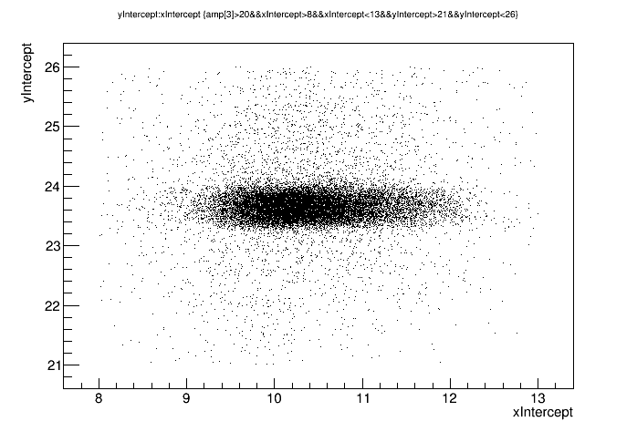
TESTBEAM AT FERMILAB
CHARGE COLLECTION HOMOGENEITY OF THE PIXEL
Very preliminary !
Hits aligning with the telescope for one pixel of 0.5 mm x 1 mm
(200 µm thinned CACTUS chip, backbias (-300V))
Charge collection homogeneity checked on analog monitoring signal with the 4-plane telescope
Charge collection seems quite homogenous (no particular structure, no dead area)

Slide 24
CONCLUSIONS & PERSPECTIVES
Summary of preliminary test results
The breakdown voltages are as expected (~230V for ver. A and ~350V for ver. B)
Noise levels are globally as expected : 200-300 e-. Threshold dispersion lower than temporal noise after tuning.
Homogenous charge collection inside pixel, no dead areas
Time resolution at the expected level from simulation for high amplitude signals (>100 mV)
Thinning and backside processing done successfully.
Good yield and reproducibility of results.
Signal level lower than expected, limiting the detection efficiency and timing resolution
The chip is globally very sensitive to incoming and outcoming digital signals (plan to put frond-end electronics outside the charge collection diode at the column-level for the next submission to overcome this issue)
Tests on-going. Will investigate the signal level problem and plan to submit a new small prototype to address the identified problems of the first version
Current problems
Next steps

Slide 25
Thank your for your attention!
Thanks to our colleagues from Bonn and CPPM-Marseille HV-CMOS groups!

Slide 26
BACKUP SLIDES

Slide 27
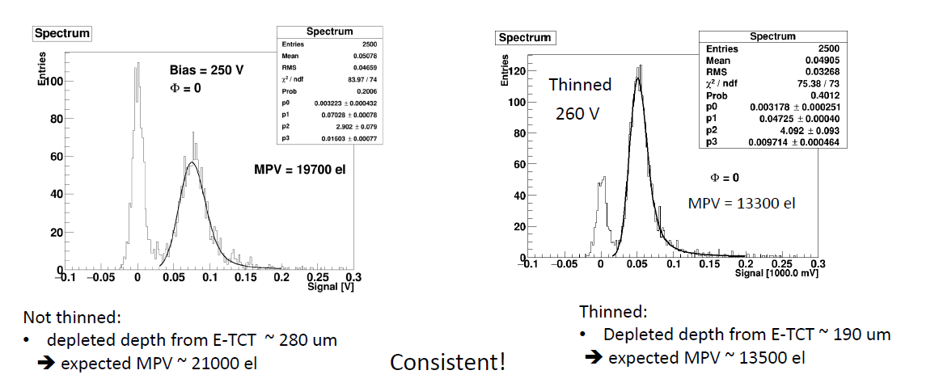
CHARGE COLLECTION
[I.Mandic et al., ATLAS CMOS Demonstrator Meeting, 29/05/2017]

Slide 28
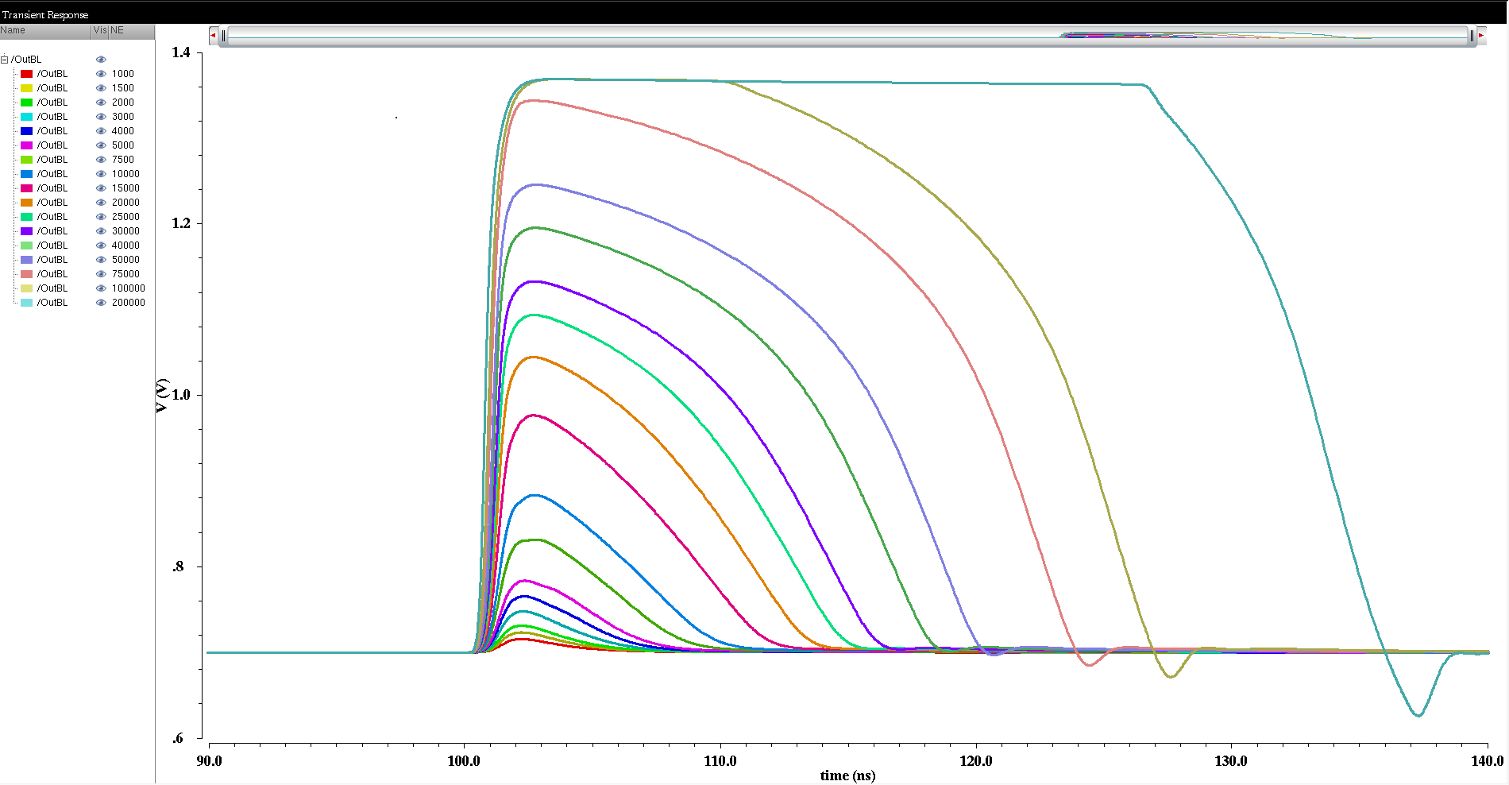
SIMULATION RESULTS (CSA)
Output transient signals for different input signal values (from 1ke- to 200ke-)
200ke-
(~20 MIP)
1ke-
40 ns

Slide 29
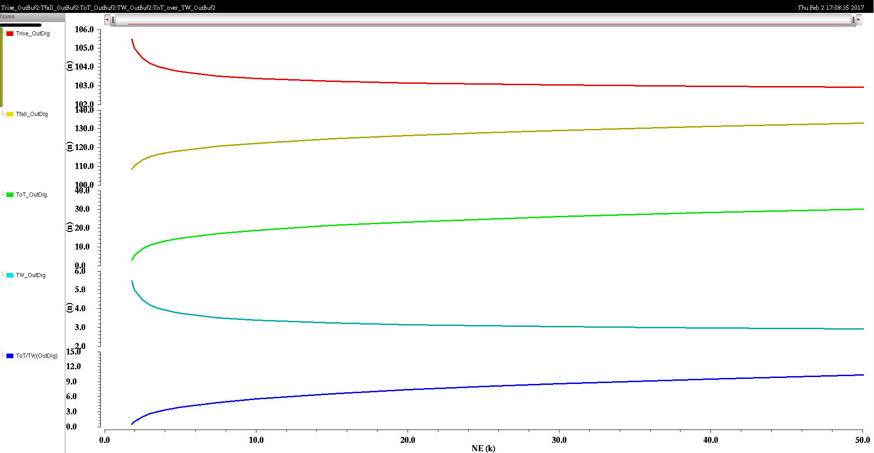
SIMULATION RESULTS (Full FRONT-END)
Simulation of TW and ToT for one pixel as function of input signal (e-)
Tlead
Tfall
ToT
TW
ToT/TW

Slide 30
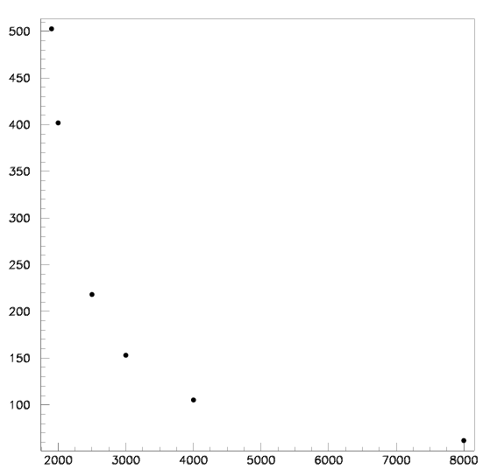

SIMULATION RESULTS (Full FRONT-END)
Estimation of jitter and dispersion of ToT of the full front-end (@Cdet=1.5pF)
NE (e-) | σ_{(Tlead)} _{(OutDig)} | σ_{(ToT)} _{(OutDig)}
8K | 61.8 ps | 311.8 ps
4K | 105.2 ps | 513.2 ps
3K | 153.2 ps | 799.3 ps
2.5K | 218.3 ps | 1.24 ns
2K | 402 ps | 1.87 ns
Distributed RC
Tlead dispersion
(jitter)
ToT dispersion
ps
(rms)
ps
(rms)
Charge (e-)

Slide 31
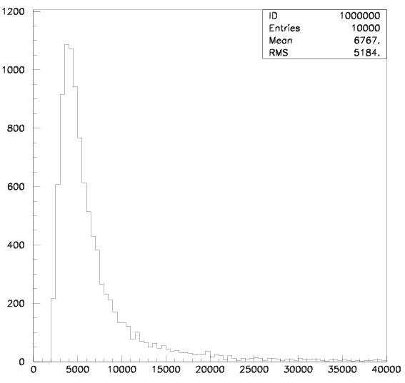
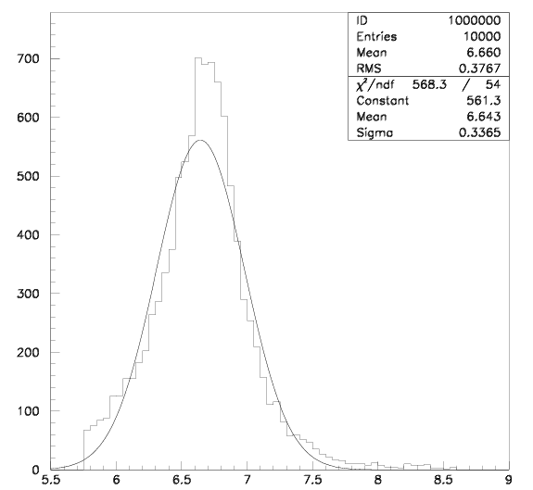
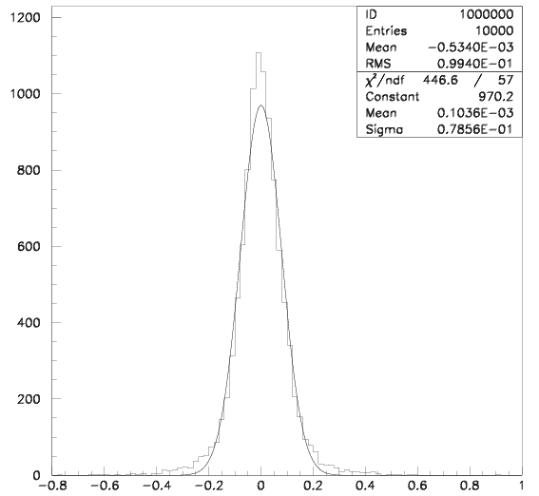
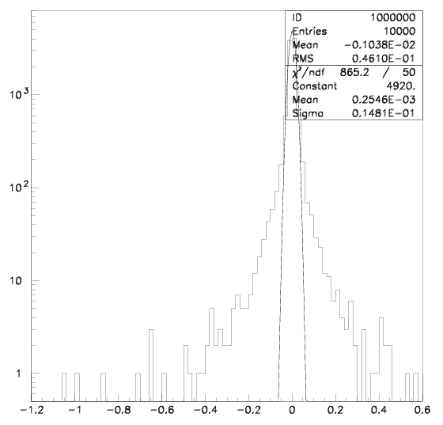
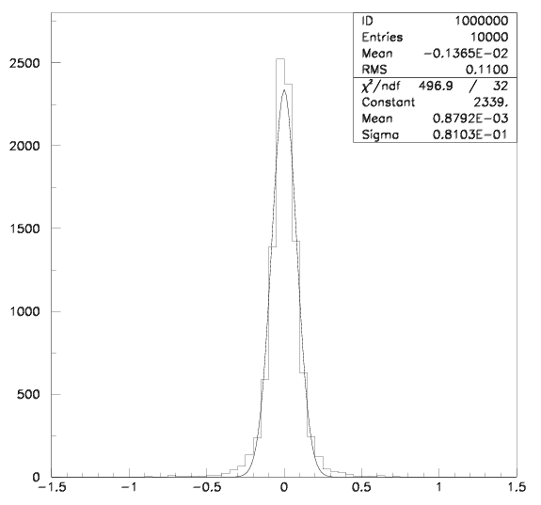
Physics performance ESTIMATION
Input Landau Signal height
MPV=4000 e-
Width=832 e-
Tlead distribution (TW effect)
σ=337 ps,
No ToT correction
Jitter contribution σ=79 ps
After ToT correction
No ToT dispersion included
Global ~81 ps time resolution expected provided 4000 e- collected in ~1 ns
Effect of ToT dispersion
σ=15 ps
Large tails !
Total jitter σ=81 ps
After ToT correction
ToT dispersion included

Slide 32
InLAb TEStS
IN-LAB TEST BENCH
A Raspberry-Pi used for slow control and a WaveWatcher for fast data sampling of analog or digital outputs
Basic characterizations done with this testbench:
S-curve measurements (threshold dispersion and temporal noise)
Threshold tuning of discriminator
Gain calibration with external injection pulse and ⁵⁵Fe source

