Slide 1
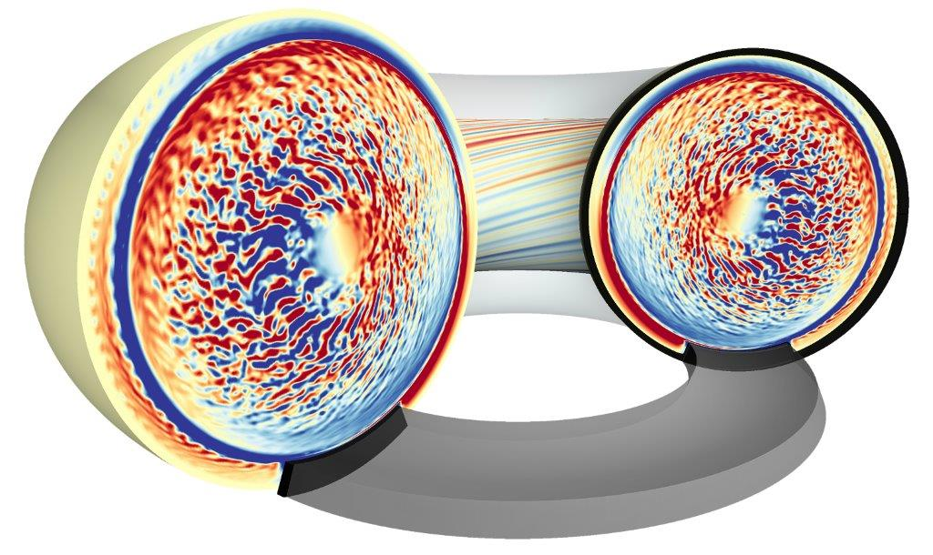
data analysis strategies with GYSELA: Characterization of $φ_{00}$
E. Caschera
and GYSELA Team:
G. Dif-Pradalier, X. Garbet, P. Ghendrih, C. Gillot,
V. Grandgirard, G. Latu, C. Passeron, G. Richard,
Y. Sarazin
Notes:
Good afternoon I am elisabetta caschera second year phd in GTS group under tha direction of P. Ghendrih and G. Dif pradalier. My phd subject is focused on charachterizing global properties of fusion plasma confinement using the global code GYSELa, here the name of GYSELA group members.

Slide 2
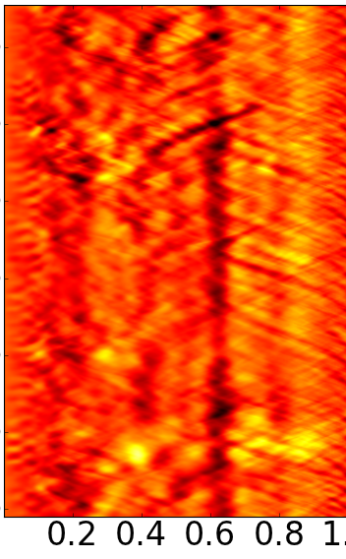
Turbulence is a channel for heat transport
Toroidal magnetic surfaces
High gradients → Turbulence → Channel for heat transport
Nonlinear = Avalanches, Barriers, Zonal Flows
Turbulent Heat Flux
x${10}^{5}$
x${10}^{−5}$
$$2$$
$$2$$
Time $(Ω_{ci}^{−1})$
$$0$$
$$1,5$$
$$1$$
$$−2$$
$$ρ=r/a$$
Notes:
Plasma is an open system that naturally discharge its internal energy content to external enviroment. It is charachterized by strong gradients between the core and the wall wich makes the plasma a big reservoir of free energy. This free energy gives rise to turbulence, which represents the main channel of heat transport outside the system and is a complex non linear phenomenon difficult to describe analytically. Usually this complicated system is described through reduced models, like the fully integrated energy balance. From here the energy confinement time has been defined as the ratio between internal energy and power loss and express the typical time for the energy to stay confined inside plasma volume. It is a foundamental parameter that escribes fusion performance and of course we want it as high as possible. A strong experimental effort has been done in the past years to relate the confinement time to the main plasma parameters, boulding a multimachine scaling law. Iter has been designed on extrapolation of this scaling. A more recent work of comparison of DIID and Jet discharges results a different scaling, specially for the beta parameter. Thus from a theoretical point of view we question the scaling law, addressing the questions if the power law is an appropiate model to express tauE dependencies and what is behind this results, what controls confinement through numerical simulations.

Slide 3
Zonal Flows are big players in turbulence self-organization
ZF ↔ (0,0) mode of the potential
$$v_{θ}∝∂_{r}φ_{00}$$
Zonal Flows
$$v_{E×B}=\frac{E×B}{B^{2}}$$
${∂_{r}v}_{θ}∝∂_{r}^{2}φ_{00}$
Shear
Reduced radial extention of turbulent eddies
[2008]
Transport barriers, staircases, profiles corrugations depend on ${∂_{r}^{}φ}_{00}$and $∂_{r}^{2}φ_{00}$

Slide 4
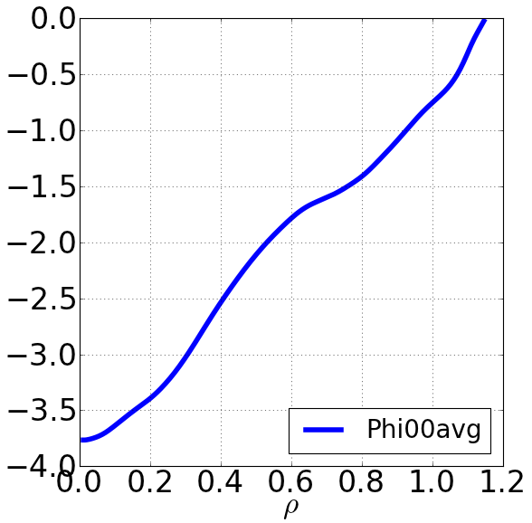
Parametric MACHINE LEARNING FOR $φ_{00}(ν_{∗},A,ρ_{∗},b.c.,n,T,∇n,∇T)$
$$φ_{00}$$
Self-consistently generated by $f_{i}≠f_{e}$
Global structure, fast time scale reaction
No analytical prediction with plasma parameters
$$Ω_{c}t=500$$
$$φ_{00}^{2}$$
$$0$$
$$1$$
$$2$$
$$3$$
$$4$$
$$Ω_{c}t×{10}^{3}$$
Idea : Train an algorithm
Build a database
How many data?
Level of confidence ?
Fit $φ_{00}$ to a target function
Info on ZF and shear?
$${\left\langle φ_{00} \right\rangle }_{t}$$
$$ρ=r/a$$

Slide 5
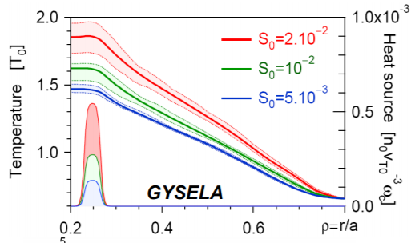
Is Flux-driven willing to build a database?
GYSELA
GK Vlasov + Q.N (5D)
GLOBAL = full torus, full-f
$S_{heat}$ → Self-organized
0
0.3
$$φ_{00}(ν_{∗},A,ρ_{∗},b.c.,n,T,∇n,∇T)$$
Database = independent simulations
Evolving profiles
input = init state & geometry
time windows as different simulations
Collect old ‘good’ simulations
Standard simulation
Run time | ${\sim 10}^{7}$ h/monoproc
2D data stored | ~10 G
3D data stored | ~1 T
5D data | ~1 T/iteration
$φ_{00}$ as additional test

Slide 6
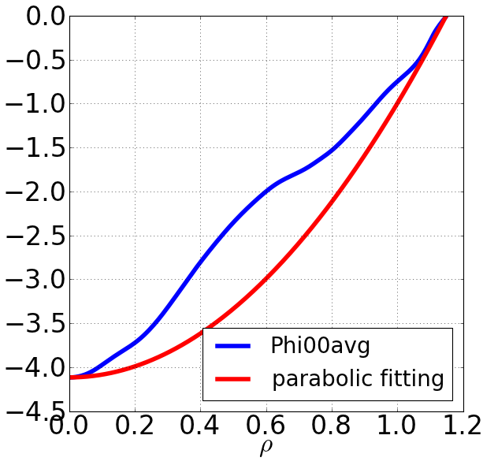
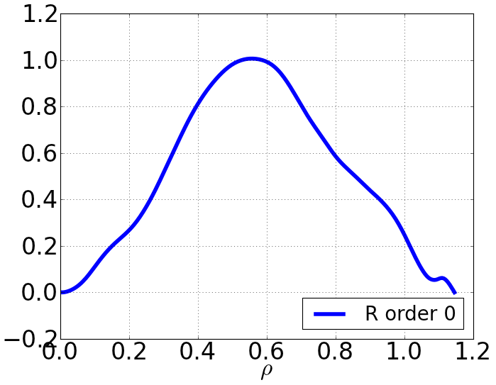
Parametric machine learning require a basis of functions
Parametric machine learning → restricted database
require a suitable basis
Boundary conditions
$$∂_{r}φ_{00}\left(0\right)=0$$
$φ_{00}\left(r_{max}\right)=0$
Fitting function
Linear regression
$$f^{N}=aρ^{2}+b+\sum_{n=1}^{N}{A_{n}sin⁡(nπρ/ρ_{max}) }$$
$$R^{0}$$
Residue
$$R^{N}=Φ_{00}−f^{N}$$
$${〈φ_{00}〉}_{ time}$$
$$ρ=r/a$$
$$ρ=r/a$$

Slide 7
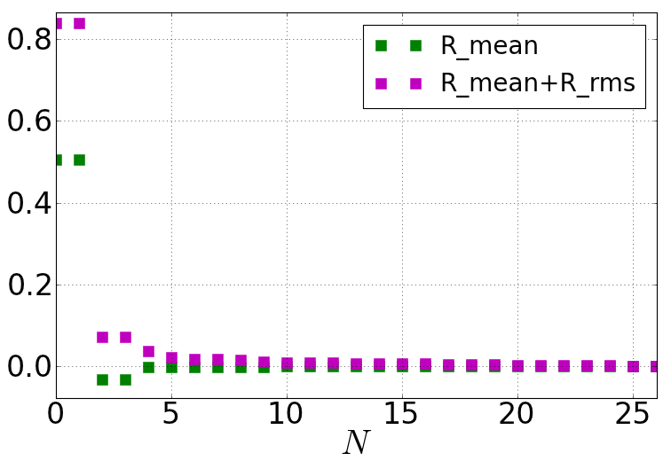
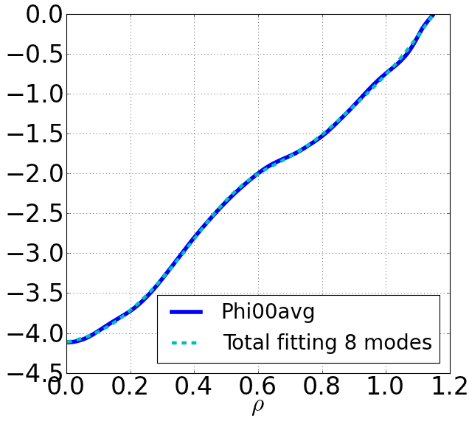
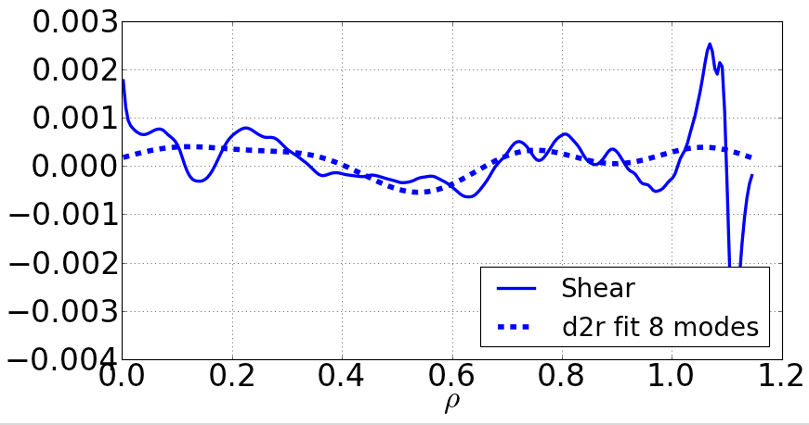
8 modes capture the general shape
Fitting with 8 modes
Mean and rms of R
$$ρ=r/a$$
Shear
… and the details?
Boundary conditions
Base of functions
$$ρ=r/a$$

Slide 8
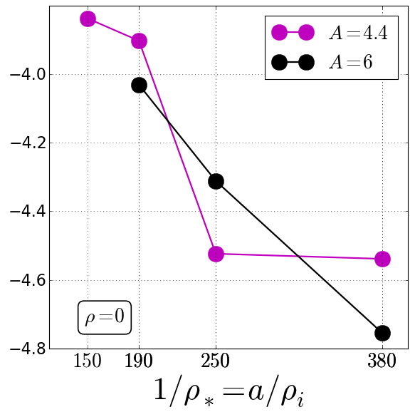
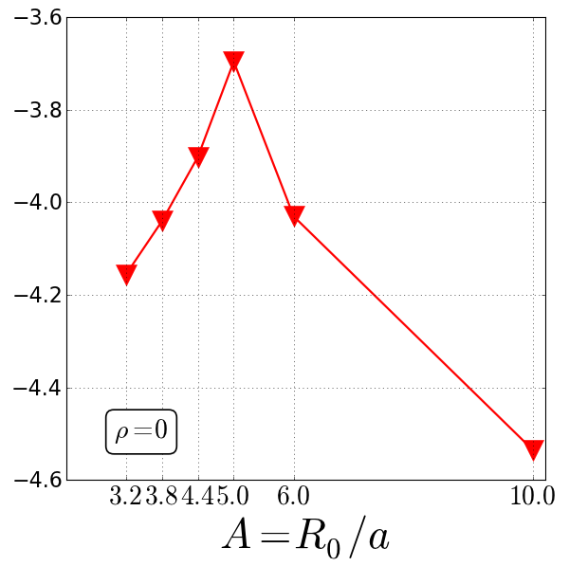
Depth of $φ_{00}$ increase with plasma size
$φ_{00}$ is a complex function of geometrical parameters
$$φ_{00}(0)$$
$$φ_{00}(0)$$
Building GYSELA database
now
Python dictionary
NEW
SQL lite
easy surf
Save plots

Slide 9
Summing up: the project
Characterization of $φ_{00}$ and 1st , 2nd derivative is determinant in understanding plasma confinement
Use data analysis strategies to predict $φ_{00}(ν_{∗},A,ρ_{∗},b.c.,n,T,∇n,∇T)$
Project $φ_{00}$ on a base of function and extract the coefficients
Training the algorithm on the base of existent GYSELA simulations
Recover a function to predict $φ_{00}$
Use $φ_{00}$ as additional check for simulations
Future: use the prediction to verify inrun simulations

