Slide 1
Data versus simulation
Yannis, Corinne, Thodoros, et al,
Mars 2019

Slide 2
Input to the simulation
Tumulus Description
Truncated cone
Inner Material Dirt with density 2.2 g/cm3, nothing else
Nb of detectors 3x2. Detector size (m) 2x0.07m 0.8m, 0.8m
Detector Rotations 10 deg in θ (polar) and 188 deg in φ (azimuthal) looking south
Detector digitization by Corrine
Need precise direction !

Slide 3
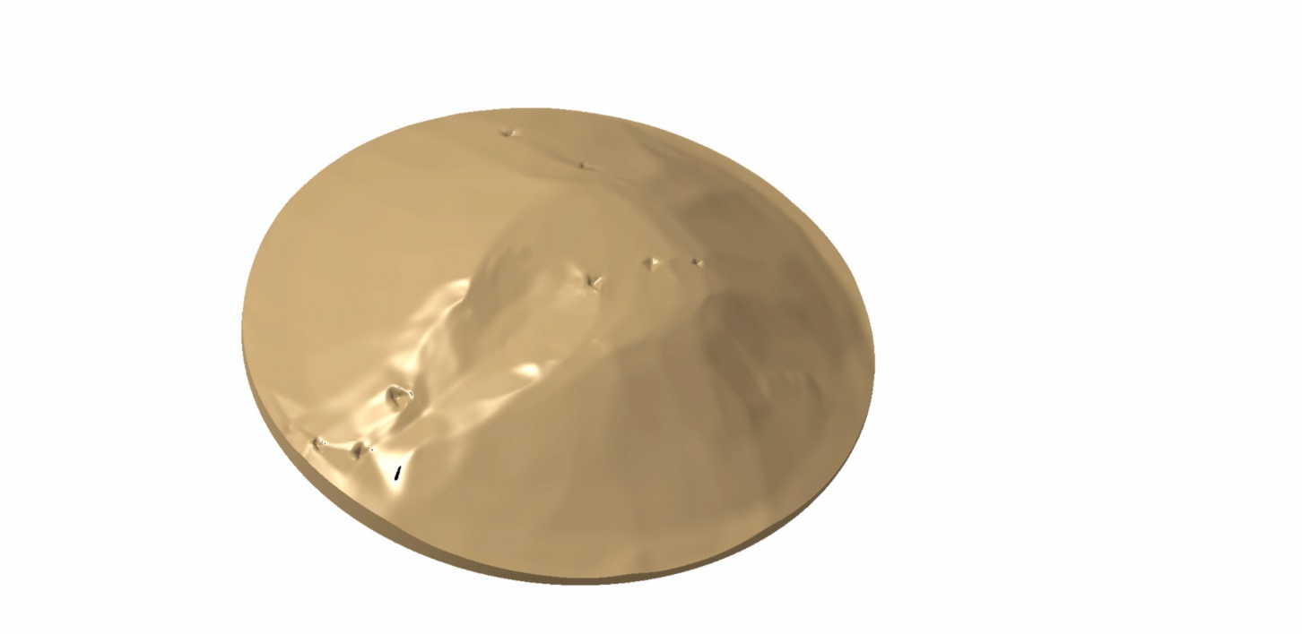
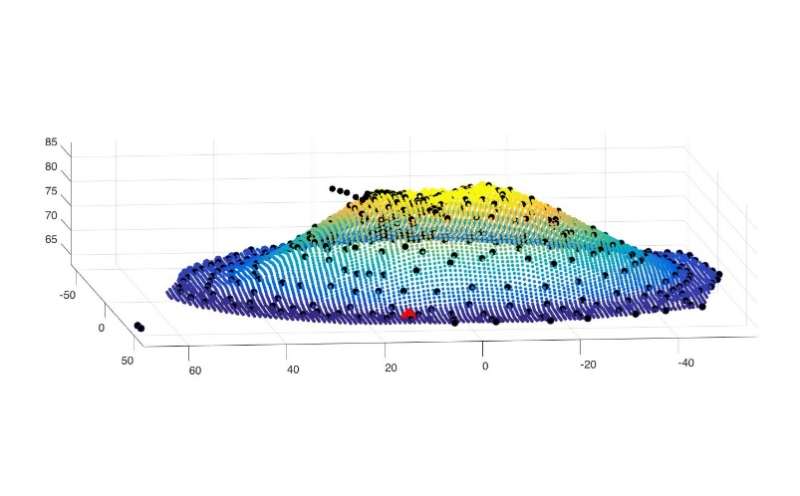
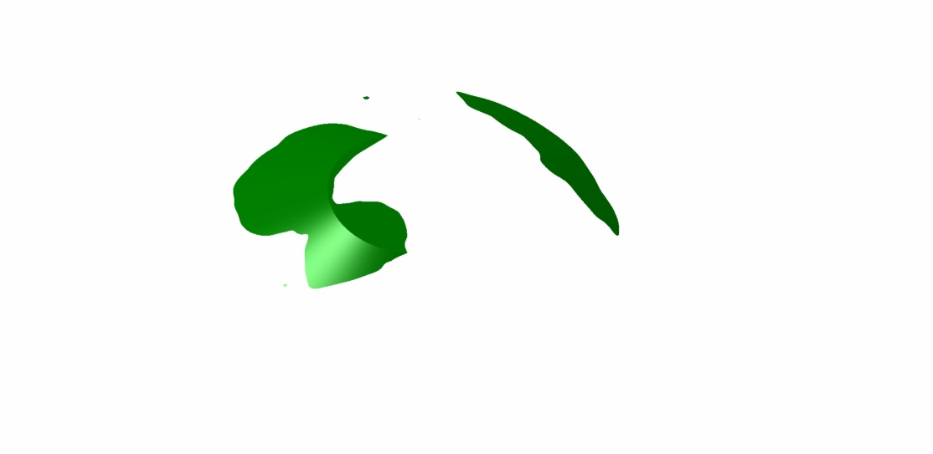
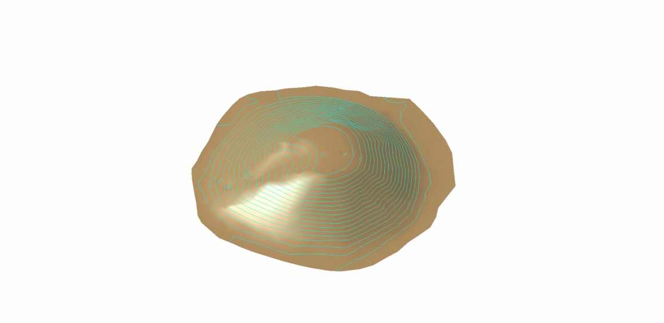
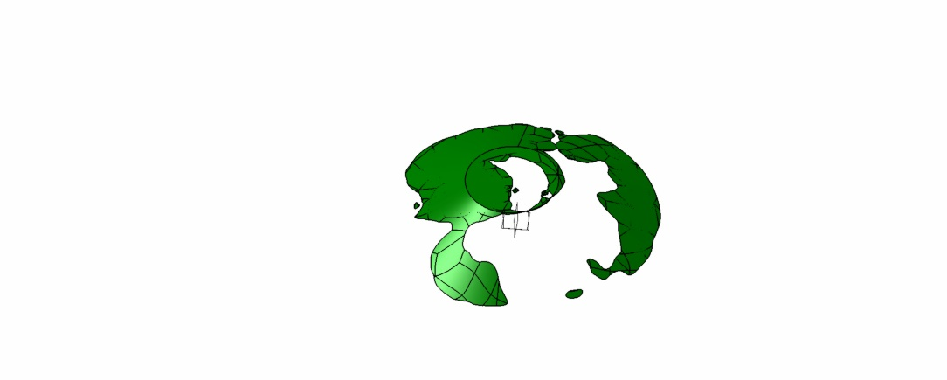
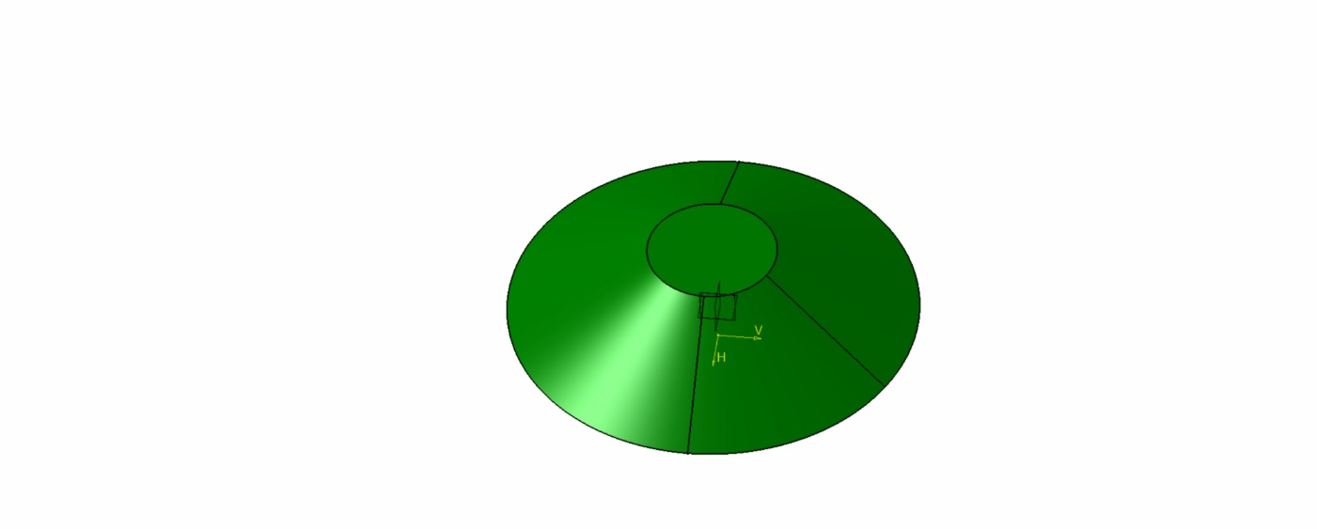
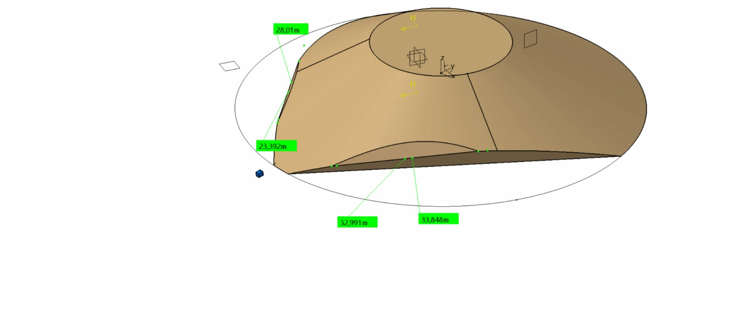
Tumulus in CATIA
Input data file
Missing or more matter
The tumulus seen by the detector
GEANT4 approximation

Slide 4
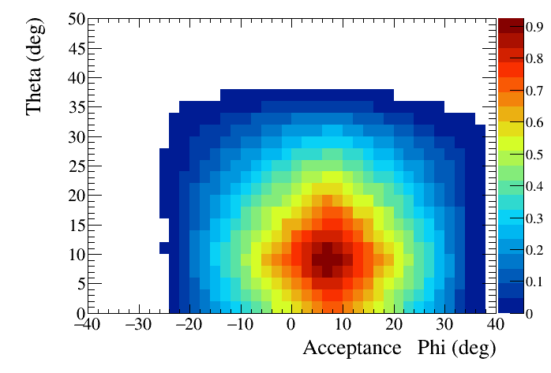
Acceptance
The acceptance with Geant 4 is computed using 50M geantinos
We generate geantinos covering all the surface of the most far detector with : θ=0-50 degrees and φ= +-40 degrees
For each θ/φ bin we count the number of events with 3(6) hits, one per detector and we divide by the number of generated events in the same bin

Slide 5
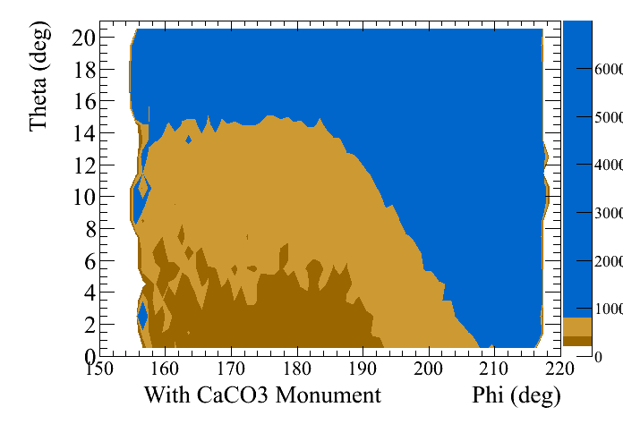
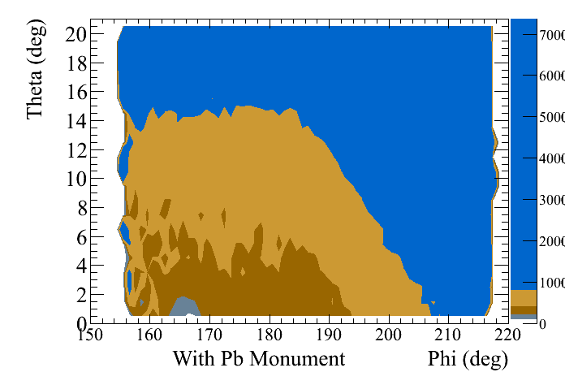
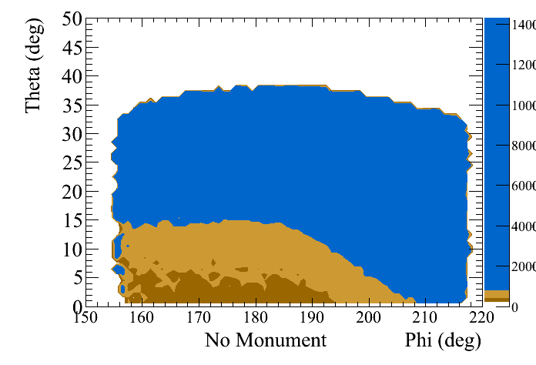
θ and φ for μ, normalized to the acceptance distributions
Distribution divided by acceptance
??
θ=0 means horizon !

Slide 6
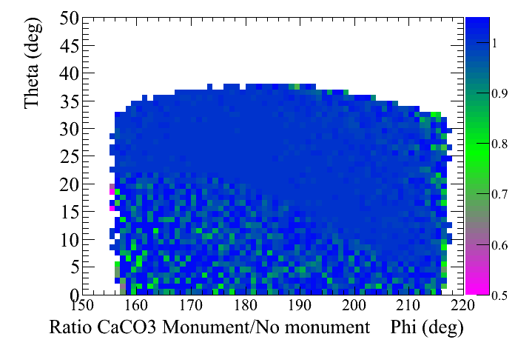
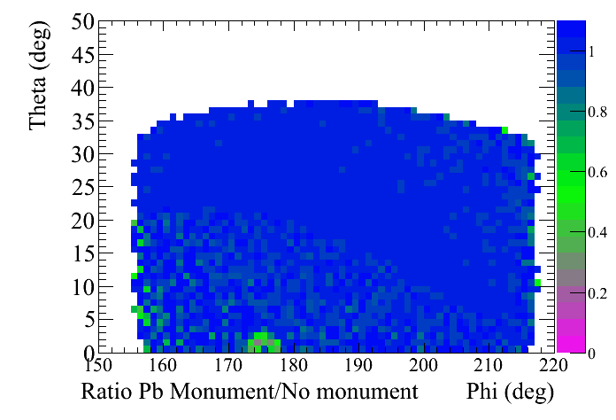
Ratios simulation only : Monument / No monument

Slide 7
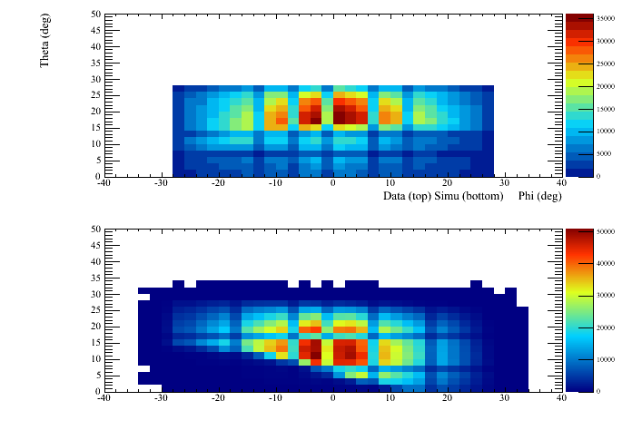
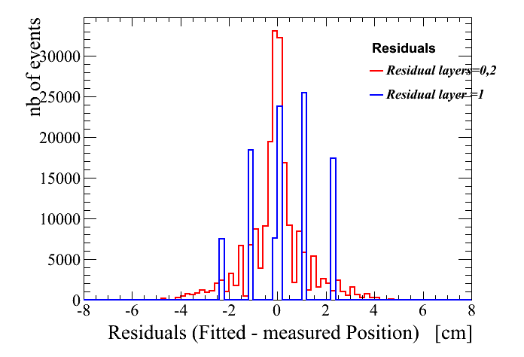
Reconstruction
Data
Events are filtered by Thodoros to validate hits (ADC <200 )
Use channel id, get coordinates in the detector system, fit a straight line in 2 directions and measure θ and φ in the detector system ! Reject bad tracks
~5M events
Simulation
Use channel id after Corrine’s digitization, fit a straight line in 2 directions and measure θ and φ in the detector system !
θ Versus φ Data
Residuals from fit
θ Versus φ Simulation

Slide 8
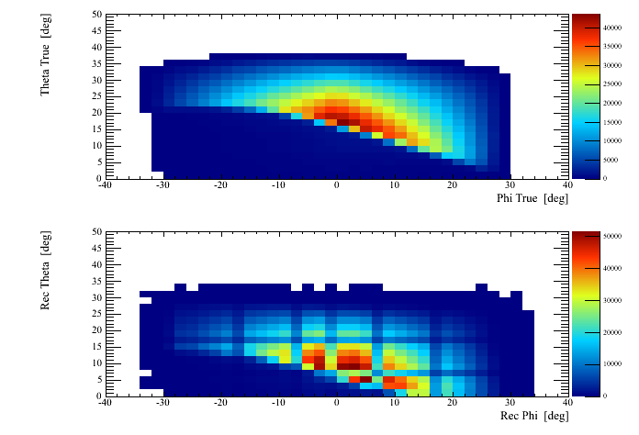
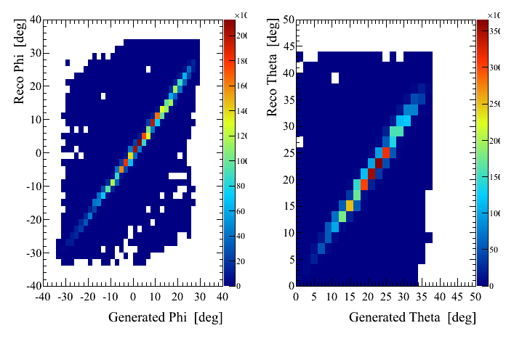
Simulation
True
Reconstructed

Slide 9
Data versus simulation
Cosmic muons angular distribution models
Simulation is done with both polar and azimuthal angles distributions uniform
Using a given law f(θ,φ) we compute for every bin θ,φ a weight = ratio of f(θ,φ) / uniform
The θ,φ distribution from simulated muon events, after reconstruction is multiplied by the weights to obtain a new θ,φ distribution . In this way we can change the model without regenerating all muons with Geant4
Normalising data and simulation
The normalization between data and simulation is computed using the events above the tumulus

Slide 10
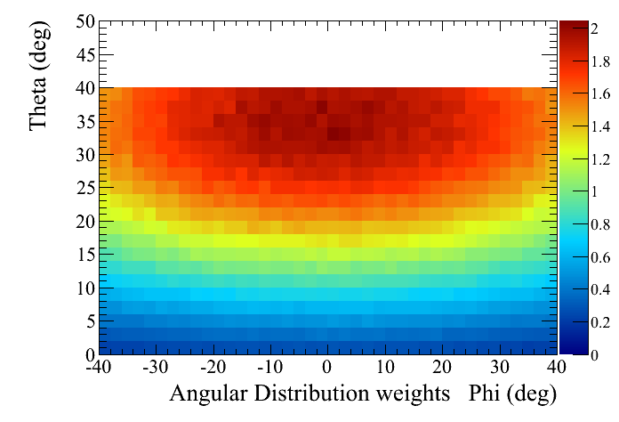

Slide 11
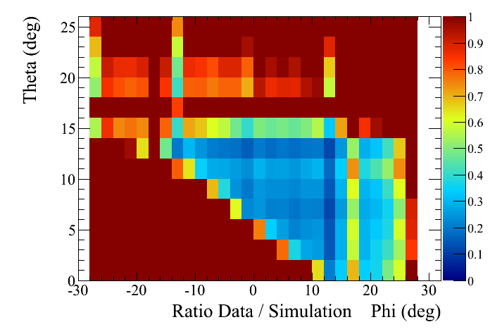
We make the ratio of Data / (Normalized weighted simulation events)
When ratio = 1 means it means > 1 !!!!

Slide 12
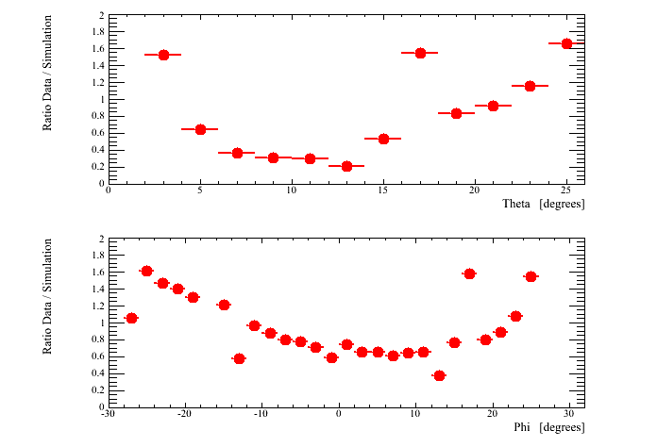
Ratio data / simulation integrating over 1 dimension

Slide 13
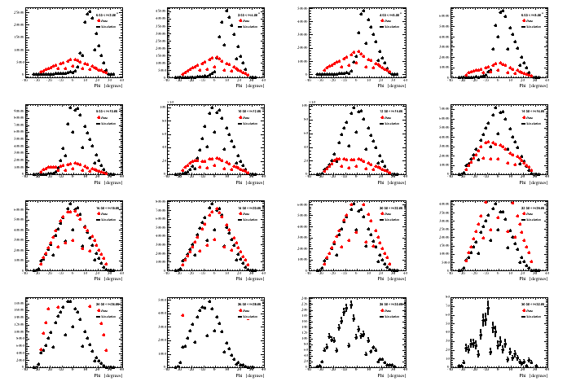
Nb of events data in red and simulation in black versus φ for 2 degrees slices in θ

Slide 14
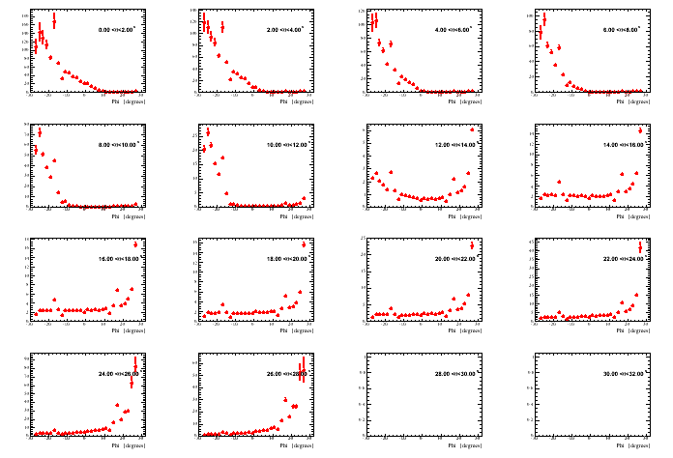
Ratio versus φ for 2 degrees slices in θ

Slide 15
Conclusions and projects
We need a reliable muon angular distribution in open sky
Use backward tracks
Work on the geometrical tumulus model. Read geo-points and build an adequate solid in Geant4
We need precise geometry for the detector position and pointing
Optimist that the method works
The detector should be positioned below the horizon if we search for a monument inside a tumulus

