Slide 1
Les detecteurs du futur
École de GIF 2019, 2-6 septembre 2019
École polytechnique - Palaiseau
D. Contardo - IP2I CNRS/IN2P3

Slide 2
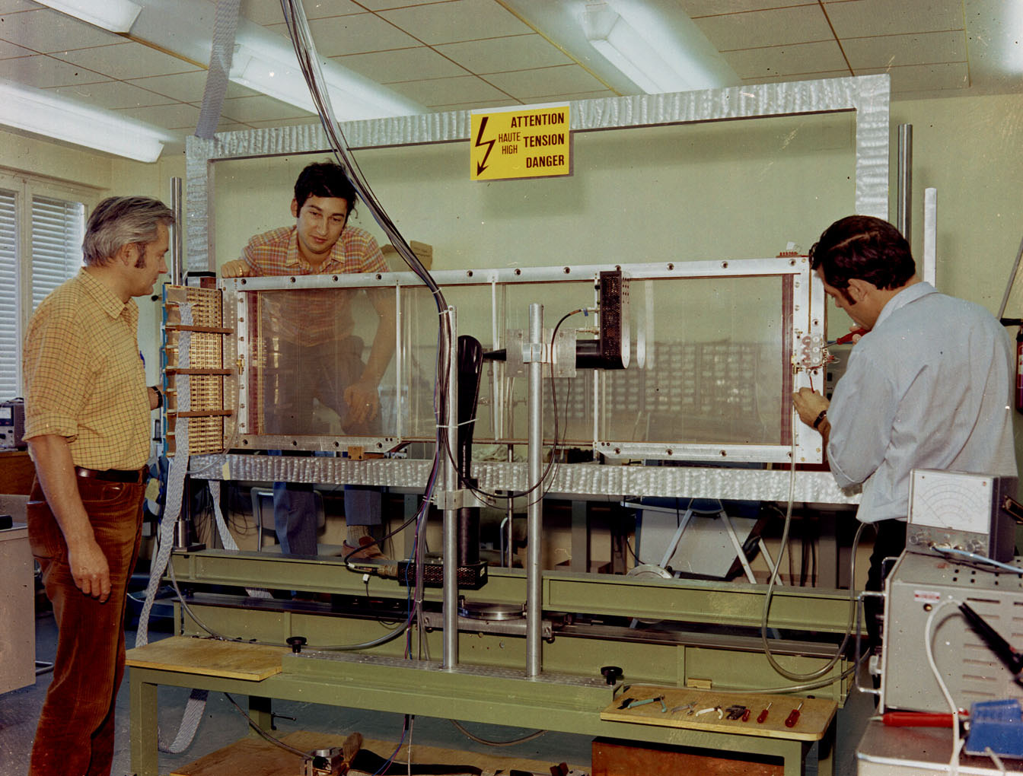
Gas detectors
Measure charged particle trajectories and/or dE/dx for mass identification
well adapted to large area muon systems or large tracking volumes
wide range of granularity and designs, provide hardware trigger
MWPC
H1 Drift Chamber
ALICE TPC

Slide 3
Gas detectors: primary signal parameters
Ionization
  I₀ = ionization potential, minimum energy required to create an e⁻-ion pair
  W_{i} average energy of a pair
  n_{prim} = L/λ, L thickness, λ mean free path¹⁾
    Fluctuations, dE/dx resolution, efficiency
  n_{tot} = L.(dE/dx)/W_{i}
    Estimate of signal
Transport of charge in E-field
    µ mobility ∝ time between collisions²⁾
    v_{d} drift velocity = µE, E-field
      O(cm/µs) for e⁻ and O(10 µm/µs) for ions
        The low ion drift velocity is a rate limiting factor
    Diffusion (electron cloud expansion) can affect detector resolution
      σ⊥(t) = √(2/3.D.t), t drift time, D = λ²/τ, λ mean free path, τ average time between collisions³⁾
        σ⊥ is O(100 µm/cm)
Gas | ρ (g/cm³) | I0 (eV) | Wi (eV) | min dE/dx (keV/cm) | nprim (cm^{–1}) | ntot (cm^{–1})
He | 1.79×10^{–4} | 24.6 | 41 | 0.32 | 3.5 | 8
Ar | 1.66×10^{–3} | 15.7 | 26 | 2.53 | 25 | 97
CH4 | 6.67×10^{–4} | 12.1 | 30 | 1.61 | 28 | 54
iC4H10 | 2.49×10^{–3} | 10.6 | 26 | 5.67 | 90 | 220
CO2 | 1.84×10^{–3} | 13.8 | 54 | 3.35 | 35 | 100
λ depends on temperature and pressure
For e⁻ µ ∝ to E.τ, τ mean time between collisions (Ramsauer-Townsend effect), it is ≃ cst (saturation with E for proper choice of gas mixture)
E and B fields, reduce diffusion effect

Slide 4
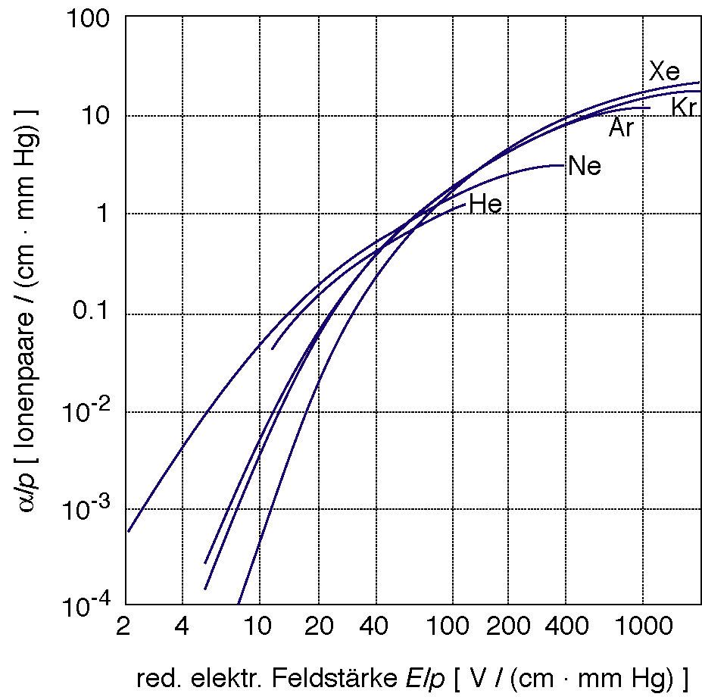
Gas detectors: amplification process
If E-field is high close to anodes, e⁻ are accelerated and generates an ionization avalanche process with an exponential gain:
  G = N/N₀ exp ∫α(x)dx, α(x) first Townsend coefficient ∝ to interaction cross section
    Typically G is O(10⁴-10⁵), this is the proportional regime
  Excitation of atoms in addition to ionization produce mostly
  UV photons (8 - 14 eV) creating photo-electrons and then secondary
  avalanches, overall gain becomes:
    N/N₀ = G/(1- γG), γ second Townsend coefficient (probability
    to create a photo-electron per e⁻)
      γG ≃1 is Geiger- Muller mode (signal no longer local)
  Avalanche quenching allows to remain in the proportional domain through
    Switching of high voltage or with resistive electrodes
    Adding gas components that absorb UV before photo-electron production, or transfer excitation to molecules (too heavy to generate ionization)
    At high gain O (10¹⁰) and high gas quenching fraction (50%) secondary avalanches can be controlled, this is the streamer mode (signal still local)
1st Townsend coefficient

Slide 5
Gas detectors: operation modes and generic designs
Streamer mode: Resistive Plate Chambers…
Proportional mode:
Single wire: Straw/Drift tubes…
MultiWire Proportional Chambers (MWPC), CSC, Drift Cahmber, TPC...
MicroPattern Gas Detectors (MPGD): MSGCs, GEMs, MicroMegas …
Counting
Ionization chambers:
Parallel plate capacitors

Slide 6
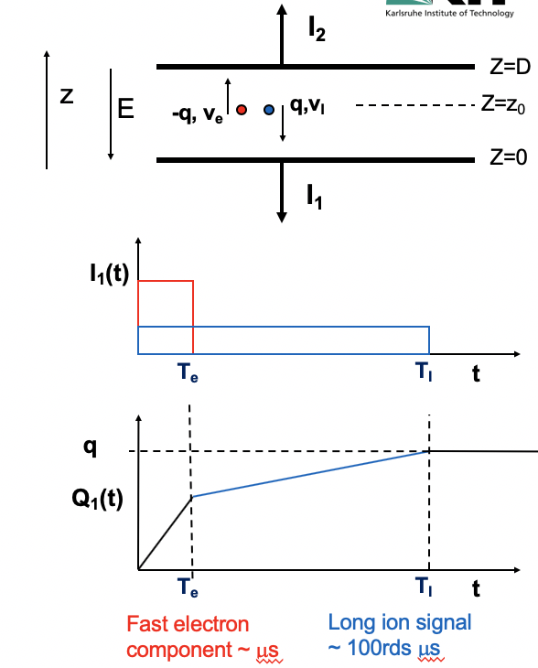
Gas detectors: signal time development
Collected signal is from induction of e⁻-ion pairs drift
  Q induced on a given electrode respectively by e⁻ and ions depends on detector geometry (field configuration), it follows Shokley-Ramo law
  It drives the signal time development as drift velocity is very different for e⁻ and ions
e⁻
ions
Garfield simulation software include all process of signal collection to guide detector design

Slide 7
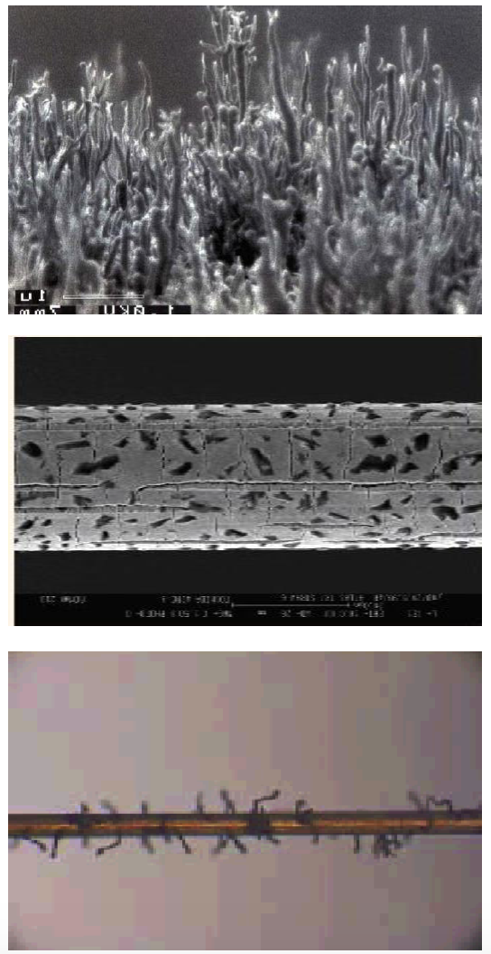
Gas detectors: radiation tolerance
Radiation tolerance is referred to as aging and is characterized by the gain degradation with the charge integrated over time per unit length (area) of electrode (C/cm(cm²))
  Aging process is typically due to formation of deposit on the electrodes
    Deposits on anodes can be conductive, creating thicker electrode, or insulating, creating charge accumulation, they decrease gain and/or introduce non uniformities
    Deposits on cathode plans can create insulating layers and a dipole effect generating electron field emission resulting in dark current or discharges
  Source of aging are:
    Gas components: ex hydrocarbons, e⁻ break CH₄ to CH₂ + H₂, CH₂ radicals create polymer deposits
    Accidental pollution of gas mixture (ex. silicon present in several materials)
    Outgassing of construction material and possible effect of irradiation on these materials (ex. glues)

Slide 8
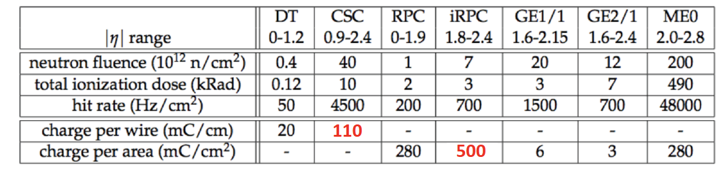
Gas detectors: radiation tolerance
Integrated charge: Q ∝ Gain x Rate x Time x Primaries
  Depend on gas, pressure, temperature, flow, operation voltage(s), detector geometry…
  Dose rate, particle type, ionization density
Aging is not an intrinsic property, gas detectors can be radiation tolerant
with careful control of aging causes and thorough pre-qualification with accelerated tests, eg:
  Choice of gas mixture
  Choice of operation parameters, renewal of flow, minimized gain (low noise electronics helps)
  Strict control of gas system, pipes, leaks
  Choice of chamber materials (databases exist)
  Addition of small amount of O₂, H₂O to etch/prevent deposits
  Some geometry are less prone to aging, ex. multiple amplification stages in GEM, far from collecting electrode, substantially increase longevity
Example of integrated charges in CMS muon systems at HL-LHC (3000 fb⁻¹)

Slide 9
Gas detectors: discharges
Under high voltage local sharp edges on electrodes and/or charge accumulations can generate discharges, that destroy electrodes and/or readout and/or introduce recovery dead time
  This is a typical effect of MicroPattern devices where metal electrodes are etched and/or distance between anodes and cathodes are small O(10-100) µm
  Quality of electrode etching process is crucial to reach required high voltage (gain)
  Control of material resistivity for charge evacuation is important
  Strict QA/QC tests need to be implemented to evaluate discharge rates
    Test can be long, acceleration can influence result (charge accumulation is rate dependent)
  Thorough electronics protections needs to be implemented considering energy released in discharges (it depends on electrode capacitance)
  Some geometries are less prone to discharges, operation at lower gain is beneficial

Slide 10
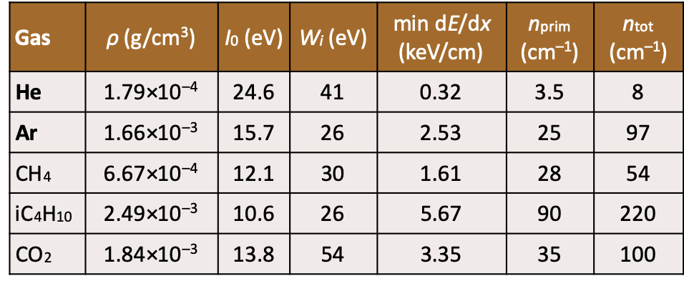
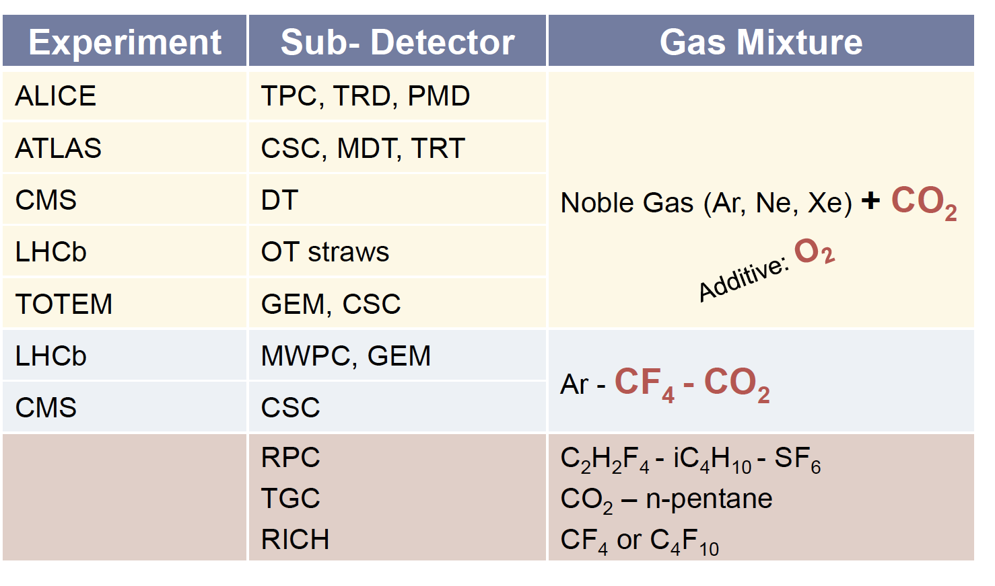
Gas detectors: gas mixture choice
Gas parameters
  Large primary ionization (fluctuations): noble gas (Ar, Kr, Ne, Xe), CO₂, hydrocarbons (similar)
  Total ionization (signal amplitude): similar behavior as primary ionization¹⁾, He and CO₂ better for sensitivity to single primary ionization
  Drift velocity (signal rise time, charge collection time (rates)):
  Hydrocarbons better than CO₂ better than noble gases²⁾,
  He x 5 better than noble gas for ions, in Ar:iC₄H₁₀ e⁻ mobility
  saturates at low E-field³⁾
Other criteria
  Avalanche quenching: iC₄H₁₀, CH₄, Ethanol in proportional mode,
  special hydrocarbons in streamer mode
  Aging properties: CF₄, O₂, H₂O
  Multiple scattering of incident particle or primary electrons:
  high X₀, favor low Z eg. Ne, He
Main components are noble gases (mostly Ar), gas mixture proportions allow optimization according to different detector types and choice of compromise in performance criteria
Some times due to compensation in different parameters, eg density, dE/dx, mean pair energy
Difference somewhat higher for electrons than for ions, 3) constant mobility is important for drift time measurement

Slide 11
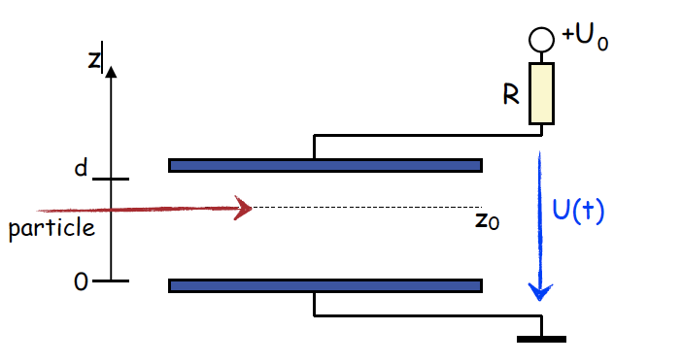
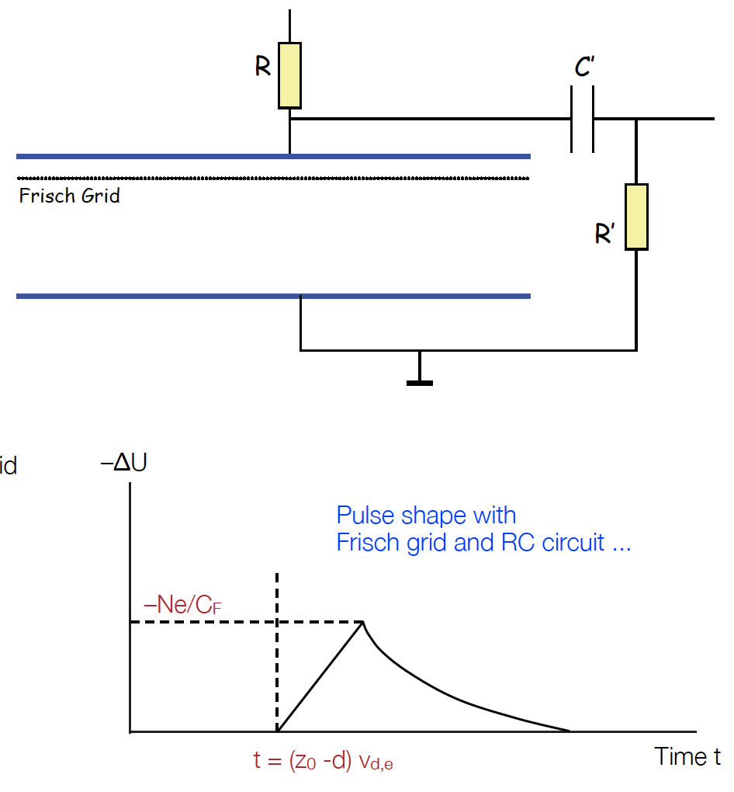
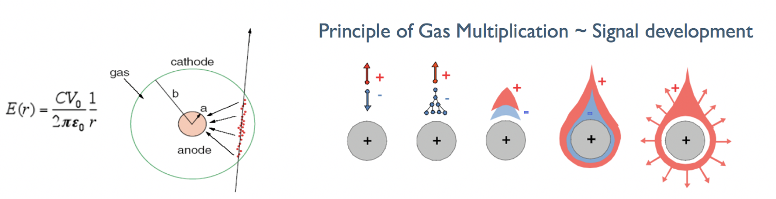
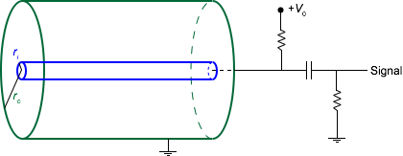
Gas detector designs: Ionization Chambers and Straw Tubes
Ionization chambers
  Large cells suitable to monitor particle flow from current or pulse measurement (not really for position)
    Typical size: O (cm x cm x cm)
    Frisch grid filter ion signal, sensitivity only to
    electron drift (signal doesn’t depend on crossing
    position)
Straw tubes, used for Transition Radiation Tracker¹⁾
  Single anode wire (usually gold plated W) in cylindrical cathode tube (ex Kapton doped carbon)
    Typically anode wire radius O(10’s) µm, and radius order O(mm-cm)
    Voltage application allows amplification in 10’s of µm around anode (order of mean free path)
    The signal is dominated by the drift of ions toward the cathode
E(r) = V/[rln(r_{b}/r_{a})]
Avalanche process
1) See Cerenkov section

Slide 12
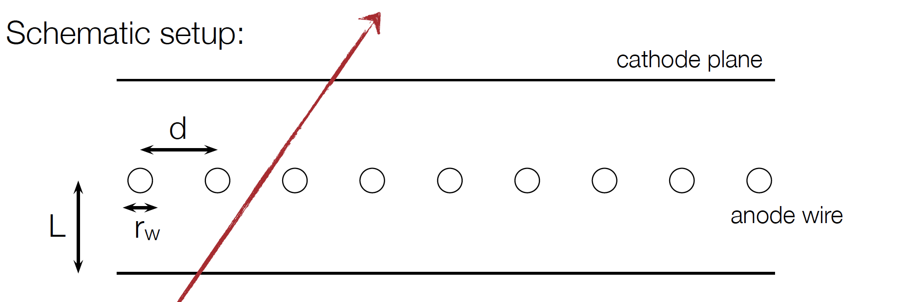
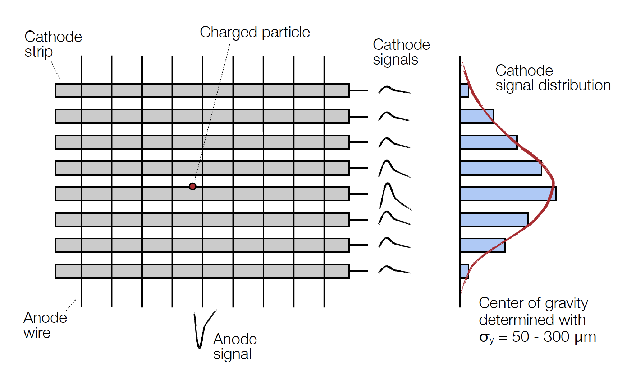
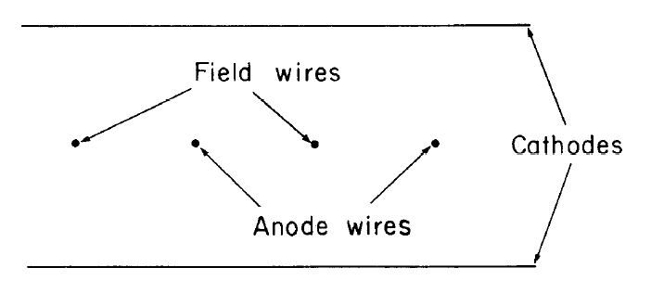
Gas detectors designs: MultiWire Proportional Chambers (MWPC)
Planar geometry to extend sensitive area to O(m²), extensively used in muons systems, TPC readout
  Operation at few kV
  Rates O(10’s) kHz/cm²
  Resolution O(50-100) µm with center of gravity of signal
  Cathode segmentation allows readout for 2D-coordinates
  measurement
1-5 mm
3-6 mm
20 -30 µm
Field lines
CMS resolutions: ≃ 50-250 µm and ≃ 5 ns
ATLAS Thin Gap Chambers resolution ≃ 50 µm
Field wires reduce weak field area between anodes

Slide 13
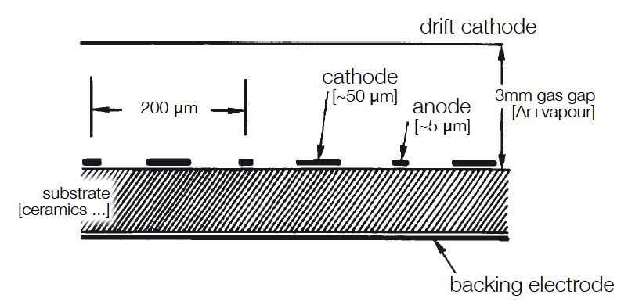
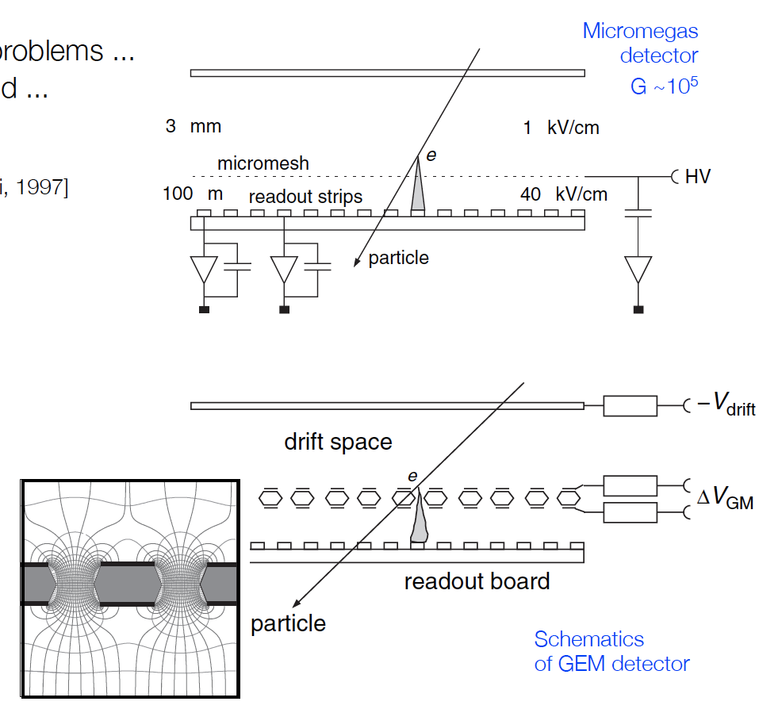
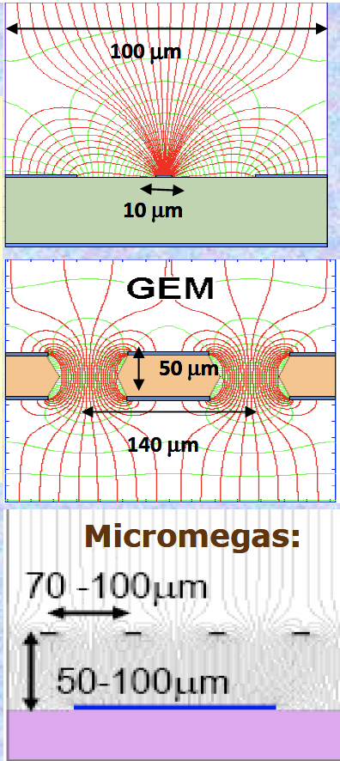
Gas detector designs: MicroPattern Gaz Detectors (MPGD)
Micro-structures on insulator using etching technologies replace wires to increase granularity for rate/occupancy capability and resolution, used for muon systems and TPC readout
  Rates O(MHz)/cm², σ_{hit} ≃ 50 µm, σ(t) ≃ few ns
  Original design with MicroStrip Gas Chambers (on glass/silicon wafers)
    Lythography technics not good enough at that time to avoid discharges
  MicroMegas: mesh design with amplification between mesh and anodes
  GEM: Intermediate amplification in metalized foil holes
MSGC
MicroMegas
GEM

Slide 14
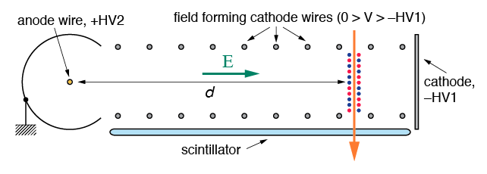
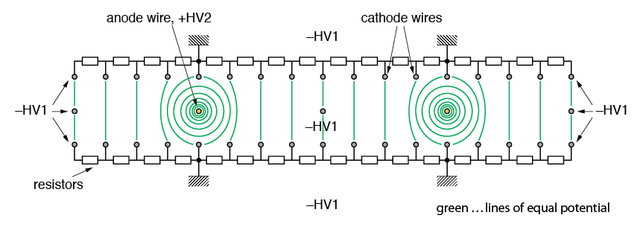
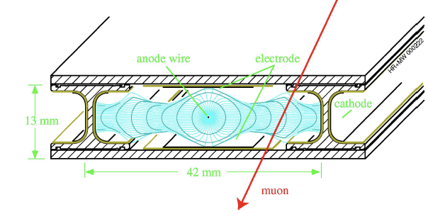
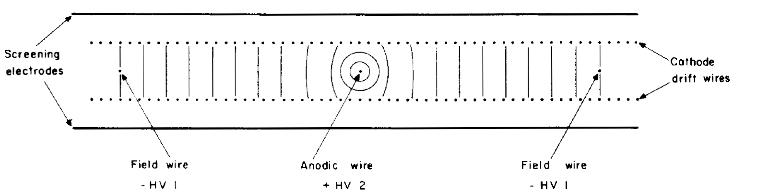
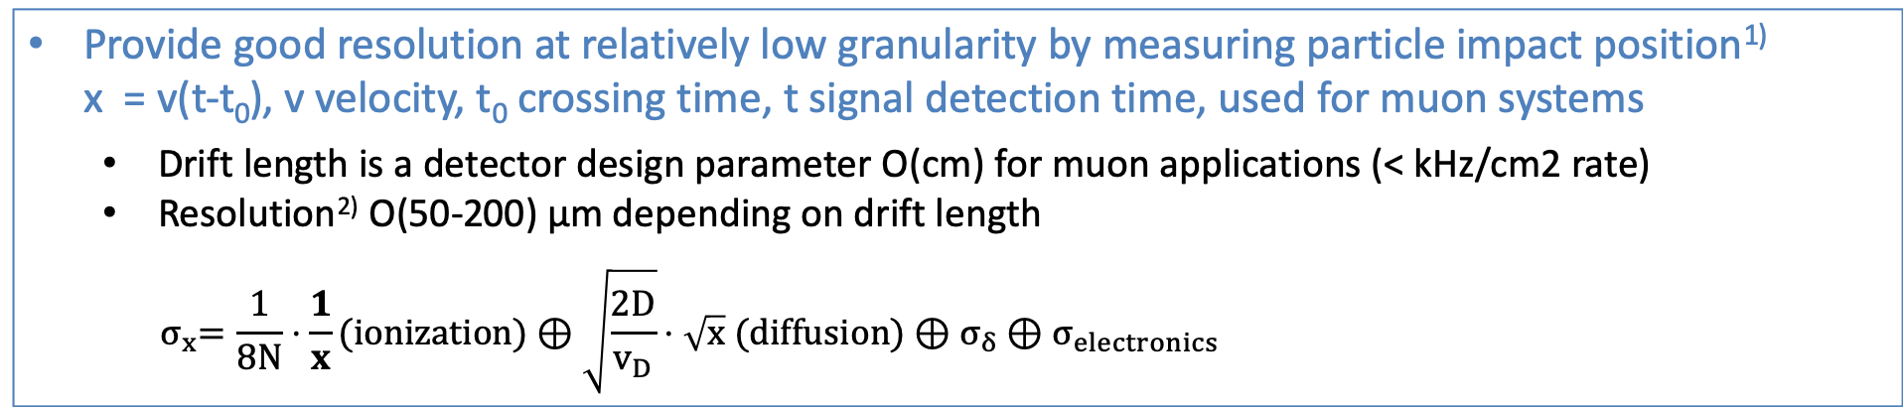
Gas detector designs: Drift detectors planar design
Provide good resolution at relatively low granularity by measuring particle impact position¹⁾ x = v(t-t₀), v velocity, t₀ crossing time, t signal detection time, used for muon systems
  Drift length is a detector design parameter O(cm) for muon applications (< kHz/cm2 rate)
  Resolution²⁾ O(50-200) µm depending on drift length
  $${ σ}_{x}=\frac{1}{8N}⋅\frac{1}{x}(ionization)⊕\sqrt{\frac{2D}{v_{D}}}⋅\sqrt{x} (diffusion)⊕σ_{δ}⊕σ_{electronics}$$
MultiWires design, field adjusted to maintain constant field (velocity) with HV divider on cathodes wires
Drift Tube designs
ATLAS/LHCB CMS
resolution:
ATLAS ≃ 100 µm
LHCb to 200 µm
resolutions:
≃ 100 µm and ≃ 2 ns
z-coordinate can be measured from charge division with readout at both ends of anodes
Pressure can improve primary ionization N and reduce diffusion

Slide 15
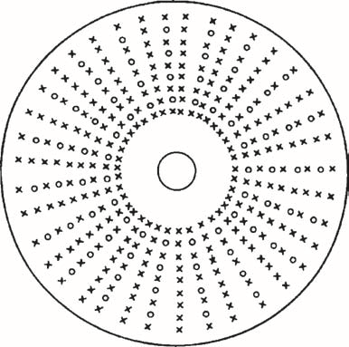
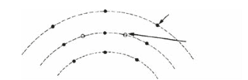
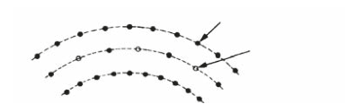
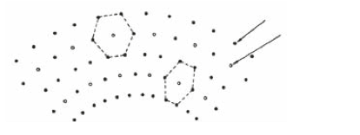
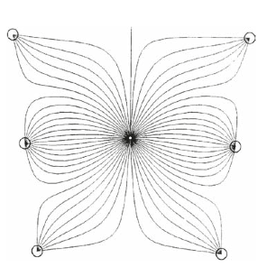
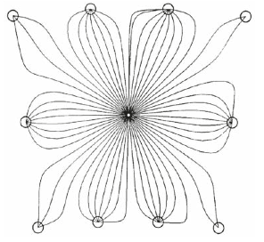
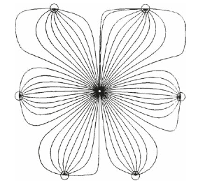
Gas detector designs: Drift Chambers cylindrical design (DC)
Extend the planar drift measurement concept to large volume and number of measurement points on track path, with low material mass, can provide particle ID with multiple dE/dx measurements, used for tracking in relatively low rate environment
  Longitudinal anode and cathode wires in cylindrical gas volumes
  Cell size can be adjusted to performance needs
  Staggered anodes can allow solving ambiguities
  Stereo can measure z coordinate
Open Drift Cell
potential
wire
Closed Drift Cell
potential
wire
Hexagonal Drift Cell
potential
wire
anode
wire
anode
wire
anode
wire

Slide 16
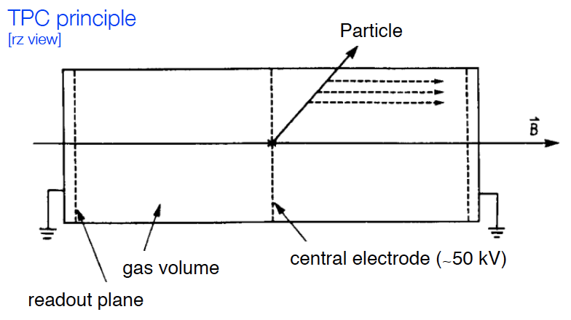
Gas detector designs: Time Projection Chamber principle
Large ionization volume and long drift from middle of cylindrical detector to endcap region equipped with MWPC/MPGD for amplification, used for tracking in relatively low rate environment
  Wires/pad provide xy coordinate as a function of drift time for full x/y/z measurement
    Typical resolutions: z O(cm), x O(100 µm), y O(mm)
  Charge measurement provide dE/dx for particle ID
    Typical resolution 5-10%
  Rate capability limited by long drift
    A gating grid in front of the MWPC/MPGD can be
    biased to prevent electrons to enter the amplification
    region in absence of trigger, it also collects ions to
    minimize feedback in the drift volume between events
1) Pressure can improve primary ionization N and reduce diffusion, B-field // to drift minimize diffusion

Slide 17
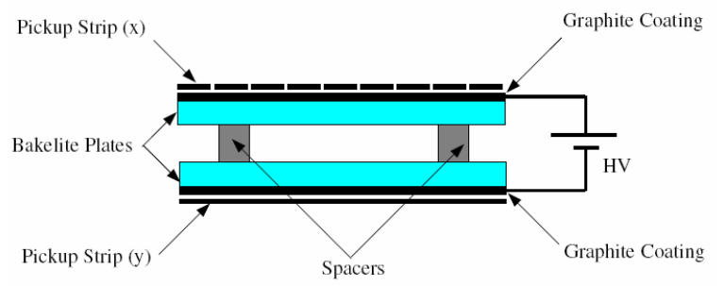
Gas detector designs: Resistive Plate Chamber
An ionization chamber operated in steamer mode (no wires), used in muon systems for trigger
  Fast signal (from first primary ionization streamer), O(ns) time resolution
  High voltage O(10kV)
  Special gas mixture with quenching ability: ex C₂H₂F₄:isoC₄H_{10:}SF₆ (95.2:4.5:0.3%)
  Strip or pad electrodes for readout with relatively large pitch O(cm)
  Relatively low rate O(0.1-1) kHz (depending on geometry and electrode resistivity)
  Relatively low resolution O(cm) (large electron cloud)
Double gap design
2 mm
HV
O(10kV)
ATLAS design resolutions: O(cm) and ≃ 2 ns
CMS design resolutions: O(cm) and ≃ 1.5 ns

Slide 18
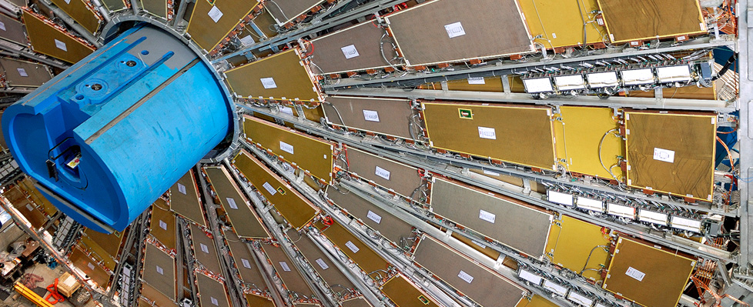
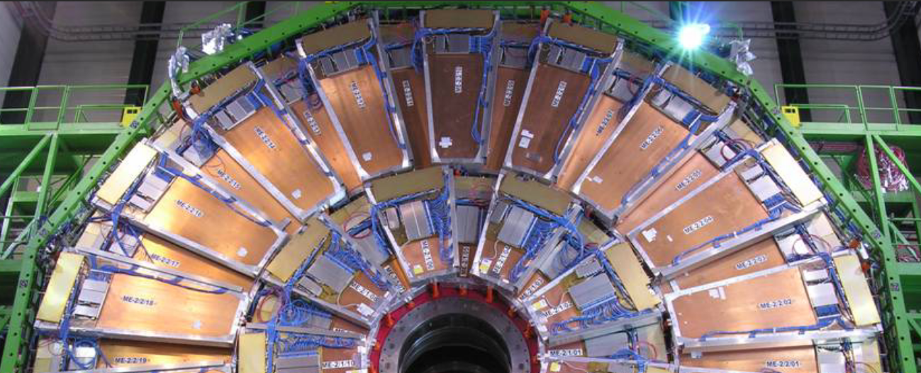
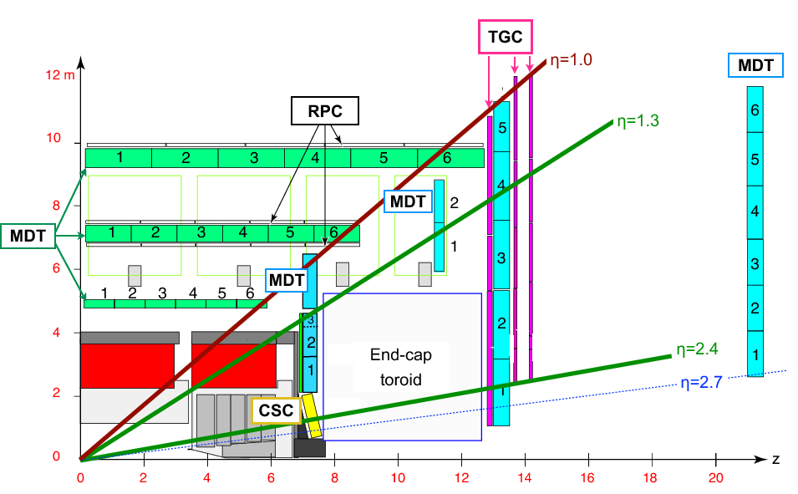
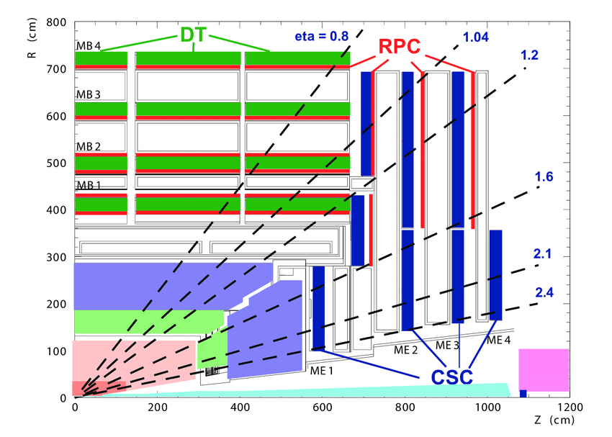
Gas detectors: ATLAS and CMS today’s muon systems
ATLAS
σ(p_{t})/p_{t} ≃ 5(10)% ATLAS (CMS)
in trigger (w/o tracker)
CMS
DT: 18000 m²
CSC: 7000 m²
RPC: 3200 m²
1171 Muon Drift Tubes 354 kch
544 Resistive Plate Chambers 380 kch for trigger¹⁾
3588 Thin Gap Chambers 440 kch for trigger¹⁾
32 Cathode Strip Chambers 70 kch
1) Also provide coordinate in the non bending plan
250 Drift Tubes (DT), 170 kch
480 Resistive Plate Chambers (RPC) 120 kch
540 Cathode Strip Chambers (CSC) 266k cat. 210k ano.
576 Resistive Plate Chambers (RPC) 55kch

Slide 19
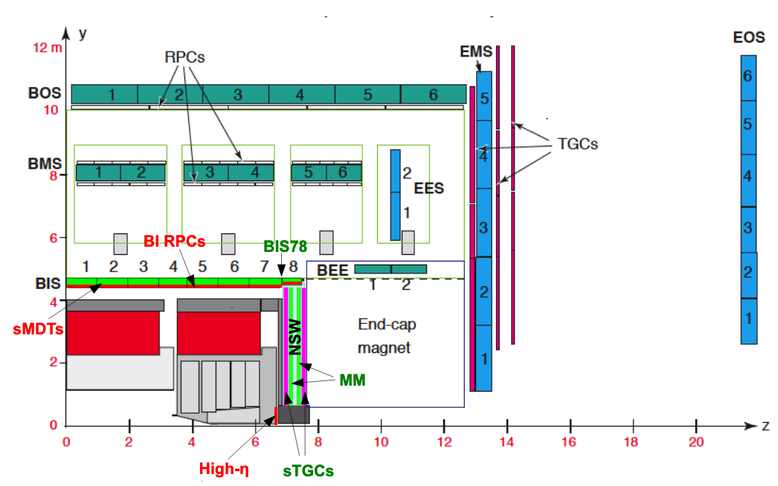
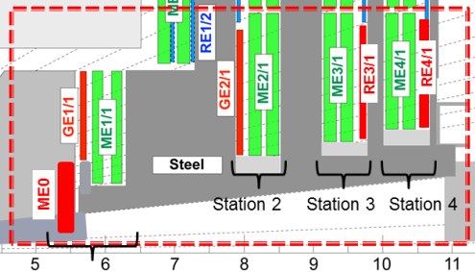
Gas detectors: ATLAS and CMS muon system upgrades
No substantial aging issues anticipated, confirmed by several test at GIF++
  Mitigations reducing gain with adjustments of operating conditions and new more sensitive electronics
Improved forward region with new stations for higher rate capability and precision to maintain low trigger thresholds and allow triggering on long-lived particles - higher granularity
Extended coverage for µ-tagging up to η ≲ 4 (in conjunction with tracker extensions)
New electronics for trigger
ATLAS
CMS
MDT
sMDT

Slide 20
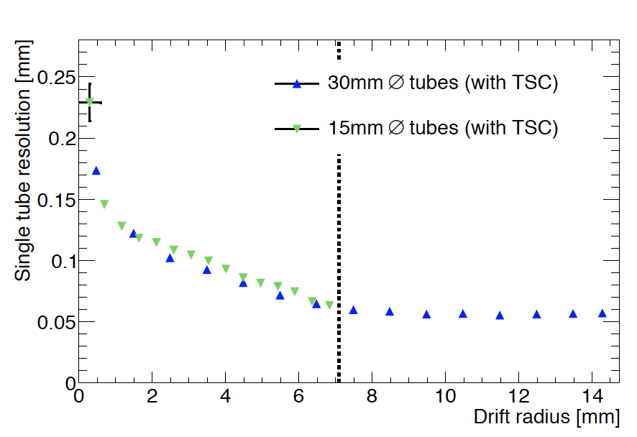
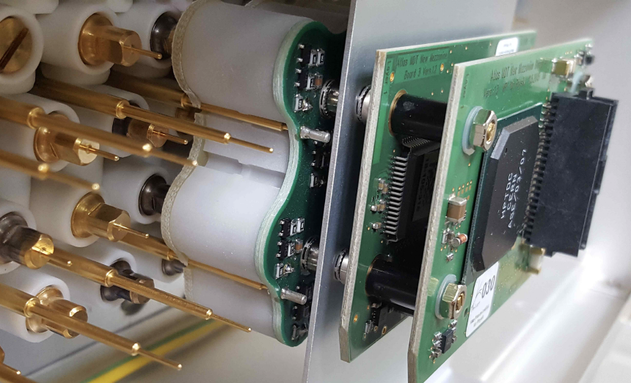
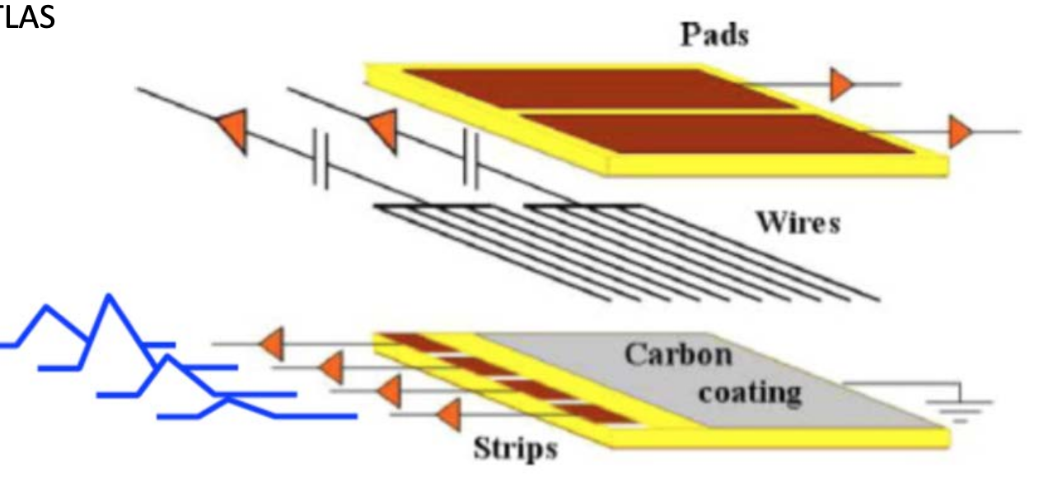
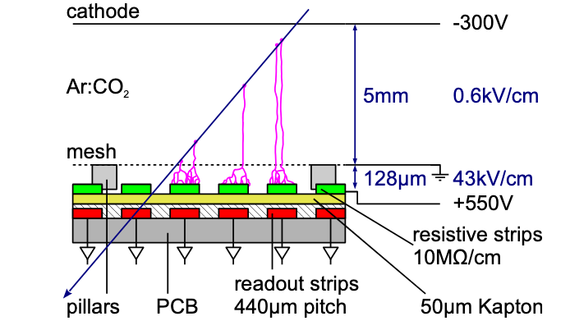
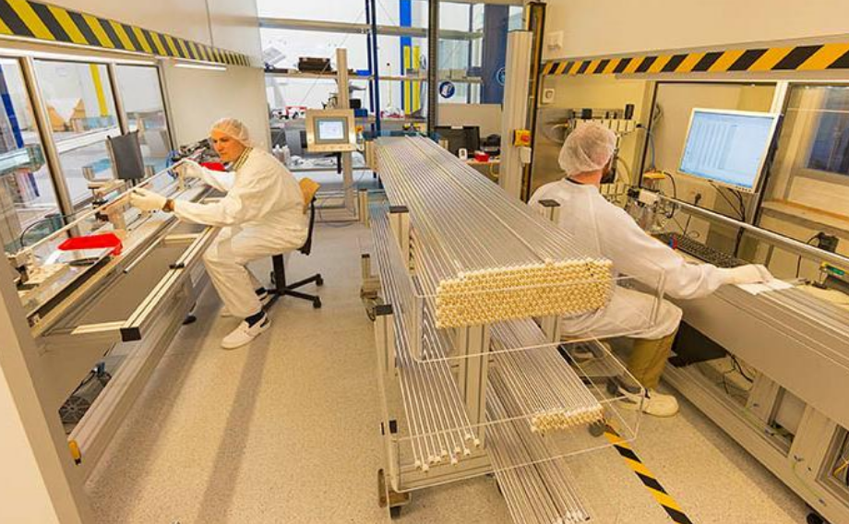
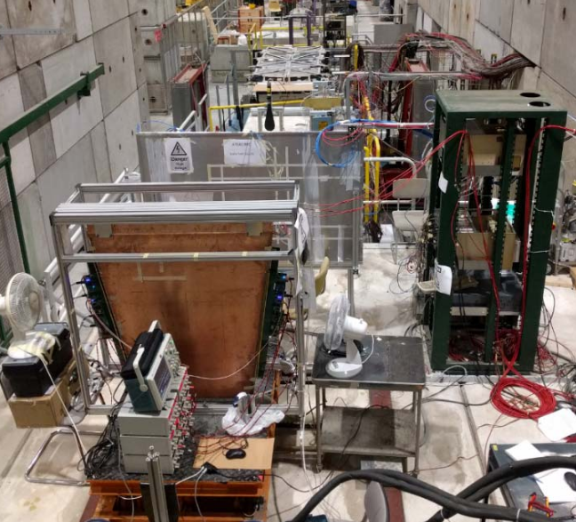
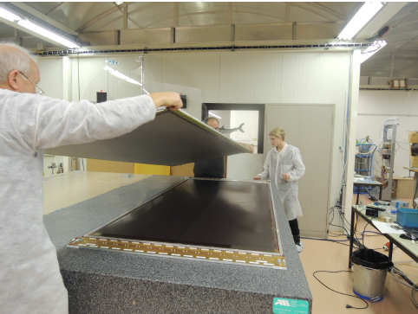
Gas detectors: ATLAS new muon system upgrades
Small Wheels
  Small Thin Gap (2.8 mm) Chambers, shorter strips 2 cm to 3.2 mm, 3 mm pitch, σ ≃ 50 µm, up to 2 x 1.2 m² , CO₂:n-pentane (55:45)
  Resistive strip Micro-Megas (0.5 mm pitch), σ ≃ 80 µm per layer, largest module 2 x 2.3 m² made of 5 PCBs, Ar:CO2 (93:7)
Small Monitoring Drift Tubes
  Reduced Φ 30 mm (200 Hz/cm²) to 15 mm (2 kHz/cm²), wires 50 µm, σ ≃ 100 µm, L = 1.6 m, Ar:CO2(93:7)
MDT/sMDT resolution
Wires 1.8 mm coarse azimuthal angle
Pads 8 cm pitch
for trigger regions
sMDT
sTGC
Strips 3 mm pitch for precise polar angle
MicroMegas
1 x 1.2 m module

Slide 21
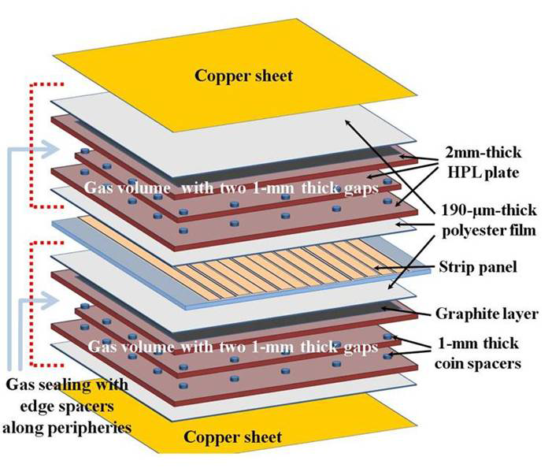
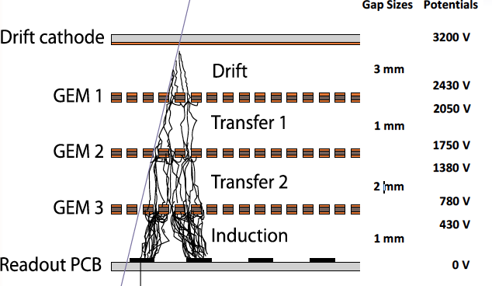
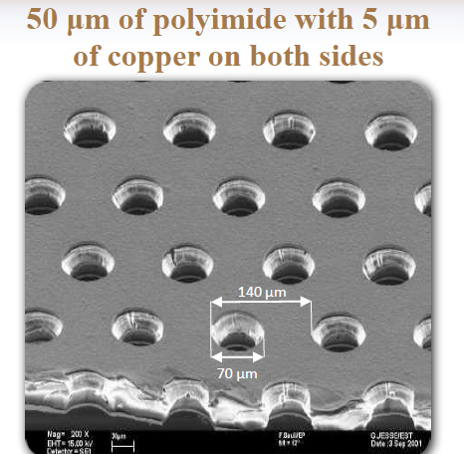
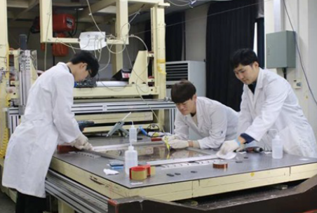
Gas detectors: CMS new muon systems upgrades
New GEM stations
  Triple GEM design, H = 1.8 m x W = 1.2 m wedges in 4 modules largest foil size so far (0.5 x 1.2 m²)
  Improved fabrication single mask foil photolithography, foil stretching mechanism
  PCB with radial strips, pitch from 0.7 mm to 1.6 mm, σ ≃ 200 to 450 µm
  Rate capability up to > 1 MHz/cm², time resolution O(10ns),
New multigap RPC stations
  Low resistivity Bakelite 1 to 3 10⁶ Ω.cm, thinner gap and electrodes 2 mm to 1.4 mm,
  Φ pitch 1.3∘ to 1.2∘, rate capability few kHz/cm², σ ≃ 0.3(2) cm ⊥ (//) to strips
  Front-end electronics with 2 ns time resolution, 2 strip-ends readout for r(η)-coordinate
Ar:CO₂ (70:30)
GEM
RPC

Slide 22
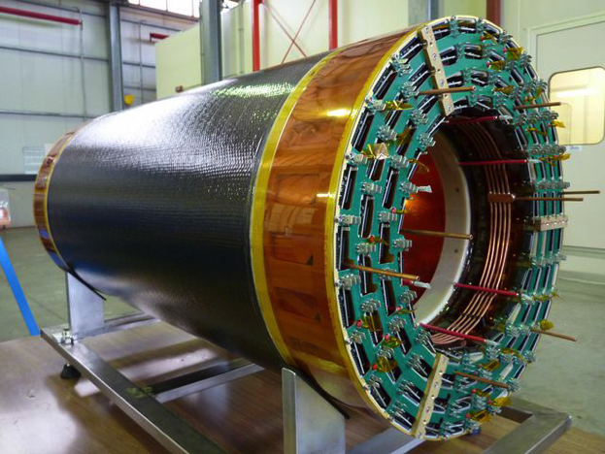
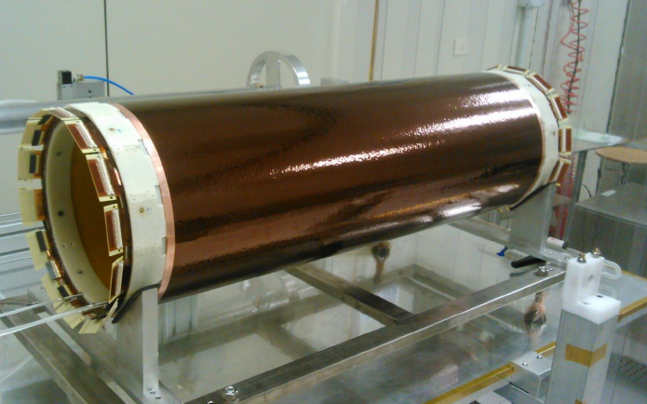
Gas detectors: KLOE-2 and BES III tracking systems
Cylindrical designs with Kapton GEMs allows low material budget
KLOE-2 at Daphne Φ-factory in Frascati
4 layers, R from 13 to 20 cm, 70 cm long
Total X/X₀ < 2%
BES III at BECP-2 in Beijing
3 layers, R from 8 to 18 cm,
Total X/X₀ <1.5%

Slide 23


Gas detectors: LHCb straw (drift) tubes Outer Tracker
3 stations 5 x 6 m² made of 4 modules of double layers (x/u/v/x orientation, u/v titled by ± 5∘)
  Double layers staggered straw tubes L = 2.4 m, Φ_{in} = 4.9 mm and pitch 5.25 mm, 3% X₀ /station
  Ar:CO2:O2 (70:28.5:1.5), V_{anode} ≃ 1.5 kV
    Fast drift time ≤ 50 ns, t_{drift}(r) = 20.5 ns·|r|/R+ 14.85 ns r^{2/}R² (measured), σ_{t} ≃ 3 ns¹⁾
    σ_{hit} ≃ 200 µm (σ(p)/p = 0.4 % 9≃ 25 MeV mass resolution in B₀ decay)
1) The CMS DT upgrade is targeting σ_{t} ≃ 2 ns for a σ_{hit} ≃ 200 µm

Slide 24



Gas detectors: MEG-II Drift Chamber¹⁾
The ultimate lightness tracking system designed to measure low momentum e⁺ (50 MeV)
Wires along z with alternating stereo layers for z-coordinate²⁾ (6∘ (8.5∘) inner(outer))
  Hyperbolic shape in z, very thin wires 20 to 50 µm, HV ≃ 1.5 kV
10 concentric radial layers 2 m long, r from 17 cm to 29 cm and very small cell size 6 x 6 mm² and 9 x 9 mm²
12 sectors in phi (stereo introduces a 2 sector shift of wires start and end)
HE:C₄H₁₀ (85:15) large radiation length ensures very low MS and high drift velocity³⁾
  X/X₀ < 0.2%, σ(r/Φ) ≃ 110 µm, momentum resolution ≃ 450 keV for 50 MeV, 30 kHz/cm² rate
Further improvements investigated with primary cluster counting technique, eg signal sampling at O(GHz)³⁾
20(40) µm sense (field) wires
Design is inspired from the KLOE-2 experiment DC in operation, MEG-II DC is being commissioned
Completed by charge division measurement
He is well adapted for cluster counting with a high primary pair average energy

Slide 25


Gas detectors: IDEA DC proposal¹⁾ for FCC-ee and CEPC
Extension of MEG II concept to much bigger volume
will use cluster counting technique for dE/dx particle identification
With vertex detector

Slide 26


Gas detectors: ALICE TPC
Tracking with σ(p)/p ≃ 2% at 10 GeV
Particle identification with σ (dE/dx)/(dE/dx) ≃ 5(6.8)% single (dN/dη = 8000)
  Gas volume 5 m long 0.85-2.5 m radius for 88m³, η < 0.9
    Ne:CO_{2:}N₂ (87.5:10) low Z
      Minimize diffusion 220 µm/√cm and high e⁻ velocity 2.65 cm/µs
      Temperature controlled at 0.1∘ to avoid velocity fluctuations
    HV at 100 kV (E = 400 V/cm)
    Total drift time ≃ 94 µs
    X/X₀ ≃ 1 % seen by a track at η=0
32.5 m²
5 m
1) B-field = 0.5T

Slide 27



Gas detectors: ALICE TPC
Tracking with σ(p)/p ≃ 2%¹⁾ at 10 GeV
Particle identification with σ (dE/dx)/(dE/dx) ≃ 5(6.8)5 single (dN/dη = 8000)
  18 endcaps MWPCs sectors with cathode pad readout (560000)
    3 pad sizes 4 x 7.5, 6 x 10 and 6 x 15 mm² front in to out 159 rows (eg number of track points)
      Occupancy 40 % to 15 % (up to 20000 tracks in acceptance)
      σ(r/Φ) and σ_{z} ≃ 0.4 to 1 mm depending on drift length and angle
Colors from ⊥ to ≃ 12∘
With gating grid²⁾ ion back-flow is ≤ 10⁻⁴ to avoid drift field distortion
the opening time is set to ≃ 100 µs (drift time) + 200 µs, limiting rate capability to < 3.5 kHz)
Mimize ionization in this gap
No field wires to avoid pick-up of pad signals
B-field = 0.5T
In open mode all wires are at the same potential, in close mode potential is on alternate wires

Slide 28




Gas detectors: ALICE TPC upgrade
Operation at 50 kHz acquisition rate doesn’t allow gating MWPC are replaced with GEMs
  Ion feedback < 1% for dE/dx < 12%
    Complex design optimization, stack of 4 GEMs with different hole size and orientation
  Hit and p_{T} resolutions similar to current TPC
  Continuous readout time resolution O(100) ns
Energy loss resolution %
GEM foil
Notes:
Due to the low cross sections, there is no rate and irradiation issues compared to LHC
Detectors …
There is one exception for DAQ rate at the Z peak where the 100 kHz Z will likely need some data compression
The low duty cycle of bunch train allow

Slide 29








Gas detectors: R&D starting from state of the art MPGD
PCB photolithography progress allow high granularity and rate capability devices
several designs adjusted to requirements for muon detection and TPC/RICH readout
MicroMegas (MM)
GEM
THGEM
Hybrid design THGEM + MM
ATLAS new small wheels
CMS GEM
ALICE TPC upgrade
COMPASS RICH
Notes:
Due to the low cross sections, there is no rate and irradiation issues compared to LHC
Detectors …
There is one exception for DAQ rate at the Z peak where the 100 kHz Z will likely need some data compression
The low duty cycle of bunch train allow

Slide 30



Gas detectors: MPGD R&D*
Single amplification stage designs (µPIC, µ-Resistive-Well/Resistive-Plate-Well)
  Ease fabrication, resistive layer with new material (ex. DLC) to improve rate capability ≥ MHz/cm²
Pixels devices (ex. InGrid CMOS integrated concept)
  First prototype with Medipix pixel chip shows 20 µm resolution
Picosecond devices with radiator and radiation tolerant photocathodes
Fabrication process for large scale detectors and transfer to industry
  3D printing, dry plasma ink jet printing (developed for flexible devices)
30-50 µm precision
25 ps achieved
µPIC
μ-Resistive-Well
Resistive-Plate-Well
InGrid CMOS MM
Radiator + photocathodes + MM
200 µm
50 µm
Pixel chip
* CERN RD51: http://rd51-public.web.cern.ch/rd51-public/

Slide 31
Gas detectors: Gas mixture R&D
New environment legislations requires reduction of Green House Gas emissions
  eg HFC gas: C₂H₂F₄, CF₄, SF₆, C₄F₁₀ (C₂H₂F₄ most critical for quantities in RPC)
    Recirculation/recuperation/abatement should fulfil current regulation, however
      Availability and cost of HFC will likely become an issue
    Alternative mixtures HydroFluoroOlefin (C3H2F4 common refrigerant replacement) do not provide sufficient performance without some amount of HFC (CF4)
Detector aging may need substantial effort to fulfill h-h collider requirements
  Current level tested ≃ 3 to 5 x HL-LHC

Slide 32
Gas detectors: example future/other domains of applications
FCC-hh, SppC colliders could potentially use any of the MPGD techniques
  For muons in high rate regions and possibly in calorimetry
TPC for ILD experiment at ILC, target 150 µm & 15 ns resolutions, and dE/dx resolution of ≃ 5%
  Gating needed for ion backflow (resolution energy, position)
  MicroMegas or GEM option with pads (1 x 6 mm²)
  InGrid CMOS option with pixels (50 x 50 µm²) for dE/dx from cluster counting
DHCAL option for ILD/SiD experiments at ILC, target 150 µm & 15 ns resolutions
  4000 m² of MM, GEMS or Resistive-Plate-Well
GEMs with photocathodes for RICH detector, ex. Electron Ion Collider project
RPC multilayer development for precise timing (see Timing Detector section)
Cryogenic MPGD for noble gas liquid TPCs and/or for Cherenkov detectors in Neutrino and Dark Matter experiments
  Ex. of R&D MPGDs with photon readout by CCD cameras outside TPC volume

